Slide 1
Circles & Sectors
Circles & Sectors
SAM
2H Q17
June 2017 2H Q17
Nov 2017 2H Q20
Edexcel
SAM
3H Q1
June 2017 3H Q18
Nov 2018 1H Q7
AQA
Spec 1
2H Q8
Nov 2017 1H Q4
Nov 2018 2H Q13
OCR
Spec 2
2H Q7
Nov 2017 2H Q3
Nov 2018 3H Q16
Spec 2
3H Q16
Nov 2017 2H Q11
June 2019 2H Q12
Sectors

Slide 2
Circles & Sectors
Circles & Sectors
May 2017
1H Q12
June 2018
2H Q1
Edexcel
June 2017
2H Q25
Nov 2018
2H Q5
AQA
1 Marker
Nov 2017
1H Q7
Nov 2018
2H Q8
OCR
Nov 2017
2H Q22
Nov 2018
3H Q9
Sectors

Slide 3
Circles & Sectors
Circles & Sectors
May 2017
1H Q6
SAM
1H Q18
Nov 2017
2H Q1
Edexcel
SAM
2H Q12
Nov 2017
3H Q8
AQA
Practice
1H Q7
May 2018
1H Q8
OCR
Practice
3H Q7
Nov 2018
2H Q12
Nov 2018
3H Q13
Sectors

Slide 4
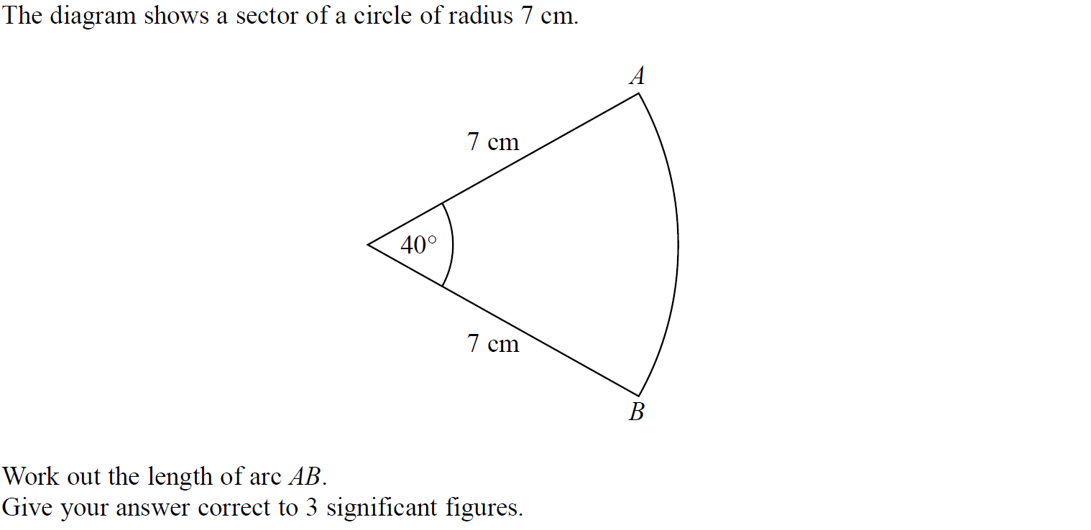
Circles & Sectors
SAM 2H Q17

Slide 5
Circles & Sectors
SAM 2H Q17
A

Slide 6
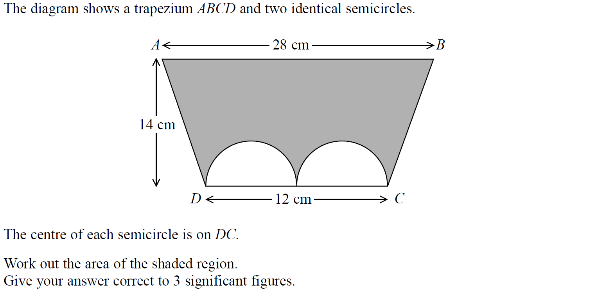
Circles & Sectors
SAM 3H Q1

Slide 7
Circles & Sectors
SAM 3H Q1
A

Slide 8
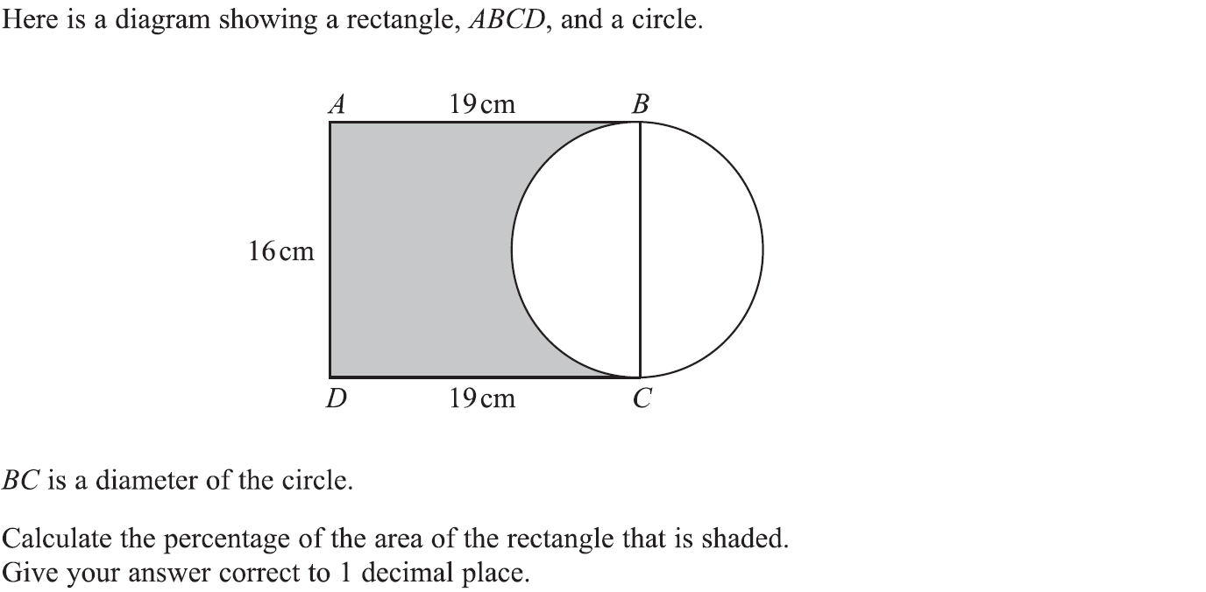
Circles & Sectors
Specimen Set 1 2H Q8

Slide 9
Circles & Sectors
Specimen Set 1 2H Q8
A

Slide 10
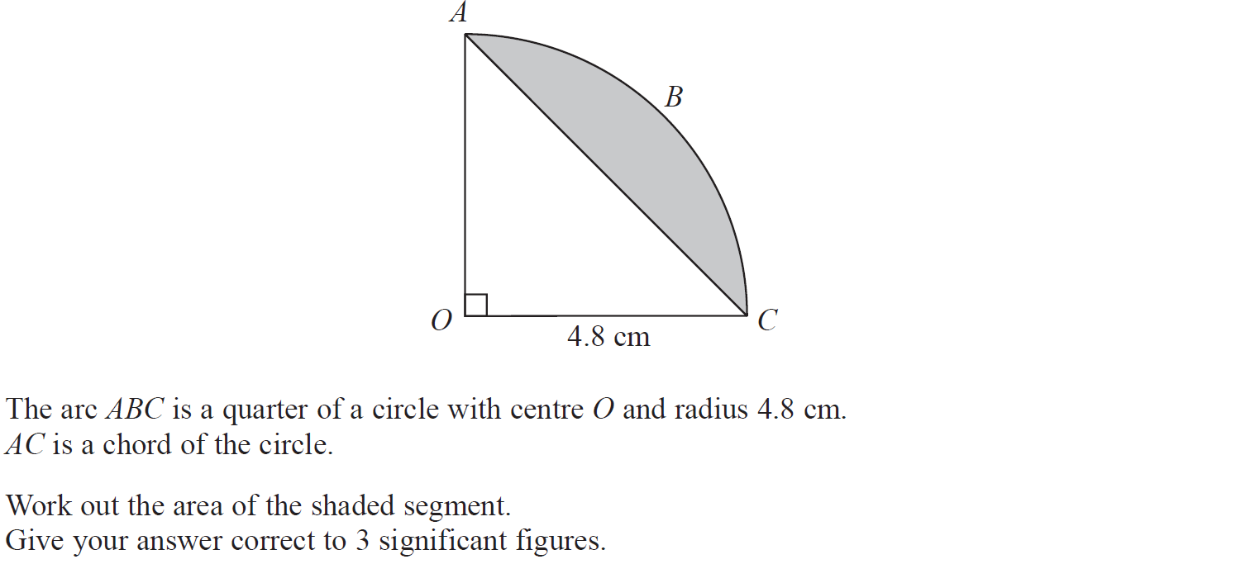
Circles & Sectors
Specimen Set 2 2H Q7

Slide 11
Circles & Sectors
Specimen Set 2 2H Q7
A

Slide 12
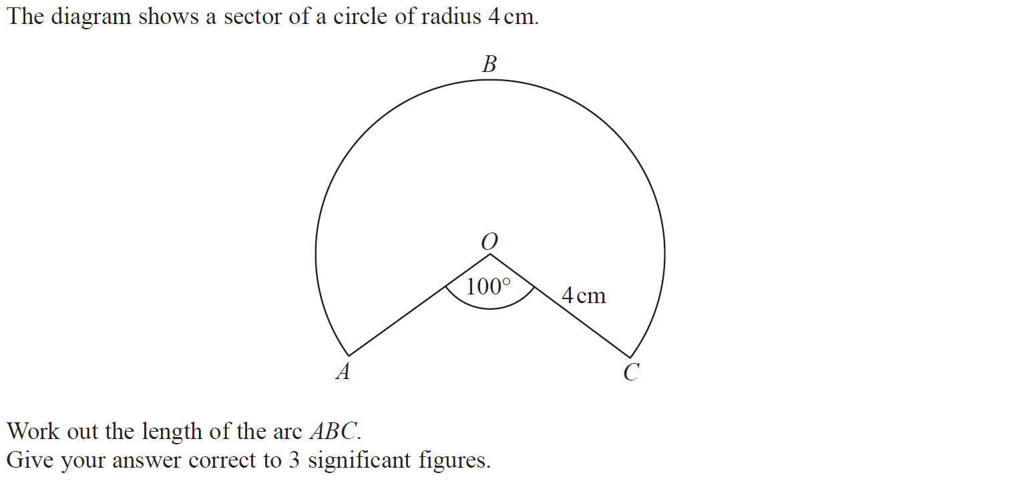
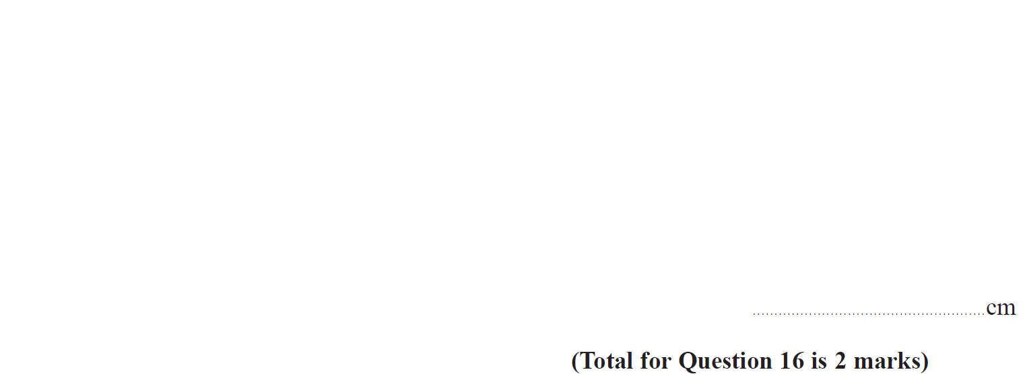
Circles & Sectors
Specimen Set 2 3H Q16

Slide 13
Circles & Sectors
Specimen Set 2 3H Q16
A

Slide 14
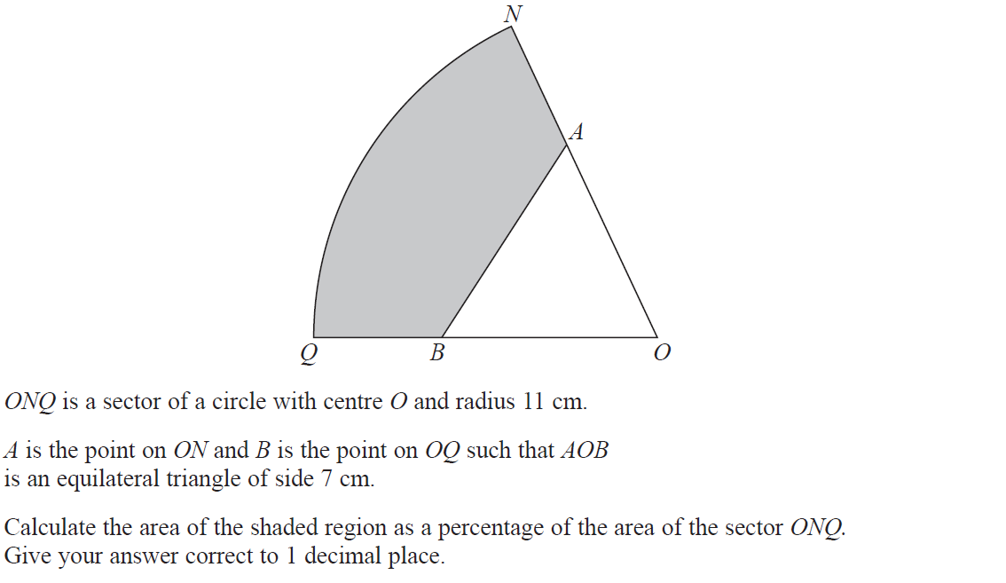
Circles & Sectors
June 2017 2H Q17

Slide 15
Circles & Sectors
June 2017 2H Q17
A

Slide 16
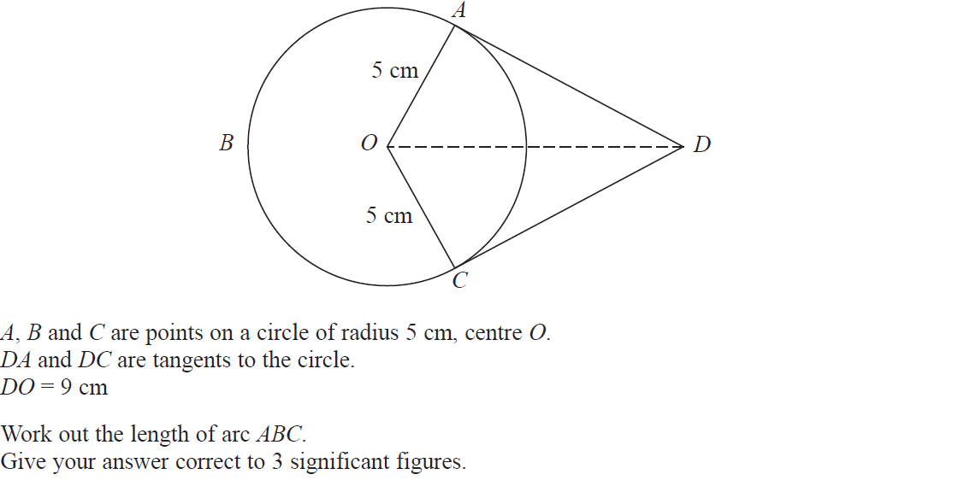
Circles & Sectors
June 2017 3H Q18

Slide 17
Circles & Sectors
June 2017 3H Q18
A

Slide 18
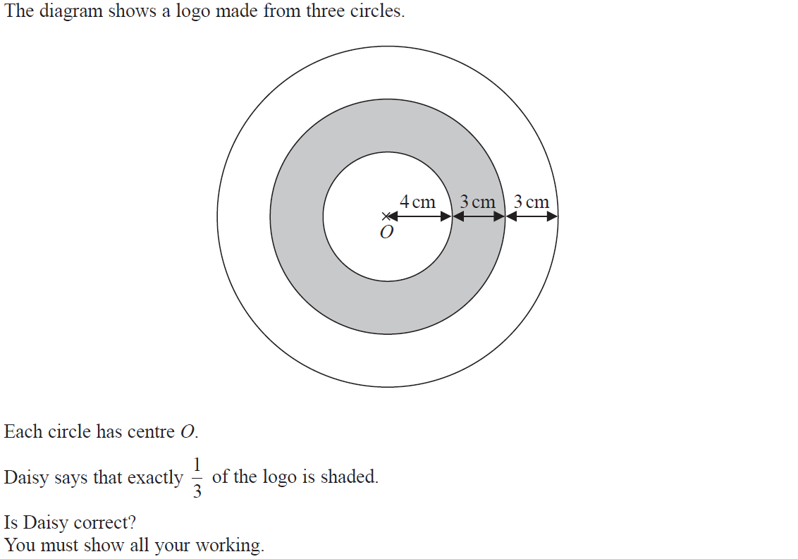
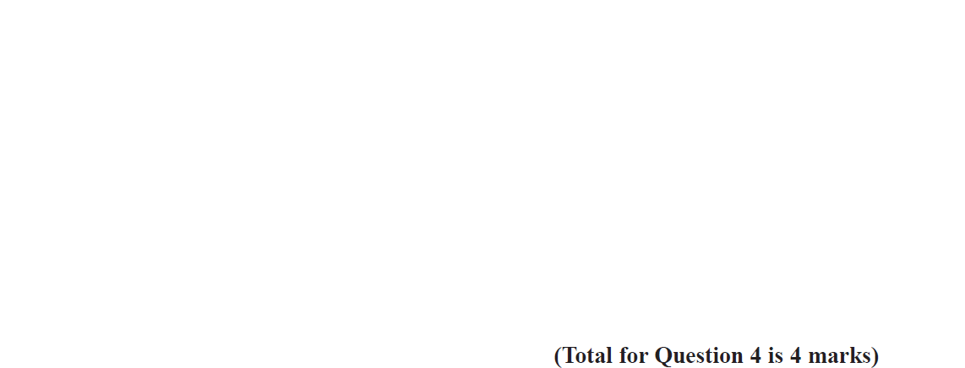
Circles & Sectors
Nov 2017 1H Q4

Slide 19
Circles & Sectors
Nov 2017 1H Q4
A

Slide 20
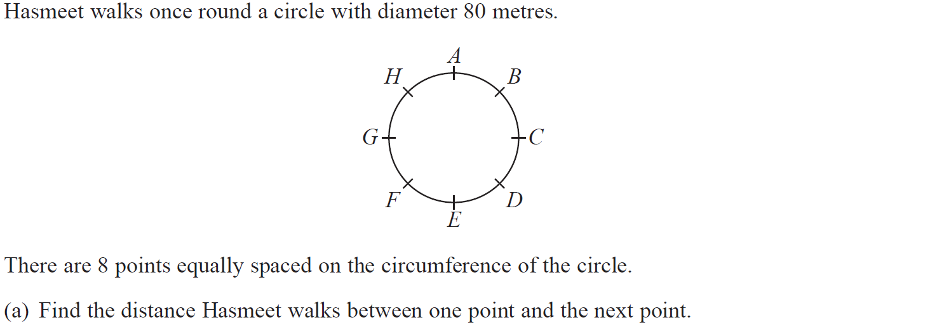
Circles & Sectors
Nov 2017 2H Q3

Slide 21
Circles & Sectors
Nov 2017 2H Q3
A
B

Slide 22
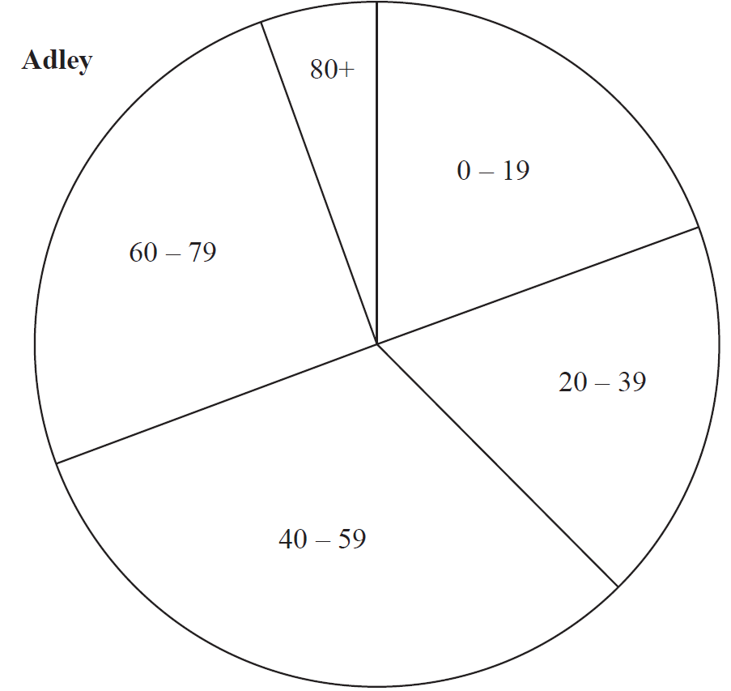
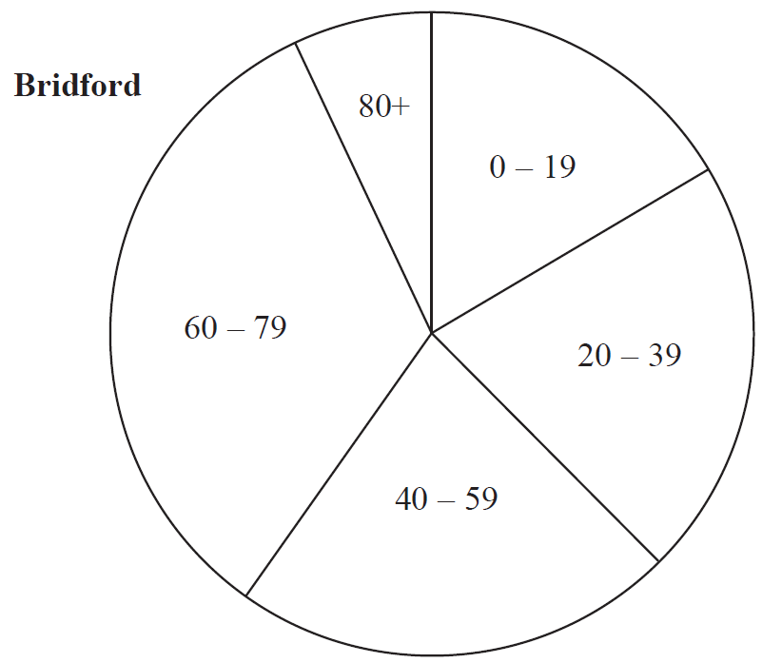
Circles & Sectors
Nov 2017 2H Q11

Slide 23
Circles & Sectors
Nov 2017 2H Q11
A

Slide 24
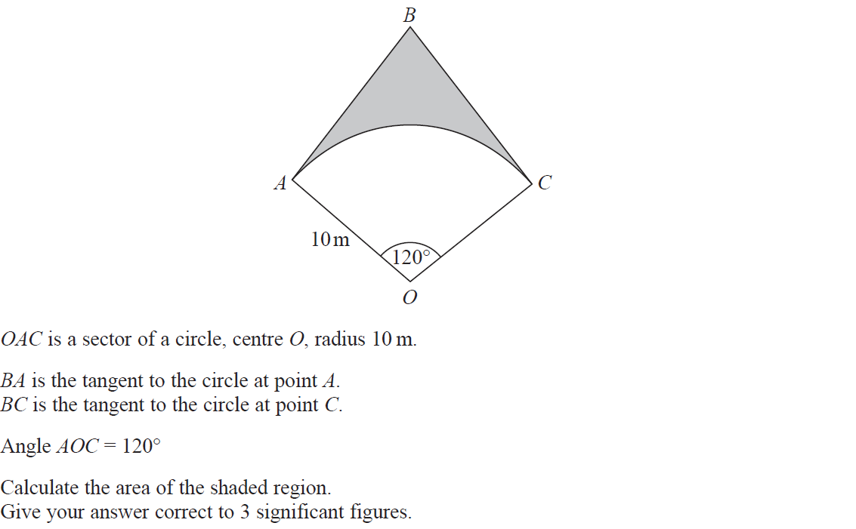
Circles & Sectors
Nov 2017 2H Q20

Slide 25
Circles & Sectors
Nov 2017 2H Q20
A

Slide 26
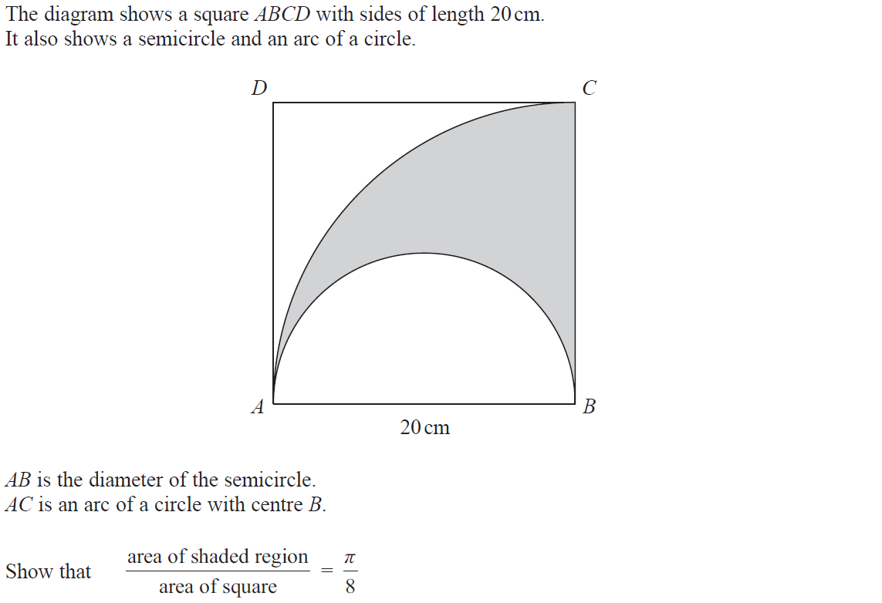
Circles & Sectors
Nov 2018 1H Q7

Slide 27
Circles & Sectors
Nov 2018 1H Q7
A

Slide 28
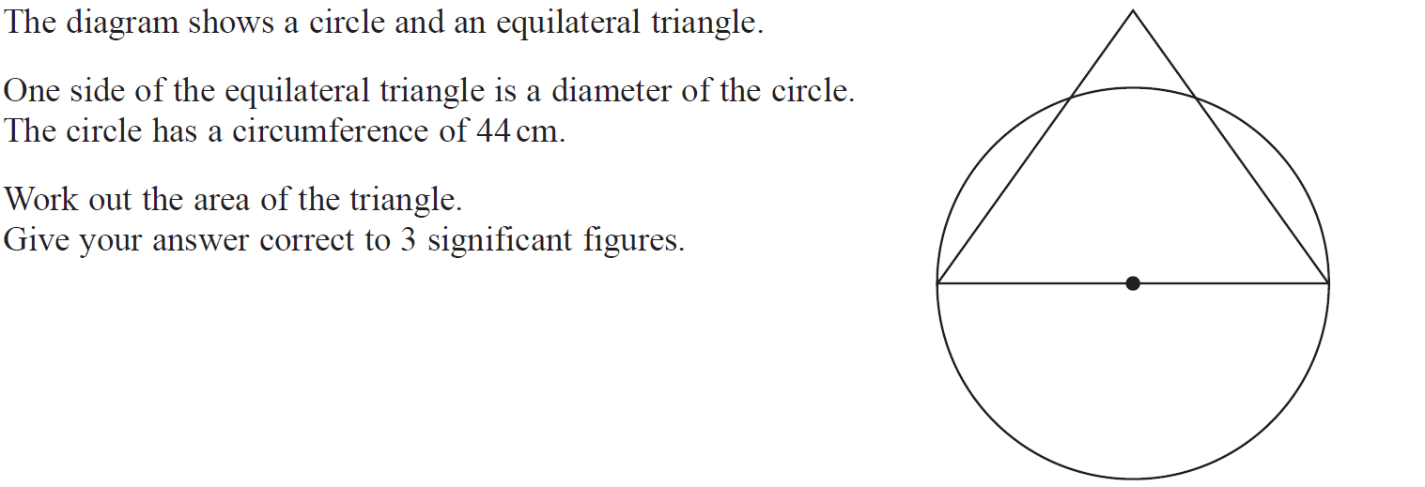
Circles & Sectors
Nov 2018 2H Q13

Slide 29
Circles & Sectors
Nov 2018 2H Q13
A

Slide 30
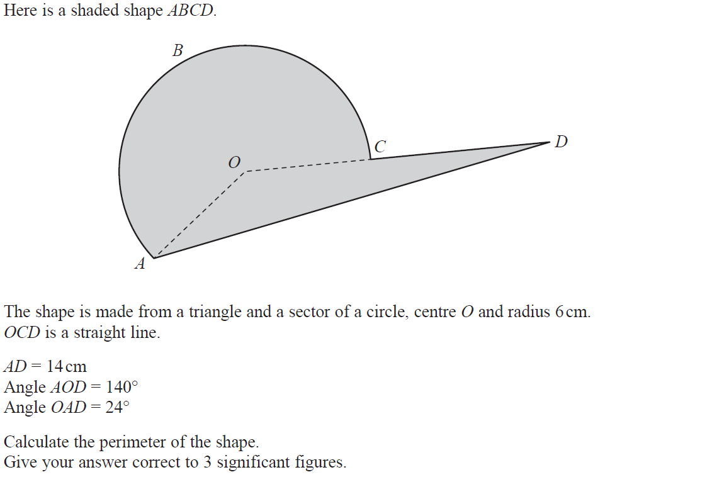
Circles & Sectors
Nov 2018 3H Q16

Slide 31
Circles & Sectors
Nov 2018 3H Q16
A

Slide 32
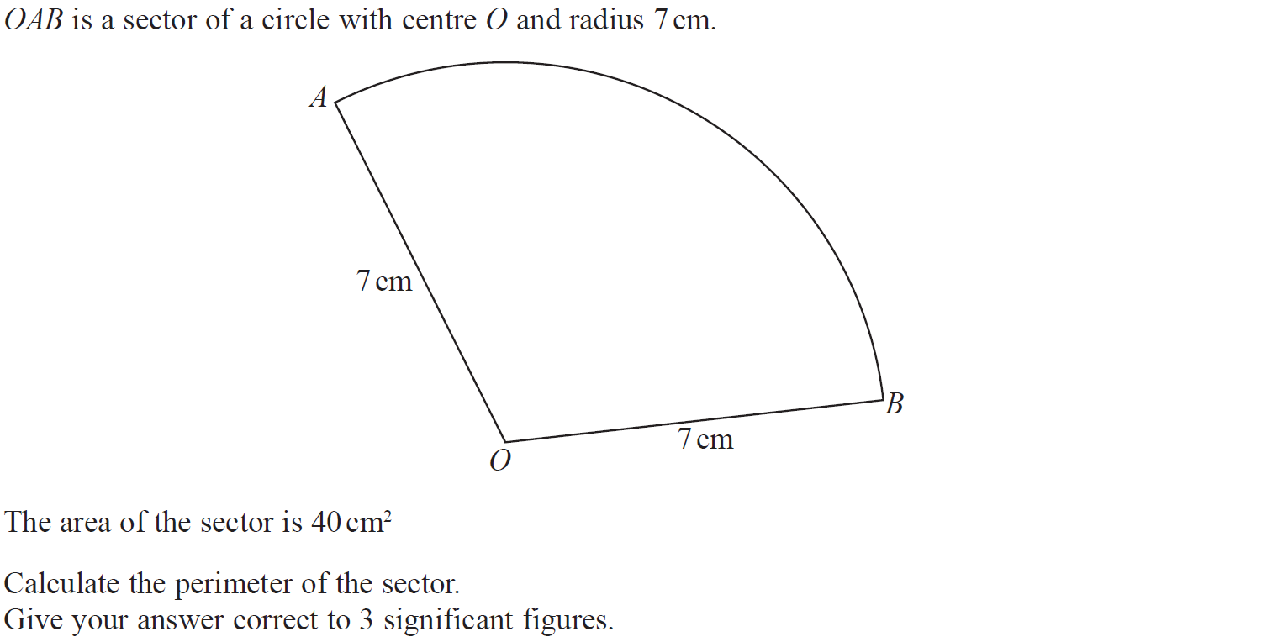
Circles & Sectors
June 2019 2H Q12

Slide 33
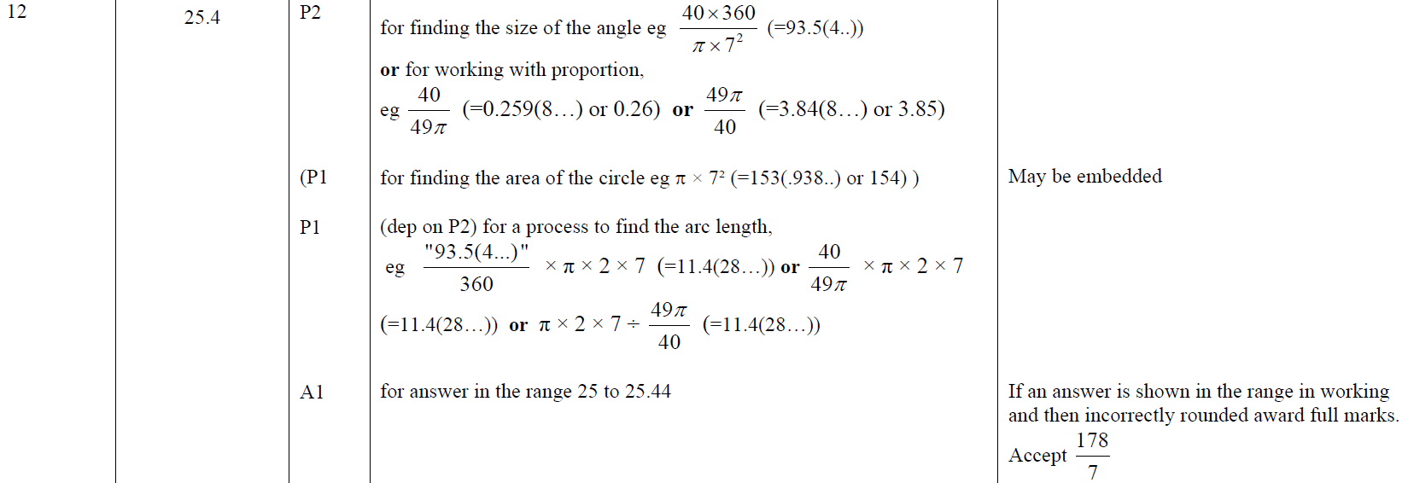
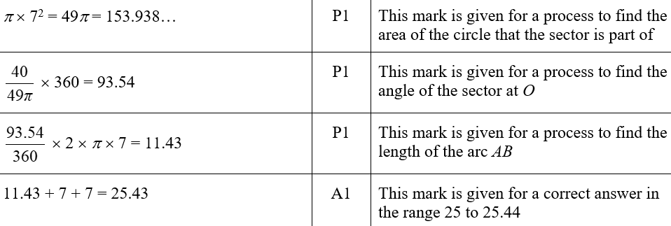
Circles & Sectors
June 2019 2H Q12
A
A SF

Slide 34
Circles & Sectors
SAM 2H Q17

Slide 35
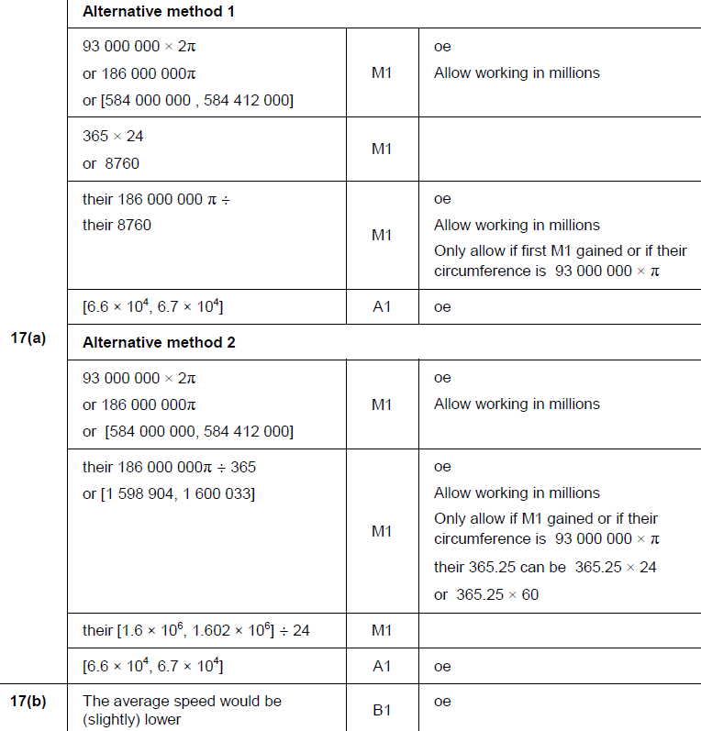
Circles & Sectors
SAM 2H Q17
A
B

Slide 36
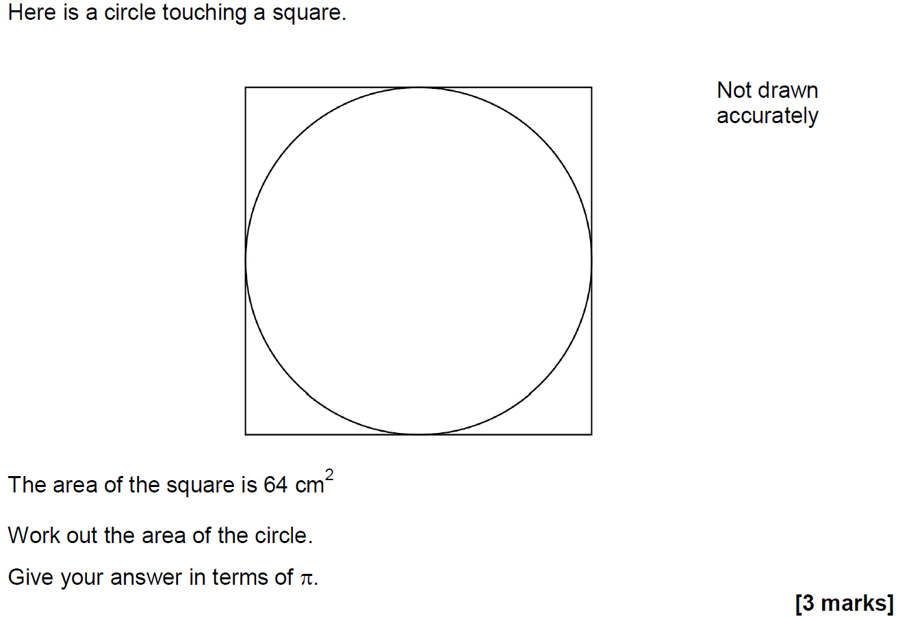
Circles & Sectors
May 2017 1H Q12

Slide 37
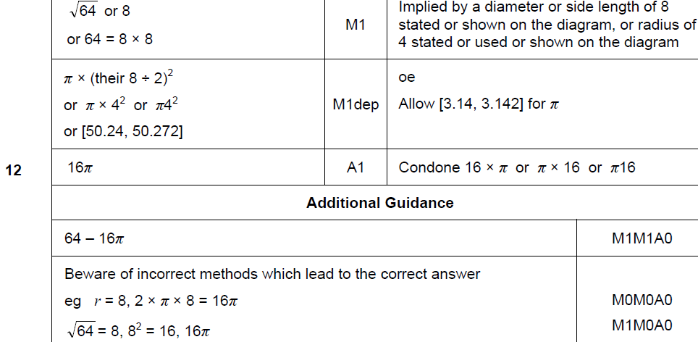
Circles & Sectors
May 2017 1H Q12
A

Slide 38
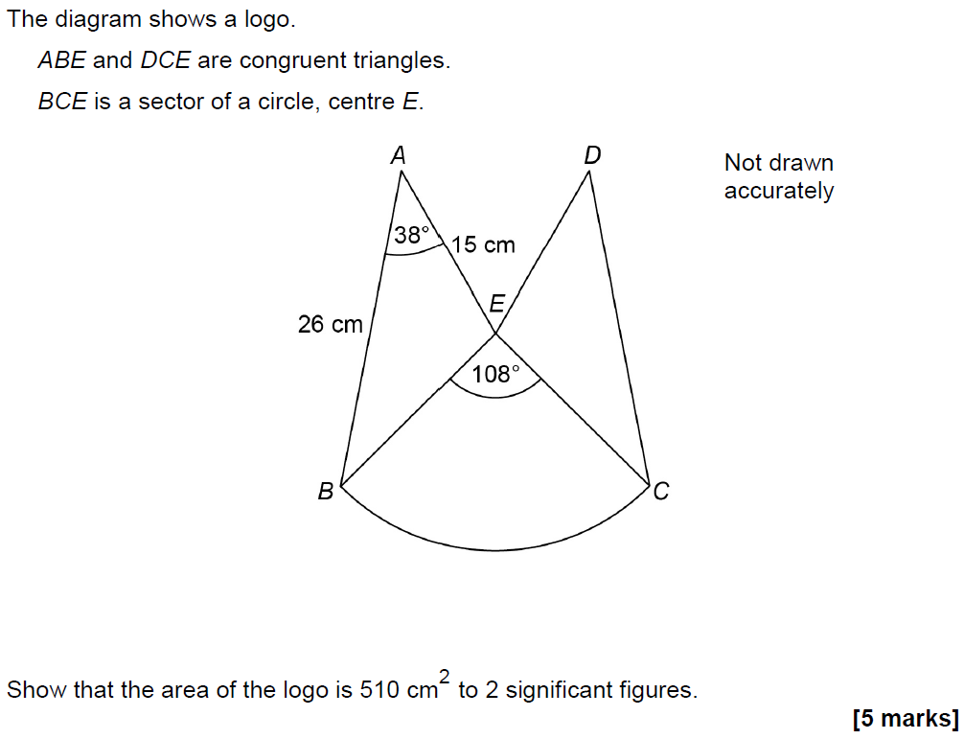
Circles & Sectors
June 2017 2H Q25

Slide 39
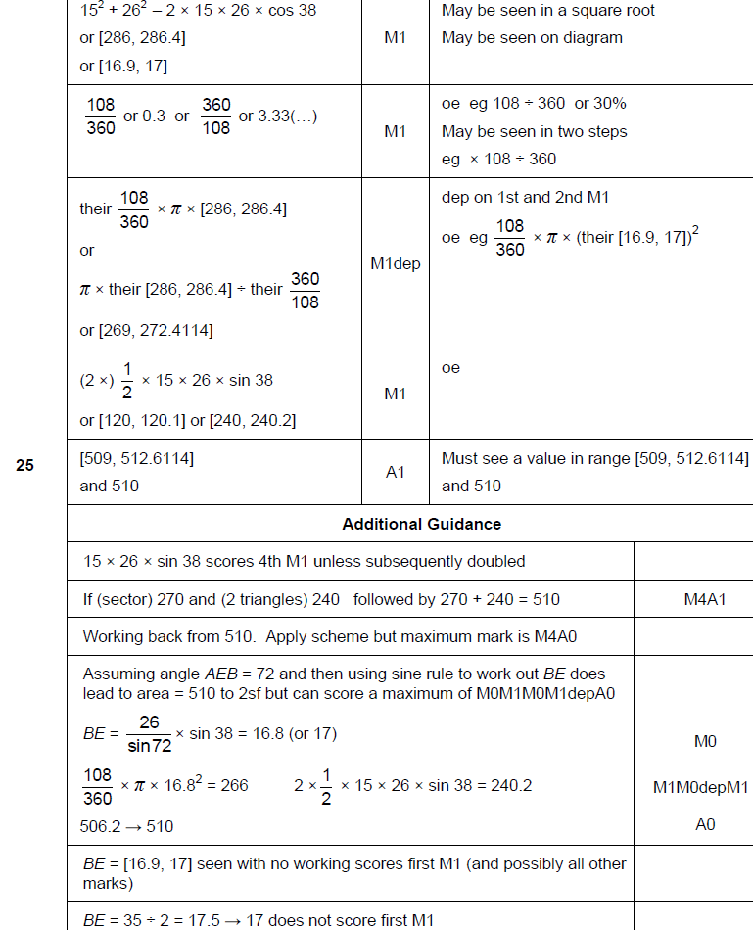
Circles & Sectors
June 2017 2H Q25
A

Slide 40
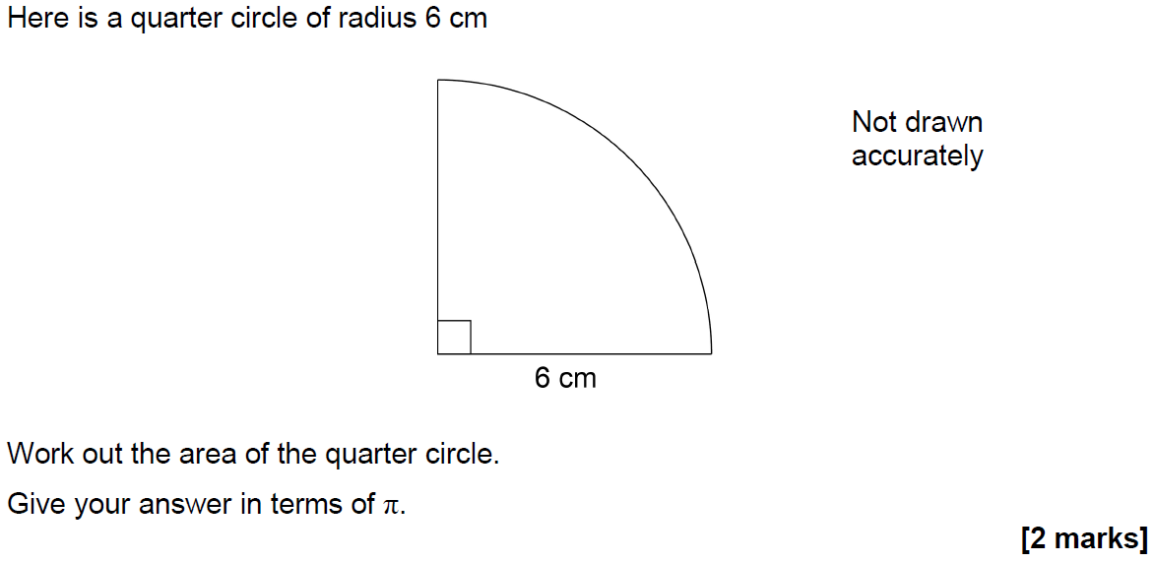
Circles & Sectors
Nov 2017 1H Q7

Slide 41
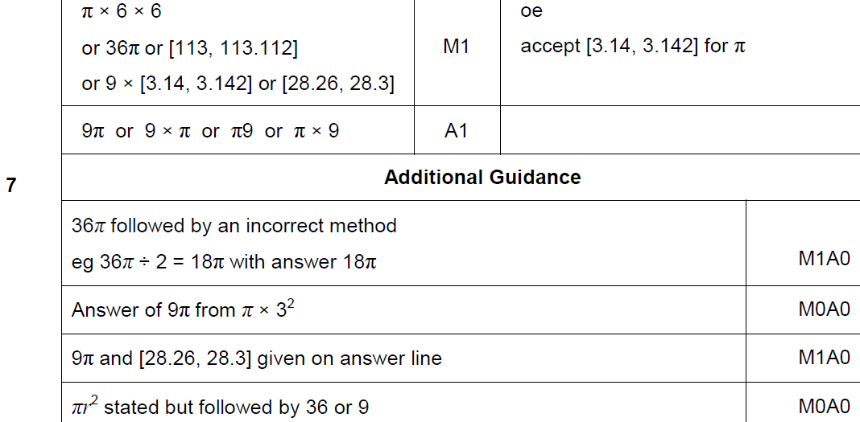
Circles & Sectors
Nov 2017 1H Q7
A

Slide 42
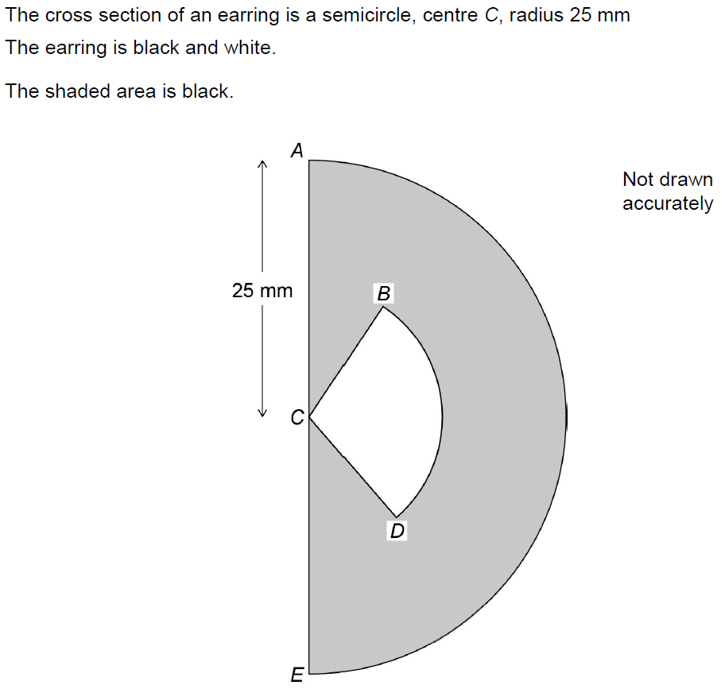
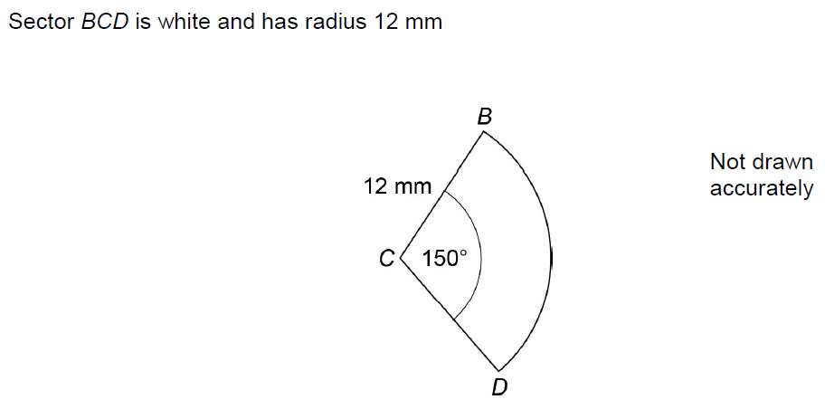
Circles & Sectors
Nov 2017 2H Q22

Slide 43
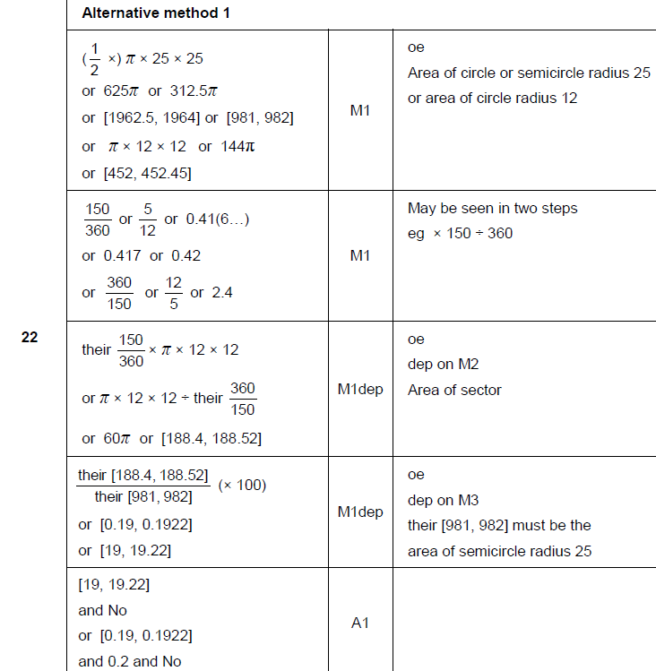
Circles & Sectors
Nov 2017 2H Q22
A

Slide 44
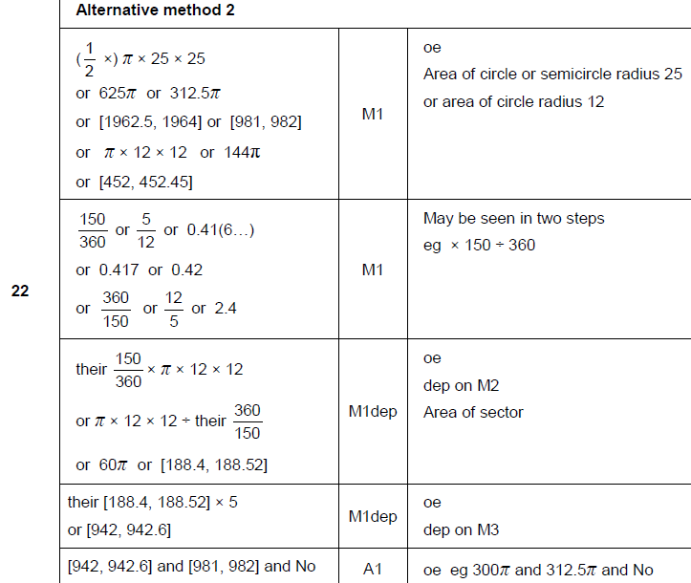
Circles & Sectors
Nov 2017 2H Q22
A Alternative 1

Slide 45
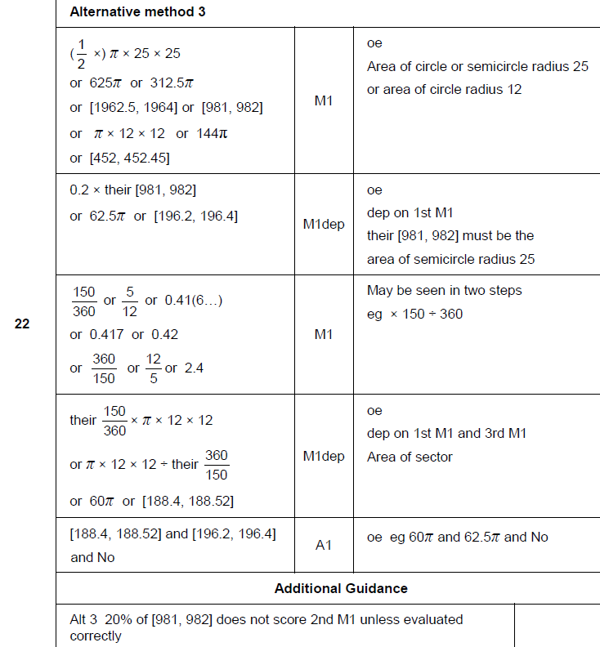
Circles & Sectors
Nov 2017 2H Q22
A Alternative 2 & notes

Slide 46
Circles & Sectors
June 2018 2H Q1

Slide 47
Circles & Sectors
June 2018 2H Q1
A

Slide 48
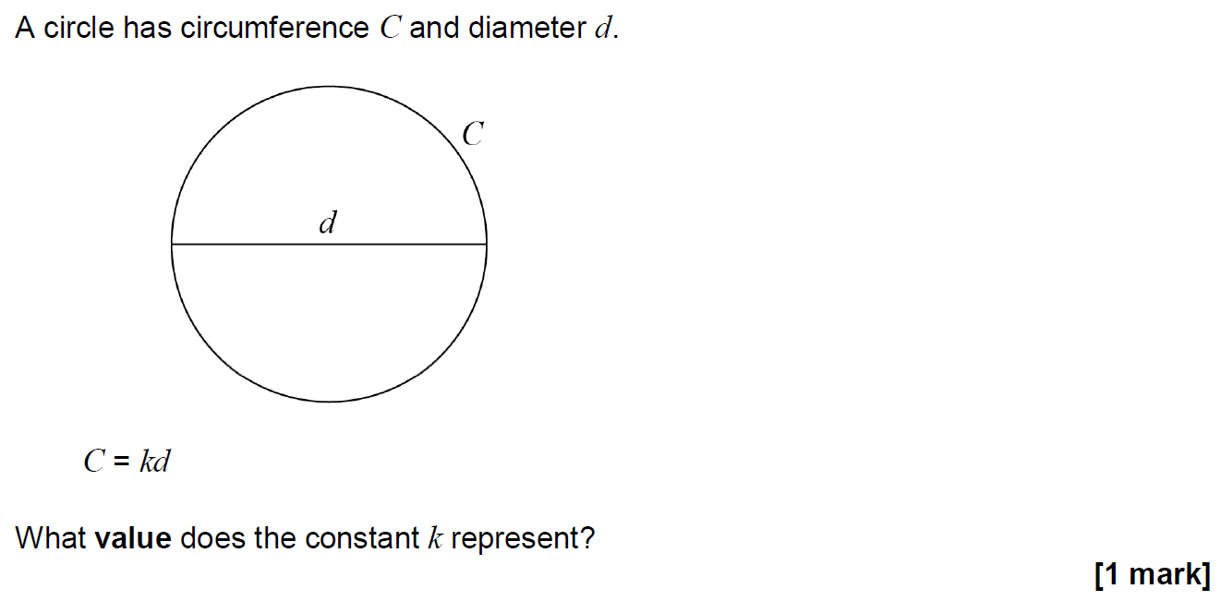
Circles & Sectors
Nov 2018 2H Q5

Slide 49
Circles & Sectors
Nov 2018 2H Q5
A

Slide 50
Circles & Sectors
Nov 2018 2H Q8

Slide 51
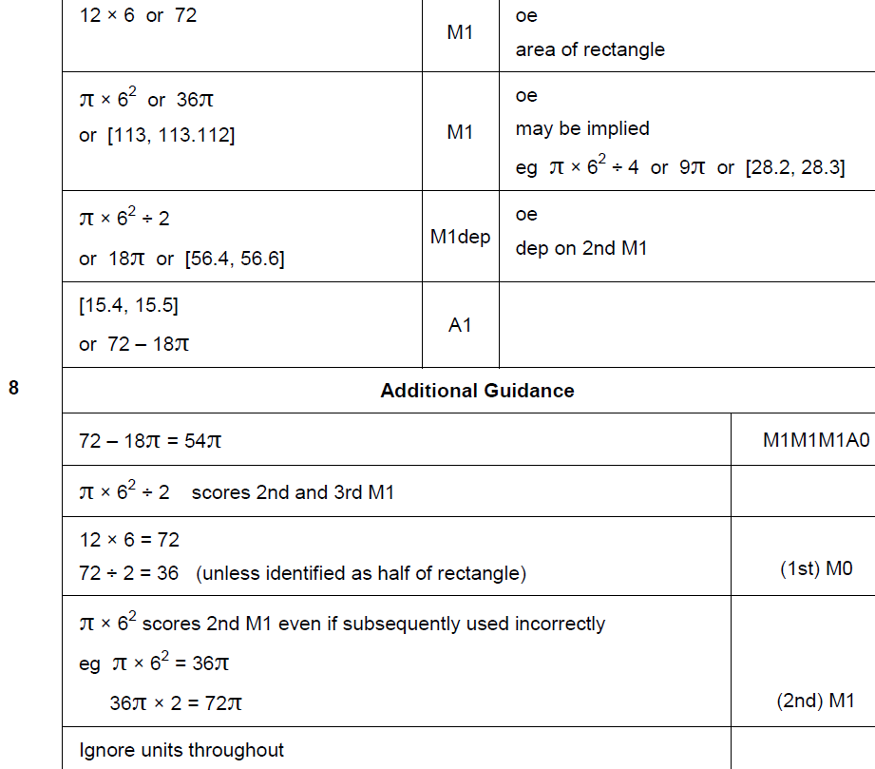
Circles & Sectors
Nov 2018 2H Q8
A

Slide 52
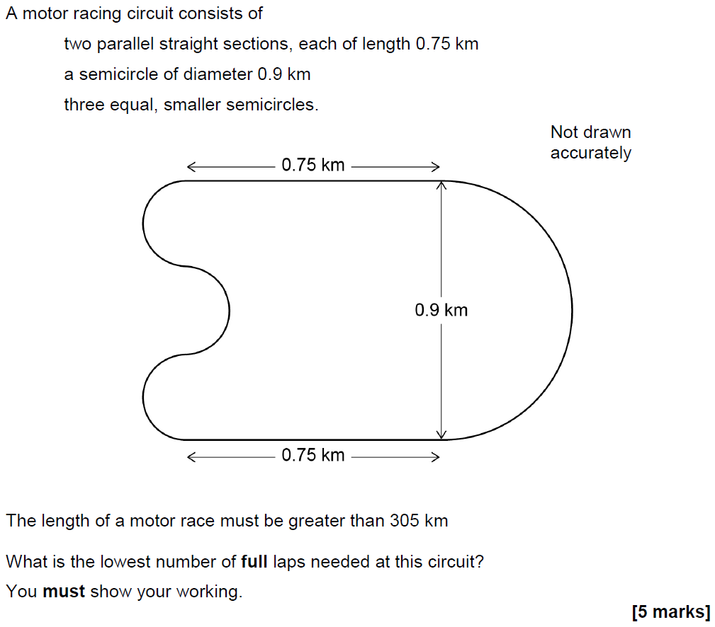
Circles & Sectors
Nov 2018 3H Q9

Slide 53
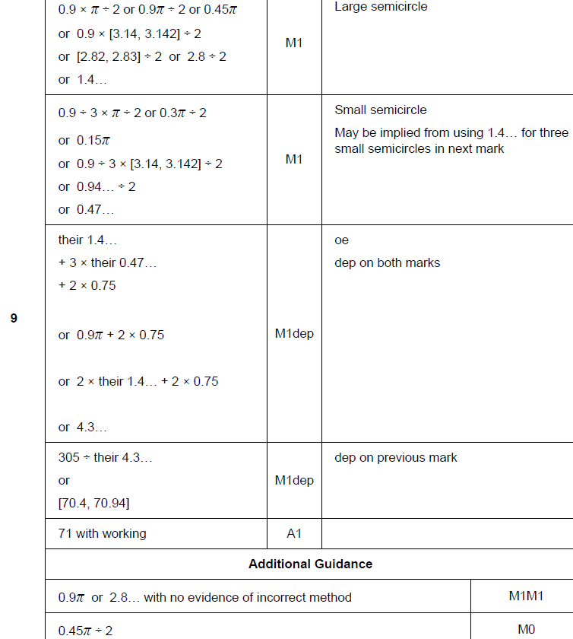
Circles & Sectors
Nov 2018 3H Q9
A

Slide 54
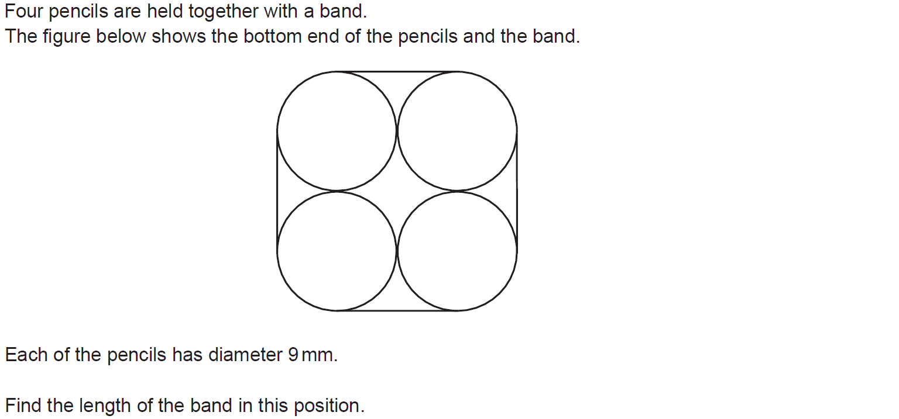
Circles & Sectors
SAM 1H Q18

Slide 55
Circles & Sectors
SAM 1H Q18
A

Slide 56
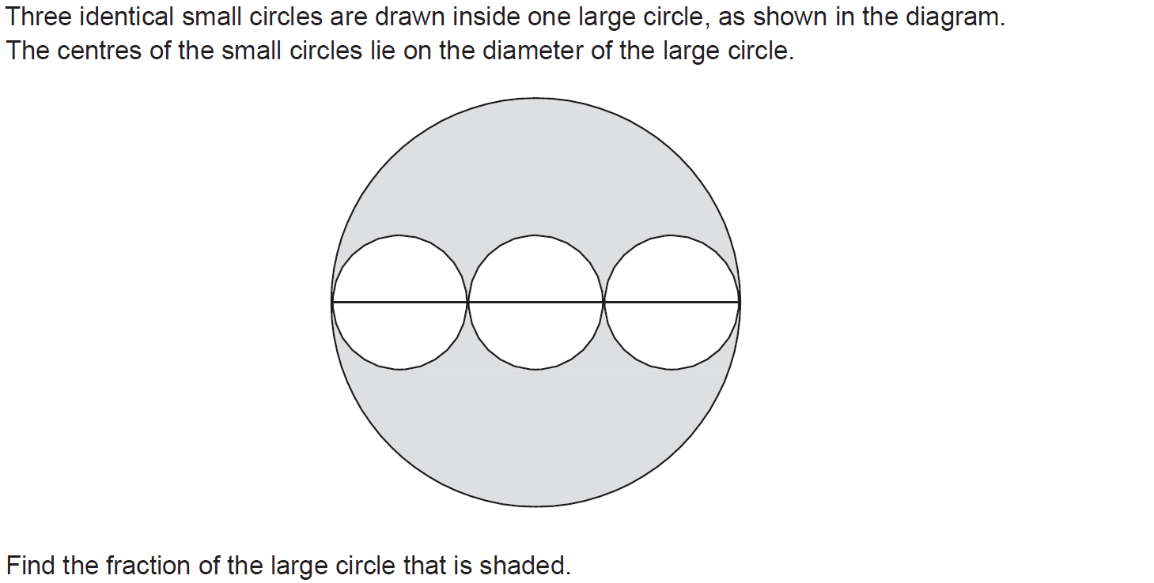
Circles & Sectors
SAM 2H Q12

Slide 57
Circles & Sectors
SAM 2H Q12
A

Slide 58
Circles & Sectors
Practice 1H Q7

Slide 59
Circles & Sectors
Practice 1H Q7
A

Slide 60
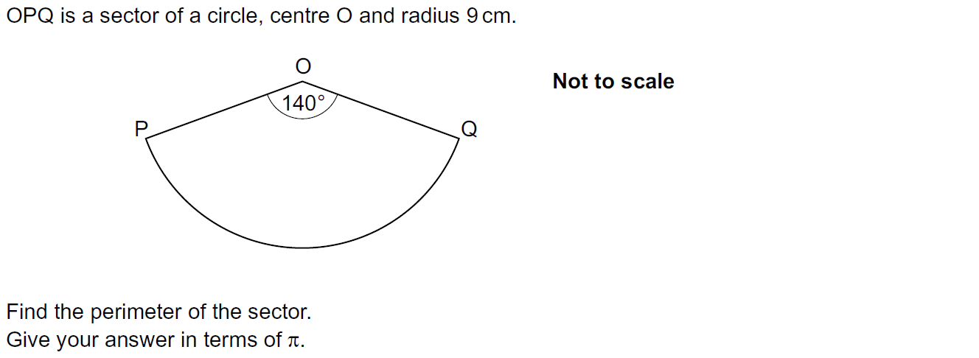
Circles & Sectors
Practice 3H Q7

Slide 61
Circles & Sectors
Practice 3H Q7
A

Slide 62
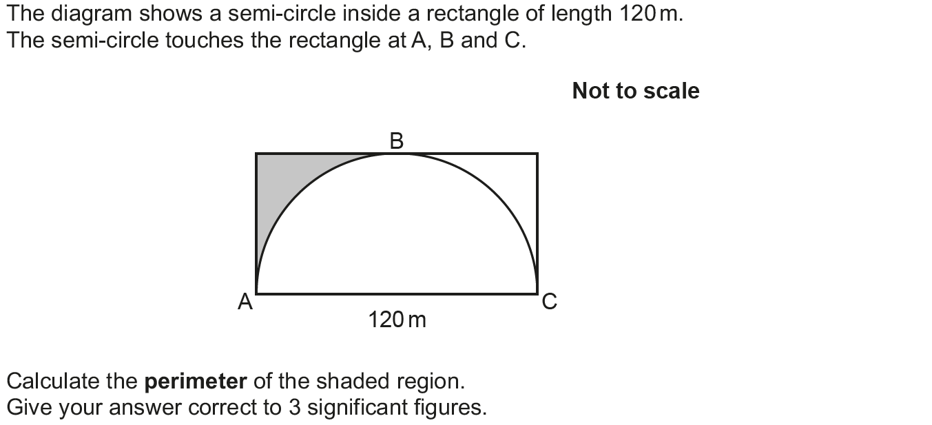
Circles & Sectors
May 2017 1H Q6

Slide 63
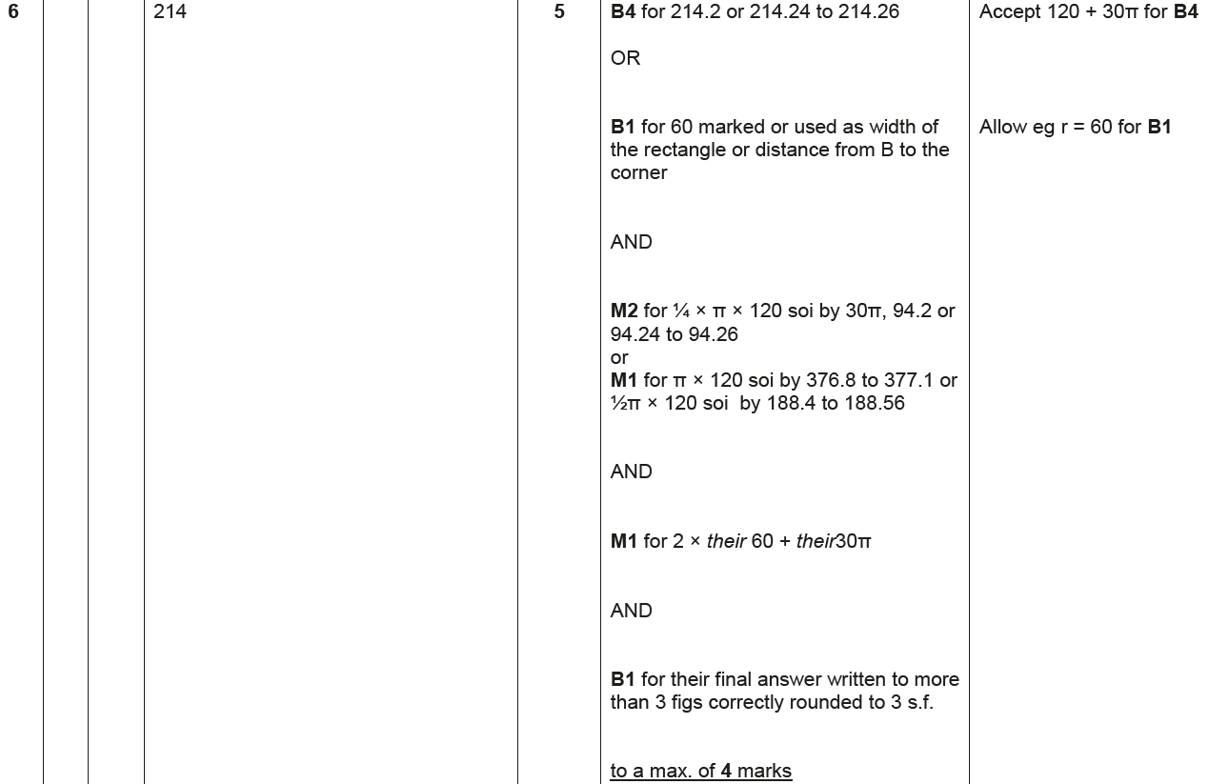
Circles & Sectors
May 2017 1H Q6
A

Slide 64
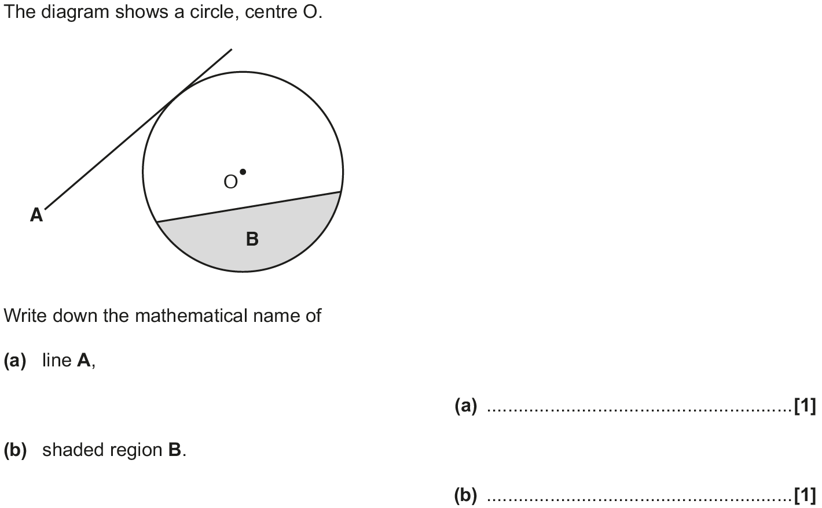
Circles & Sectors
Nov 2017 2H Q1

Slide 65
Circles & Sectors
Nov 2017 2H Q1
A
B

Slide 66
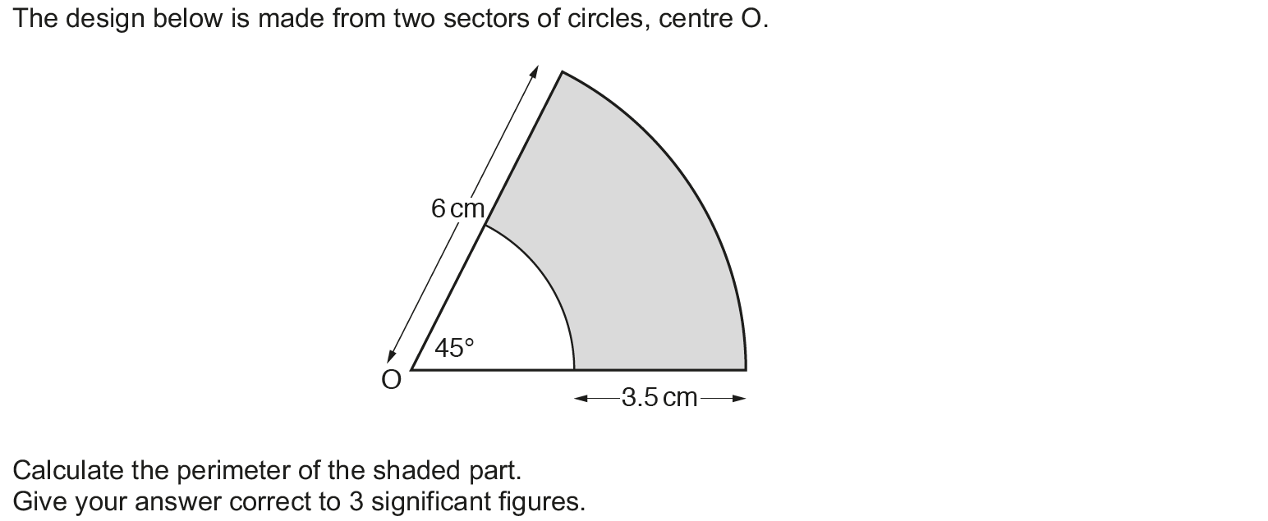
Circles & Sectors
Nov 2017 3H Q8

Slide 67
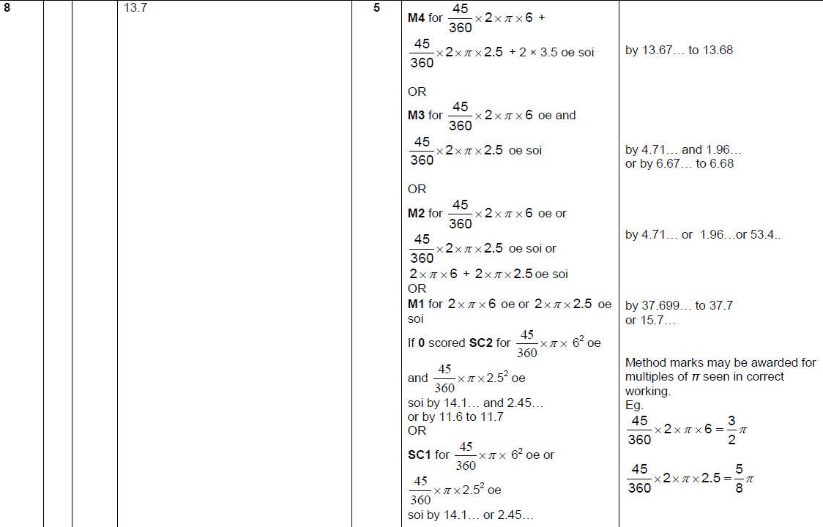
Circles & Sectors
Nov 2017 3H Q8
A

Slide 68
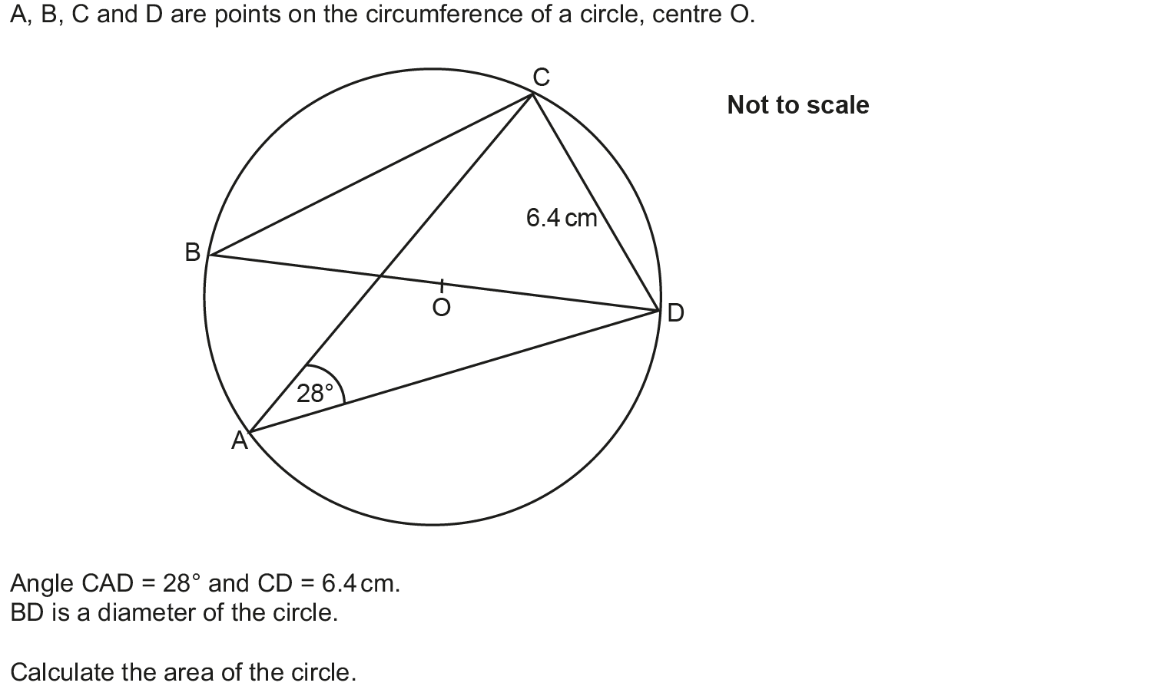
Circles & Sectors
May 2018 1H Q8

Slide 69
Circles & Sectors
May 2018 1H Q8
A

Slide 70
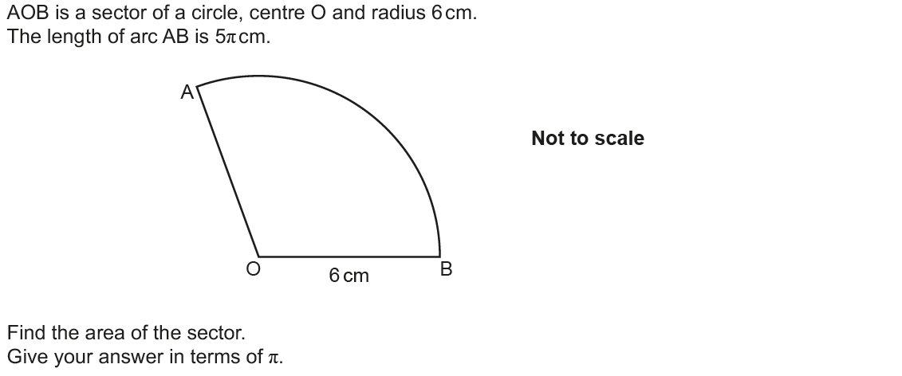
Circles & Sectors
Nov 2018 2H Q12

Slide 71
Circles & Sectors
Nov 2018 2H Q12
A

Slide 72
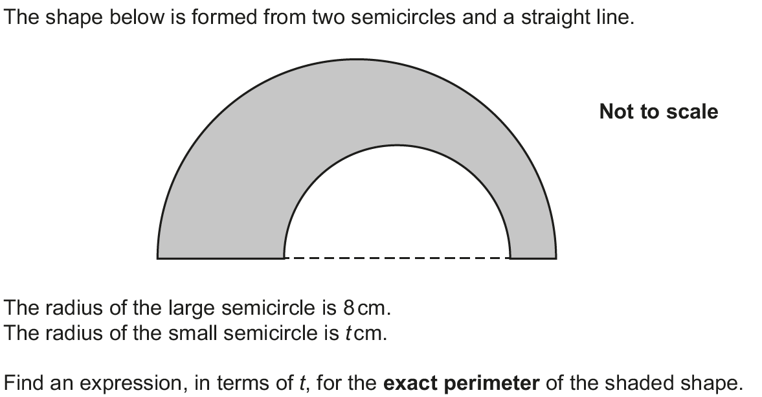
Circles & Sectors
Nov 2018 3H Q13

Slide 73
Circles & Sectors
Nov 2018 3H Q13
A

