Slide 1
Circles & Sectors
Circles & Sectors
Old Spec Q’s
SAM
1H Q10
May 2018
1H Q6
Jan 2019
1HR Q10
Jan 2019
2HR Q22
May 2019
1HR Q9
Compound Shapes

Slide 2
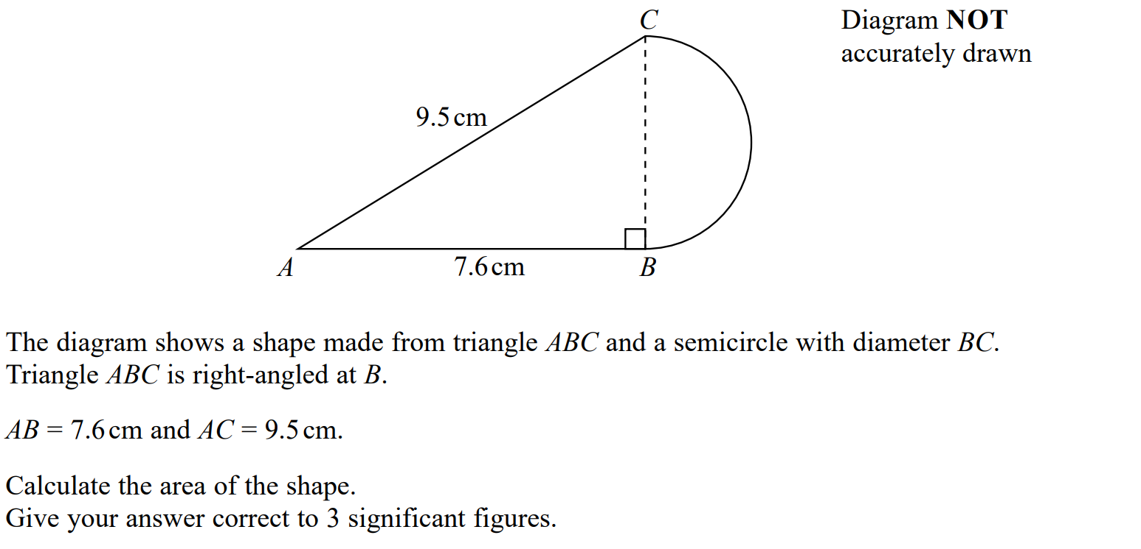
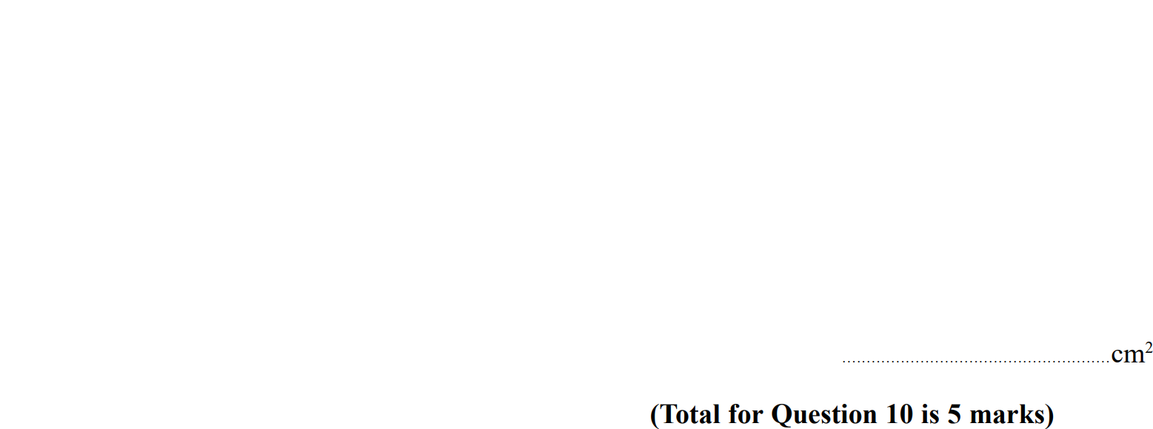
Circles & Sectors
SAM 1H Q10

Slide 3
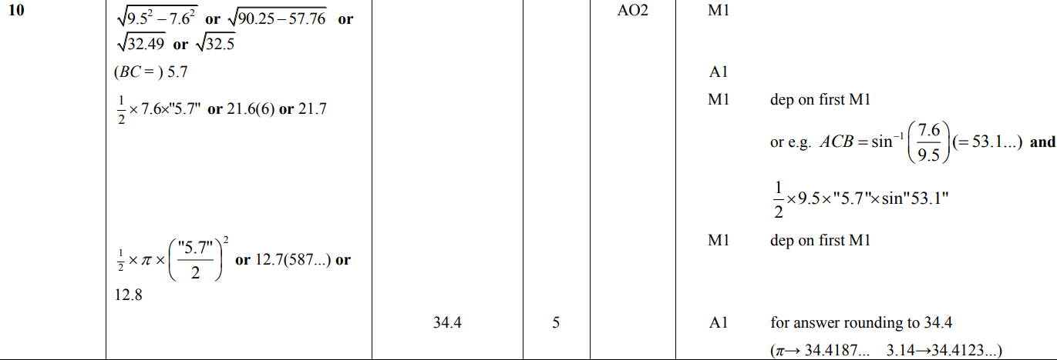
Circles & Sectors
SAM 1H Q10
A

Slide 4
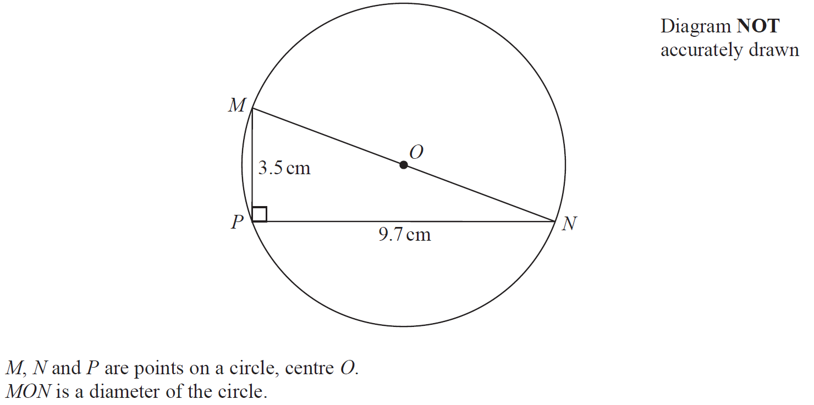
Circles & Sectors
May 2018 1H Q6

Slide 5
Circles & Sectors
May 2018 1H Q6
A

Slide 6
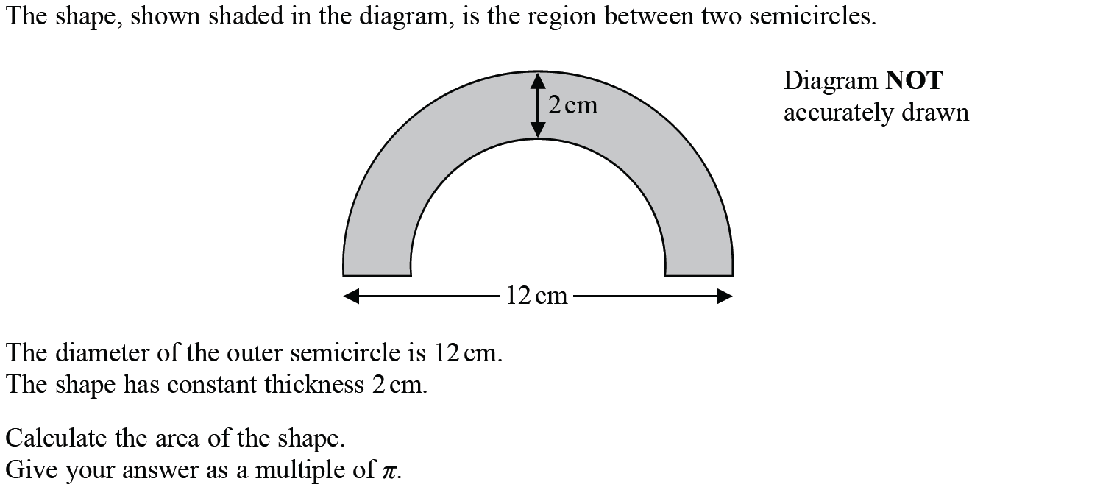
Circles & Sectors
Jan 2019 1HR Q10

Slide 7
Circles & Sectors
Jan 2019 1HR Q10
A

Slide 8
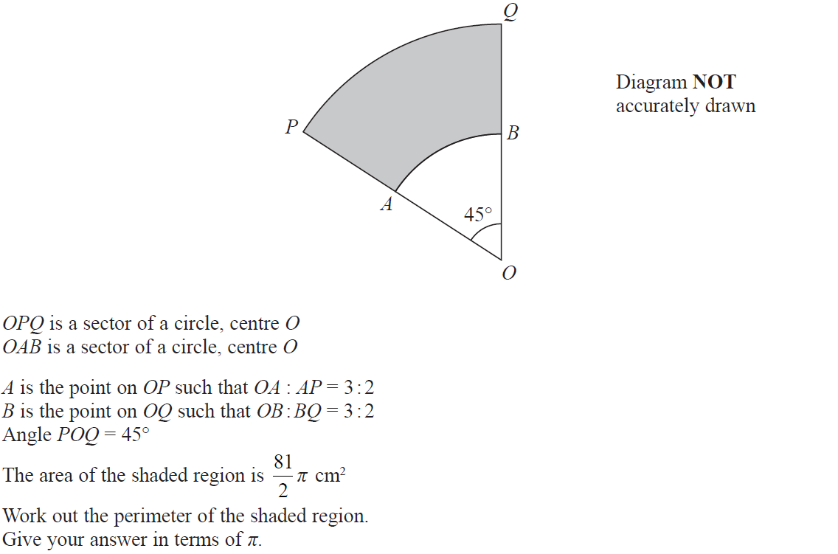
Circles & Sectors
Jan 2019 2HR Q22

Slide 9
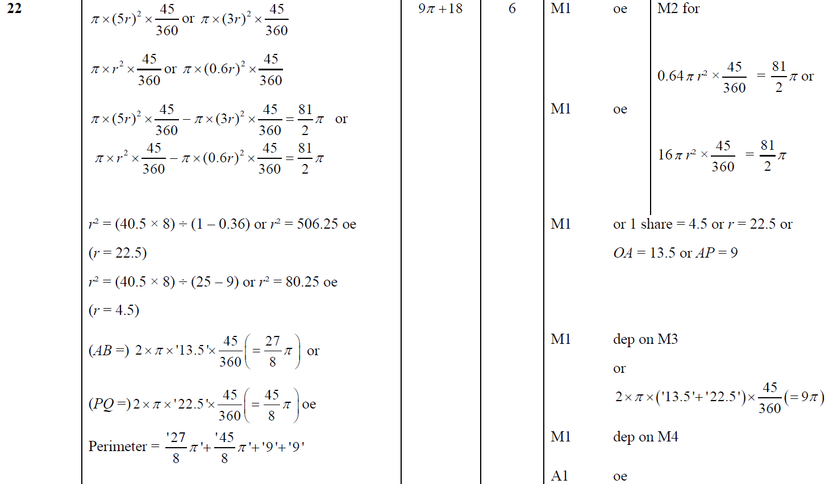
Circles & Sectors
Jan 2019 2HR Q22
A

Slide 10
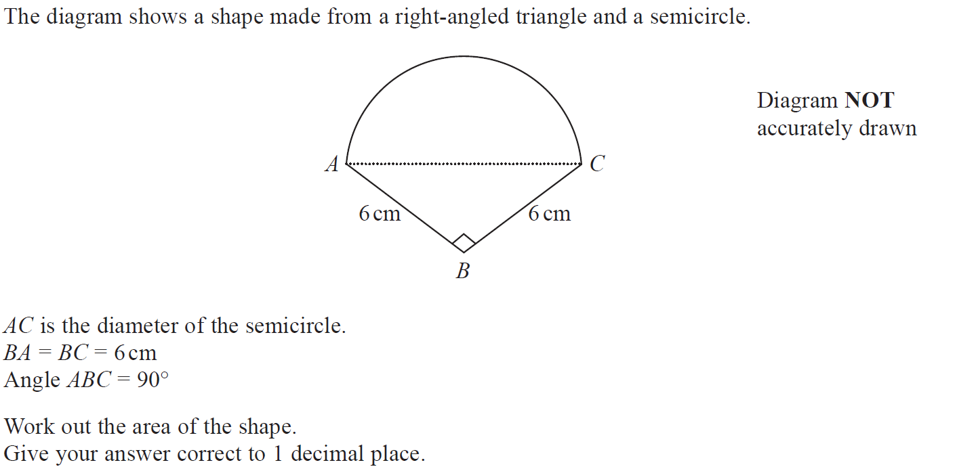
Circles & Sectors
May 2019 1H Q9

Slide 11
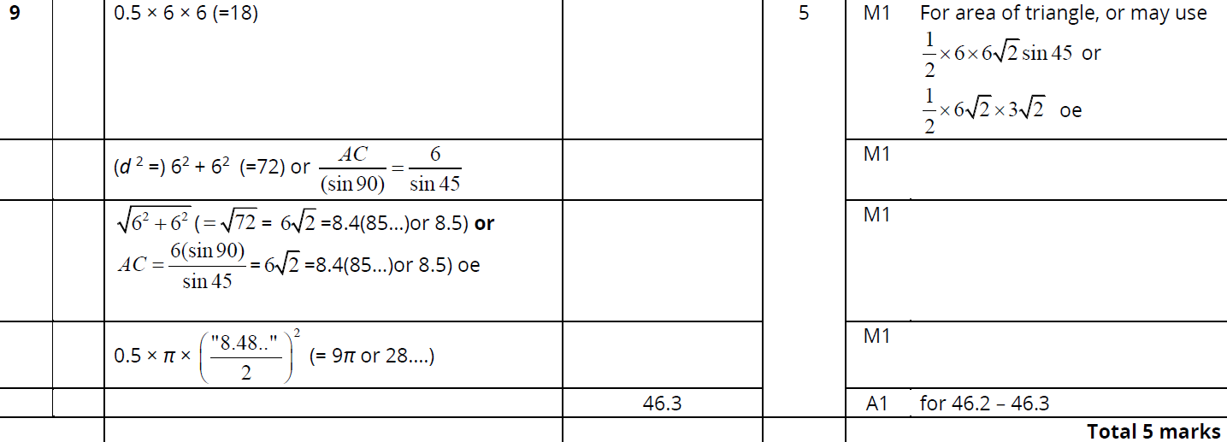
Circles & Sectors
May 2019 1H Q9
A

Slide 12
Circles & Sectors
Circles & Sectors
New Spec Q’s
May 2004
3H Q3
May 2008
3H Q7
June 2011 3H Q15
May 2014 3H Q22
Jan 2016 4H Q24
Jan 2017 4HR Q4
May 2004
3H Q10
Nov 2008
3H Q19
Jan 2012 3H Q18
May 2014 4H Q3
Jan 2016 3HR Q5
June 2017 4H Q11
Nov 2004
4H Q20
May 2009
3H Q19
May 2012 3H Q19
May 2014 4HR Q5
Jan 2016 4HR Q11
May 2017 3HR Q5
May 2005
4H Q15
June 2009
4H Q5
Jan 2013 4H Q2
Jan 2015 4H Q2
May 2016 3H Q10
June 2017 4HR Q24
May 2006
3H Q10
Nov 2009
3H Q7
May 2013 3H Q21
Jan 2015 4H Q24
May 2016 3HR Q22
Jan 2018 4H Q5
Nov 2006
4H Q17
Nov 2009
3H Q18
May 2013 3HR Q10
Jan 2015 4HR Q2
June 2016 4HR Q7
Jan 2018 3HR Q6
May 2007
4H Q19
June 2010
3H Q11
Jan 2014 3H Q12
May 2015 3H Q6
Jan 2017 3H Q4
June 2018 4H Q6
Nov 2007
3H Q5
June 2010
4H Q17
Jan 2014 4H Q7
May 2015 3HR Q19
Jan 2017 3H Q22
June 2018 4HR Q24
Nov 2007
3H Q15
Nov 2010
3H Q4
May 2014 3H Q13
June 2015 4HR Q20
Jan 2017 3HR Q21
Compound Shapes

Slide 13
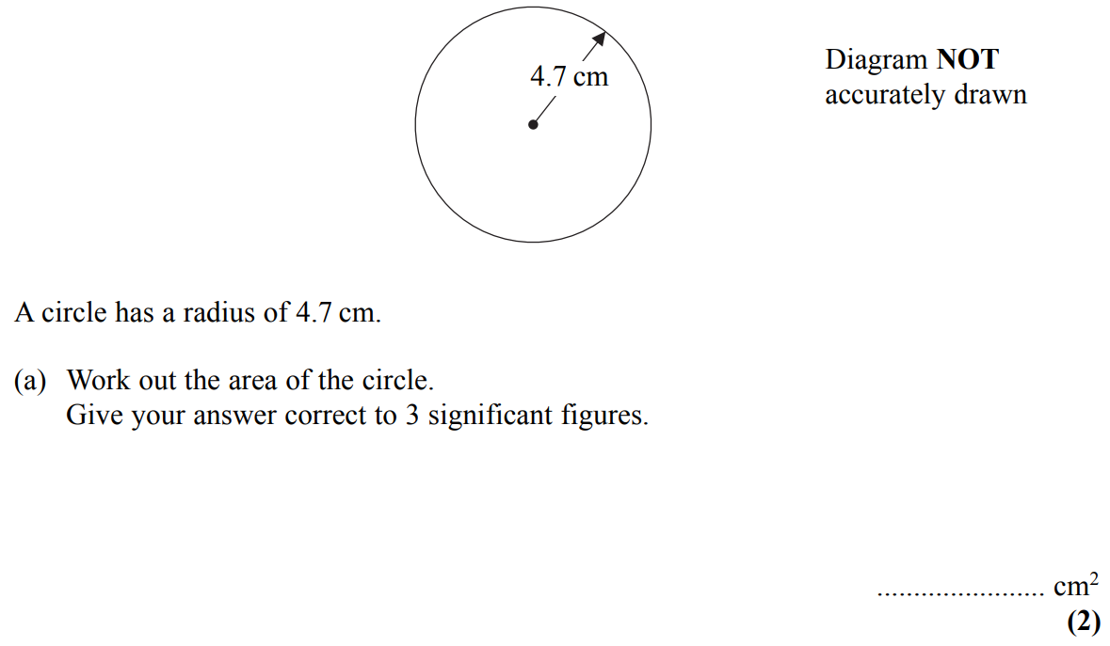
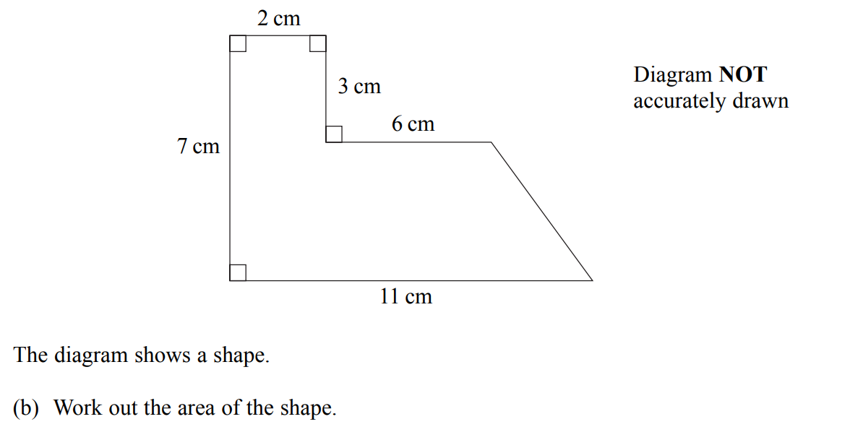
Circles & Sectors
May 2004 3H Q3

Slide 14
Circles & Sectors
May 2004 3H Q3
A
B

Slide 15
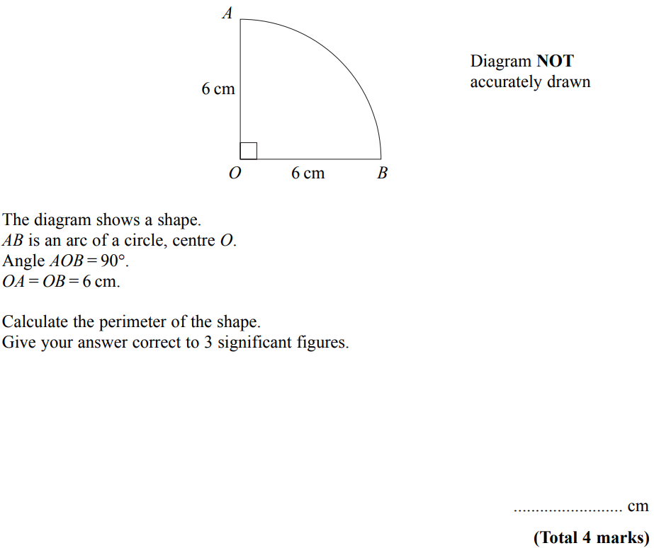
Circles & Sectors
May 2004 3H Q10

Slide 16
Circles & Sectors
May 2004 3H Q10
A

Slide 17
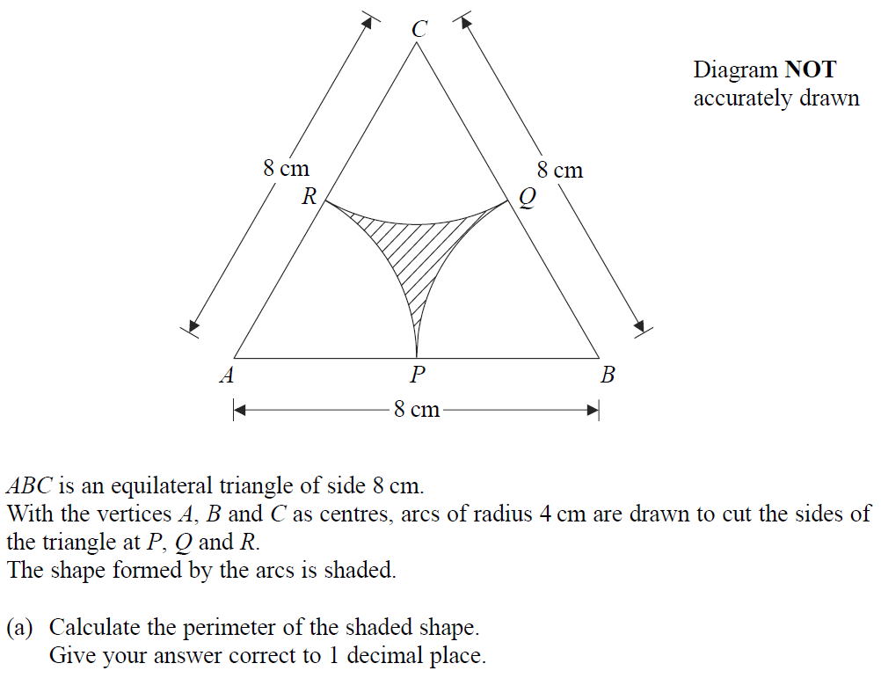
Circles & Sectors
Nov 2004 4H Q20

Slide 18
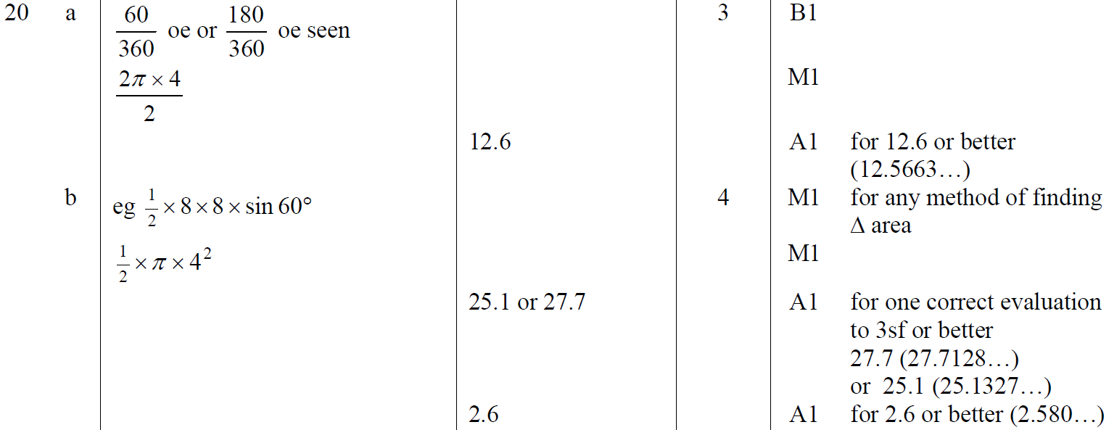
Circles & Sectors
Nov 2004 4H Q20
A
B

Slide 19
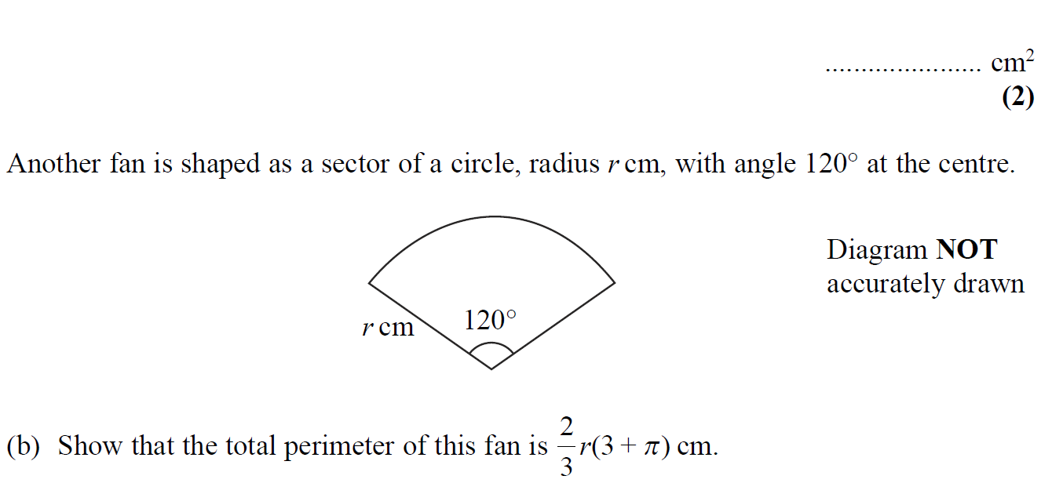
Circles & Sectors
May 2005 4H Q15

Slide 20
Circles & Sectors
May 2005 4H Q15
A
B

Slide 21
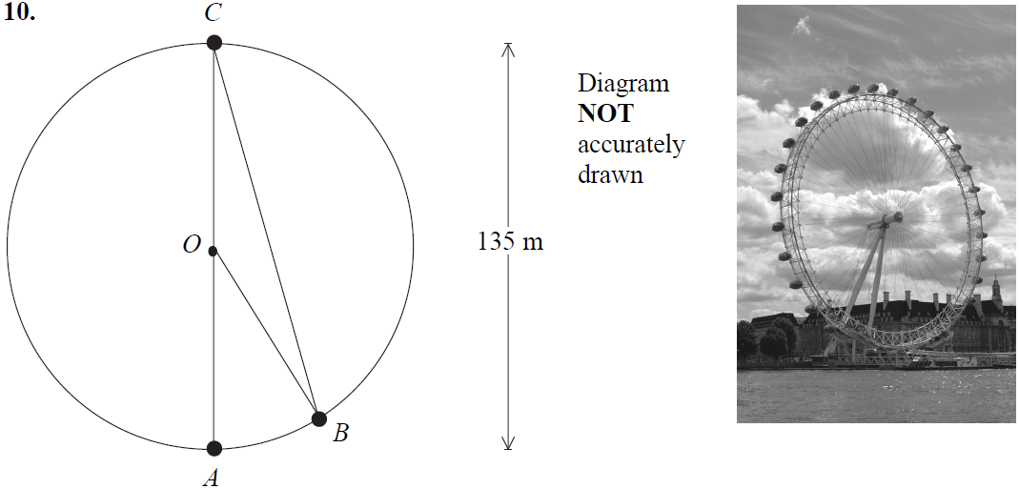
Circles & Sectors
May 2006 3H Q10

Slide 22
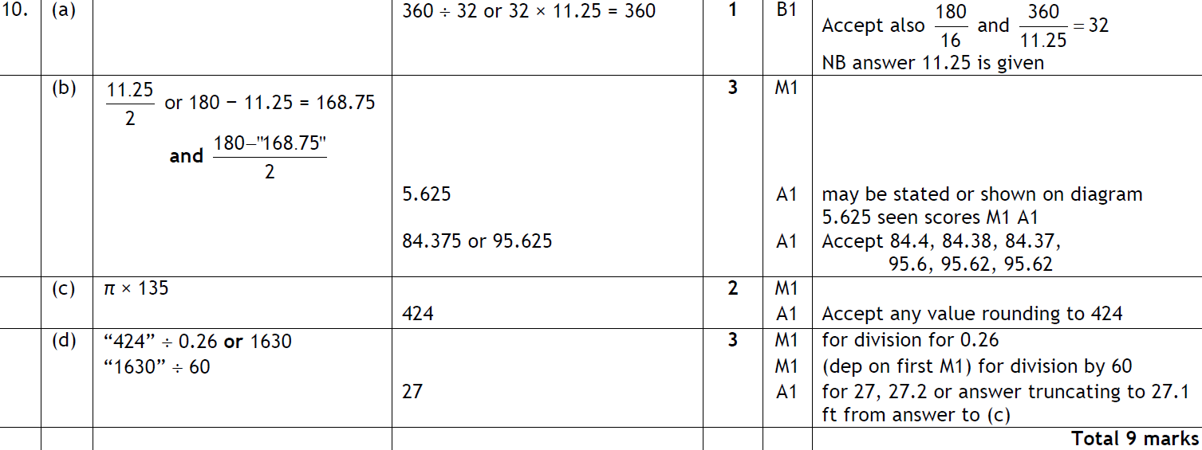
Circles & Sectors
May 2006 3H Q10
A
B
C
D

Slide 23
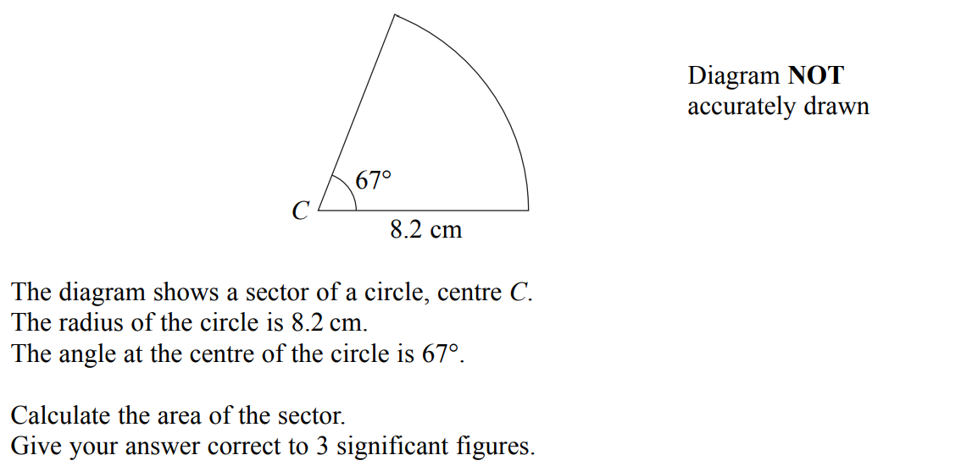
Circles & Sectors
Nov 2006 4H Q17

Slide 24
Circles & Sectors
Nov 2006 4H Q17
A

Slide 25
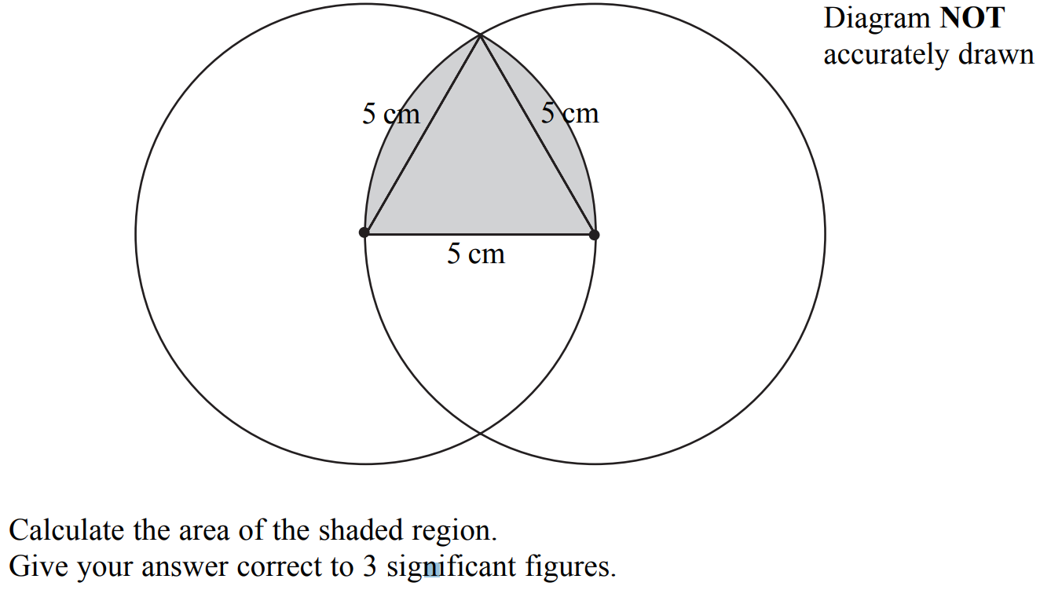
Circles & Sectors
May 2007 4H Q19

Slide 26
Circles & Sectors
May 2007 4H Q19
A
B

Slide 27
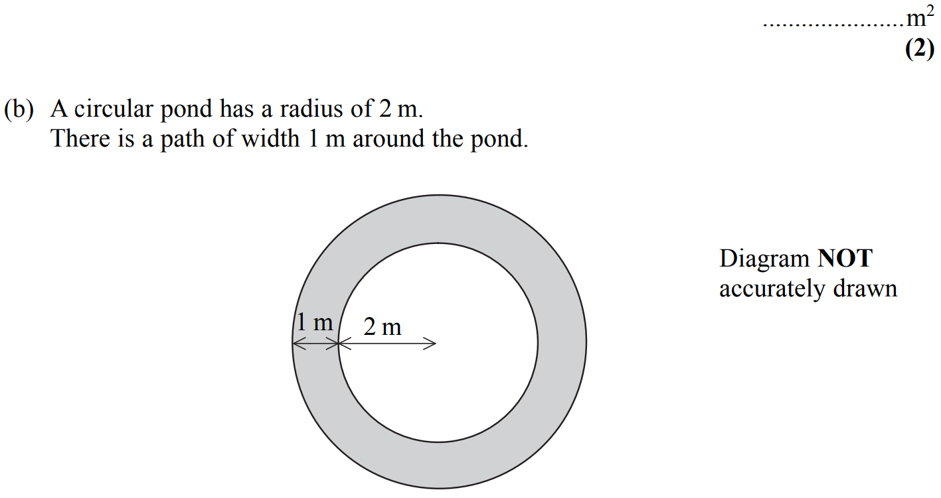
Circles & Sectors
Nov 2007 3H Q5

Slide 28
Circles & Sectors
Nov 2007 3H Q5
A
B
C

Slide 29
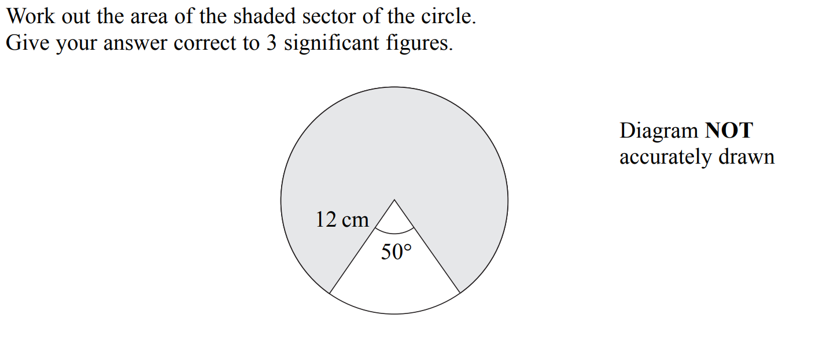
Circles & Sectors
Nov 2007 3H Q15

Slide 30
Circles & Sectors
Nov 2007 3H Q15
A

Slide 31
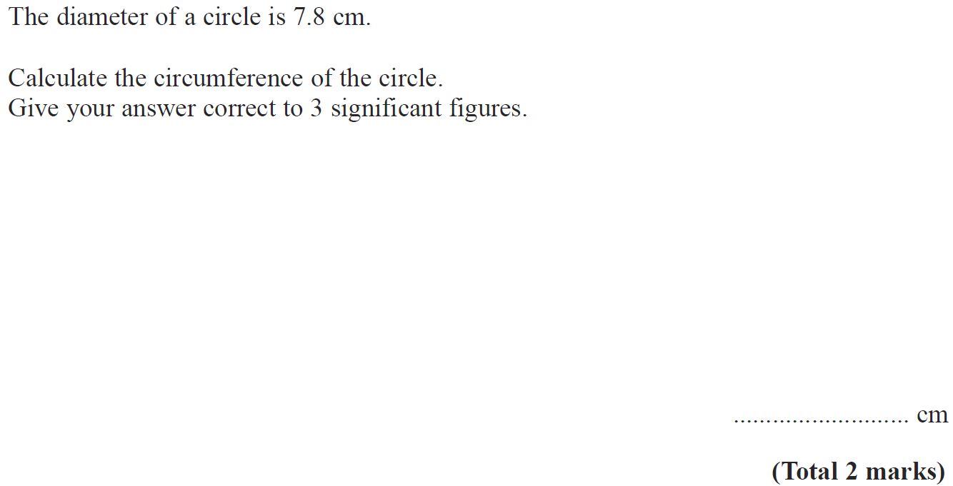
Circles & Sectors
May 2008 3H Q7

Slide 32
Circles & Sectors
May 2008 3H Q7
A

Slide 33
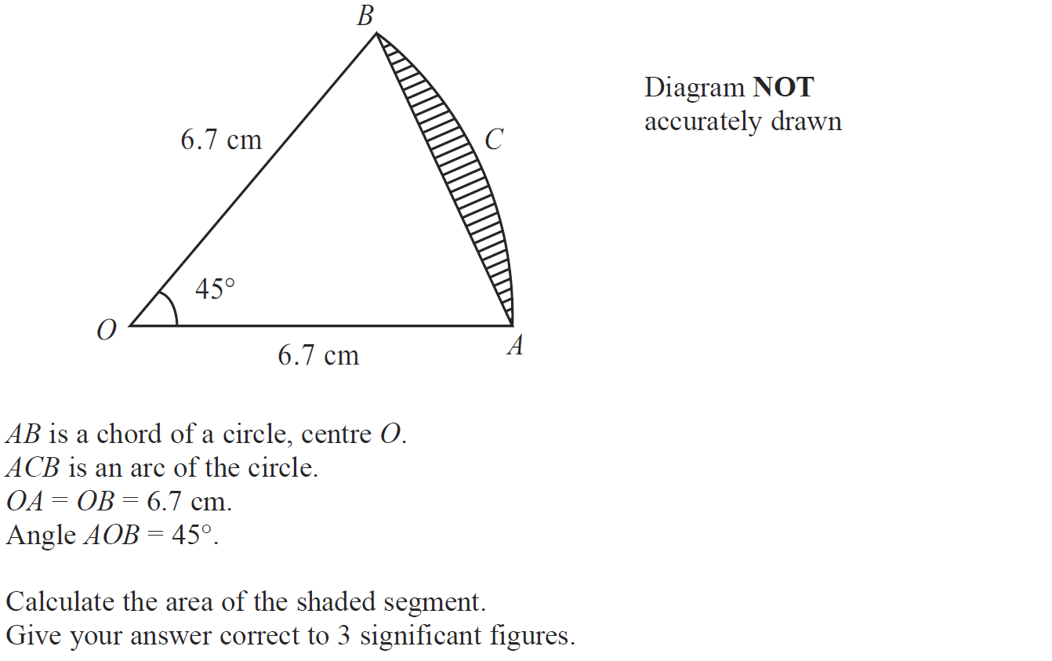
Circles & Sectors
Nov 2008 3H Q19

Slide 34
Circles & Sectors
Nov 2008 3H Q19
A

Slide 35
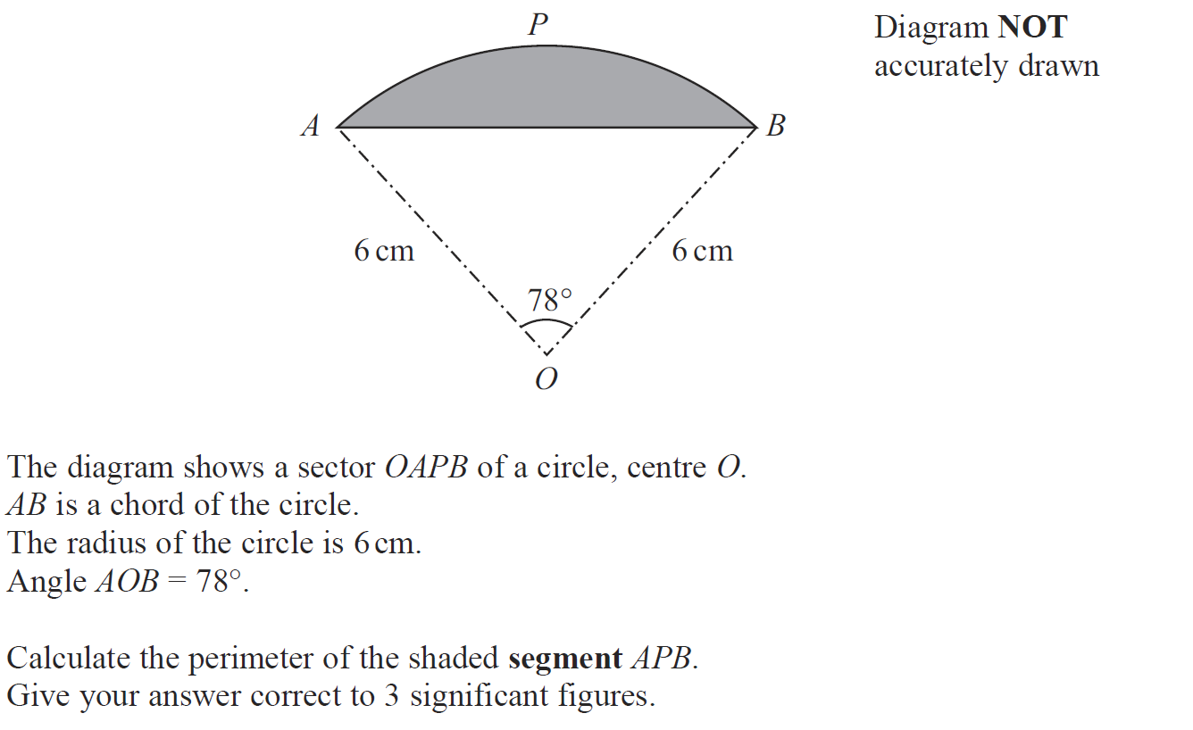
Circles & Sectors
May 2009 3H Q19

Slide 36
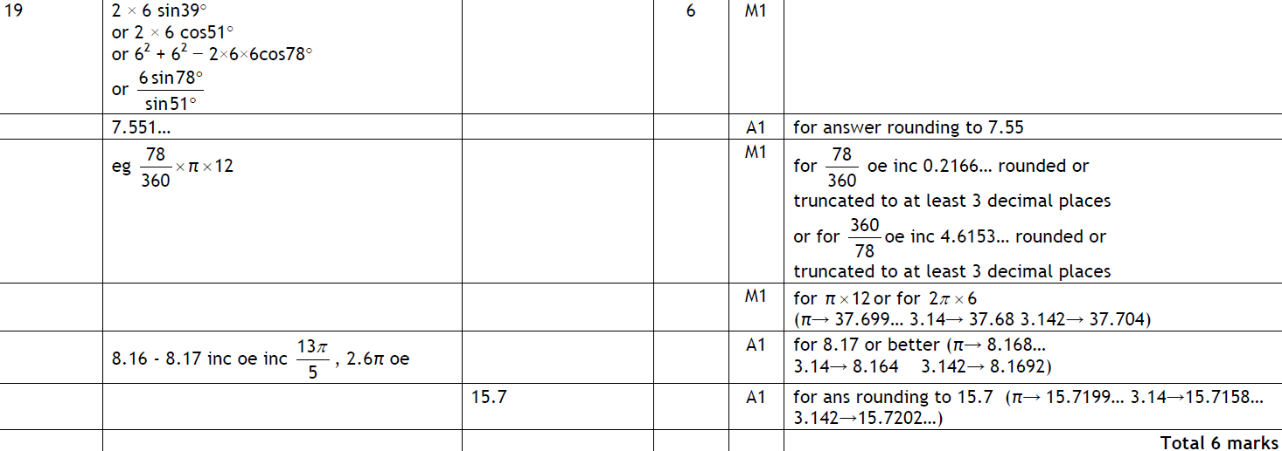
Circles & Sectors
May 2009 3H Q19
A

Slide 37
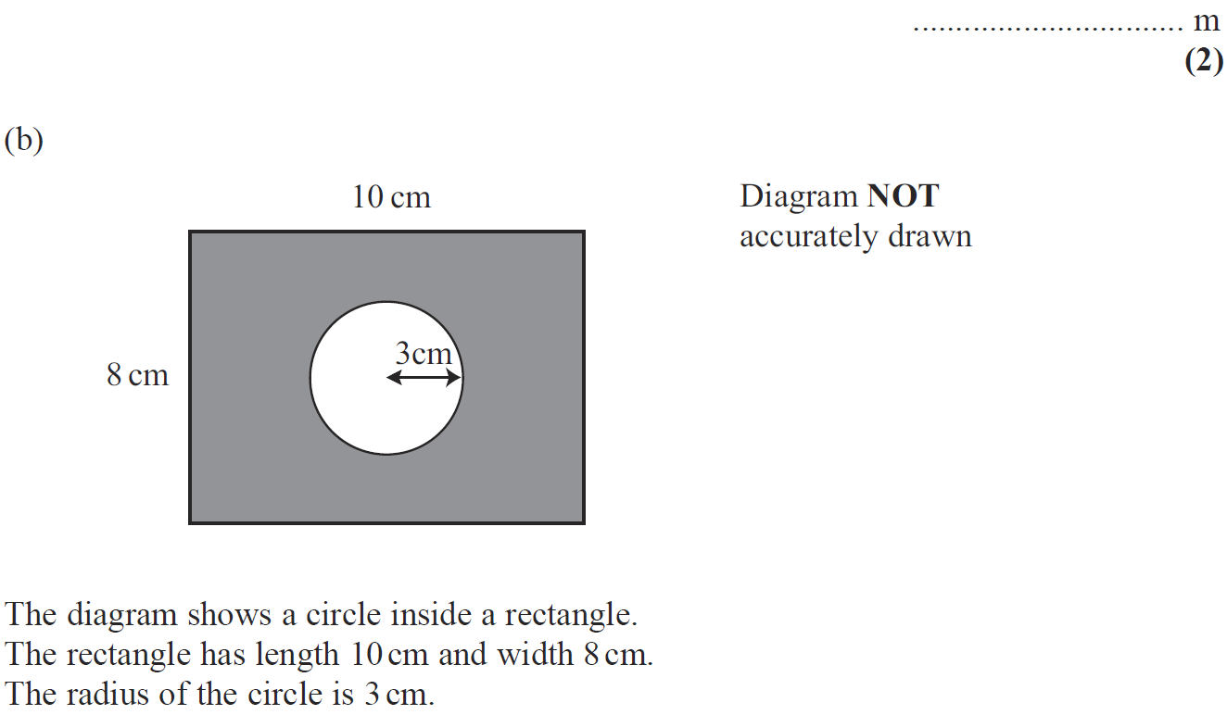
Circles & Sectors
June 2009 4H Q5

Slide 38
Circles & Sectors
June 2009 4H Q5
A
B

Slide 39
Circles & Sectors
Nov 2009 3H Q7

Slide 40
Circles & Sectors
Nov 2009 3H Q7
A
B

Slide 41
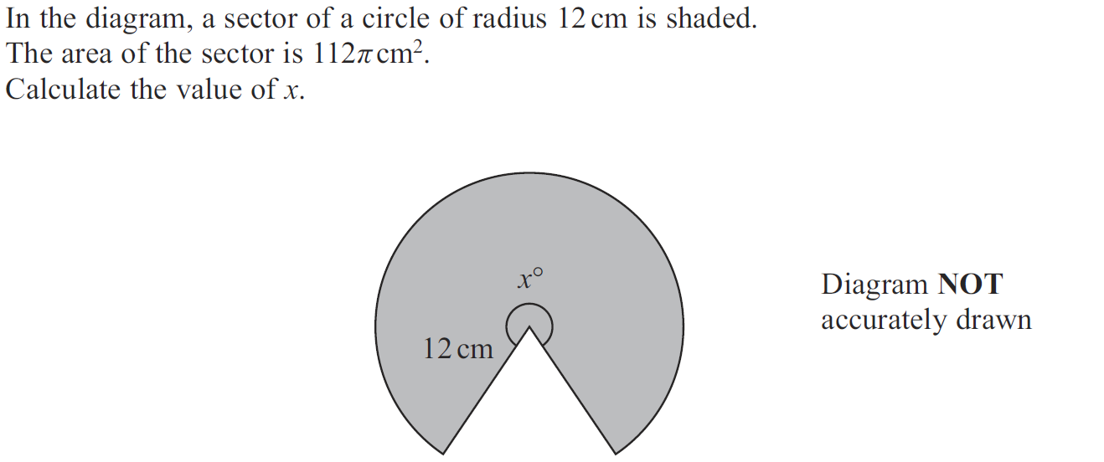
Circles & Sectors
Nov 2009 3H Q18

Slide 42
Circles & Sectors
Nov 2009 3H Q18
A

Slide 43
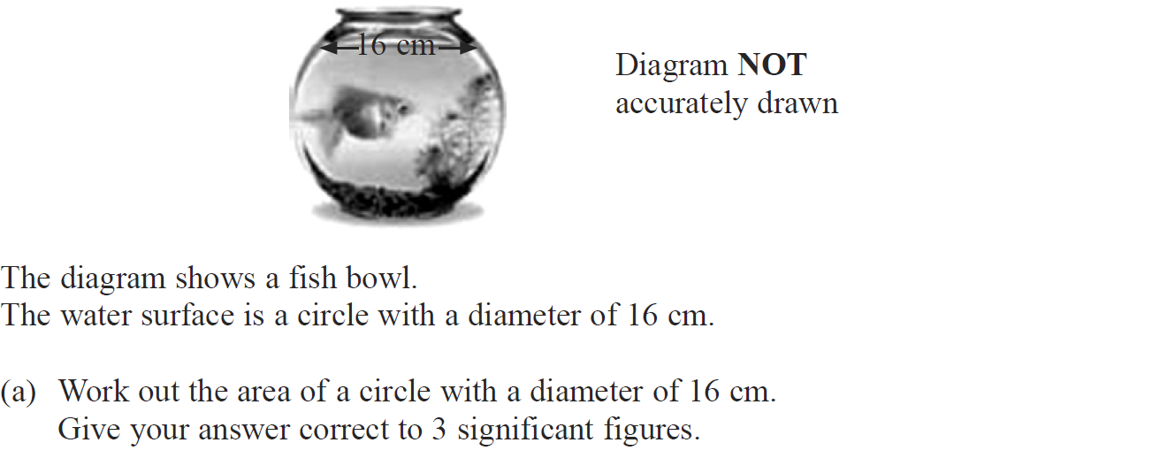
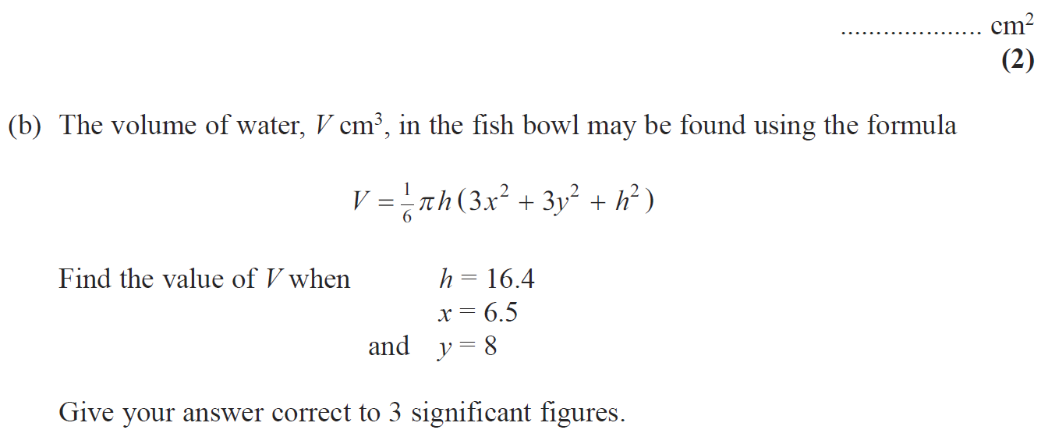
Circles & Sectors
June 2010 3H Q11

Slide 44
Circles & Sectors
June 2010 3H Q11
A
B

Slide 45
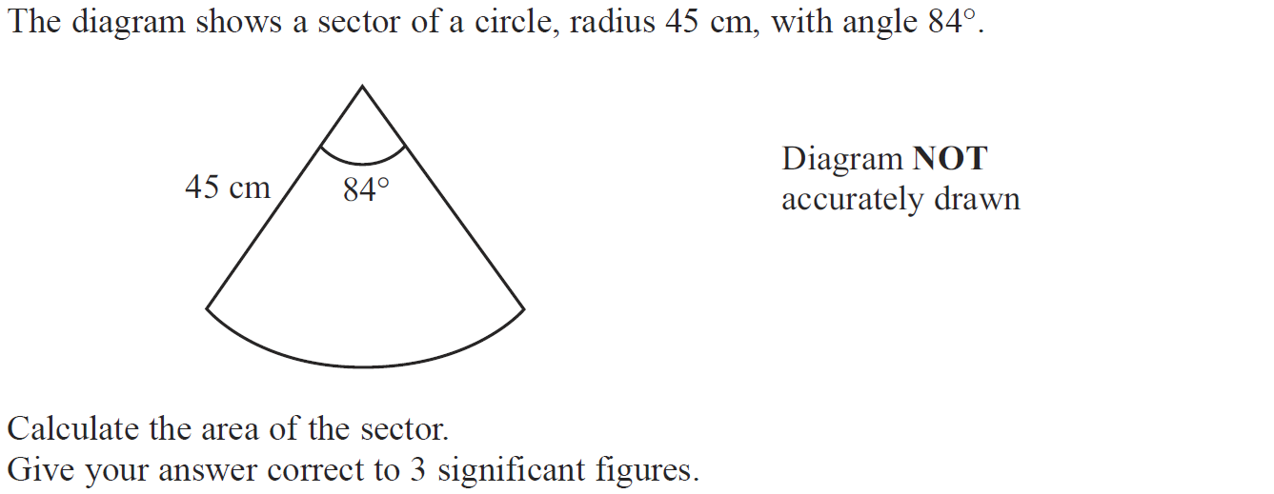
Circles & Sectors
June 2010 4H Q17

Slide 46
Circles & Sectors
June 2010 4H Q17
A

Slide 47
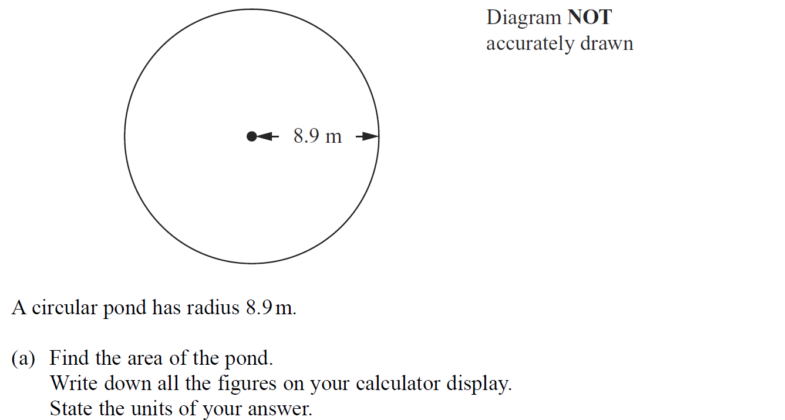
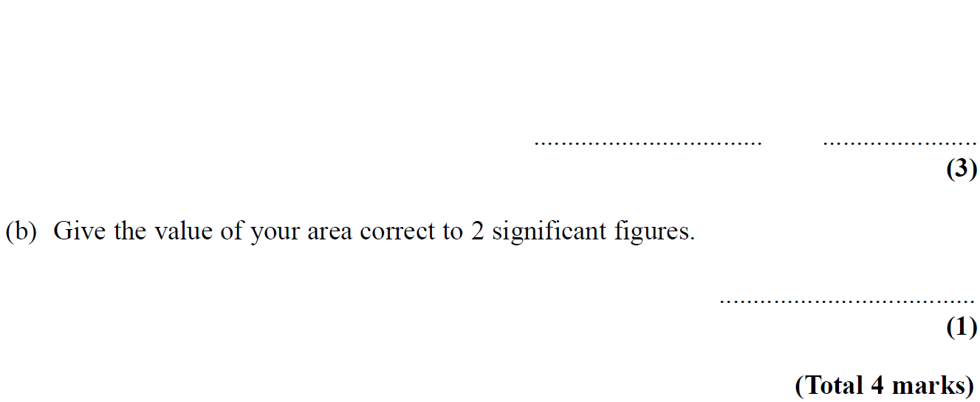
Circles & Sectors
Nov 2010 3H Q4

Slide 48
Circles & Sectors
Nov 2010 3H Q4
A
B

Slide 49
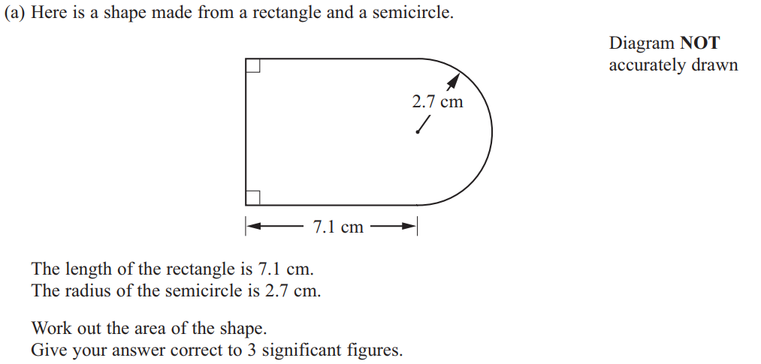
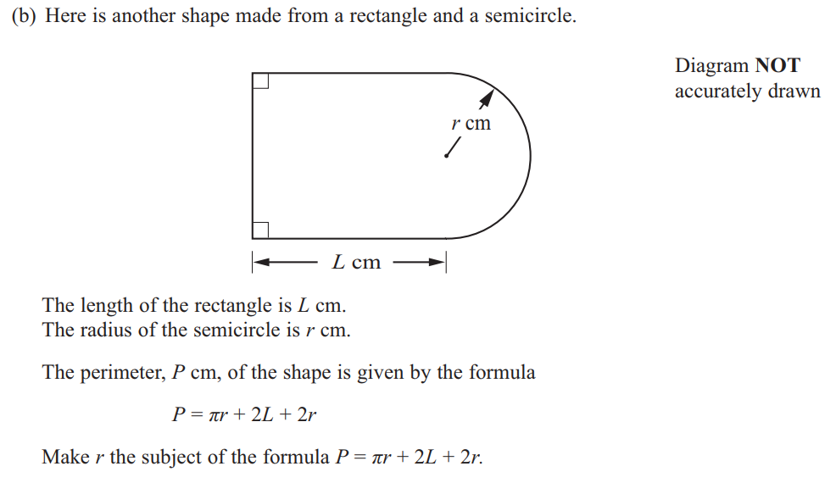
Circles & Sectors
June 2011 3H Q15

Slide 50
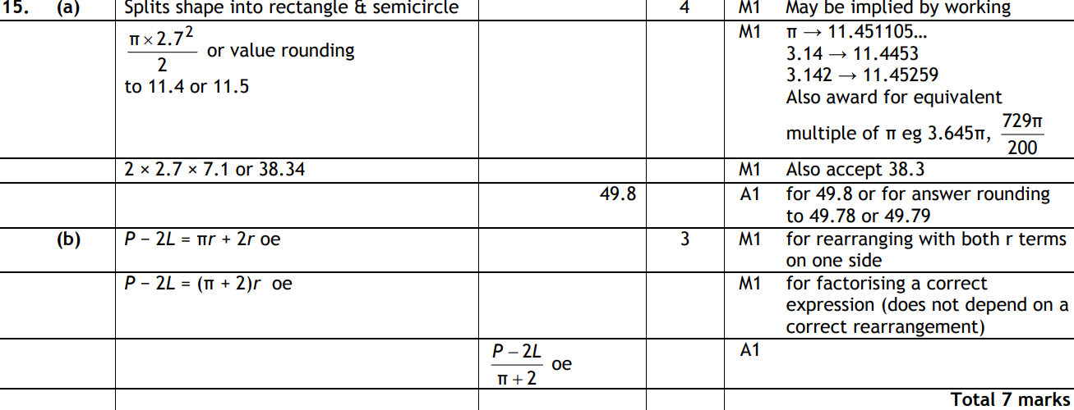
Circles & Sectors
June 2011 3H Q15
A
B

Slide 51
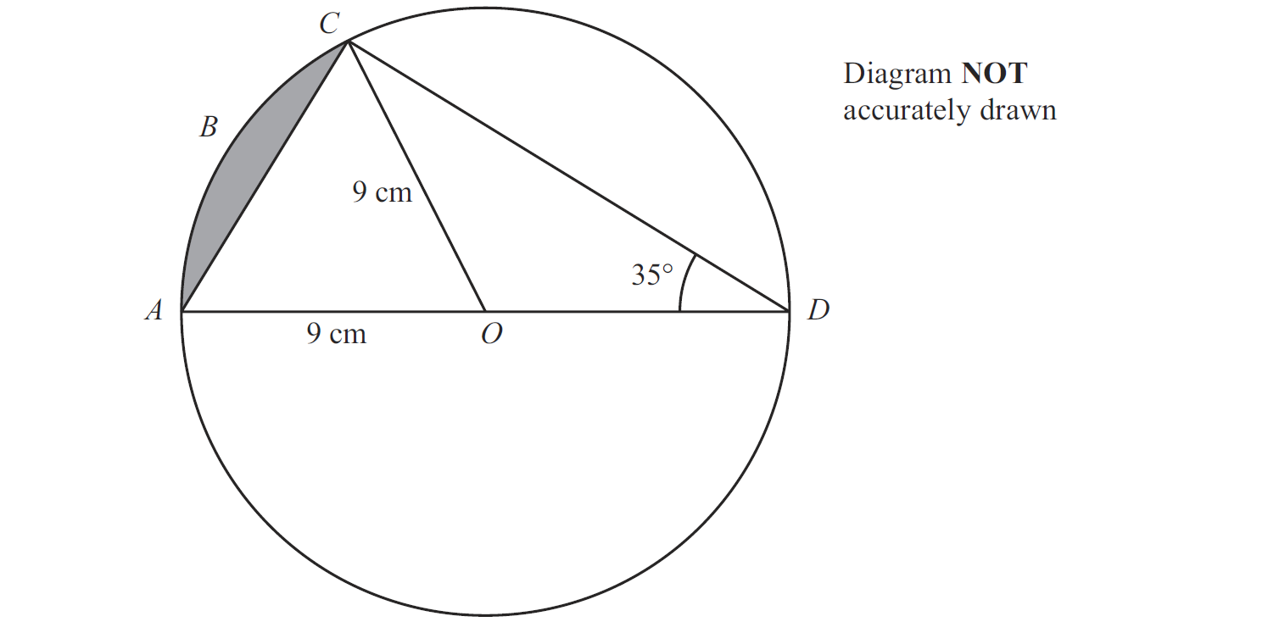
Circles & Sectors
Jan 2012 3H Q18

Slide 52
Circles & Sectors
Jan 2012 3H Q18
A

Slide 53
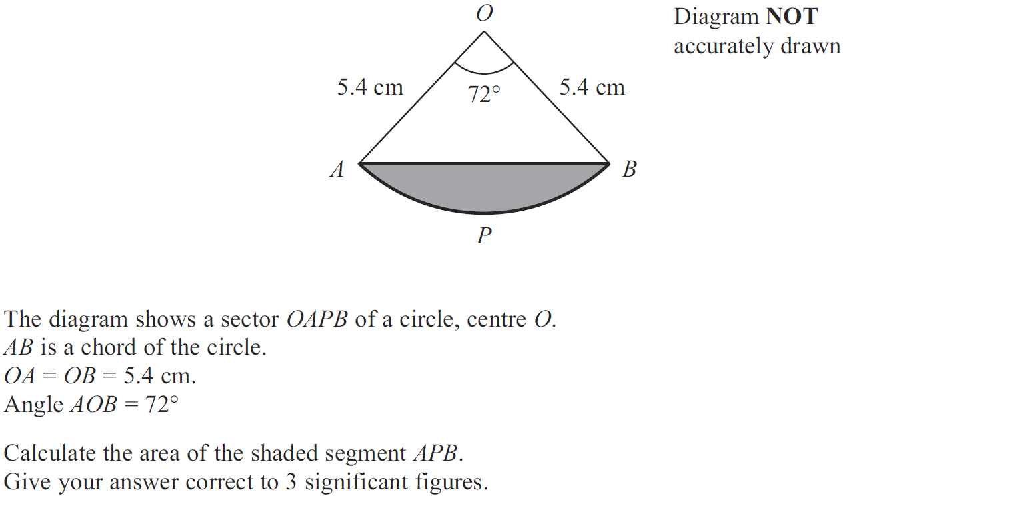
Circles & Sectors
May 2012 3H Q19

Slide 54
Circles & Sectors
May 2012 3H Q19
A

Slide 55
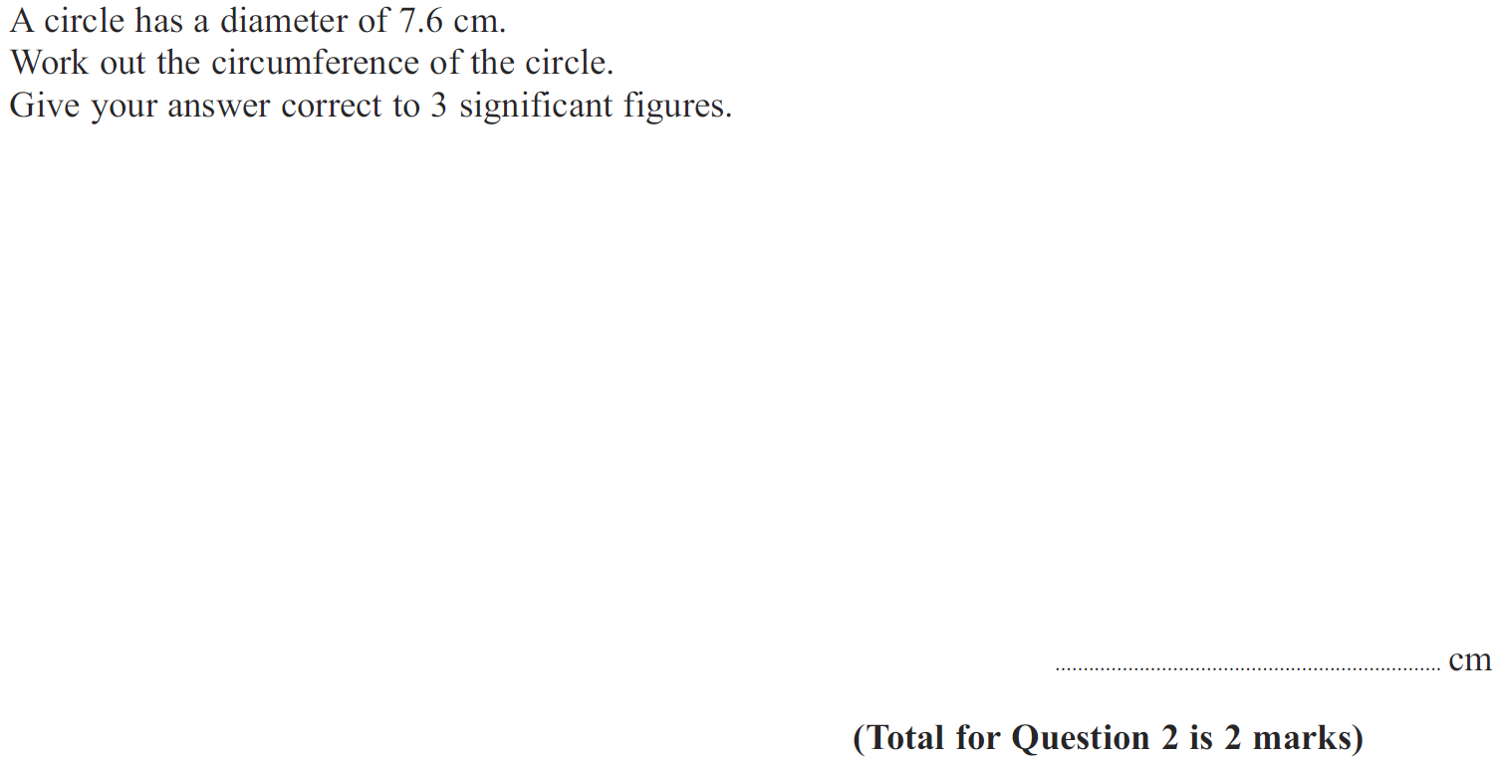
Circles & Sectors
Jan 2013 4H Q2

Slide 56
Circles & Sectors
Jan 2013 4H Q2
A

Slide 57
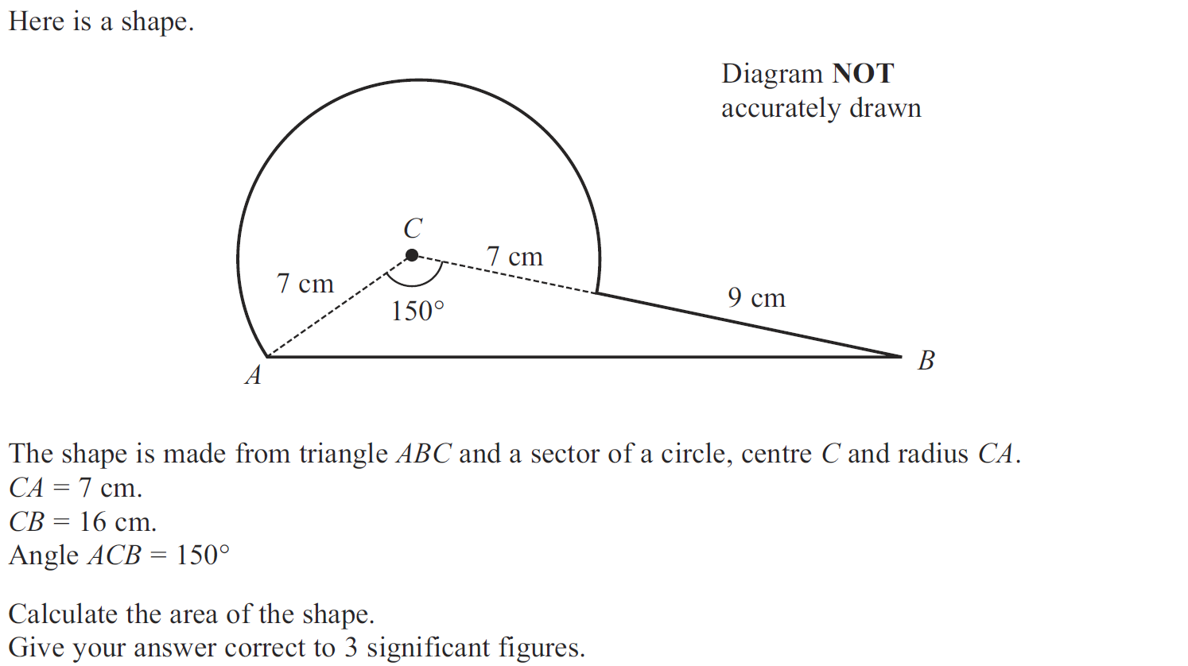
Circles & Sectors
May 2013 3H Q21

Slide 58
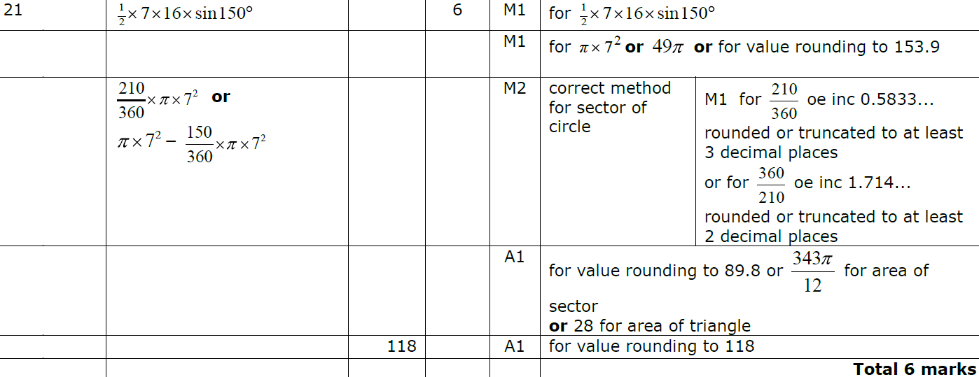
Circles & Sectors
May 2013 3H Q21
A

Slide 59
Circles & Sectors
May 2013 3HR Q10

Slide 60
Circles & Sectors
May 2013 3HR Q10
A

Slide 61
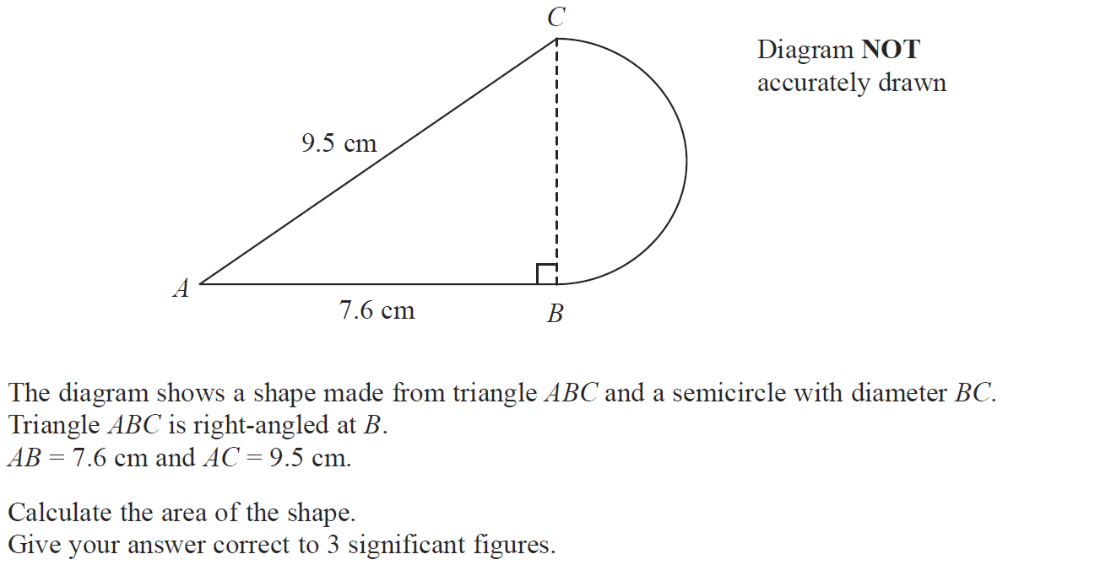
Circles & Sectors
Jan 2014 3H Q12

Slide 62
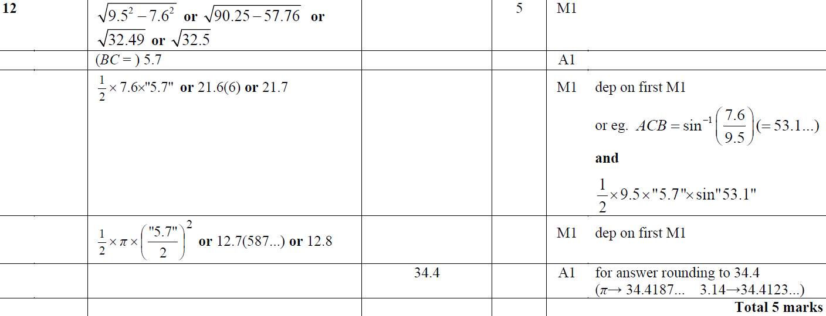
Circles & Sectors
Jan 2014 3H Q12
A

Slide 63
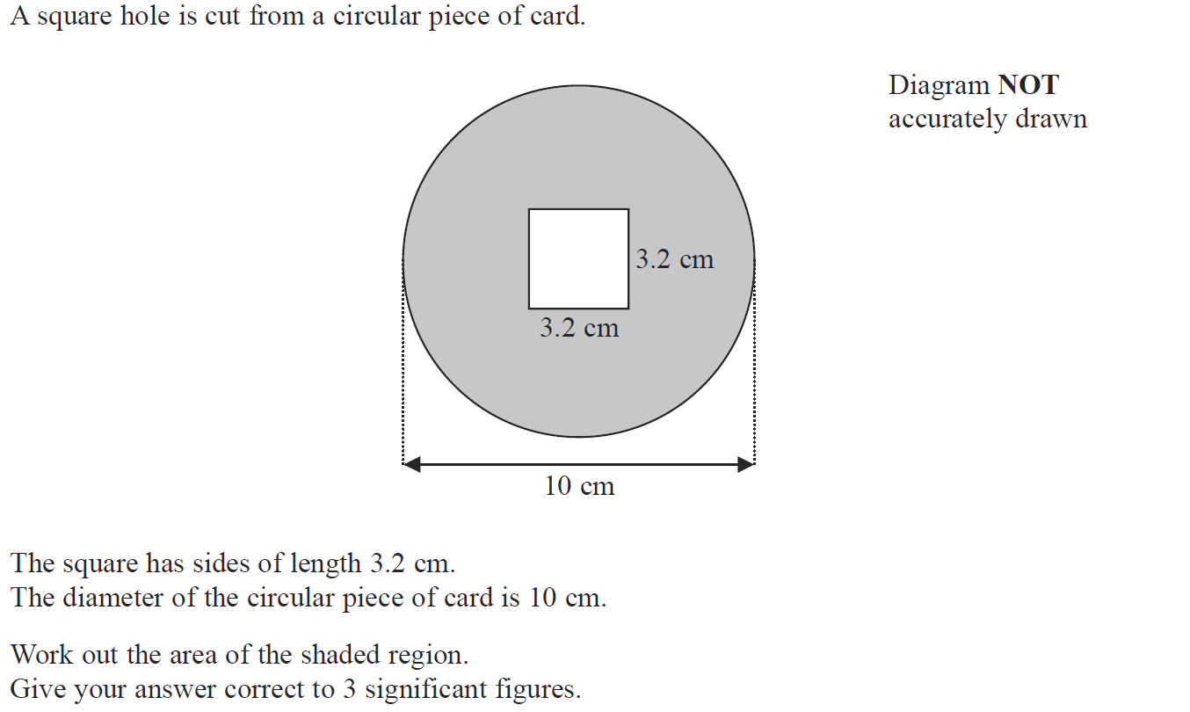
Circles & Sectors
Jan 2014 4H Q7

Slide 64
Circles & Sectors
Jan 2014 4H Q7
A

Slide 65
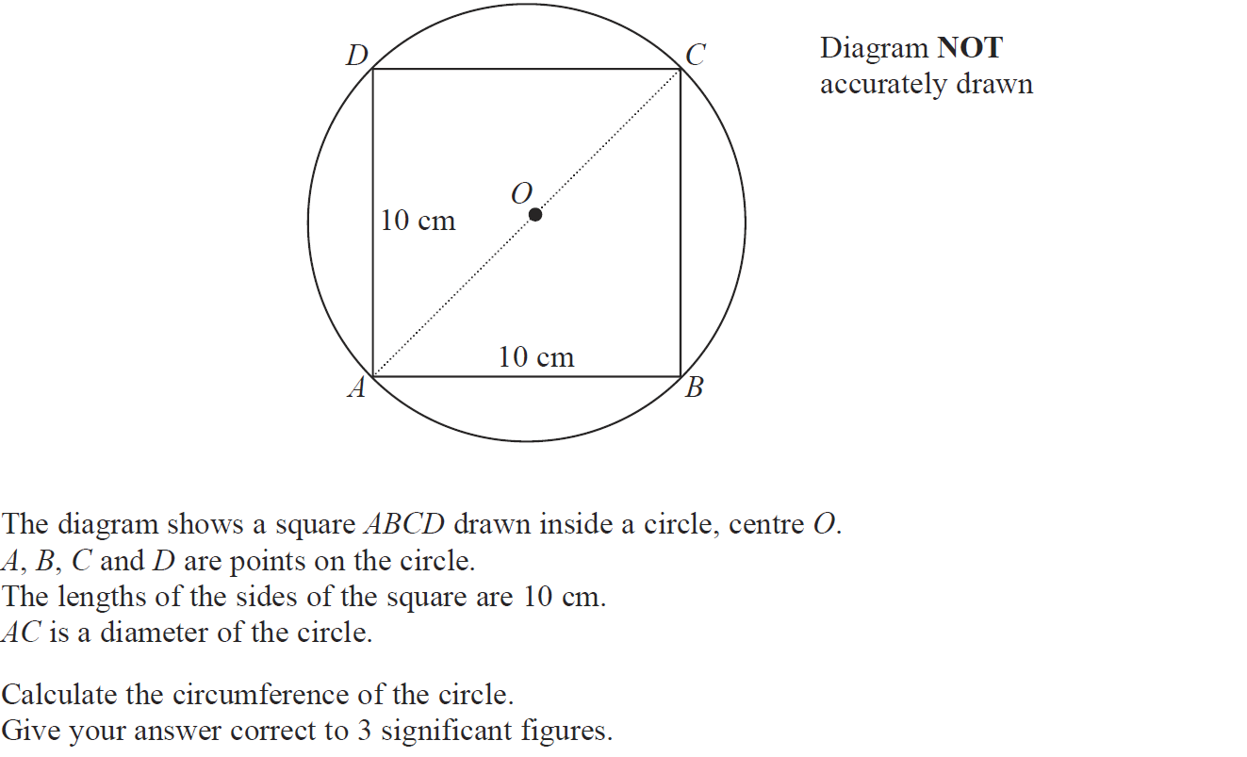
Circles & Sectors
May 2014 3H Q13

Slide 66
Circles & Sectors
May 2014 3H Q13
A

Slide 67
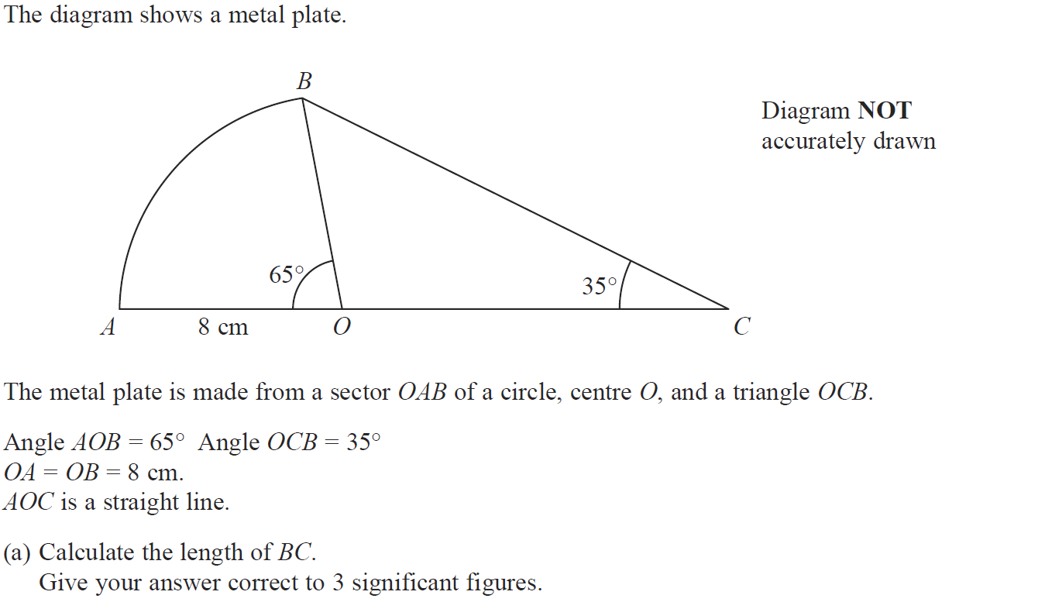
Circles & Sectors
May 2014 3H Q22

Slide 68
Circles & Sectors
May 2014 3H Q22
A
B

Slide 69
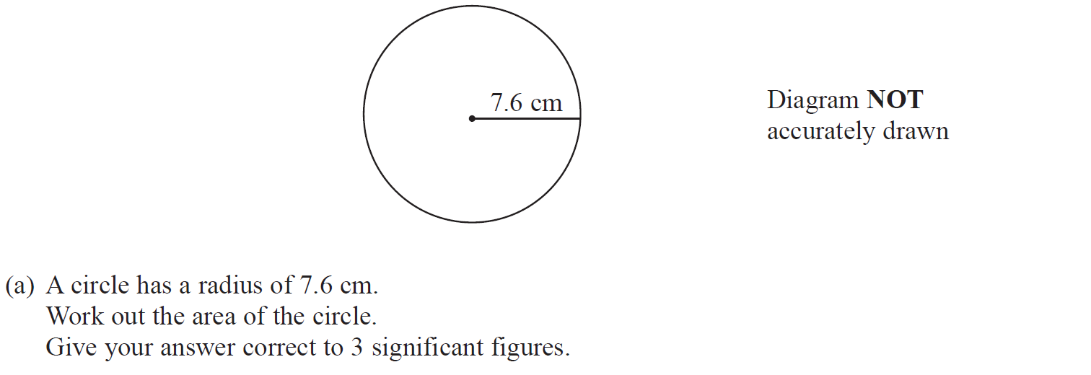
Circles & Sectors
May 2014 4H Q3

Slide 70
Circles & Sectors
May 2014 4H Q3
A
B (i)
B (ii)

Slide 71
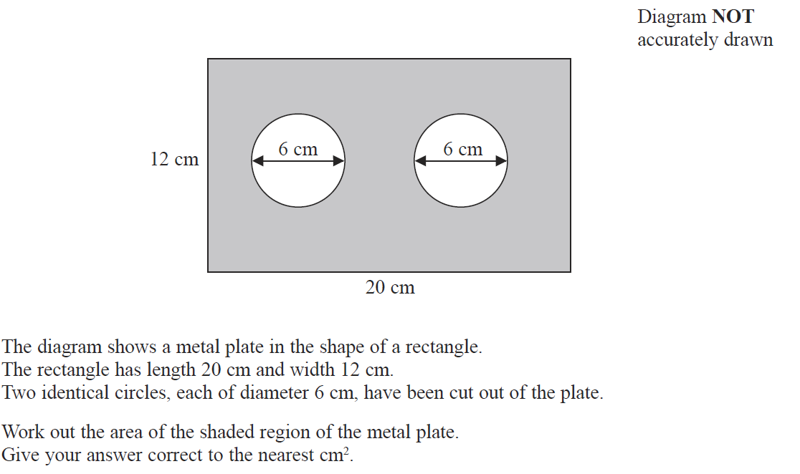
Circles & Sectors
May 2014 4HR Q5

Slide 72
Circles & Sectors
May 2014 4HR Q5
A

Slide 73
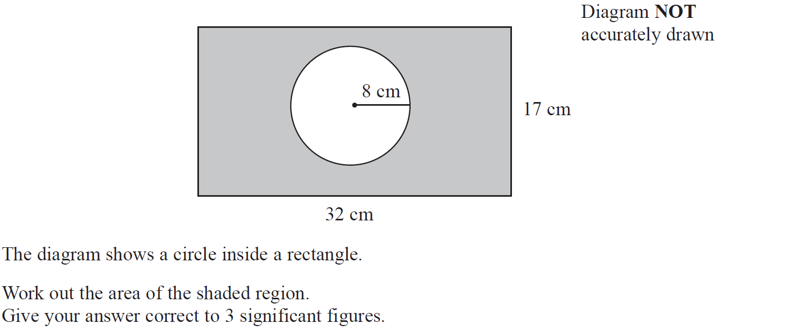
Circles & Sectors
Jan 2015 4H Q2

Slide 74
Circles & Sectors
Jan 2015 4H Q2
A

Slide 75
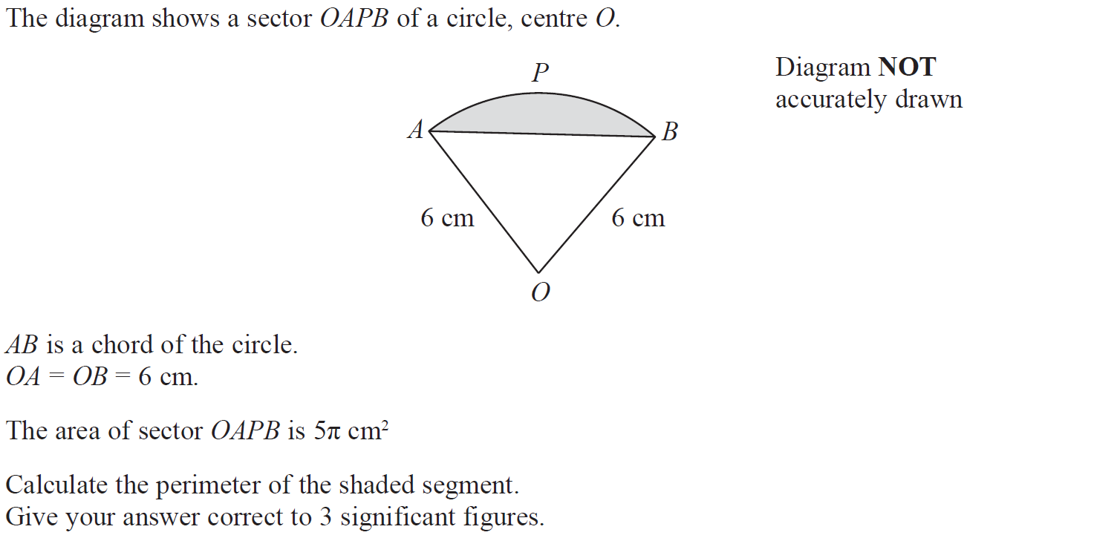
Circles & Sectors
Jan 2015 4H Q24

Slide 76
Circles & Sectors
Jan 2015 4H Q24
A

Slide 77
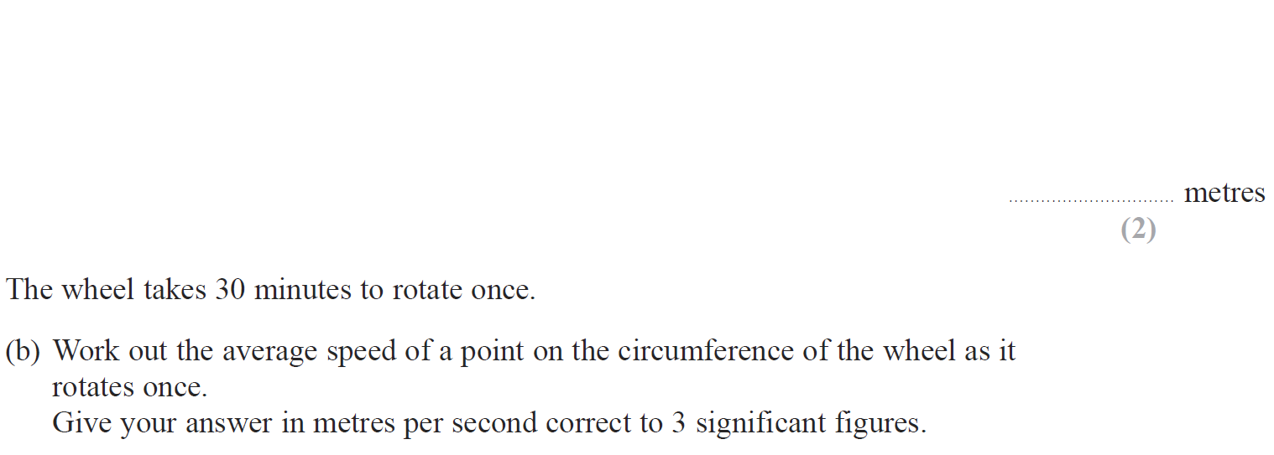
Circles & Sectors
Jan 2015 4HR Q2

Slide 78
Circles & Sectors
Jan 2015 4HR Q2
A
B
C

Slide 79
Circles & Sectors
May 2015 3H Q6

Slide 80
Circles & Sectors
May 2015 3H Q6
A
B

Slide 81
Circles & Sectors
May 2015 3HR Q19

Slide 82
Circles & Sectors
May 2015 3HR Q19
A
B

Slide 83
Circles & Sectors
June 2015 4HR Q20

Slide 84
Circles & Sectors
June 2015 4HR Q20
A

Slide 85
Circles & Sectors
Jan 2016 4H Q24

Slide 86
Circles & Sectors
Jan 2016 4H Q24
A

Slide 87
Circles & Sectors
Jan 2016 3HR Q5

Slide 88
Circles & Sectors
Jan 2016 3HR Q5
A
B

Slide 89
Circles & Sectors
Jan 2016 4HR Q11

Slide 90
Circles & Sectors
Jan 2016 4HR Q11
A

Slide 91
Circles & Sectors
May 2016 3H Q10

Slide 92
Circles & Sectors
May 2016 3H Q10
A

Slide 93
Circles & Sectors
May 2016 3HR Q22

Slide 94
Circles & Sectors
May 2016 3HR Q22
A

Slide 95
Circles & Sectors
June 2016 4HR Q7

Slide 96
Circles & Sectors
June 2016 4HR Q7
A

Slide 97
Circles & Sectors
Jan 2017 3H Q4

Slide 98
Circles & Sectors
Jan 2017 3H Q4
A

Slide 99
Circles & Sectors
Jan 2017 3H Q22

Slide 100
Circles & Sectors
Jan 2017 3H Q22
A

Slide 101
Circles & Sectors
Jan 2017 3HR Q21

Slide 102
Circles & Sectors
Jan 2017 3HR Q21
A

Slide 103
Circles & Sectors
Jan 2017 4HR Q4

Slide 104
Circles & Sectors
Jan 2017 4HR Q4
A

Slide 105
Circles & Sectors
June 2017 4H Q11

Slide 106
Circles & Sectors
June 2017 4H Q11
A

Slide 107
Circles & Sectors
May 2017 3HR Q5

Slide 108
Circles & Sectors
May 2017 3HR Q5
A
B

Slide 109
Circles & Sectors
June 2017 4HR Q24

Slide 110
Circles & Sectors
June 2017 4HR Q24
A

Slide 111
Circles & Sectors
Jan 2018 3H Q5

Slide 112
Circles & Sectors
Jan 2018 3H Q5
A

Slide 113
Circles & Sectors
Jan 2018 3HR Q6

Slide 114
Circles & Sectors
Jan 2018 3HR Q6
A

Slide 115
Circles & Sectors
June 2018 4H Q6

Slide 116
Circles & Sectors
June 2018 4H Q6
A

Slide 117
Circles & Sectors
June 2018 4HR Q24

Slide 118
Circles & Sectors
June 2018 4HR Q24
A

