Slide 1
Circles & Sectors
Circles & Sectors
May 2017
1H Q6
SAM
1H Q18
Nov 2017
2H Q1
SAM
2H Q12
Nov 2017
3H Q8
Practice
1H Q7
May 2018
1H Q8
Practice
3H Q7
Nov 2018
2H Q12
Nov 2018
3H Q13
Sectors

Slide 2
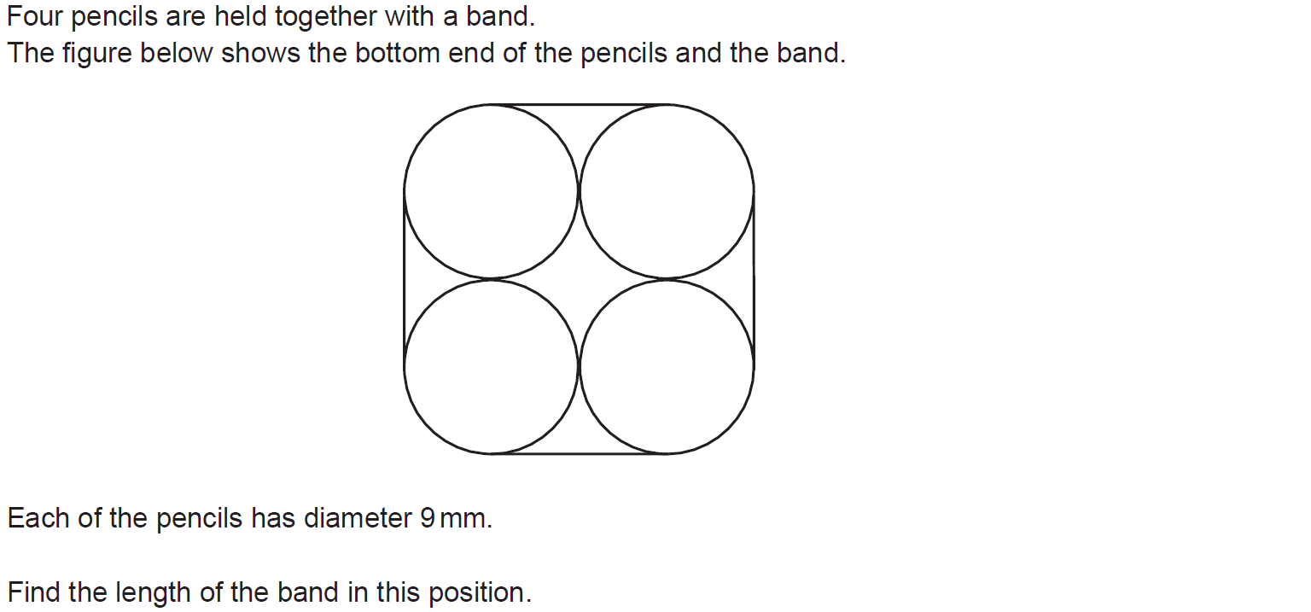
Circles & Sectors
SAM 1H Q18

Slide 3
Circles & Sectors
SAM 1H Q18
A

Slide 4
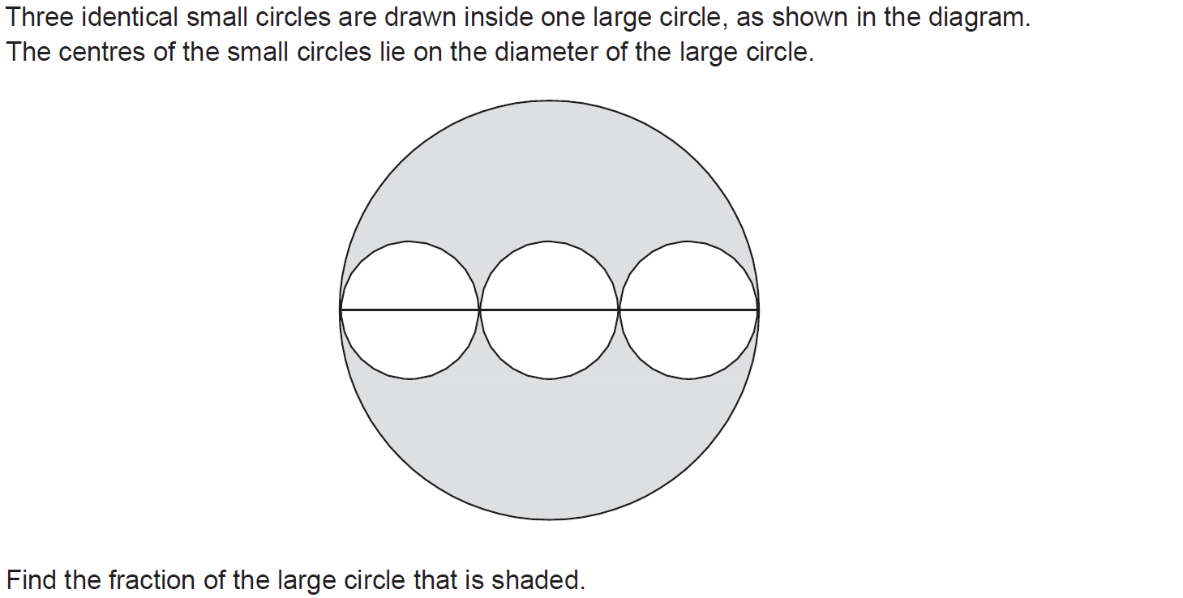
Circles & Sectors
SAM 2H Q12

Slide 5
Circles & Sectors
SAM 2H Q12
A

Slide 6
Circles & Sectors
Practice 1H Q7

Slide 7
Circles & Sectors
Practice 1H Q7
A

Slide 8
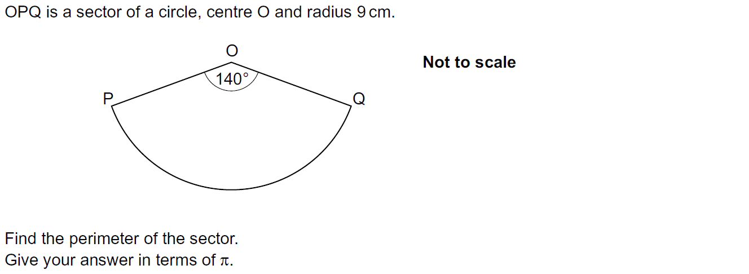
Circles & Sectors
Practice 3H Q7

Slide 9
Circles & Sectors
Practice 3H Q7
A

Slide 10
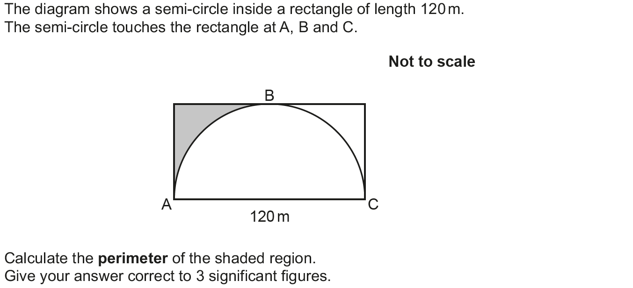
Circles & Sectors
May 2017 1H Q6

Slide 11
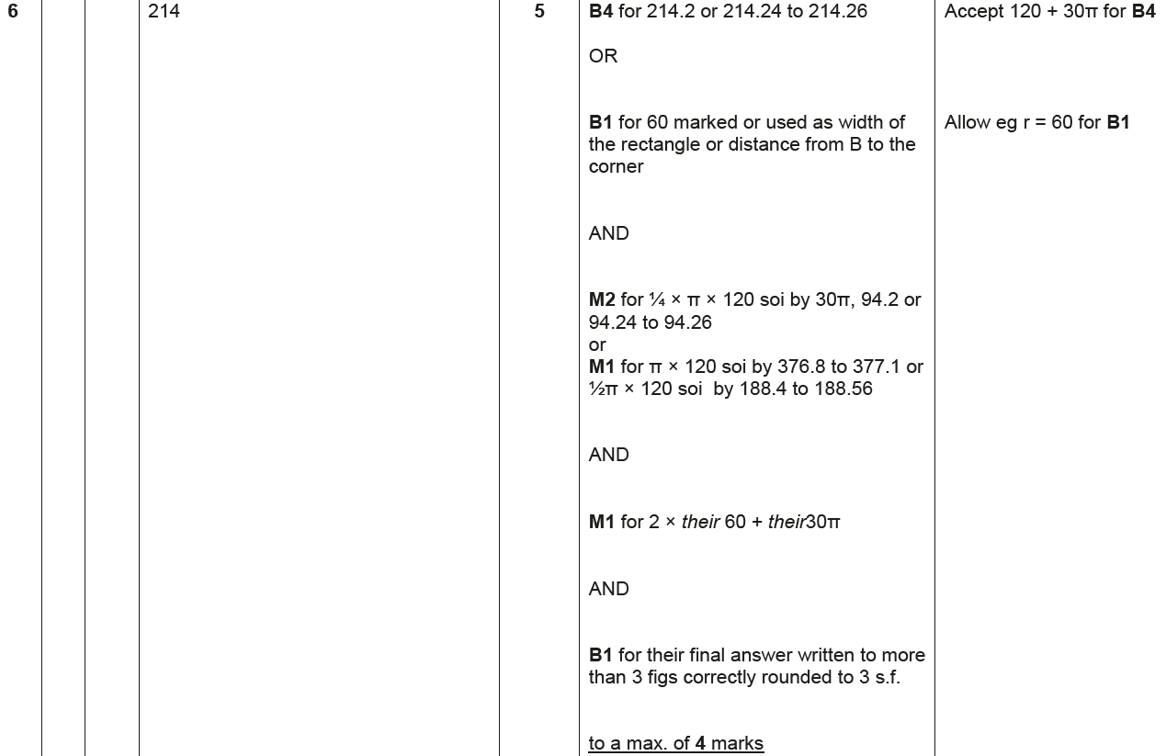
Circles & Sectors
May 2017 1H Q6
A

Slide 12
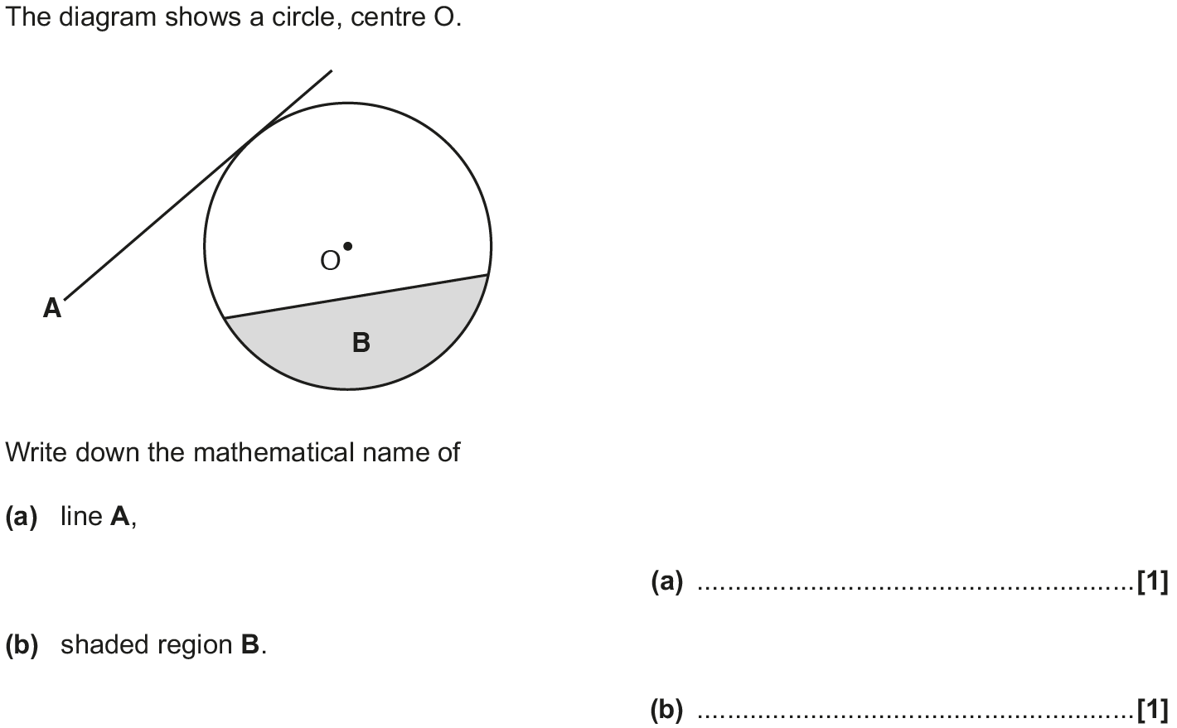
Circles & Sectors
Nov 2017 2H Q1

Slide 13
Circles & Sectors
Nov 2017 2H Q1
A
B

Slide 14
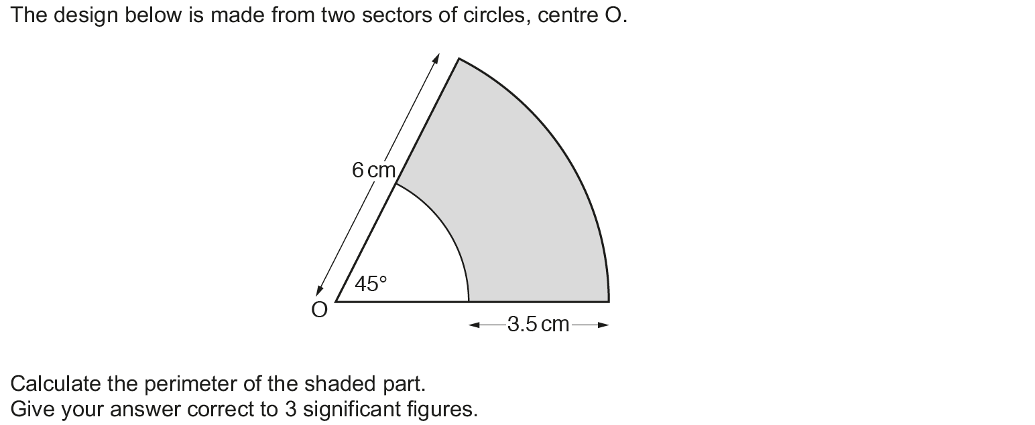
Circles & Sectors
Nov 2017 3H Q8

Slide 15
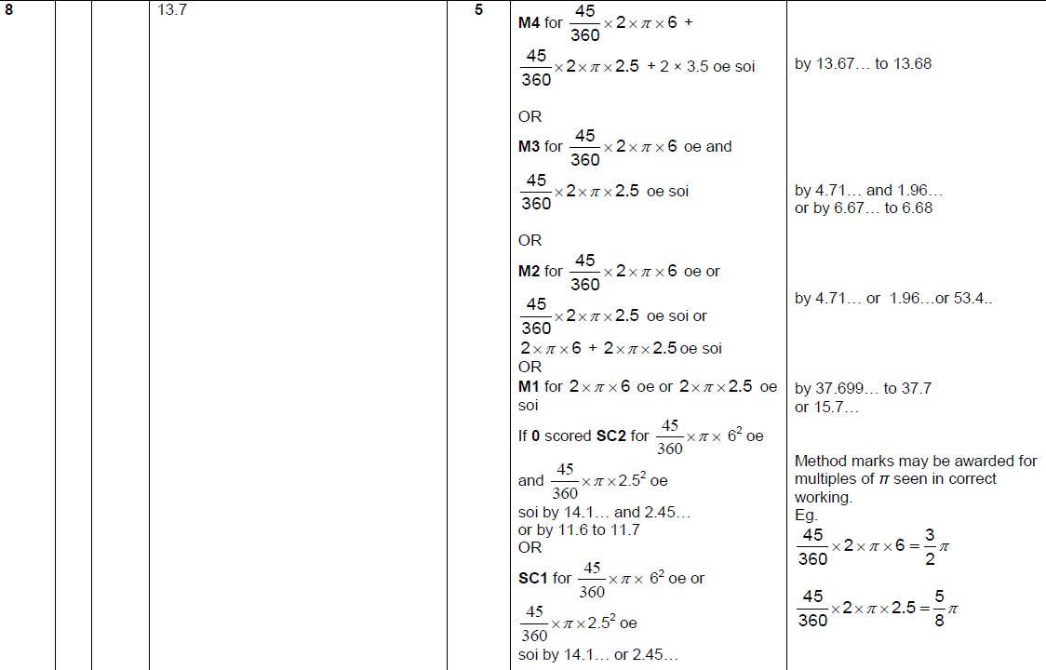
Circles & Sectors
Nov 2017 3H Q8
A

Slide 16
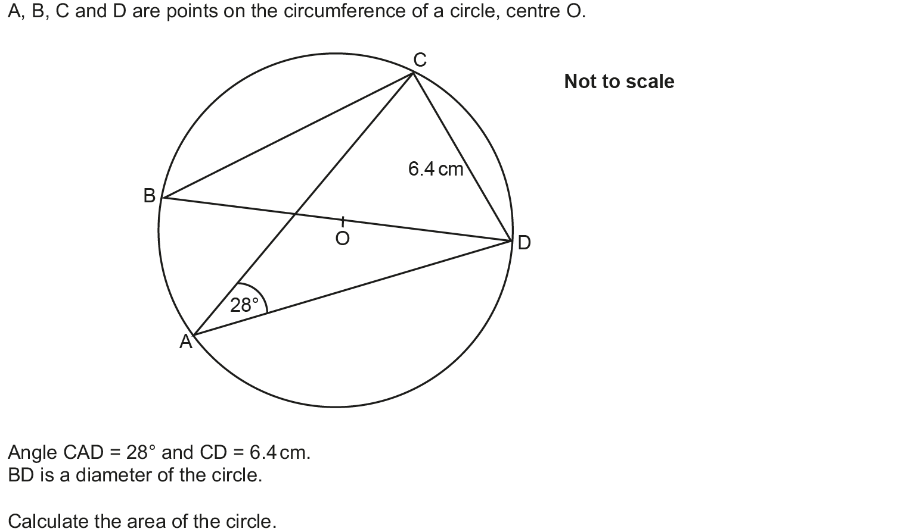
Circles & Sectors
May 2018 1H Q8

Slide 17
Circles & Sectors
May 2018 1H Q8
A

Slide 18
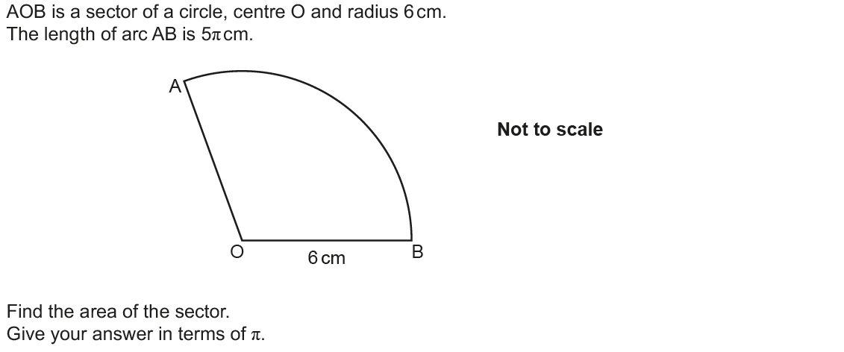
Circles & Sectors
Nov 2018 2H Q12

Slide 19
Circles & Sectors
Nov 2018 2H Q12
A

Slide 20
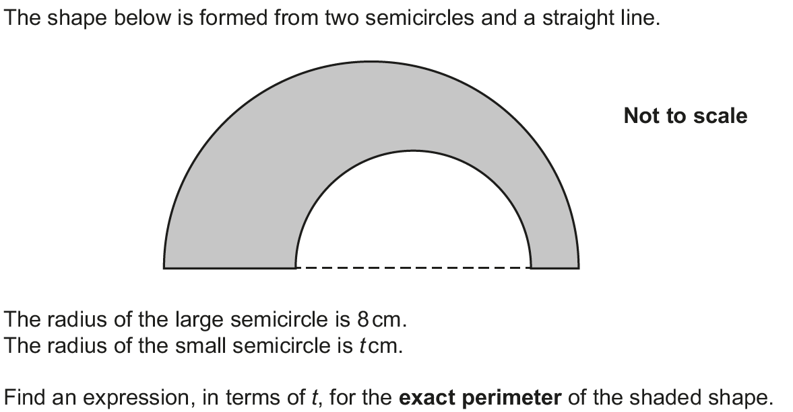
Circles & Sectors
Nov 2018 3H Q13

Slide 21
Circles & Sectors
Nov 2018 3H Q13
A

