Slide 1
Circles & Sectors
Circles & Sectors
SAM
2H Q17
June 2017 2H Q17
Nov 2017 2H Q20
SAM
3H Q1
June 2017 3H Q18
Nov 2018 1H Q7
Spec 1
2H Q8
Nov 2017 1H Q4
Nov 2018 2H Q13
Spec 2
2H Q7
Nov 2017 2H Q3
Nov 2018 3H Q16
Spec 2
3H Q16
Nov 2017 2H Q11
June 2019 2H Q12
Sectors

Slide 2
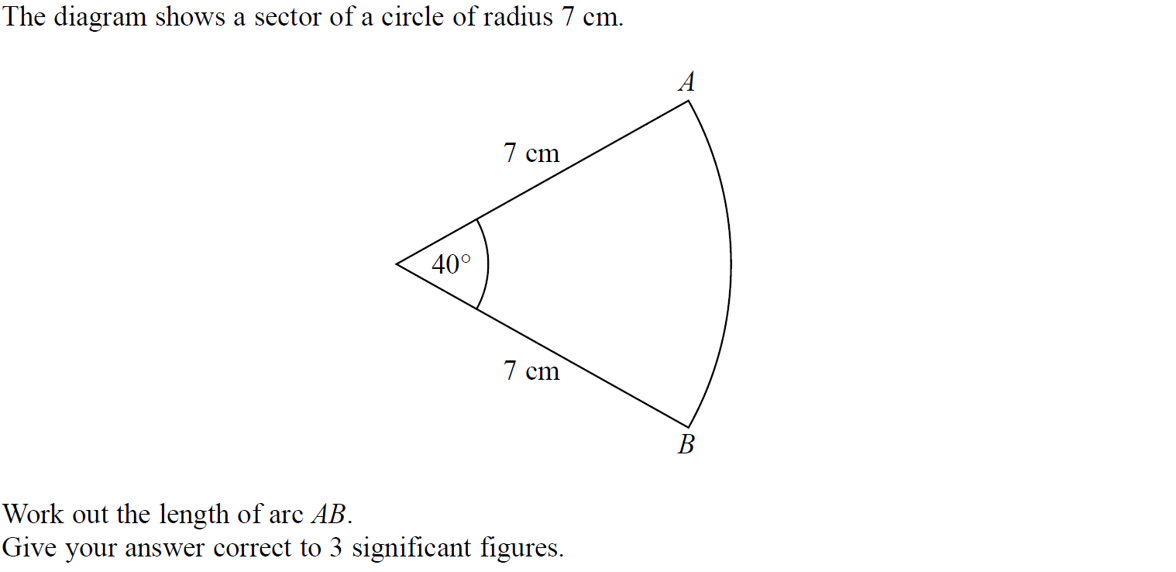
Circles & Sectors
SAM 2H Q17

Slide 3
Circles & Sectors
SAM 2H Q17
A

Slide 4
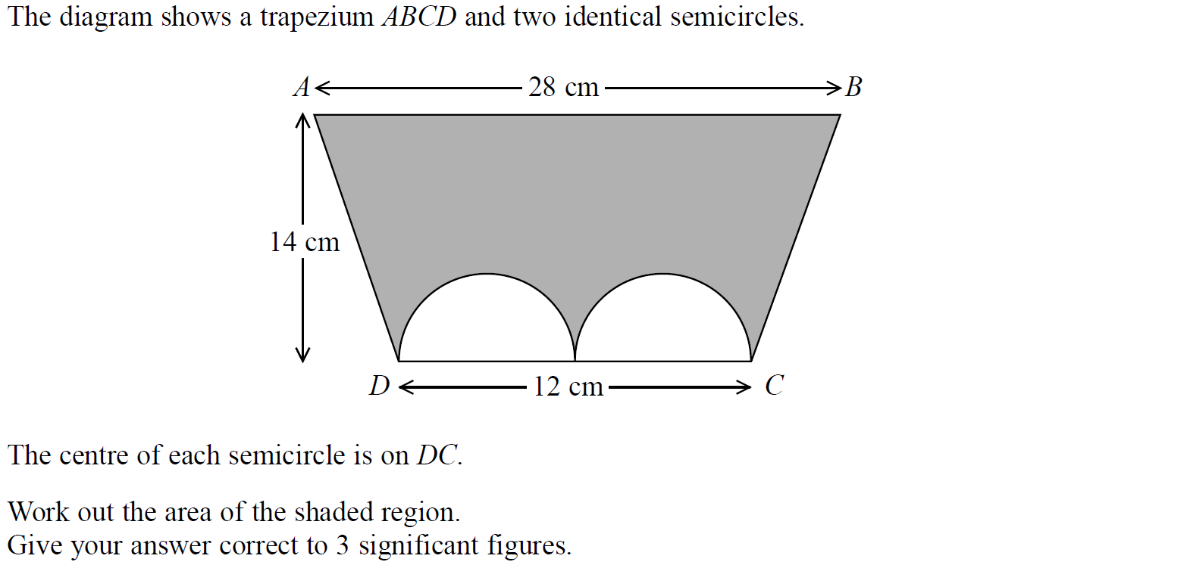
Circles & Sectors
SAM 3H Q1

Slide 5
Circles & Sectors
SAM 3H Q1
A

Slide 6
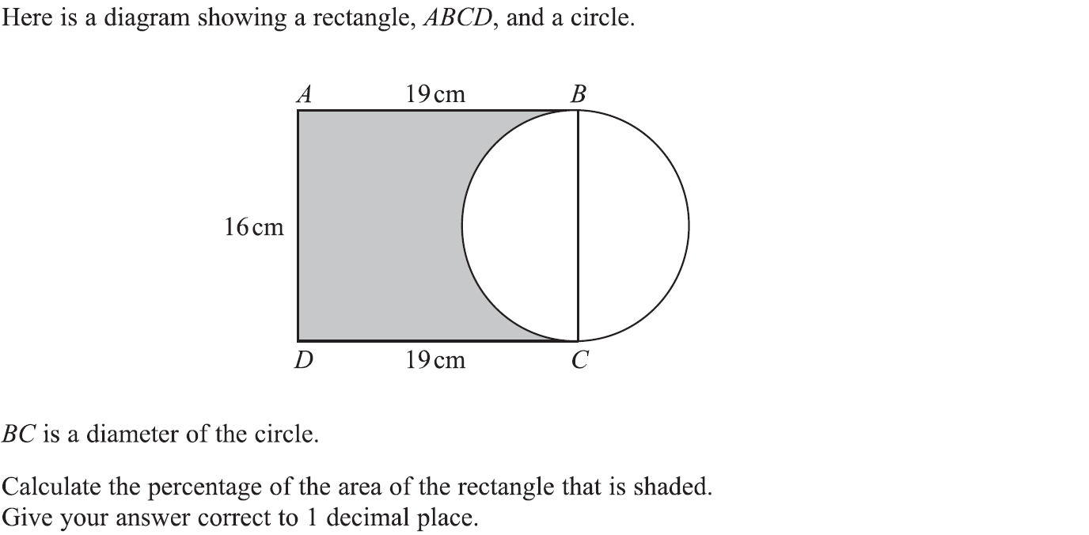
Circles & Sectors
Specimen Set 1 2H Q8

Slide 7
Circles & Sectors
Specimen Set 1 2H Q8
A

Slide 8
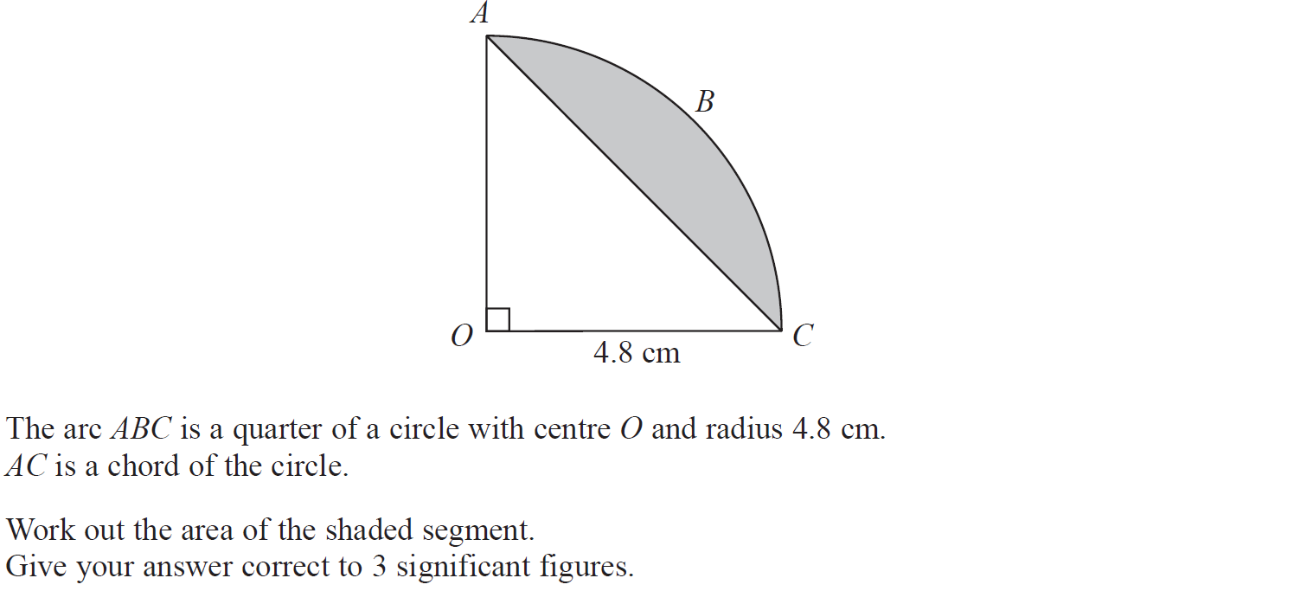
Circles & Sectors
Specimen Set 2 2H Q7

Slide 9
Circles & Sectors
Specimen Set 2 2H Q7
A

Slide 10
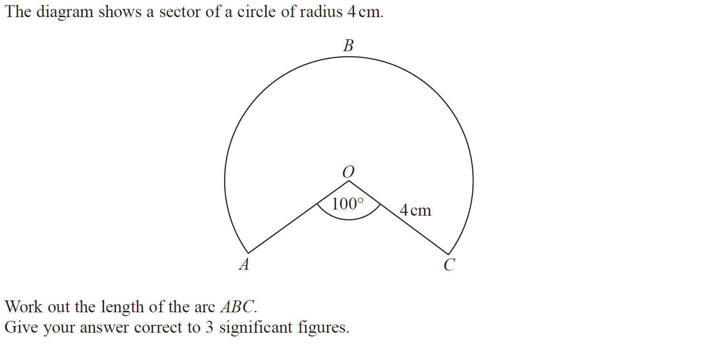
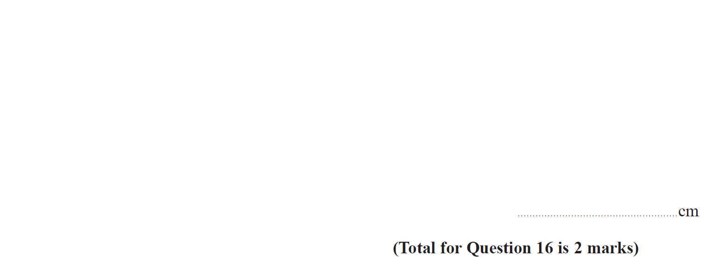
Circles & Sectors
Specimen Set 2 3H Q16

Slide 11
Circles & Sectors
Specimen Set 2 3H Q16
A

Slide 12
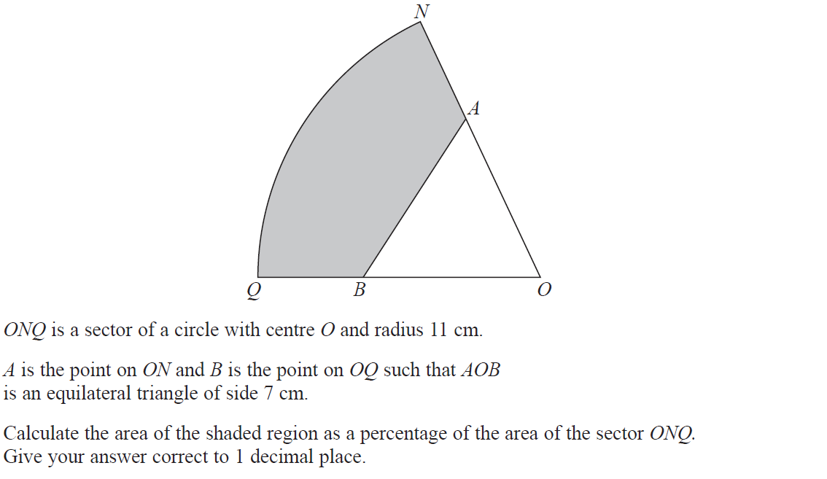
Circles & Sectors
June 2017 2H Q17

Slide 13
Circles & Sectors
June 2017 2H Q17
A

Slide 14
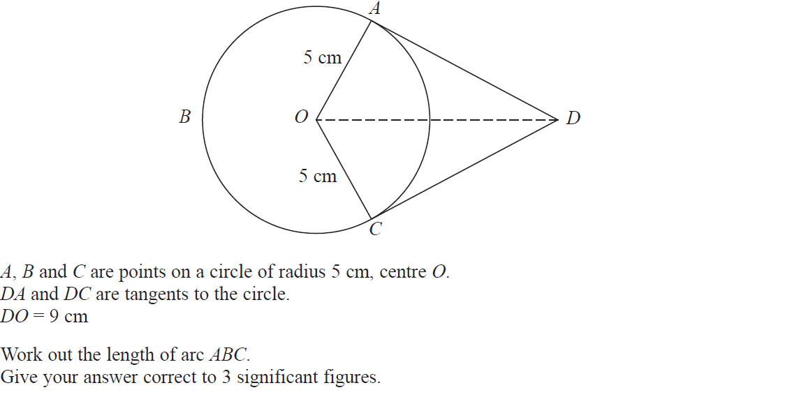
Circles & Sectors
June 2017 3H Q18

Slide 15
Circles & Sectors
June 2017 3H Q18
A

Slide 16
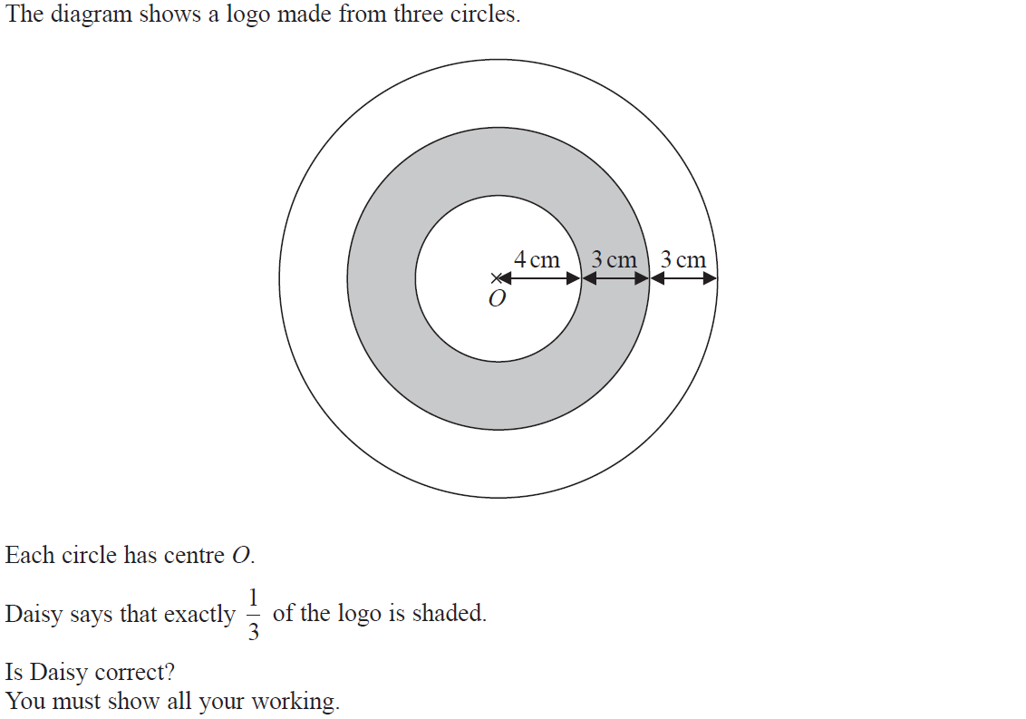
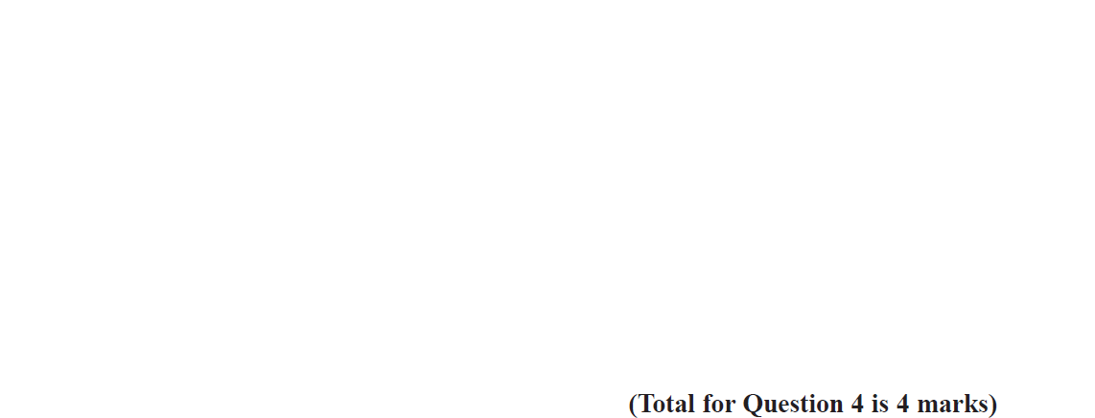
Circles & Sectors
Nov 2017 1H Q4

Slide 17
Circles & Sectors
Nov 2017 1H Q4
A

Slide 18
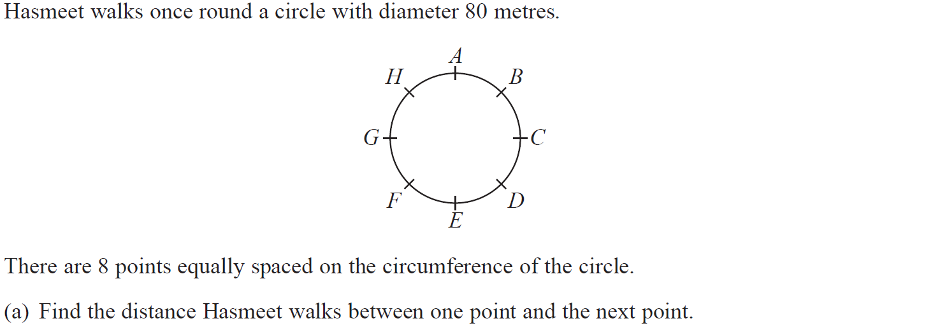
Circles & Sectors
Nov 2017 2H Q3

Slide 19
Circles & Sectors
Nov 2017 2H Q3
A
B

Slide 20
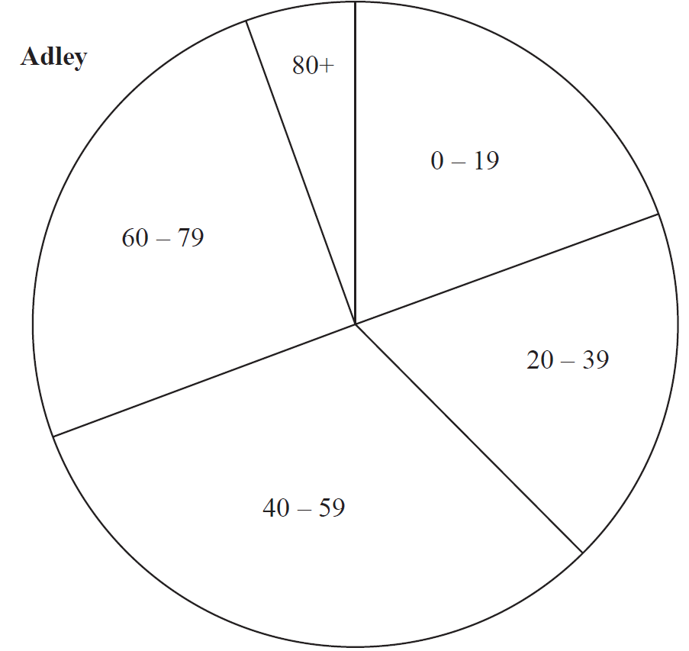
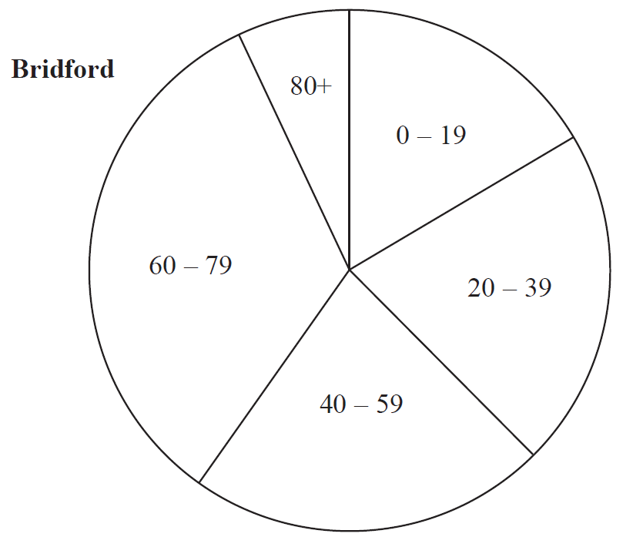
Circles & Sectors
Nov 2017 2H Q11

Slide 21
Circles & Sectors
Nov 2017 2H Q11
A

Slide 22
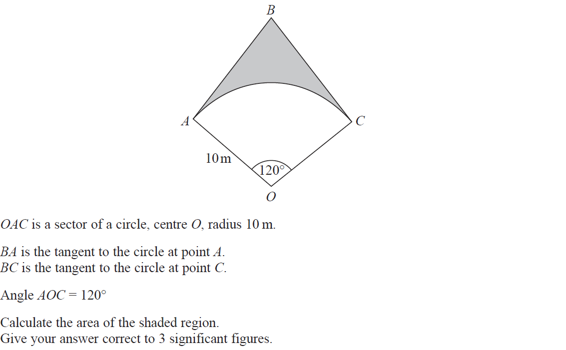
Circles & Sectors
Nov 2017 2H Q20

Slide 23
Circles & Sectors
Nov 2017 2H Q20
A

Slide 24
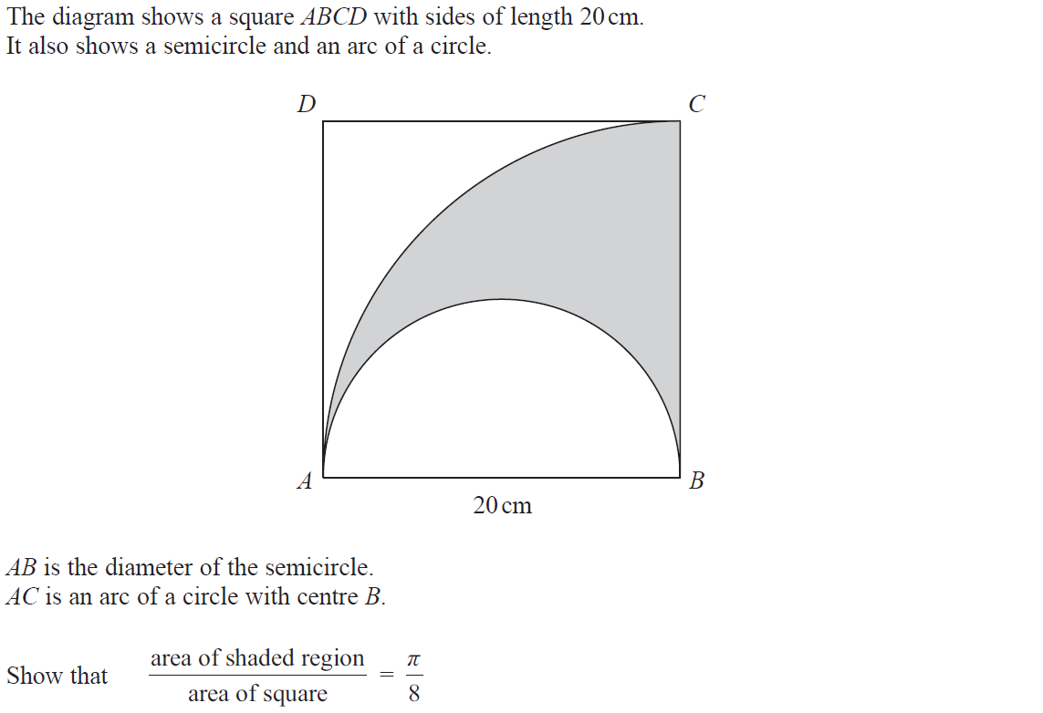
Circles & Sectors
Nov 2018 1H Q7

Slide 25
Circles & Sectors
Nov 2018 1H Q7
A

Slide 26
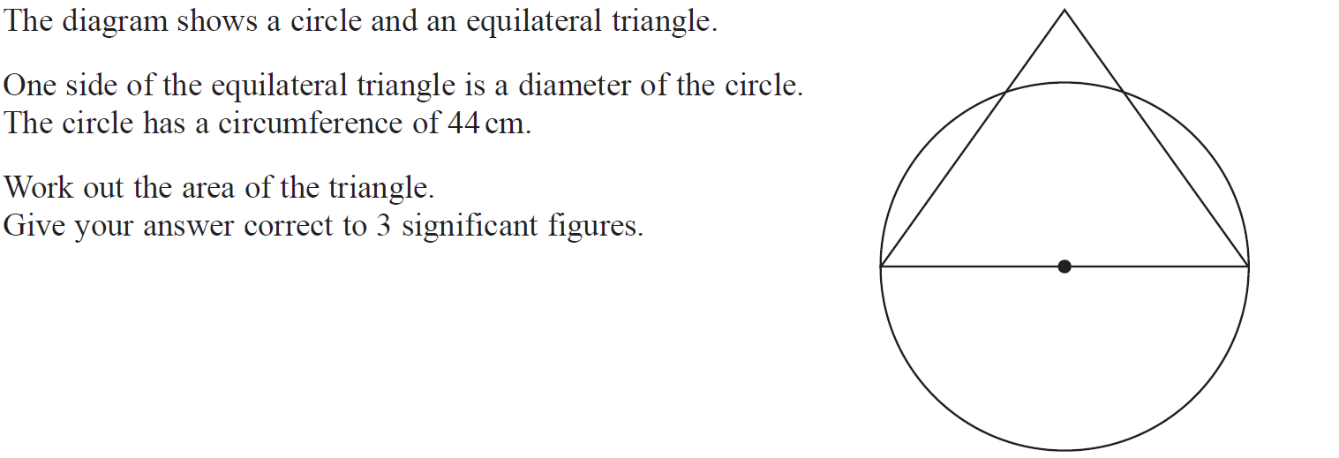
Circles & Sectors
Nov 2018 2H Q13

Slide 27
Circles & Sectors
Nov 2018 2H Q13
A

Slide 28
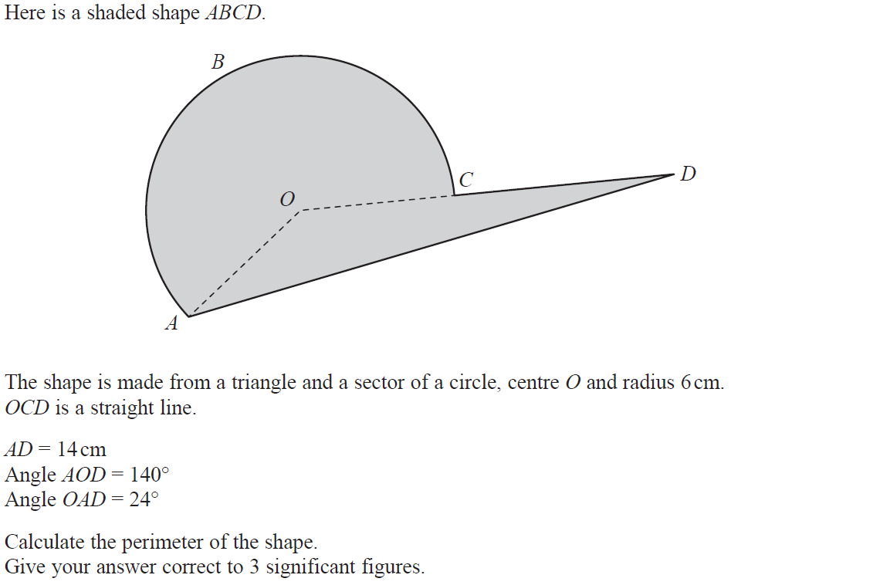
Circles & Sectors
Nov 2018 3H Q16

Slide 29
Circles & Sectors
Nov 2018 3H Q16
A

Slide 30
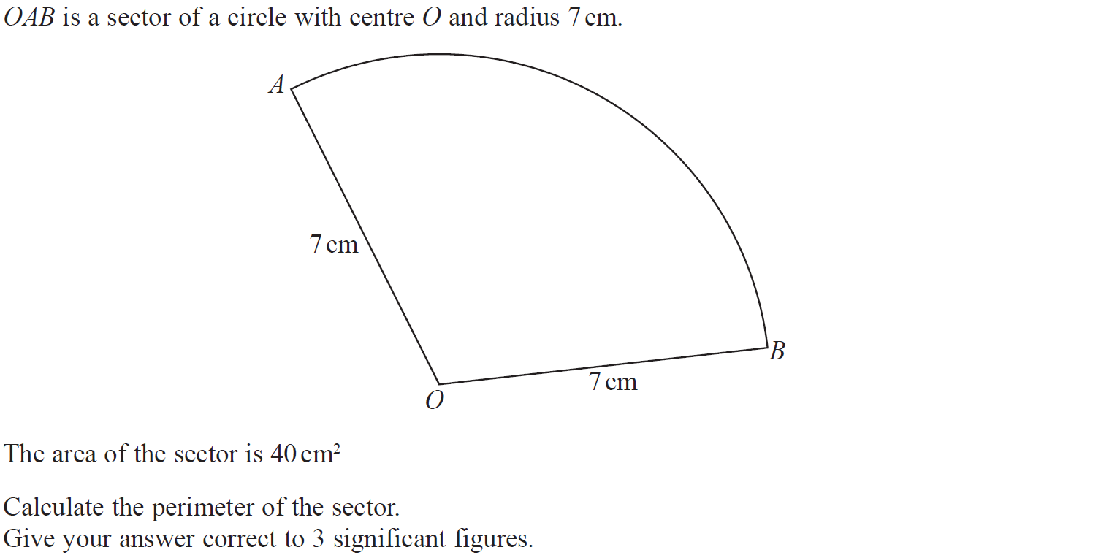
Circles & Sectors
June 2019 2H Q12

Slide 31
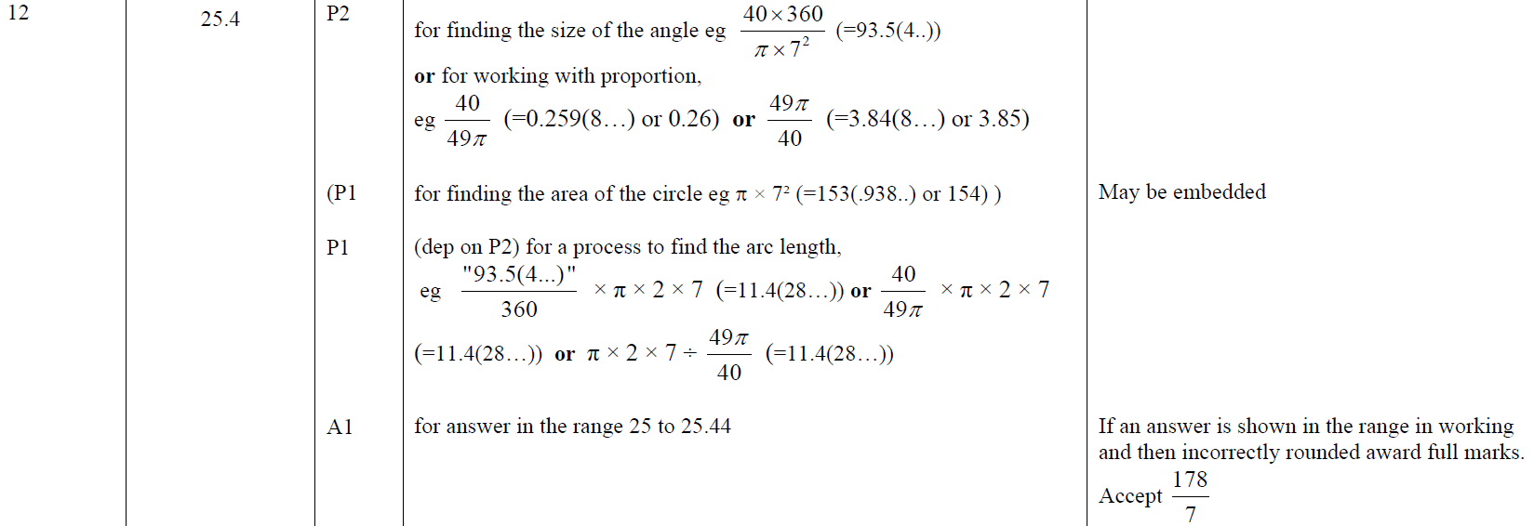
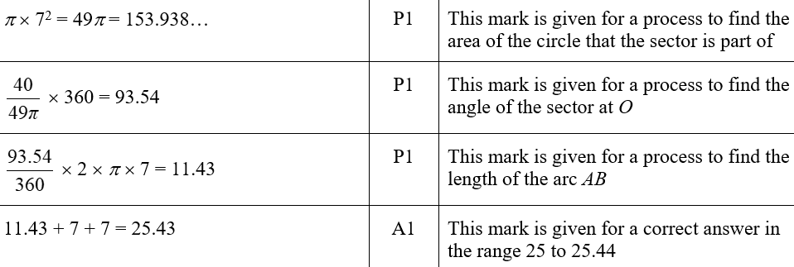
Circles & Sectors
June 2019 2H Q12
A
A SF

