Slide 1
Circle Theorems
Circle Theorems
June 2017
2H Q12
Nov 2017
3H Q19
SAM
1H Q21
June 2017
3H Q19
June 2018
3H Q22
1 Marker
Nov 2017
1H Q24
Nov 2018
1H Q20
Proof

Slide 2
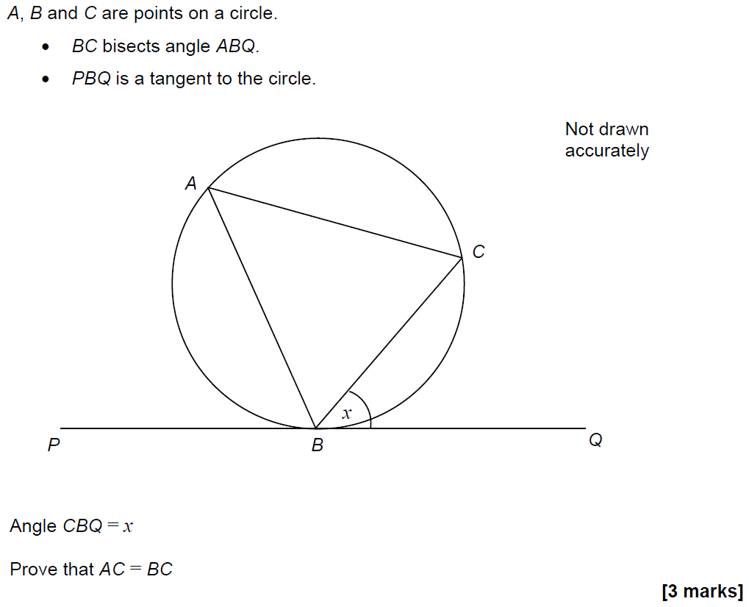
Circle Theorems
SAM 1H Q21

Slide 3
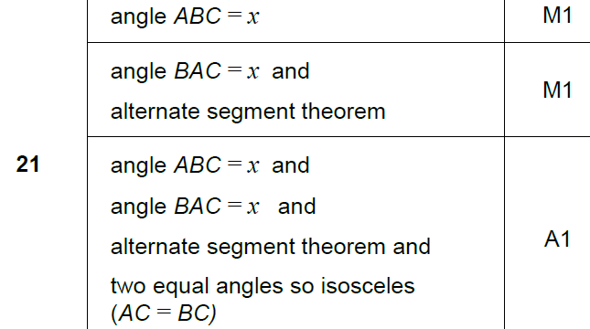
Circle Theorems
SAM 1H Q21
A

Slide 4
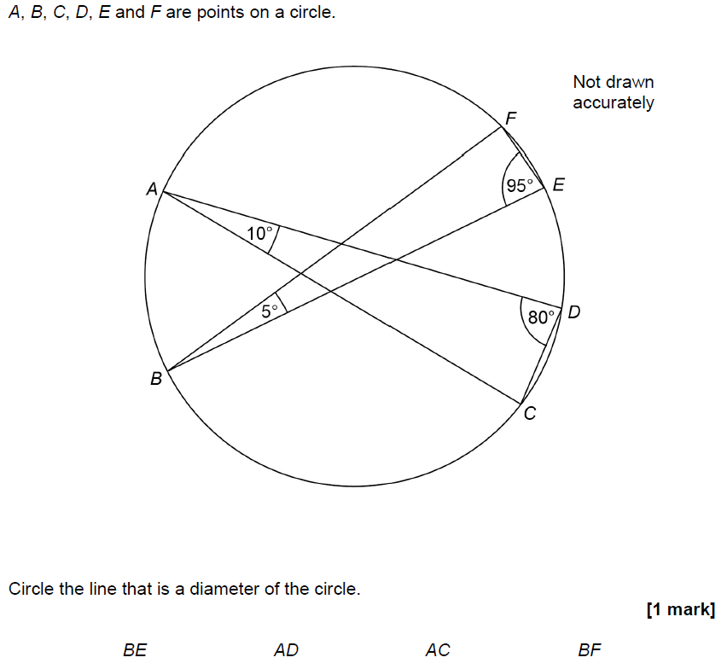
Circle Theorems
June 2017 2H Q12

Slide 5
Circle Theorems
June 2017 2H Q12
A

Slide 6
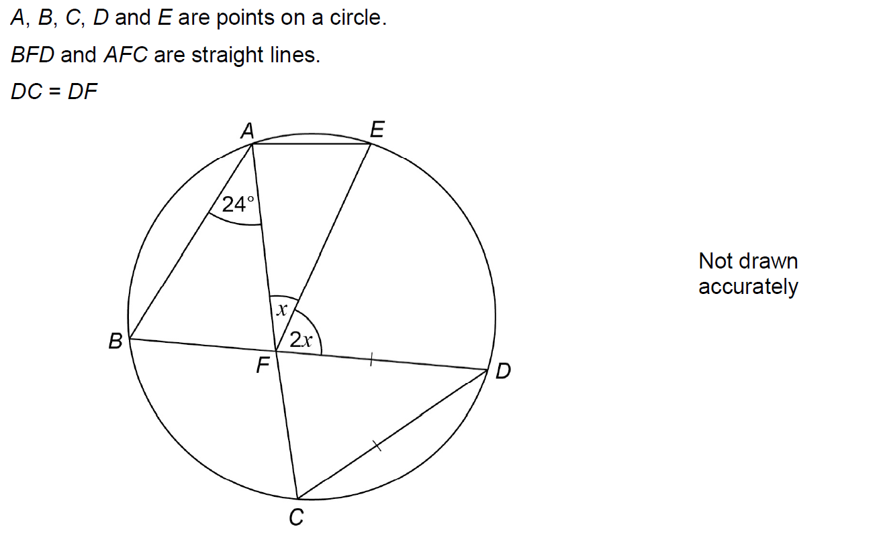
Circle Theorems
June 2017 3H Q19

Slide 7
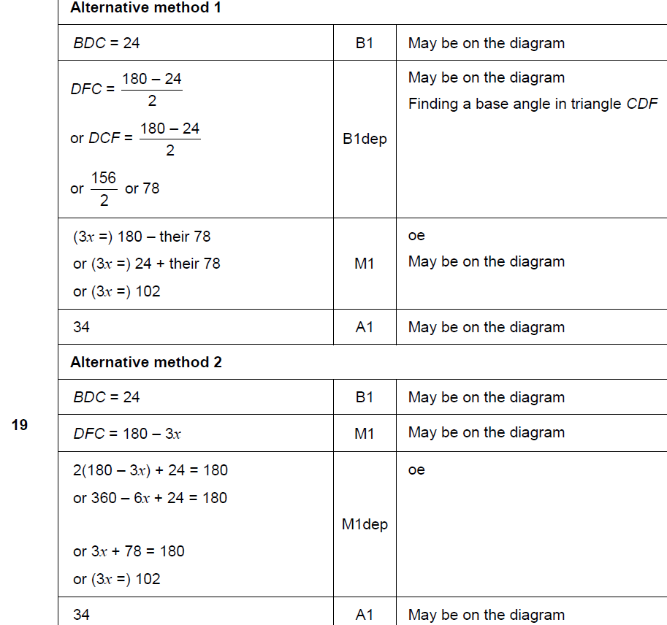
Circle Theorems
June 2017 3H Q19
A

Slide 8
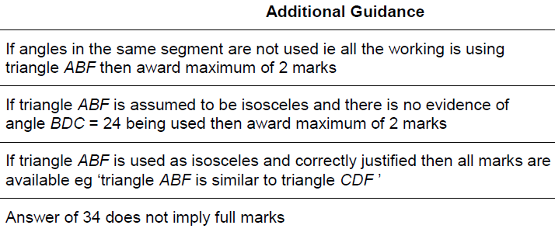
Circle Theorems
June 2017 3H Q19
A notes

Slide 9
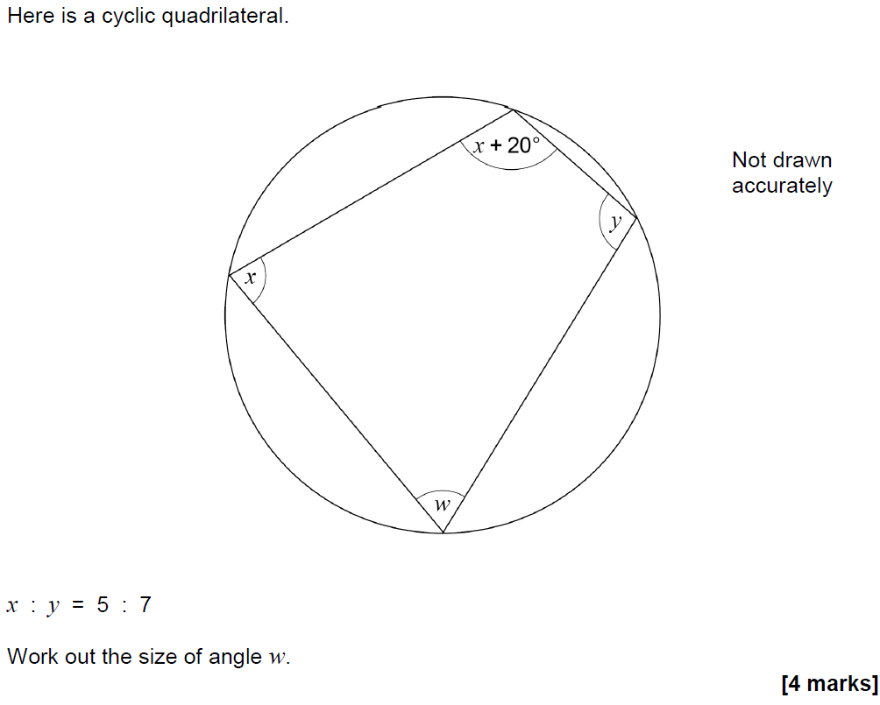
Circle Theorems
Nov 2017 1H Q24

Slide 10
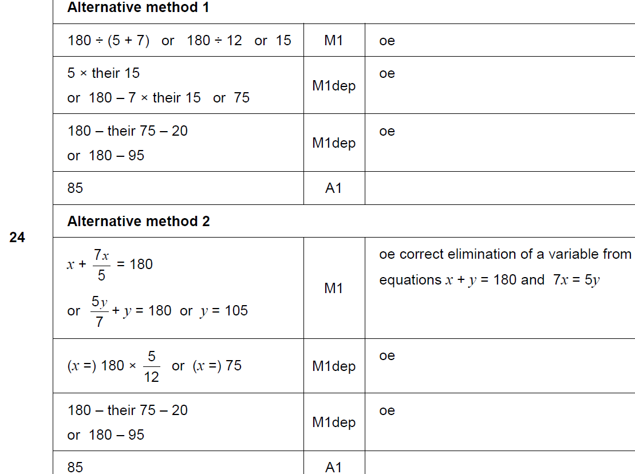
Circle Theorems
Nov 2017 1H Q24
A

Slide 11
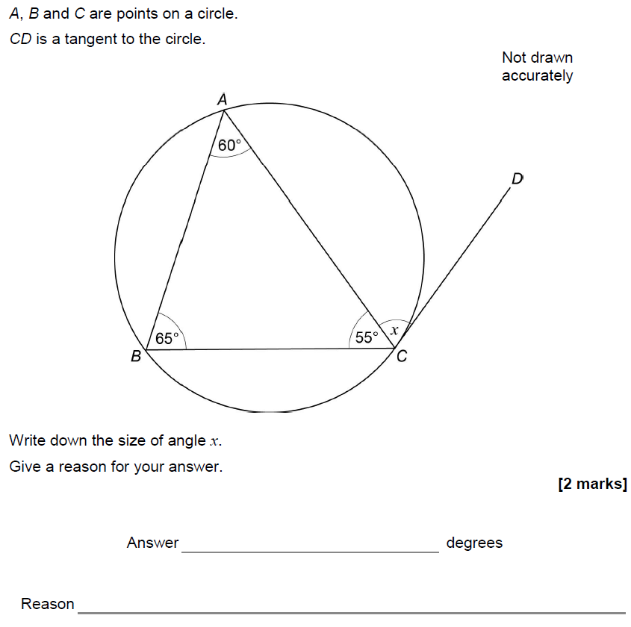
Circle Theorems
Nov 2017 3H Q19

Slide 12
Circle Theorems
Nov 2017 3H Q19
A

Slide 13
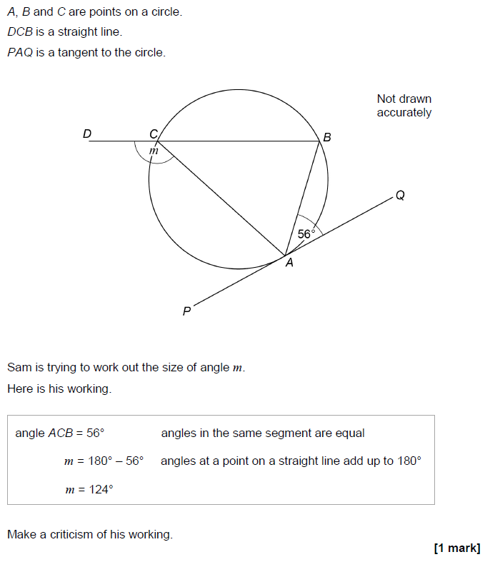
Circle Theorems
June 2018 3H Q22

Slide 14
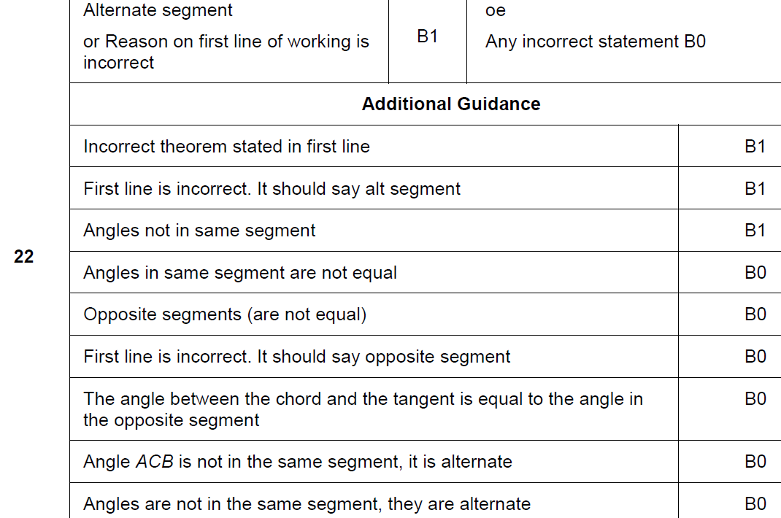
Circle Theorems
June 2018 3H Q22
A

Slide 15
Circle Theorems
Nov 2018 1H Q20

Slide 16
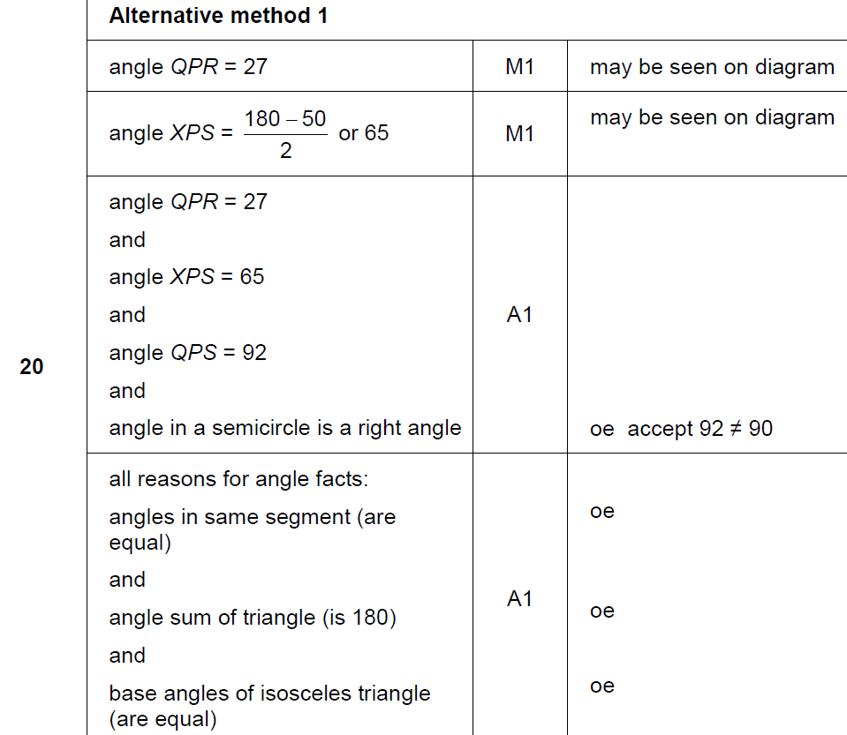
Circle Theorems
Nov 2018 1H Q20
A

Slide 17
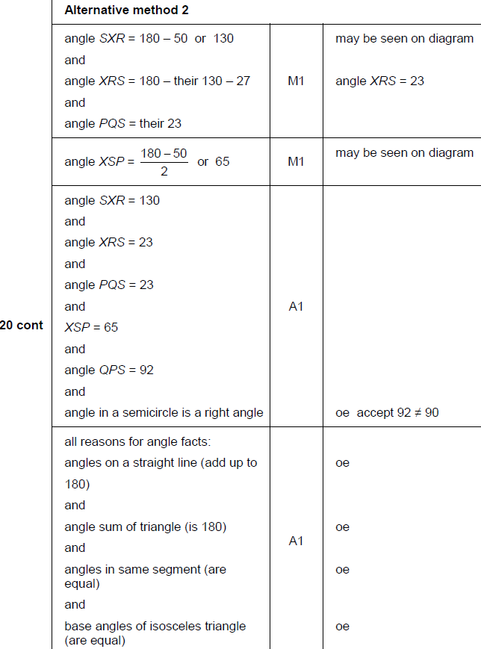
Circle Theorems
Nov 2018 1H Q20
A

