Slide 1
Circle Theorems
Circle Theorems
June 2017 2H Q15
Edexcel
SAM
2H Q11
Nov 2018 1H Q12
Nov 2017 3H Q20
AQA
Spec 1
2H Q24
Nov 2018 2H Q21
May 2018 1H Q11
OCR
Spec 2
2H Q20
June 2019 2H Q18
June 2018 2H Q13
Proof

Slide 2
Circle Theorems
Circle Theorems
Edexcel
June 2017
2H Q12
Nov 2017
3H Q19
AQA
SAM
1H Q21
June 2017
3H Q19
June 2018
3H Q22
1 Marker
OCR
Nov 2017
1H Q24
Nov 2018
1H Q20
Proof

Slide 3
Circle Theorems
Circle Theorems
June 2017
2H Q16
Edexcel
June 2017
3H Q13
SAM
1H Q16
AQA
May 2018
1H Q8
Practice
1H Q10
OCR
June 2018
2H Q16
Nov 2018
2H Q19
Proof

Slide 4
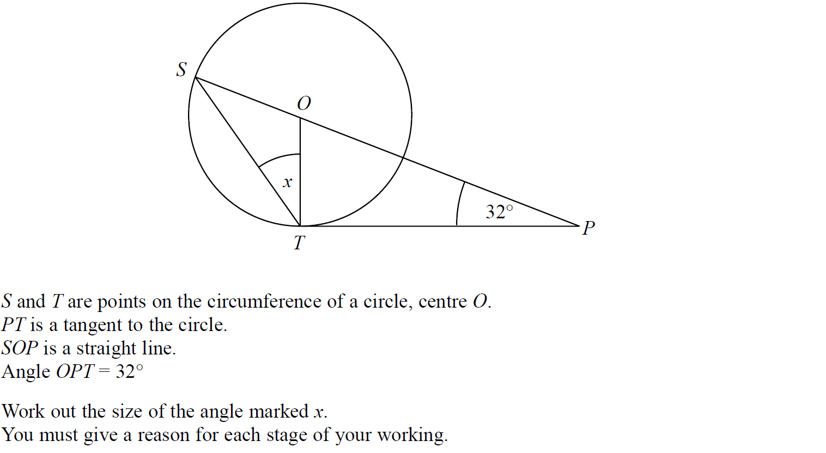
Circle Theorems
SAM 2H Q11

Slide 5
Circle Theorems
SAM 2H Q11
A

Slide 6
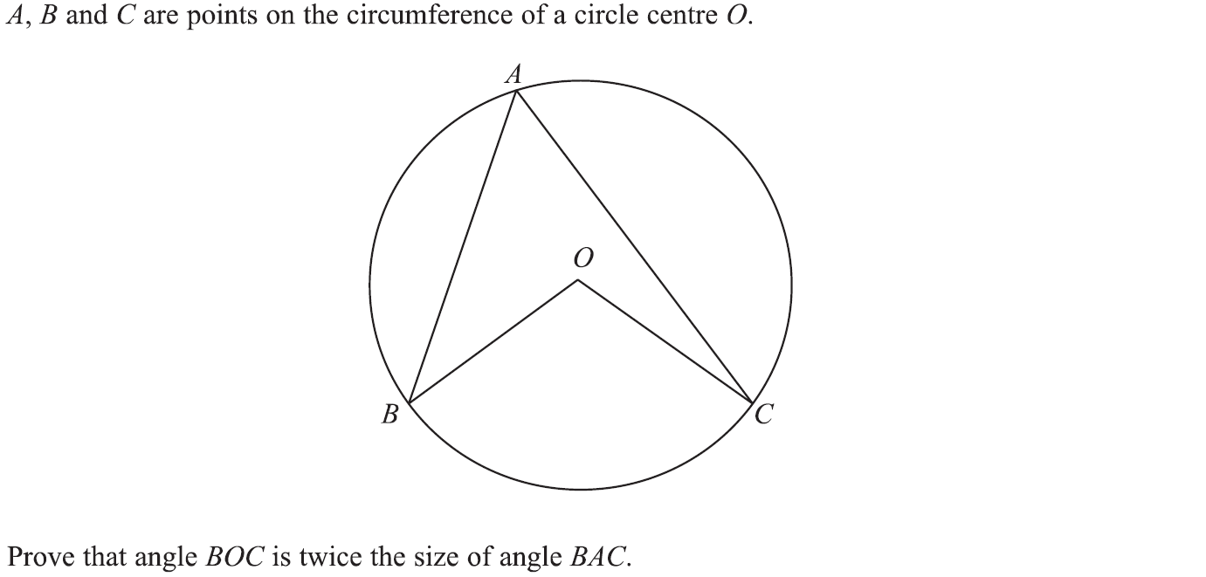
Circle Theorems
Specimen Set 1 2H Q24

Slide 7
Circle Theorems
Specimen Set 1 2H Q24
A

Slide 8
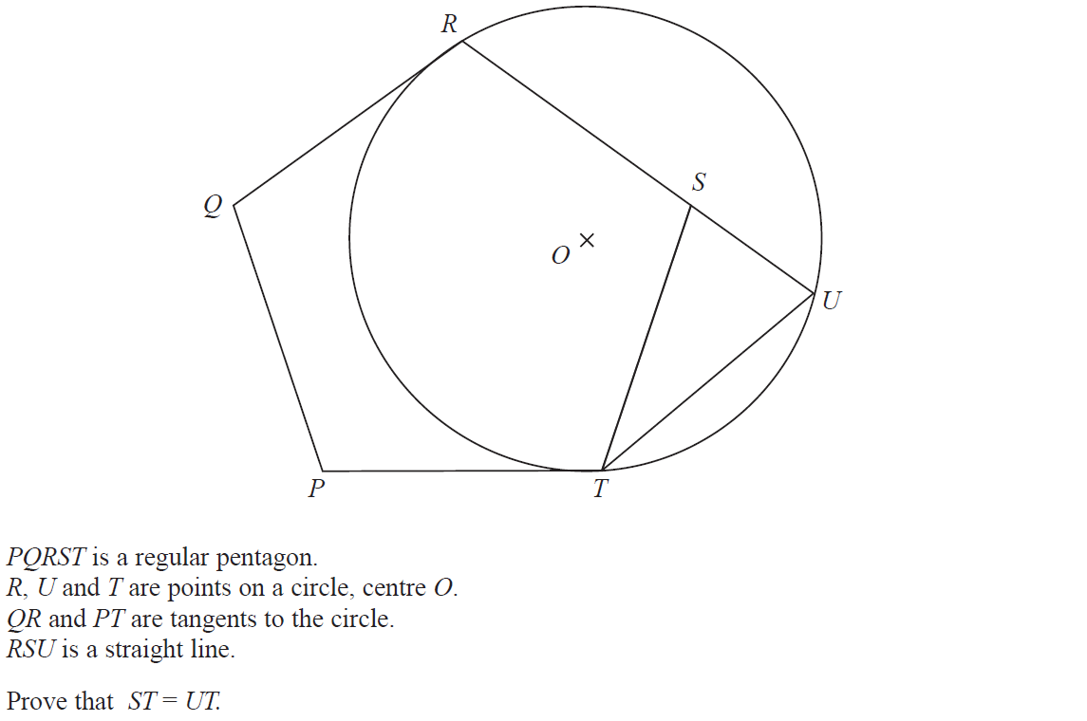
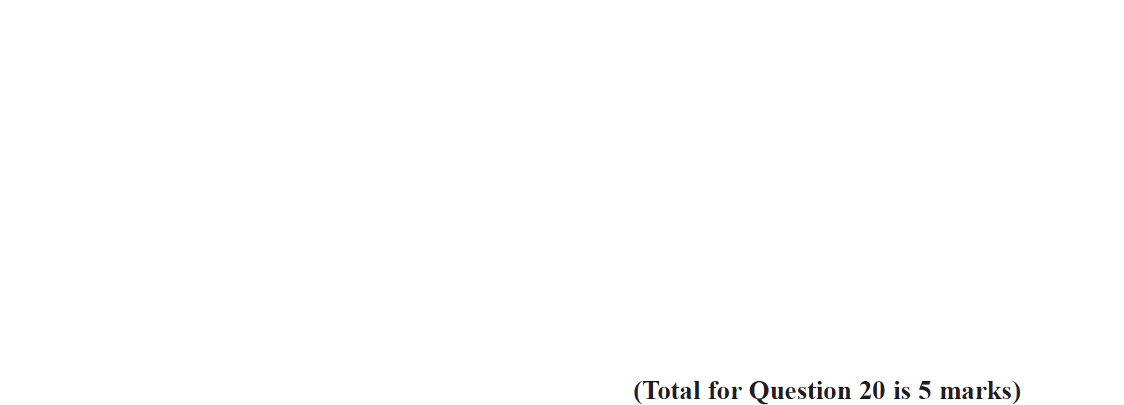
Circle Theorems
Specimen Set 2 2H Q20

Slide 9
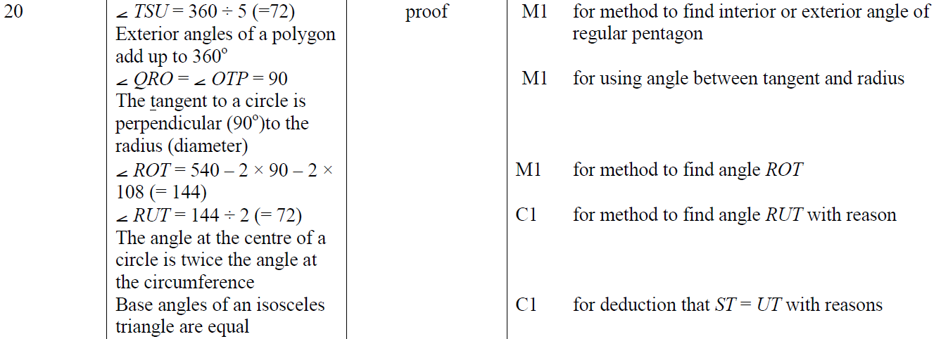
Circle Theorems
Specimen Set 2 2H Q20
A

Slide 10
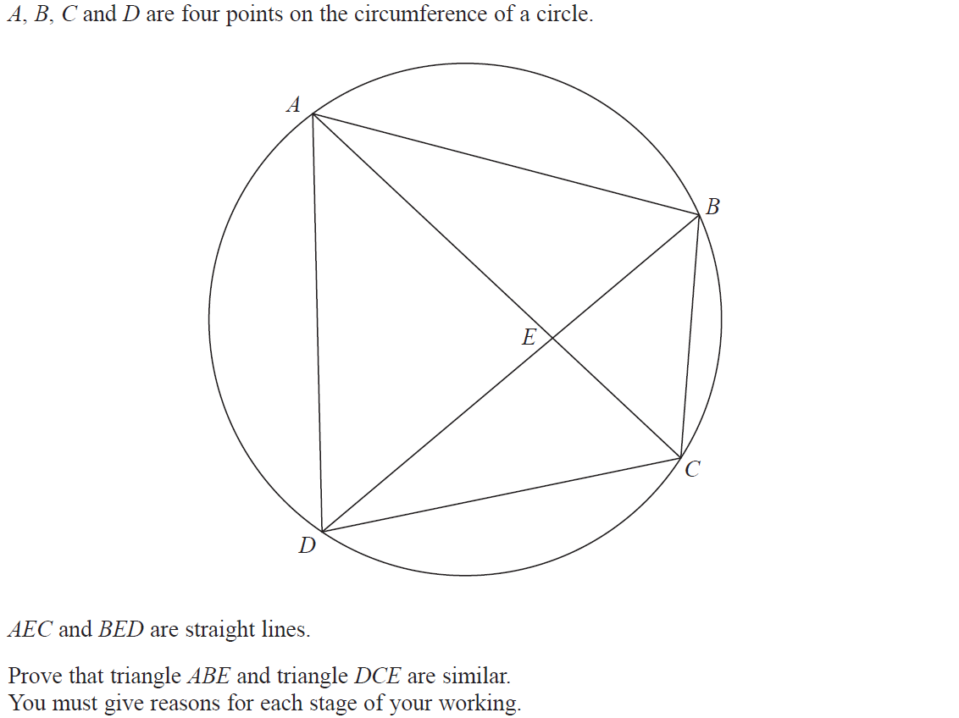
Circle Theorems
June 2017 2H Q15

Slide 11
Circle Theorems
June 2017 2H Q15
A

Slide 12
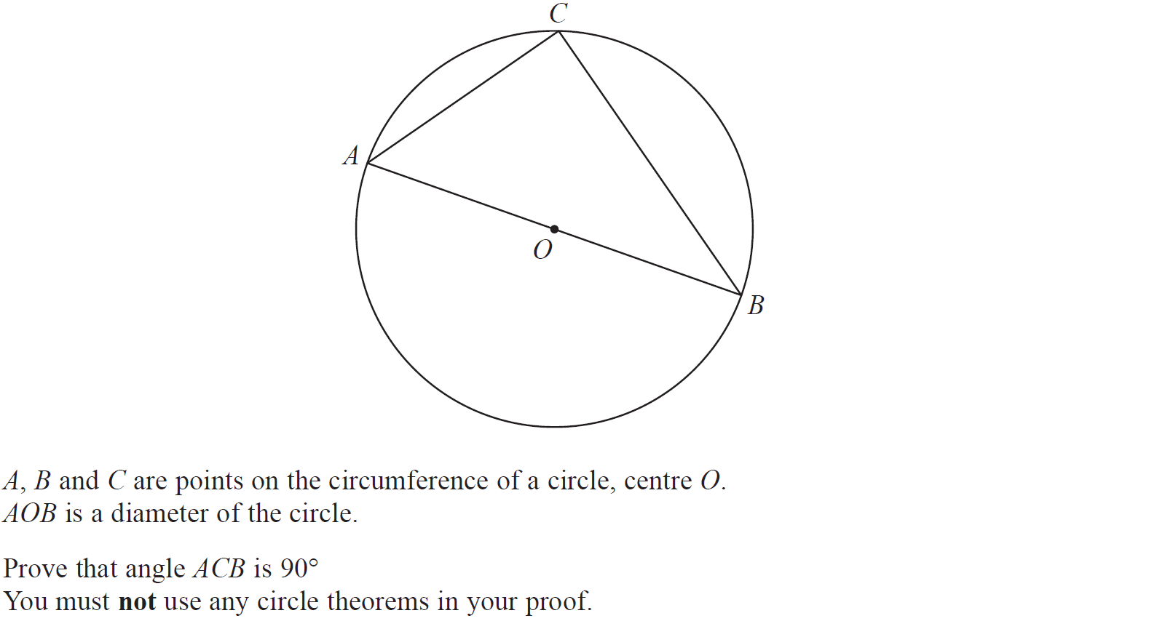
Circle Theorems
Nov 2017 3H Q20

Slide 13
Circle Theorems
Nov 2017 3H Q20
A

Slide 14
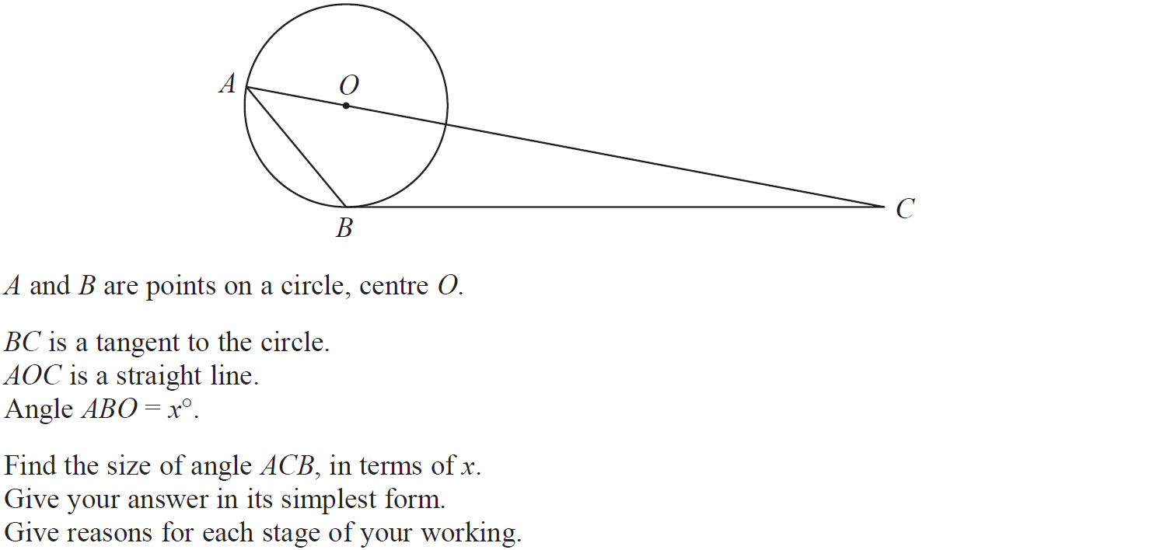
Circle Theorems
May 2018 1H Q11

Slide 15
Circle Theorems
May 2018 1H Q11
A

Slide 16
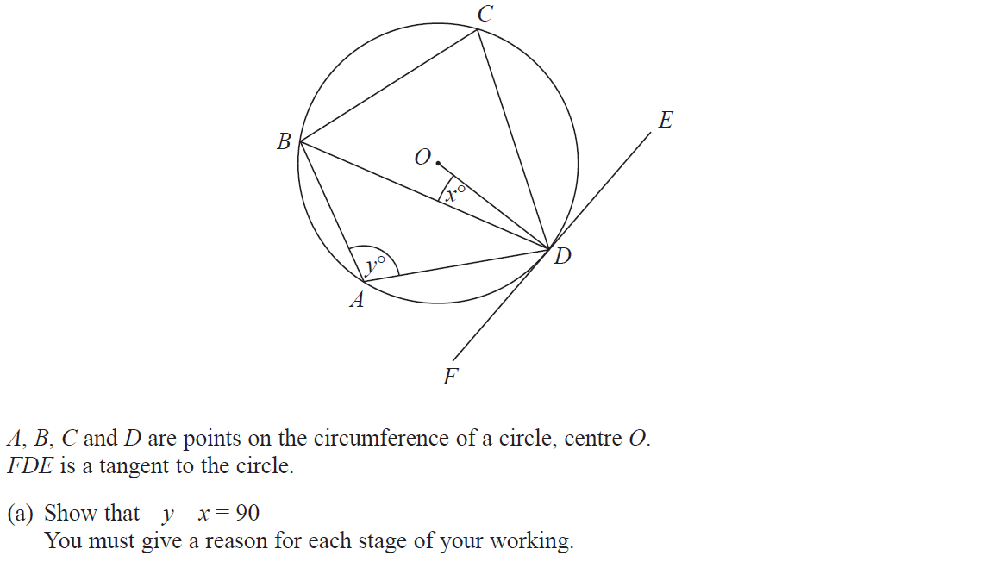
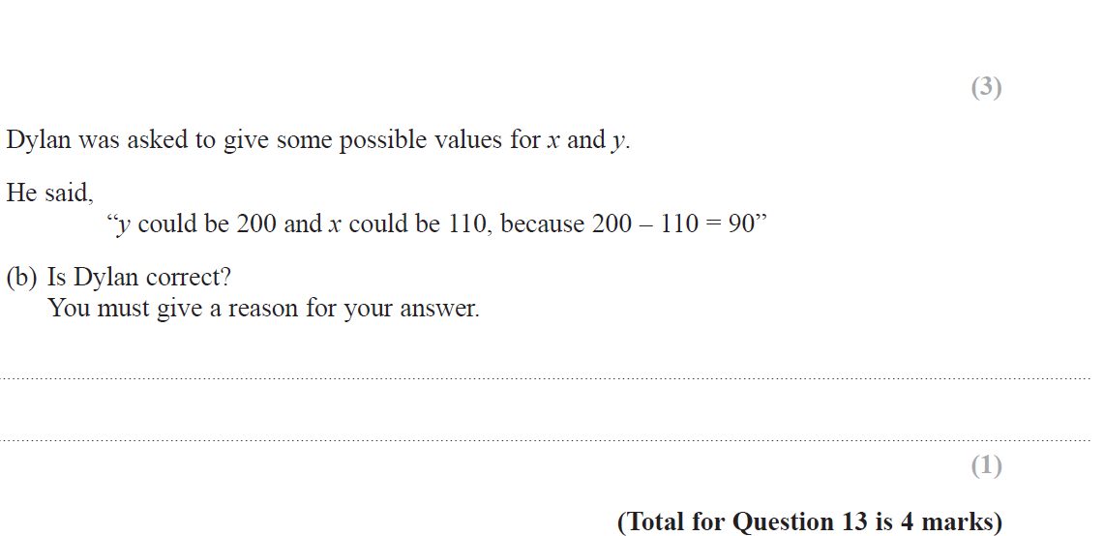
Circle Theorems
June 2018 2H Q13

Slide 17
Circle Theorems
June 2018 2H Q13
A
B

Slide 18
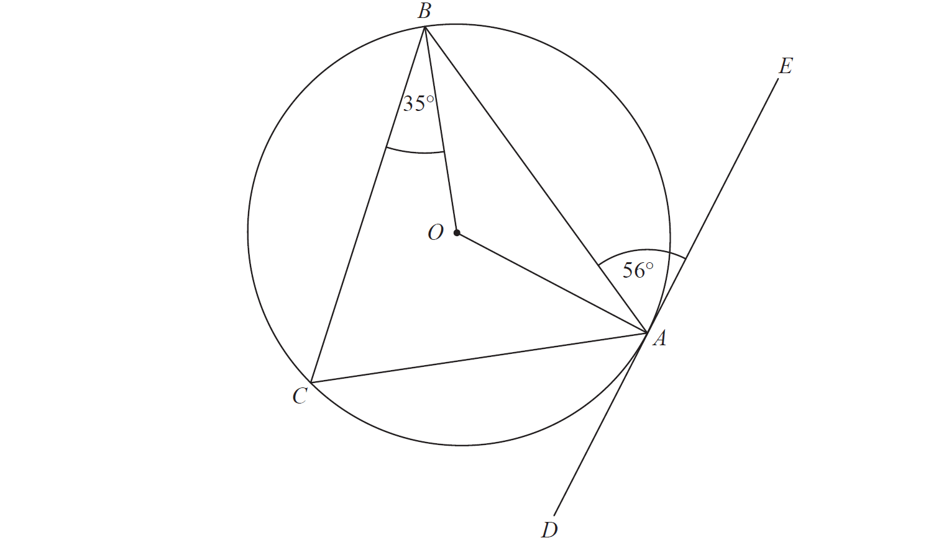
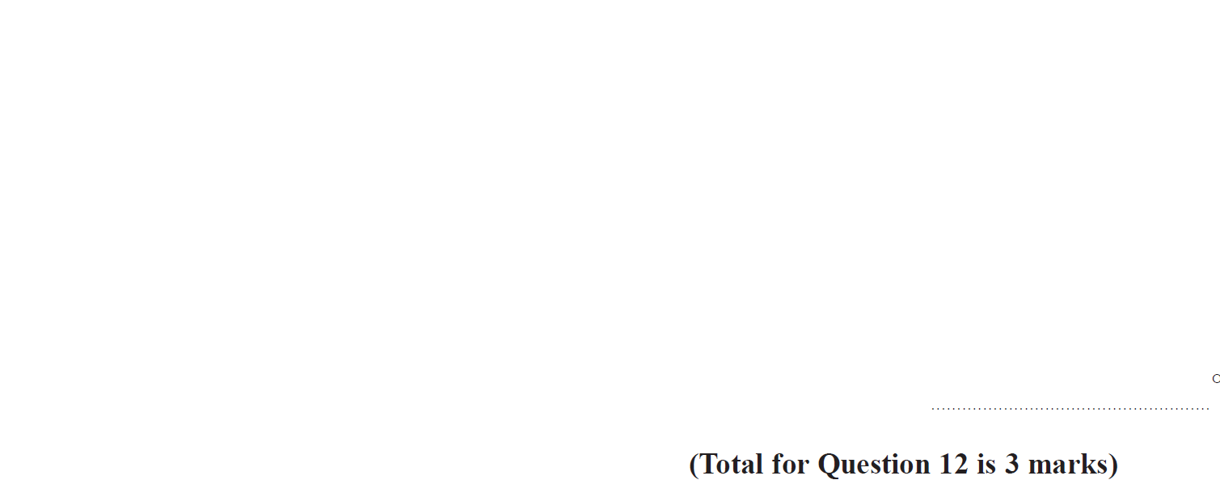
Circle Theorems
Nov 2018 1H Q12

Slide 19
Circle Theorems
Nov 2018 1H Q12
A

Slide 20
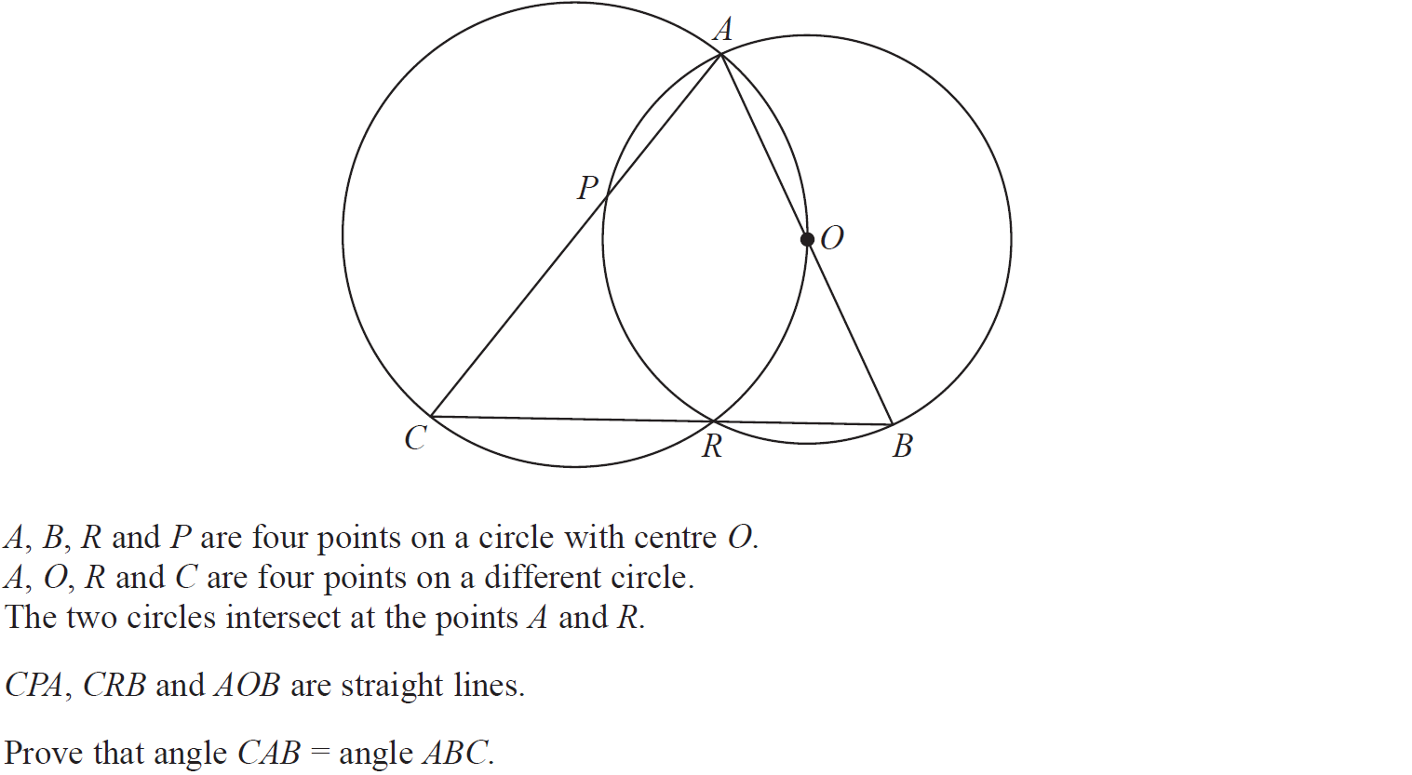
Circle Theorems
Nov 2018 2H Q21

Slide 21
Circle Theorems
Nov 2018 2H Q21
A

Slide 22
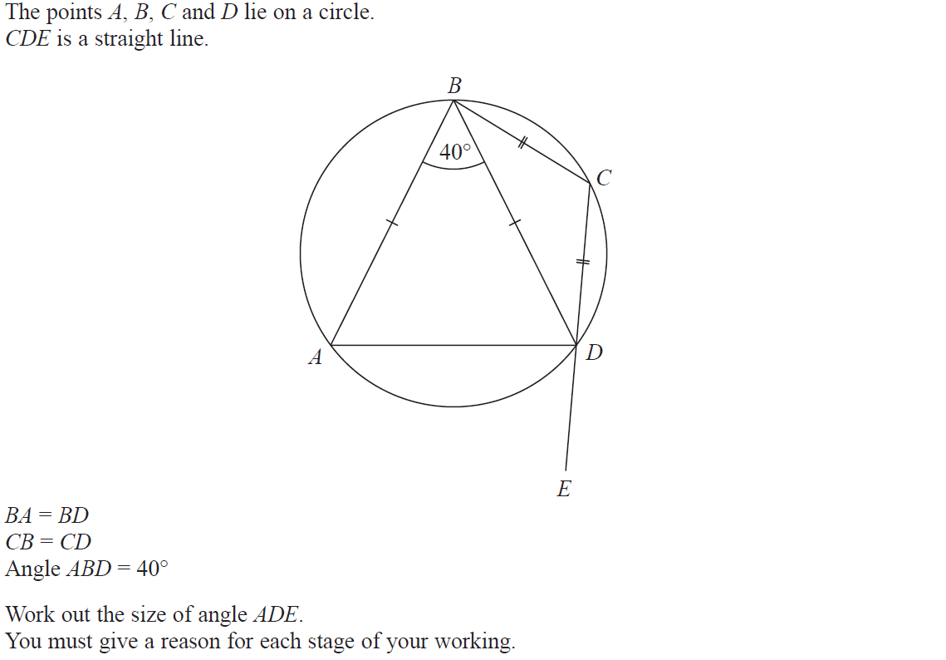
Circle Theorems
June 2019 2H Q18

Slide 23
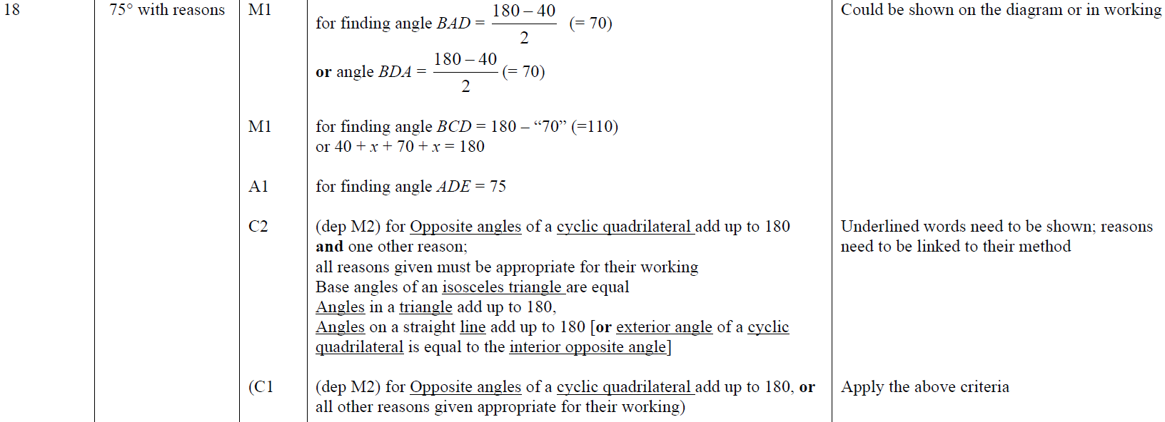
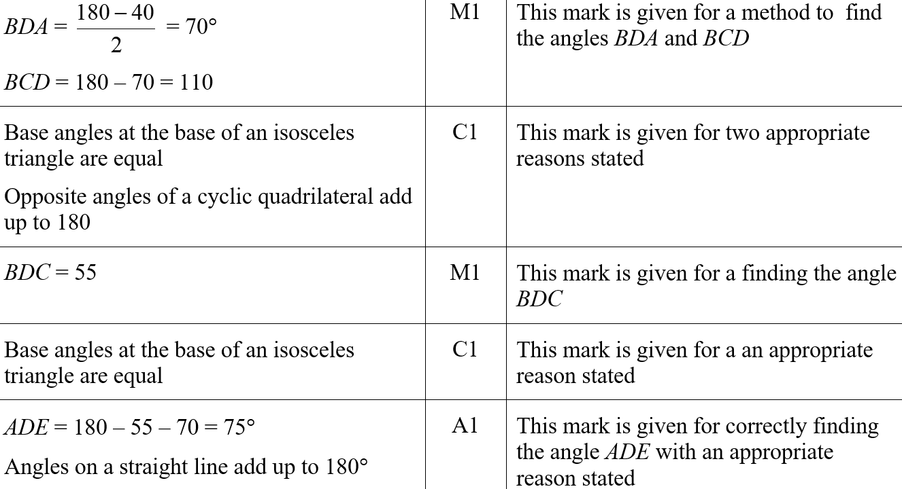
Circle Theorems
June 2019 2H Q18
A
A SF

Slide 24
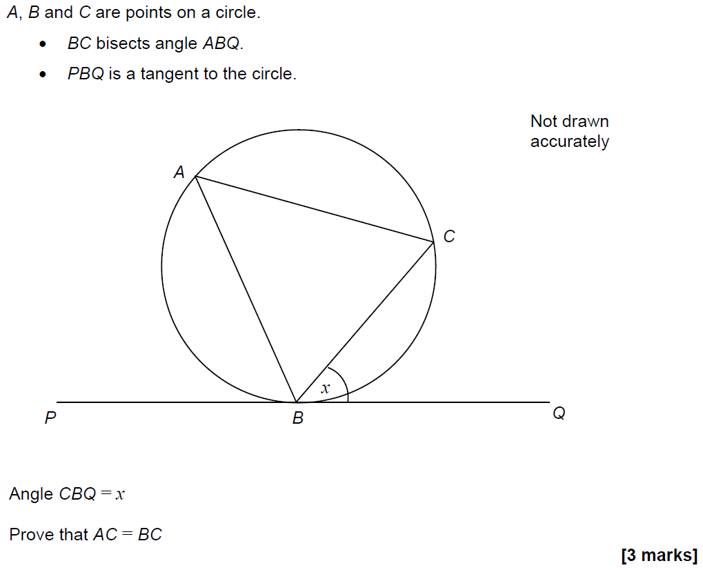
Circle Theorems
SAM 1H Q21

Slide 25
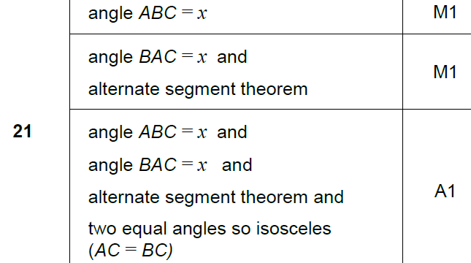
Circle Theorems
SAM 1H Q21
A

Slide 26
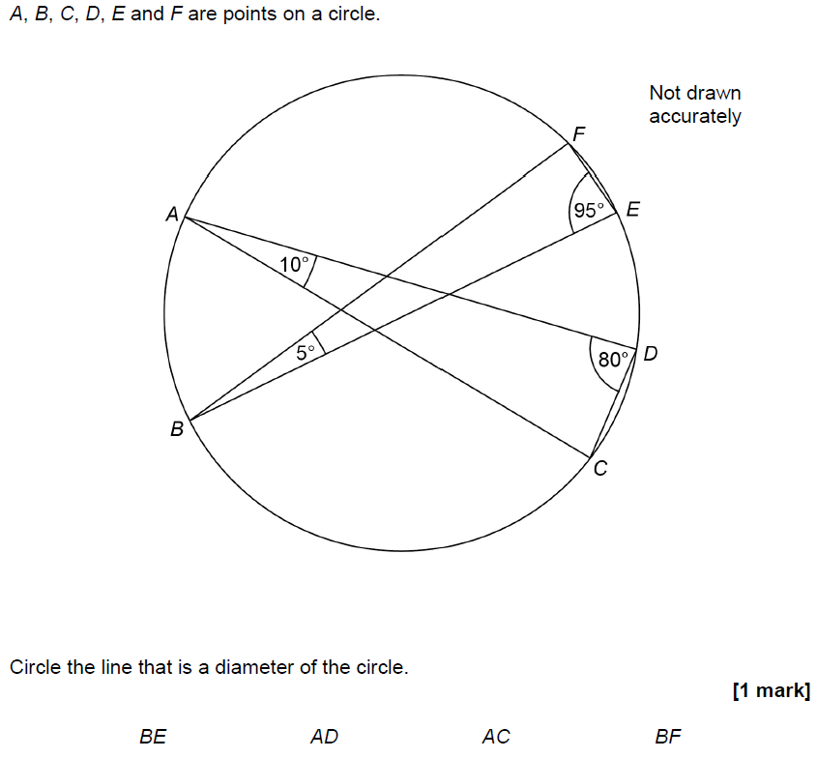
Circle Theorems
June 2017 2H Q12

Slide 27
Circle Theorems
June 2017 2H Q12
A

Slide 28
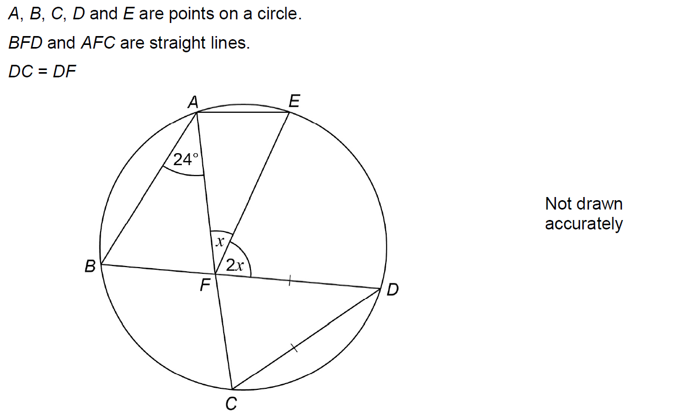
Circle Theorems
June 2017 3H Q19

Slide 29
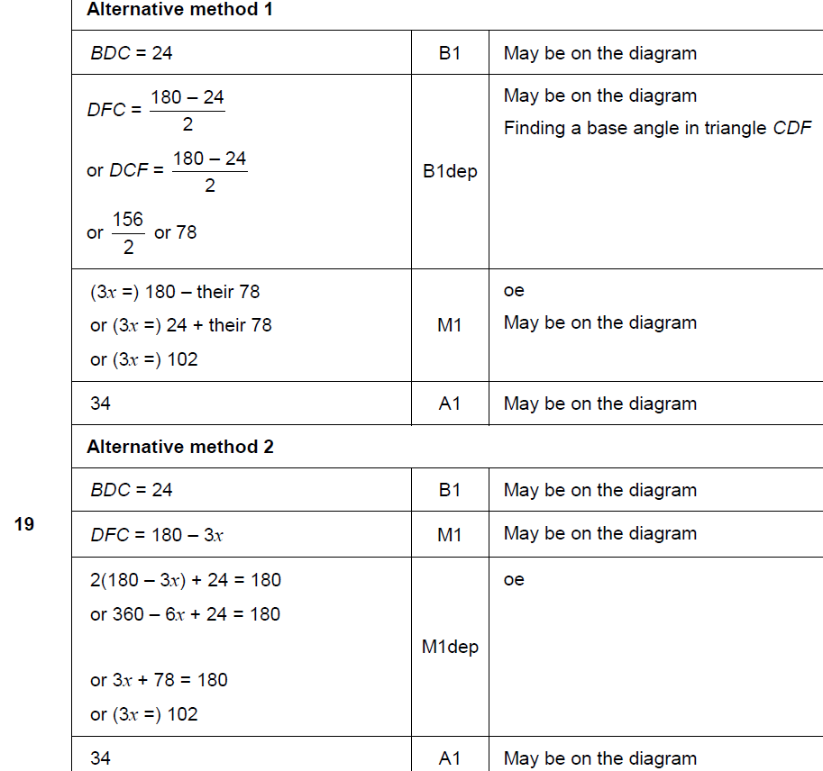
Circle Theorems
June 2017 3H Q19
A

Slide 30
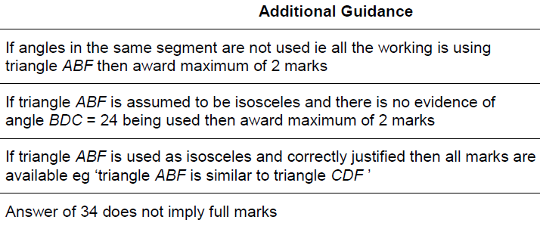
Circle Theorems
June 2017 3H Q19
A notes

Slide 31
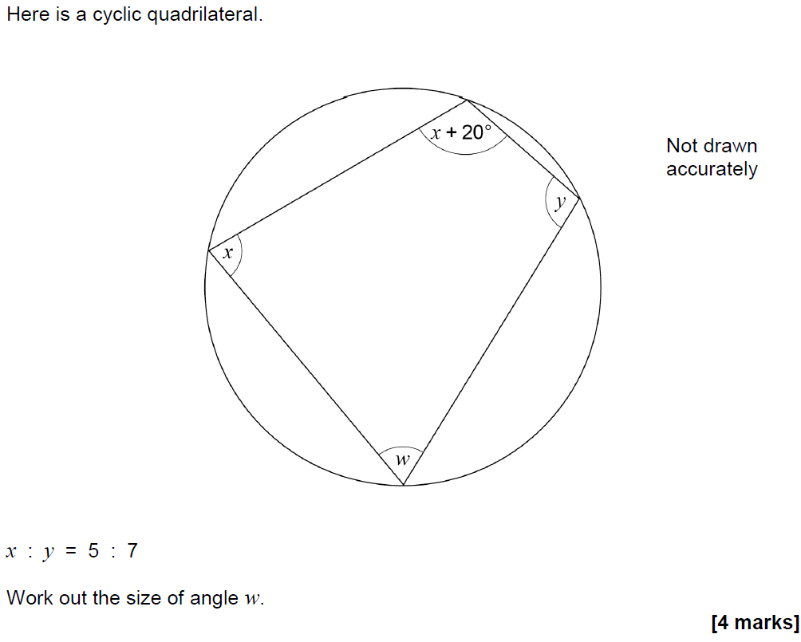
Circle Theorems
Nov 2017 1H Q24

Slide 32
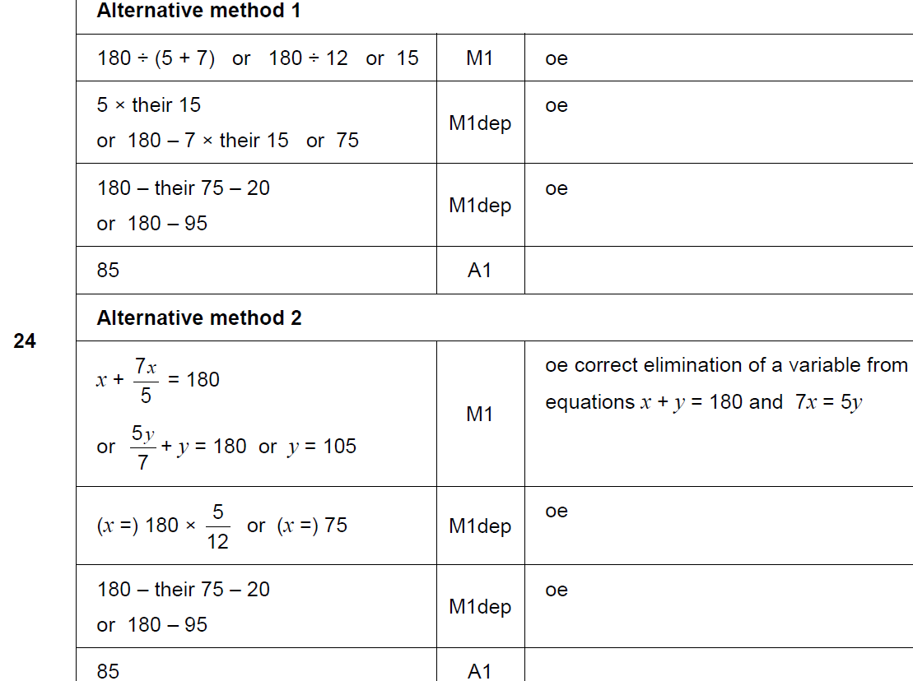
Circle Theorems
Nov 2017 1H Q24
A

Slide 33
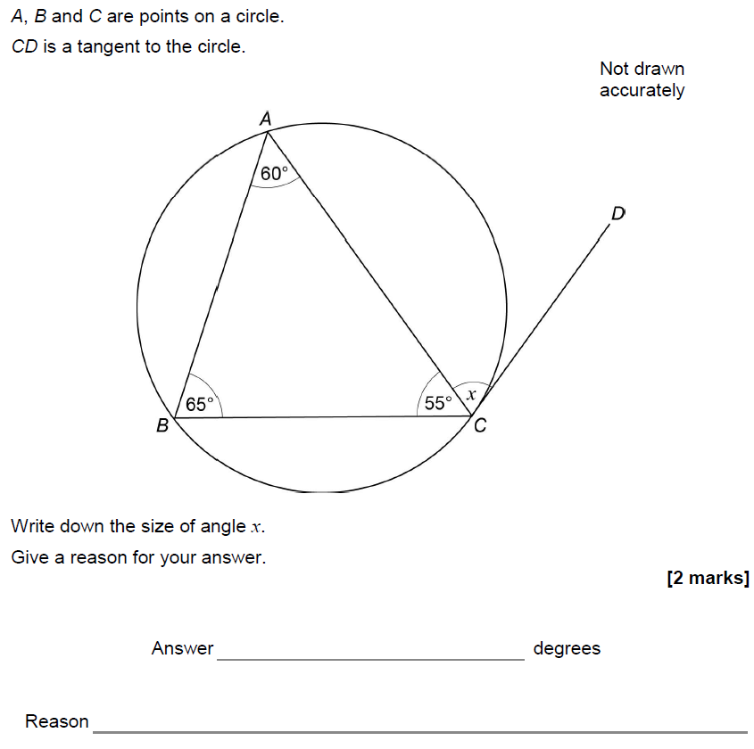
Circle Theorems
Nov 2017 3H Q19

Slide 34
Circle Theorems
Nov 2017 3H Q19
A

Slide 35
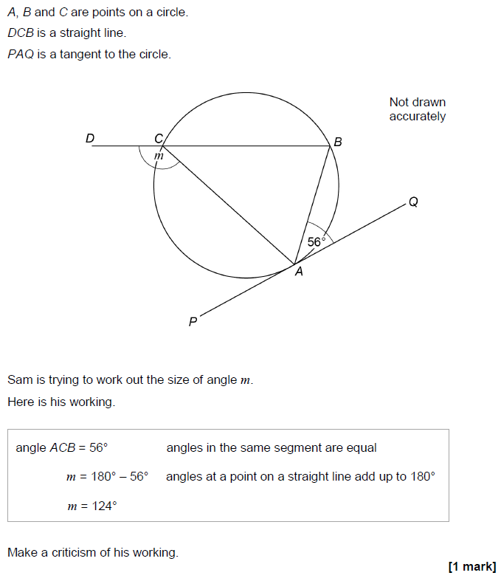
Circle Theorems
June 2018 3H Q22

Slide 36
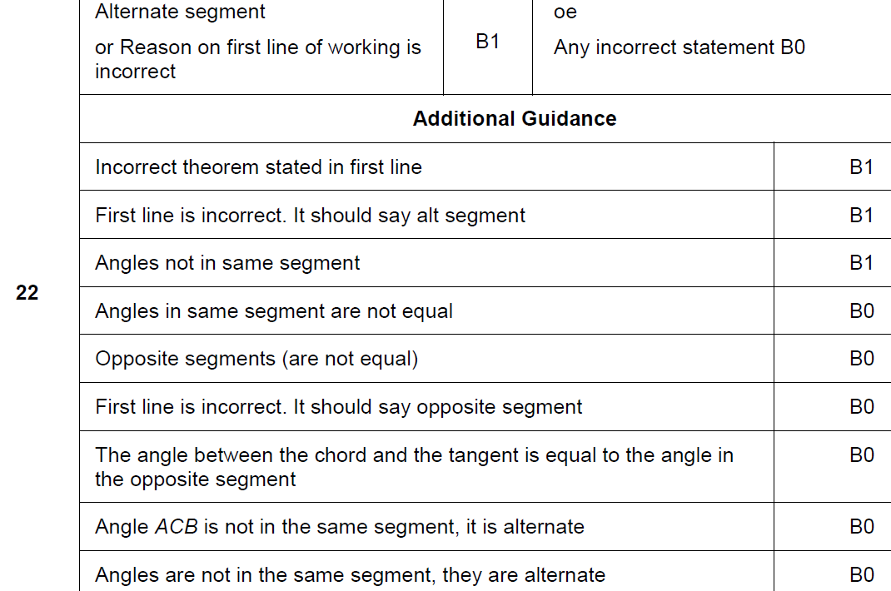
Circle Theorems
June 2018 3H Q22
A

Slide 37
Circle Theorems
Nov 2018 1H Q20

Slide 38
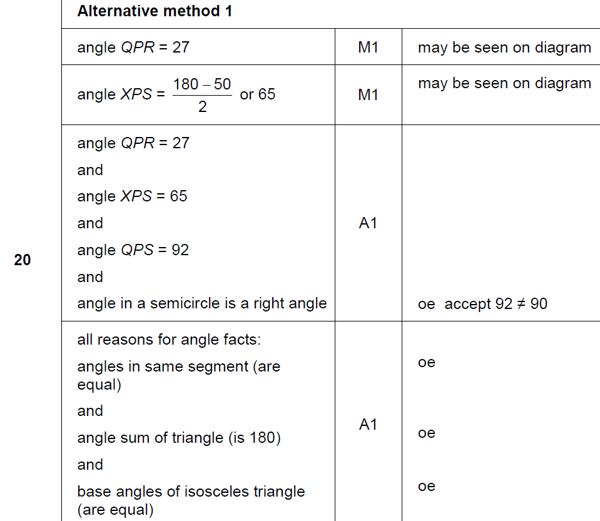
Circle Theorems
Nov 2018 1H Q20
A

Slide 39
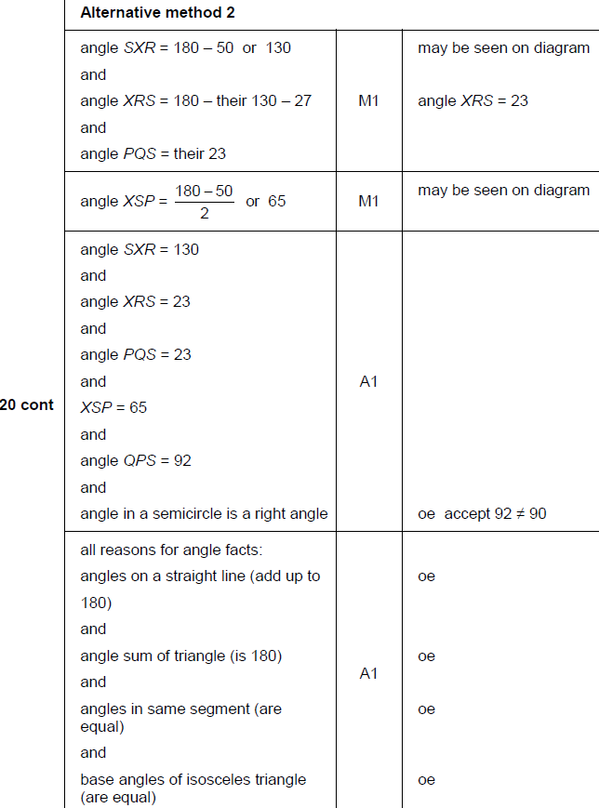
Circle Theorems
Nov 2018 1H Q20
A

Slide 40
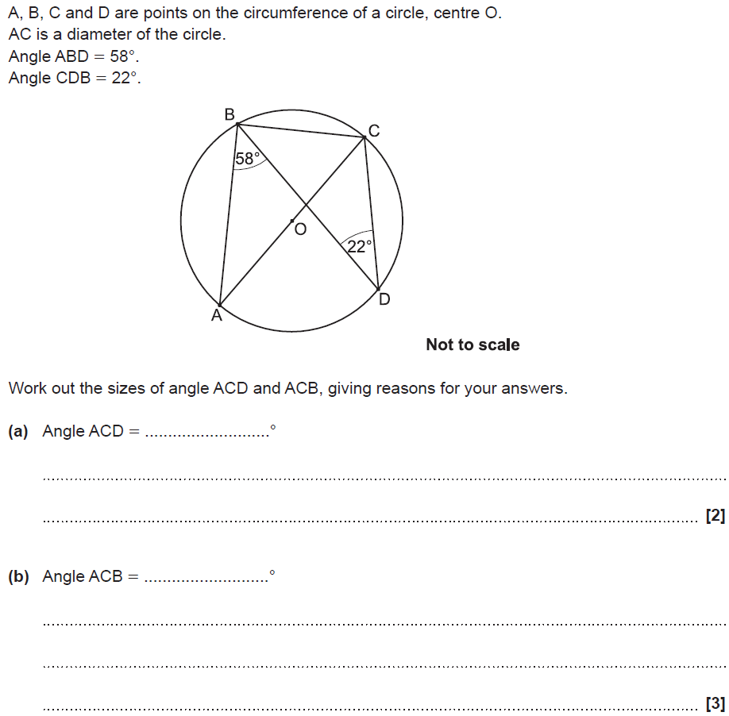
Circle Theorems
SAM 1H Q16

Slide 41
Circle Theorems
SAM 1H Q16
A
B

Slide 42
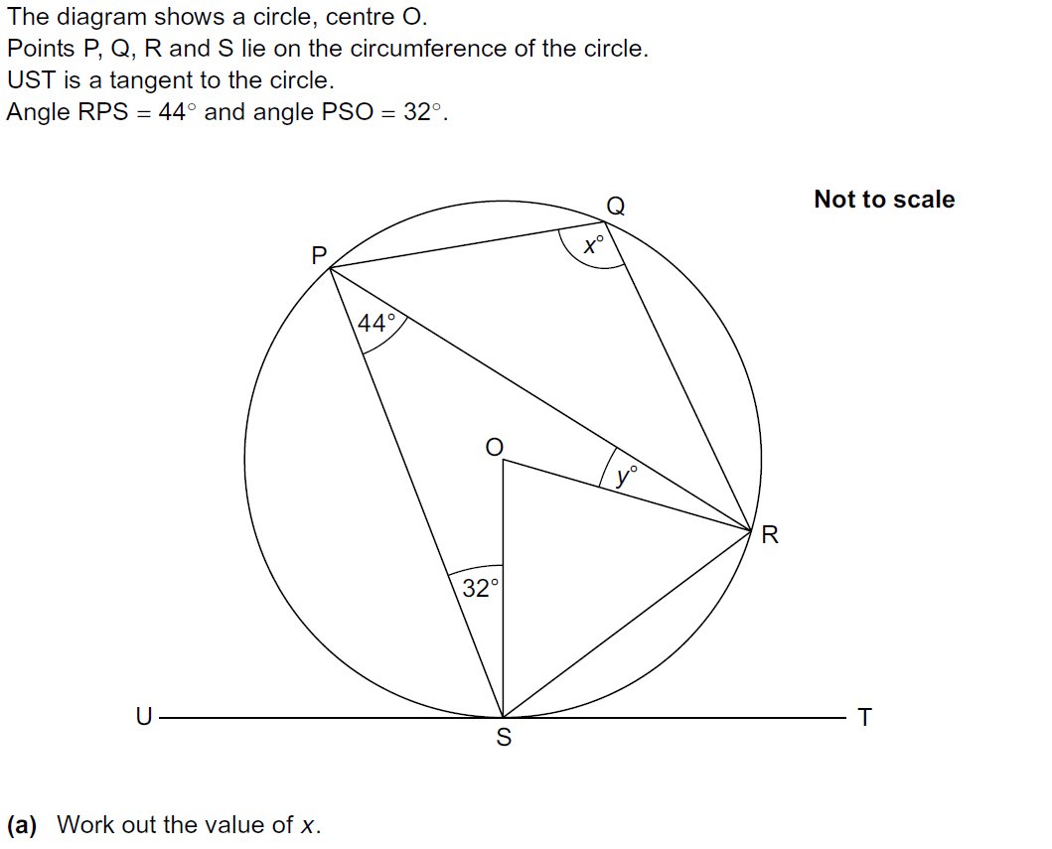
Circle Theorems
Practice 1H Q10

Slide 43
Circle Theorems
Practice 1H Q10
A
B

Slide 44
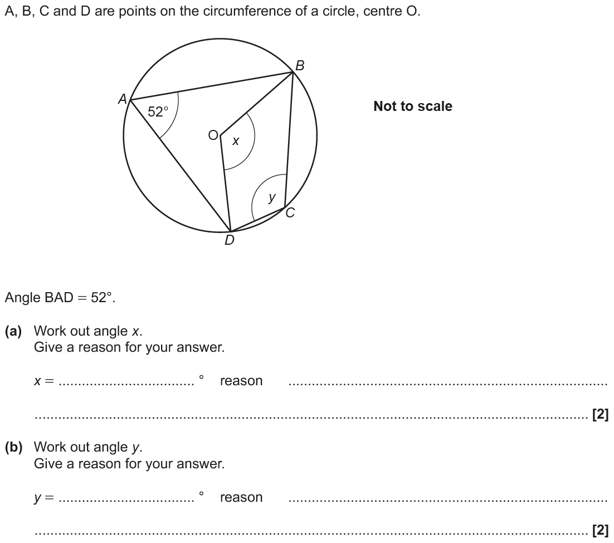
Circle Theorems
June 2017 2H Q16

Slide 45
Circle Theorems
June 2017 2H Q16
A
B

Slide 46
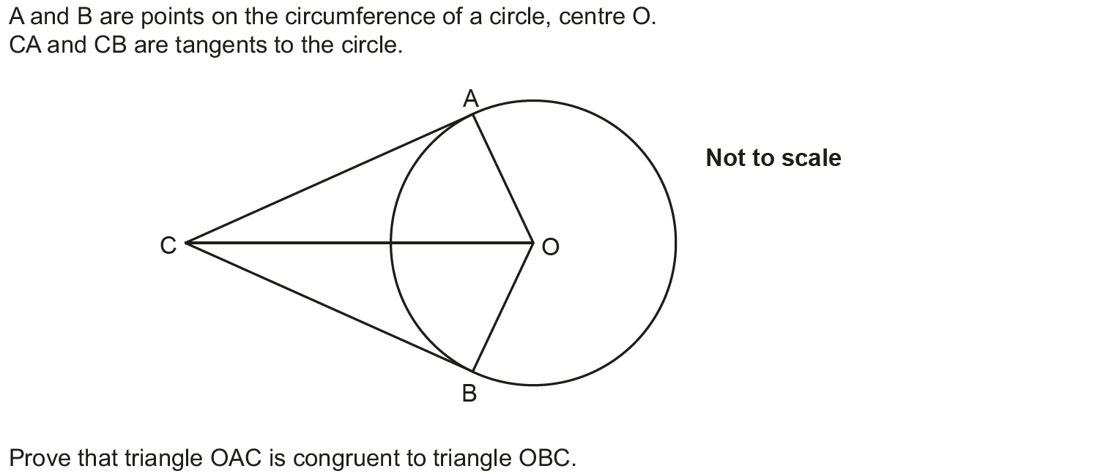
Circle Theorems
June 2017 3H Q13

Slide 47
Circle Theorems
June 2017 3H Q13
A

Slide 48
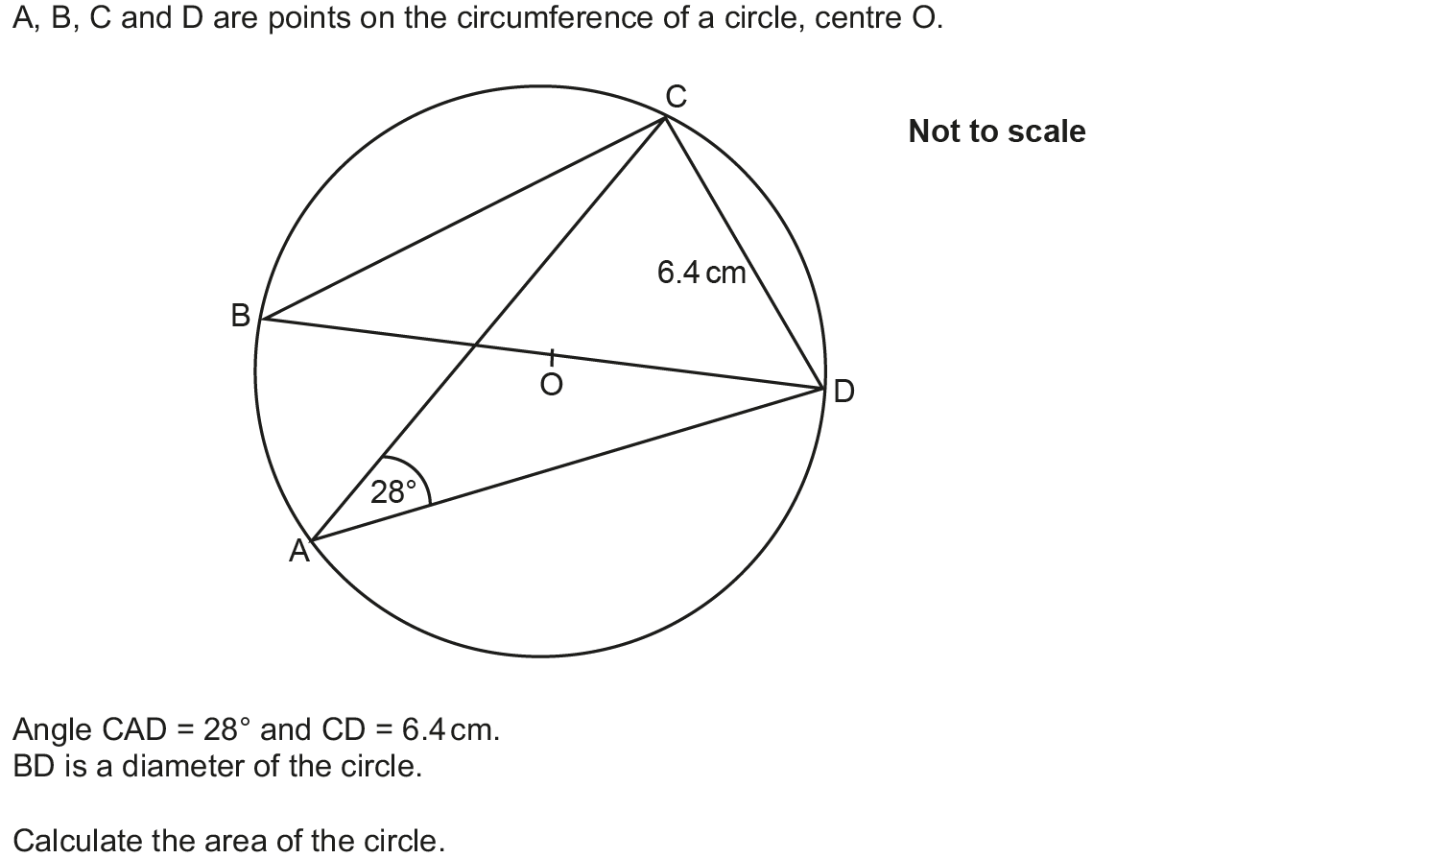
Circle Theorems
May 2018 1H Q8

Slide 49
Circle Theorems
May 2018 1H Q8
A

Slide 50
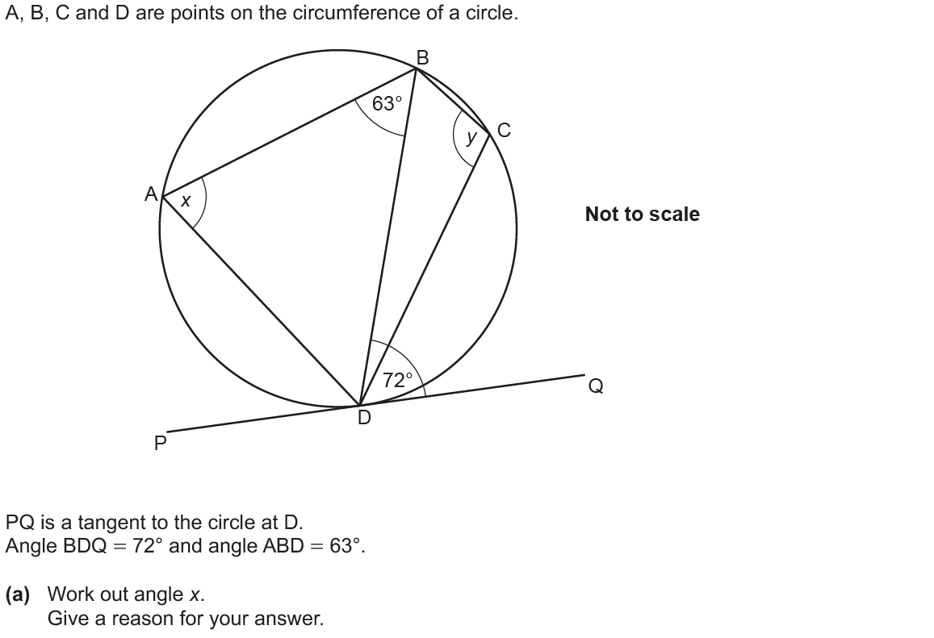
Circle Theorems
June 2018 2H Q16

Slide 51
Circle Theorems
June 2018 2H Q16
A
B

Slide 52
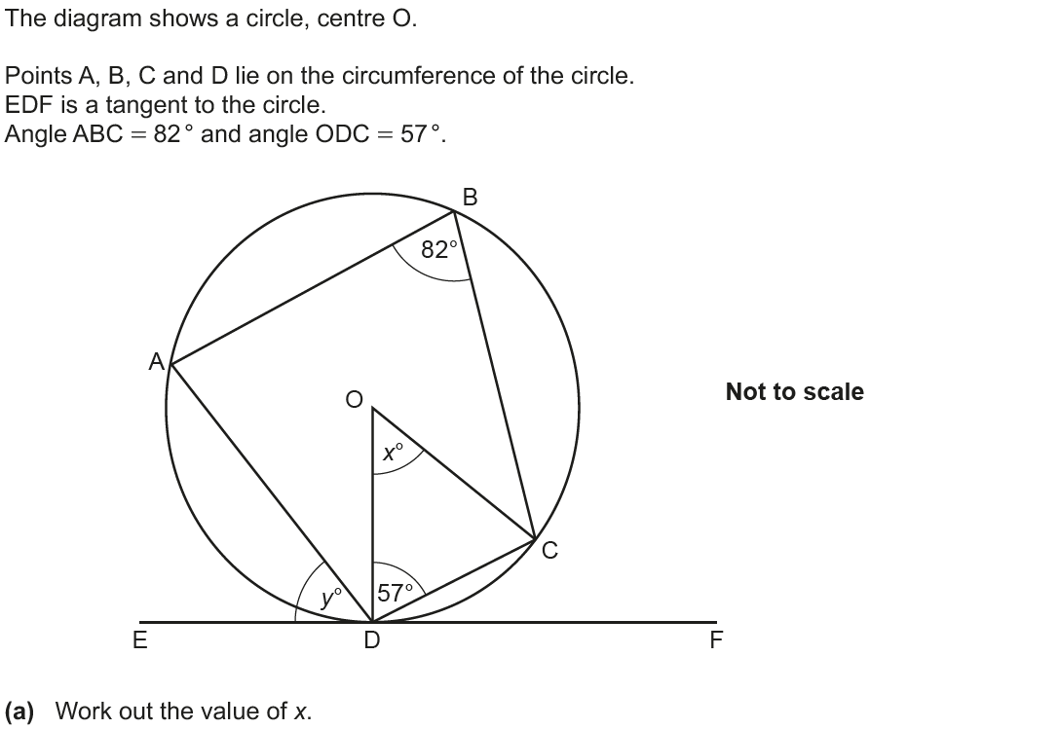
Circle Theorems
Nov 2018 2H Q19

Slide 53
Circle Theorems
Nov 2018 2H Q19
A
B

