Slide 1
Circle Theorems
Circle Theorems
June 2017 2H Q15
SAM
2H Q11
Nov 2018 1H Q12
Nov 2017 3H Q20
Spec 1
2H Q24
Nov 2018 2H Q21
May 2018 1H Q11
Spec 2
2H Q20
June 2019 2H Q18
June 2018 2H Q13
Proof

Slide 2
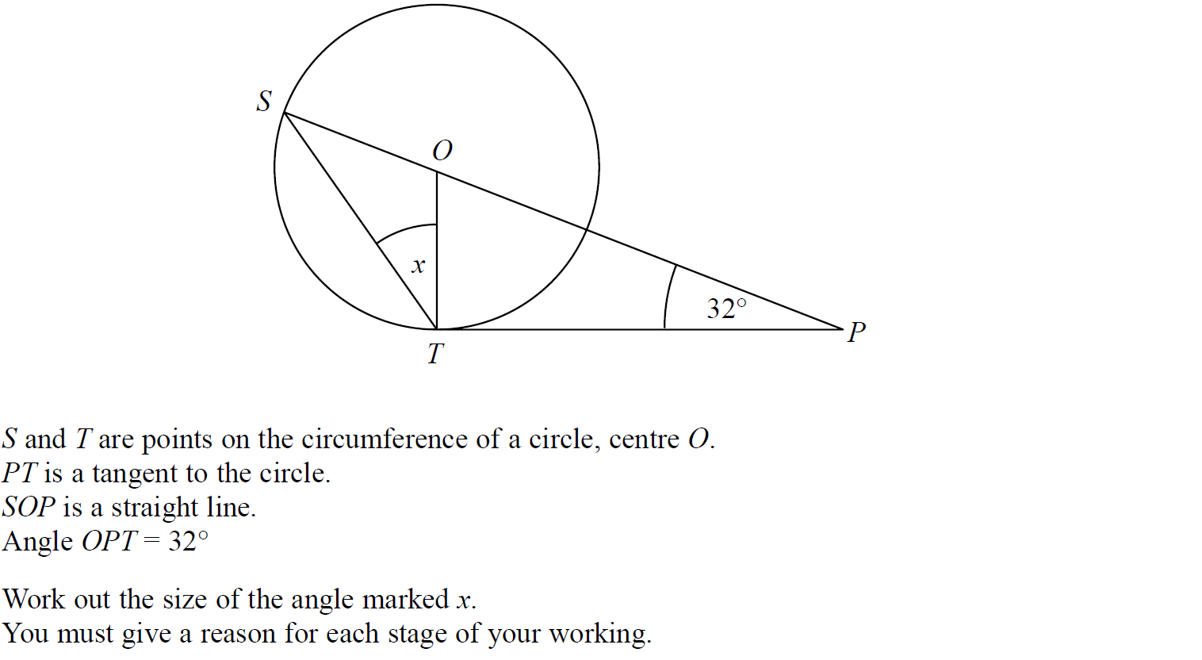
Circle Theorems
SAM 2H Q11

Slide 3
Circle Theorems
SAM 2H Q11
A

Slide 4
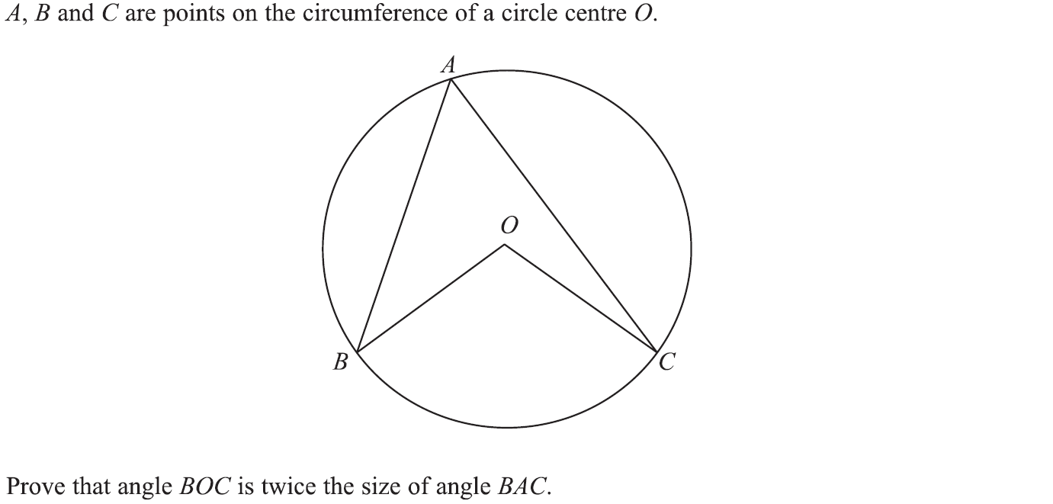
Circle Theorems
Specimen Set 1 2H Q24

Slide 5
Circle Theorems
Specimen Set 1 2H Q24
A

Slide 6
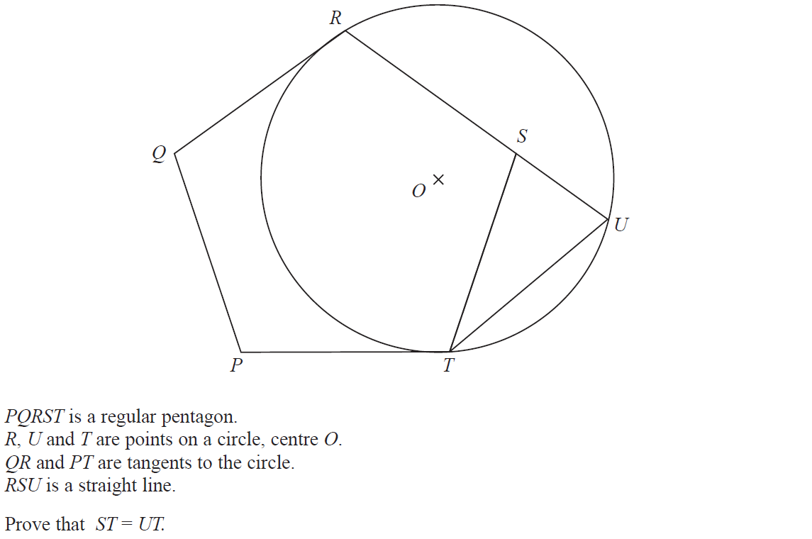
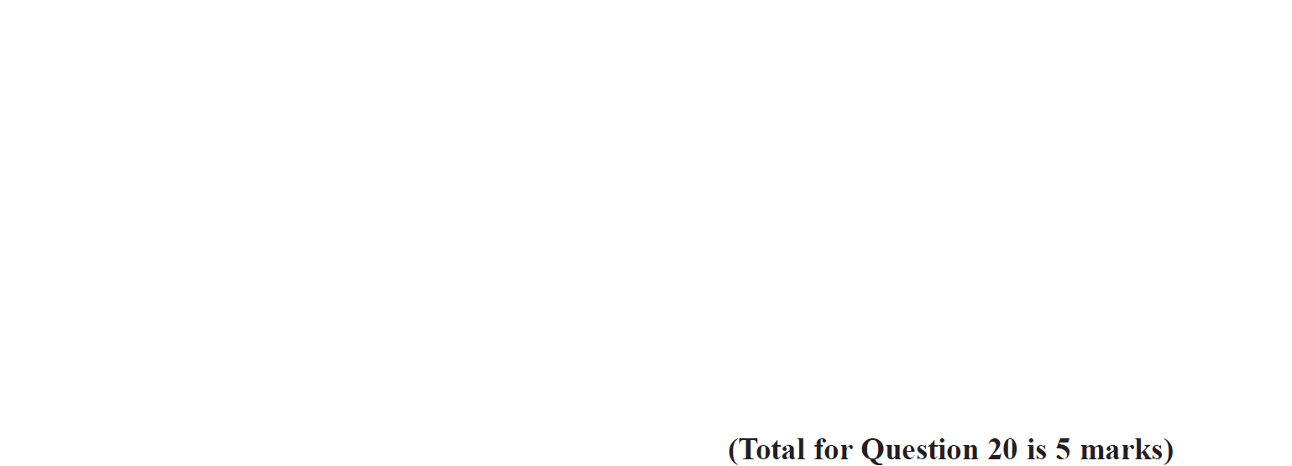
Circle Theorems
Specimen Set 2 2H Q20

Slide 7
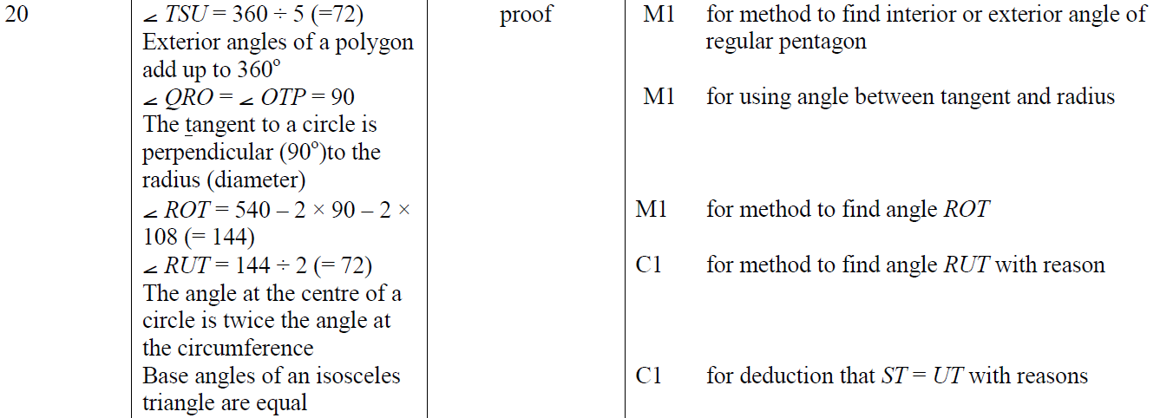
Circle Theorems
Specimen Set 2 2H Q20
A

Slide 8
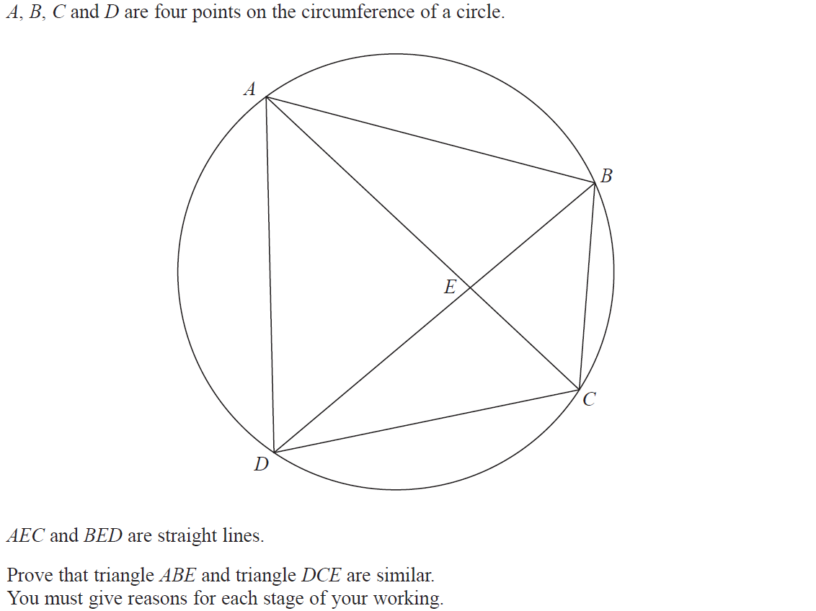
Circle Theorems
June 2017 2H Q15

Slide 9
Circle Theorems
June 2017 2H Q15
A

Slide 10
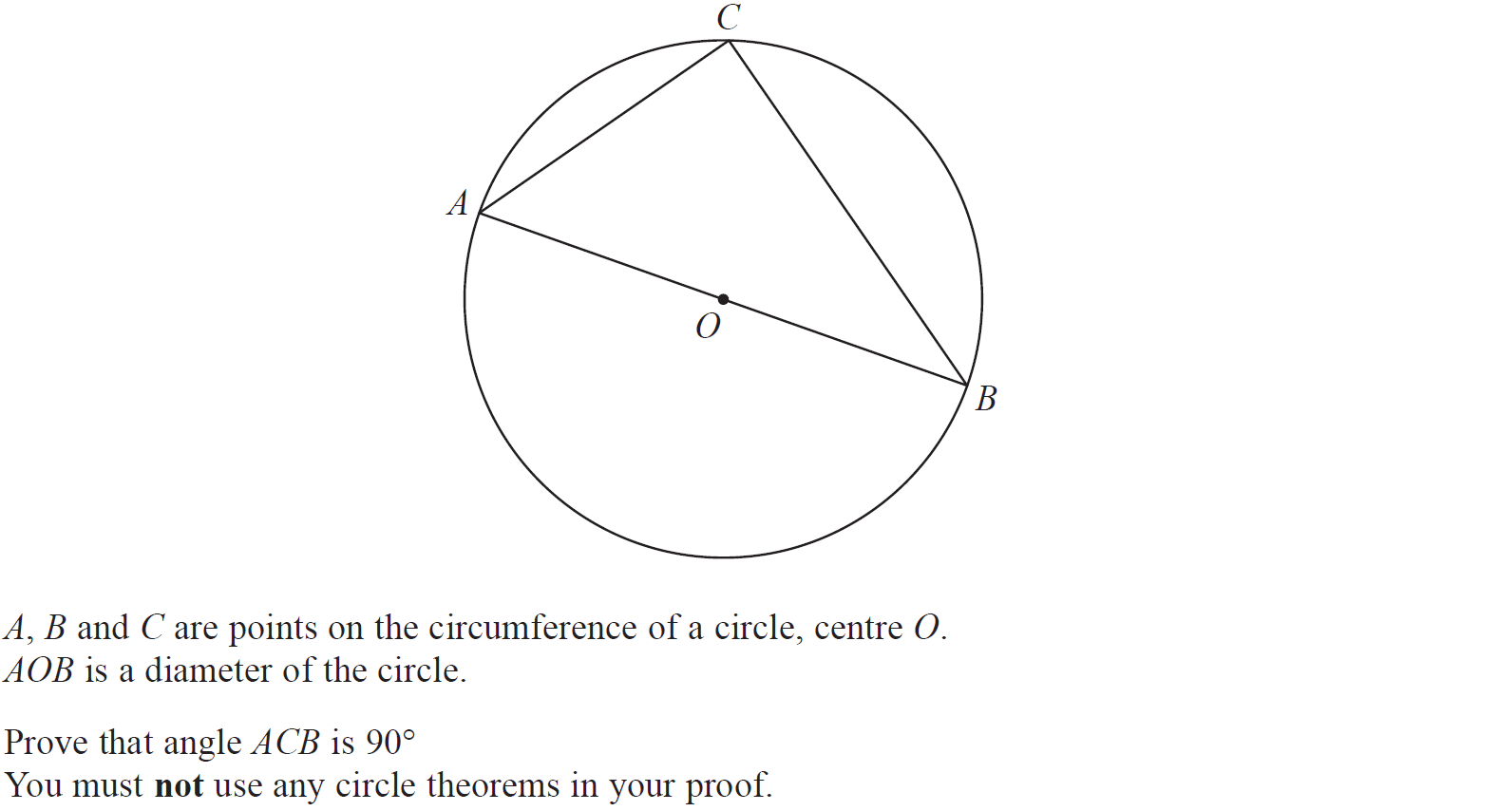
Circle Theorems
Nov 2017 3H Q20

Slide 11
Circle Theorems
Nov 2017 3H Q20
A

Slide 12
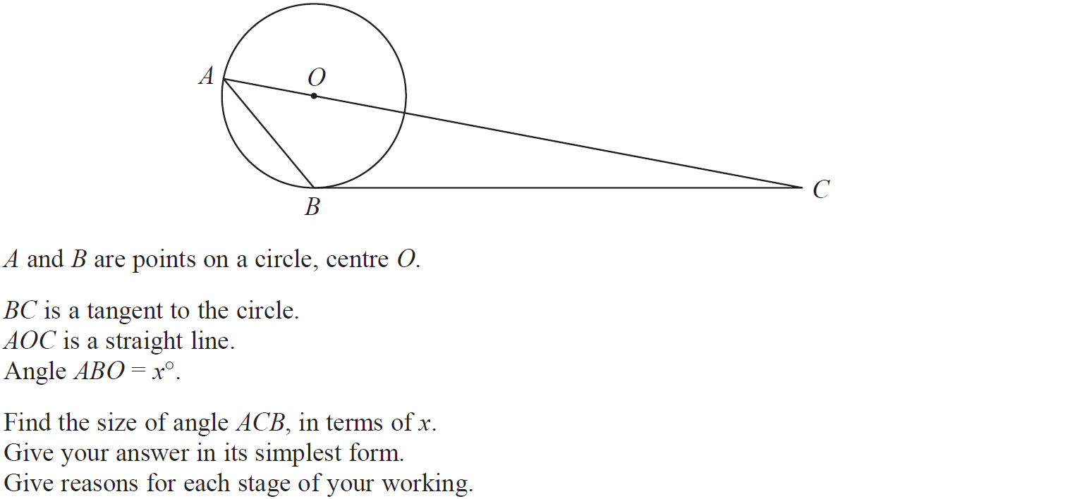
Circle Theorems
May 2018 1H Q11

Slide 13
Circle Theorems
May 2018 1H Q11
A

Slide 14
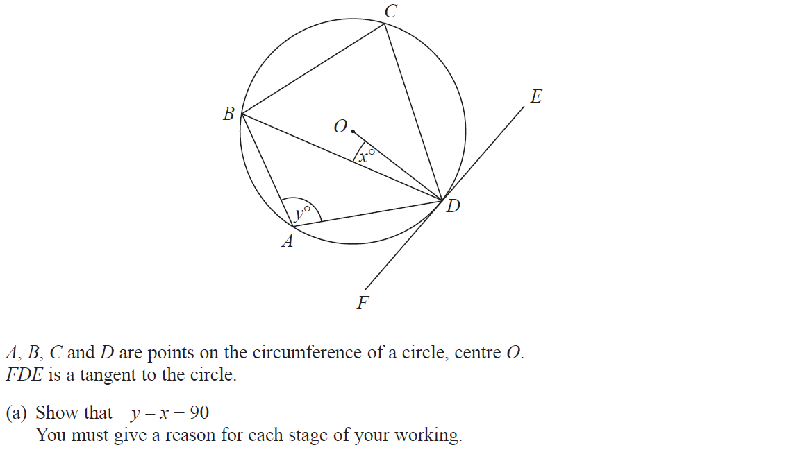
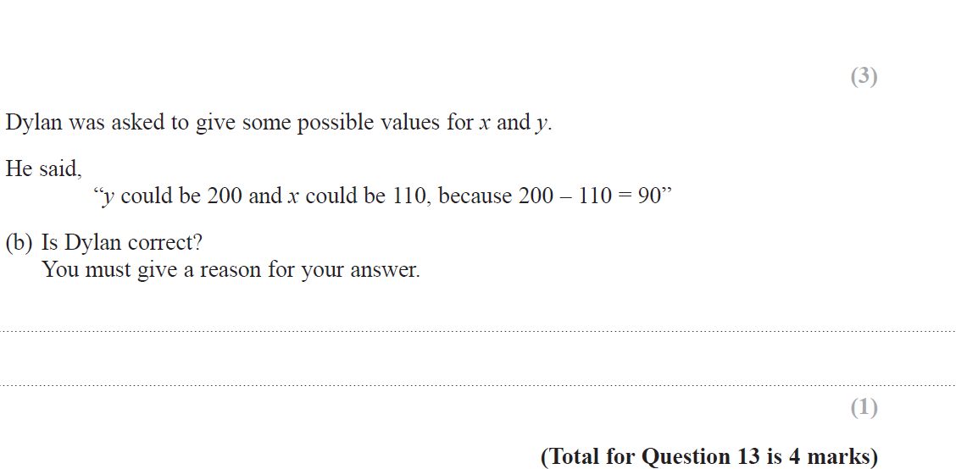
Circle Theorems
June 2018 2H Q13

Slide 15
Circle Theorems
June 2018 2H Q13
A
B

Slide 16
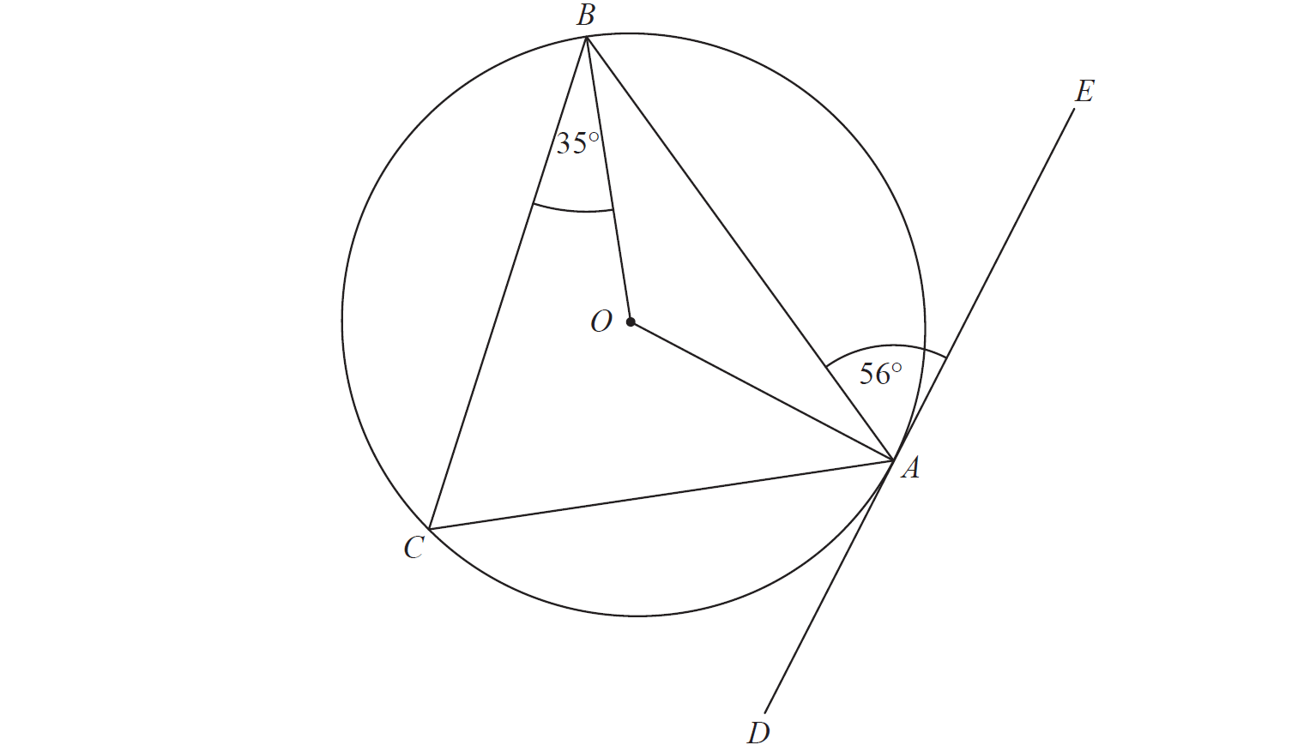
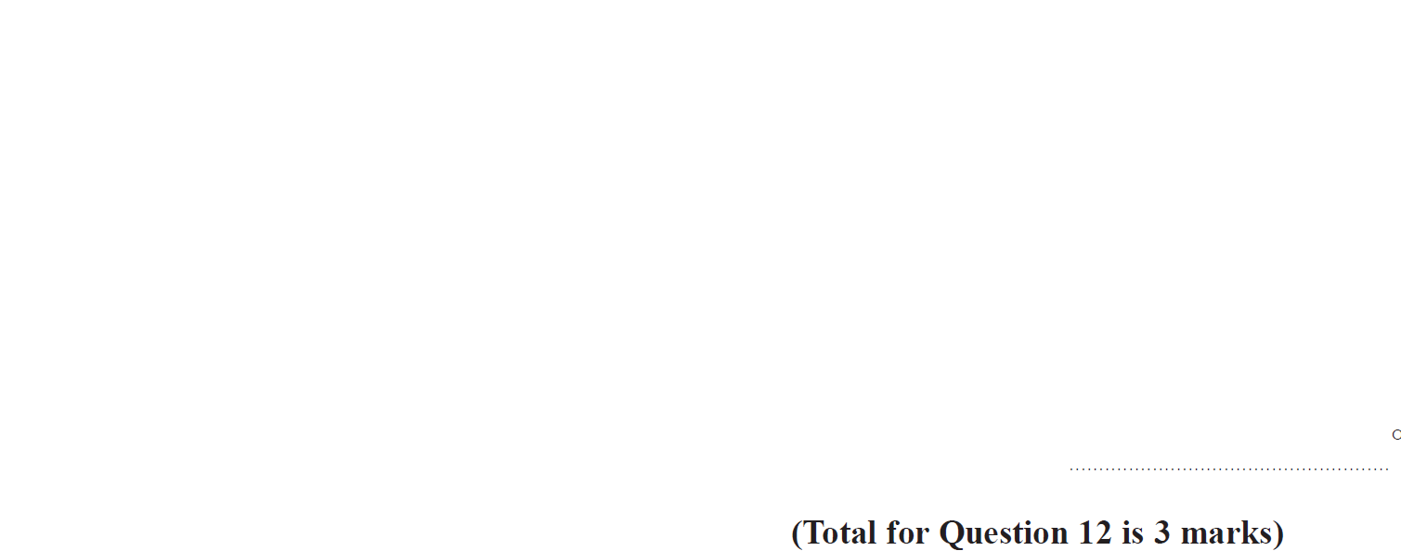
Circle Theorems
Nov 2018 1H Q12

Slide 17
Circle Theorems
Nov 2018 1H Q12
A

Slide 18
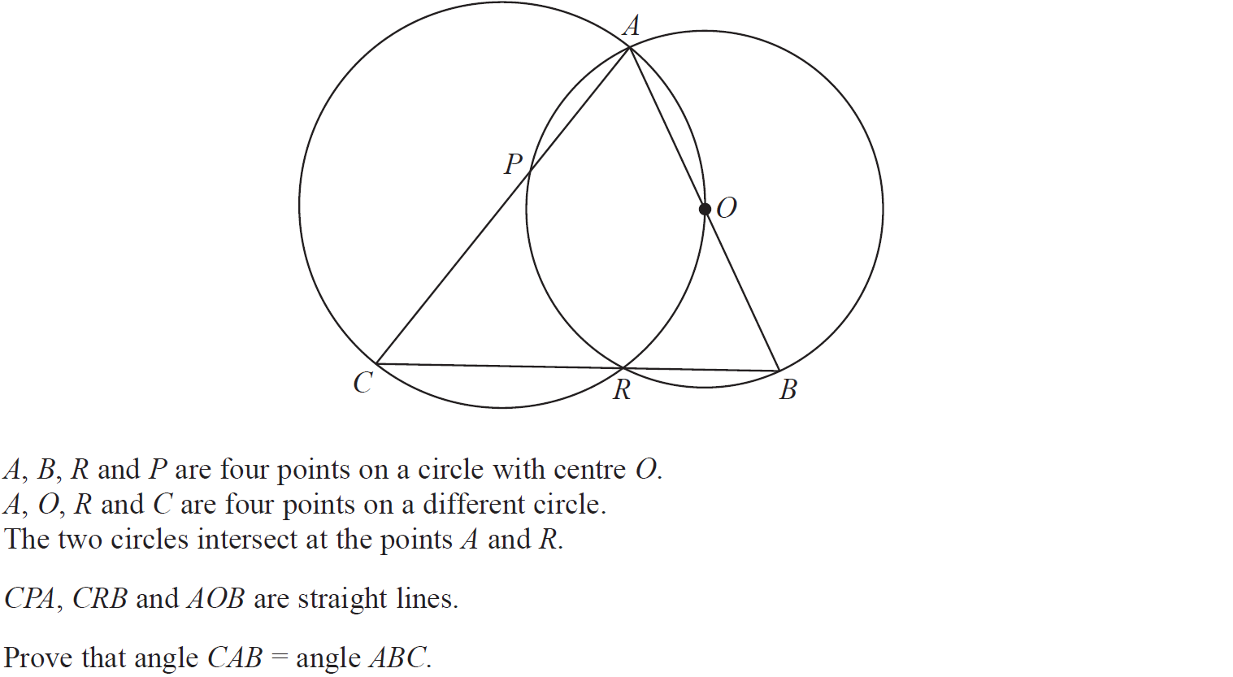
Circle Theorems
Nov 2018 2H Q21

Slide 19
Circle Theorems
Nov 2018 2H Q21
A

Slide 20
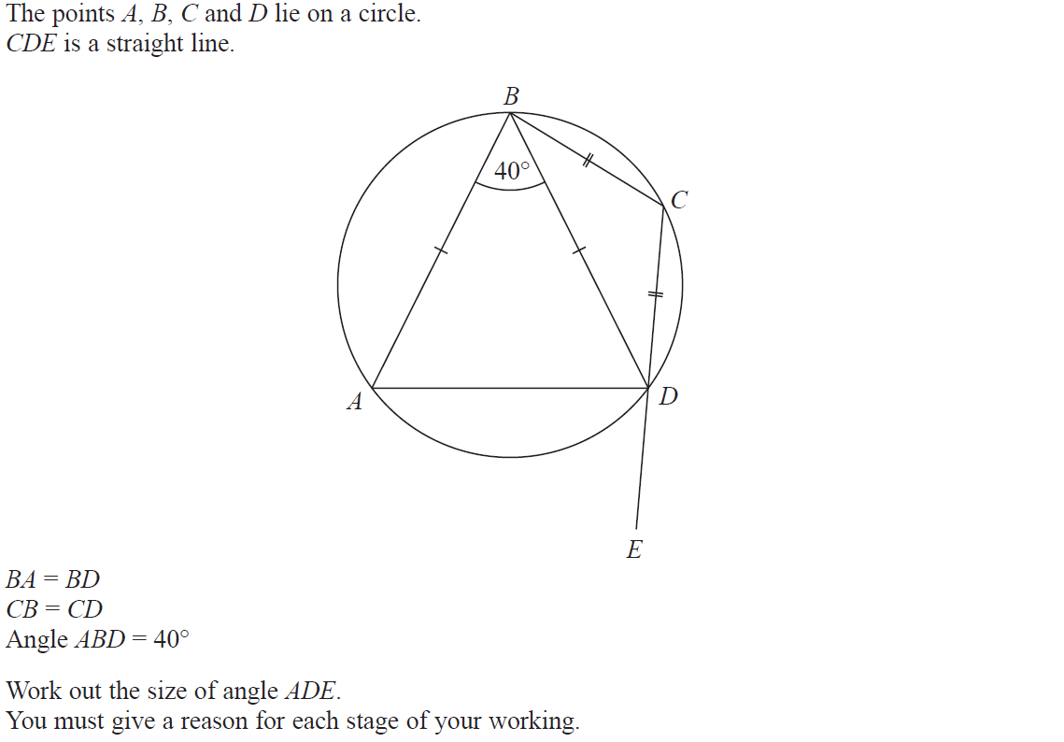
Circle Theorems
June 2019 2H Q18

Slide 21
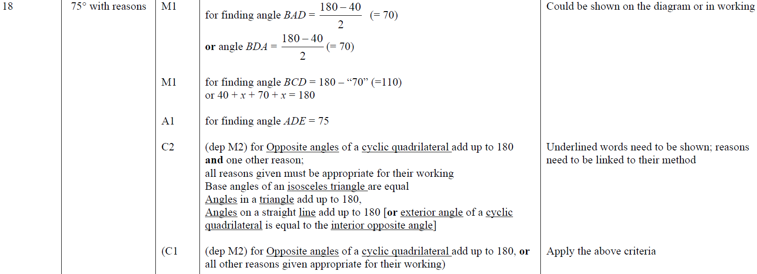
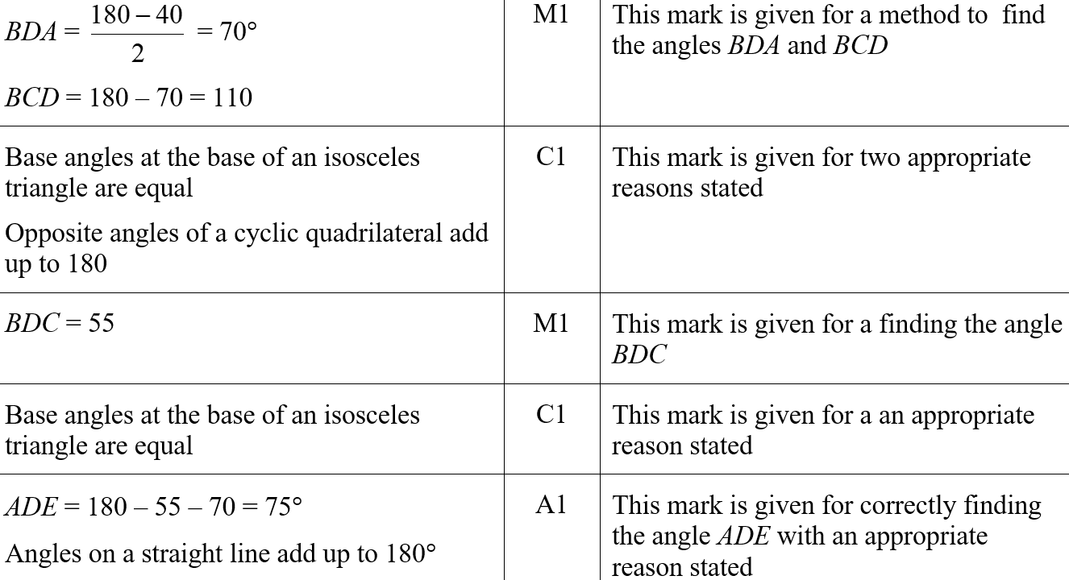
Circle Theorems
June 2019 2H Q18
A
A SF

