Slide 1
Manipulating Formulae/ Changing the Subject
Manipulating Formulae/ Changing the Subject
SAM
1H Q17
June 2017 3H Q14
Spec 1
1H Q13
Nov 2018 1H Q2
Spec 1
2H Q1
June 2019 2H Q15
Spec 2
3H Q3

Slide 2
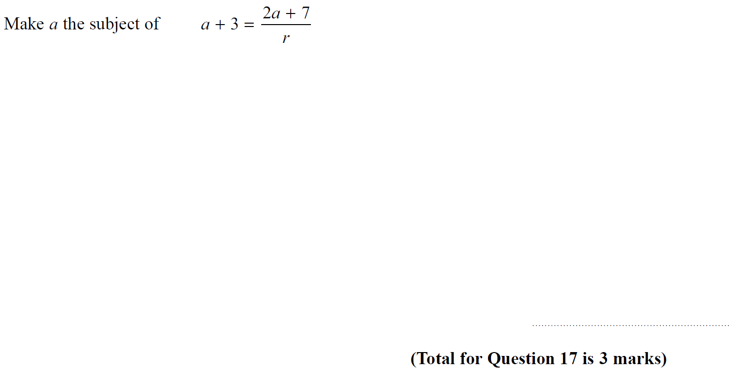
Manipulating Formulae/ Changing the Subject
SAM 1H Q17

Slide 3
Manipulating Formulae/ Changing the Subject
SAM 1H Q17
A

Slide 4
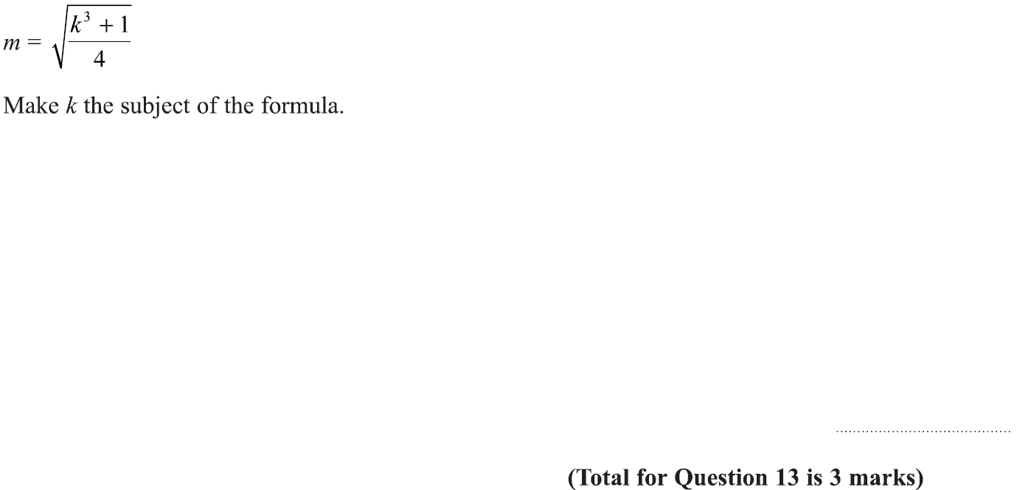
Manipulating Formulae/ Changing the Subject
Specimen Set 1 1H Q13

Slide 5
Manipulating Formulae/ Changing the Subject
Specimen Set 1 1H Q13
A

Slide 6
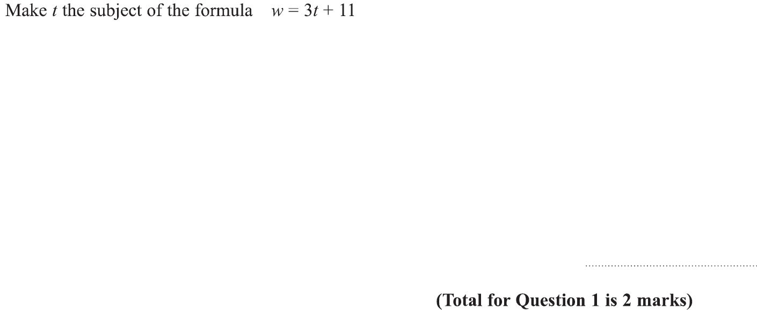
Manipulating Formulae/ Changing the Subject
Specimen Set 1 2H Q1

Slide 7
Manipulating Formulae/ Changing the Subject
Specimen Set 1 2H Q1
A

Slide 8
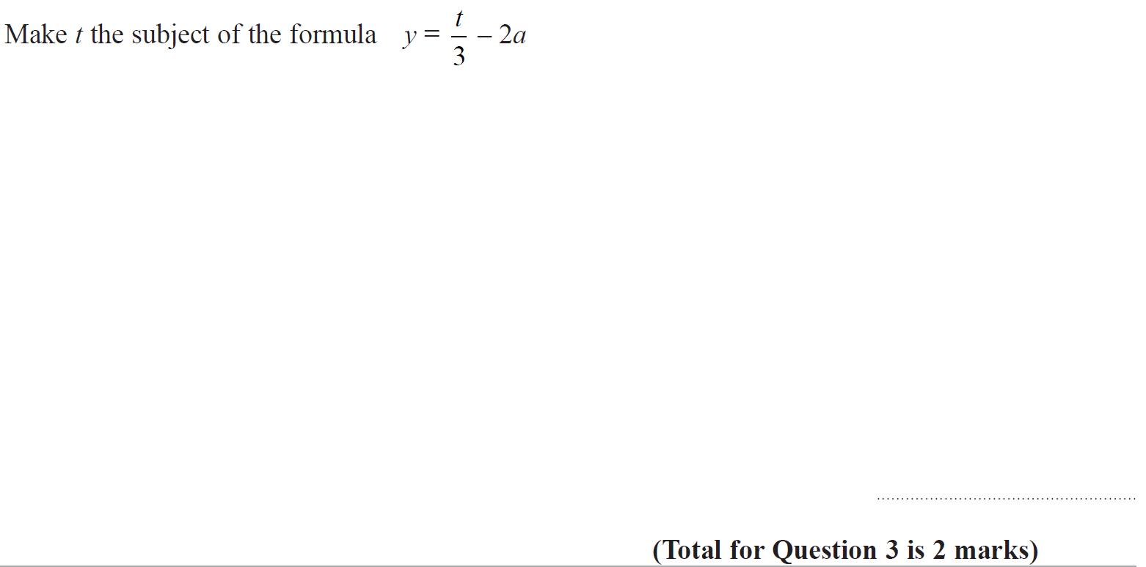
Manipulating Formulae/ Changing the Subject
Specimen Set 2 3H Q3

Slide 9
Manipulating Formulae/ Changing the Subject
Specimen Set 2 3H Q3
A

Slide 10
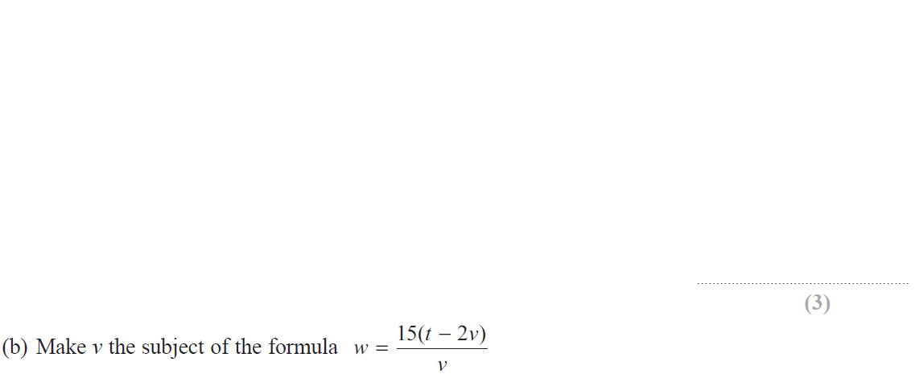
Manipulating Formulae/ Changing the Subject
June 2017 3H Q14

Slide 11
Manipulating Formulae/ Changing the Subject
June 2017 3H Q14
A
B

Slide 12
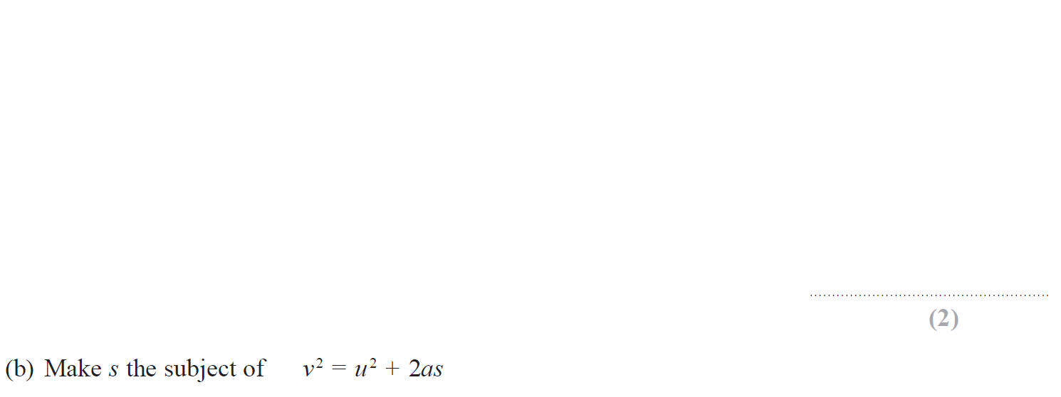
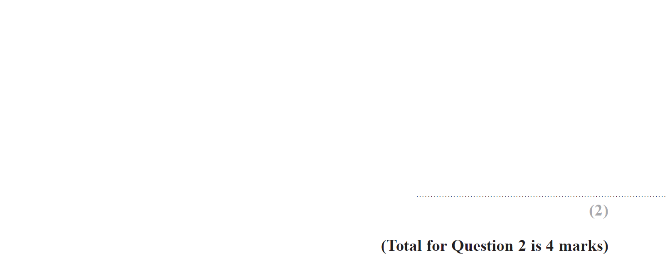
Manipulating Formulae/ Changing the Subject
Nov 2018 1H Q2

Slide 13
Manipulating Formulae/ Changing the Subject
Nov 2018 1H Q2
A
B

Slide 14
Manipulating Formulae/ Changing the Subject
June 2019 2H Q15

Slide 15
Manipulating Formulae/ Changing the Subject
June 2019 2H Q15
A
A SF

