Slide 1
Manipulating Formulae/ Changing the Subject
Manipulating Formulae/ Changing the Subject
SAM
1H Q17
Edexcel
June 2017 3H Q14
Spec 1
1H Q13
AQA
Nov 2018 1H Q2
Spec 1
2H Q1
OCR
June 2019 2H Q15
Spec 2
3H Q3

Slide 2
Manipulating Formulae/ Changing the Subject
Manipulating Formulae/ Changing the Subject
June 2017 3H Q3
Edexcel
Nov 2017 1H Q4
AQA
1 Marker
Nov 2017 3H Q9
OCR
Nov 2018 3H Q17

Slide 3
Manipulating Formulae/ Changing the Subject
Manipulating Formulae/ Changing the Subject
Edexcel
June 2017
2H Q5
Practice
1H Q12
AQA
Nov 2017
3H Q1
Practice
3H Q3
OCR
Nov 2018
2H Q9

Slide 4
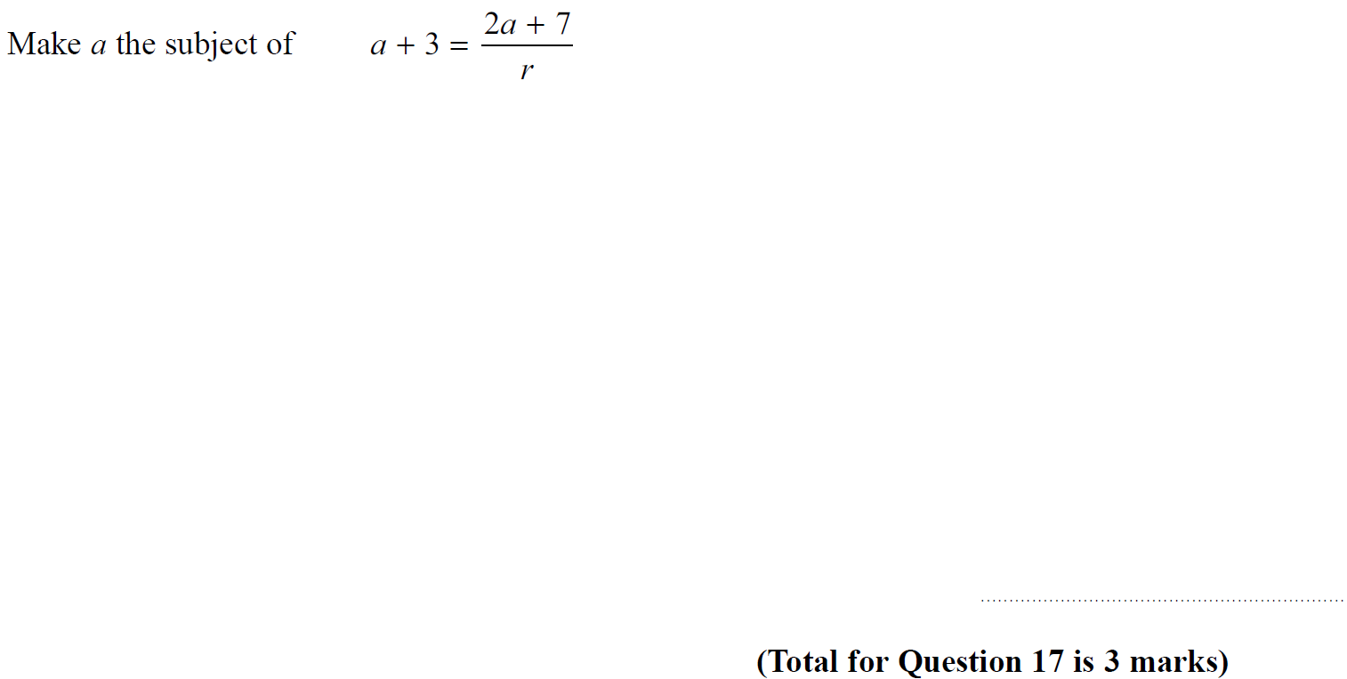
Manipulating Formulae/ Changing the Subject
SAM 1H Q17

Slide 5
Manipulating Formulae/ Changing the Subject
SAM 1H Q17
A

Slide 6
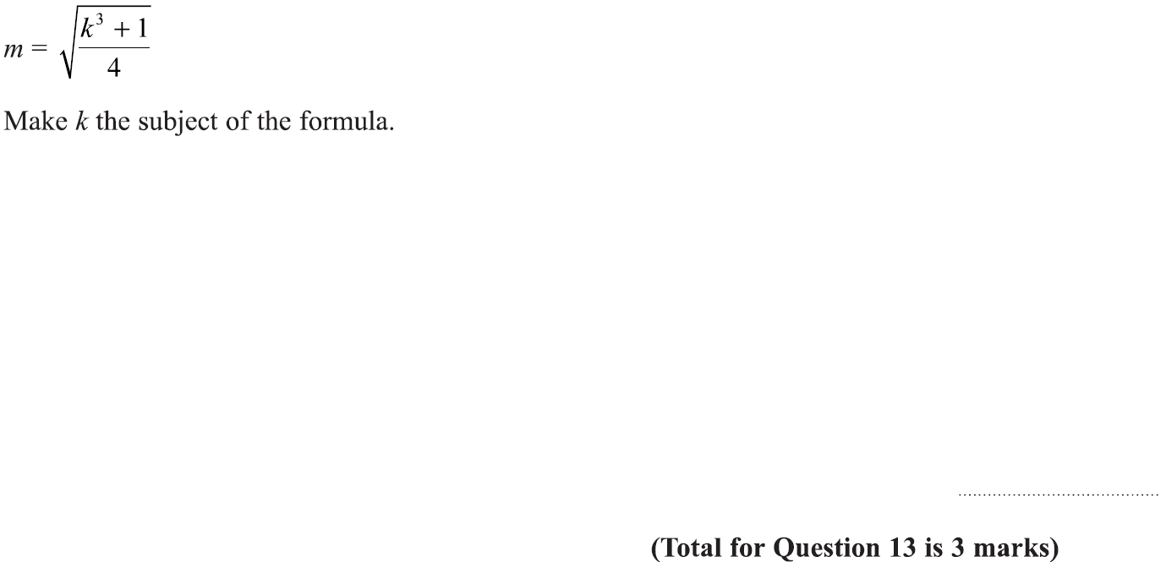
Manipulating Formulae/ Changing the Subject
Specimen Set 1 1H Q13

Slide 7
Manipulating Formulae/ Changing the Subject
Specimen Set 1 1H Q13
A

Slide 8
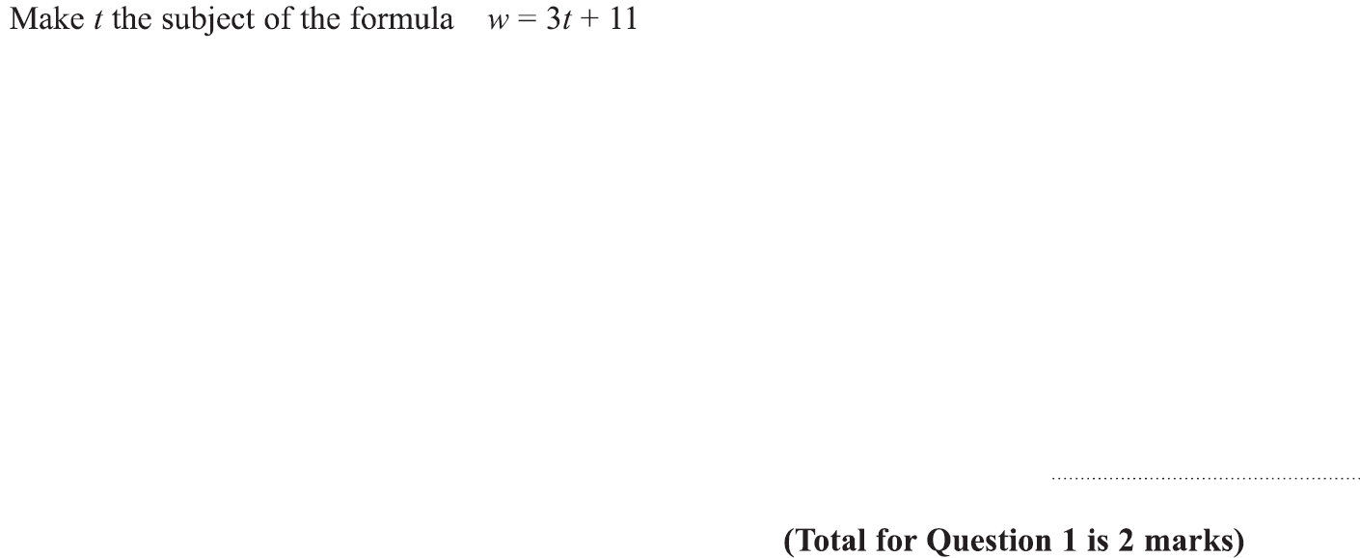
Manipulating Formulae/ Changing the Subject
Specimen Set 1 2H Q1

Slide 9
Manipulating Formulae/ Changing the Subject
Specimen Set 1 2H Q1
A

Slide 10
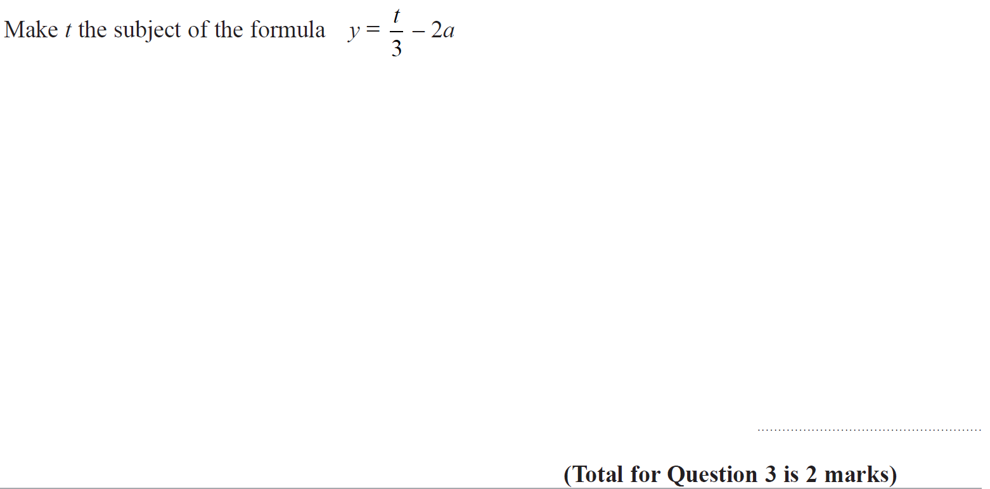
Manipulating Formulae/ Changing the Subject
Specimen Set 2 3H Q3

Slide 11
Manipulating Formulae/ Changing the Subject
Specimen Set 2 3H Q3
A

Slide 12
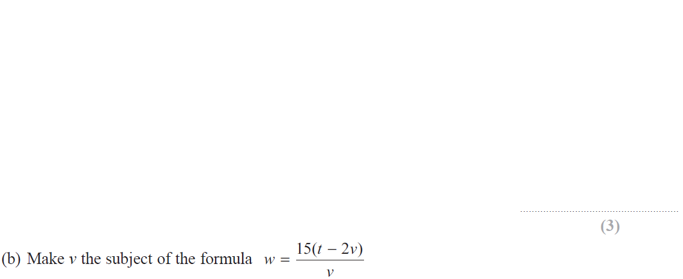
Manipulating Formulae/ Changing the Subject
June 2017 3H Q14

Slide 13
Manipulating Formulae/ Changing the Subject
June 2017 3H Q14
A
B

Slide 14
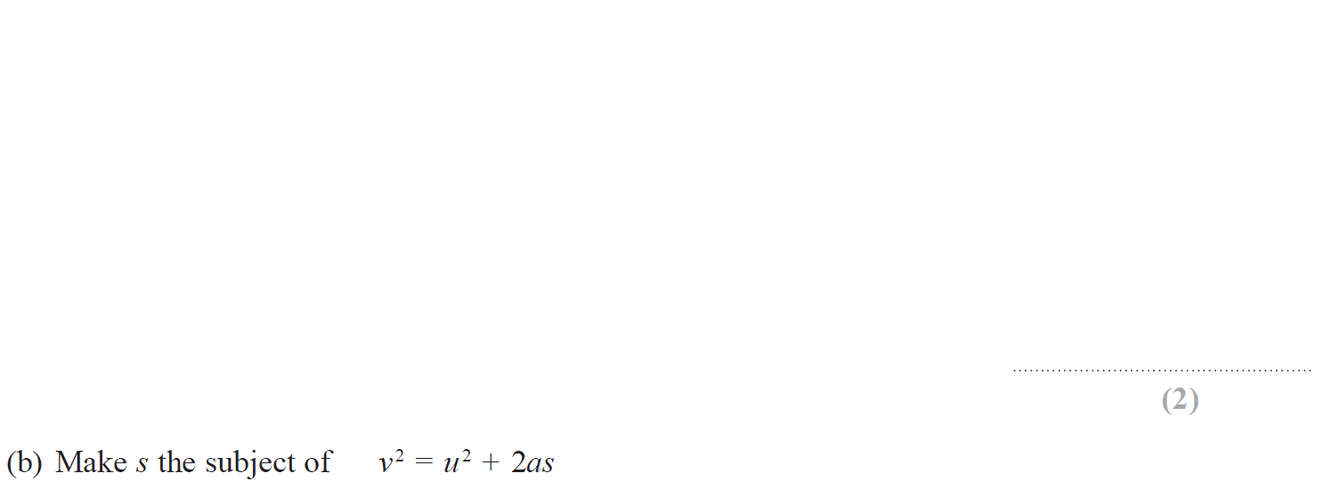
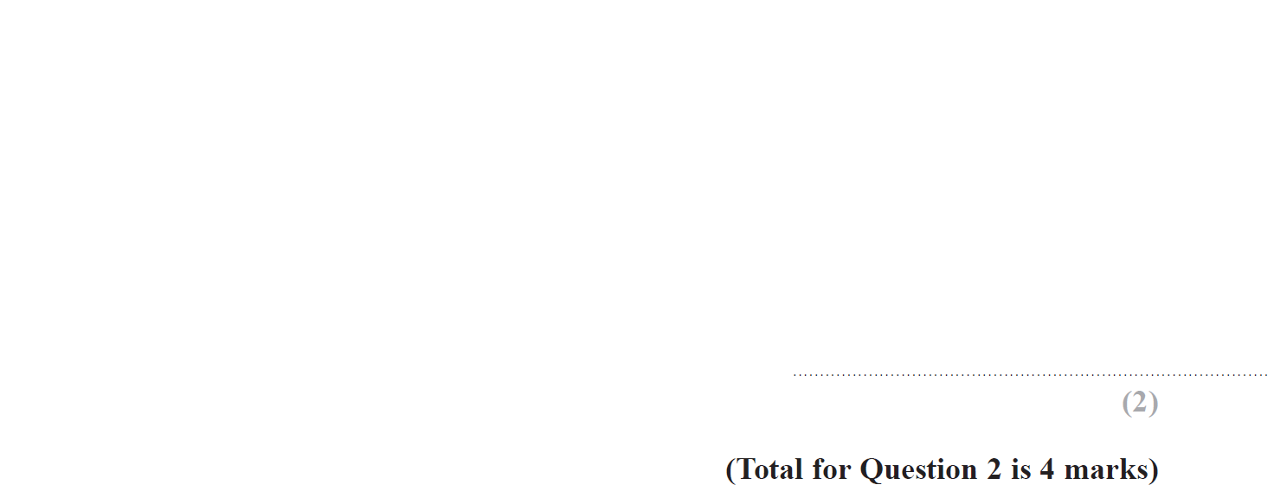
Manipulating Formulae/ Changing the Subject
Nov 2018 1H Q2

Slide 15
Manipulating Formulae/ Changing the Subject
Nov 2018 1H Q2
A
B

Slide 16
Manipulating Formulae/ Changing the Subject
June 2019 2H Q15

Slide 17
Manipulating Formulae/ Changing the Subject
June 2019 2H Q15
A
A SF

Slide 18
Manipulating Formulae/ Changing the Subject
June 2017 3H Q3

Slide 19
Manipulating Formulae/ Changing the Subject
June 2017 3H Q3
A

Slide 20
Manipulating Formulae/ Changing the Subject
Nov 2017 1H Q4

Slide 21
Manipulating Formulae/ Changing the Subject
Nov 2017 1H Q4
A

Slide 22
Manipulating Formulae/ Changing the Subject
Nov 2017 3H Q9

Slide 23
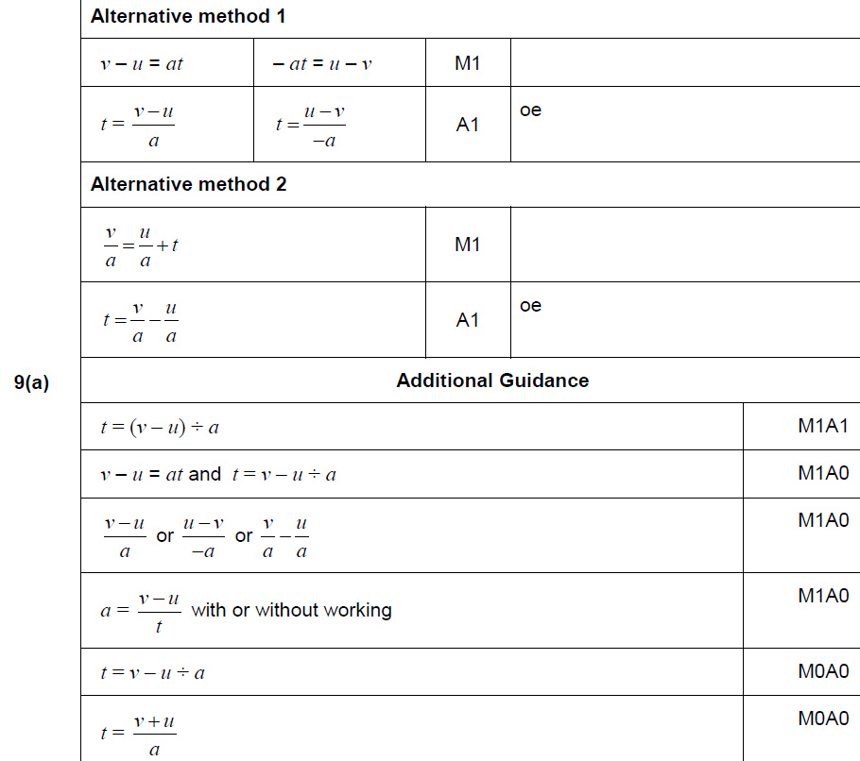
Manipulating Formulae/ Changing the Subject
Nov 2017 3H Q9
A

Slide 24
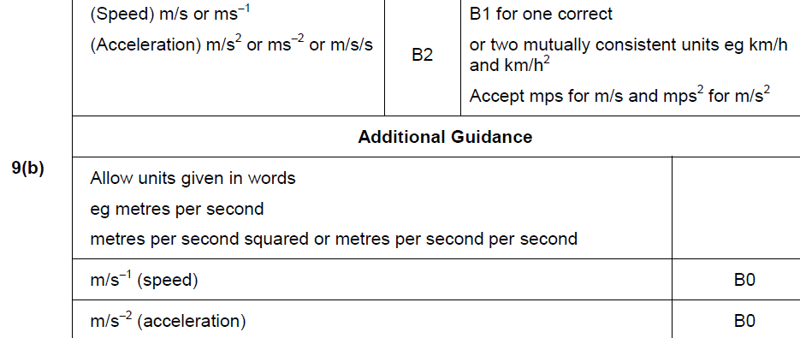
Manipulating Formulae/ Changing the Subject
Nov 2017 3H Q9
B

Slide 25
Manipulating Formulae/ Changing the Subject
Nov 2018 3H Q17

Slide 26
Manipulating Formulae/ Changing the Subject
Nov 2018 3H Q17
A

Slide 27
Manipulating Formulae/ Changing the Subject
Practice 1H Q12

Slide 28
Manipulating Formulae/ Changing the Subject
Practice 1H Q12
A

Slide 29
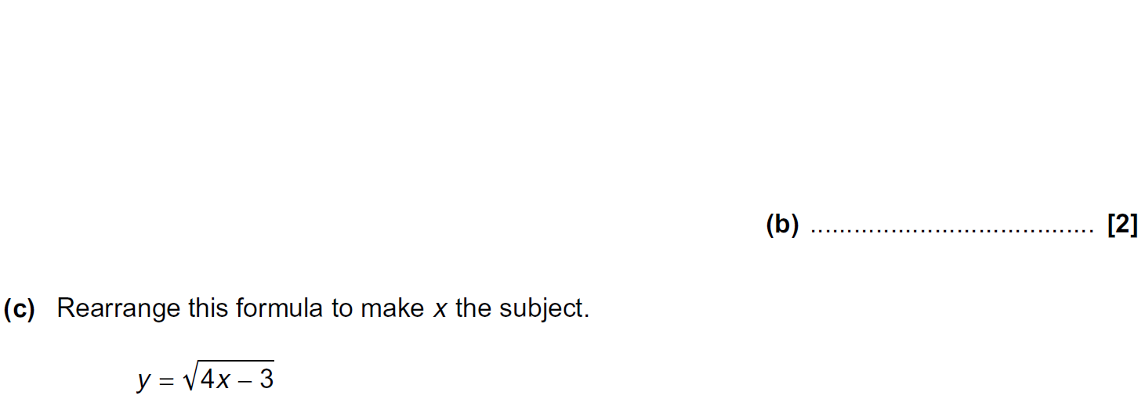
Manipulating Formulae/ Changing the Subject
Practice 3H Q3

Slide 30
Manipulating Formulae/ Changing the Subject
Practice 3H Q3
A
B
C

Slide 31
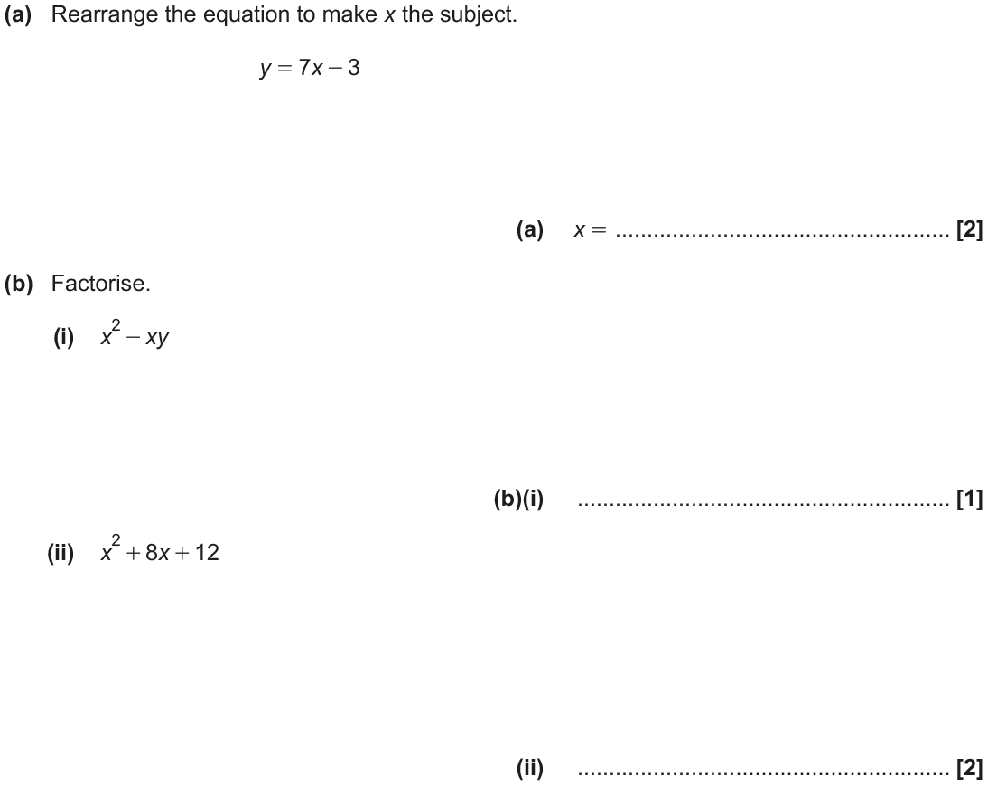
Manipulating Formulae/ Changing the Subject
June 2017 2H Q5

Slide 32
Manipulating Formulae/ Changing the Subject
June 2017 2H Q5
A
B (i)
B (ii)

Slide 33
Manipulating Formulae/ Changing the Subject
Nov 2017 3H Q1

Slide 34
Manipulating Formulae/ Changing the Subject
Nov 2017 3H Q1
A
B

Slide 35
Manipulating Formulae/ Changing the Subject
Nov 2018 2H Q9

Slide 36
Manipulating Formulae/ Changing the Subject
Nov 2018 2H Q9
A

