Slide 1
Manipulating Formulae/ Changing the Subject
Manipulating Formulae/ Changing the Subject
June 2017
2H Q5
Practice
1H Q12
Nov 2017
3H Q1
Practice
3H Q3
Nov 2018
2H Q9

Slide 2
Manipulating Formulae/ Changing the Subject
Practice 1H Q12

Slide 3
Manipulating Formulae/ Changing the Subject
Practice 1H Q12
A

Slide 4
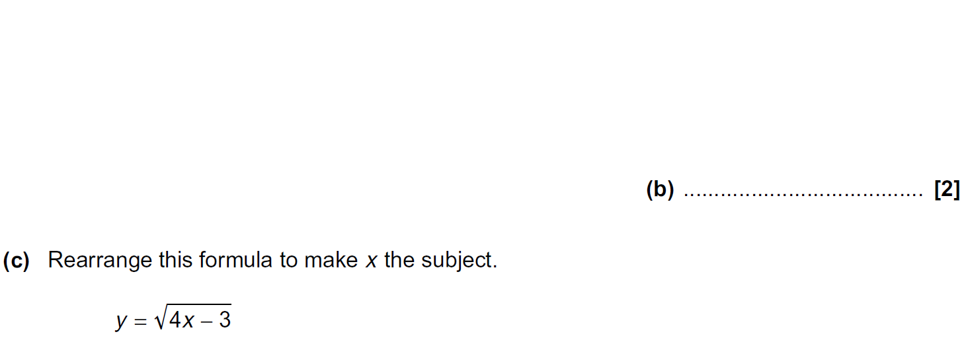
Manipulating Formulae/ Changing the Subject
Practice 3H Q3

Slide 5
Manipulating Formulae/ Changing the Subject
Practice 3H Q3
A
B
C

Slide 6
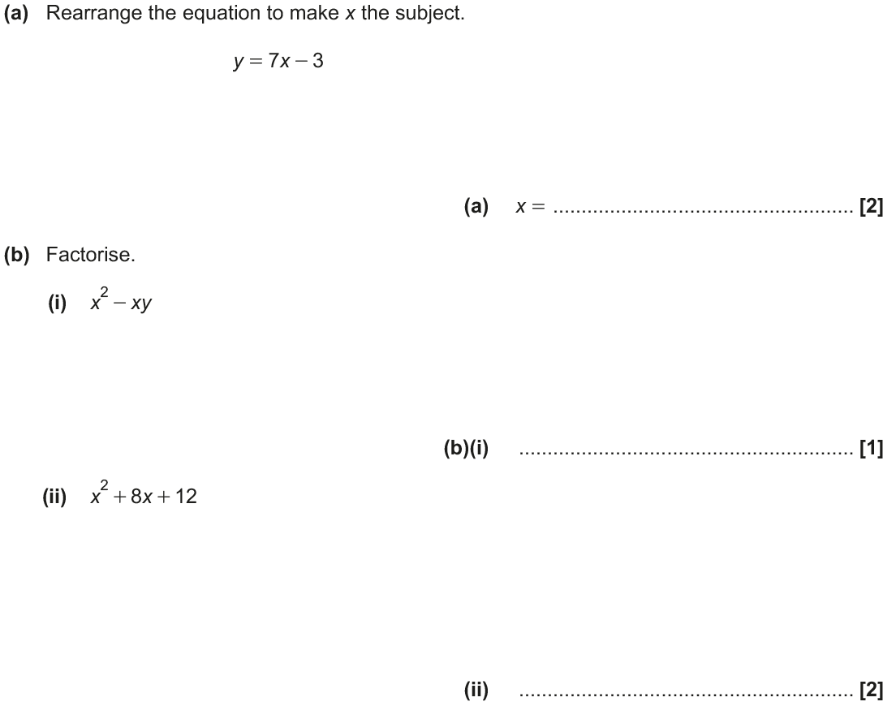
Manipulating Formulae/ Changing the Subject
June 2017 2H Q5

Slide 7
Manipulating Formulae/ Changing the Subject
June 2017 2H Q5
A
B (i)
B (ii)

Slide 8
Manipulating Formulae/ Changing the Subject
Nov 2017 3H Q1

Slide 9
Manipulating Formulae/ Changing the Subject
Nov 2017 3H Q1
A
B

Slide 10
Manipulating Formulae/ Changing the Subject
Nov 2018 2H Q9

Slide 11
Manipulating Formulae/ Changing the Subject
Nov 2018 2H Q9
A

