Slide 1
Basic Trigonometry
Basic Trigonometry
SAM
1H Q13
June 2017
2H Q7
Nov 2017
3H Q27
SAM
2H Q14
June 2017
3H Q25
June 2018
2H Q19
1 Marker
SAM
2H Q24
Nov 2017
2H Q9
June 2018
3H Q25
SAM
3H Q15
Nov 2017
2H Q17
Nov 2018
3H Q11
3D
*May use Pythagoras instead

Slide 2
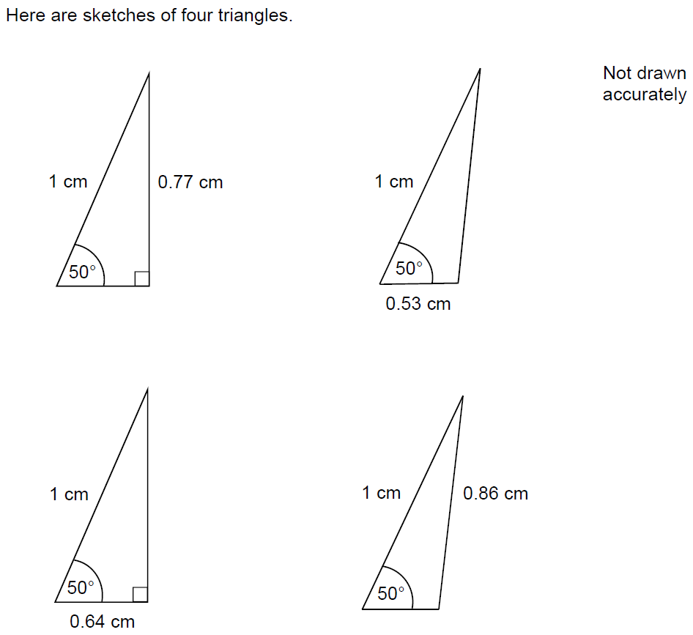
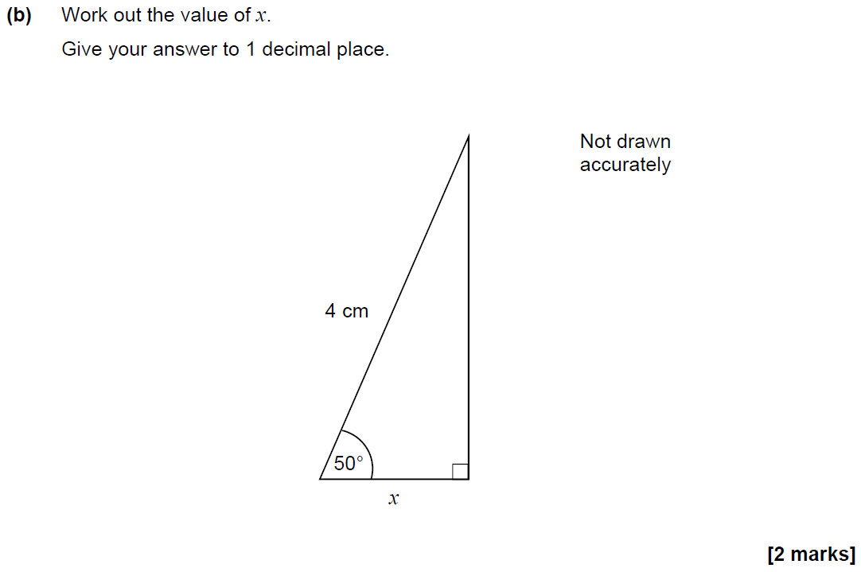
Basic Trigonometry
SAM 1H Q13

Slide 3
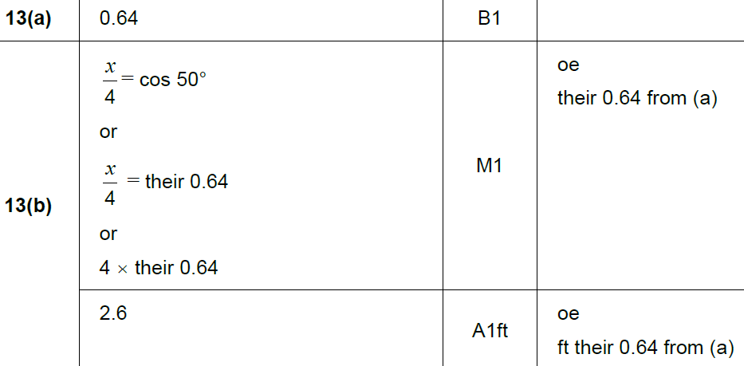
Basic Trigonometry
SAM 1H Q13
A
B

Slide 4
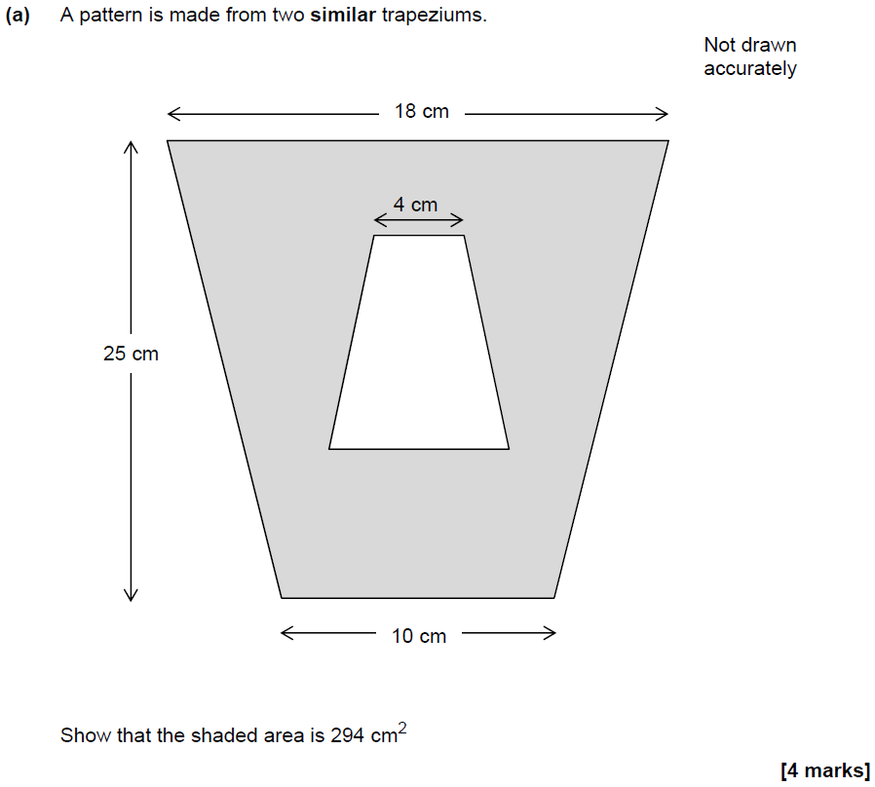
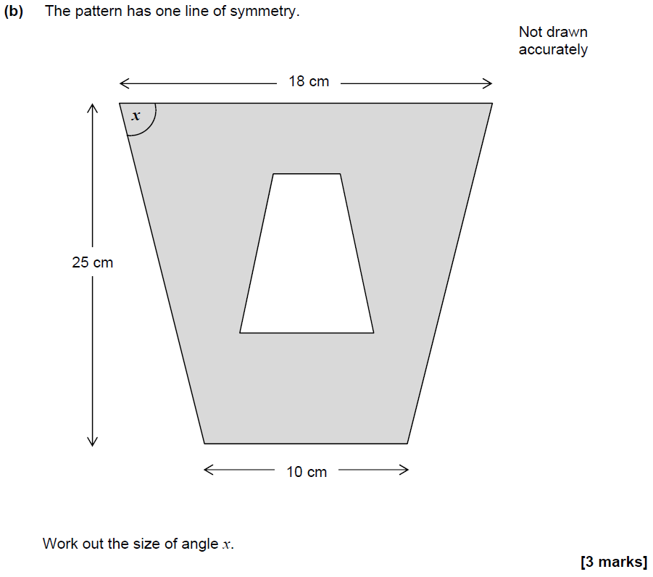
Basic Trigonometry
SAM 2H Q14

Slide 5
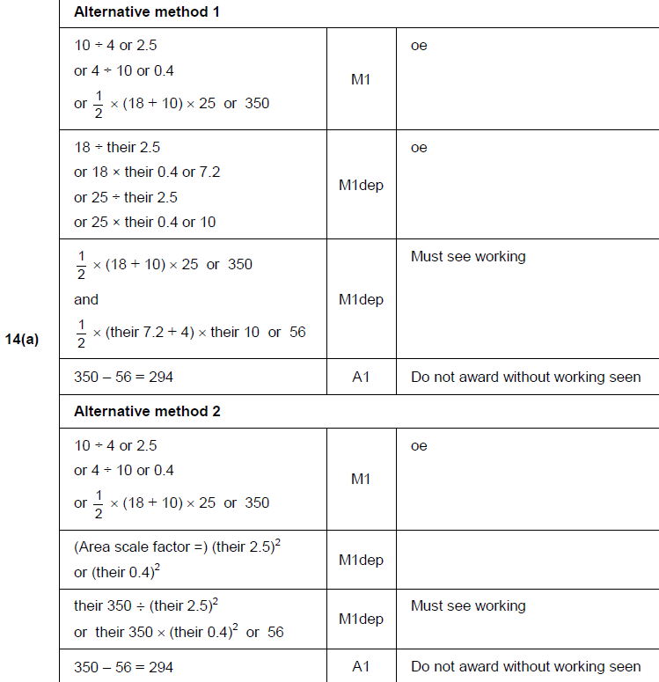
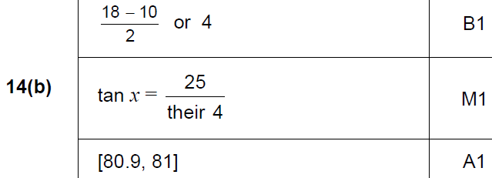
Basic Trigonometry
SAM 2H Q14
A
B

Slide 6
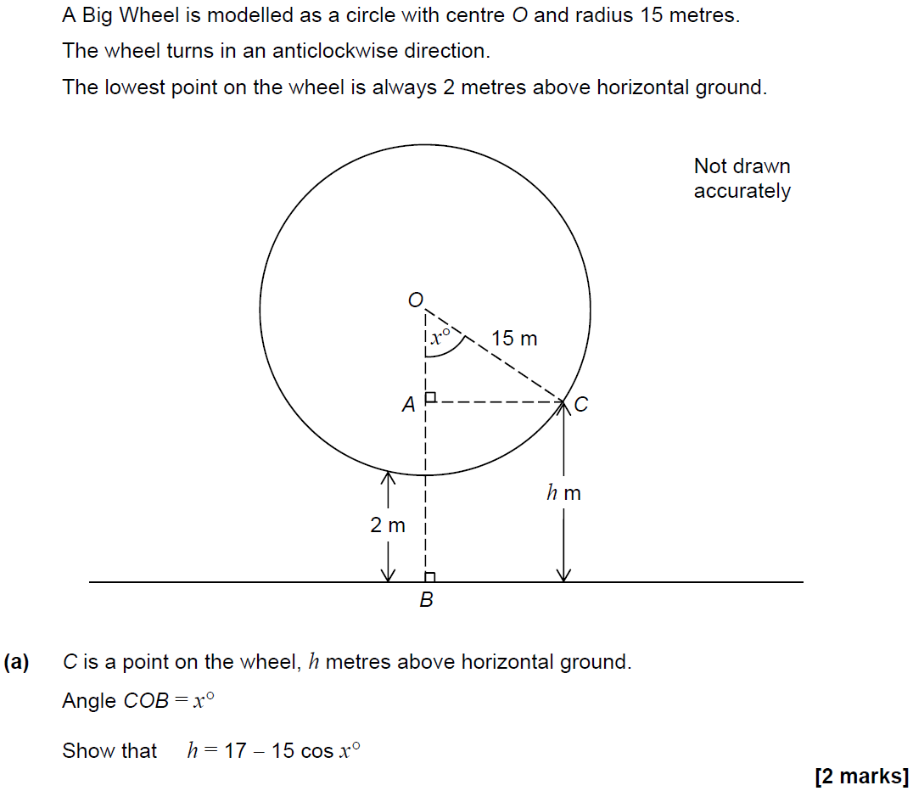
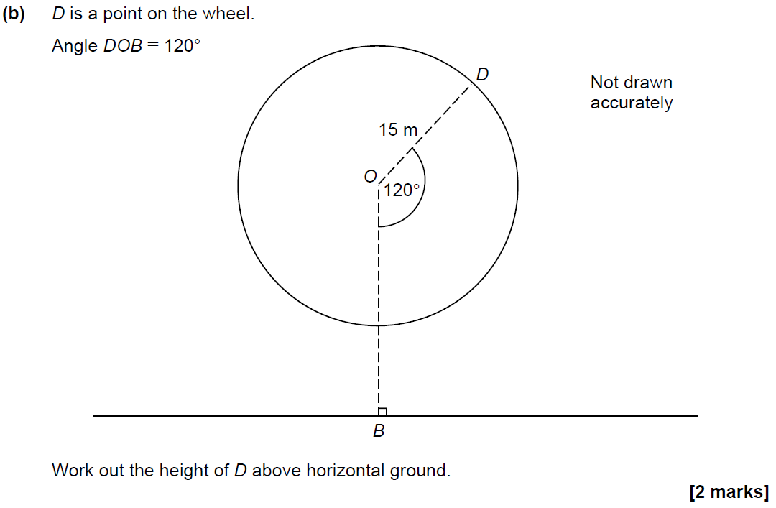
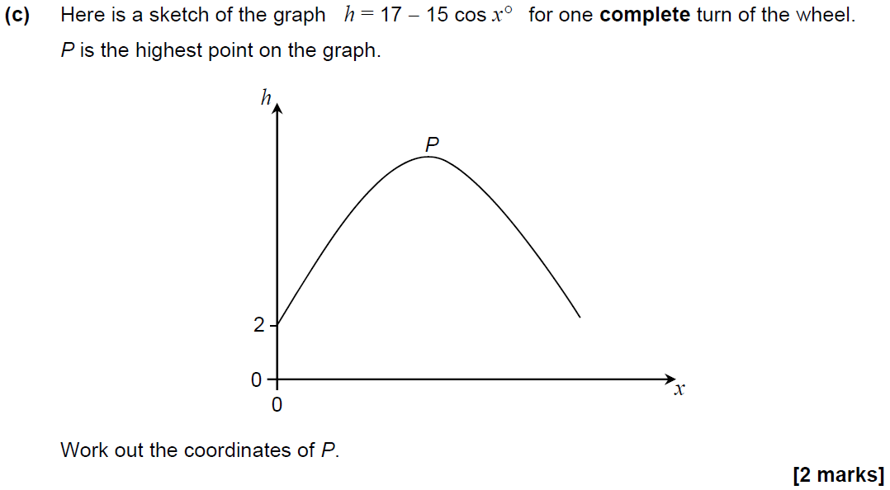
Basic Trigonometry
SAM 2H Q24

Slide 7
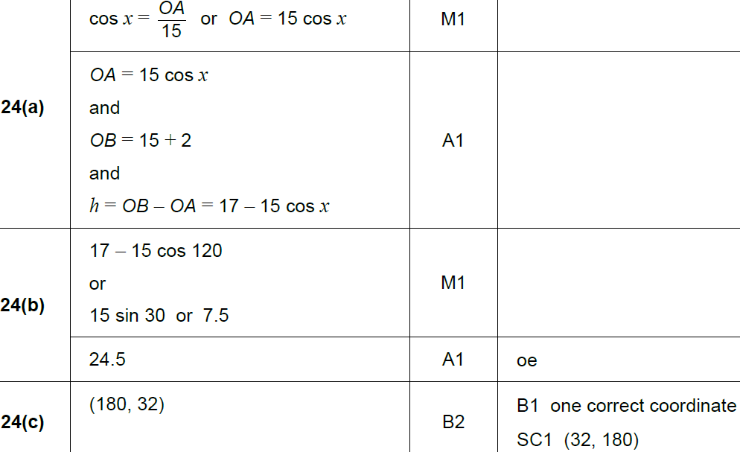
Basic Trigonometry
SAM 2H Q24
A
B
C

Slide 8
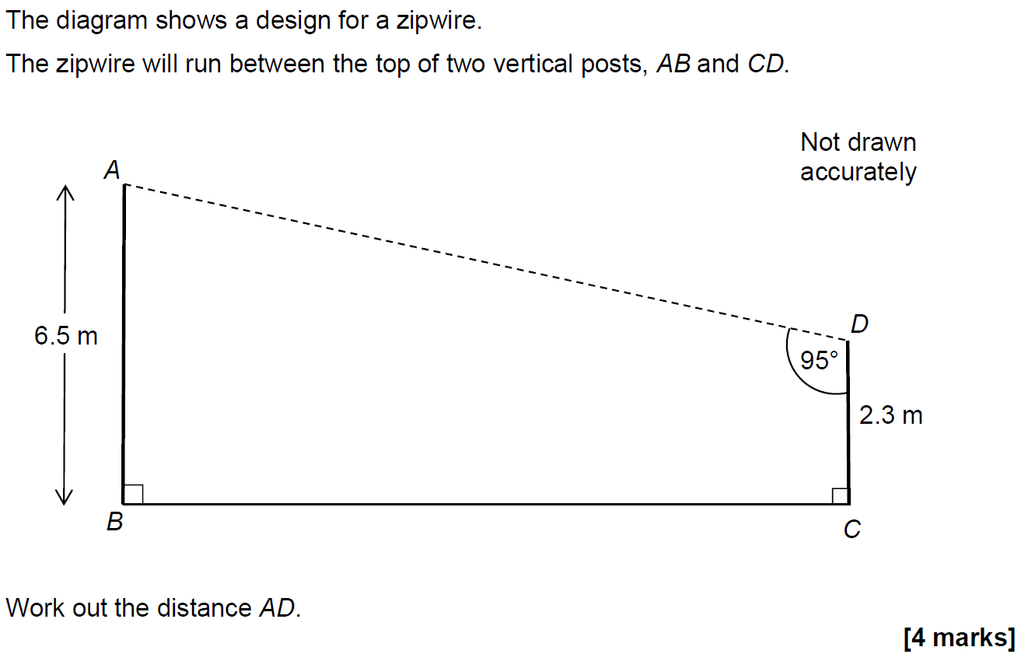
Basic Trigonometry
SAM 3H Q15

Slide 9
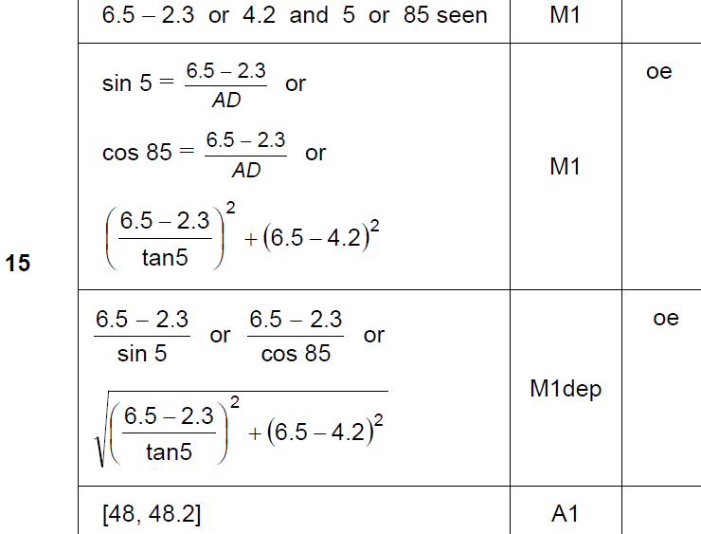
Basic Trigonometry
SAM 3H Q15
A

Slide 10
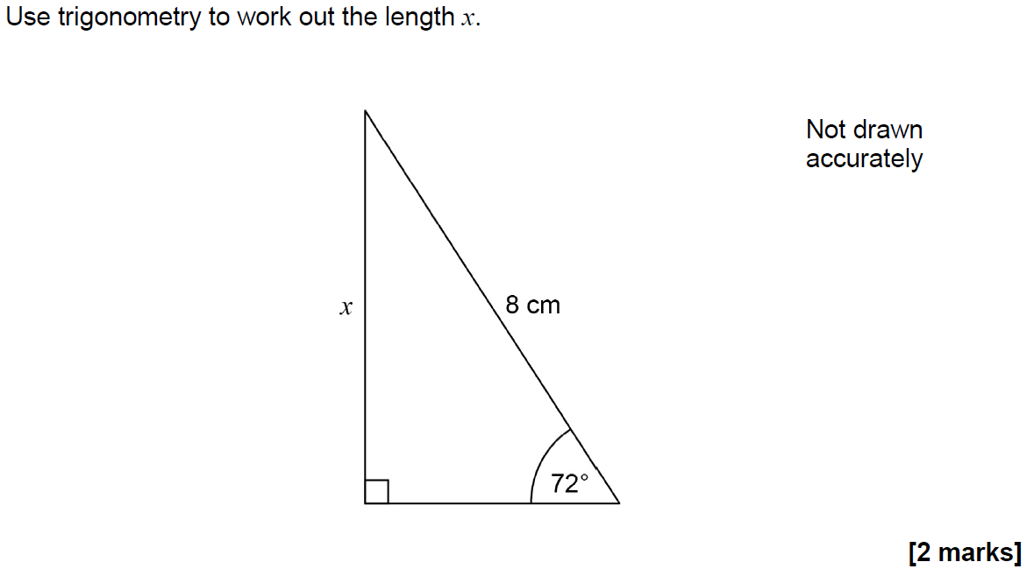
Basic Trigonometry
June 2017 2H Q7

Slide 11
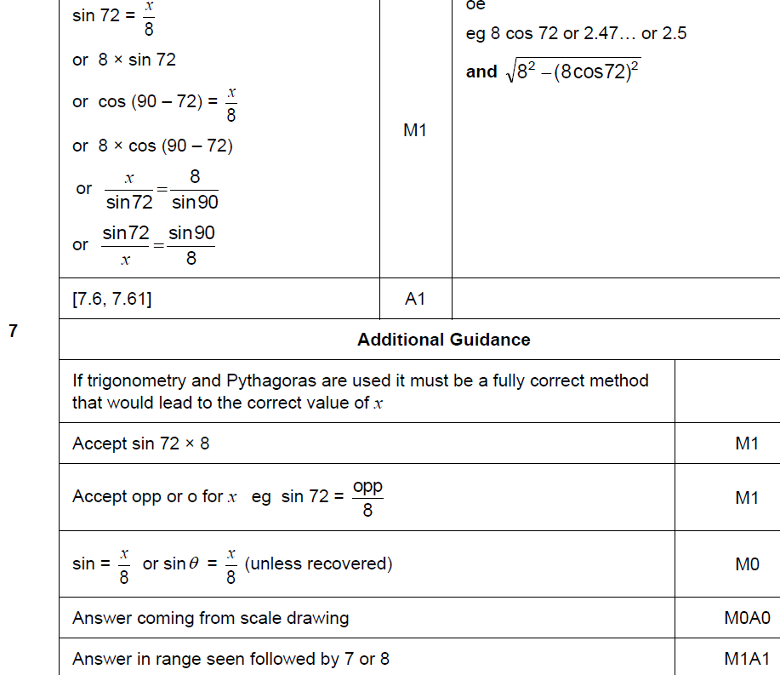
Basic Trigonometry
June 2017 2H Q7
A

Slide 12
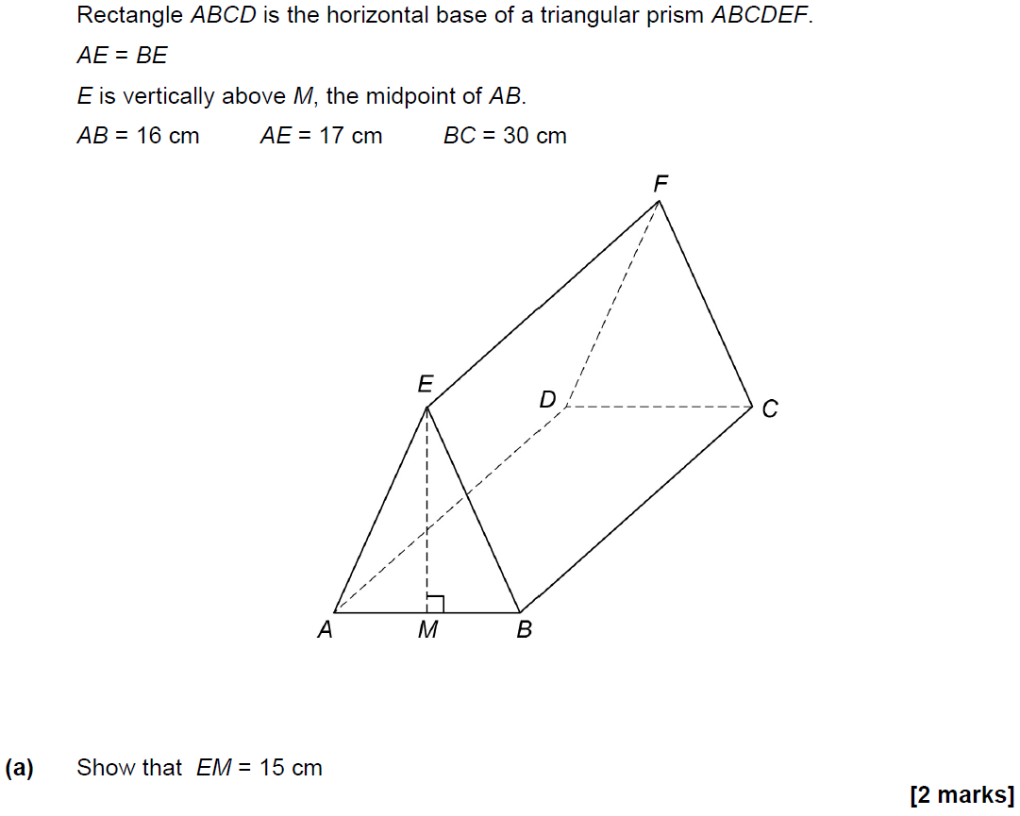
Basic Trigonometry
June 2017 3H Q25

Slide 13
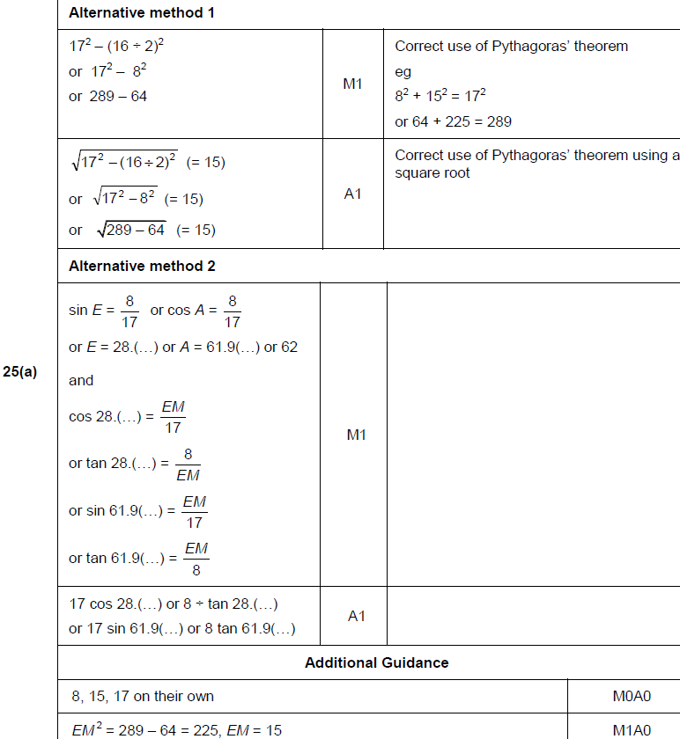
Basic Trigonometry
June 2017 3H Q25
A

Slide 14
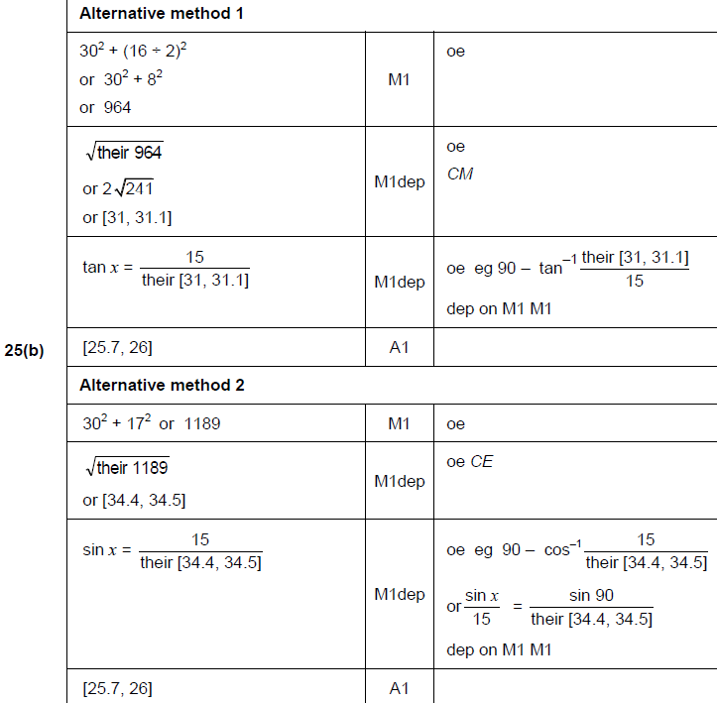
Basic Trigonometry
June 2017 3H Q25
B

Slide 15
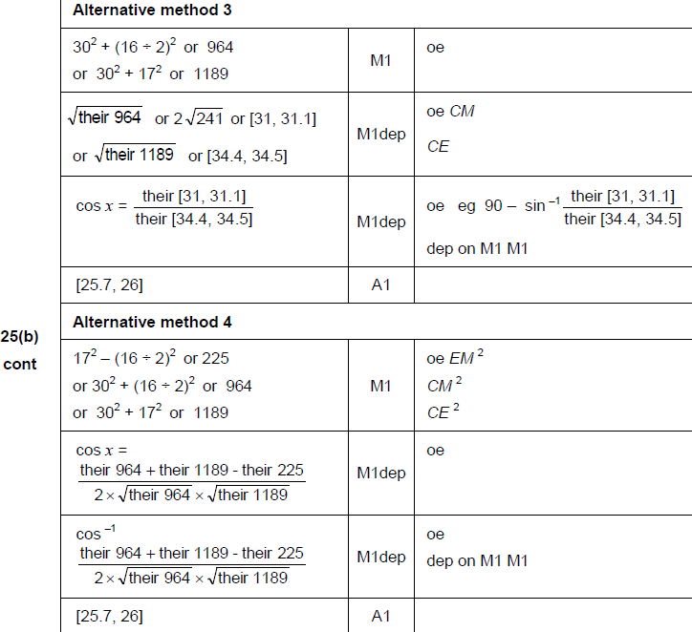
Basic Trigonometry
June 2017 3H Q25
B Alternatives

Slide 16
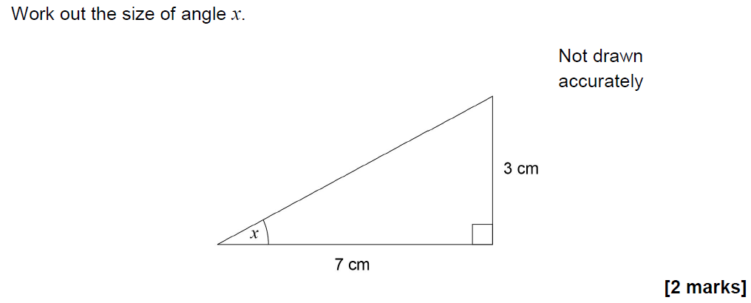
Basic Trigonometry
Nov 2017 2H Q9

Slide 17
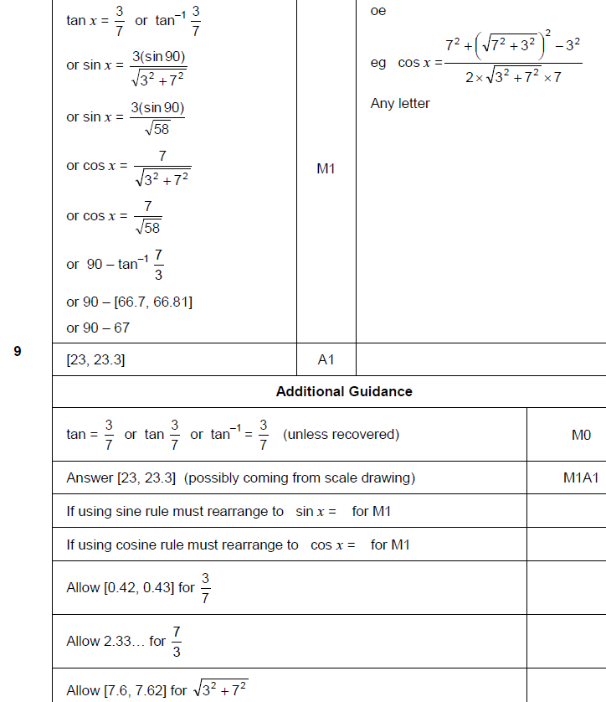
Basic Trigonometry
Nov 2017 2H Q9
A

Slide 18
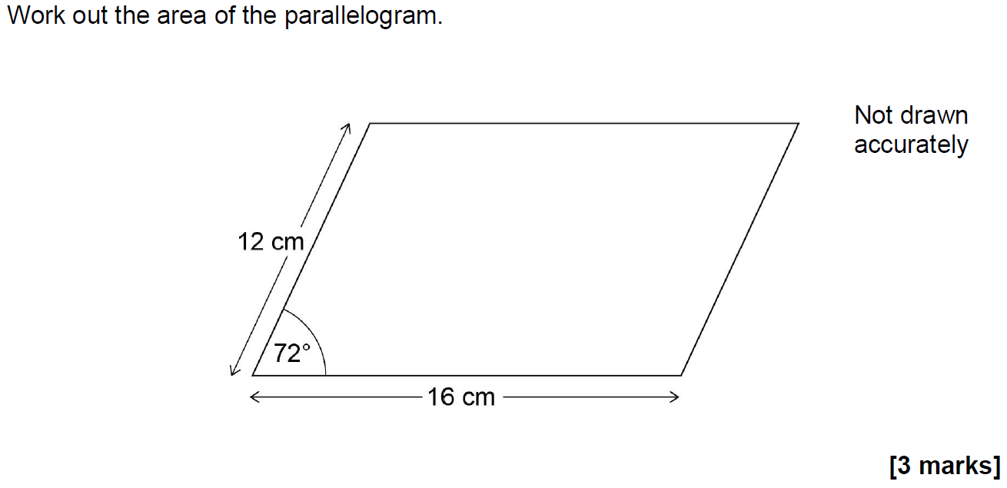
Basic Trigonometry
Nov 2017 2H Q17

Slide 19
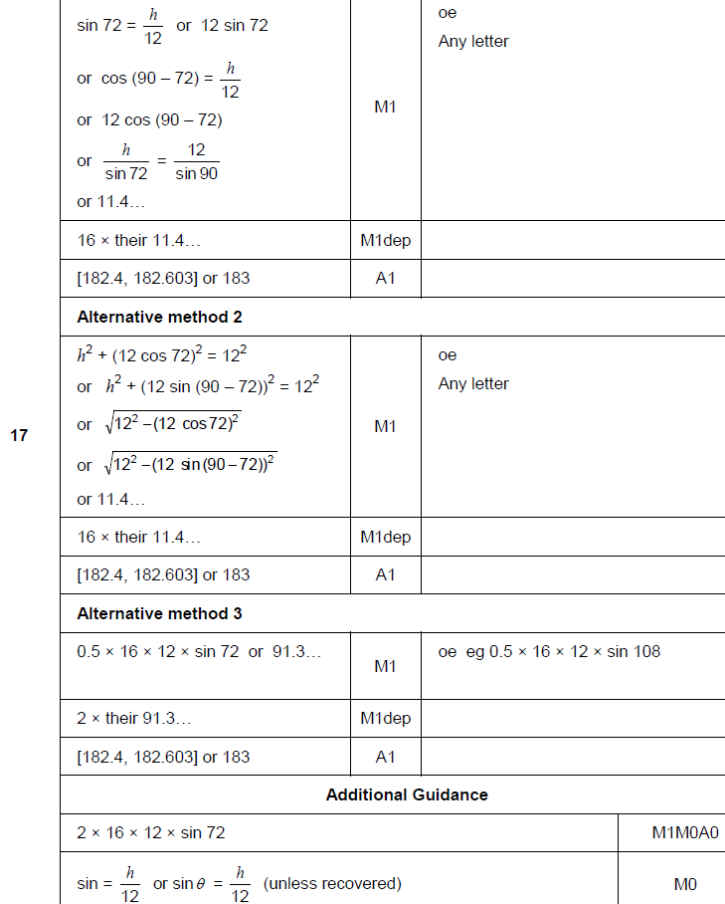
Basic Trigonometry
Nov 2017 2H Q17
A

Slide 20
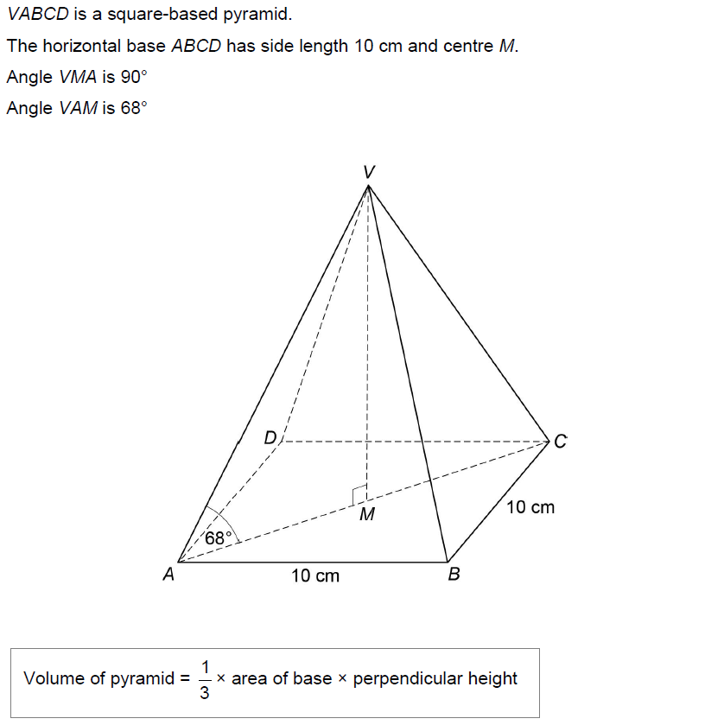
Basic Trigonometry
Nov 2017 3H Q27
Work out the volume of the pyramid.
[6 marks]

Slide 21
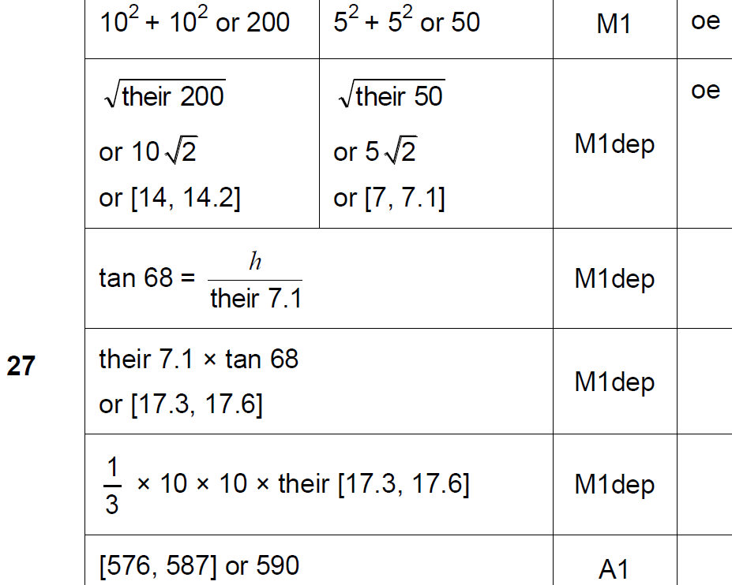
Basic Trigonometry
Nov 2017 3H Q27
A

Slide 22
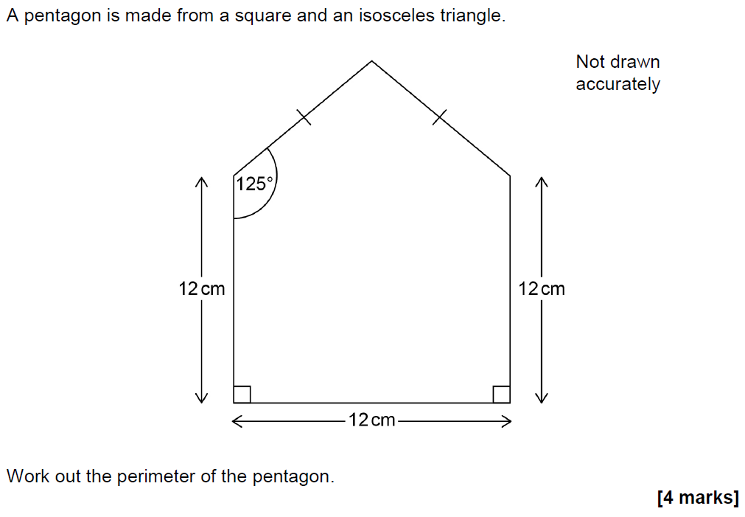
Basic Trigonometry
June 2018 2H Q19

Slide 23
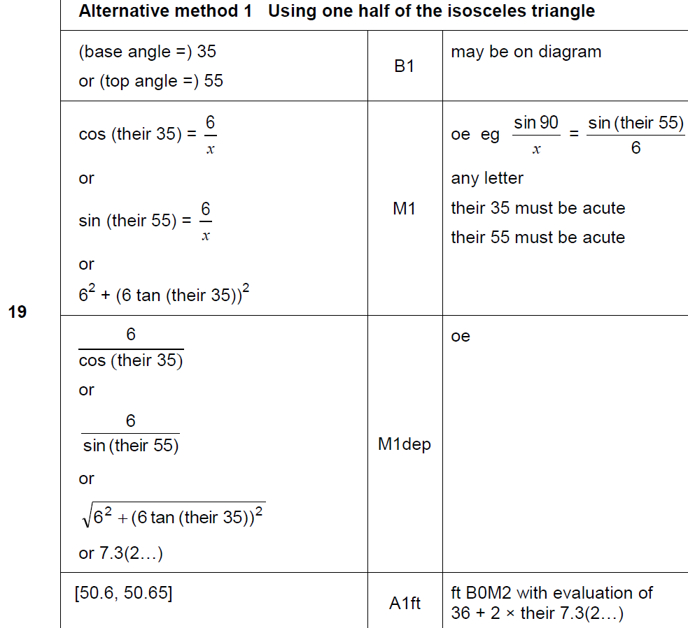
Basic Trigonometry
June 2018 2H Q19
A

Slide 24
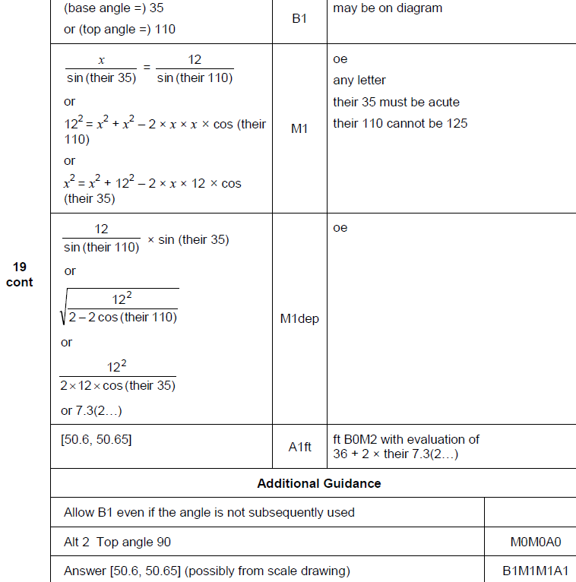
Basic Trigonometry
June 2018 2H Q19
A Alternative & notes

Slide 25
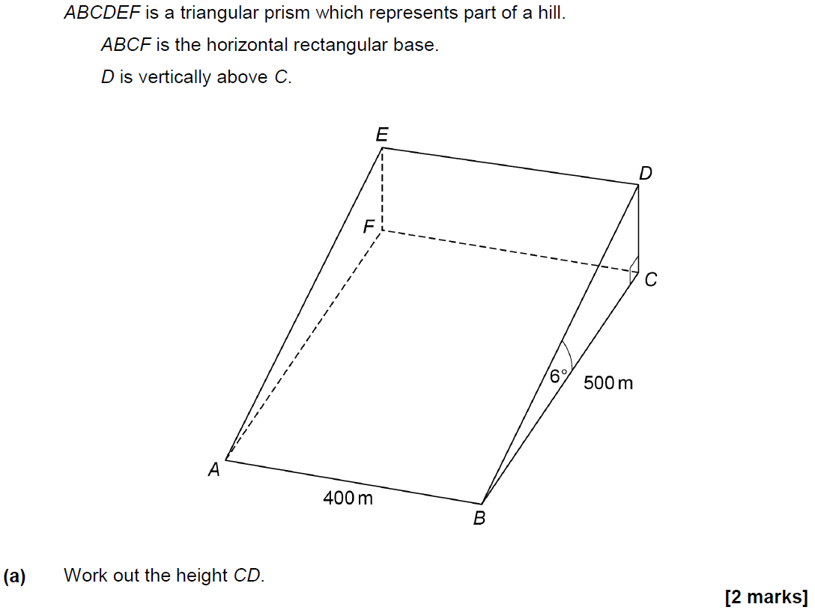
Basic Trigonometry
June 2018 3H Q25

Slide 26
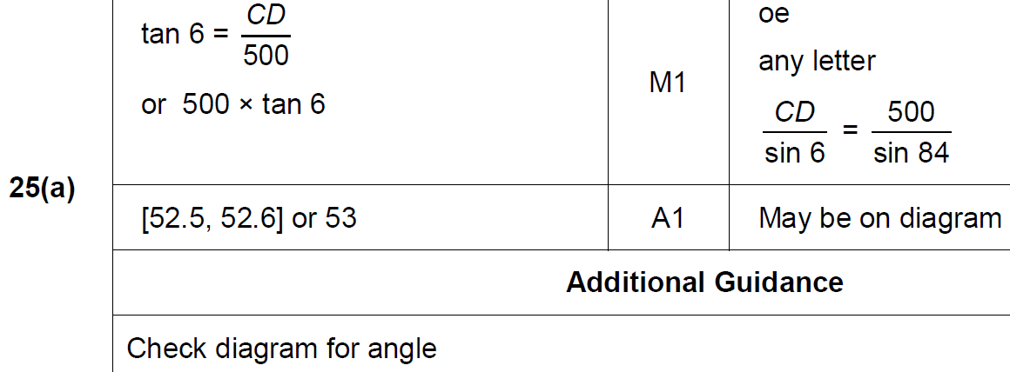
Basic Trigonometry
June 2018 3H Q25
A

Slide 27
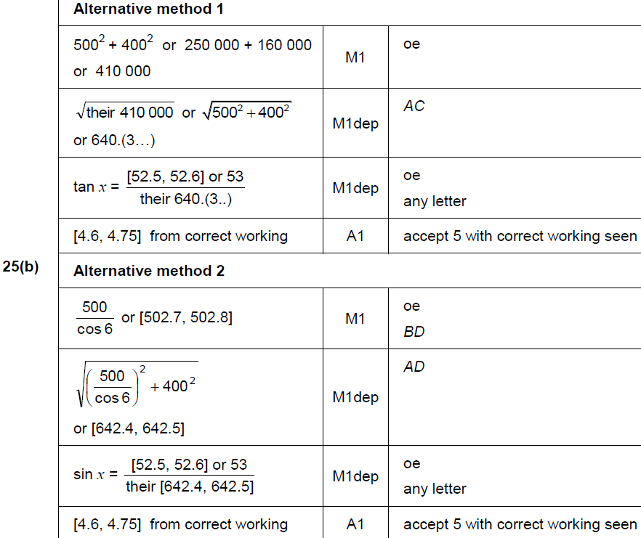
Basic Trigonometry
June 2018 3H Q25
B

Slide 28
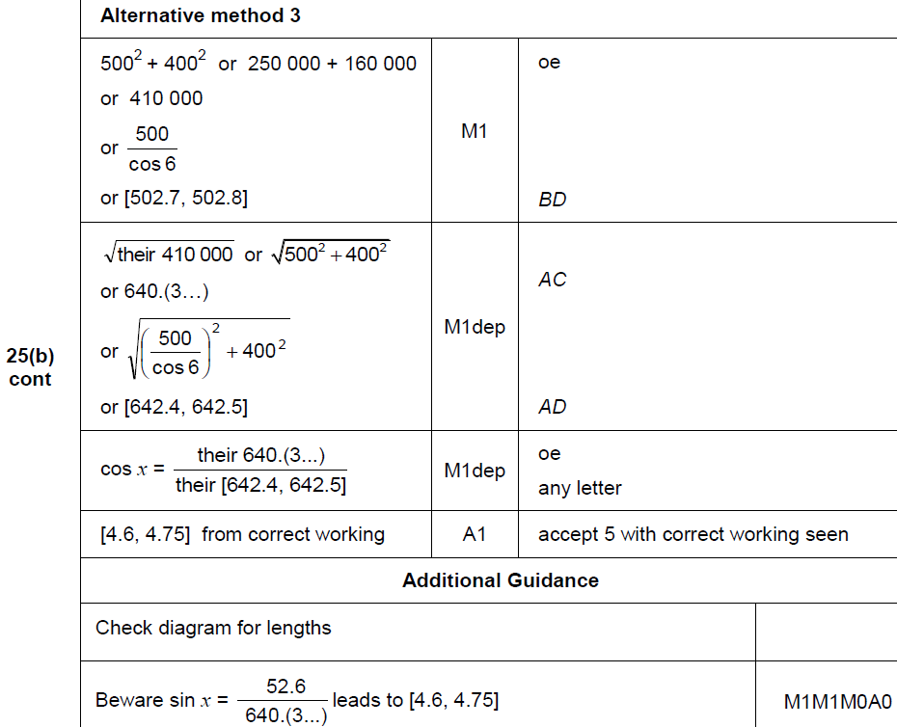
Basic Trigonometry
June 2018 3H Q25
B Alternative

Slide 29
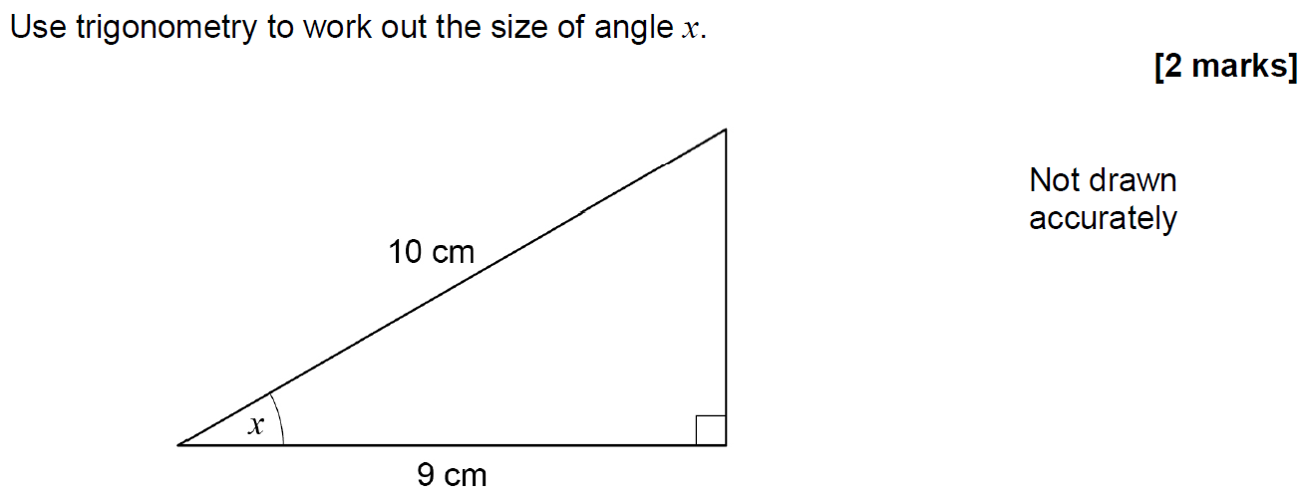
Basic Trigonometry
Nov 2018 3H Q11

Slide 30
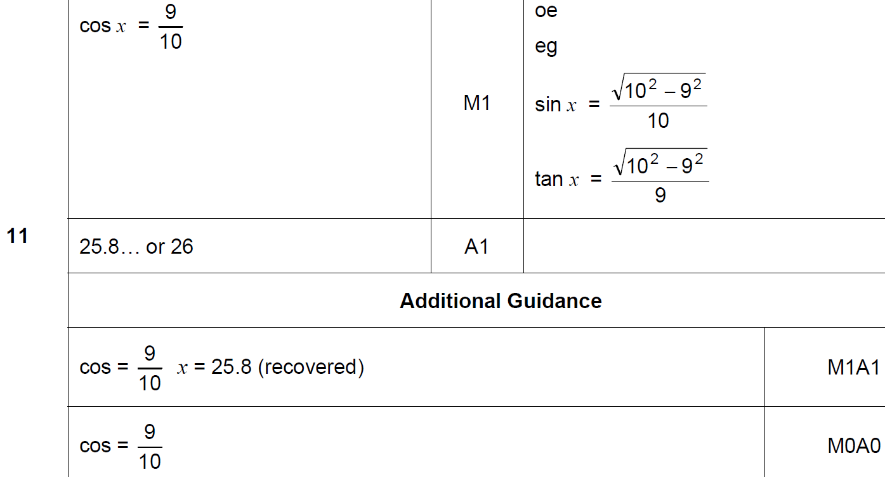
Basic Trigonometry
Nov 2018 3H Q11
A

