Slide 1
Basic Trigonometry
Basic Trigonometry
Old Spec Q’s
SAM
1H Q7
Jan 2019
2HR Q7
SAM
1H Q19
June 2019
2H Q12
May 2018
1H Q9
June 2019
2H Q21
June 2018
2H Q8
June 2018
2H Q19
June 2018
2HR Q10
Jan 2019
1H Q10
Jan 2019
1HR Q20
3D
*May use Pythagoras instead

Slide 2
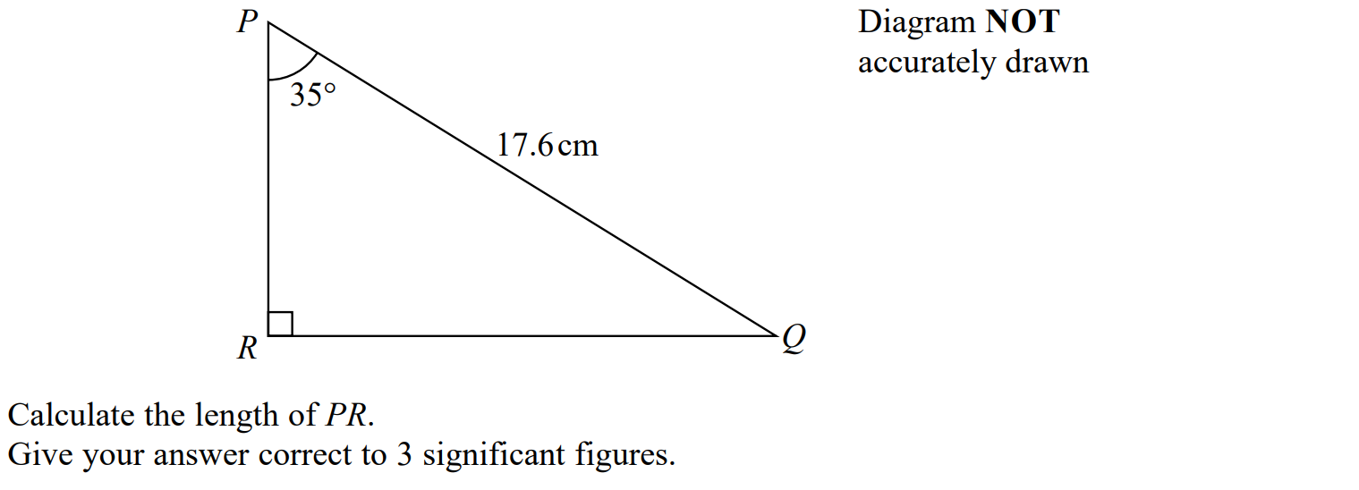
Basic Trigonometry
SAM 1H Q7

Slide 3
Basic Trigonometry
SAM 1H Q7
A

Slide 4
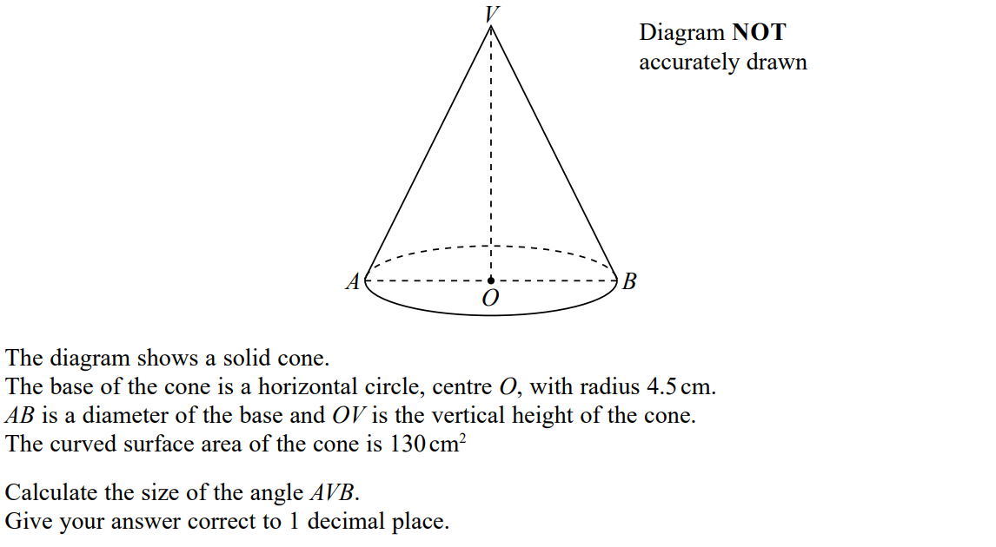
Basic Trigonometry
SAM 1H Q19

Slide 5
Basic Trigonometry
SAM 1H Q19
A

Slide 6
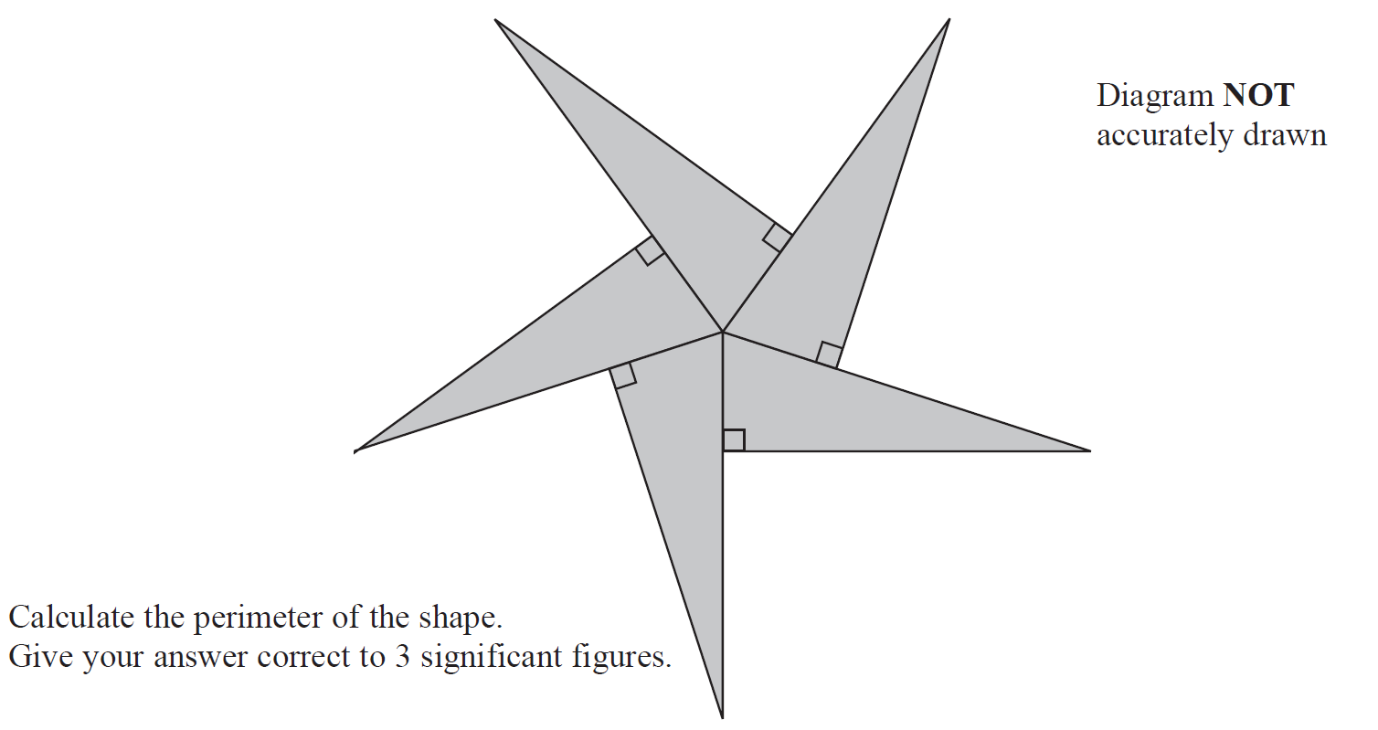
Basic Trigonometry
May 2018 1H Q9

Slide 7
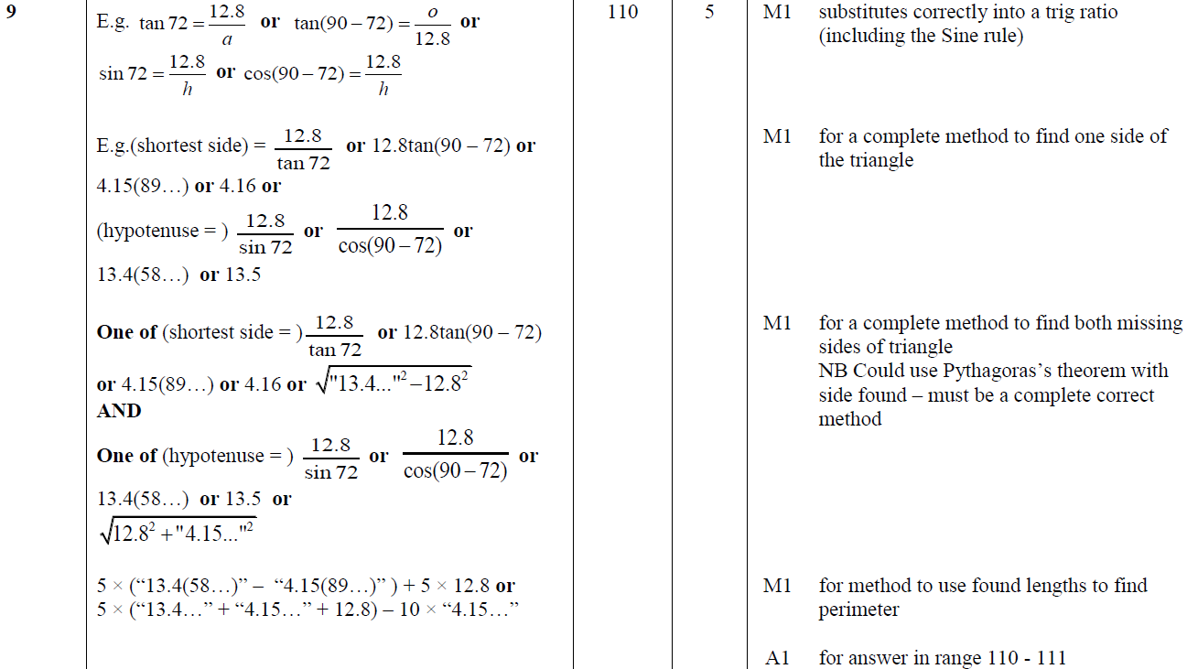
Basic Trigonometry
May 2018 1H Q9
A

Slide 8
Basic Trigonometry
June 2018 2H Q8

Slide 9
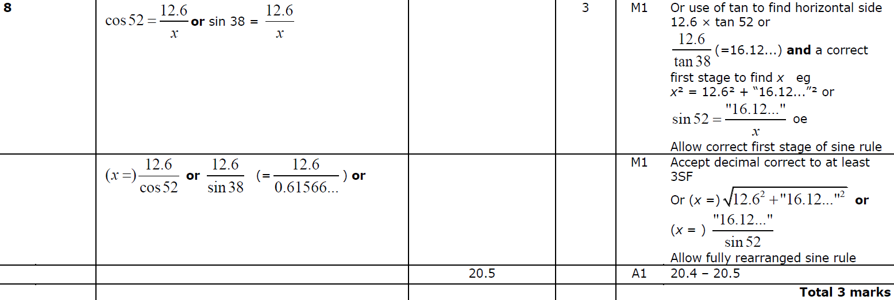
Basic Trigonometry
June 2018 2H Q8
A

Slide 10
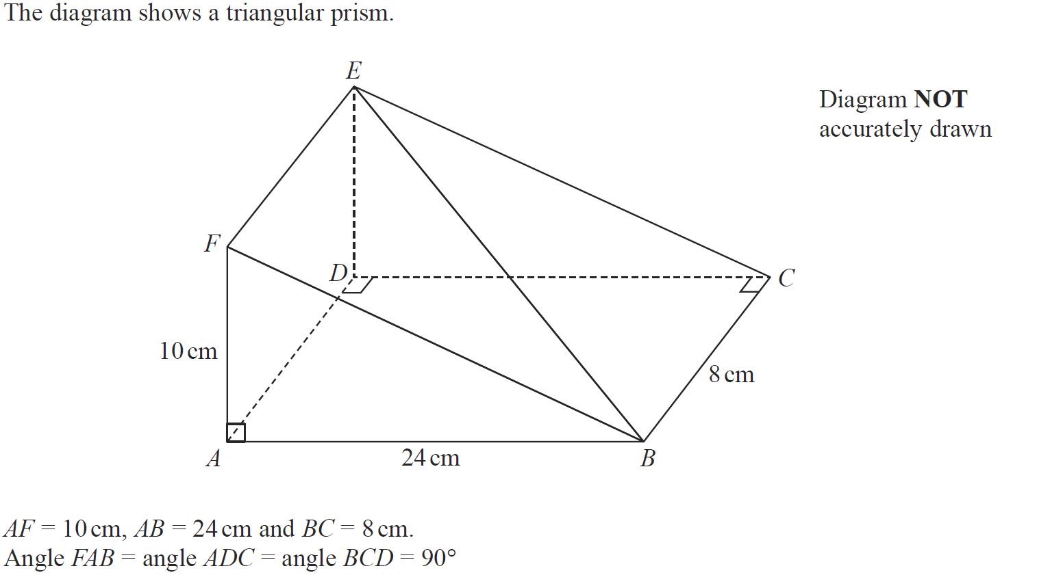
Basic Trigonometry
June 2018 2H Q19

Slide 11
Basic Trigonometry
June 2018 2H Q19
A

Slide 12
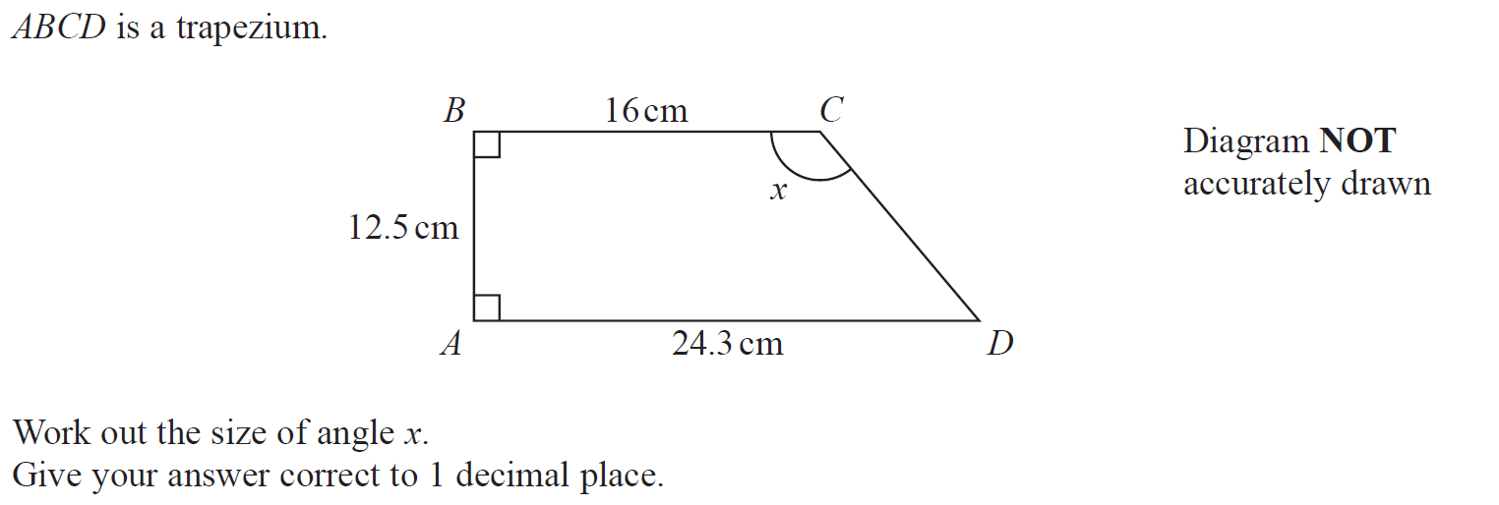
Basic Trigonometry
June 2018 2HR Q10

Slide 13
Basic Trigonometry
June 2018 2HR Q10
A

Slide 14
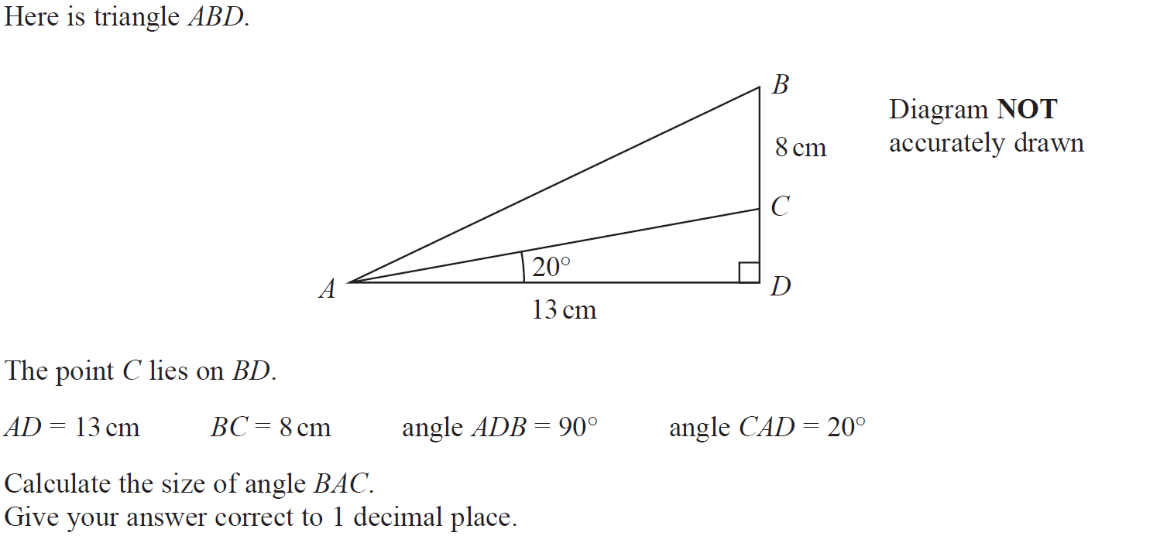
Basic Trigonometry
Jan 2019 1H Q10

Slide 15
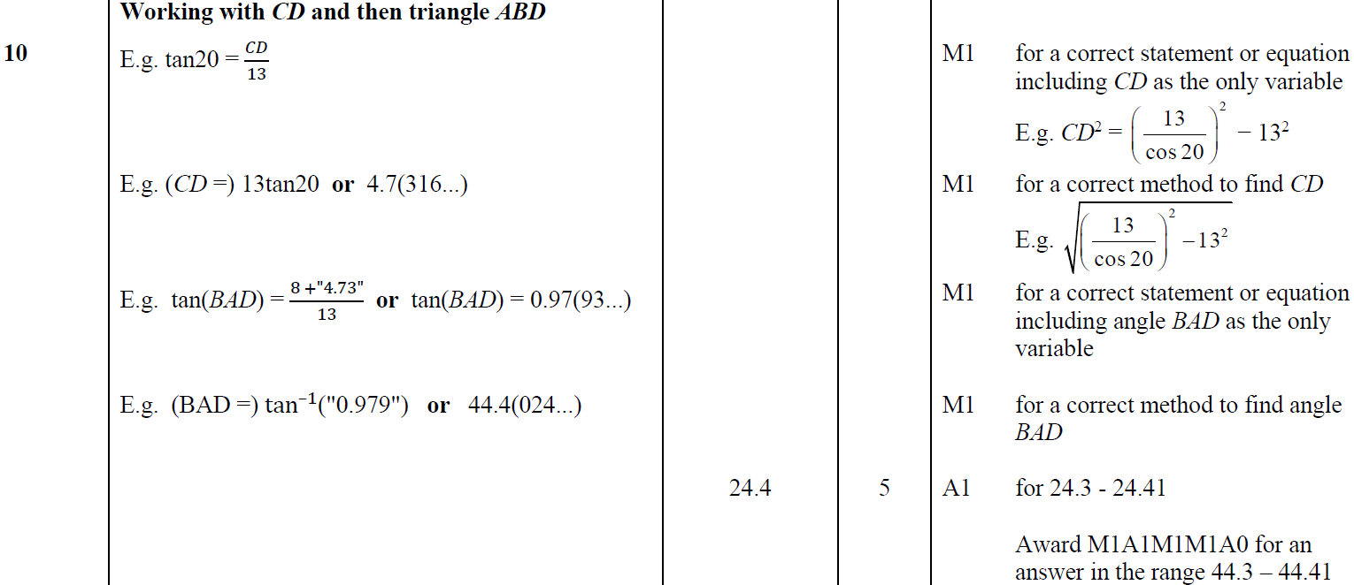
Basic Trigonometry
Jan 2019 1H Q10
A

Slide 16
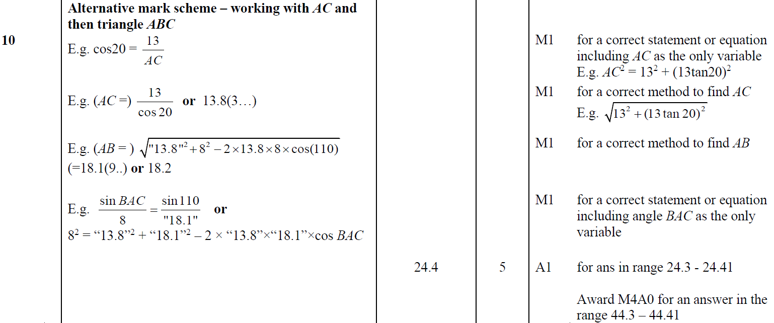
Basic Trigonometry
Jan 2019 1H Q10
A Alternative

Slide 17
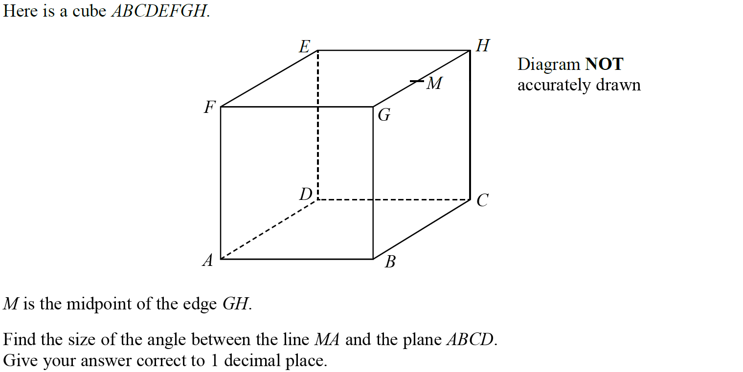
Basic Trigonometry
Jan 2019 1HR Q20

Slide 18
Basic Trigonometry
Jan 2019 1HR Q20
A

Slide 19
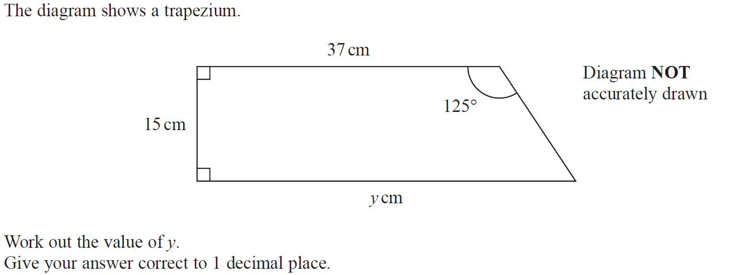
Basic Trigonometry
Jan 2019 2HR Q7

Slide 20
Basic Trigonometry
Jan 2019 2HR Q7
A

Slide 21
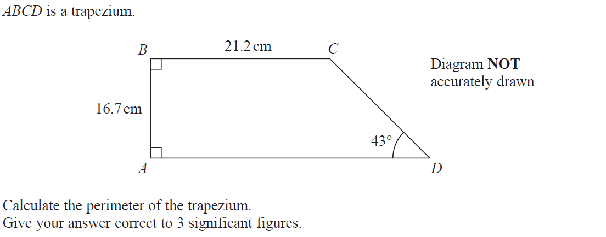
Basic Trigonometry
June 2019 2H Q12

Slide 22
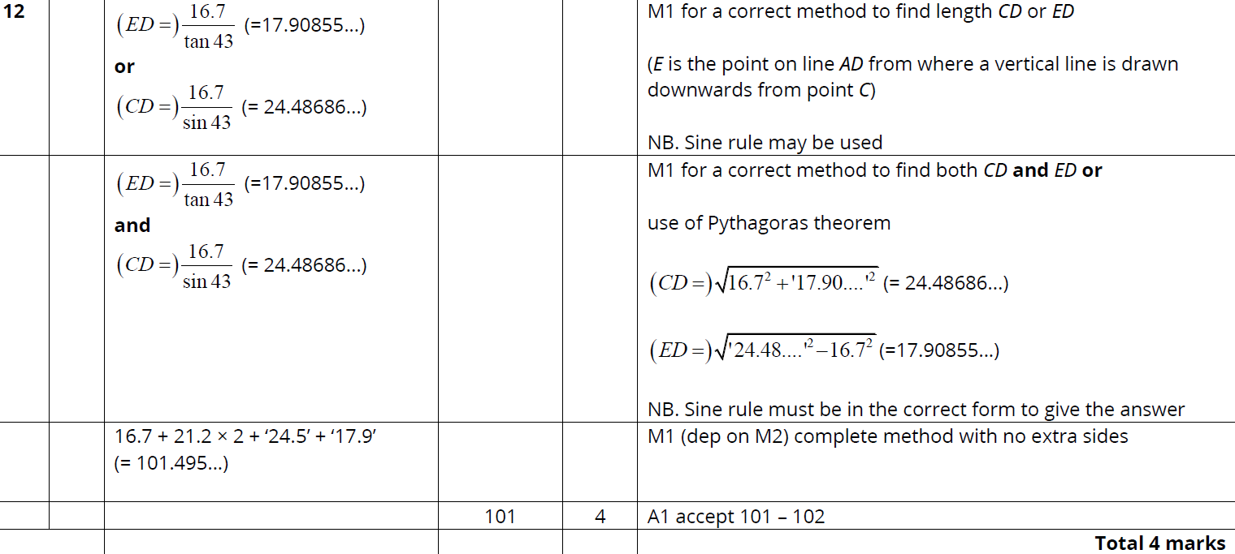
Basic Trigonometry
June 2019 2H Q12
A

Slide 23
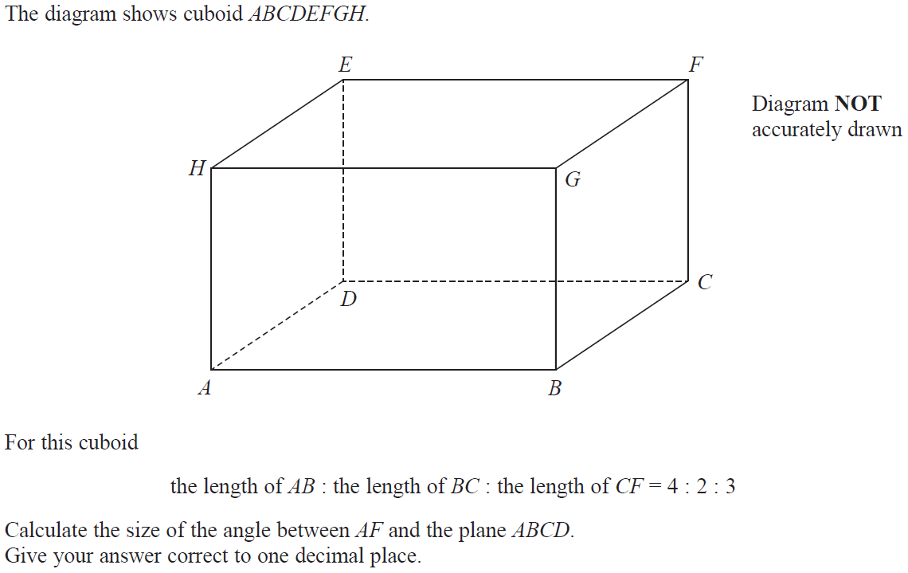
Basic Trigonometry
June 2019 2H Q21

Slide 24
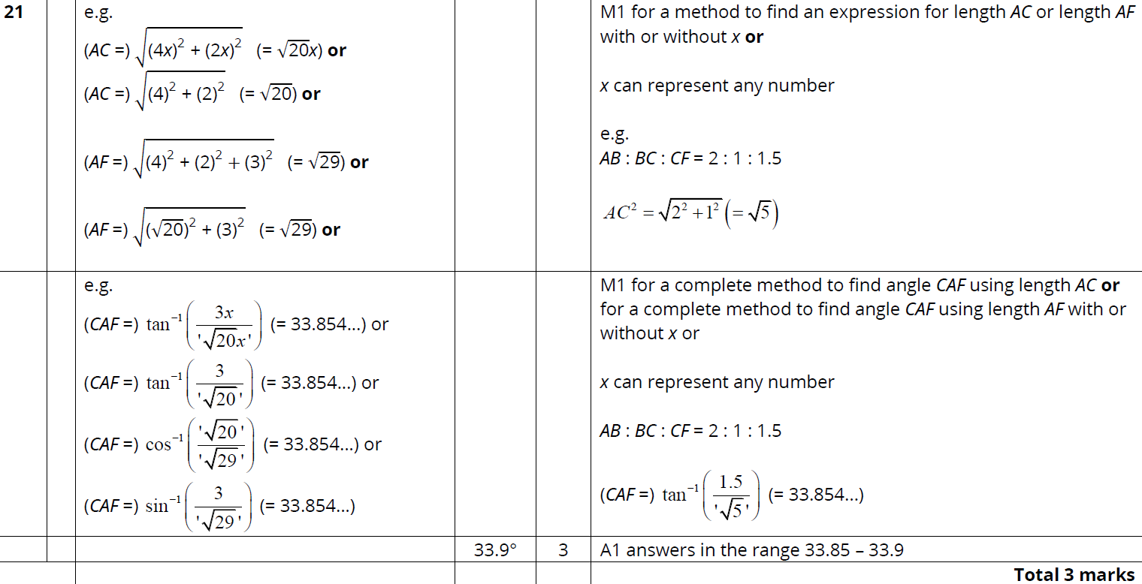
Basic Trigonometry
June 2019 2H Q21
A

Slide 25
Basic Trigonometry
Basic Trigonometry
New Spec Q’s
May 2004
4H Q10
Nov 2007
3H Q6
Nov 2009
3H Q12
May 2012 3H Q15
Jan 2014 3HR Q17
May 2015 3HR Q23
Jan 2017 4H Q9
June 2018 4HR Q8
Nov 2004
3H Q1
Nov 2007
3H Q12
Nov 2009
4H Q18
May 2012 4H Q6
Jan 2014 3HR Q21
June 2015 4HR Q10
Jan 2017 4H Q21
June 2018 4HR Q23
Nov 2004
3H Q7
May 2008
3H Q6
June 2010
3H Q7
Jan 2013 3H Q8
Jan 2014 4HR Q21
Jan 2016 3H Q11
Jan 2017 4HR Q9
May 2005
3H Q16
May 2008
3H Q22*
June 2010
3H Q14
Jan 2013 3H Q21
May 2014 3H Q5
Jan 2016 4H Q19
May 2017 3H Q7
May 2005
4H Q7
Nov 2008
3H Q9
June 2010
3H Q20
May 2013 3H Q10
May 2014 4H Q23
Jan 2016 3HR Q10
May 2017 3H Q21
Nov 2005
4H Q9
Nov 2008
4H Q14
Nov 2010
3H Q8
May 2013 4H Q22
May 2014 3HR Q18
Jan 2016 4HR Q21
June 2017 4HR Q13
Nov 2005
4H Q21
Nov 2008
4H Q22
June 2011 3H Q18
May 2013 3HR Q11
Jan 2015 3H Q8
May 2016 3H Q8
June 2017 4HR Q22
May 2006
3H Q18
May 2009
3H Q7
June 2011 4H Q11
May 2013 3HR Q24
Jan 2015 3HR Q11
May 2016 3H Q16
Jan 2018 3H Q6
May 2006
4H Q4
June 2009
4H Q8
June 2011 4H Q22
Jan 2014 3H Q3
May 2015 3H Q15
June 2016 4HR Q11
Jan 2018 4HR Q8
May 2007
4H Q7
June 2009
4H Q20
Jan 2012 3H Q9
Jan 2014 3H Q15
June 2015 4H Q8
June 2016 4HR Q17
June 2018 4H Q9
3D
*May use Pythagoras instead

Slide 26
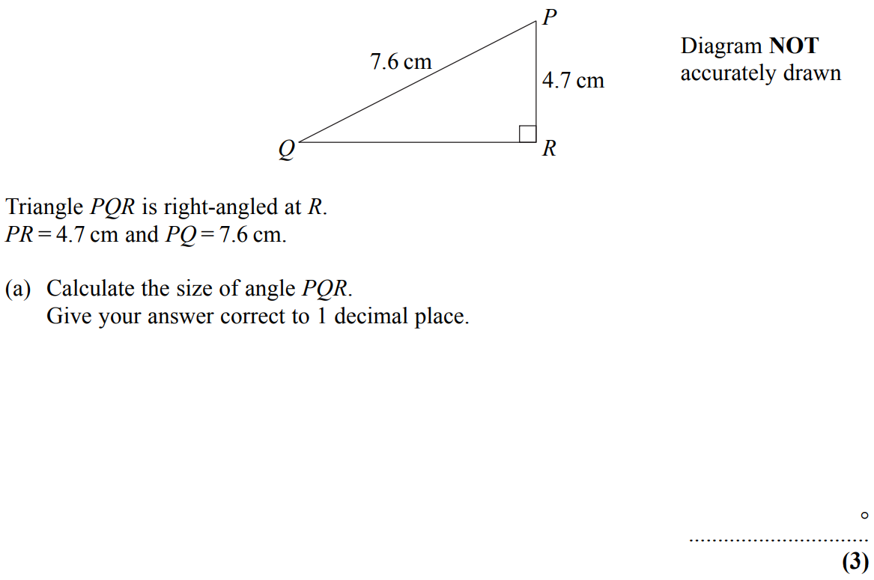
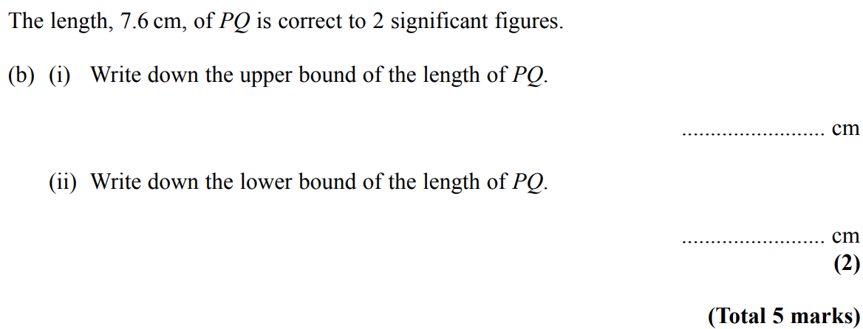
Basic Trigonometry
May 2004 4H Q10

Slide 27
Basic Trigonometry
May 2004 4H Q10
A
B (i)
B (ii)

Slide 28
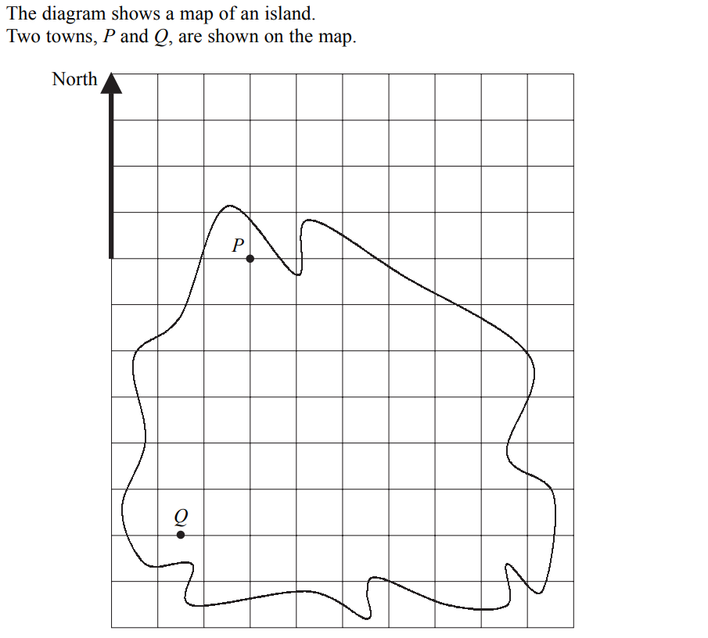
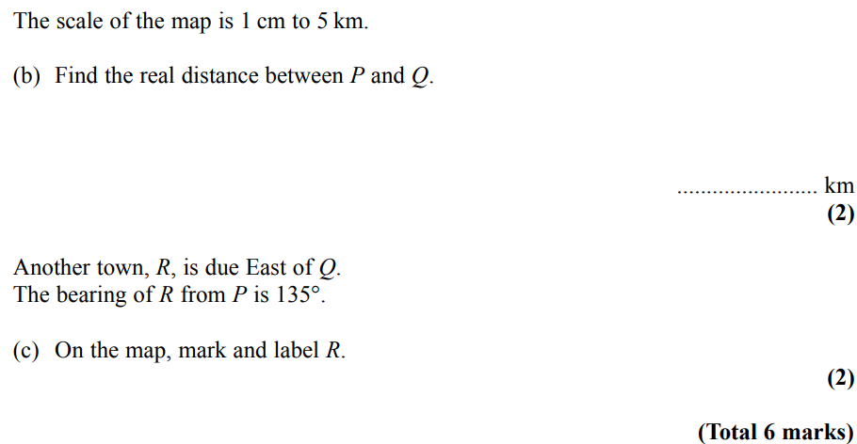
Basic Trigonometry
Nov 2004 3H Q1
*Note that the intension of this question was for it to be physically measured

Slide 29
Basic Trigonometry
Nov 2004 3H Q1
A
B
C

Slide 30
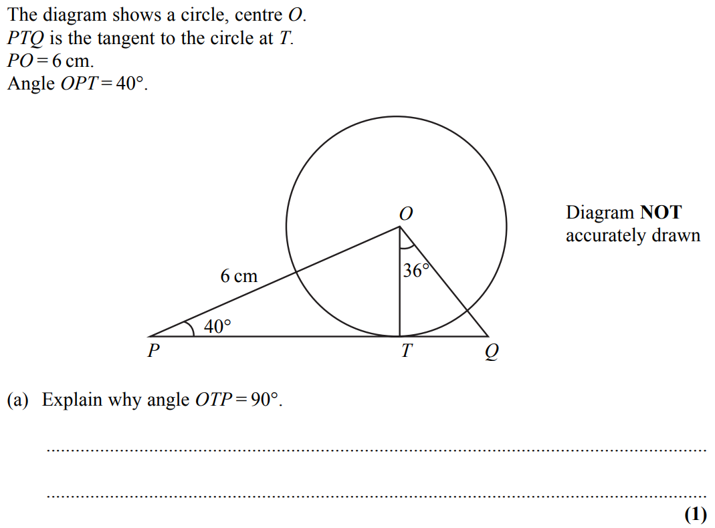
Basic Trigonometry
Nov 2004 3H Q7

Slide 31
Basic Trigonometry
Nov 2004 3H Q7
A
B
C

Slide 32
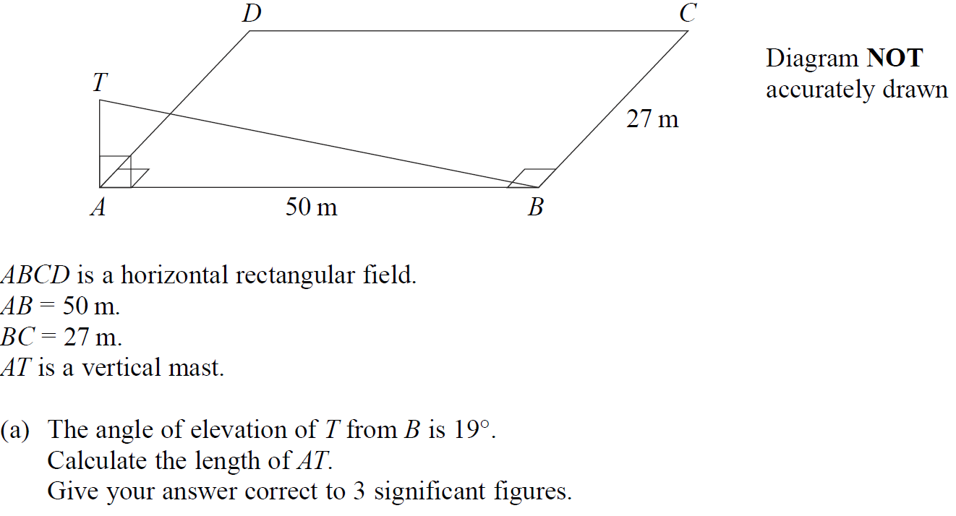
Basic Trigonometry
May 2005 3H Q16

Slide 33
Basic Trigonometry
May 2005 3H Q16
A
B

Slide 34
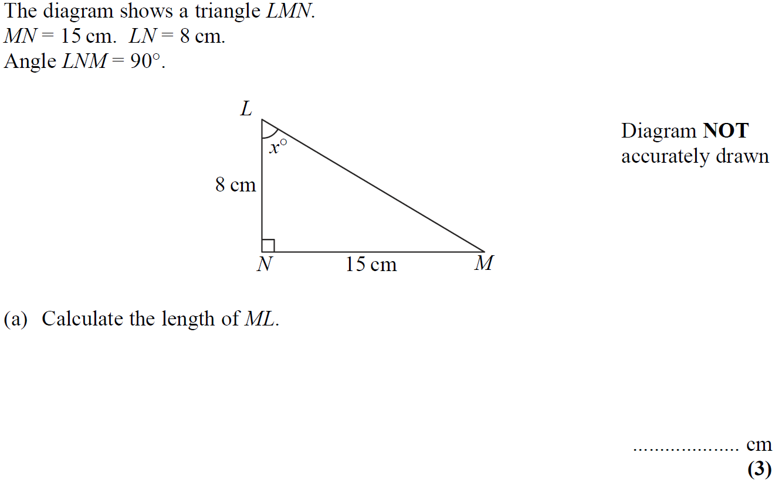
Basic Trigonometry
May 2005 4H Q7

Slide 35
Basic Trigonometry
May 2005 4H Q7
A
B

Slide 36
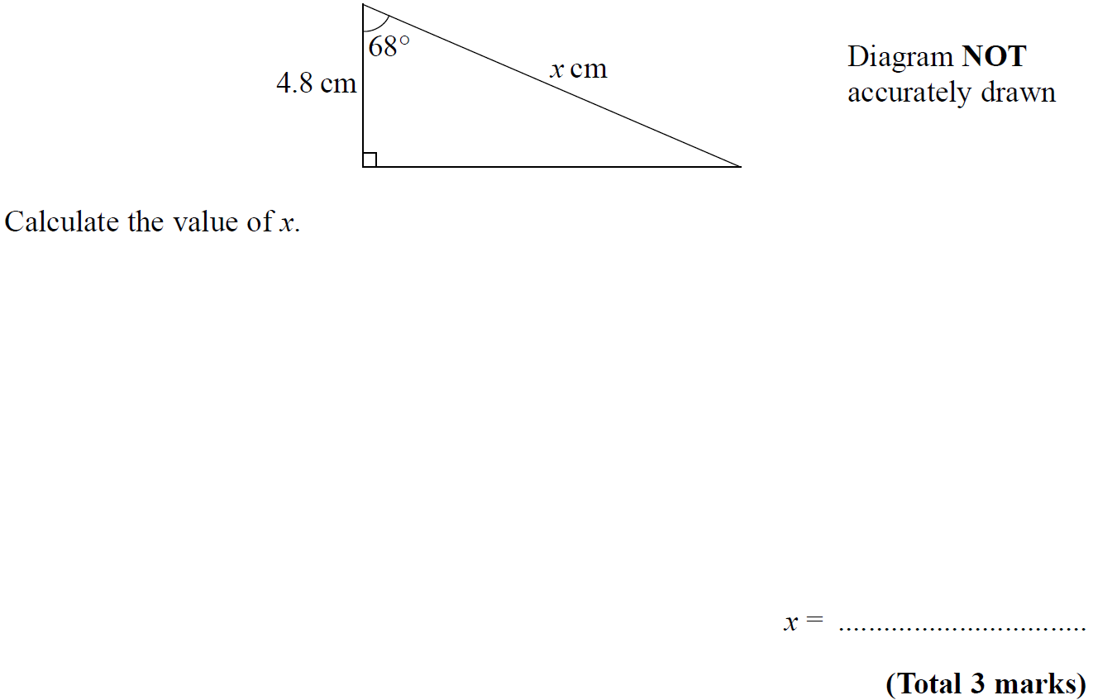
Basic Trigonometry
Nov 2005 4H Q9

Slide 37
Basic Trigonometry
Nov 2005 4H Q9
A

Slide 38
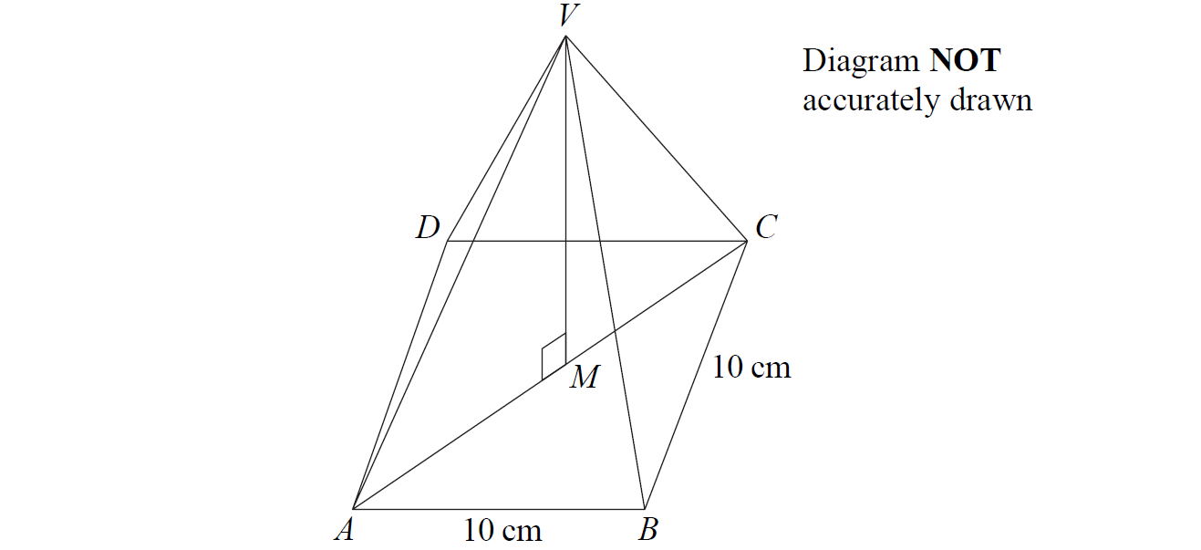
Basic Trigonometry
Nov 2005 4H Q21

Slide 39
Basic Trigonometry
Nov 2005 4H Q21
A

Slide 40
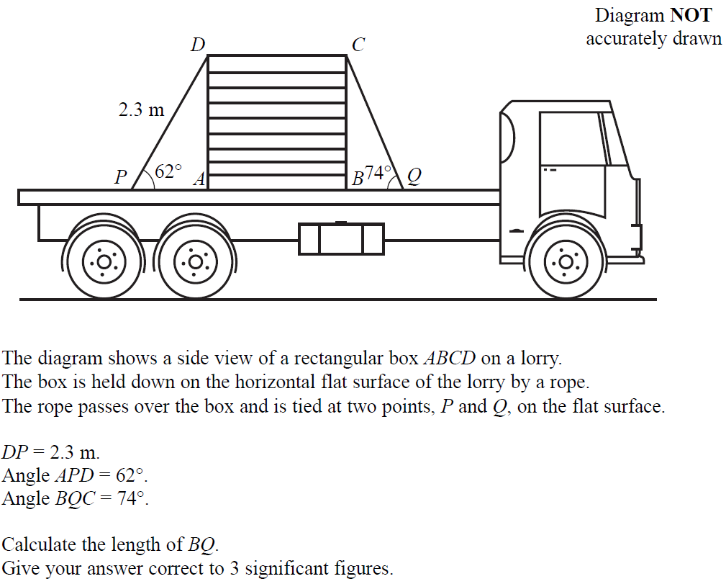
Basic Trigonometry
May 2006 3H Q18

Slide 41
Basic Trigonometry
May 2006 3H Q18
A

Slide 42
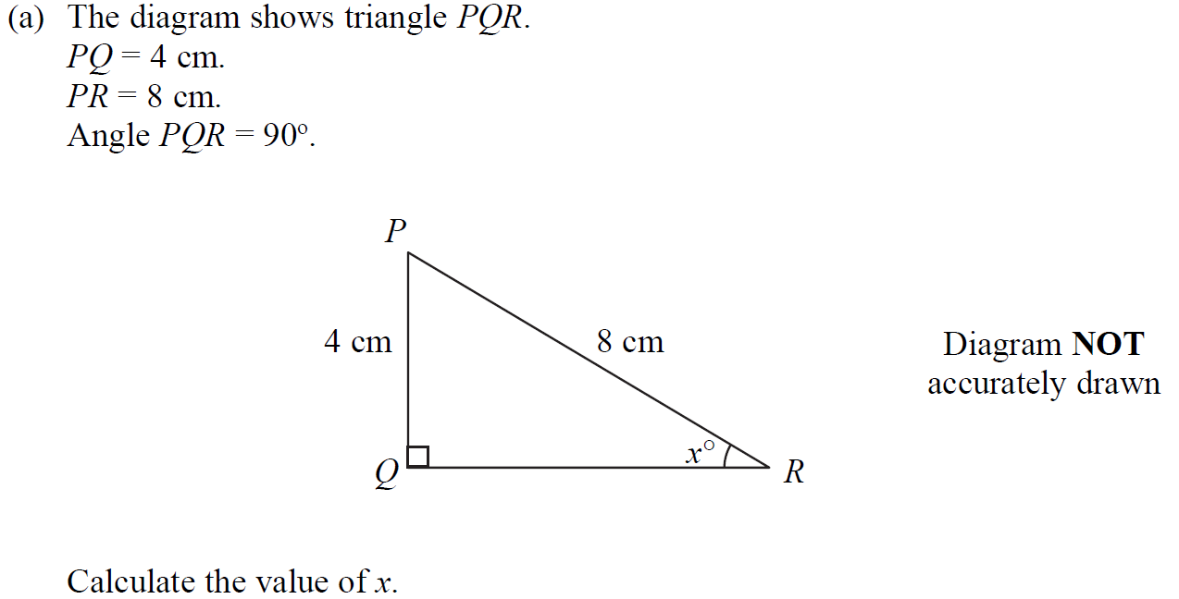
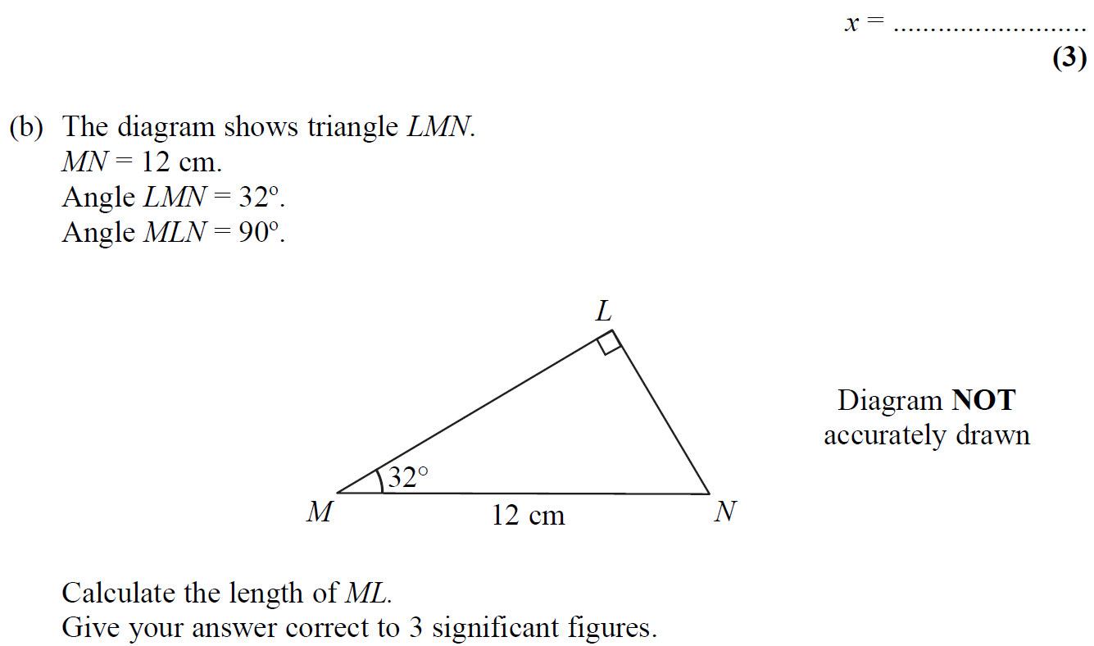
Basic Trigonometry
May 2006 4H Q4

Slide 43
Basic Trigonometry
May 2006 4H Q4
A
B

Slide 44
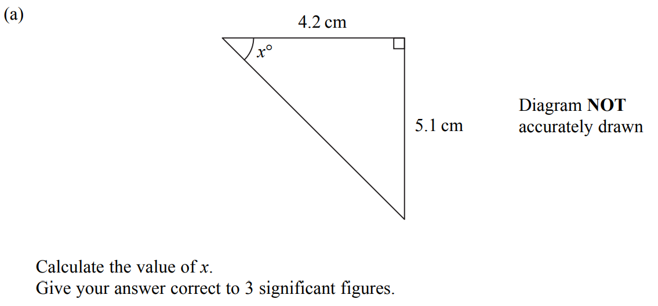
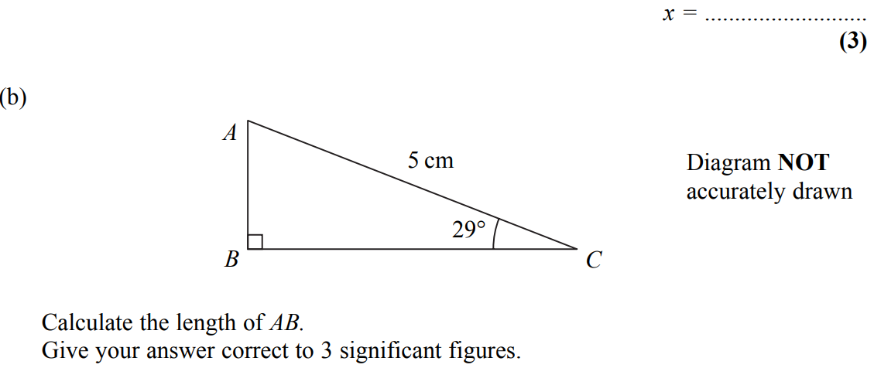
Basic Trigonometry
May 2007 4H Q7

Slide 45
Basic Trigonometry
May 2007 4H Q7
A
B

Slide 46
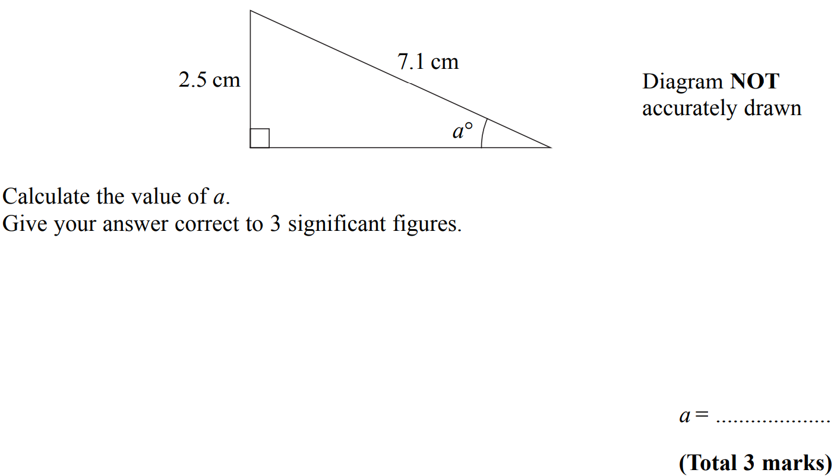
Basic Trigonometry
Nov 2007 3H Q6

Slide 47
Basic Trigonometry
Nov 2007 3H Q6
A

Slide 48
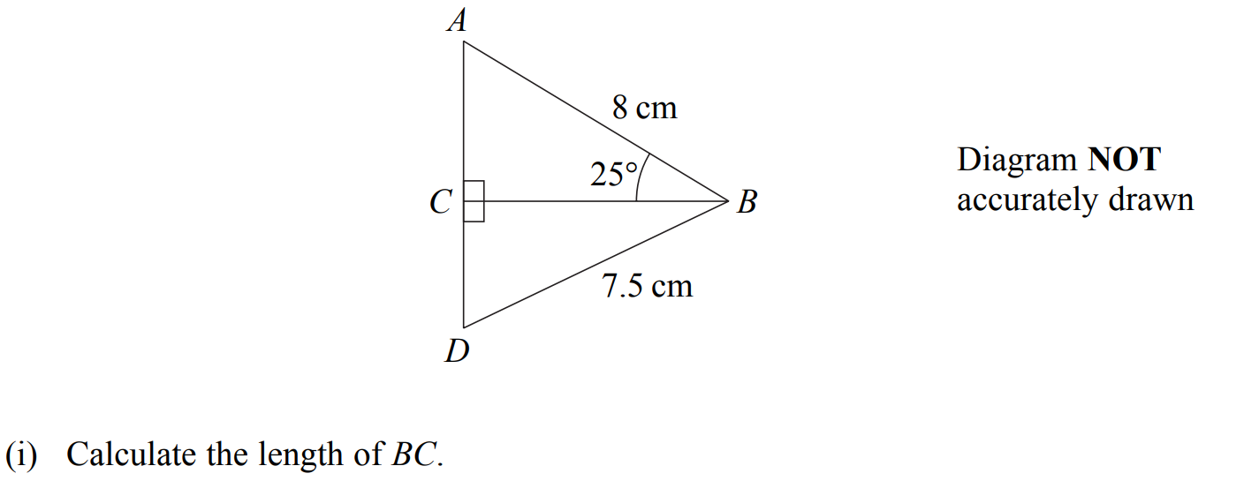
Basic Trigonometry
Nov 2007 3H Q12

Slide 49
Basic Trigonometry
Nov 2007 3H Q12
A
B

Slide 50
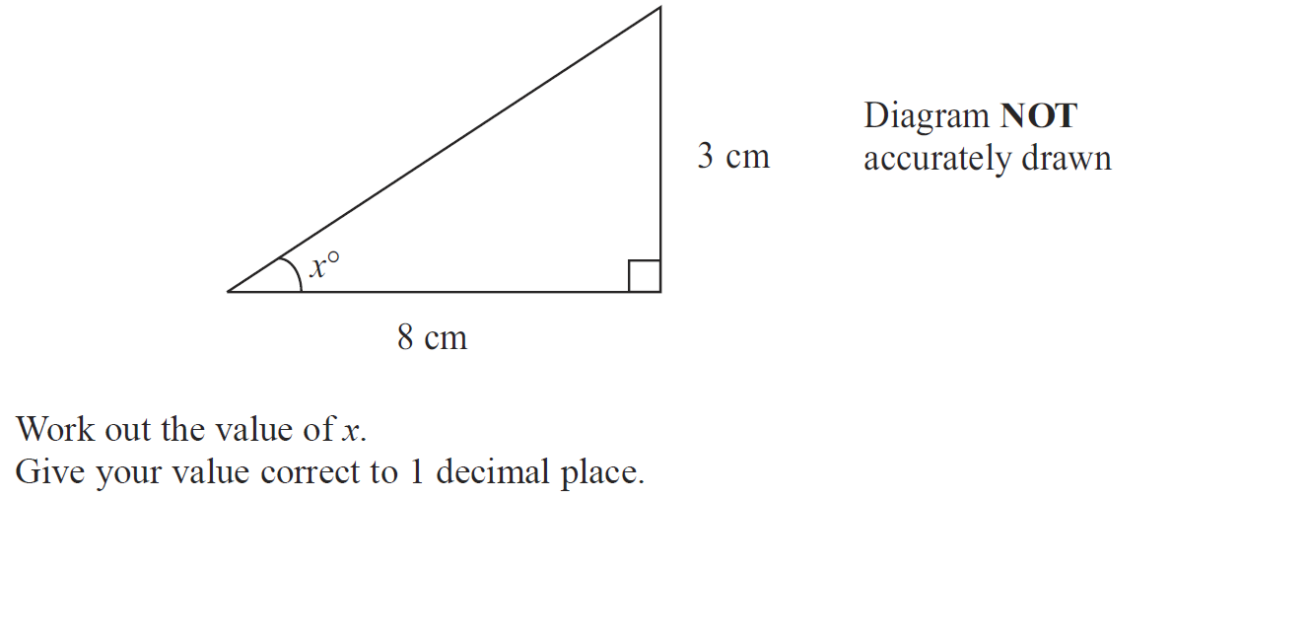
Basic Trigonometry
May 2008 3H Q6

Slide 51
Basic Trigonometry
May 2008 3H Q6
A

Slide 52
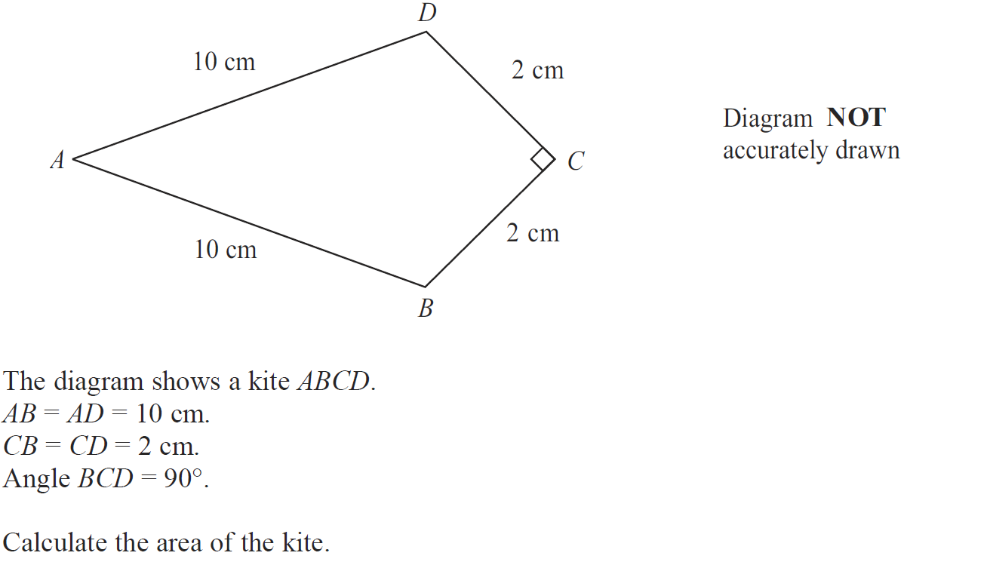
Basic Trigonometry
May 2008 3H Q22

Slide 53
Basic Trigonometry
May 2008 3H Q22
A

Slide 54
Basic Trigonometry
Nov 2008 3H Q9

Slide 55
Basic Trigonometry
Nov 2008 3H Q9
A

Slide 56
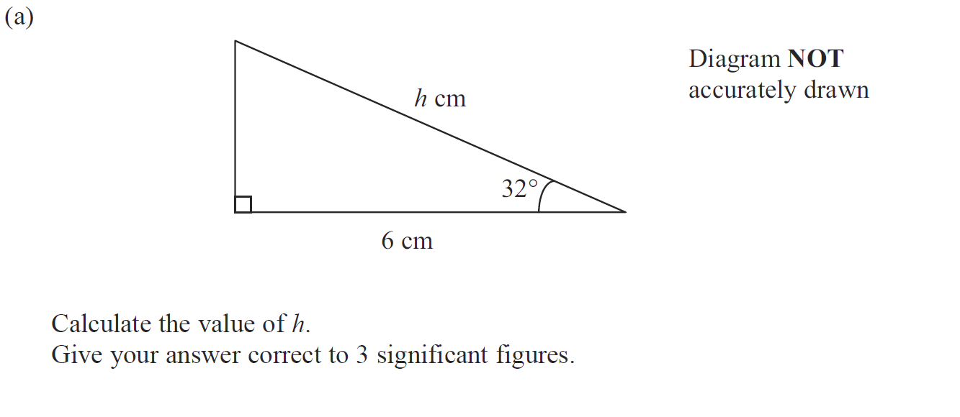
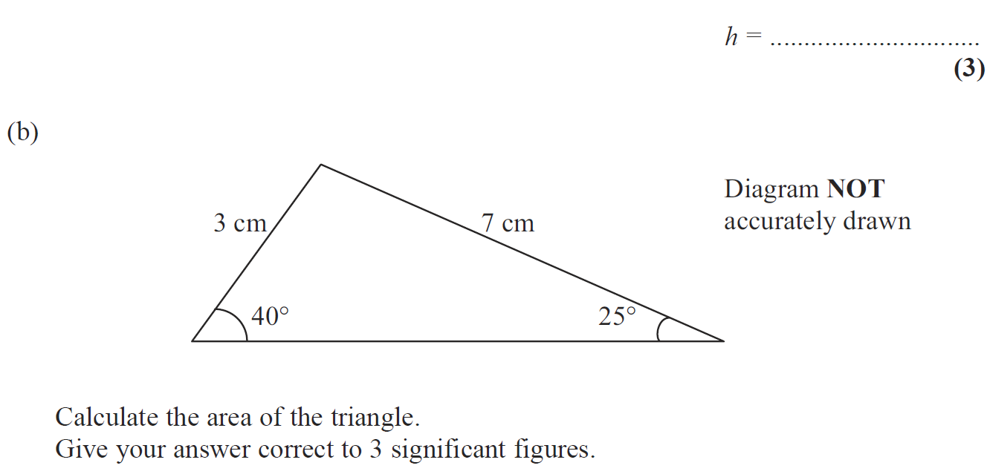
Basic Trigonometry
Nov 2008 4H Q14

Slide 57
Basic Trigonometry
Nov 2008 4H Q14
A
B

Slide 58
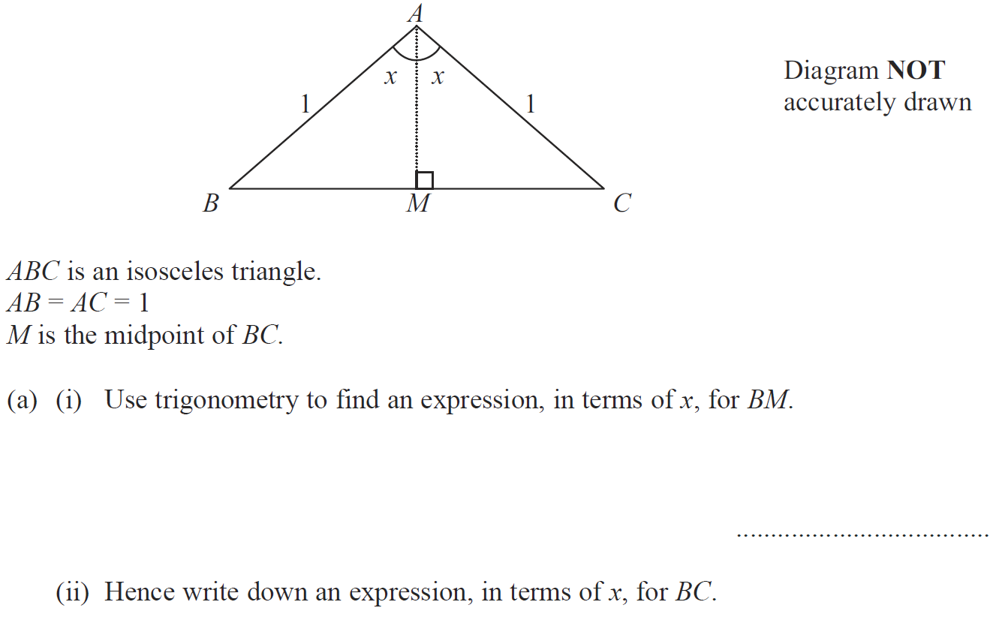
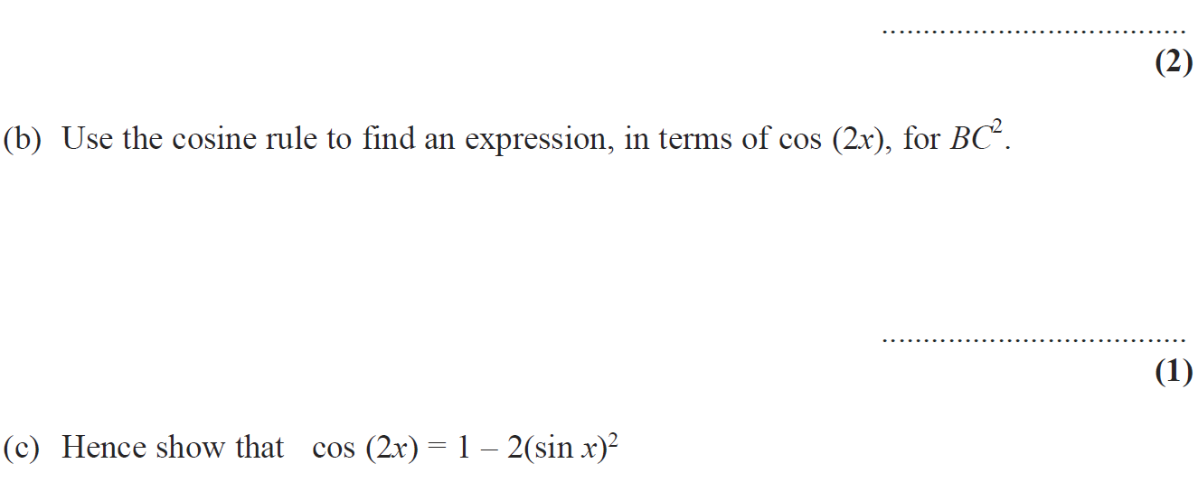
Basic Trigonometry
Nov 2008 4H Q22

Slide 59
Basic Trigonometry
Nov 2008 4H Q22
A (i)
A (ii)
B
C

Slide 60
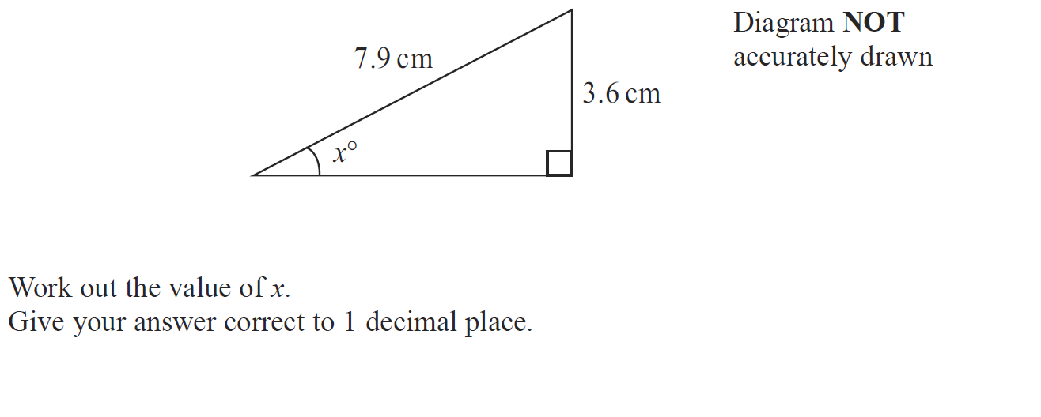
Basic Trigonometry
May 2009 3H Q7

Slide 61
Basic Trigonometry
May 2009 3H Q7
A

Slide 62
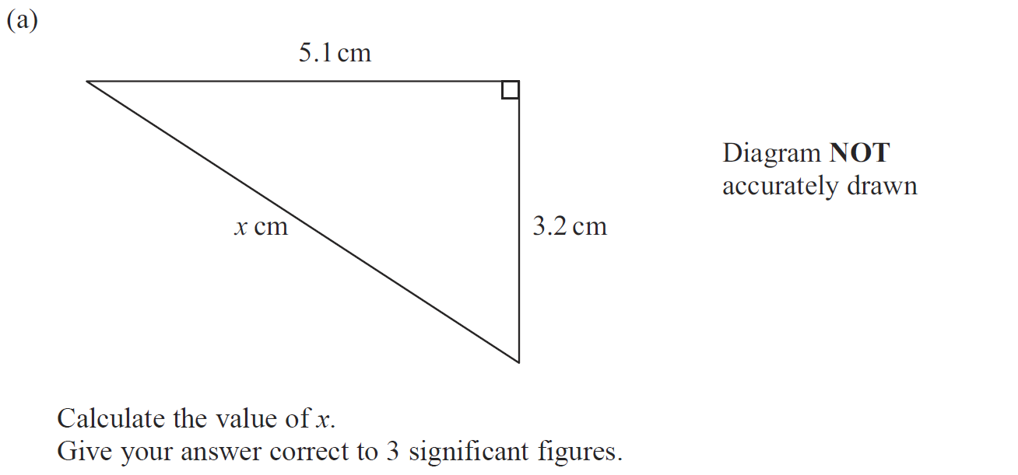
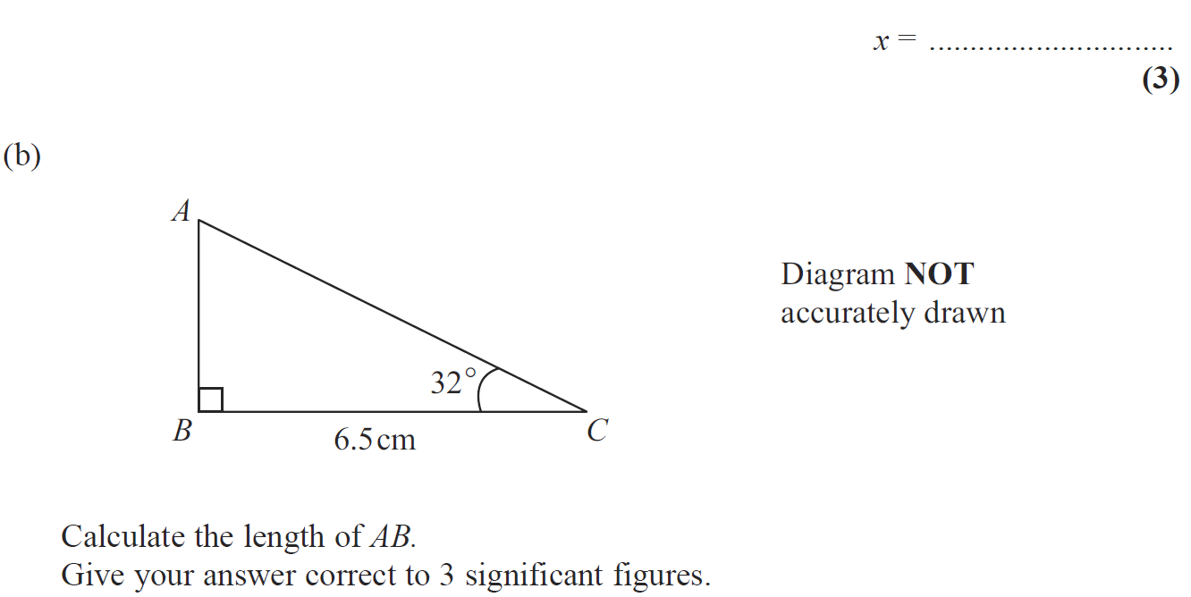
Basic Trigonometry
June 2009 4H Q8

Slide 63
Basic Trigonometry
June 2009 4H Q8
A
B

Slide 64
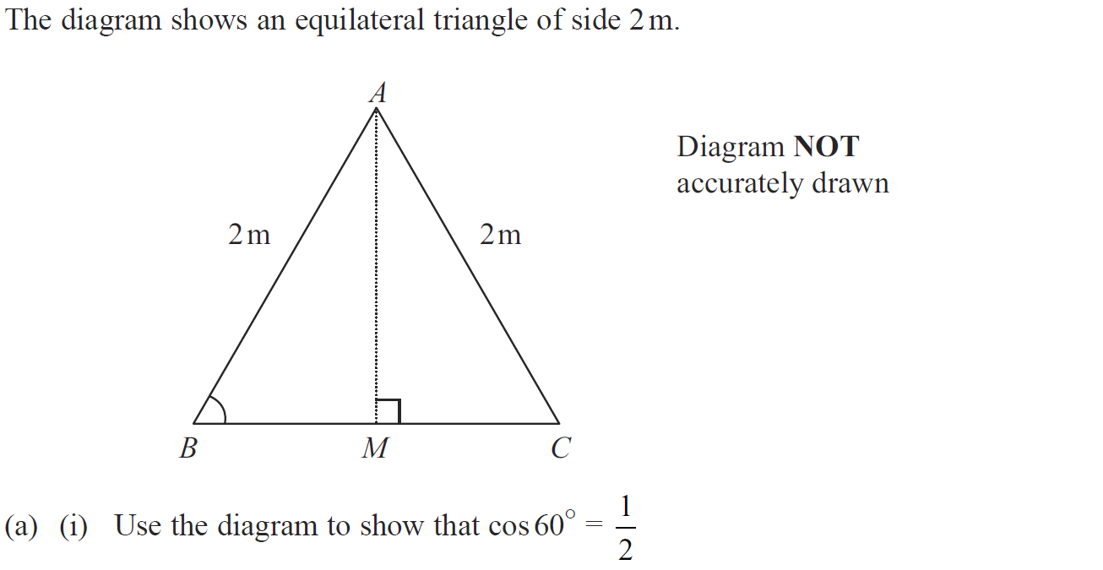
Basic Trigonometry
June 2009 4H Q20

Slide 65
Basic Trigonometry
June 2009 4H Q20
A (i)
A (ii)
B

Slide 66
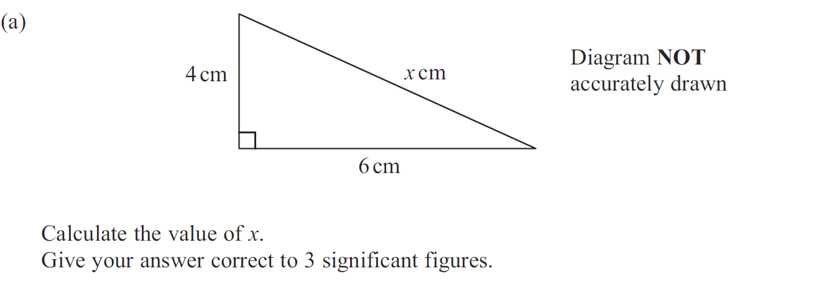
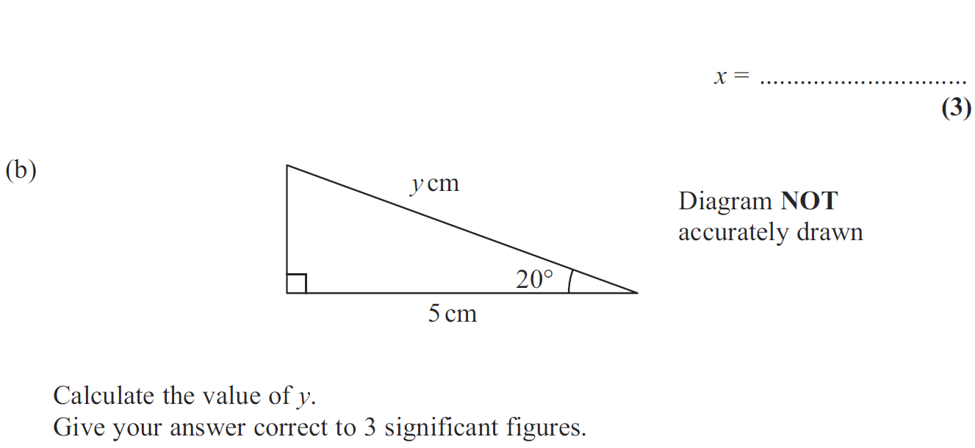
Basic Trigonometry
Nov 2009 3H Q12

Slide 67
Basic Trigonometry
Nov 2009 3H Q12
A
B

Slide 68
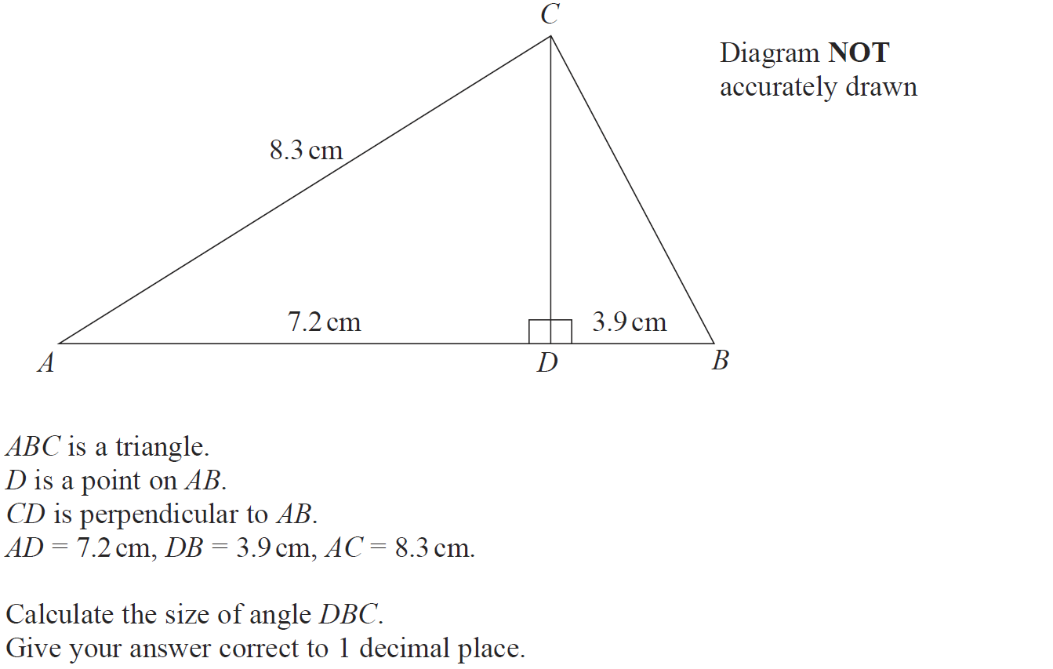
Basic Trigonometry
Nov 2009 4H Q18

Slide 69
Basic Trigonometry
Nov 2009 4H Q18
A
Alternative 1
Alternative 2

Slide 70
Basic Trigonometry
Nov 2009 4H Q18
Alternative 3
Alternative 4

Slide 71
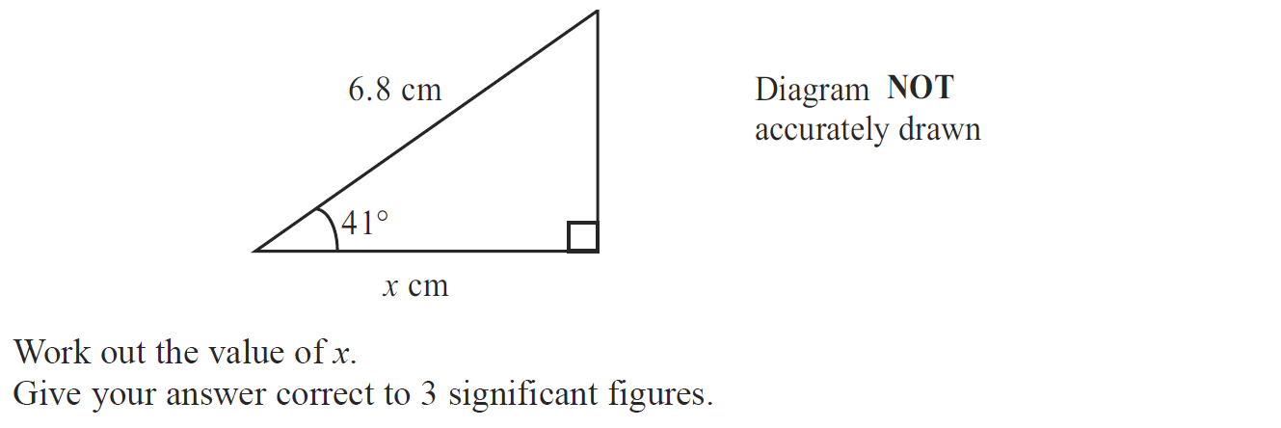
Basic Trigonometry
June 2010 3H Q7

Slide 72
Basic Trigonometry
June 2010 3H Q7
A

Slide 73
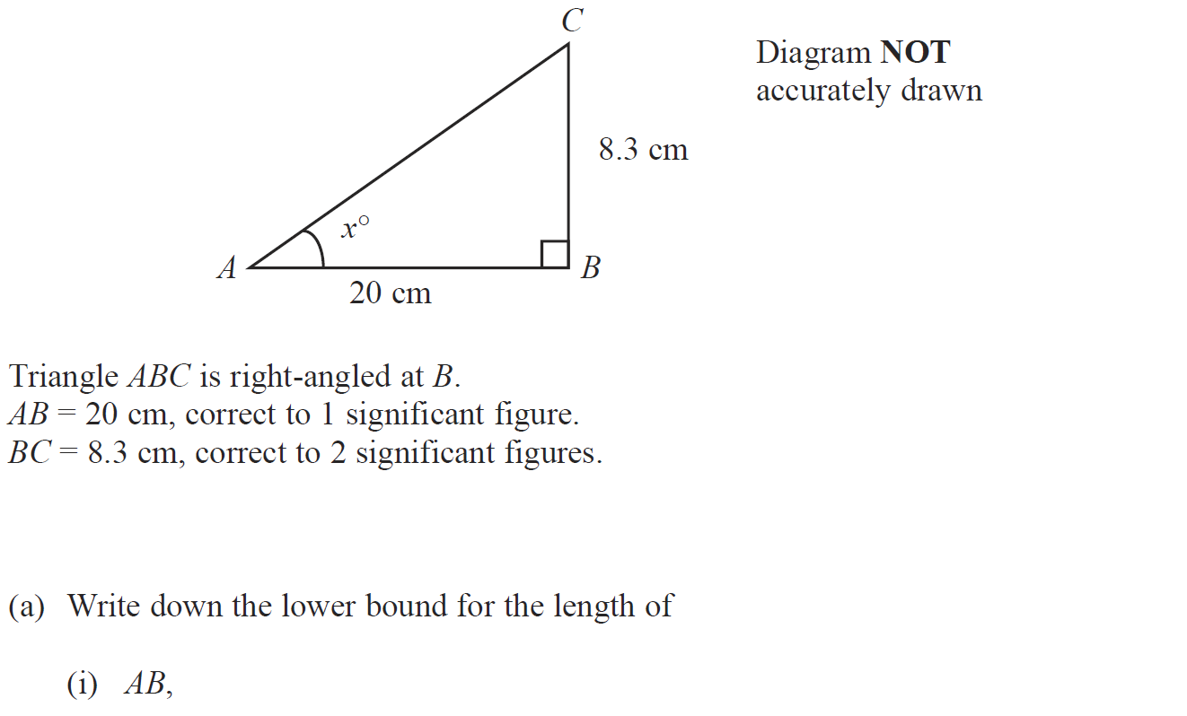
Basic Trigonometry
June 2010 3H Q14

Slide 74
Basic Trigonometry
June 2010 3H Q14
A (i)
A (ii)
B
C

Slide 75
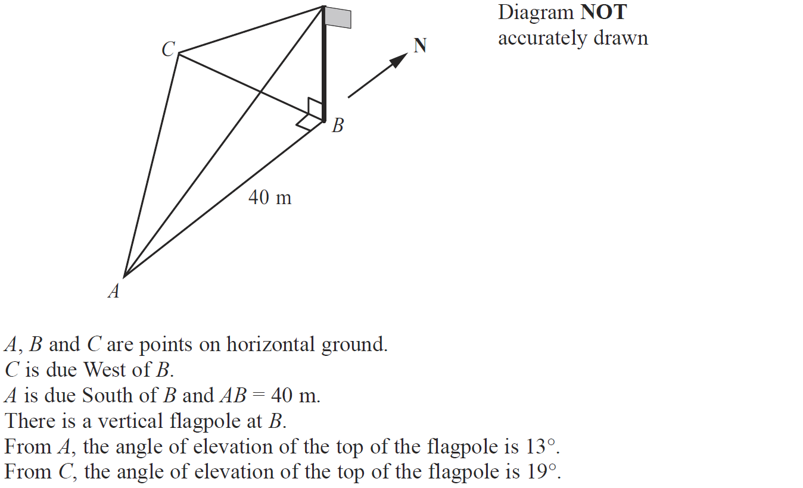
Basic Trigonometry
June 2010 3H Q20

Slide 76
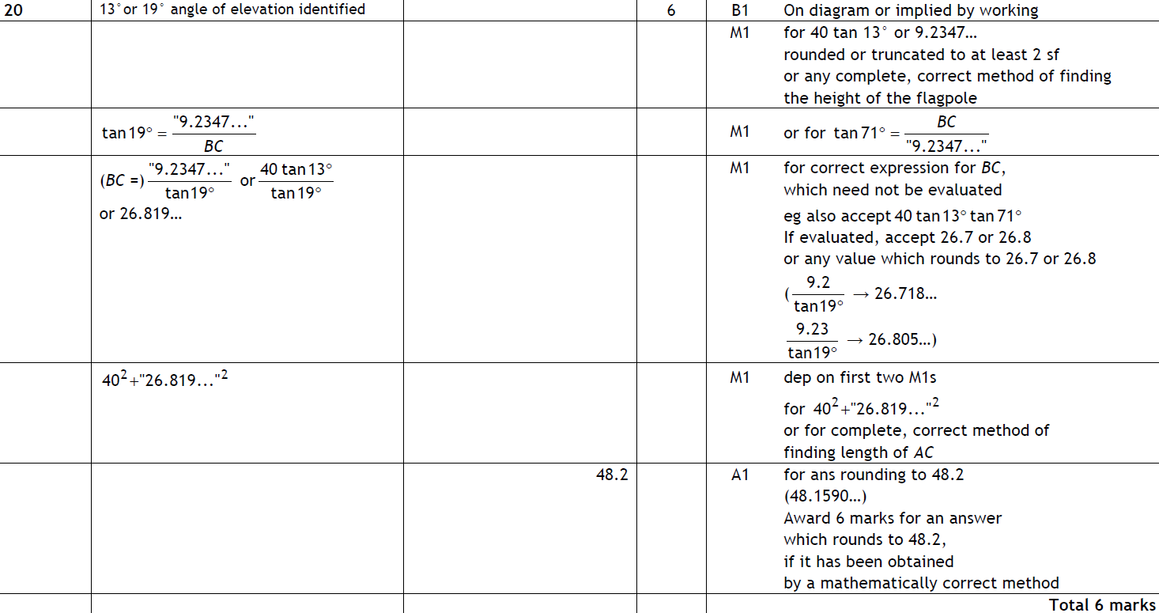
Basic Trigonometry
June 2010 3H Q20
A

Slide 77
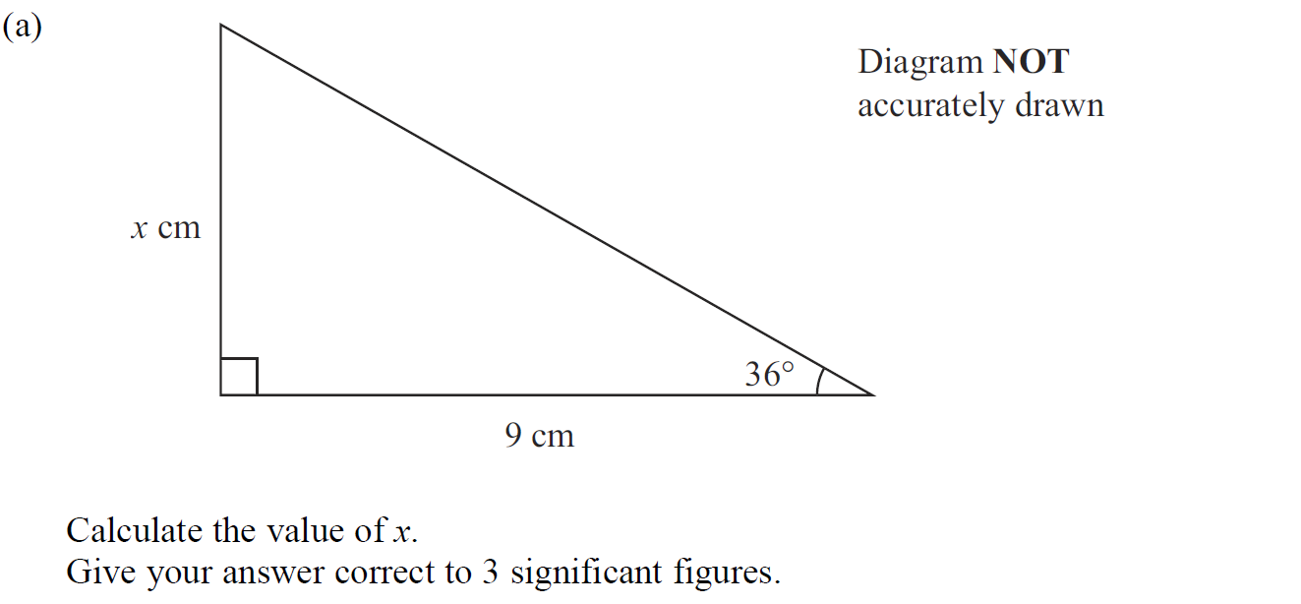
Basic Trigonometry
Nov 2010 3H Q8

Slide 78
Basic Trigonometry
Nov 2010 3H Q8
A
B

Slide 79
Basic Trigonometry
June 2011 3H Q18

Slide 80
Basic Trigonometry
June 2011 3H Q18
A

Slide 81
Basic Trigonometry
June 2011 4H Q11

Slide 82
Basic Trigonometry
June 2011 4H Q11
A

Slide 83
Basic Trigonometry
June 2011 4H Q22

Slide 84
Basic Trigonometry
June 2011 4H Q22
A
B

Slide 85
Basic Trigonometry
Jan 2012 3H Q9

Slide 86
Basic Trigonometry
Jan 2012 3H Q9
A
B (i)
B (ii)

Slide 87
Basic Trigonometry
May 2012 3H Q15

Slide 88
Basic Trigonometry
May 2012 3H Q15
A

Slide 89
Basic Trigonometry
May 2012 4H Q6

Slide 90
Basic Trigonometry
May 2012 4H Q6
A

Slide 91
Basic Trigonometry
Jan 2013 3H Q8

Slide 92
Basic Trigonometry
Jan 2013 3H Q8
A
B (i)
B (ii)

Slide 93
Basic Trigonometry
Jan 2013 3H Q21

Slide 94
Basic Trigonometry
Jan 2013 3H Q21
A

Slide 95
Basic Trigonometry
May 2013 3H Q10

Slide 96
Basic Trigonometry
May 2013 3H Q10
A

Slide 97
Basic Trigonometry
May 2013 4H Q22

Slide 98
Basic Trigonometry
May 2013 4H Q22
A

Slide 99
Basic Trigonometry
May 2013 3HR Q11

Slide 100
Basic Trigonometry
May 2013 3HR Q11
A

Slide 101
Basic Trigonometry
May 2013 3HR Q24

Slide 102
Basic Trigonometry
May 2013 3HR Q24
A

Slide 103
Basic Trigonometry
Jan 2014 3H Q3

Slide 104
Basic Trigonometry
Jan 2014 3H Q3
A

Slide 105
Basic Trigonometry
Jan 2014 3H Q15

Slide 106
Basic Trigonometry
Jan 2014 3H Q15
A

Slide 107
Basic Trigonometry
Jan 2014 3HR Q17

Slide 108
Basic Trigonometry
Jan 2014 3HR Q17
A

Slide 109
Basic Trigonometry
Jan 2014 3HR Q21

Slide 110
Basic Trigonometry
Jan 2014 3HR Q21
A

Slide 111
Basic Trigonometry
Jan 2014 4HR Q21

Slide 112
Basic Trigonometry
Jan 2014 4HR Q21
A

Slide 113
Basic Trigonometry
May 2014 3H Q5

Slide 114
Basic Trigonometry
May 2014 3H Q5
A

Slide 115
Basic Trigonometry
May 2014 4H Q23

Slide 116
Basic Trigonometry
May 2014 4H Q23
A

Slide 117
Basic Trigonometry
May 2014 3HR Q18

Slide 118
Basic Trigonometry
May 2014 3HR Q18
A
B

Slide 119
Basic Trigonometry
Jan 2015 3H Q8

Slide 120
Basic Trigonometry
Jan 2015 3H Q8
A
B

Slide 121
Basic Trigonometry
Jan 2015 3HR Q11

Slide 122
Basic Trigonometry
Jan 2015 3HR Q11
A

Slide 123
Basic Trigonometry
May 2015 3H Q15

Slide 124
Basic Trigonometry
May 2015 3H Q15
A

Slide 125
Basic Trigonometry
June 2015 4H Q8

Slide 126
Basic Trigonometry
June 2015 4H Q8
A

Slide 127
Basic Trigonometry
May 2015 3HR Q23

Slide 128
Basic Trigonometry
May 2015 3HR Q23
A

Slide 129
Basic Trigonometry
June 2015 4HR Q10

Slide 130
Basic Trigonometry
June 2015 4HR Q10
A

Slide 131
Basic Trigonometry
Jan 2016 3H Q11

Slide 132
Basic Trigonometry
Jan 2016 3H Q11
A

Slide 133
Basic Trigonometry
Jan 2016 4H Q19

Slide 134
Basic Trigonometry
Jan 2016 4H Q19
A

Slide 135
Basic Trigonometry
Jan 2016 3HR Q10

Slide 136
Basic Trigonometry
Jan 2016 3HR Q10
A
B

Slide 137
Basic Trigonometry
Jan 2016 4HR Q21

Slide 138
Basic Trigonometry
Jan 2016 4HR Q21
A

Slide 139
Basic Trigonometry
May 2016 3H Q8

Slide 140
Basic Trigonometry
May 2016 3H Q8
A

Slide 141
Basic Trigonometry
May 2016 3H Q16

Slide 142
Basic Trigonometry
May 2016 3H Q16
A

Slide 143
Basic Trigonometry
June 2016 4HR Q11

Slide 144
Basic Trigonometry
June 2016 4HR Q11
A

Slide 145
Basic Trigonometry
June 2016 4HR Q17

Slide 146
Basic Trigonometry
June 2016 4HR Q17
A

Slide 147
Basic Trigonometry
Jan 2017 4H Q9

Slide 148
Basic Trigonometry
Jan 2017 4H Q9
A
B

Slide 149
Basic Trigonometry
Jan 2017 4H Q21

Slide 150
Basic Trigonometry
Jan 2017 4H Q21
A
B

Slide 151
Basic Trigonometry
Jan 2017 4HR Q9

Slide 152
Basic Trigonometry
Jan 2017 4HR Q9
A
B
C (i)
C (ii)

Slide 153
Basic Trigonometry
May 2017 3H Q7

Slide 154
Basic Trigonometry
May 2017 3H Q7
A

Slide 155
Basic Trigonometry
May 2017 3H Q21

Slide 156
Basic Trigonometry
May 2017 3H Q21
A

Slide 157
Basic Trigonometry
June 2017 4HR Q13

Slide 158
Basic Trigonometry
June 2017 4HR Q13
A

Slide 159
Basic Trigonometry
June 2017 4HR Q22

Slide 160
Basic Trigonometry
June 2017 4HR Q22
A

Slide 161
Basic Trigonometry
Jan 2018 3H Q6

Slide 162
Basic Trigonometry
Jan 2018 3H Q6
A
B
C

Slide 163
Basic Trigonometry
Jan 2018 4HR Q8

Slide 164
Basic Trigonometry
Jan 2018 4HR Q8
A

Slide 165
Basic Trigonometry
June 2018 4H Q9

Slide 166
Basic Trigonometry
June 2018 4H Q9
A

Slide 167
Basic Trigonometry
June 2018 4HR Q8

Slide 168
Basic Trigonometry
June 2018 4HR Q8
A

Slide 169
Basic Trigonometry
June 2018 4HR Q23

Slide 170
Basic Trigonometry
June 2018 4HR Q23
A

