Slide 1
Basic Trigonometry
Basic Trigonometry
May 2017
1H Q7
June 2018
2H Q11
SAM
2H Q17
June 2017
3H Q18
June 2018
3H Q12
Practice
1H Q11
Nov 2017
1H Q14
Nov 2018
1H Q20
Practice
3H Q2*
Nov 2017
2H Q8
Nov 2018
2H Q13
May 2018
1H Q8
3D
*May use Pythagoras instead

Slide 2
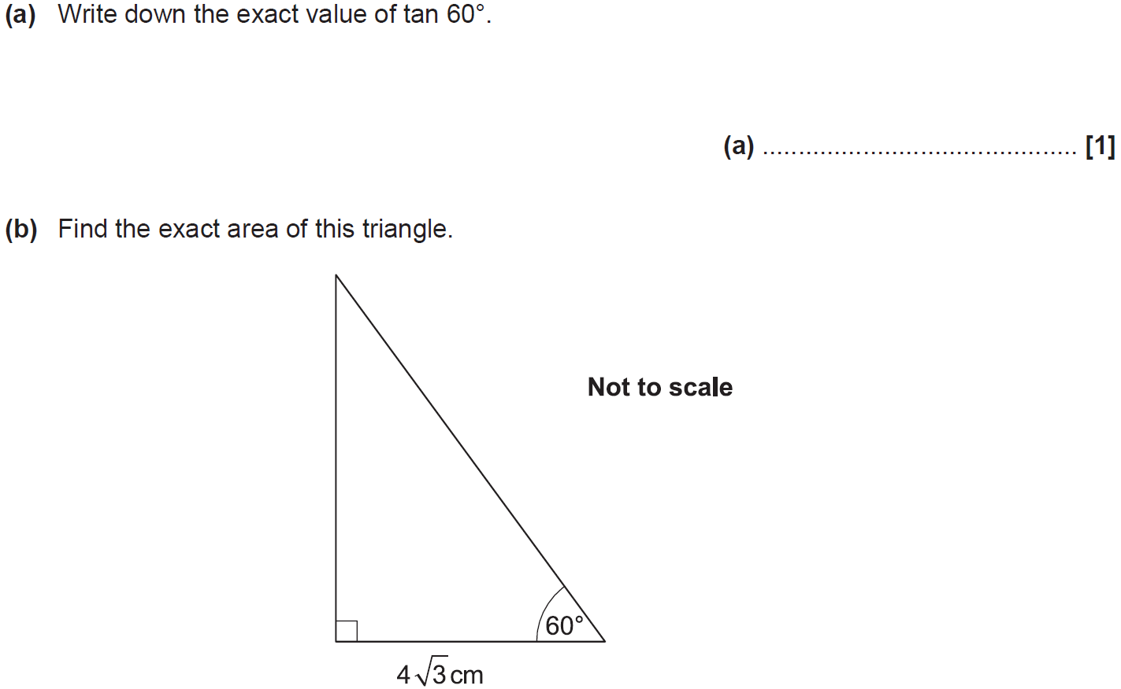
Basic Trigonometry
SAM 2H Q17

Slide 3
Basic Trigonometry
SAM 2H Q17
A
B

Slide 4
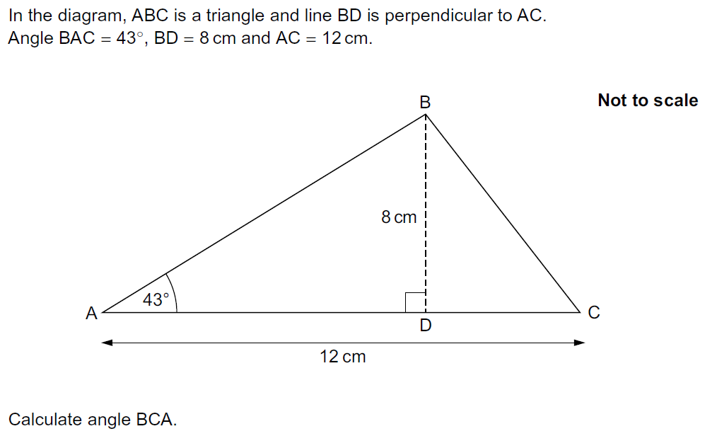
Basic Trigonometry
Practice 1H Q11

Slide 5
Basic Trigonometry
Practice 1H Q11
A

Slide 6
Basic Trigonometry
Practice 3H Q2

Slide 7
Basic Trigonometry
Practice 3H Q2
A

Slide 8
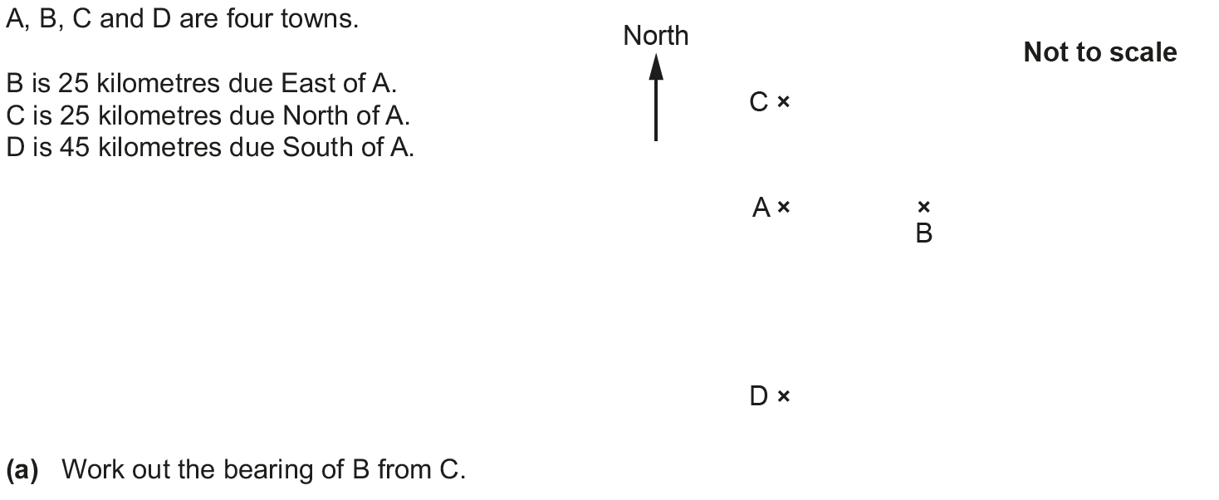
Basic Trigonometry
May 2017 1H Q7

Slide 9
Basic Trigonometry
May 2017 1H Q7
A
B

Slide 10
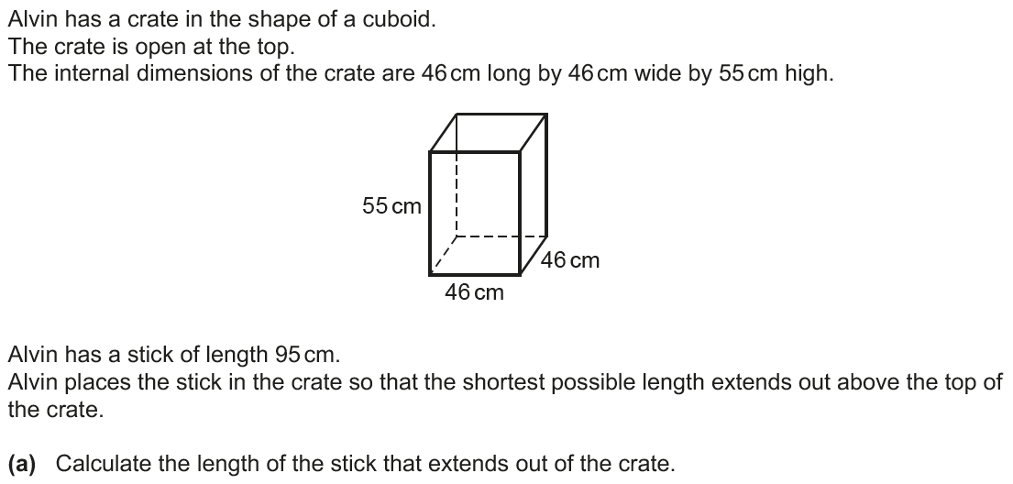
Basic Trigonometry
June 2017 3H Q18

Slide 11
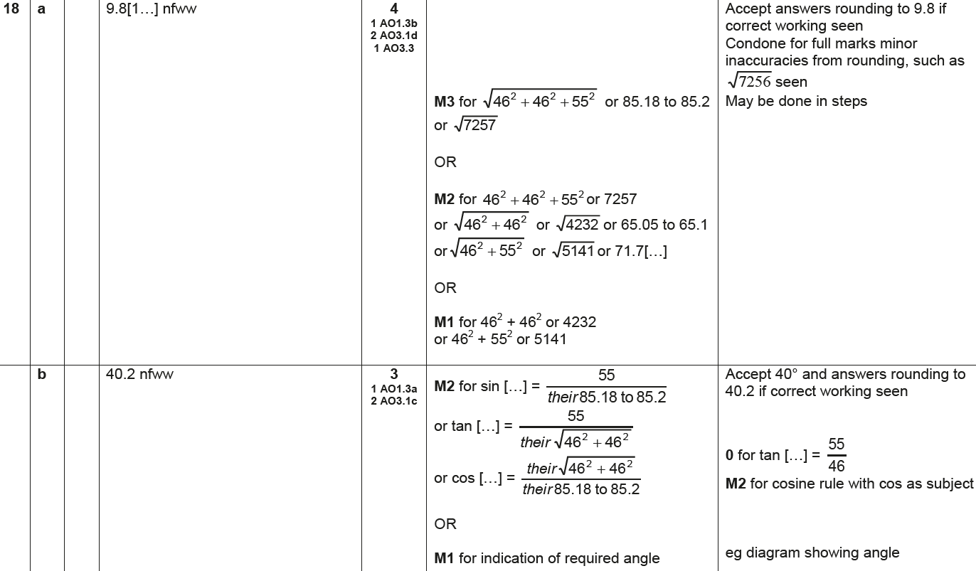
Basic Trigonometry
June 2017 3H Q18
A
B

Slide 12
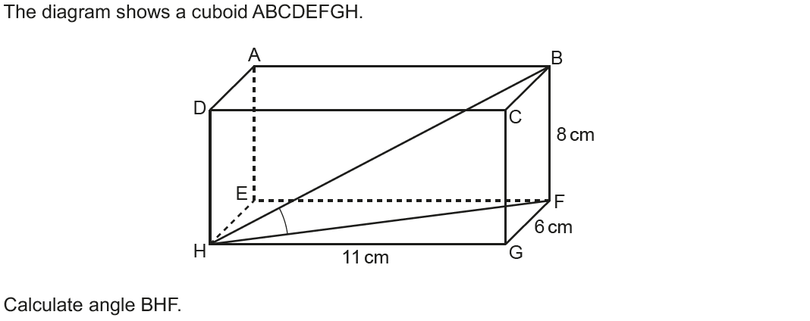
Basic Trigonometry
Nov 2017 1H Q14

Slide 13
Basic Trigonometry
Nov 2017 1H Q14
A

Slide 14
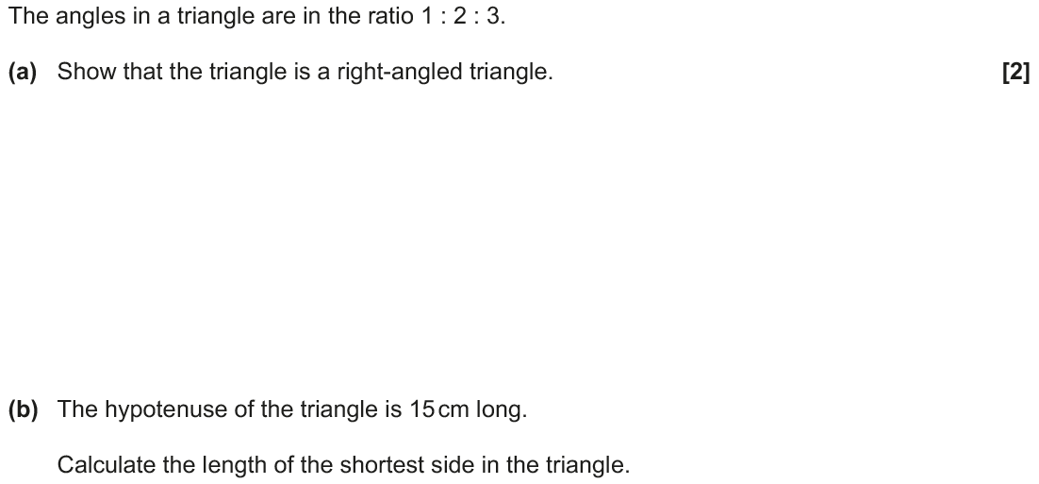
Basic Trigonometry
Nov 2017 2H Q8

Slide 15
Basic Trigonometry
Nov 2017 2H Q8
A
B

Slide 16
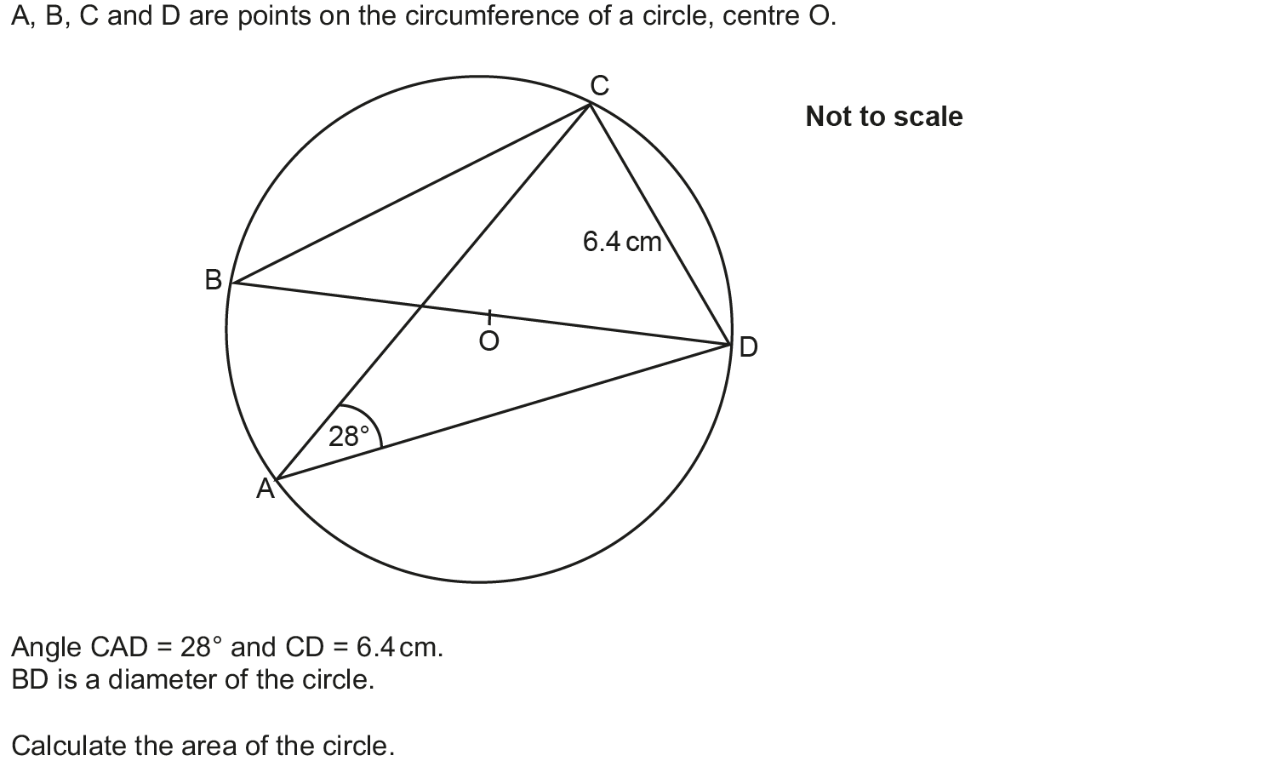
Basic Trigonometry
May 2018 1H Q8

Slide 17
Basic Trigonometry
May 2018 1H Q8
A

Slide 18
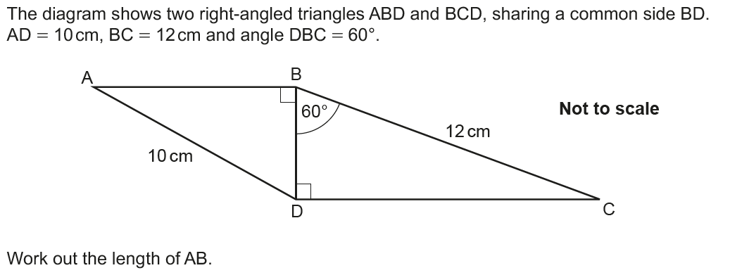
Basic Trigonometry
June 2018 2H Q11

Slide 19
Basic Trigonometry
June 2018 2H Q11
A

Slide 20
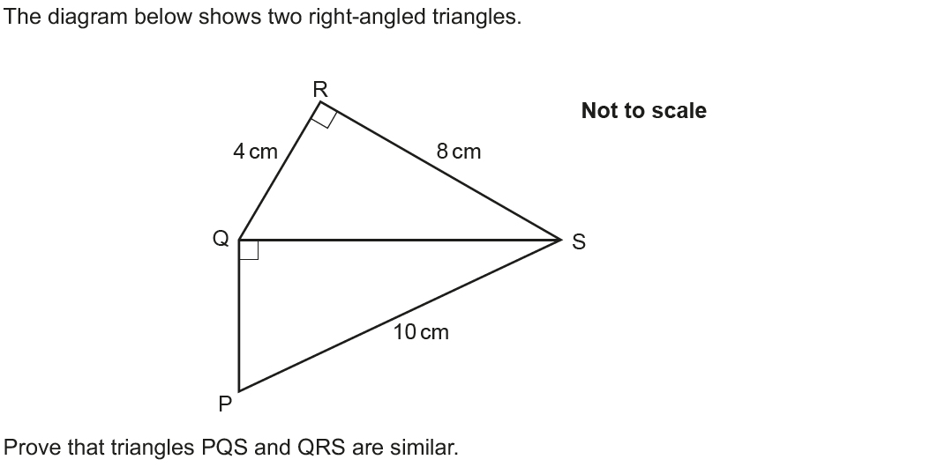
Basic Trigonometry
June 2018 3H Q12

Slide 21
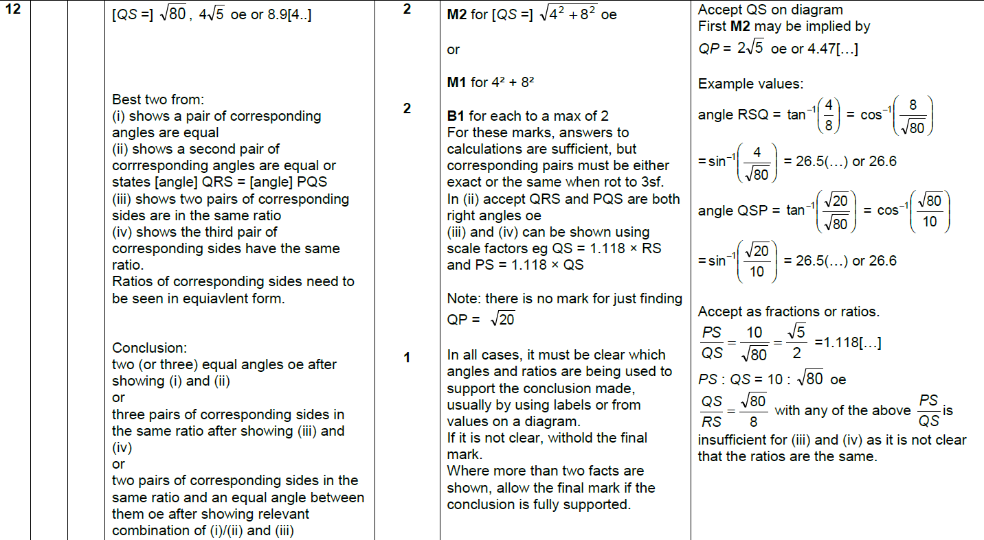
Basic Trigonometry
June 2018 3H Q12
A

Slide 22
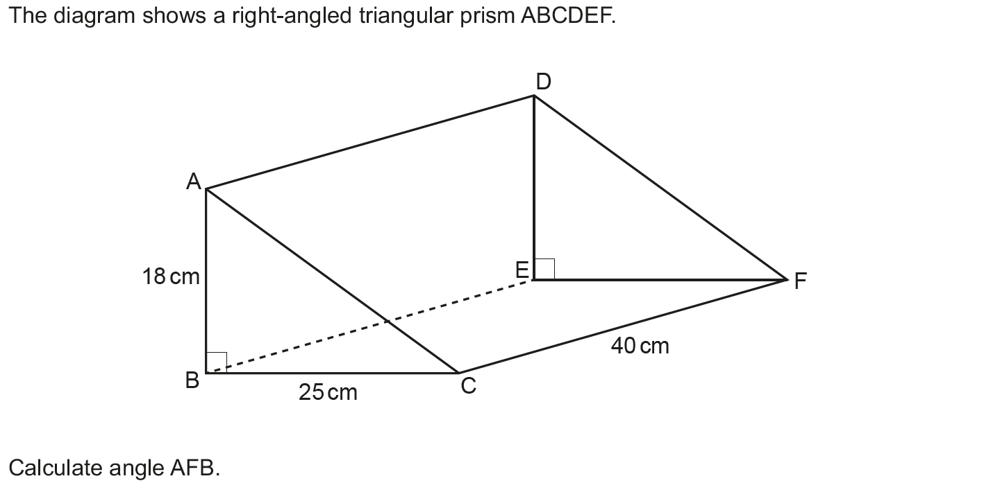
Basic Trigonometry
Nov 2018 1H Q20

Slide 23
Basic Trigonometry
Nov 2018 1H Q20
A

Slide 24
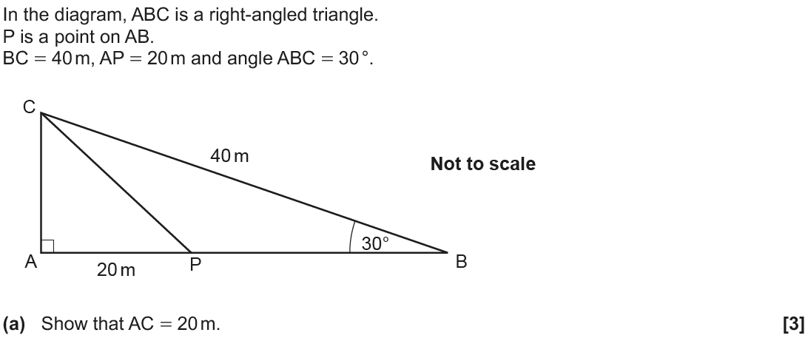
Basic Trigonometry
Nov 2018 2H Q13

Slide 25
Basic Trigonometry
Nov 2018 2H Q13
A
B

