Slide 1
Basic Trigonometry
Basic Trigonometry
June 2017
2H Q21*
Nov 2018
2H Q13*
June 2017
3H Q7
Nov 2018
3H Q6
SAM
2H Q2
June 2017
3H Q18
Nov 2018
3H Q12
SAM
3H Q16
Nov 2017
2H Q7
June 2019
2H Q5
Spec 1
3H Q9
Nov 2017
2H Q20
June 2019
2H Q19
June 2018
2H Q18
June 2019
3H Q21
June 2018
3H Q5
3D
*May use Pythagoras instead

Slide 2
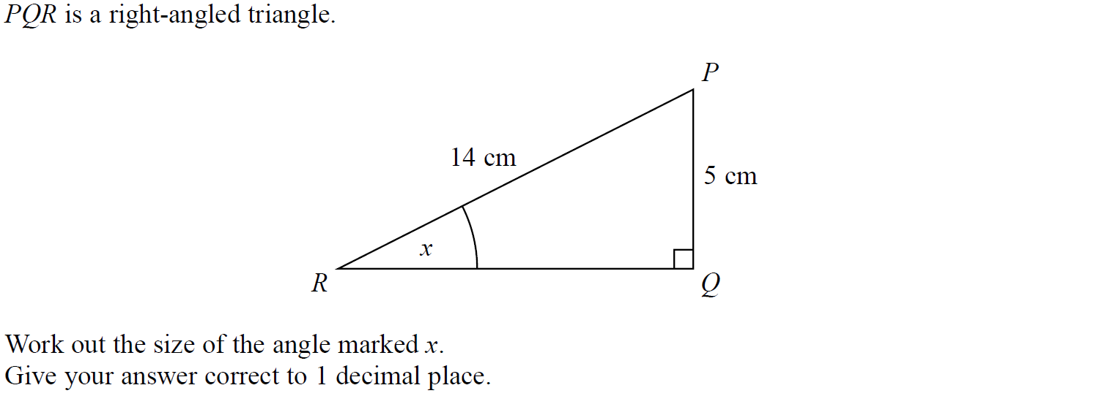
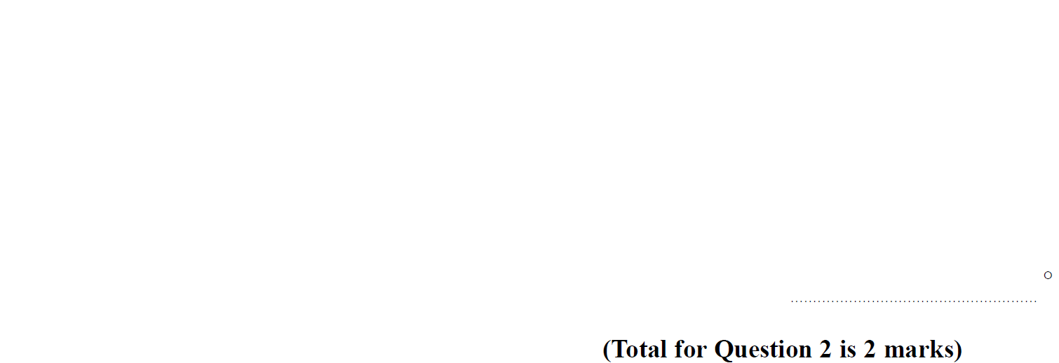
Basic Trigonometry
SAM 2H Q2

Slide 3
Basic Trigonometry
SAM 2H Q2
A

Slide 4
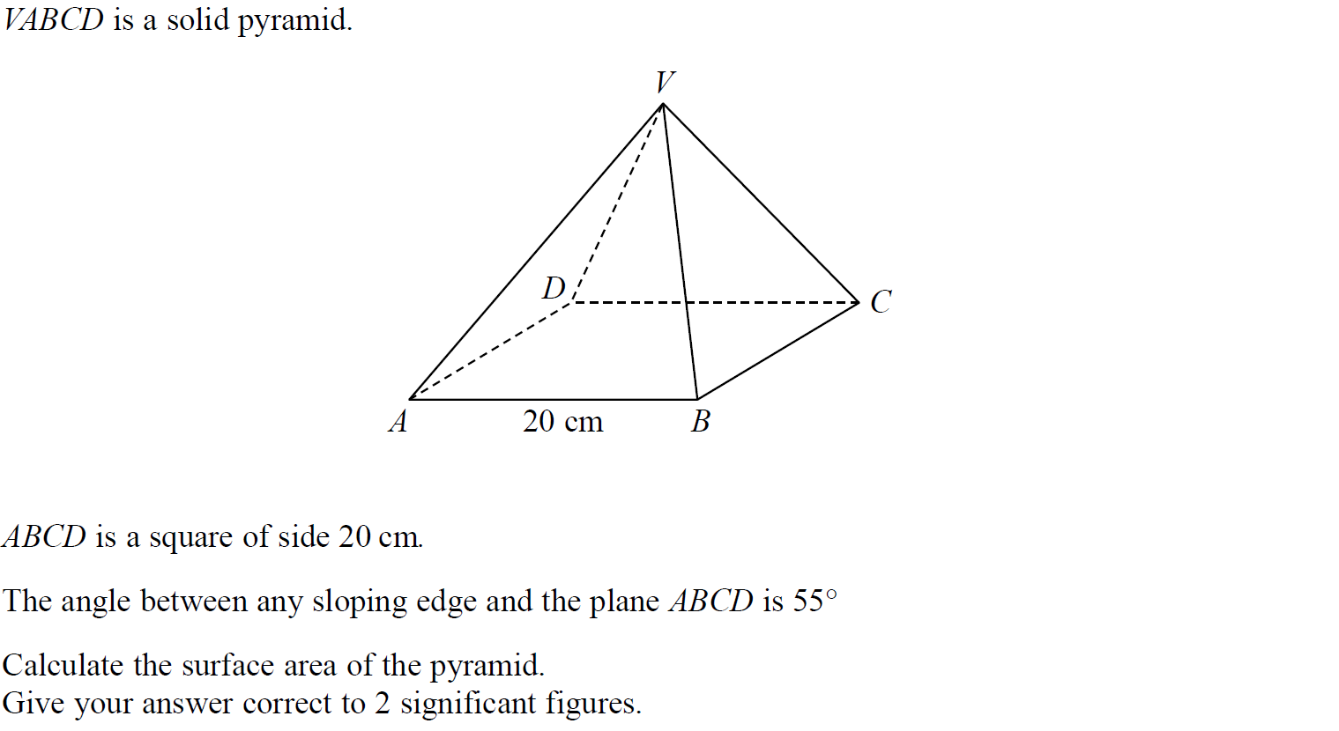
Basic Trigonometry
SAM 3H Q16

Slide 5
Basic Trigonometry
SAM 3H Q16
A

Slide 6
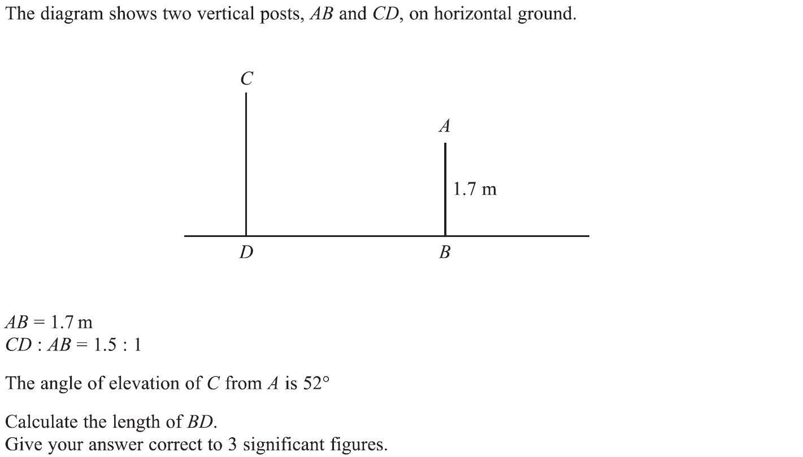
Basic Trigonometry
Specimen Set 1 3H Q9

Slide 7
Basic Trigonometry
Specimen Set 1 3H Q9
A

Slide 8
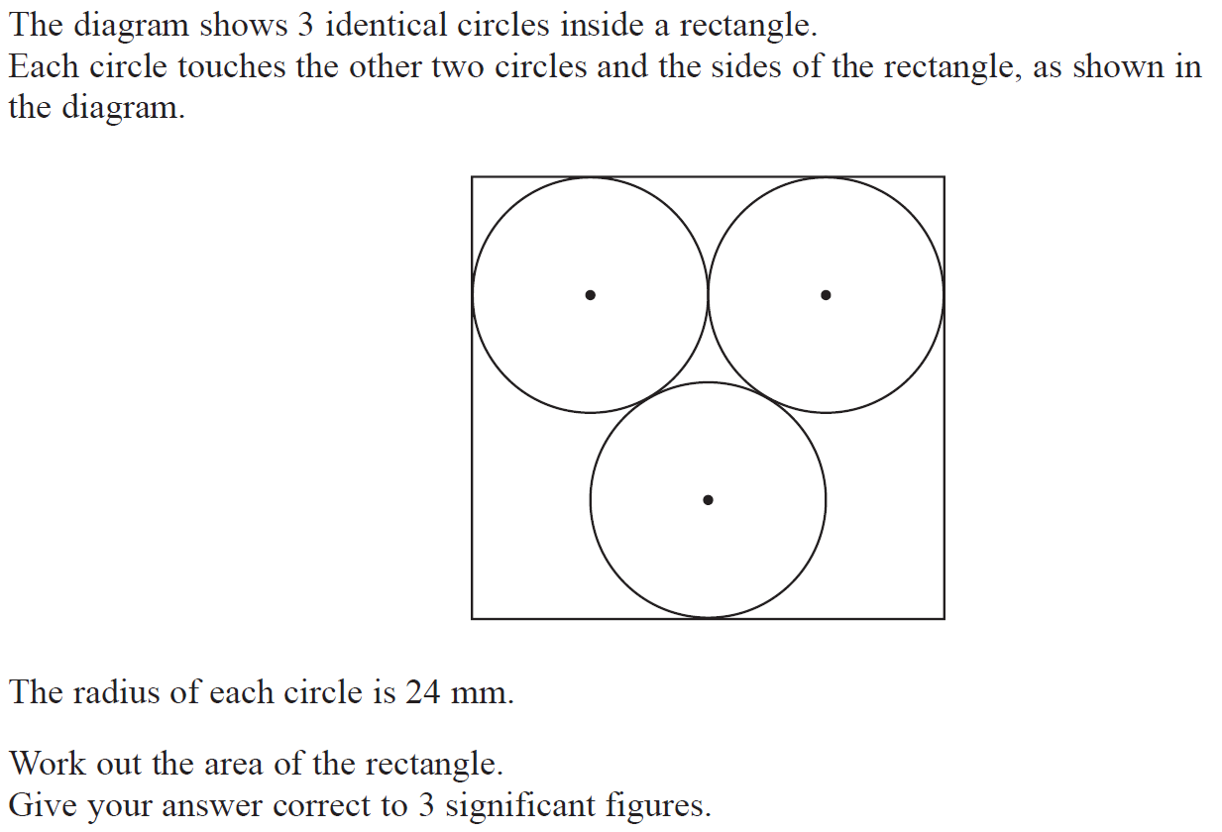
Basic Trigonometry
June 2017 2H Q21

Slide 9
Basic Trigonometry
June 2017 2H Q21
A

Slide 10
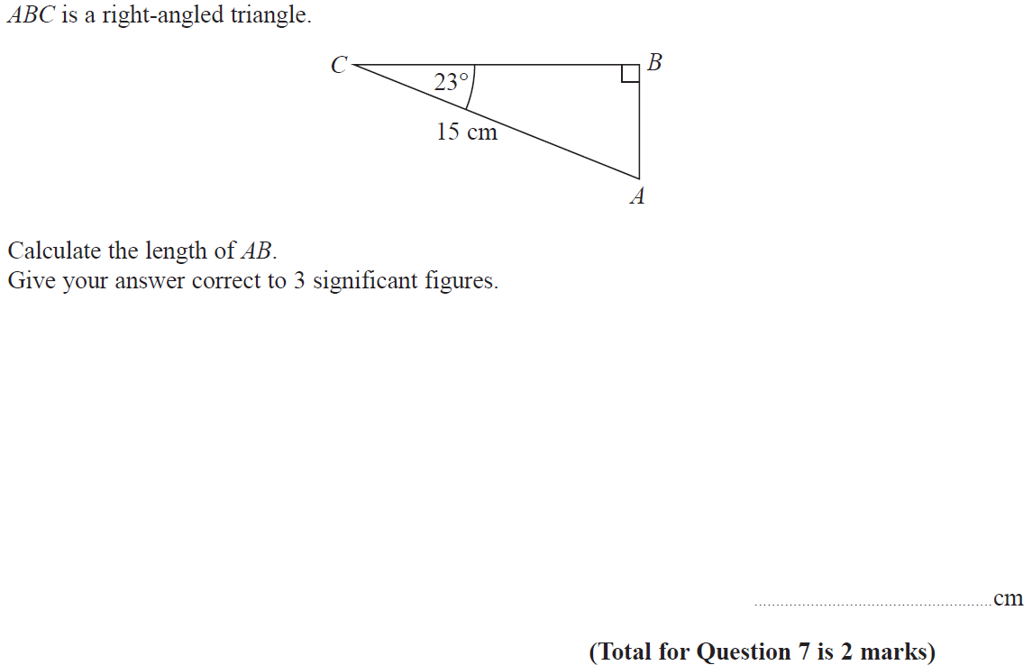
Basic Trigonometry
June 2017 3H Q7

Slide 11
Basic Trigonometry
June 2017 3H Q7
A

Slide 12
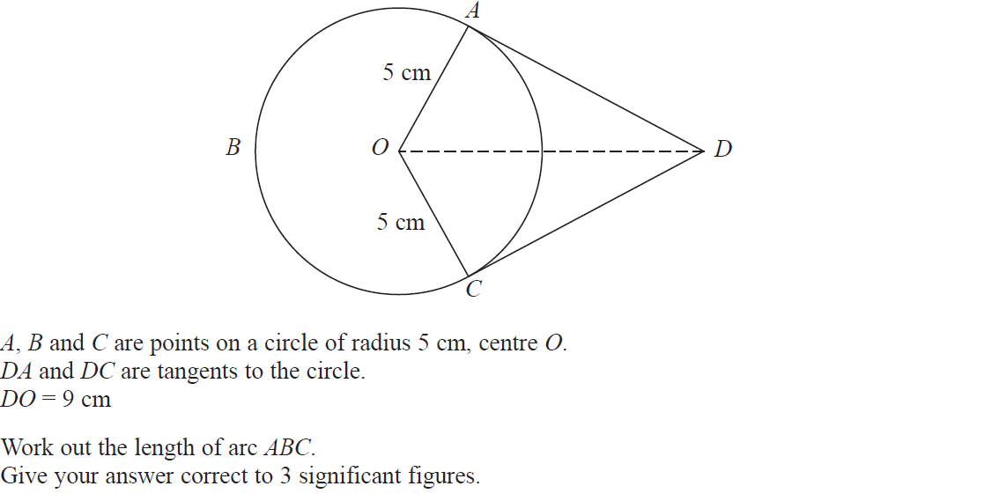
Basic Trigonometry
June 2017 3H Q18

Slide 13
Basic Trigonometry
June 2017 3H Q18
A

Slide 14
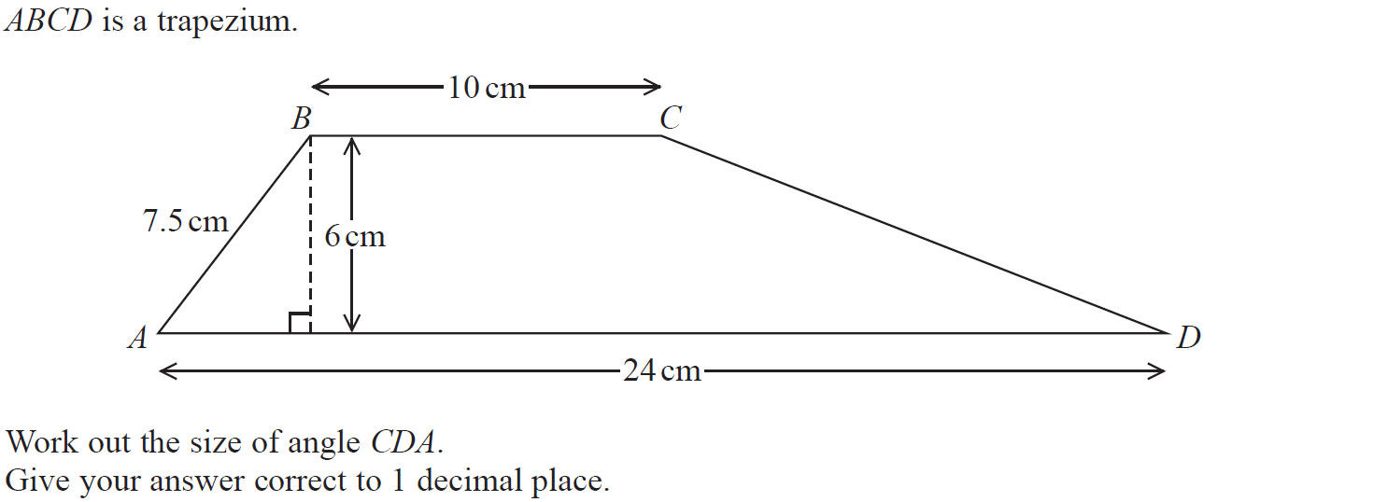
Basic Trigonometry
Nov 2017 2H Q7

Slide 15
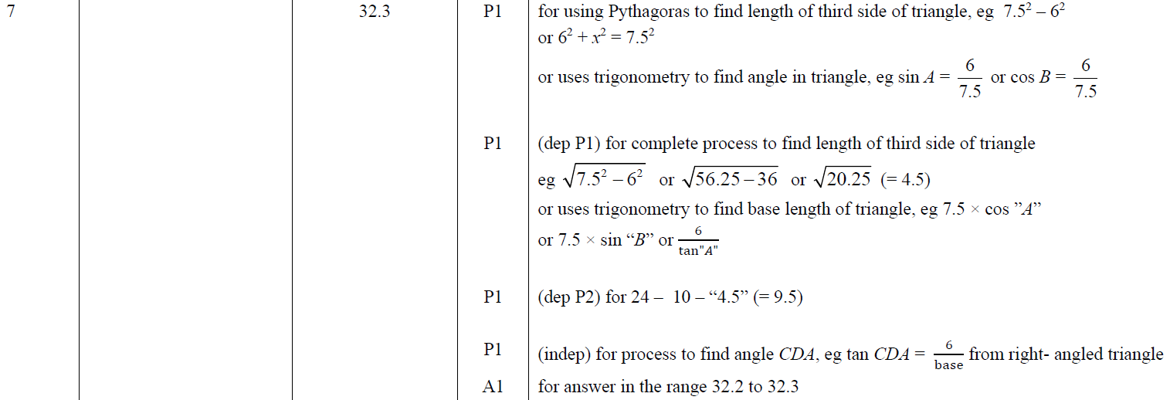
Basic Trigonometry
Nov 2017 2H Q7
A

Slide 16
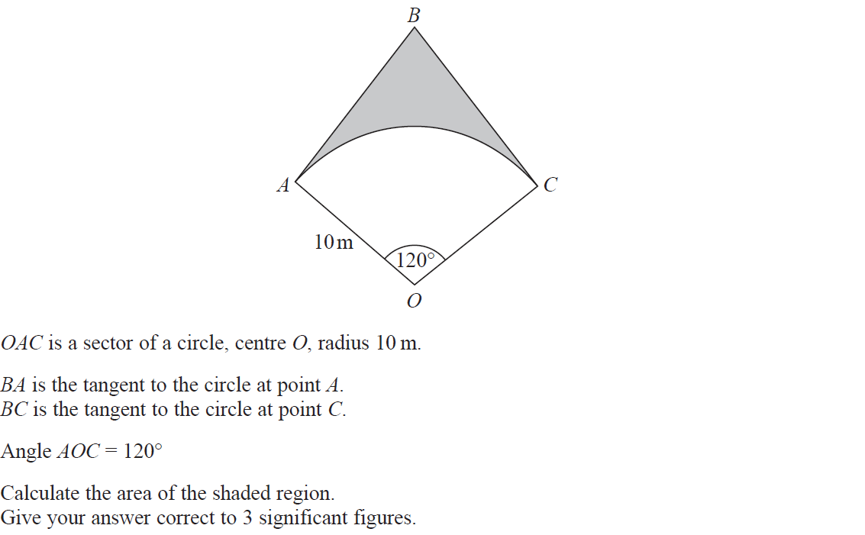
Basic Trigonometry
Nov 2017 2H Q20

Slide 17
Basic Trigonometry
Nov 2017 2H Q20
A

Slide 18
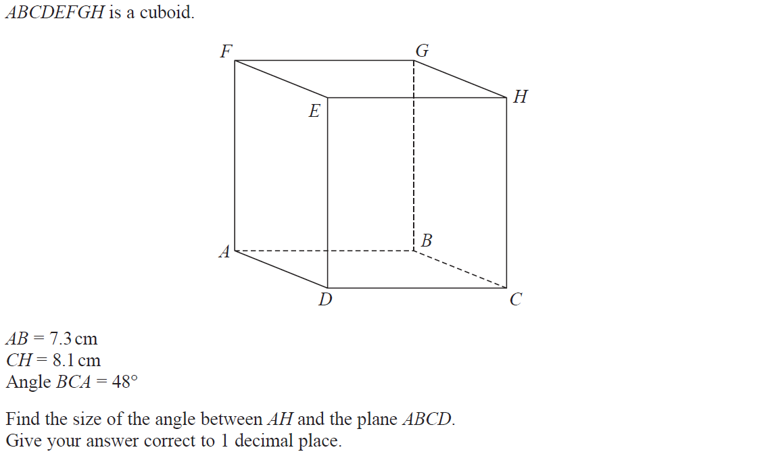
Basic Trigonometry
June 2018 2H Q18

Slide 19
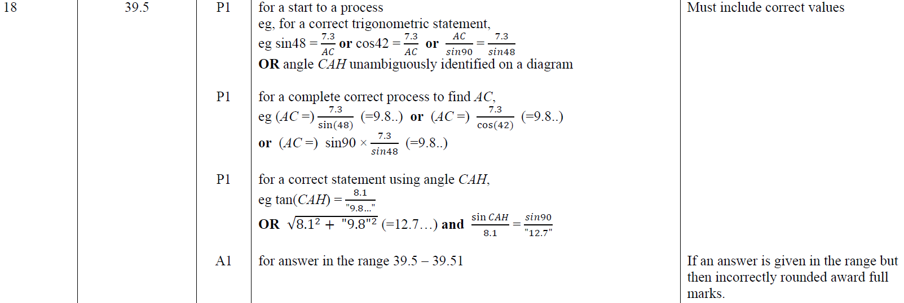
Basic Trigonometry
June 2018 2H Q18
A

Slide 20
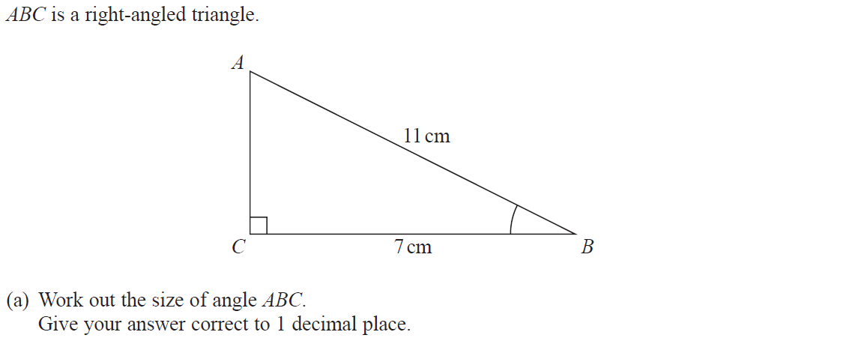
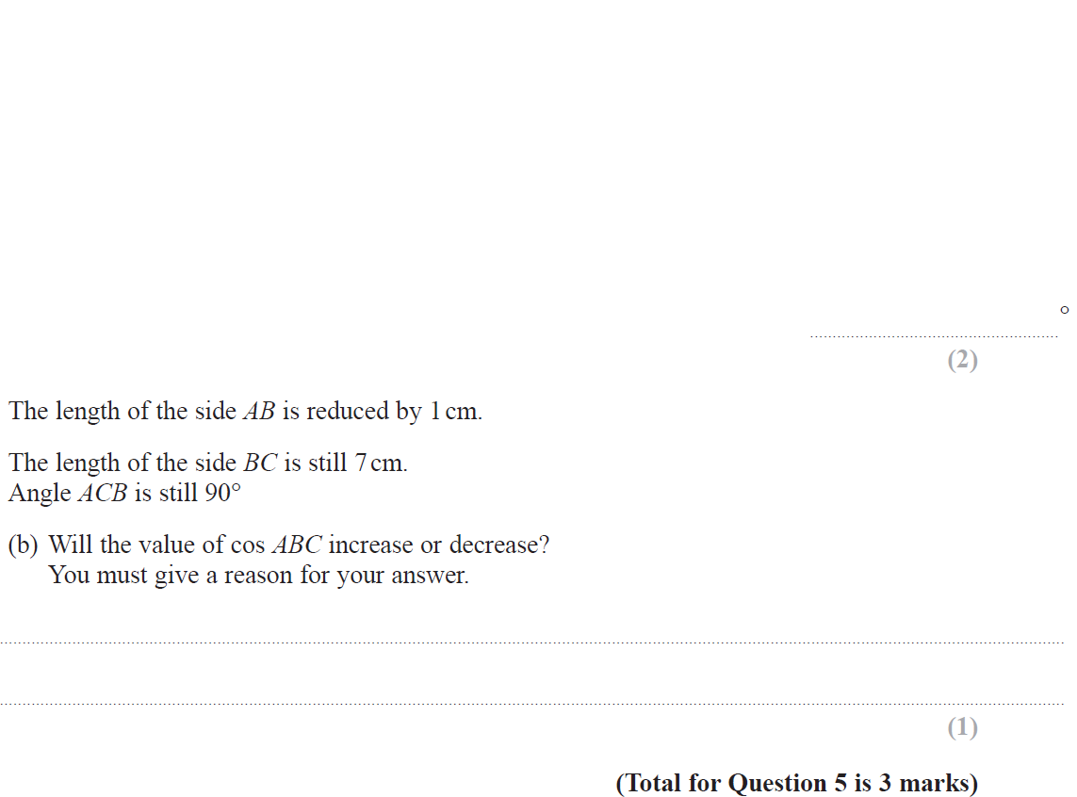
Basic Trigonometry
June 2018 3H Q5

Slide 21
Basic Trigonometry
June 2018 3H Q5
A
B

Slide 22
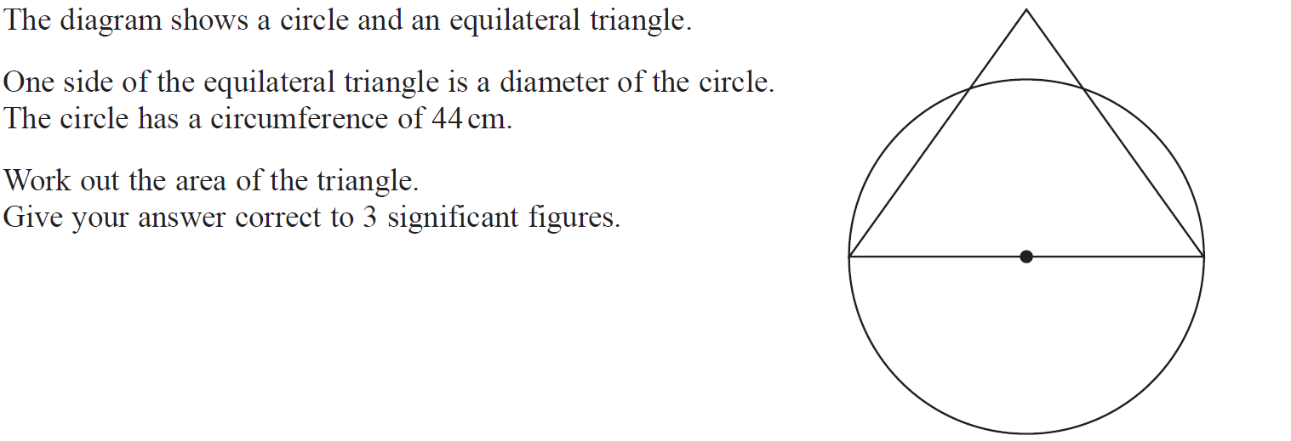
Basic Trigonometry
Nov 2018 2H Q13

Slide 23
Basic Trigonometry
Nov 2018 2H Q13
A

Slide 24
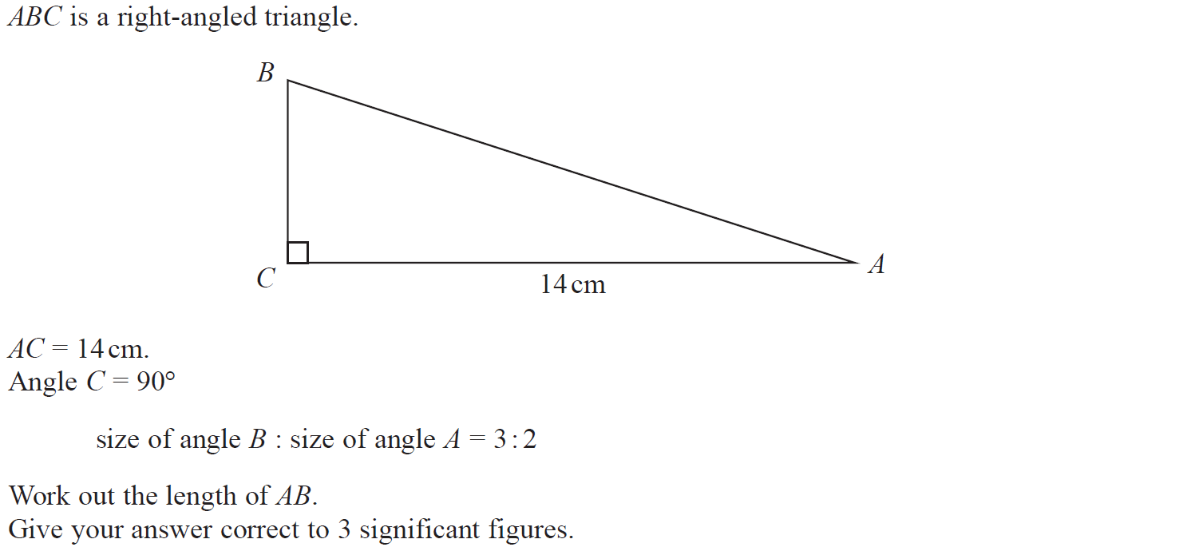
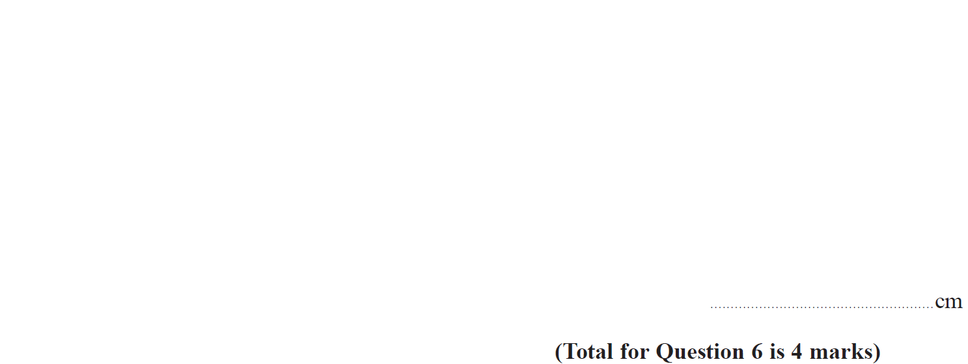
Basic Trigonometry
Nov 2018 3H Q6

Slide 25
Basic Trigonometry
Nov 2018 3H Q6
A

Slide 26
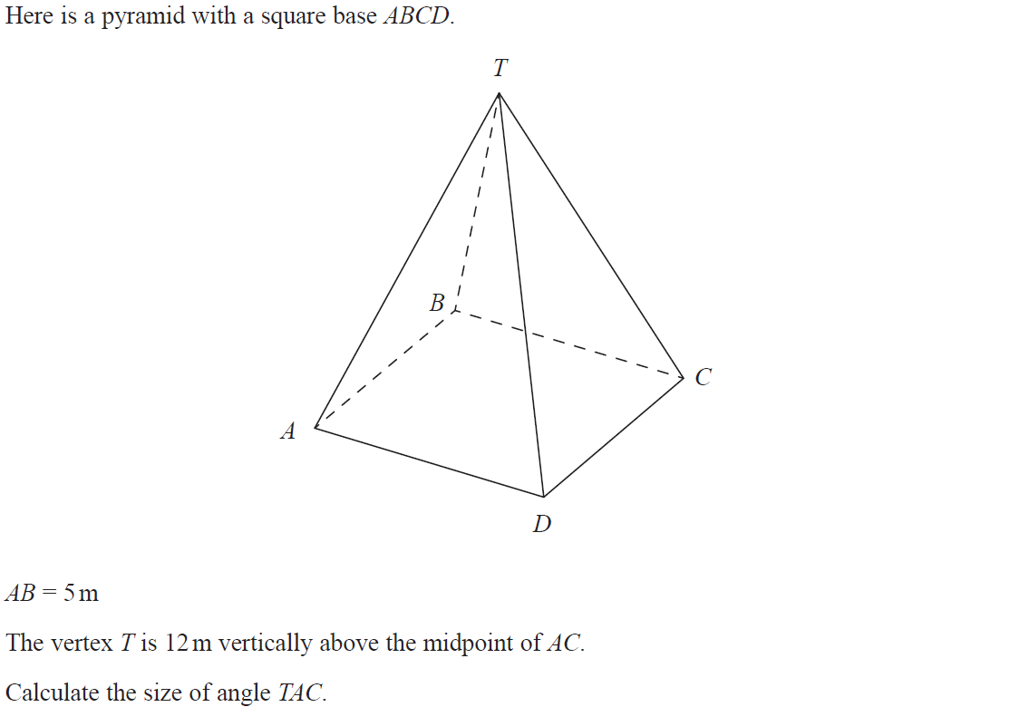
Basic Trigonometry
Nov 2018 3H Q12

Slide 27
Basic Trigonometry
Nov 2018 3H Q12
A

Slide 28
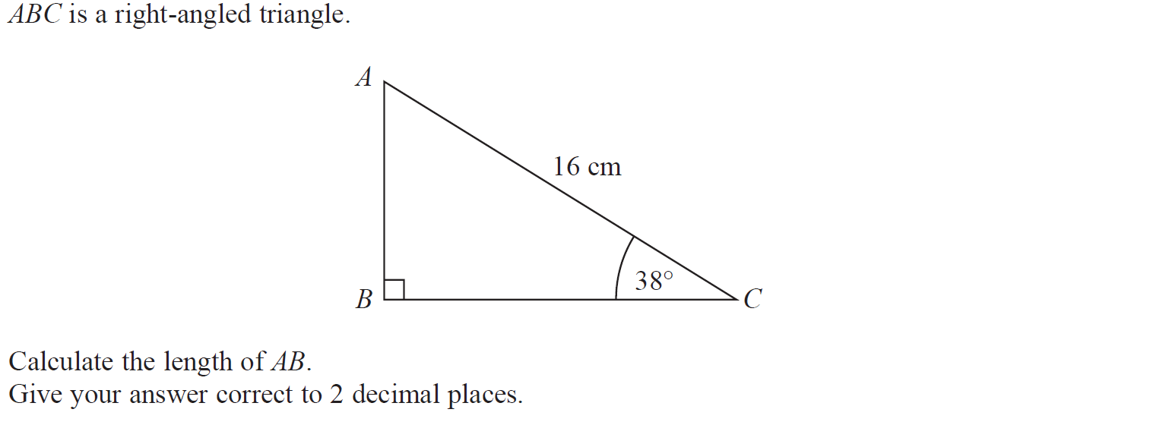
Basic Trigonometry
June 2019 2H Q5

Slide 29
Basic Trigonometry
June 2019 2H Q5
A
A SF

Slide 30
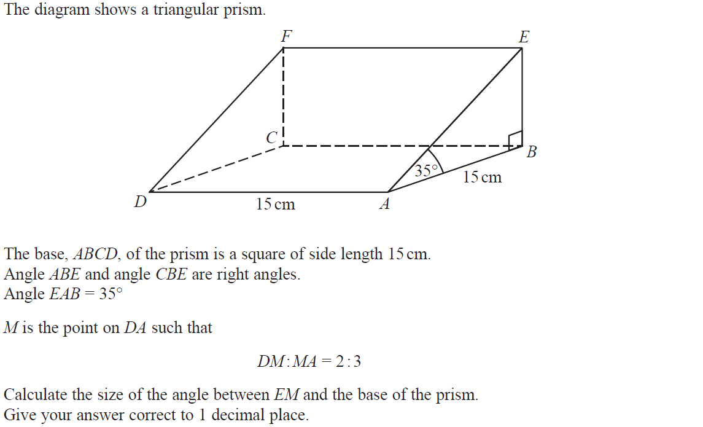
Basic Trigonometry
June 2019 2H Q19

Slide 31
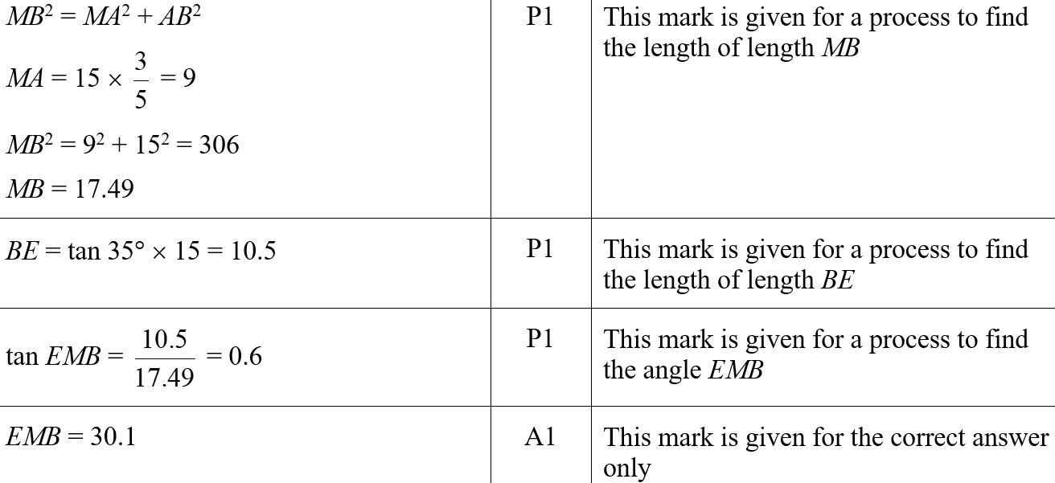
Basic Trigonometry
June 2019 2H Q19
A
A SF

Slide 32
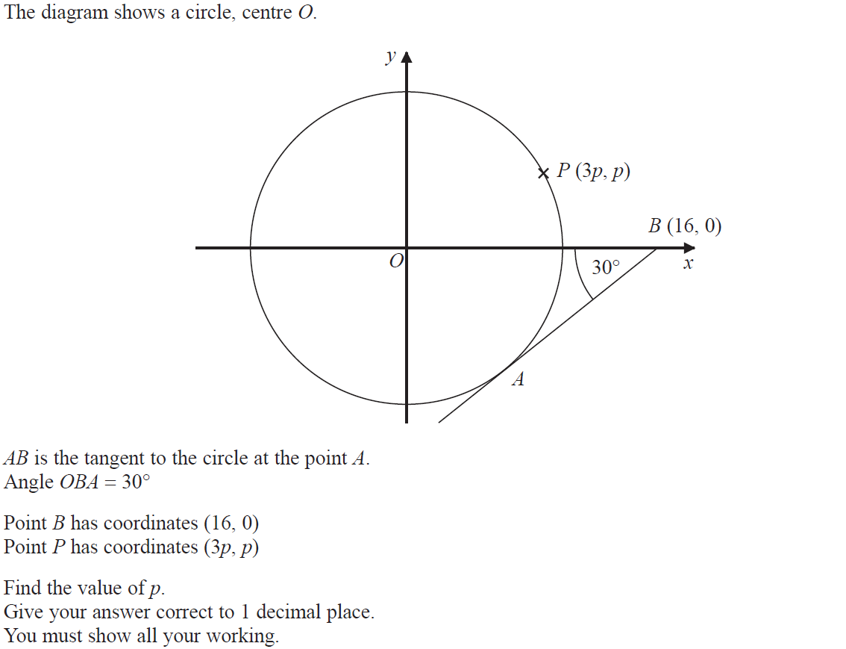
Basic Trigonometry
June 2019 3H Q21

Slide 33
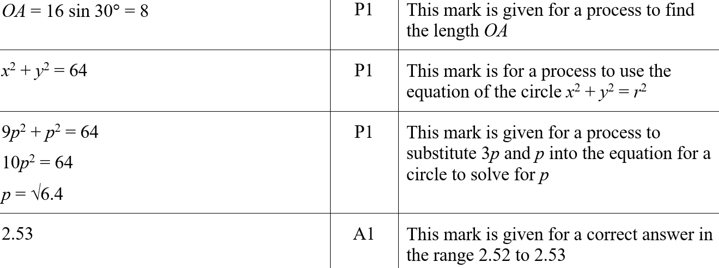
Basic Trigonometry
June 2019 3H Q21
A
A SF

