Slide 1
Basic Probability
Basic Probability
June 2017
2H Q5
May 2018
1H Q8
SAM
1H Q14
June 2017
2H Q9
May 2018
1H Q15
SAM
2H Q7
1 Marker
June 2017
3H Q5
June 2018
2H Q7
SAM
3H Q6
June 2017
3H Q9
June 2018
3H Q13
Experimental/ using samples

Slide 2
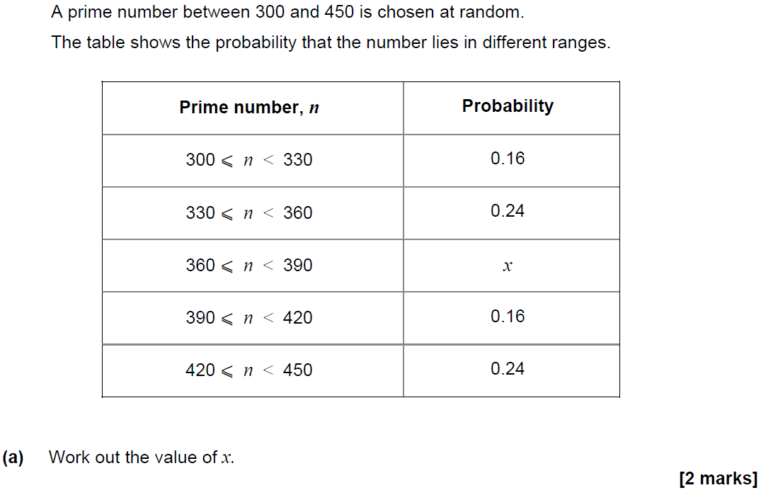
Basic Probability
SAM 1H Q14

Slide 3
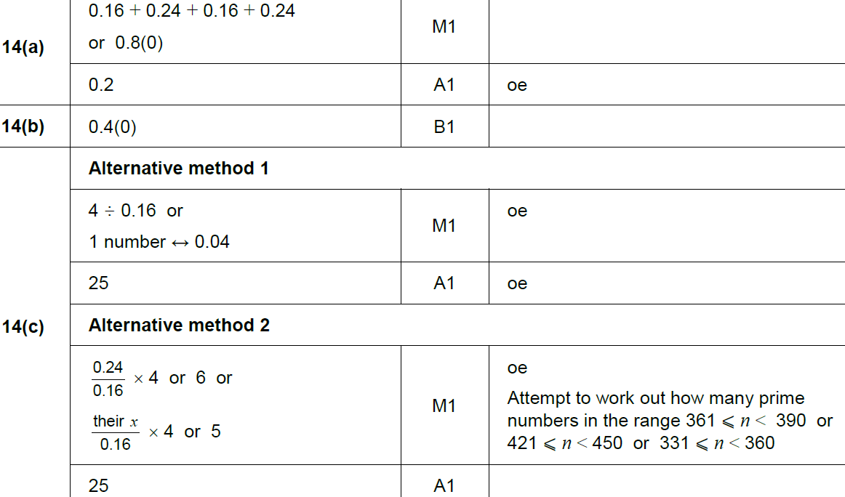
Basic Probability
SAM 1H Q14
A
B
C

Slide 4
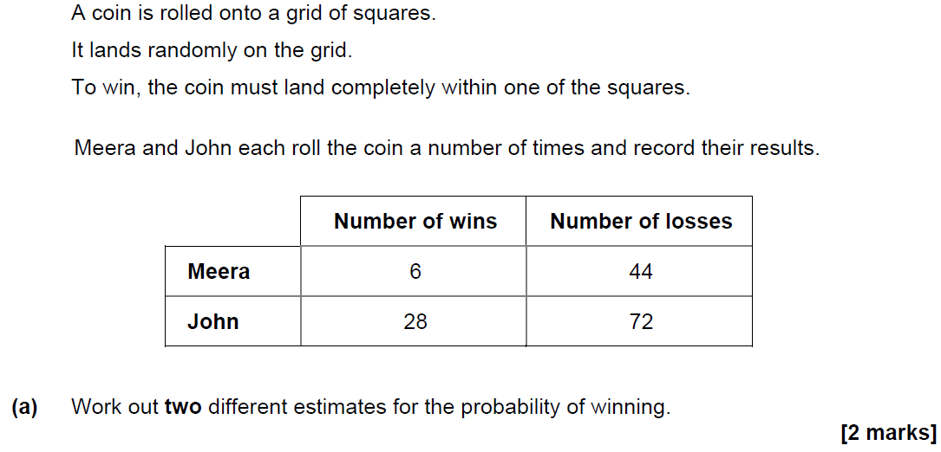
Basic Probability
SAM 2H Q7

Slide 5
Basic Probability
SAM 2H Q7
A
B

Slide 6
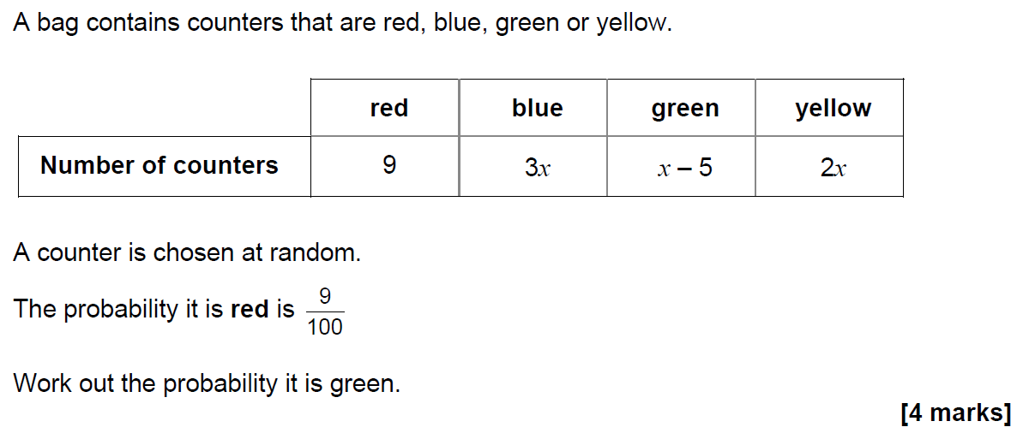
Basic Probability
SAM 3H Q6

Slide 7
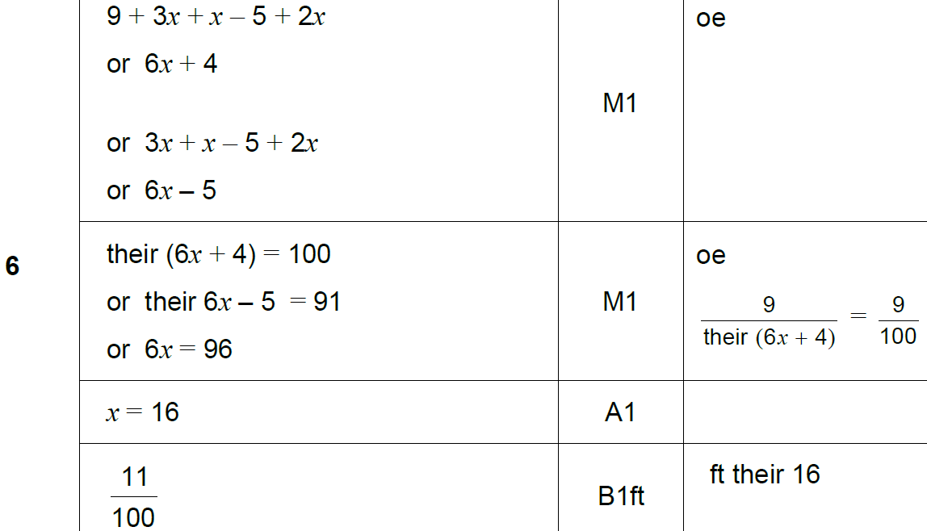
Basic Probability
SAM 3H Q6
A

Slide 8
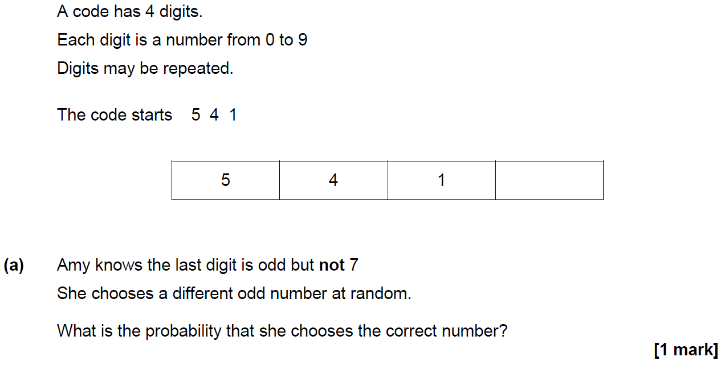
Basic Probability
June 2017 2H Q5

Slide 9
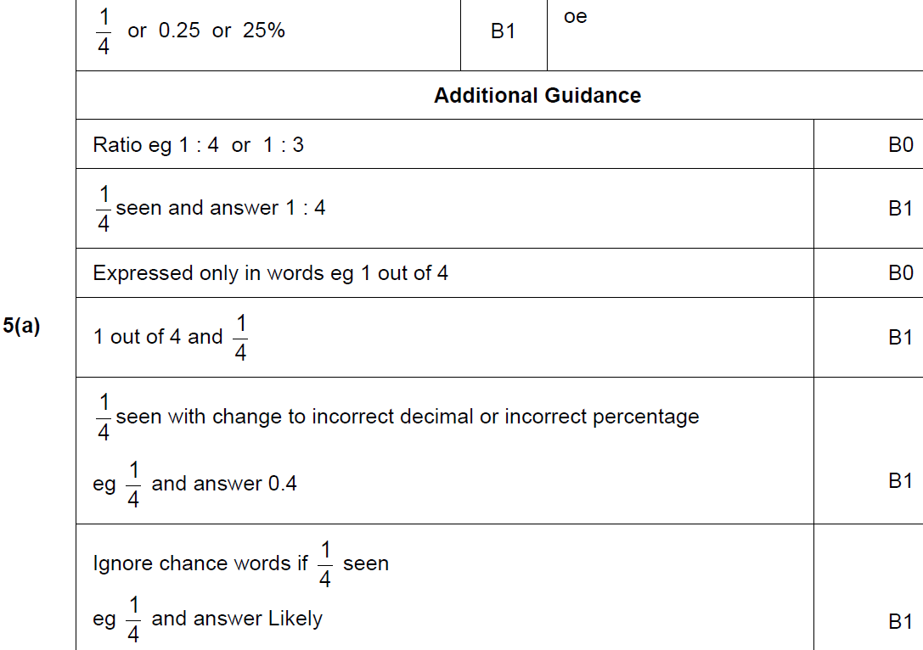
Basic Probability
June 2017 2H Q5
A

Slide 10
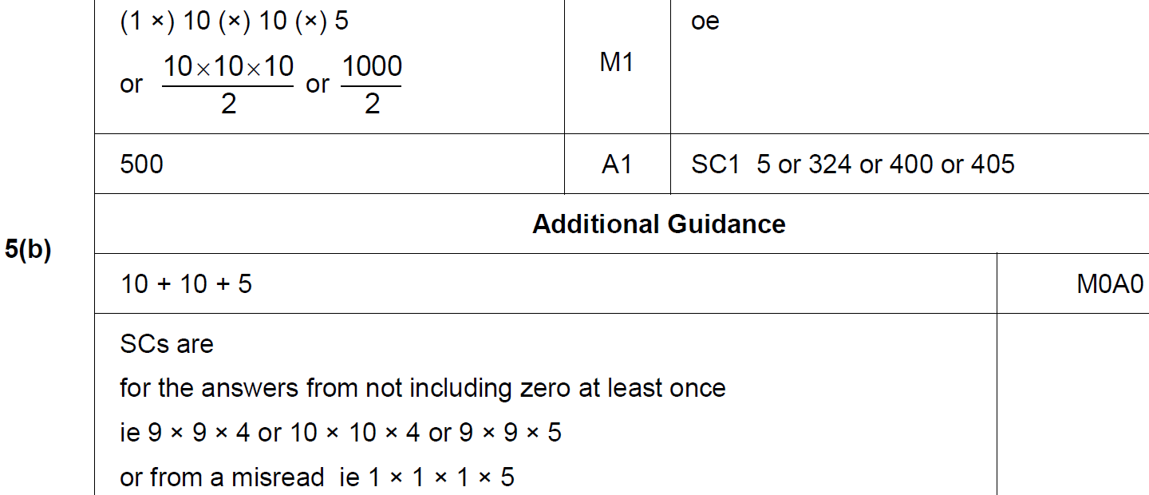
Basic Probability
June 2017 2H Q5
B

Slide 11
Basic Probability
June 2017 2H Q9

Slide 12
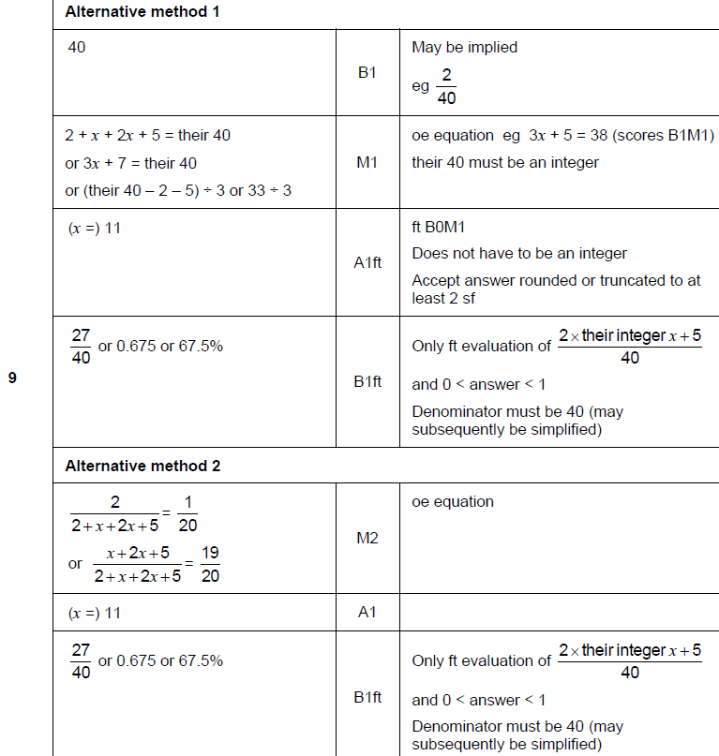
Basic Probability
June 2017 2H Q9
A

Slide 13
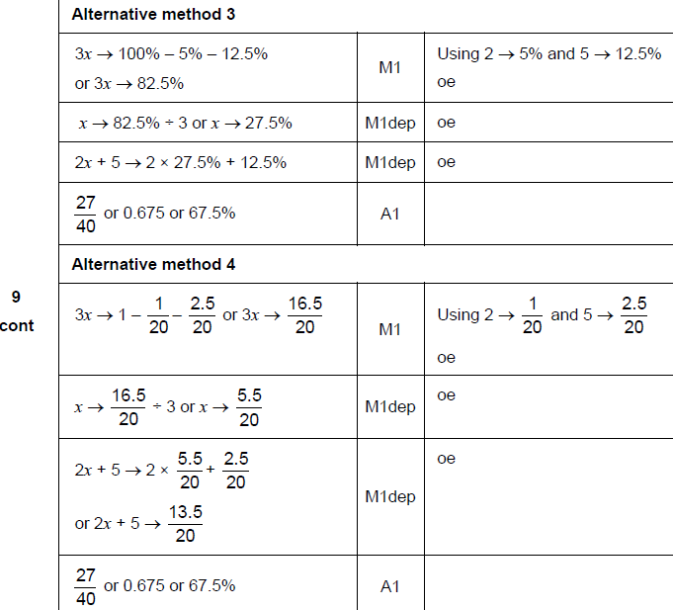
Basic Probability
June 2017 2H Q9
A Alternatives

Slide 14
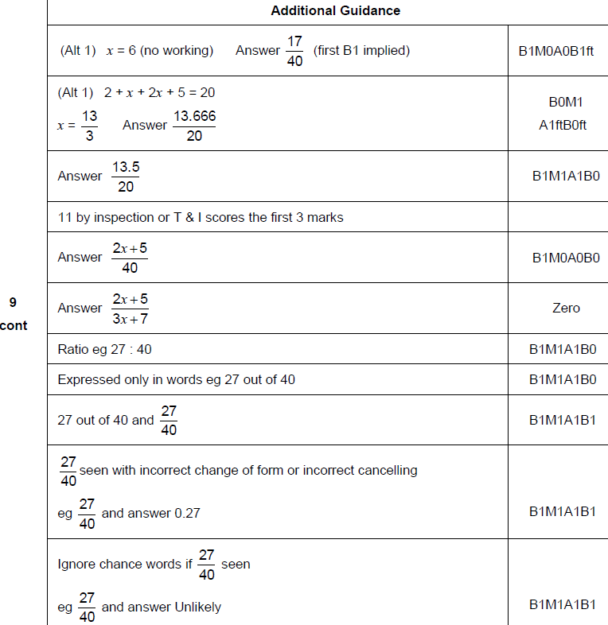
Basic Probability
June 2017 2H Q9
A notes

Slide 15
Basic Probability
June 2017 3H Q5

Slide 16
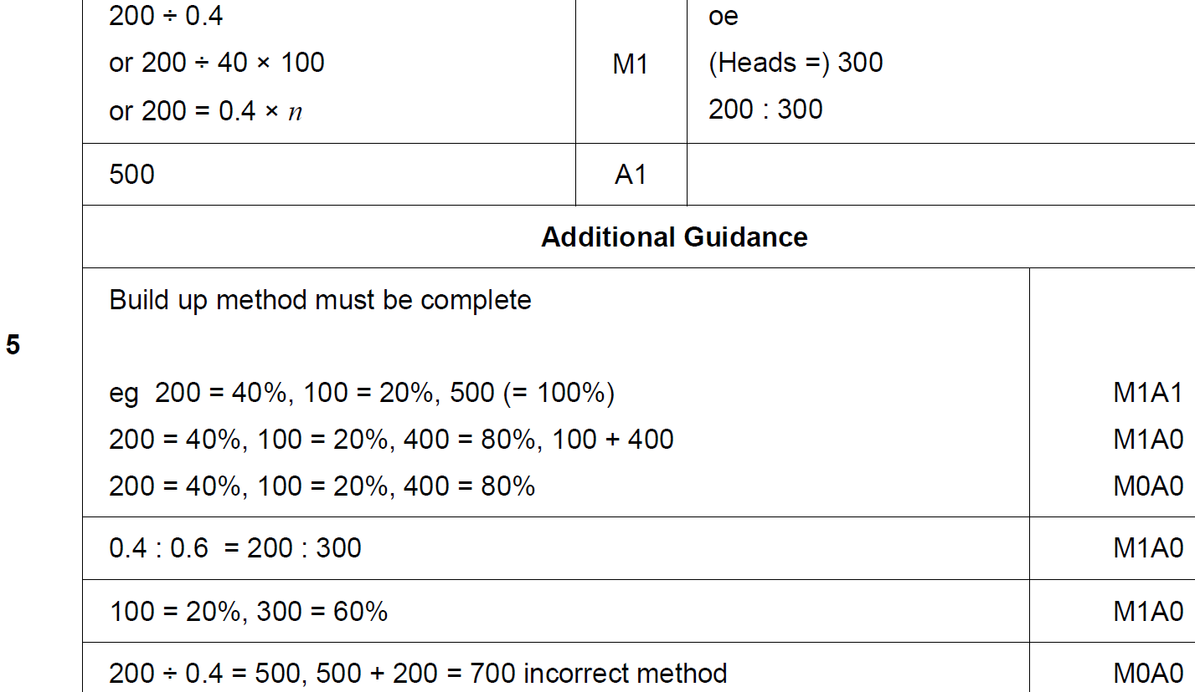
Basic Probability
June 2017 3H Q5
A

Slide 17
Basic Probability
June 2017 3H Q9

Slide 18
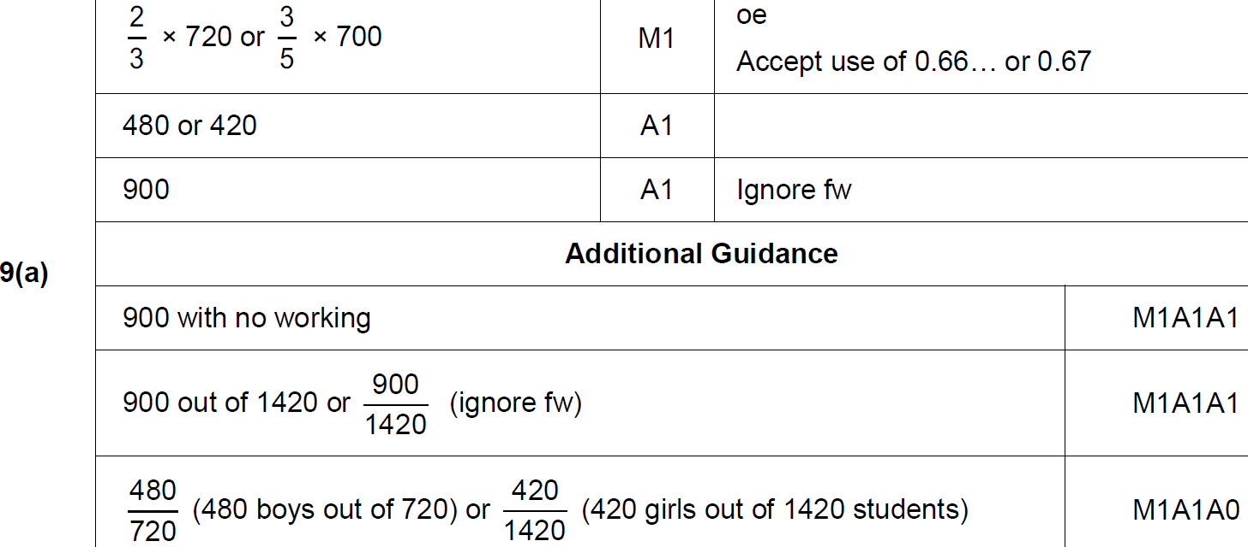
Basic Probability
June 2017 3H Q9
A

Slide 19
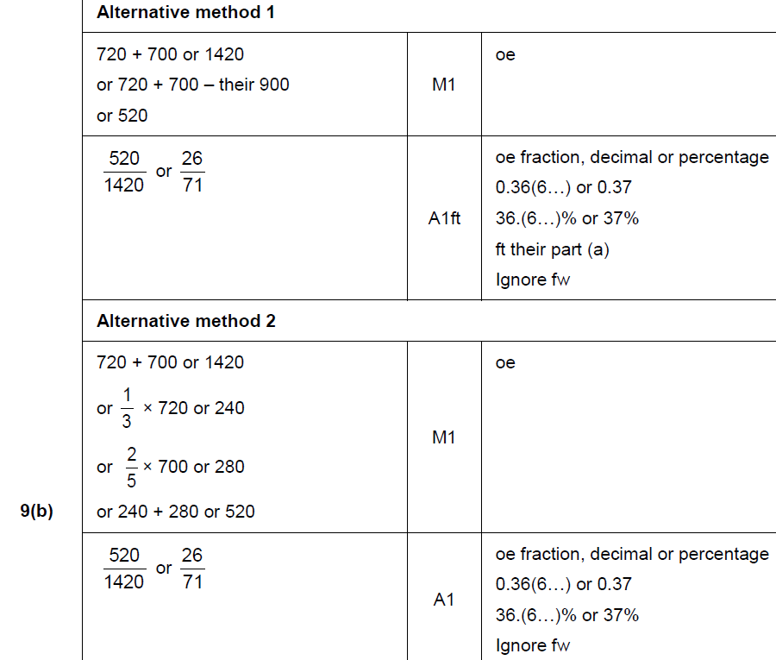
Basic Probability
June 2017 3H Q9
B

Slide 20
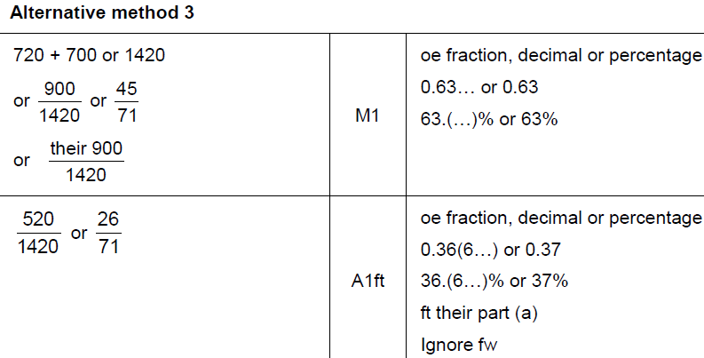
Basic Probability
June 2017 3H Q9
B Alternative & notes

Slide 21
Basic Probability
May 2018 1H Q8
A coin is thrown 50 times.
It lands on heads 31 times.
(a) Write down the relative frequency it lands on heads.
[1 mark]
(b) Raj says,
“The coin is biased towards heads.”
Use the data to give a reason why he might be correct.
[1 mark]

Slide 22
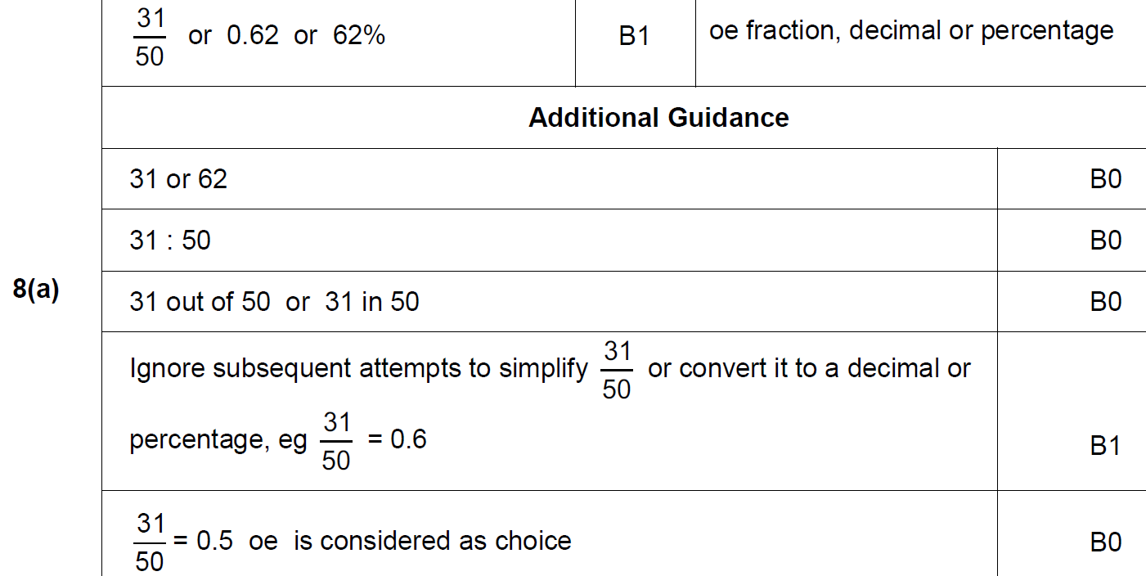
Basic Probability
May 2018 1H Q8
A

Slide 23
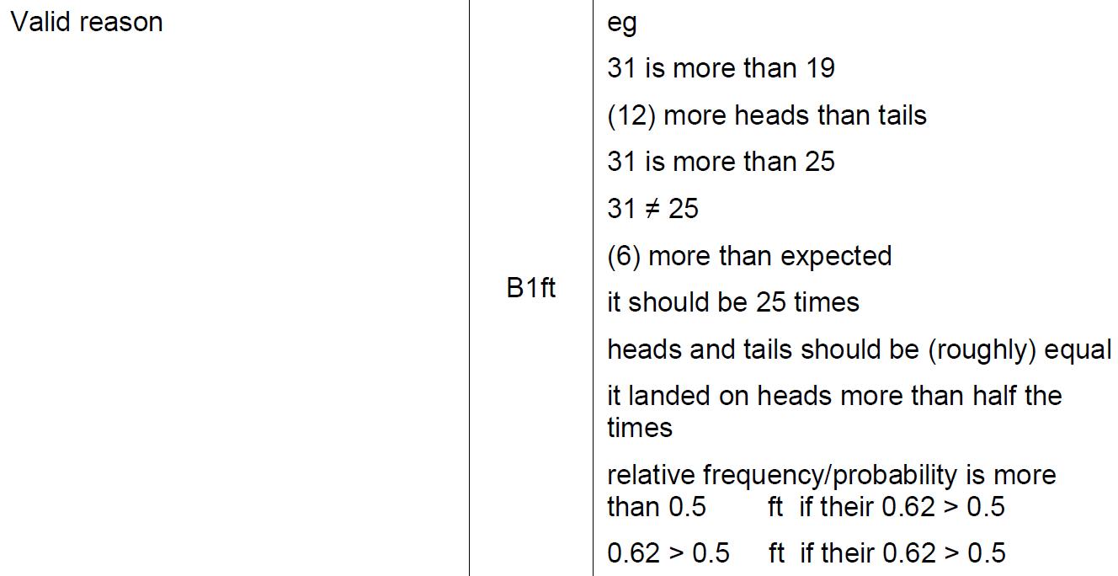
Basic Probability
May 2018 1H Q8
B

Slide 24
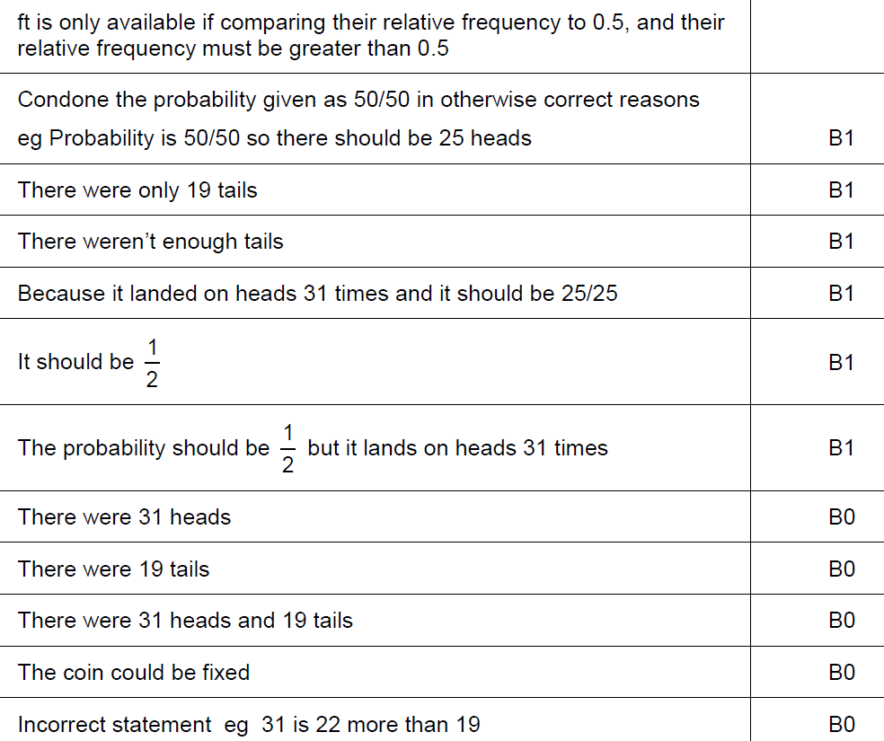
Basic Probability
May 2018 1H Q8
B notes

Slide 25
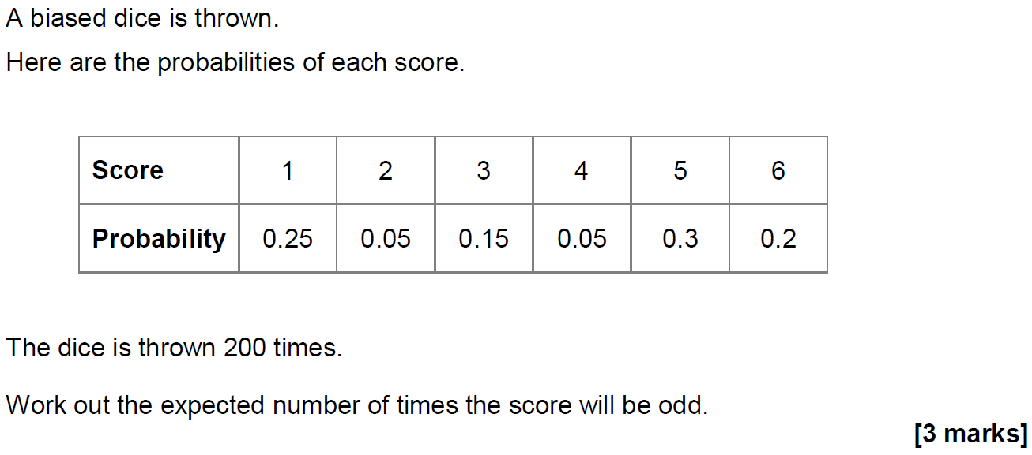
Basic Probability
May 2018 1H Q15

Slide 26
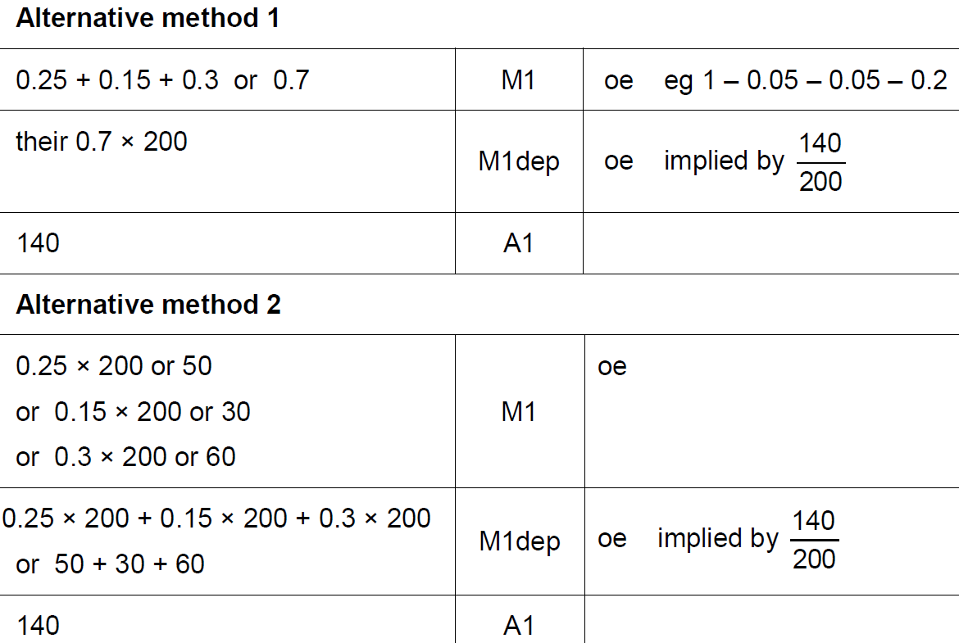
Basic Probability
May 2018 1H Q15
A

Slide 27
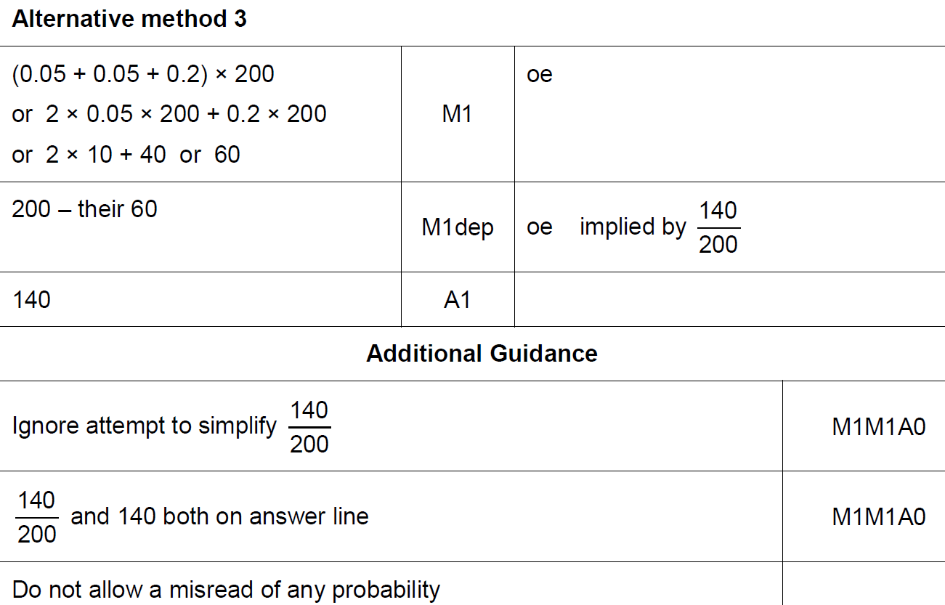
Basic Probability
May 2018 1H Q15
A Alternative 2 & notes

Slide 28
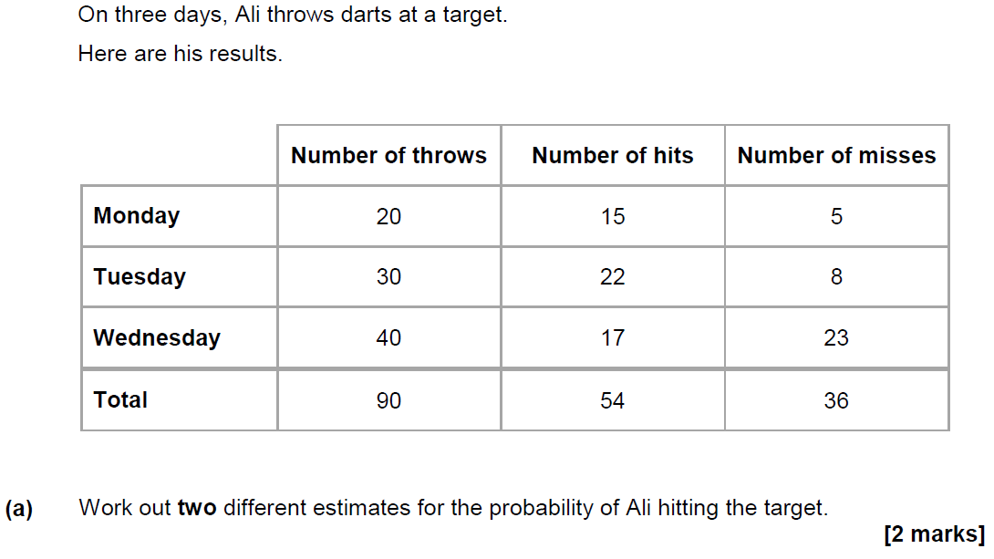
Basic Probability
June 2018 2H Q7

Slide 29
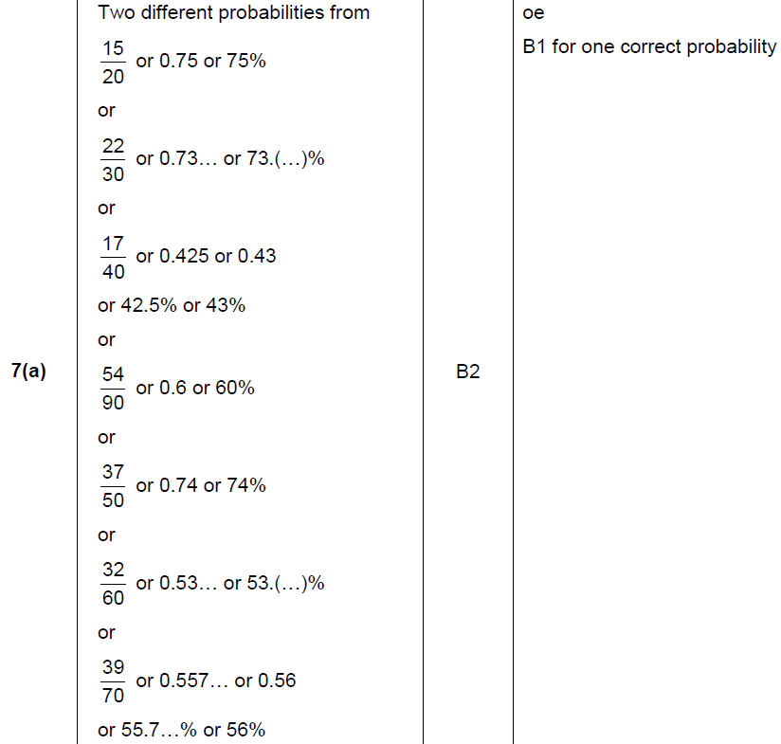
Basic Probability
June 2018 2H Q7
A

Slide 30
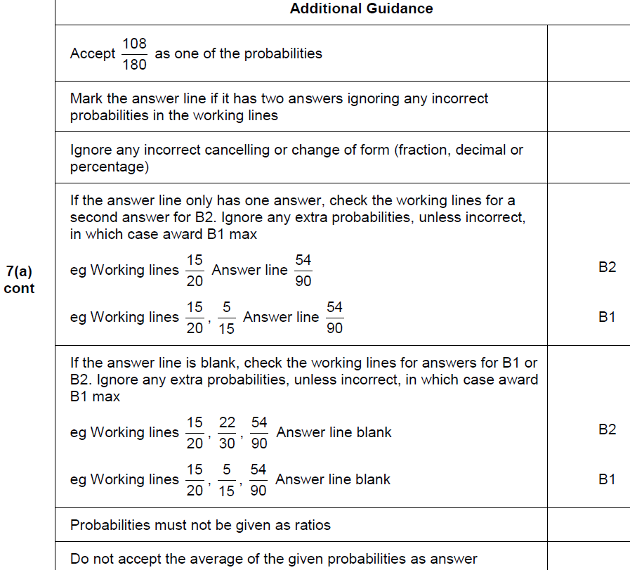
Basic Probability
June 2018 2H Q7
A notes

Slide 31
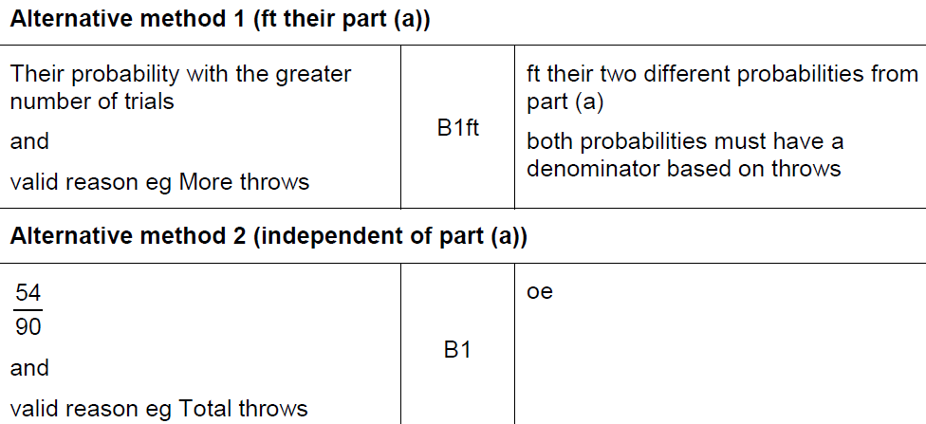
Basic Probability
June 2018 2H Q7
B

Slide 32
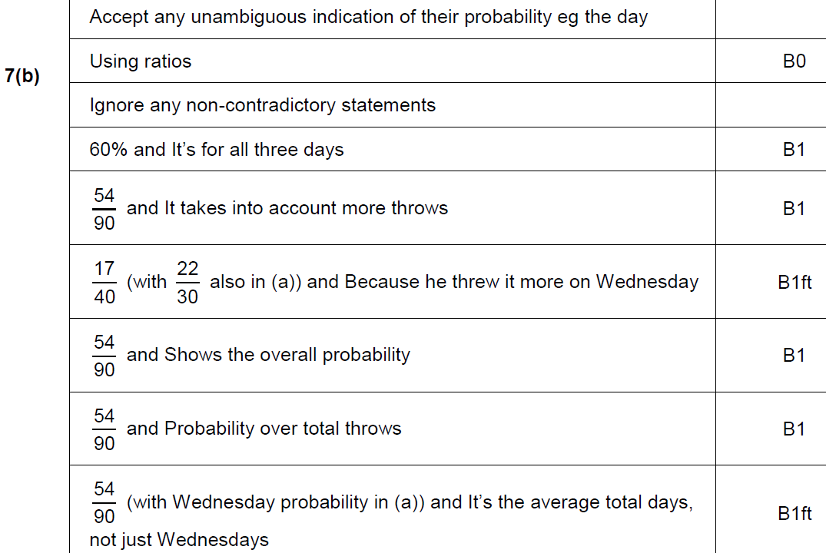
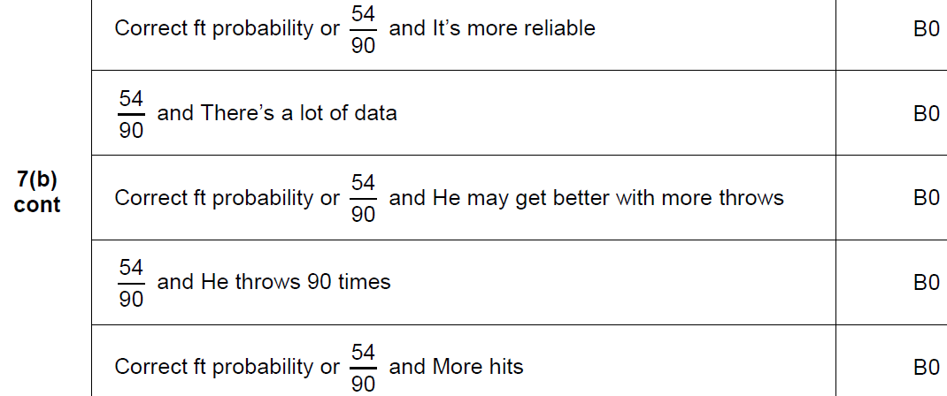
Basic Probability
June 2018 2H Q7
B notes

Slide 33
Basic Probability
Nov 2018 3H Q13

Slide 34
Basic Probability
Nov 2018 3H Q13
A

