Slide 1
Basic Probability
Basic Probability
June 2017
2H Q9
SAM
1H Q7
Nov 2017
1H Q1
SAM
2H Q3
Nov 2017
3H Q4
SAM
2H Q6
June 2018
2H Q5
SAM
3H Q5
June 2018
3H Q7
Experimental/ using samples

Slide 2
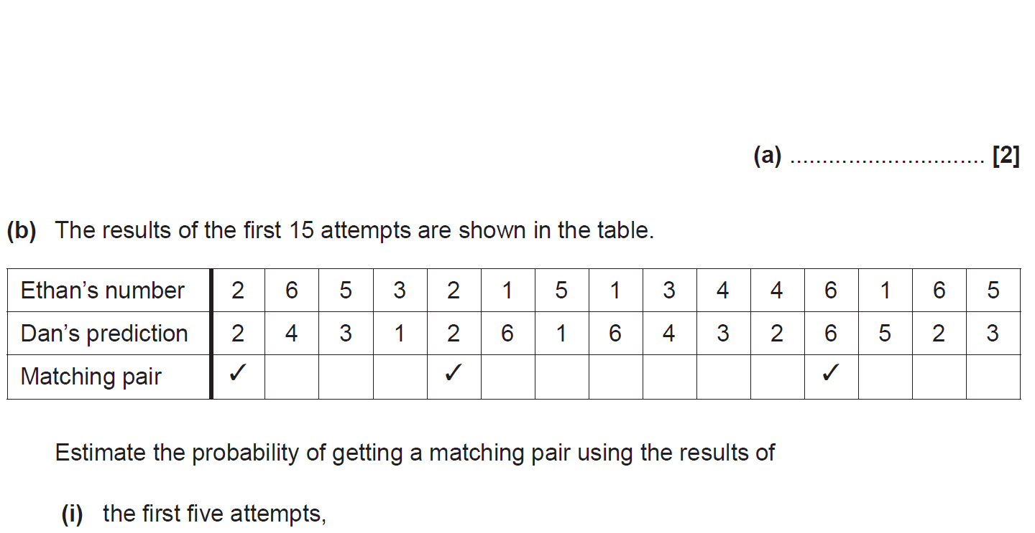
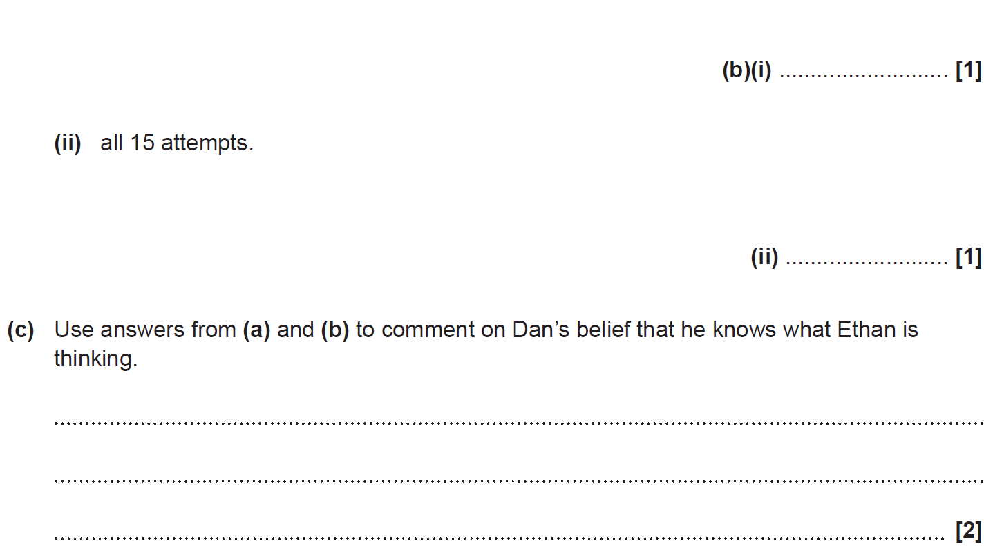
Basic Probability
SAM 1H Q7

Slide 3
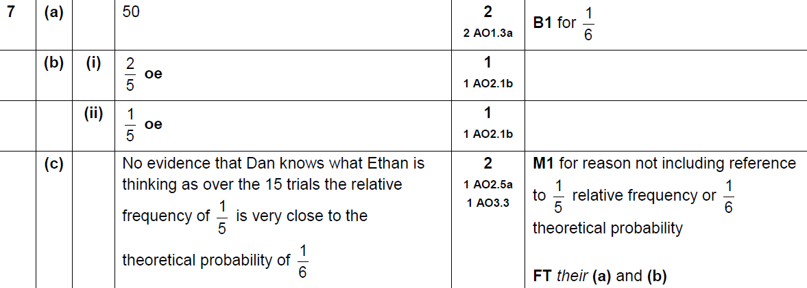
Basic Probability
SAM 1H Q7
A
B (i)
B (ii)
C

Slide 4
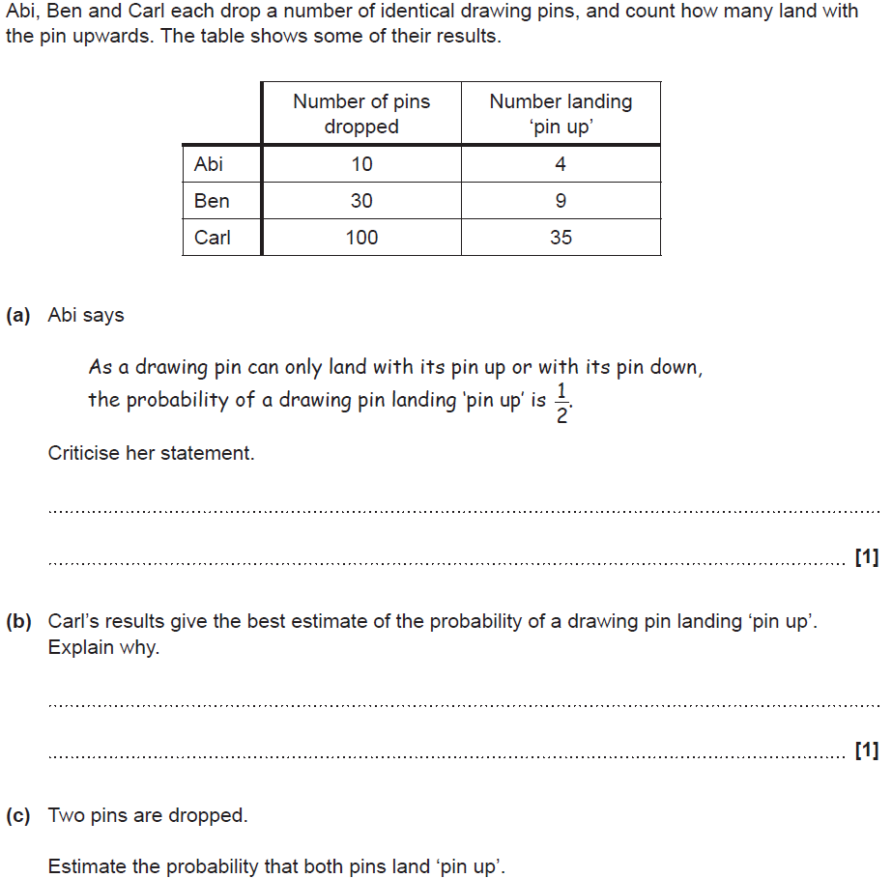
Basic Probability
SAM 2H Q3

Slide 5
Basic Probability
SAM 2H Q3
A
B
C

Slide 6
Basic Probability
SAM 2H Q6

Slide 7
Basic Probability
SAM 2H Q6
A

Slide 8
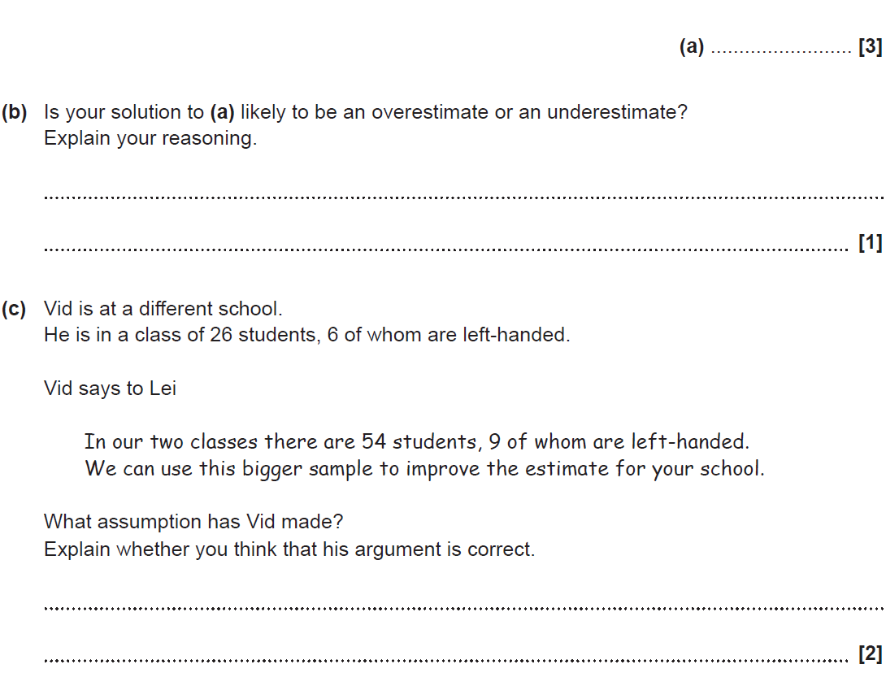
Basic Probability
SAM 3H Q5

Slide 9
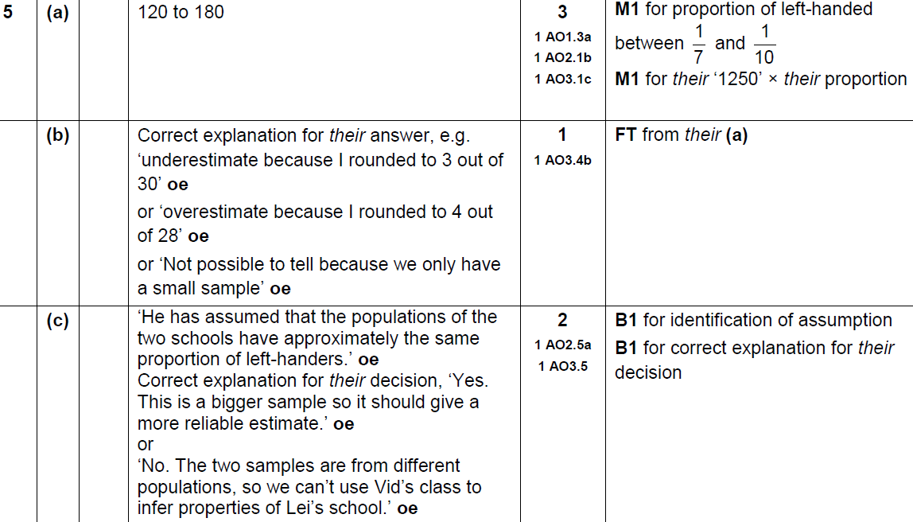
Basic Probability
SAM 3H Q5
A
B
C

Slide 10
Basic Probability
June 2017 2H Q9

Slide 11
Basic Probability
June 2017 2H Q9
A

Slide 12
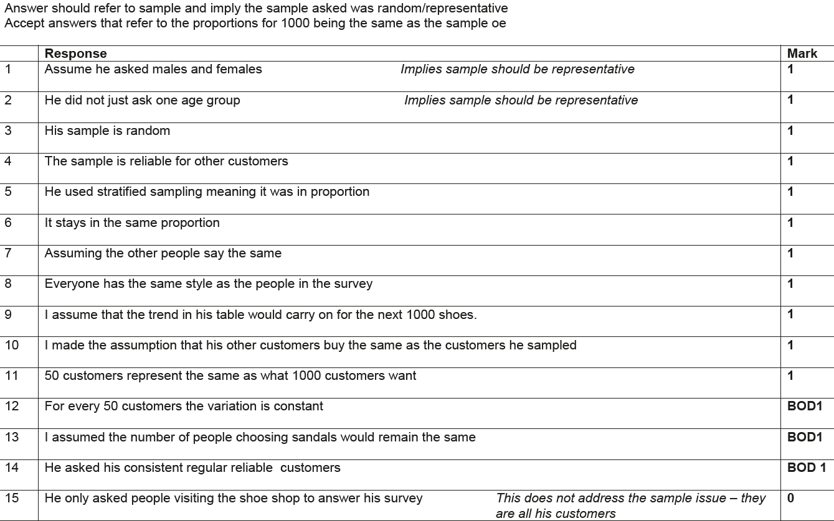
Basic Probability
June 2017 2H Q9
A Exemplar responses

Slide 13
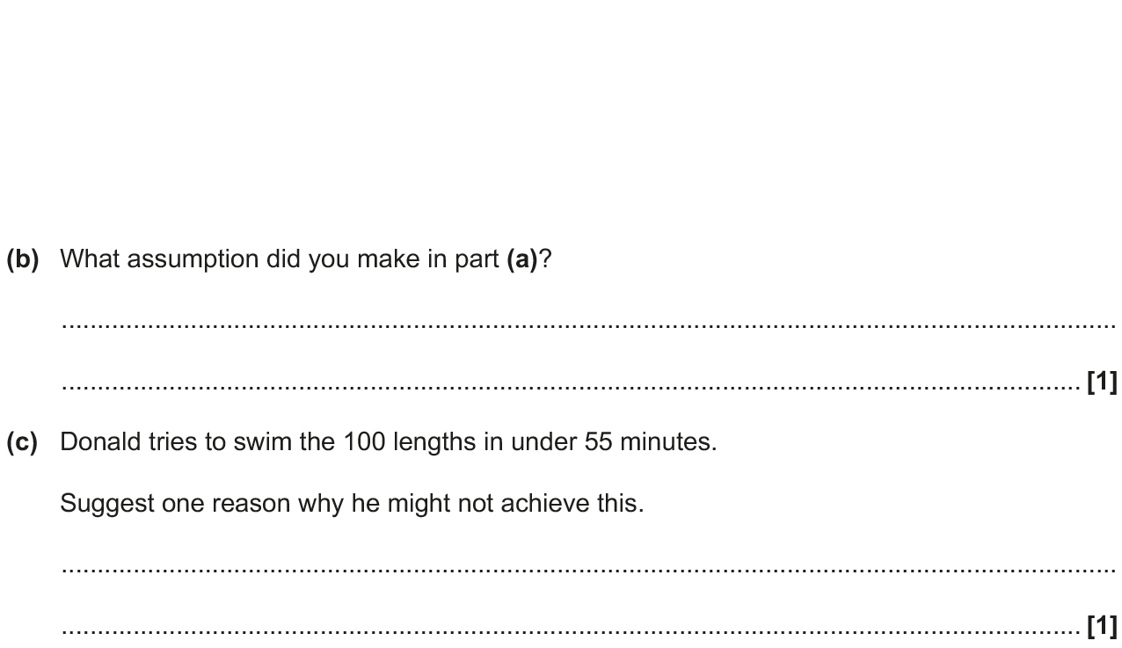
Basic Probability
Nov 2017 1H Q1

Slide 14
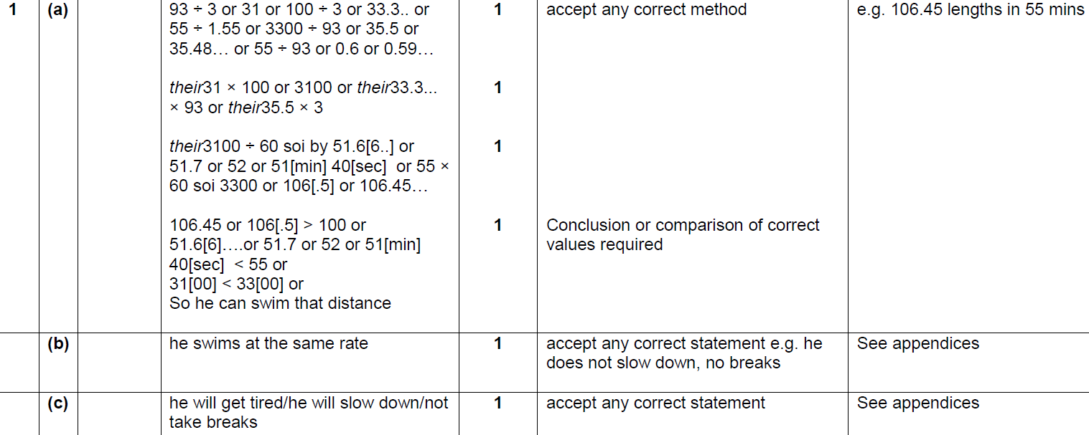
Basic Probability
Nov 2017 1H Q1
A
B
C

Slide 15
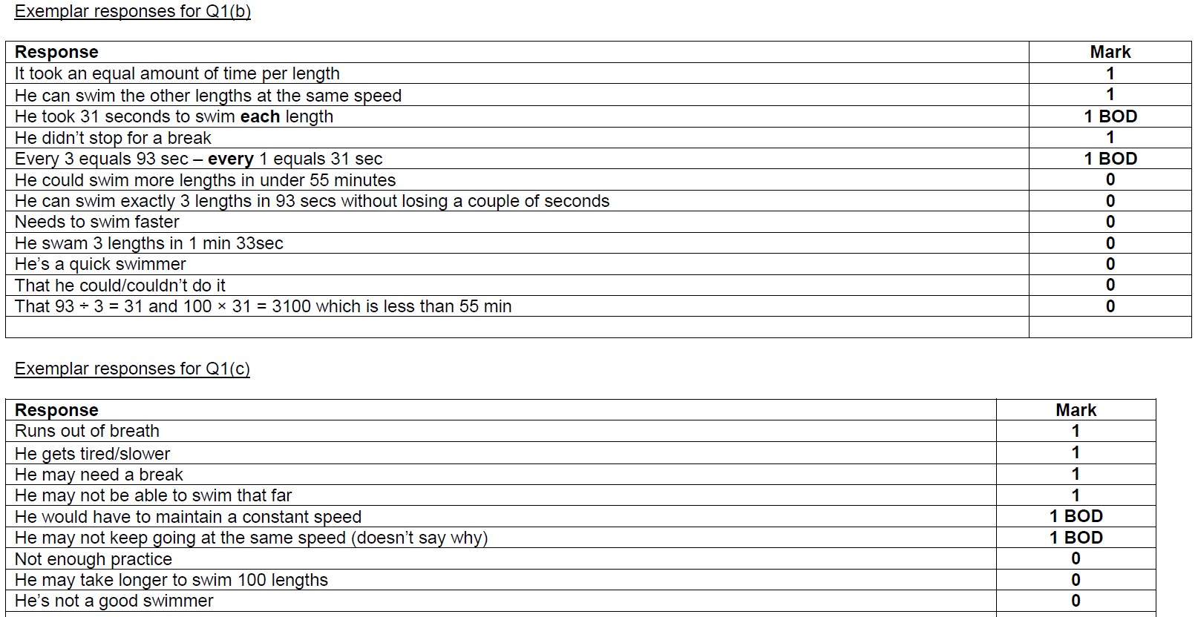
Basic Probability
Nov 2017 1H Q1
B Exemplar responses
C Exemplar responses

Slide 16
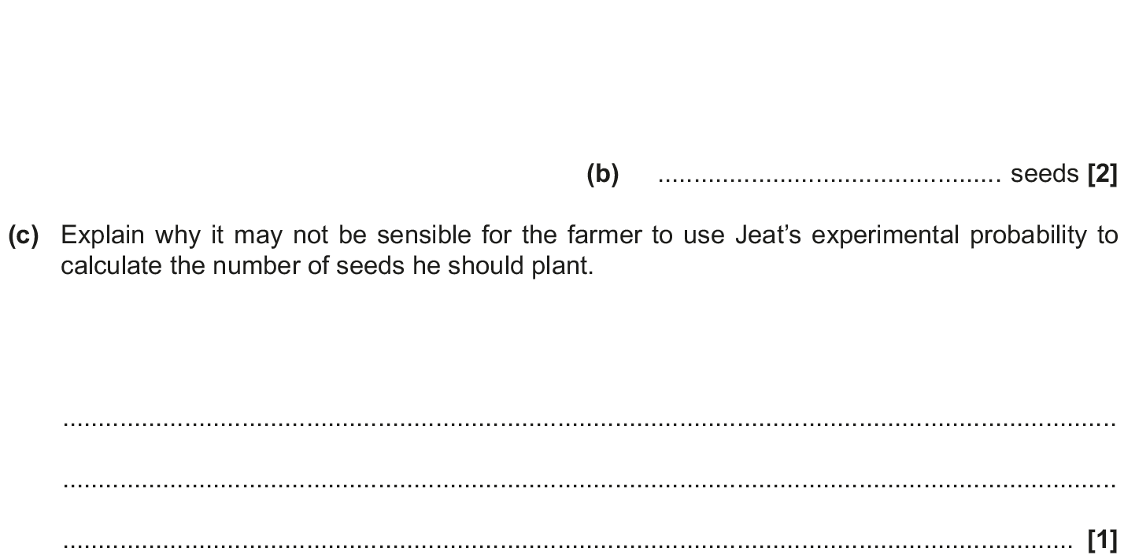
Basic Probability
Nov 2017 3H Q4

Slide 17
Basic Probability
Nov 2017 3H Q4
A
B
C

Slide 18
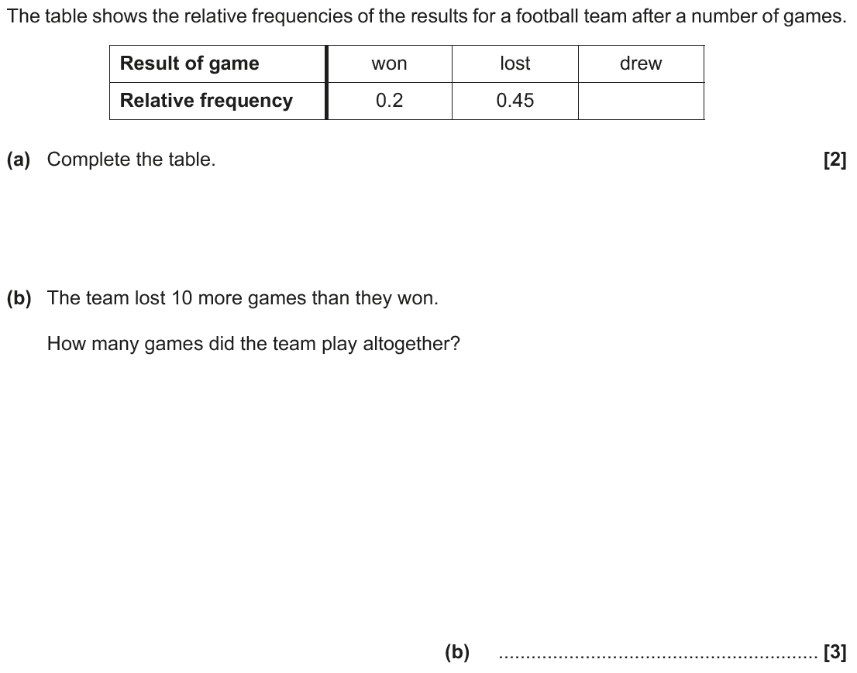
Basic Probability
June 2018 2H Q5

Slide 19
Basic Probability
June 2018 2H Q5
A
B

Slide 20
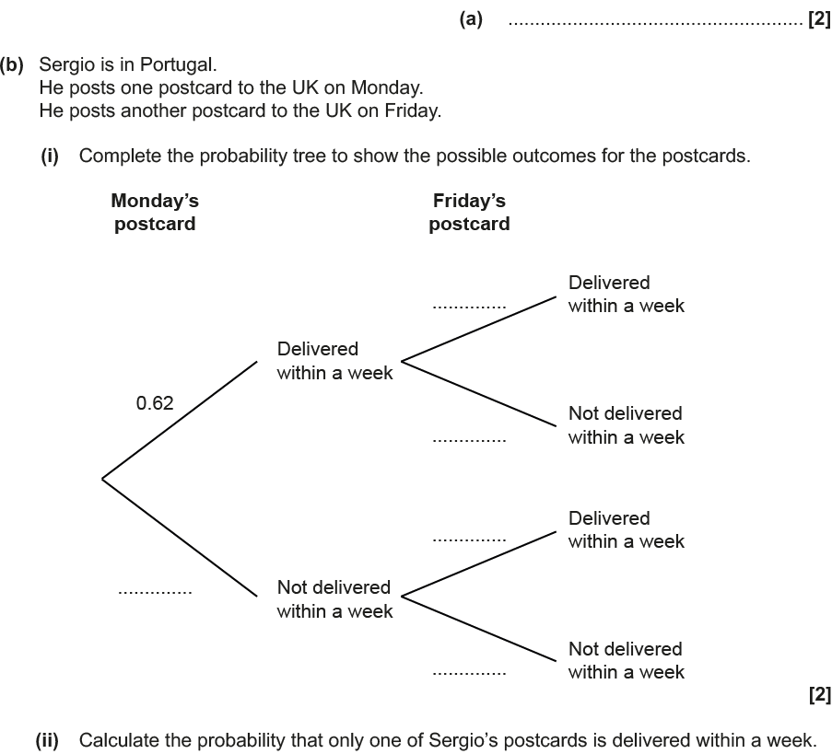
Basic Probability
Nov 2018 3H Q7

Slide 21
Basic Probability
Nov 2018 3H Q7
A
B (i)
B (ii)

