Slide 1
Basic Probability
Basic Probability
June 2017
2H Q1
June 2018
3H Q6
Nov 2017
2H Q4
SAM
1H Q7
Nov 2018
2H Q16
Nov 2017
3H Q8
Spec 1
1H Q3
May 2019
1H Q1
Nov 2017
3H Q10
Spec 1
1H Q6
May 2019
1H Q22
May 2018
1H Q16
June 2019
2H Q3
June 2018
2H Q8
Probability Space
Experimental/ using samples

Slide 2
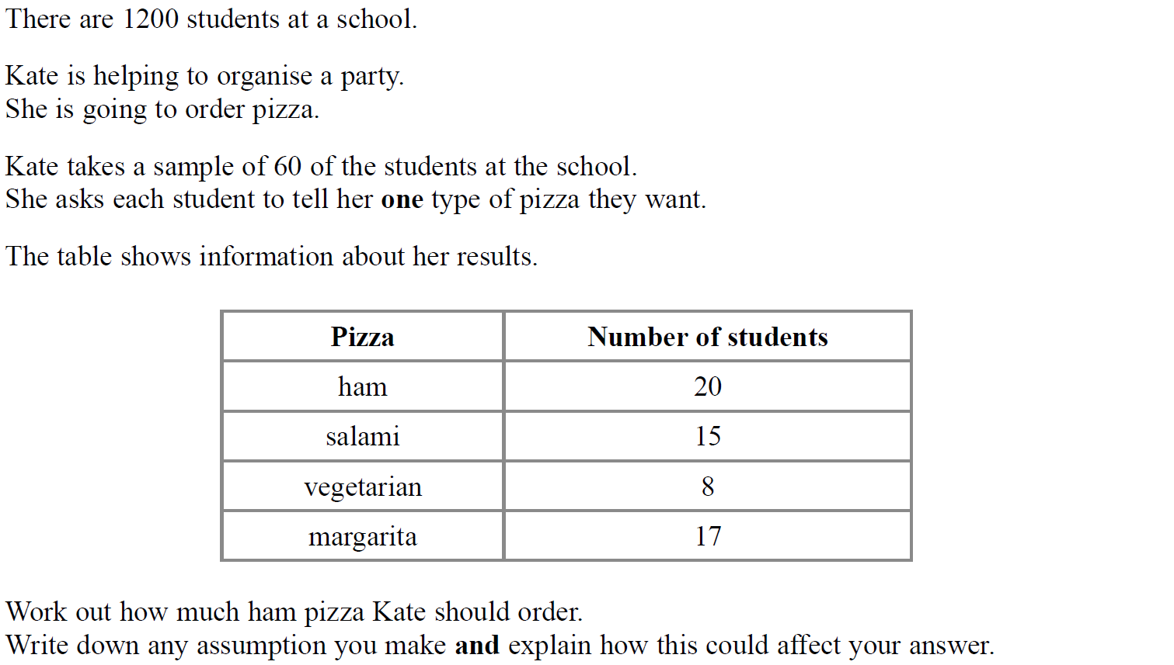
Basic Probability
SAM 1H Q7

Slide 3
Basic Probability
SAM 1H Q7
A

Slide 4
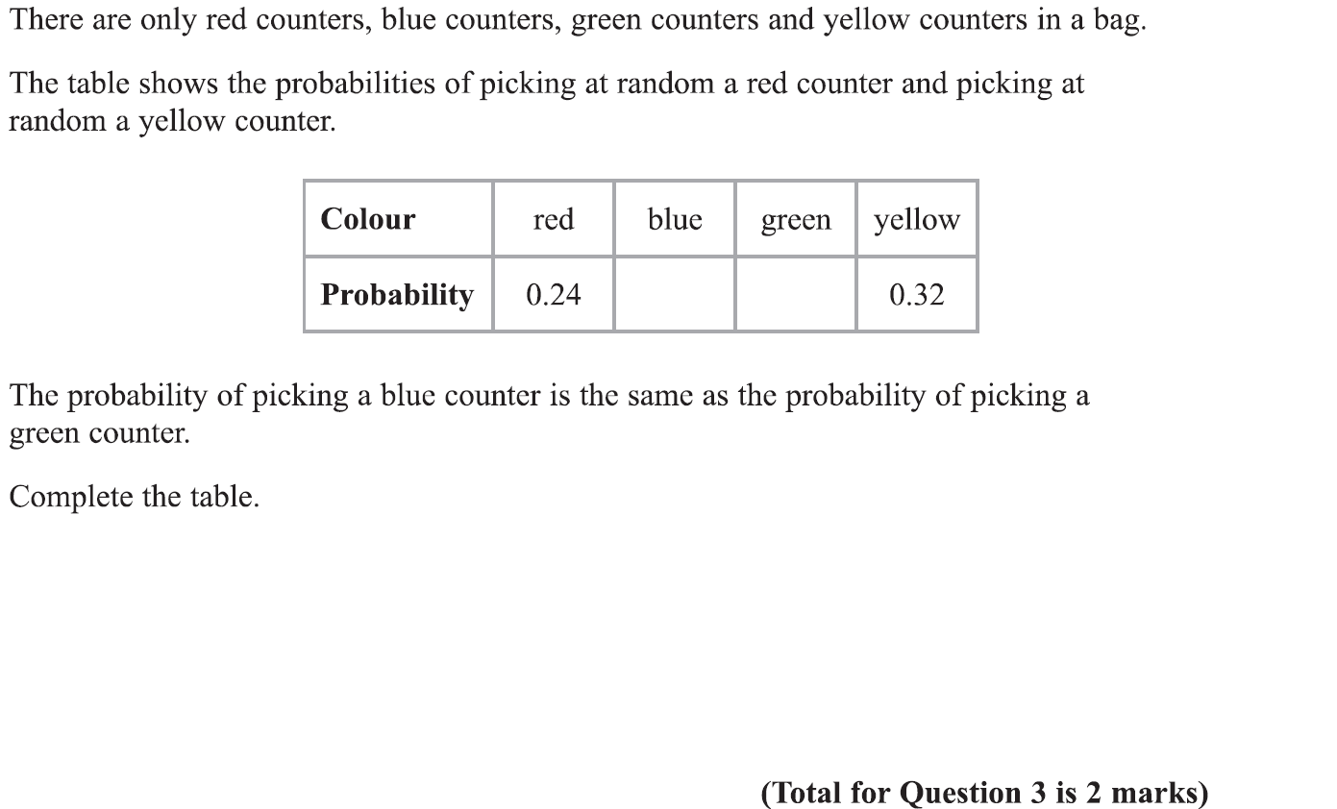
Basic Probability
Specimen Set 1 1H Q3

Slide 5
Basic Probability
Specimen Set 1 1H Q3
A

Slide 6
Basic Probability
Specimen Set 1 1H Q6

Slide 7
Basic Probability
Specimen Set 1 1H Q6
A
B
C

Slide 8
Basic Probability
June 2017 2H Q1

Slide 9
Basic Probability
June 2017 2H Q1
A

Slide 10
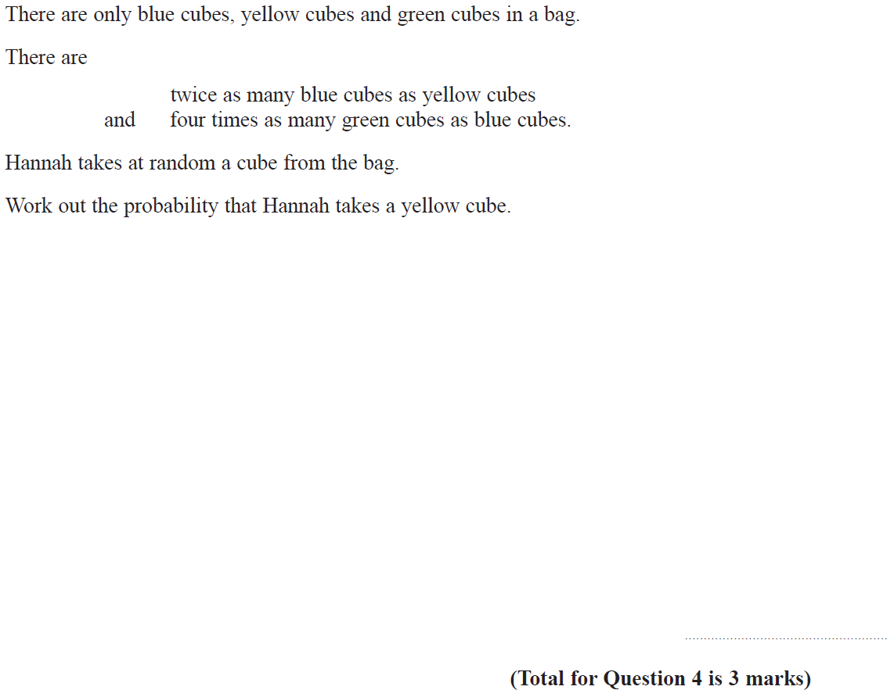
Basic Probability
Nov 2017 2H Q4

Slide 11
Basic Probability
Nov 2017 2H Q4
A

Slide 12
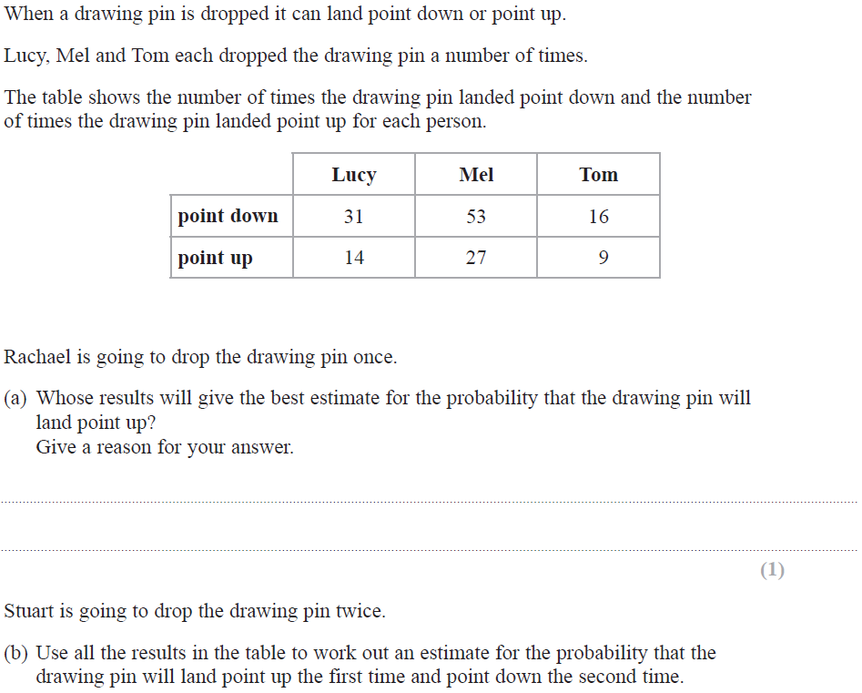
Basic Probability
Nov 2017 3H Q8

Slide 13
Basic Probability
Nov 2017 3H Q8
A
B

Slide 14
Basic Probability
Nov 2017 3H Q10

Slide 15
Basic Probability
Nov 2017 3H Q10
A
B

Slide 16
Basic Probability
May 2018 1H Q16

Slide 17
Basic Probability
May 2018 1H Q16
A

Slide 18
Basic Probability
June 2018 2H Q8

Slide 19
Basic Probability
June 2018 2H Q8
A

Slide 20
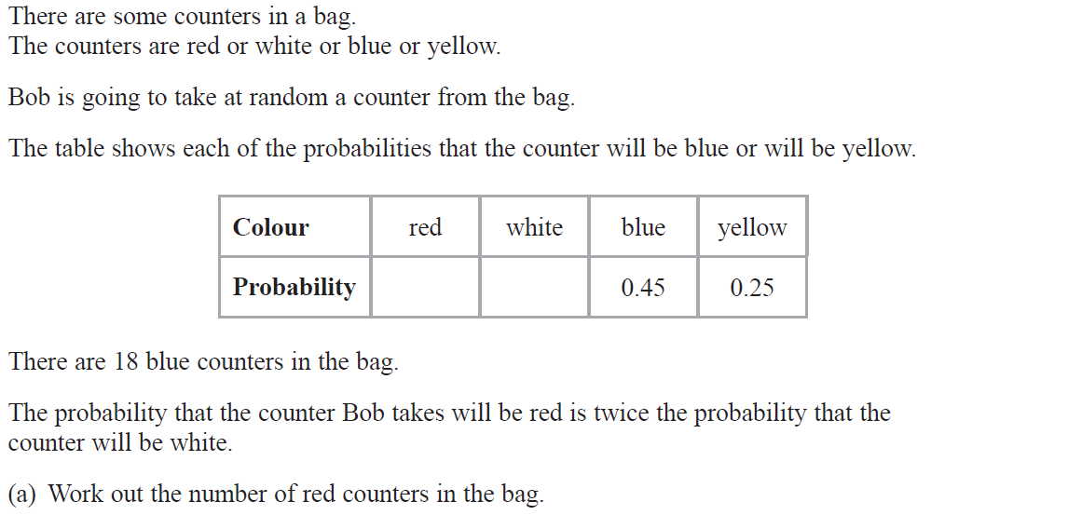
Basic Probability
June 2018 3H Q6

Slide 21
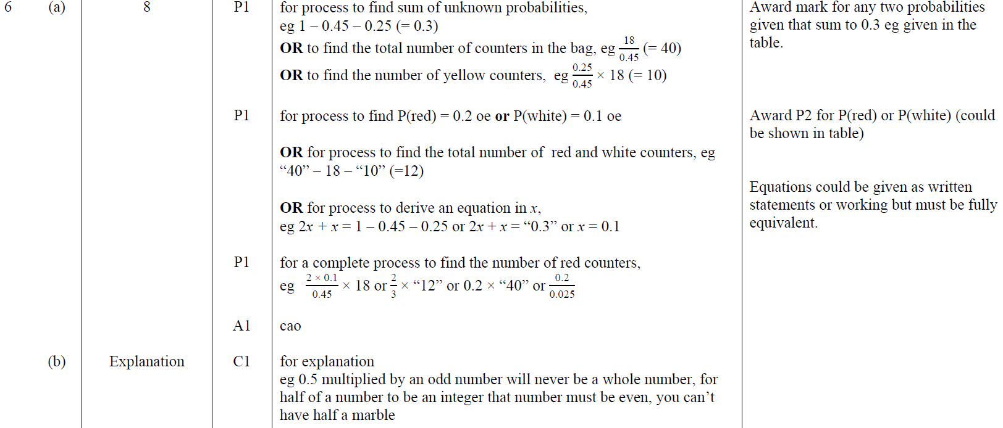
Basic Probability
June 2018 3H Q6
A
B

Slide 22
Basic Probability
Nov 2018 2H Q16

Slide 23
Basic Probability
Nov 2018 2H Q16
A
B

Slide 24
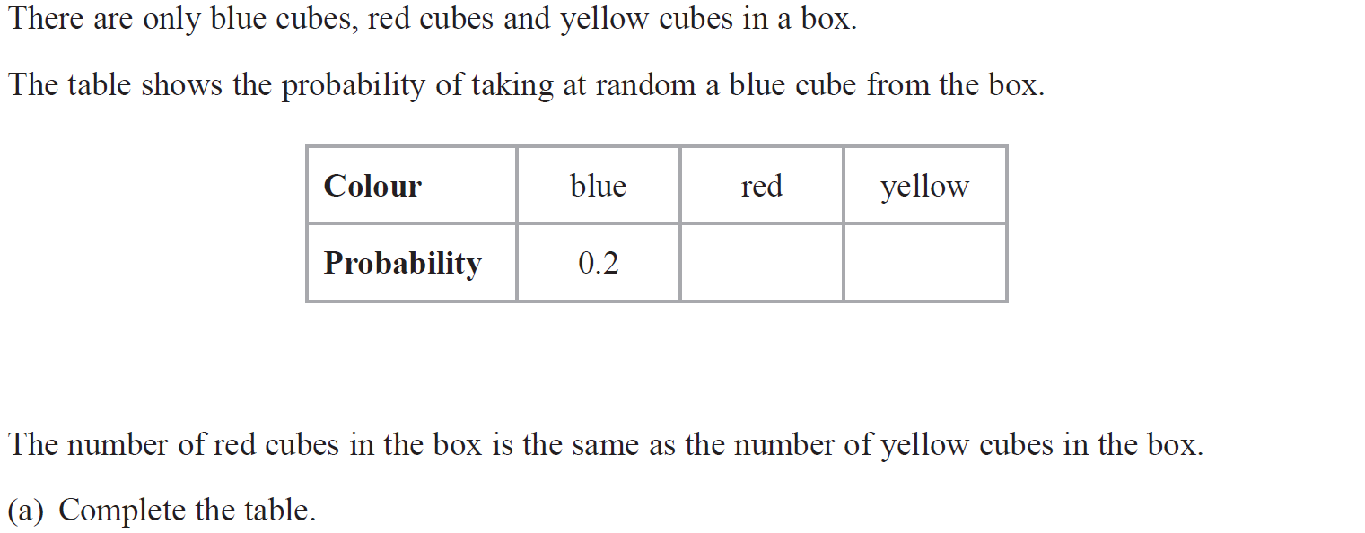
Basic Probability
May 2019 1H Q1

Slide 25
Basic Probability
May 2019 1H Q1
A
B
A SF
B SF

Slide 26
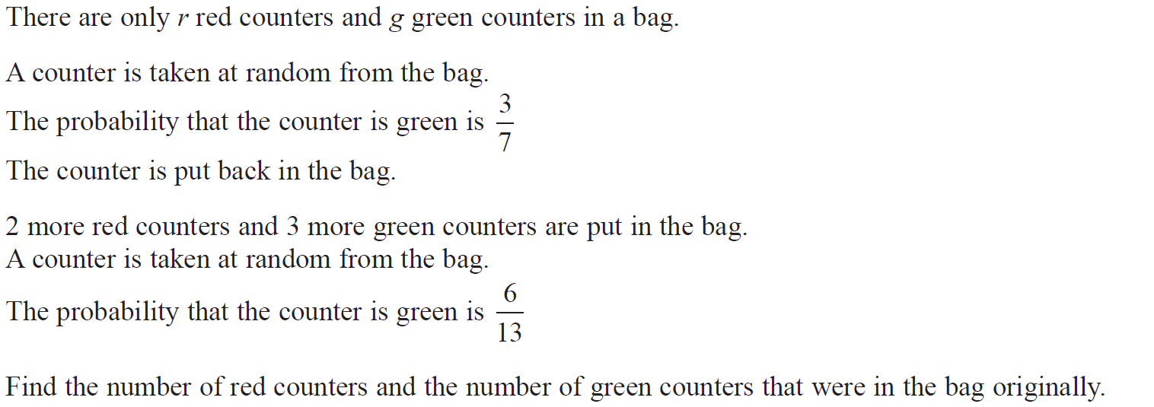
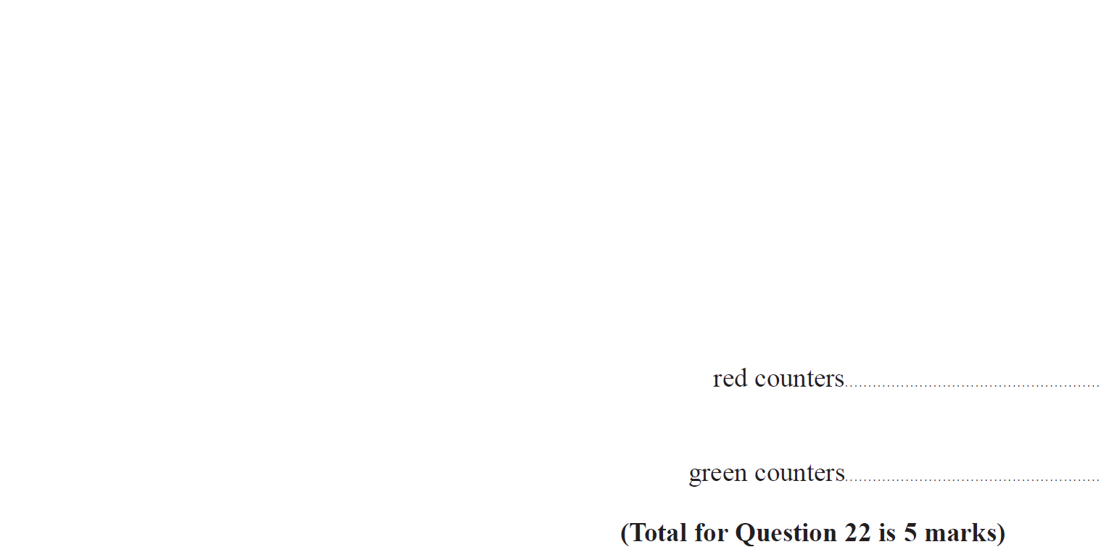
Basic Probability
May 2019 1H Q22

Slide 27
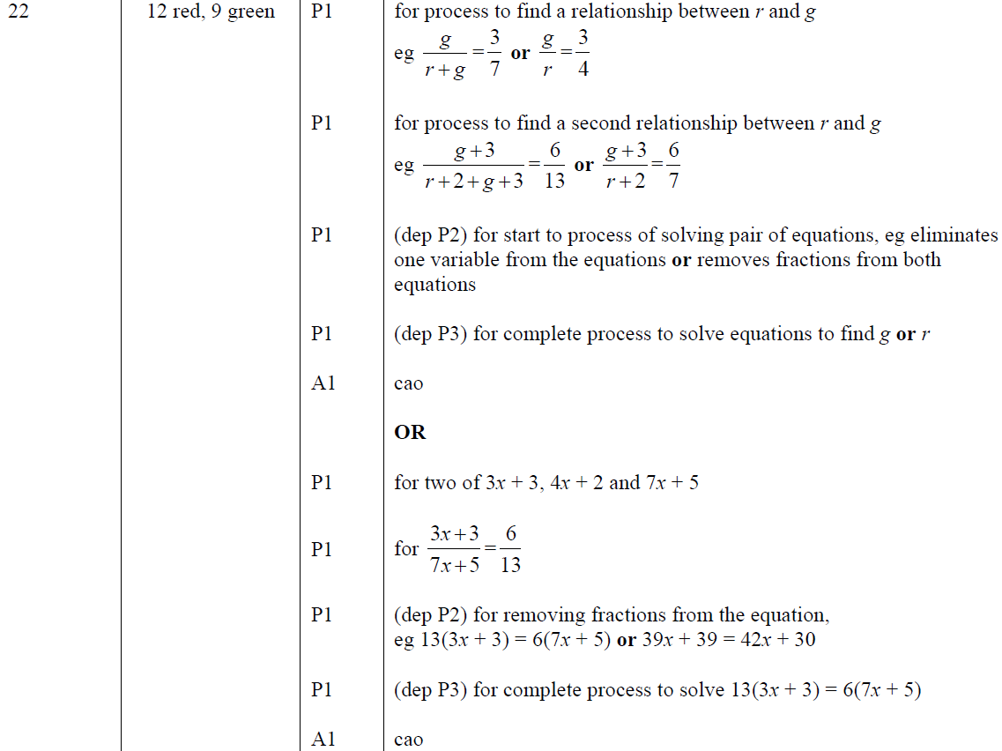
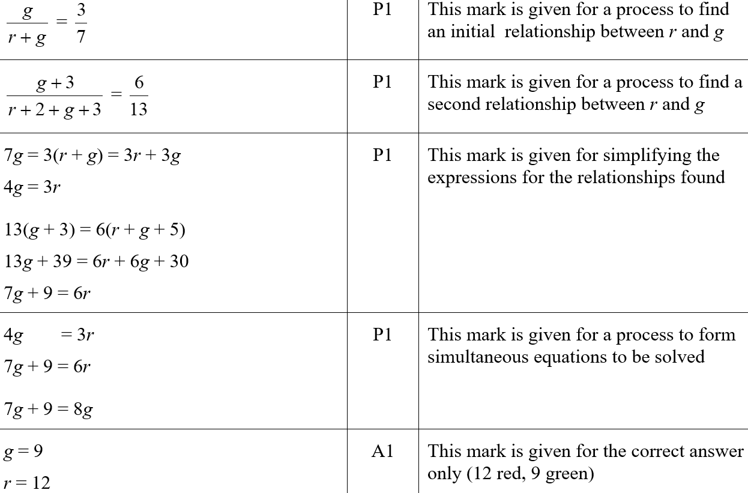
Basic Probability
May 2019 1H Q22
A
A SF

Slide 28
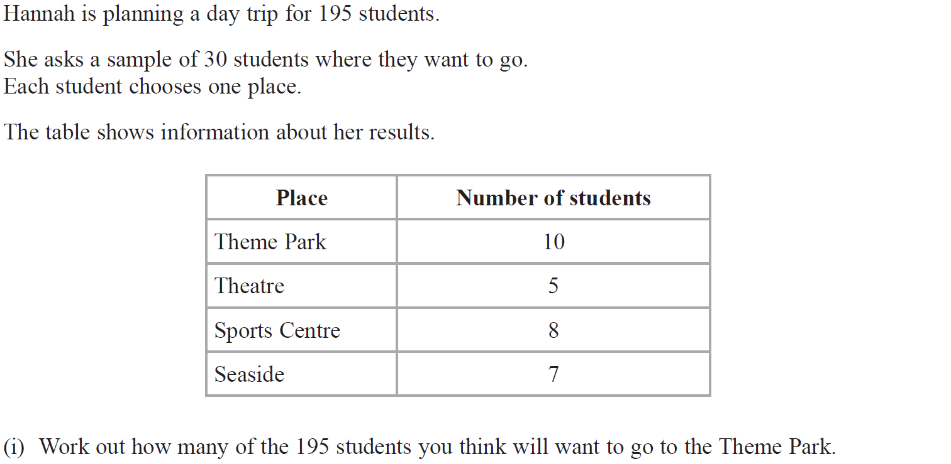
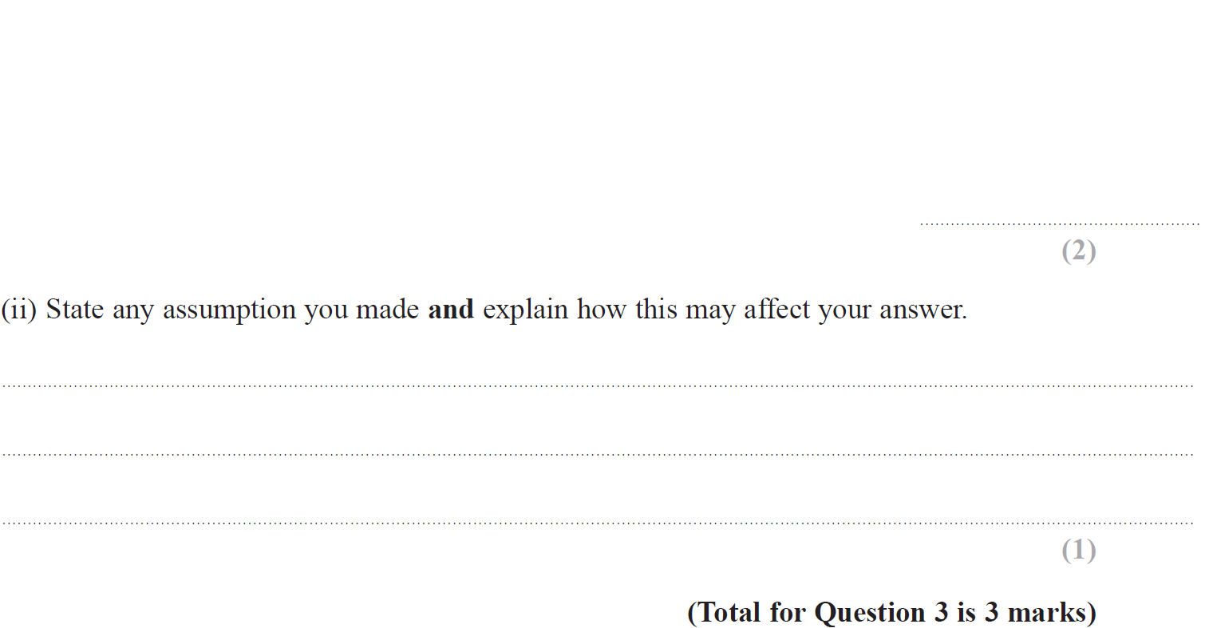
Basic Probability
June 2019 2H Q3

Slide 29
Basic Probability
June 2019 2H Q3
(i)
(ii)
(i) SF
(ii) SF

