Slide 1
Basic Probability
Basic Probability
Old Spec Q’s
SAM
1H Q3
Jan 2019
1H Q3
May 2019
1H Q5

Slide 2
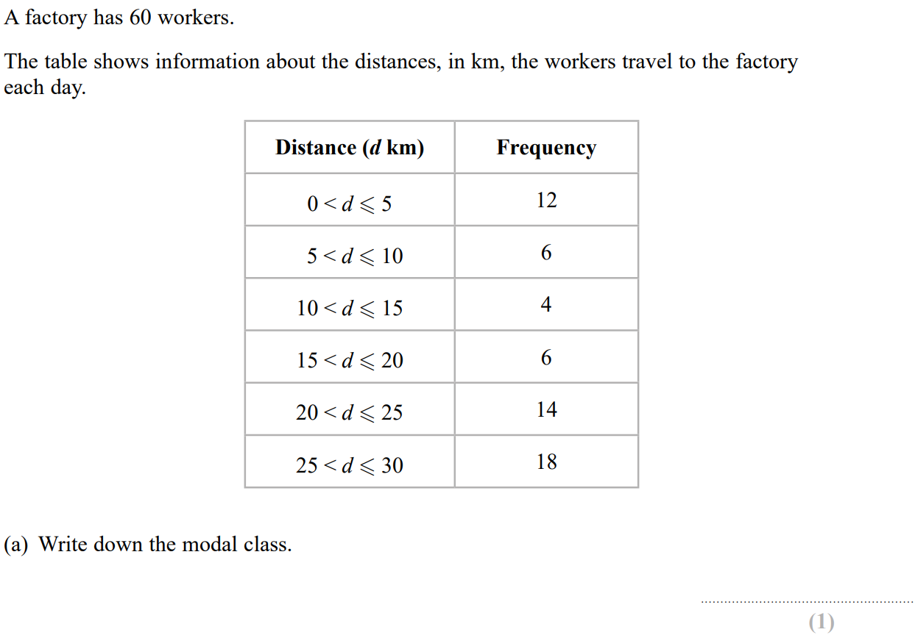
Basic Probability
SAM 1H Q3

Slide 3
Basic Probability
SAM 1H Q3
A
B
C

Slide 4
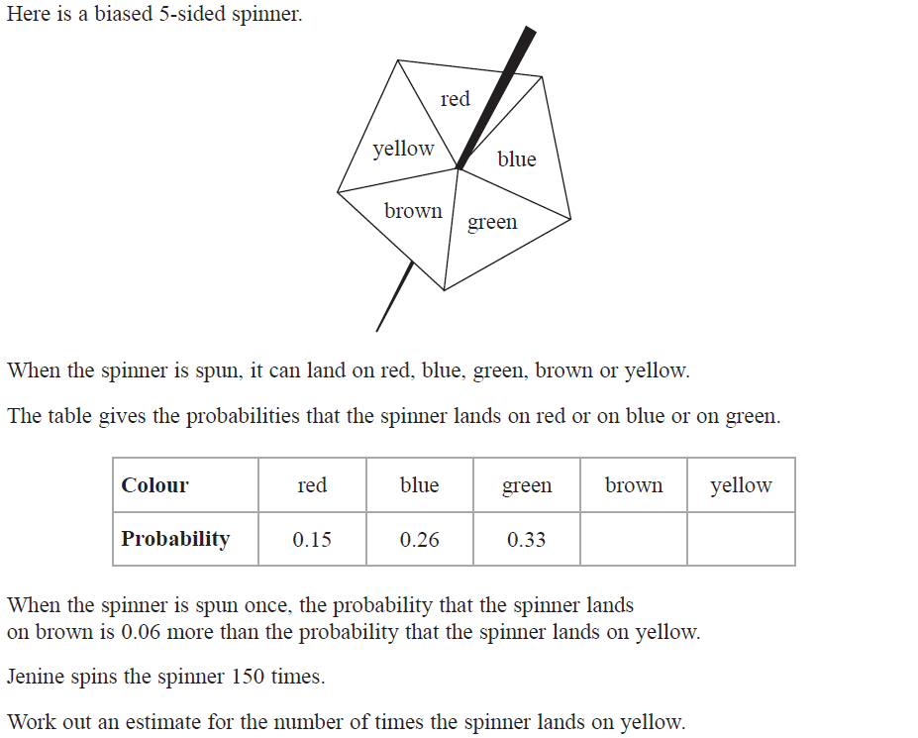
Basic Probability
Jan 2019 1H Q3

Slide 5
Basic Probability
Jan 2019 1H Q3
A

Slide 6
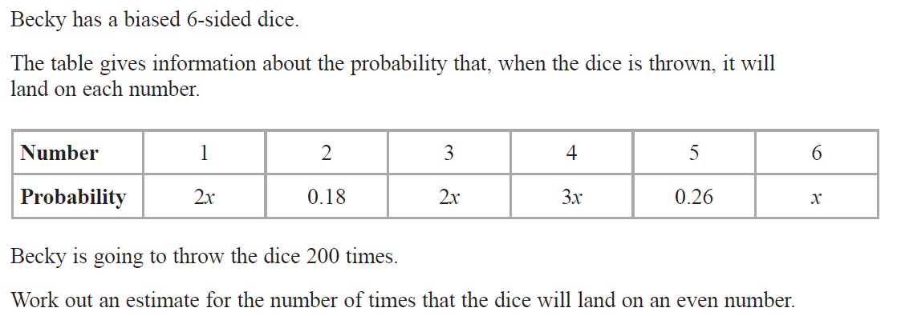
Basic Probability
May 2019 1H Q5

Slide 7
Basic Probability
May 2019 1H Q5
A

Slide 8
Basic Probability
Basic Probability
New Spec Q’s
May 2004
3H Q4
May 2007
3H Q10
June 2009
4H Q6
Jan 2013 3H Q1
Jan 2015 3H Q5
Jan 2017 4H Q2
May 2018 3HR Q2
Nov 2004
4H Q4
May 2007
4H Q8
Nov 2009
3H Q8
Jan 2013 4H Q4
Jan 2015 4H Q3
Jan 2017 4HR Q2
May 2005
3H Q5
Nov 2007
3H Q8
Nov 2009
4H Q4
May 2013 4H Q1
June 2015 4H Q1
May 2017 3H Q11
May 2005
4H Q6
May 2008
3H Q2
June 2010
4H Q3
May 2013 3HR Q1
June 2015 4HR Q6
June 2017 4H Q5
Nov 2005
4H Q7
May 2008
4H Q3
Nov 2010
4H Q4
Jan 2014 3H Q13
Jan 2016 4H Q4
Jan 2018 3H Q4
May 2006
4H Q14
May 2008
4H Q5
June 2011 3H Q4
Jan 2014 3HR Q8
Jan 2016 4H Q8
Jan 2018 4H Q7
Nov 2006
3H Q4
Nov 2008
3H Q3
June 2011 4H Q2
May 2014 4H Q2
Jan 2016 3HR Q4
Jan 2018 4HR Q6
Nov 2006
3H Q8
Nov 2008
4H Q5
Jan 2012 3H Q2
May 2014 3HR Q4
May 2016 3HR Q3
May 2018 3H Q5
Nov 2006
4H Q9
May 2009
3H Q4
Jan 2012 3H Q8
May 2014 4HR Q7
May 2016 3HR Q9
June 2018 4H Q3

Slide 9
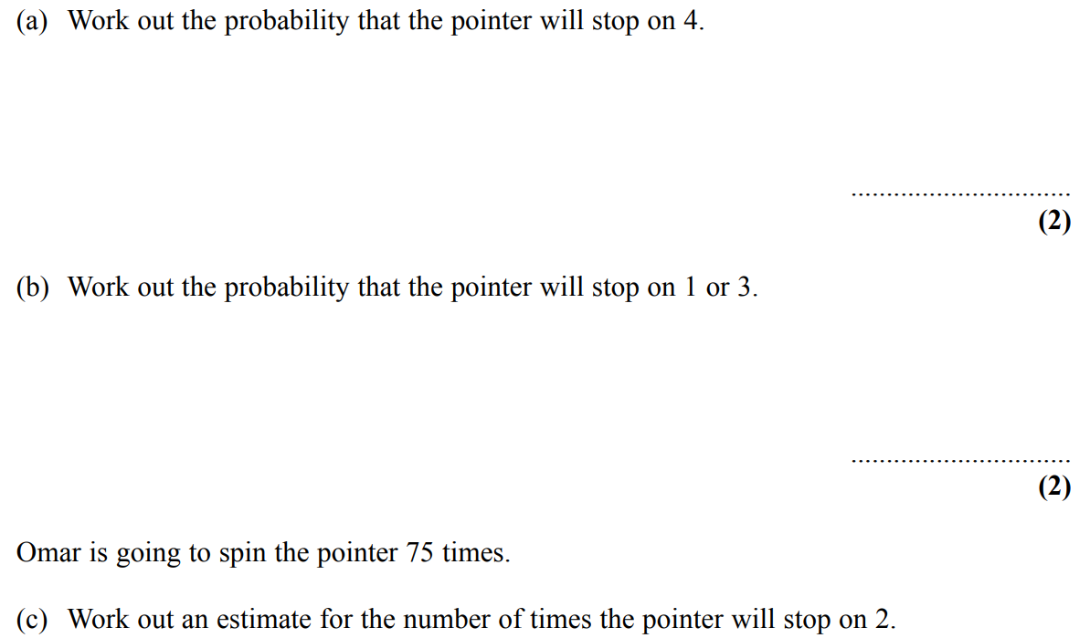
Basic Probability
May 2004 3H Q4

Slide 10
Basic Probability
May 2004 3H Q4
A (i)
A (ii)
B

Slide 11
Basic Probability
Nov 2004 4H Q4

Slide 12
Basic Probability
Nov 2004 4H Q4
A
B

Slide 13
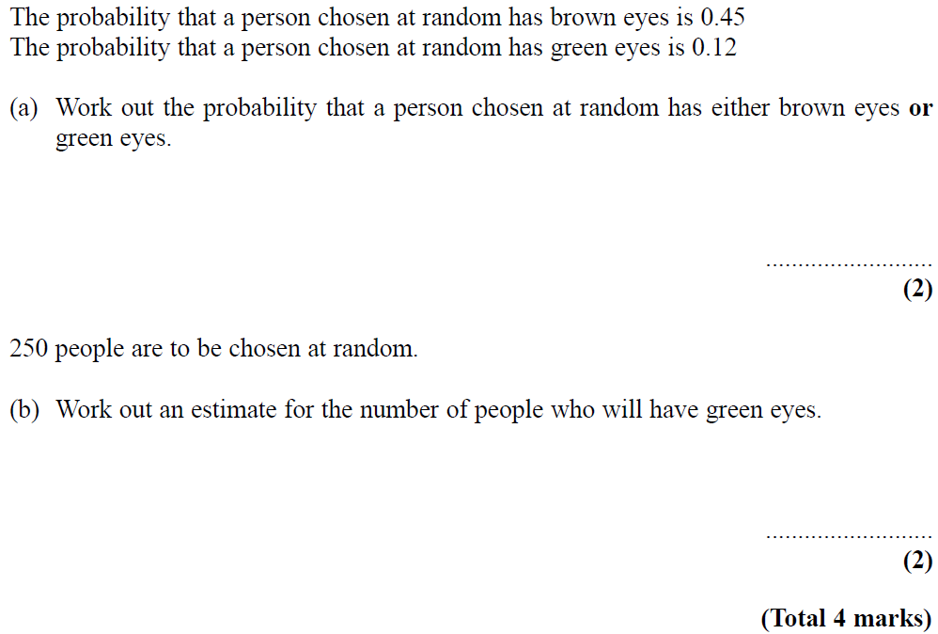
Basic Probability
May 2005 3H Q5

Slide 14
Basic Probability
May 2005 3H Q5
A
B

Slide 15
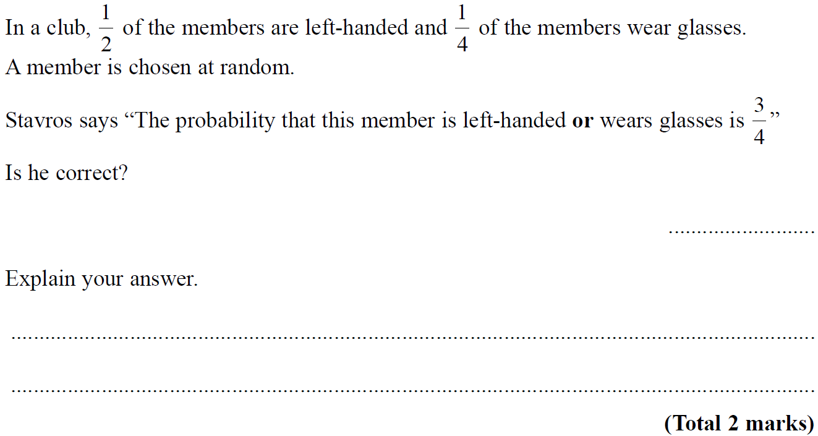
Basic Probability
May 2005 4H Q6

Slide 16
Basic Probability
May 2005 4H Q6
A

Slide 17
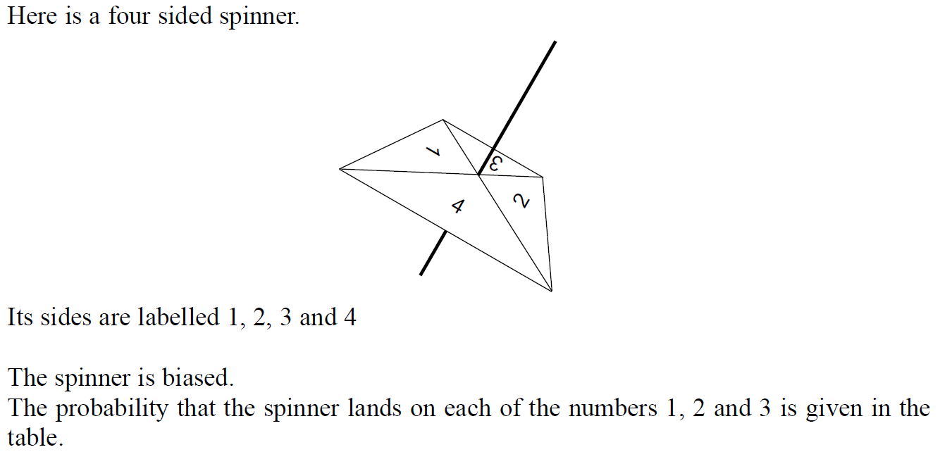
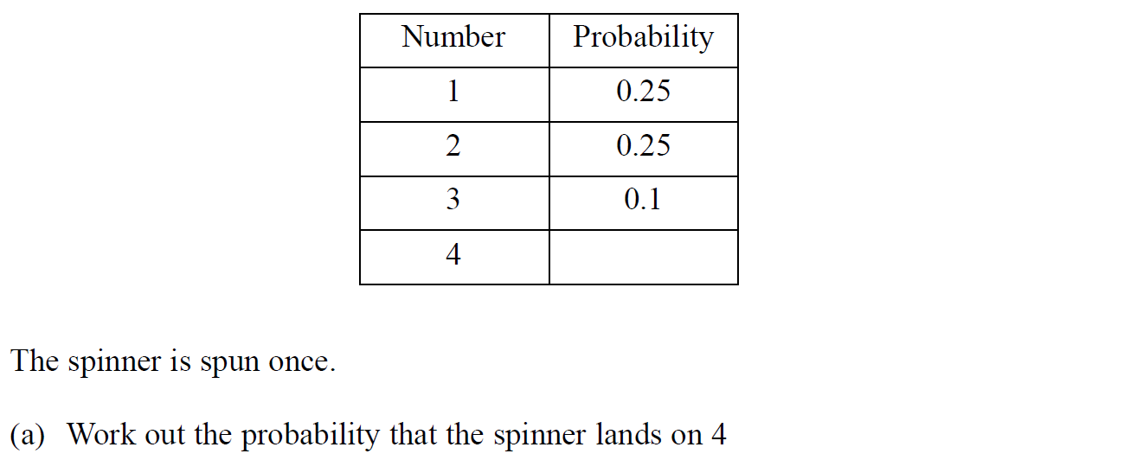
Basic Probability
Nov 2005 4H Q7

Slide 18
Basic Probability
Nov 2005 4H Q7
A
B

Slide 19
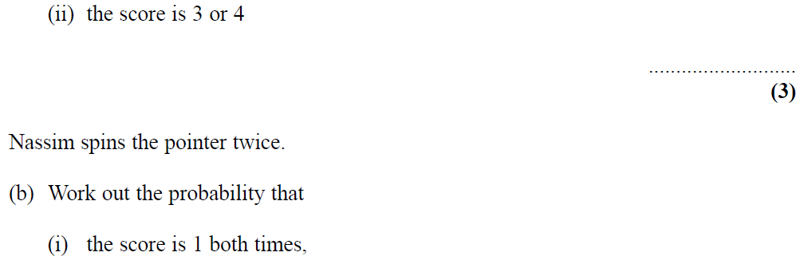
Basic Probability
May 2006 3H Q14

Slide 20
Basic Probability
May 2006 3H Q14
A (i)
A (ii)
B

Slide 21
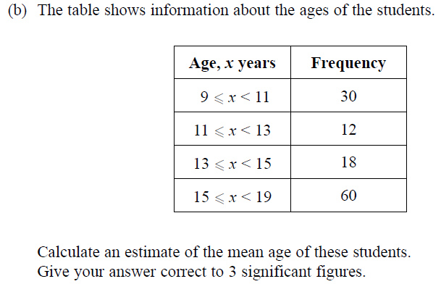
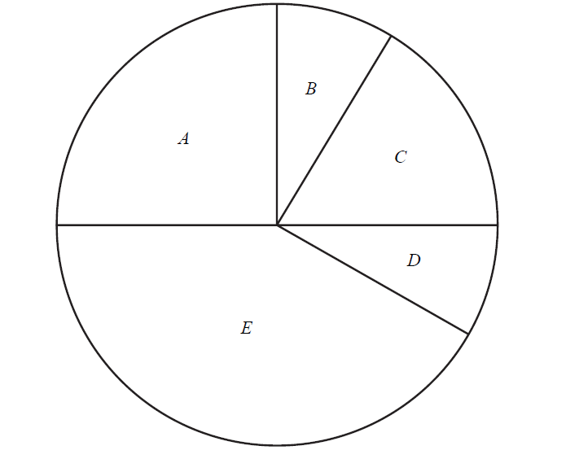
Basic Probability
Nov 2006 3H Q4

Slide 22
Basic Probability
Nov 2006 3H Q4
A
B

Slide 23
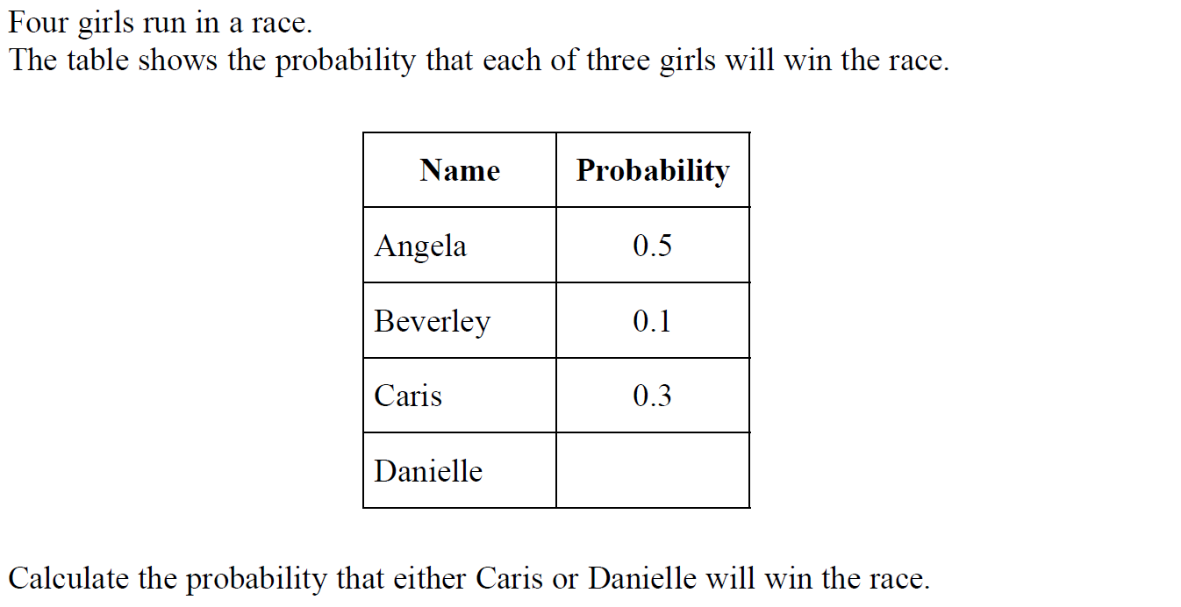
Basic Probability
Nov 2006 3H Q8

Slide 24
Basic Probability
Nov 2006 3H Q8
A

Slide 25
Basic Probability
Nov 2006 4H Q9

Slide 26
Basic Probability
Nov 2006 4H Q9
A
B

Slide 27
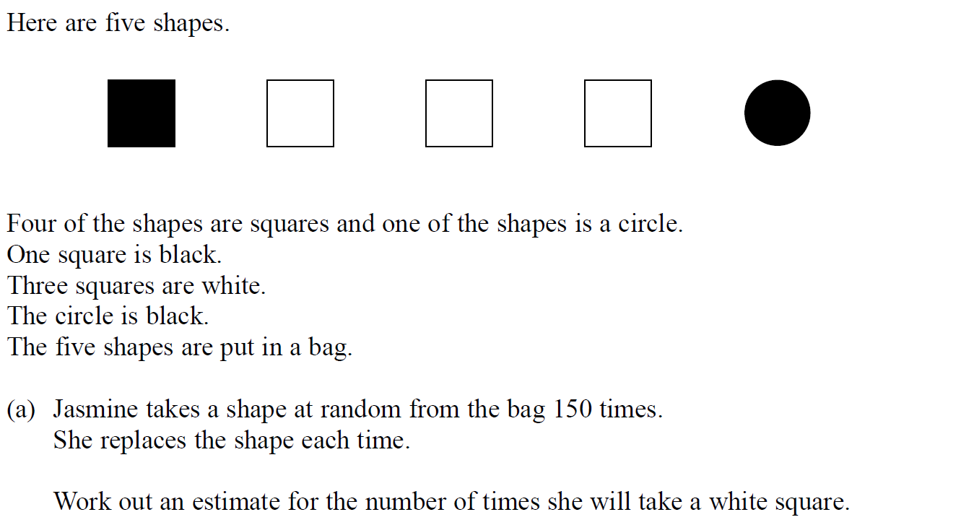
Basic Probability
May 2007 3H Q10

Slide 28
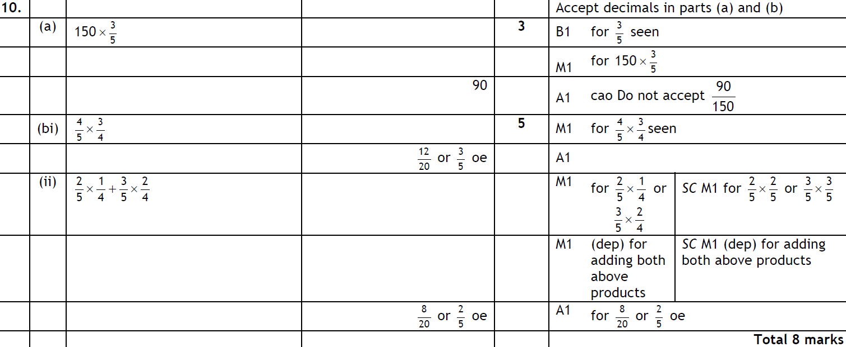
Basic Probability
May 2007 3H Q10
A
B (i)
B (ii)

Slide 29
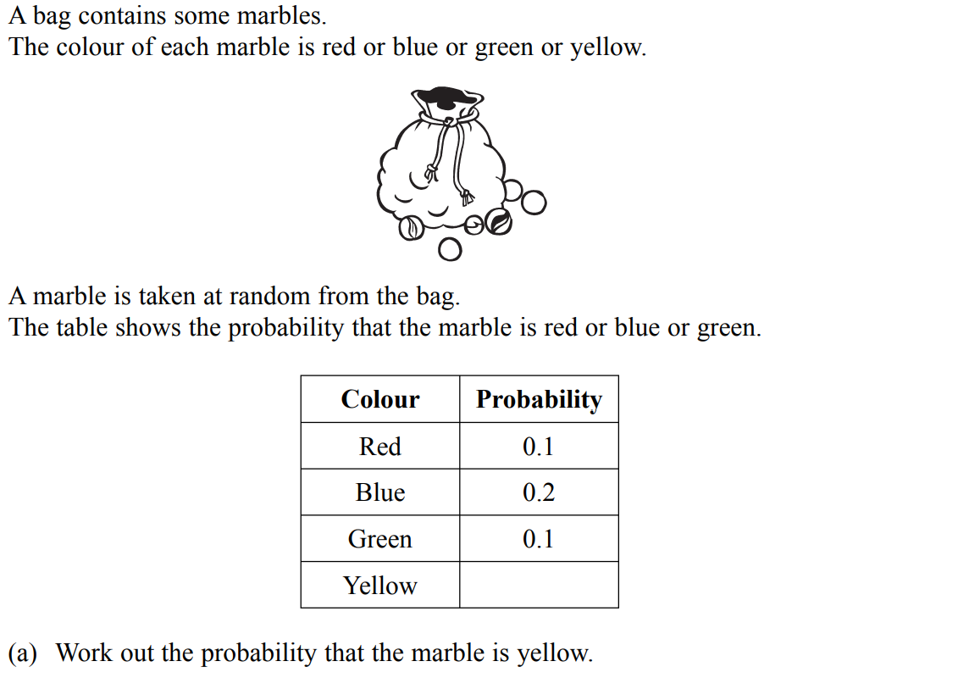
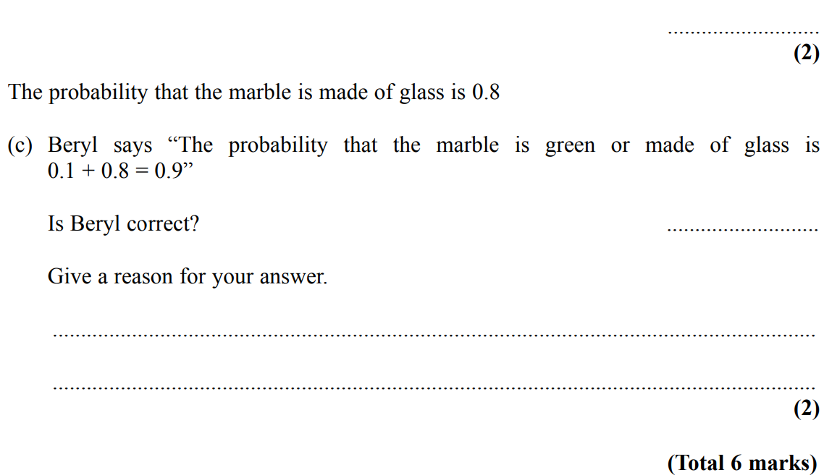
Basic Probability
May 2007 4H Q8

Slide 30
Basic Probability
May 2007 4H Q8
A
B
C

Slide 31
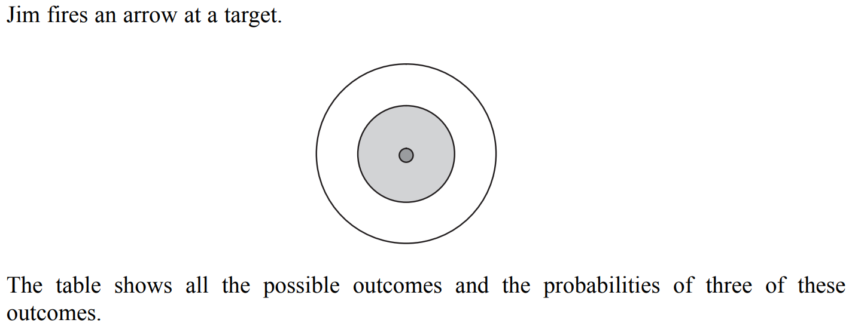
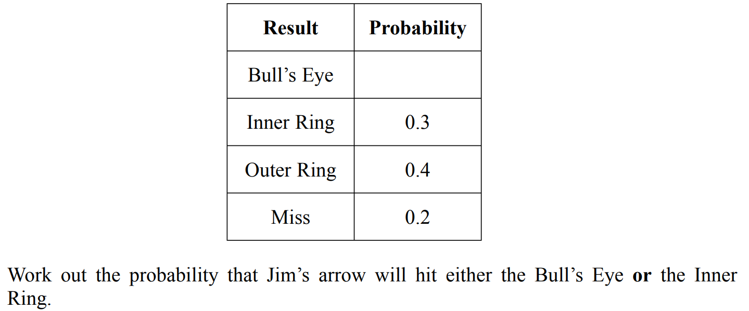
Basic Probability
Nov 2007 3H Q8

Slide 32
Basic Probability
Nov 2007 3H Q8
A

Slide 33
Basic Probability
May 2008 3H Q2

Slide 34
Basic Probability
May 2008 3H Q2
A

Slide 35
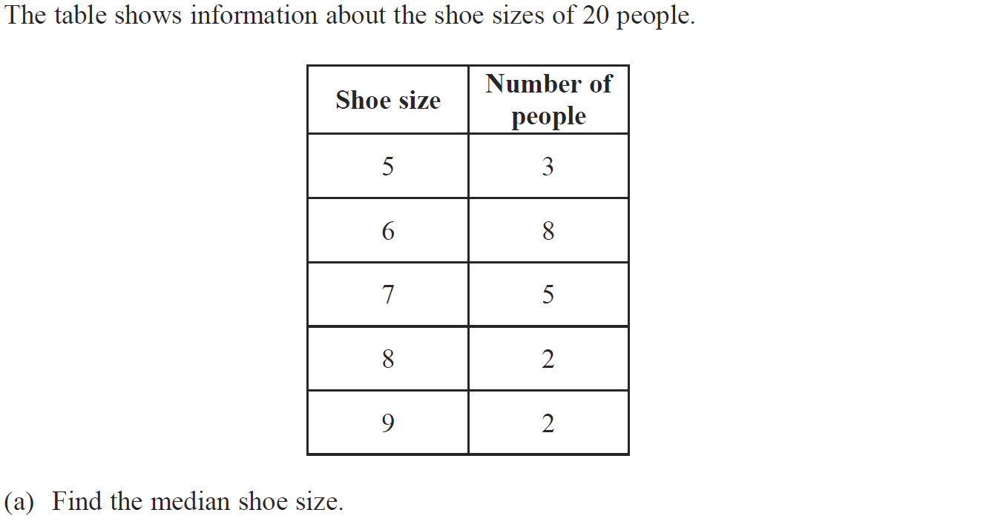
Basic Probability
May 2008 4H Q3

Slide 36
Basic Probability
May 2008 4H Q3
A
B

Slide 37
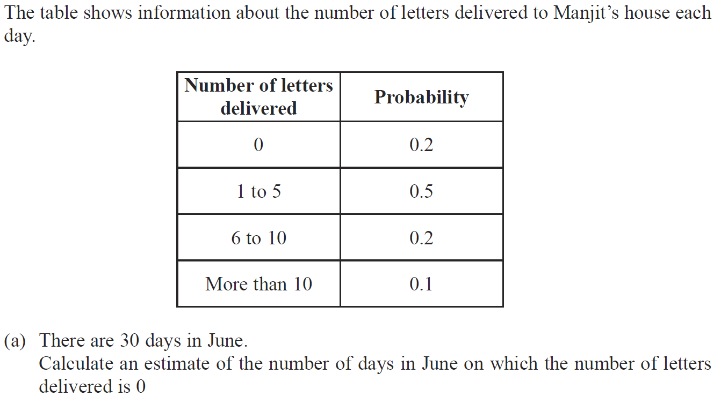
Basic Probability
May 2008 4H Q5

Slide 38
Basic Probability
May 2008 4H Q5
A
B

Slide 39
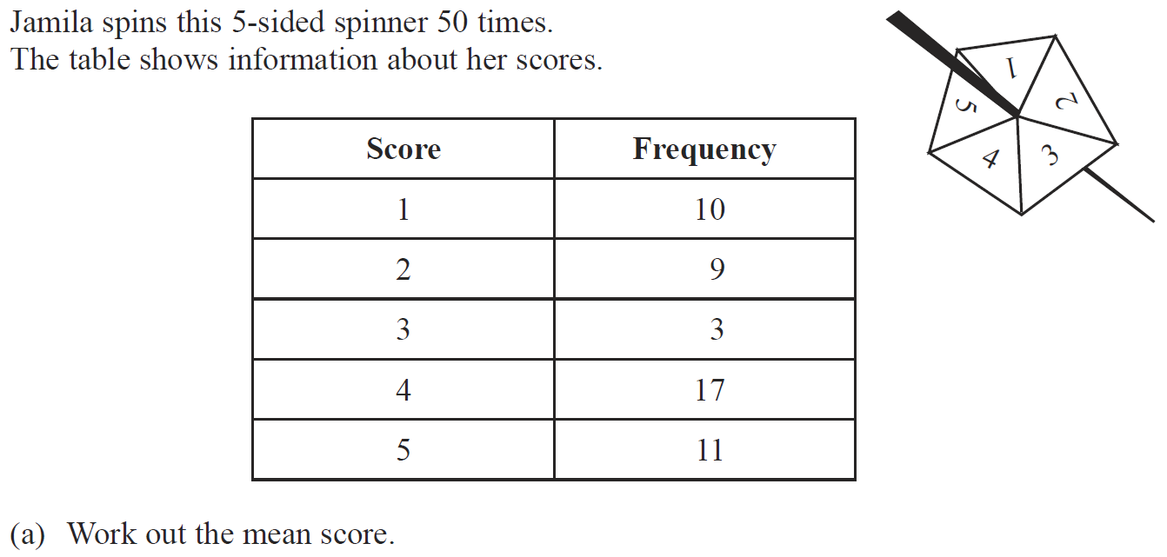
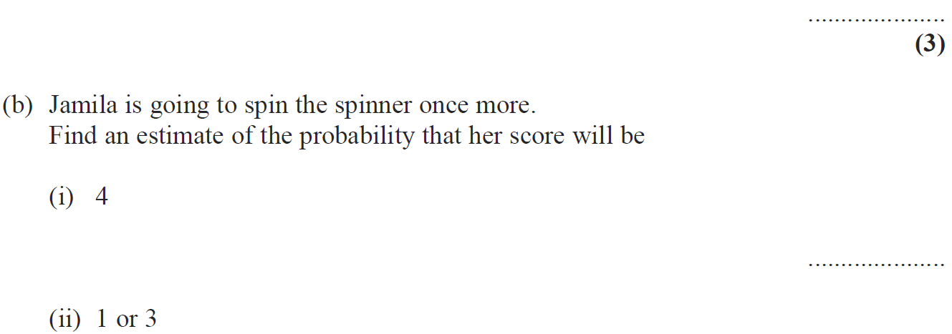
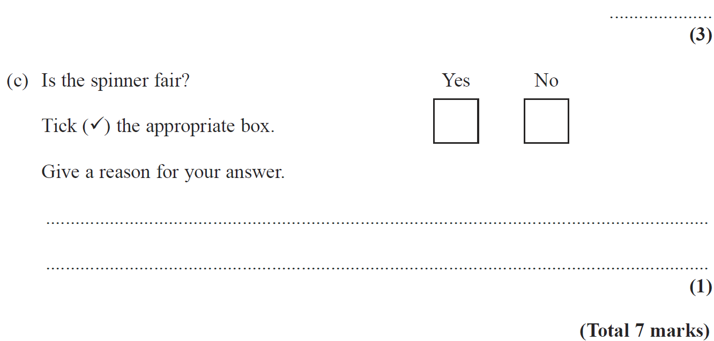
Basic Probability
Nov 2008 3H Q3

Slide 40
Basic Probability
Nov 2008 3H Q3
A
B (i)
B (ii)
C

Slide 41
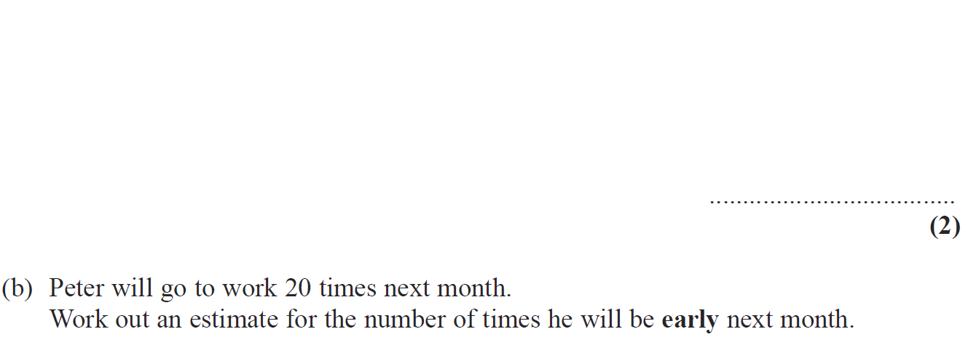
Basic Probability
Nov 2008 4H Q5

Slide 42
Basic Probability
Nov 2008 4H Q5
A
B

Slide 43
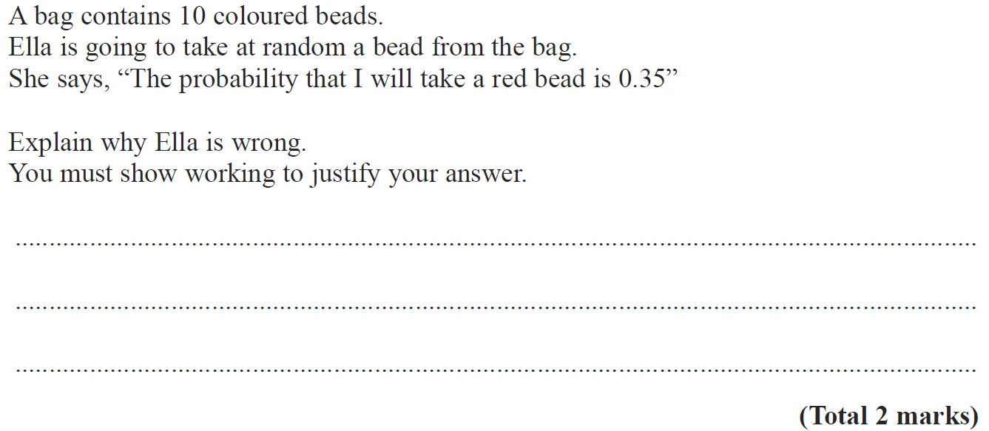
Basic Probability
May 2009 3H Q4

Slide 44
Basic Probability
May 2009 3H Q4
A

Slide 45
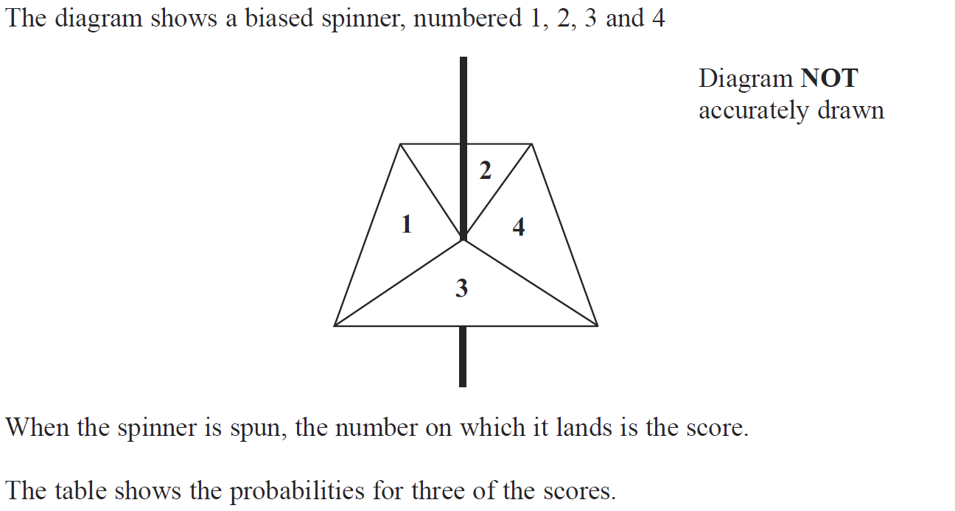
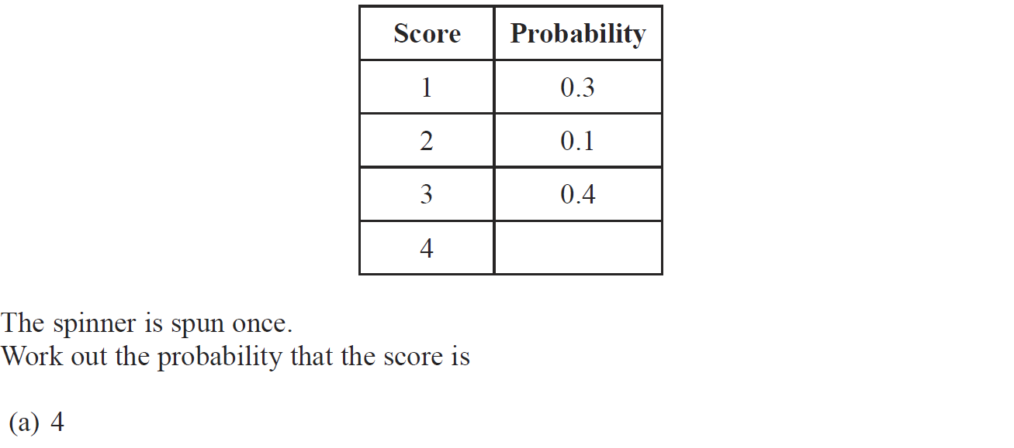
Basic Probability
June 2009 4H Q6

Slide 46
Basic Probability
June 2009 4H Q6
A
B

Slide 47
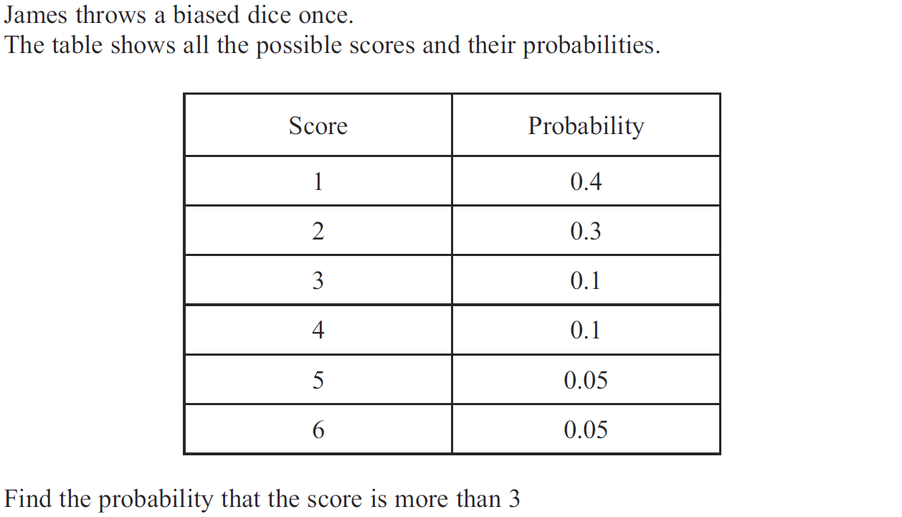
Basic Probability
Nov 2009 3H Q8

Slide 48
Basic Probability
Nov 2009 3H Q8
A

Slide 49
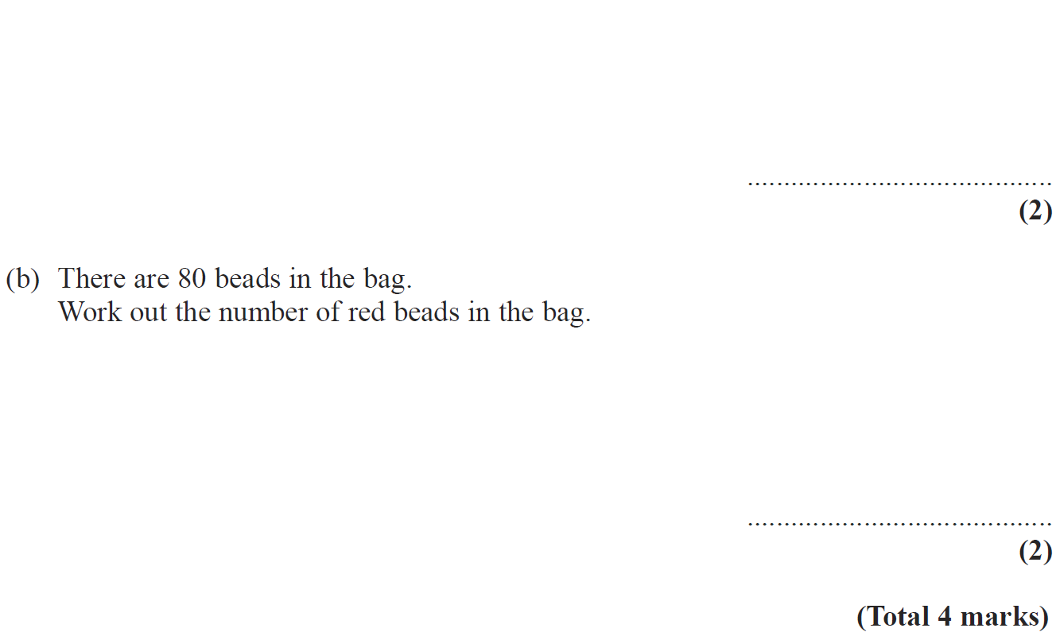
Basic Probability
Nov 2009 4H Q4

Slide 50
Basic Probability
Nov 2009 4H Q4
A
B

Slide 51
Basic Probability
June 2010 4H Q3

Slide 52
Basic Probability
June 2010 4H Q3
A
B

Slide 53
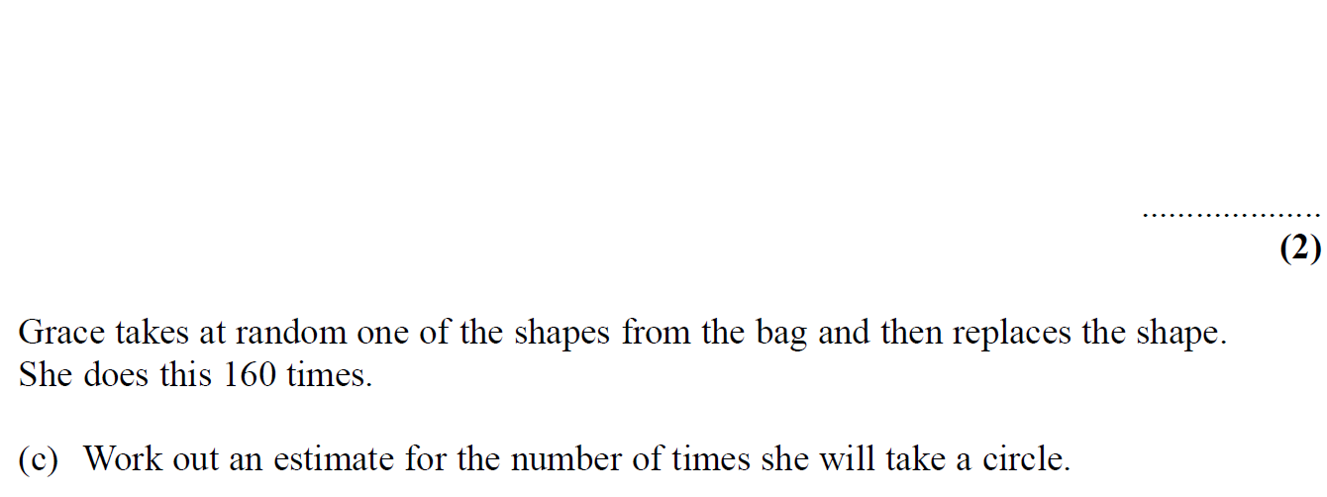
Basic Probability
Nov 2010 4H Q4

Slide 54
Basic Probability
Nov 2010 4H Q4
A
B
C

Slide 55
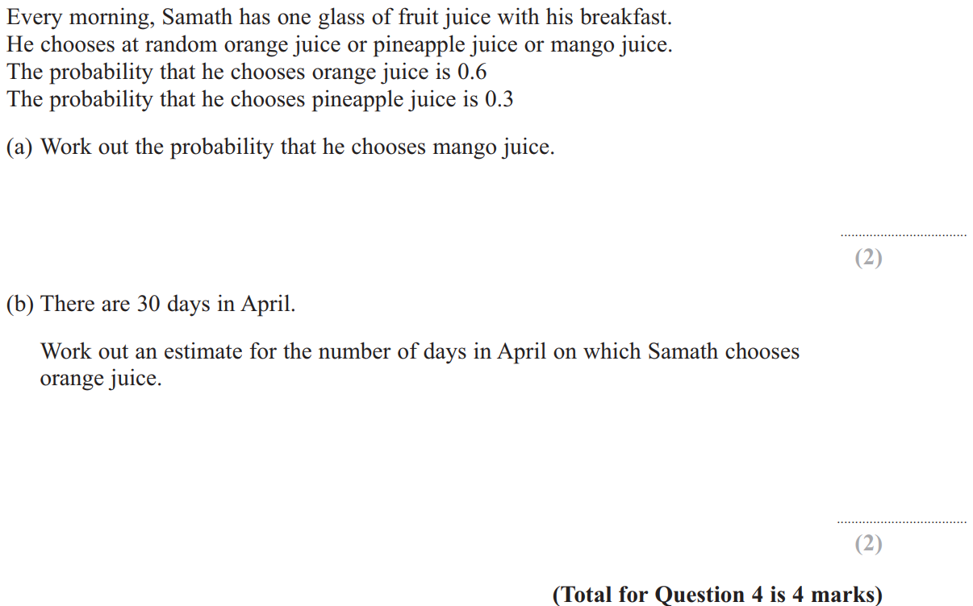
Basic Probability
June 2011 3H Q4

Slide 56
Basic Probability
June 2011 3H Q4
A
B

Slide 57
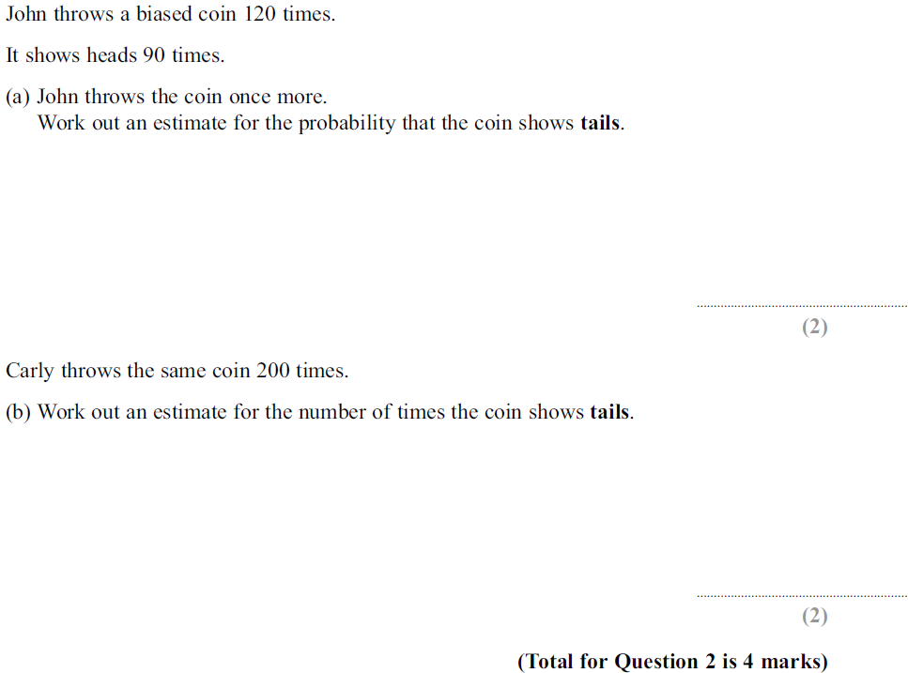
Basic Probability
June 2011 4H Q2

Slide 58
Basic Probability
June 2011 4H Q2
A
B

Slide 59
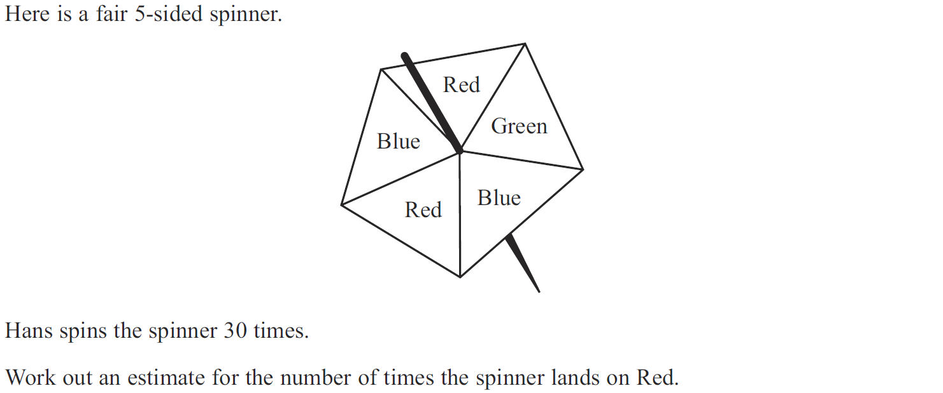
Basic Probability
Jan 2012 3H Q2

Slide 60
Basic Probability
Jan 2012 3H Q2
A

Slide 61
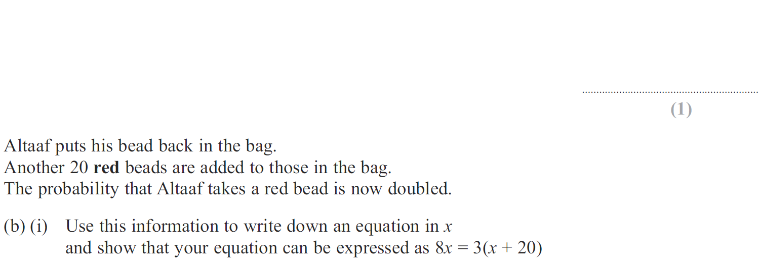
Basic Probability
Jan 2012 3H Q8

Slide 62
Basic Probability
Jan 2012 3H Q8
A
B (i)
B (ii)

Slide 63
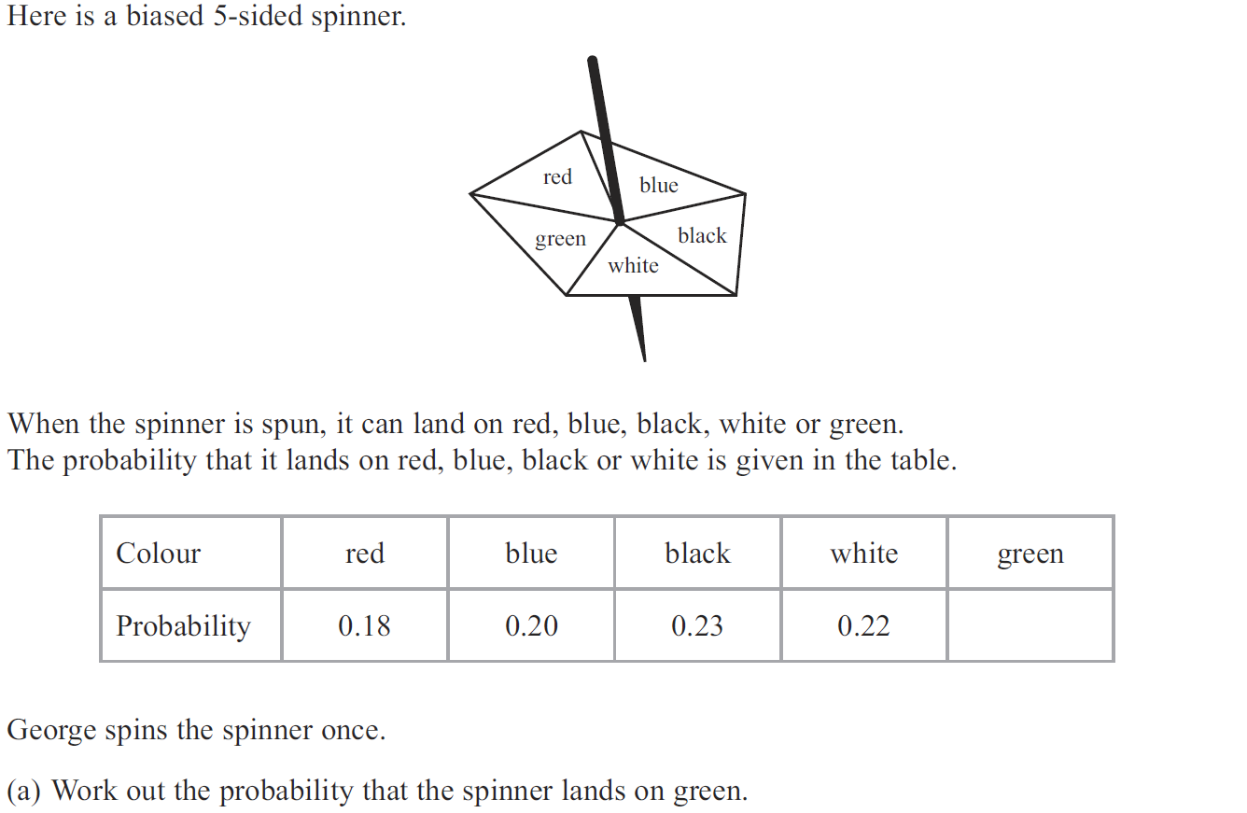
Basic Probability
Jan 2013 3H Q1

Slide 64
Basic Probability
Jan 2013 3H Q1
A
B

Slide 65
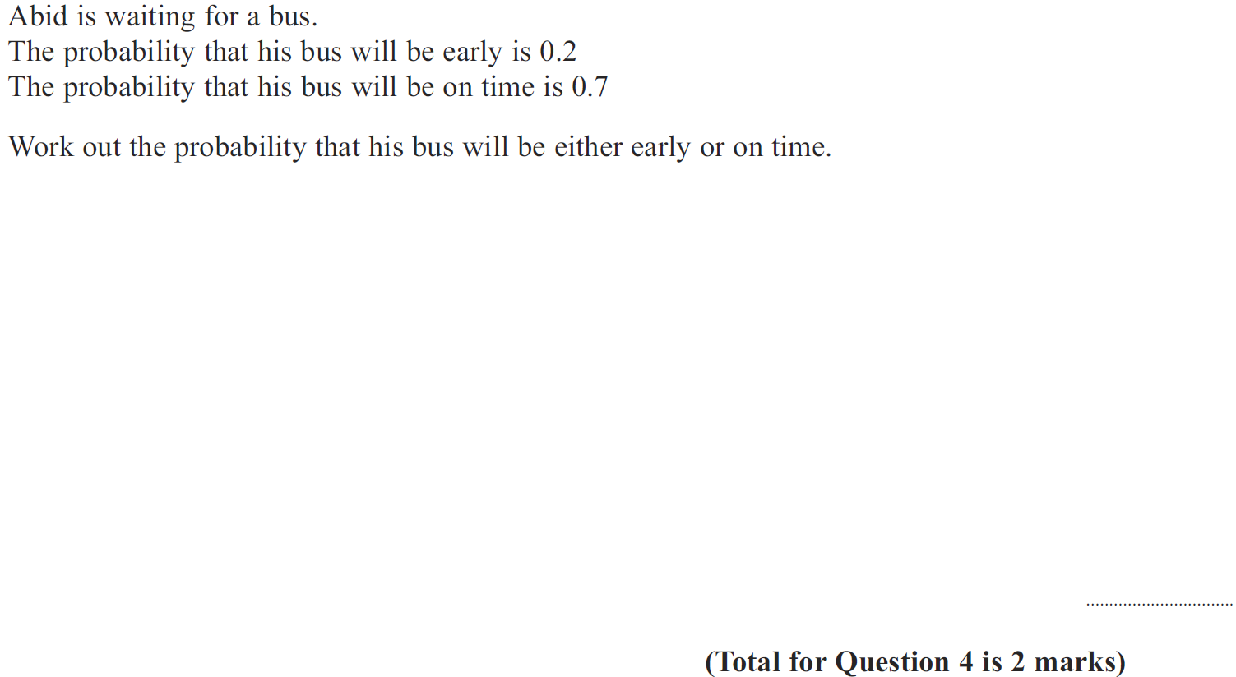
Basic Probability
Jan 2013 4H Q4

Slide 66
Basic Probability
Jan 2013 4H Q4
A

Slide 67
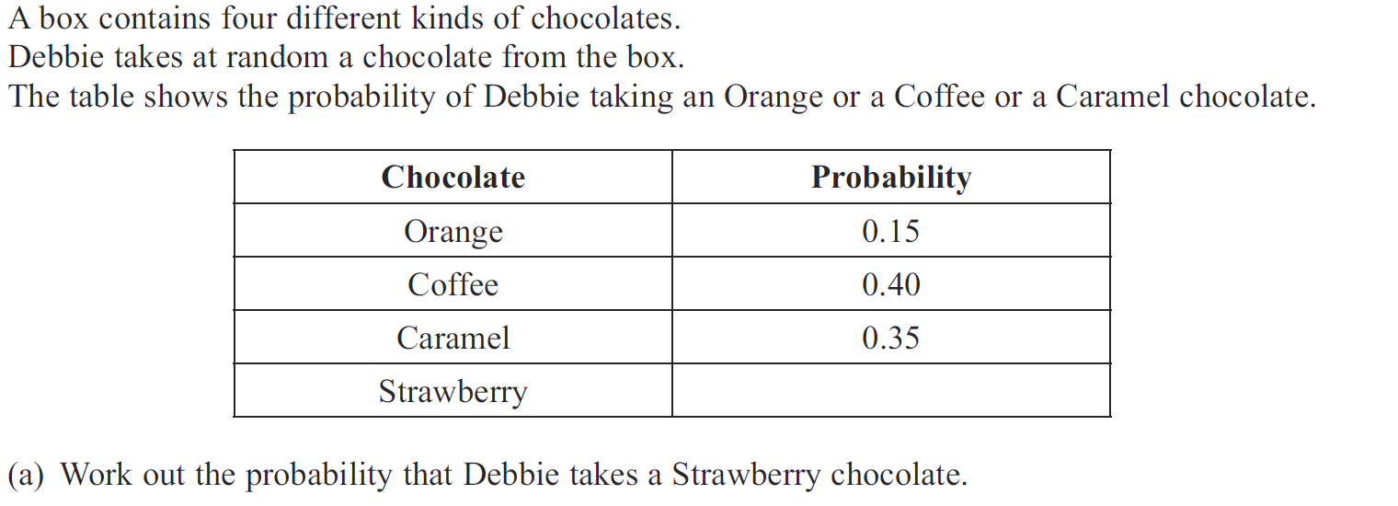
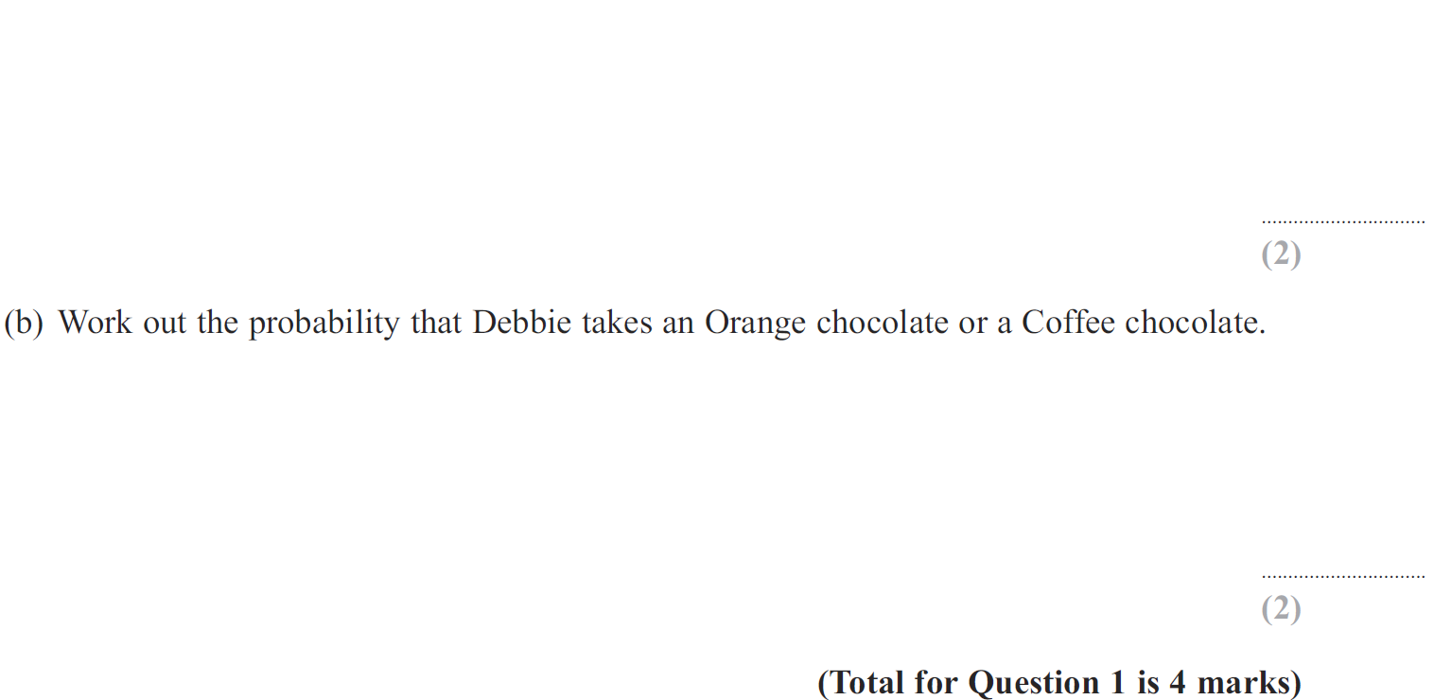
Basic Probability
May 2013 4H Q1

Slide 68
Basic Probability
May 2013 4H Q1
A
B

Slide 69
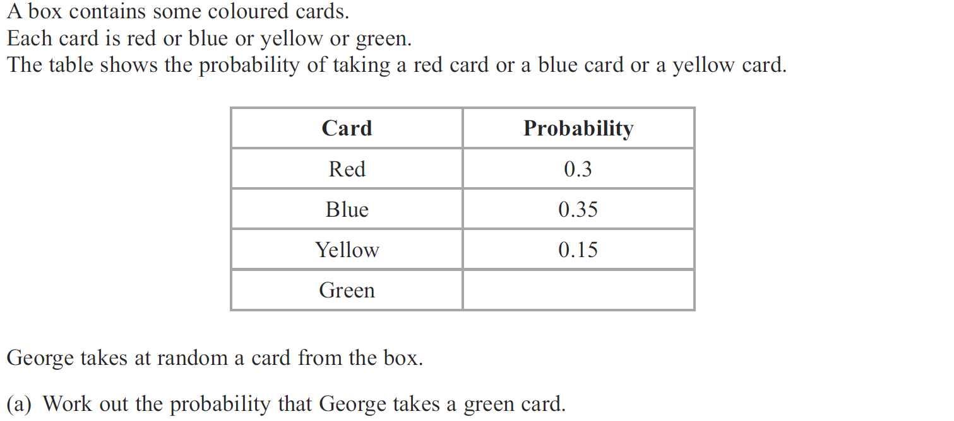
Basic Probability
May 2013 3HR Q1

Slide 70
Basic Probability
May 2013 3HR Q1
A
B

Slide 71
Basic Probability
Jan 2014 3H Q13

Slide 72
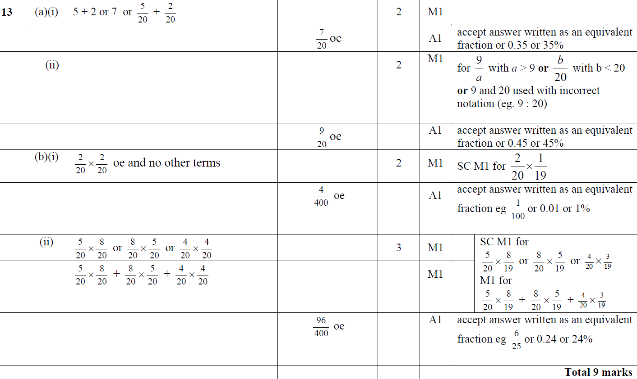
Basic Probability
Jan 2014 3H Q13
A (i)
A (ii)
B (i)
B (ii)

Slide 73
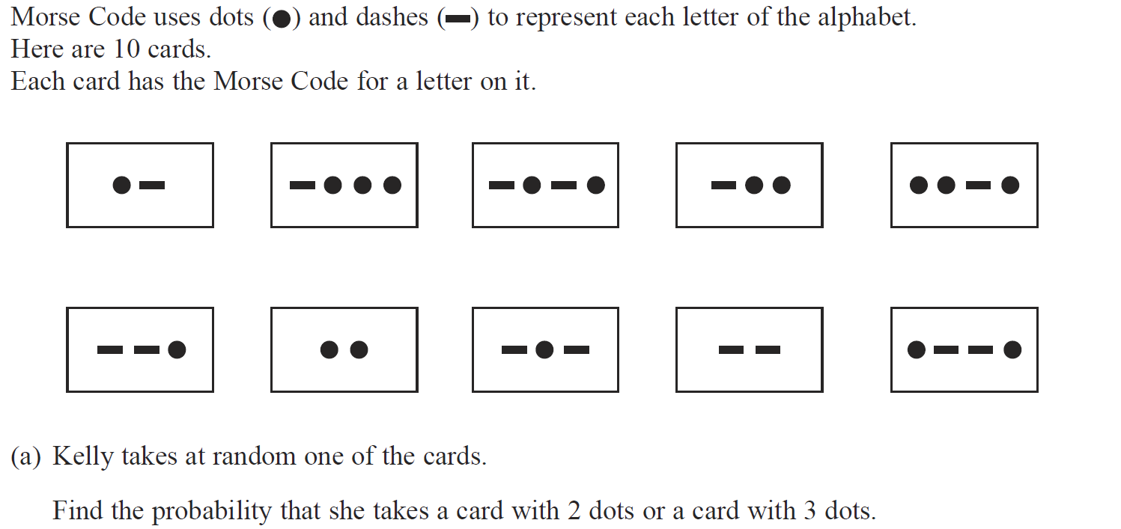
Basic Probability
Jan 2014 3HR Q8

Slide 74
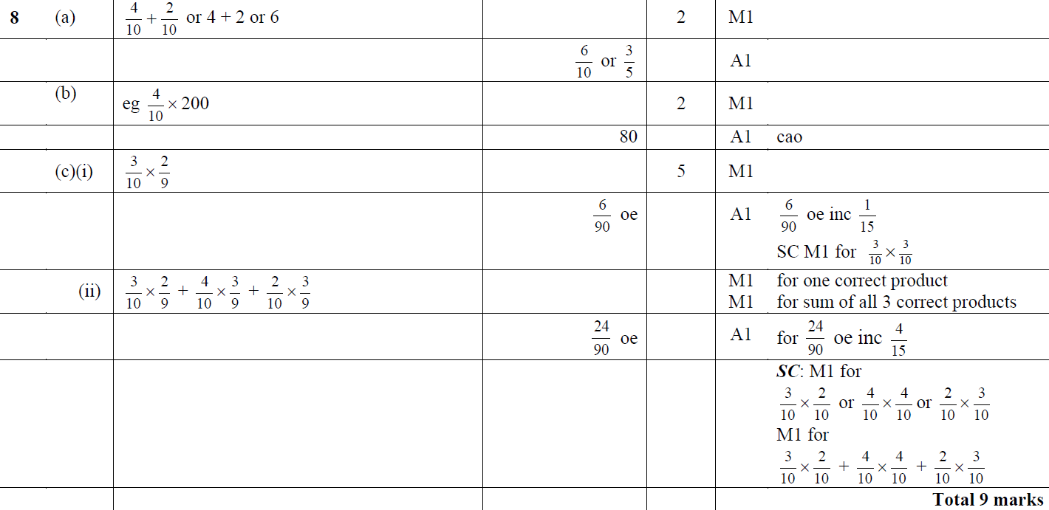
Basic Probability
Jan 2014 3HR Q8
A
B
C (i)
C (ii)

Slide 75
Basic Probability
May 2014 4H Q2

Slide 76
Basic Probability
May 2014 4H Q2
A
B

Slide 77
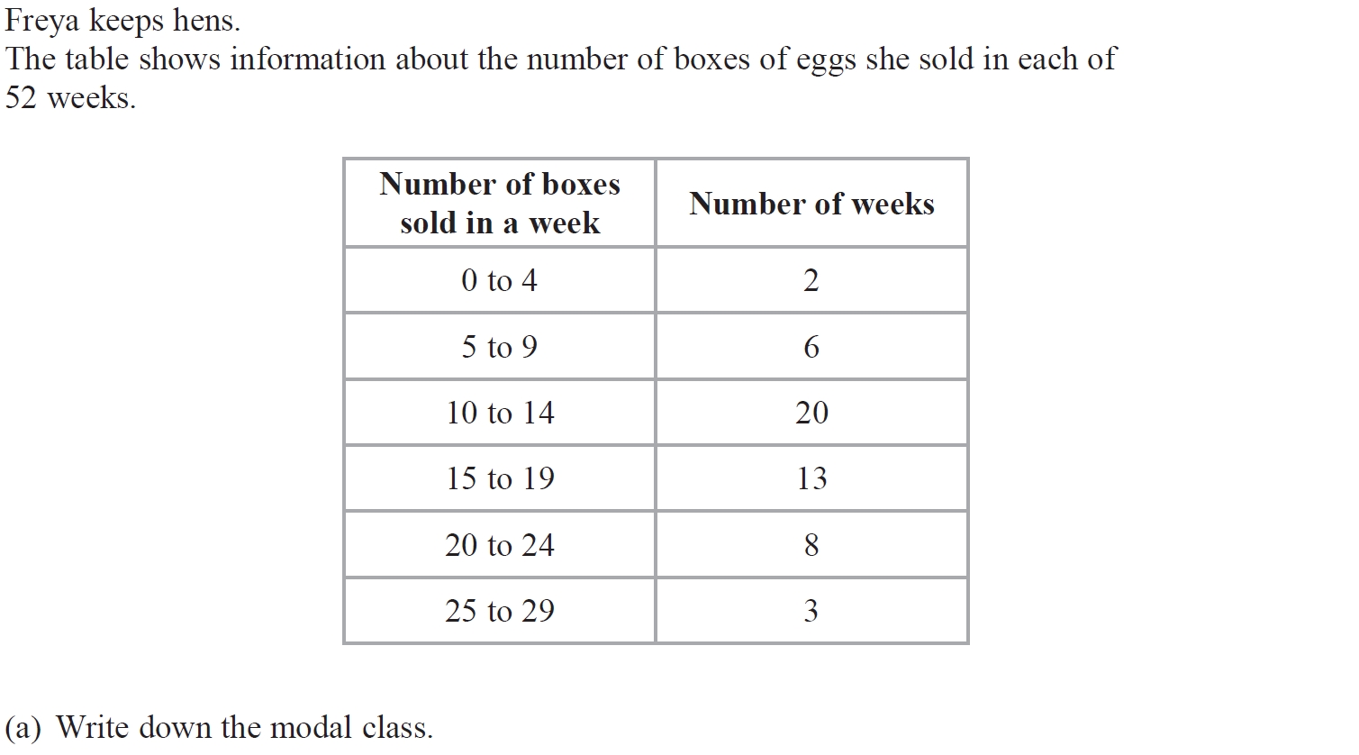
Basic Probability
May 2014 3HR Q4

Slide 78
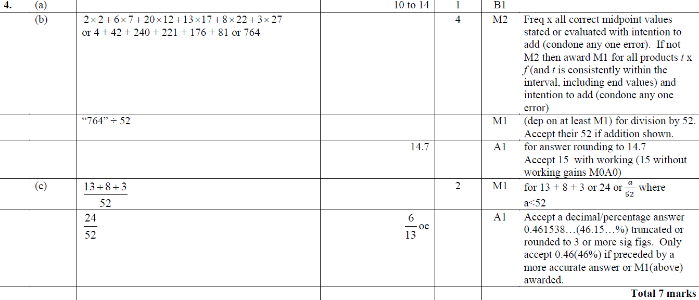
Basic Probability
May 2014 3HR Q4
A
B
C

Slide 79
Basic Probability
May 2014 4HR Q7

Slide 80
Basic Probability
May 2014 4HR Q7
A
B

Slide 81
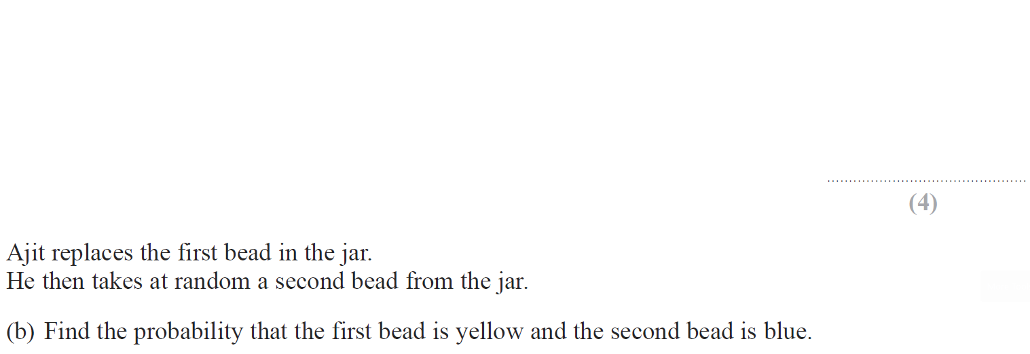
Basic Probability
Jan 2015 3H Q5

Slide 82
Basic Probability
Jan 2015 3H Q5
A (i)
A (ii)
B
C

Slide 83
Basic Probability
Jan 2015 4H Q3

Slide 84
Basic Probability
Jan 2015 4H Q3
A

Slide 85
Basic Probability
June 2015 4H Q1

Slide 86
Basic Probability
June 2015 4H Q1
A

Slide 87
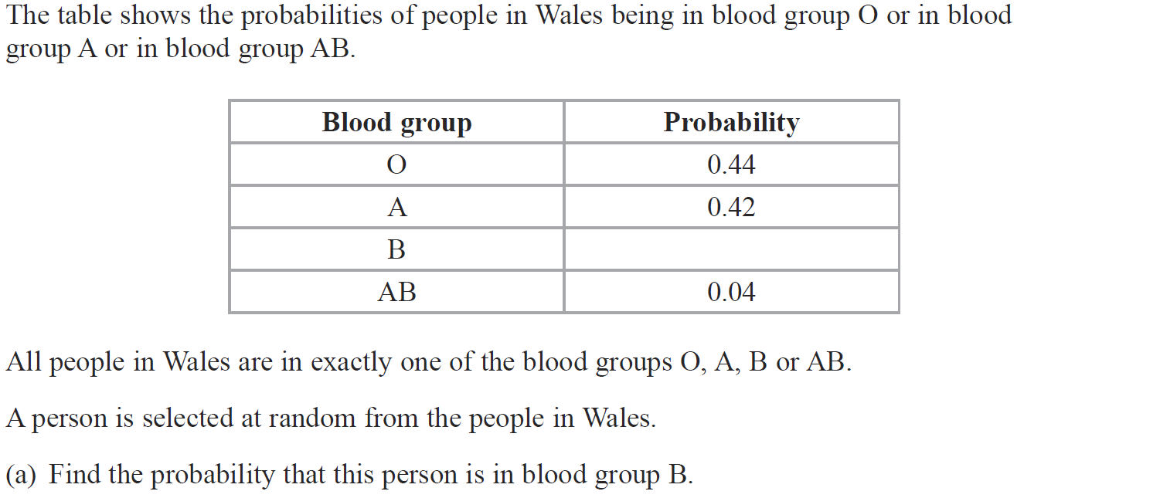
Basic Probability
June 2015 4HR Q6

Slide 88
Basic Probability
June 2015 4HR Q6
A
B
C

Slide 89
Basic Probability
Jan 2016 4H Q4

Slide 90
Basic Probability
Jan 2016 4H Q4
A

Slide 91
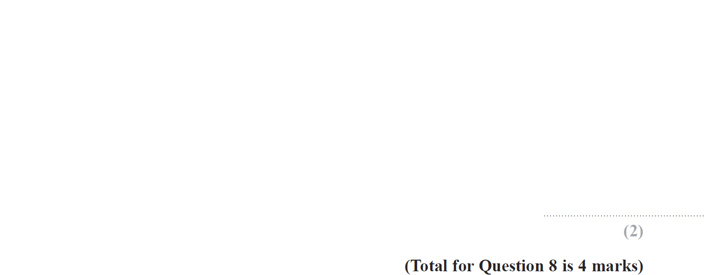
Basic Probability
Jan 2016 4H Q8

Slide 92
Basic Probability
Jan 2016 4H Q8
A
B

Slide 93
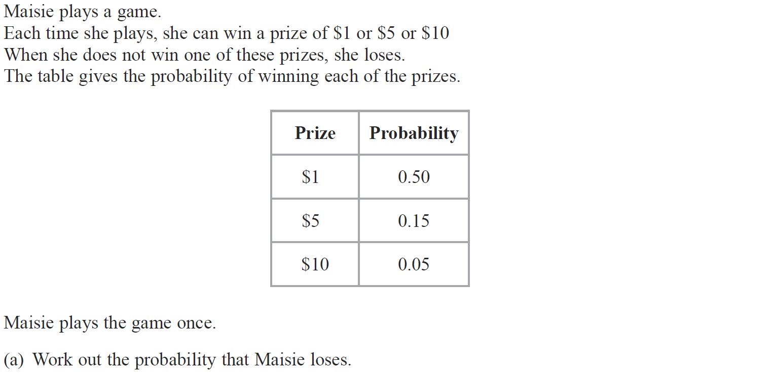
Basic Probability
Jan 2016 3HR Q4

Slide 94
Basic Probability
Jan 2016 3HR Q4
A
B (i)
B (ii)

Slide 95
Basic Probability
May 2016 3HR Q3

Slide 96
Basic Probability
May 2016 3HR Q3
A

Slide 97
Basic Probability
May 2016 3HR Q9

Slide 98
Basic Probability
May 2016 3HR Q9
A
B

Slide 99
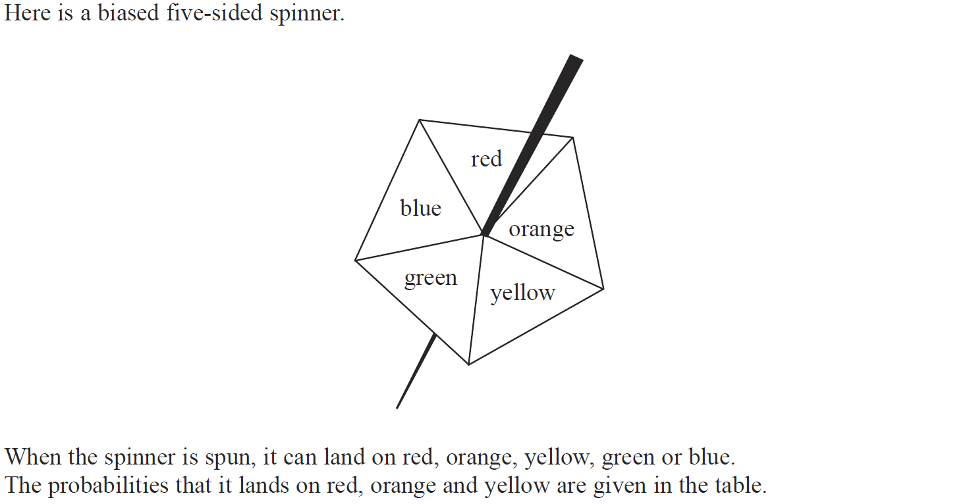
Basic Probability
Jan 2017 4H Q2

Slide 100
Basic Probability
Jan 2017 4H Q2
A
B

Slide 101
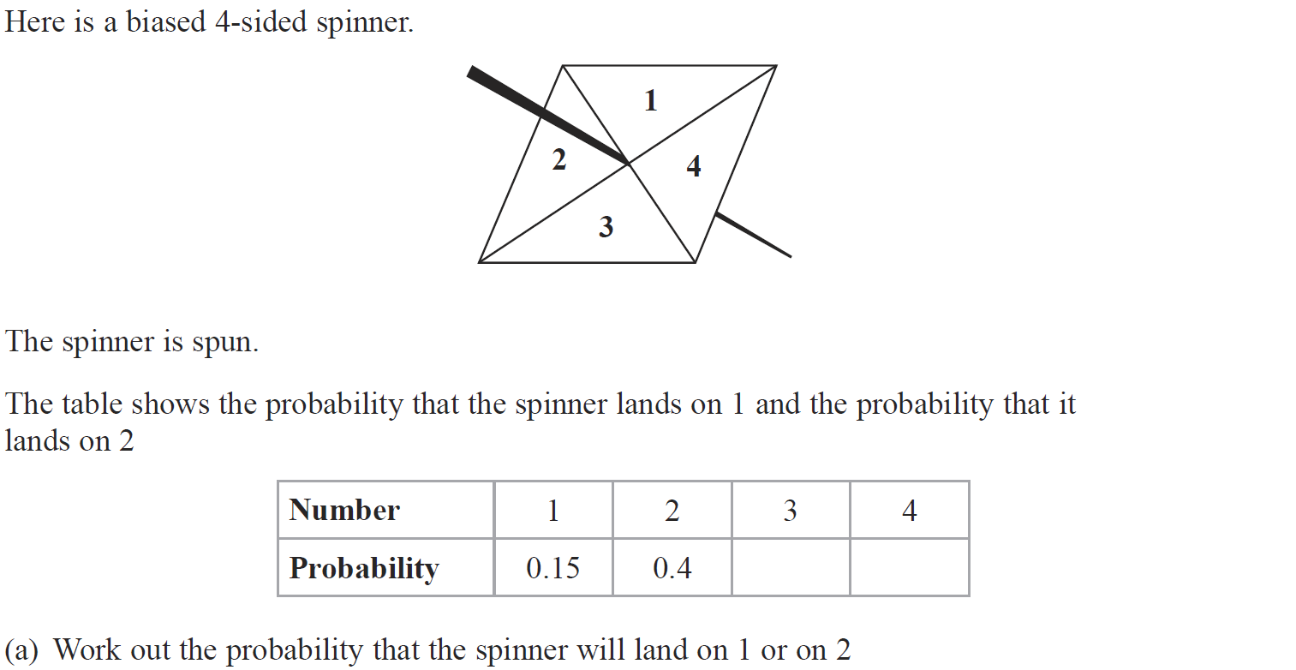
Basic Probability
Jan 2017 4HR Q2

Slide 102
Basic Probability
Jan 2017 4HR Q2
A
B
C

Slide 103
Basic Probability
May 2017 3H Q11
Show Graph
Hide Graph

Slide 104
Basic Probability
May 2017 3H Q11
A
B
C
D

Slide 105
Basic Probability
June 2017 4H Q5

Slide 106
Basic Probability
June 2017 4H Q5
A
B

Slide 107
Basic Probability
Jan 2018 3H Q4

Slide 108
Basic Probability
Jan 2018 3H Q4
A
B
C

Slide 109
Basic Probability
Jan 2018 4H Q7

Slide 110
Basic Probability
Jan 2018 4H Q7
A

Slide 111
Basic Probability
Jan 2018 4HR Q6

Slide 112
Basic Probability
Jan 2018 4HR Q6
A
B
C

Slide 113
Basic Probability
May 2018 3H Q5

Slide 114
Basic Probability
May 2018 3H Q5
A
B

Slide 115
Basic Probability
June 2018 4H Q3

Slide 116
Basic Probability
June 2018 4H Q3
A
B

Slide 117
Basic Probability
May 2018 3HR Q2

Slide 118
Basic Probability
May 2018 3HR Q2
A

