Slide 1
Basic Probability
Basic Probability
June 2017
2H Q1
June 2018
3H Q6
Nov 2017
2H Q4
Edexcel
SAM
1H Q7
Nov 2018
2H Q16
Nov 2017
3H Q8
AQA
Spec 1
1H Q3
May 2019
1H Q1
Nov 2017
3H Q10
OCR
Spec 1
1H Q6
May 2019
1H Q22
May 2018
1H Q16
June 2019
2H Q3
June 2018
2H Q8
Probability Space
Experimental/ using samples

Slide 2
Basic Probability
Basic Probability
June 2017
2H Q5
May 2018
1H Q8
Edexcel
SAM
1H Q14
June 2017
2H Q9
May 2018
1H Q15
AQA
SAM
2H Q7
1 Marker
June 2017
3H Q5
June 2018
2H Q7
OCR
SAM
3H Q6
June 2017
3H Q9
June 2018
3H Q13
Experimental/ using samples

Slide 3
Basic Probability
Basic Probability
June 2017
2H Q9
SAM
1H Q7
Edexcel
Nov 2017
1H Q1
SAM
2H Q3
AQA
Nov 2017
3H Q4
SAM
2H Q6
OCR
June 2018
2H Q5
SAM
3H Q5
June 2018
3H Q7
Experimental/ using samples

Slide 4
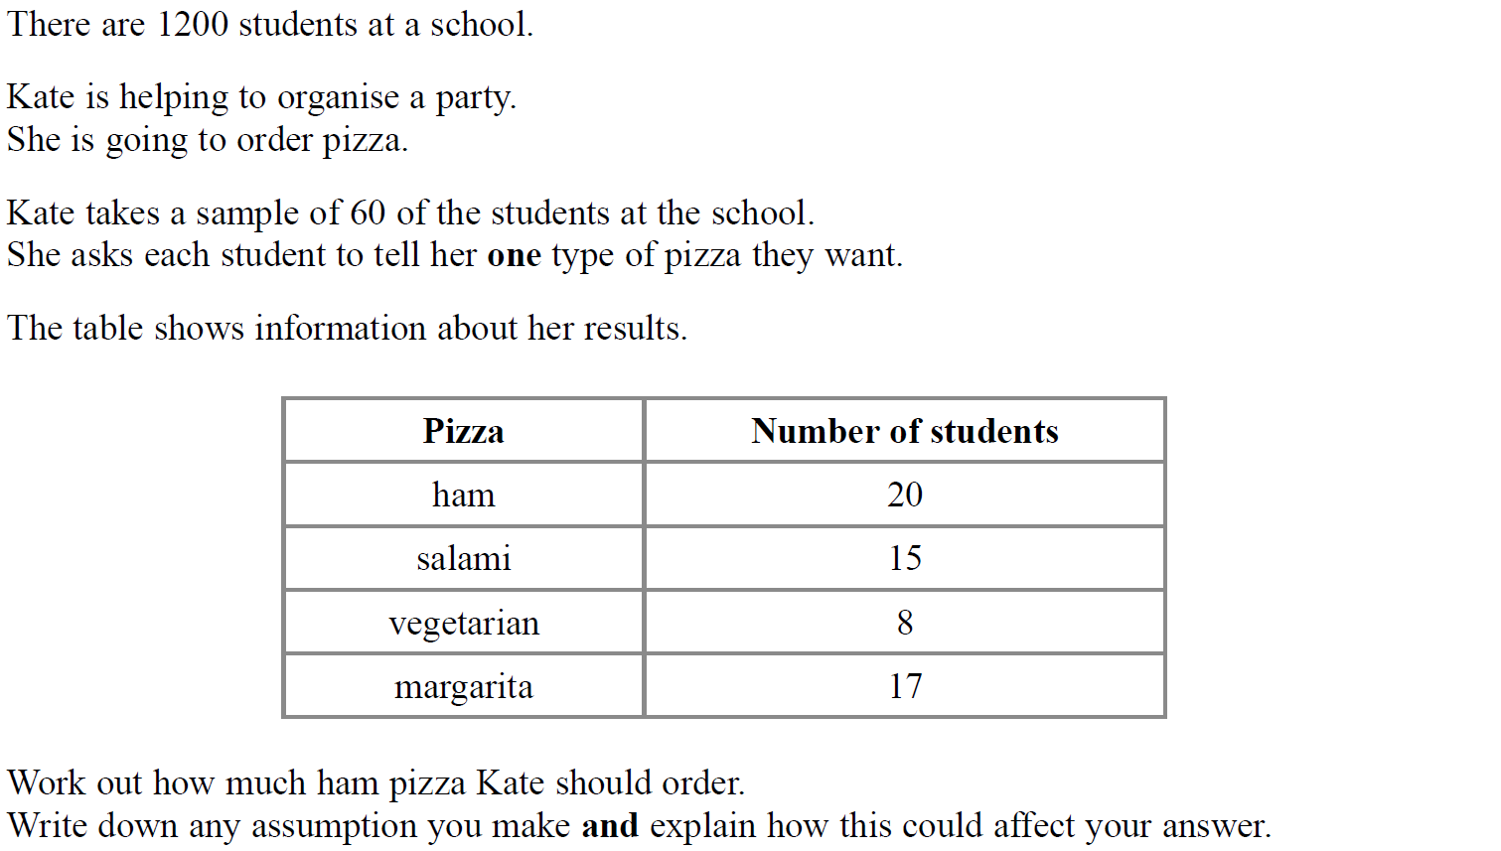
Basic Probability
SAM 1H Q7

Slide 5
Basic Probability
SAM 1H Q7
A

Slide 6
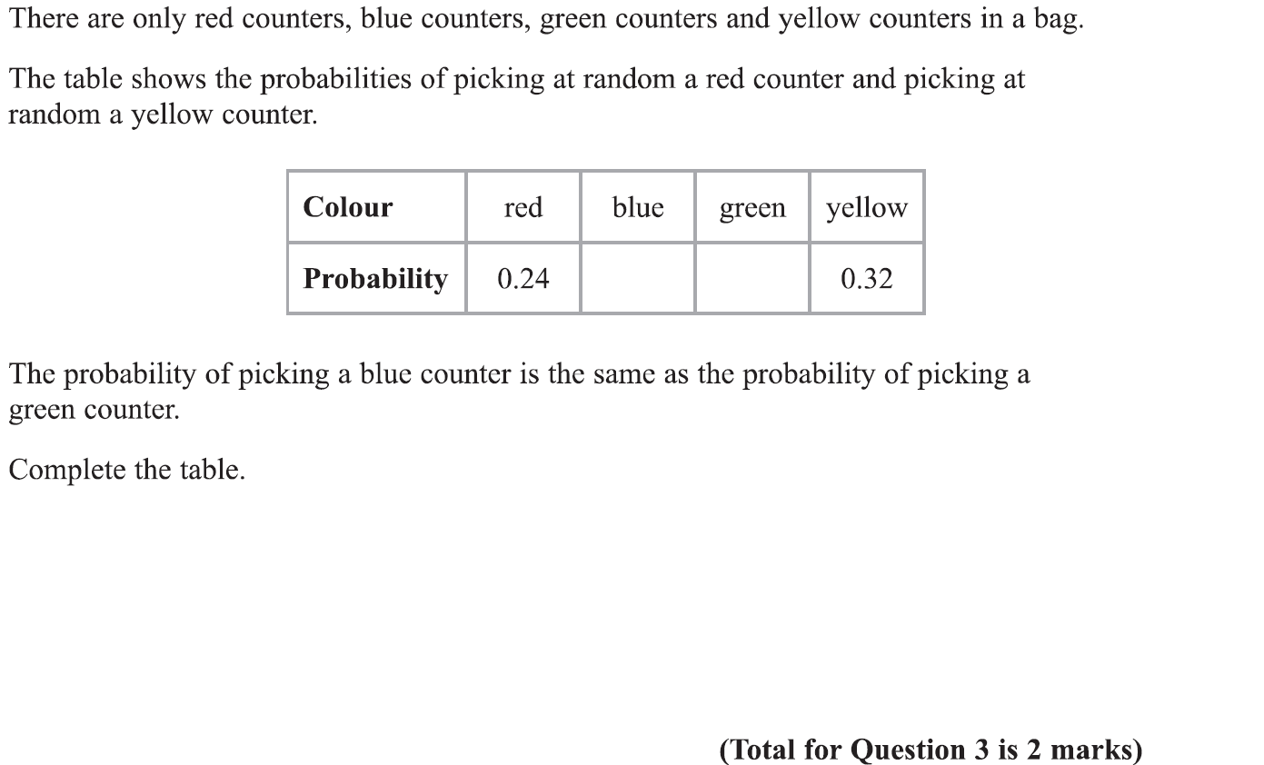
Basic Probability
Specimen Set 1 1H Q3

Slide 7
Basic Probability
Specimen Set 1 1H Q3
A

Slide 8
Basic Probability
Specimen Set 1 1H Q6

Slide 9
Basic Probability
Specimen Set 1 1H Q6
A
B
C

Slide 10
Basic Probability
June 2017 2H Q1

Slide 11
Basic Probability
June 2017 2H Q1
A

Slide 12
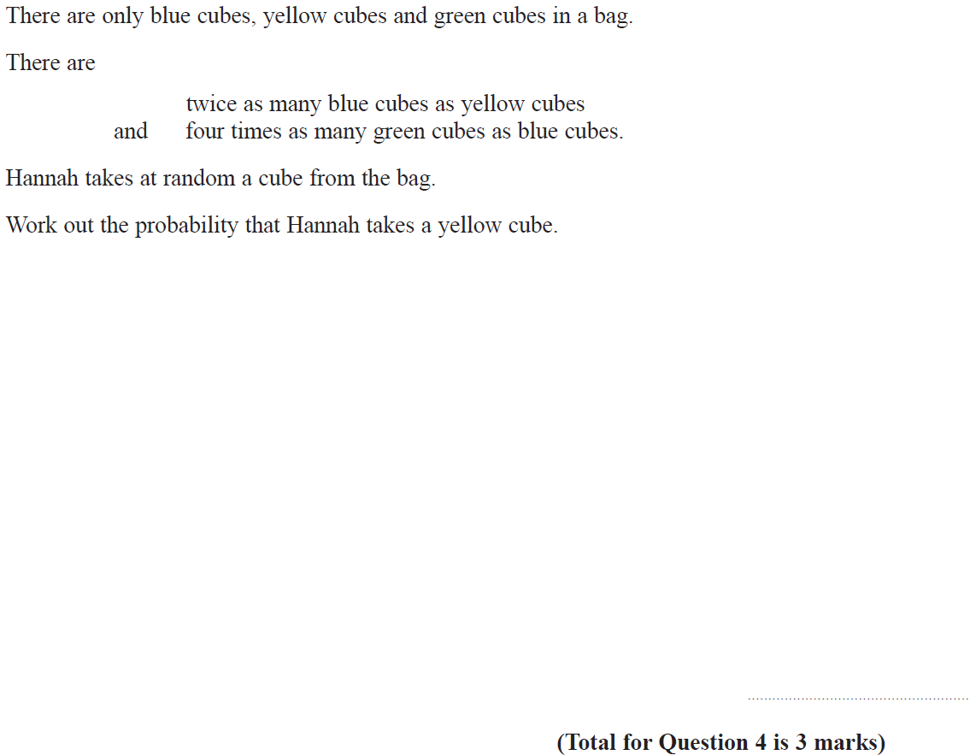
Basic Probability
Nov 2017 2H Q4

Slide 13
Basic Probability
Nov 2017 2H Q4
A

Slide 14
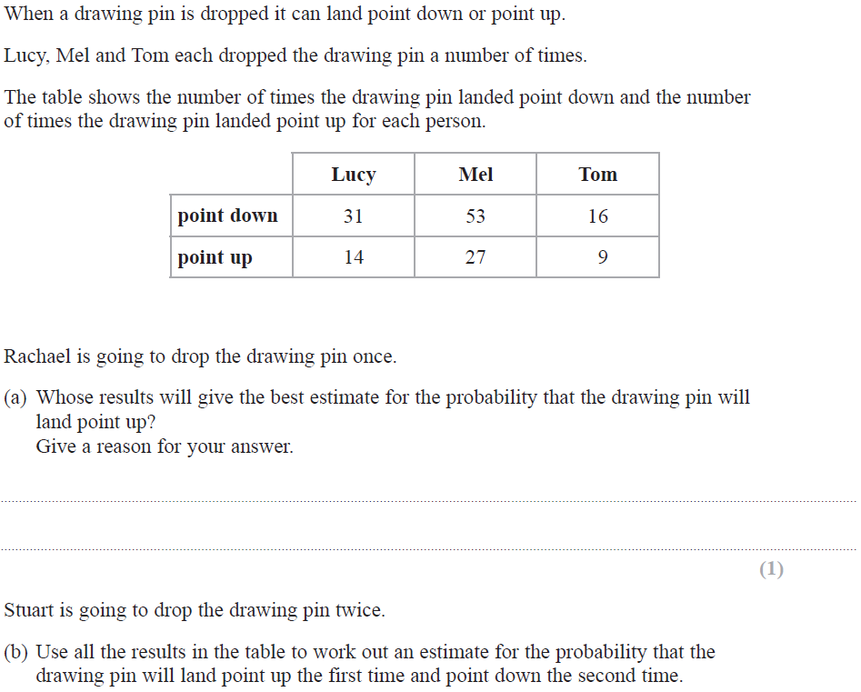
Basic Probability
Nov 2017 3H Q8

Slide 15
Basic Probability
Nov 2017 3H Q8
A
B

Slide 16
Basic Probability
Nov 2017 3H Q10

Slide 17
Basic Probability
Nov 2017 3H Q10
A
B

Slide 18
Basic Probability
May 2018 1H Q16

Slide 19
Basic Probability
May 2018 1H Q16
A

Slide 20
Basic Probability
June 2018 2H Q8

Slide 21
Basic Probability
June 2018 2H Q8
A

Slide 22
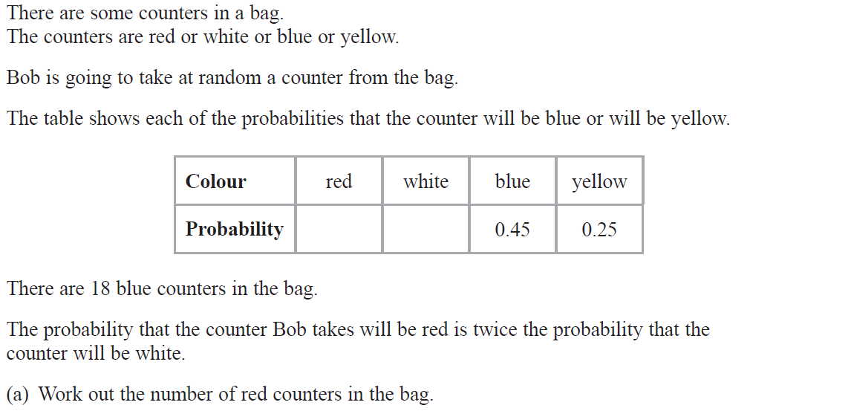
Basic Probability
June 2018 3H Q6

Slide 23
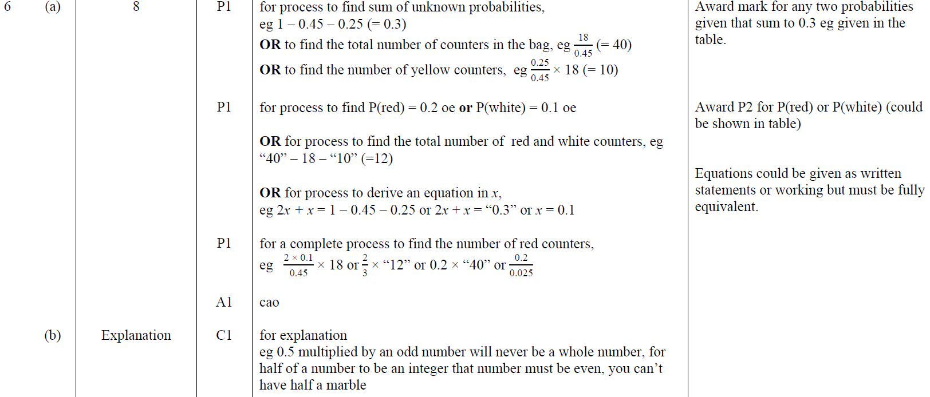
Basic Probability
June 2018 3H Q6
A
B

Slide 24
Basic Probability
Nov 2018 2H Q16

Slide 25
Basic Probability
Nov 2018 2H Q16
A
B

Slide 26
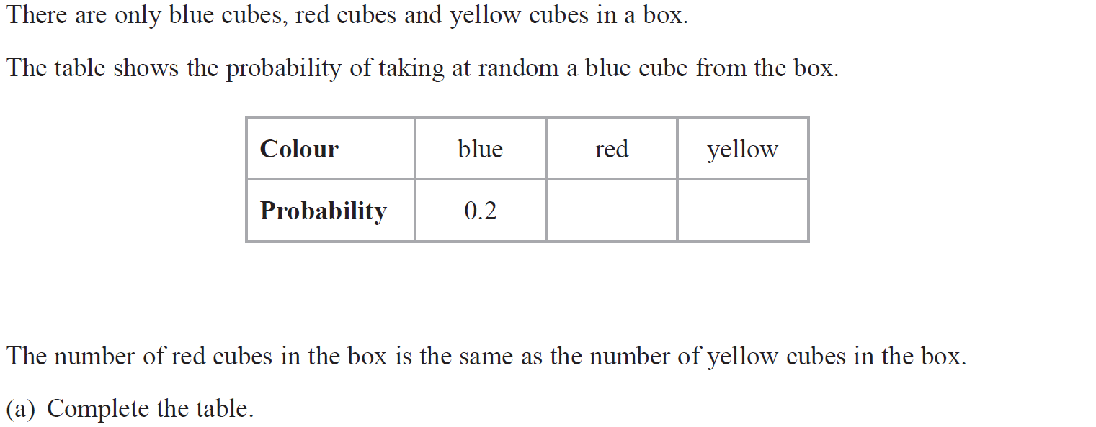
Basic Probability
May 2019 1H Q1

Slide 27
Basic Probability
May 2019 1H Q1
A
B
A SF
B SF

Slide 28
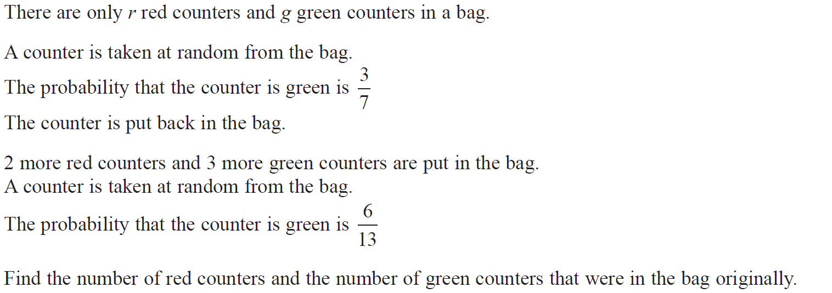
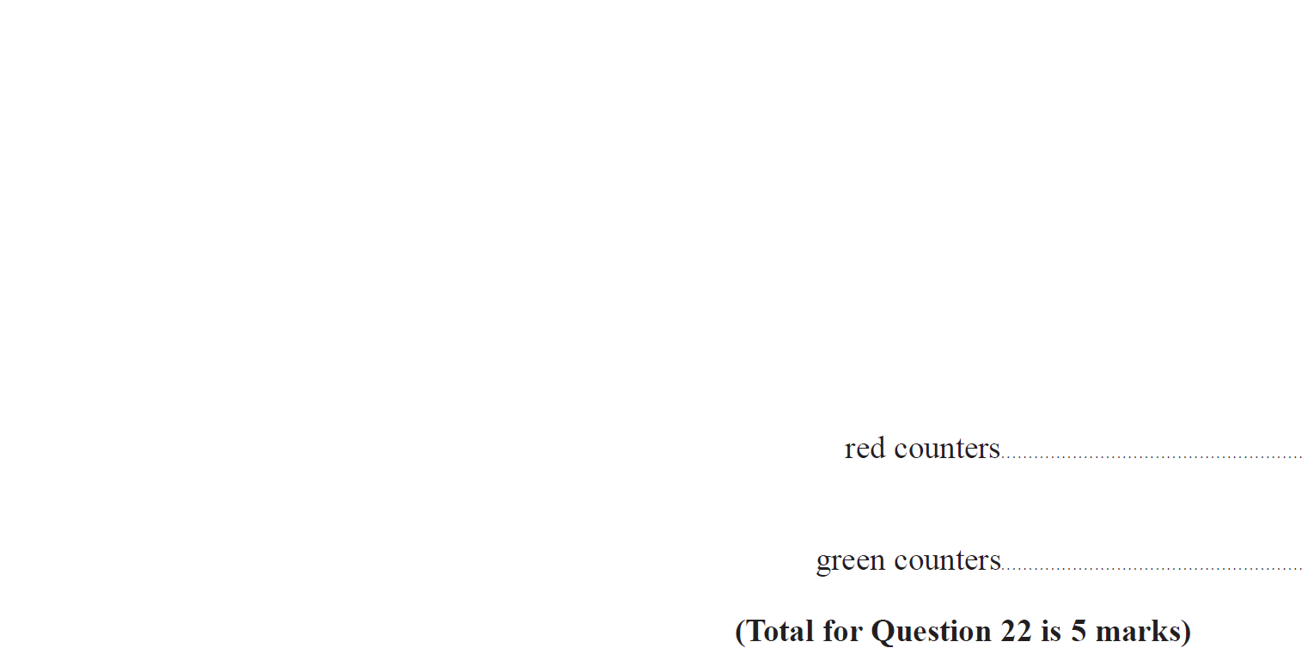
Basic Probability
May 2019 1H Q22

Slide 29
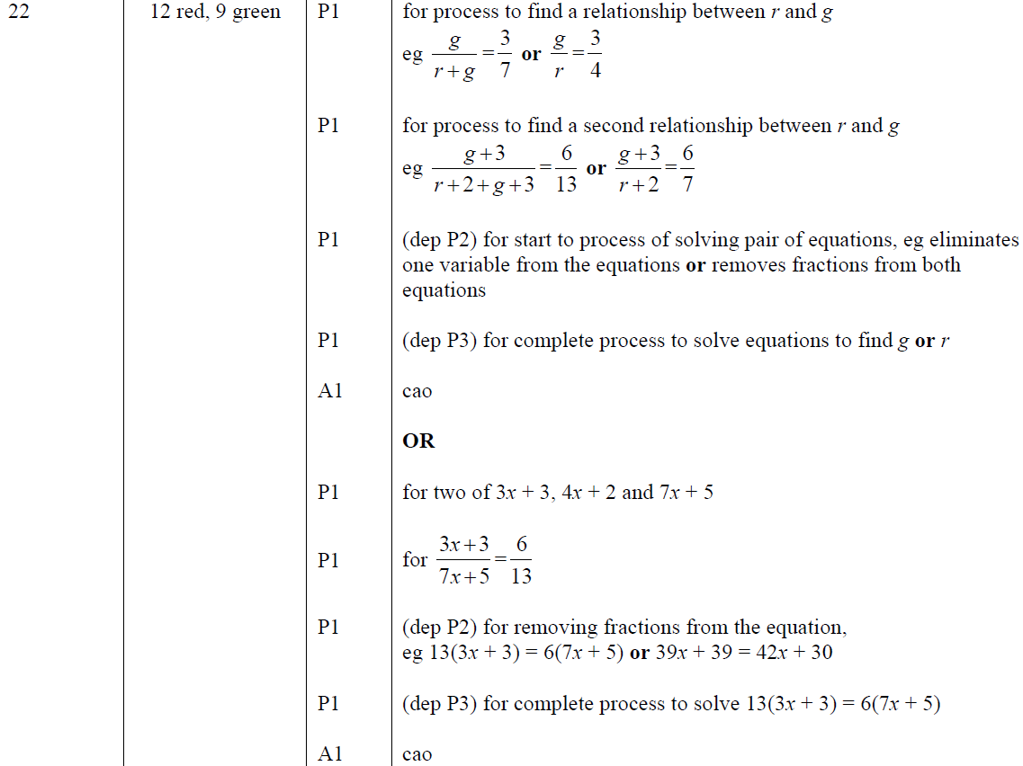
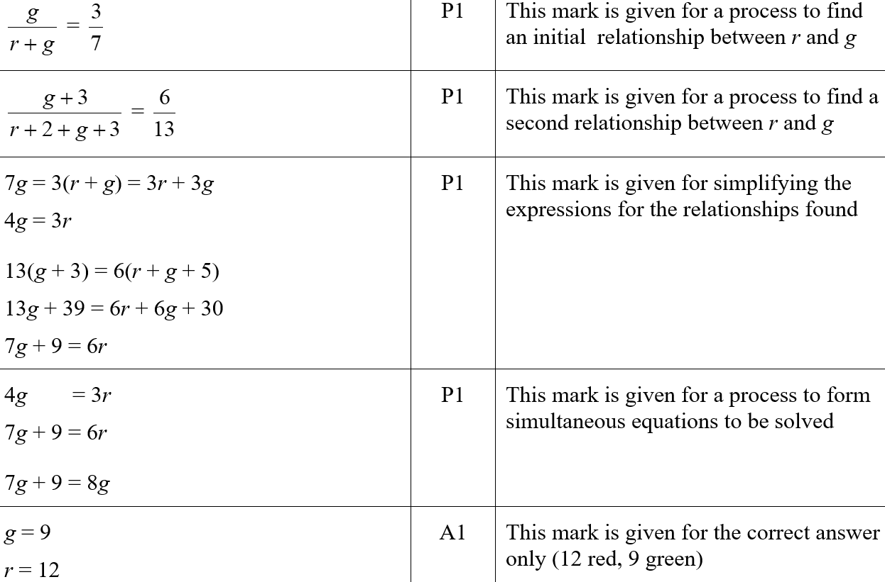
Basic Probability
May 2019 1H Q22
A
A SF

Slide 30
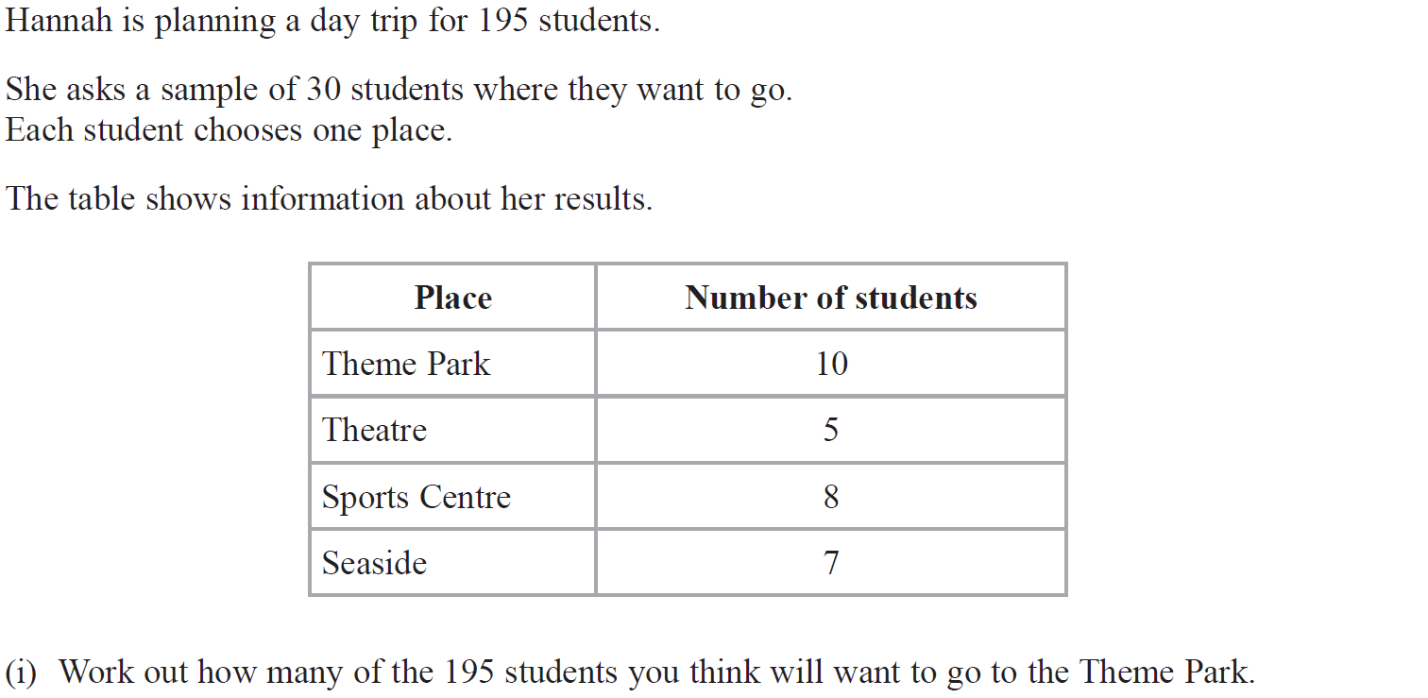
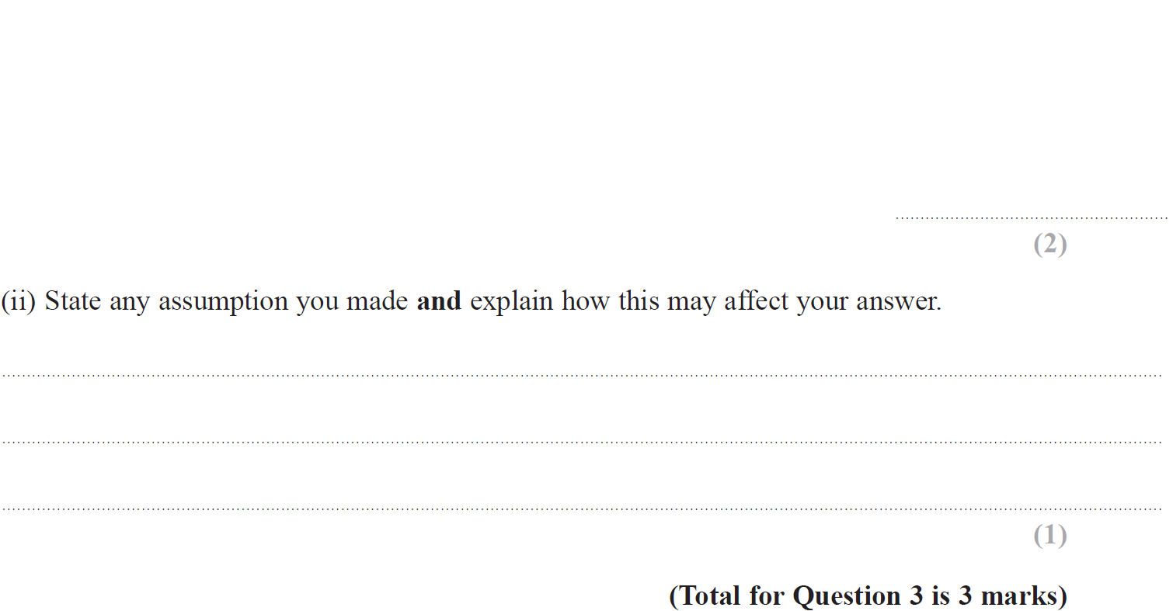
Basic Probability
June 2019 2H Q3

Slide 31
Basic Probability
June 2019 2H Q3
(i)
(ii)
(i) SF
(ii) SF

Slide 32
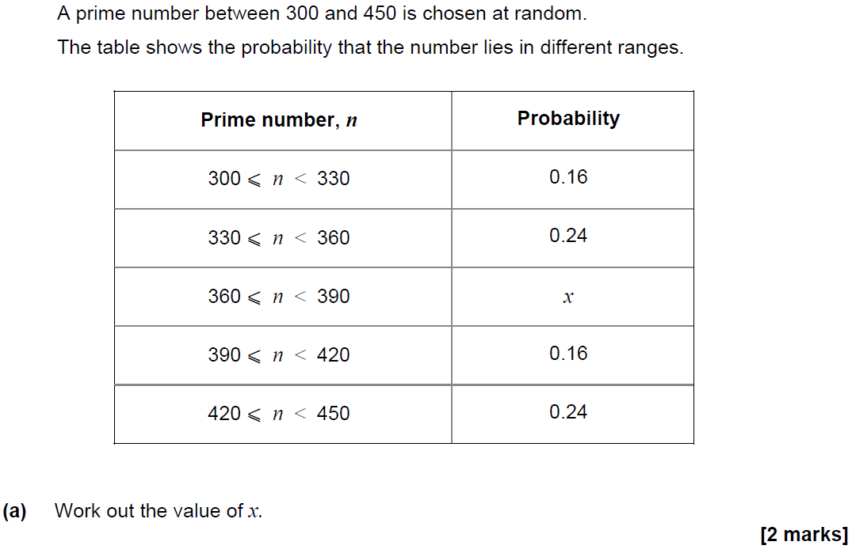
Basic Probability
SAM 1H Q14

Slide 33
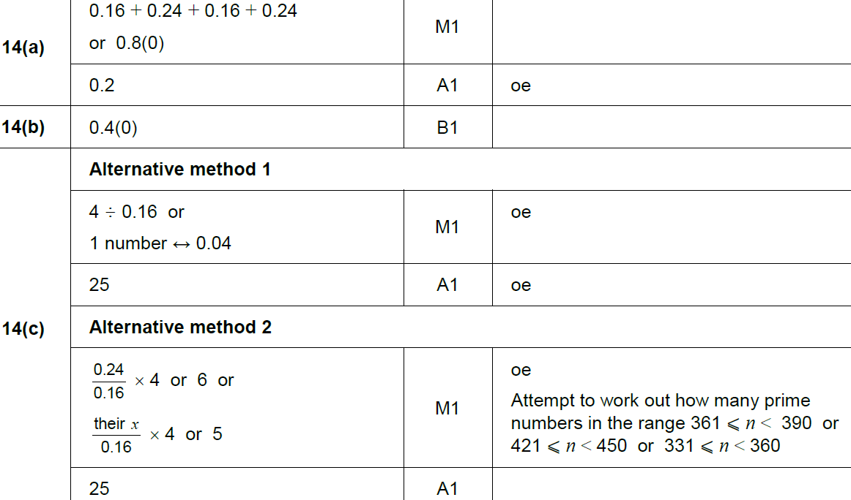
Basic Probability
SAM 1H Q14
A
B
C

Slide 34
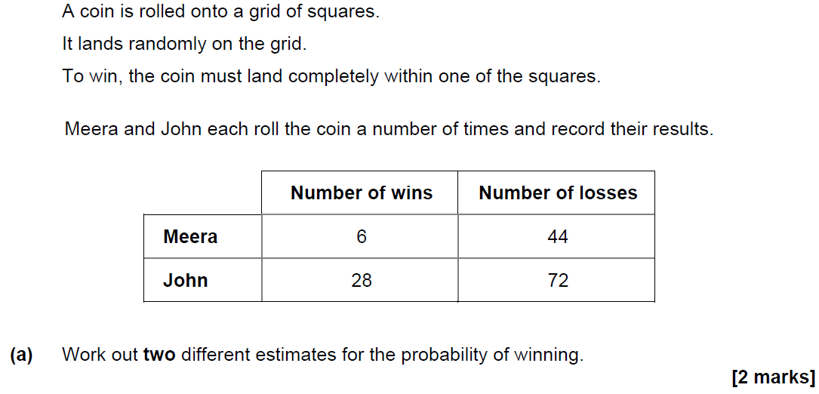
Basic Probability
SAM 2H Q7

Slide 35
Basic Probability
SAM 2H Q7
A
B

Slide 36
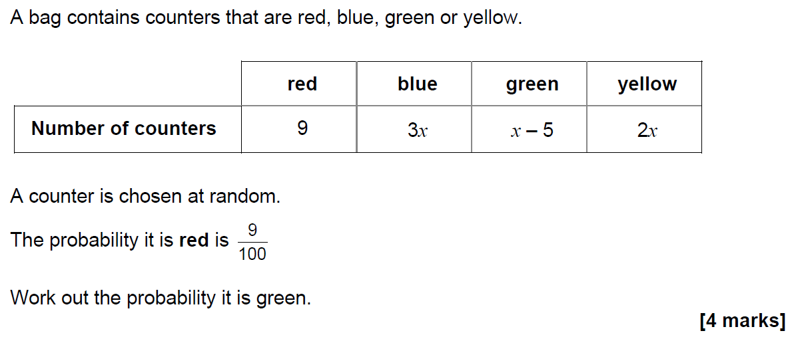
Basic Probability
SAM 3H Q6

Slide 37
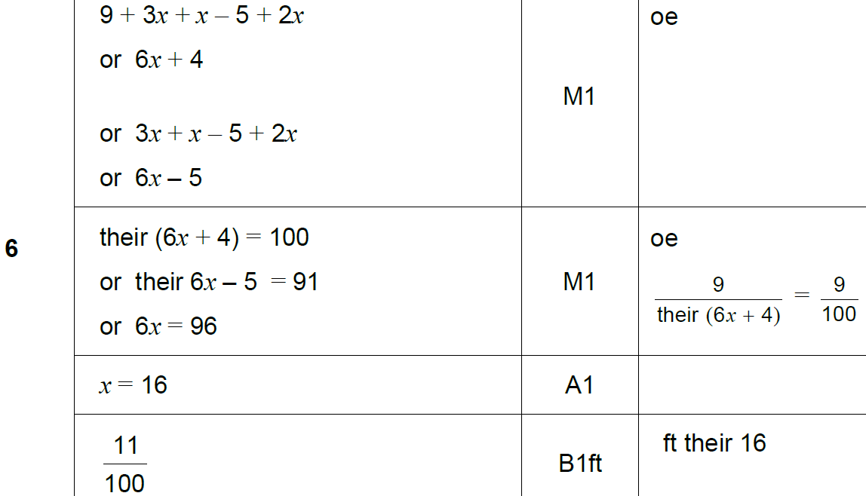
Basic Probability
SAM 3H Q6
A

Slide 38
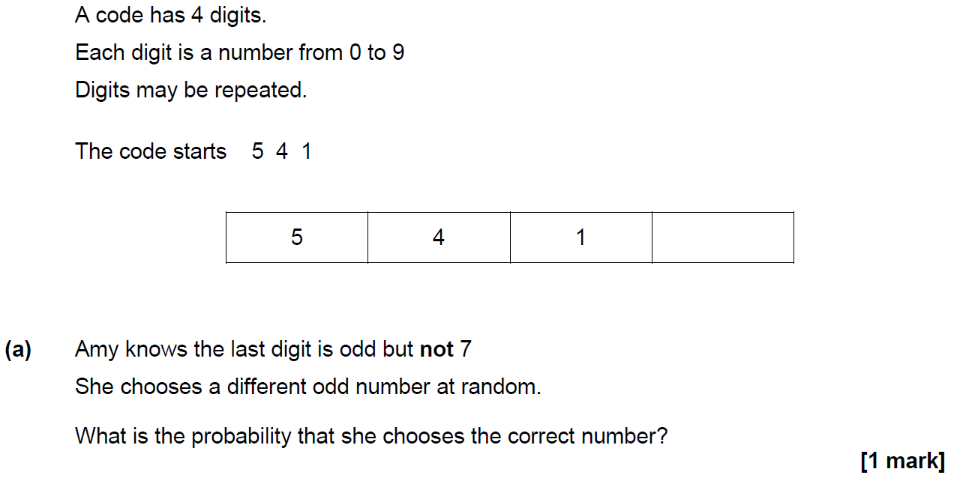
Basic Probability
June 2017 2H Q5

Slide 39
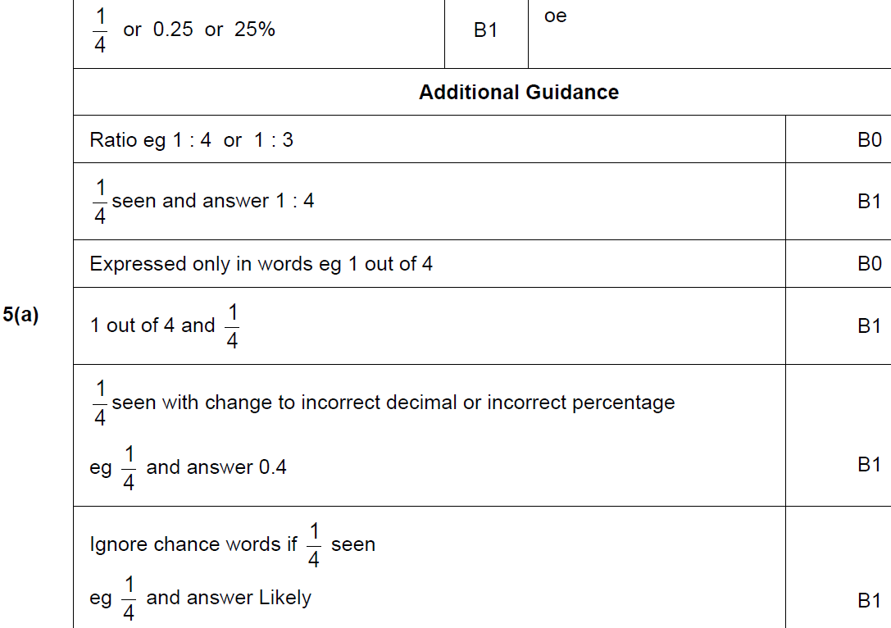
Basic Probability
June 2017 2H Q5
A

Slide 40
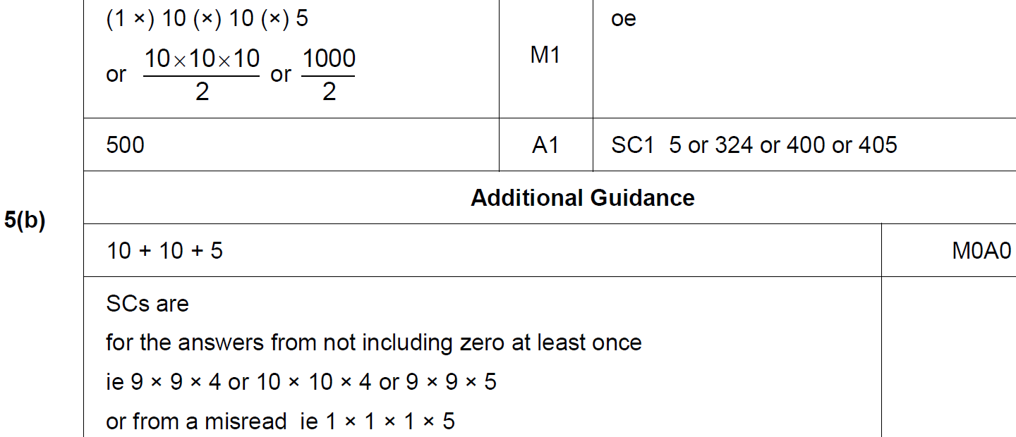
Basic Probability
June 2017 2H Q5
B

Slide 41
Basic Probability
June 2017 2H Q9

Slide 42
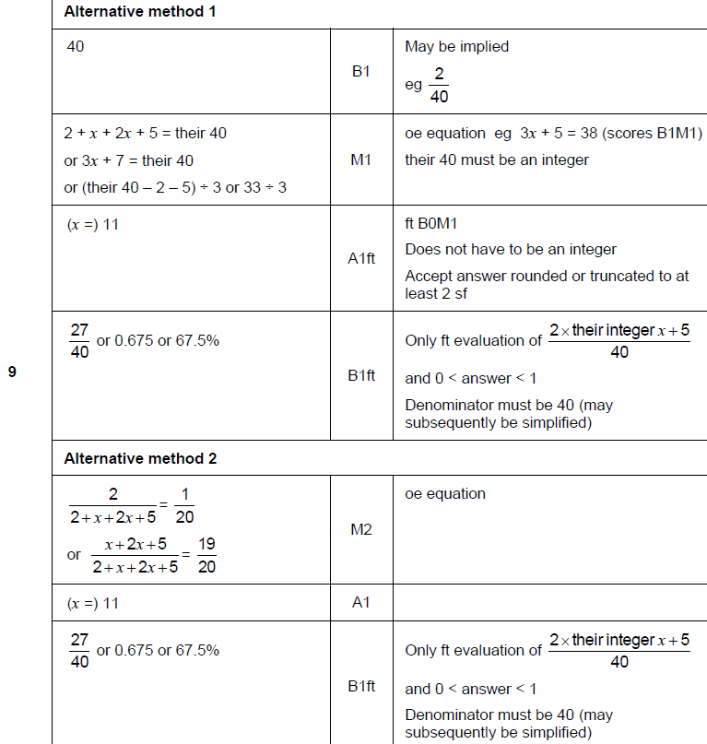
Basic Probability
June 2017 2H Q9
A

Slide 43
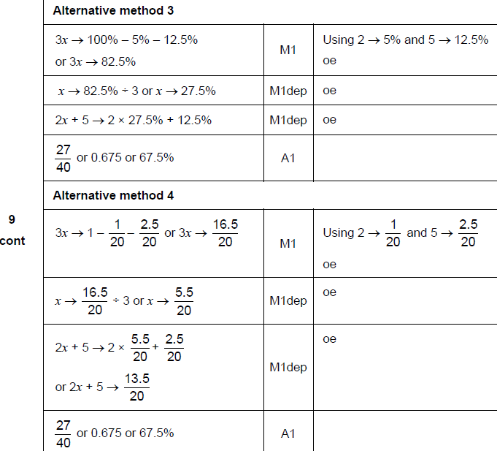
Basic Probability
June 2017 2H Q9
A Alternatives

Slide 44
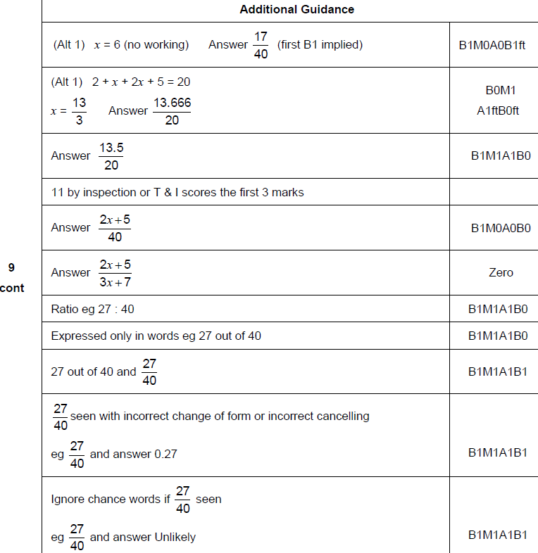
Basic Probability
June 2017 2H Q9
A notes

Slide 45
Basic Probability
June 2017 3H Q5

Slide 46
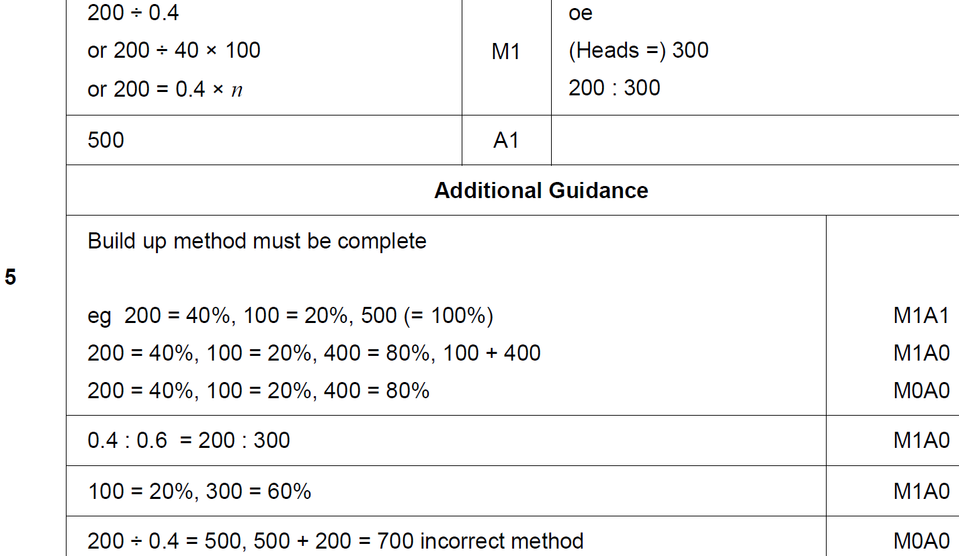
Basic Probability
June 2017 3H Q5
A

Slide 47
Basic Probability
June 2017 3H Q9

Slide 48
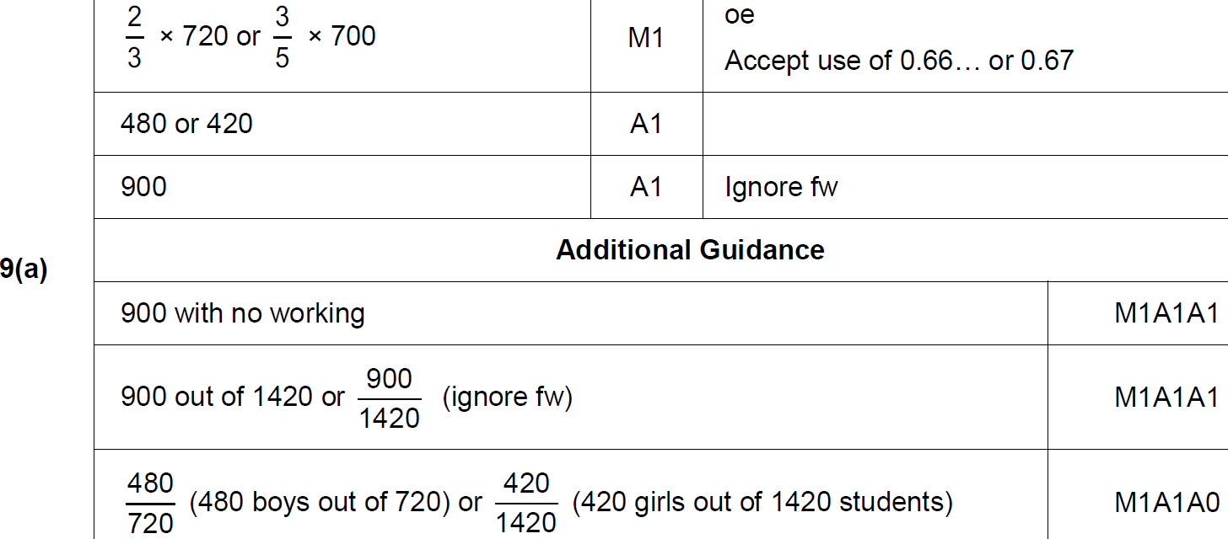
Basic Probability
June 2017 3H Q9
A

Slide 49
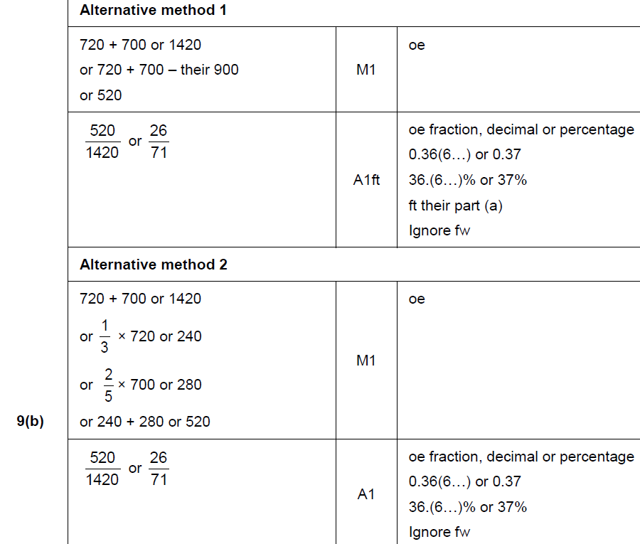
Basic Probability
June 2017 3H Q9
B

Slide 50
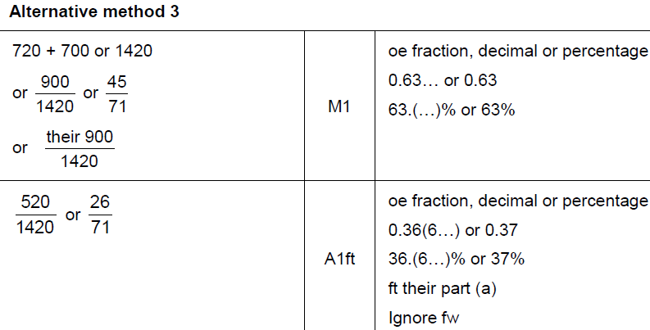
Basic Probability
June 2017 3H Q9
B Alternative & notes

Slide 51
Basic Probability
May 2018 1H Q8
A coin is thrown 50 times.
It lands on heads 31 times.
(a) Write down the relative frequency it lands on heads.
[1 mark]
(b) Raj says,
“The coin is biased towards heads.”
Use the data to give a reason why he might be correct.
[1 mark]

Slide 52
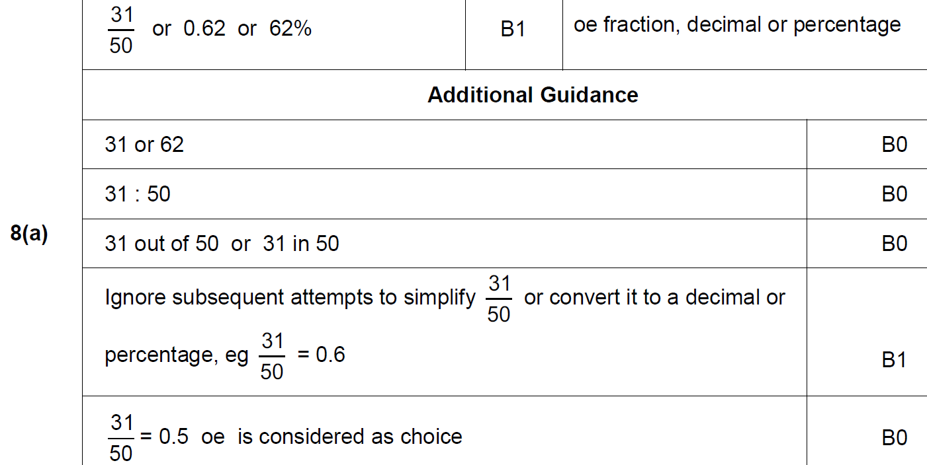
Basic Probability
May 2018 1H Q8
A

Slide 53
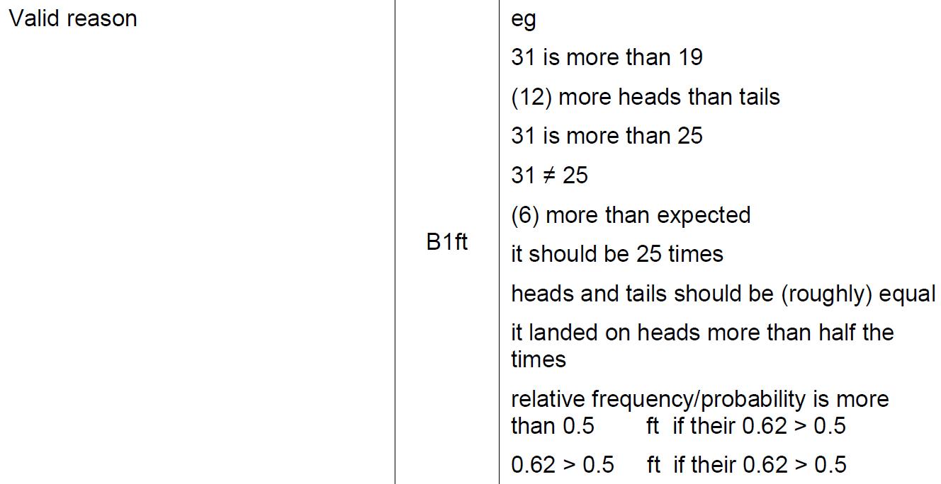
Basic Probability
May 2018 1H Q8
B

Slide 54
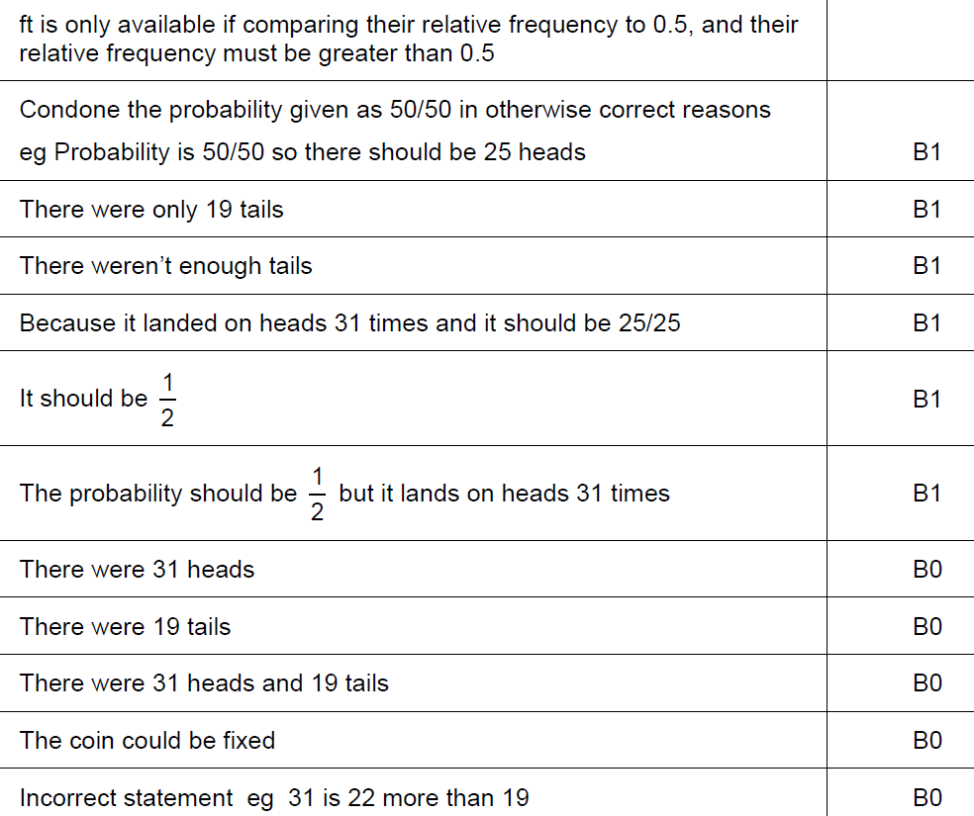
Basic Probability
May 2018 1H Q8
B notes

Slide 55
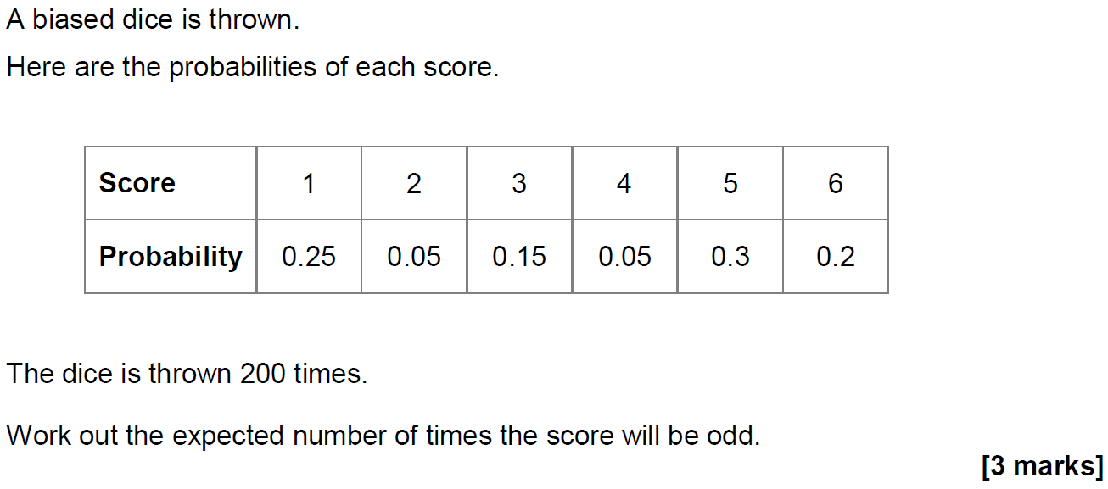
Basic Probability
May 2018 1H Q15

Slide 56
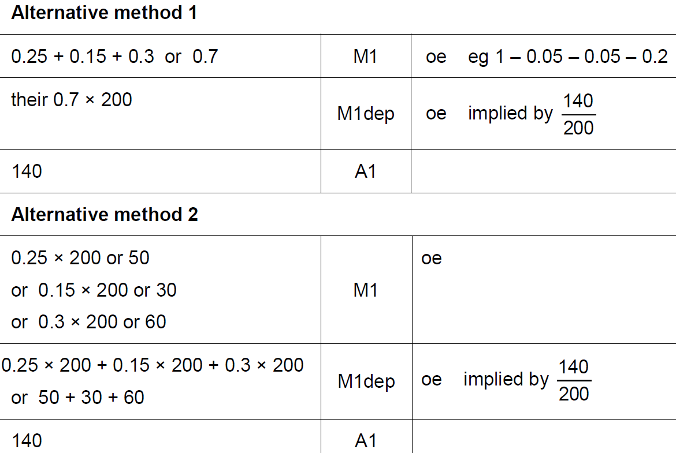
Basic Probability
May 2018 1H Q15
A

Slide 57
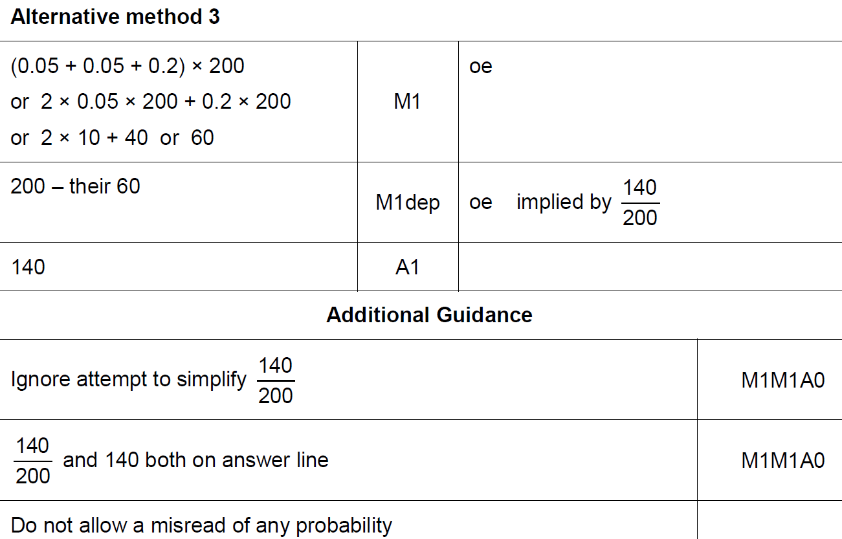
Basic Probability
May 2018 1H Q15
A Alternative 2 & notes

Slide 58
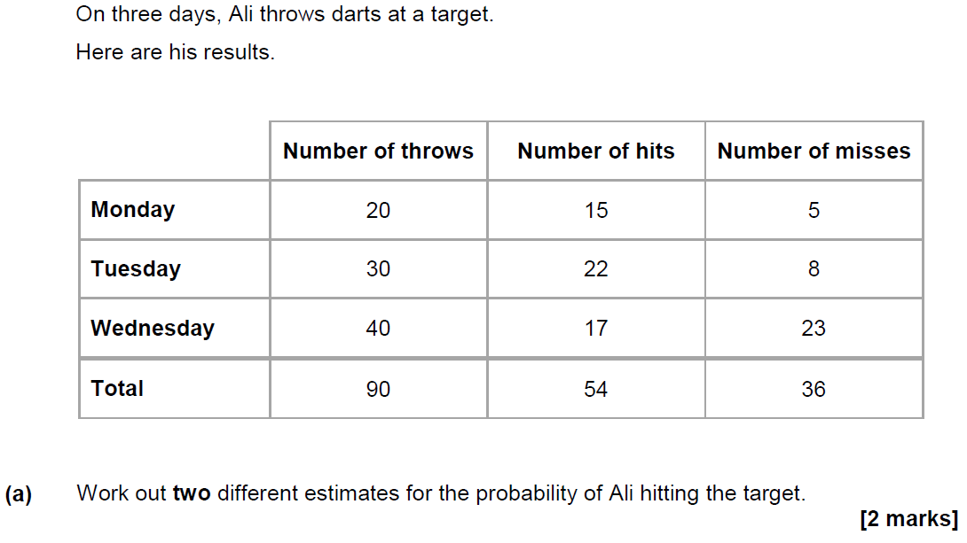
Basic Probability
June 2018 2H Q7

Slide 59
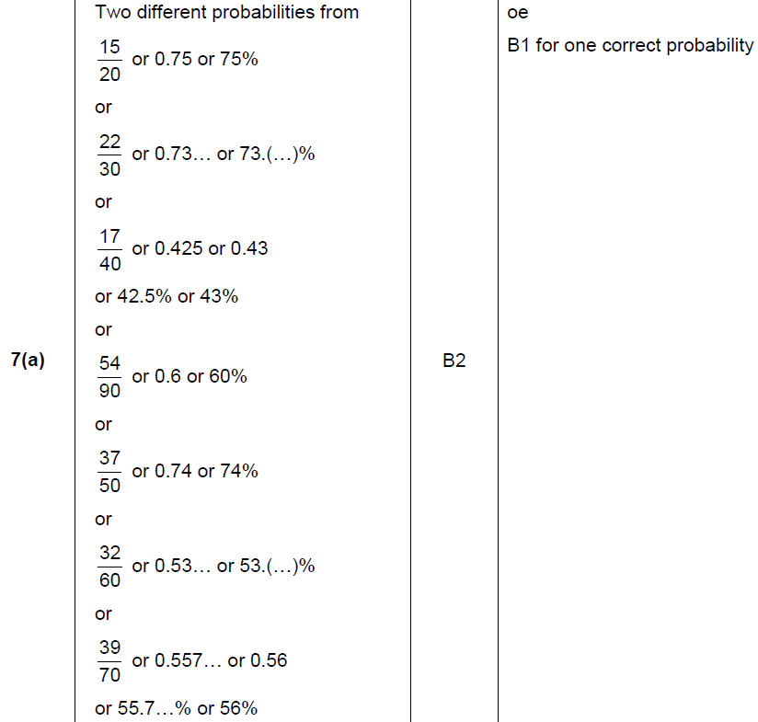
Basic Probability
June 2018 2H Q7
A

Slide 60
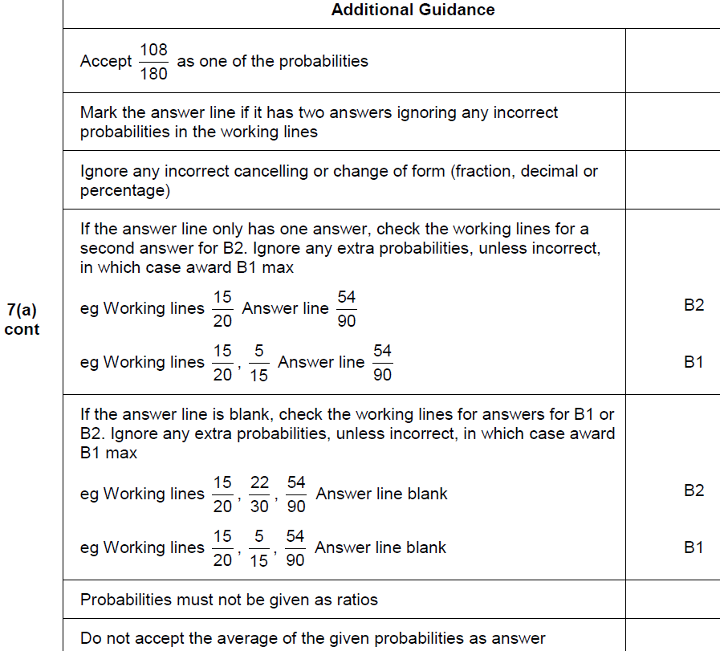
Basic Probability
June 2018 2H Q7
A notes

Slide 61
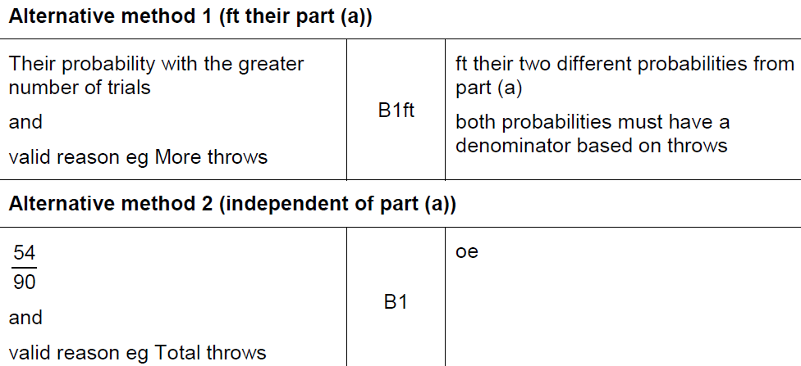
Basic Probability
June 2018 2H Q7
B

Slide 62
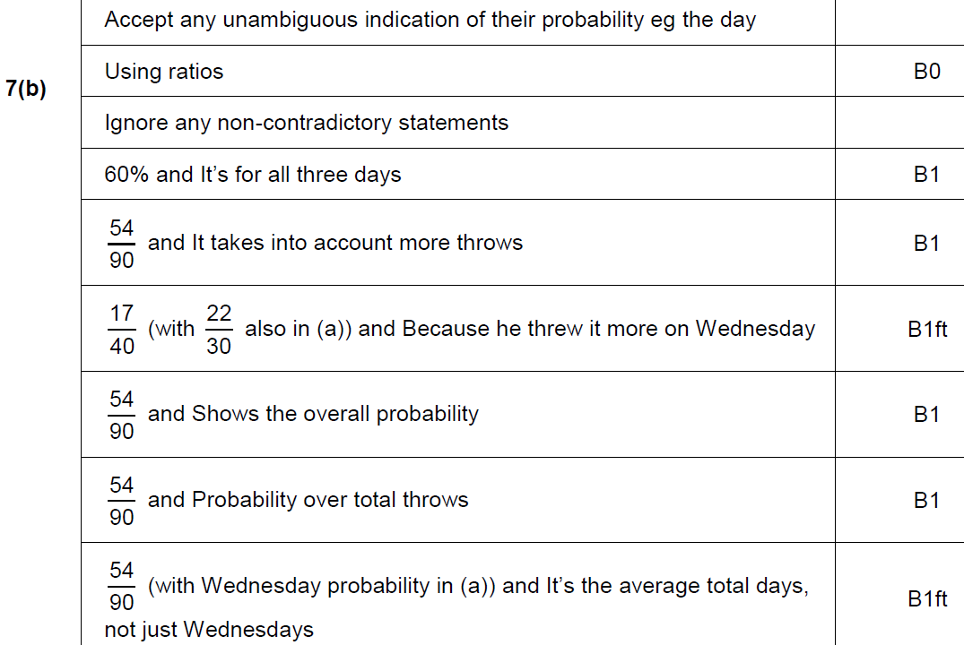
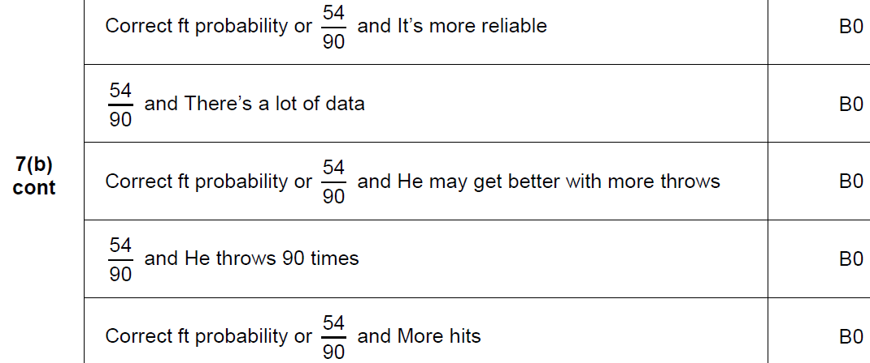
Basic Probability
June 2018 2H Q7
B notes

Slide 63
Basic Probability
Nov 2018 3H Q13

Slide 64
Basic Probability
Nov 2018 3H Q13
A

Slide 65
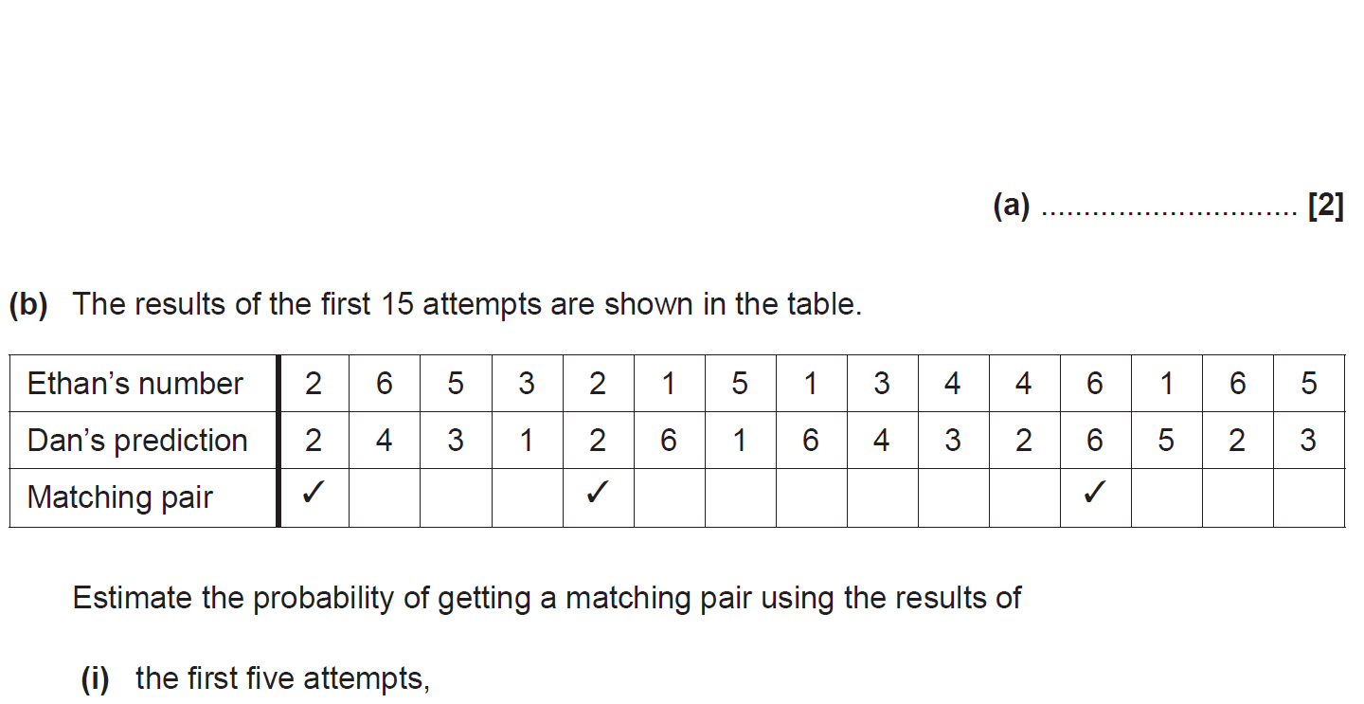
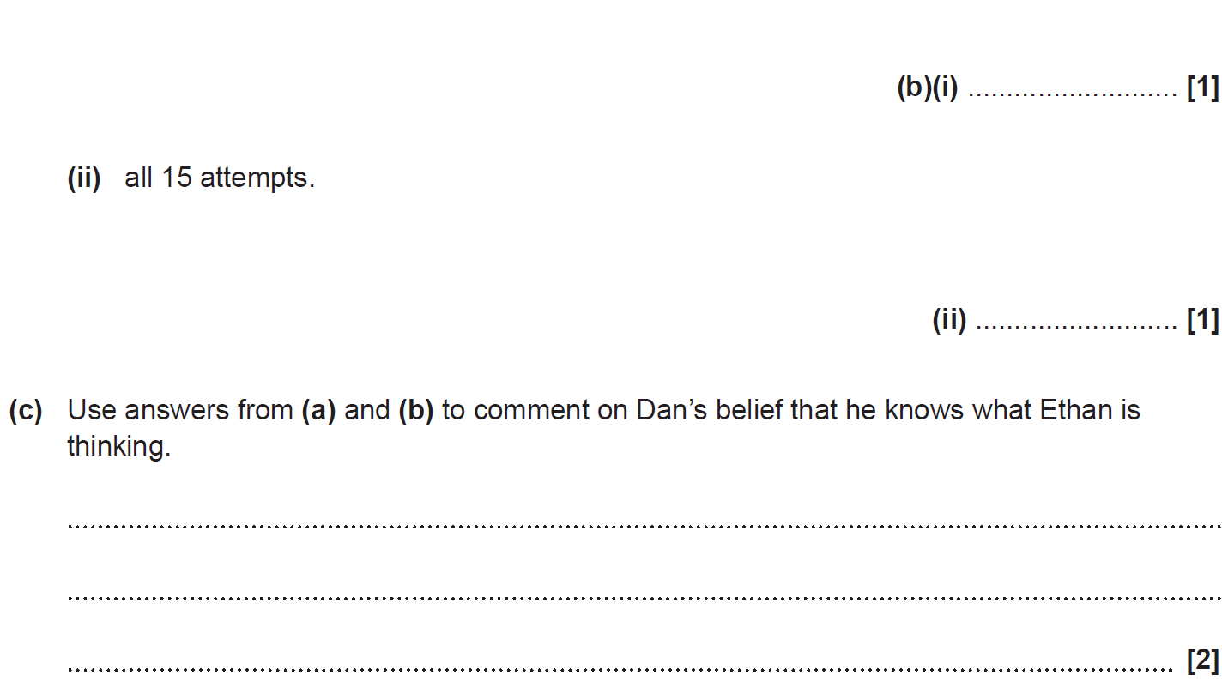
Basic Probability
SAM 1H Q7

Slide 66
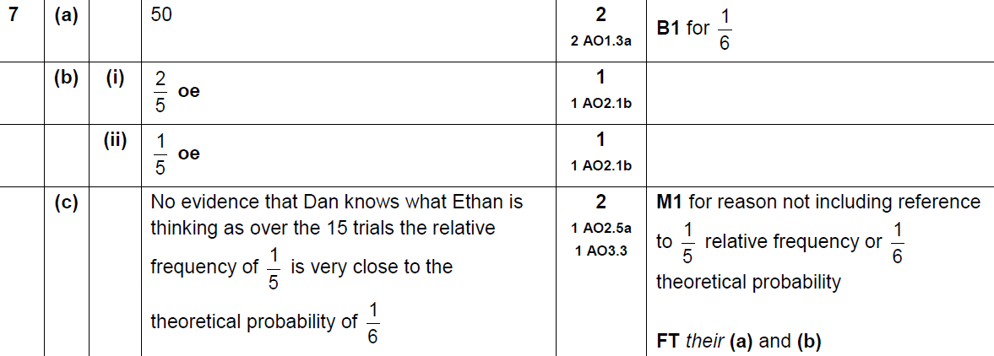
Basic Probability
SAM 1H Q7
A
B (i)
B (ii)
C

Slide 67
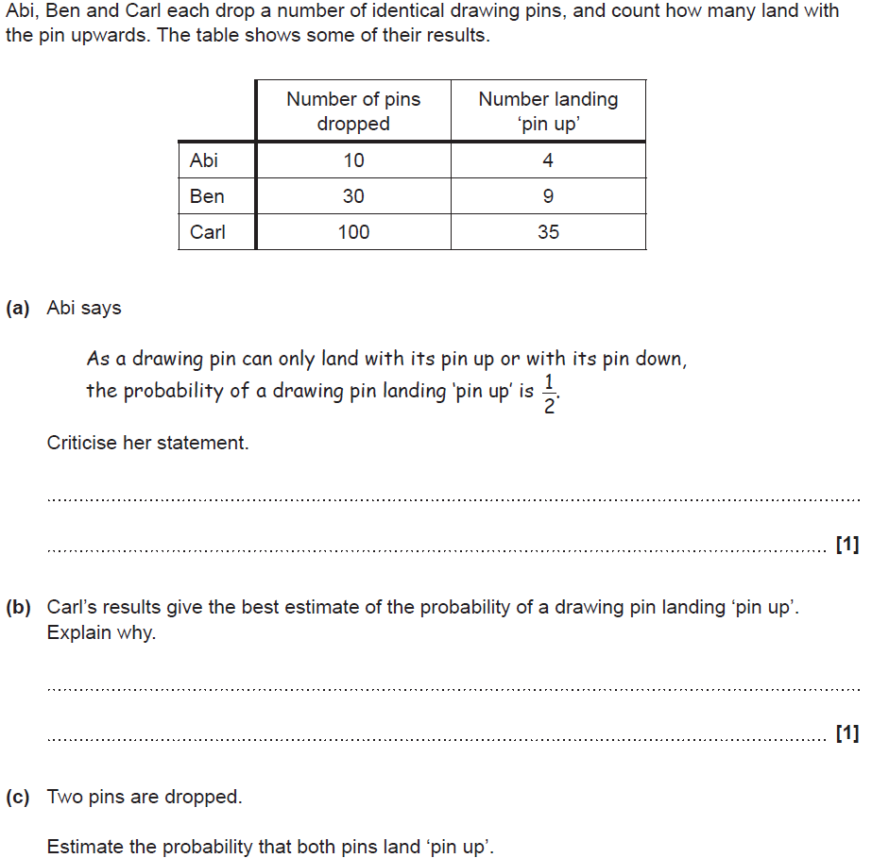
Basic Probability
SAM 2H Q3

Slide 68
Basic Probability
SAM 2H Q3
A
B
C

Slide 69
Basic Probability
SAM 2H Q6

Slide 70
Basic Probability
SAM 2H Q6
A

Slide 71
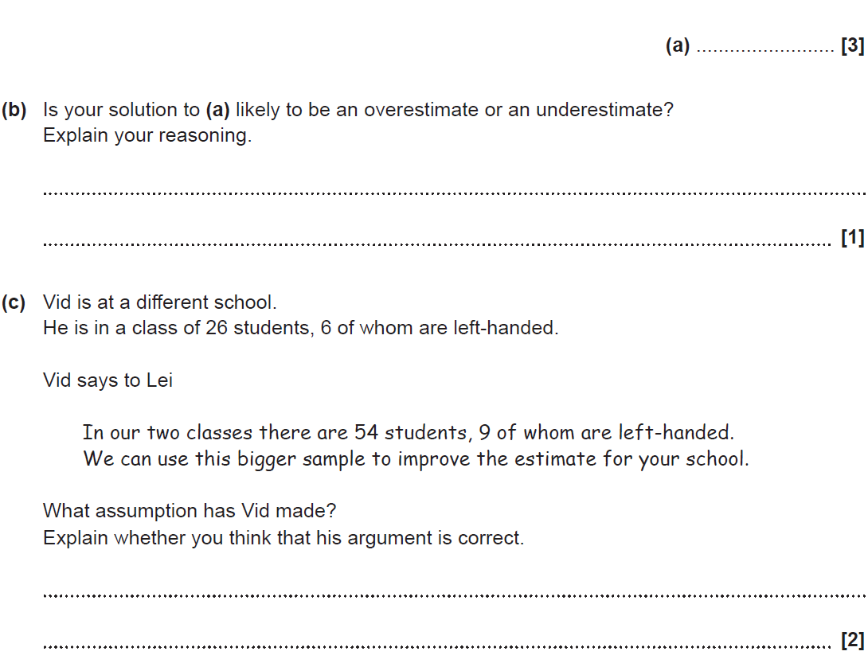
Basic Probability
SAM 3H Q5

Slide 72
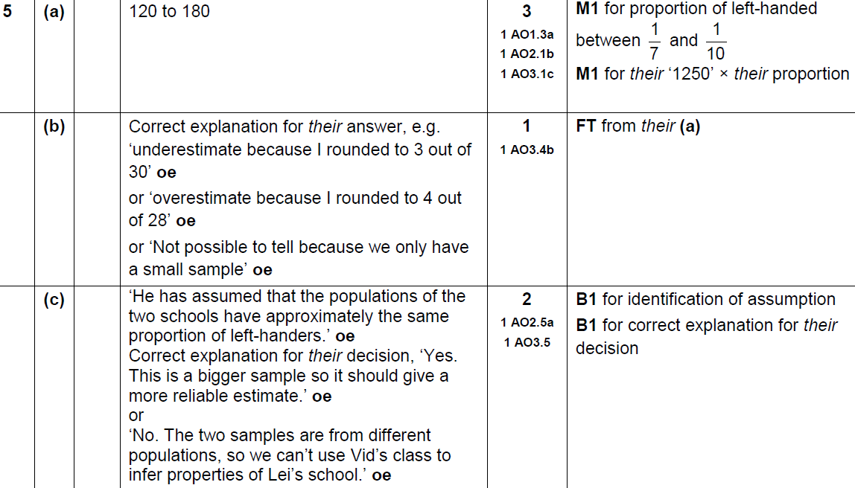
Basic Probability
SAM 3H Q5
A
B
C

Slide 73
Basic Probability
June 2017 2H Q9

Slide 74
Basic Probability
June 2017 2H Q9
A

Slide 75
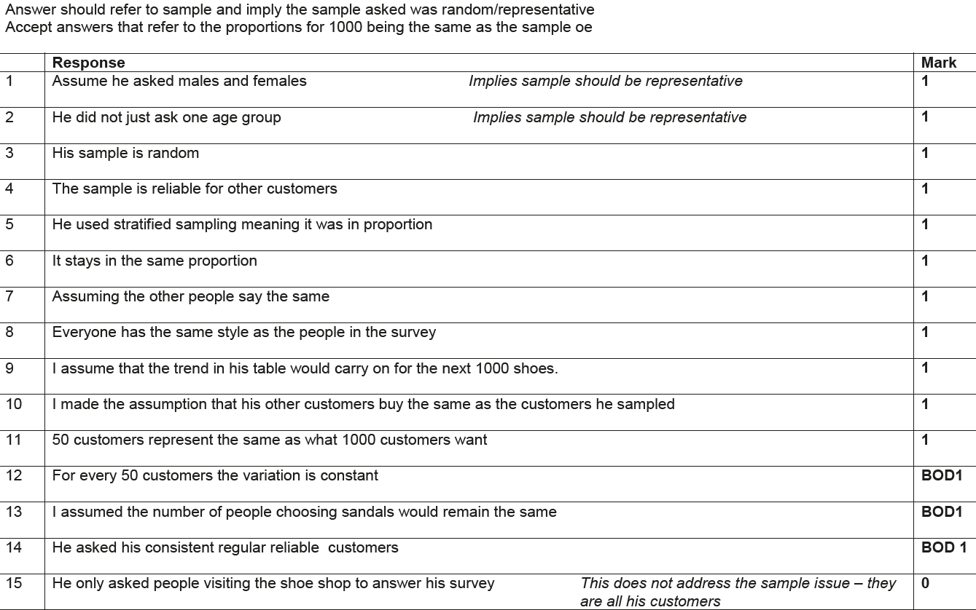
Basic Probability
June 2017 2H Q9
A Exemplar responses

Slide 76
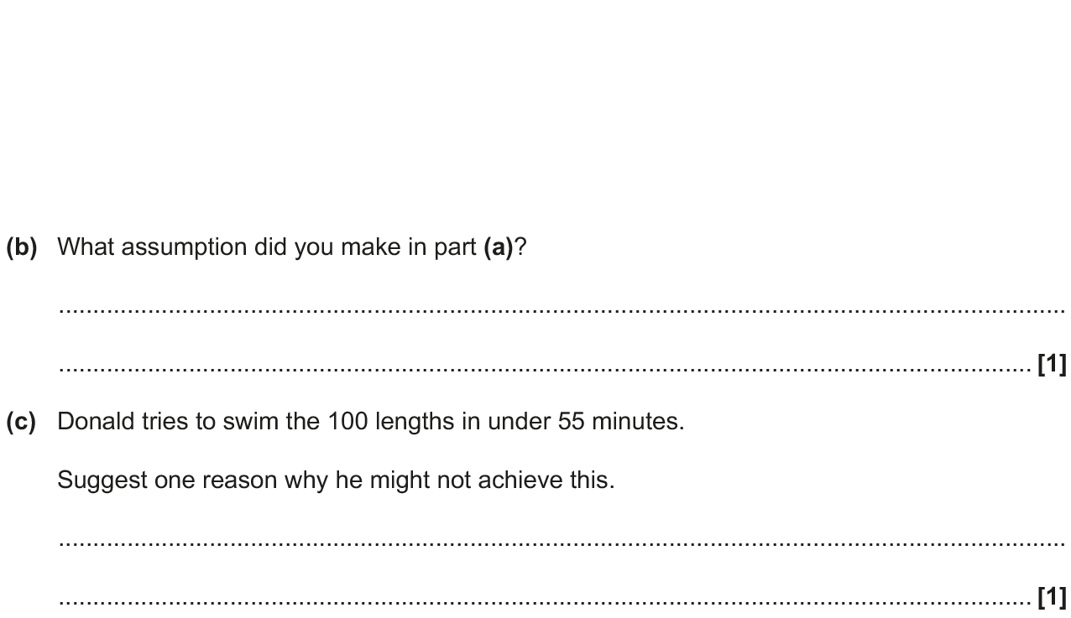
Basic Probability
Nov 2017 1H Q1

Slide 77
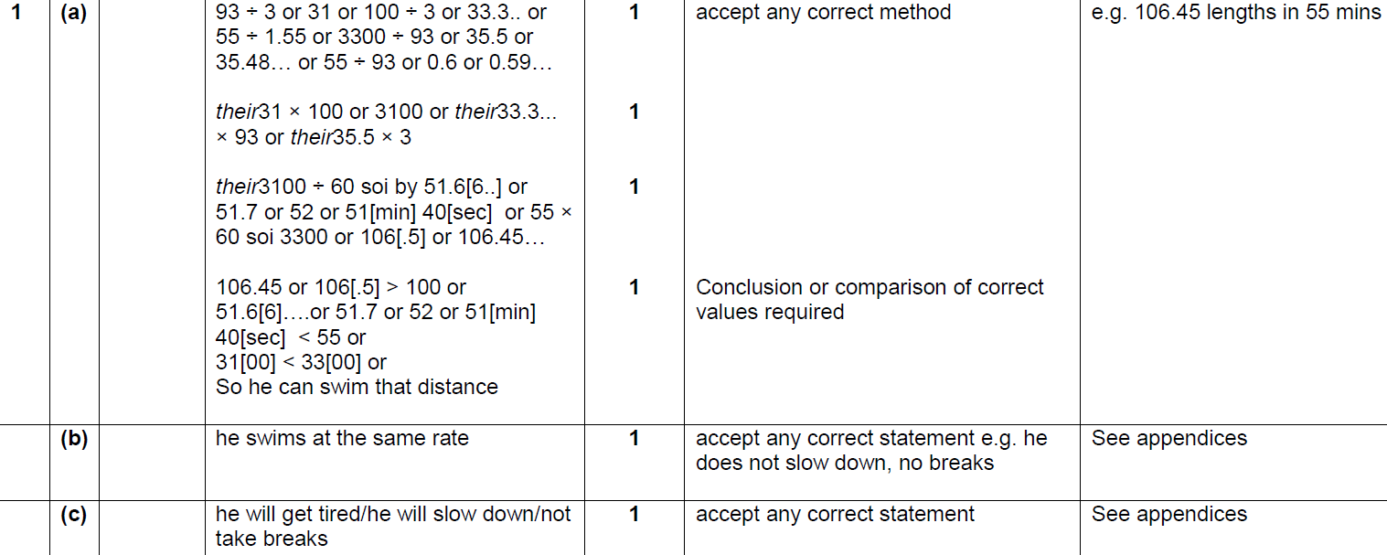
Basic Probability
Nov 2017 1H Q1
A
B
C

Slide 78
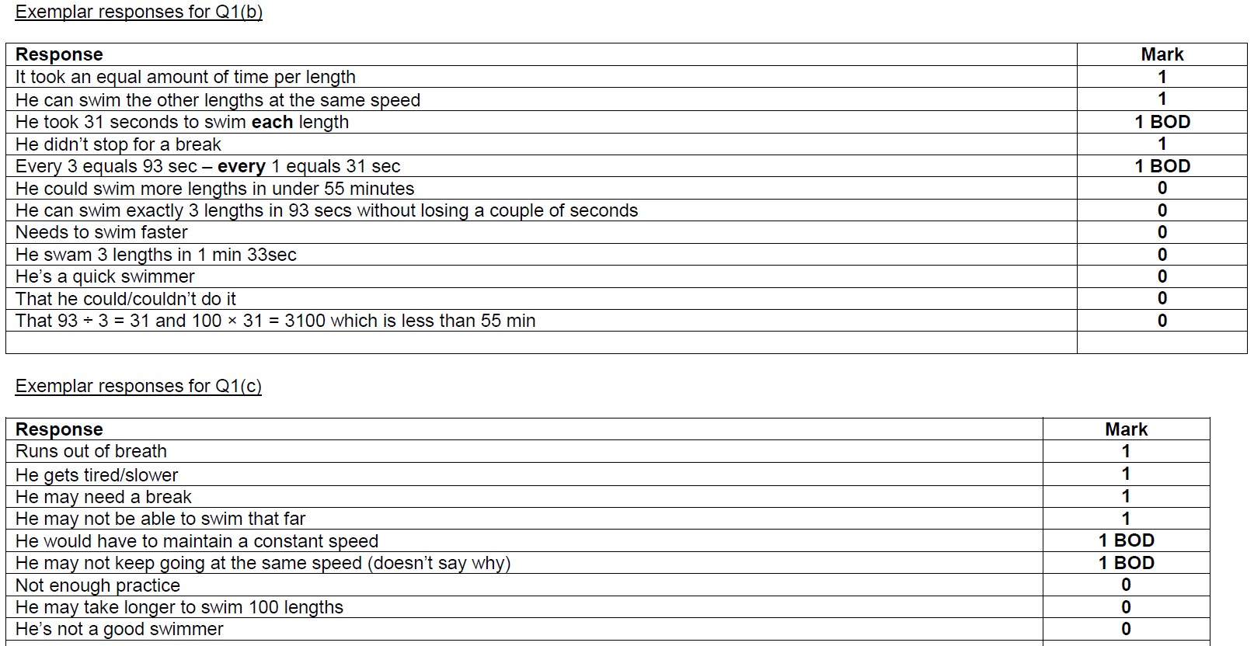
Basic Probability
Nov 2017 1H Q1
B Exemplar responses
C Exemplar responses

Slide 79
Basic Probability
Nov 2017 3H Q4

Slide 80
Basic Probability
Nov 2017 3H Q4
A
B
C

Slide 81
Basic Probability
June 2018 2H Q5

Slide 82
Basic Probability
June 2018 2H Q5
A
B

Slide 83
Basic Probability
Nov 2018 3H Q7

Slide 84
Basic Probability
Nov 2018 3H Q7
A
B (i)
B (ii)

