Slide 1
Averages
Averages
May 2017
2H Q6
May 2018
1H Q9
June 2017
3H Q13
SAM
1H Q11
June 2018
2H Q15
Nov 2017
1H Q9
1 Marker
SAM
3H Q18
Nov 2018
2H Q6
Nov 2017
1H Q20
Nov 2018
3H Q14
Nov 2017
2H Q8
IQR/ Range
Table of Data

Slide 2
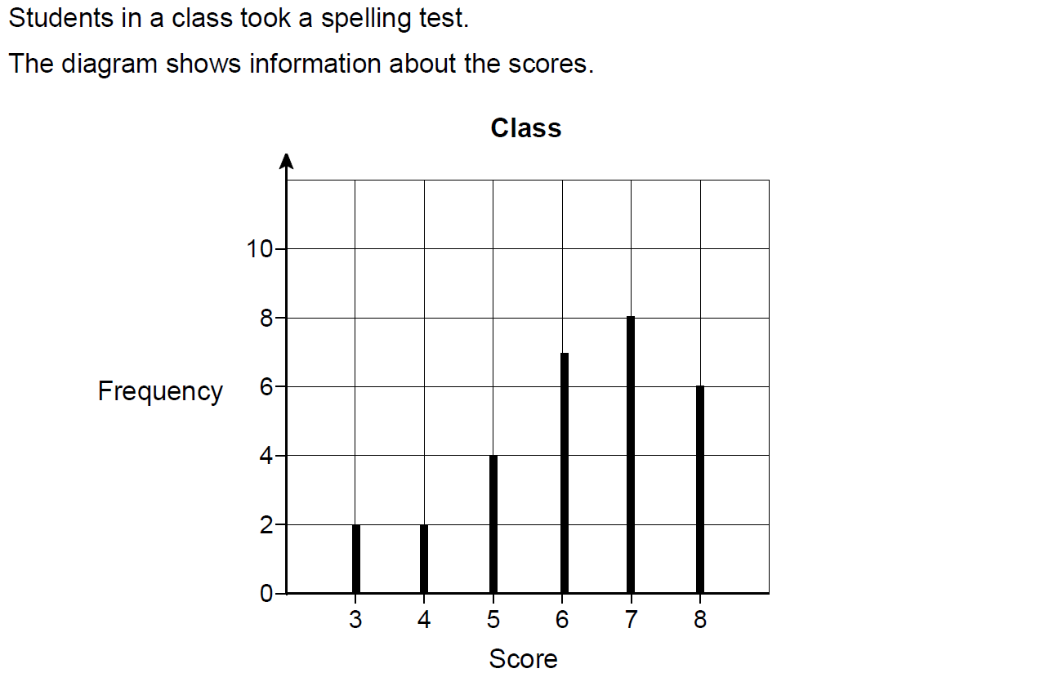
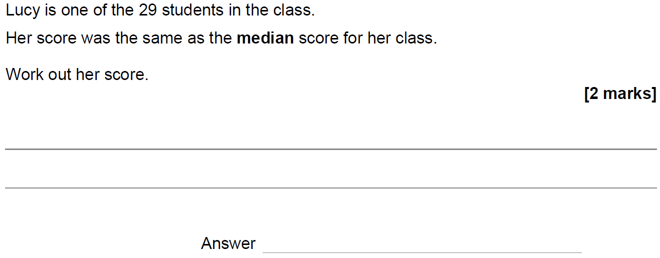
Averages
SAM 1H Q11

Slide 3
Averages
SAM 1H Q11
A

Slide 4
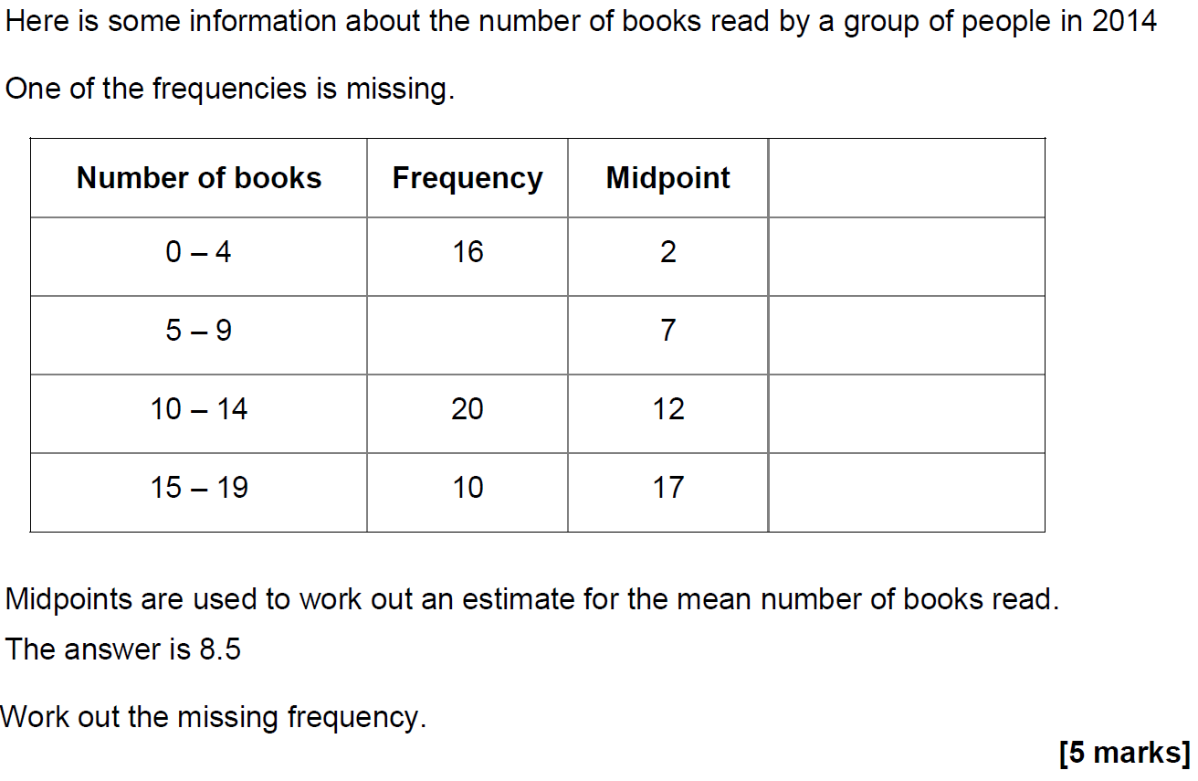
Averages
SAM 3H Q18

Slide 5
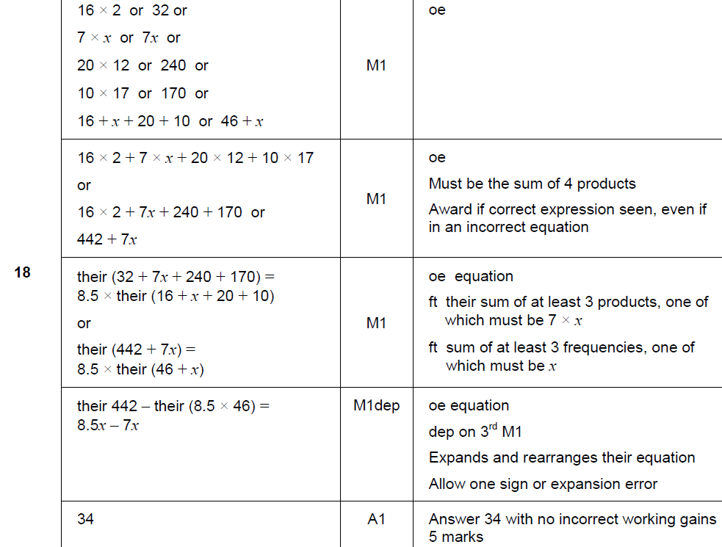
Averages
SAM 3H Q18
A

Slide 6
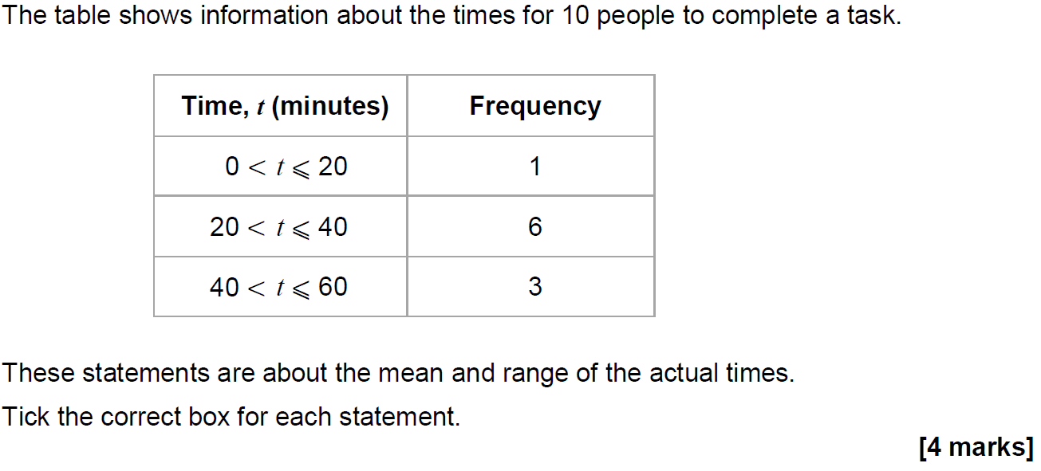
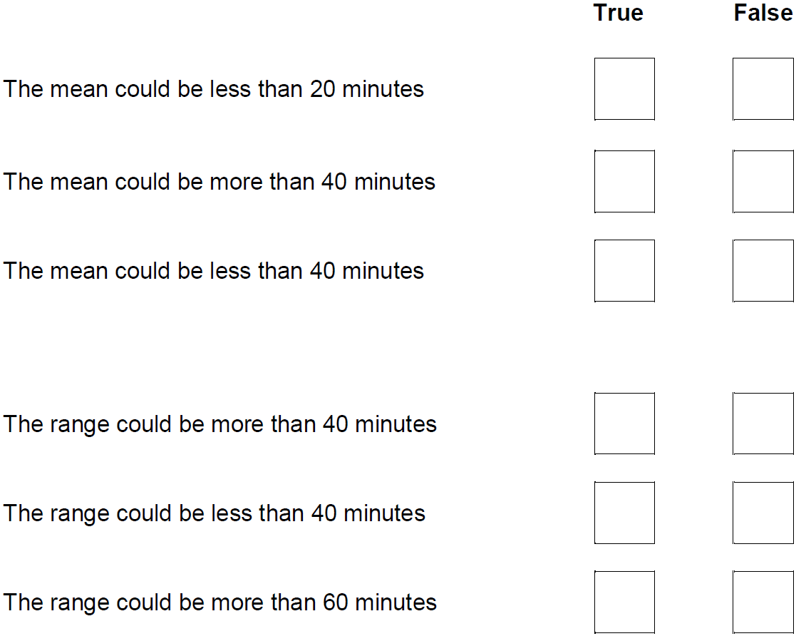
Averages
May 2017 1H Q6

Slide 7
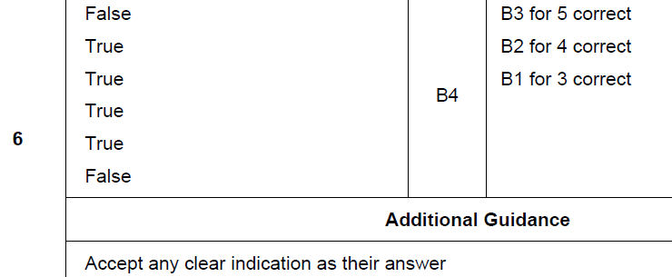
Averages
May 2017 1H Q6
A

Slide 8
Averages
June 2017 3H Q13

Slide 9
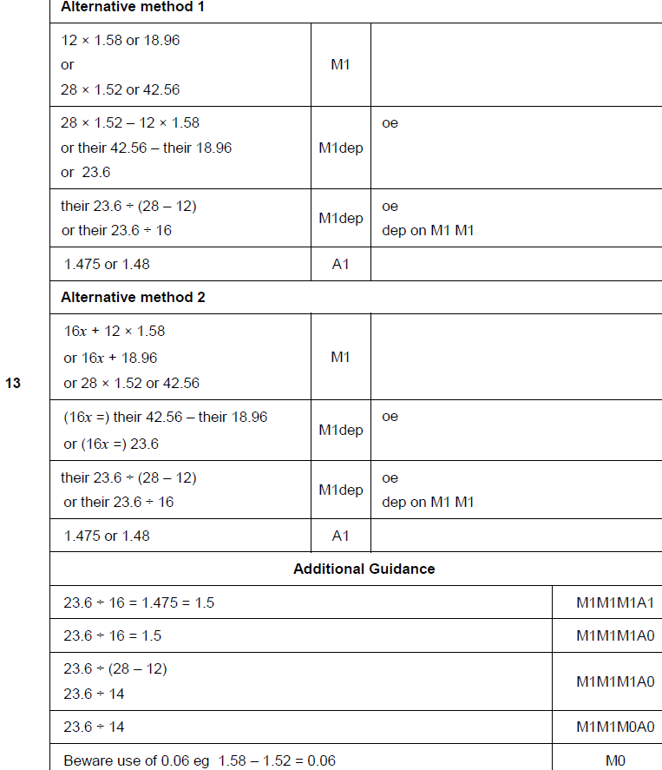
Averages
June 2017 3H Q13
A

Slide 10
Averages
Nov 2017 1H Q9

Slide 11
Averages
Nov 2017 1H Q9
A

Slide 12
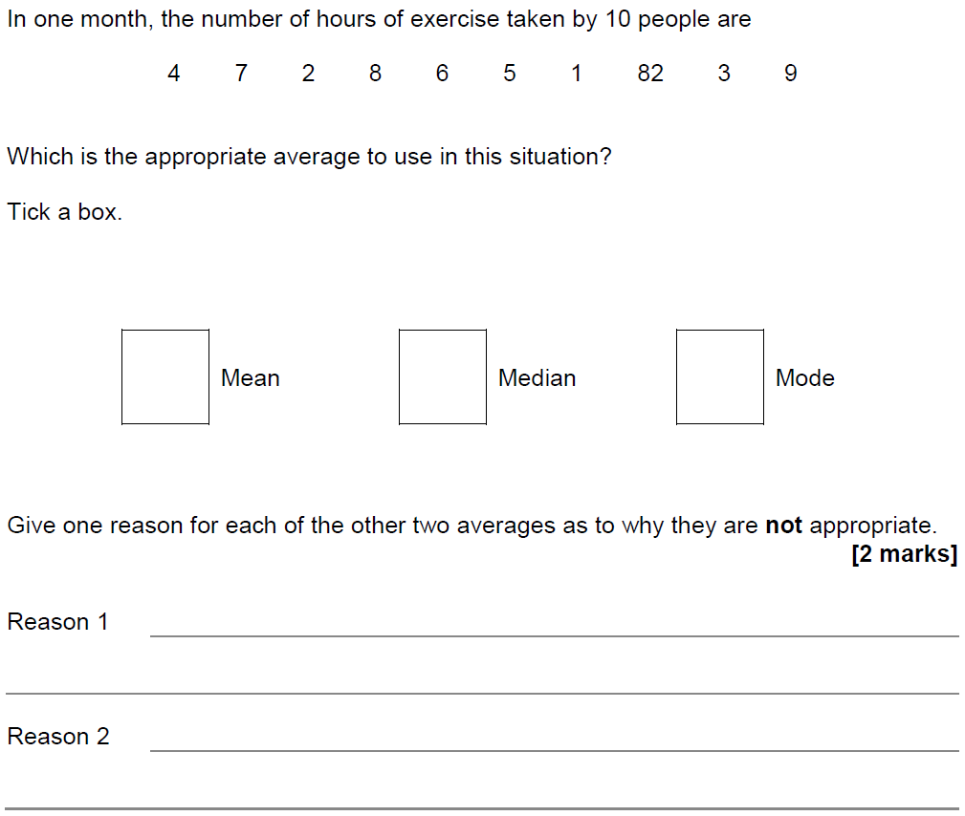
Averages
Nov 2017 1H Q20

Slide 13
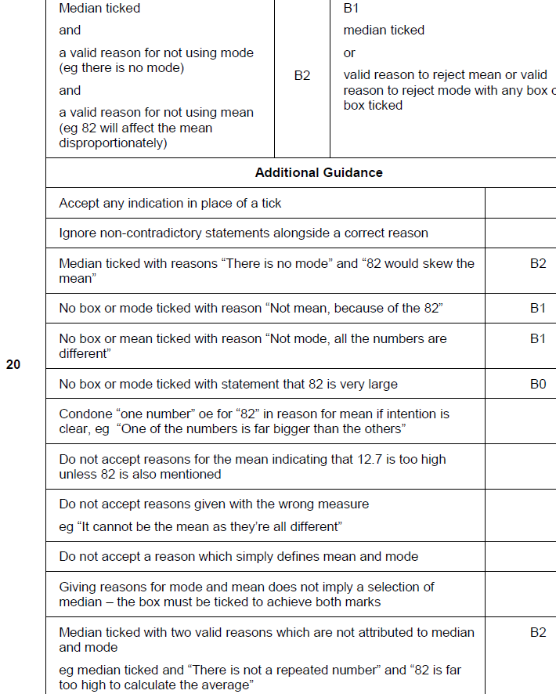
Averages
Nov 2017 1H Q20
A

Slide 14
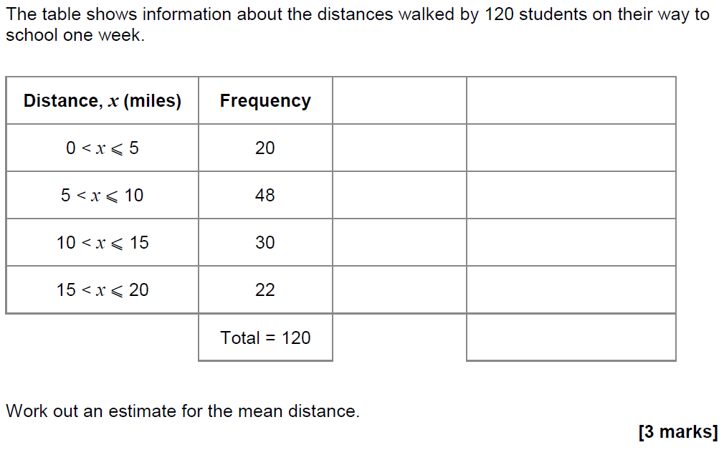
Averages
Nov 2017 2H Q8

Slide 15
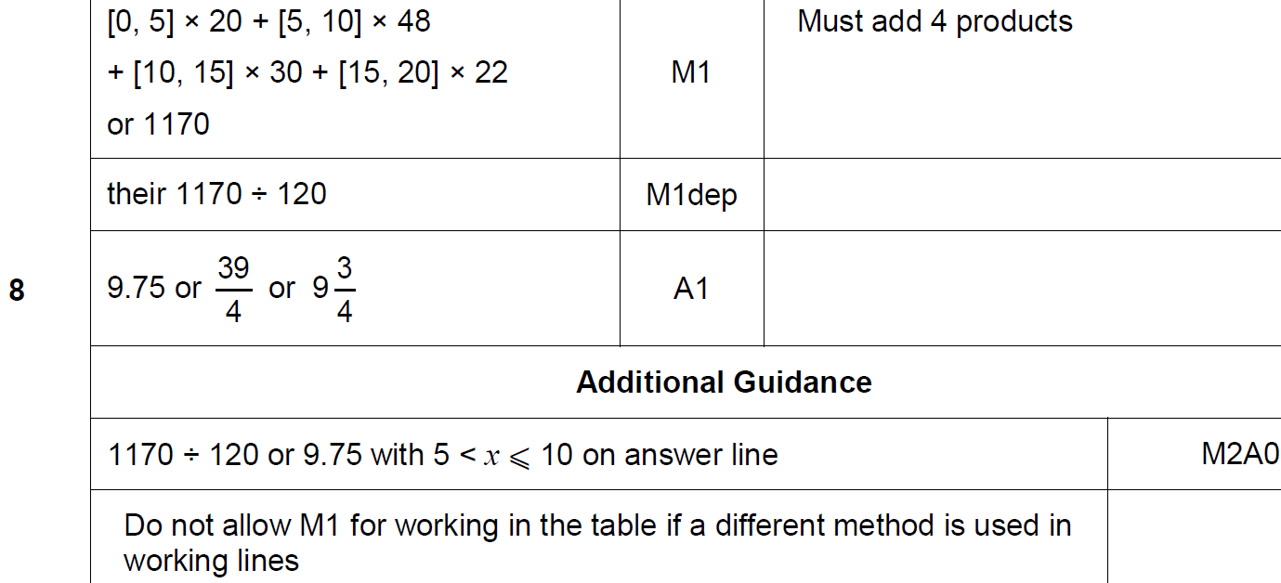
Averages
Nov 2017 2H Q8
A

Slide 16
Averages
May 2018 1H Q9

Slide 17
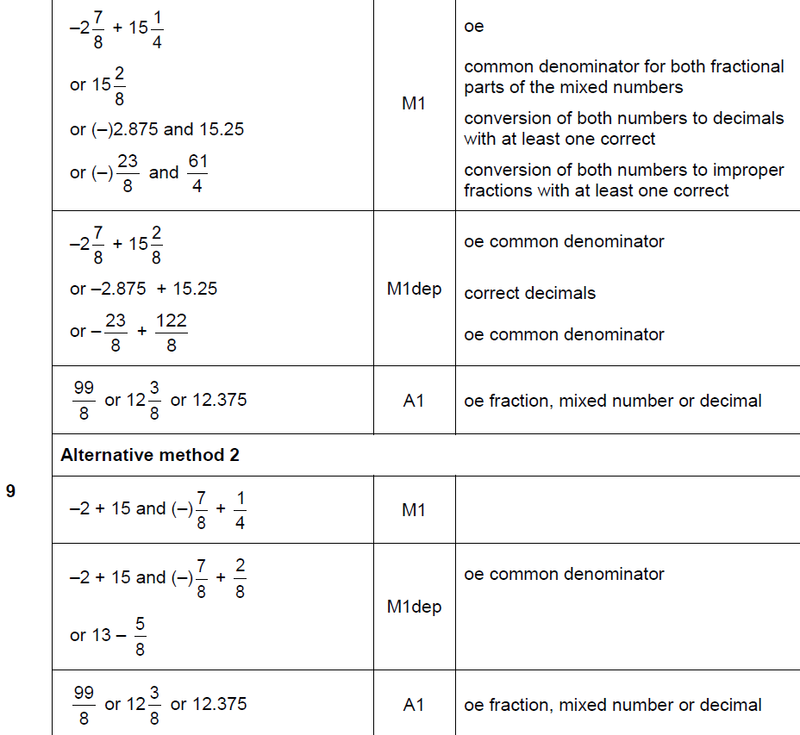
Averages
May 2018 1H Q9
A

Slide 18
Averages
May 2018 1H Q9
A notes

Slide 19
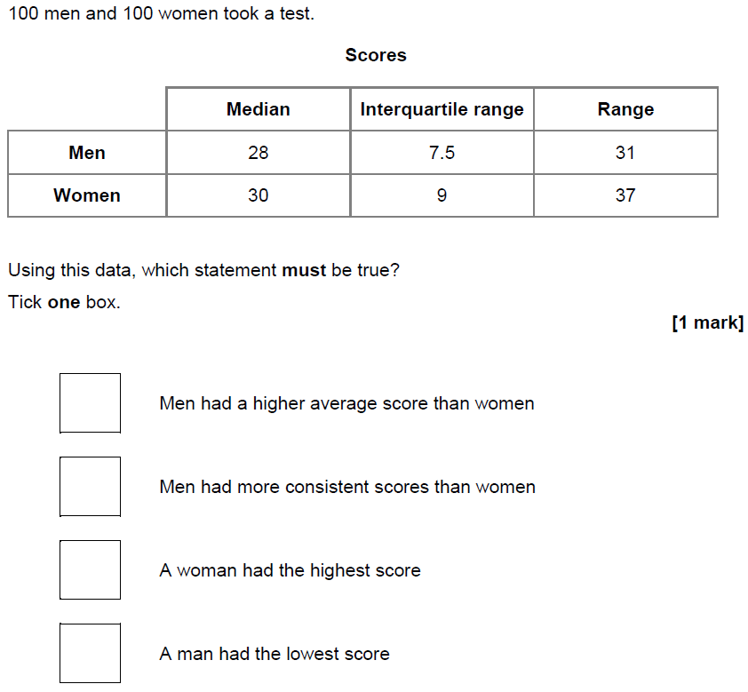
Averages
June 2018 2H Q15

Slide 20
Averages
June 2018 2H Q15
A

Slide 21
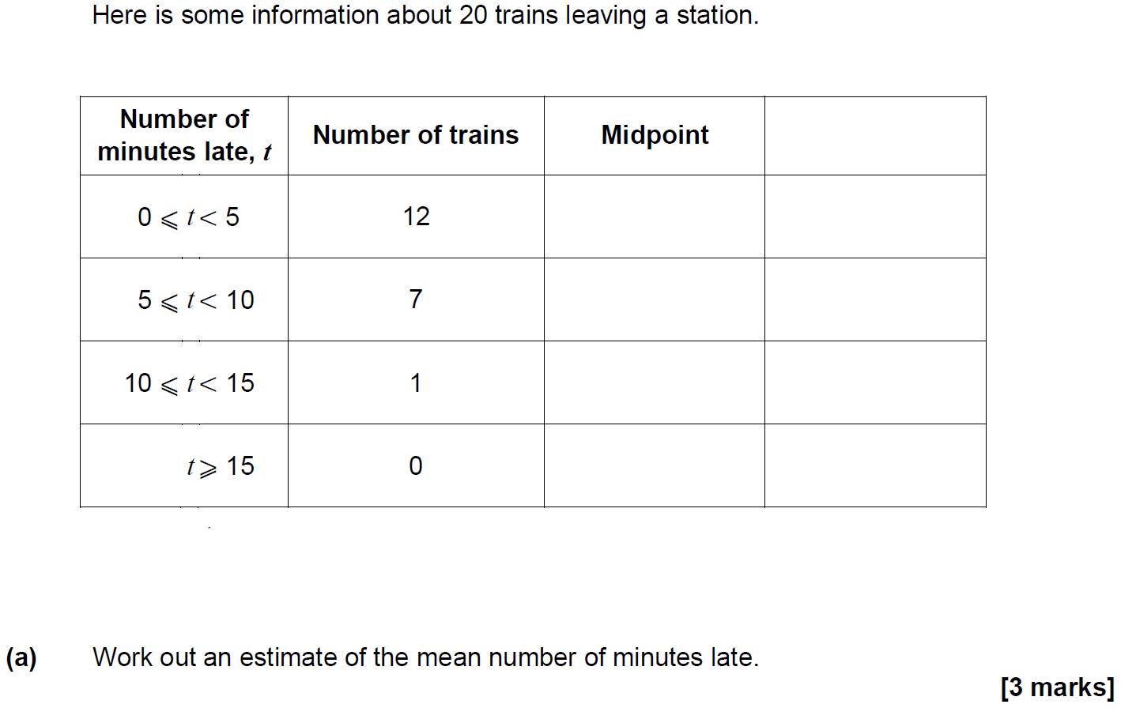
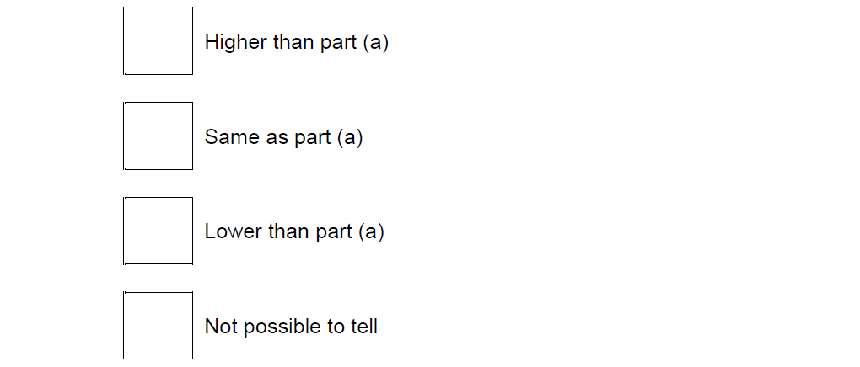
Averages
Nov 2018 2H Q6

Slide 22
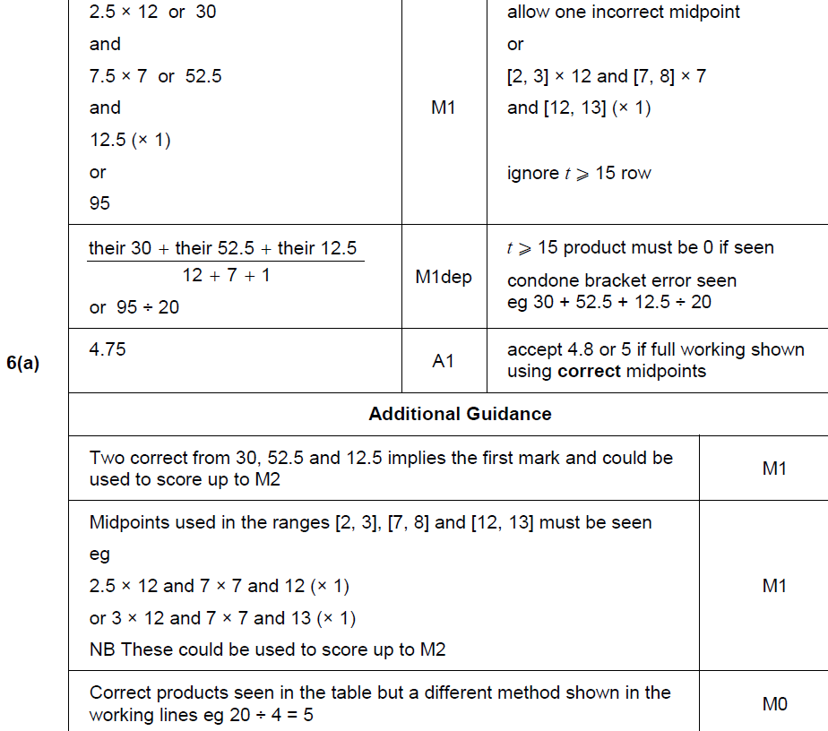
Averages
Nov 2018 2H Q6
A

Slide 23
Averages
Nov 2018 2H Q6
B

Slide 24
Averages
Nov 2018 3H Q14
The mean mass of a squad of 19 hockey players is 82 kg
A player of mass 93 kg joins the squad.
Work out the mean mass of the squad now.
[3 marks]

Slide 25
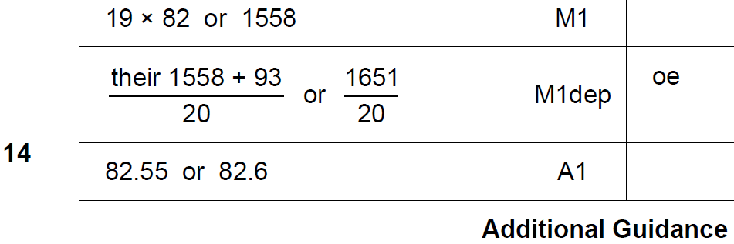
Averages
Nov 2018 3H Q14
A

