Slide 1
Averages
Averages
SAM
2H Q5
May 2017
1H Q7
Spec 1
1H Q9
Edexcel
June 2017
3H Q3
Spec 1
2H Q3
AQA
Nov 2017
1H Q5
Spec 1
2H Q4
OCR
Nov 2018
4H Q4
Spec 1
3H Q4
May 2019
1H Q11
Spec 2
1H Q13
IQR
Table of Data

Slide 2
Averages
Averages
May 2017
2H Q6
May 2018
1H Q9
Edexcel
June 2017
3H Q13
SAM
1H Q11
June 2018
2H Q15
AQA
Nov 2017
1H Q9
1 Marker
SAM
3H Q18
Nov 2018
2H Q6
OCR
Nov 2017
1H Q20
Nov 2018
3H Q14
Nov 2017
2H Q8
IQR/ Range
Table of Data

Slide 3
Averages
Averages
June 2017 2H Q6
Edexcel
Nov 2017 3H Q3
AQA
June 2018 3H Q1
OCR
Nov 2018 3H Q2
IQR
Table of Data

Slide 4
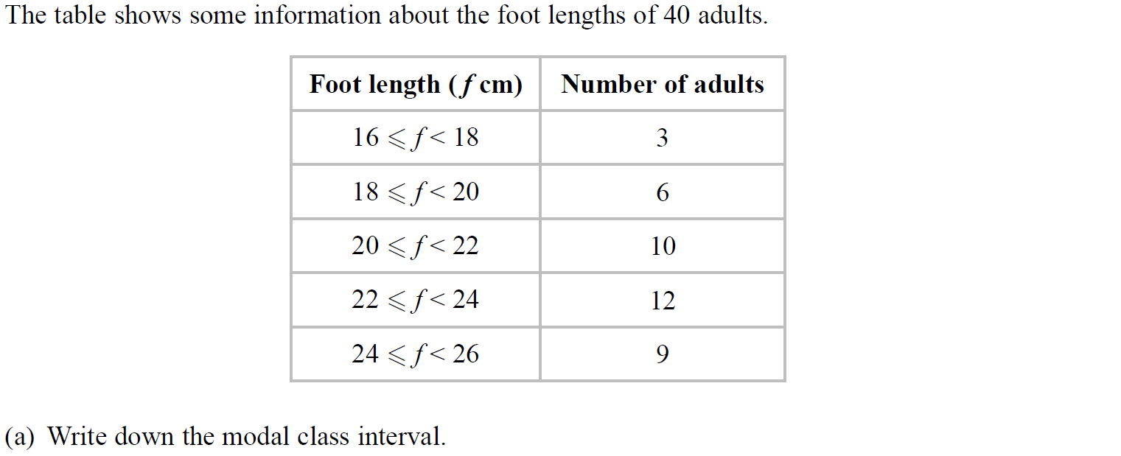
Averages
SAM 2H Q5

Slide 5
Averages
SAM 2H Q5
A
B

Slide 6
Averages
Specimen Set 1 1H Q9

Slide 7
Averages
Specimen Set 1 1H Q9
A

Slide 8
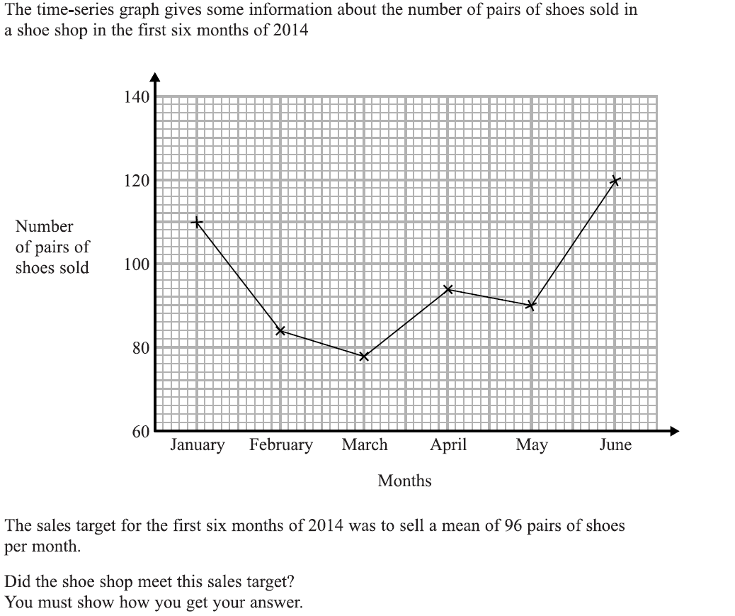
Averages
Specimen Set 1 2H Q3

Slide 9
Averages
Specimen Set 1 2H Q3
A

Slide 10
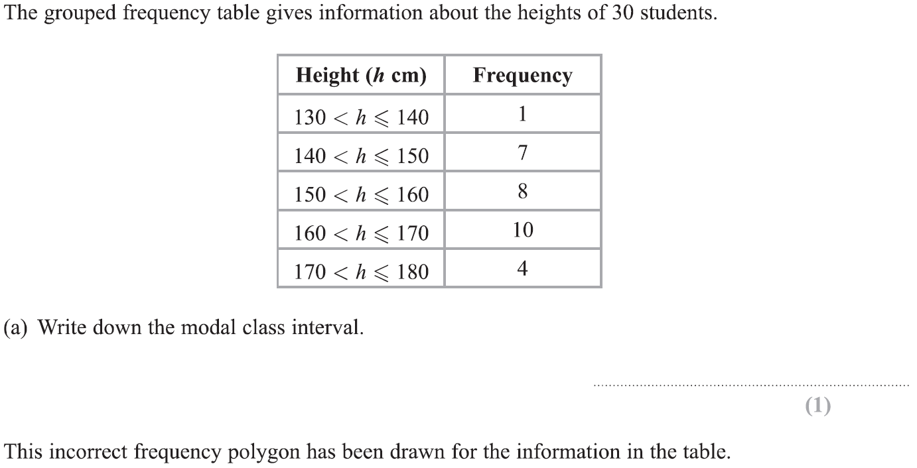
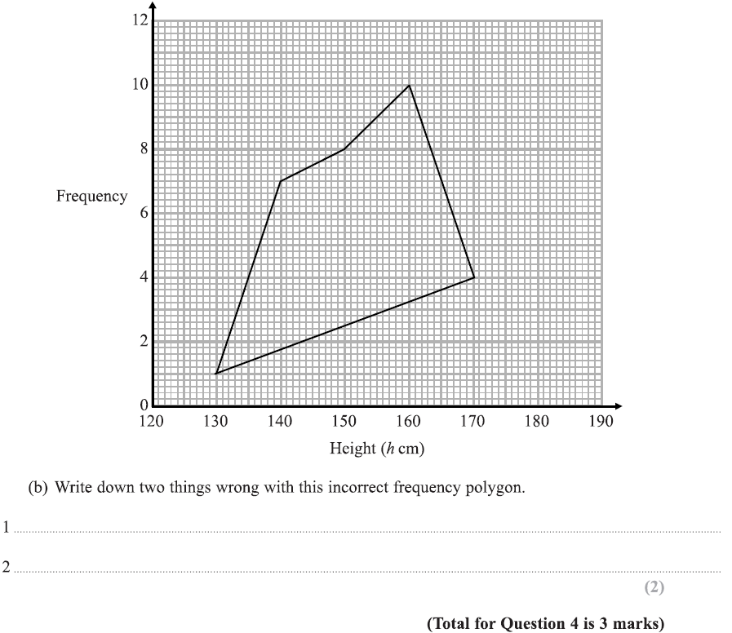
Averages
Specimen Set 1 2H Q4

Slide 11
Averages
Specimen Set 1 2H Q4
A
B

Slide 12
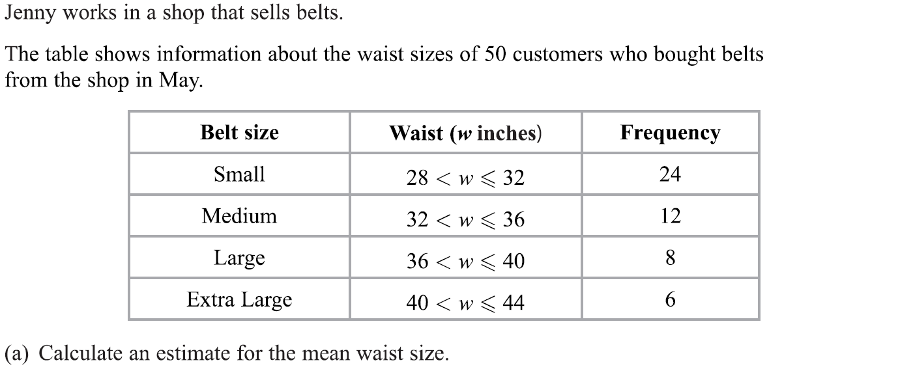
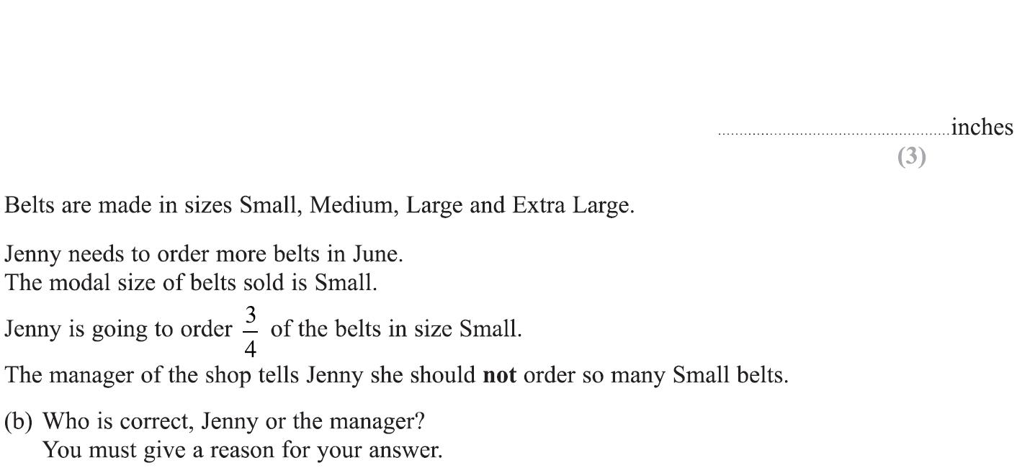
Averages
Specimen Set 1 3H Q4

Slide 13
Averages
Specimen Set 1 3H Q4
A
B

Slide 14
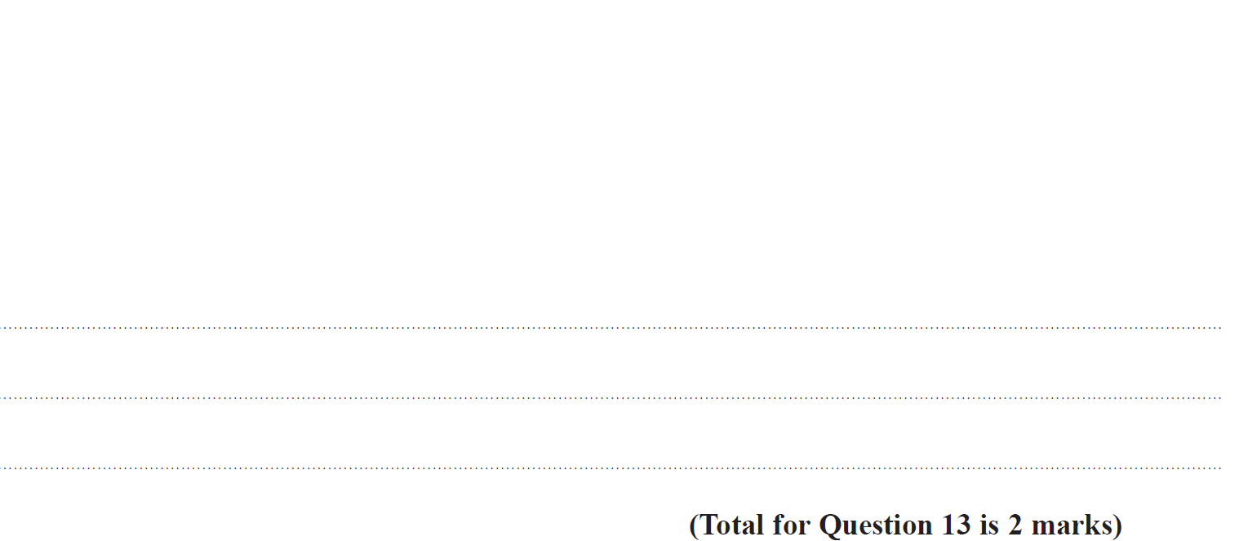
Averages
Specimen Set 2 1H Q13

Slide 15
Averages
Specimen Set 2 1H Q13
A

Slide 16
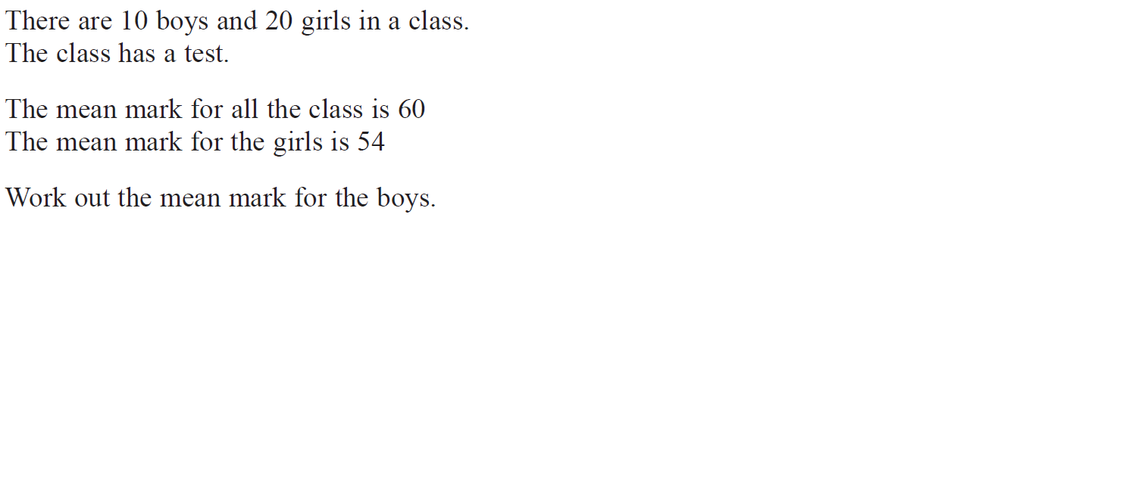
Averages
May 2017 1H Q7

Slide 17
Averages
May 2017 1H Q7
A

Slide 18
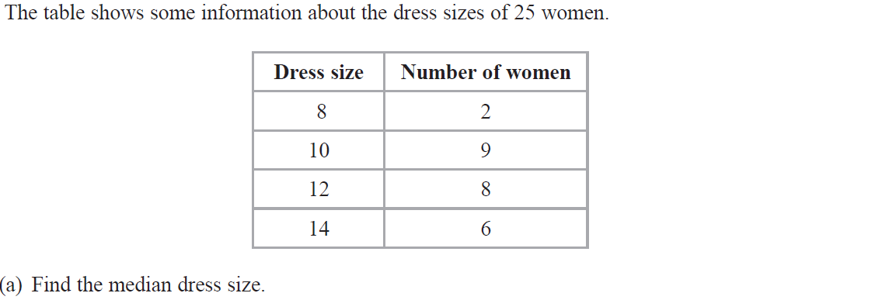
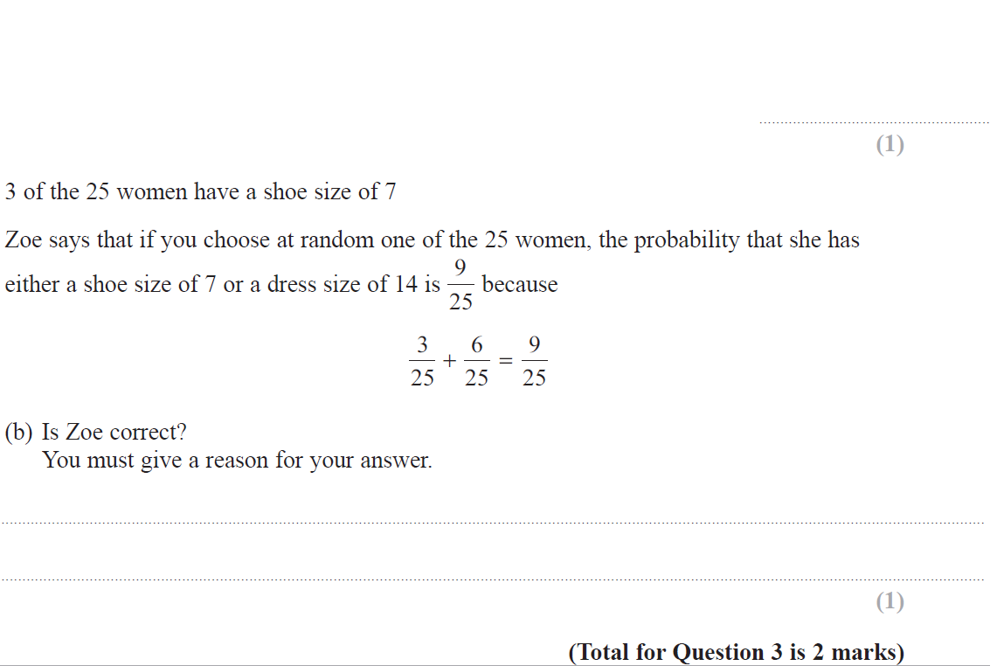
Averages
June 2017 3H Q3

Slide 19
Averages
June 2017 3H Q3
A
B

Slide 20
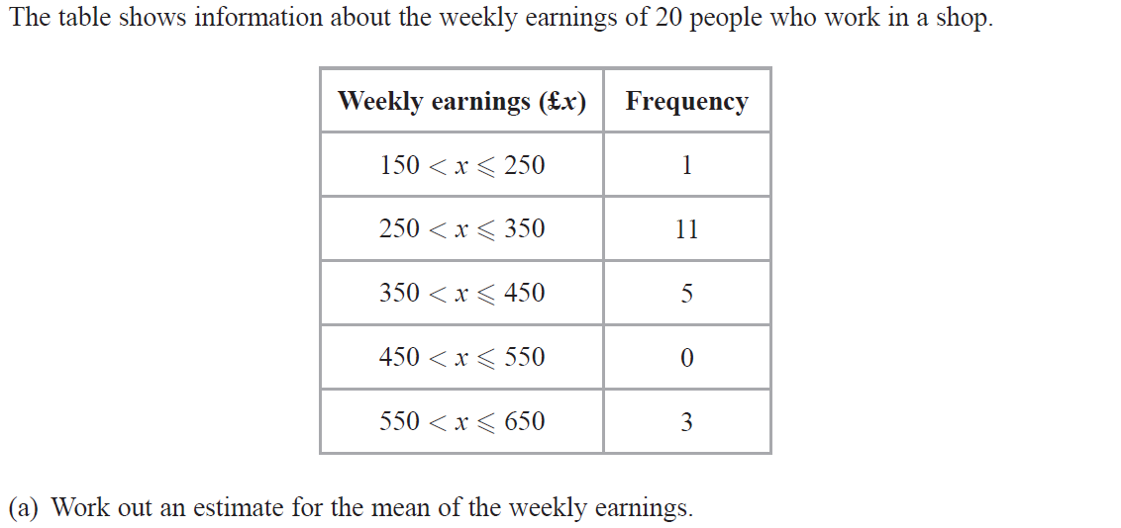
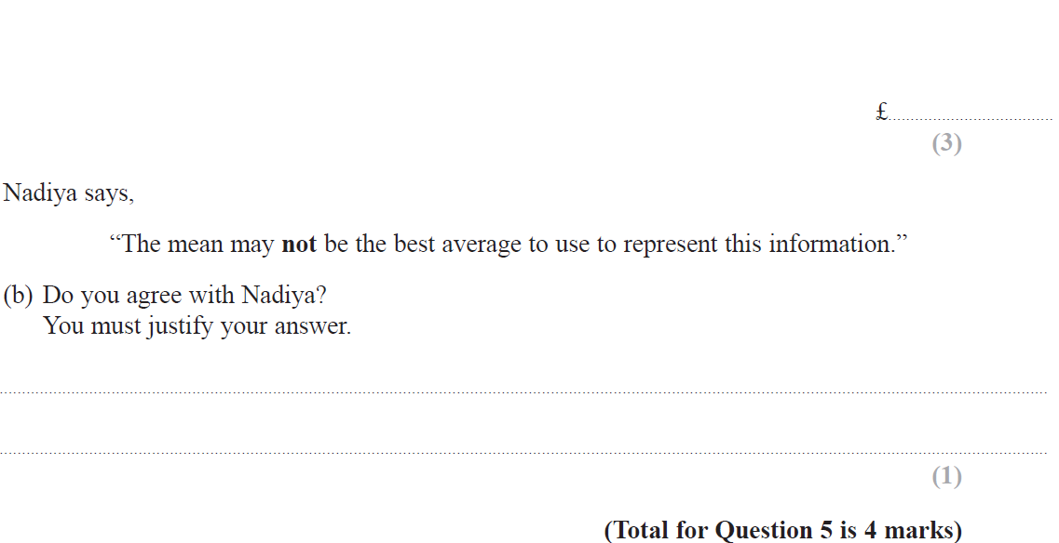
Averages
Nov 2017 1H Q5

Slide 21
Averages
Nov 2017 1H Q5
A
B

Slide 22
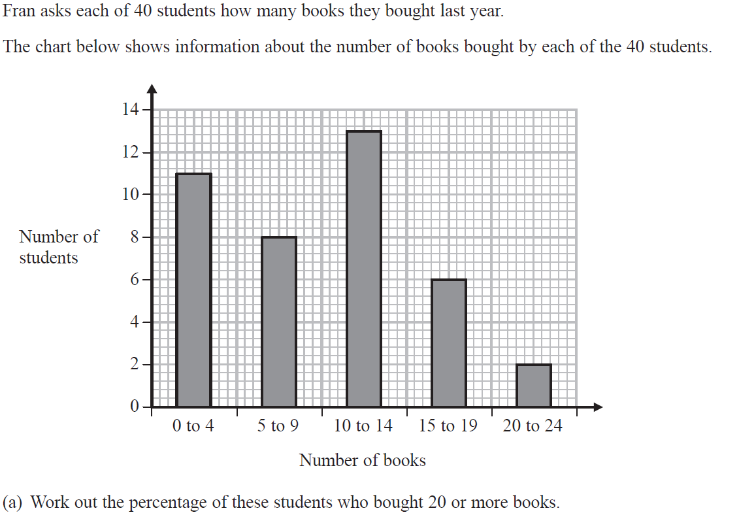
Averages
Nov 2018 3H Q4

Slide 23
Averages
Nov 2018 3H Q4
A
B

Slide 24
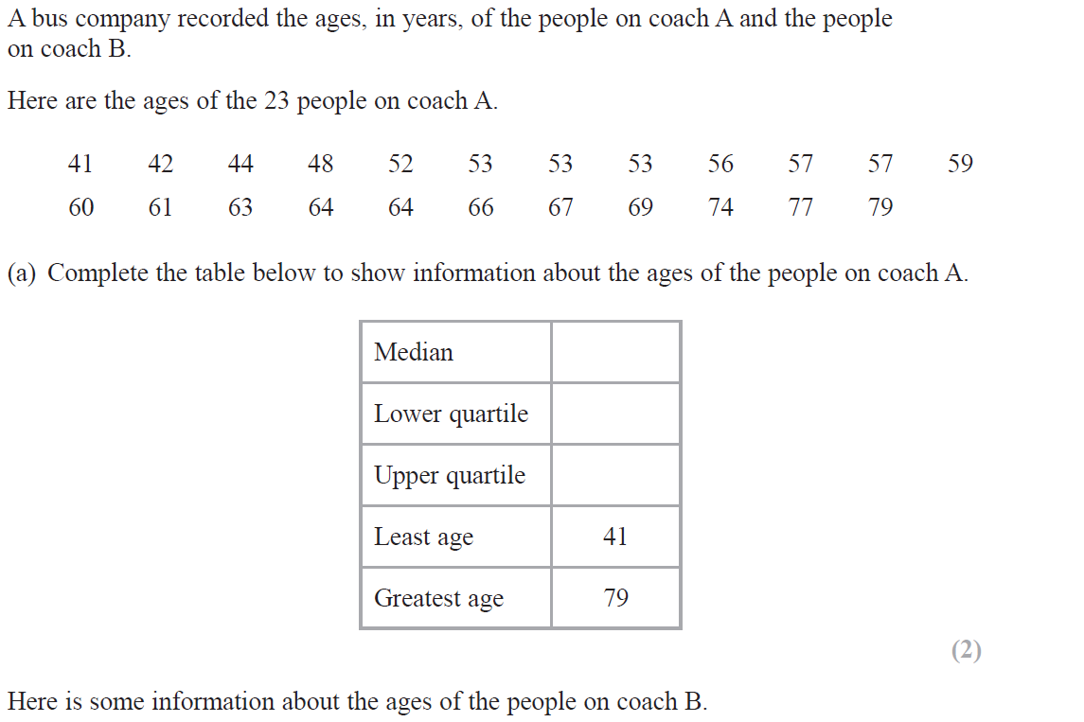
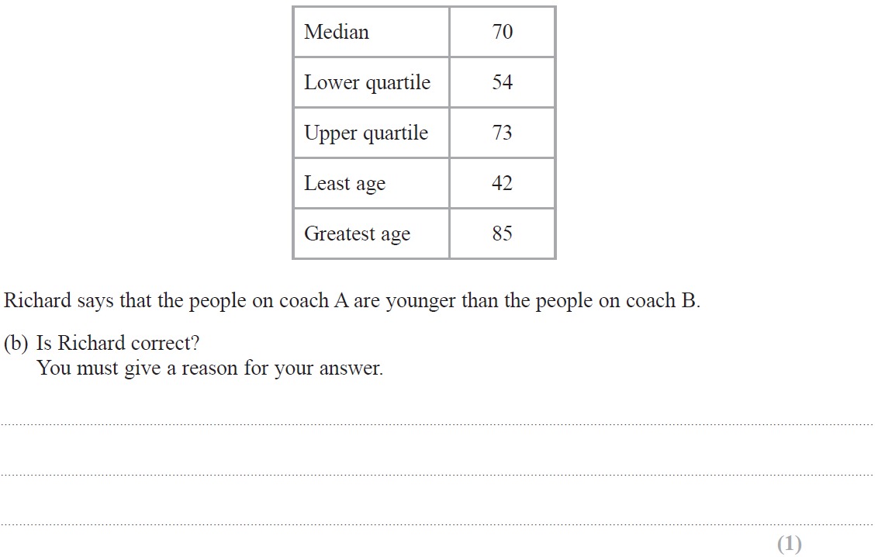
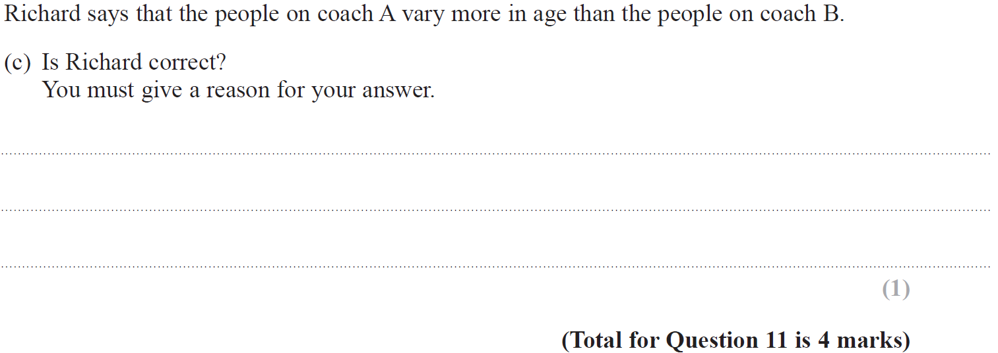
Averages
May 2019 1H Q11

Slide 25
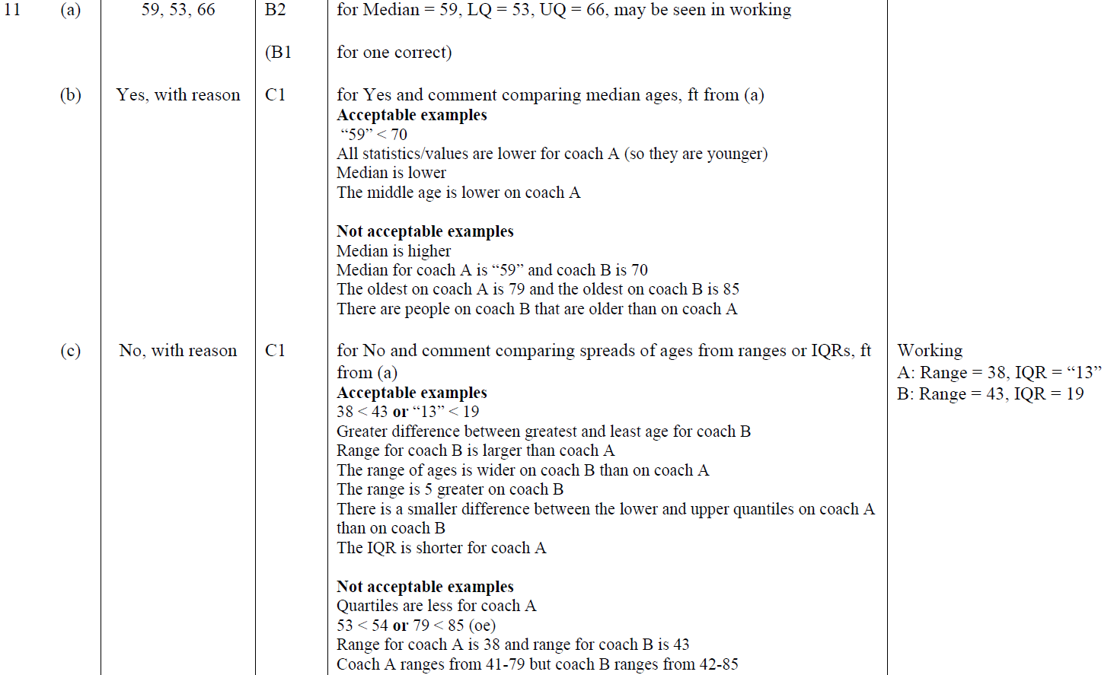
Averages
May 2019 1H Q11
A
B
C
A SF
B SF
C SF

Slide 26
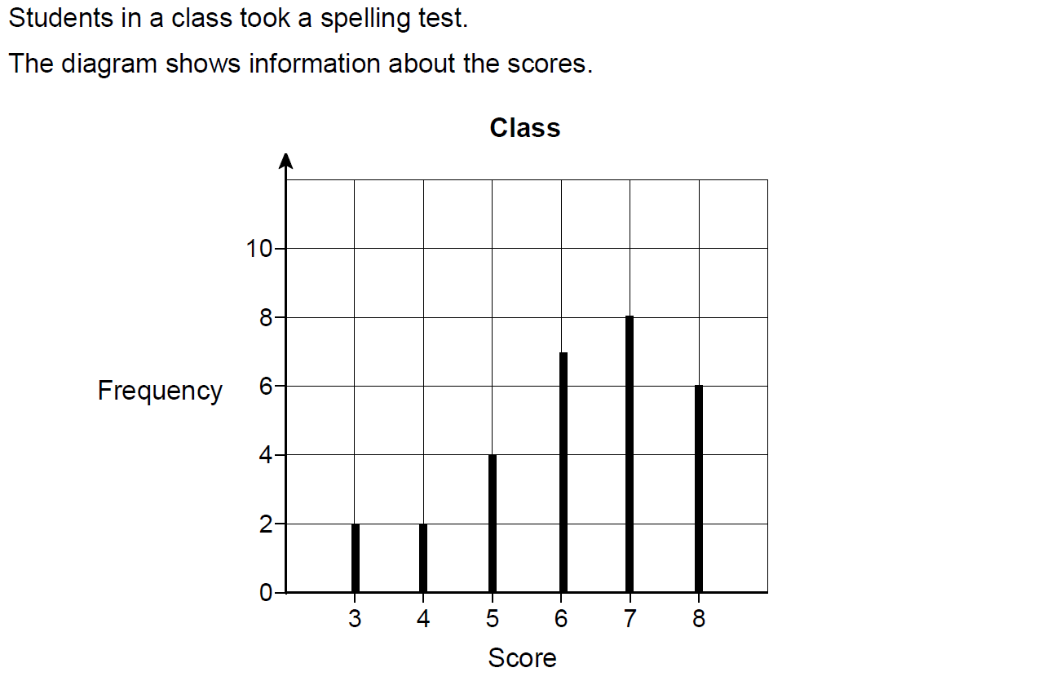
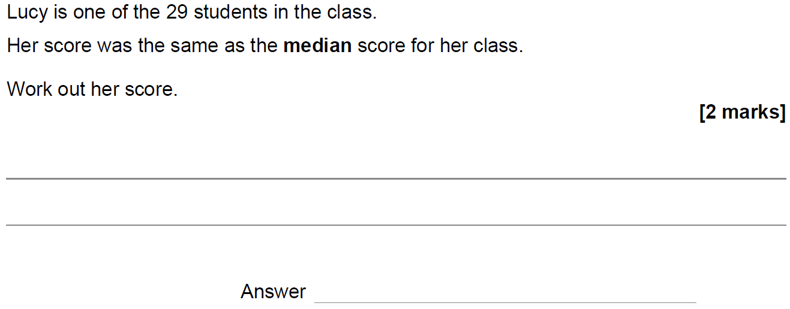
Averages
SAM 1H Q11

Slide 27
Averages
SAM 1H Q11
A

Slide 28
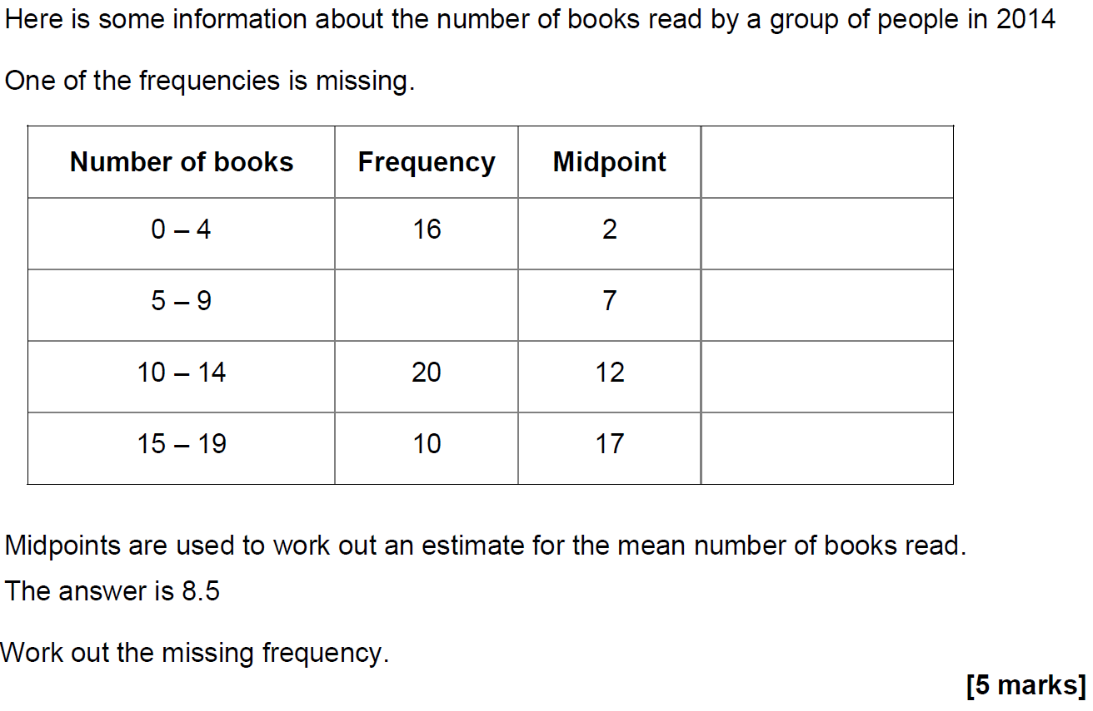
Averages
SAM 3H Q18

Slide 29
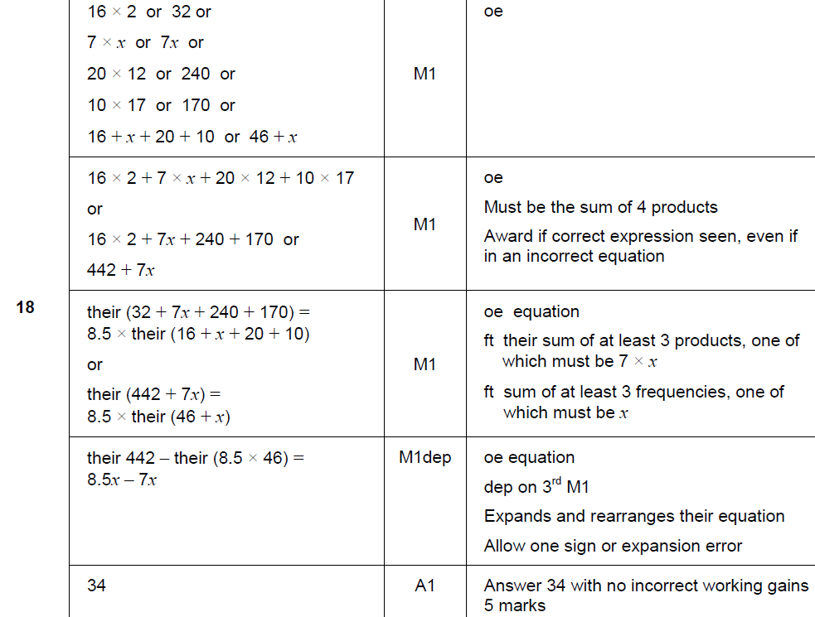
Averages
SAM 3H Q18
A

Slide 30
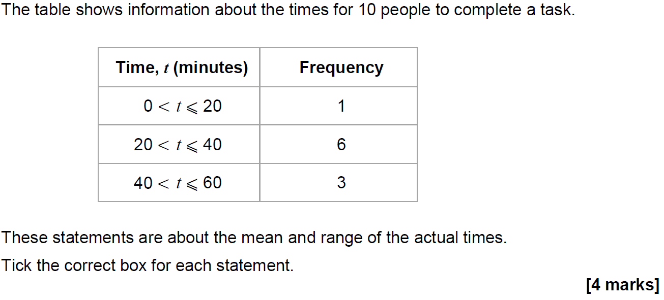
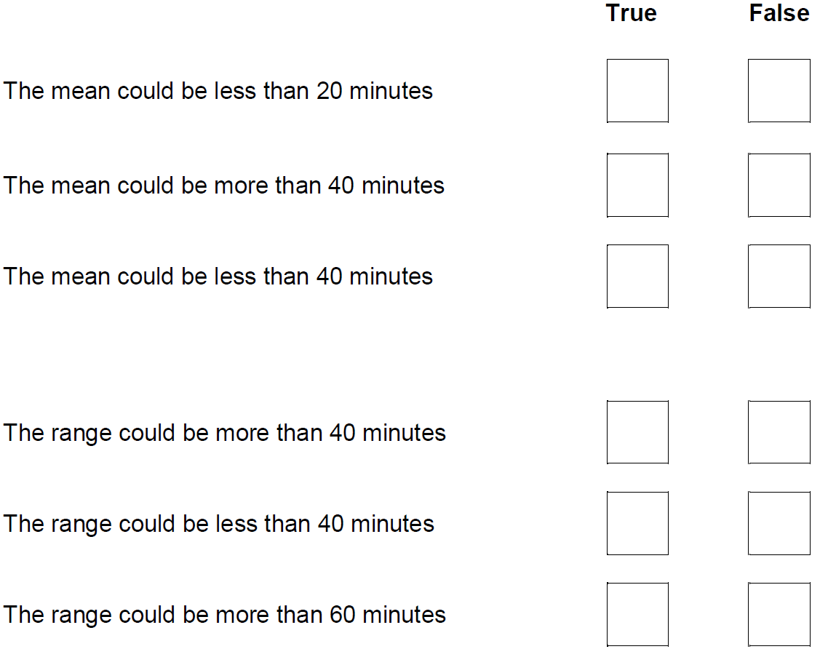
Averages
May 2017 1H Q6

Slide 31
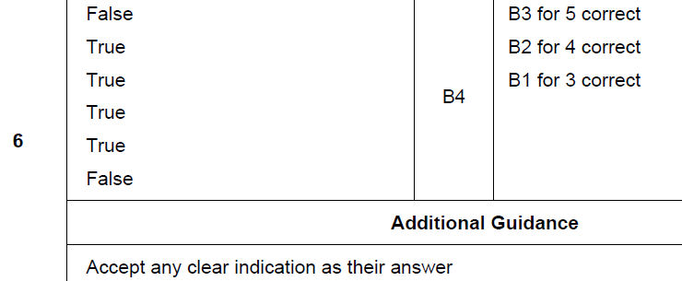
Averages
May 2017 1H Q6
A

Slide 32
Averages
June 2017 3H Q13

Slide 33
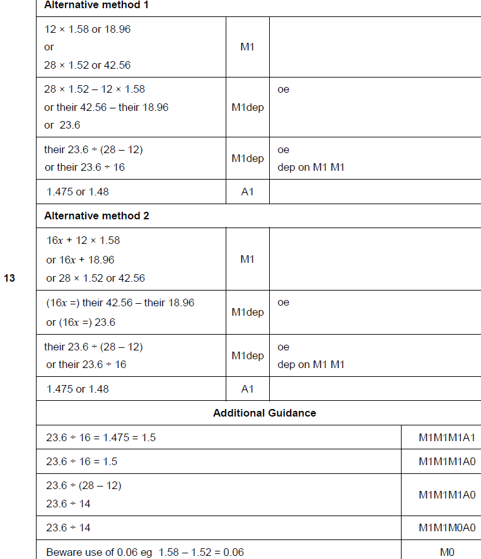
Averages
June 2017 3H Q13
A

Slide 34
Averages
Nov 2017 1H Q9

Slide 35
Averages
Nov 2017 1H Q9
A

Slide 36
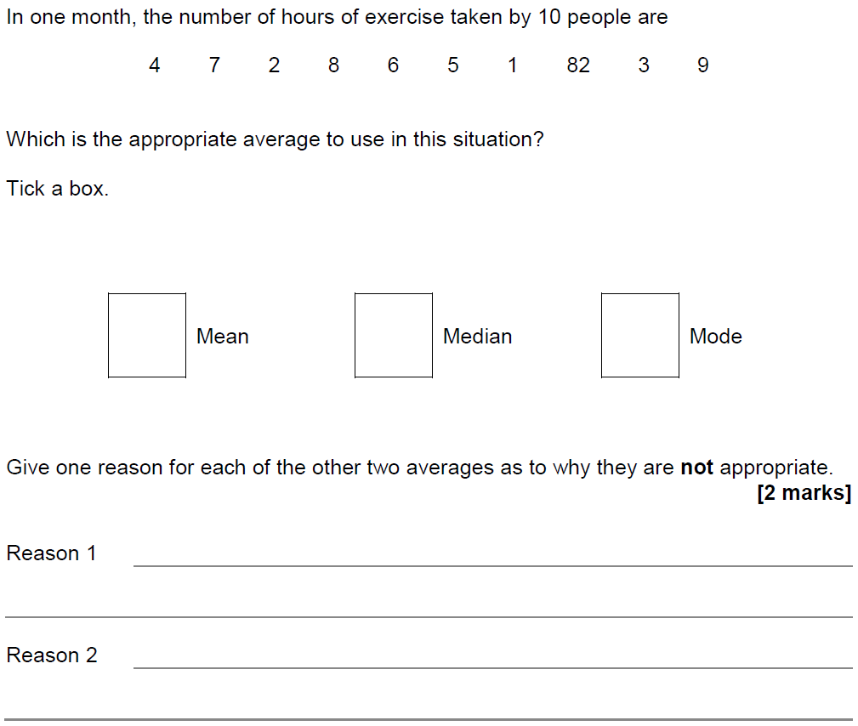
Averages
Nov 2017 1H Q20

Slide 37
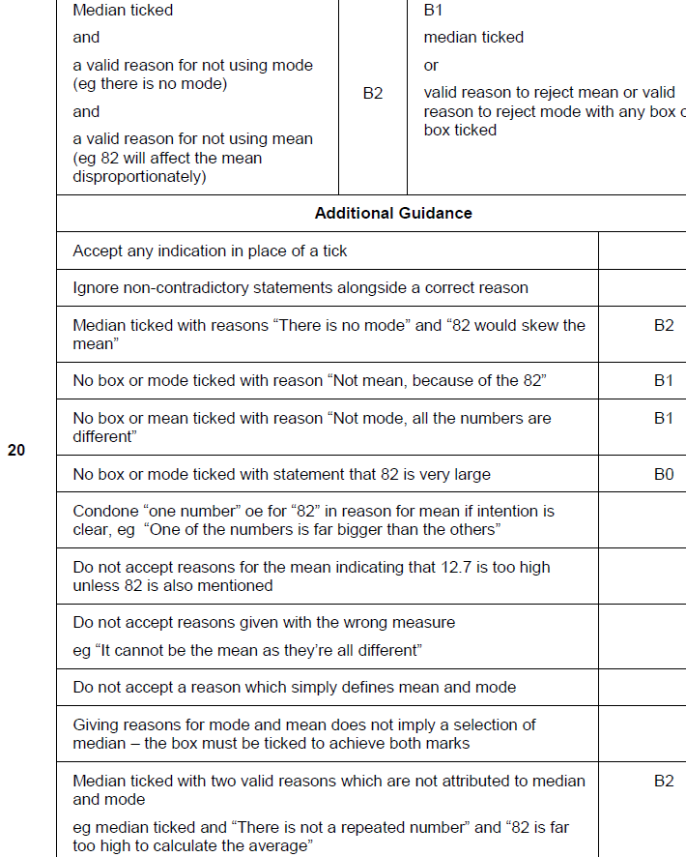
Averages
Nov 2017 1H Q20
A

Slide 38
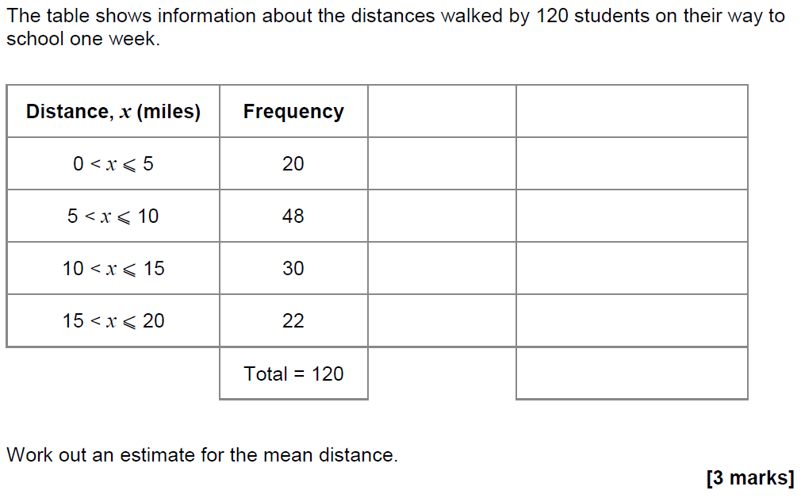
Averages
Nov 2017 2H Q8

Slide 39
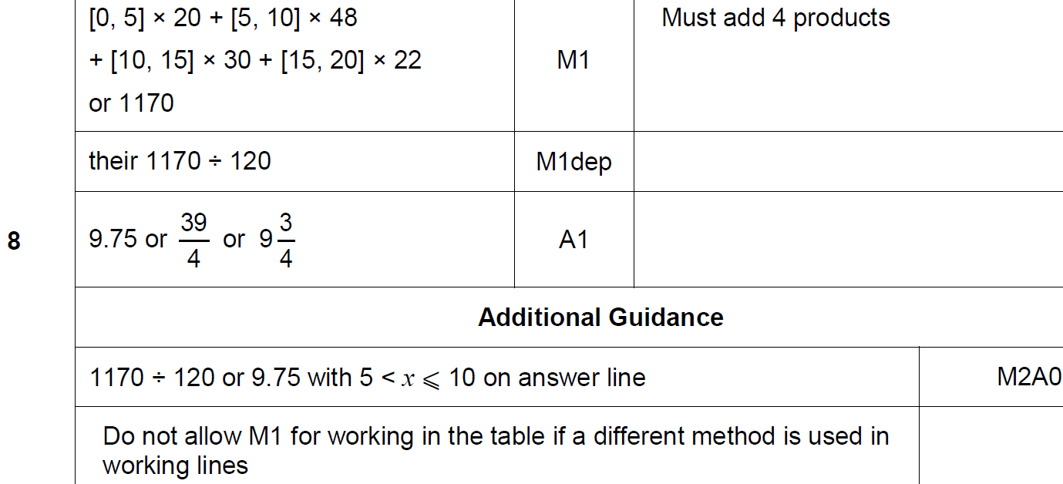
Averages
Nov 2017 2H Q8
A

Slide 40
Averages
May 2018 1H Q9

Slide 41
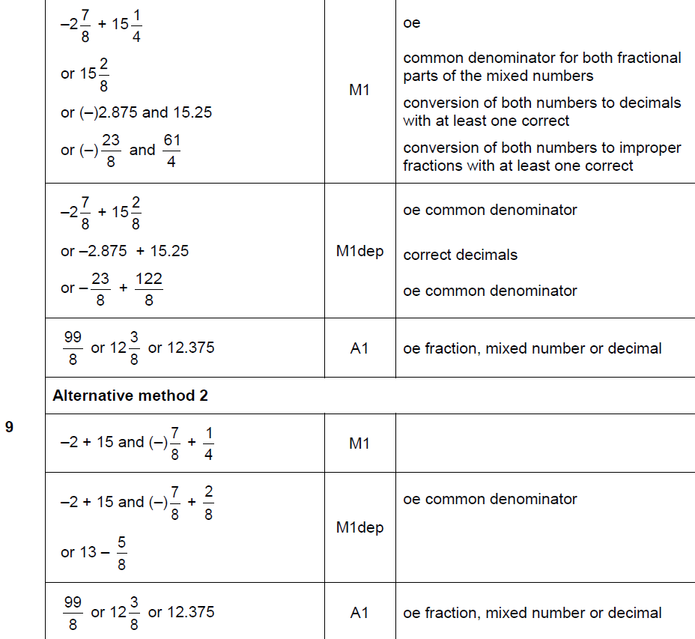
Averages
May 2018 1H Q9
A

Slide 42
Averages
May 2018 1H Q9
A notes

Slide 43
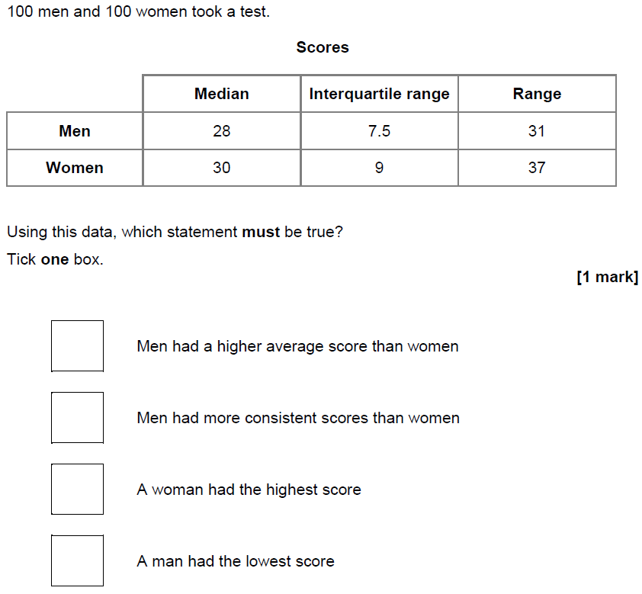
Averages
June 2018 2H Q15

Slide 44
Averages
June 2018 2H Q15
A

Slide 45
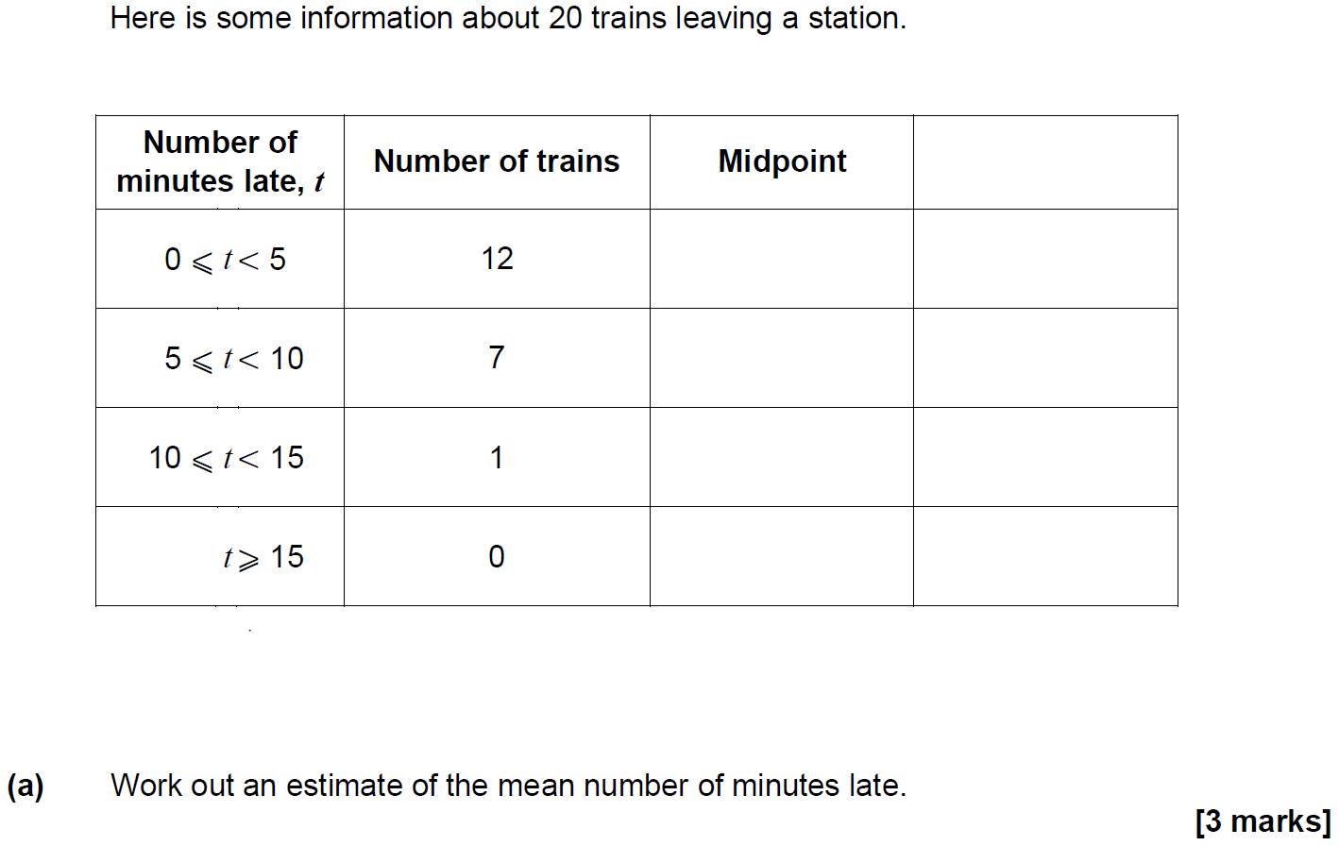
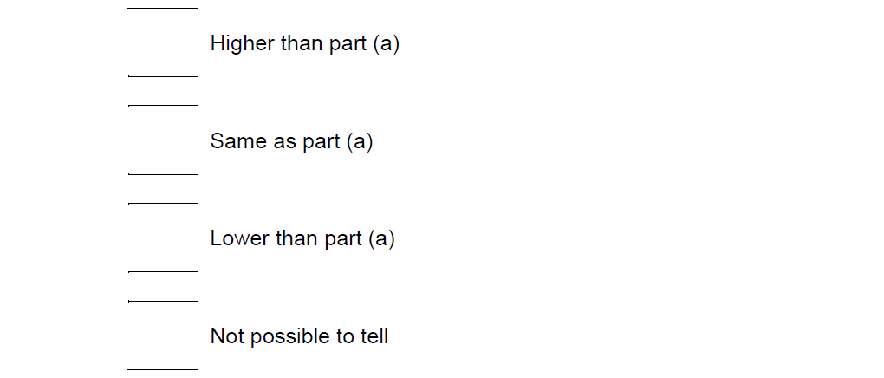
Averages
Nov 2018 2H Q6

Slide 46
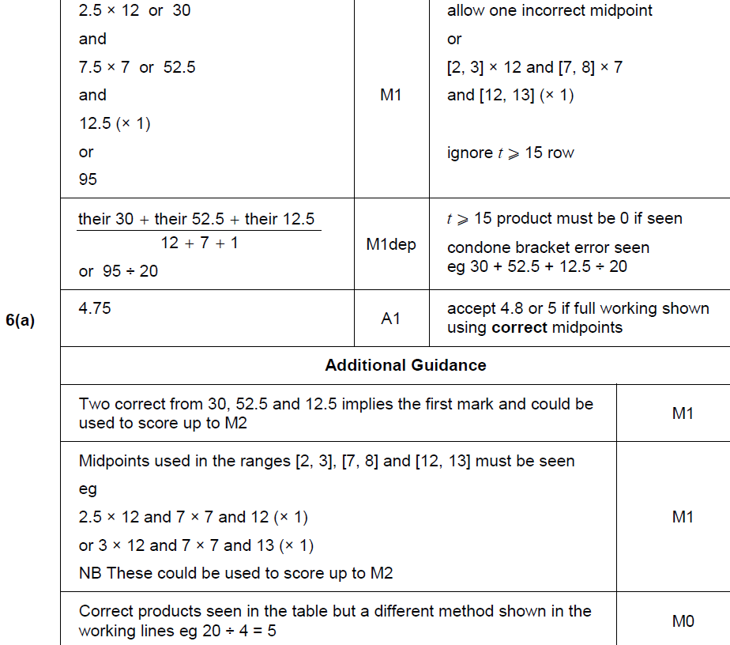
Averages
Nov 2018 2H Q6
A

Slide 47
Averages
Nov 2018 2H Q6
B

Slide 48
Averages
Nov 2018 3H Q14
The mean mass of a squad of 19 hockey players is 82 kg
A player of mass 93 kg joins the squad.
Work out the mean mass of the squad now.
[3 marks]

Slide 49
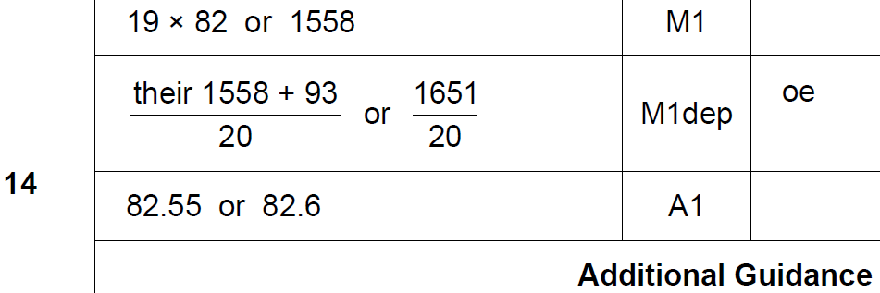
Averages
Nov 2018 3H Q14
A

Slide 50
Averages
June 2017 2H Q6

Slide 51
Averages
June 2017 2H Q6
A

Slide 52
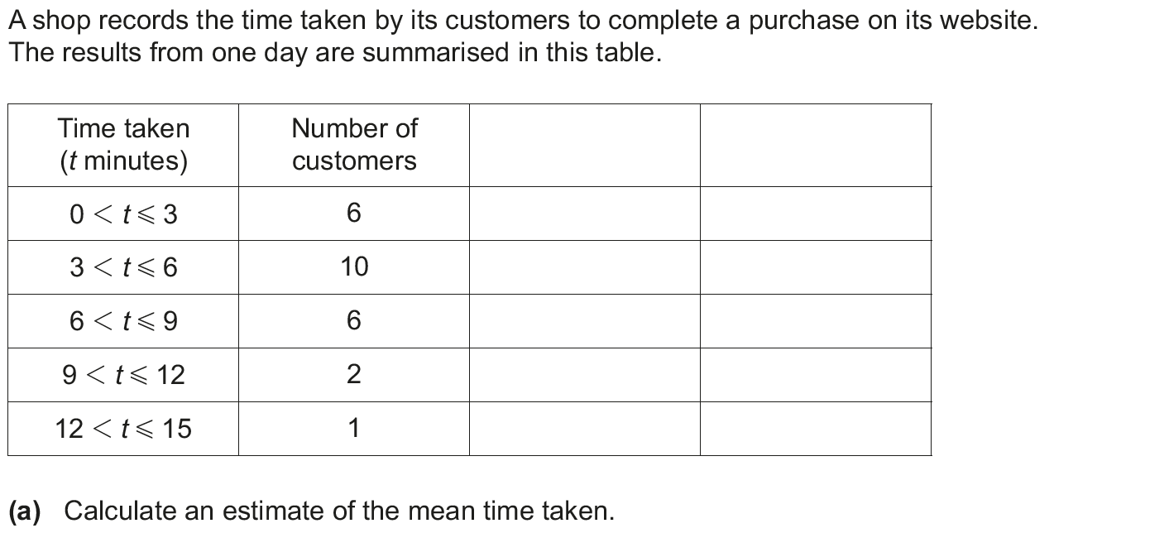
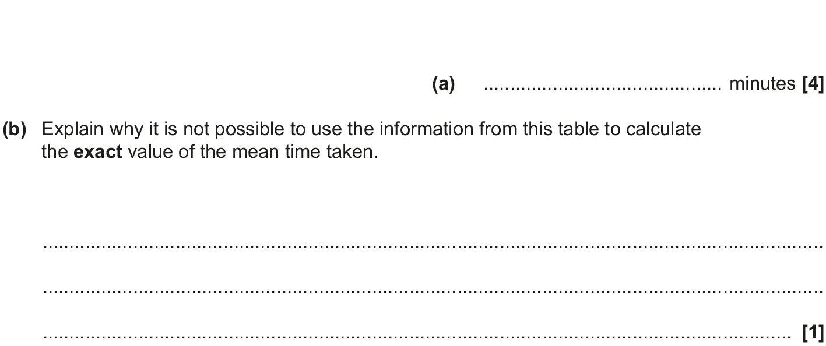
Averages
Nov 2017 3H Q3

Slide 53
Averages
Nov 2017 3H Q3
A
B

Slide 54
Averages
June 2018 3H Q1

Slide 55
Averages
June 2018 3H Q1
A

Slide 56
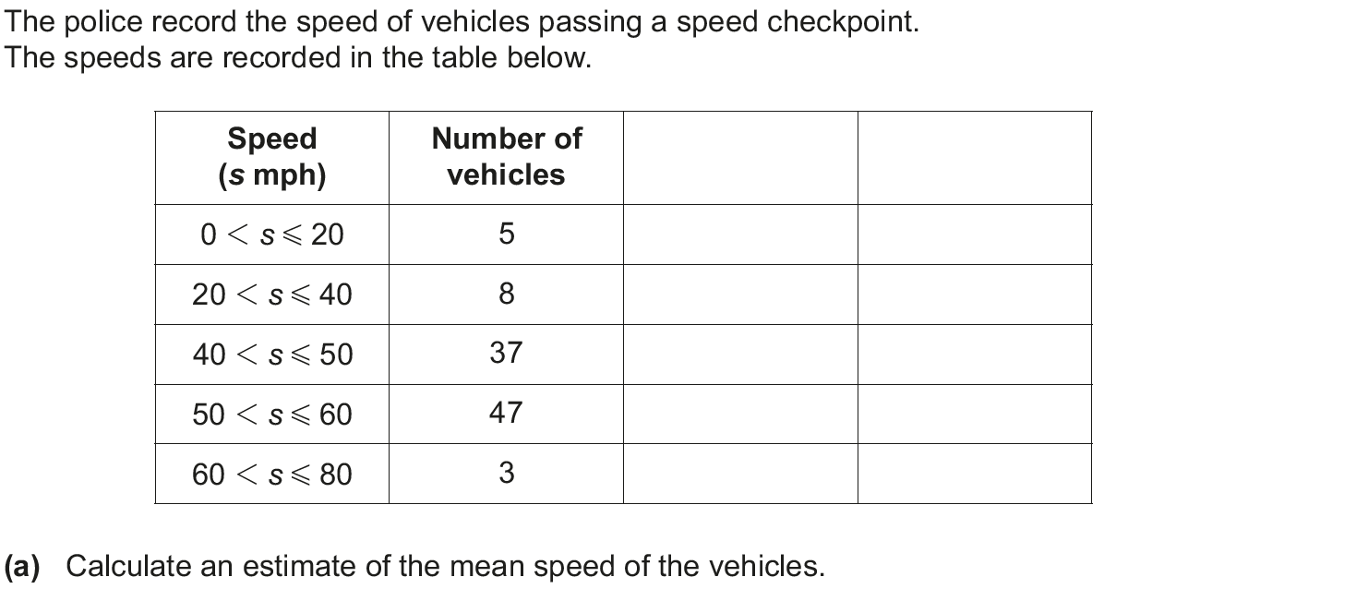
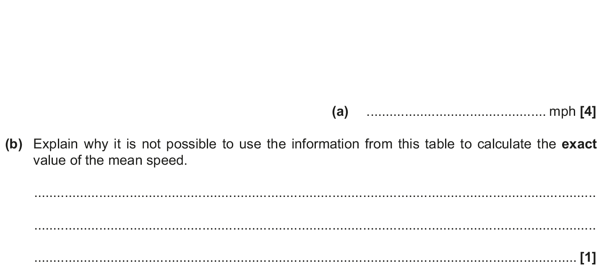
Averages
Nov 2018 3H Q2

Slide 57
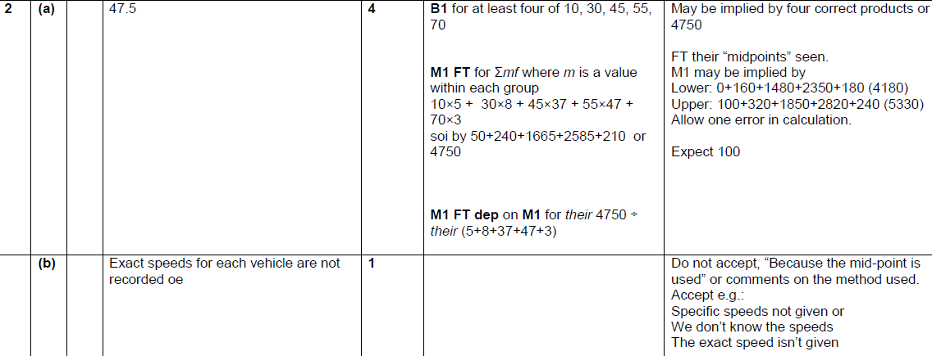
Averages
Nov 2018 3H Q2
A
B

