Slide 1
Averages
Averages
June 2017 2H Q6
Nov 2017 3H Q3
June 2018 3H Q1
Nov 2018 3H Q2
IQR
Table of Data

Slide 2
Averages
June 2017 2H Q6

Slide 3
Averages
June 2017 2H Q6
A

Slide 4
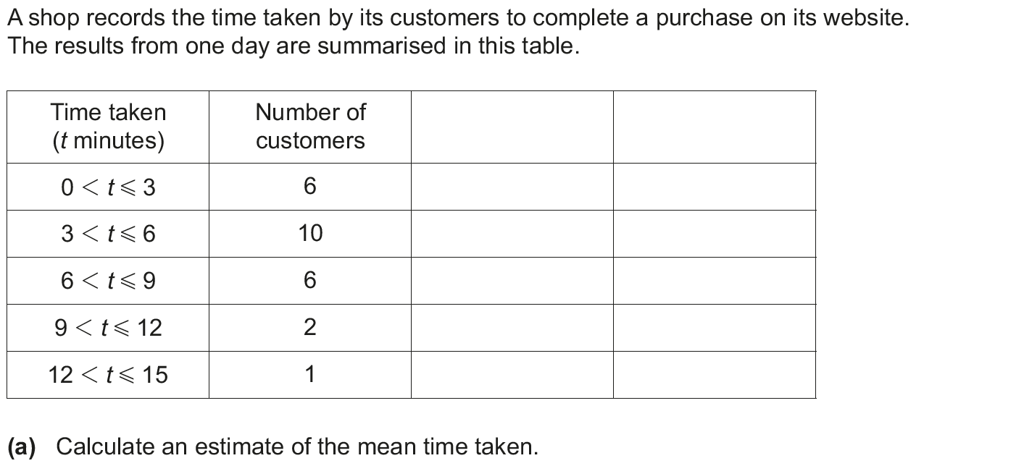
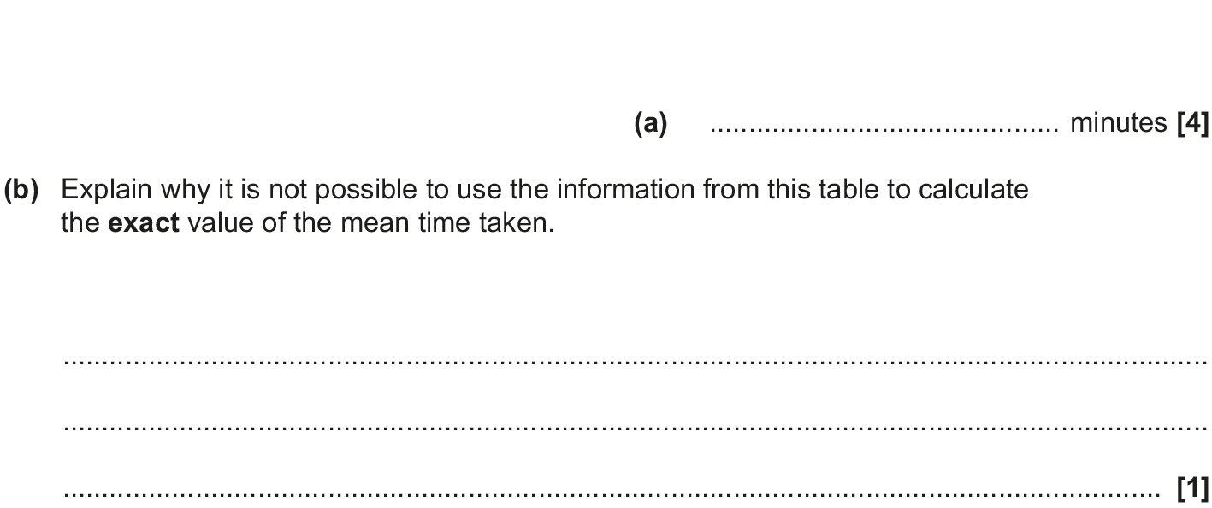
Averages
Nov 2017 3H Q3

Slide 5
Averages
Nov 2017 3H Q3
A
B

Slide 6
Averages
June 2018 3H Q1

Slide 7
Averages
June 2018 3H Q1
A

Slide 8
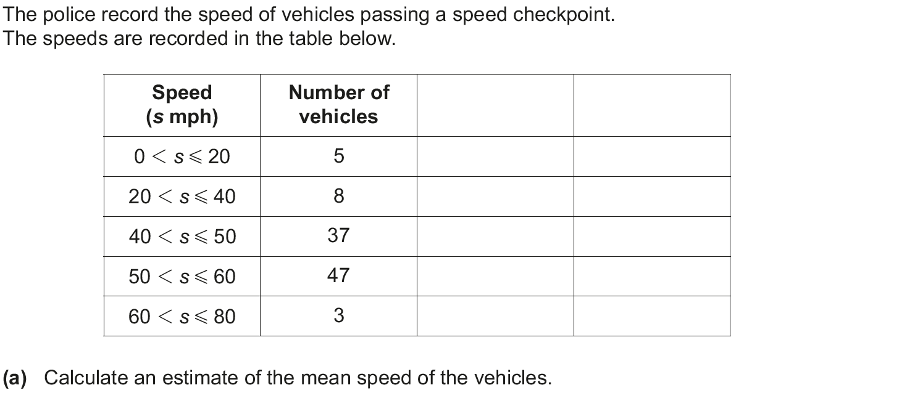
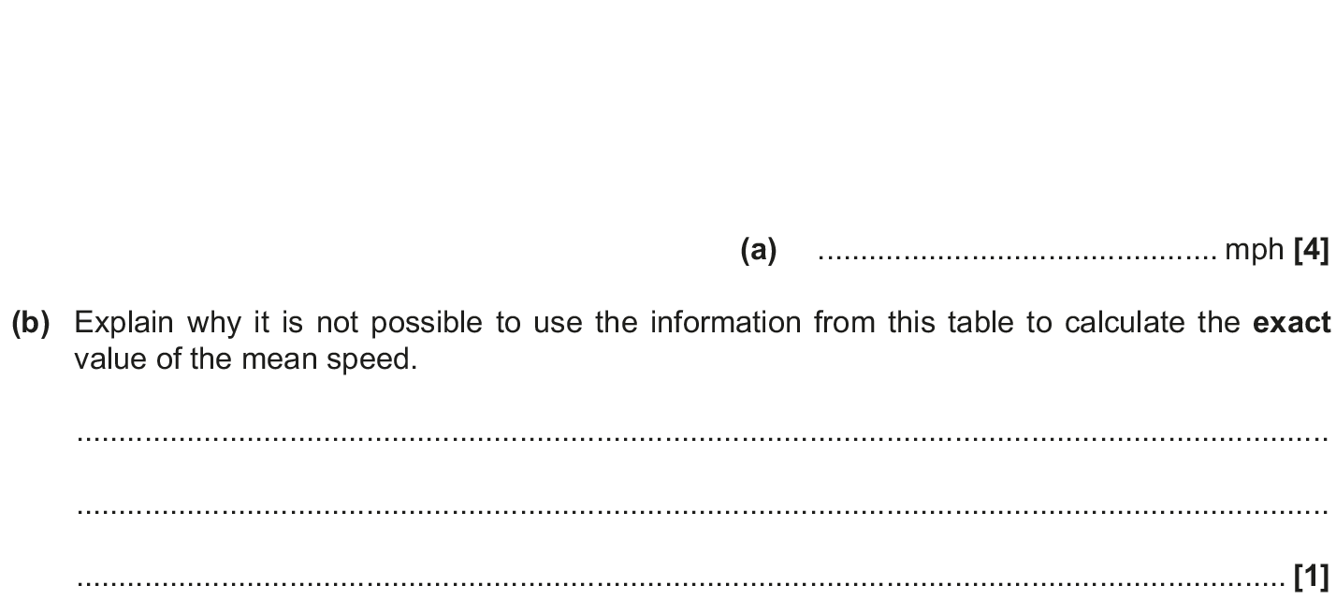
Averages
Nov 2018 3H Q2

Slide 9
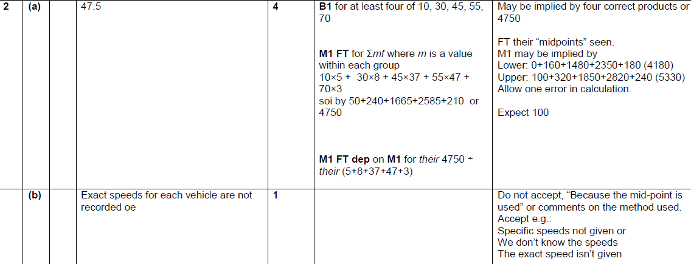
Averages
Nov 2018 3H Q2
A
B

