Slide 1
Averages
Averages
SAM
2H Q5
May 2017
1H Q7
Spec 1
1H Q9
June 2017
3H Q3
Spec 1
2H Q3
Nov 2017
1H Q5
Spec 1
2H Q4
Nov 2018
4H Q4
Spec 1
3H Q4
May 2019
1H Q11
Spec 2
1H Q13
IQR
Table of Data

Slide 2
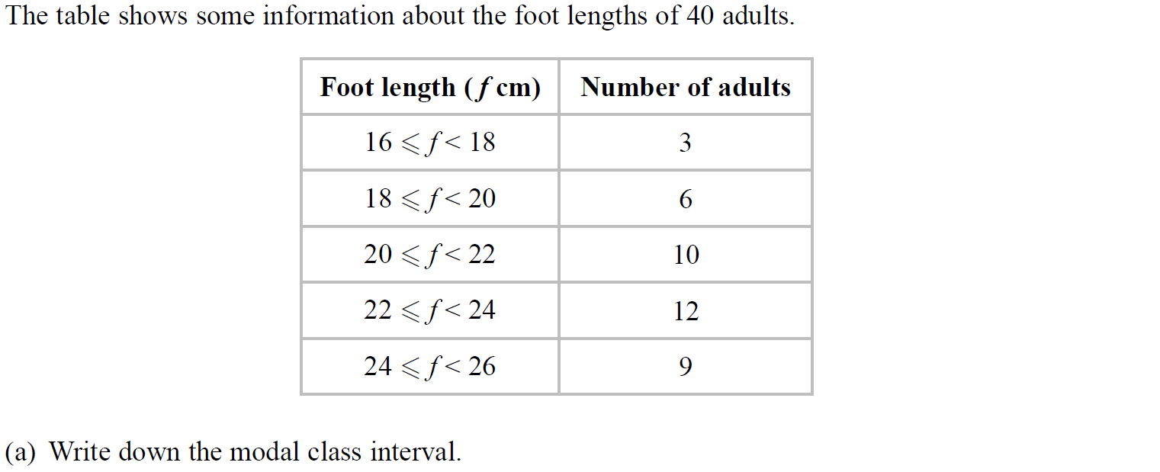
Averages
SAM 2H Q5

Slide 3
Averages
SAM 2H Q5
A
B

Slide 4
Averages
Specimen Set 1 1H Q9

Slide 5
Averages
Specimen Set 1 1H Q9
A

Slide 6
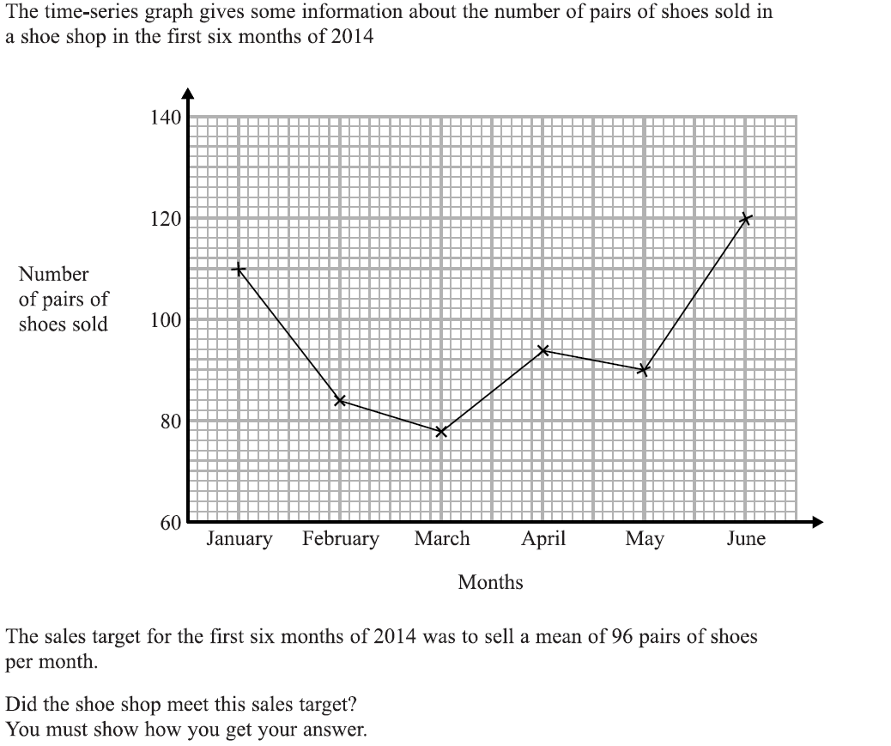
Averages
Specimen Set 1 2H Q3

Slide 7
Averages
Specimen Set 1 2H Q3
A

Slide 8
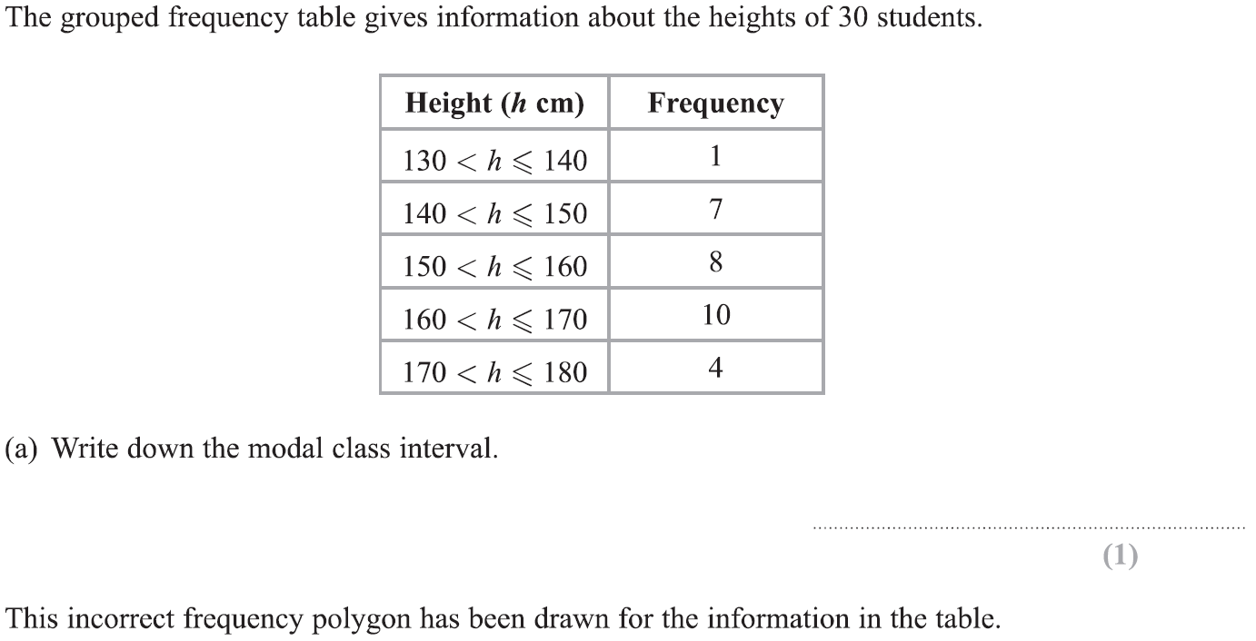
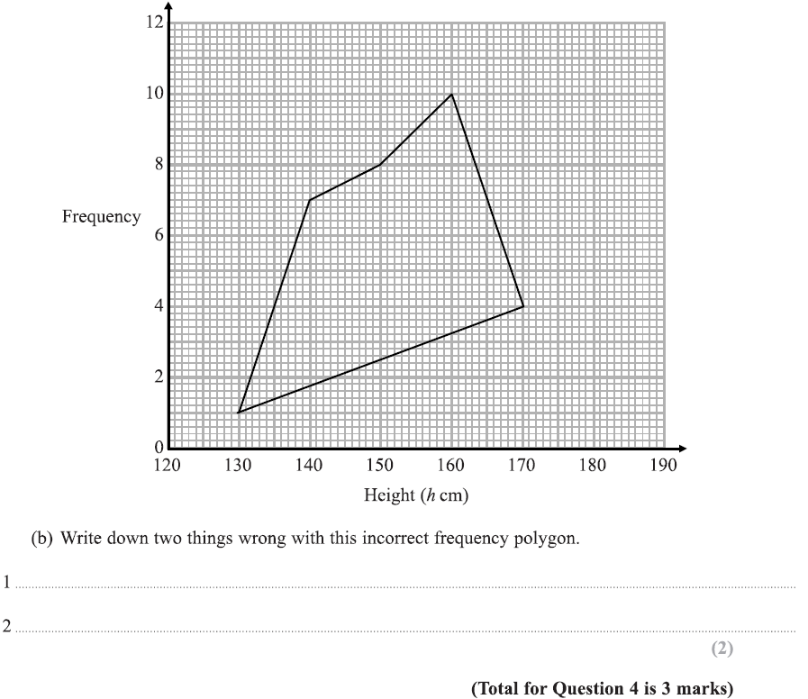
Averages
Specimen Set 1 2H Q4

Slide 9
Averages
Specimen Set 1 2H Q4
A
B

Slide 10
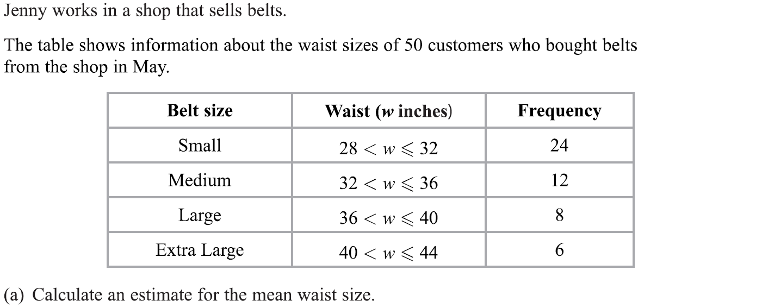
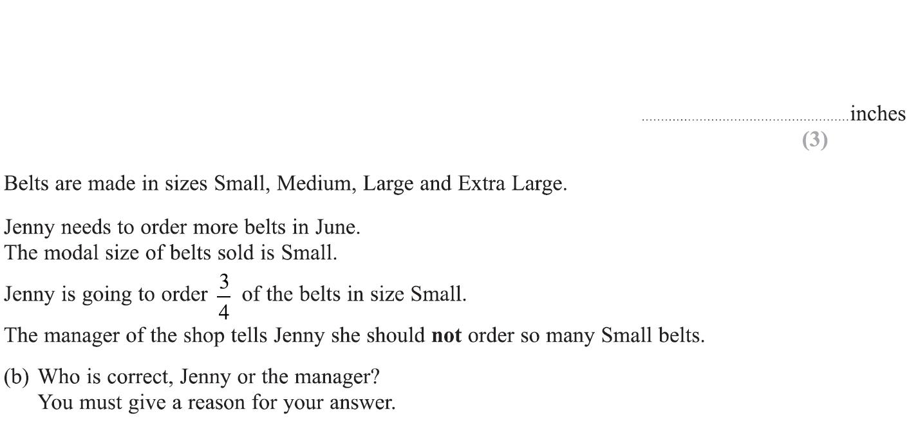
Averages
Specimen Set 1 3H Q4

Slide 11
Averages
Specimen Set 1 3H Q4
A
B

Slide 12
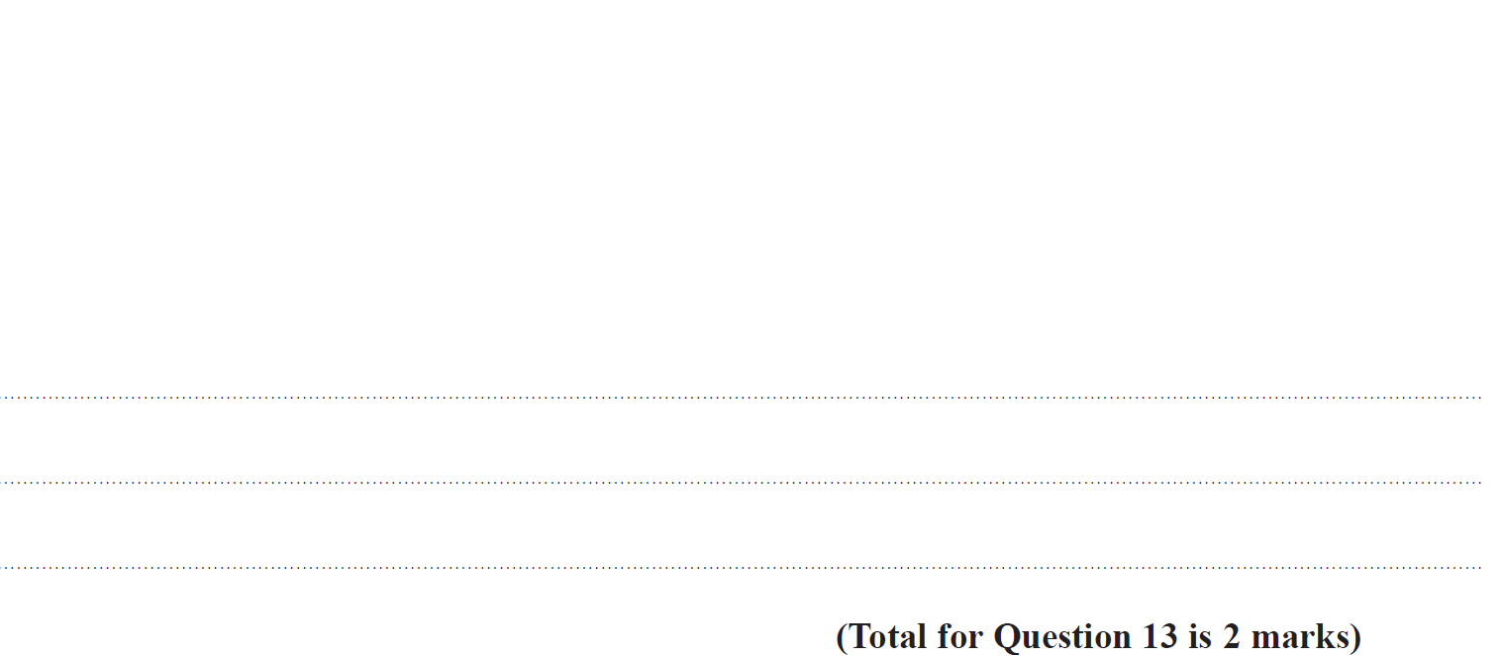
Averages
Specimen Set 2 1H Q13

Slide 13
Averages
Specimen Set 2 1H Q13
A

Slide 14
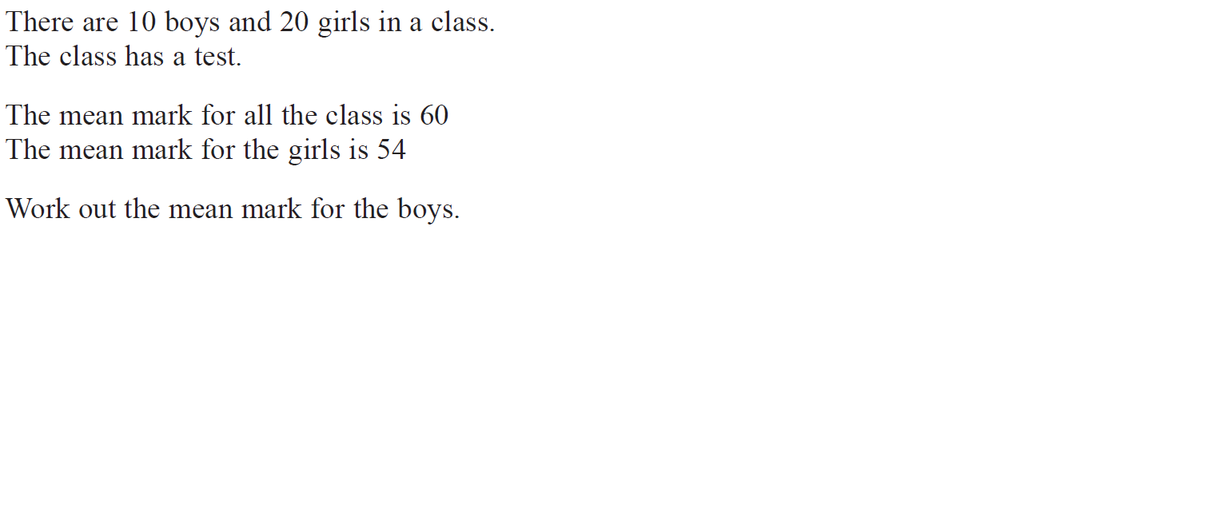
Averages
May 2017 1H Q7

Slide 15
Averages
May 2017 1H Q7
A

Slide 16
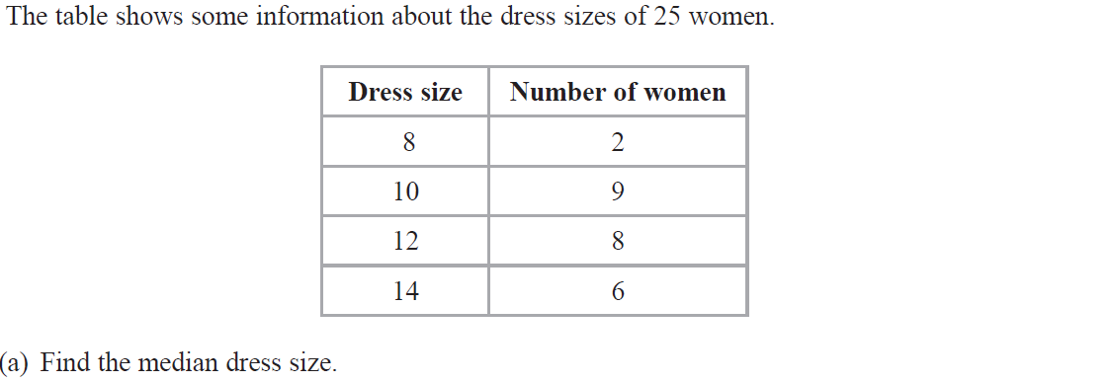
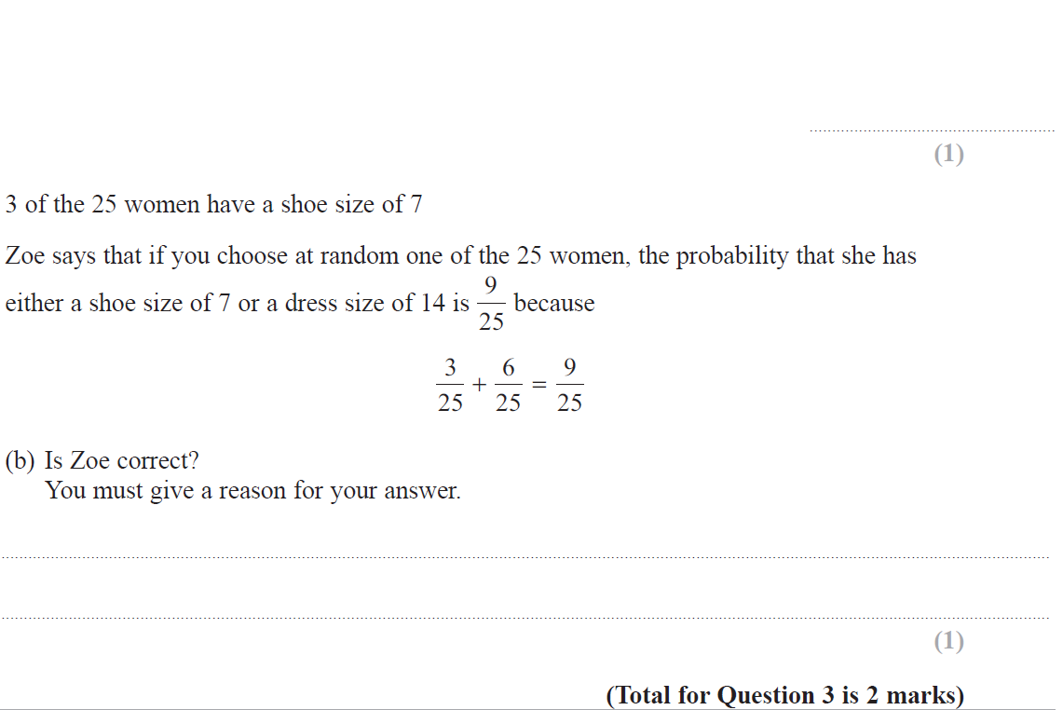
Averages
June 2017 3H Q3

Slide 17
Averages
June 2017 3H Q3
A
B

Slide 18
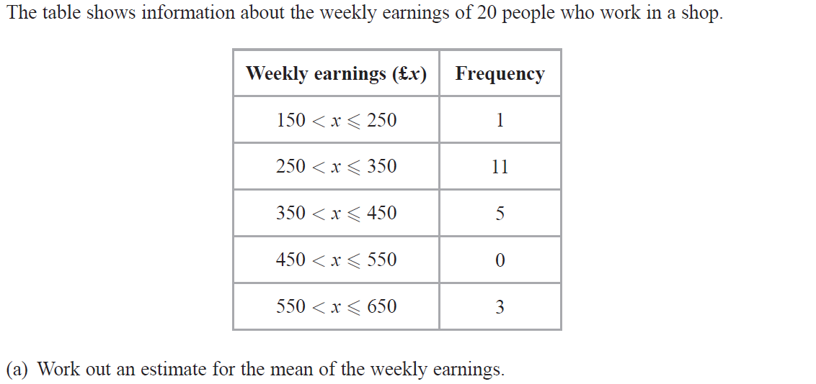
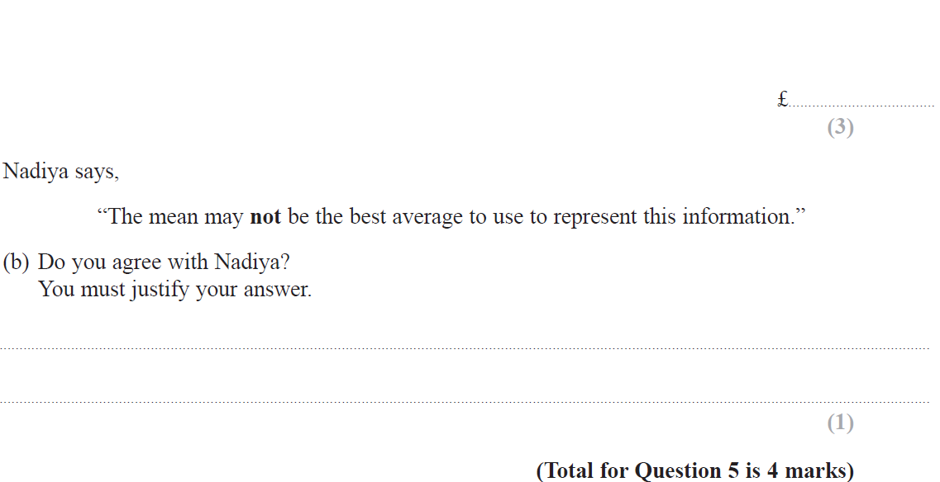
Averages
Nov 2017 1H Q5

Slide 19
Averages
Nov 2017 1H Q5
A
B

Slide 20
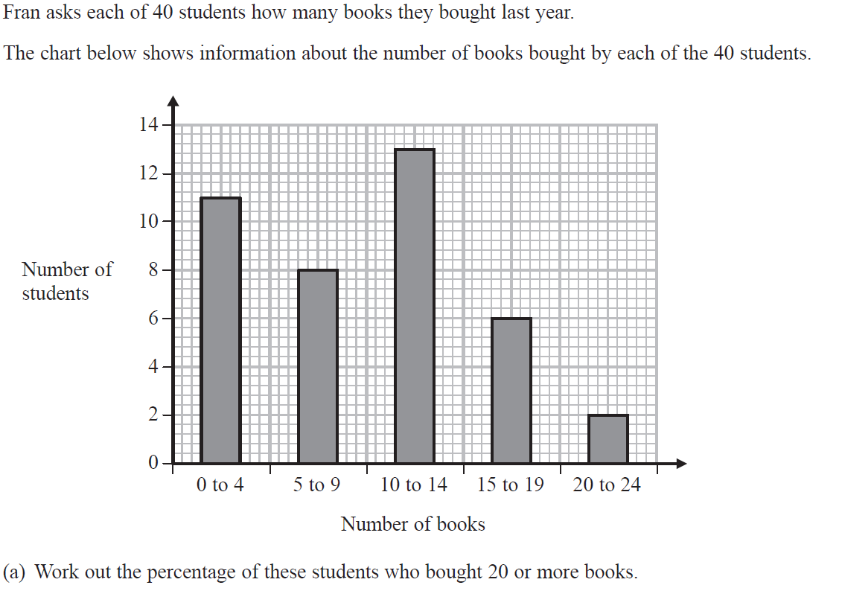
Averages
Nov 2018 3H Q4

Slide 21
Averages
Nov 2018 3H Q4
A
B

Slide 22
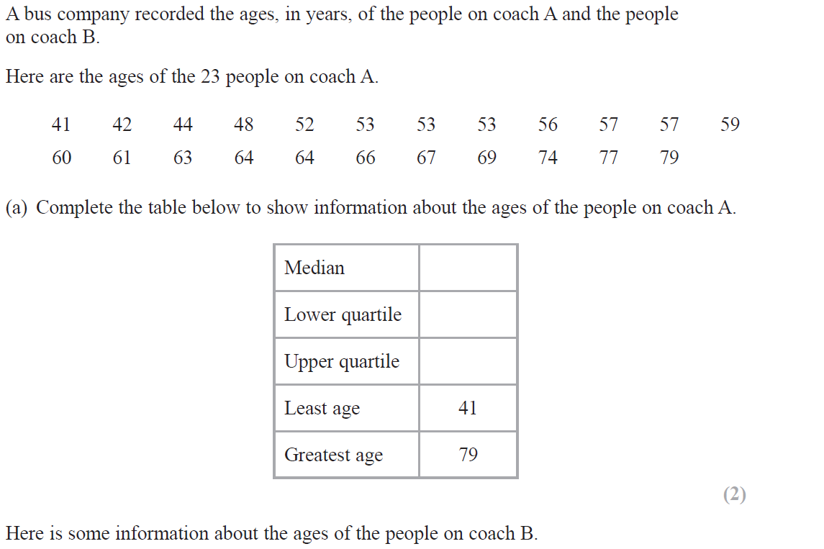
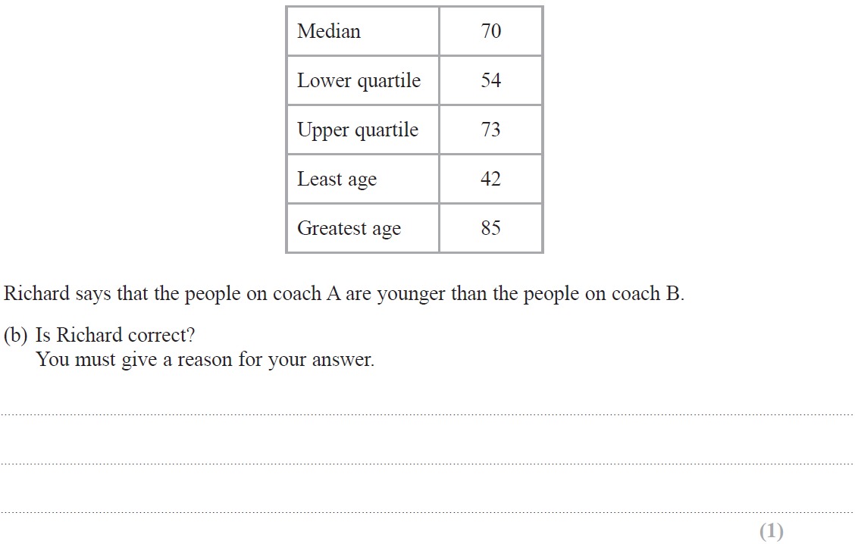
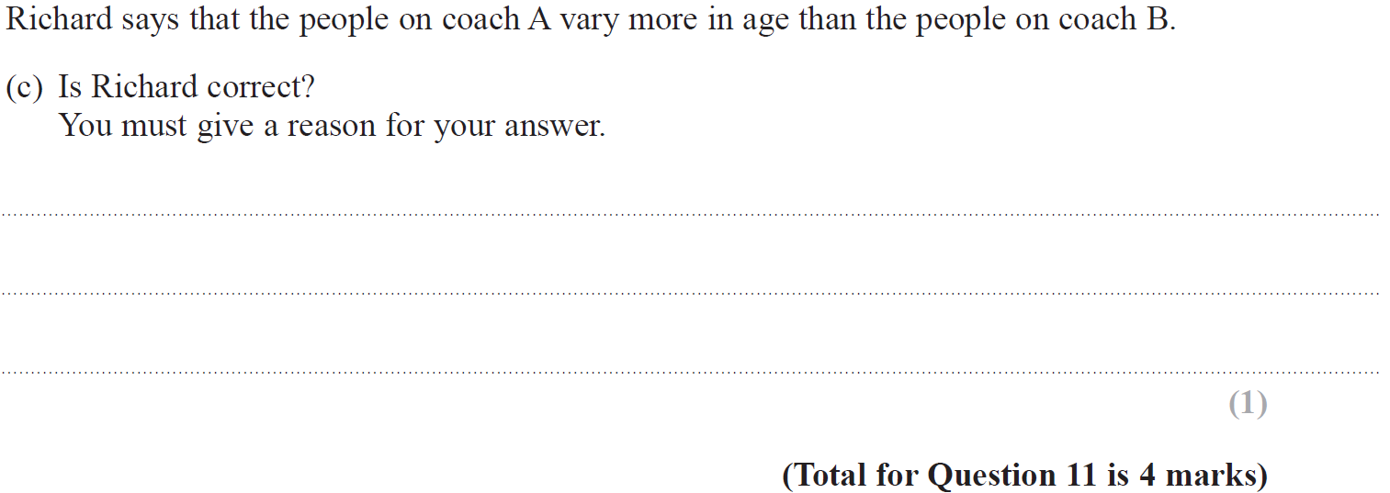
Averages
May 2019 1H Q11

Slide 23
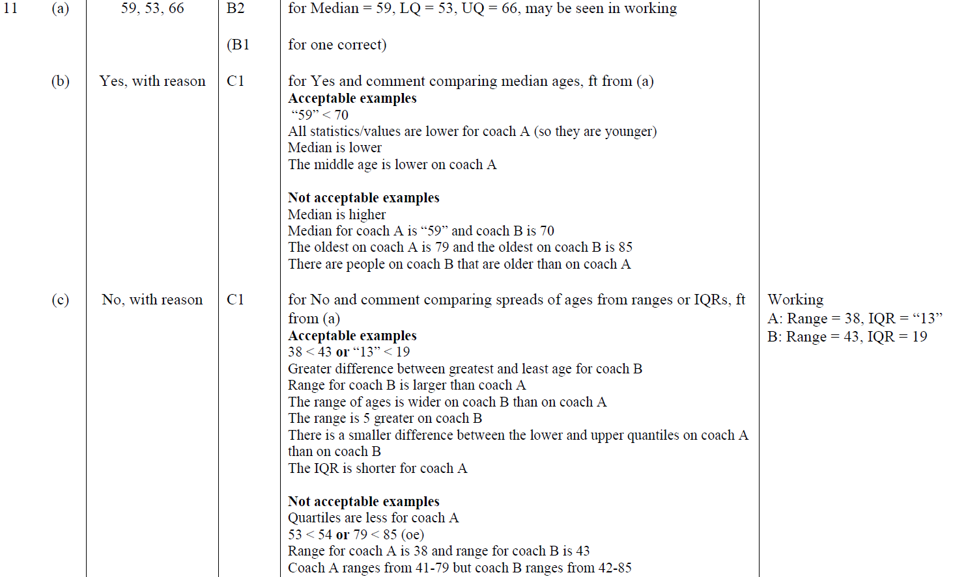
Averages
May 2019 1H Q11
A
B
C
A SF
B SF
C SF

