Slide 1
2D Area & Perimeter
2D Area & Perimeter
June 2017 2H Q21
SAM
2H Q9
Spec 1
3H Q5
Nov 2017 1H Q23
Edexcel
SAM
3H Q1
Spec 2
1H Q2
May 2018 1H Q8
AQA
Spec 1
1H Q4
Spec 2
1H Q18
June 2018 3H Q3
OCR
Spec 1
2H Q19
Spec 2
3H Q7
Nov 2018 2H Q5
May 2019 1H Q7

Slide 2
2D Area & Perimeter
2D Area & Perimeter
June 2017 3H Q26
Edexcel
Nov 2017 2H Q19
Nov 2017 1H Q10
AQA
May 2018 1H Q11
1 Marker
Nov 2017 1H Q21
OCR
Nov 2018 2H Q10
Nov 2017 2H Q17

Slide 3
2D Area & Perimeter
2D Area & Perimeter
Edexcel
Nov 2017 2H Q6
AQA
June 2018 2H Q7
OCR
Nov 2018 3H Q12

Slide 4
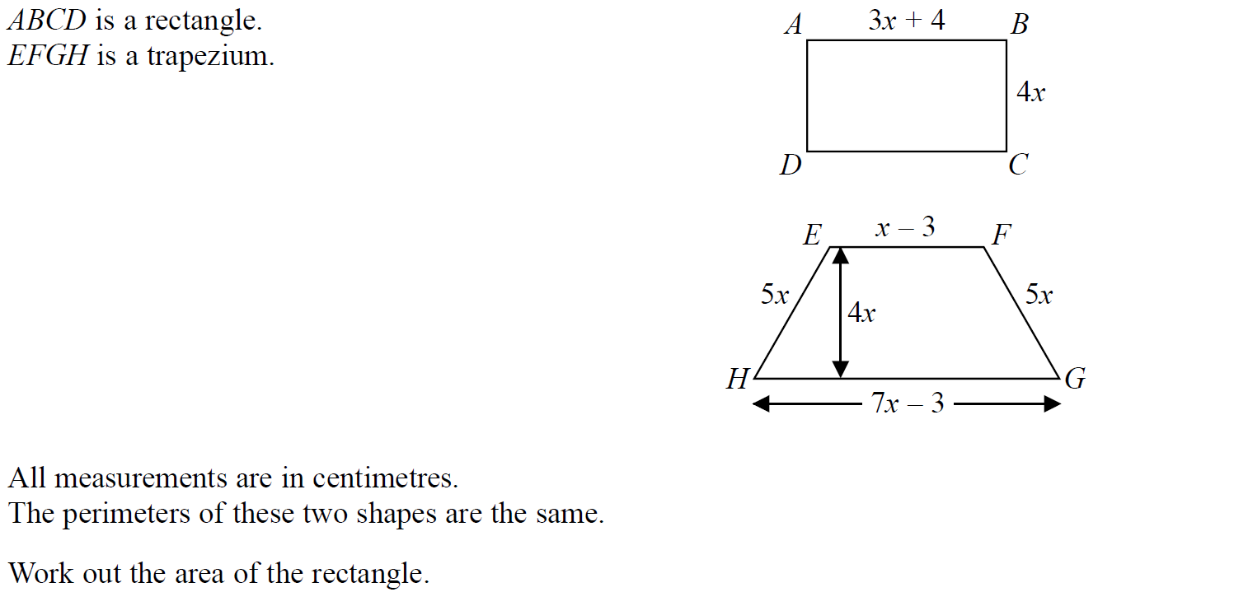
2D Area & Perimeter
SAM 2H Q9

Slide 5
2D Area & Perimeter
SAM 2H Q9
A

Slide 6
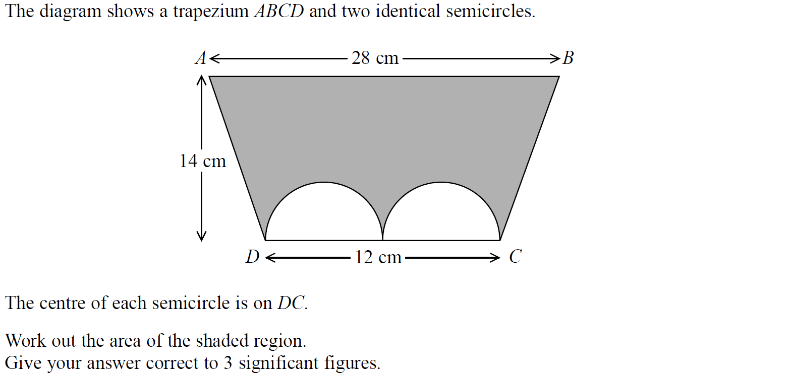
2D Area & Perimeter
SAM 3H Q1

Slide 7
2D Area & Perimeter
SAM 3H Q1
A

Slide 8
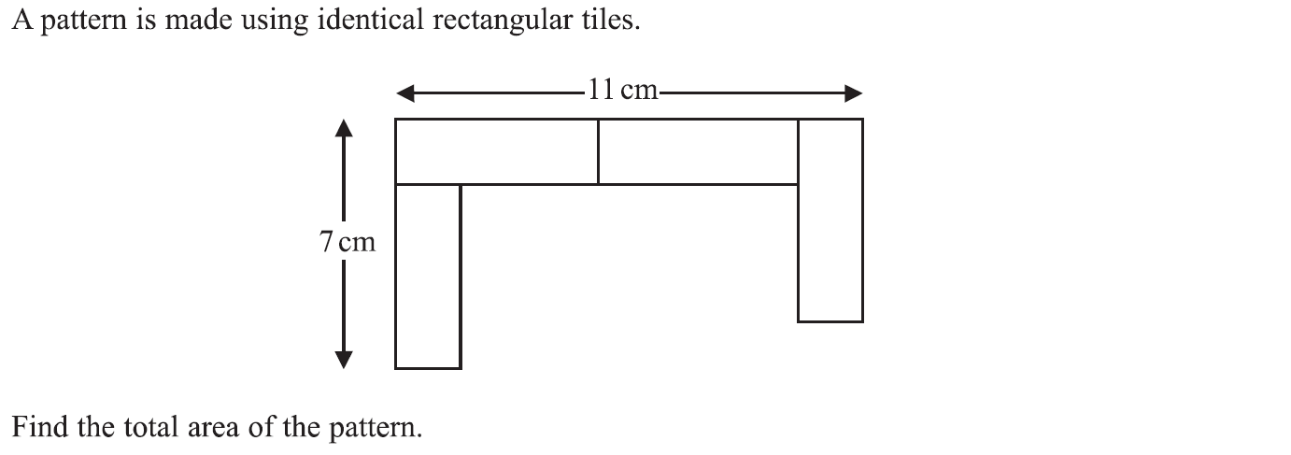
2D Area & Perimeter
Specimen Set 1 1H Q4

Slide 9
2D Area & Perimeter
Specimen Set 1 1H Q4
A

Slide 10
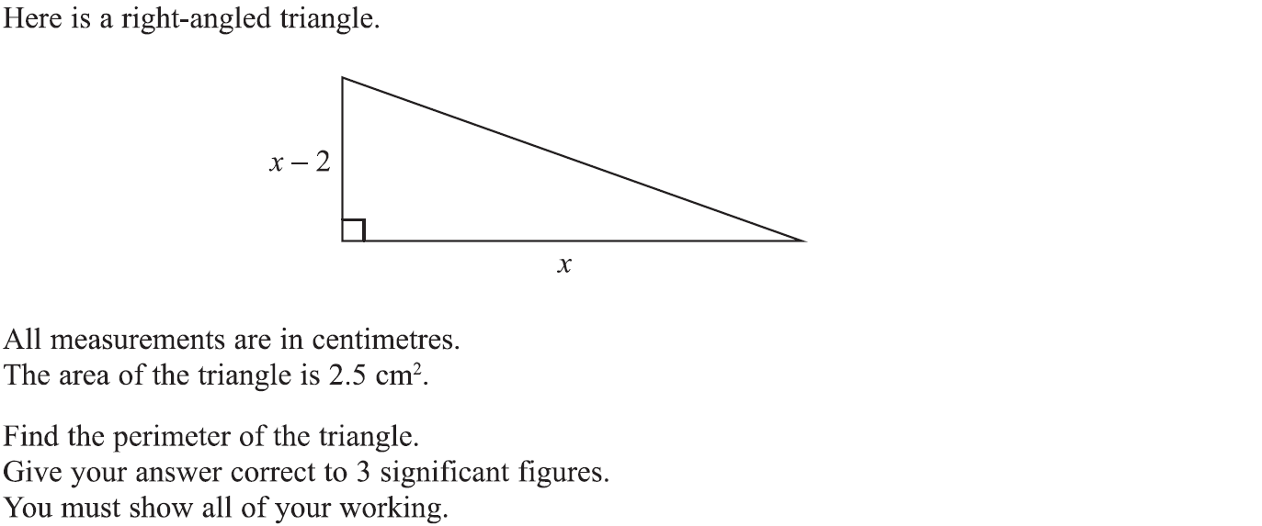
2D Area & Perimeter
Specimen Set 1 2H Q19

Slide 11
2D Area & Perimeter
Specimen Set 1 2H Q19
A

Slide 12
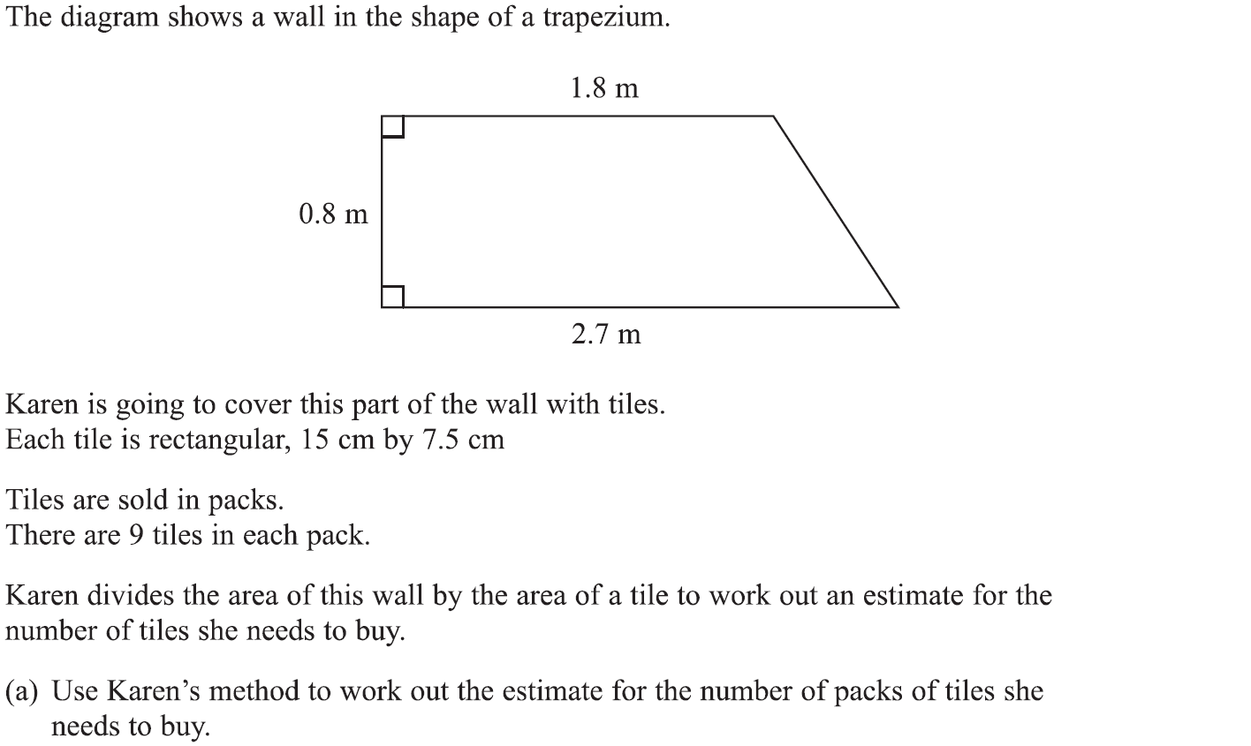
2D Area & Perimeter
Specimen Set 1 3H Q5

Slide 13
2D Area & Perimeter
Specimen Set 1 3H Q5
A
B

Slide 14
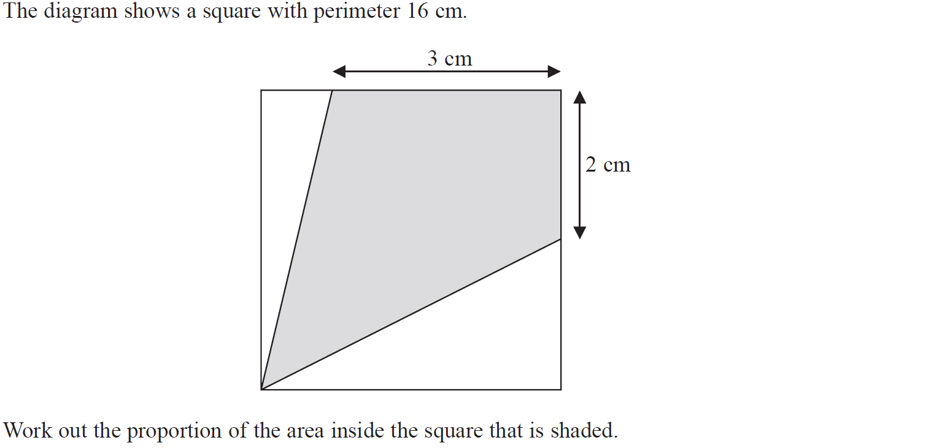
2D Area & Perimeter
Specimen Set 2 1H Q2

Slide 15
2D Area & Perimeter
Specimen Set 2 1H Q2
A

Slide 16
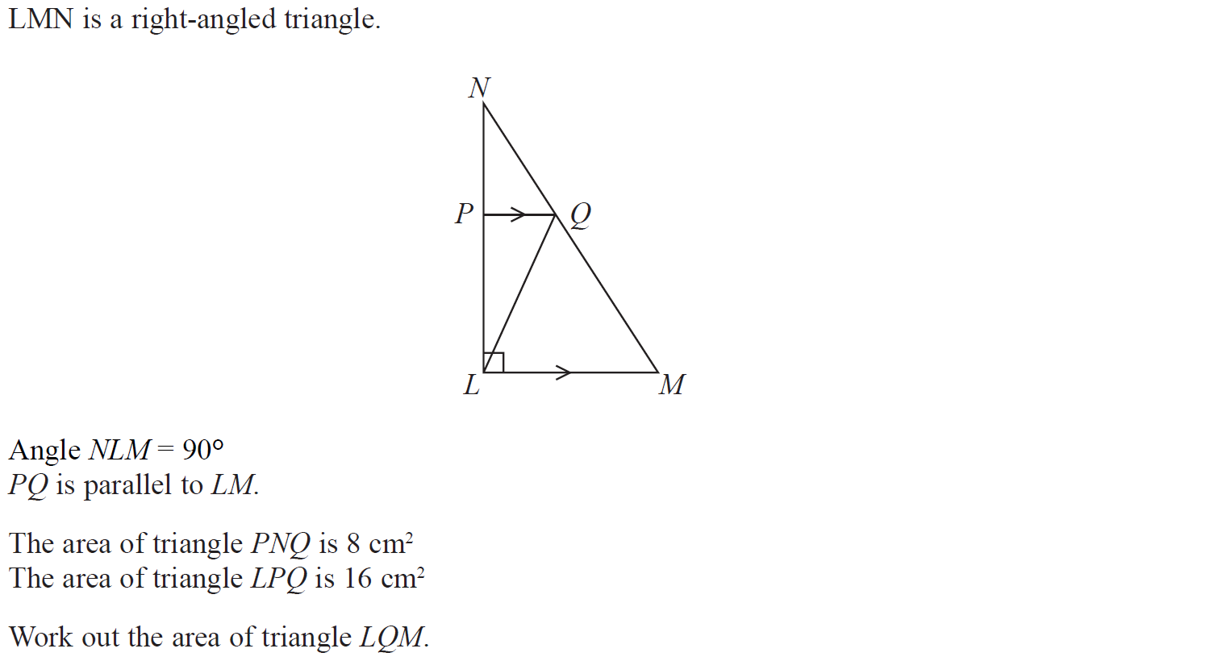
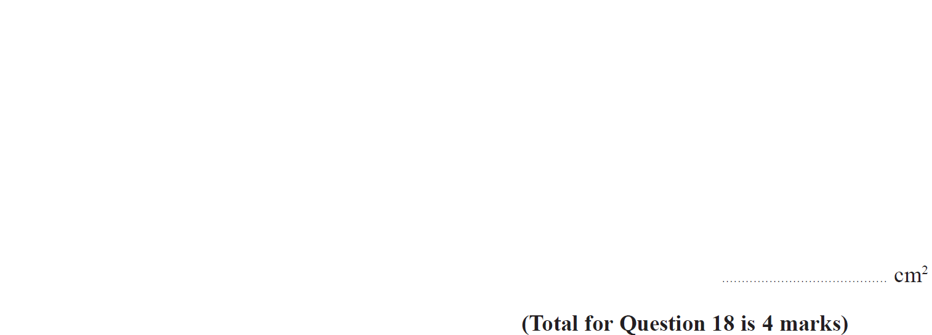
2D Area & Perimeter
Specimen Set 2 1H Q18

Slide 17
2D Area & Perimeter
Specimen Set 2 1H Q18
A

Slide 18
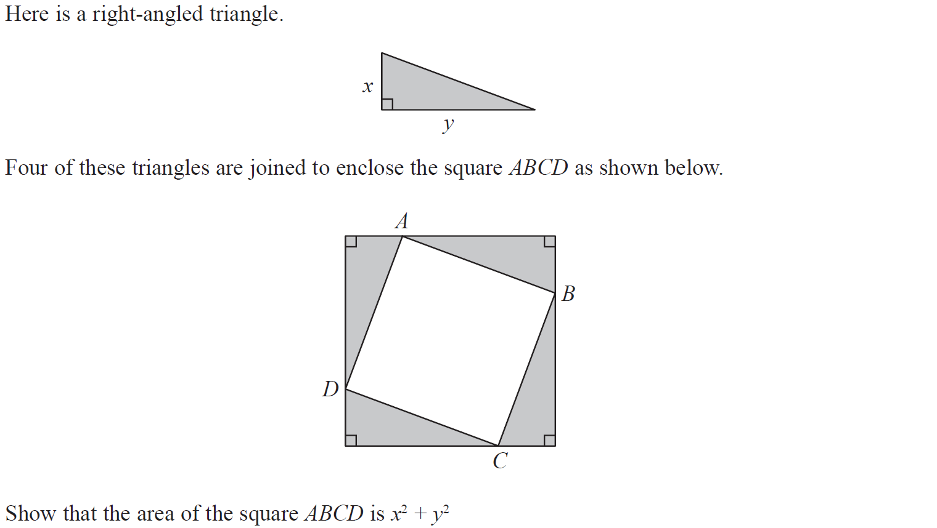
2D Area & Perimeter
Specimen Set 2 3H Q7

Slide 19
2D Area & Perimeter
Specimen Set 2 3H Q7
A

Slide 20
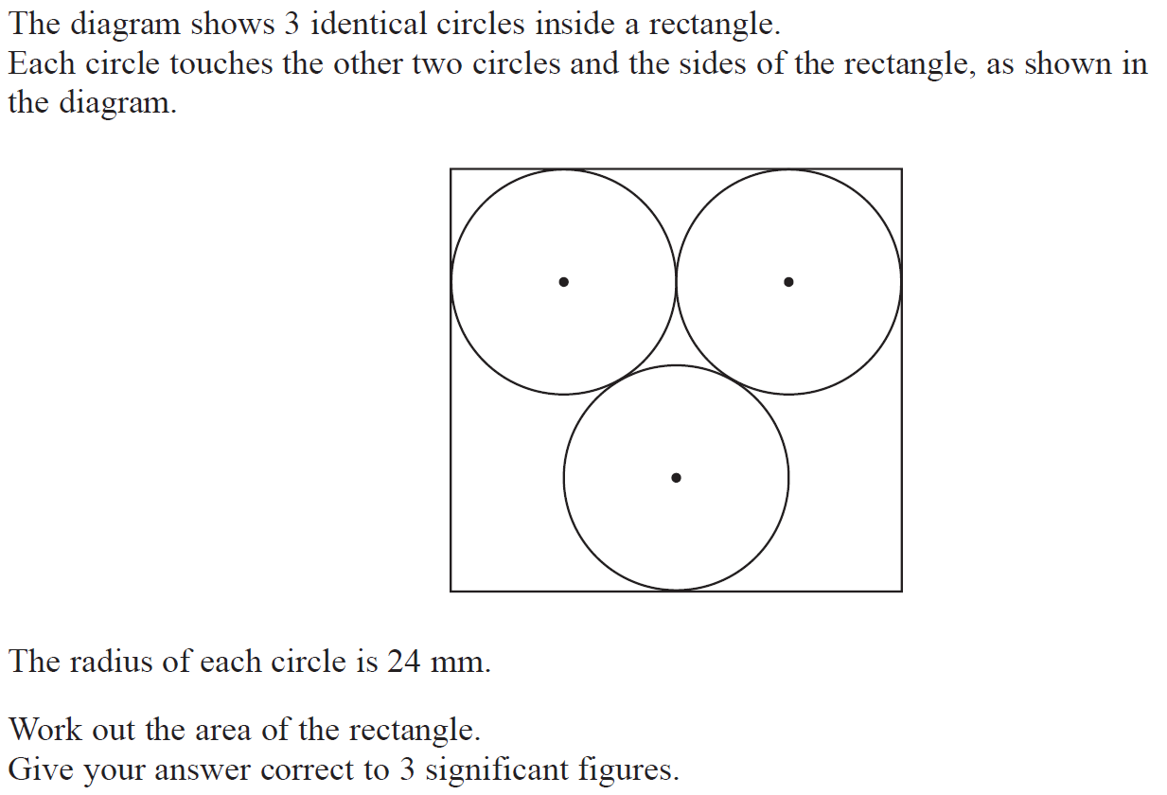
2D Area & Perimeter
June 2017 2H Q21

Slide 21
2D Area & Perimeter
June 2017 2H Q21
A

Slide 22
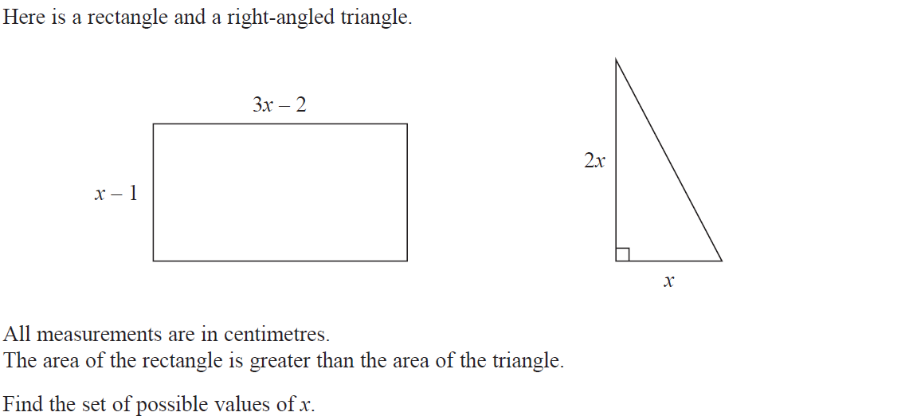
2D Area & Perimeter
Nov 2017 1H Q23

Slide 23
2D Area & Perimeter
Nov 2017 1H Q23
A

Slide 24
2D Area & Perimeter
May 2018 1H Q8

Slide 25
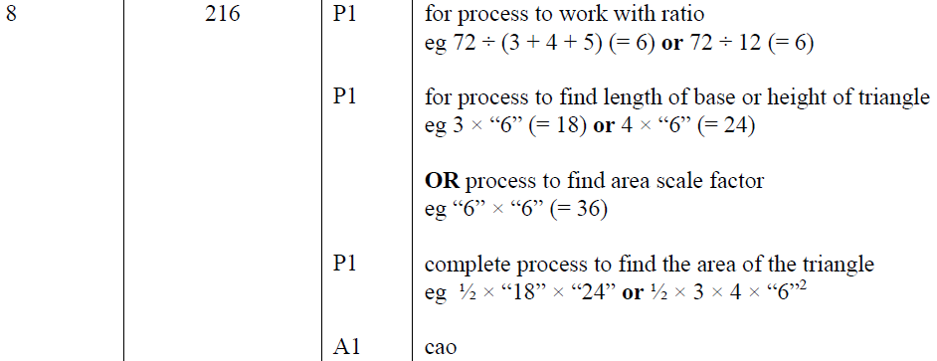
2D Area & Perimeter
May 2018 1H Q8
A

Slide 26
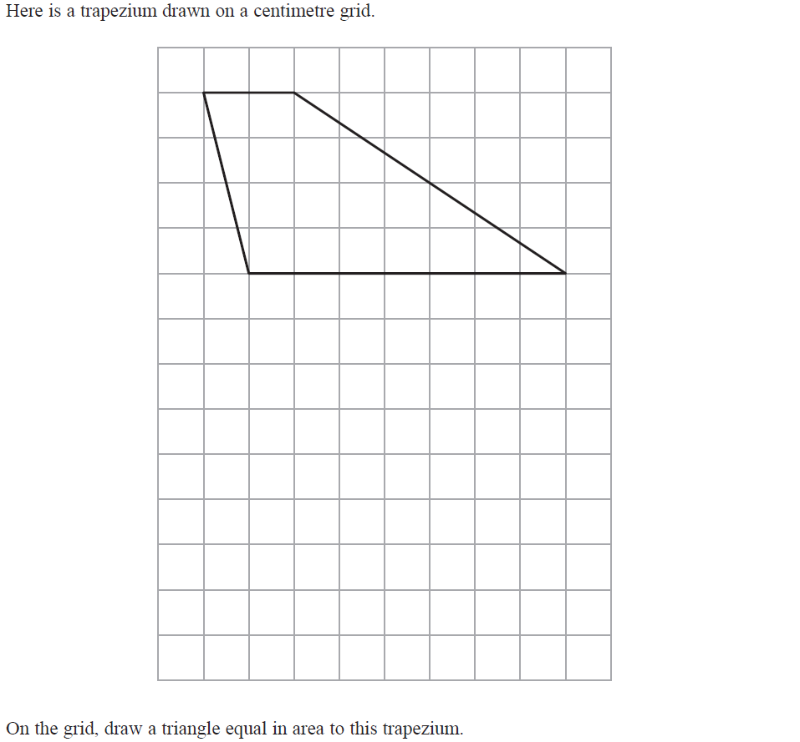
2D Area & Perimeter
June 2018 3H Q3

Slide 27
2D Area & Perimeter
June 2018 3H Q3
A

Slide 28
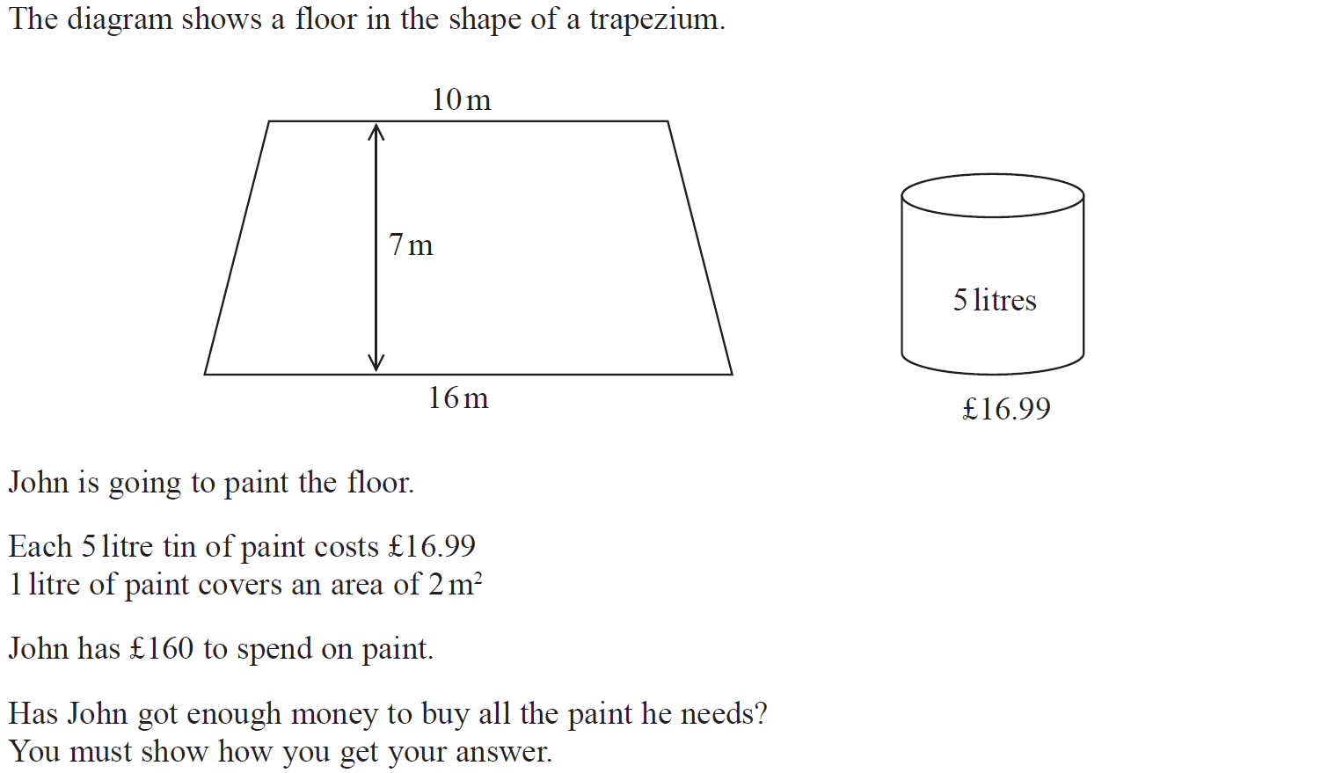
2D Area & Perimeter
Nov 2018 2H Q5

Slide 29
2D Area & Perimeter
Nov 2018 2H Q5
A

Slide 30
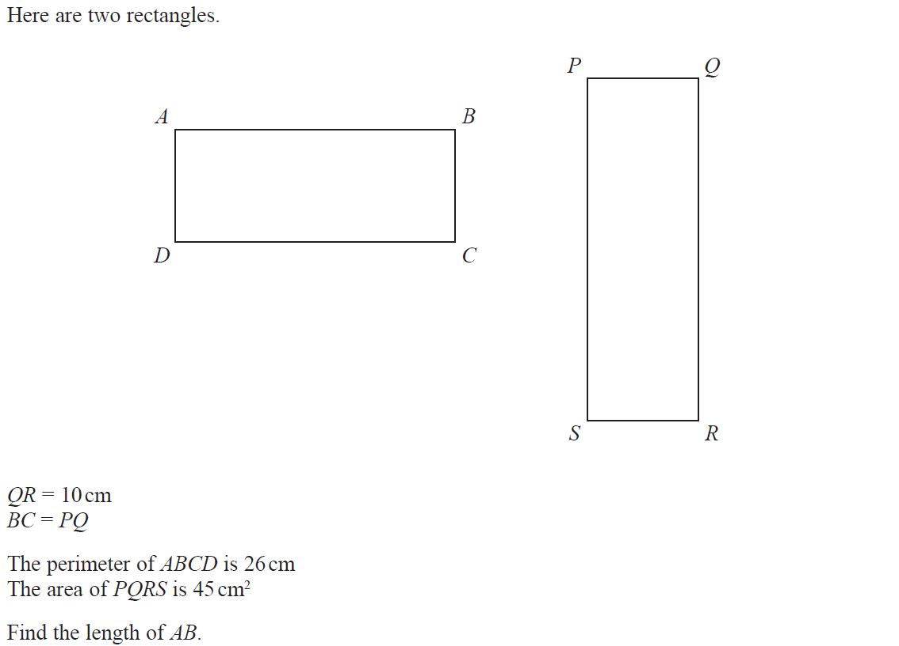
2D Area & Perimeter
May 2019 1H Q7

Slide 31
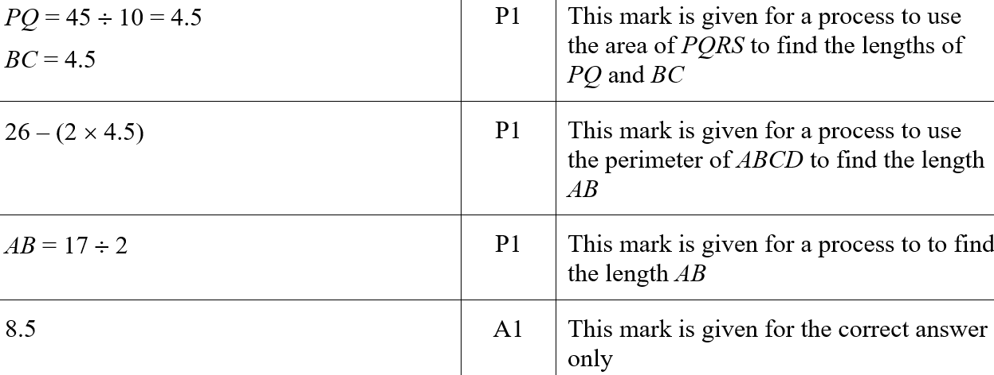
2D Area & Perimeter
May 2019 1H Q7
A
A SF

Slide 32
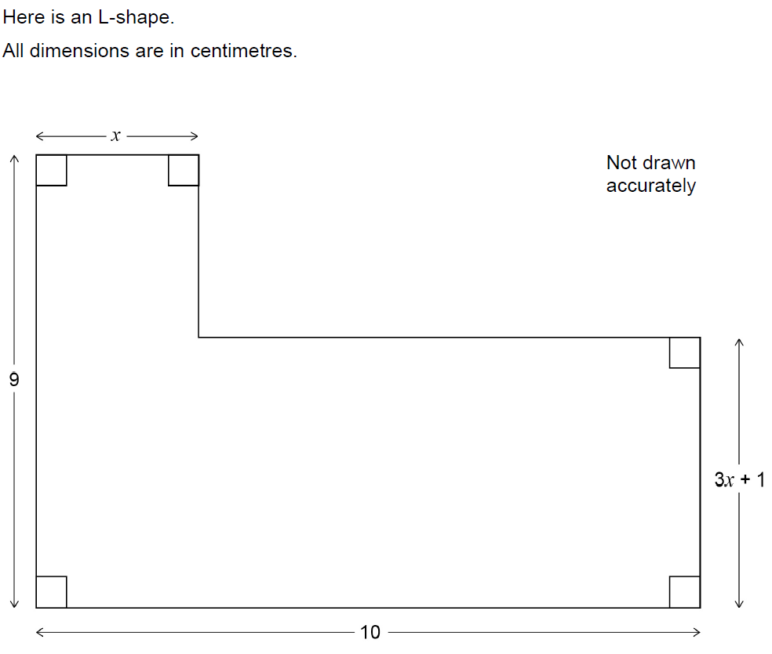
2D Area & Perimeter
June 2017 3H Q26

Slide 33
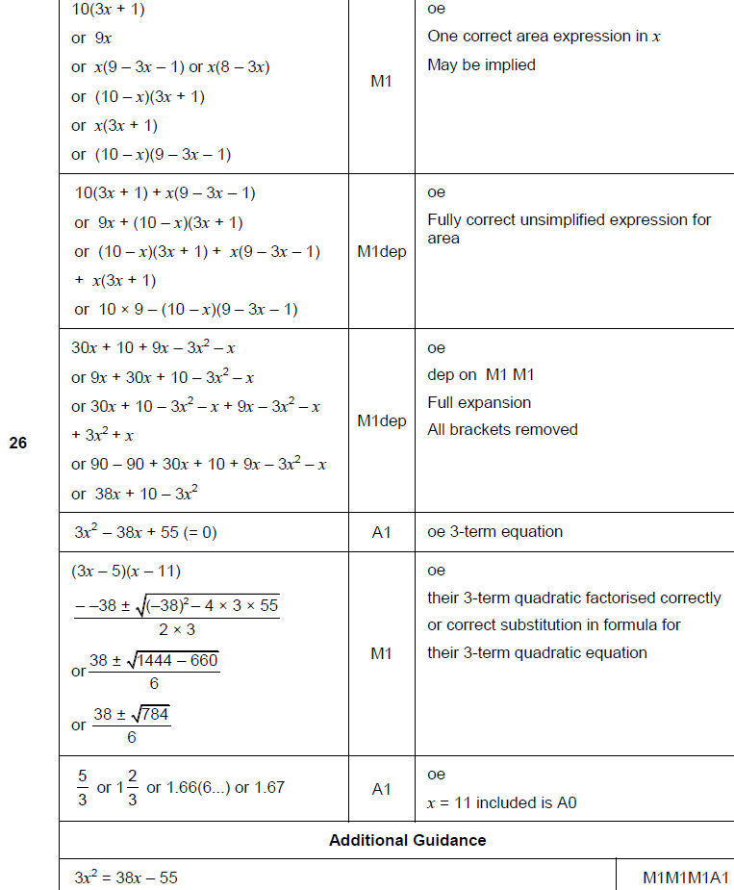
2D Area & Perimeter
June 2017 3H Q26
A

Slide 34
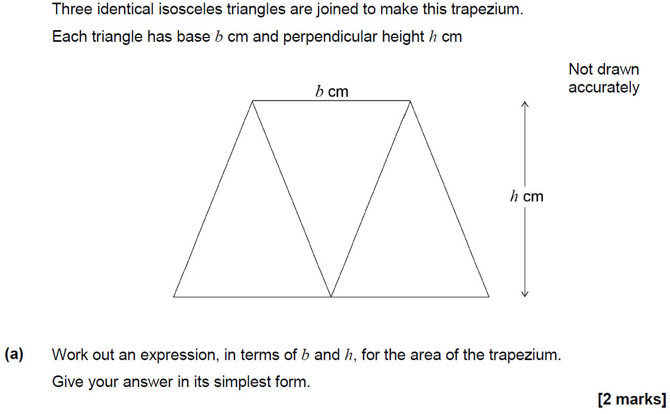
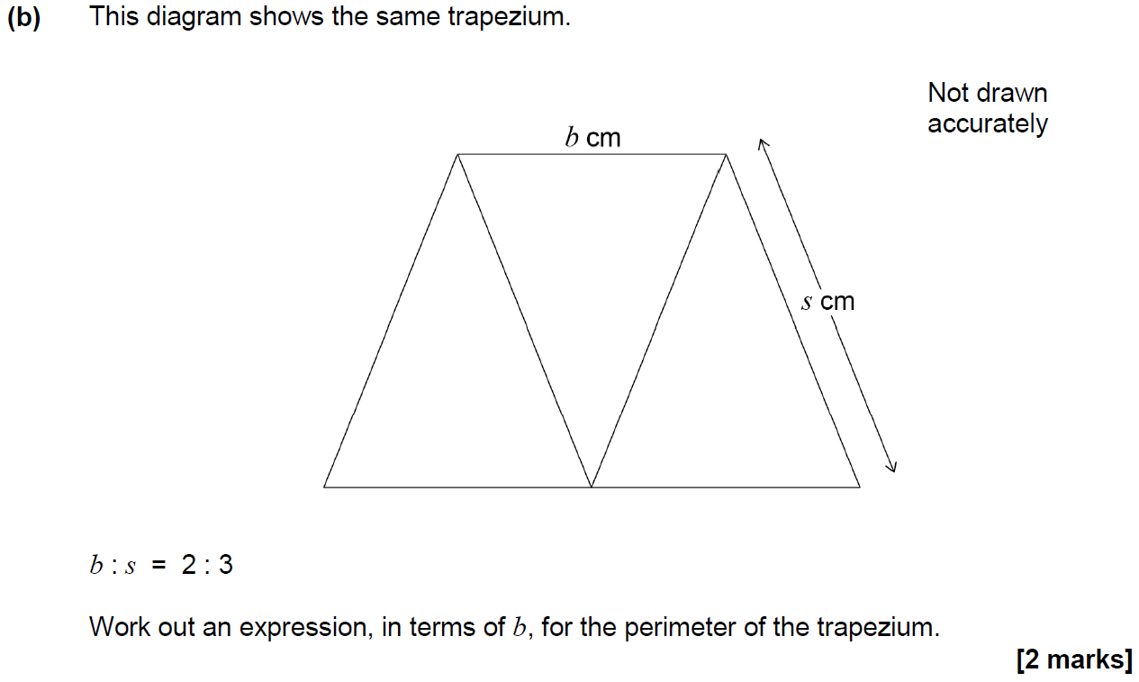
2D Area & Perimeter
Nov 2017 1H Q10

Slide 35
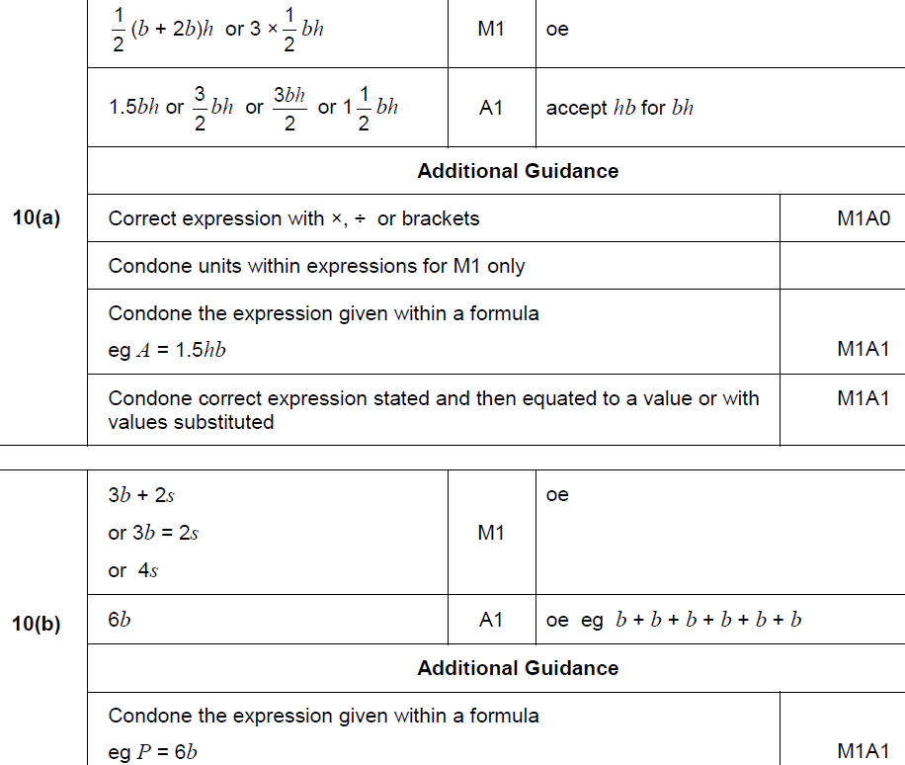
2D Area & Perimeter
Nov 2017 1H Q10
A
B

Slide 36
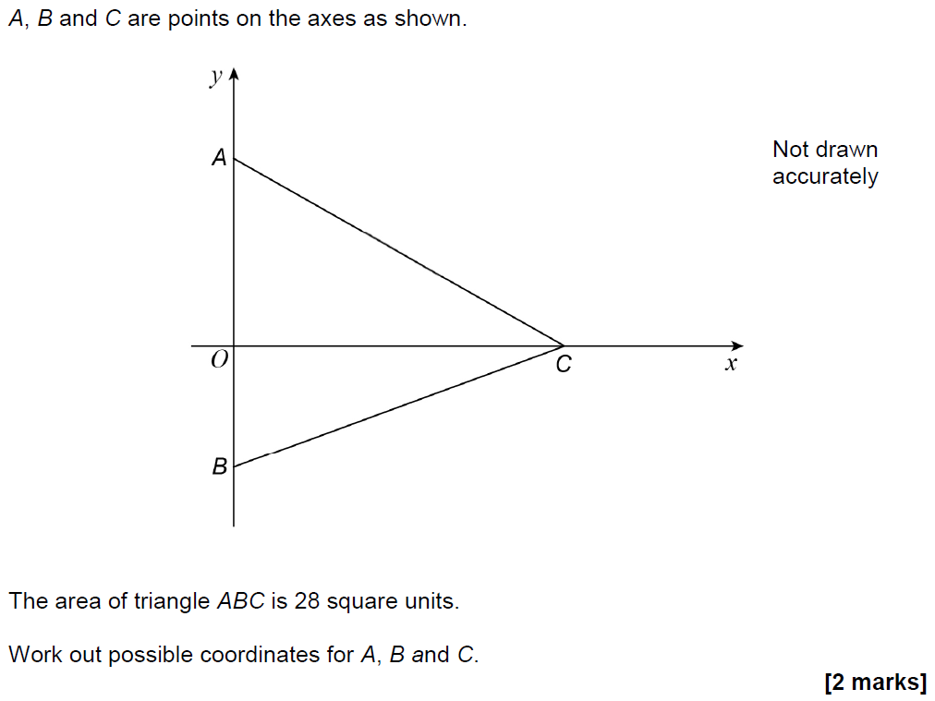
2D Area & Perimeter
Nov 2017 1H Q21

Slide 37
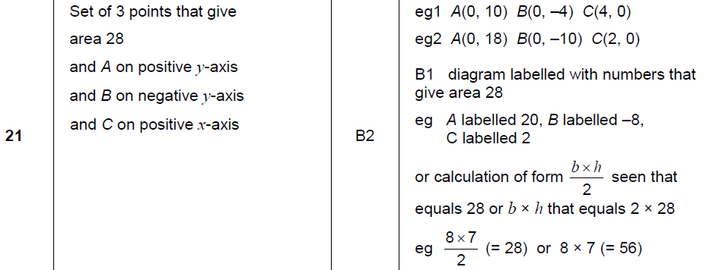
2D Area & Perimeter
Nov 2017 1H Q21
A

Slide 38
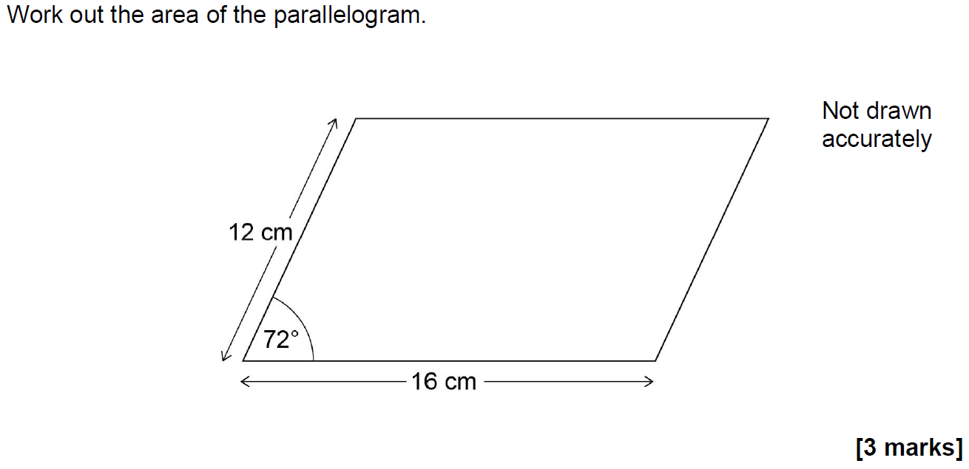
2D Area & Perimeter
Nov 2017 2H Q17

Slide 39
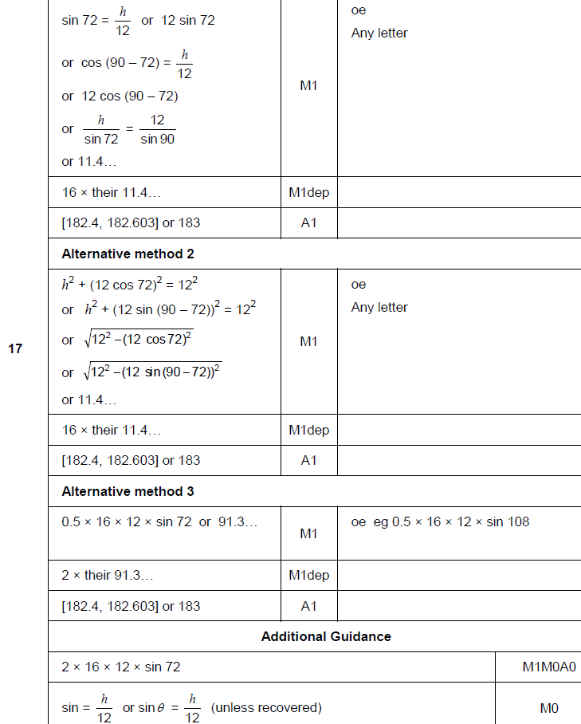
2D Area & Perimeter
Nov 2017 2H Q17
A

Slide 40
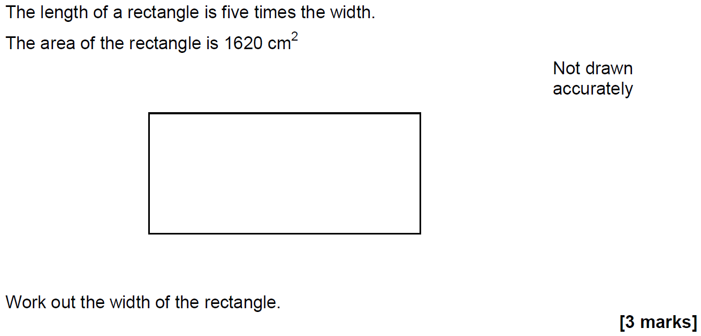
2D Area & Perimeter
Nov 2017 2H Q19

Slide 41
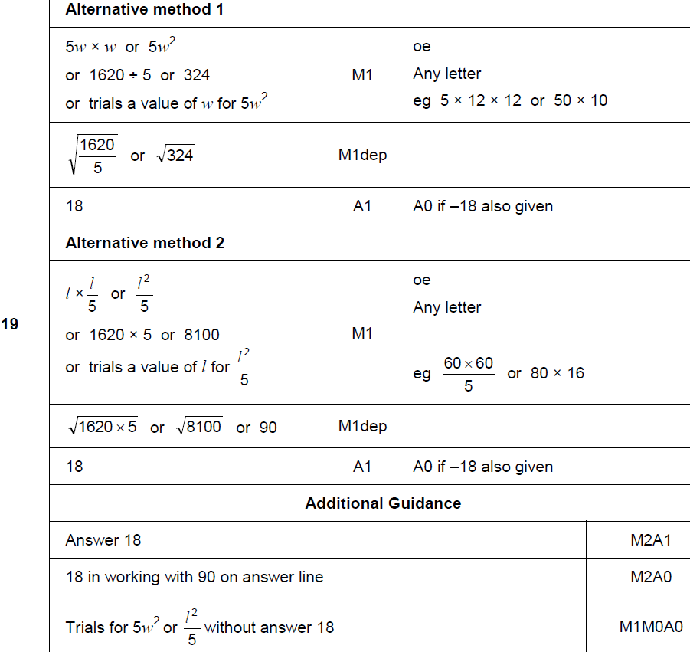
2D Area & Perimeter
Nov 2017 2H Q19
A

Slide 42
2D Area & Perimeter
May 2018 1H Q11

Slide 43
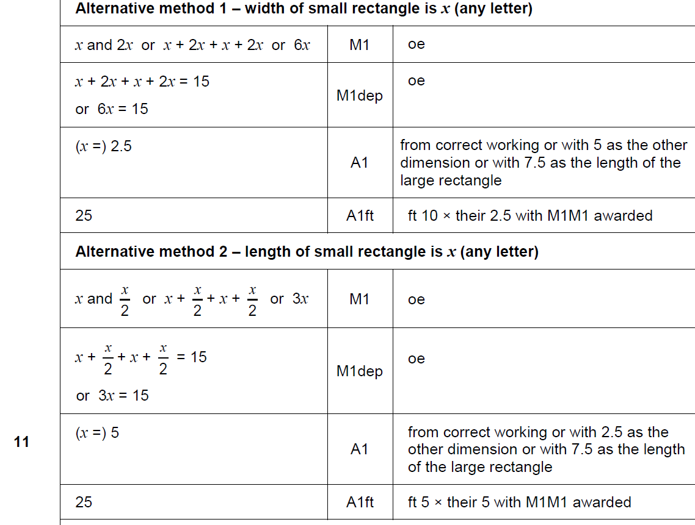
2D Area & Perimeter
May 2018 1H Q11
A

Slide 44
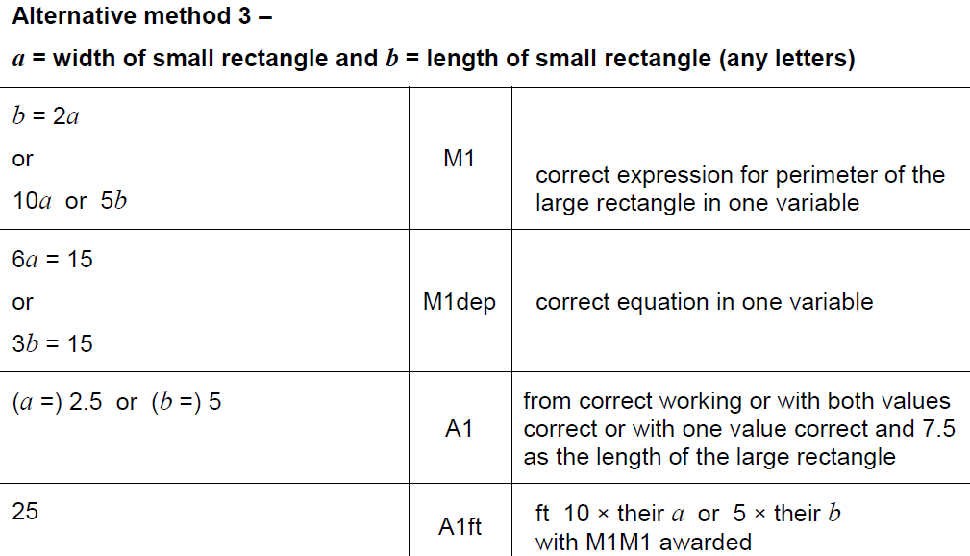
2D Area & Perimeter
May 2018 1H Q11
A Alternative 2

Slide 45
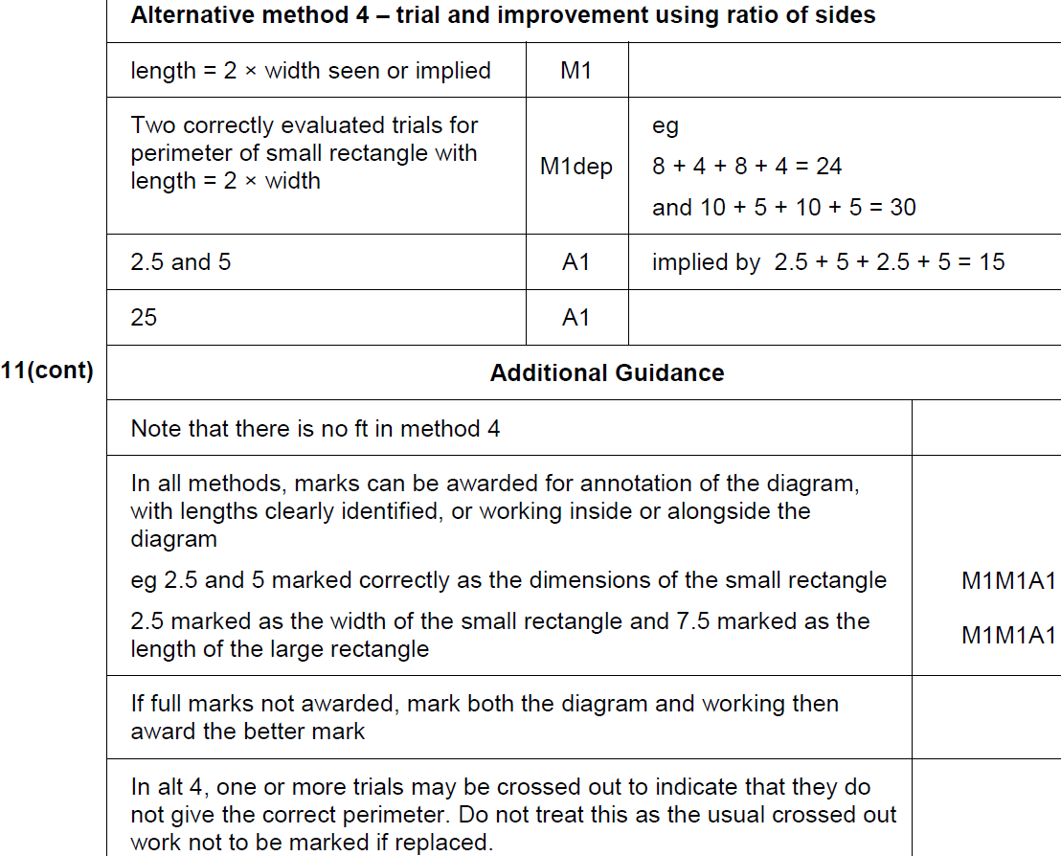
2D Area & Perimeter
May 2018 1H Q11
A Alternative 2 & notes

Slide 46
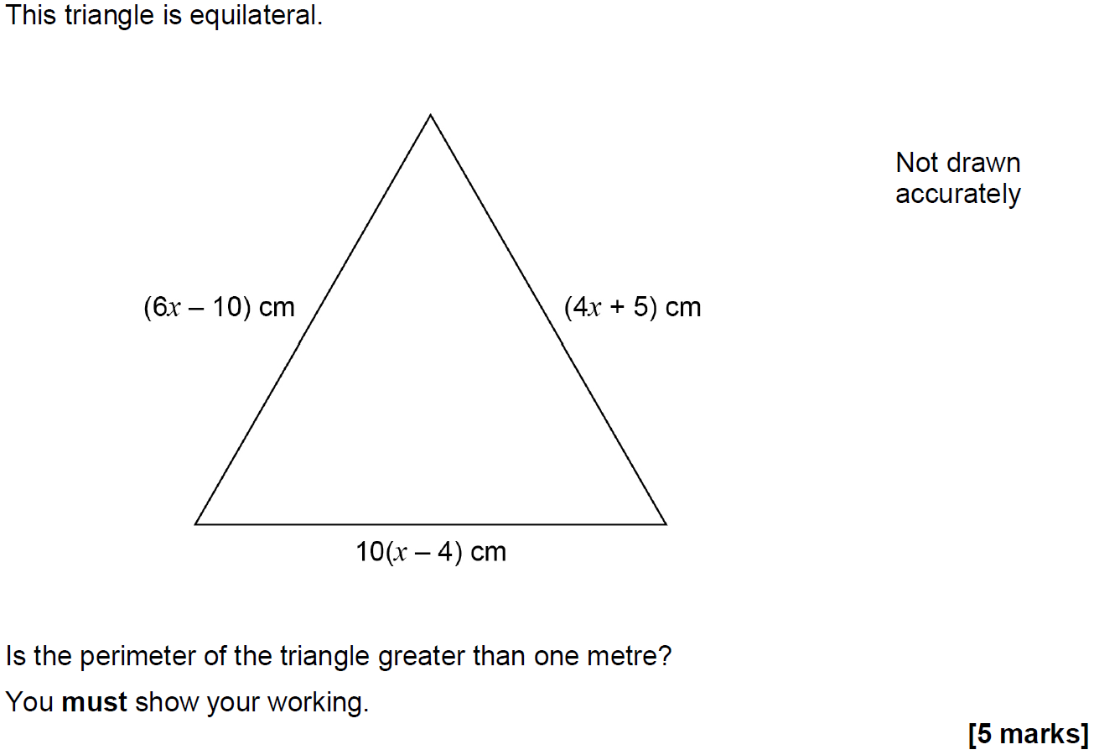
2D Area & Perimeter
Nov 2018 2H Q10

Slide 47
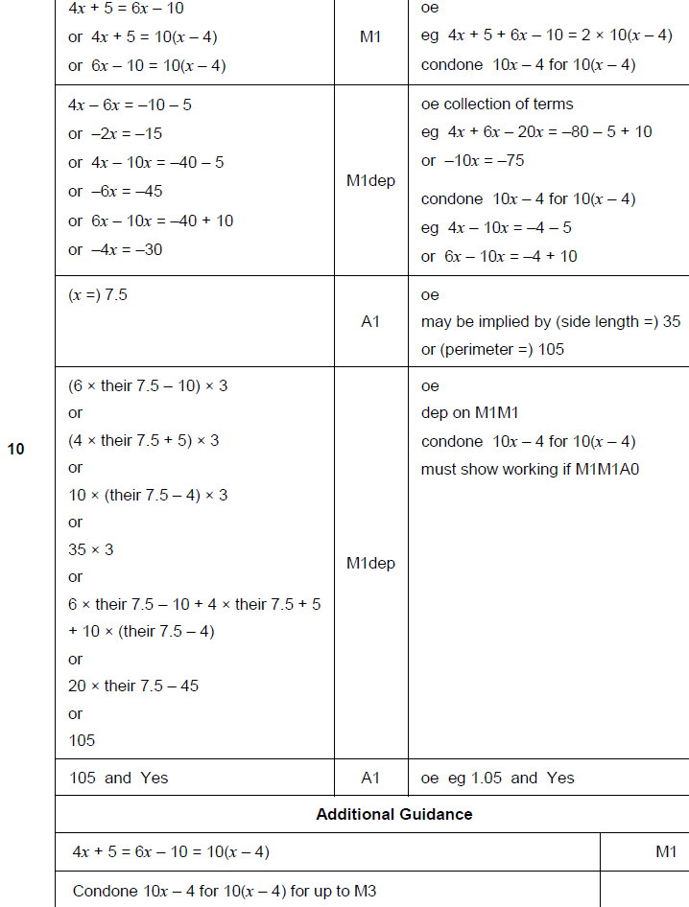
2D Area & Perimeter
Nov 2018 2H Q10
A

Slide 48
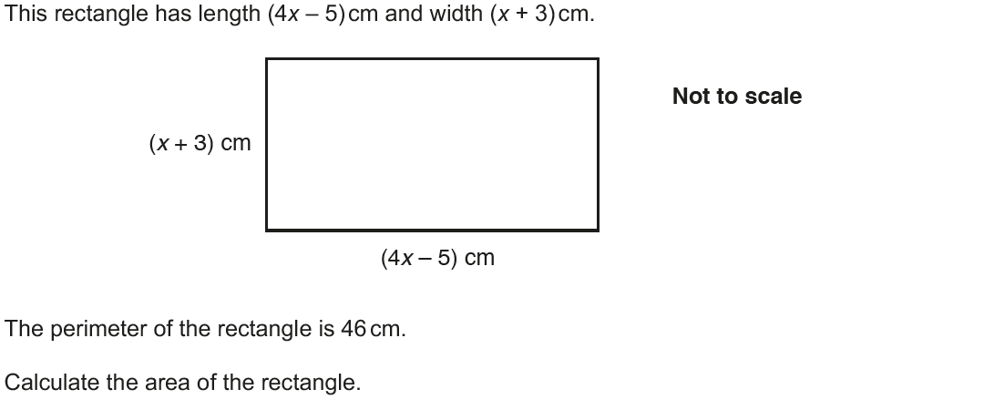
2D Area & Perimeter
Nov 2017 2H Q6

Slide 49
2D Area & Perimeter
Nov 2017 2H Q6
A

Slide 50
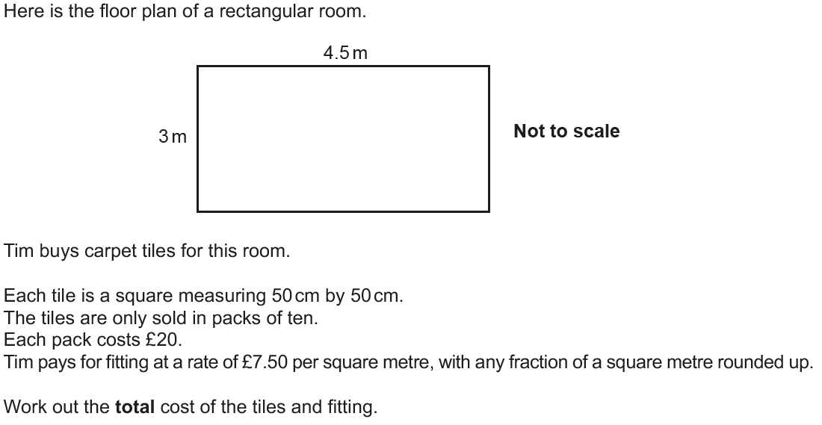
2D Area & Perimeter
June 2018 2H Q7

Slide 51
2D Area & Perimeter
June 2018 2H Q7
A

Slide 52
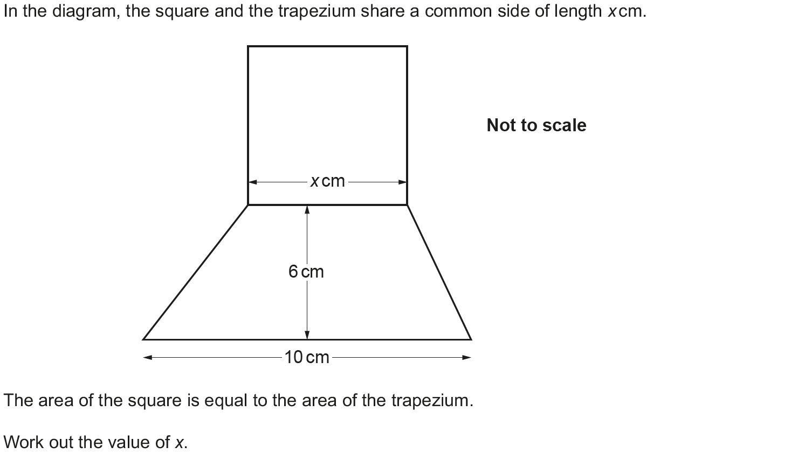
2D Area & Perimeter
Nov 2018 3H Q12

Slide 53
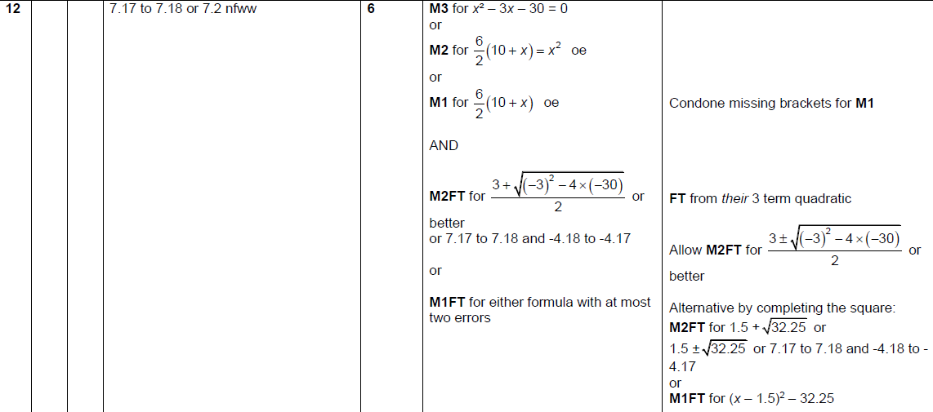
2D Area & Perimeter
Nov 2018 3H Q12
A

