Slide 1
Algebraic Fractions
Algebraic Fractions
Nov 2017
2H Q11
June 2018
3H Q18
Nov 2017
2H Q27
1 Marker
SAM
2H Q16
Nov 2018
1H Q22
June 2018
2H Q13
Nov 2018
2H Q22
June 2018
2H Q25

Slide 2
Algebraic Fractions
SAM 2H Q16

Slide 3
Algebraic Fractions
SAM 2H Q16
A

Slide 4
Algebraic Fractions
Nov 2017 2H Q11

Slide 5
Algebraic Fractions
Nov 2017 2H Q11
A

Slide 6
Algebraic Fractions
Nov 2017 2H Q27

Slide 7
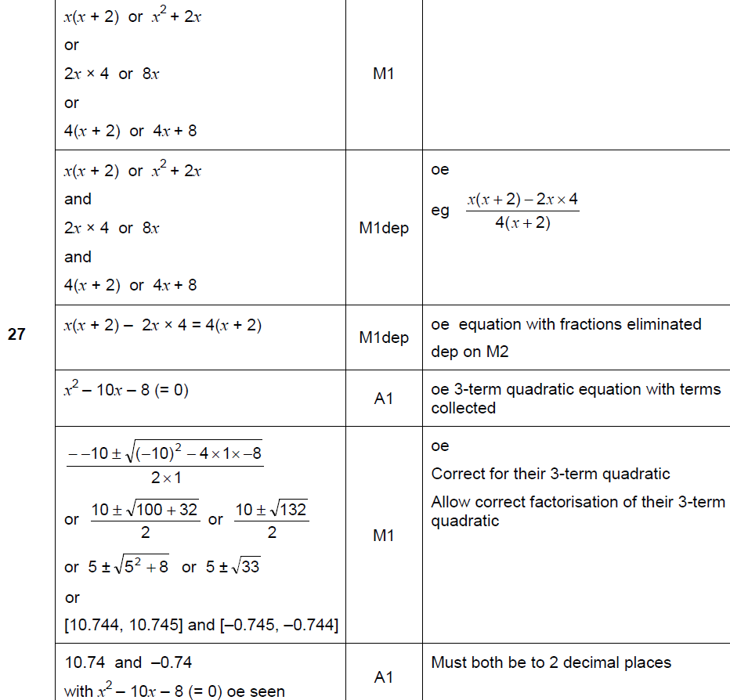
Algebraic Fractions
Nov 2017 2H Q27
A

Slide 8
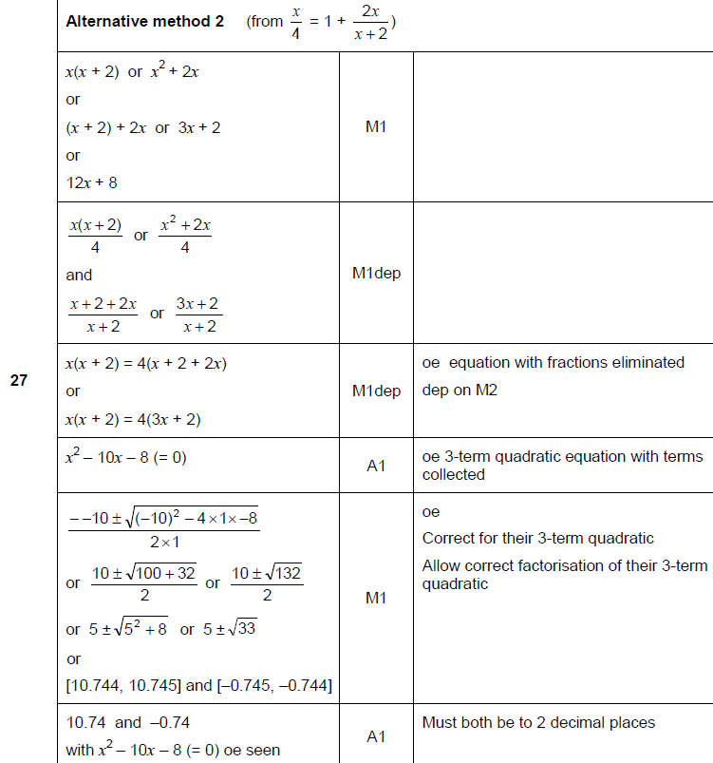
Algebraic Fractions
Nov 2017 2H Q27
A Alternative 1

Slide 9
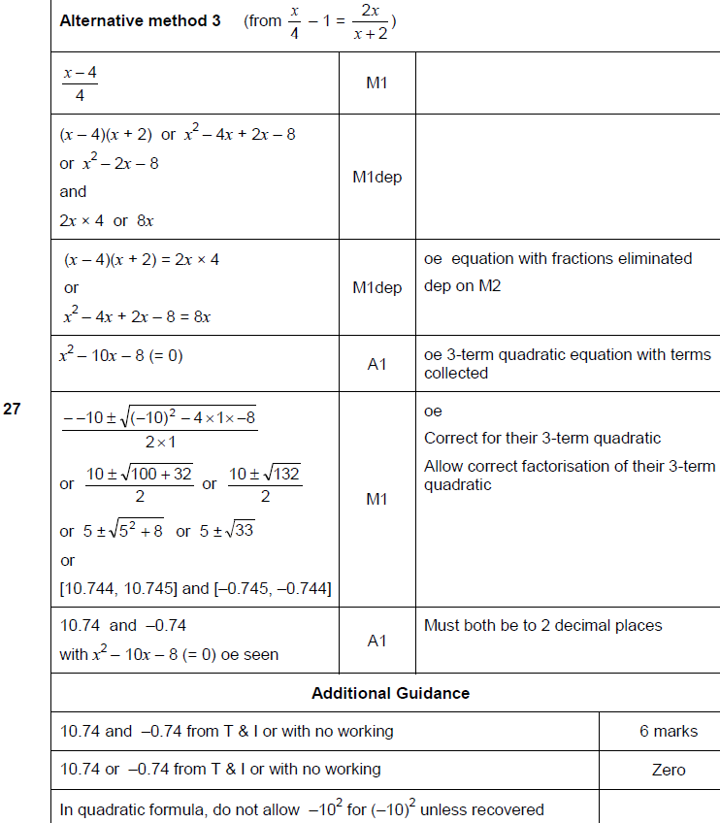
Algebraic Fractions
Nov 2017 2H Q27
A Alternative 2 & notes

Slide 10
Algebraic Fractions
June 2018 2H Q13

Slide 11
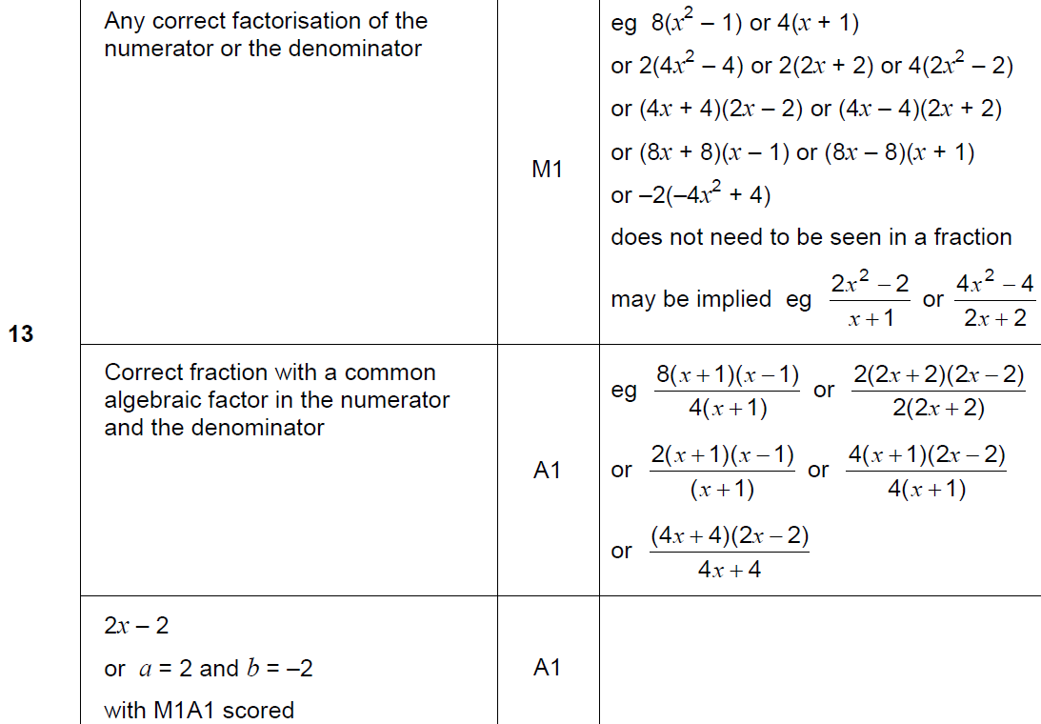
Algebraic Fractions
June 2018 2H Q13
A

Slide 12
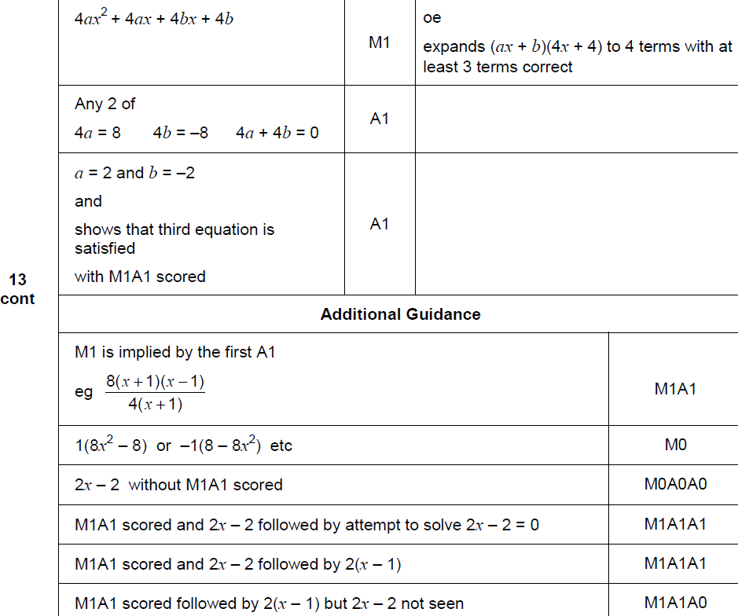
Algebraic Fractions
June 2018 2H Q13
A Alternative & notes

Slide 13
Algebraic Fractions
June 2018 2H Q25

Slide 14
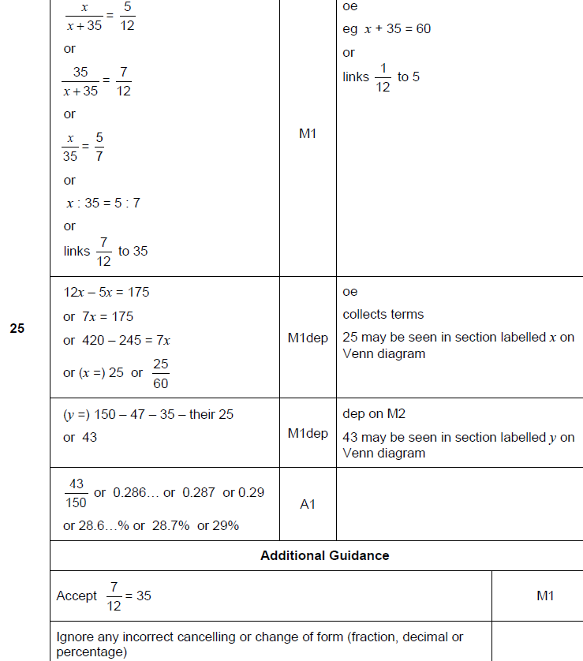
Algebraic Fractions
June 2018 2H Q25
A

Slide 15
Algebraic Fractions
June 2018 3H Q18

Slide 16
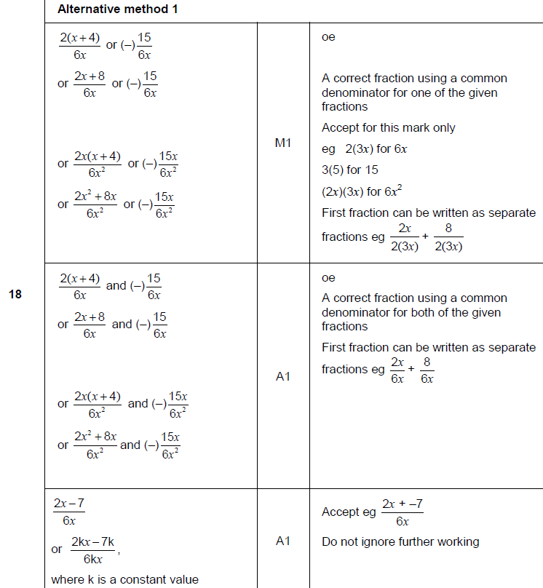
Algebraic Fractions
June 2018 3H Q18
A

Slide 17
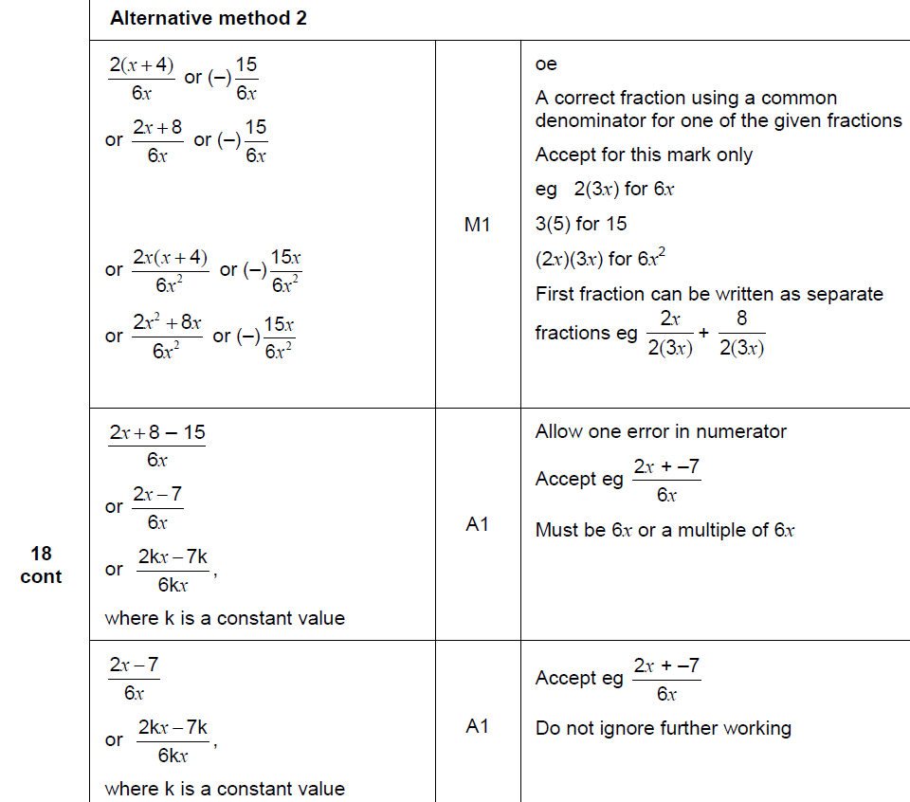
Algebraic Fractions
June 2018 3H Q18
A Alternative

Slide 18
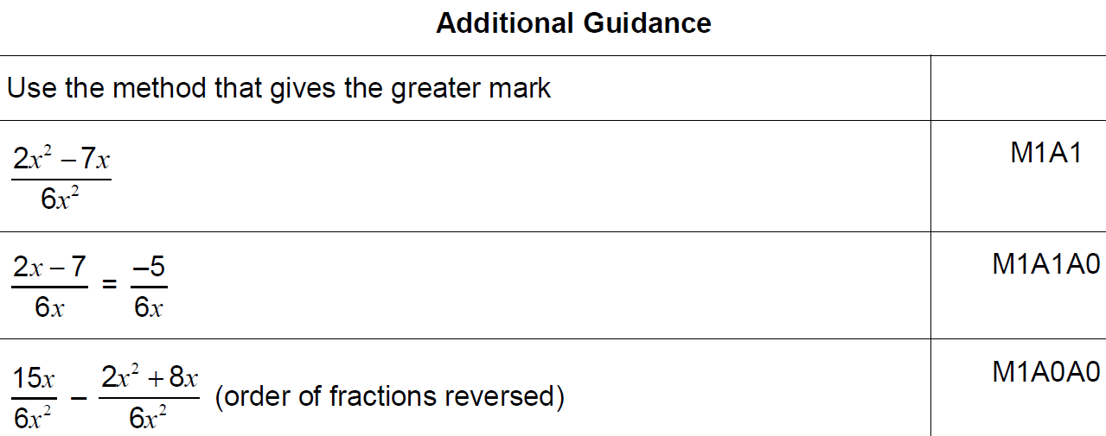
Algebraic Fractions
June 2018 3H Q18
A notes

Slide 19
Algebraic Fractions
Nov 2018 1H Q22

Slide 20
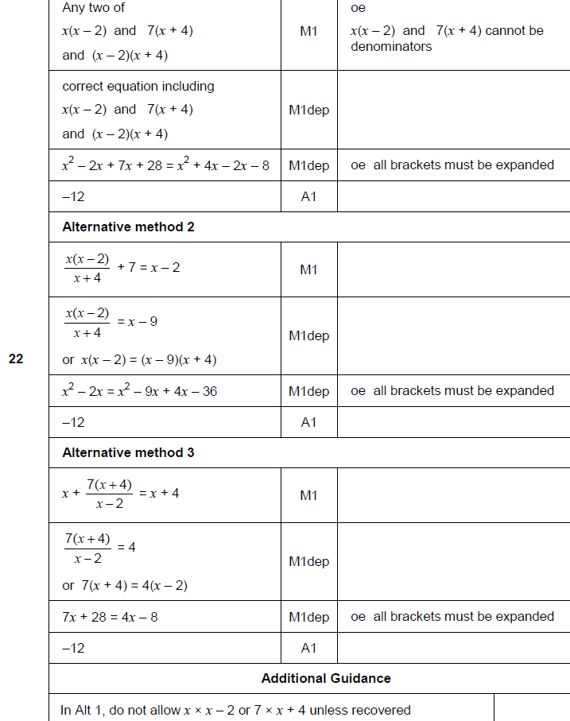
Algebraic Fractions
Nov 2018 1H Q22
A

Slide 21
Algebraic Fractions
Nov 2018 2H Q22

Slide 22
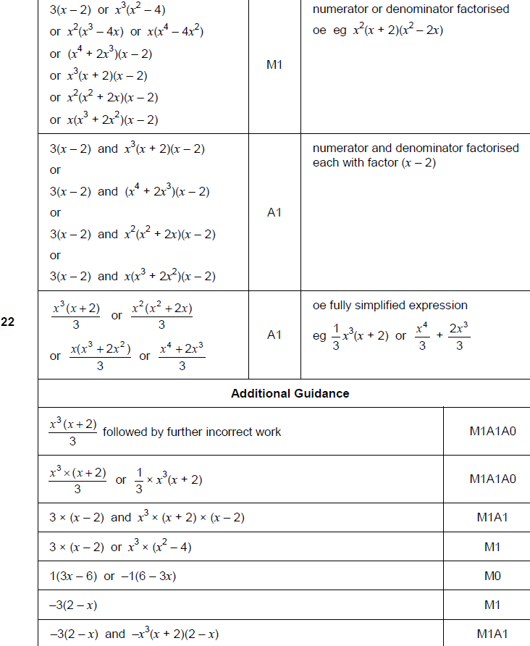
Algebraic Fractions
Nov 2018 2H Q22
A

