Slide 1
Algebraic Fractions
Algebraic Fractions
SAM
2H Q16
June 2017
2H Q11
Nov 2018
1H Q10
Edexcel
Spec 2
1H Q20
Spec 1
1H Q14
June 2017
2H Q19
Nov 2018
2H Q12
AQA
Spec 2
2H Q21
Spec 1
1H Q15
June 2017
3H Q14
May 2019
1H Q17
OCR
Spec 2
3H Q15
Spec 1
3H Q14
May 2018
1H Q17
June 2019
2H Q13

Slide 2
Algebraic Fractions
Algebraic Fractions
Nov 2017
2H Q11
Edexcel
June 2018
3H Q18
Nov 2017
2H Q27
AQA
SAM
2H Q16
Nov 2018
1H Q22
1 Marker
June 2018
2H Q13
OCR
Nov 2018
2H Q22
June 2018
2H Q25

Slide 3
Algebraic Fractions
Algebraic Fractions
June 2017
2H Q17
Edexcel
June 2017
3H Q16
SAM
1H Q20
AQA
May 2018
1H Q20
Practice
3H Q15
OCR
June 2018
3H Q19
Nov 2018
3H Q21

Slide 4
Algebraic Fractions
SAM 2H Q16

Slide 5
Algebraic Fractions
SAM 2H Q16
A

Slide 6
Algebraic Fractions
Specimen Set 1 1H Q14

Slide 7
Algebraic Fractions
Specimen Set 1 1H Q14
A

Slide 8
Algebraic Fractions
Specimen Set 1 1H Q15

Slide 9
Algebraic Fractions
Specimen Set 1 1H Q15
A

Slide 10
Algebraic Fractions
Specimen Set 1 3H Q14

Slide 11
Algebraic Fractions
Specimen Set 1 3H Q14
A

Slide 12
Algebraic Fractions
Specimen Set 2 1H Q20

Slide 13
Algebraic Fractions
Specimen Set 2 1H Q20
A

Slide 14
Algebraic Fractions
Specimen Set 2 2H Q21

Slide 15
Algebraic Fractions
Specimen Set 2 2H Q21
A

Slide 16
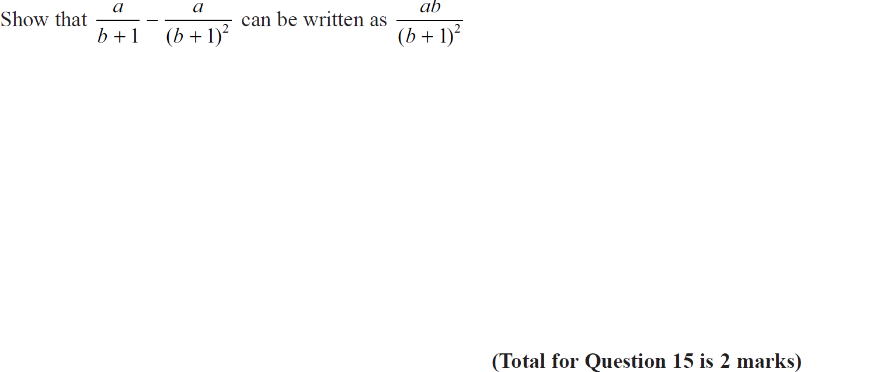
Algebraic Fractions
Specimen Set 2 3H Q15

Slide 17
Algebraic Fractions
Specimen Set 2 3H Q15
A

Slide 18
Algebraic Fractions
June 2017 2H Q11

Slide 19
Algebraic Fractions
June 2017 2H Q11
A

Slide 20
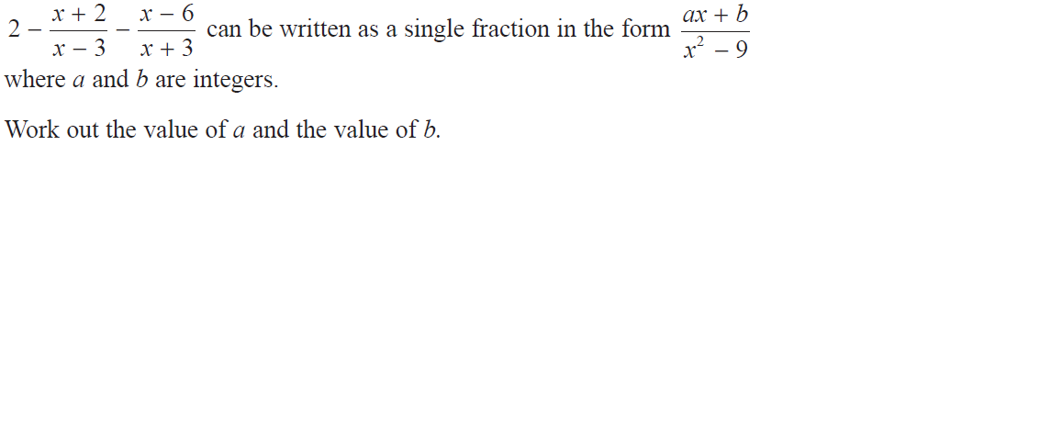
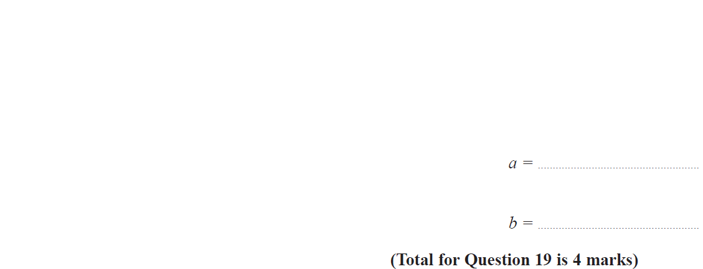
Algebraic Fractions
June 2017 2H Q19

Slide 21
Algebraic Fractions
June 2017 2H Q19
A

Slide 22
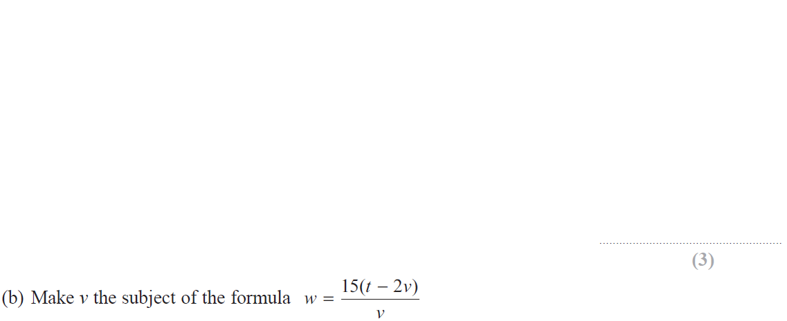
Algebraic Fractions
June 2017 3H Q14

Slide 23
Algebraic Fractions
June 2017 3H Q14
A
B

Slide 24
Algebraic Fractions
May 2018 1H Q17

Slide 25
Algebraic Fractions
May 2018 1H Q17
A

Slide 26
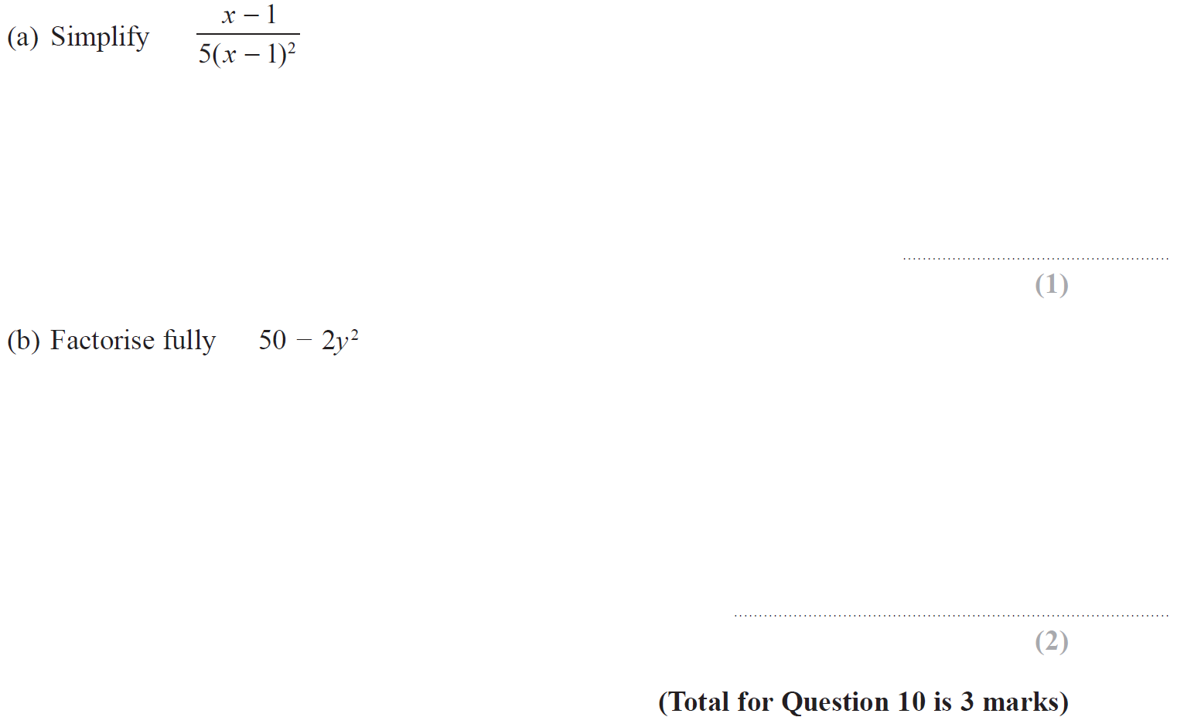
Algebraic Fractions
Nov 2018 1H Q10

Slide 27
Algebraic Fractions
Nov 2018 1H Q10
A
B

Slide 28
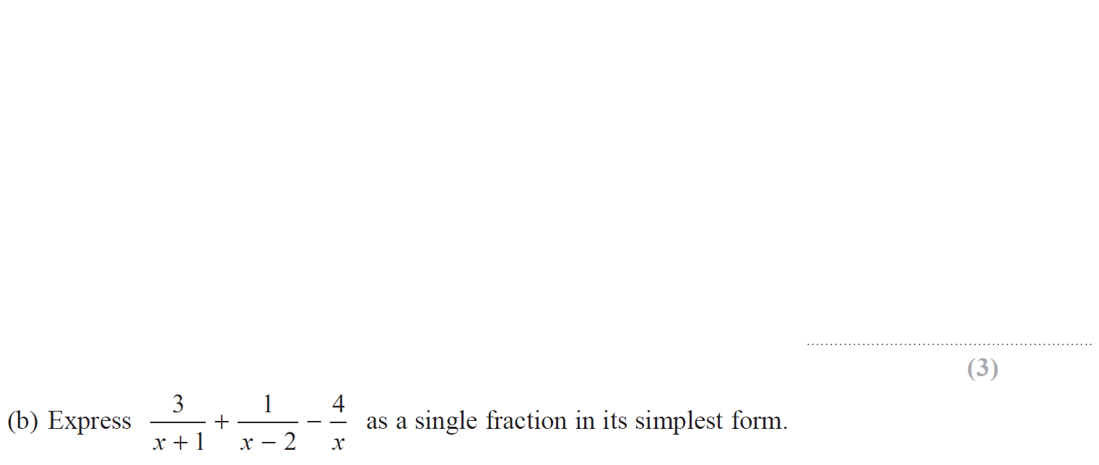
Algebraic Fractions
Nov 2018 2H Q12

Slide 29
Algebraic Fractions
Nov 2018 2H Q12
A
B

Slide 30
Algebraic Fractions
May 2019 1H Q17

Slide 31
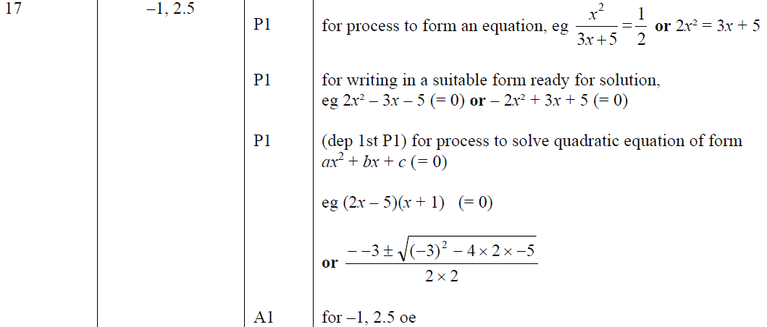
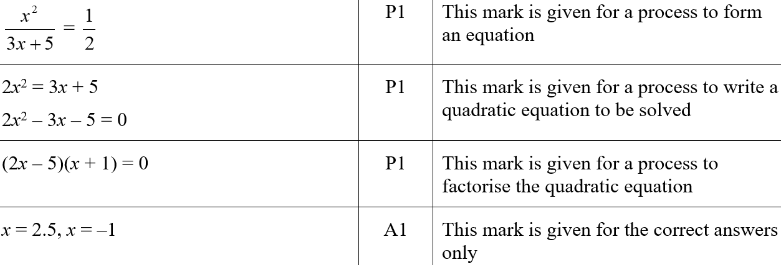
Algebraic Fractions
May 2019 1H Q17
A
A SF

Slide 32
Algebraic Fractions
June 2019 2H Q13

Slide 33
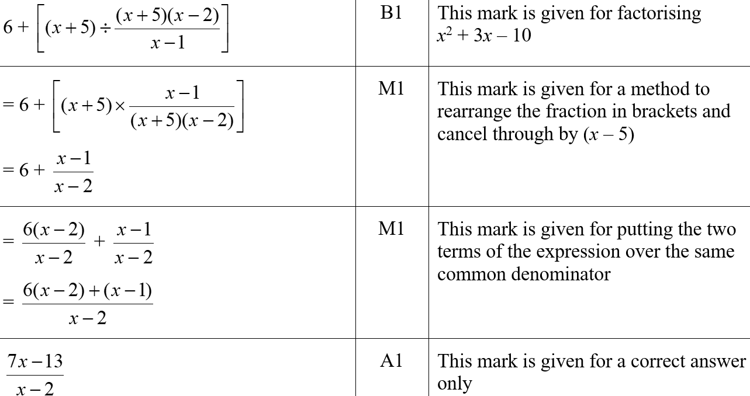
Algebraic Fractions
June 2019 2H Q13
A
A SF

Slide 34
Algebraic Fractions
SAM 2H Q16

Slide 35
Algebraic Fractions
SAM 2H Q16
A

Slide 36
Algebraic Fractions
Nov 2017 2H Q11

Slide 37
Algebraic Fractions
Nov 2017 2H Q11
A

Slide 38
Algebraic Fractions
Nov 2017 2H Q27

Slide 39
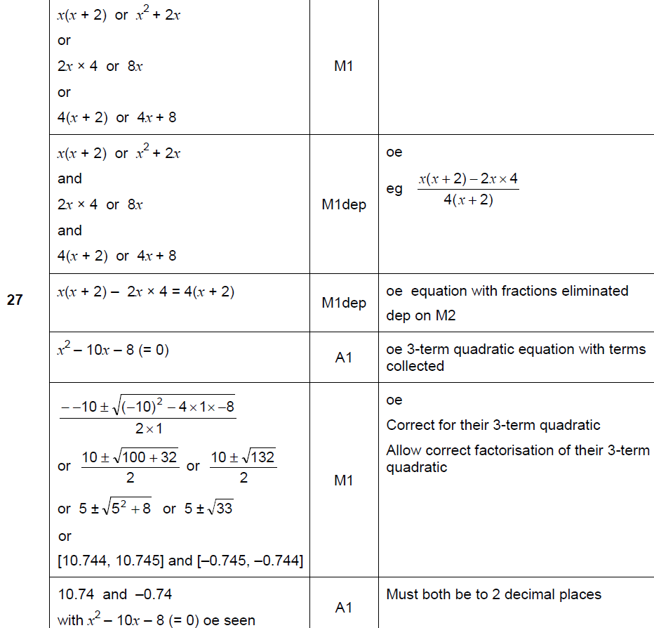
Algebraic Fractions
Nov 2017 2H Q27
A

Slide 40
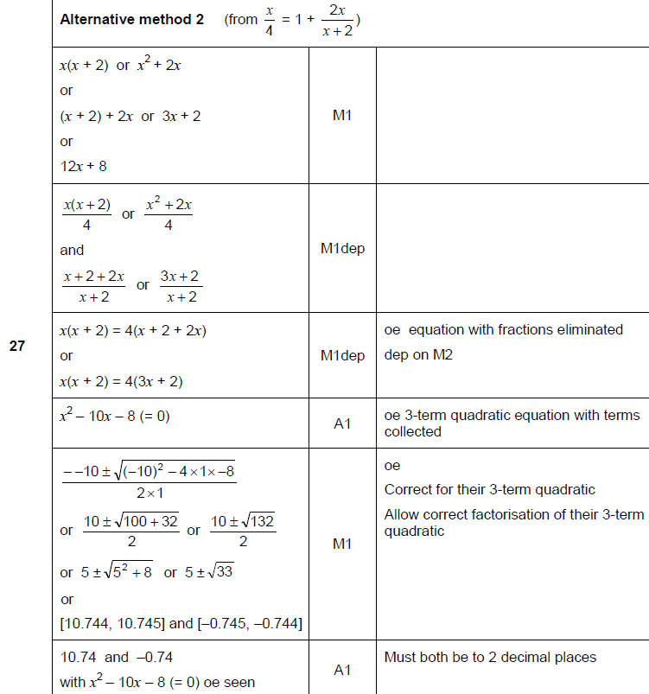
Algebraic Fractions
Nov 2017 2H Q27
A Alternative 1

Slide 41
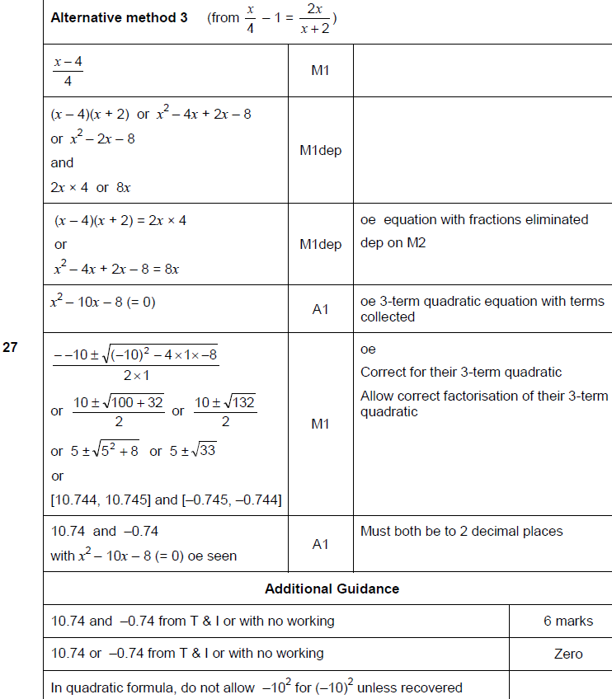
Algebraic Fractions
Nov 2017 2H Q27
A Alternative 2 & notes

Slide 42
Algebraic Fractions
June 2018 2H Q13

Slide 43
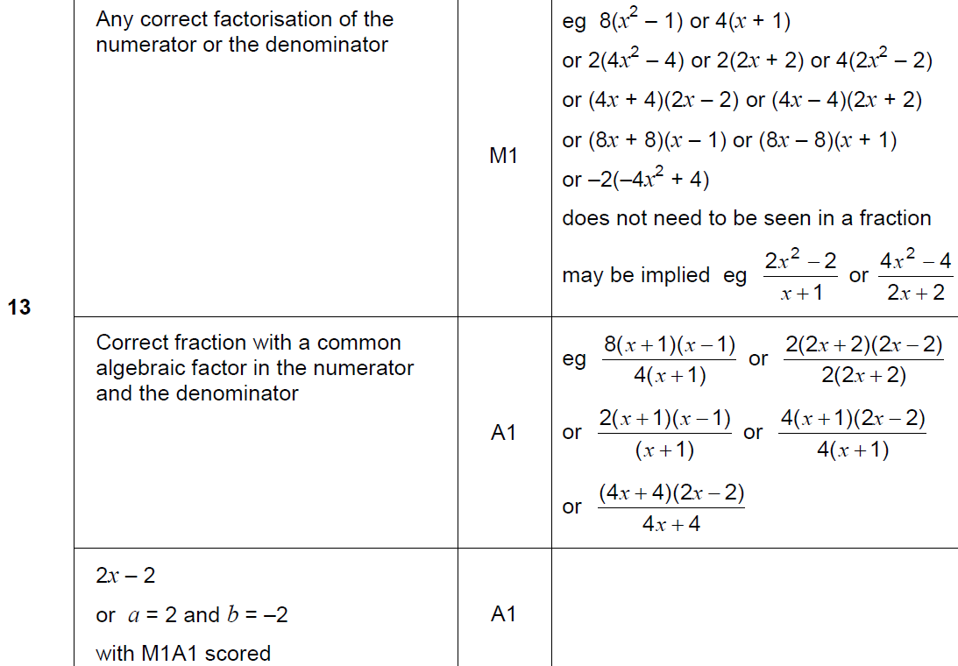
Algebraic Fractions
June 2018 2H Q13
A

Slide 44
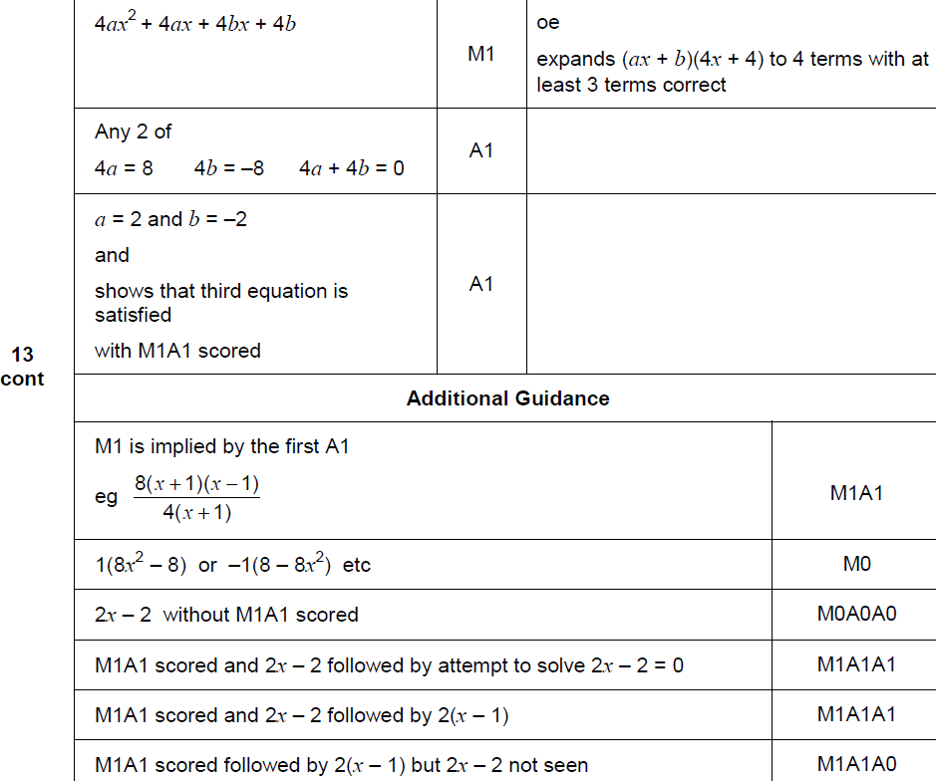
Algebraic Fractions
June 2018 2H Q13
A Alternative & notes

Slide 45
Algebraic Fractions
June 2018 2H Q25

Slide 46
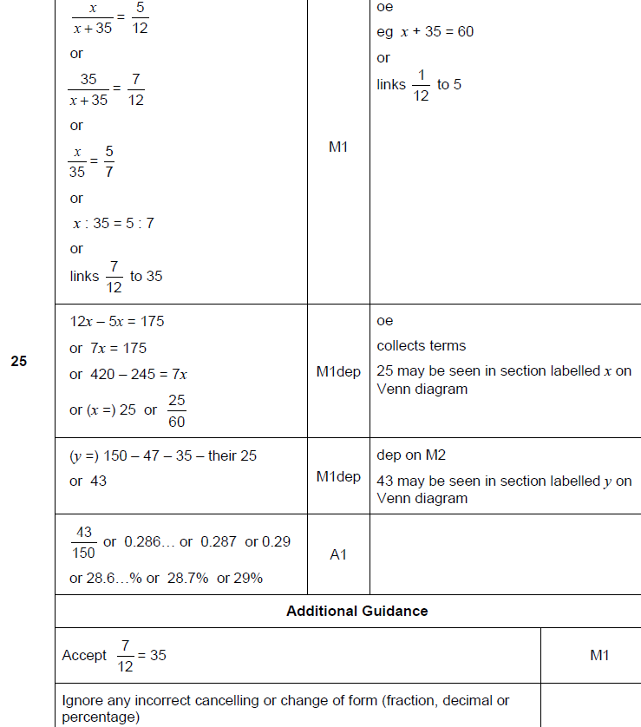
Algebraic Fractions
June 2018 2H Q25
A

Slide 47
Algebraic Fractions
June 2018 3H Q18

Slide 48
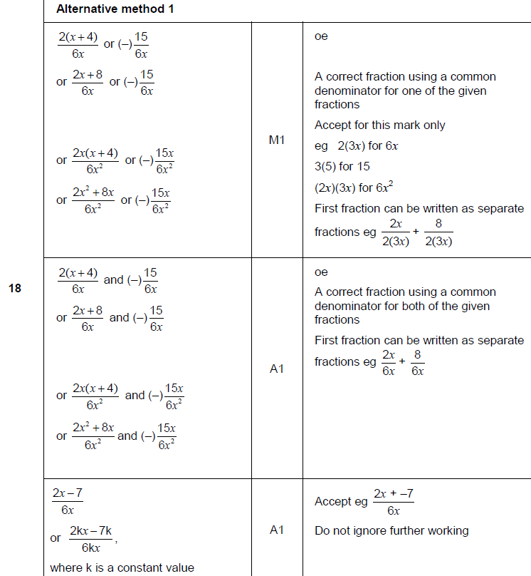
Algebraic Fractions
June 2018 3H Q18
A

Slide 49
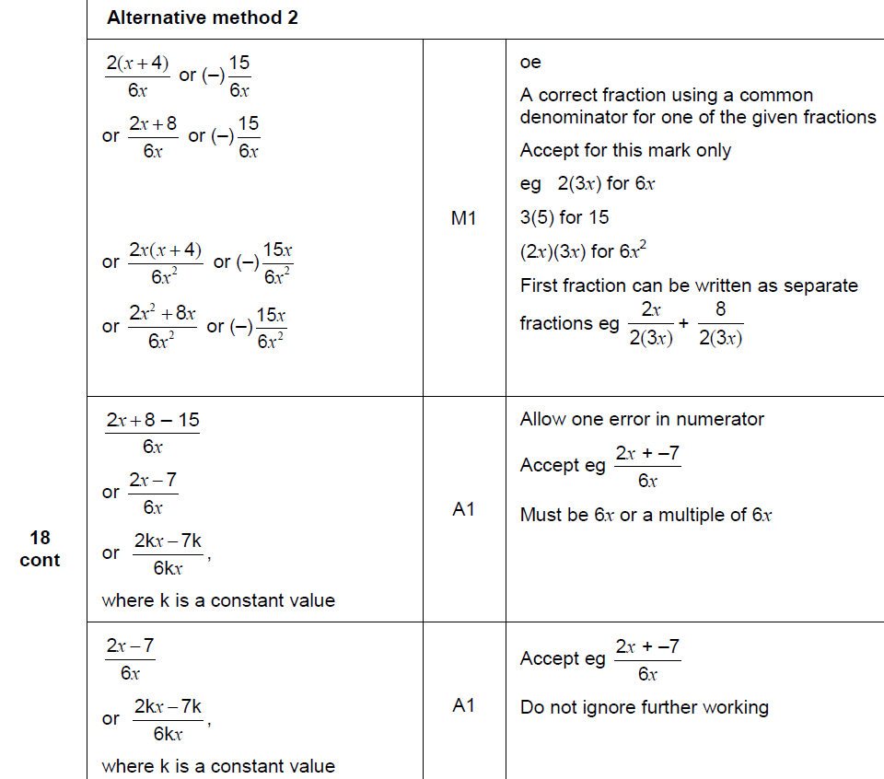
Algebraic Fractions
June 2018 3H Q18
A Alternative

Slide 50
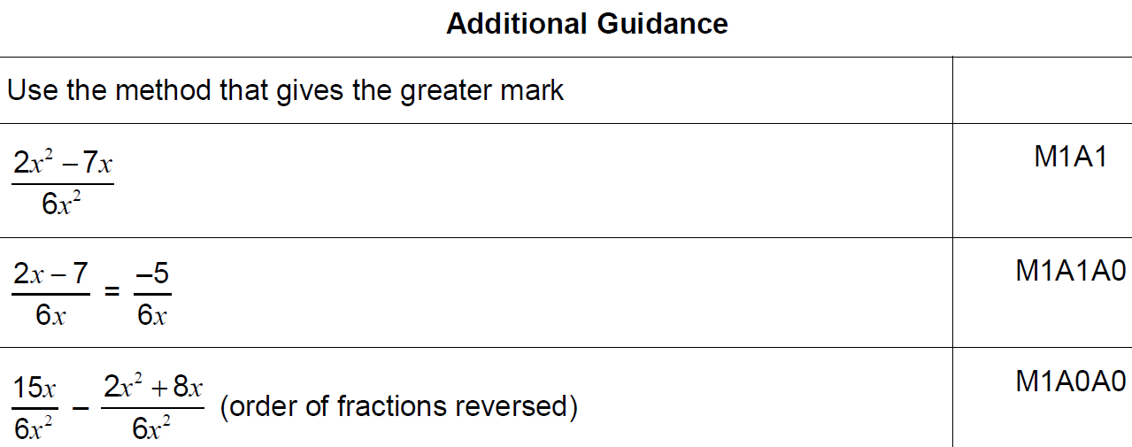
Algebraic Fractions
June 2018 3H Q18
A notes

Slide 51
Algebraic Fractions
Nov 2018 1H Q22

Slide 52
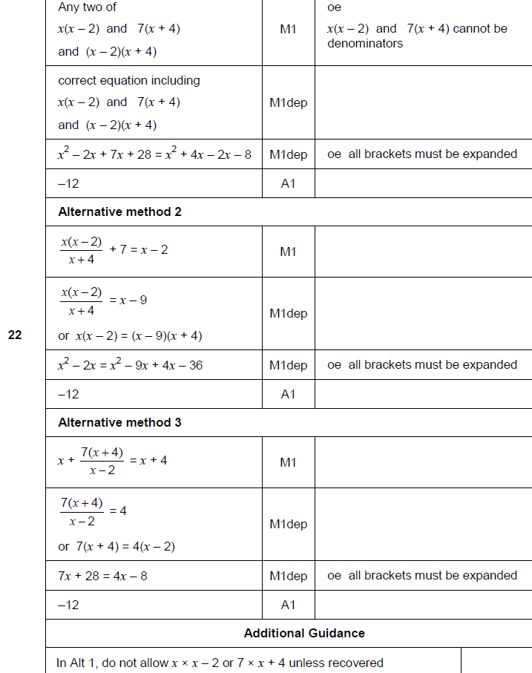
Algebraic Fractions
Nov 2018 1H Q22
A

Slide 53
Algebraic Fractions
Nov 2018 2H Q22

Slide 54
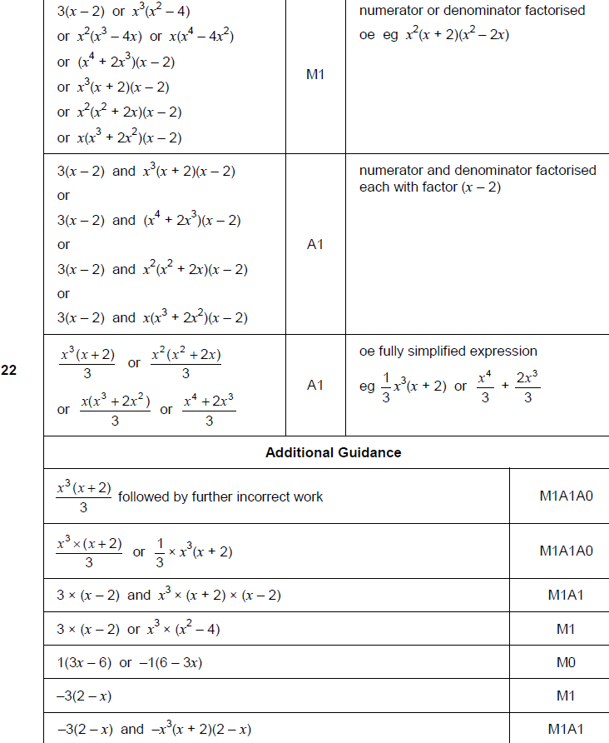
Algebraic Fractions
Nov 2018 2H Q22
A

Slide 55
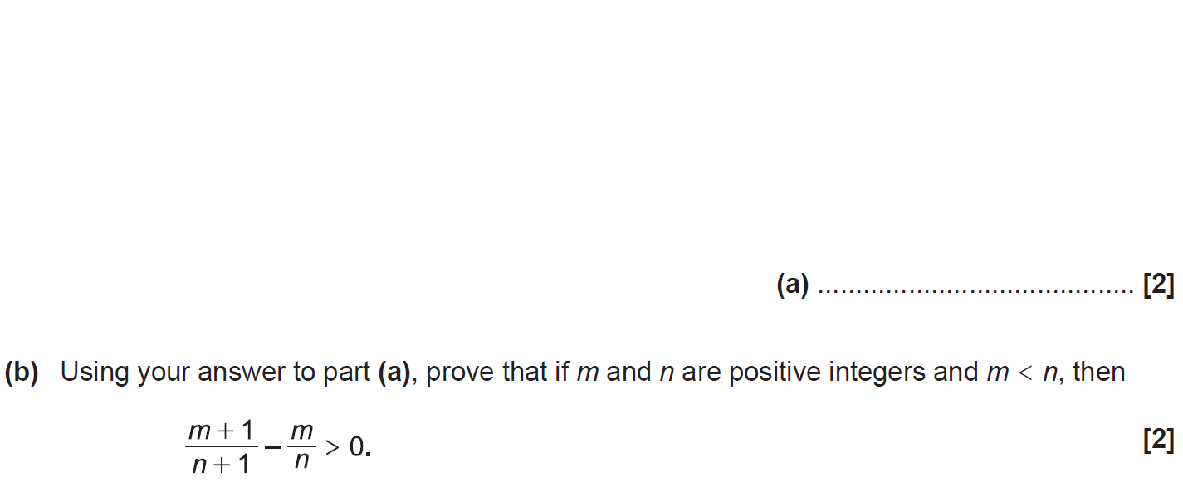
Algebraic Fractions
SAM 1H Q20

Slide 56
Algebraic Fractions
SAM 1H Q20
A
B

Slide 57
Algebraic Fractions
Practice 3H Q15

Slide 58
Algebraic Fractions
Practice 3H Q15
A

Slide 59
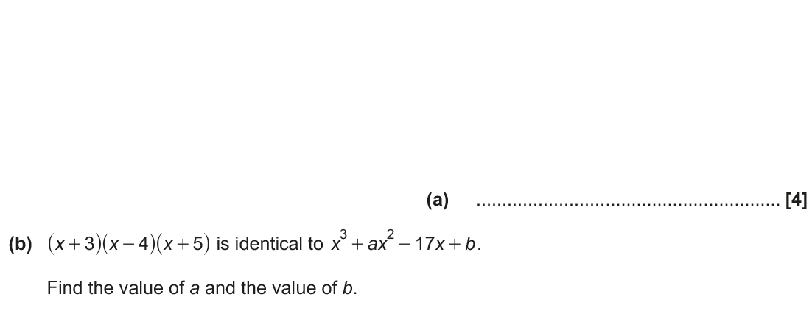
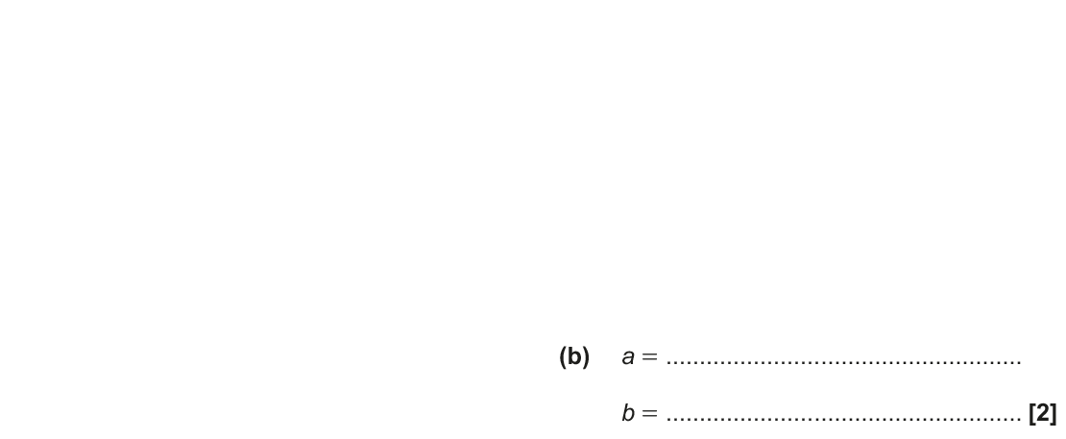
Algebraic Fractions
June 2017 2H Q17

Slide 60
Algebraic Fractions
June 2017 2H Q17
A
B

Slide 61
Algebraic Fractions
June 2017 3H Q16

Slide 62
Algebraic Fractions
June 2017 3H Q16
A
B

Slide 63
Algebraic Fractions
May 2018 1H Q20

Slide 64
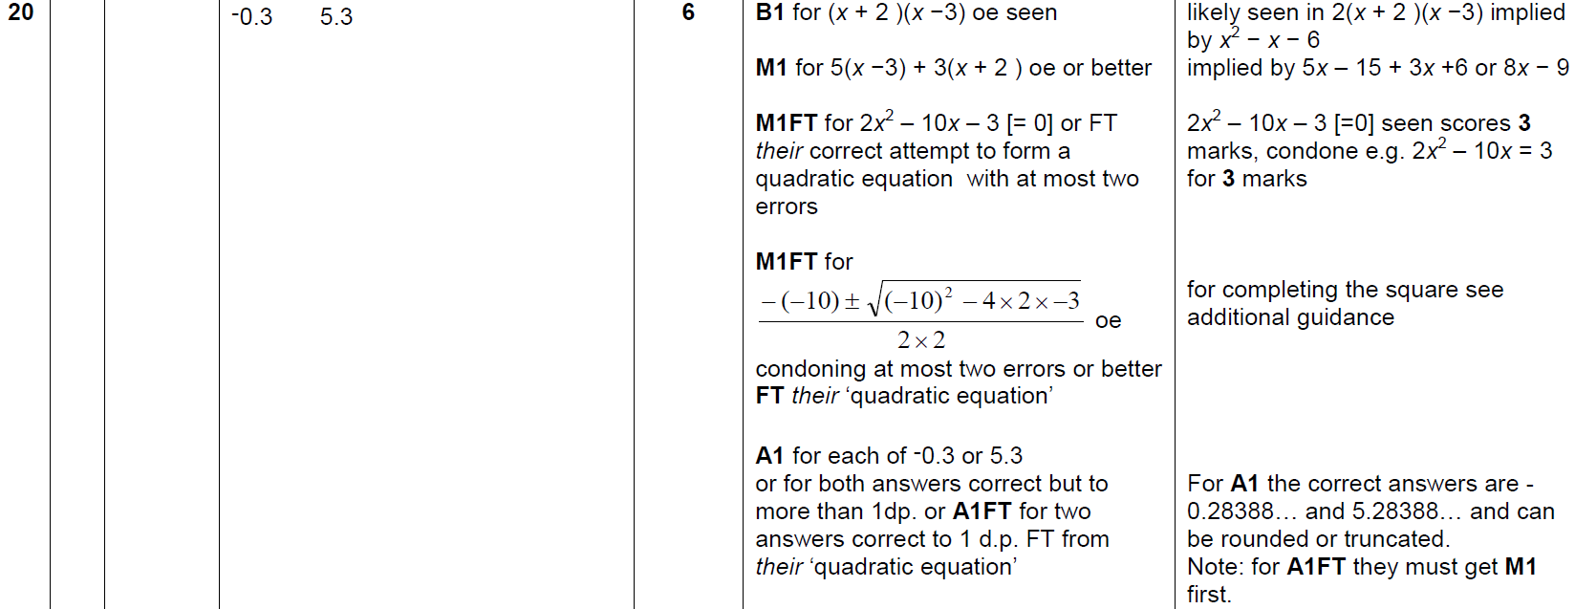
Algebraic Fractions
May 2018 1H Q20
A

Slide 65
Algebraic Fractions
June 2018 3H Q19

Slide 66
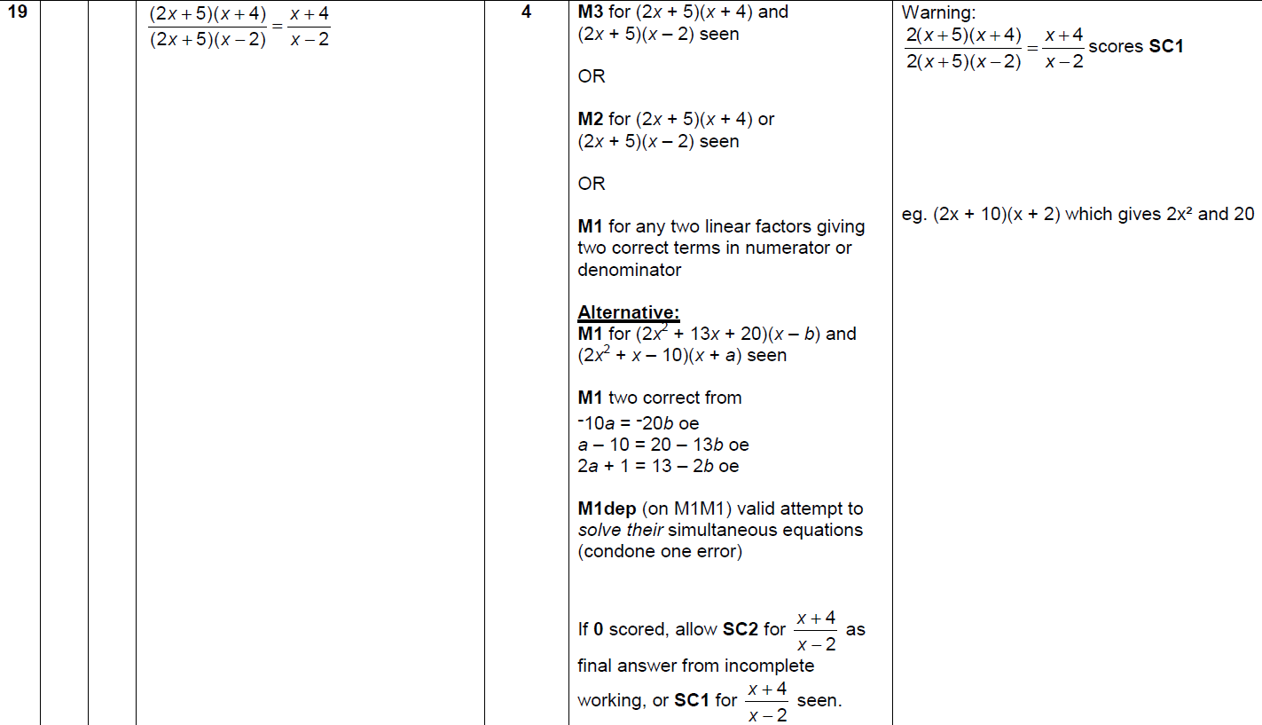
Algebraic Fractions
June 2018 3H Q19
A

Slide 67
Algebraic Fractions
Nov 2018 3H Q21

Slide 68
Algebraic Fractions
Nov 2018 3H Q21
A

