Slide 1
Algebraic Fractions
Algebraic Fractions
Old Spec Q’s
SAM
1H Q18
Jan 2019
1HR Q15
May 2018
1H Q15
Jan 2019
2HR Q8
May 2018
1HR Q14
Jan 2019
2HR Q10
May 2018
1HR Q20
June 2019
2H Q22
June 2018
2HR Q7
June 2018
2HR Q22
Jan 2019
1H Q11

Slide 2
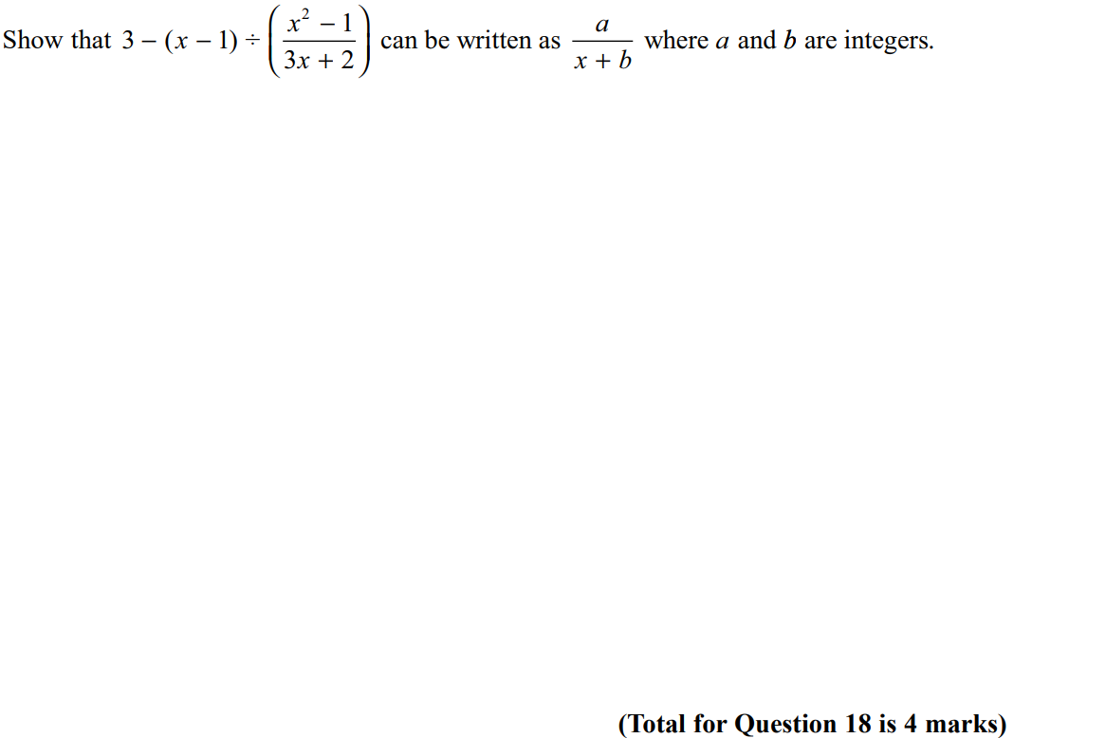
Algebraic Fractions
SAM 1H Q18

Slide 3
Algebraic Fractions
SAM 1H Q18
A

Slide 4
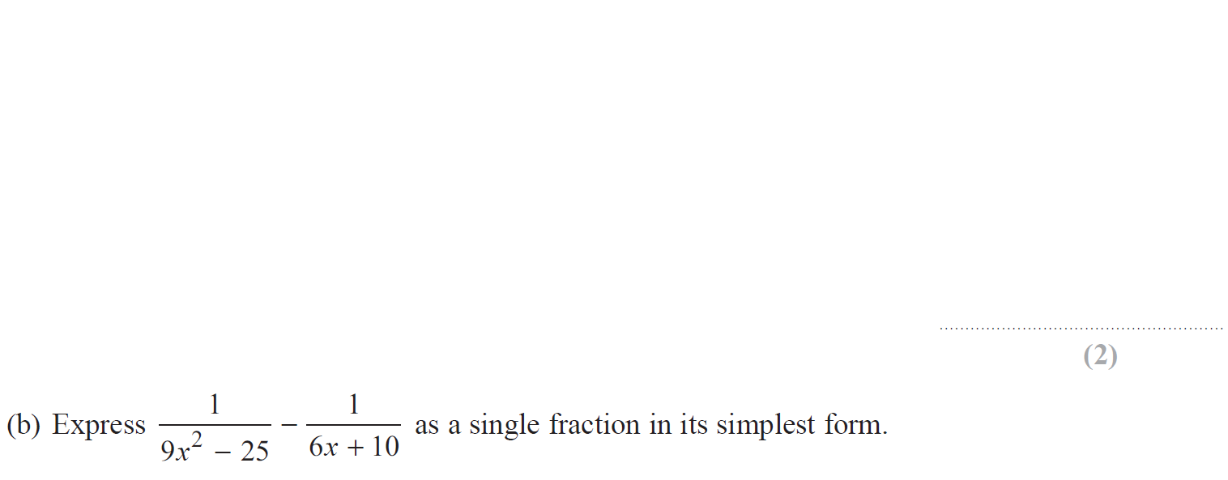
Algebraic Fractions
May 2018 1H Q15

Slide 5
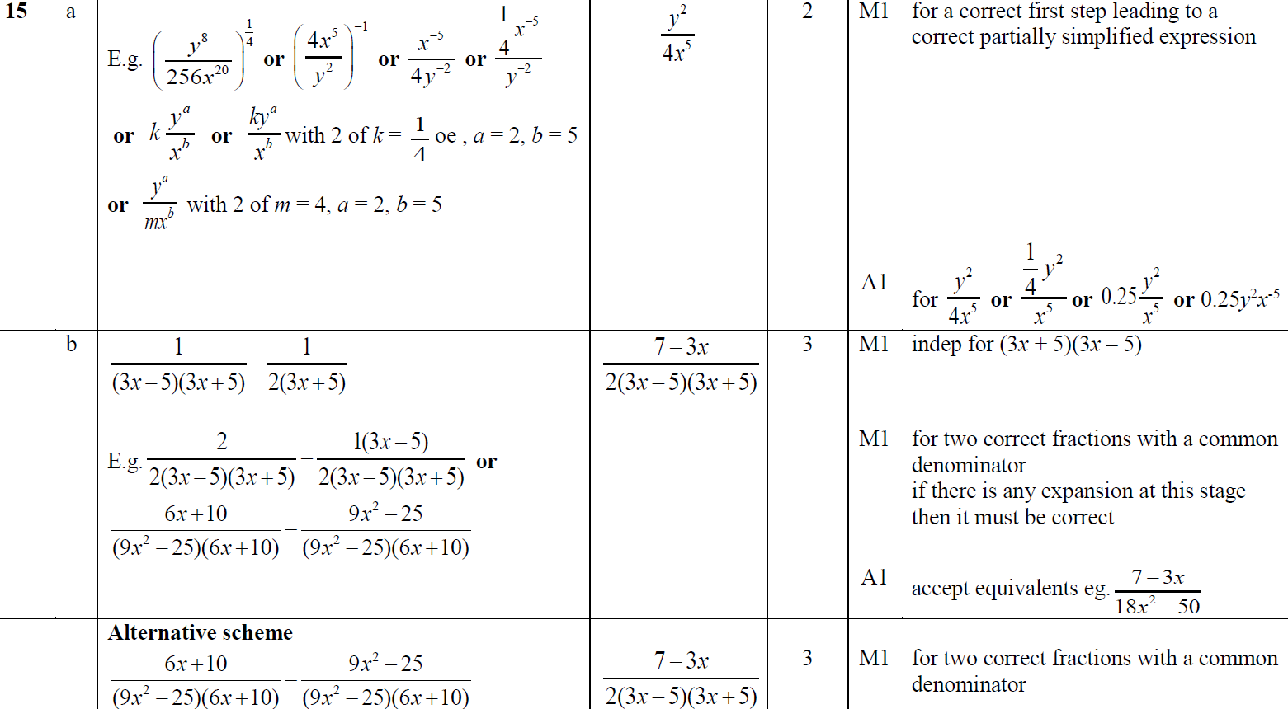
Algebraic Fractions
May 2018 1H Q15
A
B

Slide 6
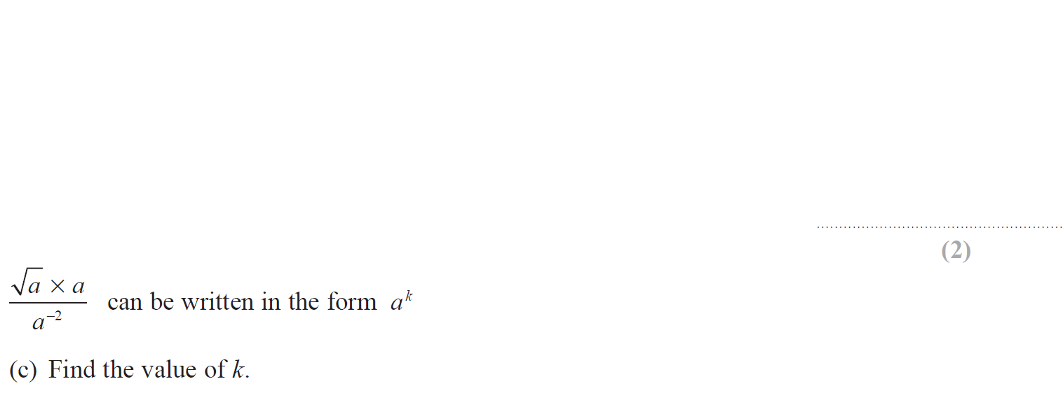
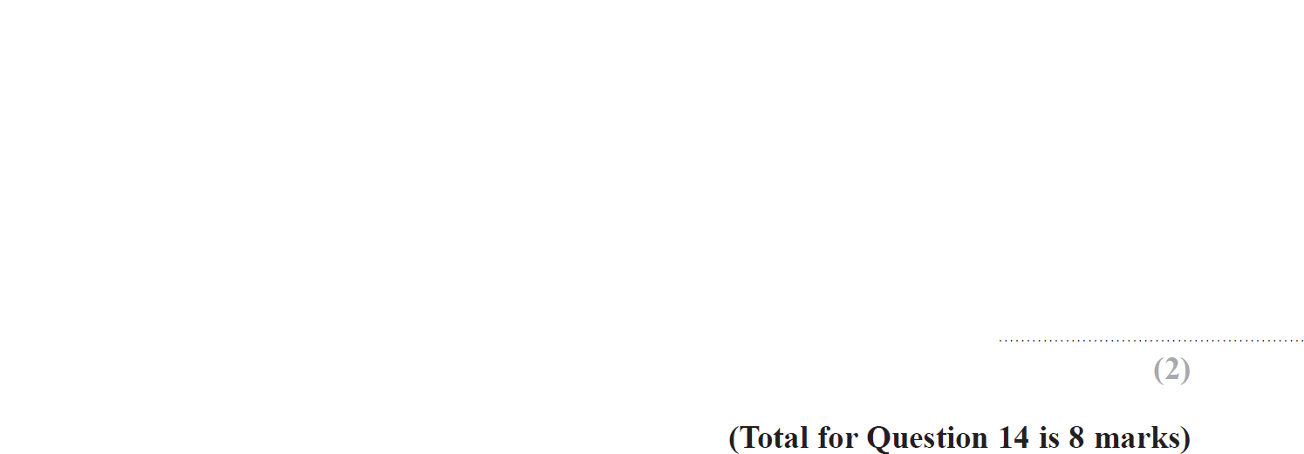
Algebraic Fractions
May 2018 1HR Q14

Slide 7
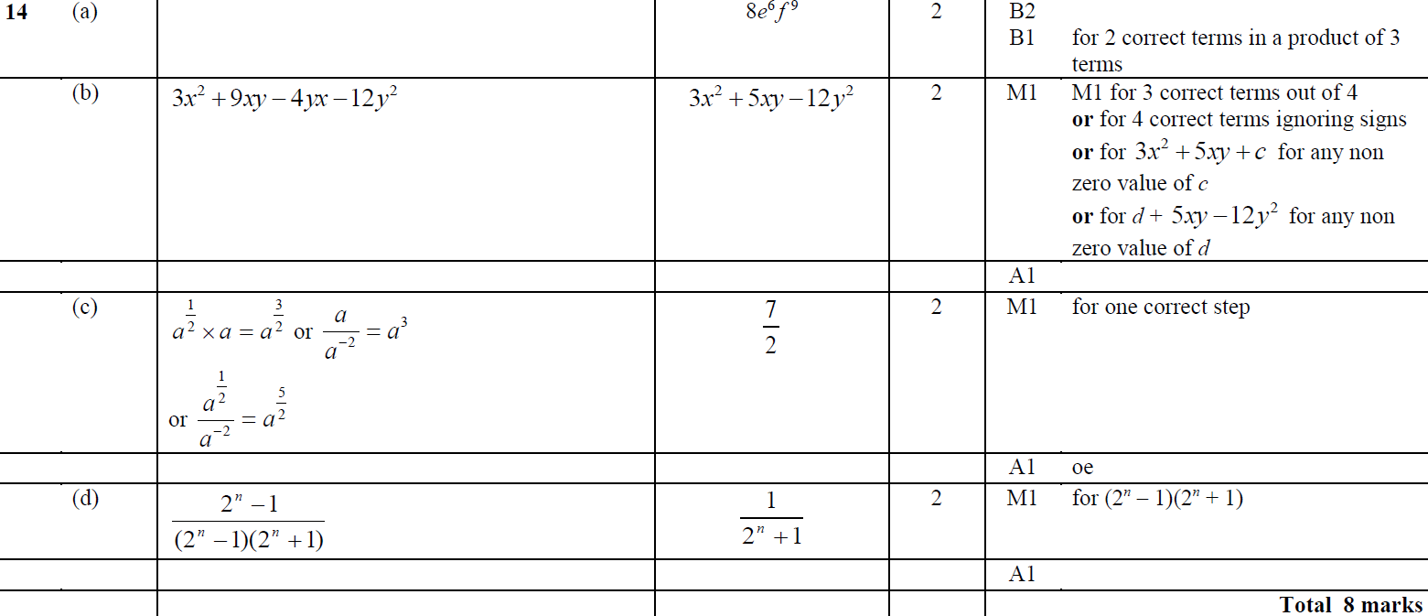
Algebraic Fractions
May 2018 1HR Q14
A
B
C
D

Slide 8
Algebraic Fractions
May 2018 1HR Q20

Slide 9
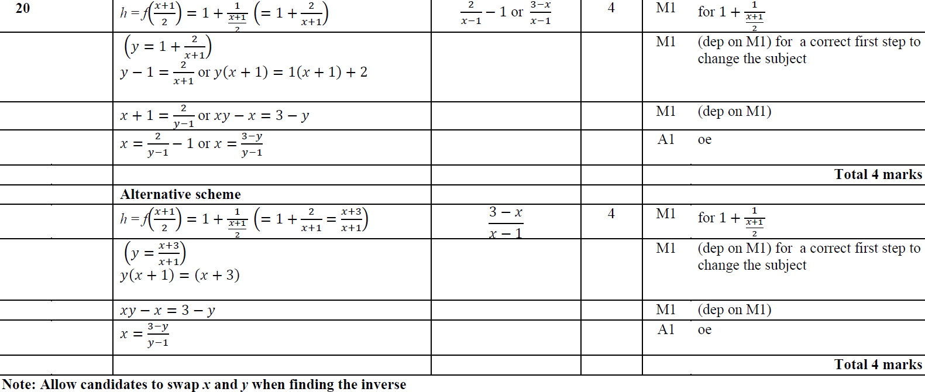
Algebraic Fractions
May 2018 1HR Q20
A

Slide 10
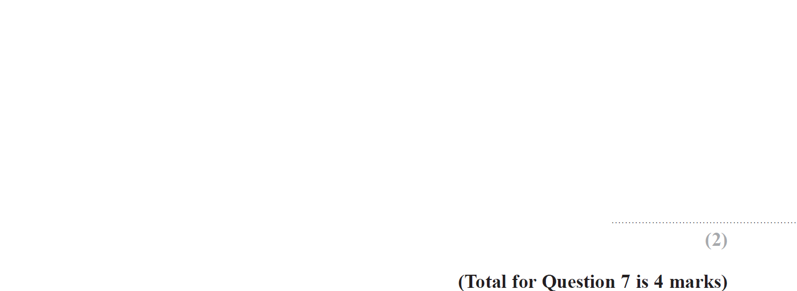
Algebraic Fractions
June 2018 2HR Q7

Slide 11
Algebraic Fractions
June 2018 2HR Q7
A
B

Slide 12
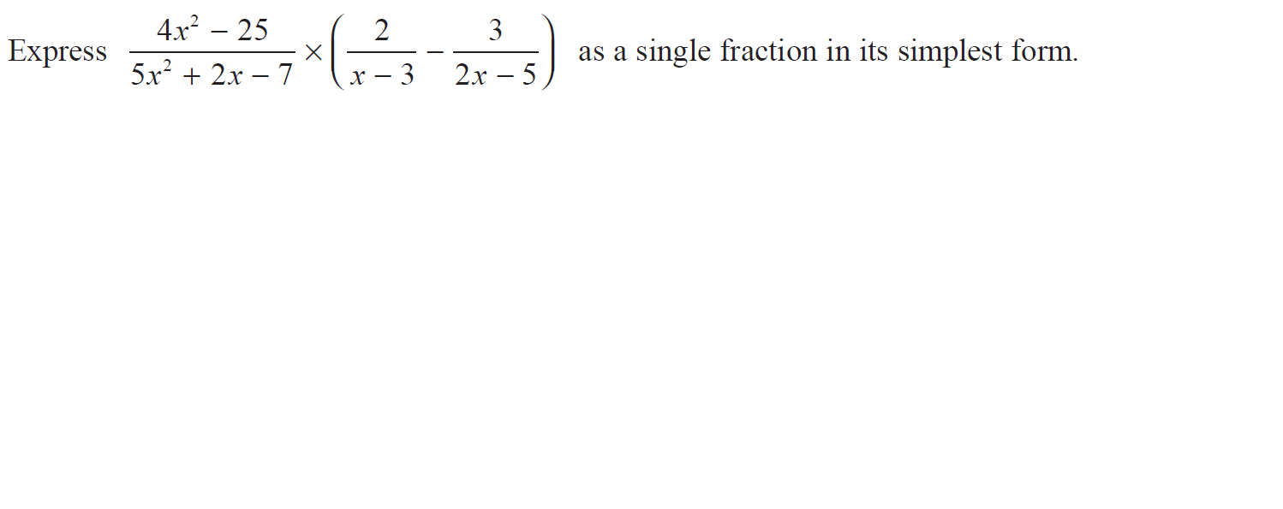
Algebraic Fractions
June 2018 2HR Q22

Slide 13
Algebraic Fractions
June 2018 2HR Q22
A

Slide 14
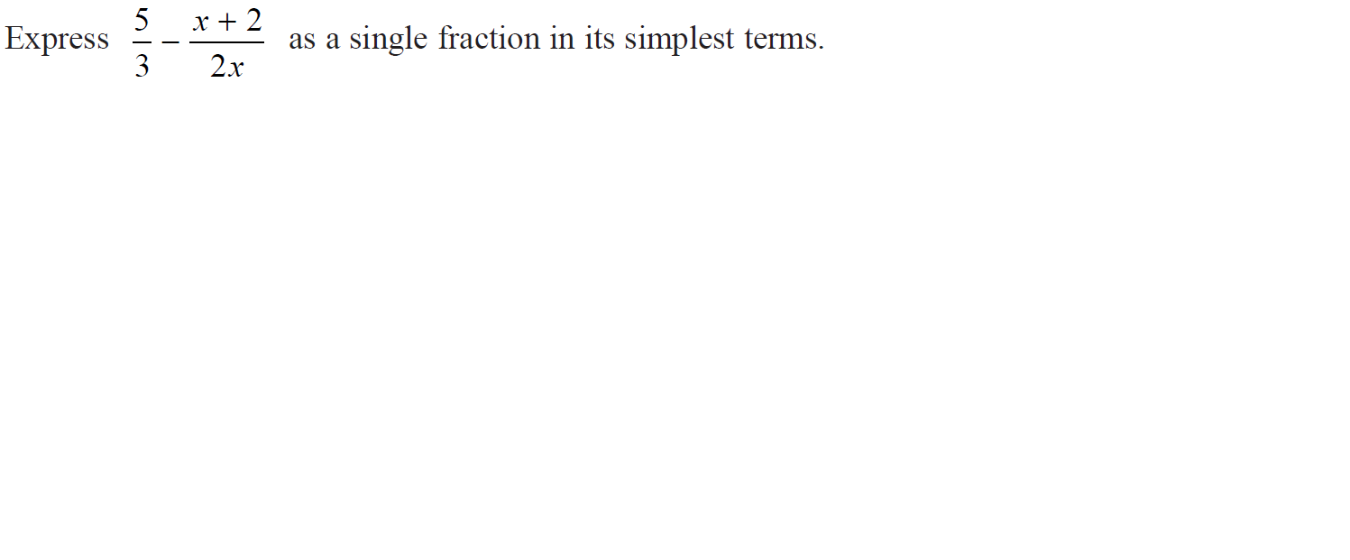
Algebraic Fractions
Jan 2019 1H Q11

Slide 15
Algebraic Fractions
Jan 2019 1H Q11
A

Slide 16
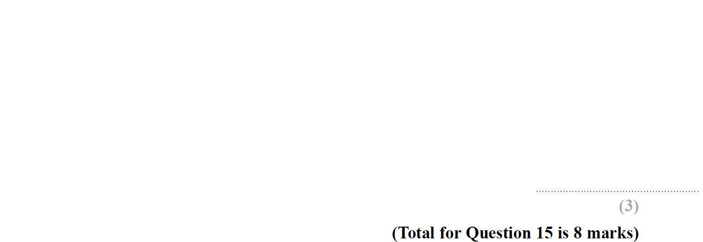
Algebraic Fractions
Jan 2019 1HR Q15

Slide 17
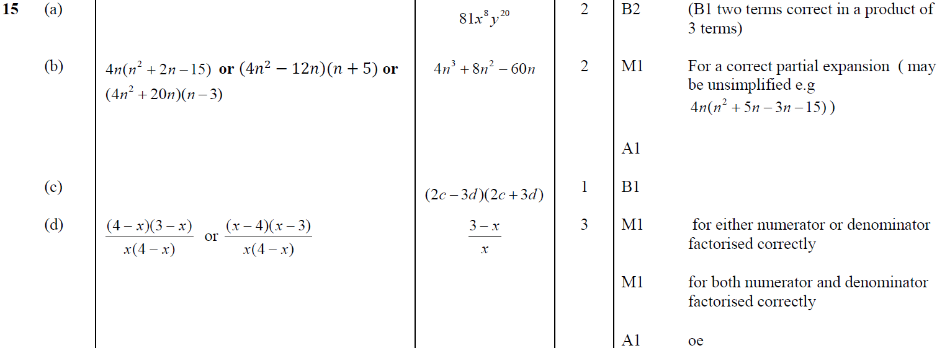
Algebraic Fractions
Jan 2019 1HR Q15
A
B
C
D

Slide 18
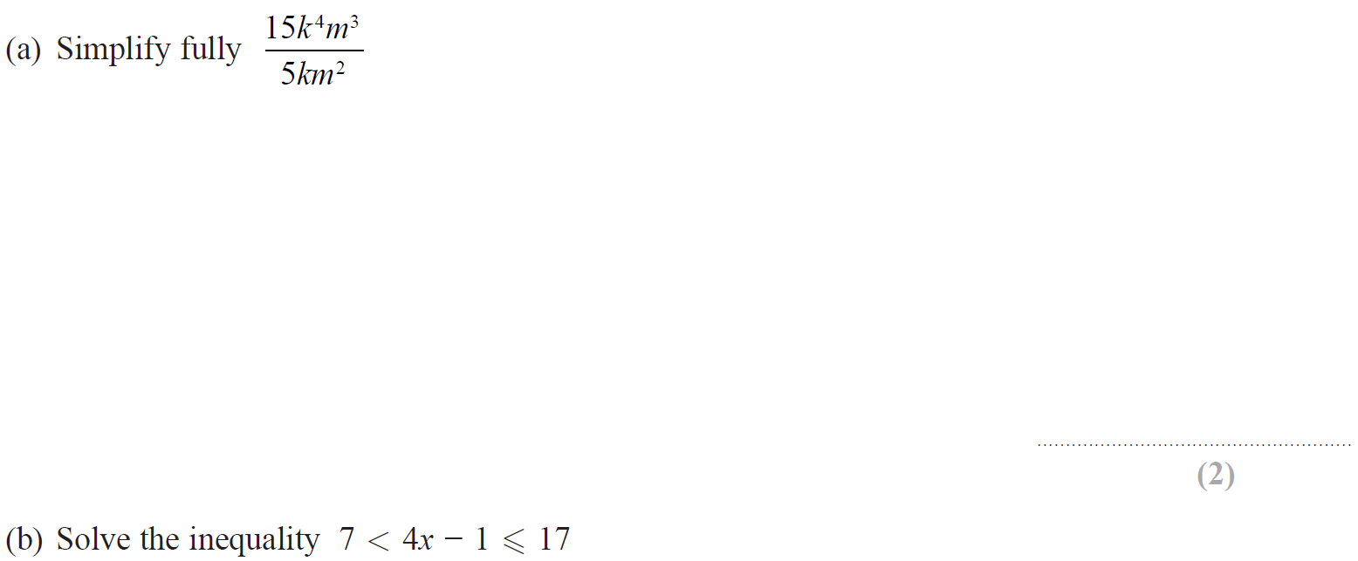
Algebraic Fractions
Jan 2019 2HR Q8

Slide 19
Algebraic Fractions
Jan 2019 2HR Q8
A
B

Slide 20
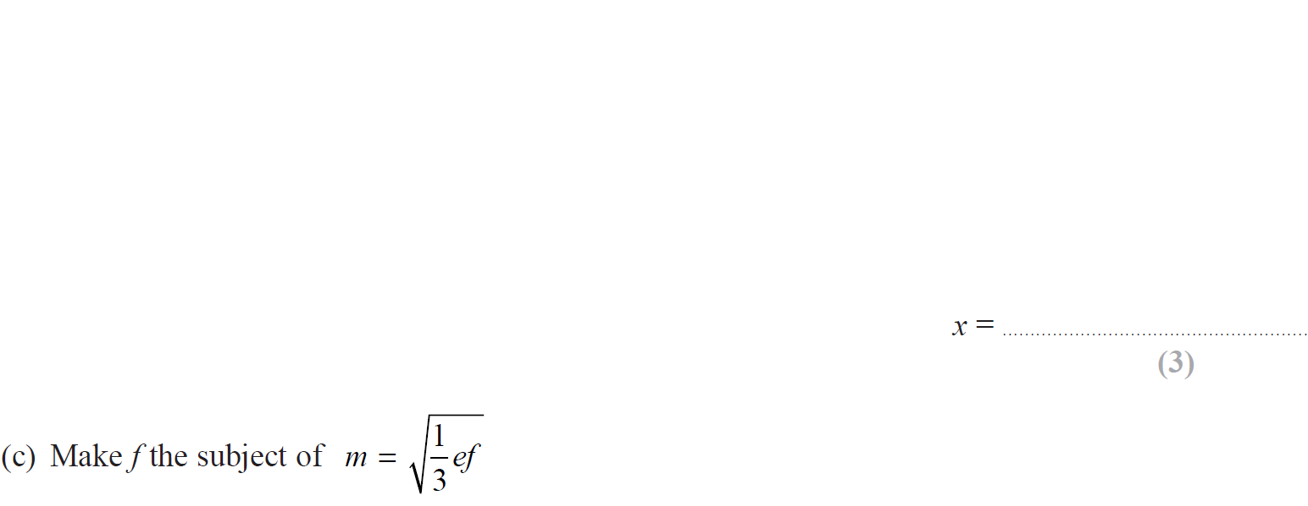
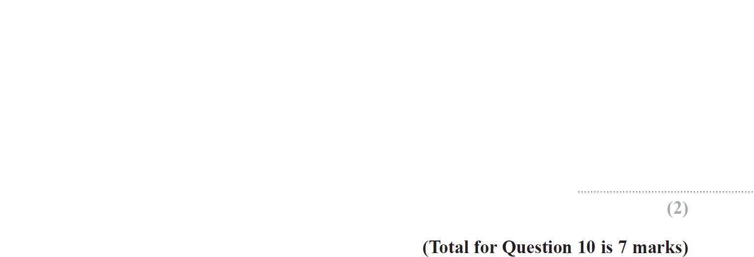
Algebraic Fractions
Jan 2019 2HR Q10

Slide 21
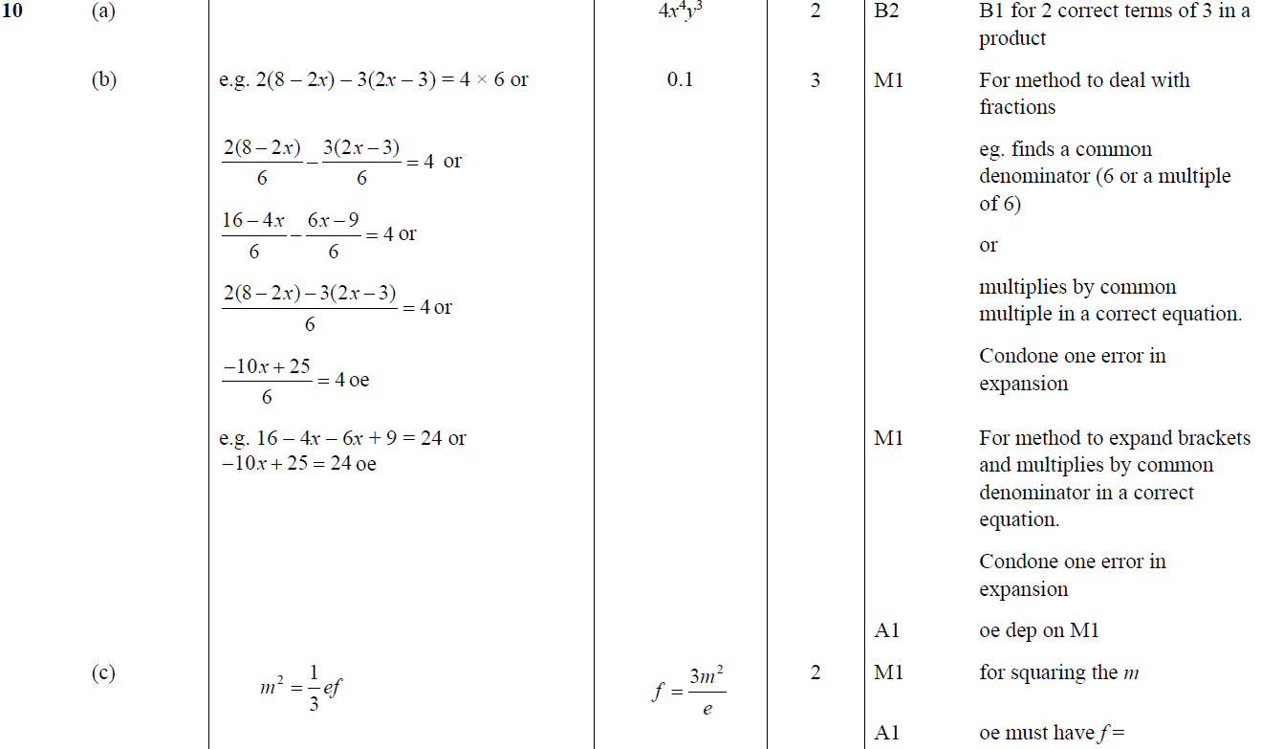
Algebraic Fractions
Jan 2019 2HR Q10
A
B
C

Slide 22
Algebraic Fractions
June 2019 2H Q22

Slide 23
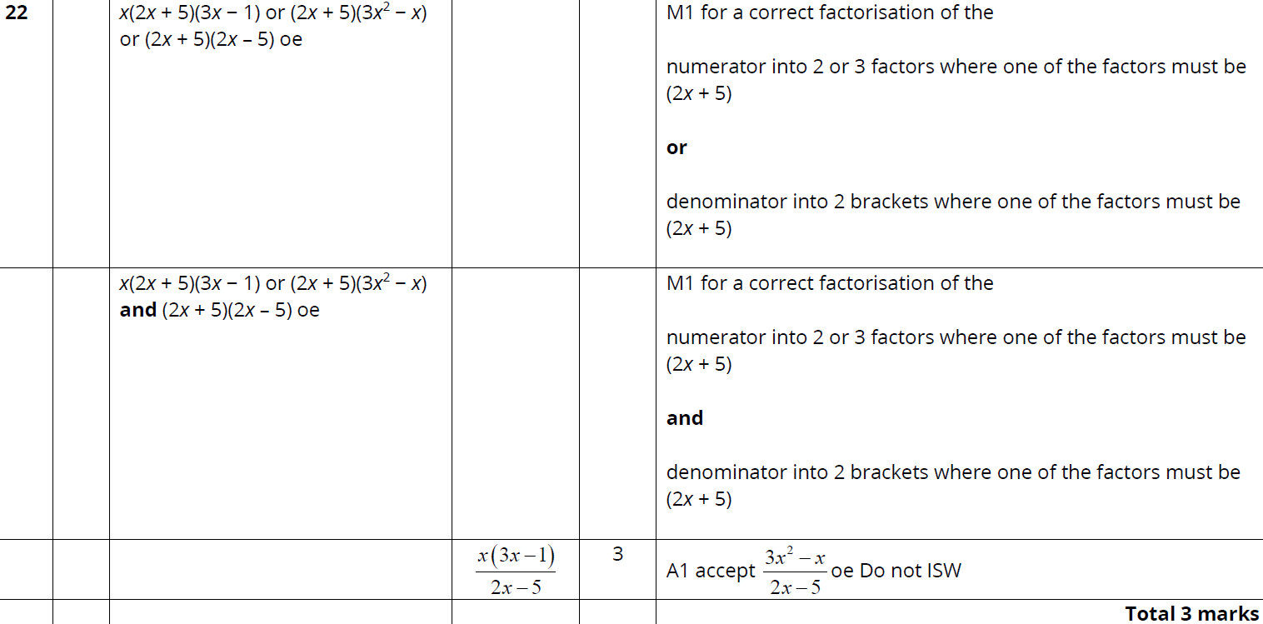
Algebraic Fractions
June 2019 2H Q22
A

Slide 24
Algebraic Fractions
Algebraic Fractions
New Spec Q’s
May 2004
3H Q16
Nov 2008
3H Q18
June 2011 4H Q15
Jan 2014 3H Q11
May 2015 3H Q9
June 2016 4HR Q2
Jan 2018 3HR Q17
Nov 2004
3H Q16
Nov 2008
4H Q13
Jan 2012 3H Q20
Jan 2014 3HR Q20
May 2015 3H Q17
June 2016 4HR Q14
Jan 2018 4HR Q11
May 2005
3H Q14
May 2009
3H Q18
May 2012 3H Q9
Jan 2014 4HR Q20
May 2015 3HR Q22
Jan 2017 3HR Q16
May 2018 3H Q15
May 2005
3H Q22
June 2009
4H Q15
May 2012 4H Q21
May 2014 3H Q23
Jan 2016 4H Q17
Jan 2017 3HR Q19
June 2018 4H Q12
Nov 2006
4H Q23
June 2009
4H Q21
Jan 2013 3H Q17
May 2014 4H Q25
Jan 2016 4H Q22
Jan 2017 4HR Q15
May 2018 3HR Q22
May 2007
4H Q12
Nov 2009
3H Q19
Jan 2013 4H Q14
May 2014 4HR Q17
Jan 2016 4HR Q20
May 2017 3H Q19
June 2018 4HR Q12
May 2007
4H Q14
June 2010
3H Q18
Jan 2013 4H Q15
Jan 2015 4H Q12
May 2016 3H Q7
May 2017 3H Q22
June 2018 4HR Q21
Nov 2007
3H Q16
June 2010
4H Q11
May 2013 3H Q22
Jan 2015 4H Q23
June 2016 4H Q14
June 2017 4H Q10
May 2008
4H Q23
Nov 2010
4H Q22
May 2013 4H Q23
Jan 2015 4HR Q11
June 2016 4H Q15
June 2017 4HR Q14
Nov 2008
3H Q17*
June 2011 3H Q13
May 2013 4HR Q23
Jan 2015 4HR Q20
May 2016 3HR Q20
Jan 2018 3H Q12

Slide 25
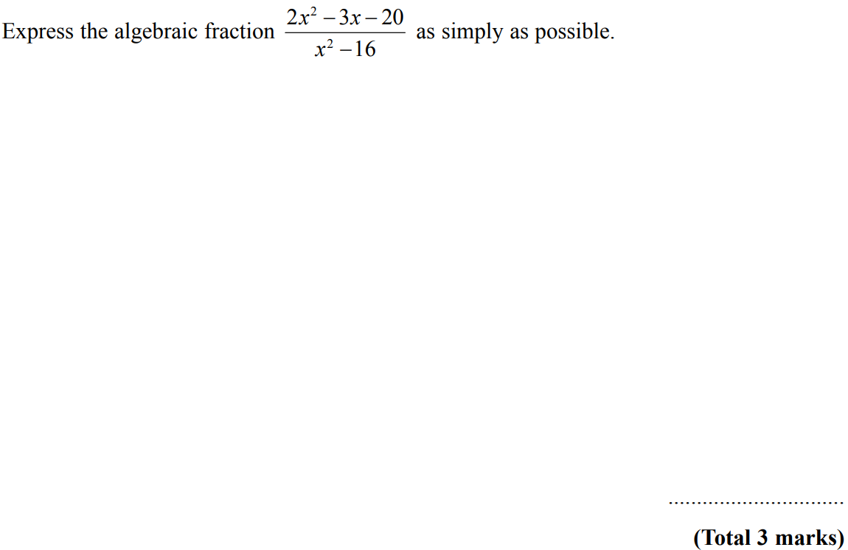
Algebraic Fractions
May 2004 3H Q16

Slide 26
Algebraic Fractions
May 2004 3H Q16
A

Slide 27
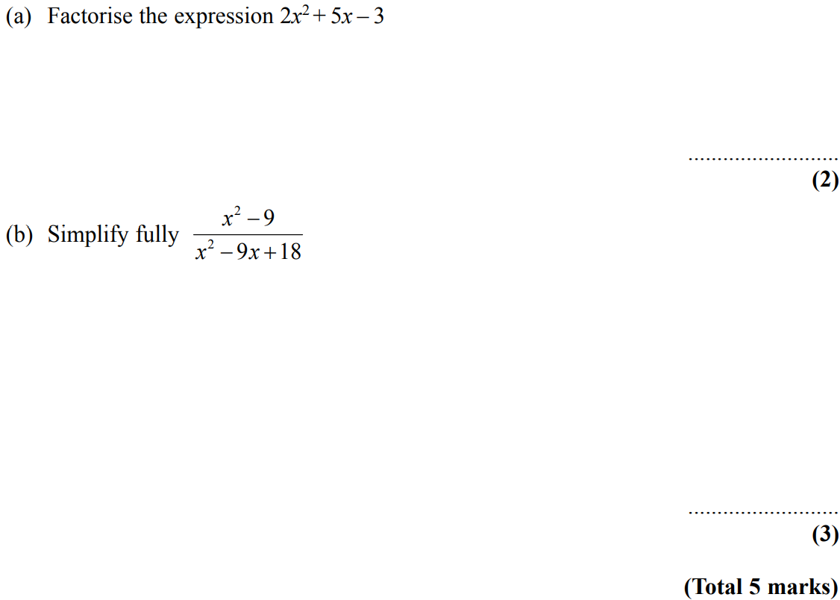
Algebraic Fractions
Nov 2004 3H Q16

Slide 28
Algebraic Fractions
Nov 2004 3H Q16
A
B

Slide 29
Algebraic Fractions
May 2005 3H Q14

Slide 30
Algebraic Fractions
May 2005 3H Q14
A

Slide 31
Algebraic Fractions
May 2005 3H Q22

Slide 32
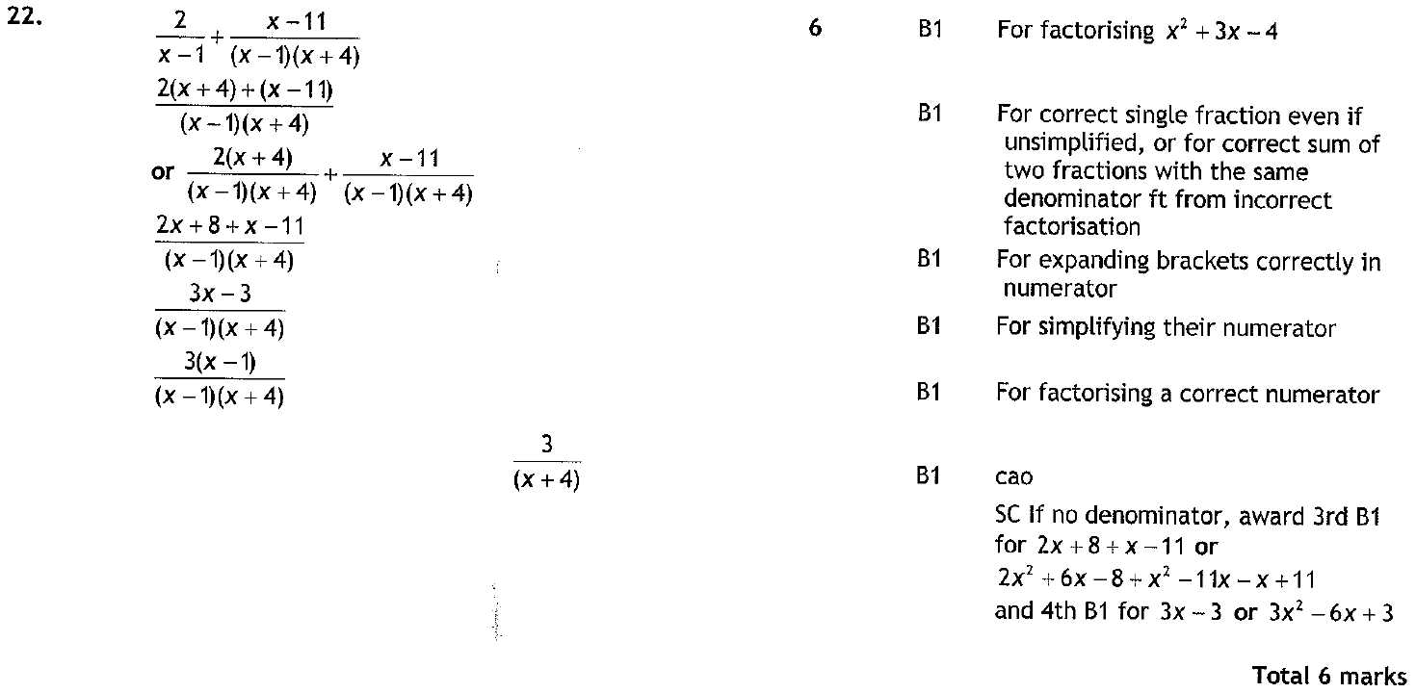
Algebraic Fractions
May 2005 3H Q22
A

Slide 33
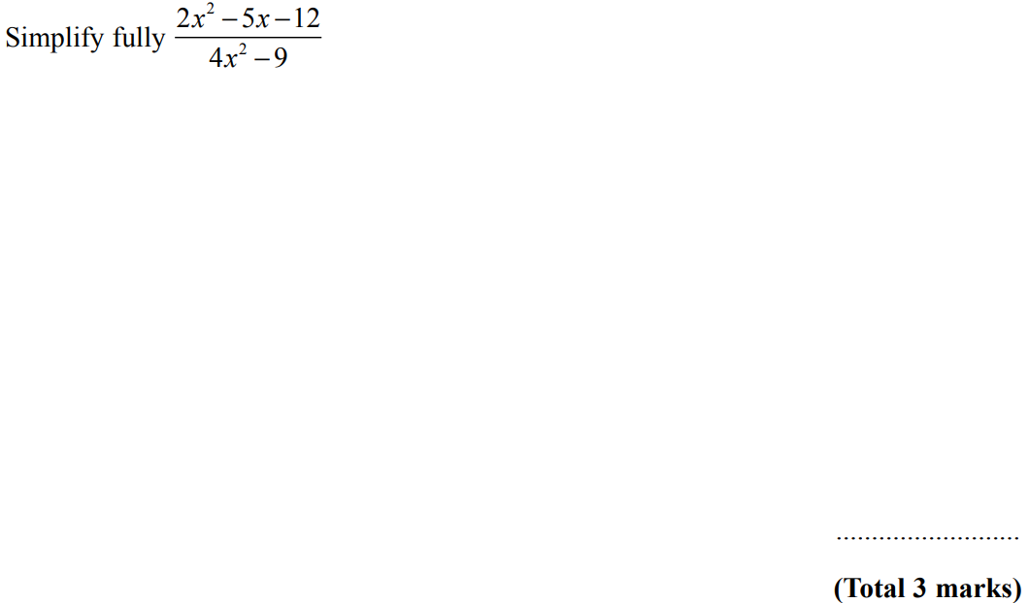
Algebraic Fractions
Nov 2006 4H Q23

Slide 34
Algebraic Fractions
Nov 2006 4H Q23
A

Slide 35
Algebraic Fractions
May 2007 4H Q12

Slide 36
Algebraic Fractions
May 2007 4H Q12
A
B
C

Slide 37
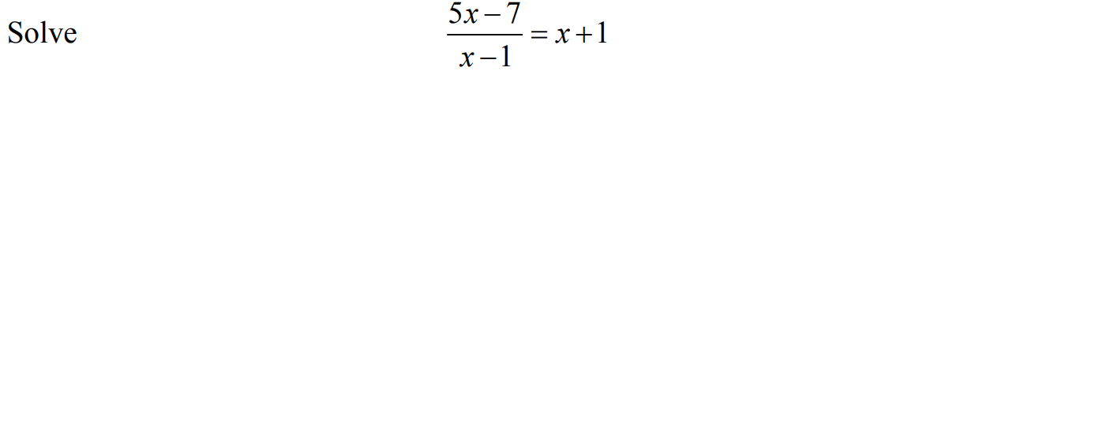
Algebraic Fractions
May 2007 4H Q14

Slide 38
Algebraic Fractions
May 2007 4H Q14
A

Slide 39
Algebraic Fractions
Nov 2007 3H Q16

Slide 40
Algebraic Fractions
Nov 2007 3H Q16
A
B

Slide 41
Algebraic Fractions
May 2008 4H Q23

Slide 42
Algebraic Fractions
May 2008 4H Q23
A
B

Slide 43
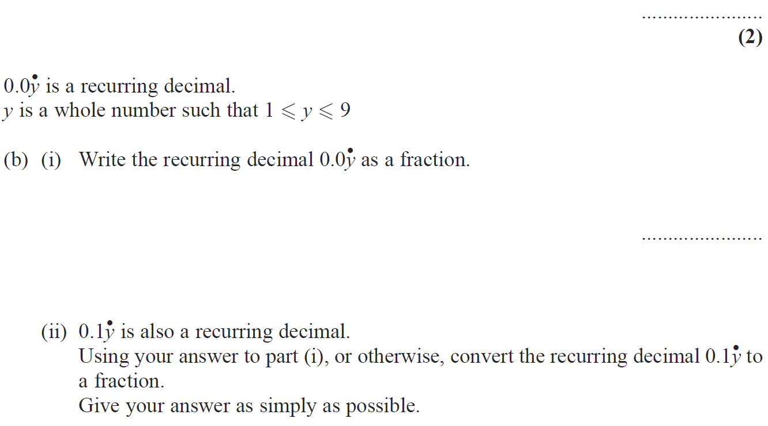
Algebraic Fractions
Nov 2008 3H Q17

Slide 44
Algebraic Fractions
Nov 2008 3H Q17
A
B (i)
B (ii)

Slide 45
Algebraic Fractions
Nov 2008 3H Q18

Slide 46
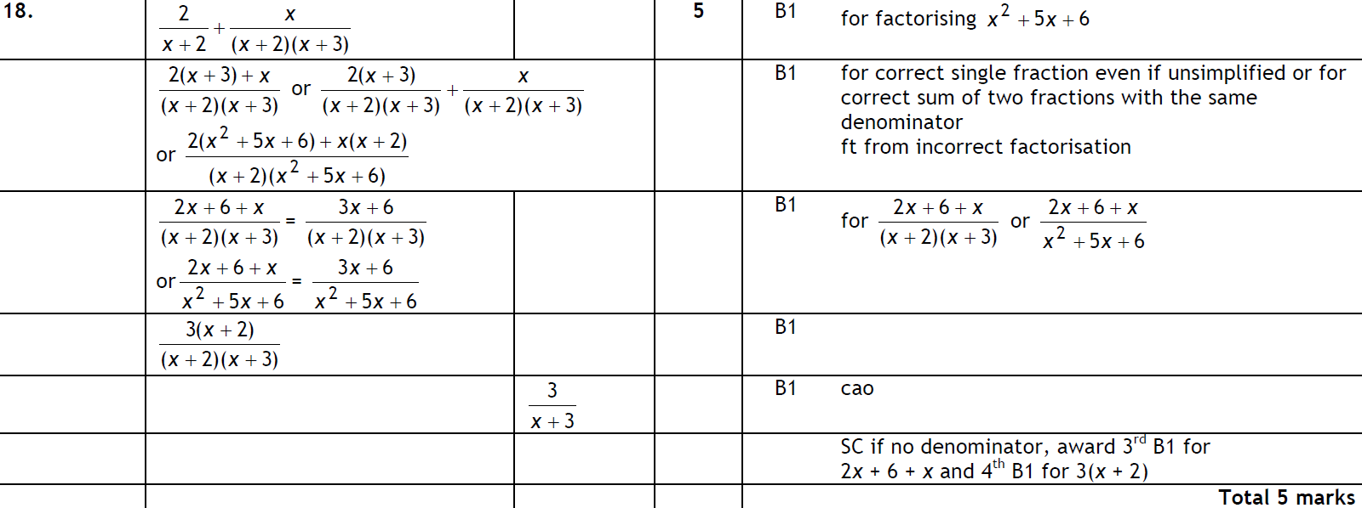
Algebraic Fractions
Nov 2008 3H Q18
A

Slide 47
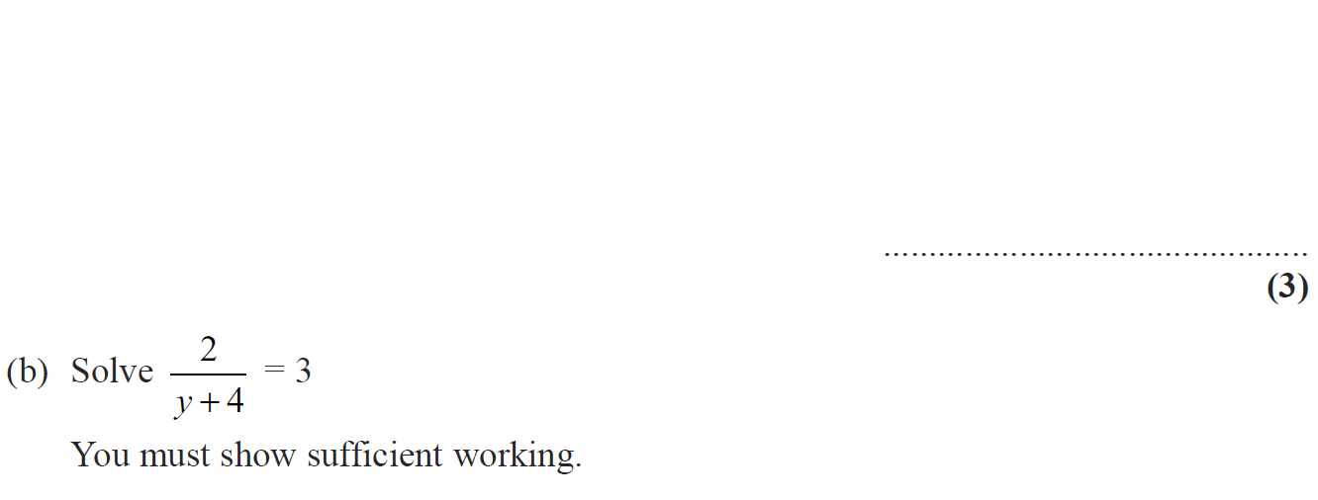
Algebraic Fractions
Nov 2008 4H Q13

Slide 48
Algebraic Fractions
Nov 2008 4H Q13
A
B

Slide 49
Algebraic Fractions
May 2009 3H Q18

Slide 50
Algebraic Fractions
May 2009 3H Q18
A

Slide 51
Algebraic Fractions
June 2009 4H Q15

Slide 52
Algebraic Fractions
June 2009 4H Q15
A
B
C

Slide 53
Algebraic Fractions
June 2009 4H Q21

Slide 54
Algebraic Fractions
June 2009 4H Q21
A
B

Slide 55
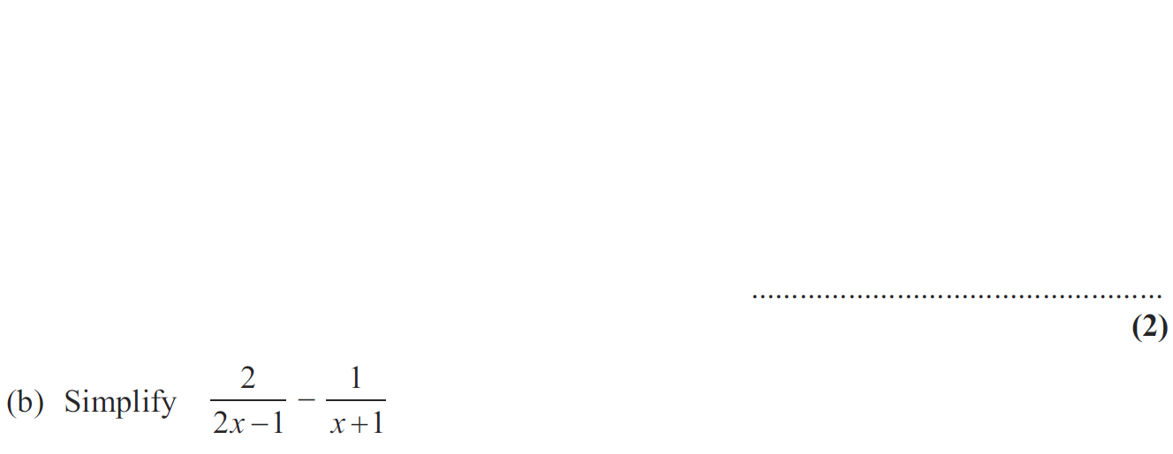
Algebraic Fractions
Nov 2009 3H Q19

Slide 56
Algebraic Fractions
Nov 2009 3H Q19
A
B

Slide 57
Algebraic Fractions
June 2010 3H Q18

Slide 58
Algebraic Fractions
June 2010 3H Q18
A

Slide 59
Algebraic Fractions
June 2010 4H Q11

Slide 60
Algebraic Fractions
June 2010 4H Q11
A

Slide 61
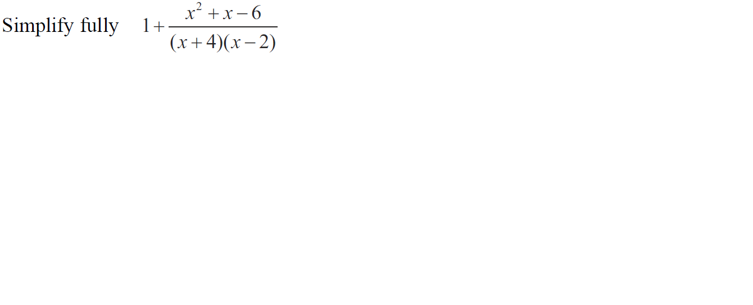
Algebraic Fractions
Nov 2010 4H Q22

Slide 62
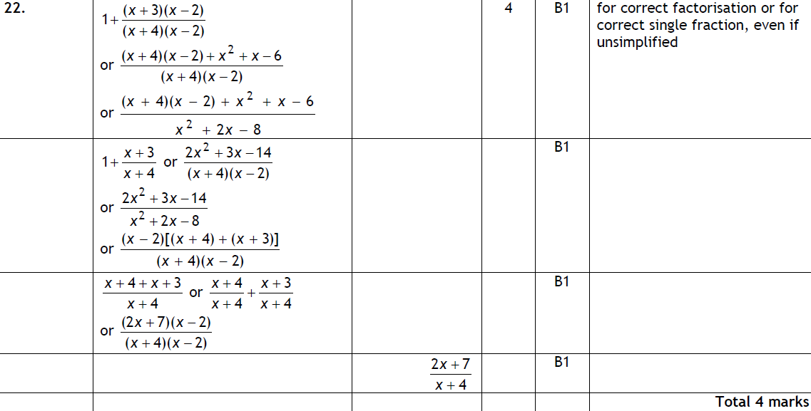
Algebraic Fractions
Nov 2010 4H Q22
A

Slide 63
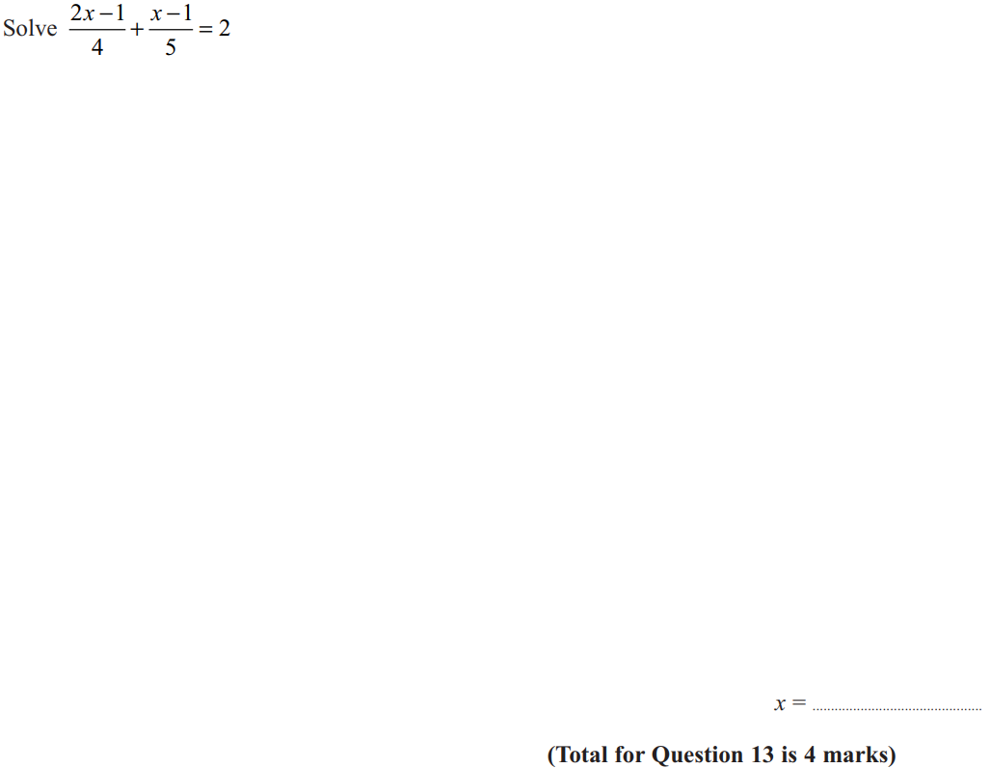
Algebraic Fractions
June 2011 3H Q13

Slide 64
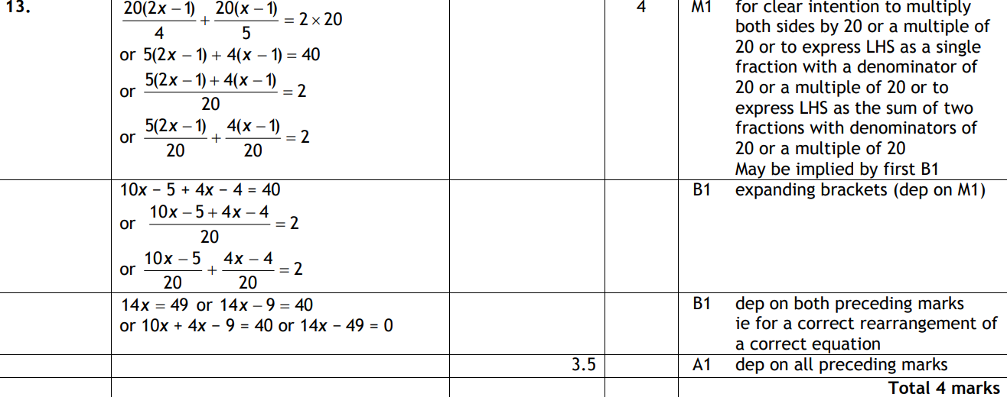
Algebraic Fractions
June 2011 3H Q13
A

Slide 65
Algebraic Fractions
June 2011 4H Q15

Slide 66
Algebraic Fractions
June 2011 4H Q15
A
B
C
D

Slide 67
Algebraic Fractions
Jan 2012 3H Q20

Slide 68
Algebraic Fractions
Jan 2012 3H Q20
A

Slide 69
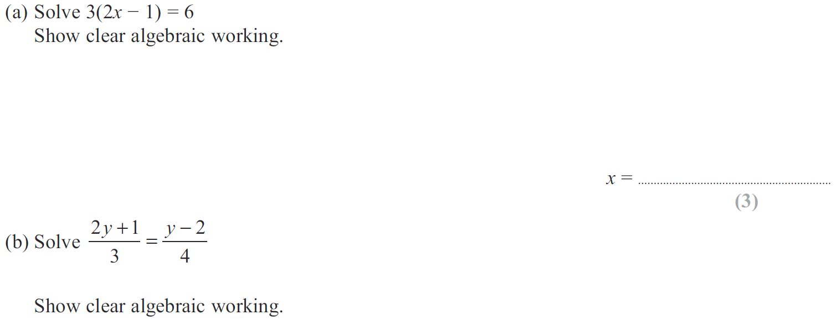
Algebraic Fractions
May 2012 3H Q9

Slide 70
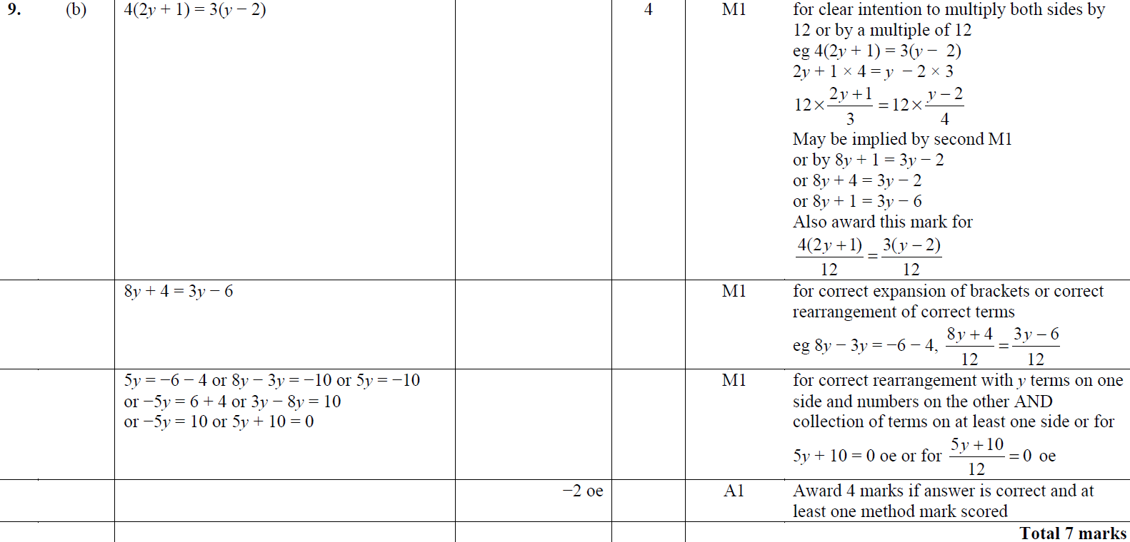
Algebraic Fractions
May 2012 3H Q9
A
B
B Alternative

Slide 71
Algebraic Fractions
May 2012 4H Q21

Slide 72
Algebraic Fractions
May 2012 4H Q21
A

Slide 73
Algebraic Fractions
Jan 2013 3H Q17

Slide 74
Algebraic Fractions
Jan 2013 3H Q17
A

Slide 75
Algebraic Fractions
Jan 2013 4H Q14

Slide 76
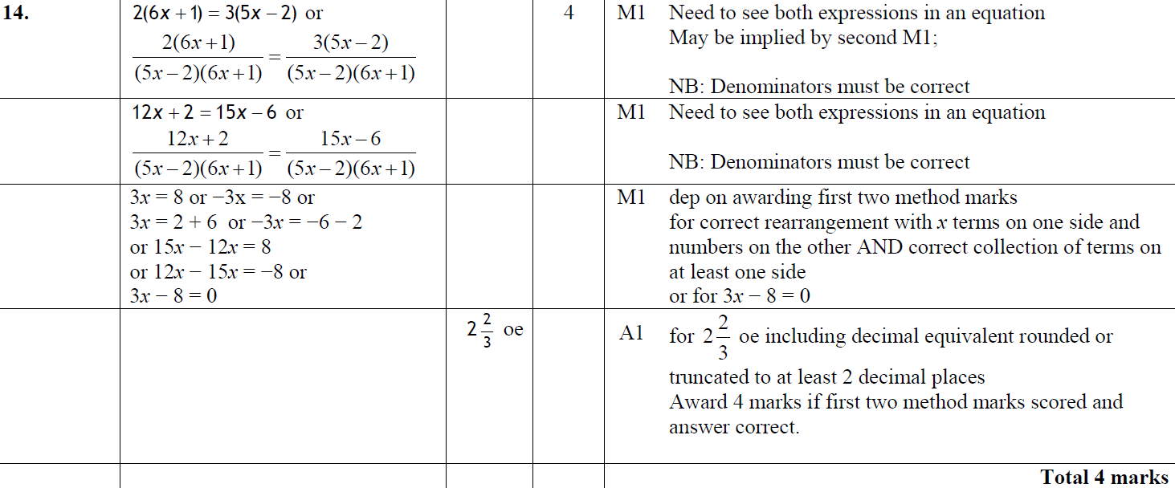
Algebraic Fractions
Jan 2013 4H Q14
A

Slide 77
Algebraic Fractions
Jan 2013 4H Q15

Slide 78
Algebraic Fractions
Jan 2013 4H Q15
A
B

Slide 79
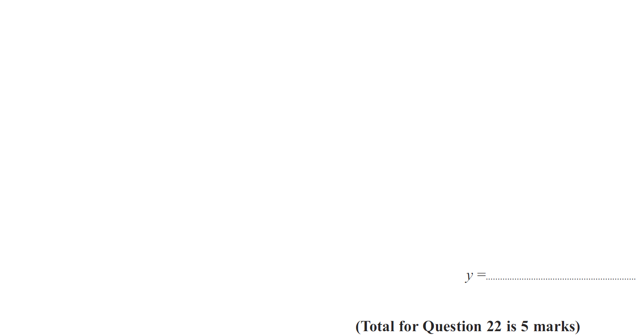
Algebraic Fractions
May 2013 3H Q22

Slide 80
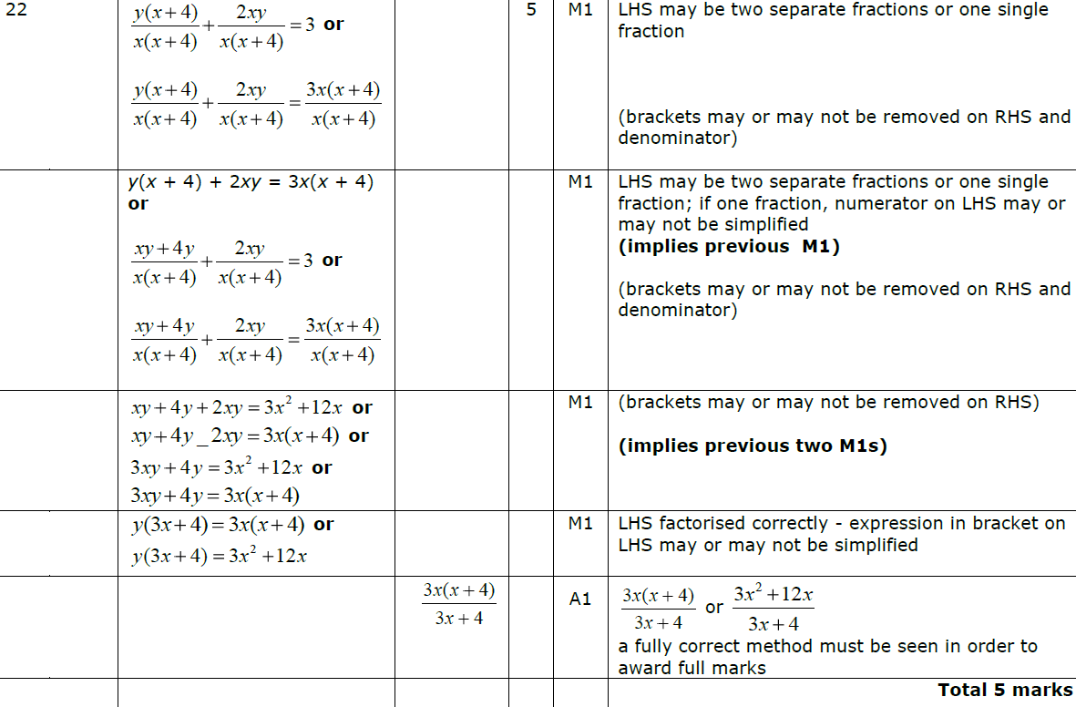
Algebraic Fractions
May 2013 3H Q22
A

Slide 81
Algebraic Fractions
May 2013 4H Q23

Slide 82
Algebraic Fractions
May 2013 4H Q23
A

Slide 83
Algebraic Fractions
May 2013 4HR Q23

Slide 84
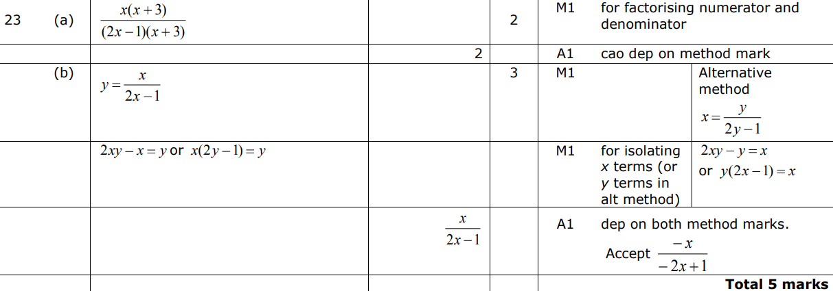
Algebraic Fractions
May 2013 4HR Q23
A
B

Slide 85
Algebraic Fractions
Jan 2014 3H Q11

Slide 86
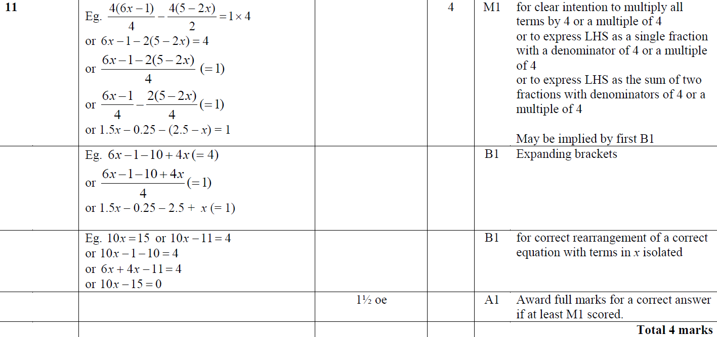
Algebraic Fractions
Jan 2014 3H Q11
A

Slide 87
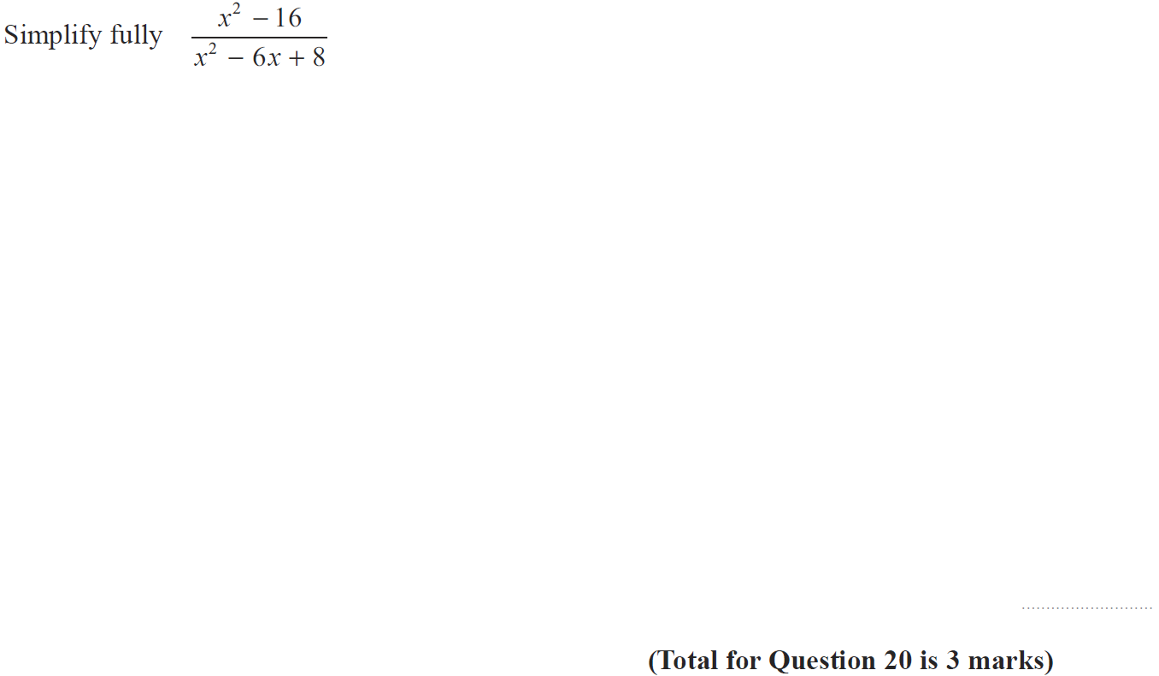
Algebraic Fractions
Jan 2014 3HR Q20

Slide 88
Algebraic Fractions
Jan 2014 3HR Q20
A

Slide 89
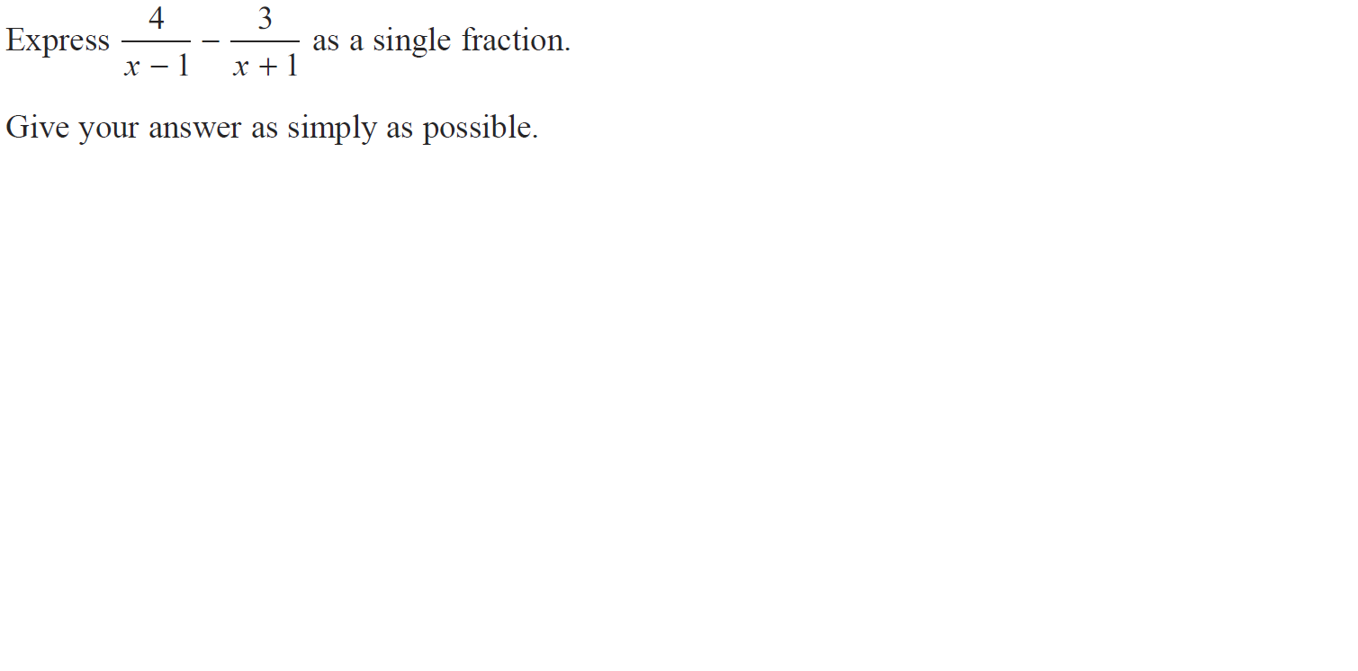
Algebraic Fractions
Jan 2014 4HR Q20

Slide 90
Algebraic Fractions
Jan 2014 4HR Q20
A

Slide 91
Algebraic Fractions
May 2014 3H Q23

Slide 92
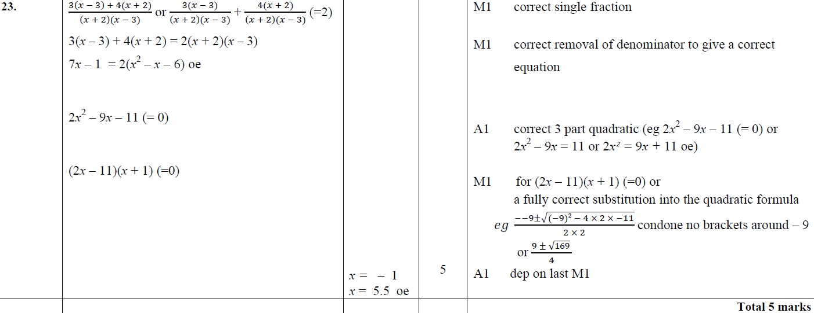
Algebraic Fractions
May 2014 3H Q23
A

Slide 93
Algebraic Fractions
May 2014 4H Q25

Slide 94
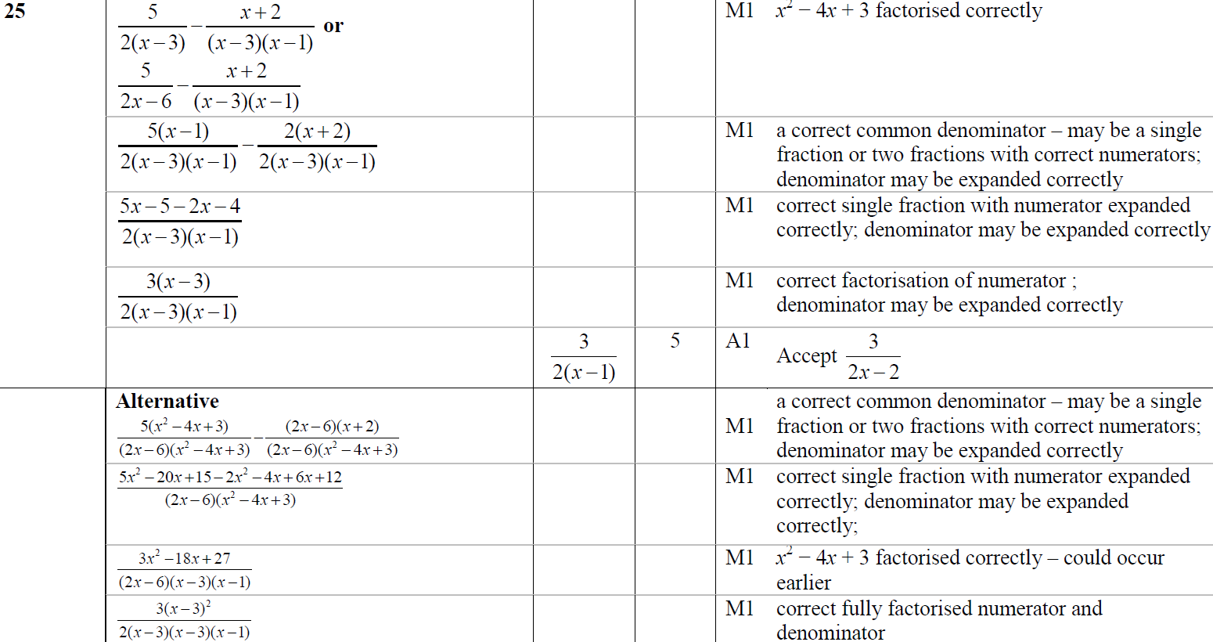
Algebraic Fractions
May 2014 4H Q25
A

Slide 95
Algebraic Fractions
May 2014 4HR Q17

Slide 96
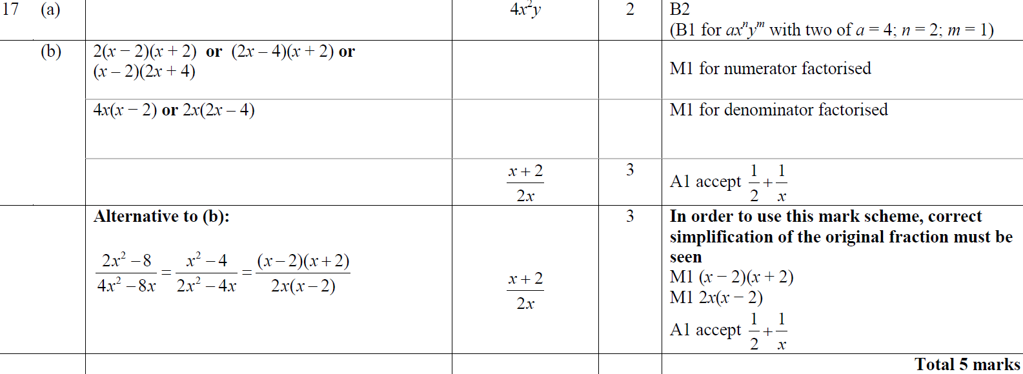
Algebraic Fractions
May 2014 4HR Q17
A
B

Slide 97
Algebraic Fractions
Jan 2015 4H Q12

Slide 98
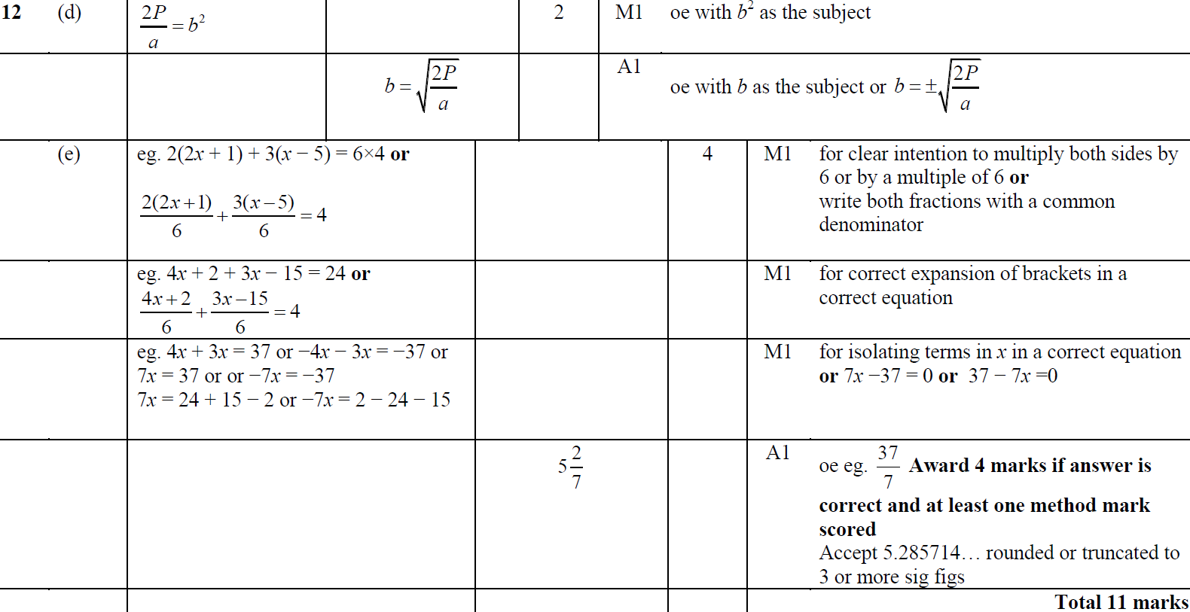
Algebraic Fractions
Jan 2015 4H Q12
A
B
C
D
E

Slide 99
Algebraic Fractions
Jan 2015 4H Q23

Slide 100
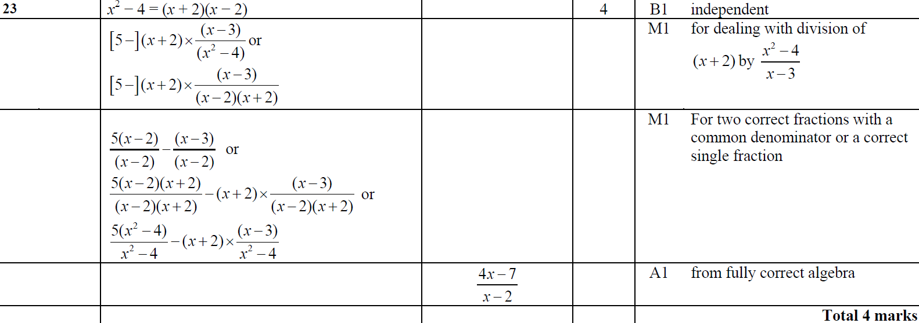
Algebraic Fractions
Jan 2015 4H Q23
A

Slide 101
Algebraic Fractions
Jan 2015 4HR Q11

Slide 102
Algebraic Fractions
Jan 2015 4HR Q11
A
B
C
D

Slide 103
Algebraic Fractions
Jan 2015 4HR Q20

Slide 104
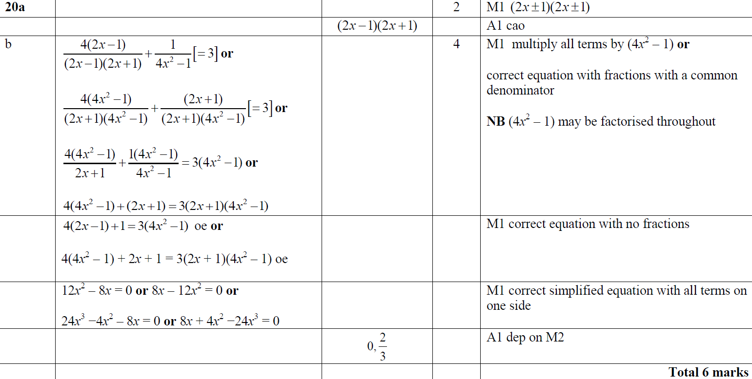
Algebraic Fractions
Jan 2015 4HR Q20
A
B

Slide 105
Algebraic Fractions
May 2015 3H Q9

Slide 106
Algebraic Fractions
May 2015 3H Q9
A
B
C
D

Slide 107
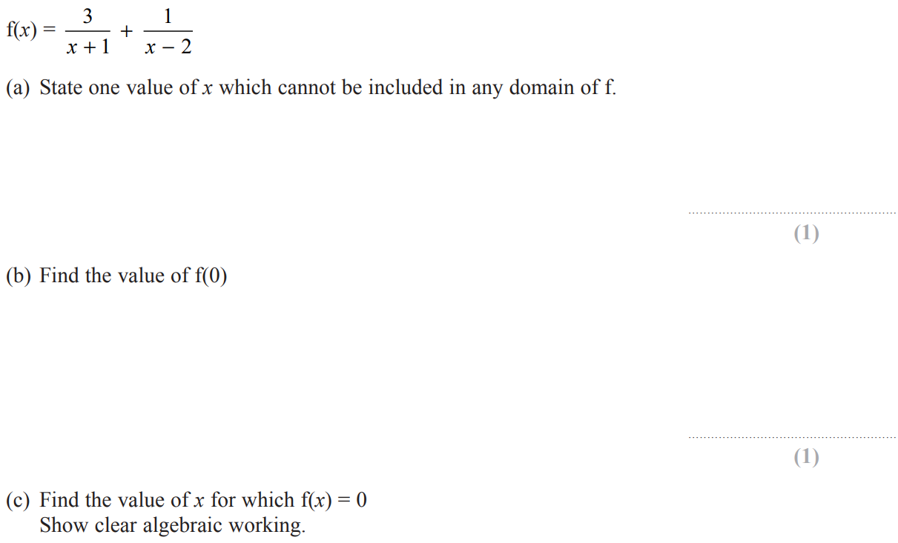
Algebraic Fractions
May 2015 3H Q17

Slide 108
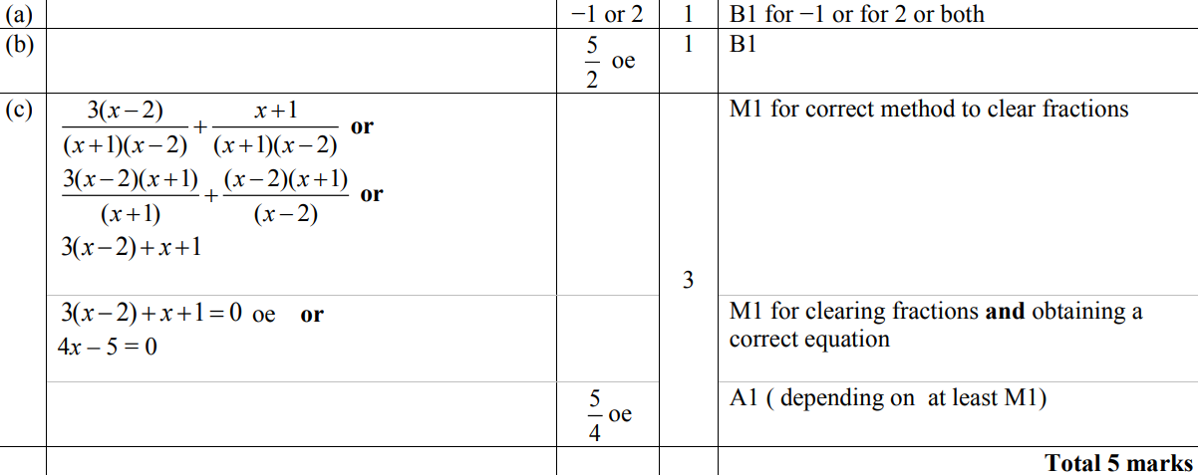
Algebraic Fractions
May 2015 3H Q17
A
B
C

Slide 109
Algebraic Fractions
May 2015 3HR Q22

Slide 110
Algebraic Fractions
May 2015 3HR Q22
A

Slide 111
Algebraic Fractions
Jan 2016 4H Q17

Slide 112
Algebraic Fractions
Jan 2016 4H Q17
A
B
C

Slide 113
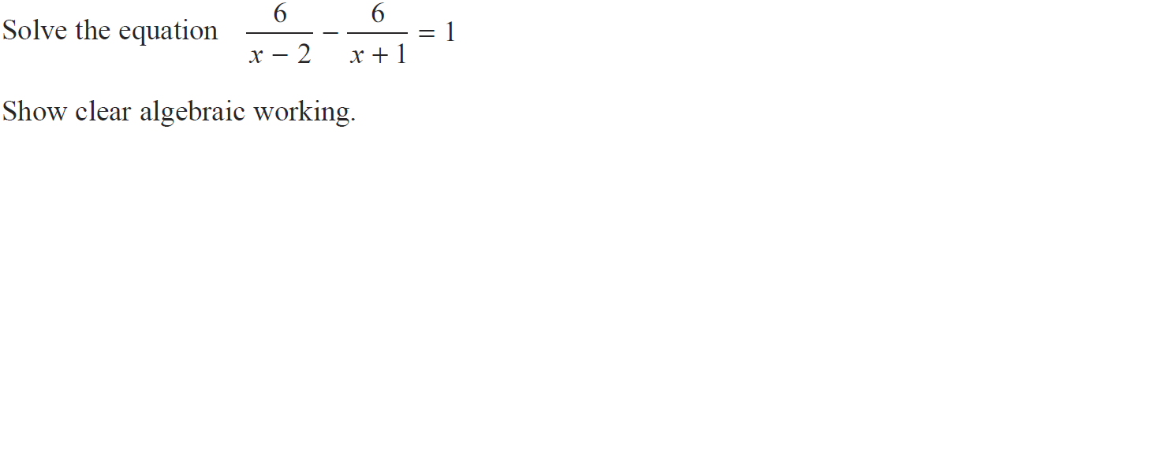
Algebraic Fractions
Jan 2016 4H Q22

Slide 114
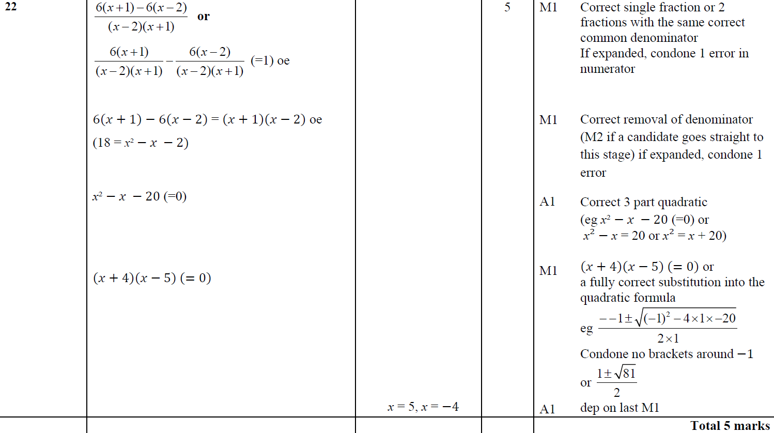
Algebraic Fractions
Jan 2016 4H Q22
A

Slide 115
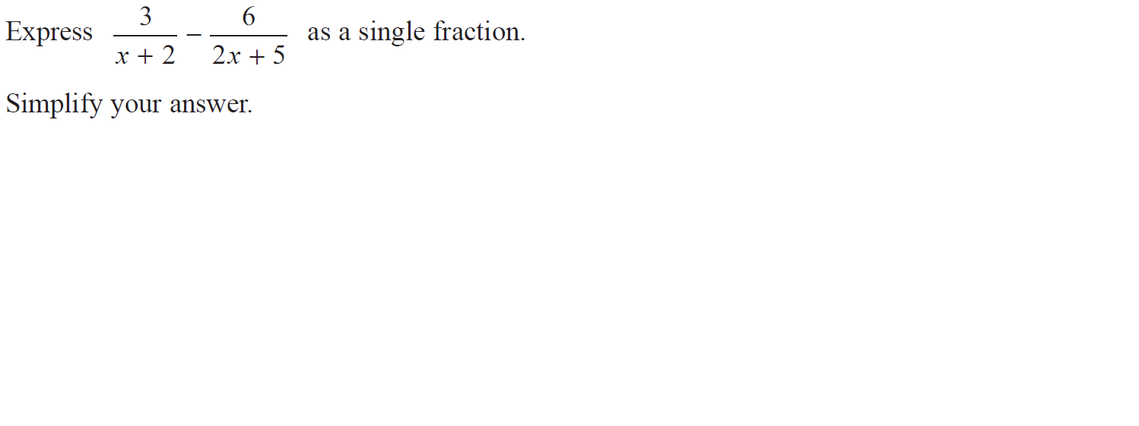
Algebraic Fractions
Jan 2016 4HR Q20

Slide 116
Algebraic Fractions
Jan 2016 4HR Q20
A

Slide 117
Algebraic Fractions
May 2016 3H Q7

Slide 118
Algebraic Fractions
May 2016 3H Q7
A
B
C (i)
C (ii)
D

Slide 119
Algebraic Fractions
June 2016 4H Q14

Slide 120
Algebraic Fractions
June 2016 4H Q14
A

Slide 121
Algebraic Fractions
June 2016 4H Q15

Slide 122
Algebraic Fractions
June 2016 4H Q15
A
B
C

Slide 123
Algebraic Fractions
May 2016 3HR Q20

Slide 124
Algebraic Fractions
May 2016 3HR Q20
A
B

Slide 125
Algebraic Fractions
June 2016 4HR Q2

Slide 126
Algebraic Fractions
June 2016 4HR Q2
A
B
C

Slide 127
Algebraic Fractions
June 2016 4HR Q14

Slide 128
Algebraic Fractions
June 2016 4HR Q14
A
B
C

Slide 129
Algebraic Fractions
Jan 2017 3HR Q16

Slide 130
Algebraic Fractions
Jan 2017 3HR Q16
A
B

Slide 131
Algebraic Fractions
Jan 2017 3HR Q19

Slide 132
Algebraic Fractions
Jan 2017 3HR Q19
A
B
C
D

Slide 133
Algebraic Fractions
Jan 2017 4HR Q15

Slide 134
Algebraic Fractions
Jan 2017 4HR Q15
A
B
C

Slide 135
Algebraic Fractions
May 2017 3H Q19

Slide 136
Algebraic Fractions
May 2017 3H Q19
A
B

Slide 137
Algebraic Fractions
May 2017 3H Q22

Slide 138
Algebraic Fractions
May 2017 3H Q22
A

Slide 139
Algebraic Fractions
June 2017 4H Q10

Slide 140
Algebraic Fractions
June 2017 4H Q10
A
B
C
D

Slide 141
Algebraic Fractions
June 2017 4HR Q14

Slide 142
Algebraic Fractions
June 2017 4HR Q14
A

Slide 143
Algebraic Fractions
Jan 2018 3H Q12

Slide 144
Algebraic Fractions
Jan 2018 3H Q12
A

Slide 145
Algebraic Fractions
Jan 2018 3HR Q17

Slide 146
Algebraic Fractions
Jan 2018 3HR Q17
A
B

Slide 147
Algebraic Fractions
Jan 2018 4HR Q11

Slide 148
Algebraic Fractions
Jan 2018 4HR Q11
A
B
C
D

Slide 149
Algebraic Fractions
May 2018 3H Q15

Slide 150
Algebraic Fractions
May 2018 3H Q15
A
B

Slide 151
Algebraic Fractions
June 2018 4H Q12

Slide 152
Algebraic Fractions
June 2018 4H Q12
A

Slide 153
Algebraic Fractions
May 2018 3HR Q22

Slide 154
Algebraic Fractions
May 2018 3HR Q22
A

Slide 155
Algebraic Fractions
June 2018 4HR Q12

Slide 156
Algebraic Fractions
June 2018 4HR Q12
A

Slide 157
Algebraic Fractions
June 2018 4HR Q21

Slide 158
Algebraic Fractions
June 2018 4HR Q21
A

