Slide 1
Algebraic Fractions
Algebraic Fractions
June 2017
2H Q17
June 2017
3H Q16
SAM
1H Q20
May 2018
1H Q20
Practice
3H Q15
June 2018
3H Q19
Nov 2018
3H Q21

Slide 2
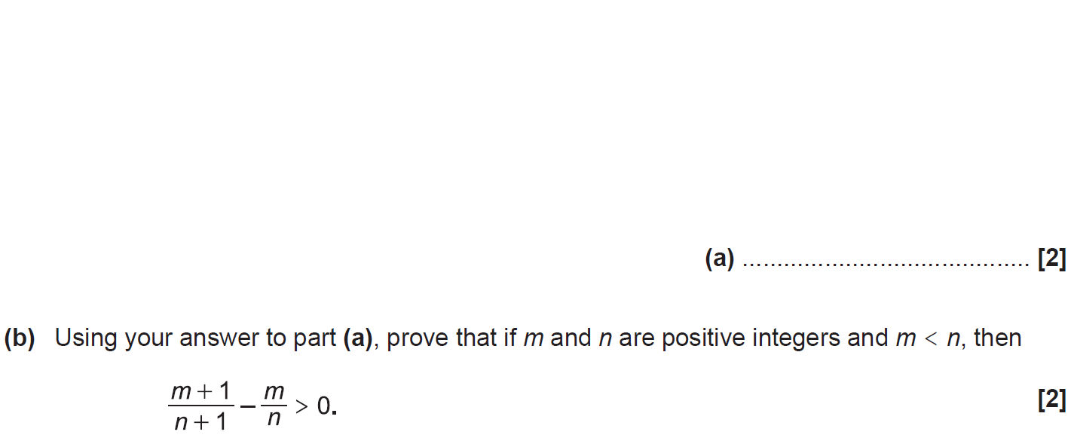
Algebraic Fractions
SAM 1H Q20

Slide 3
Algebraic Fractions
SAM 1H Q20
A
B

Slide 4
Algebraic Fractions
Practice 3H Q15

Slide 5
Algebraic Fractions
Practice 3H Q15
A

Slide 6
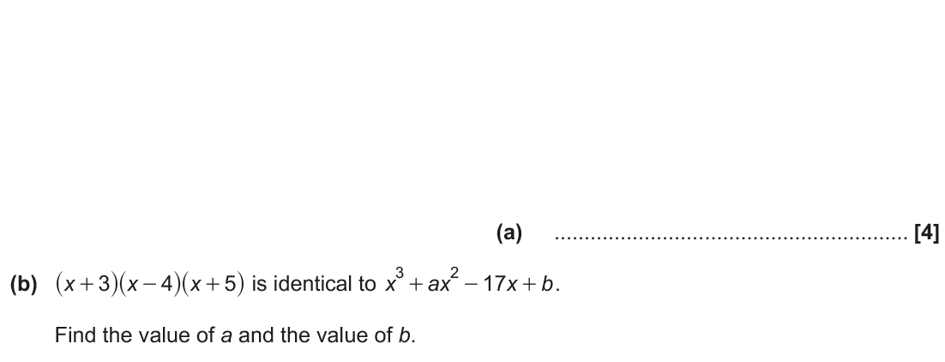
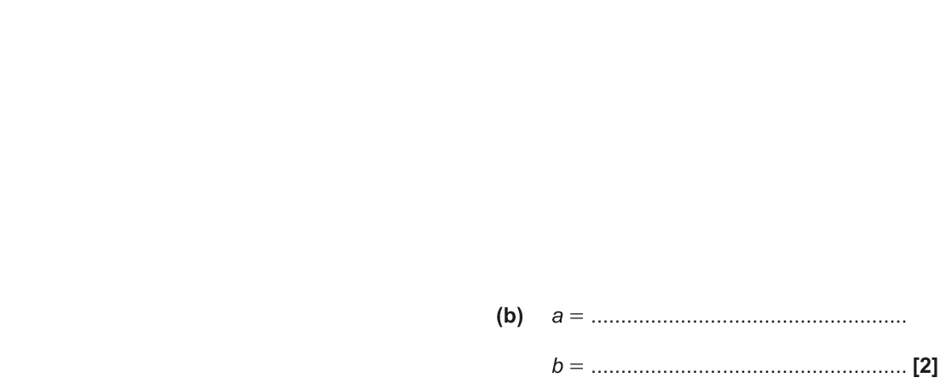
Algebraic Fractions
June 2017 2H Q17

Slide 7
Algebraic Fractions
June 2017 2H Q17
A
B

Slide 8
Algebraic Fractions
June 2017 3H Q16

Slide 9
Algebraic Fractions
June 2017 3H Q16
A
B

Slide 10
Algebraic Fractions
May 2018 1H Q20

Slide 11
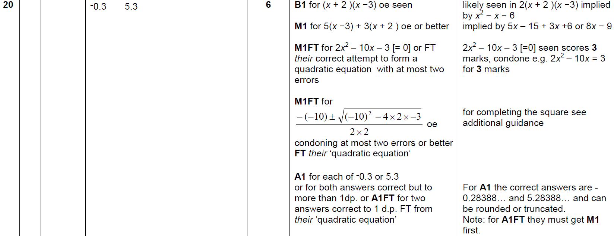
Algebraic Fractions
May 2018 1H Q20
A

Slide 12
Algebraic Fractions
June 2018 3H Q19

Slide 13
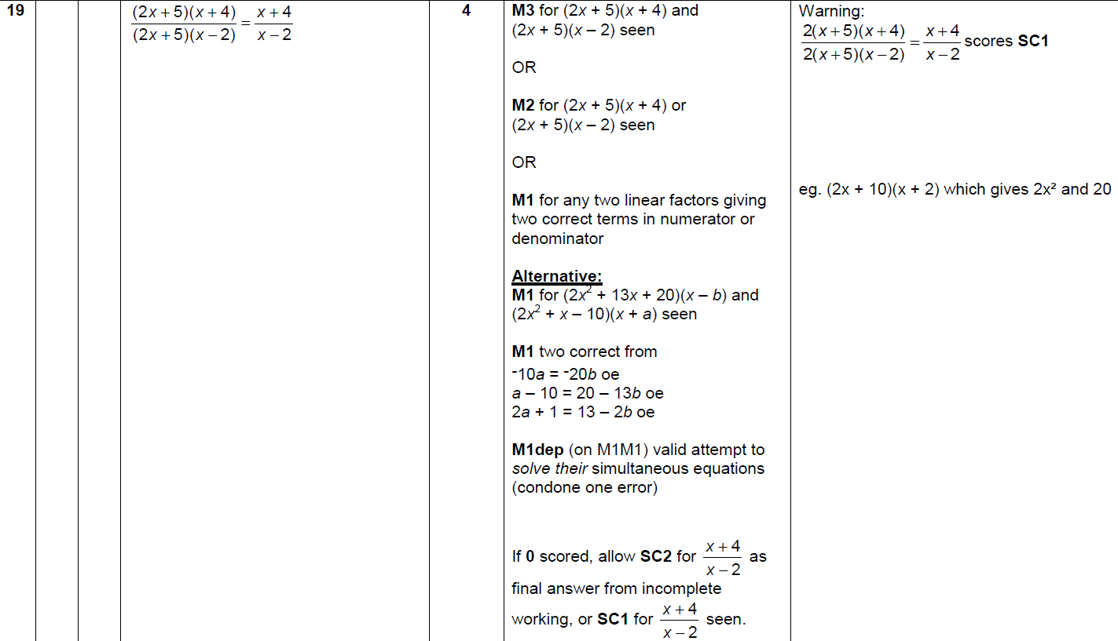
Algebraic Fractions
June 2018 3H Q19
A

Slide 14
Algebraic Fractions
Nov 2018 3H Q21

Slide 15
Algebraic Fractions
Nov 2018 3H Q21
A

