Slide 1
Advanced Trigonometry
Advanced Trigonometry
June 2017
2H Q20
June 2017
2H Q25
Nov 2017
3H Q22
SAM
3H Q20
May 2018
1H Q17
1 Marker
June 2018
2H Q21
Nov 2018
1H Q26
Nov 2018
2H Q25
Area

Slide 2
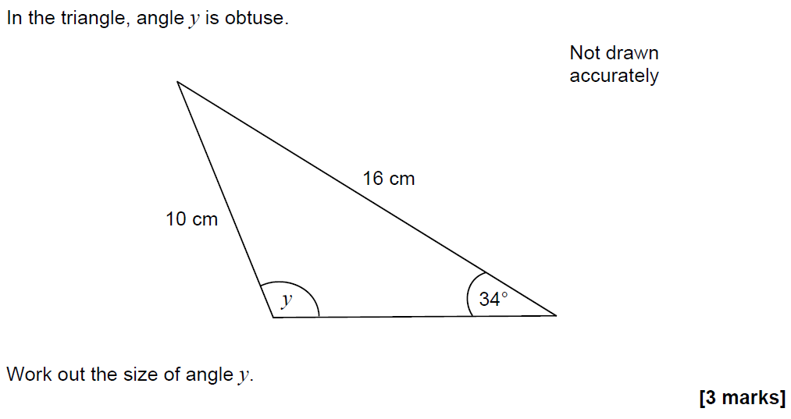
Advanced Trigonometry
SAM 3H Q20

Slide 3
Advanced Trigonometry
SAM 3H Q20
A

Slide 4
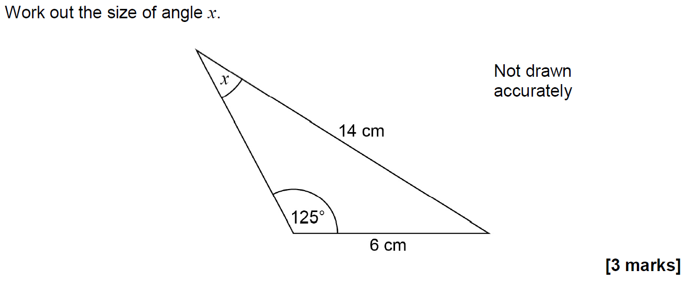
Advanced Trigonometry
June 2017 2H Q20

Slide 5
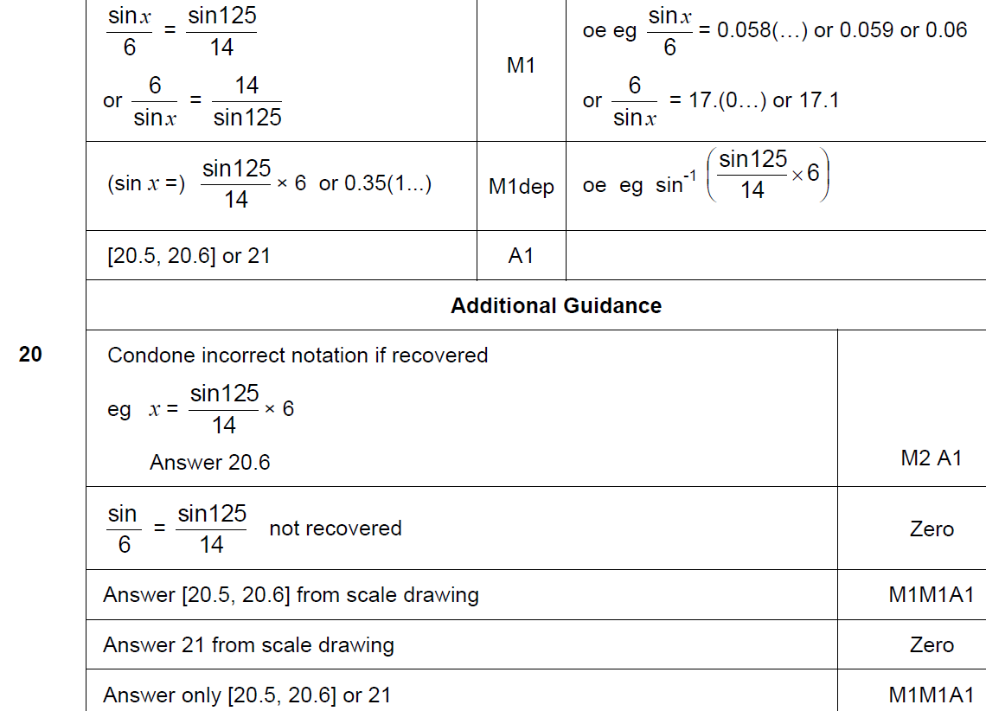
Advanced Trigonometry
June 2017 2H Q20
A

Slide 6
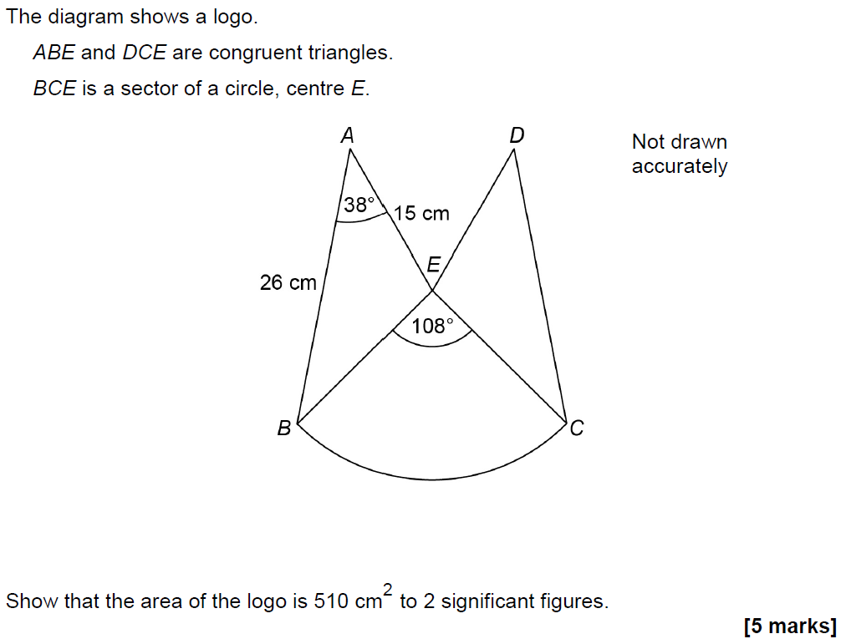
Advanced Trigonometry
June 2017 2H Q25

Slide 7
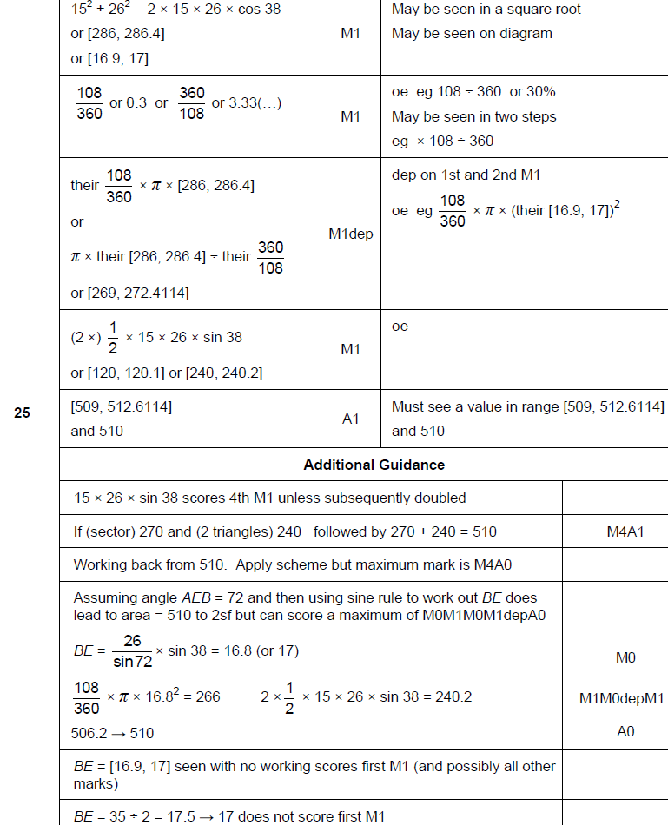
Advanced Trigonometry
June 2017 2H Q25
A

Slide 8
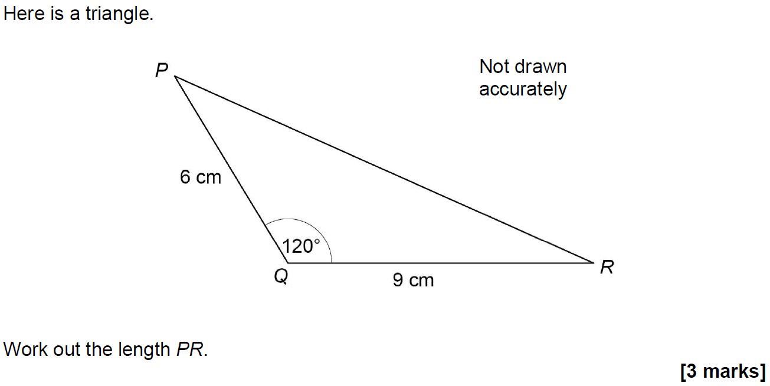
Advanced Trigonometry
Nov 2017 3H Q22

Slide 9
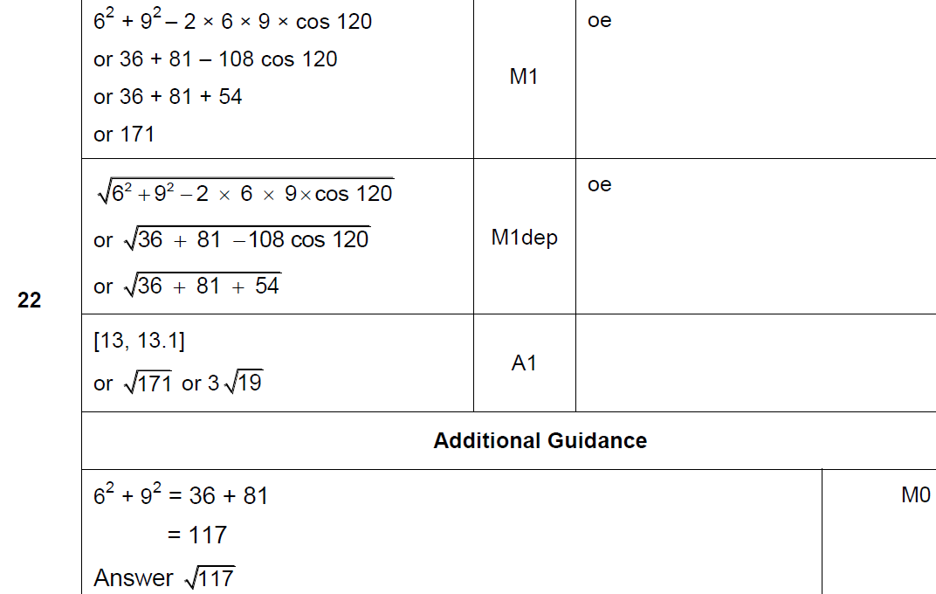
Advanced Trigonometry
Nov 2017 3H Q22
A

Slide 10
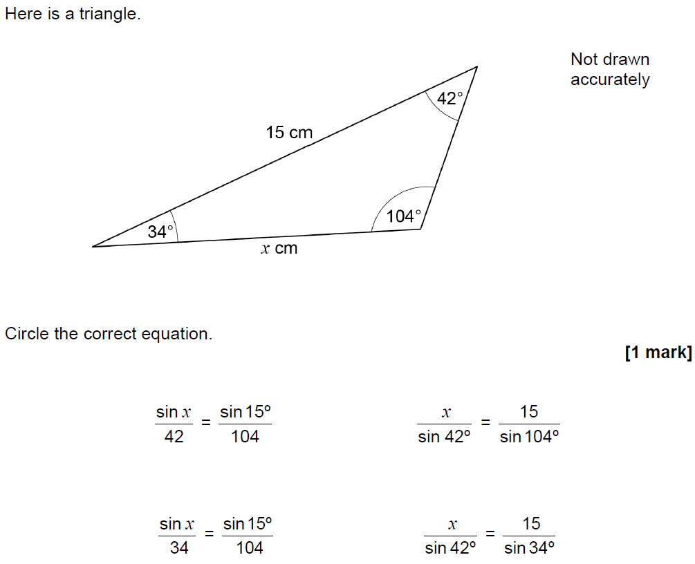
Advanced Trigonometry
May 2018 1H Q17

Slide 11
Advanced Trigonometry
May 2018 1H Q17
A

Slide 12
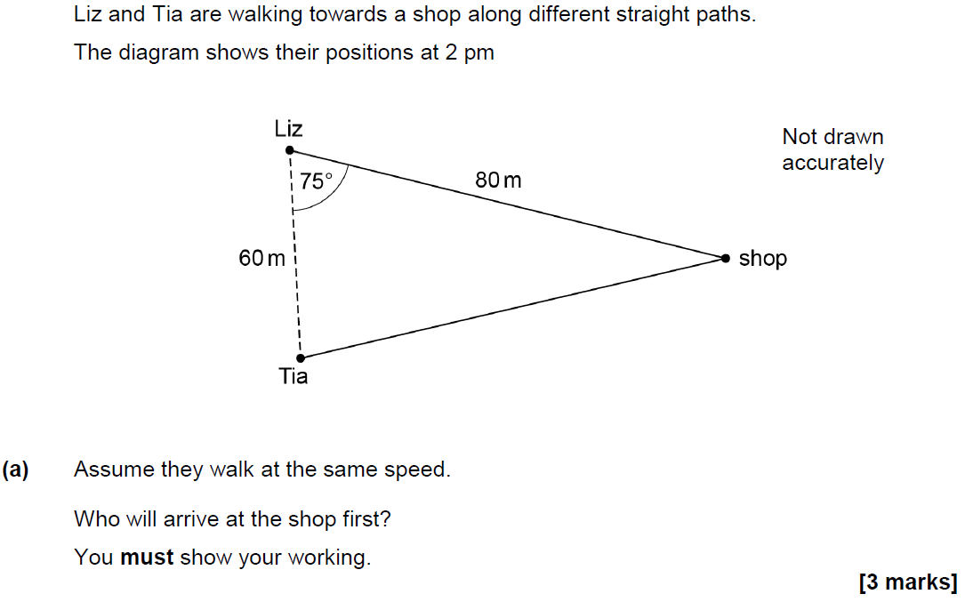
Advanced Trigonometry
June 2018 2H Q21

Slide 13
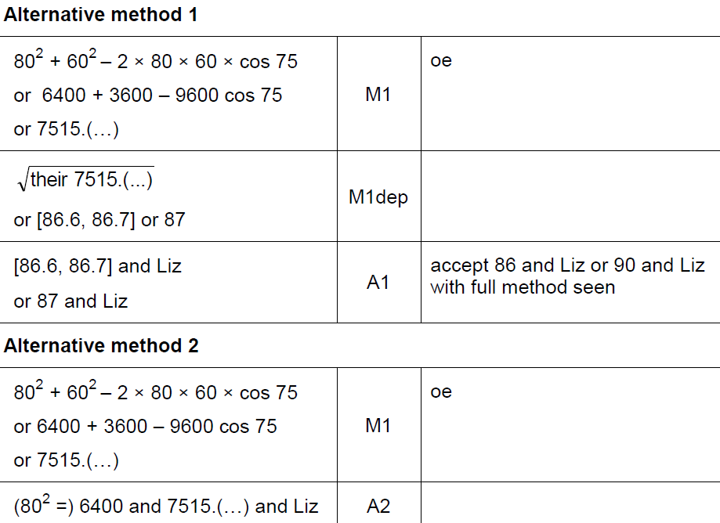
Advanced Trigonometry
June 2018 2H Q21
A

Slide 14
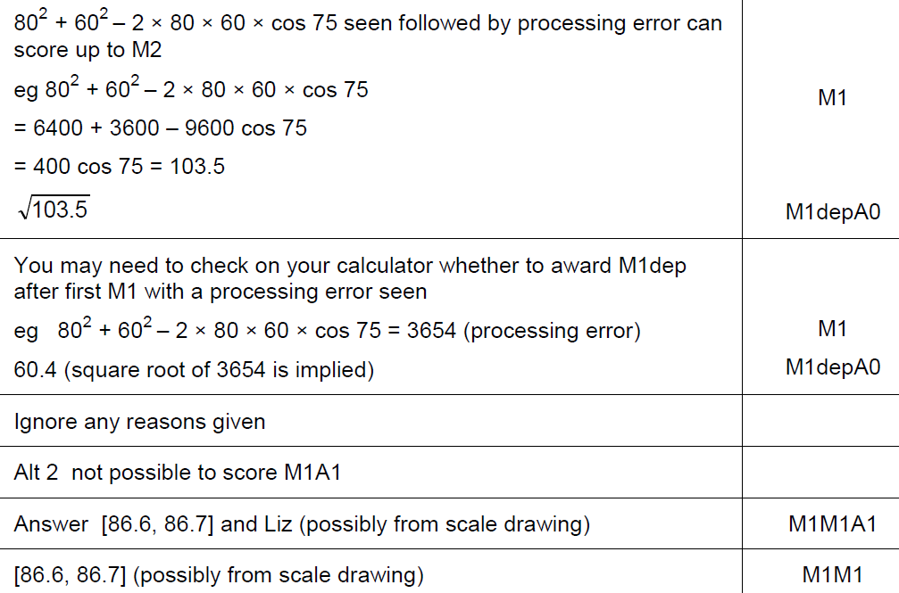
Advanced Trigonometry
June 2018 2H Q21
A notes

Slide 15
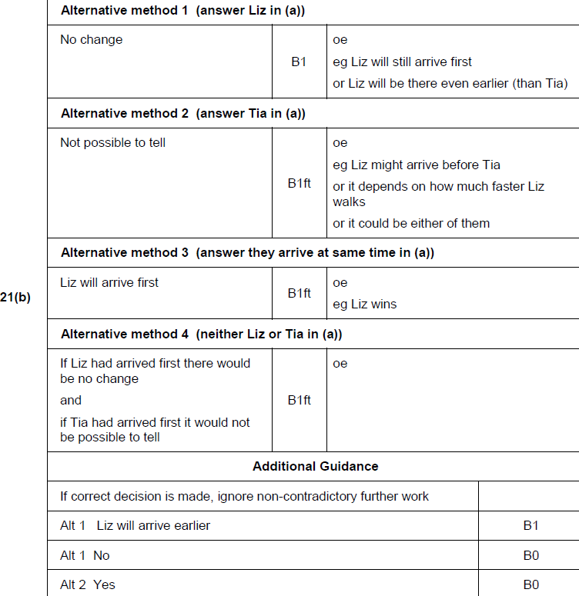
Advanced Trigonometry
June 2018 2H Q21
B

Slide 16
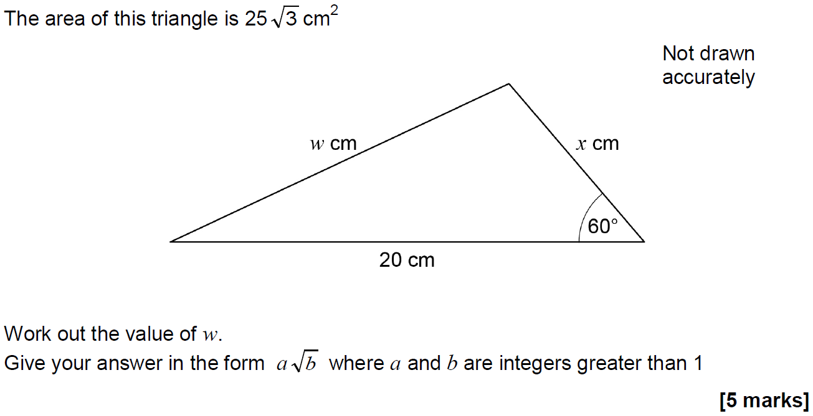
Advanced Trigonometry
Nov 2018 1H Q26

Slide 17
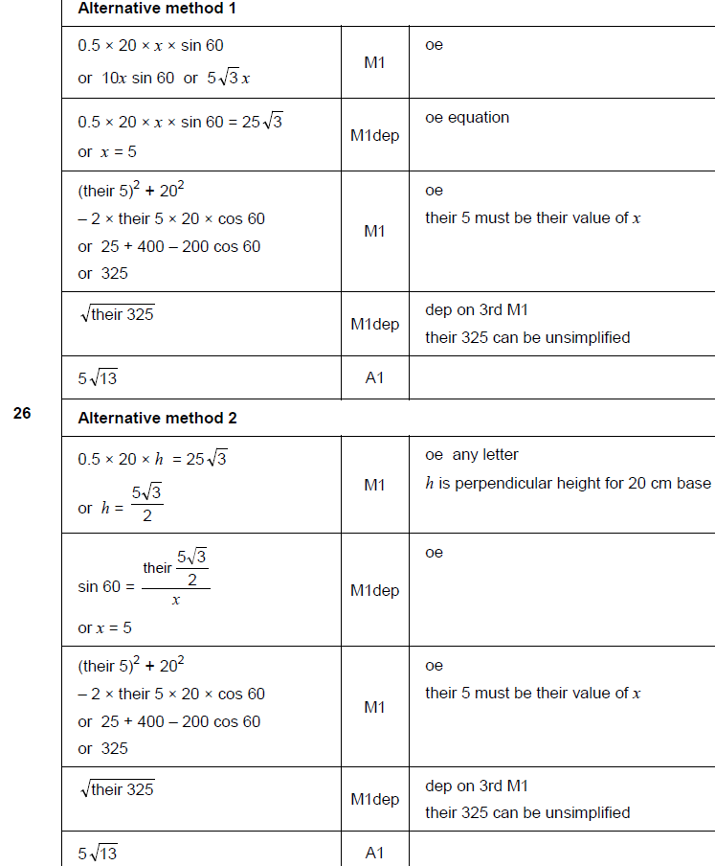
Advanced Trigonometry
Nov 2018 1H Q26
A

Slide 18
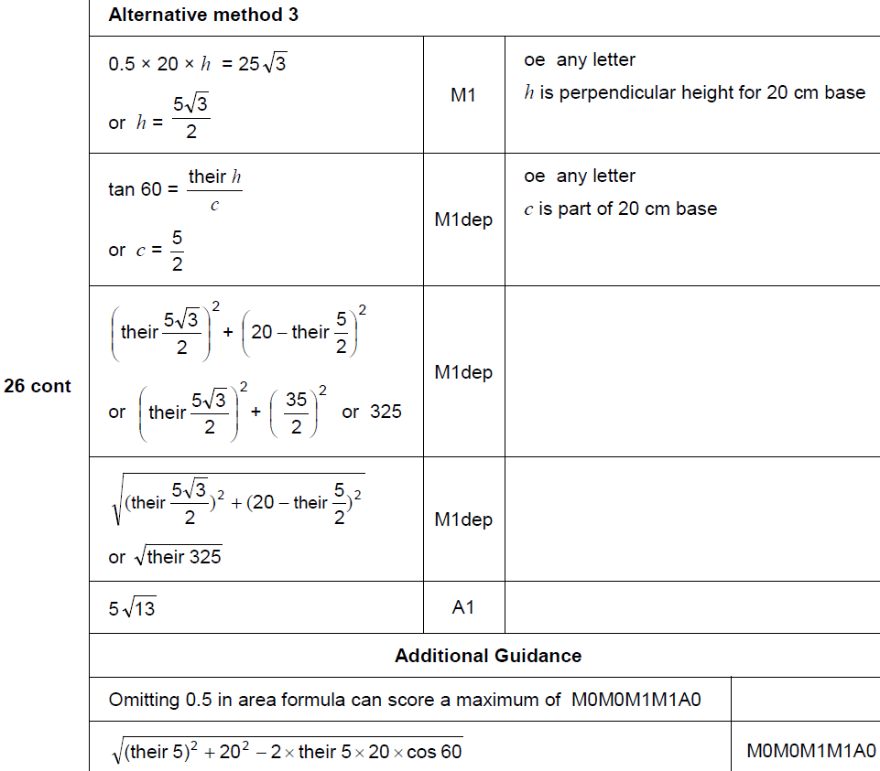
Advanced Trigonometry
Nov 2018 1H Q26
A Alternative & notes

Slide 19
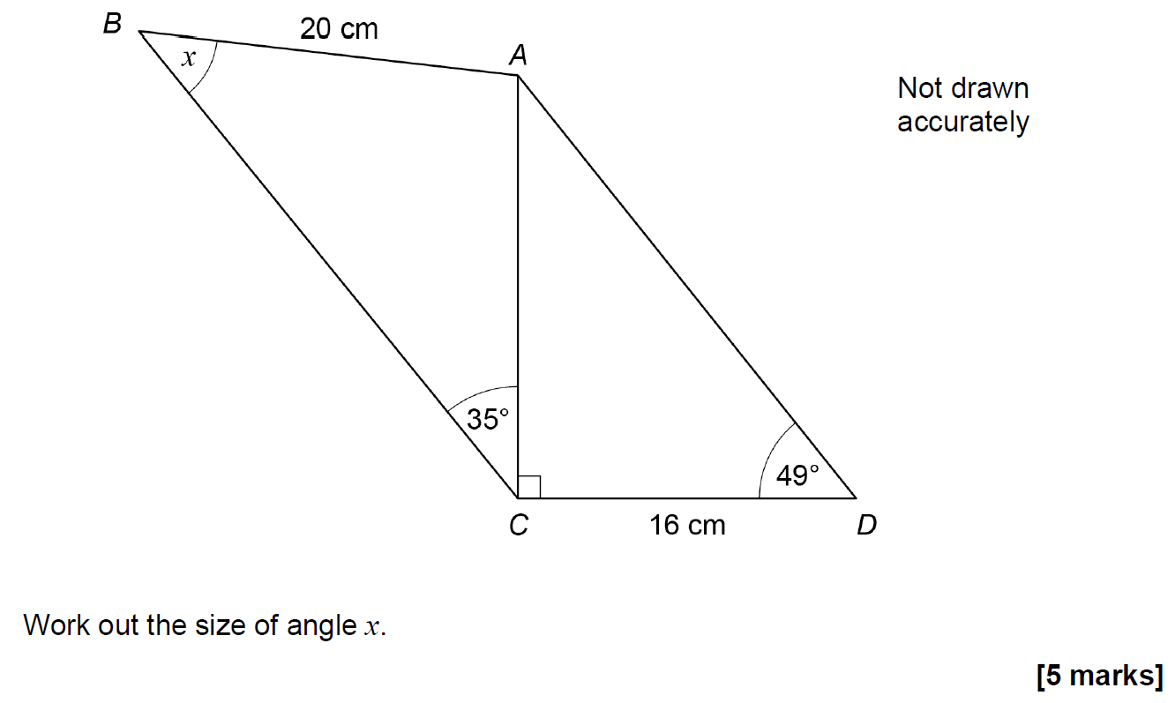
Advanced Trigonometry
Nov 2018 2H Q25

Slide 20
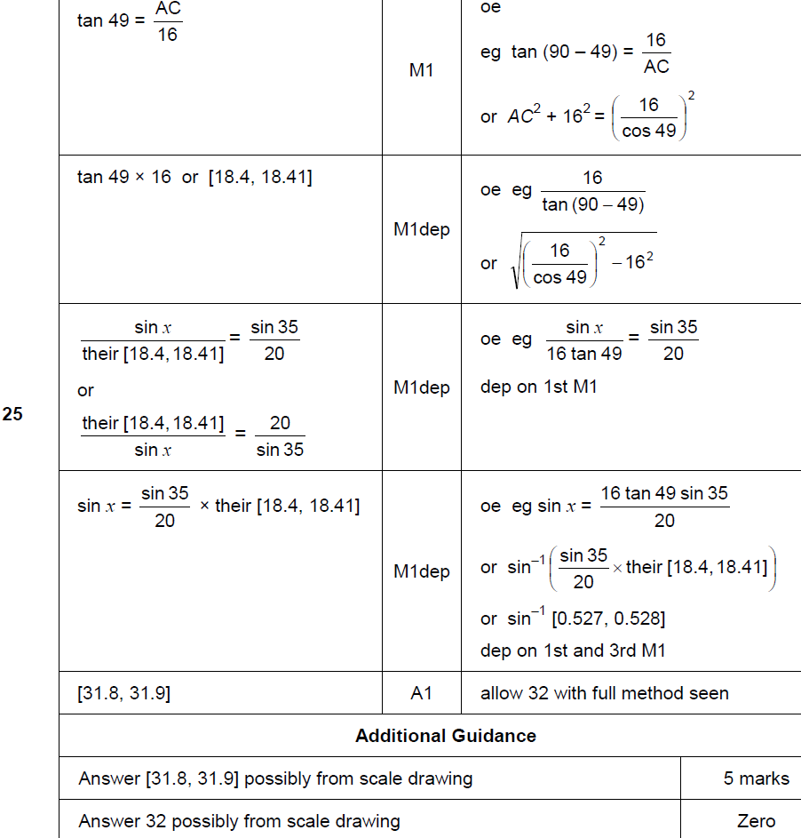
Advanced Trigonometry
Nov 2018 2H Q25
A

Slide 21
Advanced Trigonometry
Nov 2018 1H Q26
A Alternative & notes

