Slide 1
Advanced Trigonometry
Advanced Trigonometry
May 2017
1H Q22
Nov 2018
2H Q13
Edexcel
June 2017
2H Q17
SAM
2H Q21
Nov 2018
3H Q16
AQA
June 2017
3H Q15
Spec 2
3H Q21
June 2019
3H Q14
OCR
Nov 2017
3H Q17
June 2019
3H Q23
June 2018
3H Q17
Area

Slide 2
Advanced Trigonometry
Advanced Trigonometry
June 2017
2H Q20
June 2017
2H Q25
Edexcel
Nov 2017
3H Q22
AQA
SAM
3H Q20
May 2018
1H Q17
1 Marker
OCR
June 2018
2H Q21
Nov 2018
1H Q26
Nov 2018
2H Q25
Area

Slide 3
Advanced Trigonometry
Advanced Trigonometry
May 2017
1H Q14
SAM
3H Q13
Edexcel
June 2017
2H Q20
SAM
3H Q16
AQA
Nov 2017
1H Q17
Practice
2H Q16
OCR
May 2018
1H Q18
Practice
3H Q16
Nov 2018
3H Q19
Area

Slide 4
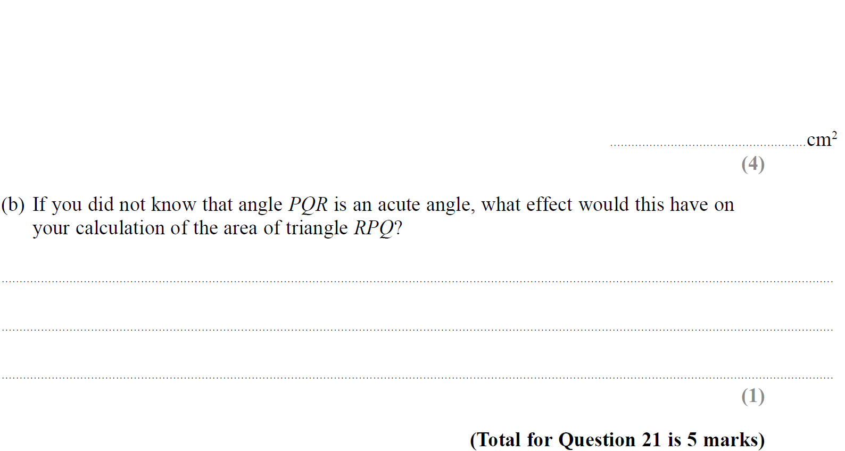
Advanced Trigonometry
SAM 2H Q21

Slide 5
Advanced Trigonometry
SAM 2H Q21
A
B

Slide 6
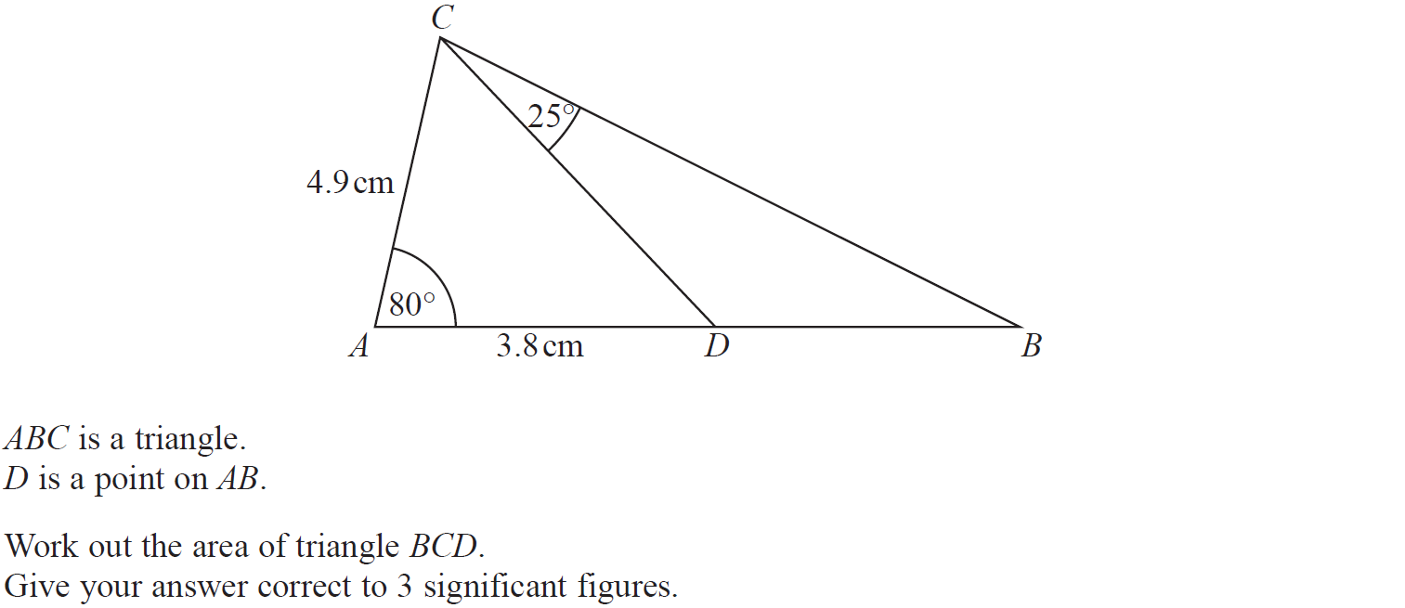
Advanced Trigonometry
Specimen Set 2 3H Q21

Slide 7
Advanced Trigonometry
Specimen Set 2 3H Q21
A

Slide 8
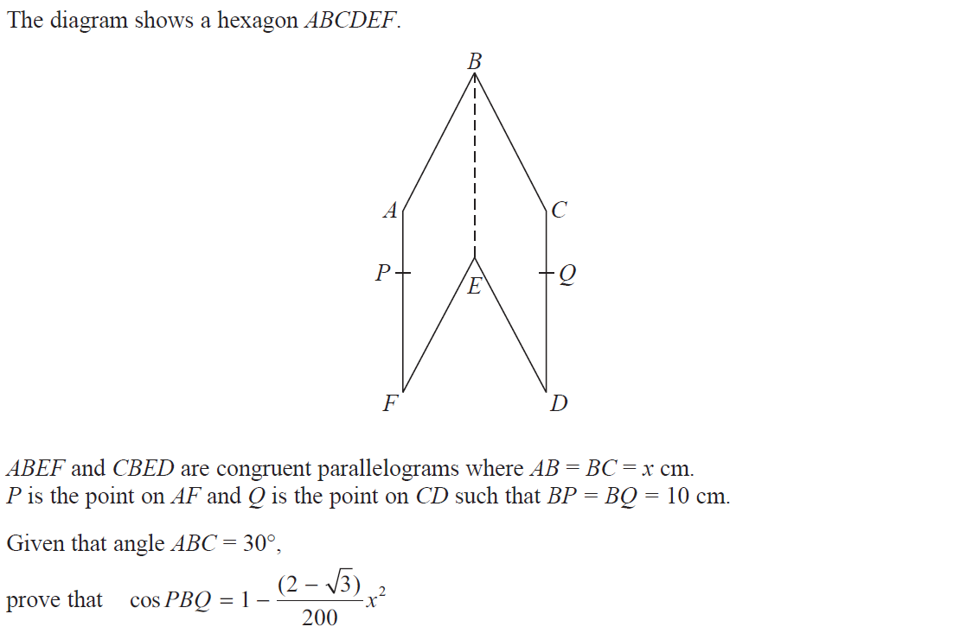
Advanced Trigonometry
May 2017 1H Q22

Slide 9
Advanced Trigonometry
May 2017 1H Q22
A

Slide 10
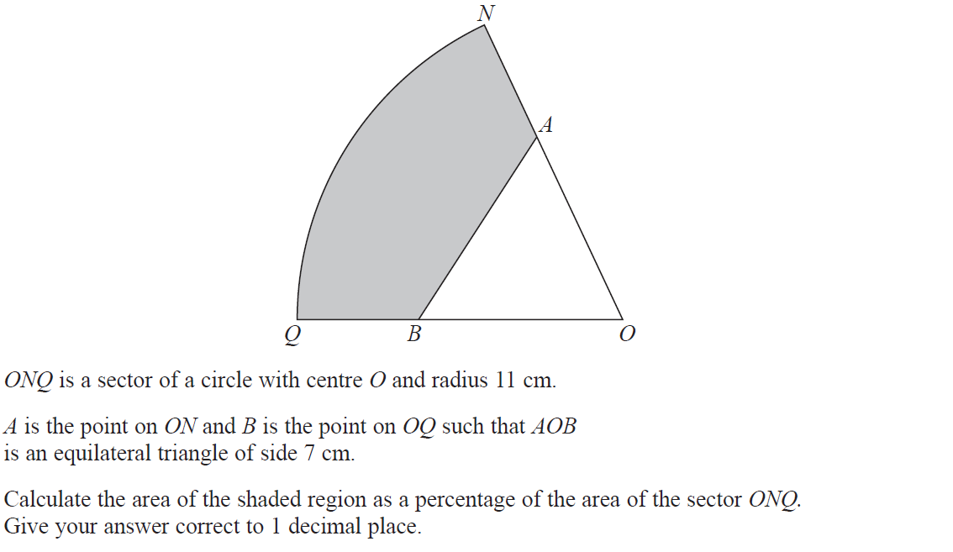
Advanced Trigonometry
June 2017 2H Q17

Slide 11
Advanced Trigonometry
June 2017 2H Q17
A

Slide 12
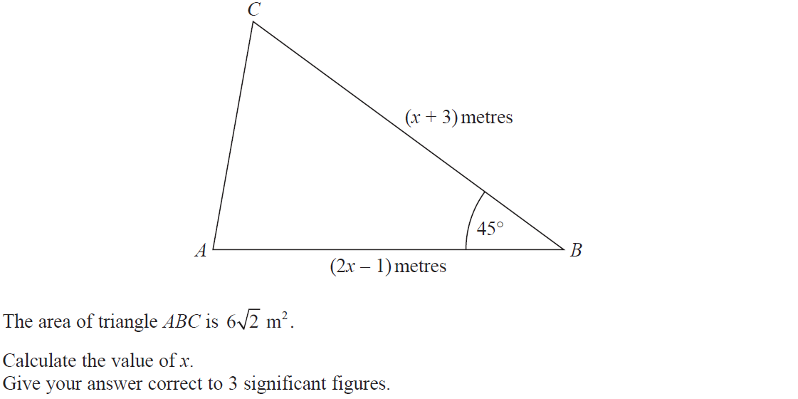
Advanced Trigonometry
June 2017 3H Q15

Slide 13
Advanced Trigonometry
June 2017 3H Q15
A

Slide 14
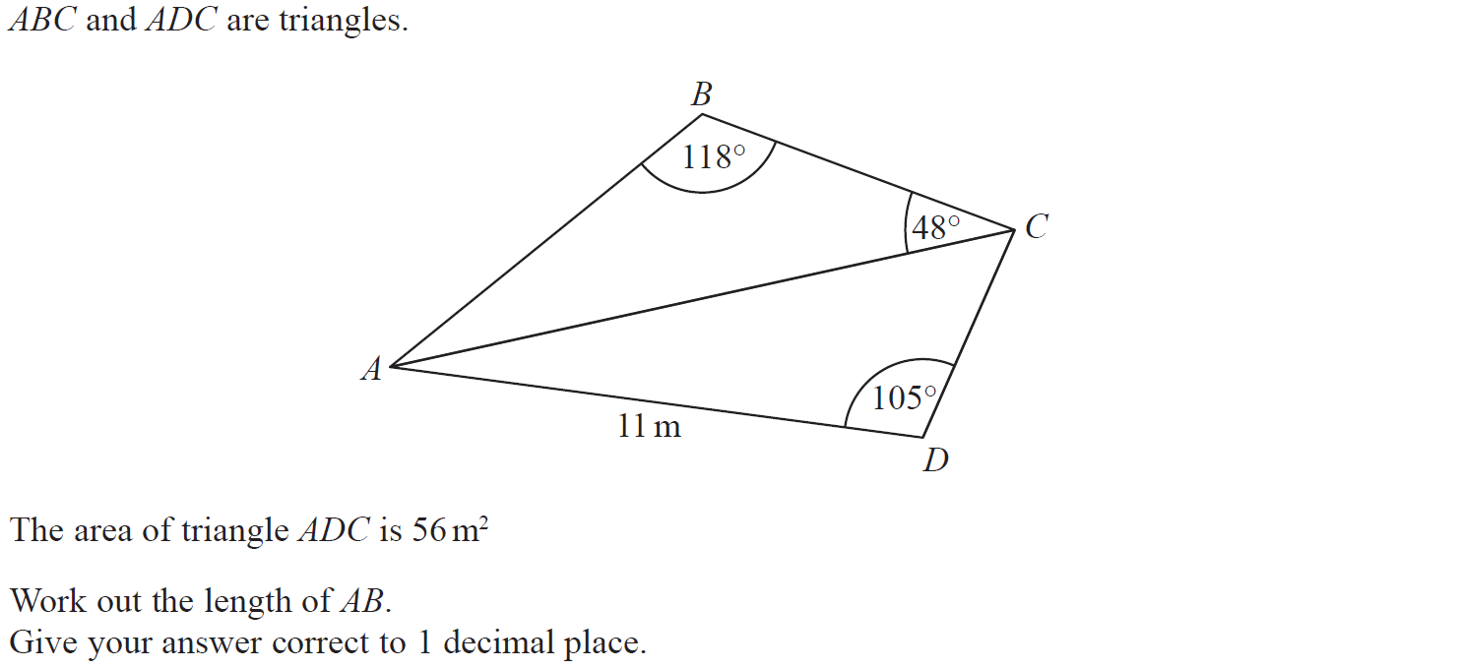
Advanced Trigonometry
Nov 2017 3H Q17

Slide 15
Advanced Trigonometry
Nov 2017 3H Q17
A

Slide 16
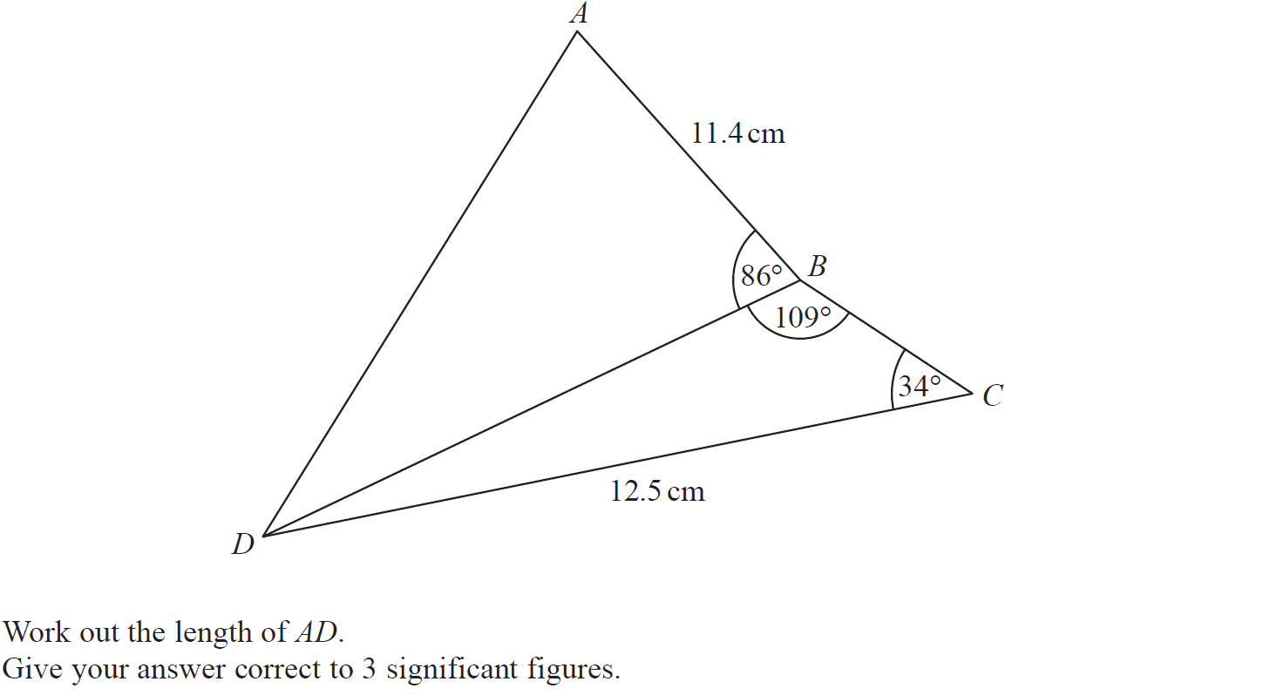
Advanced Trigonometry
June 2018 3H Q17

Slide 17
Advanced Trigonometry
June 2018 3H Q17
A

Slide 18
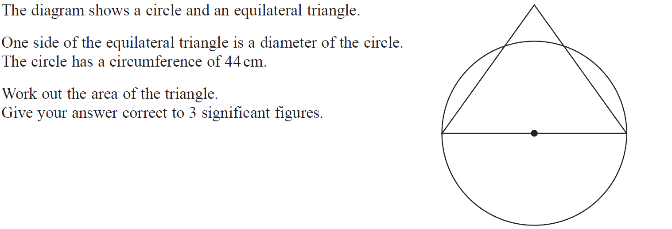
Advanced Trigonometry
Nov 2018 2H Q13

Slide 19
Advanced Trigonometry
Nov 2018 2H Q13
A

Slide 20
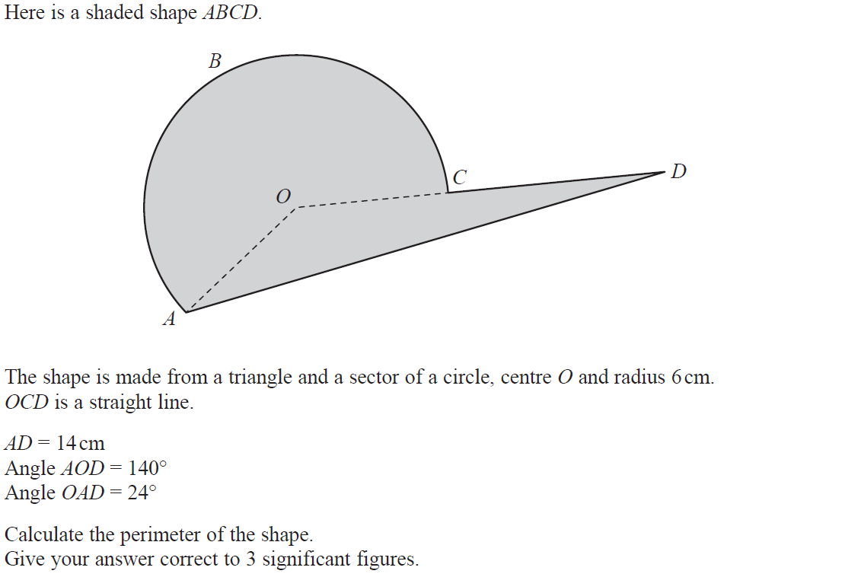
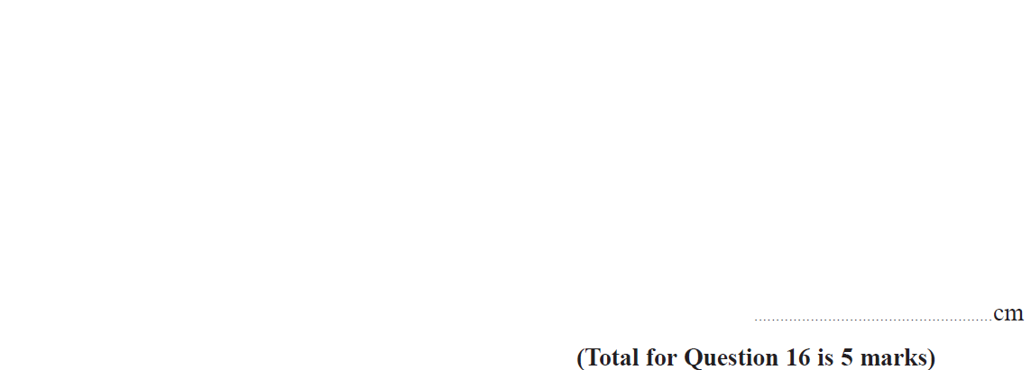
Advanced Trigonometry
Nov 2018 3H Q16

Slide 21
Advanced Trigonometry
Nov 2018 3H Q16
A

Slide 22
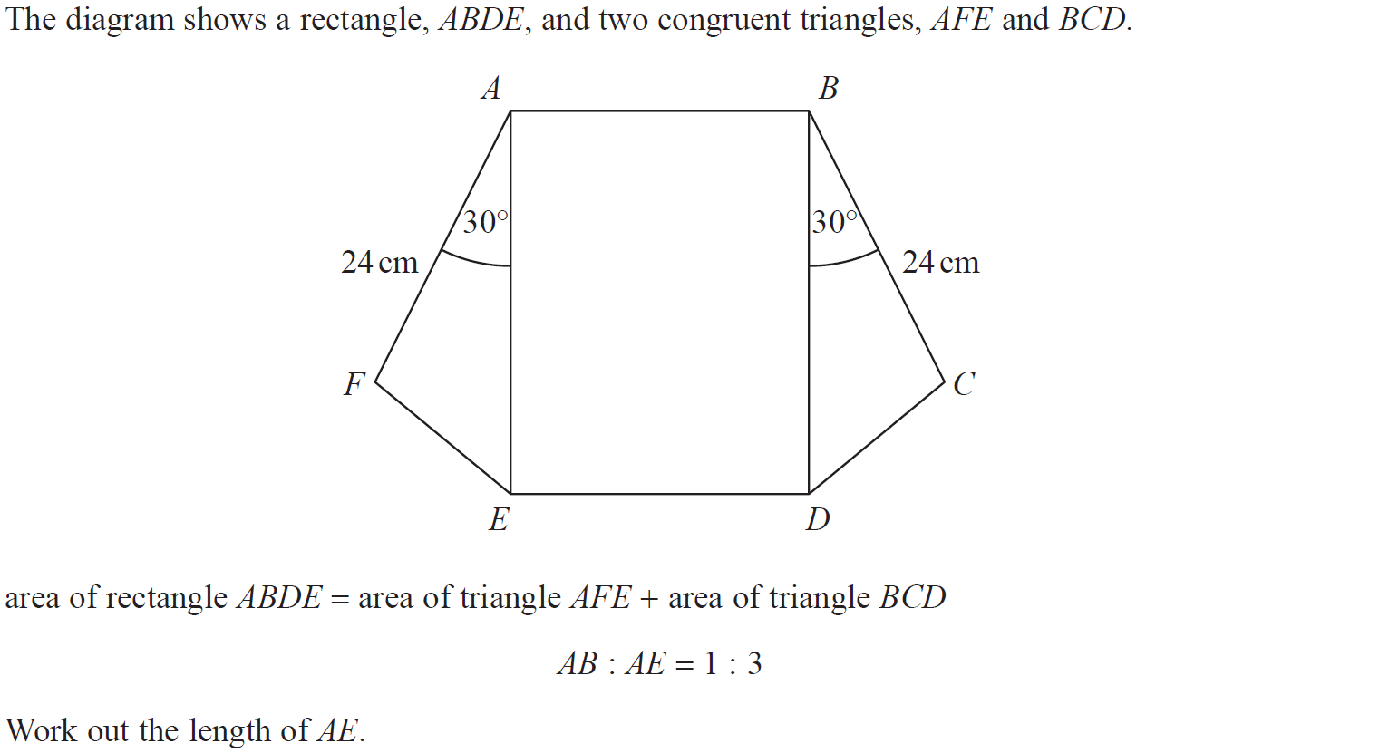
Advanced Trigonometry
June 2019 3H Q14

Slide 23
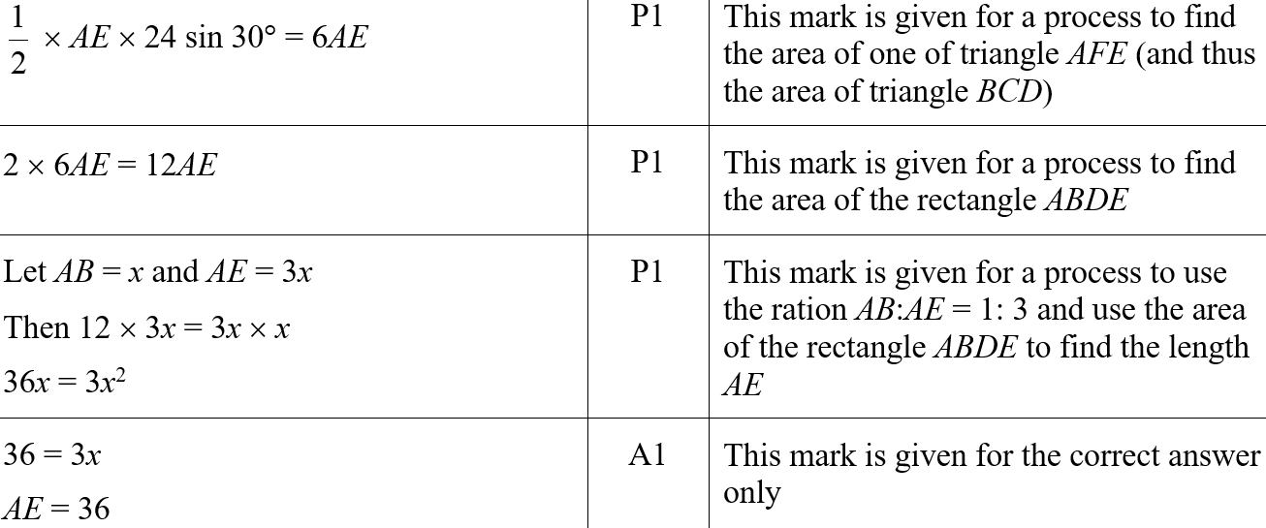
Advanced Trigonometry
June 2019 3H Q14
A
A SF

Slide 24
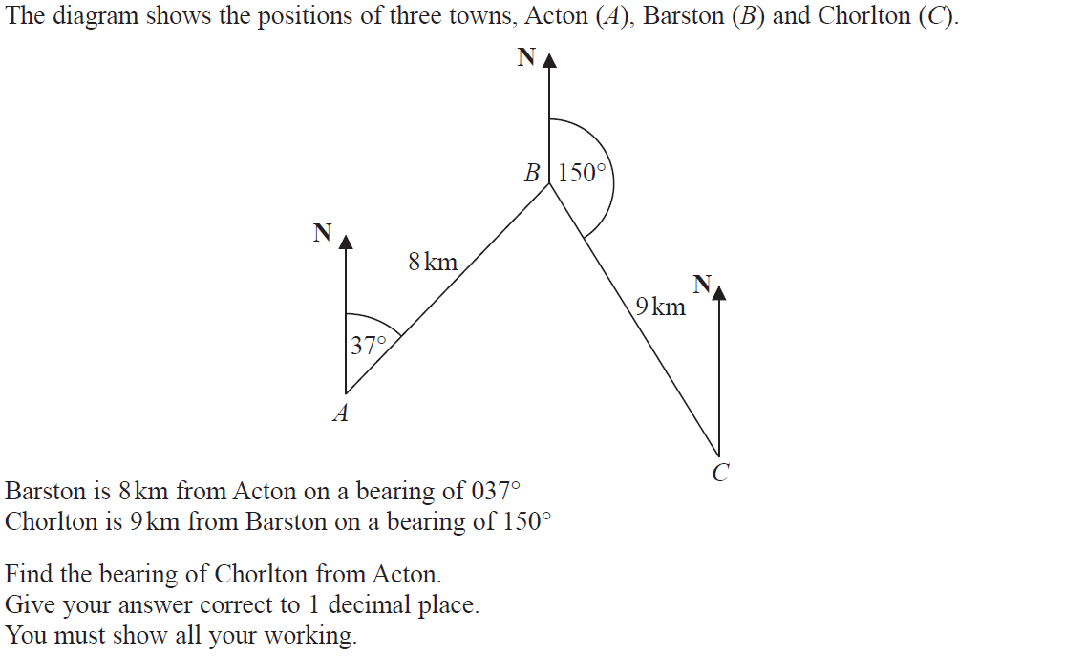
Advanced Trigonometry
June 2019 3H Q23

Slide 25
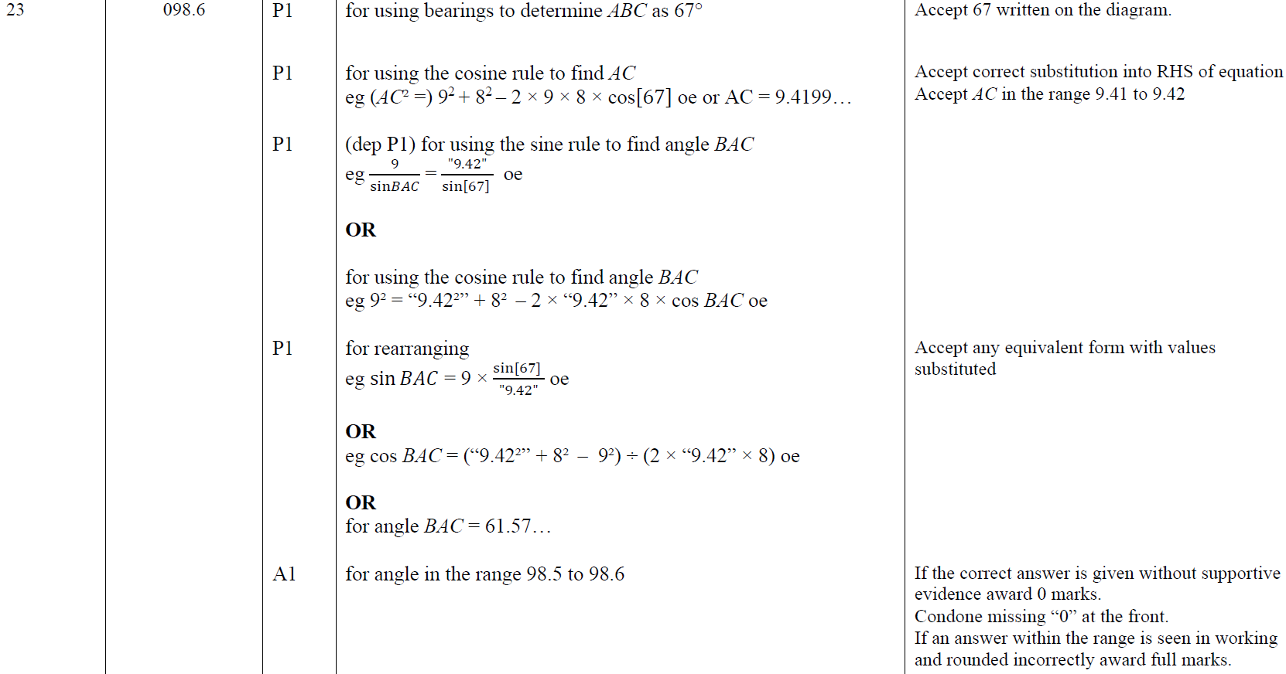
Advanced Trigonometry
June 2019 3H Q23
A

Slide 26
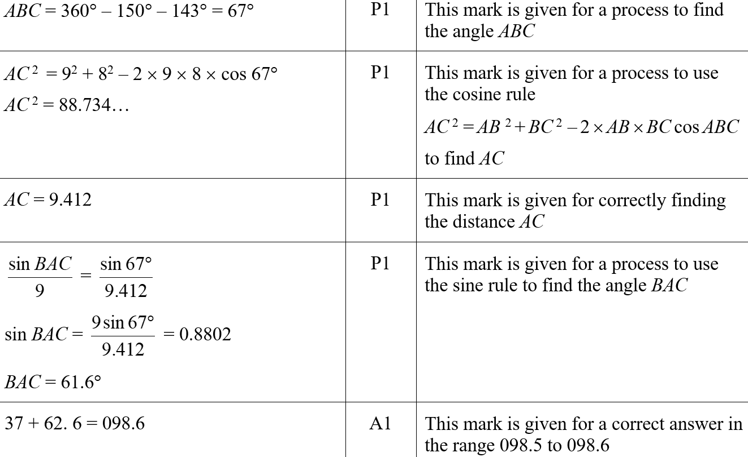
Advanced Trigonometry
June 2019 3H Q23
A SF

Slide 27
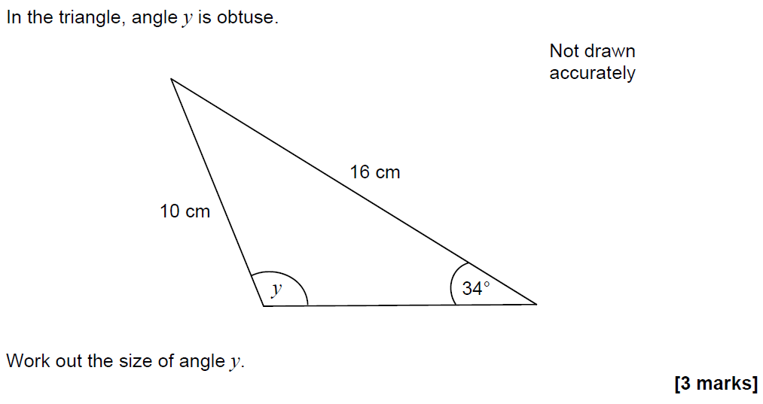
Advanced Trigonometry
SAM 3H Q20

Slide 28
Advanced Trigonometry
SAM 3H Q20
A

Slide 29
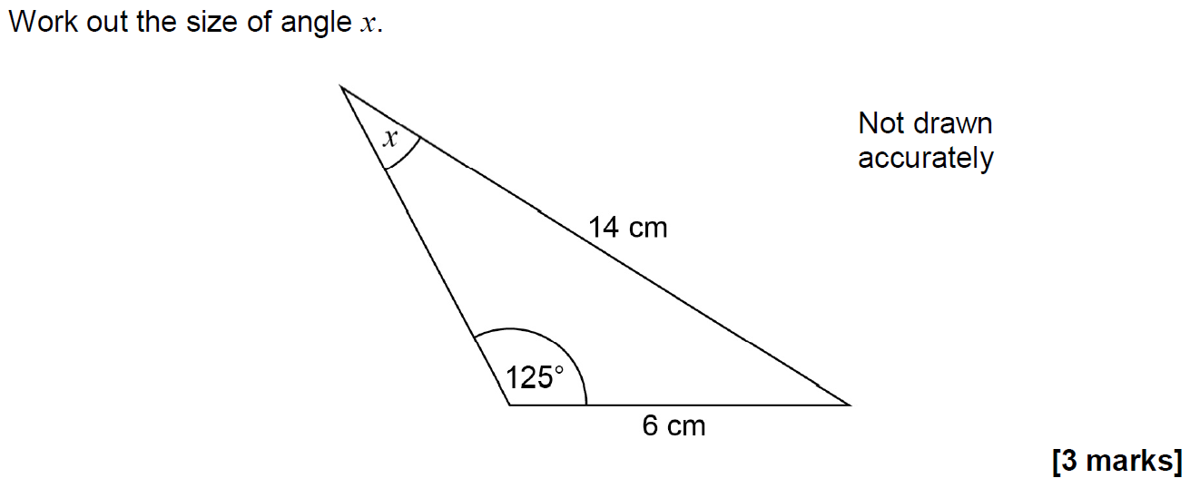
Advanced Trigonometry
June 2017 2H Q20

Slide 30
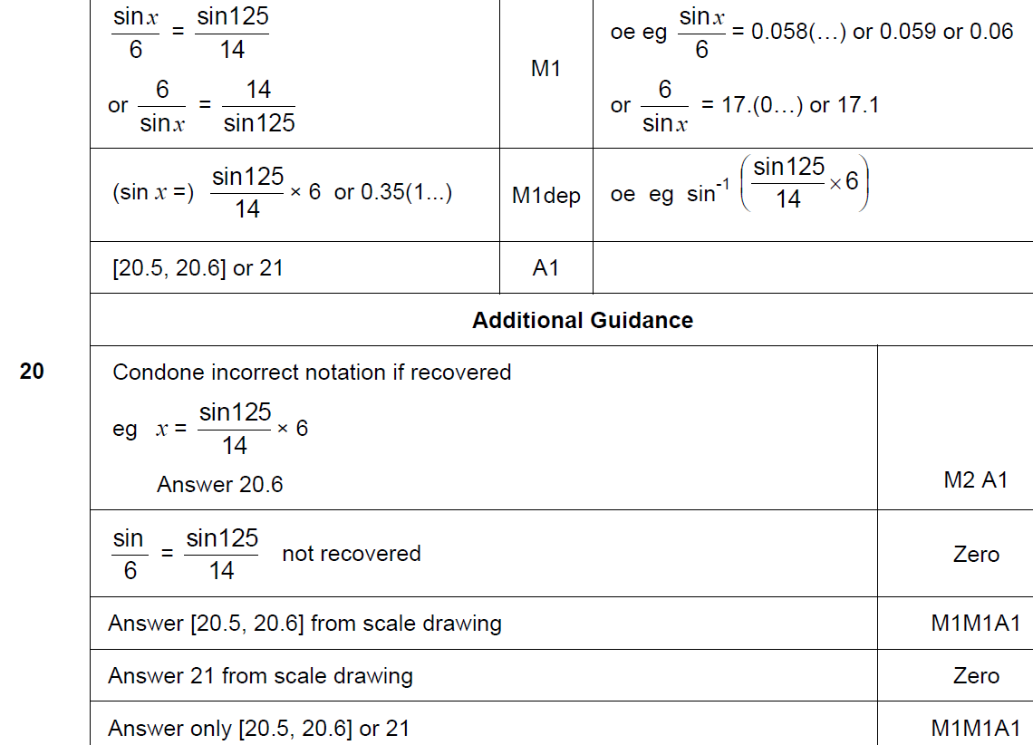
Advanced Trigonometry
June 2017 2H Q20
A

Slide 31
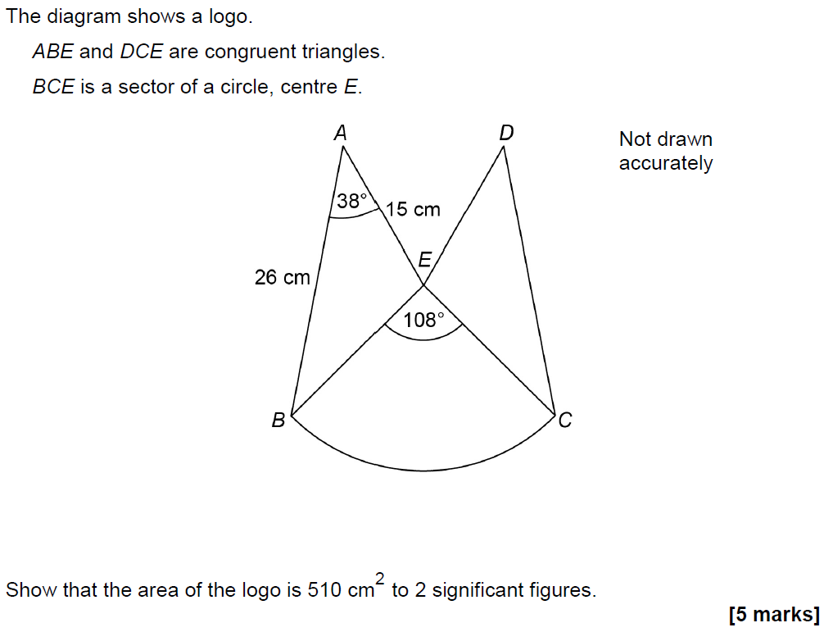
Advanced Trigonometry
June 2017 2H Q25

Slide 32
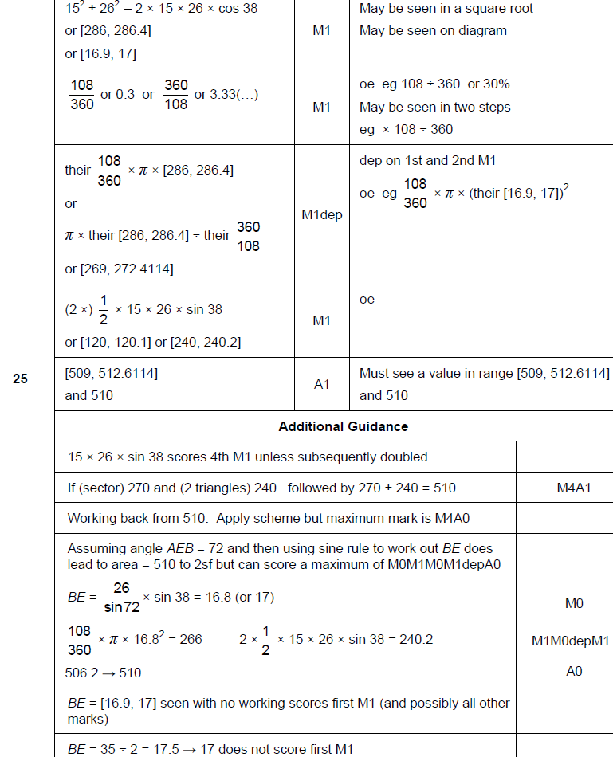
Advanced Trigonometry
June 2017 2H Q25
A

Slide 33
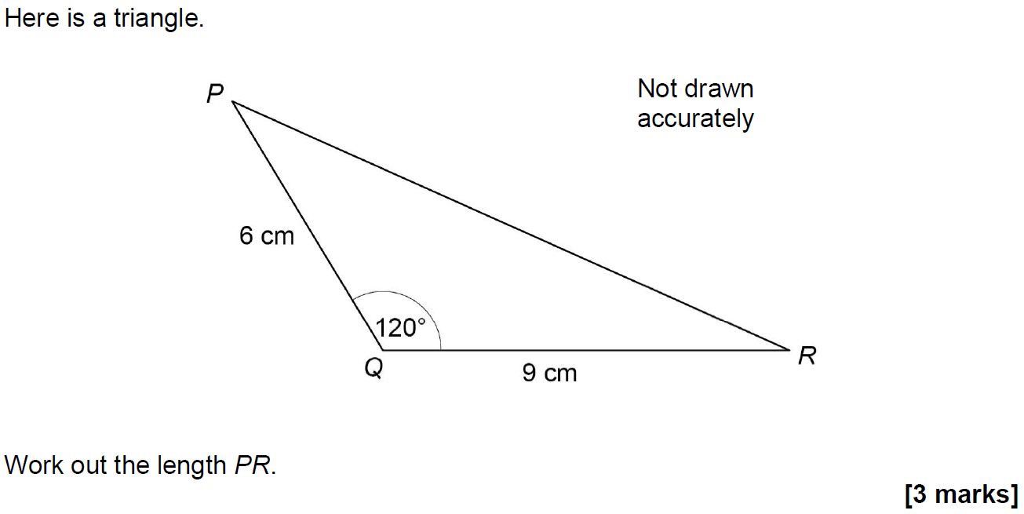
Advanced Trigonometry
Nov 2017 3H Q22

Slide 34
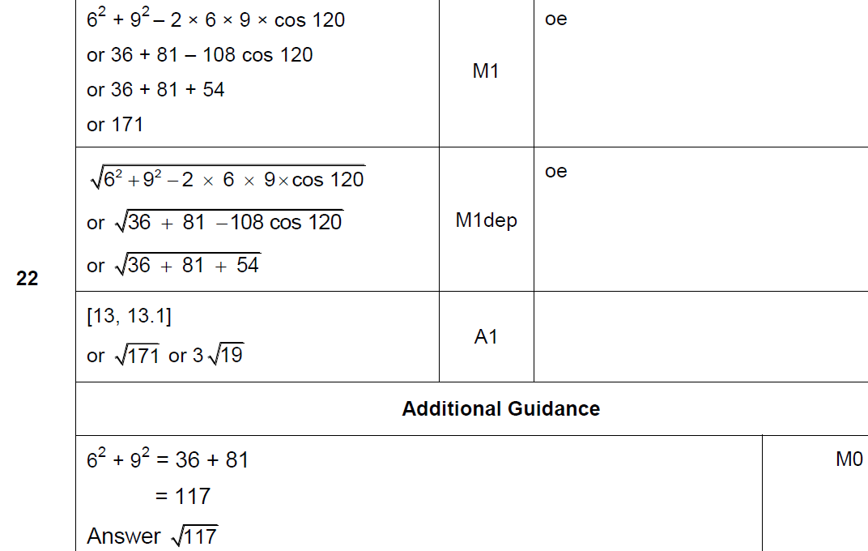
Advanced Trigonometry
Nov 2017 3H Q22
A

Slide 35
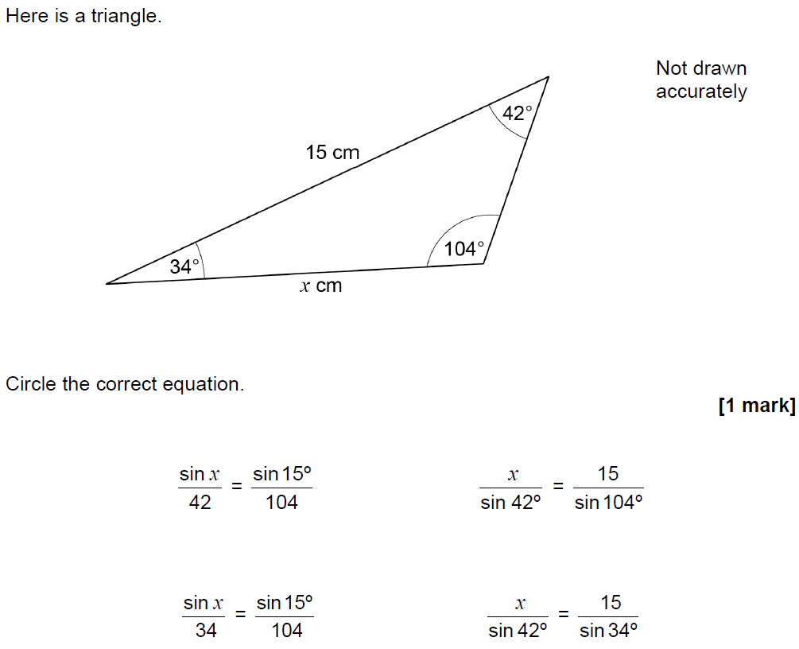
Advanced Trigonometry
May 2018 1H Q17

Slide 36
Advanced Trigonometry
May 2018 1H Q17
A

Slide 37
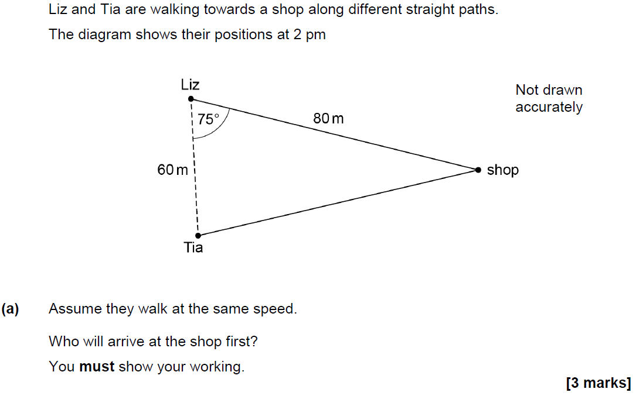
Advanced Trigonometry
June 2018 2H Q21

Slide 38
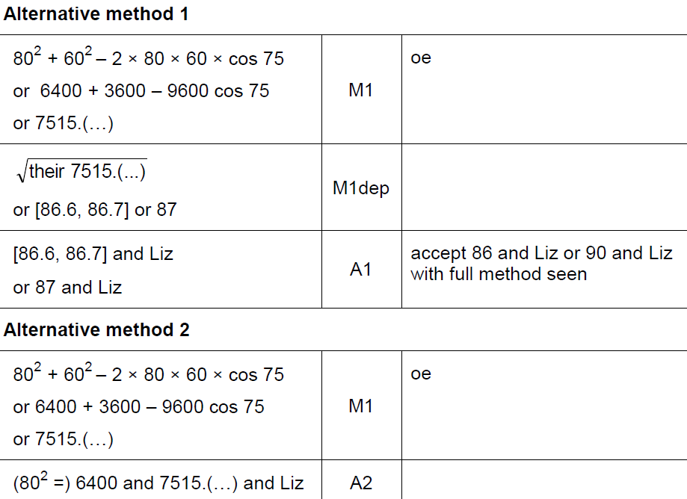
Advanced Trigonometry
June 2018 2H Q21
A

Slide 39
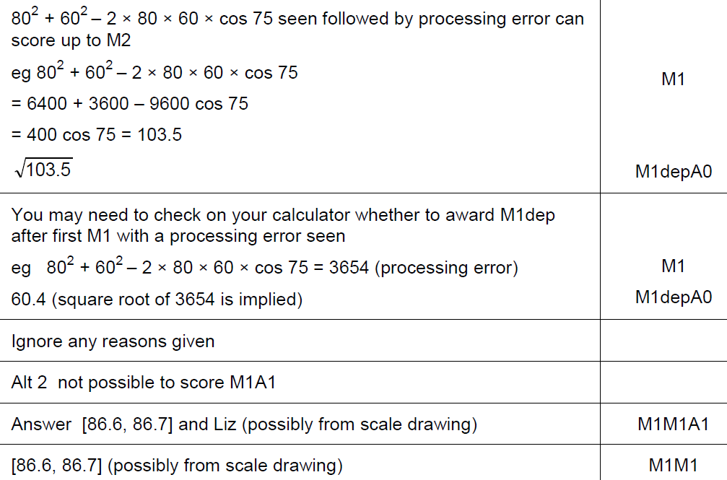
Advanced Trigonometry
June 2018 2H Q21
A notes

Slide 40
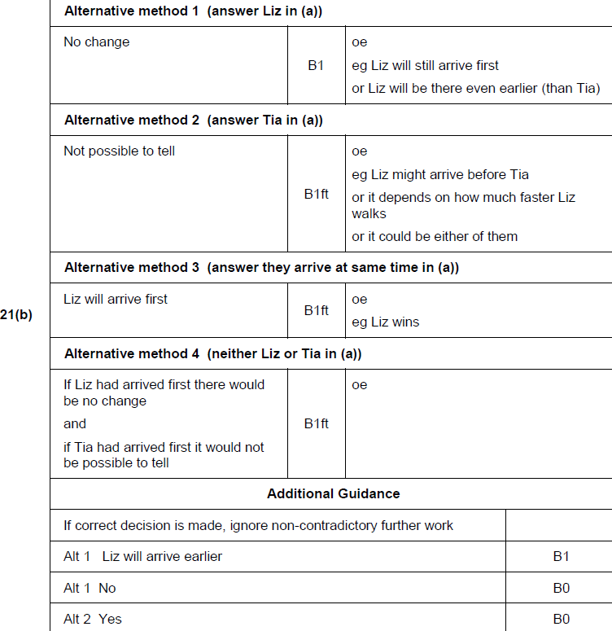
Advanced Trigonometry
June 2018 2H Q21
B

Slide 41
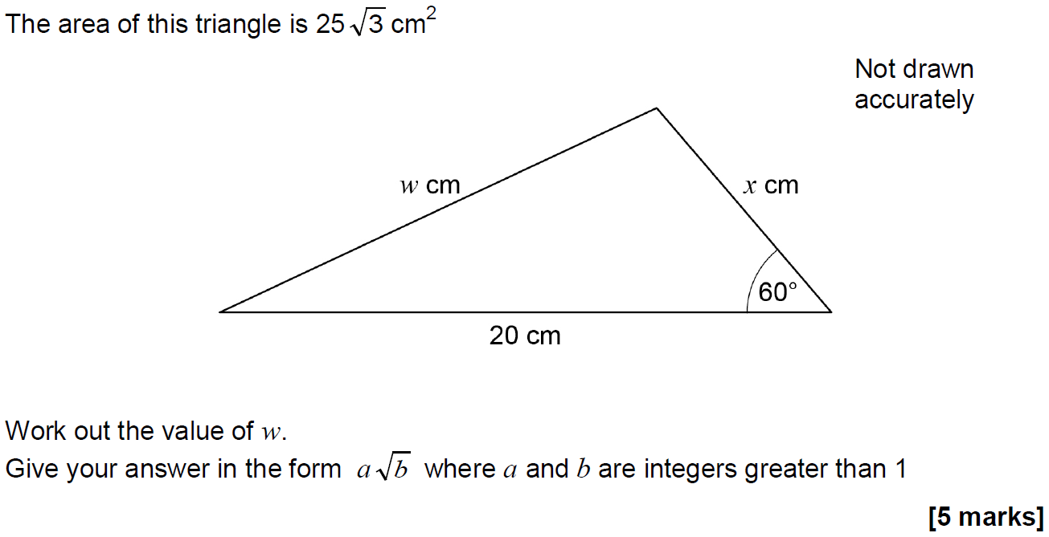
Advanced Trigonometry
Nov 2018 1H Q26

Slide 42
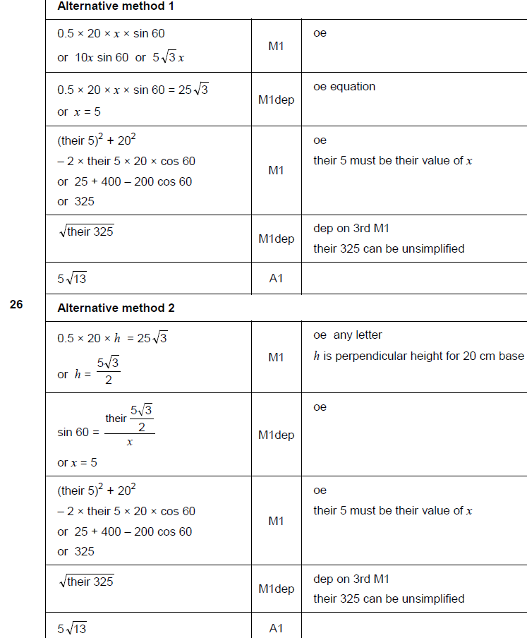
Advanced Trigonometry
Nov 2018 1H Q26
A

Slide 43
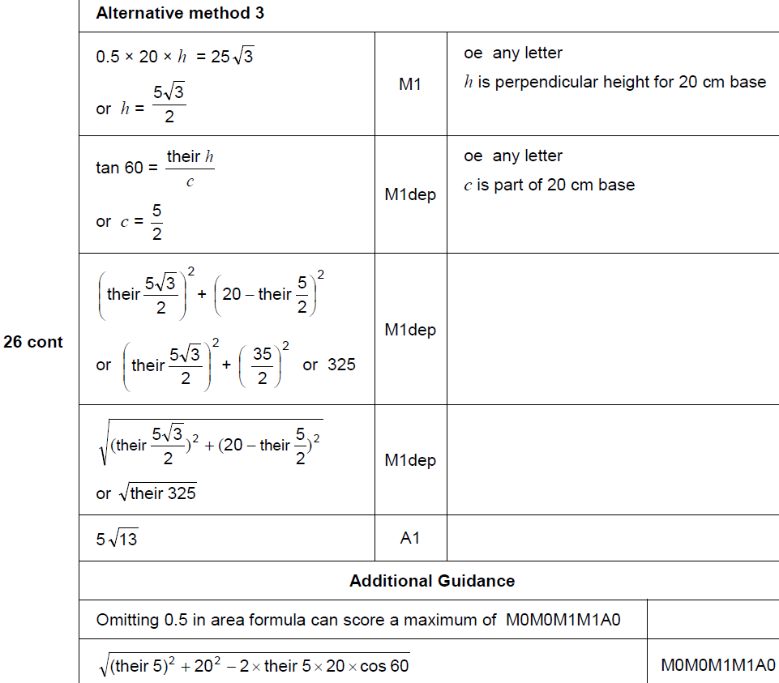
Advanced Trigonometry
Nov 2018 1H Q26
A Alternative & notes

Slide 44
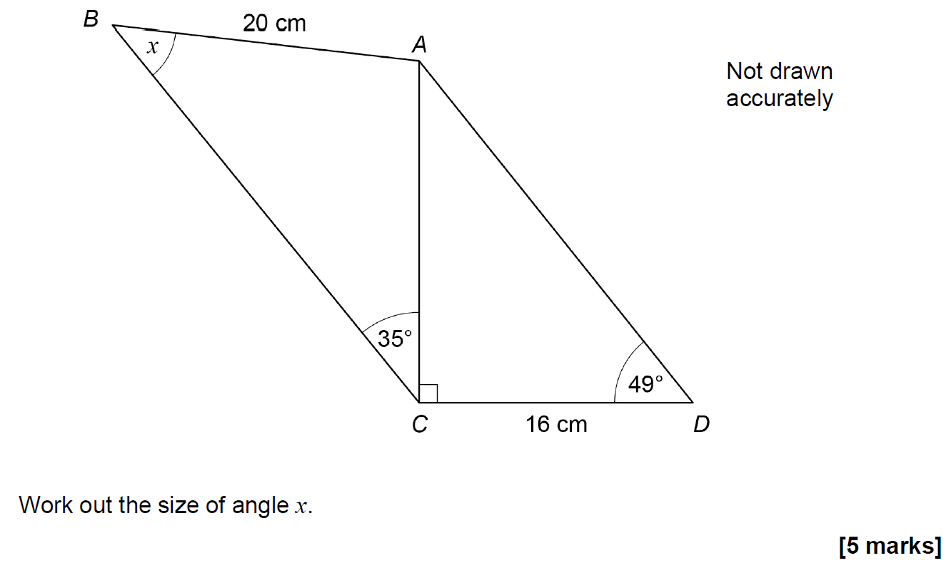
Advanced Trigonometry
Nov 2018 2H Q25

Slide 45
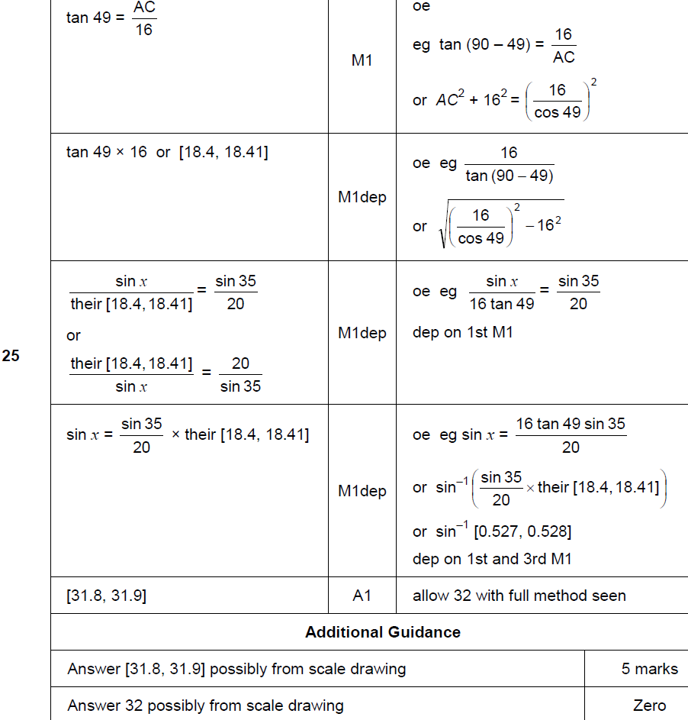
Advanced Trigonometry
Nov 2018 2H Q25
A

Slide 46
Advanced Trigonometry
Nov 2018 1H Q26
A Alternative & notes

Slide 47
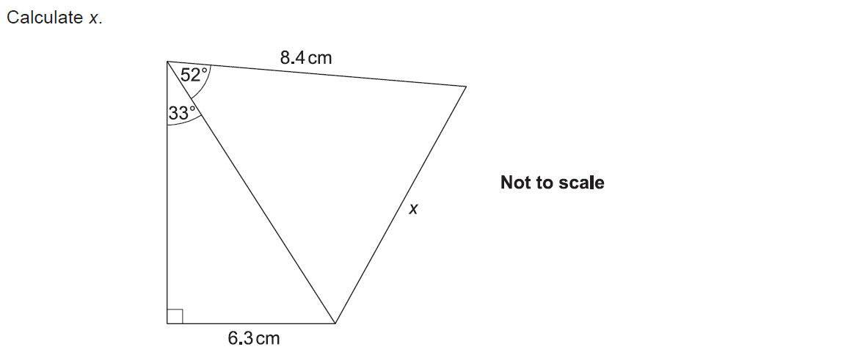
Advanced Trigonometry
SAM 3H Q13

Slide 48
Advanced Trigonometry
SAM 3H Q13
A

Slide 49
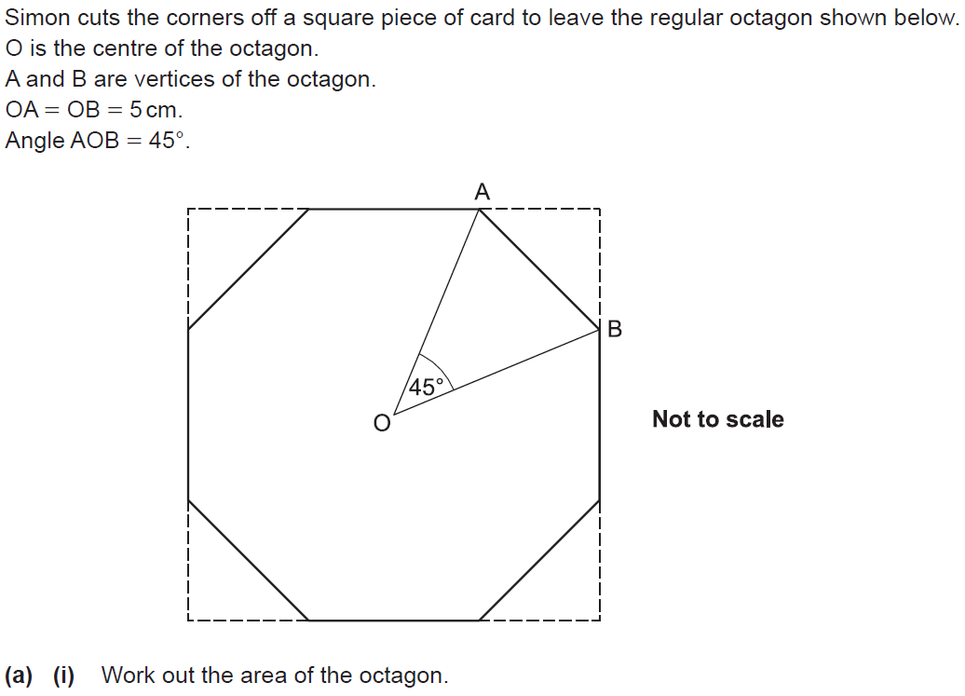
Advanced Trigonometry
SAM 3H Q16

Slide 50
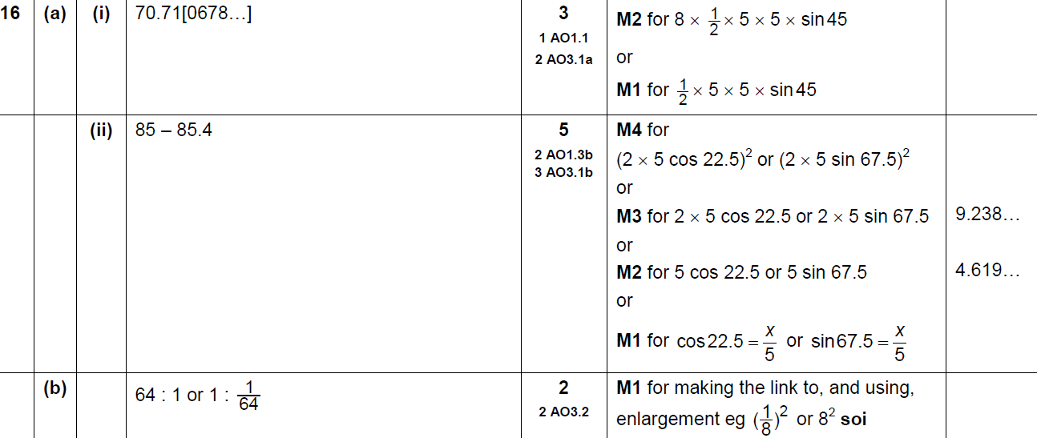
Advanced Trigonometry
SAM 3H Q16
A (i)
A (ii)
B

Slide 51
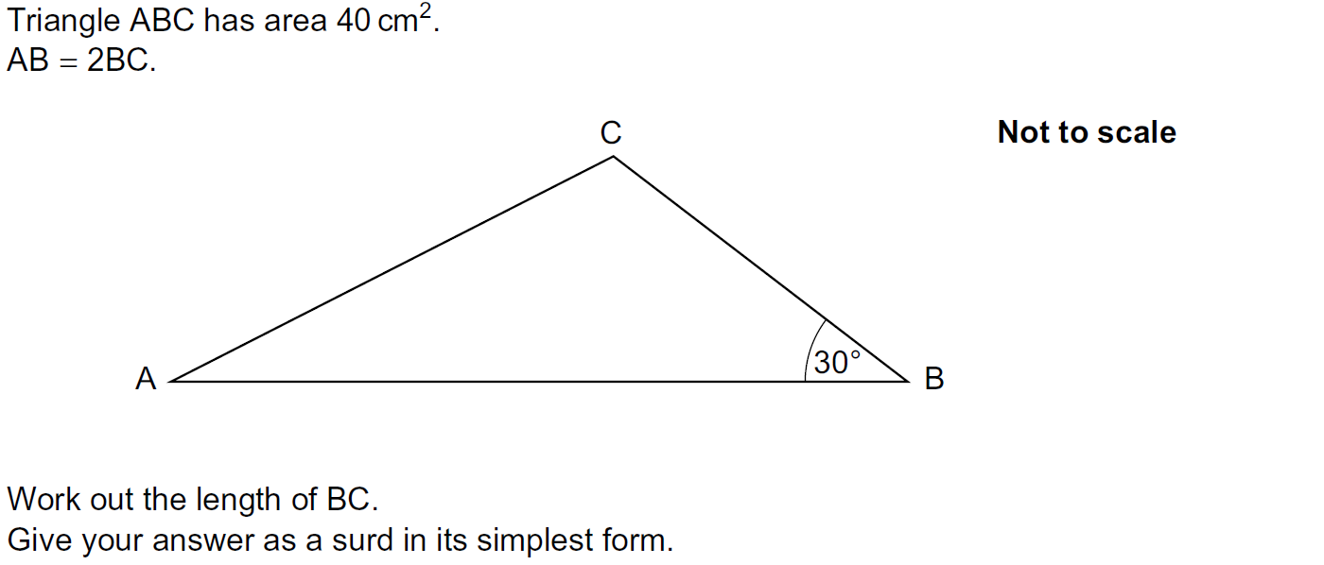
Advanced Trigonometry
Practice 2H Q16

Slide 52
Advanced Trigonometry
Practice 2H Q16
A

Slide 53
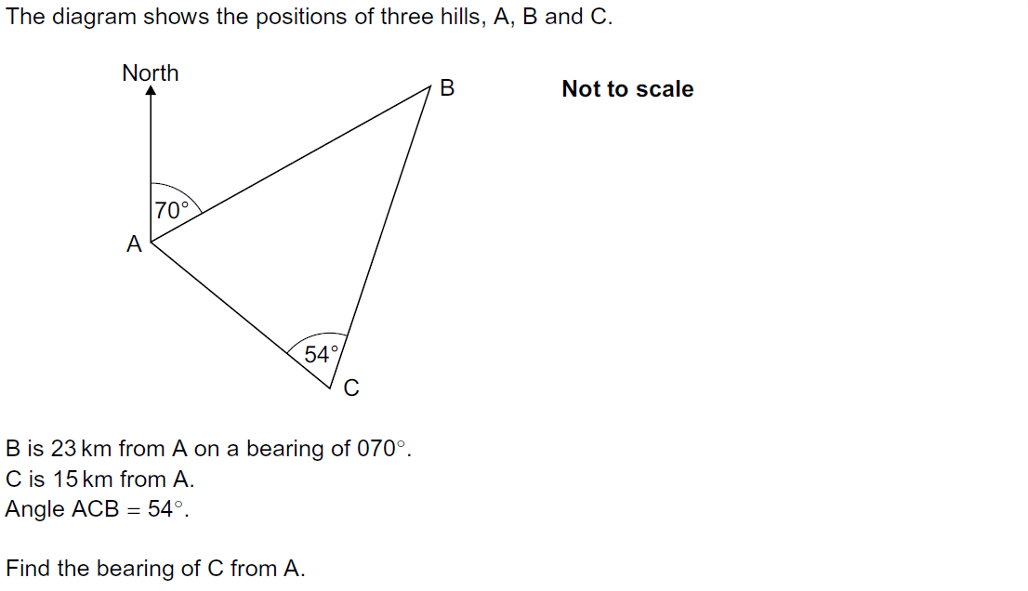
Advanced Trigonometry
Practice 3H Q16

Slide 54
Advanced Trigonometry
Practice 3H Q16
A

Slide 55
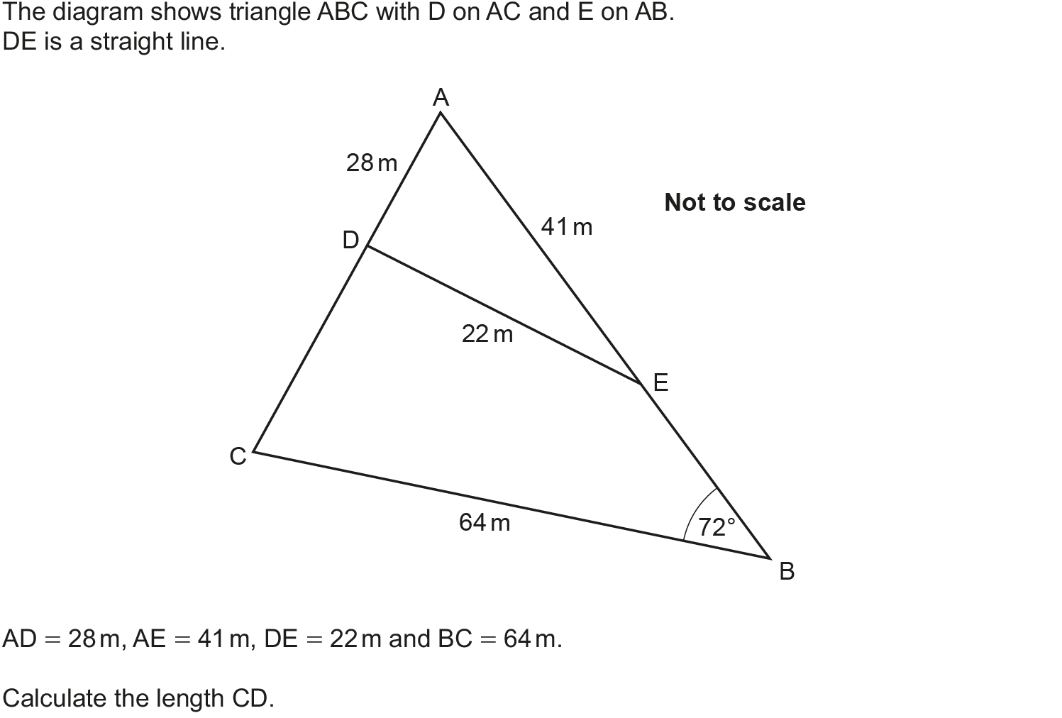
Advanced Trigonometry
May 2017 1H Q14

Slide 56
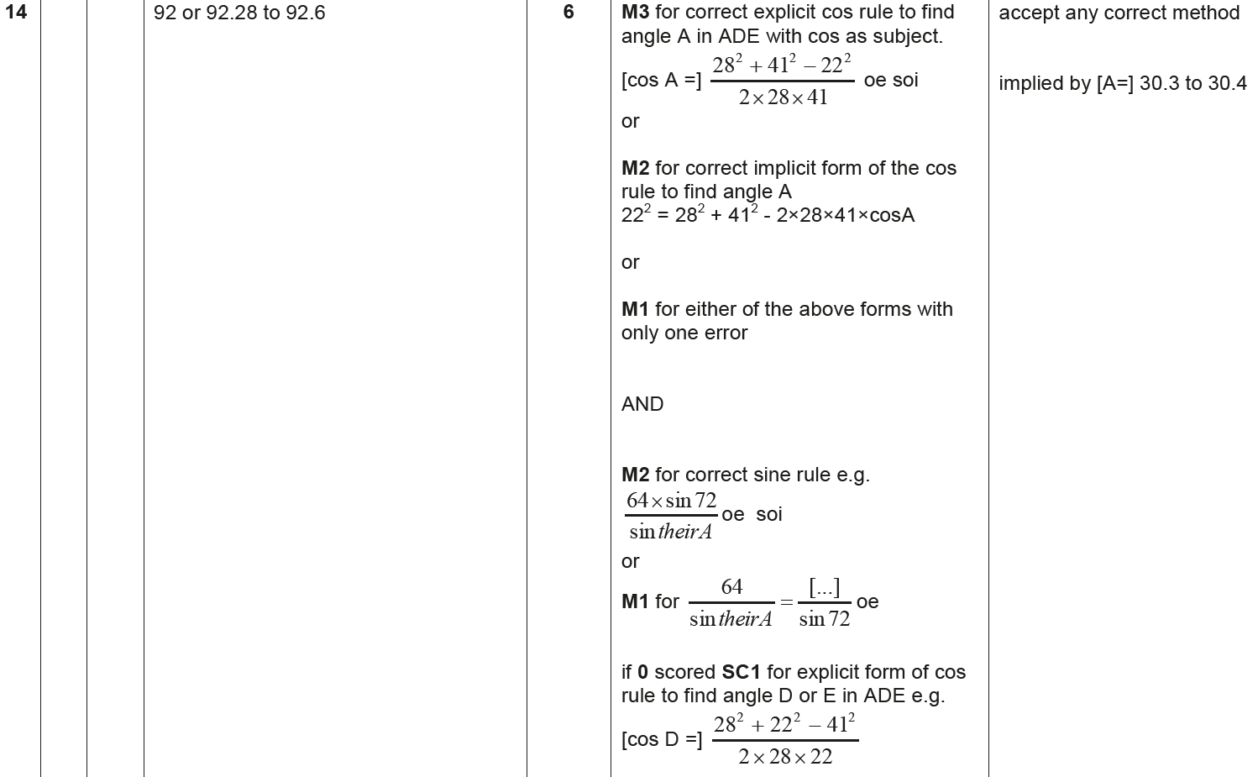
Advanced Trigonometry
May 2017 1H Q14
A

Slide 57
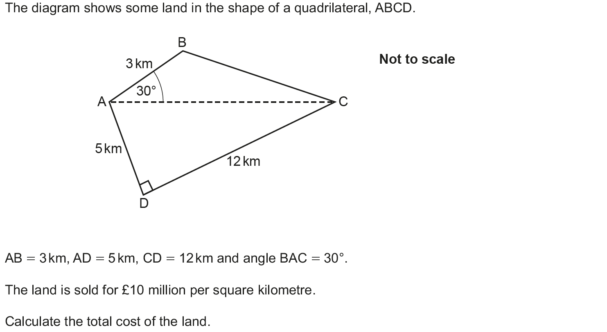
Advanced Trigonometry
June 2017 2H Q20

Slide 58
Advanced Trigonometry
June 2017 2H Q20
A

Slide 59
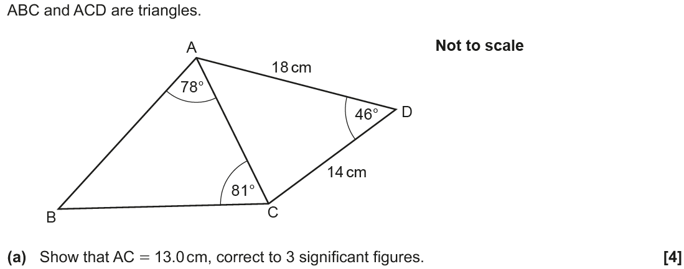
Advanced Trigonometry
Nov 2017 1H Q17

Slide 60
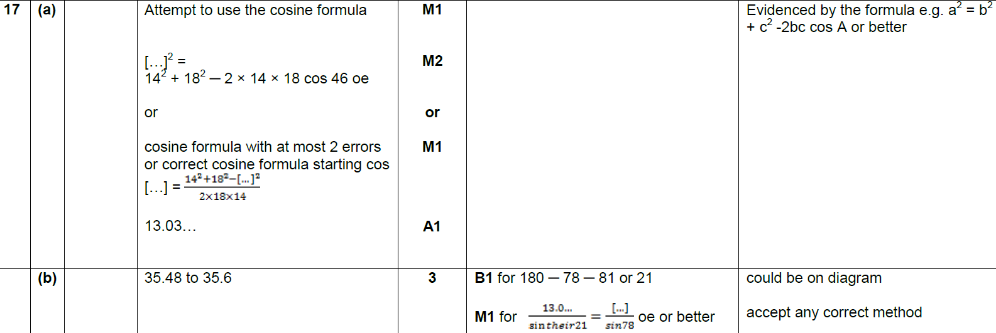
Advanced Trigonometry
Nov 2017 1H Q17
A
B

Slide 61
Advanced Trigonometry
May 2018 1H Q18

Slide 62
Advanced Trigonometry
May 2018 1H Q18
A

Slide 63
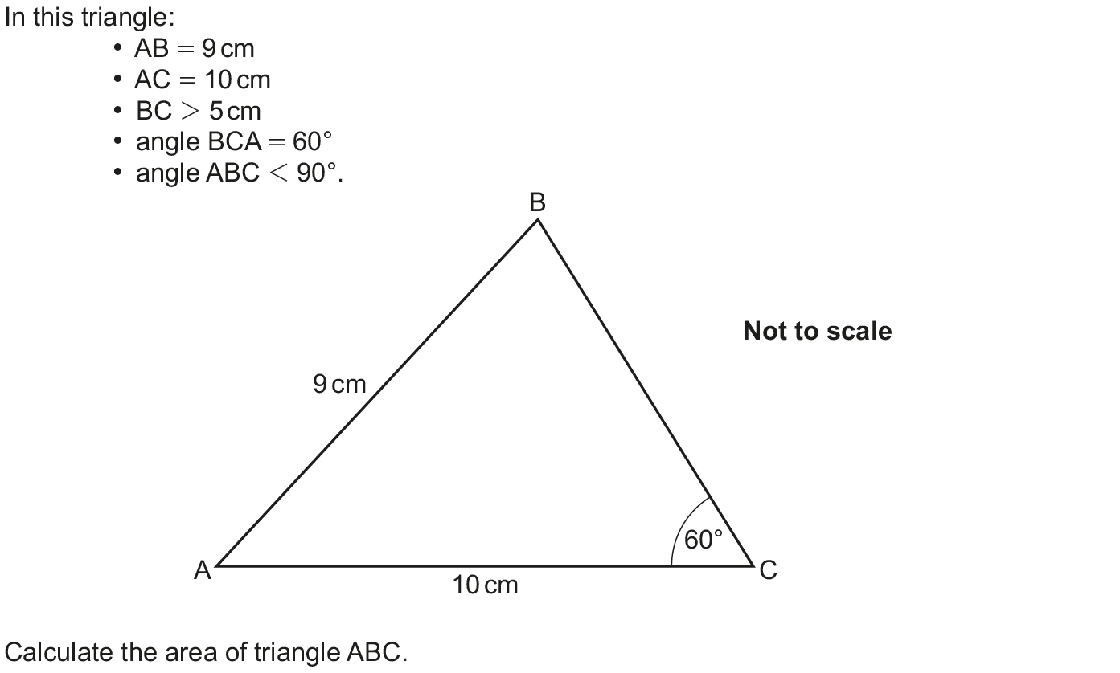
Advanced Trigonometry
Nov 2018 3H Q19

Slide 64
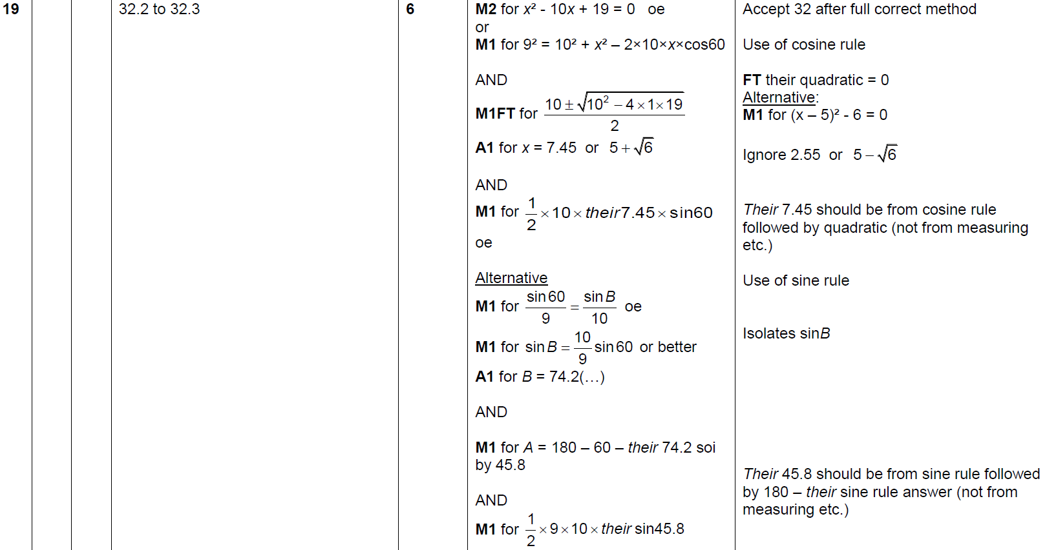
Advanced Trigonometry
Nov 2018 3H Q19
A

