Slide 1
Advanced Trigonometry
Advanced Trigonometry
Old Spec Q’s
SAM
2H Q21
June 2019
2H Q19
June 2018
2H Q18
May 2018
1HR Q18
Jan 2019
1H Q17
Jan 2019
1HR Q21
Jan 2019
2HR Q19
May 2019
1H Q18
With Functions*

Slide 2
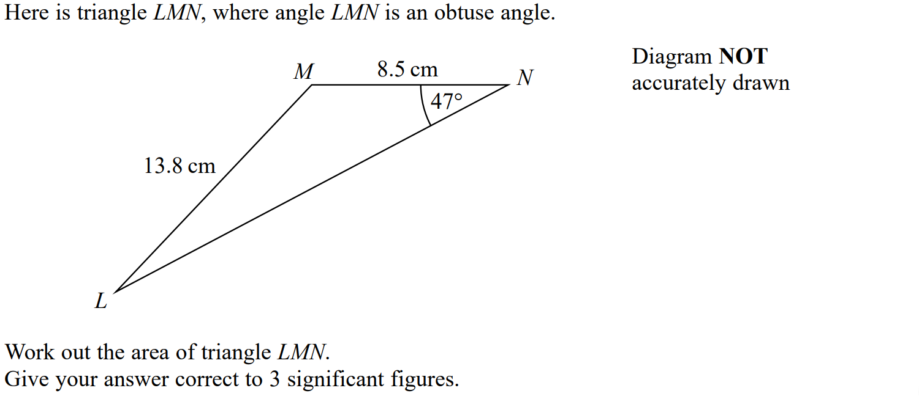
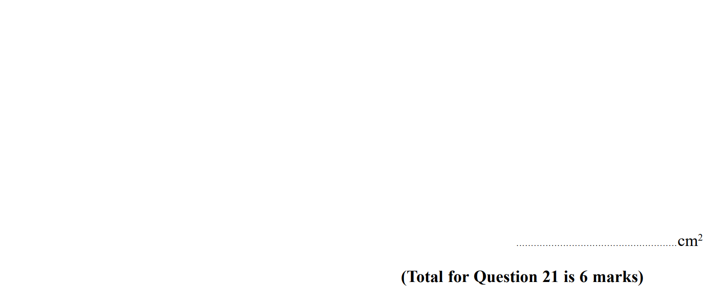
Advanced Trigonometry
SAM 2H Q21

Slide 3
Advanced Trigonometry
SAM 2H Q21
A

Slide 4
Advanced Trigonometry
June 2018 2H Q18

Slide 5
Advanced Trigonometry
June 2018 2H Q18
A

Slide 6
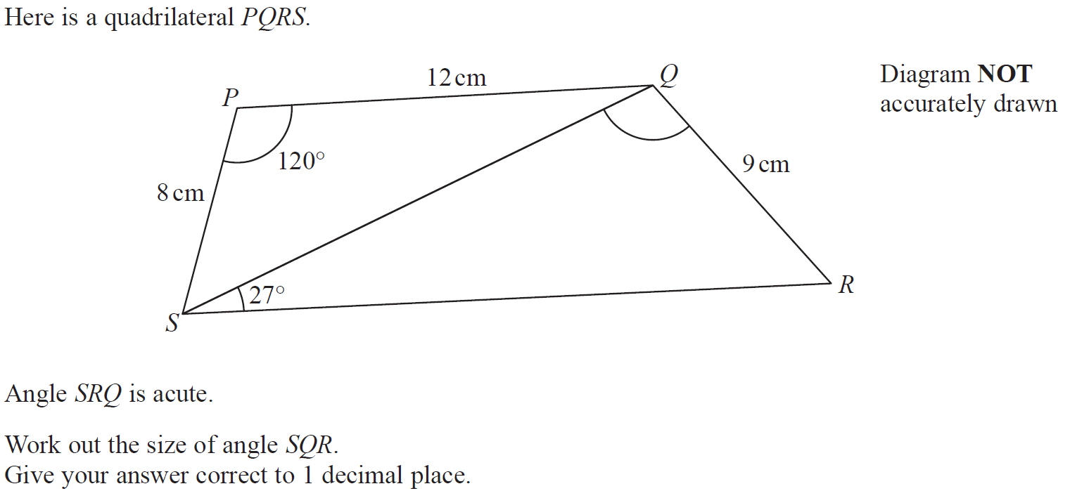
Advanced Trigonometry
May 2018 1HR Q18

Slide 7
Advanced Trigonometry
May 2018 1HR Q18
A

Slide 8
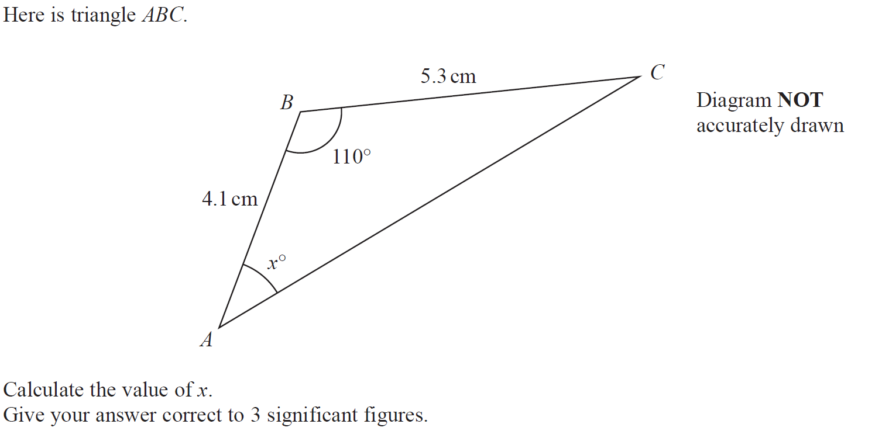
Advanced Trigonometry
Jan 2019 1H Q17

Slide 9
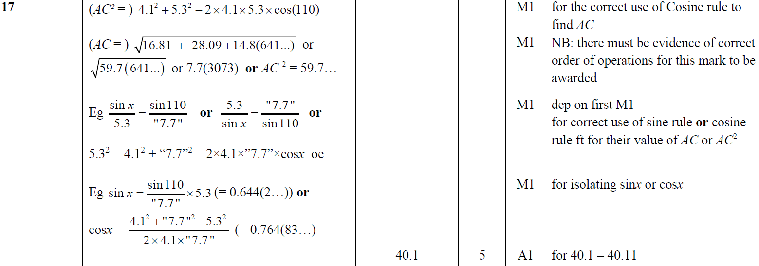
Advanced Trigonometry
Jan 2019 1H Q17
A

Slide 10
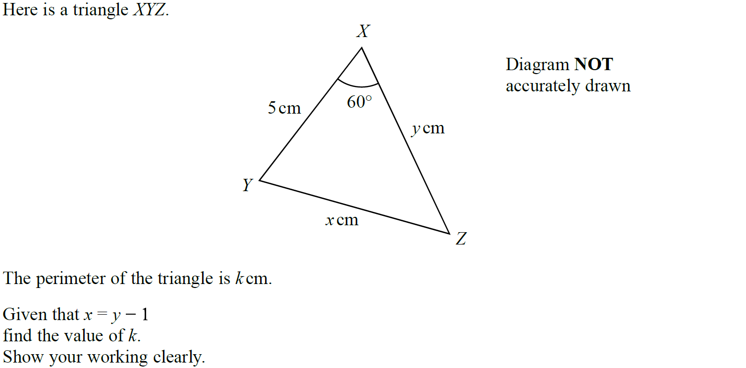
Advanced Trigonometry
Jan 2019 1HR Q21

Slide 11
Advanced Trigonometry
Jan 2019 1HR Q21
A

Slide 12
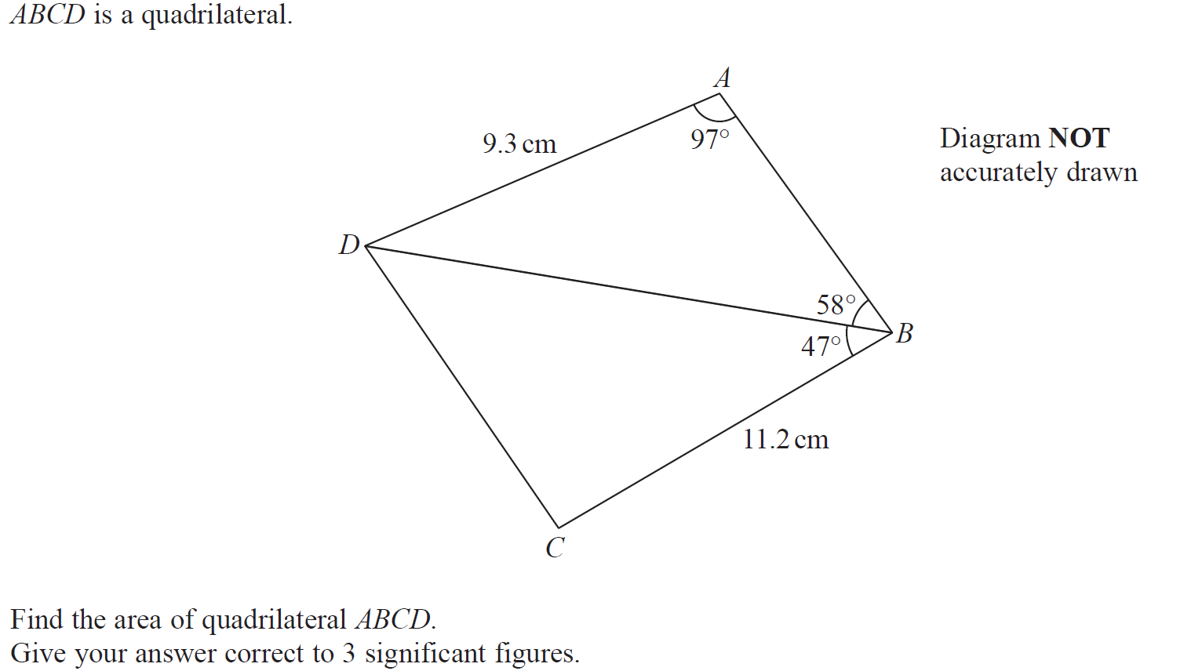
Advanced Trigonometry
Jan 2019 2HR Q19

Slide 13
Advanced Trigonometry
Jan 2019 2HR Q19
A

Slide 14
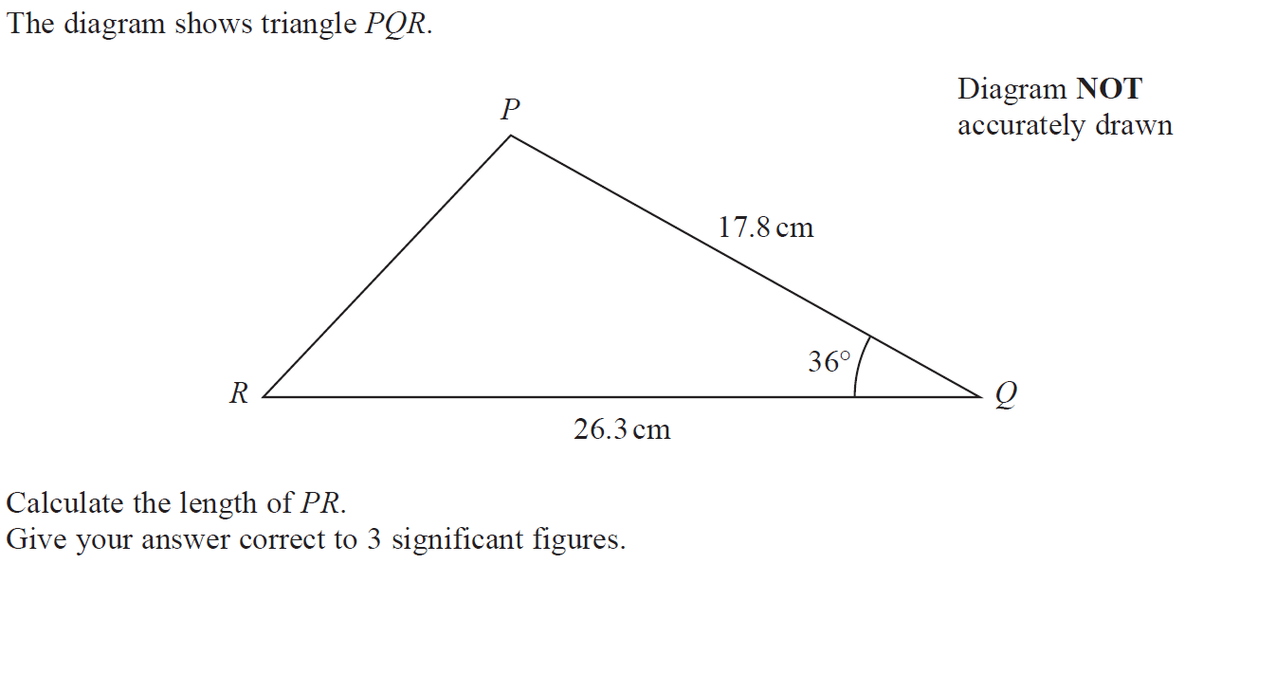
Advanced Trigonometry
May 2019 1H Q18

Slide 15
Advanced Trigonometry
May 2019 1H Q18
A

Slide 16
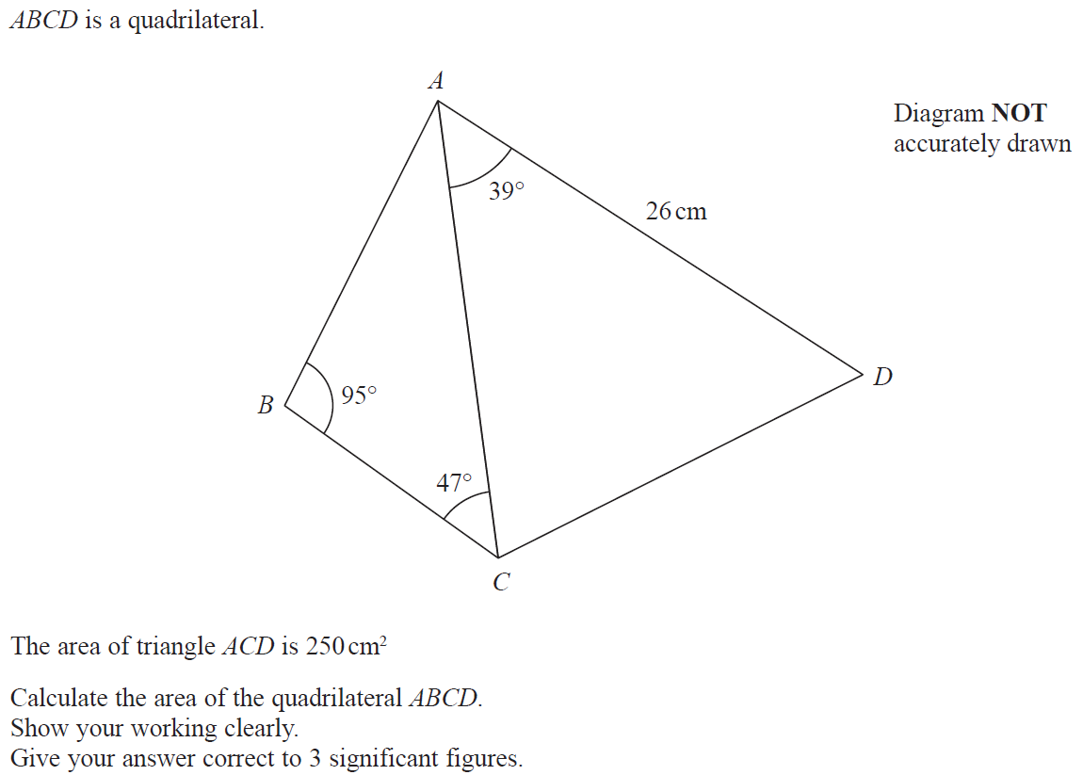
Advanced Trigonometry
June 2019 2H Q19

Slide 17
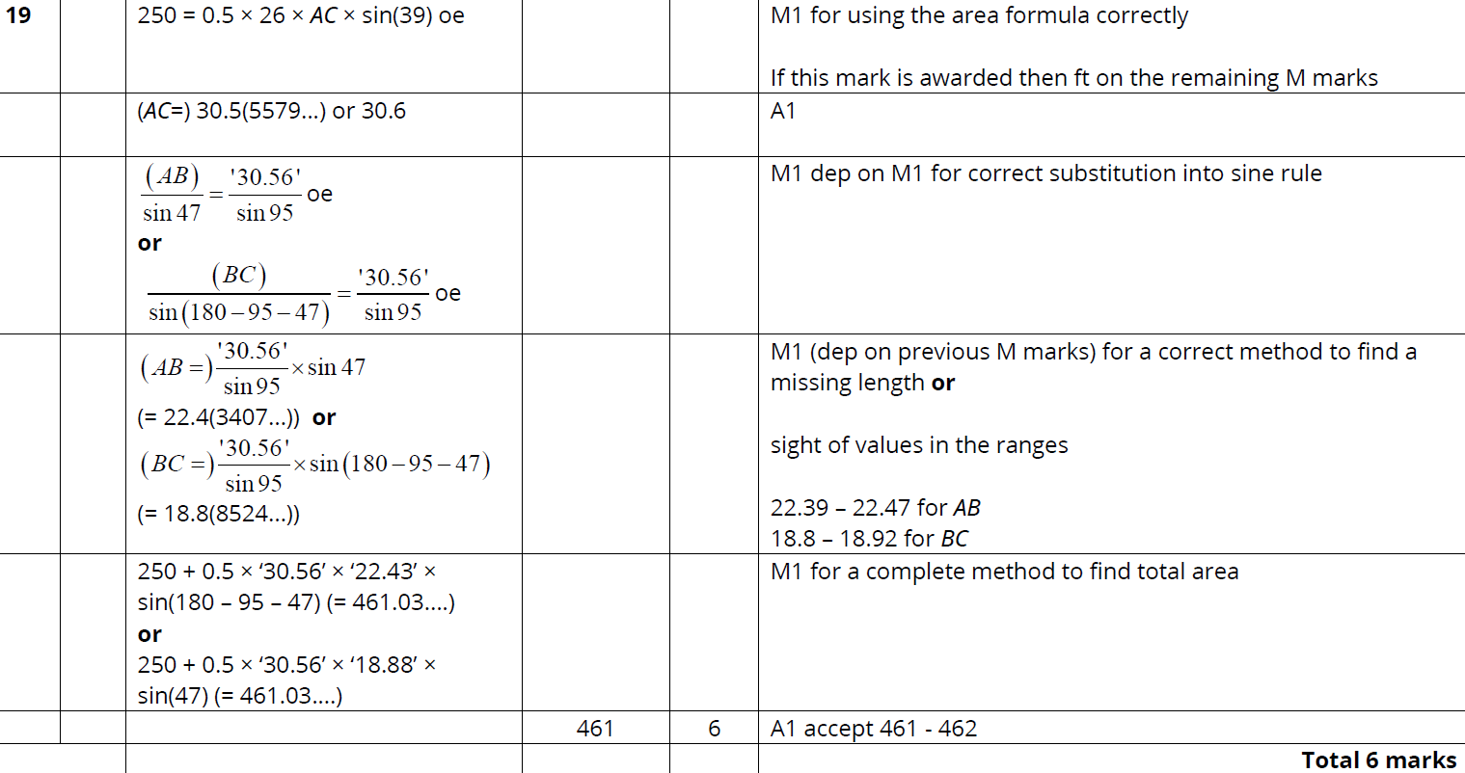
Advanced Trigonometry
June 2019 2H Q19
A

Slide 18
Advanced Trigonometry
Advanced Trigonometry
New Spec Q’s
May 2004
3H Q18
May 2008
3H Q18
June 2010
4H Q18
May 2013 3H Q18
Jan 2015 4H Q24
May 2016 3HR Q22
Jan 2018 4H Q16
Nov 2004
4H Q20
May 2008
4H Q15
Nov 2010
3H Q19
May 2013 3H Q21
Jan 2015 3HR Q23
Jan 2017 3H Q15
Jan 2018 4HR Q15
May 2005
3H Q18
May 2008
4H Q22
Nov 2010
4H Q19
May 2013 4H Q19
June 2015 4H Q16
Jan 2017 4H Q21
May 2018 3H Q16
Nov 2005
3H Q14
Nov 2008
3H Q19
June 2011 4H Q19
May 2013 4HR Q16
June 2015 4H Q22
Jan 2017 3HR Q21
May 2018 3HR Q21
Nov 2005
4H Q17*
Nov 2008
4H Q14
Jan 2012 3H Q18
May 2013 4HR Q22
May 2015 3HR Q16
June 2017 4H Q19
June 2018 4HR Q24
May 2006
4H Q9
Nov 2008
4H Q22
Jan 2012 4H Q18
Jan 2014 4H Q17
June 2015 4HR Q20
June 2017 4H Q21
Nov 2006
4H Q24
May 2009
3H Q19
May 2012 3H Q19
Jan 2014 3HR Q21
Jan 2016 3H Q20
May 2017 3HR Q14
May 2007
4H Q16
May 2009
3H Q21
May 2012 4H Q16
May 2014 3H Q22
Jan 2016 4H Q21
May 2017 3HR Q21
May 2007
4H Q19
Nov 2009
3H Q22
Jan 2013 3H Q16
May 2014 4HR Q19
Jan 2016 4HR Q23
June 2017 4HR Q24
Nov 2007
3H Q20
June 2010
4H Q14
Jan 2013 4H Q25
Jan 2015 3H Q22
May 2016 3H Q22
Jan 2018 3H Q25
With Functions*

Slide 19
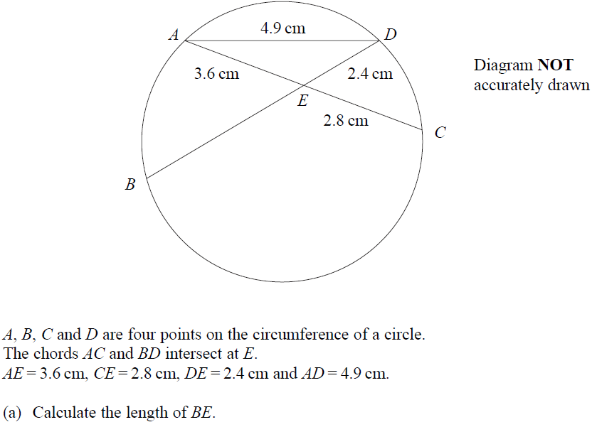
Advanced Trigonometry
May 2004 3H Q18

Slide 20
Advanced Trigonometry
May 2004 3H Q18
A
B

Slide 21
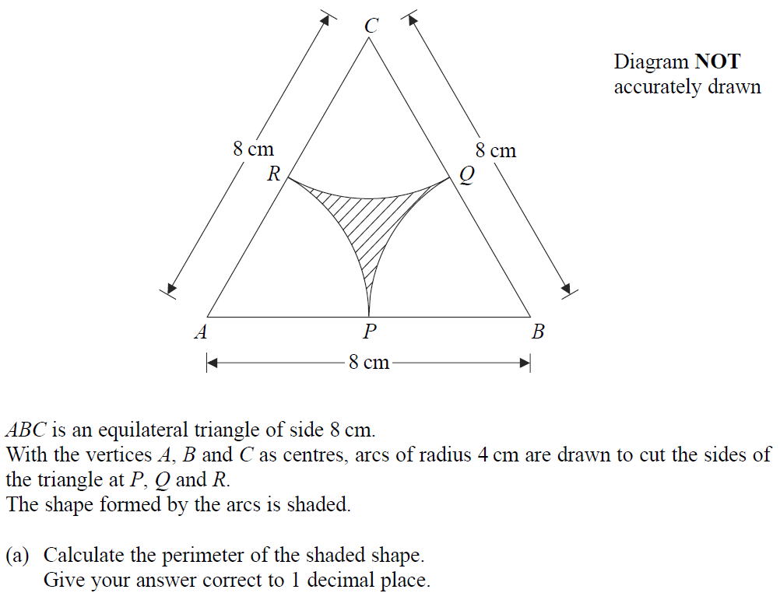
Advanced Trigonometry
Nov 2004 4H Q20

Slide 22
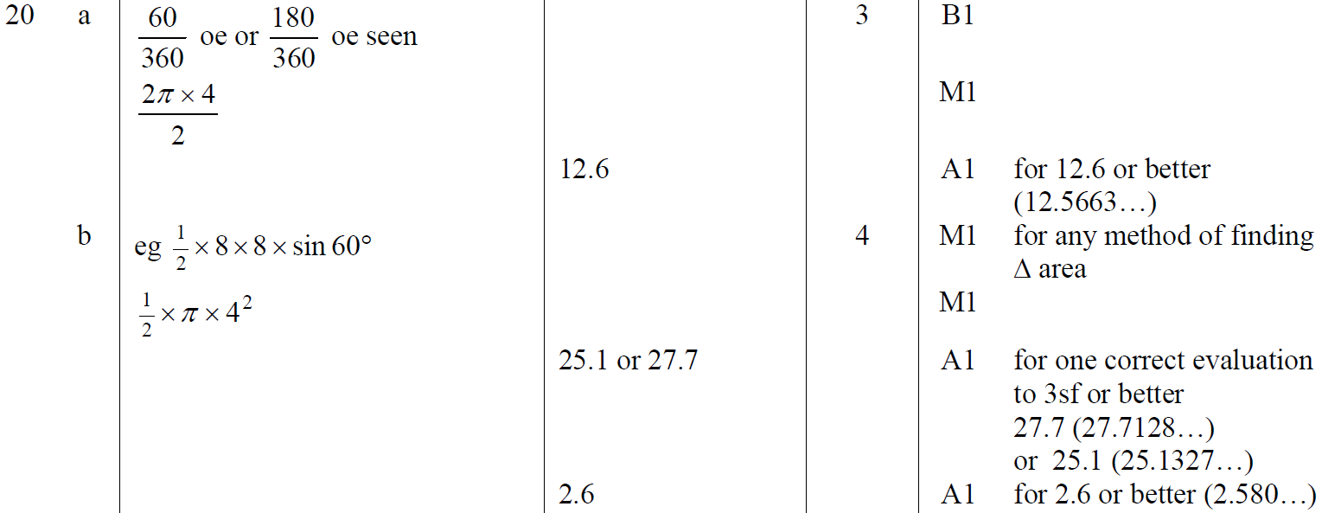
Advanced Trigonometry
Nov 2004 4H Q20
A
B

Slide 23
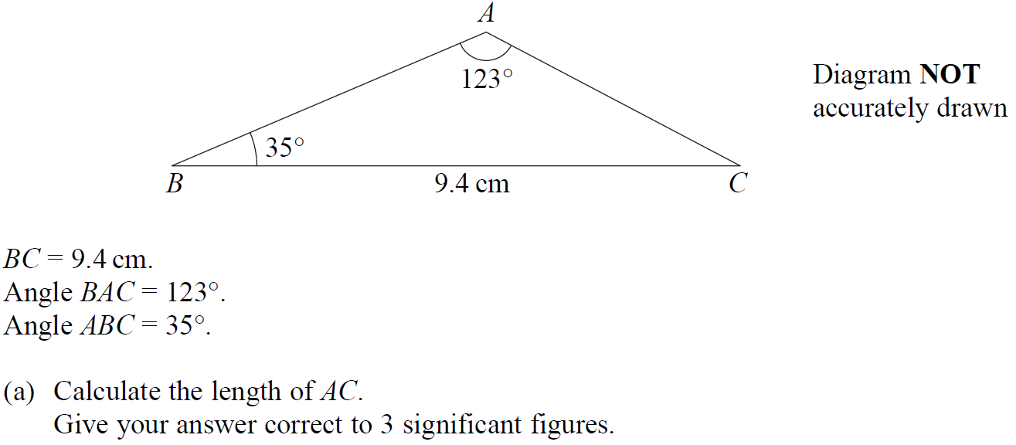
Advanced Trigonometry
May 2005 3H Q18

Slide 24
Advanced Trigonometry
May 2005 3H Q18
A
B

Slide 25
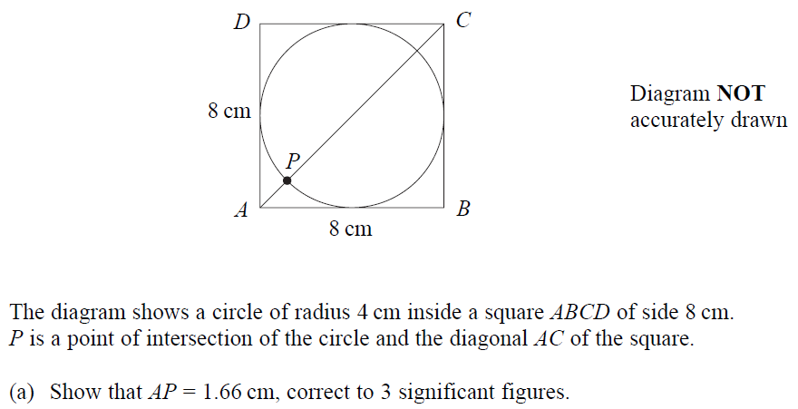
Advanced Trigonometry
Nov 2005 3H Q14

Slide 26
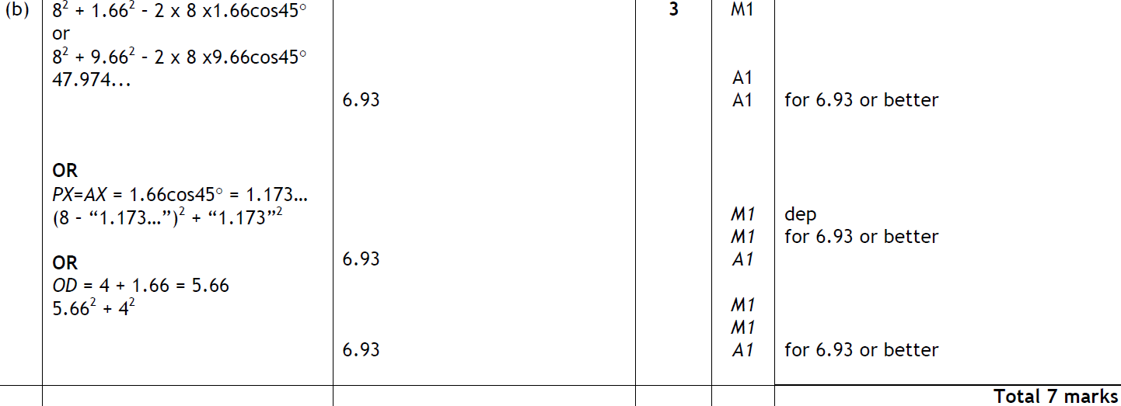
Advanced Trigonometry
Nov 2005 3H Q14
A
B

Slide 27
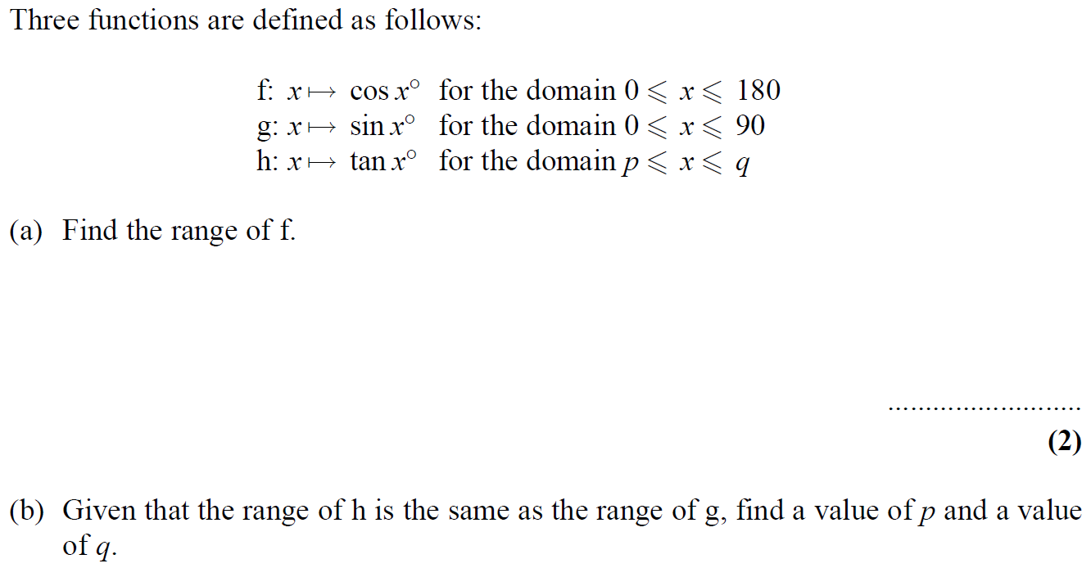
Advanced Trigonometry
Nov 2005 4H Q17

Slide 28
Advanced Trigonometry
Nov 2005 4H Q17
A
B

Slide 29
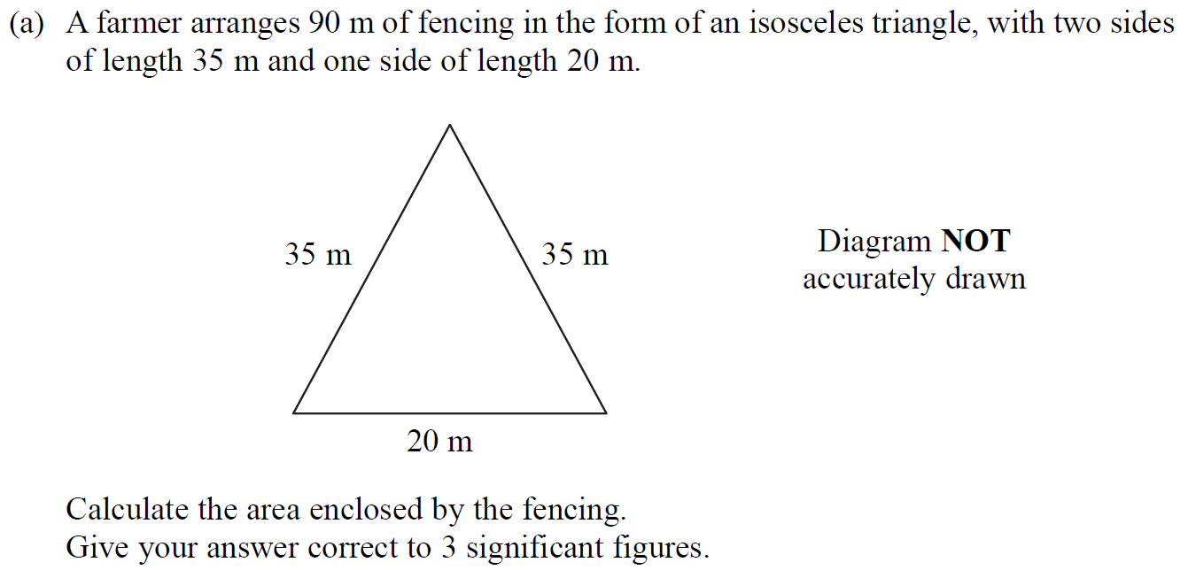
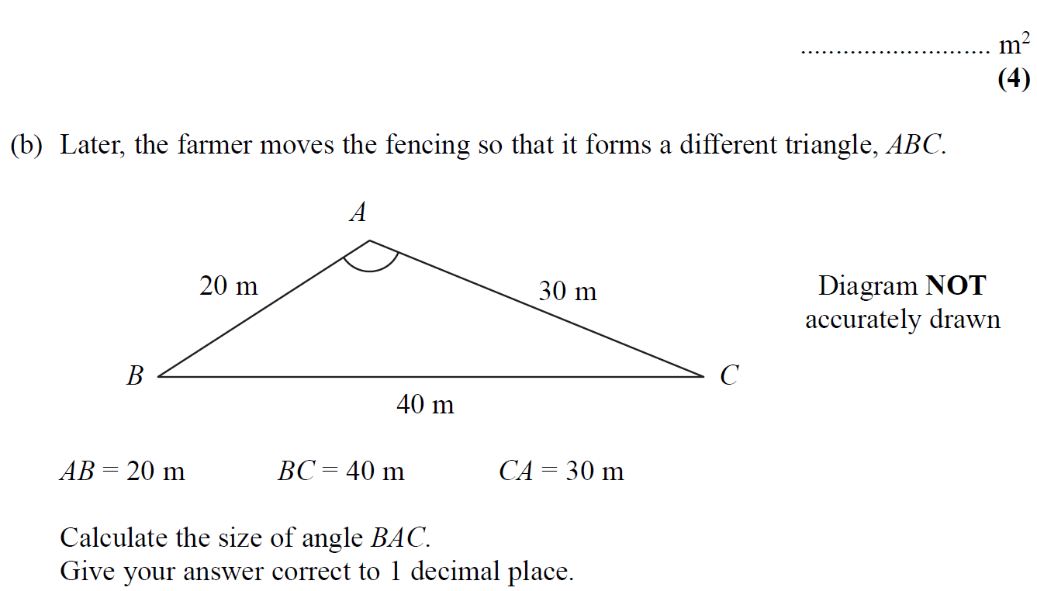
Advanced Trigonometry
May 2006 4H Q9

Slide 30
Advanced Trigonometry
May 2006 4H Q9
A
B

Slide 31
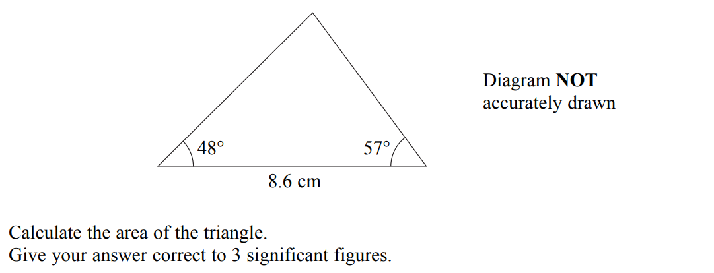
Advanced Trigonometry
Nov 2006 4H Q24

Slide 32
Advanced Trigonometry
Nov 2006 4H Q24
A

Slide 33
Advanced Trigonometry
May 2007 4H Q16

Slide 34
Advanced Trigonometry
May 2007 4H Q16
A

Slide 35
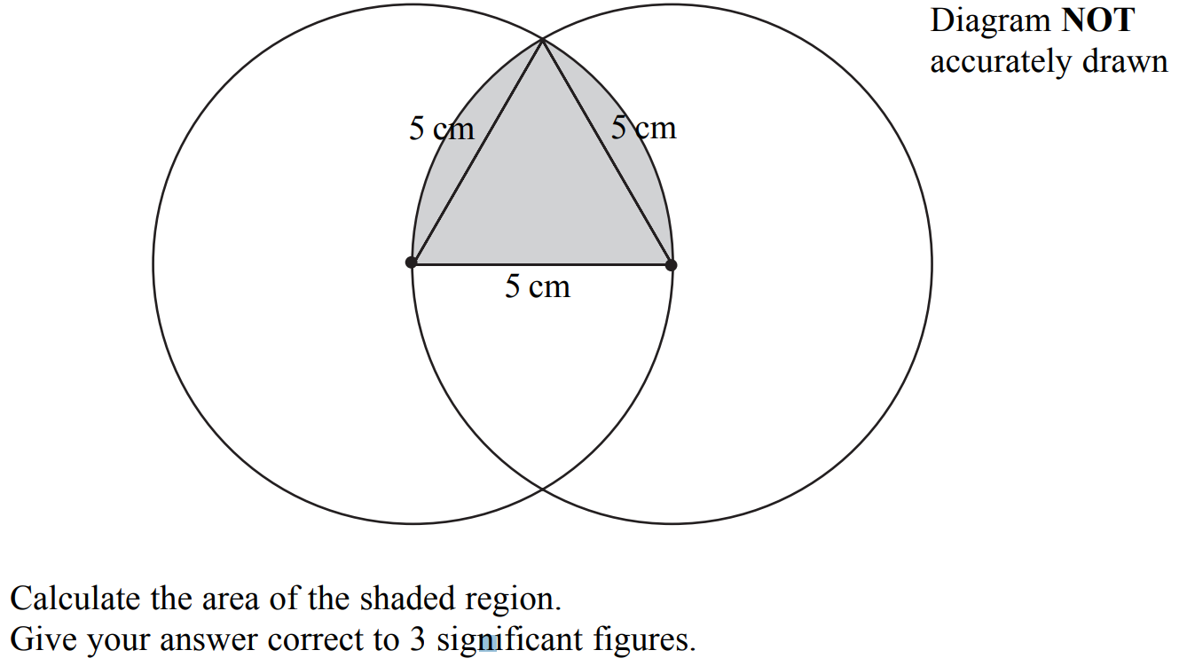
Advanced Trigonometry
May 2007 4H Q19

Slide 36
Advanced Trigonometry
May 2007 4H Q19
A
B

Slide 37
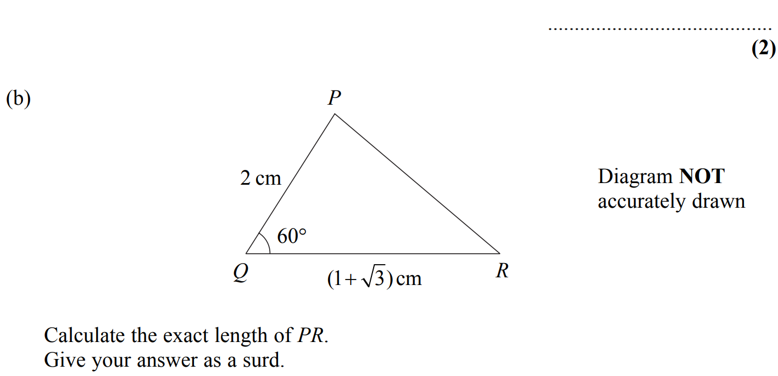
Advanced Trigonometry
Nov 2007 3H Q20

Slide 38
Advanced Trigonometry
Nov 2007 3H Q20
A
B

Slide 39
Advanced Trigonometry
May 2008 3H Q18

Slide 40
Advanced Trigonometry
May 2008 3H Q18
A

Slide 41
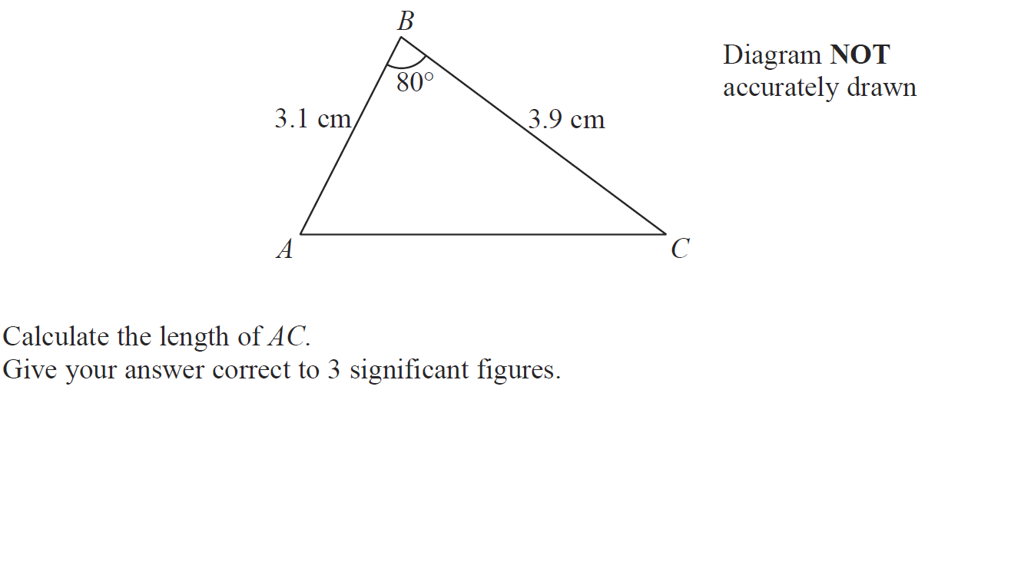
Advanced Trigonometry
May 2008 4H Q15

Slide 42
Advanced Trigonometry
May 2008 4H Q15
A

Slide 43
Advanced Trigonometry
May 2008 4H Q22

Slide 44
Advanced Trigonometry
May 2008 4H Q22
A

Slide 45
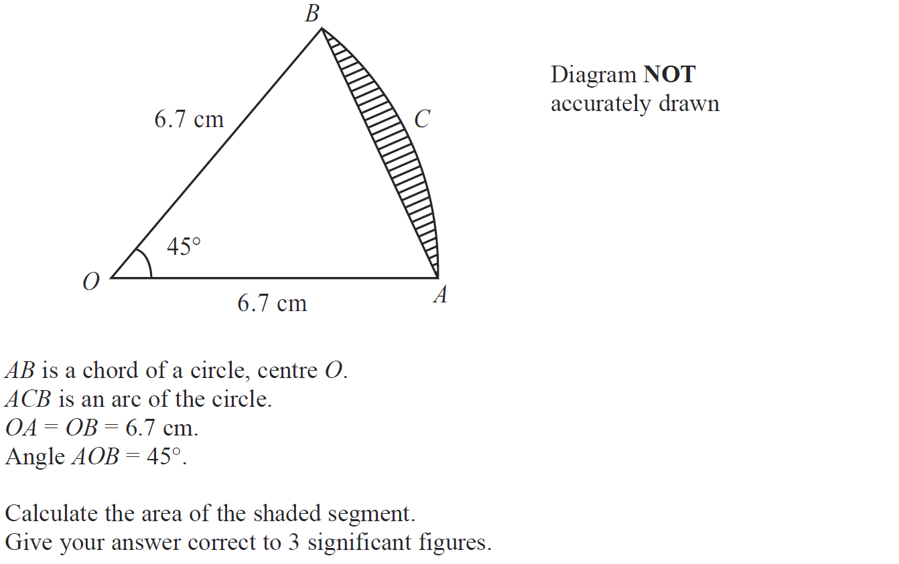
Advanced Trigonometry
Nov 2008 3H Q19

Slide 46
Advanced Trigonometry
Nov 2008 3H Q19
A

Slide 47
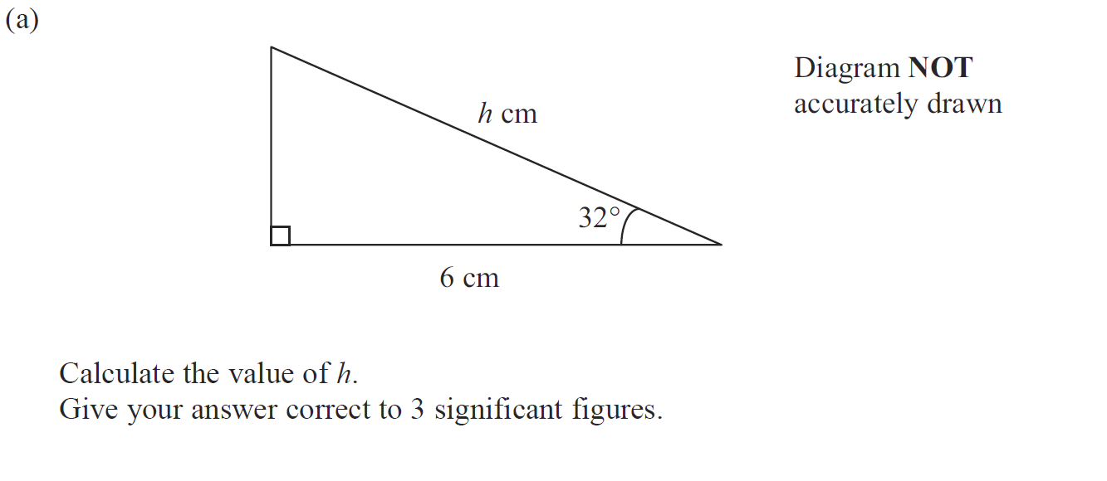
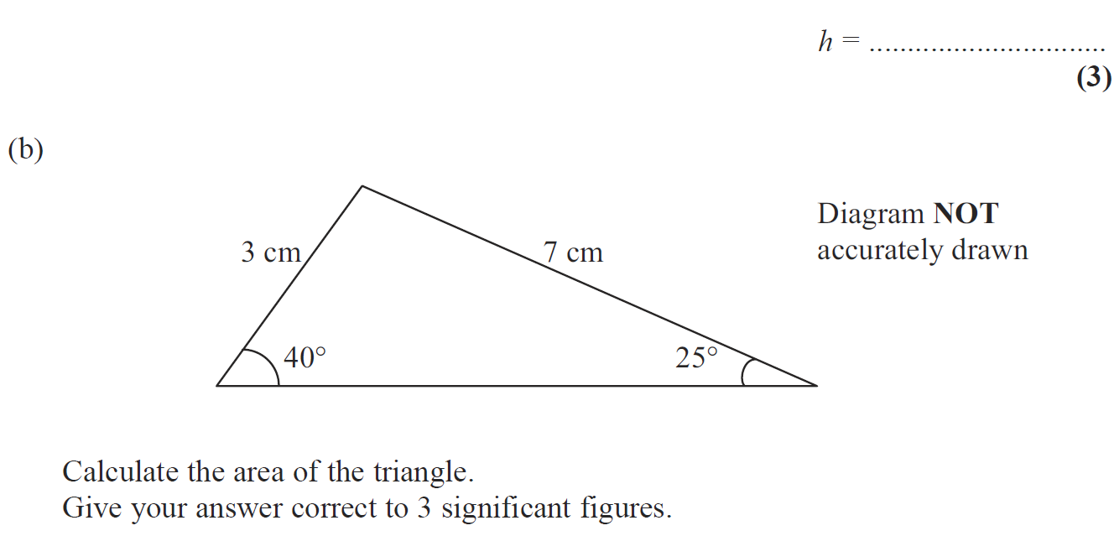
Advanced Trigonometry
Nov 2008 4H Q14

Slide 48
Advanced Trigonometry
Nov 2008 4H Q14
A
B

Slide 49
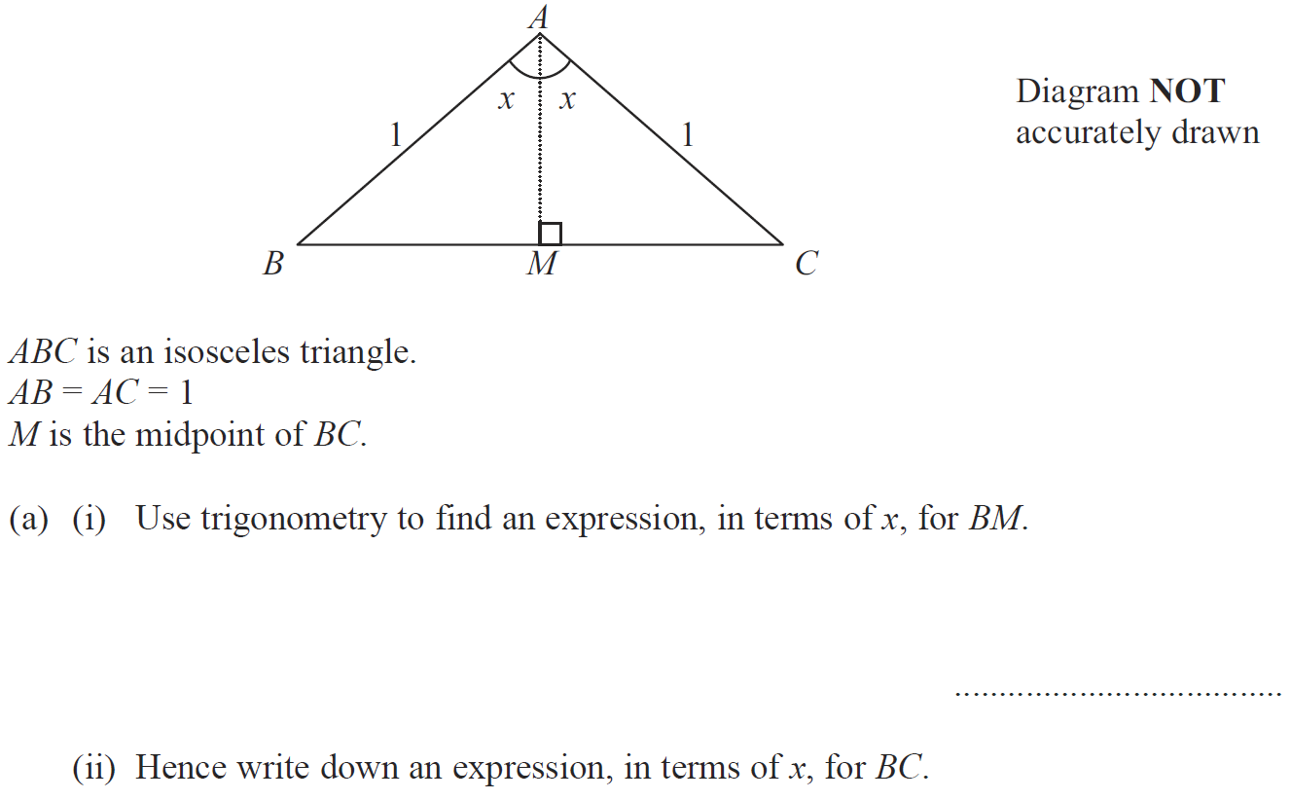
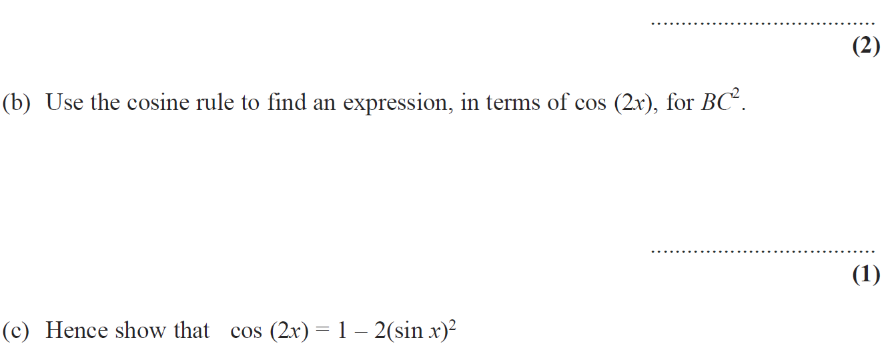
Advanced Trigonometry
Nov 2008 4H Q22

Slide 50
Advanced Trigonometry
Nov 2008 4H Q22
A (i)
A (ii)
B
C

Slide 51
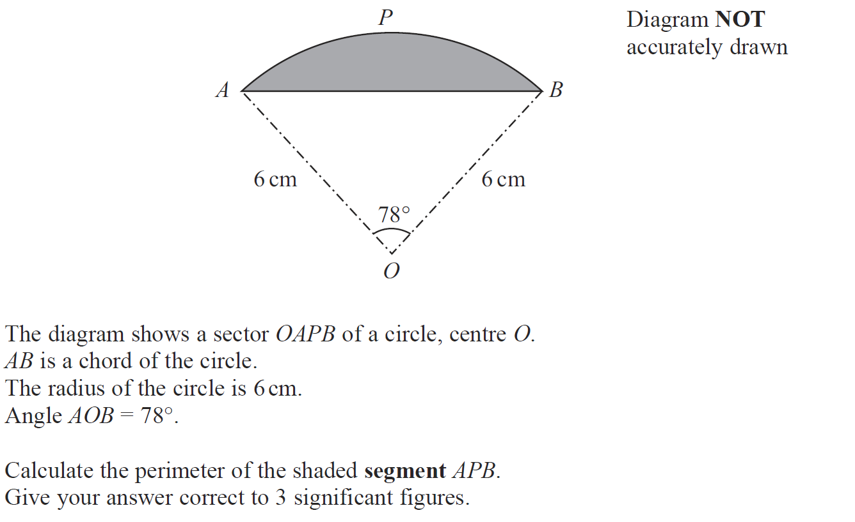
Advanced Trigonometry
May 2009 3H Q19

Slide 52
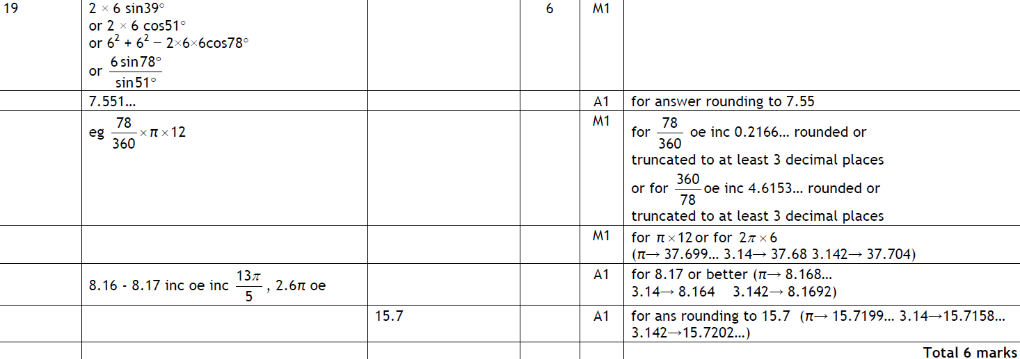
Advanced Trigonometry
May 2009 3H Q19
A

Slide 53
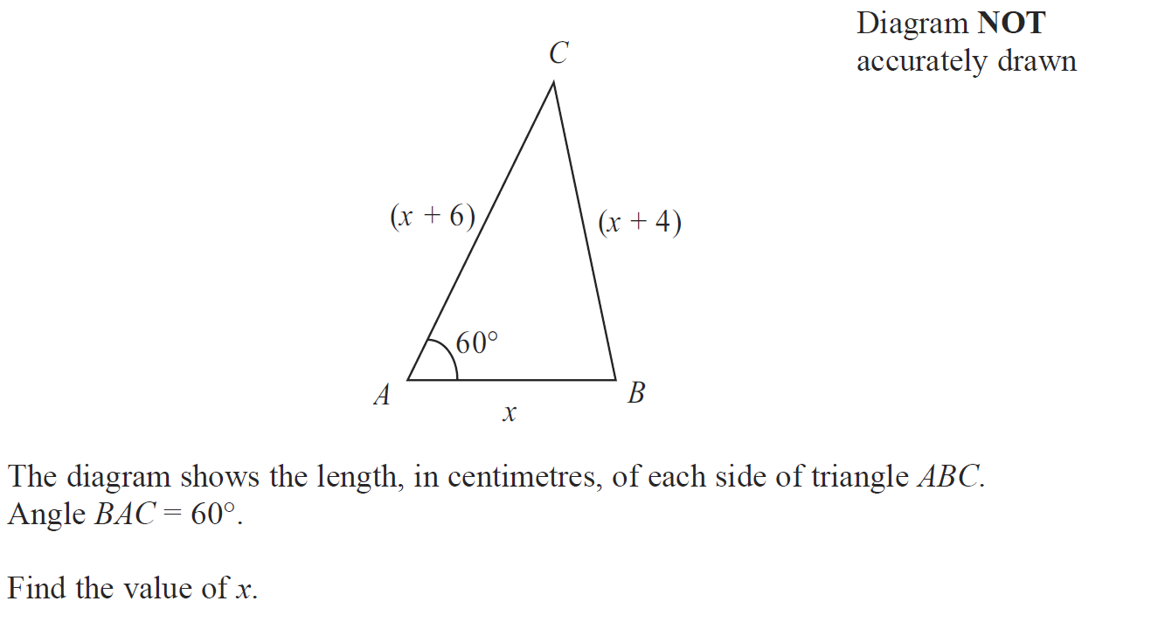
Advanced Trigonometry
May 2009 3H Q21

Slide 54
Advanced Trigonometry
May 2009 3H Q21
A

Slide 55
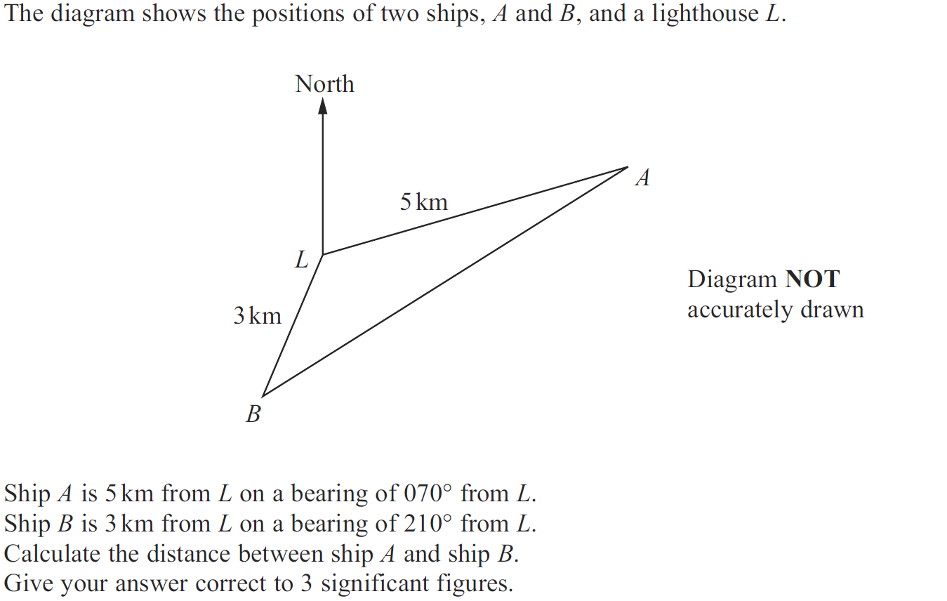
Advanced Trigonometry
Nov 2009 3H Q22

Slide 56
Advanced Trigonometry
Nov 2009 3H Q22
A

Slide 57
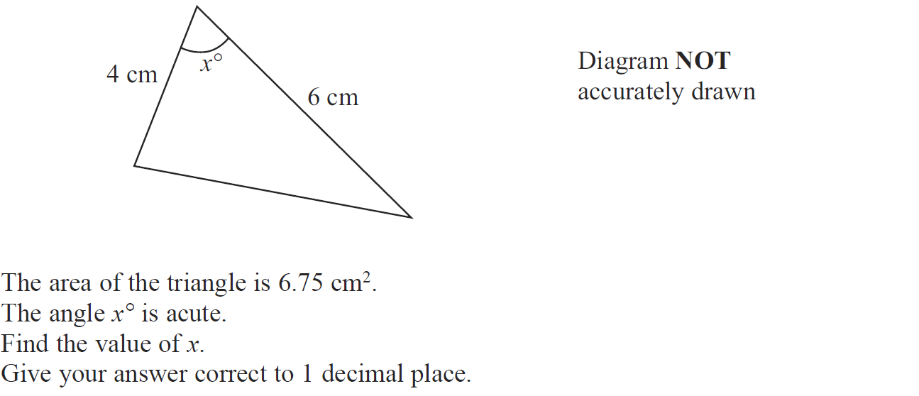
Advanced Trigonometry
June 2010 4H Q14

Slide 58
Advanced Trigonometry
June 2010 4H Q14
A

Slide 59
Advanced Trigonometry
June 2010 4H Q18

Slide 60
Advanced Trigonometry
June 2010 4H Q18
A

Slide 61
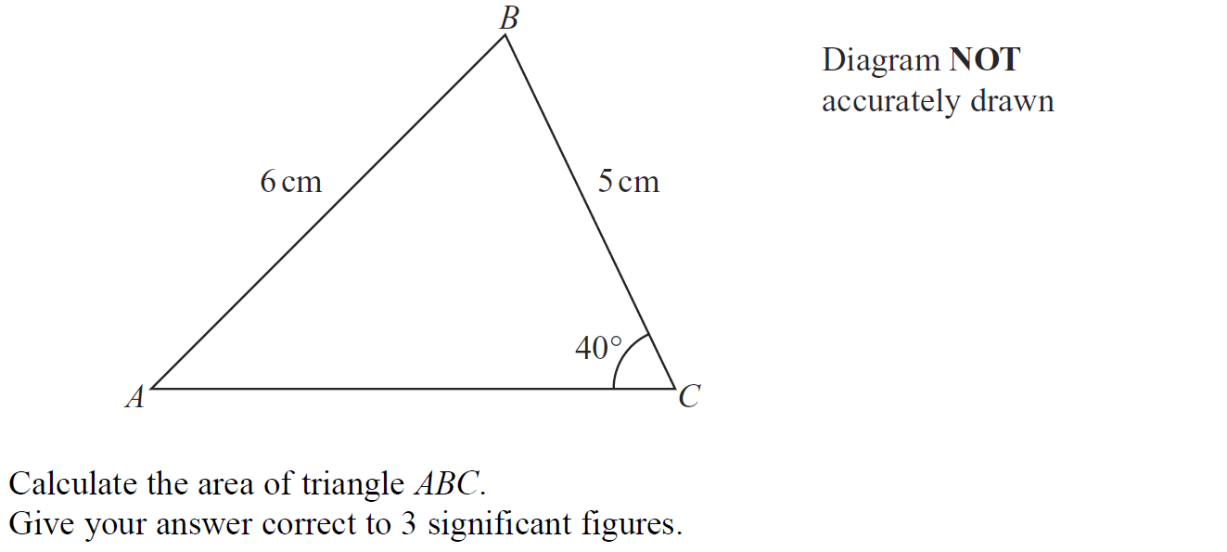
Advanced Trigonometry
Nov 2010 3H Q19

Slide 62
Advanced Trigonometry
Nov 2010 3H Q19
A

Slide 63
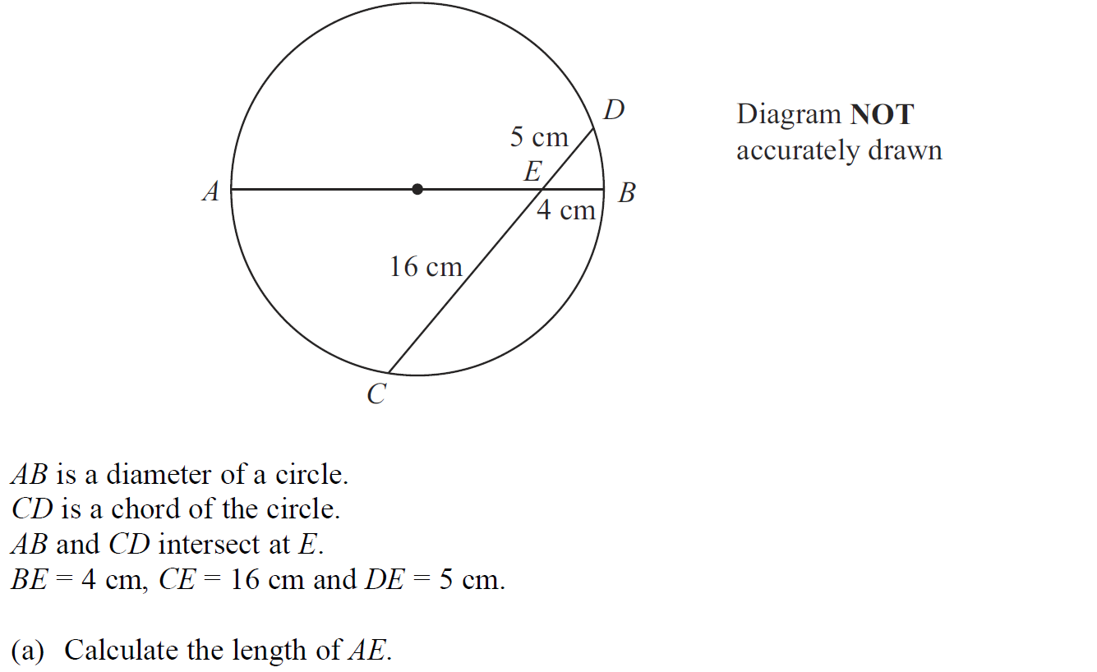
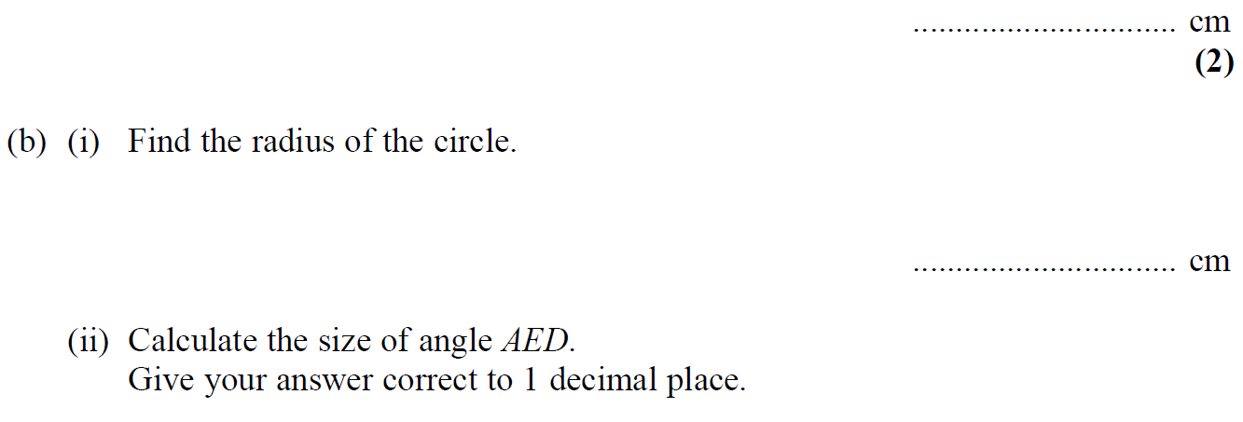
Advanced Trigonometry
Nov 2010 4H Q19

Slide 64
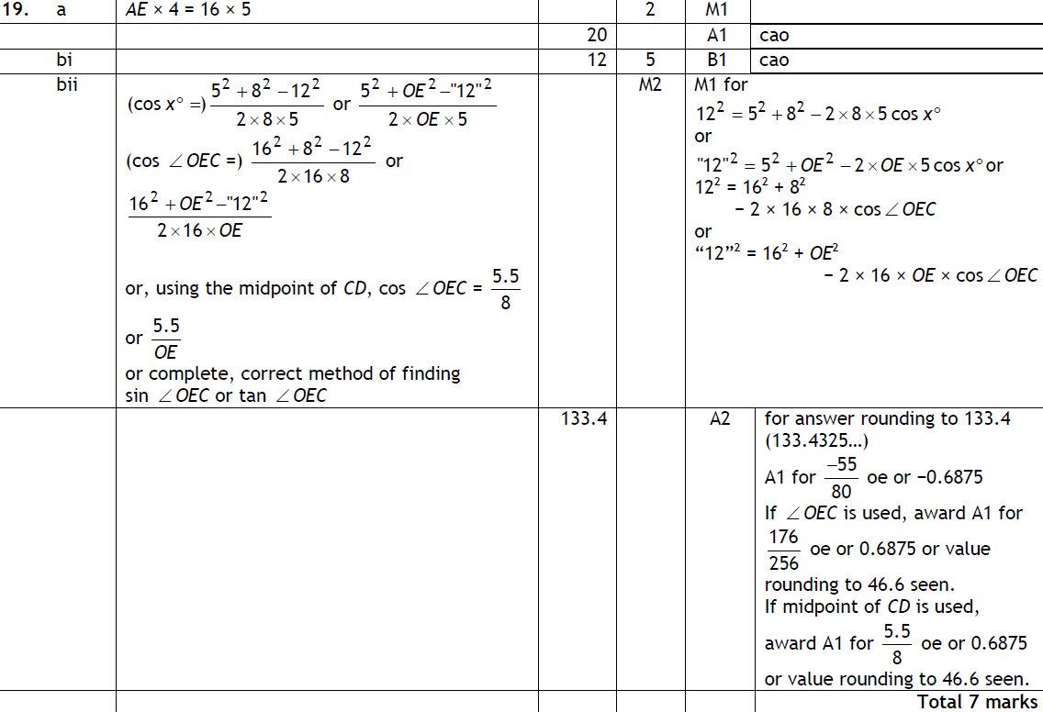
Advanced Trigonometry
Nov 2010 4H Q19
A

Slide 65
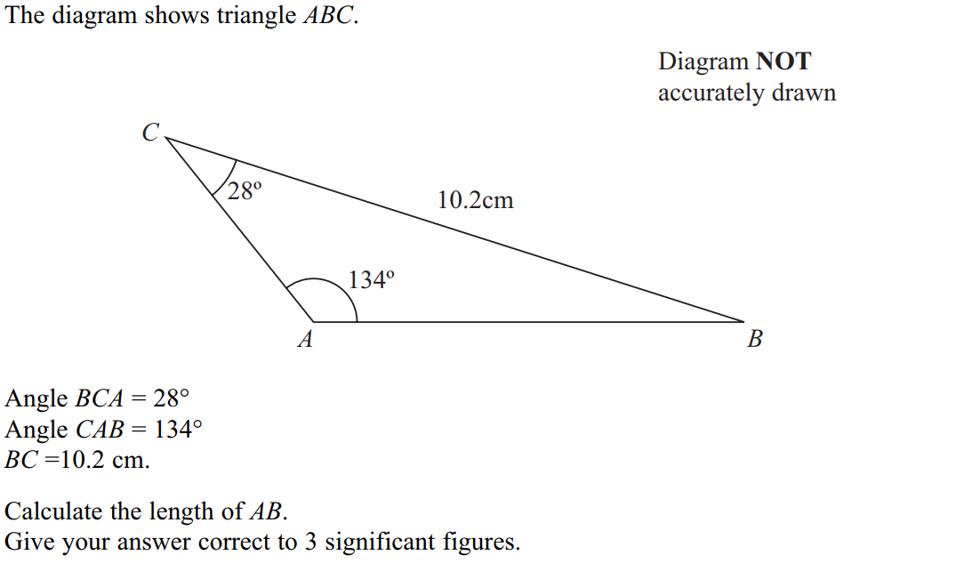
Advanced Trigonometry
June 2011 4H Q19

Slide 66
Advanced Trigonometry
June 2011 4H Q19
A

Slide 67
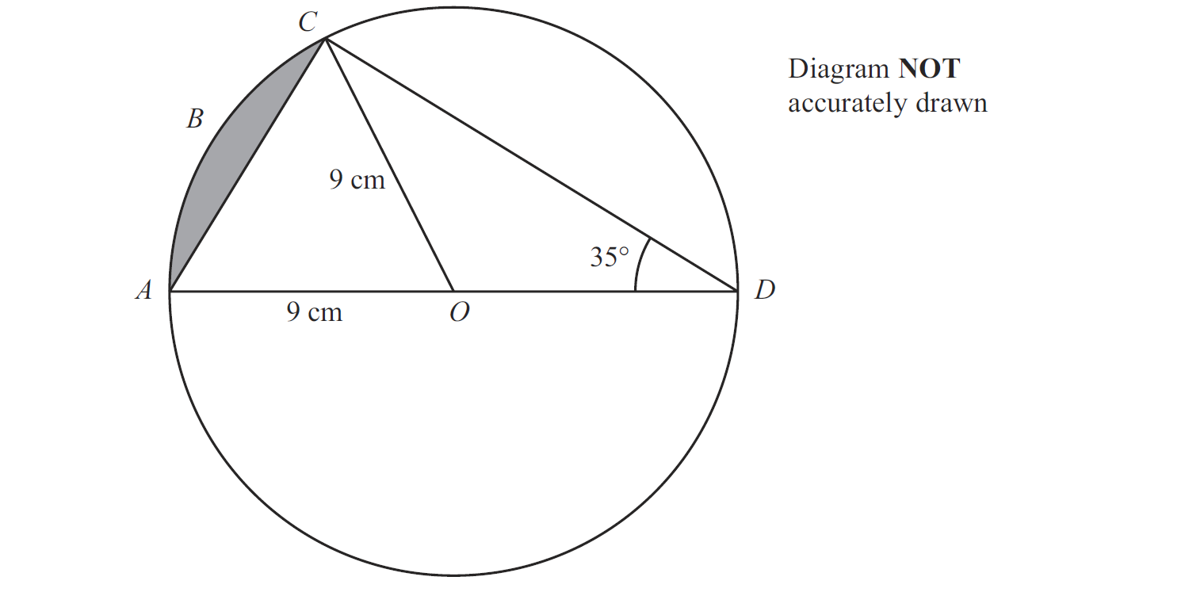
Advanced Trigonometry
Jan 2012 3H Q18

Slide 68
Advanced Trigonometry
Jan 2012 3H Q18
A

Slide 69
Advanced Trigonometry
Jan 2012 4H Q18

Slide 70
Advanced Trigonometry
Jan 2012 4H Q18
A

Slide 71
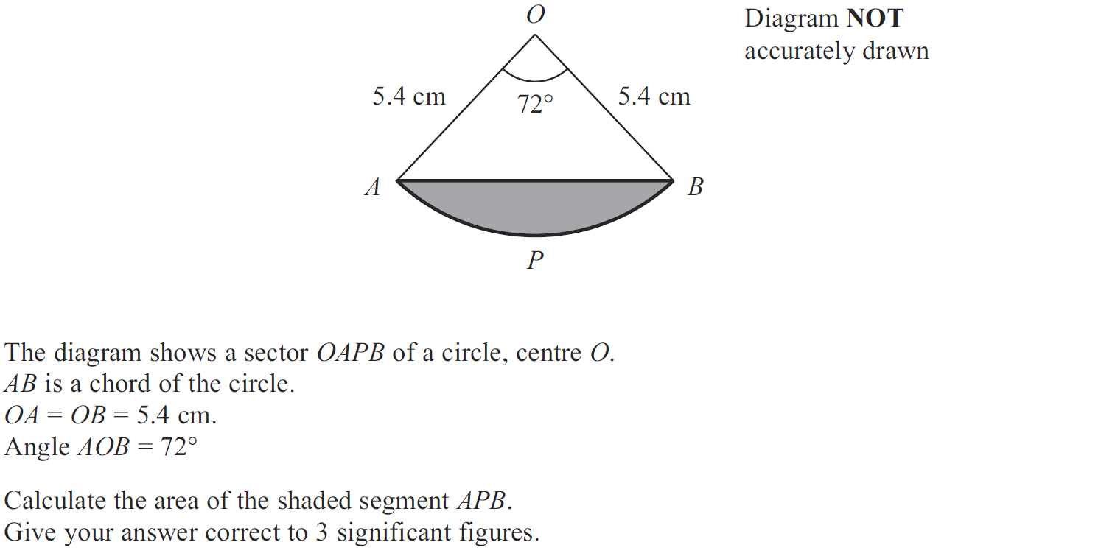
Advanced Trigonometry
May 2012 3H Q19

Slide 72
Advanced Trigonometry
May 2012 3H Q19
A

Slide 73
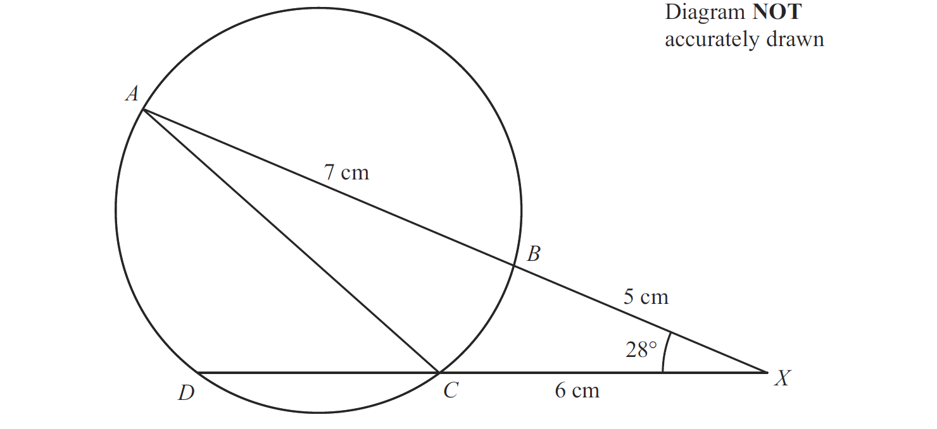
Advanced Trigonometry
May 2012 4H Q16

Slide 74
Advanced Trigonometry
May 2012 4H Q16
A
B

Slide 75
Advanced Trigonometry
Jan 2013 3H Q16

Slide 76
Advanced Trigonometry
Jan 2013 3H Q16
A

Slide 77
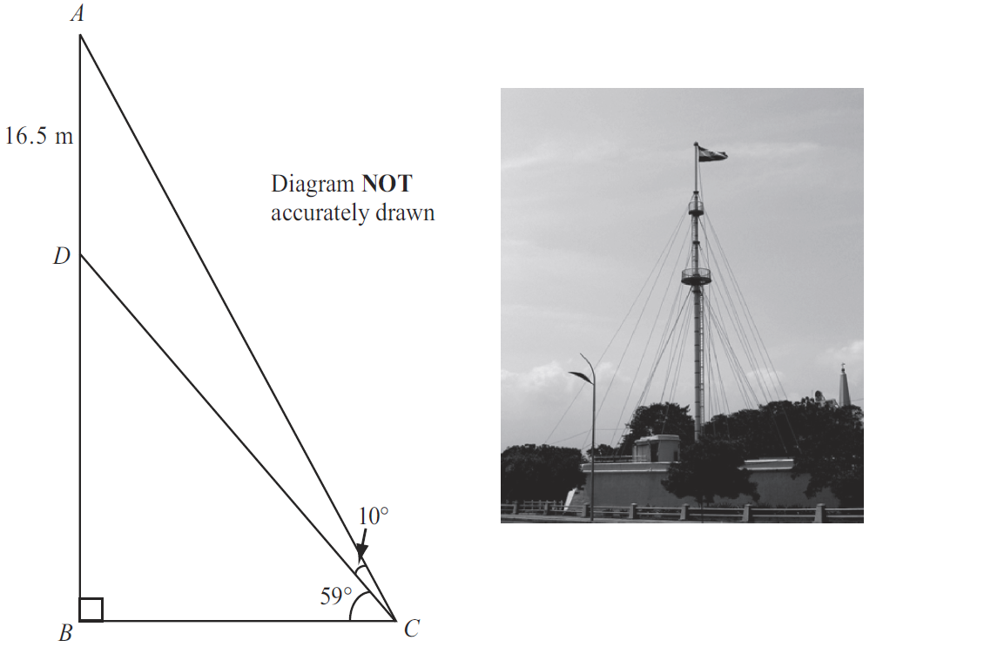
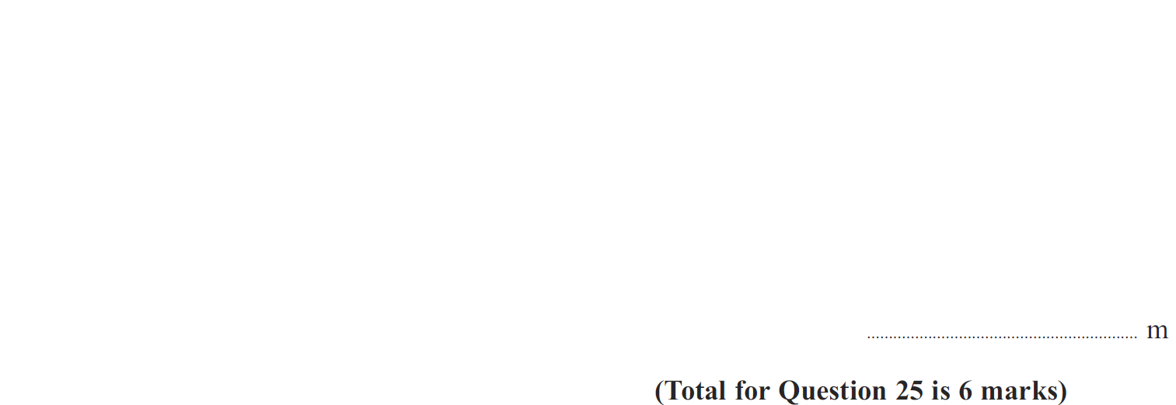
Advanced Trigonometry
Jan 2013 4H Q25

Slide 78
Advanced Trigonometry
Jan 2013 4H Q25
A

Slide 79
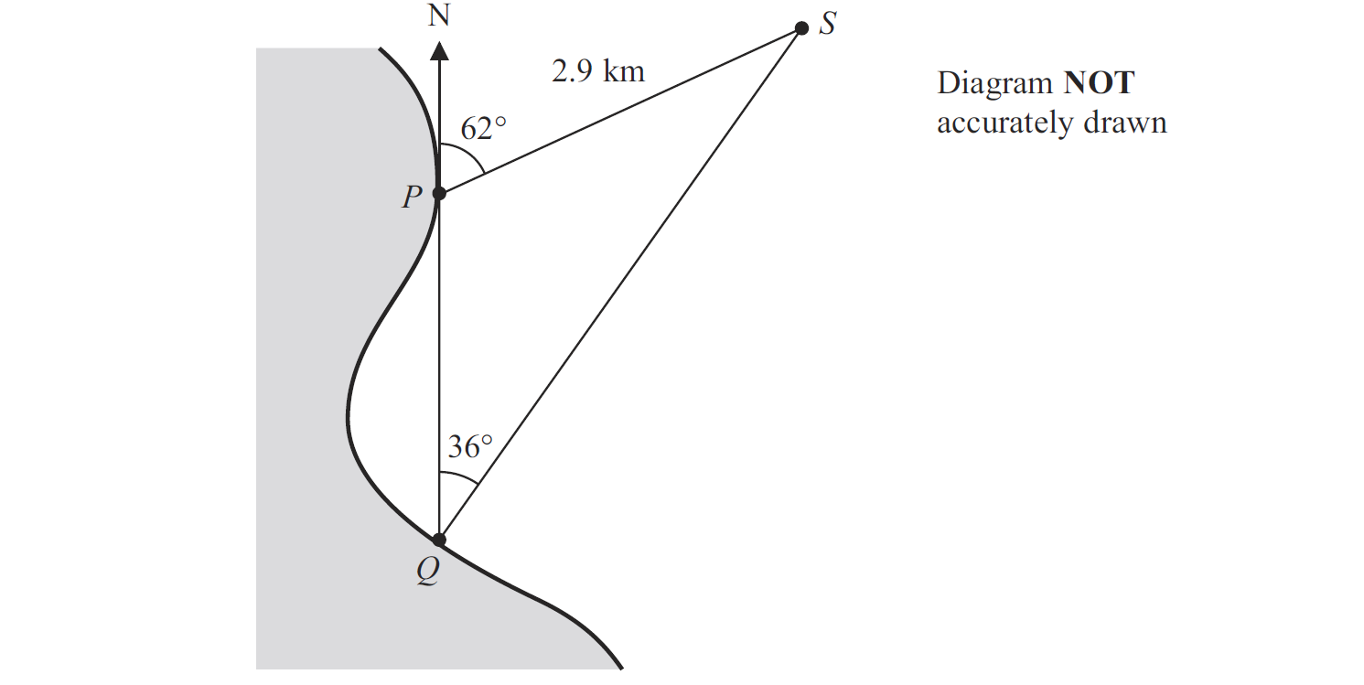
Advanced Trigonometry
May 2013 3H Q18

Slide 80
Advanced Trigonometry
May 2013 3H Q18
A

Slide 81
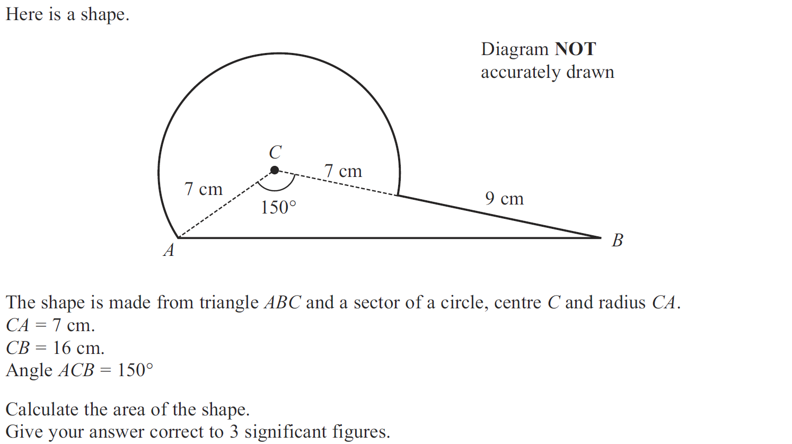
Advanced Trigonometry
May 2013 3H Q21

Slide 82
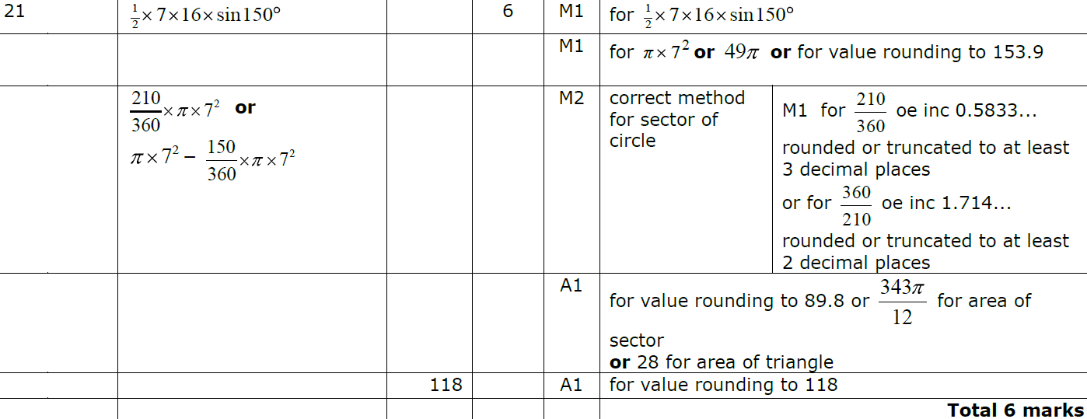
Advanced Trigonometry
May 2013 3H Q21
A

Slide 83
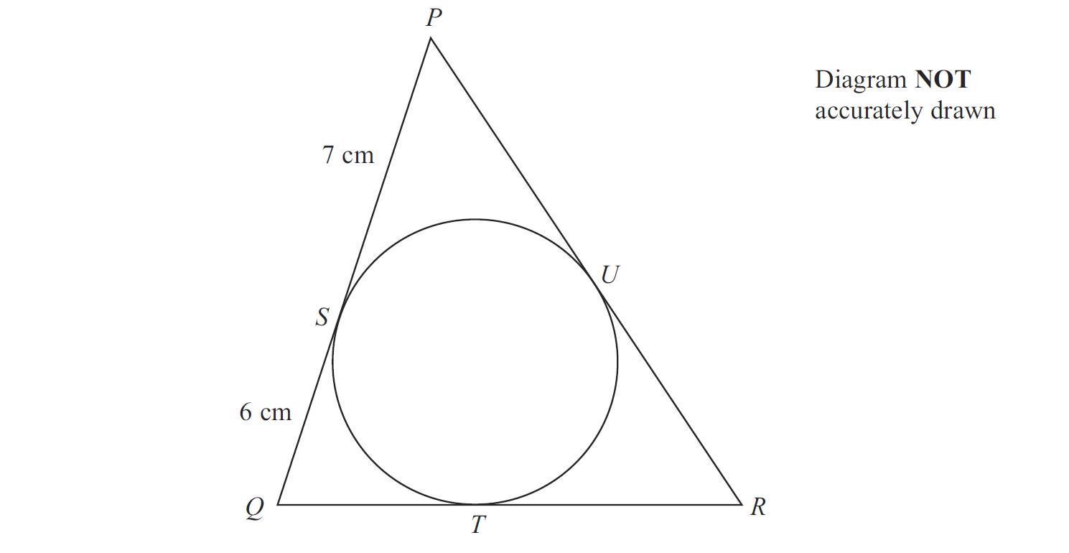
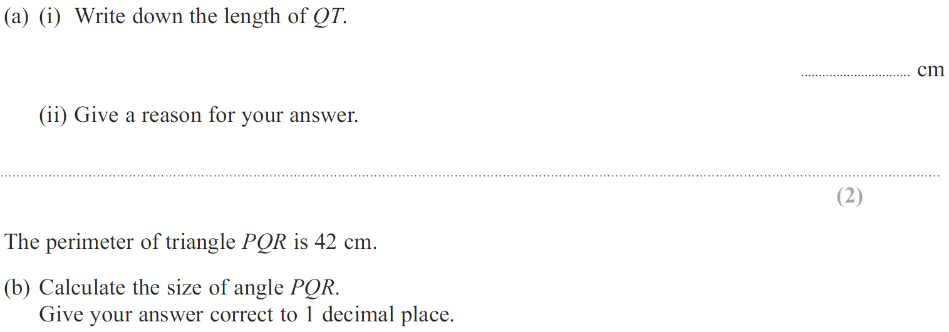
Advanced Trigonometry
May 2013 4H Q19

Slide 84
Advanced Trigonometry
May 2013 4H Q19
A (i)
A (ii)
B

Slide 85
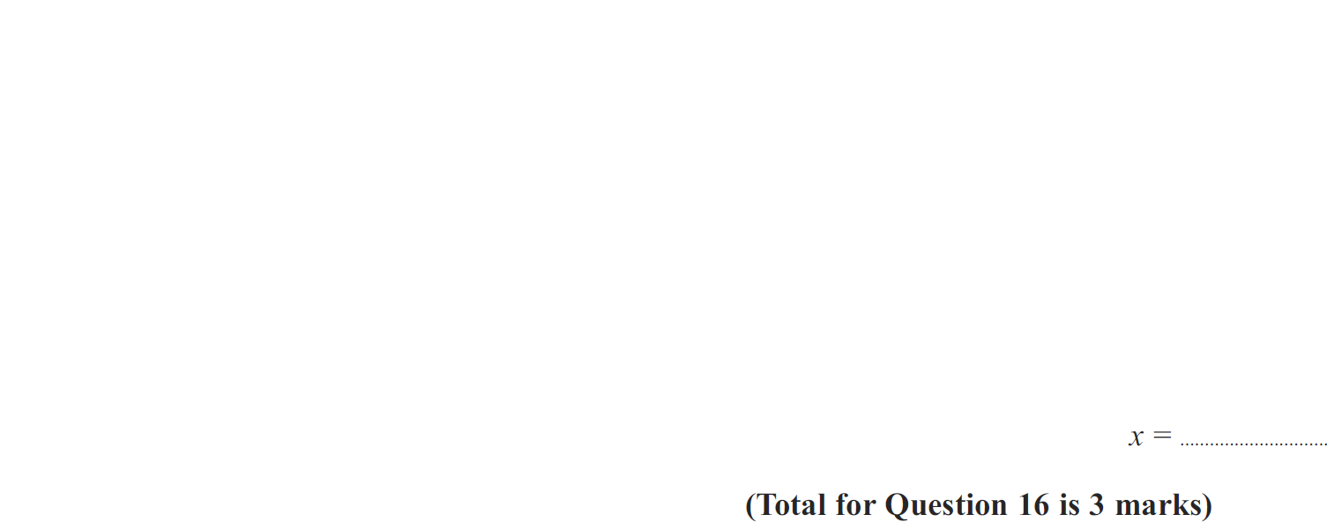
Advanced Trigonometry
May 2013 4HR Q16

Slide 86
Advanced Trigonometry
May 2013 4HR Q16
A

Slide 87
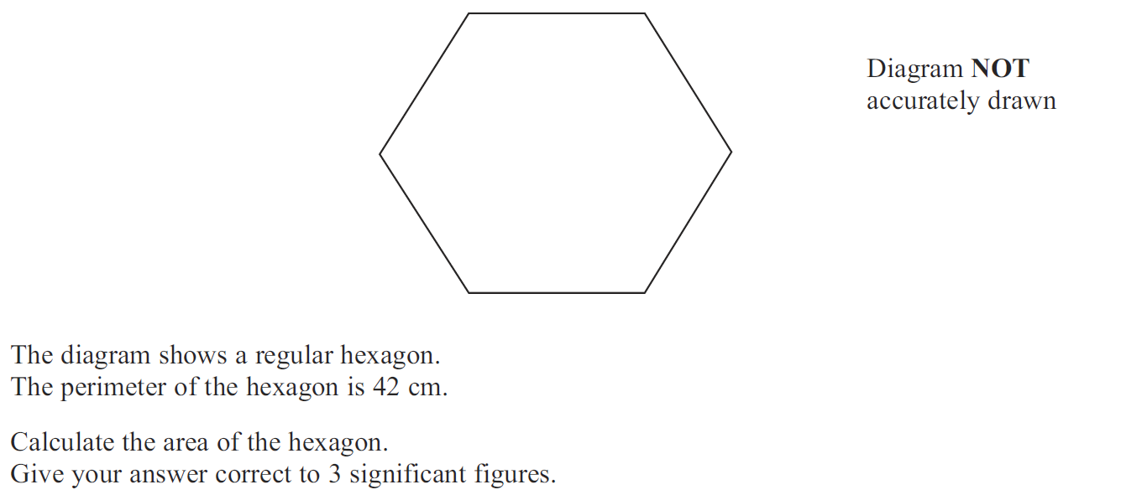
Advanced Trigonometry
May 2013 4HR Q22

Slide 88
Advanced Trigonometry
May 2013 4HR Q22
A

Slide 89
Advanced Trigonometry
Jan 2014 4H Q17

Slide 90
Advanced Trigonometry
Jan 2014 4H Q17
A

Slide 91
Advanced Trigonometry
Jan 2014 3HR Q21

Slide 92
Advanced Trigonometry
Jan 2014 3HR Q21
A

Slide 93
Advanced Trigonometry
May 2014 3H Q22

Slide 94
Advanced Trigonometry
May 2014 3H Q22
A
B

Slide 95
Advanced Trigonometry
May 2014 4HR Q19

Slide 96
Advanced Trigonometry
May 2014 4HR Q19
A

Slide 97
Advanced Trigonometry
Jan 2015 3H Q22

Slide 98
Advanced Trigonometry
Jan 2015 3H Q22
A

Slide 99
Advanced Trigonometry
Jan 2015 4H Q24

Slide 100
Advanced Trigonometry
Jan 2015 4H Q24
A

Slide 101
Advanced Trigonometry
Jan 2015 3HR Q23

Slide 102
Advanced Trigonometry
Jan 2015 3HR Q23
A

Slide 103
Advanced Trigonometry
June 2015 4H Q16

Slide 104
Advanced Trigonometry
June 2015 4H Q16
A

Slide 105
Advanced Trigonometry
June 2015 4H Q22

Slide 106
Advanced Trigonometry
June 2015 4H Q22
A

Slide 107
Advanced Trigonometry
May 2015 3HR Q16

Slide 108
Advanced Trigonometry
May 2015 3HR Q16
A

Slide 109
Advanced Trigonometry
June 2015 4HR Q20

Slide 110
Advanced Trigonometry
June 2015 4HR Q20
A

Slide 111
Advanced Trigonometry
Jan 2016 3H Q20

Slide 112
Advanced Trigonometry
Jan 2016 3H Q20
A

Slide 113
Advanced Trigonometry
Jan 2016 4H Q21

Slide 114
Advanced Trigonometry
Jan 2016 4H Q21
A

Slide 115
Advanced Trigonometry
Jan 2016 4HR Q23

Slide 116
Advanced Trigonometry
Jan 2016 4HR Q23
A

Slide 117
Advanced Trigonometry
May 2016 3H Q22

Slide 118
Advanced Trigonometry
May 2016 3H Q22
A

Slide 119
Advanced Trigonometry
May 2016 3HR Q22

Slide 120
Advanced Trigonometry
May 2016 3HR Q22
A

Slide 121
Advanced Trigonometry
Jan 2017 3H Q15

Slide 122
Advanced Trigonometry
Jan 2017 3H Q15
A

Slide 123
Advanced Trigonometry
Jan 2017 4H Q21

Slide 124
Advanced Trigonometry
Jan 2017 4H Q21
A
B

Slide 125
Advanced Trigonometry
Jan 2017 3HR Q21

Slide 126
Advanced Trigonometry
Jan 2017 3HR Q21
A

Slide 127
Advanced Trigonometry
June 2017 4H Q19

Slide 128
Advanced Trigonometry
June 2017 4H Q19
A

Slide 129
Advanced Trigonometry
June 2017 4H Q21

Slide 130
Advanced Trigonometry
June 2017 4H Q21
A

Slide 131
Advanced Trigonometry
May 2017 3HR Q14

Slide 132
Advanced Trigonometry
May 2017 3HR Q14
A

Slide 133
Advanced Trigonometry
May 2017 3HR Q14
Alternative A

Slide 134
Advanced Trigonometry
May 2017 3HR Q21

Slide 135
Advanced Trigonometry
May 2017 3HR Q21
A

Slide 136
Advanced Trigonometry
June 2017 4HR Q24

Slide 137
Advanced Trigonometry
June 2017 4HR Q24
A

Slide 138
Advanced Trigonometry
Jan 2018 3H Q25

Slide 139
Advanced Trigonometry
Jan 2018 3H Q25
A

Slide 140
Advanced Trigonometry
Jan 2018 4H Q16

Slide 141
Advanced Trigonometry
Jan 2018 4H Q16
A
B

Slide 142
Advanced Trigonometry
Jan 2018 4HR Q15

Slide 143
Advanced Trigonometry
Jan 2018 4HR Q15
A
B

Slide 144
Advanced Trigonometry
May 2018 3H Q16

Slide 145
Advanced Trigonometry
May 2018 3H Q16
A

Slide 146
Advanced Trigonometry
May 2018 3HR Q21

Slide 147
Advanced Trigonometry
May 2018 3HR Q21
A
B

Slide 148
Advanced Trigonometry
June 2018 4HR Q24

Slide 149
Advanced Trigonometry
June 2018 4HR Q24
A

