Slide 1
Advanced Trigonometry
Advanced Trigonometry
May 2017
1H Q14
SAM
3H Q13
June 2017
2H Q20
SAM
3H Q16
Nov 2017
1H Q17
Practice
2H Q16
May 2018
1H Q18
Practice
3H Q16
Nov 2018
3H Q19
Area

Slide 2
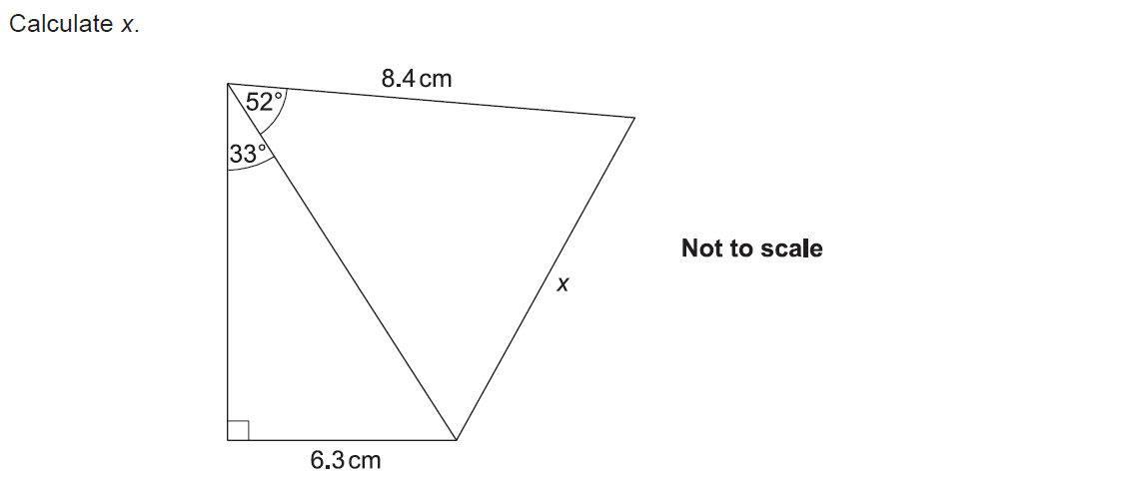
Advanced Trigonometry
SAM 3H Q13

Slide 3
Advanced Trigonometry
SAM 3H Q13
A

Slide 4
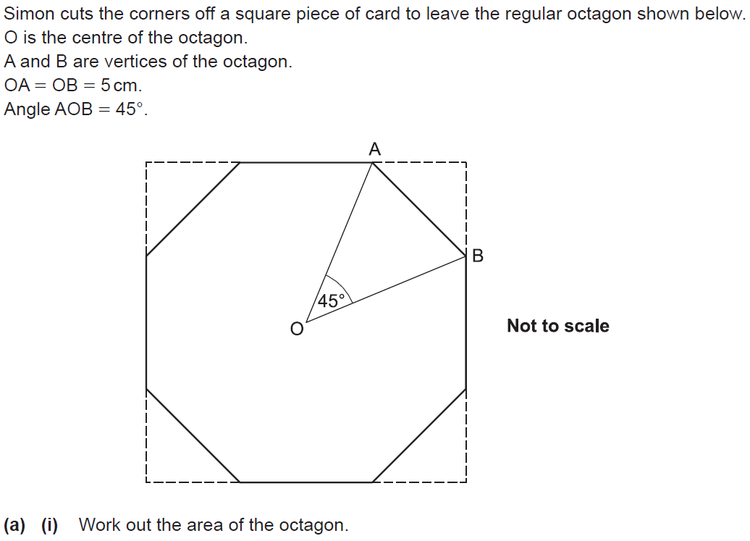
Advanced Trigonometry
SAM 3H Q16

Slide 5
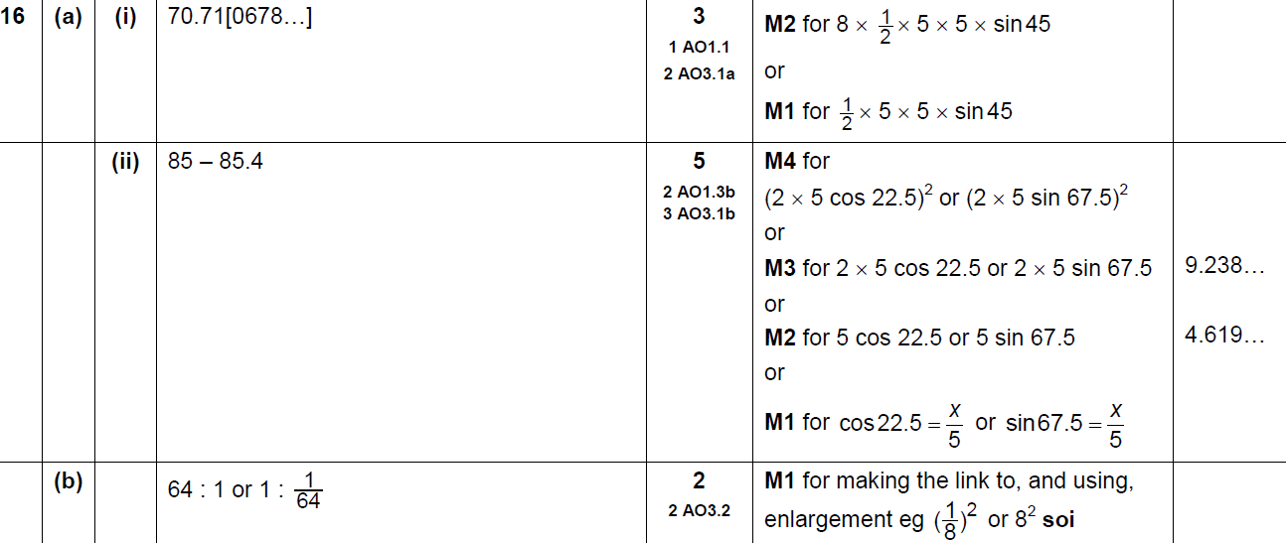
Advanced Trigonometry
SAM 3H Q16
A (i)
A (ii)
B

Slide 6
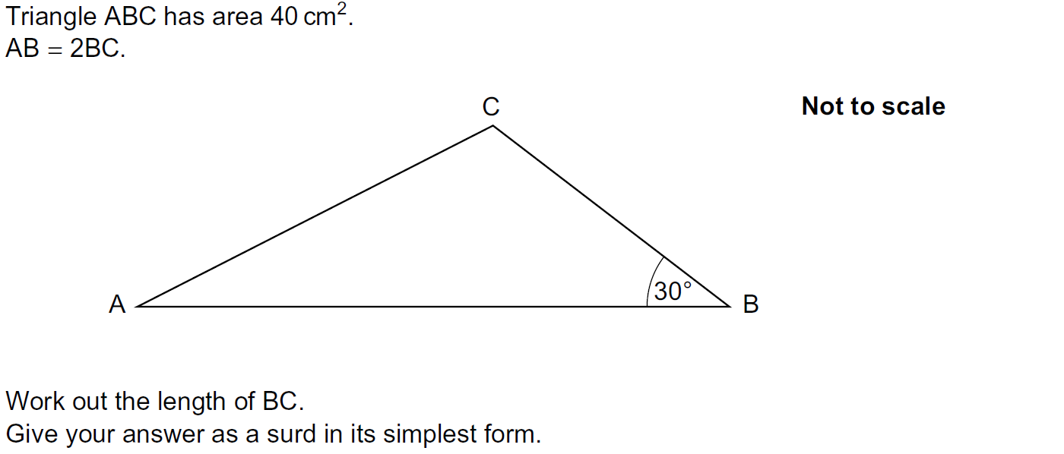
Advanced Trigonometry
Practice 2H Q16

Slide 7
Advanced Trigonometry
Practice 2H Q16
A

Slide 8
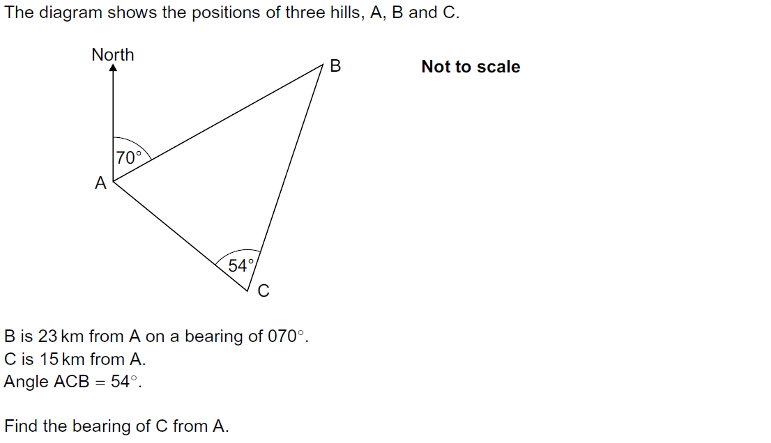
Advanced Trigonometry
Practice 3H Q16

Slide 9
Advanced Trigonometry
Practice 3H Q16
A

Slide 10
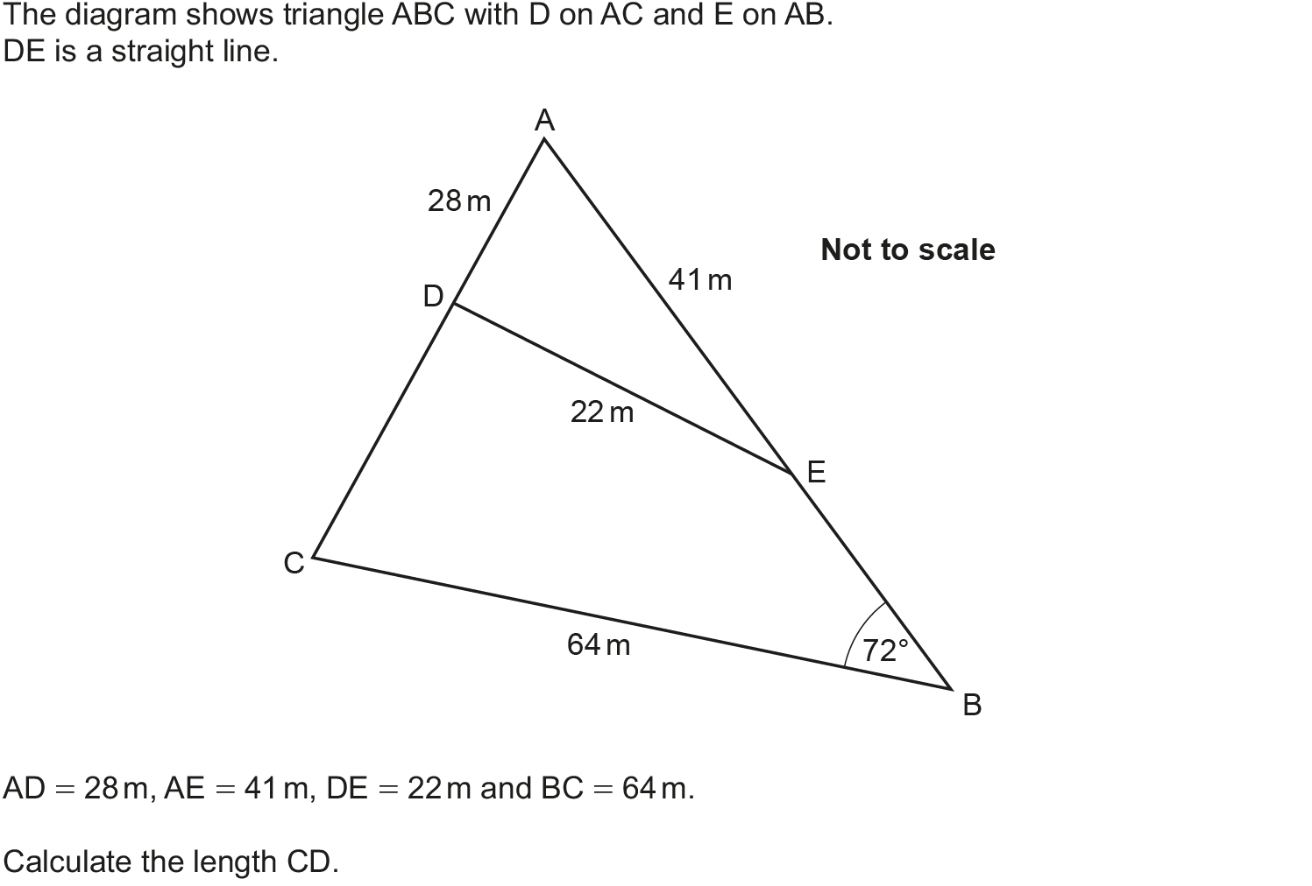
Advanced Trigonometry
May 2017 1H Q14

Slide 11
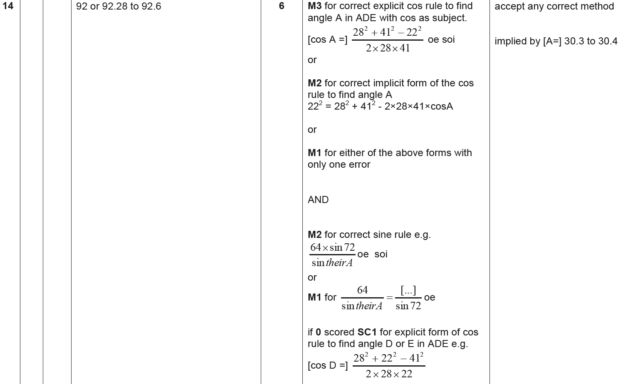
Advanced Trigonometry
May 2017 1H Q14
A

Slide 12
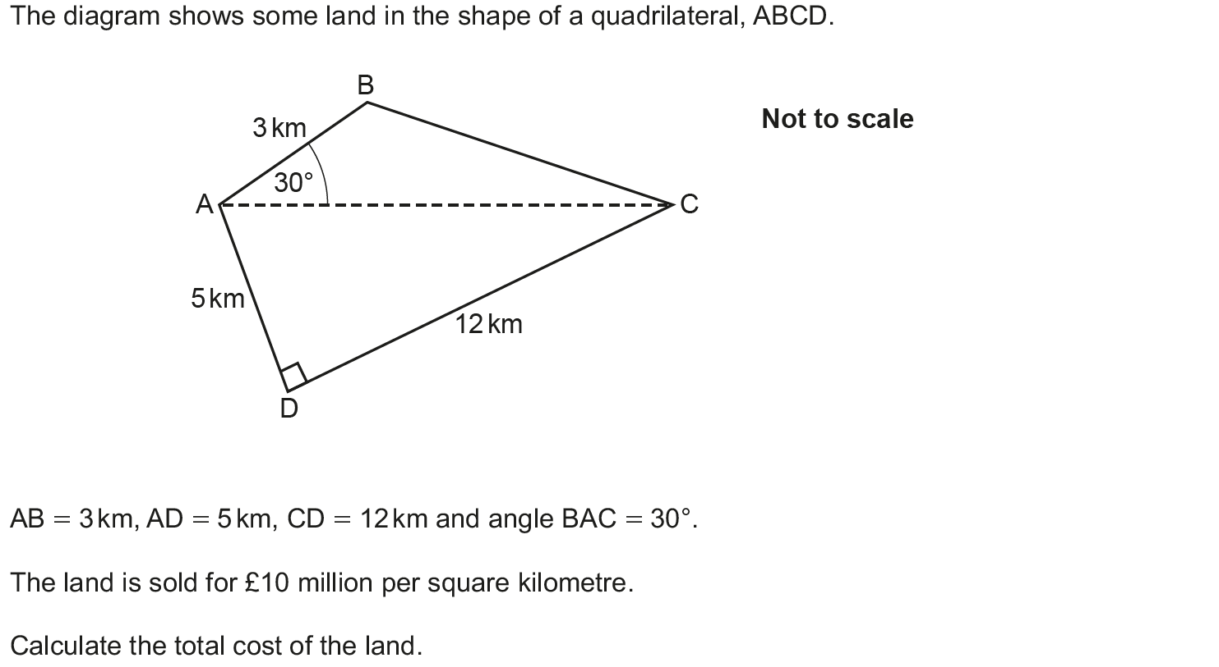
Advanced Trigonometry
June 2017 2H Q20

Slide 13
Advanced Trigonometry
June 2017 2H Q20
A

Slide 14
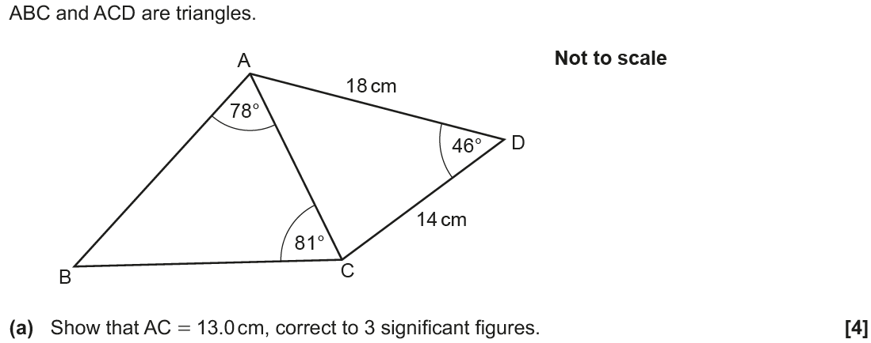
Advanced Trigonometry
Nov 2017 1H Q17

Slide 15
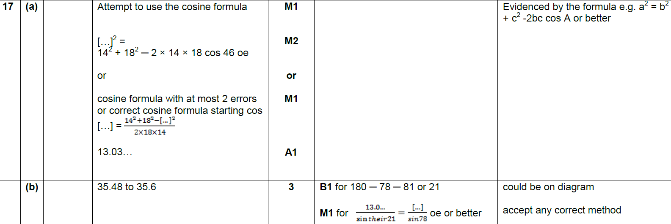
Advanced Trigonometry
Nov 2017 1H Q17
A
B

Slide 16
Advanced Trigonometry
May 2018 1H Q18

Slide 17
Advanced Trigonometry
May 2018 1H Q18
A

Slide 18
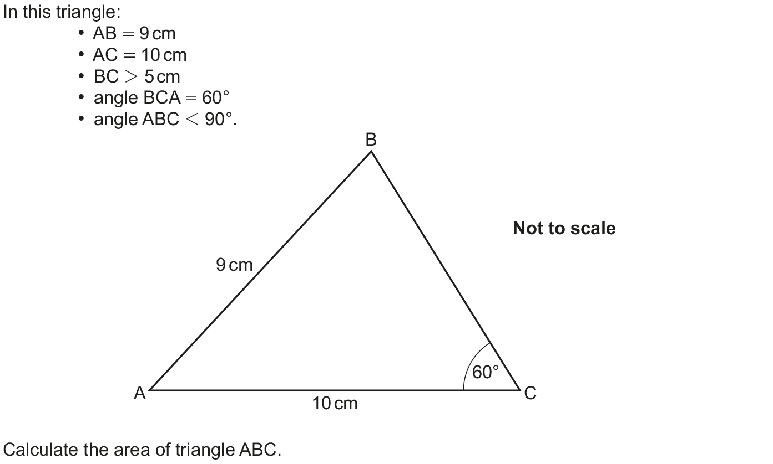
Advanced Trigonometry
Nov 2018 3H Q19

Slide 19
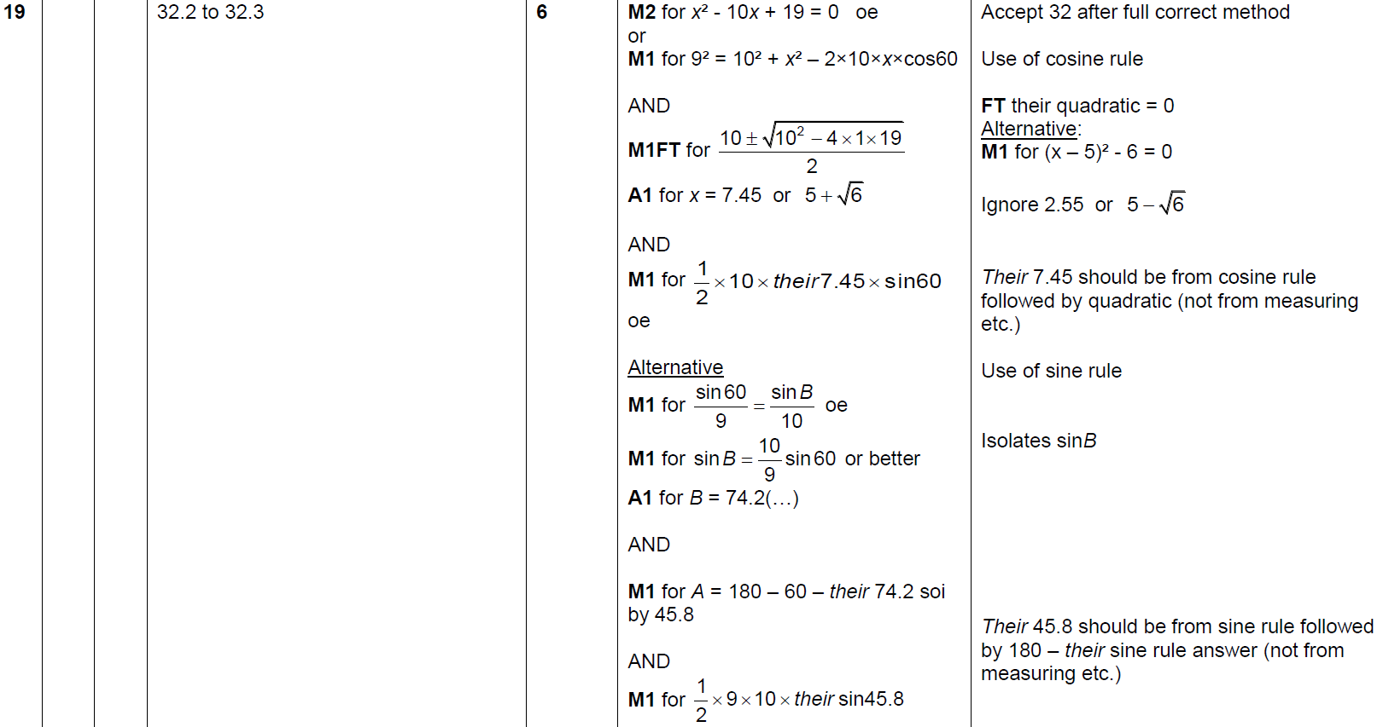
Advanced Trigonometry
Nov 2018 3H Q19
A

