Slide 1
Advanced Trigonometry
Advanced Trigonometry
May 2017
1H Q22
Nov 2018
2H Q13
June 2017
2H Q17
SAM
2H Q21
Nov 2018
3H Q16
June 2017
3H Q15
Spec 2
3H Q21
June 2019
3H Q14
Nov 2017
3H Q17
June 2019
3H Q23
June 2018
3H Q17
Area

Slide 2
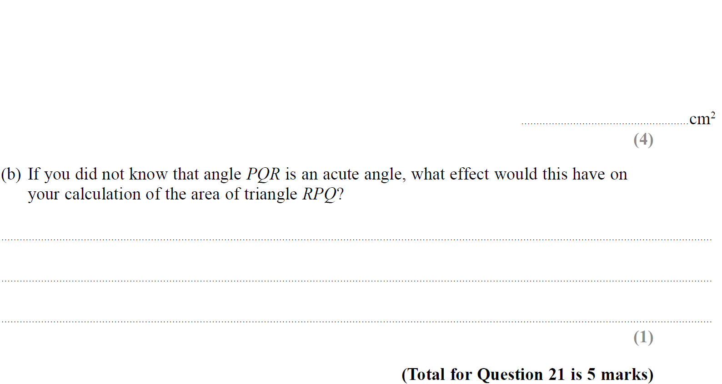
Advanced Trigonometry
SAM 2H Q21

Slide 3
Advanced Trigonometry
SAM 2H Q21
A
B

Slide 4
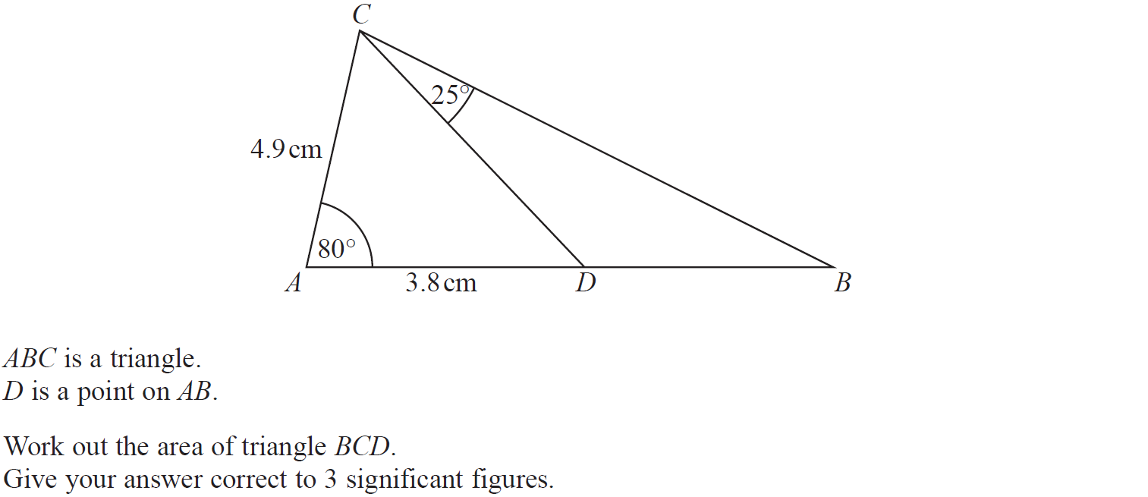
Advanced Trigonometry
Specimen Set 2 3H Q21

Slide 5
Advanced Trigonometry
Specimen Set 2 3H Q21
A

Slide 6
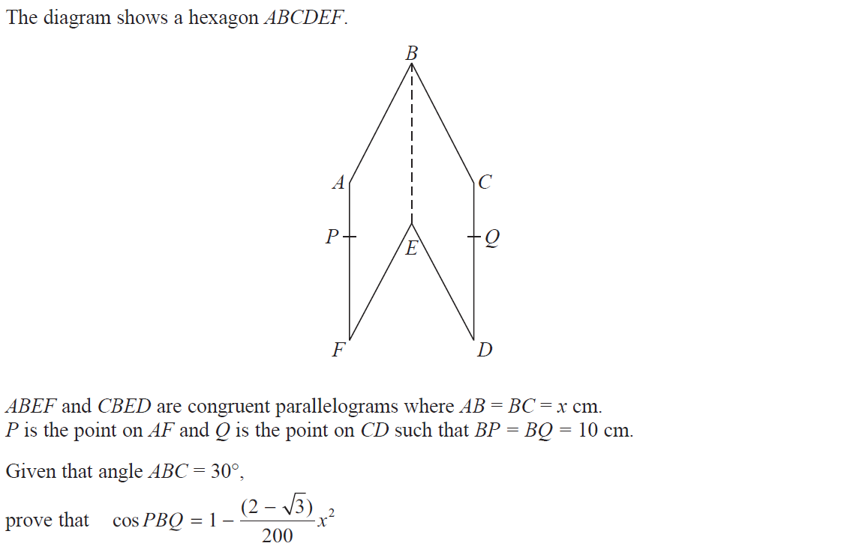
Advanced Trigonometry
May 2017 1H Q22

Slide 7
Advanced Trigonometry
May 2017 1H Q22
A

Slide 8
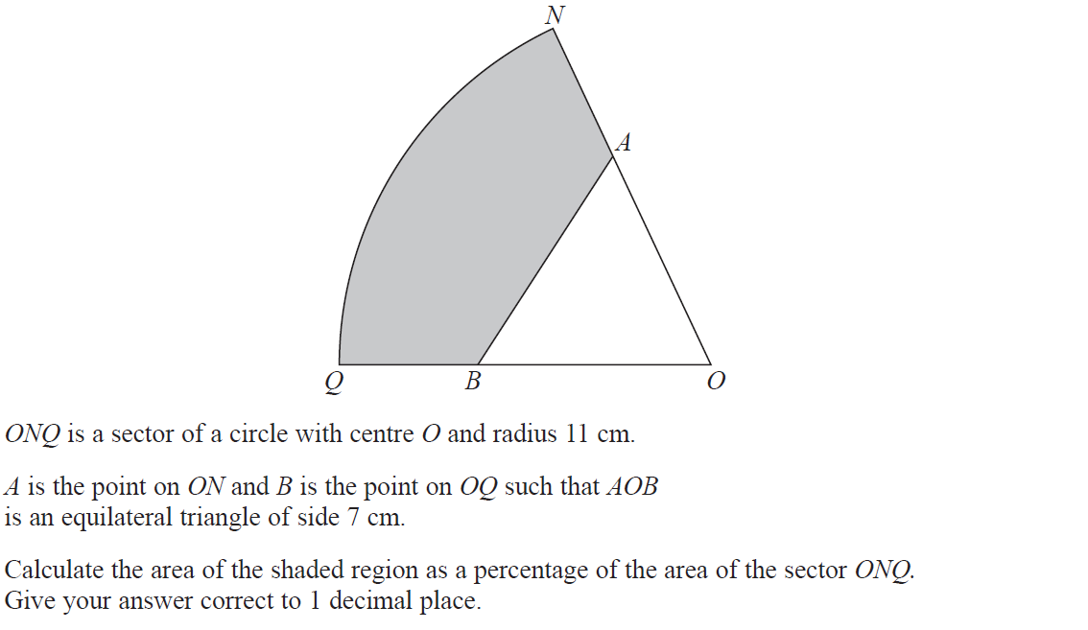
Advanced Trigonometry
June 2017 2H Q17

Slide 9
Advanced Trigonometry
June 2017 2H Q17
A

Slide 10
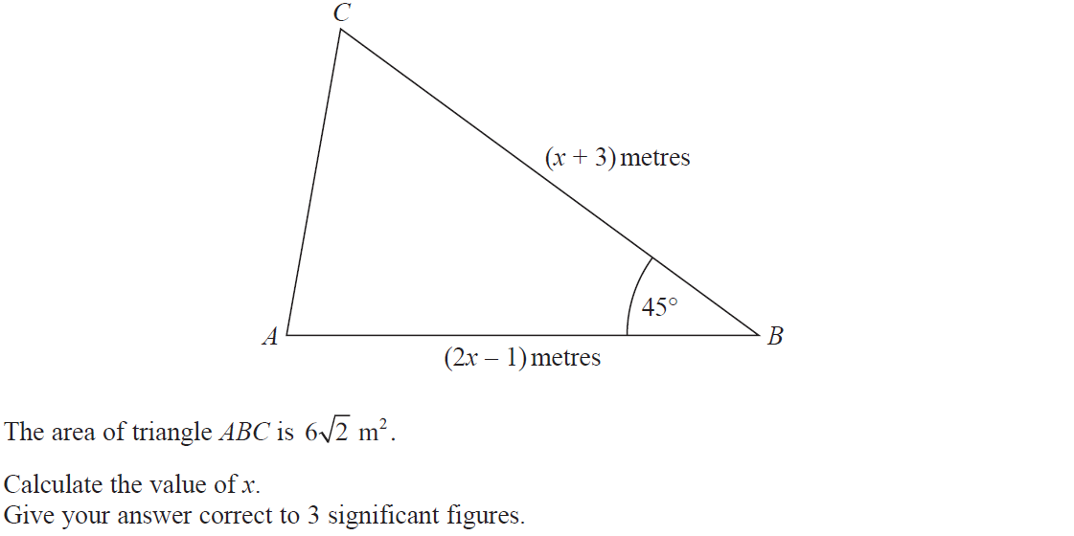
Advanced Trigonometry
June 2017 3H Q15

Slide 11
Advanced Trigonometry
June 2017 3H Q15
A

Slide 12
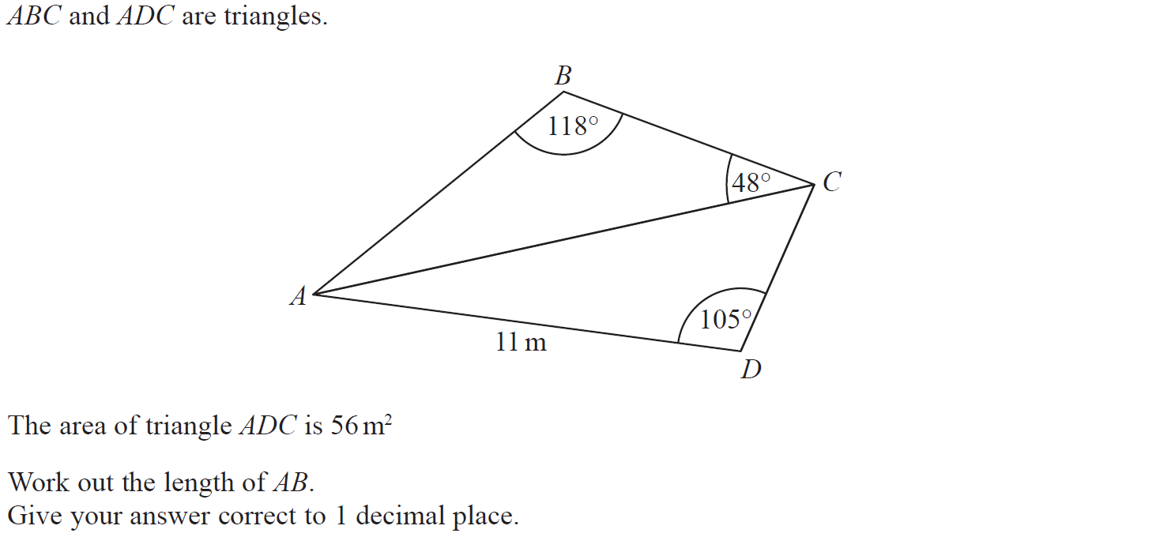
Advanced Trigonometry
Nov 2017 3H Q17

Slide 13
Advanced Trigonometry
Nov 2017 3H Q17
A

Slide 14
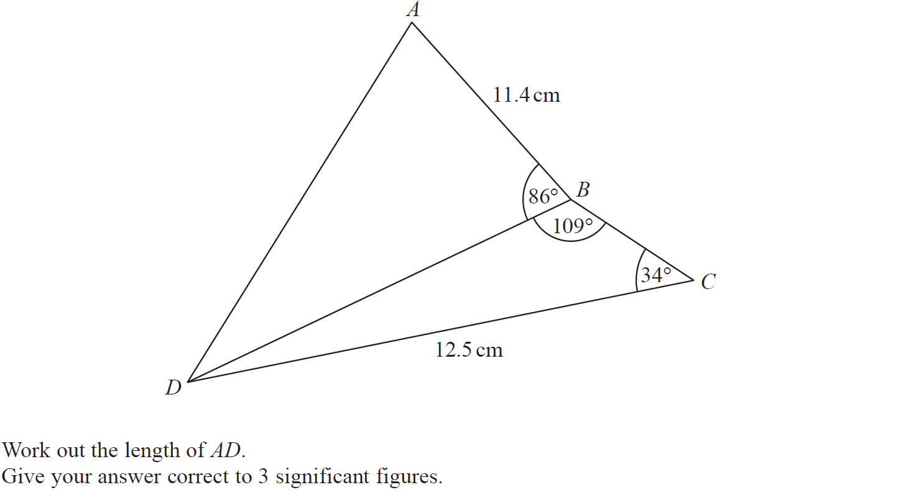
Advanced Trigonometry
June 2018 3H Q17

Slide 15
Advanced Trigonometry
June 2018 3H Q17
A

Slide 16
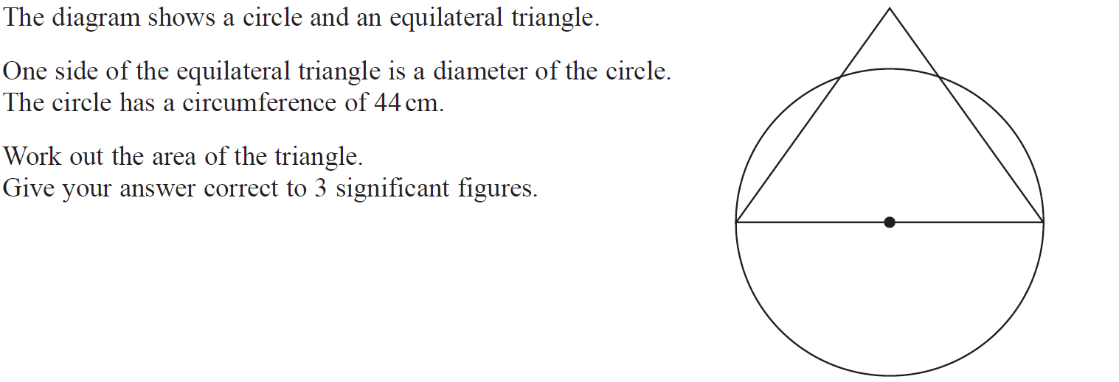
Advanced Trigonometry
Nov 2018 2H Q13

Slide 17
Advanced Trigonometry
Nov 2018 2H Q13
A

Slide 18
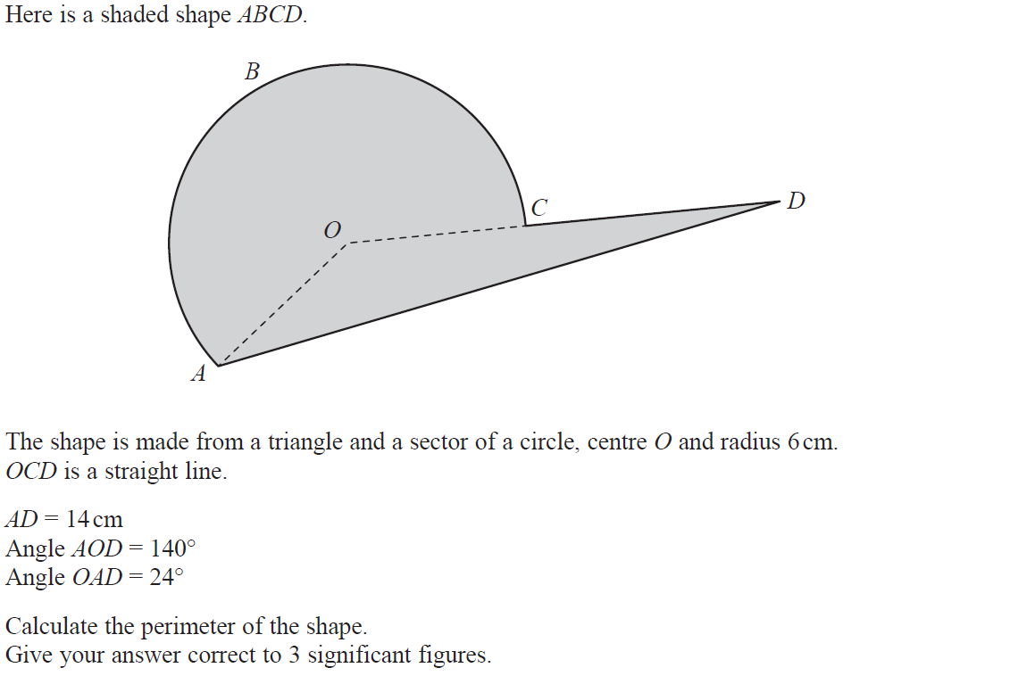
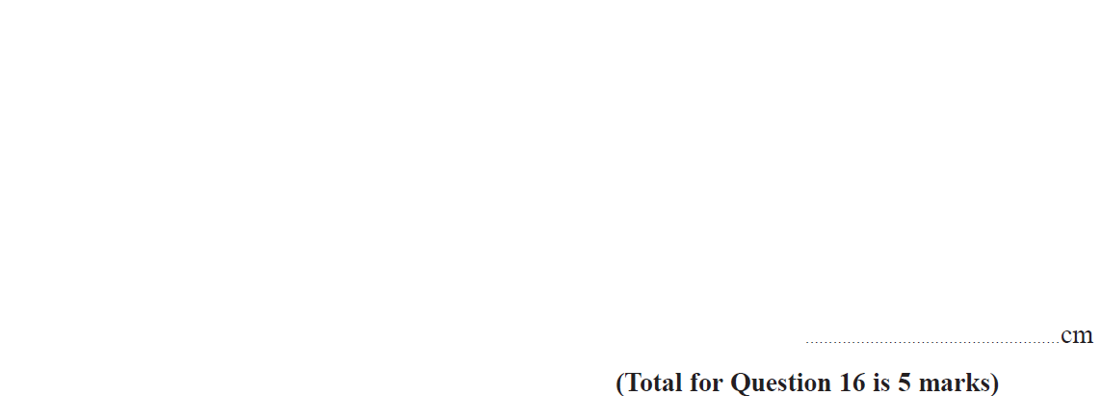
Advanced Trigonometry
Nov 2018 3H Q16

Slide 19
Advanced Trigonometry
Nov 2018 3H Q16
A

Slide 20
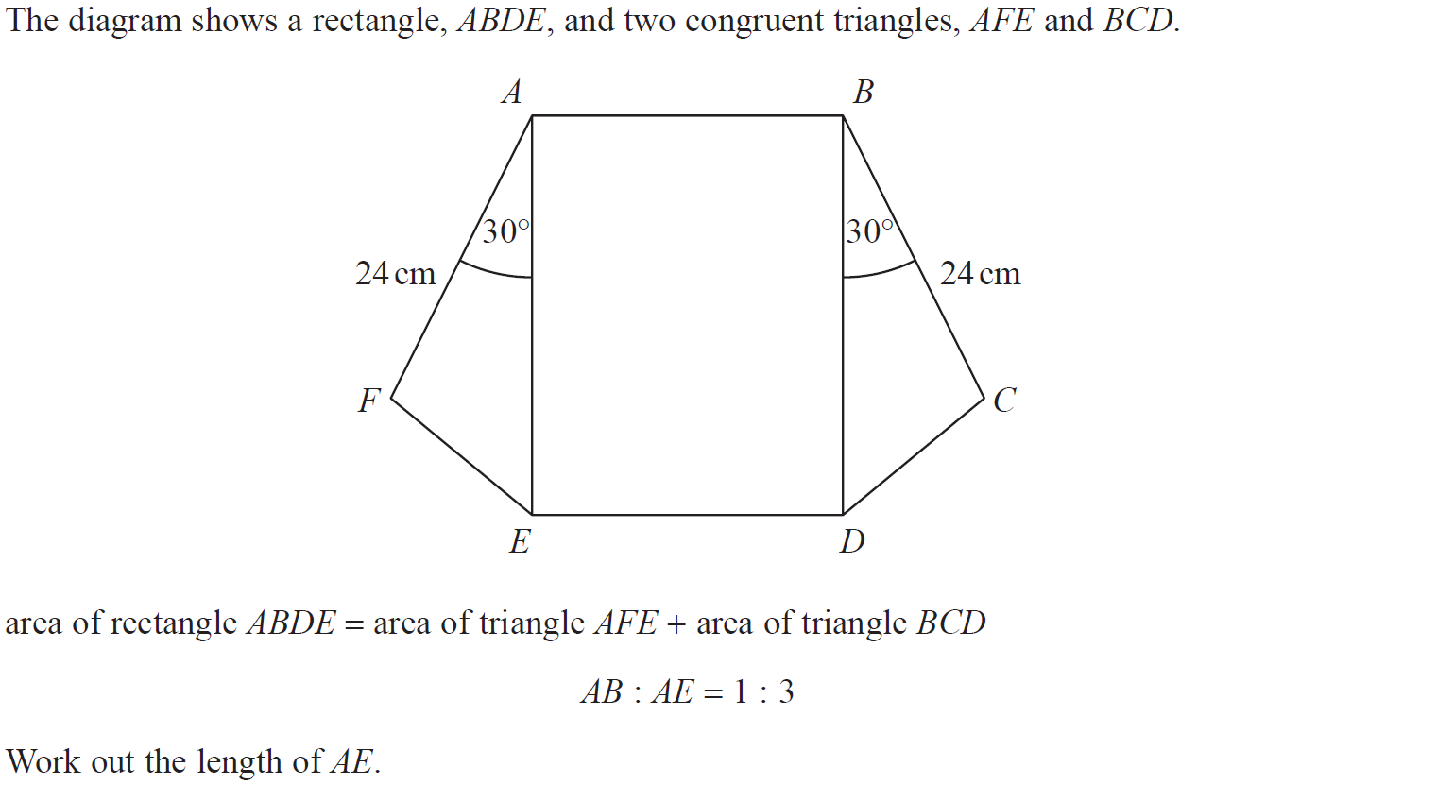
Advanced Trigonometry
June 2019 3H Q14

Slide 21
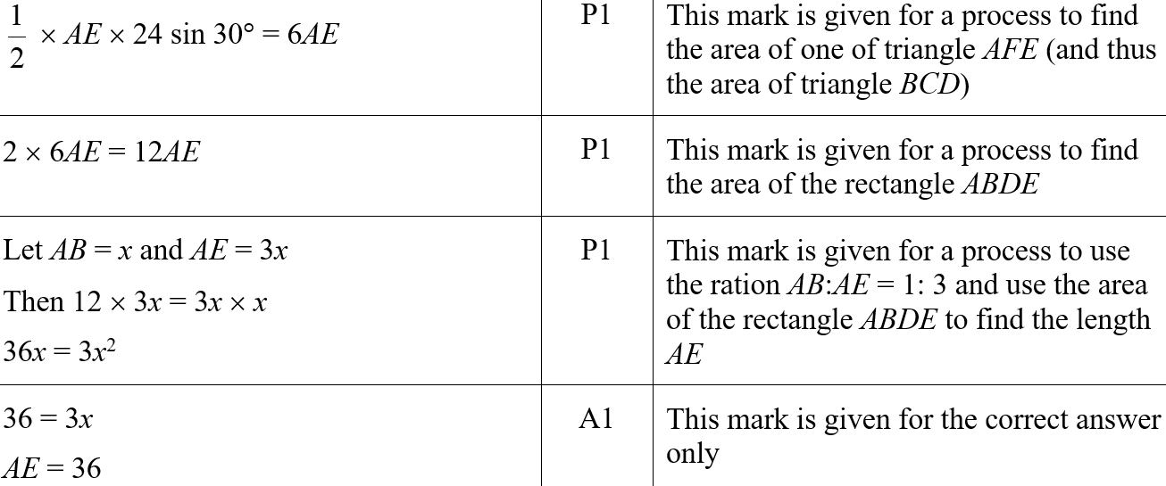
Advanced Trigonometry
June 2019 3H Q14
A
A SF

Slide 22
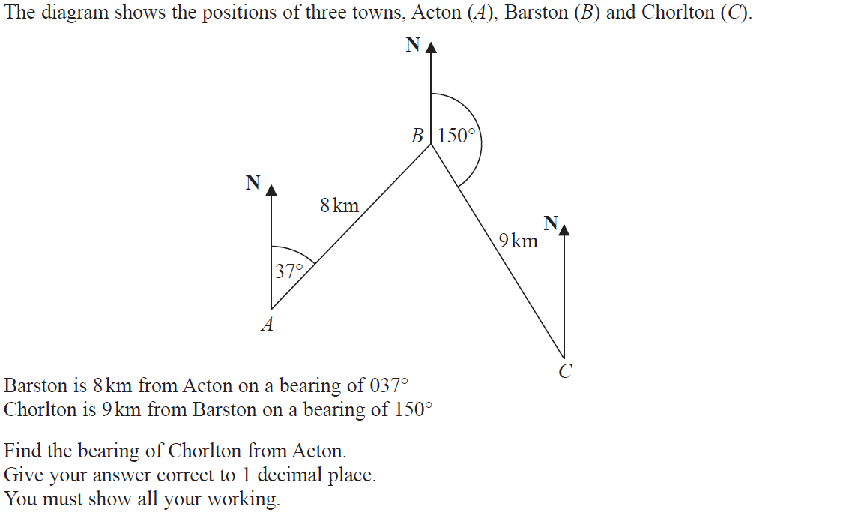
Advanced Trigonometry
June 2019 3H Q23

Slide 23
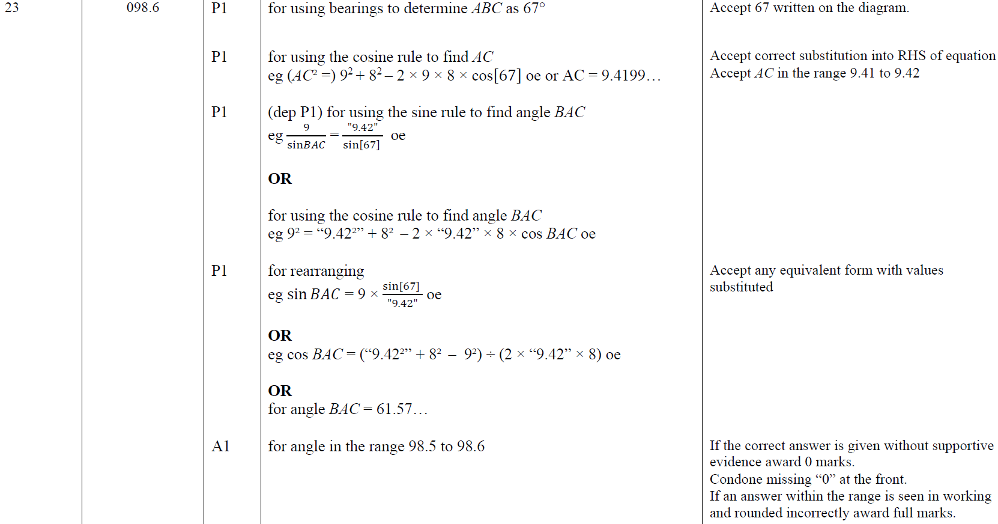
Advanced Trigonometry
June 2019 3H Q23
A

Slide 24
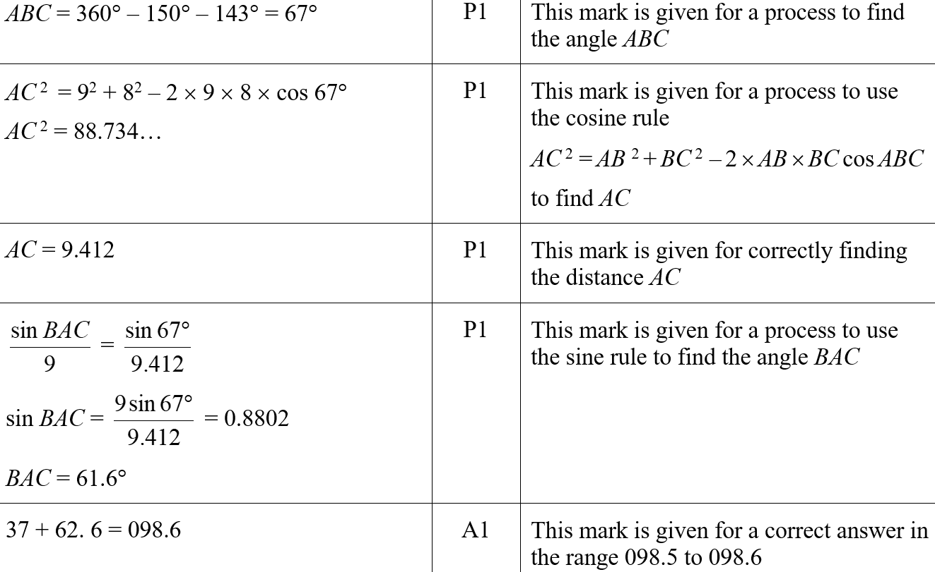
Advanced Trigonometry
June 2019 3H Q23
A SF

