Slide 1
Vectors
Vectors
May 2017
1H Q19
Edexcel
SAM
3H Q18
Nov 2017
3H Q21
AQA
Spec 1
1H Q22
June 2018
2H Q10
OCR
Spec 2
3H Q20
Nov 2018
1H Q21
June 2019
2H Q20
Show/ Prove that

Slide 2
Vectors
Vectors
June 2017
2H Q23
Edexcel
June 2017
3H Q1
SAM
3H Q2
AQA
Nov 2017
2H Q26
1 Marker
SAM
3H Q25
OCR
June 2018
3H Q11
Nov 2018
2H Q23
Show/ Prove that

Slide 3
Vectors
Vectors
June 2017
2H Q11
Edexcel
Nov 2017
3H Q16
SAM
2H Q1
AQA
June 2018
2H Q3
SAM
2H Q18
OCR
June 2018
3H Q10
Nov 2018
3H Q20
Show/ Prove that

Slide 4
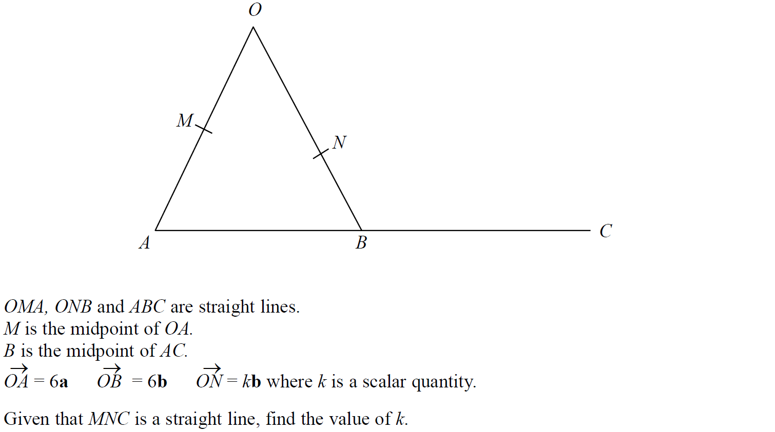
Vectors
SAM 3H Q18

Slide 5
Vectors
SAM 3H Q18
A

Slide 6
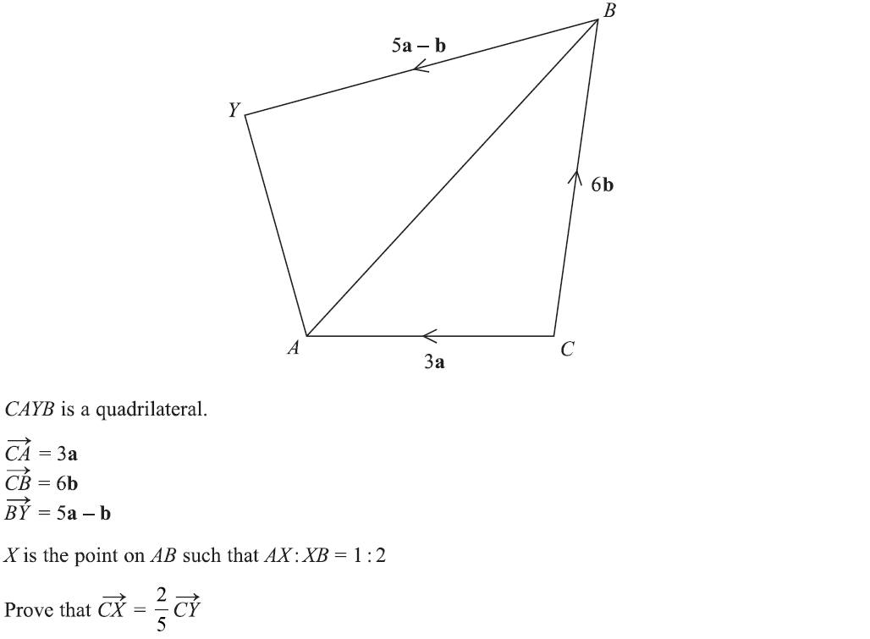
Vectors
Specimen Set 1 1H Q22

Slide 7
Vectors
Specimen Set 1 1H Q22
A

Slide 8
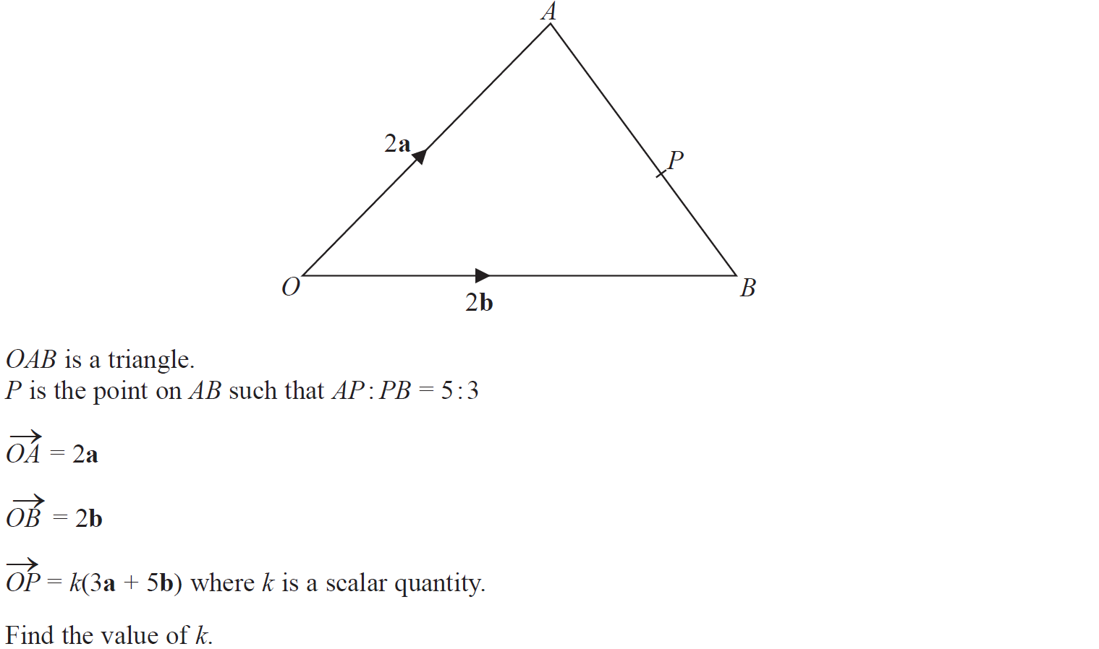
Vectors
Specimen Set 2 3H Q20

Slide 9
Vectors
Specimen Set 2 3H Q20
A

Slide 10
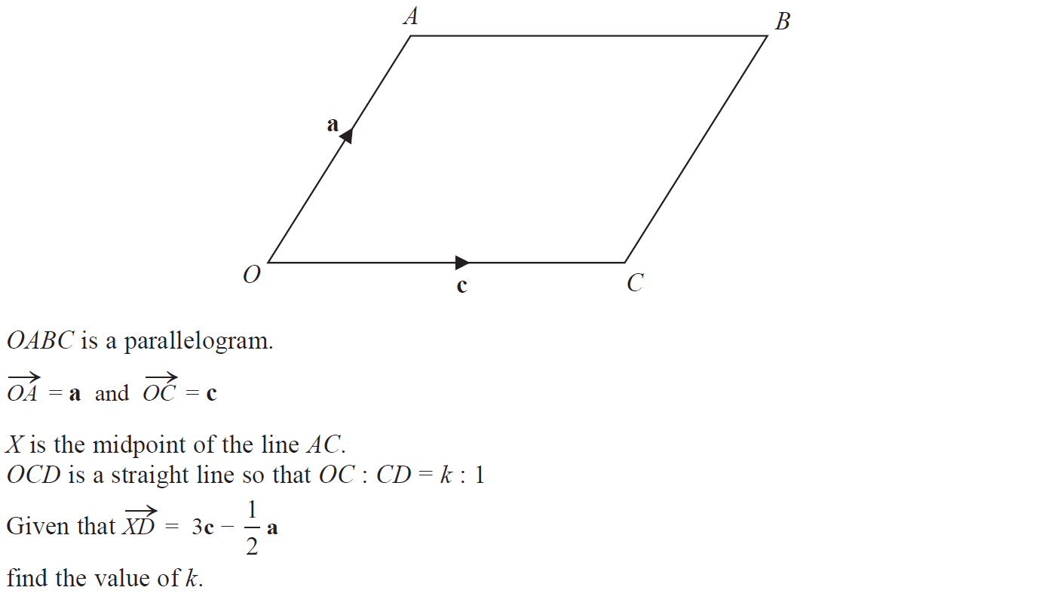
Vectors
May 2017 1H Q19

Slide 11
Vectors
May 2017 1H Q19
A

Slide 12
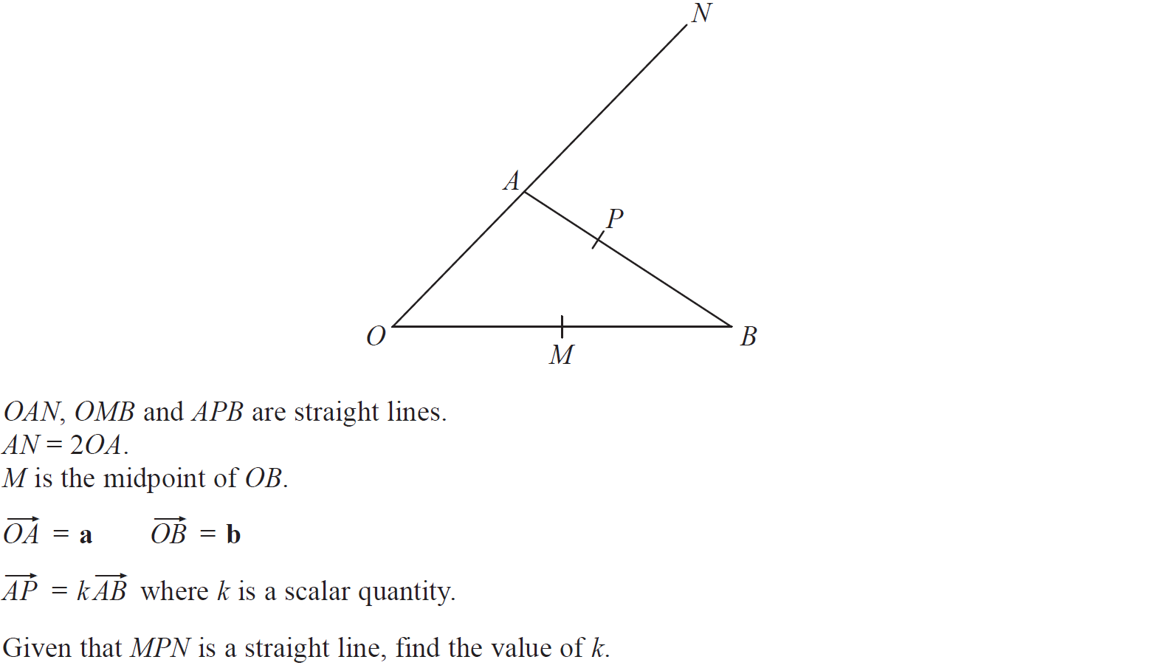
Vectors
Nov 2017 3H Q21

Slide 13
Vectors
Nov 2017 3H Q21
A

Slide 14
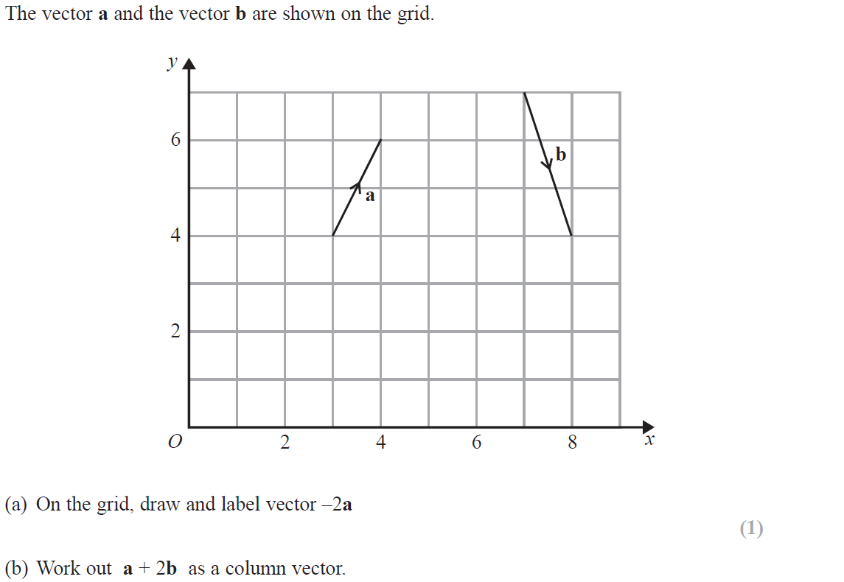
Vectors
June 2018 2H Q10
Reveal example for (a)

Slide 15
Vectors
June 2018 2H Q10
A
B

Slide 16
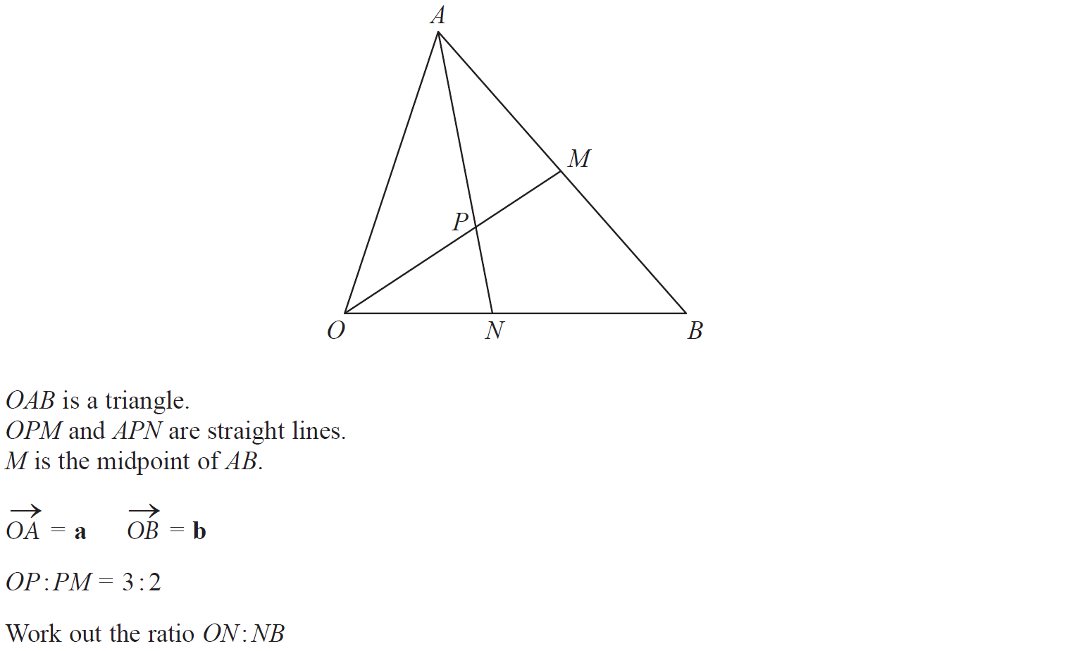
Vectors
Nov 2018 1H Q21

Slide 17
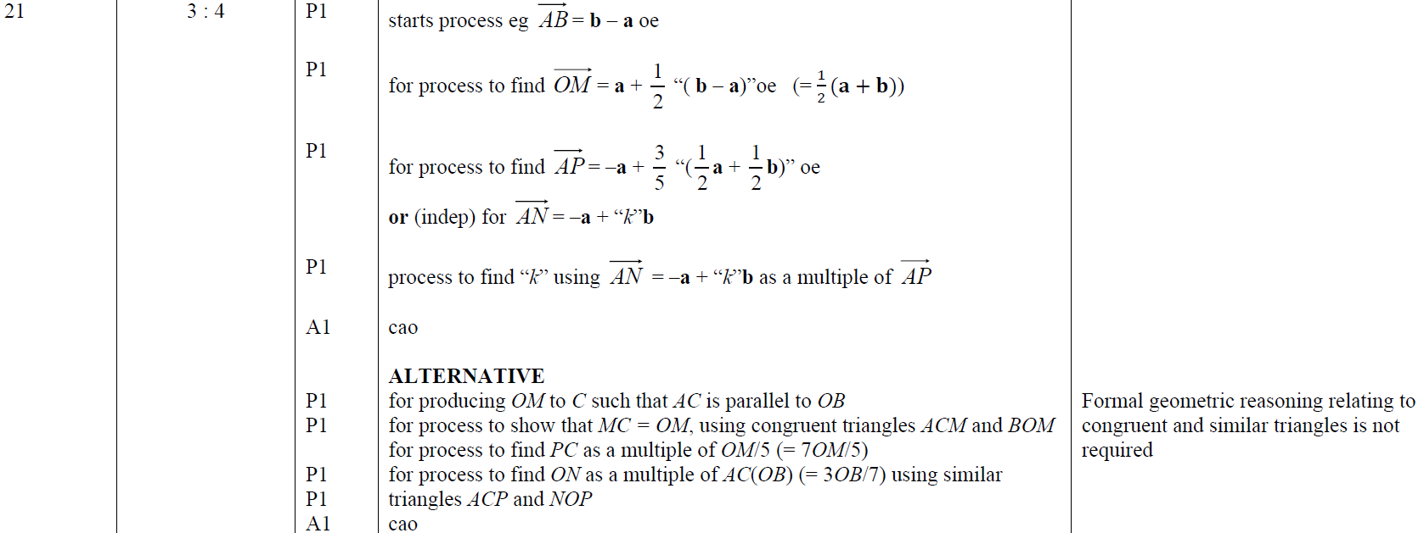
Vectors
Nov 2018 1H Q21
A

Slide 18
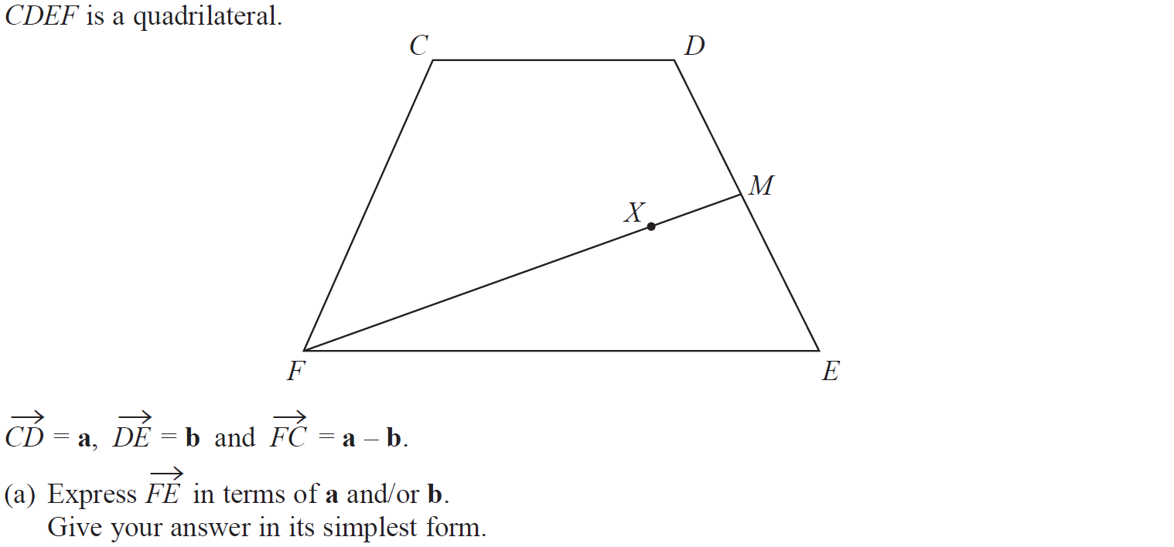
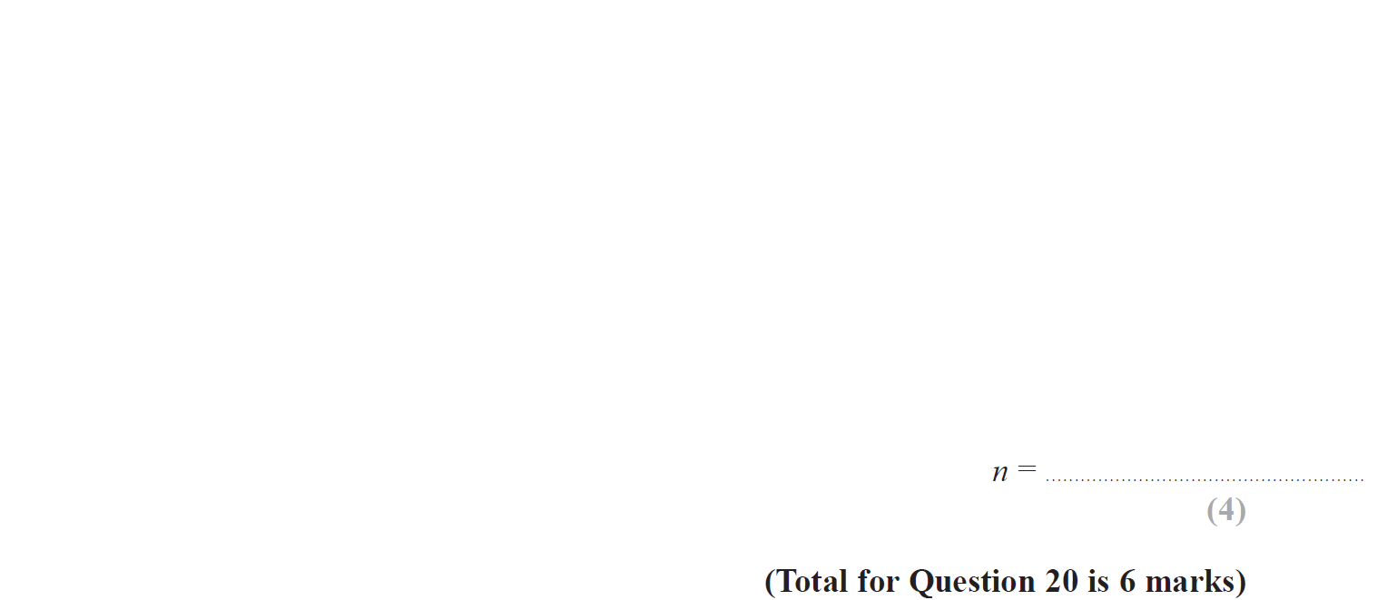
Vectors
June 2019 2H Q20

Slide 19
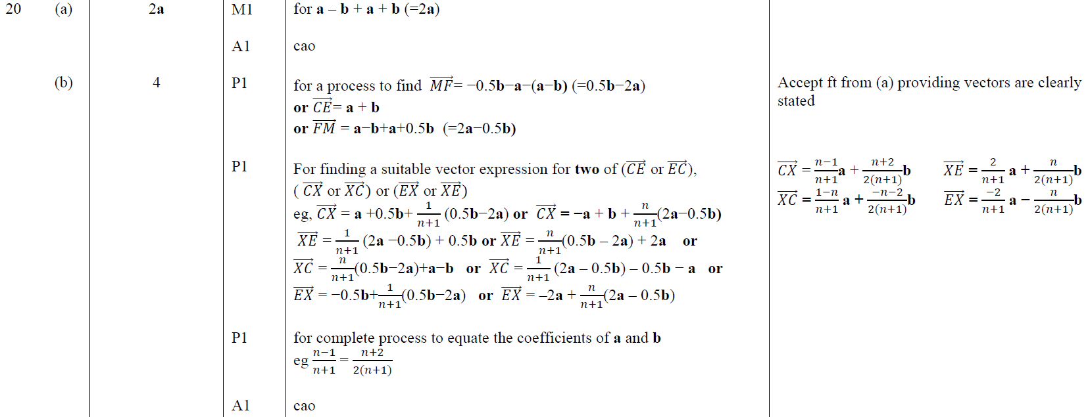
Vectors
June 2019 2H Q20
A
B

Slide 20
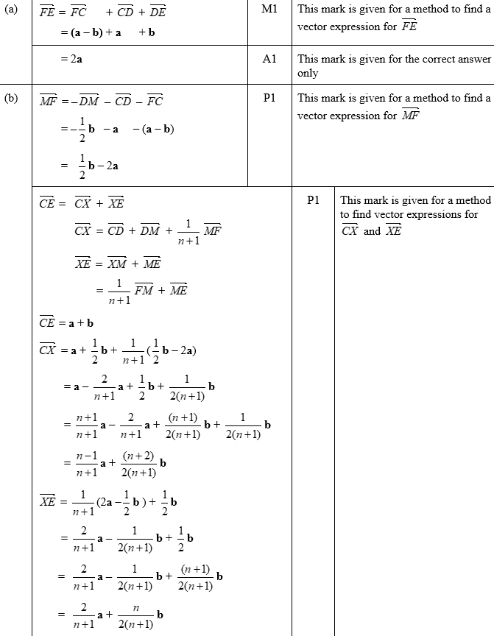
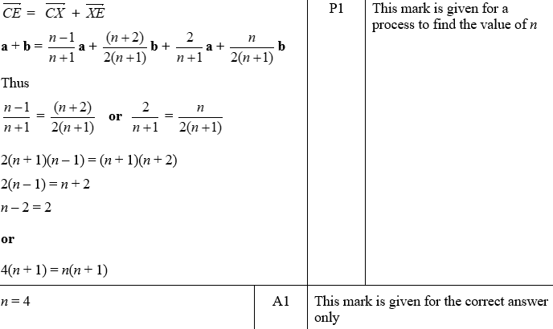
Vectors
June 2019 2H Q20
A SF
B SF

Slide 21
Vectors
SAM 3H Q2

Slide 22
Vectors
SAM 3H Q2
A

Slide 23
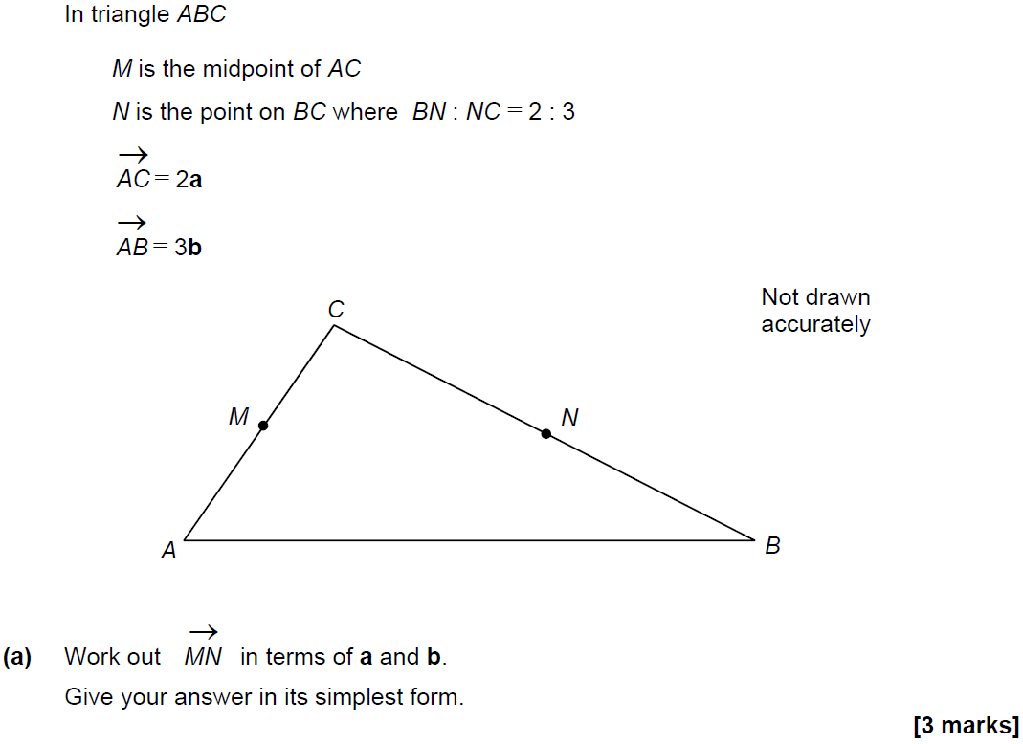
Vectors
SAM 3H Q25

Slide 24
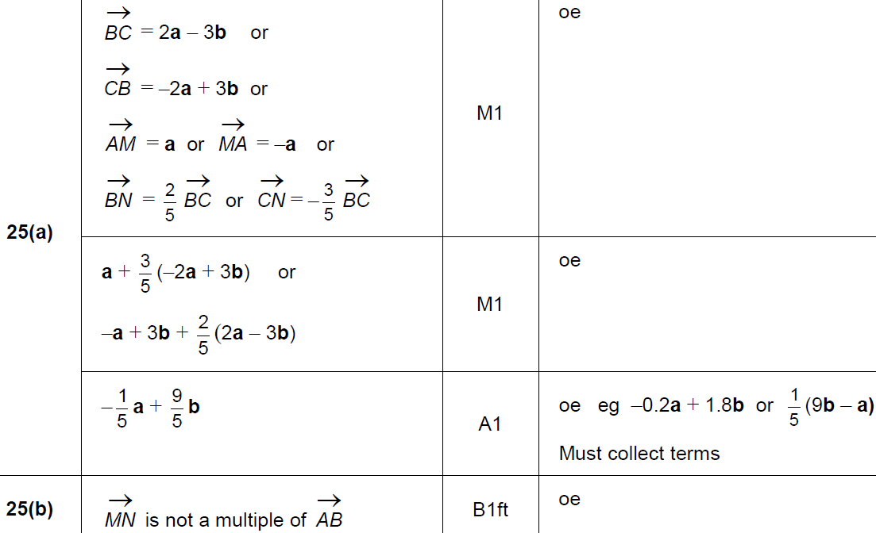
Vectors
SAM 3H Q25
A
B

Slide 25
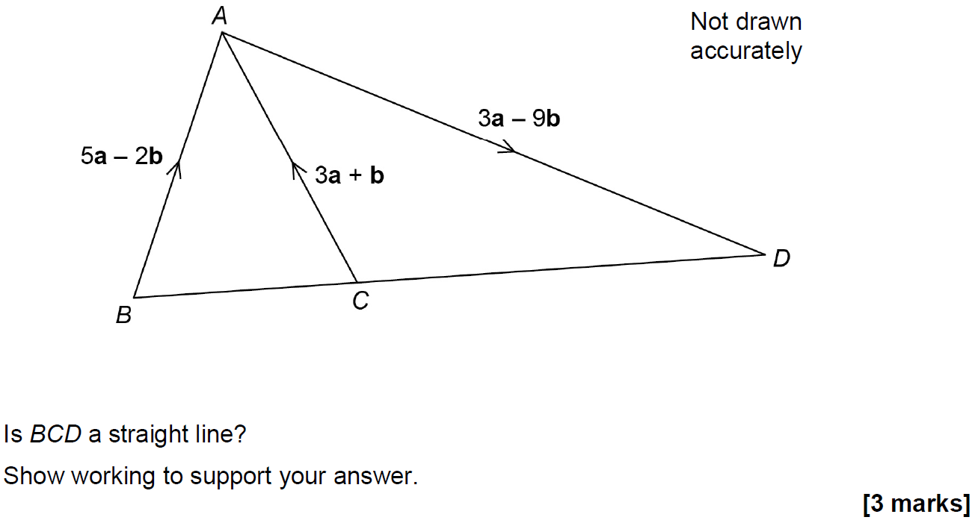
Vectors
June 2017 2H Q23

Slide 26
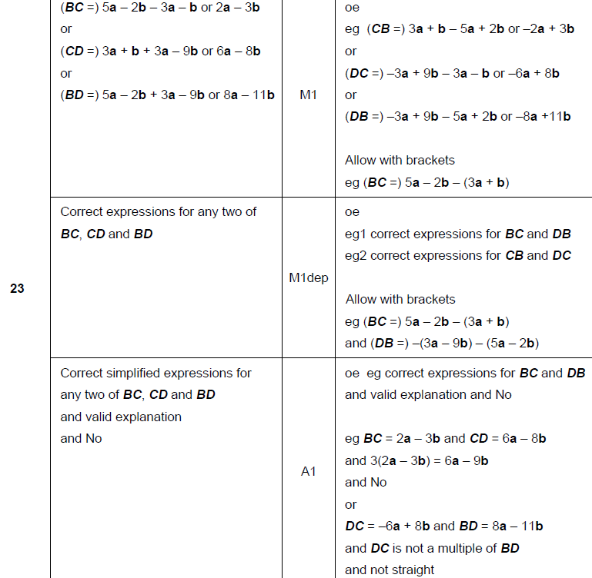
Vectors
June 2017 2H Q23
A

Slide 27
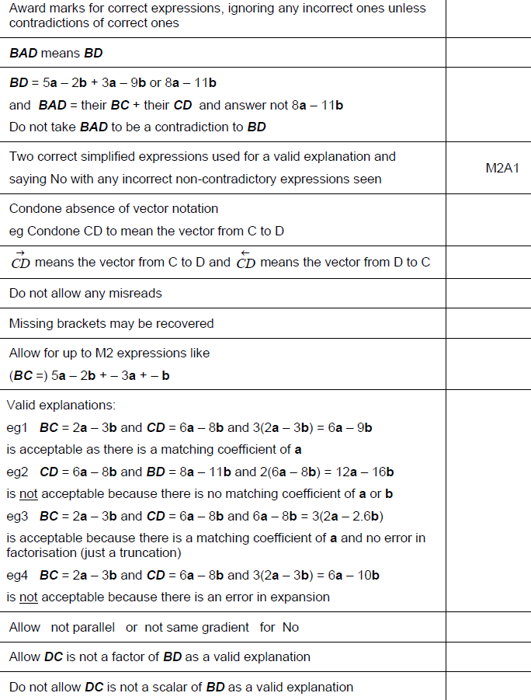
Vectors
June 2017 2H Q23
A notes

Slide 28
Vectors
June 2017 3H Q1

Slide 29
Vectors
June 2017 3H Q1
A

Slide 30
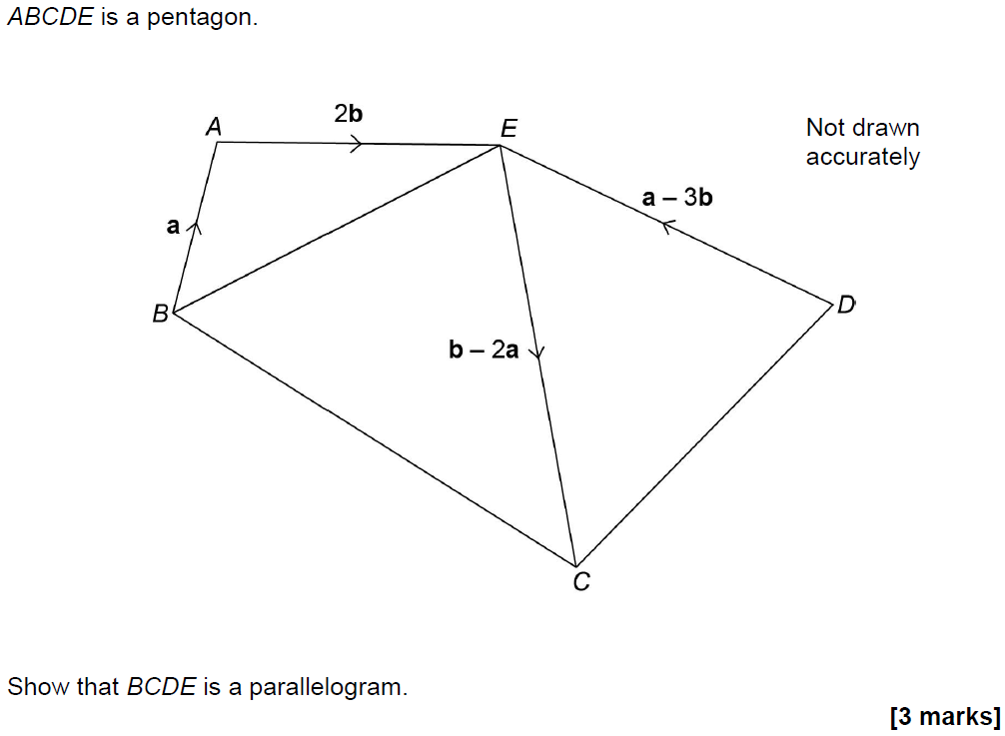
Vectors
Nov 2017 2H Q26

Slide 31
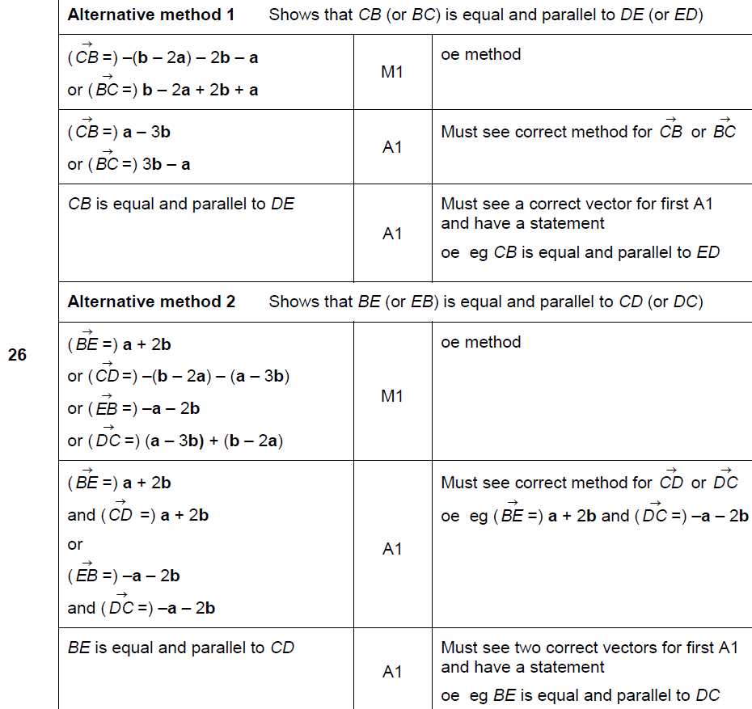
Vectors
Nov 2017 2H Q26
A

Slide 32
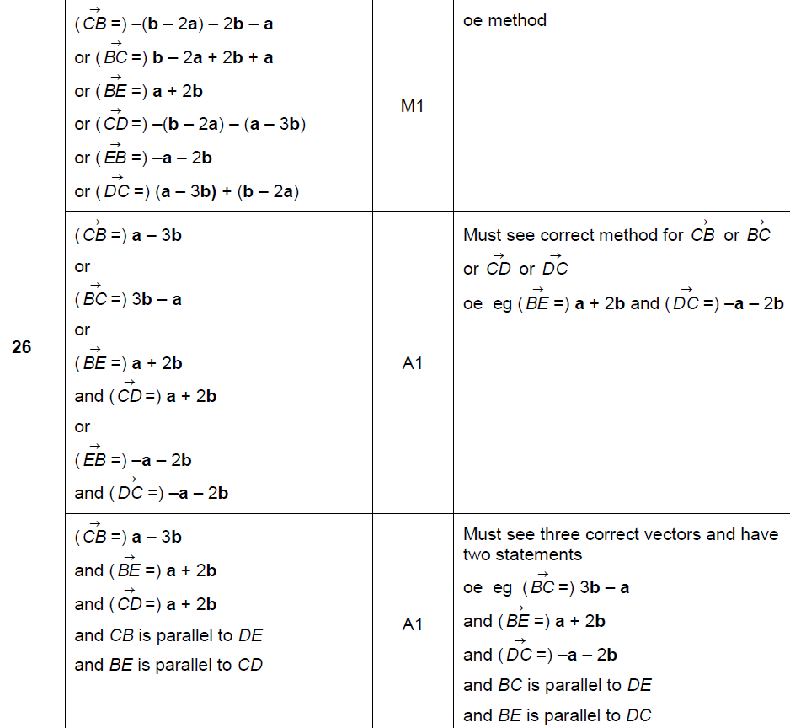
Vectors
Nov 2017 2H Q26
A Alternative 2

Slide 33
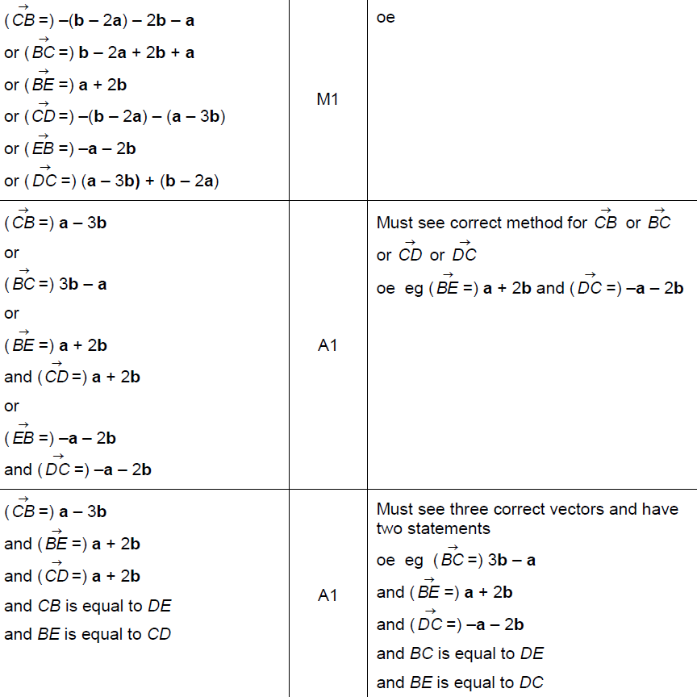
Vectors
Nov 2017 2H Q26
A Alternative 2

Slide 34
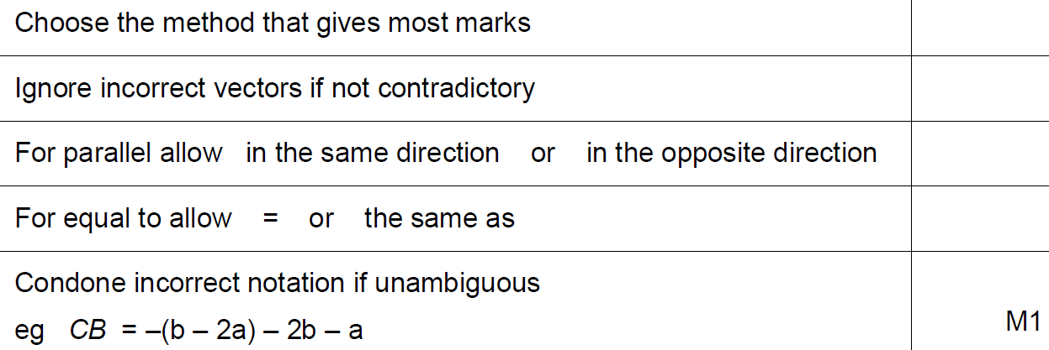
Vectors
Nov 2017 2H Q26
A notes

Slide 35
Vectors
June 2018 3H Q11

Slide 36
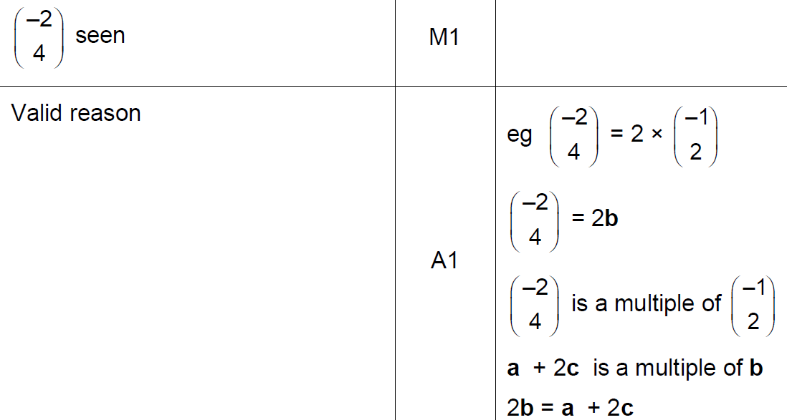
Vectors
June 2018 3H Q11
A
B

Slide 37
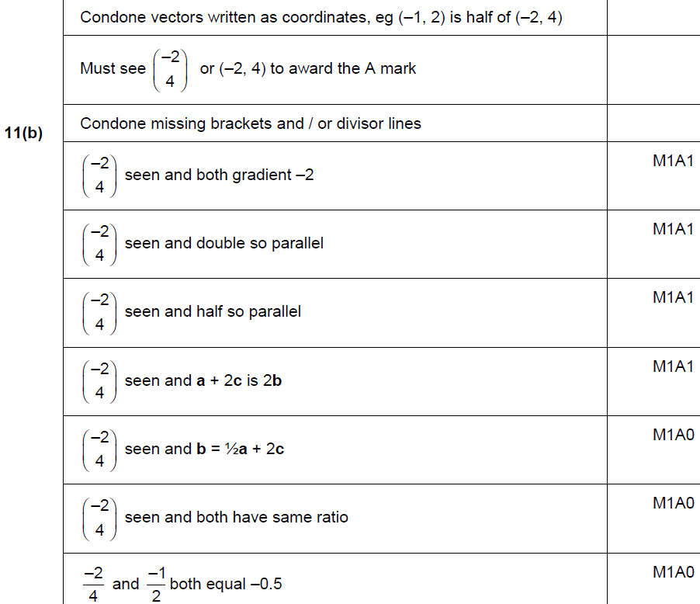
Vectors
June 2018 3H Q11
B

Slide 38
Vectors
Nov 2017 2H Q26
A Alternative 2

Slide 39
Vectors
Nov 2017 2H Q26
A notes

Slide 40
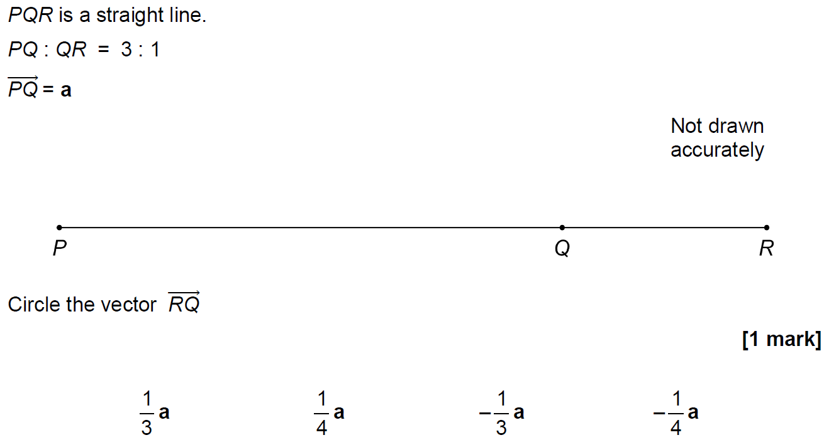
Vectors
Nov 2018 2H Q23

Slide 41
Vectors
Nov 2018 2H Q23
A

Slide 42
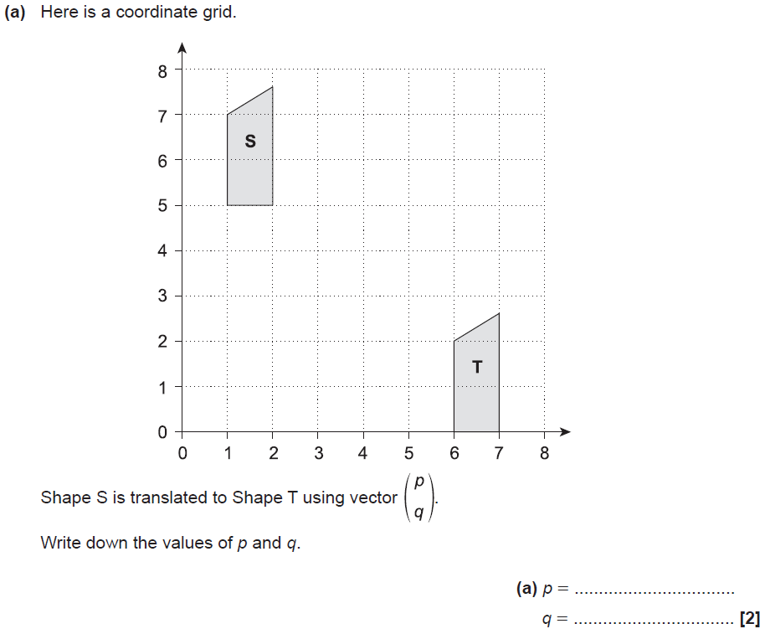
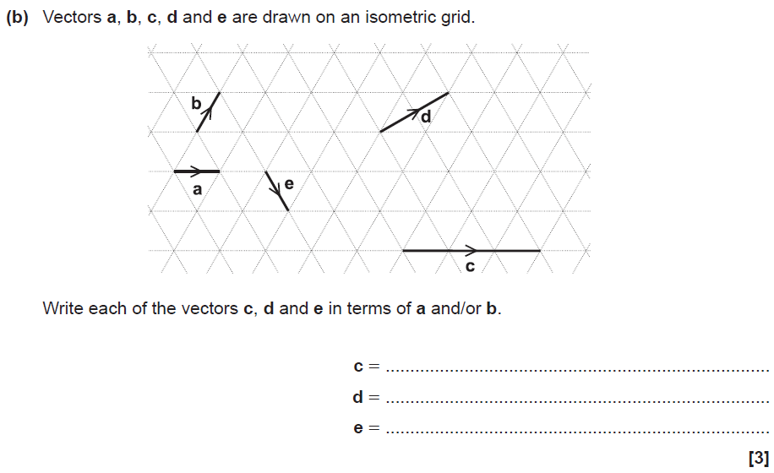
Vectors
SAM 2H Q1

Slide 43
Vectors
SAM 2H Q1
A
B

Slide 44
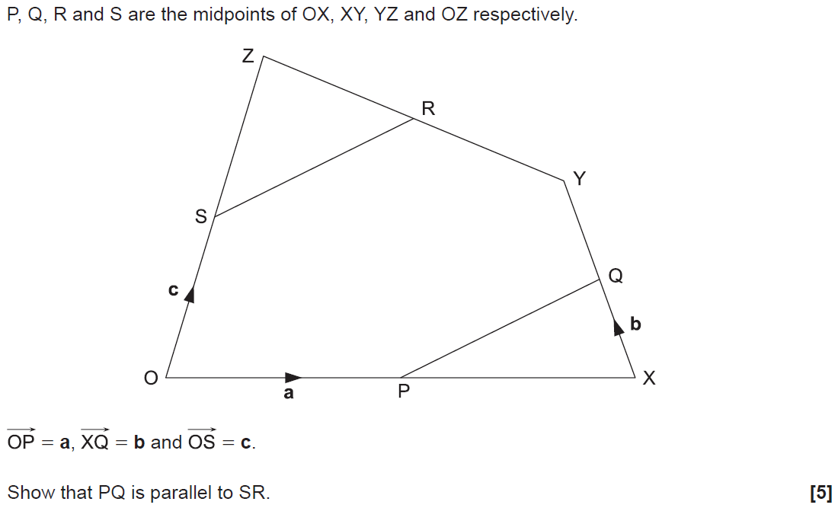
Vectors
SAM 2H Q18

Slide 45
Vectors
SAM 2H Q18
A

Slide 46
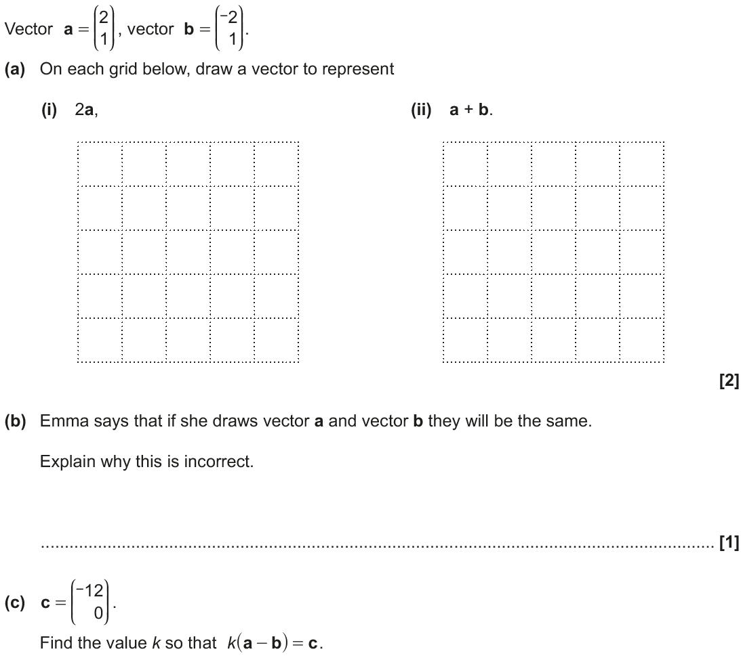
Vectors
June 2017 2H Q11
Example ans (i)
Example ans (ii)

Slide 47
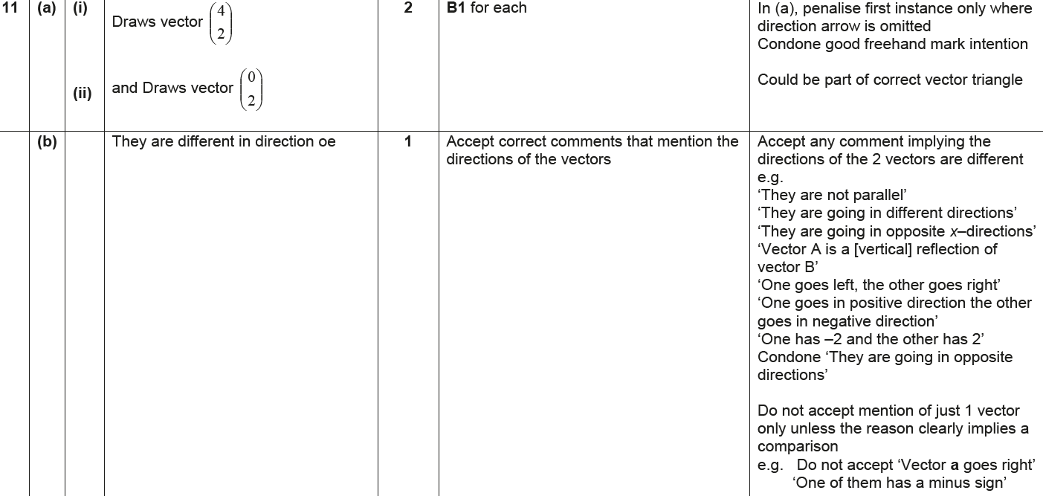
Vectors
June 2017 2H Q11
A
B
C

Slide 48
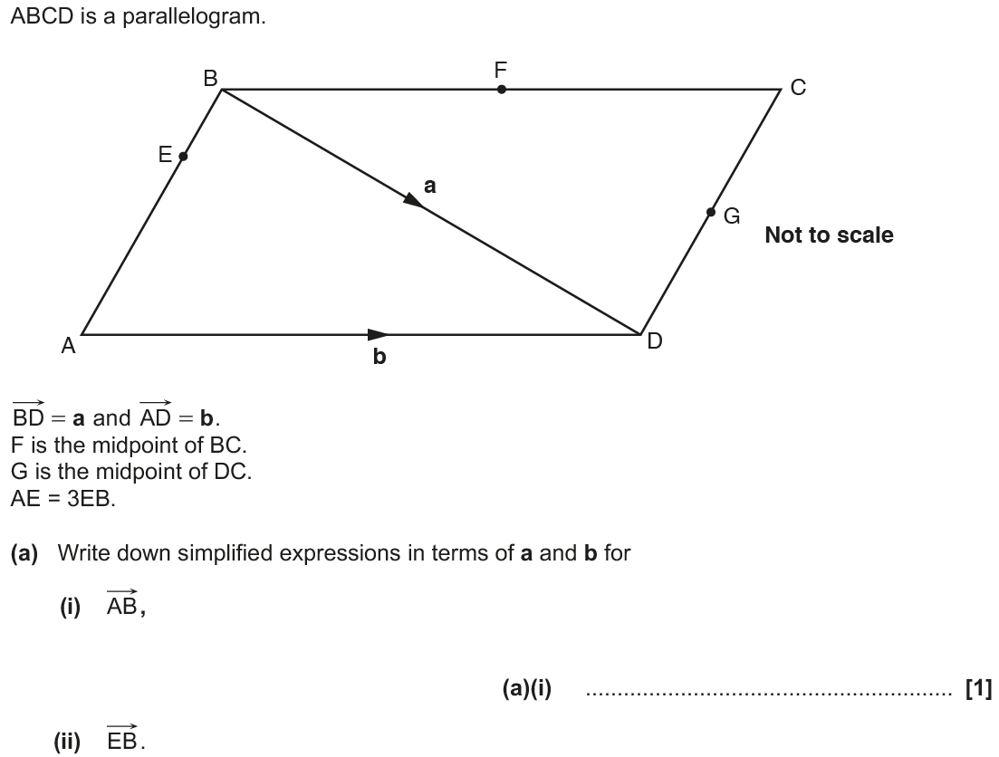
Vectors
Nov 2017 3H Q16

Slide 49
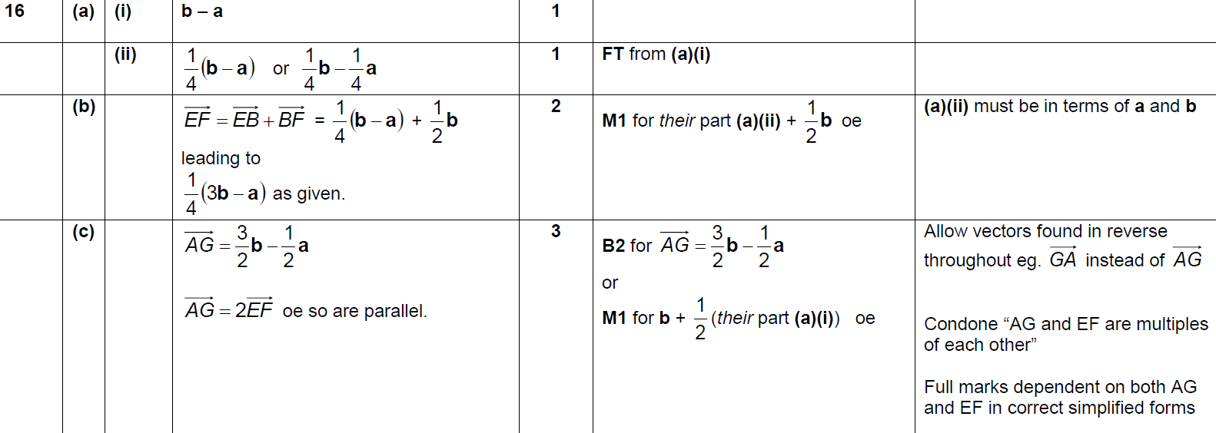
Vectors
Nov 2017 3H Q16
A (i)
A (ii)
B
C

Slide 50
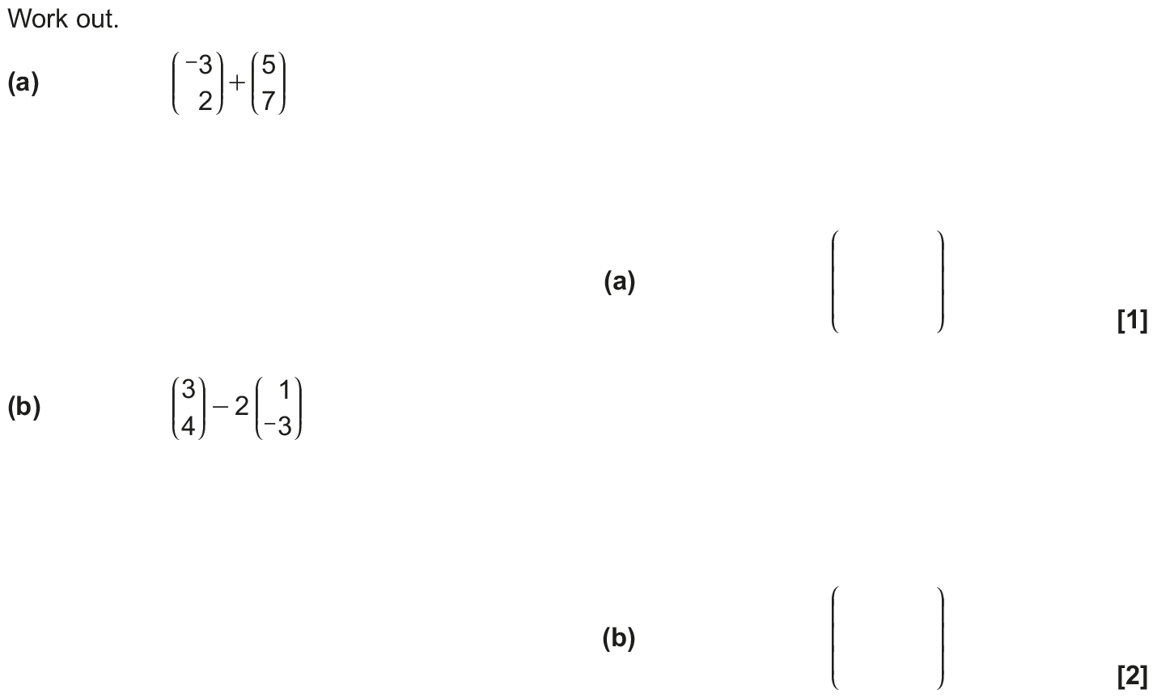
Vectors
June 2018 2H Q3

Slide 51
Vectors
June 2018 2H Q3
A
B

Slide 52
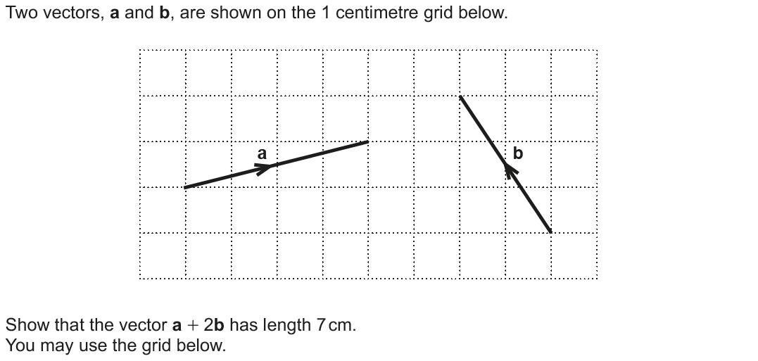
Vectors
June 2018 3H Q10

Slide 53
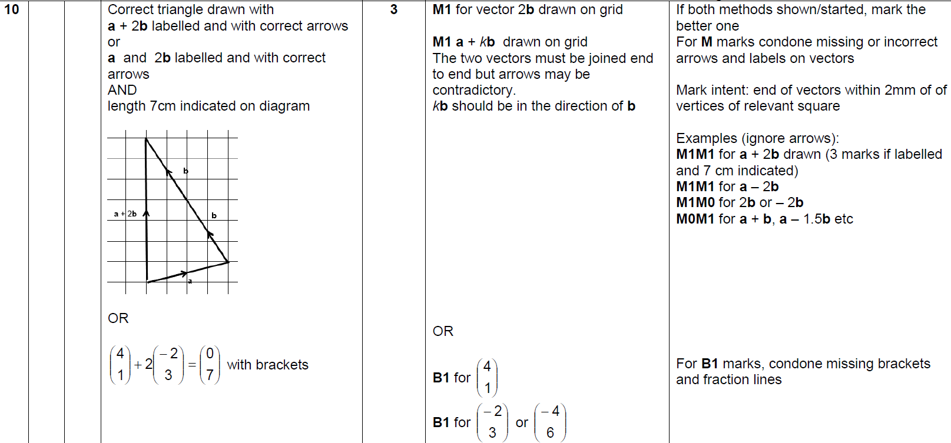
Vectors
June 2018 3H Q10
A

Slide 54
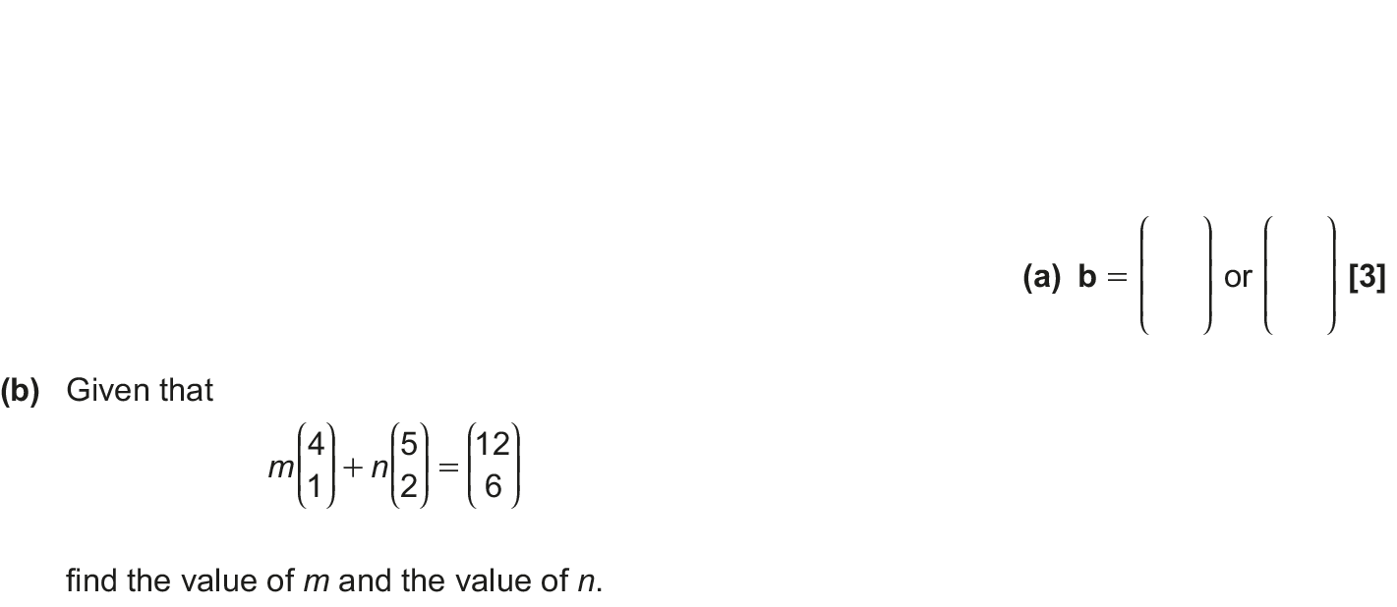
Vectors
Nov 2018 3H Q20

Slide 55
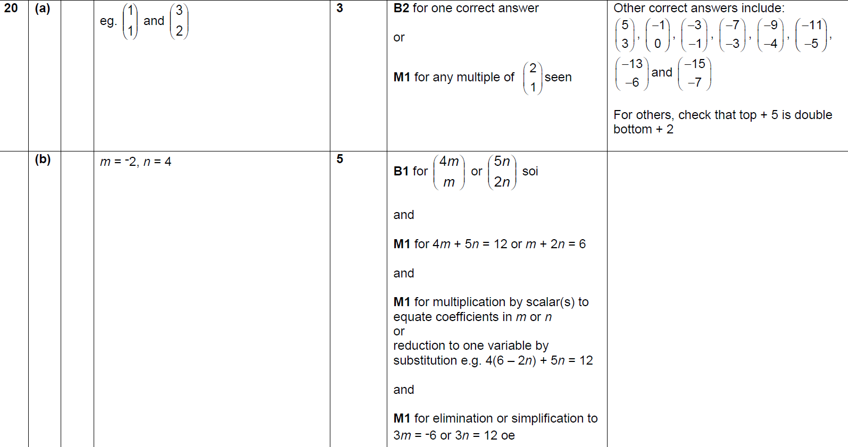
Vectors
Nov 2018 3H Q20
A
B

