Slide 1
No old spec as new to syllabus
Using Roots of Polynomials
SAM (i)
SAM 2
SAM (ii)
2019 2
2018 (i)
2018 (ii)
2019 (i)
2019 (ii)
2019 (iii)

Slide 2
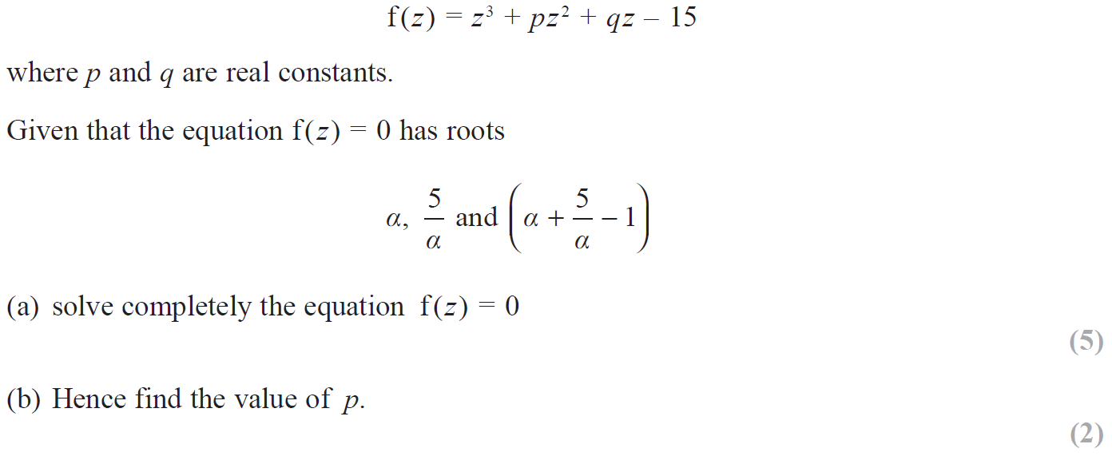
SAM

Slide 3
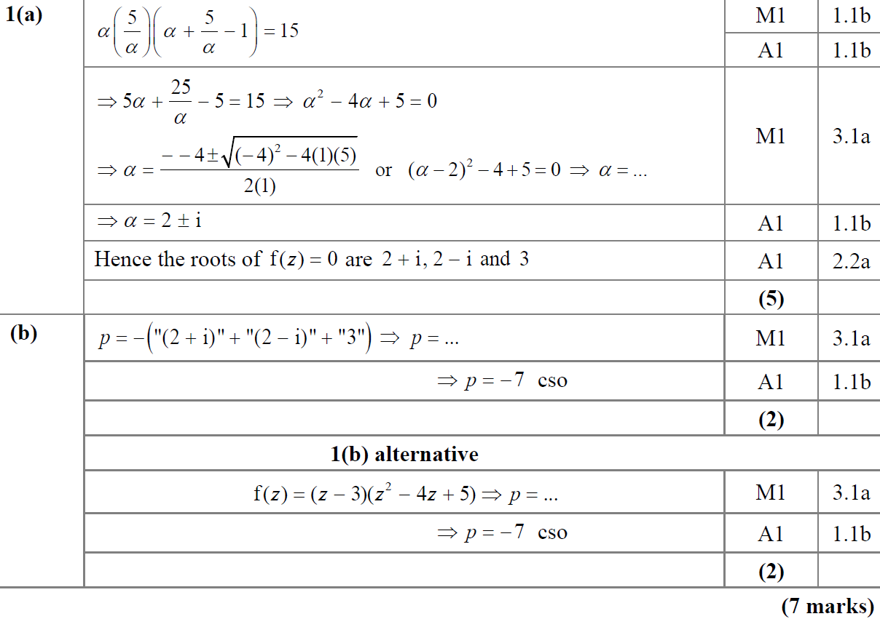
SAM
A
B

Slide 4
SAM
A notes
B notes

Slide 5
SAM

Slide 6
SAM
A

Slide 7
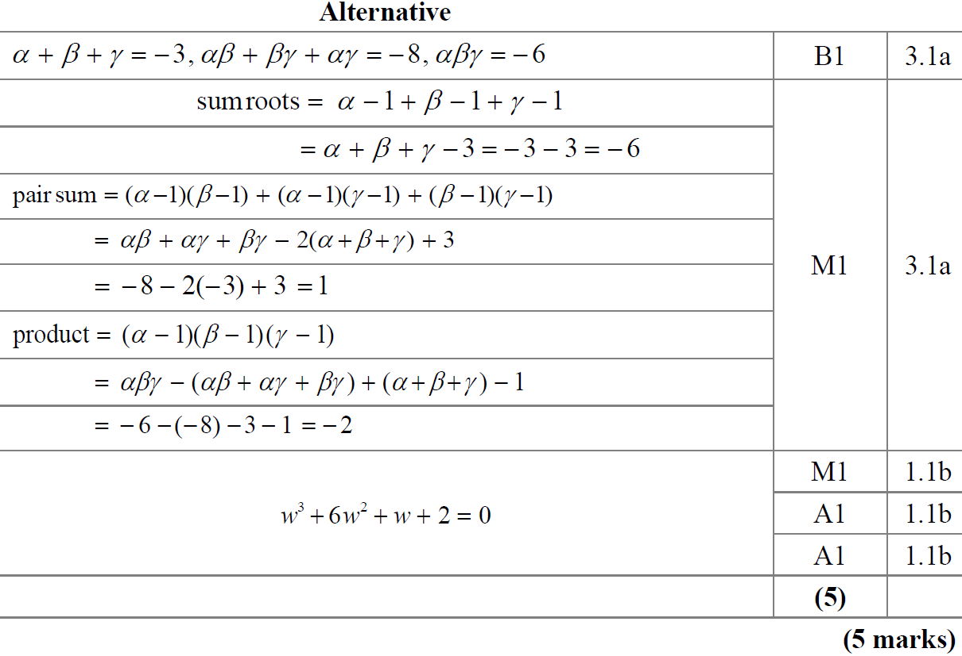
SAM
A Alternative

Slide 8
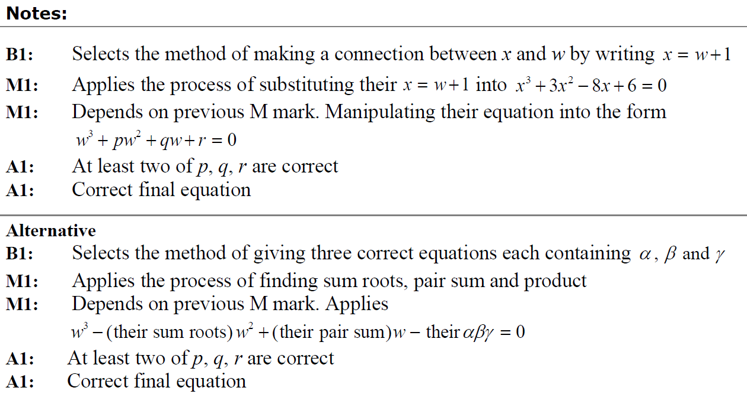
SAM
A notes
A Alternative notes

Slide 9
2018

Slide 10
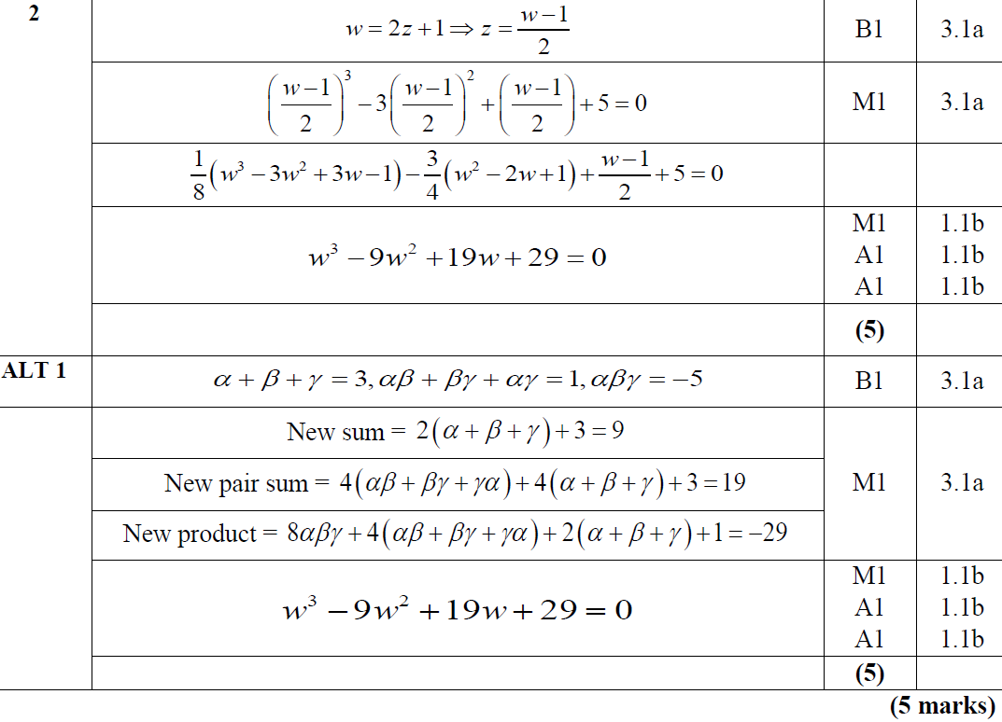
2018
A

Slide 11
2018
A notes

Slide 12
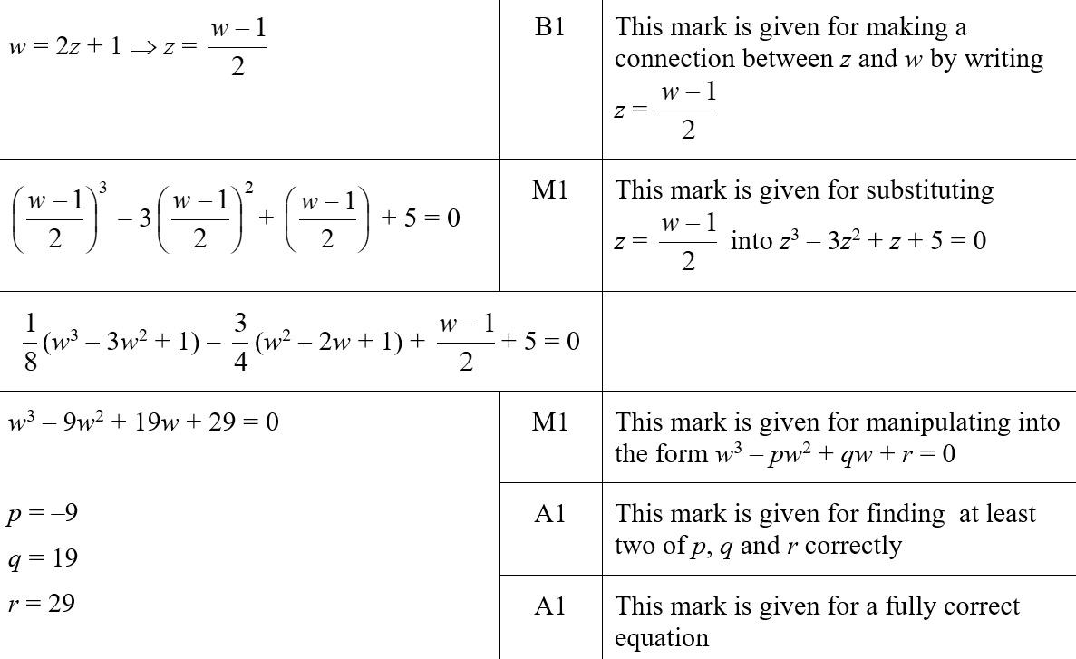
2018
A SF

Slide 13
2018

Slide 14
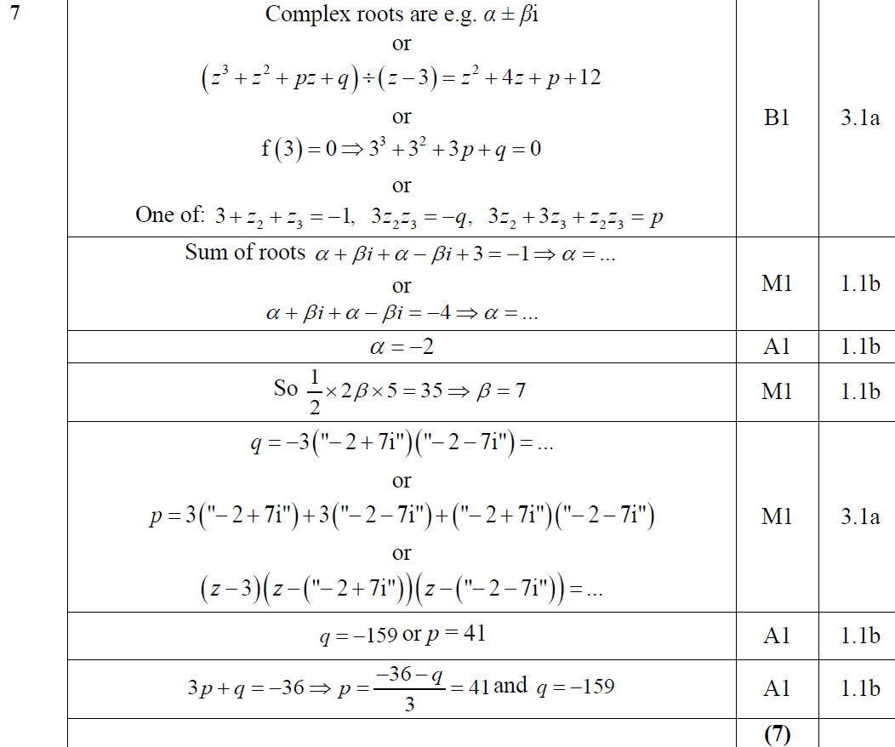
2018
A

Slide 15
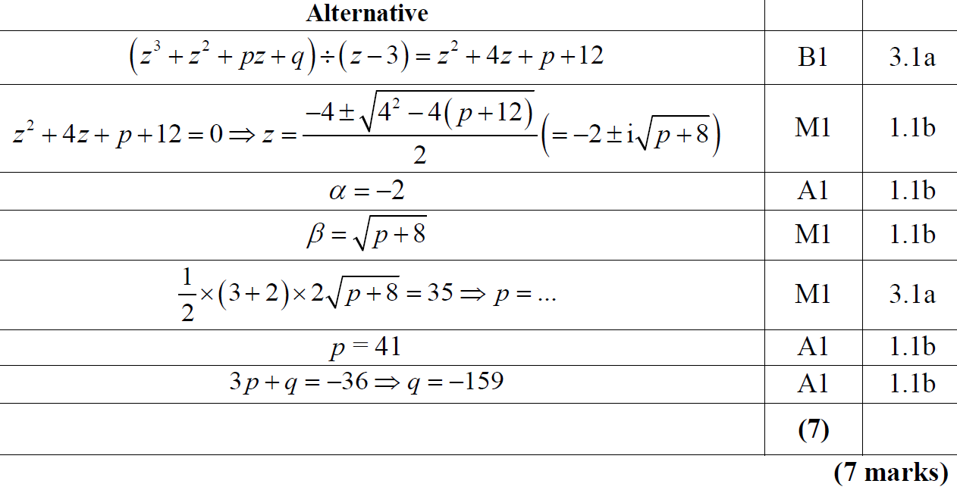
2018
A Alternative

Slide 16
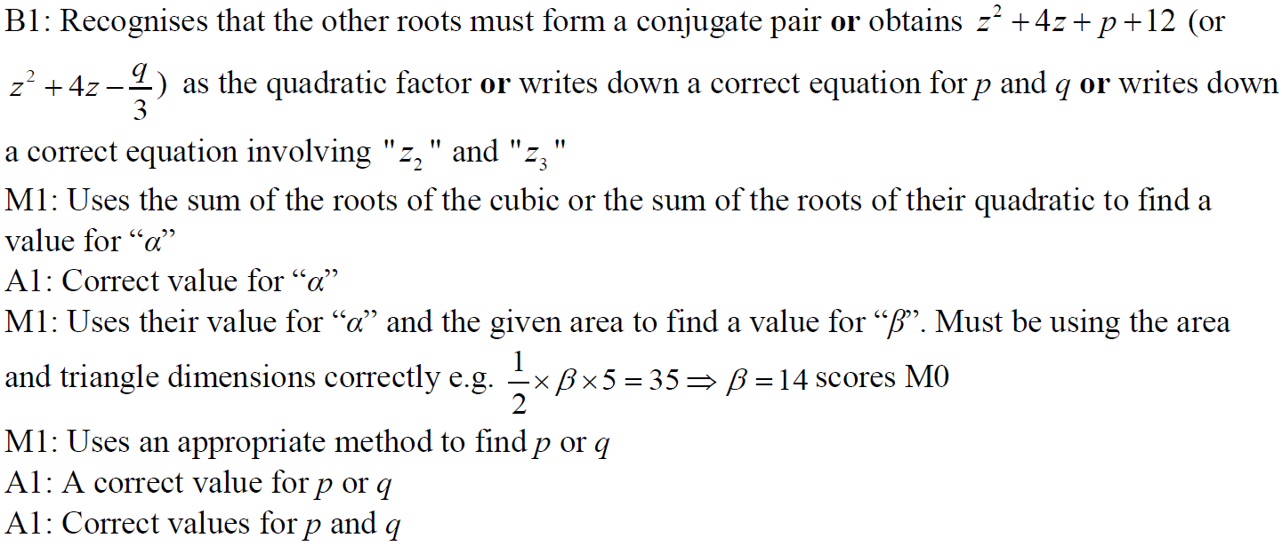
2018
A notes

Slide 17
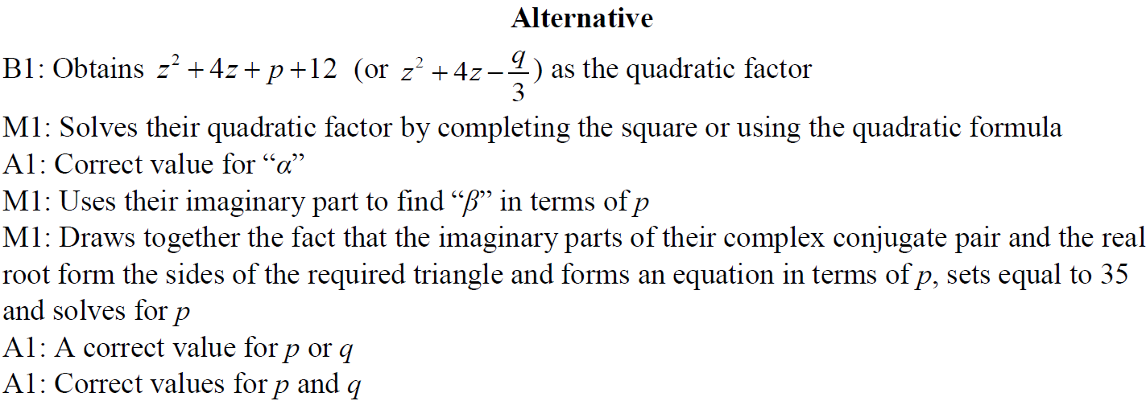
2018
A Alternative notes

Slide 18
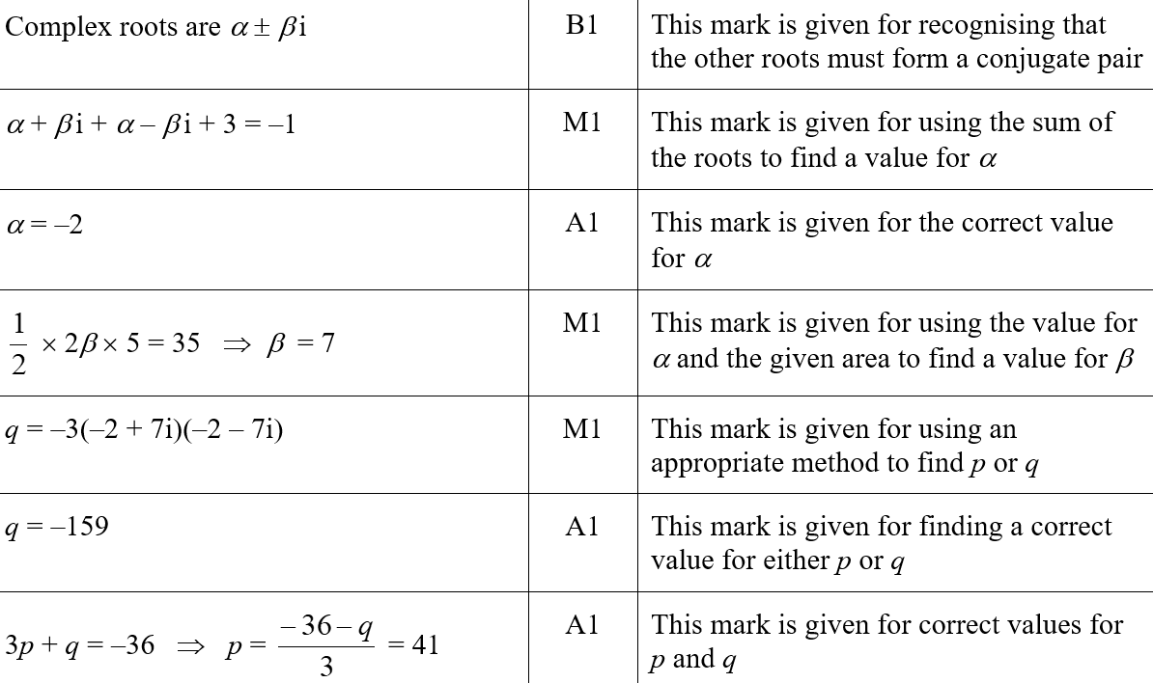
2018
A SF

Slide 19
2019

Slide 20
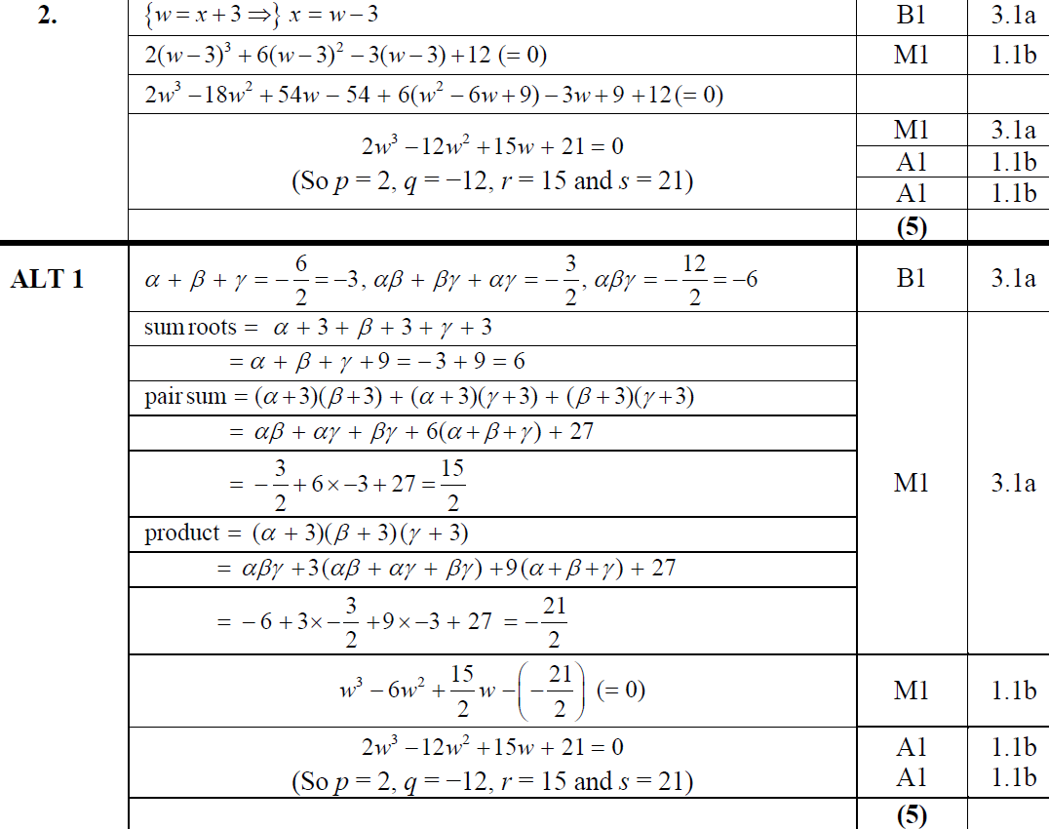
2019
A

Slide 21
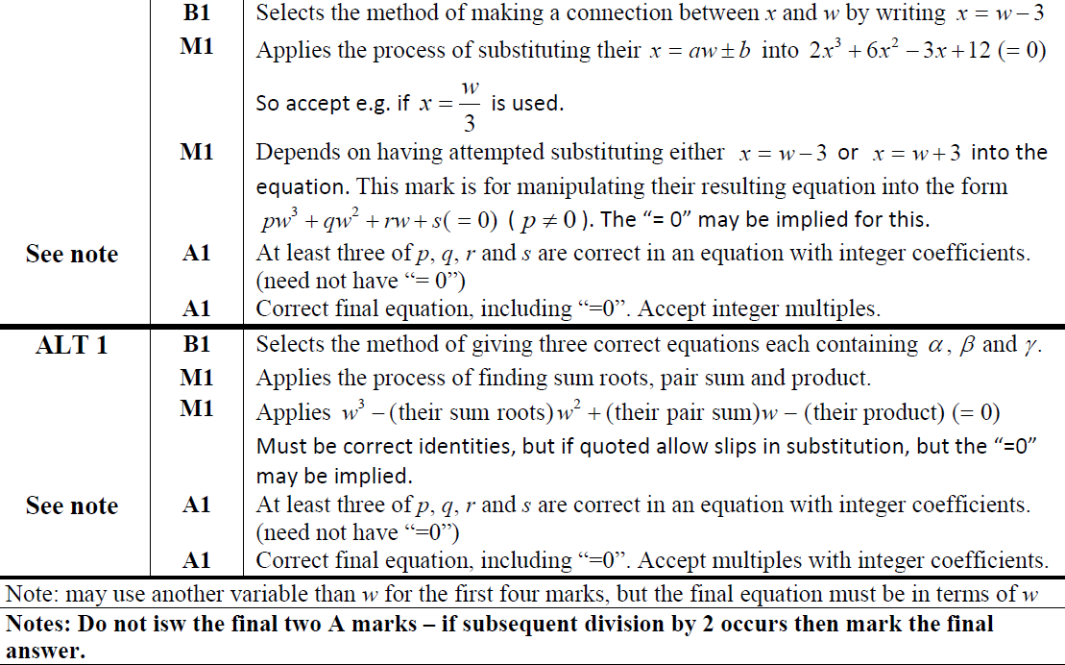
2019
A notes

Slide 22
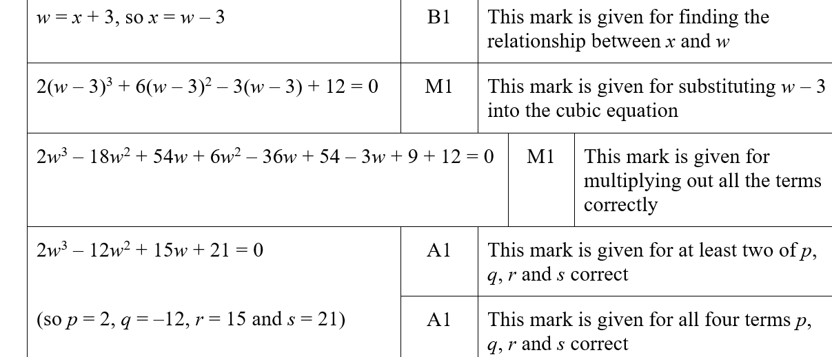
2019
A SF

Slide 23
2018
A SF

Slide 24
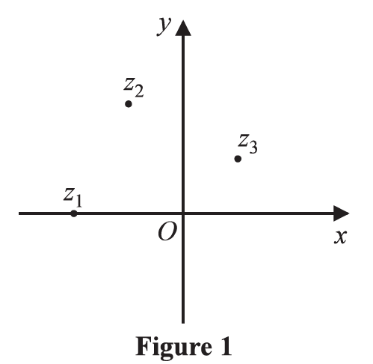
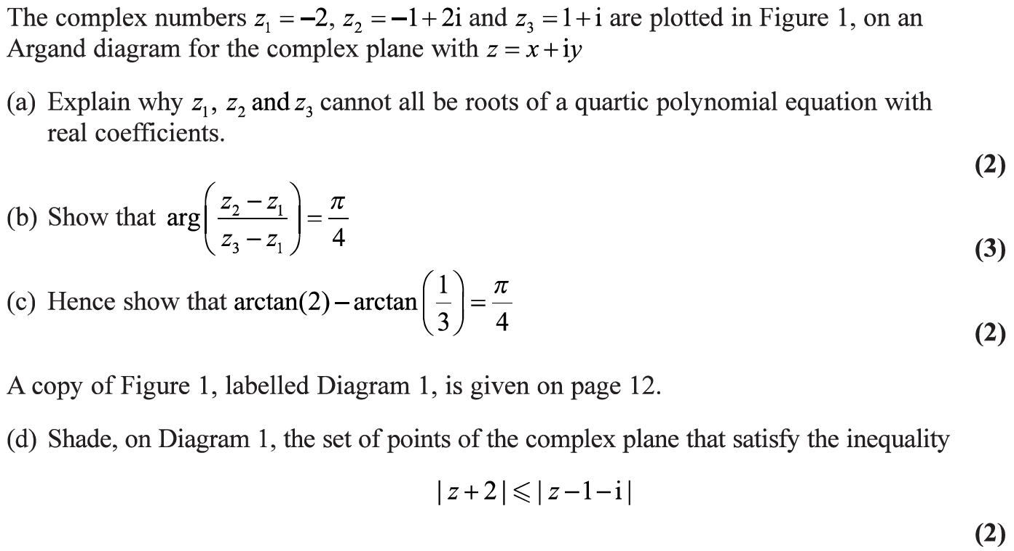
2019

Slide 25
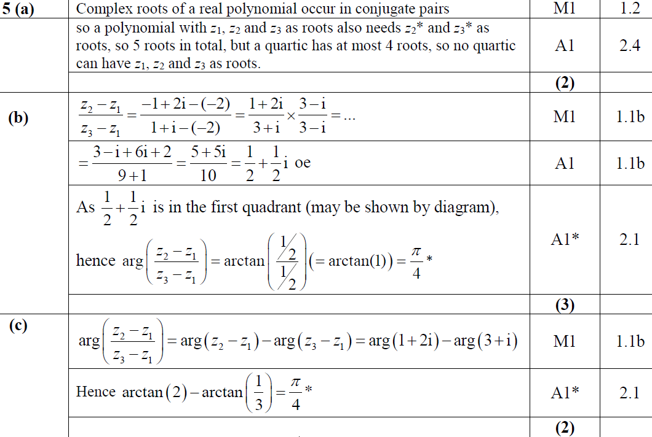
2019
A
B
C

Slide 26
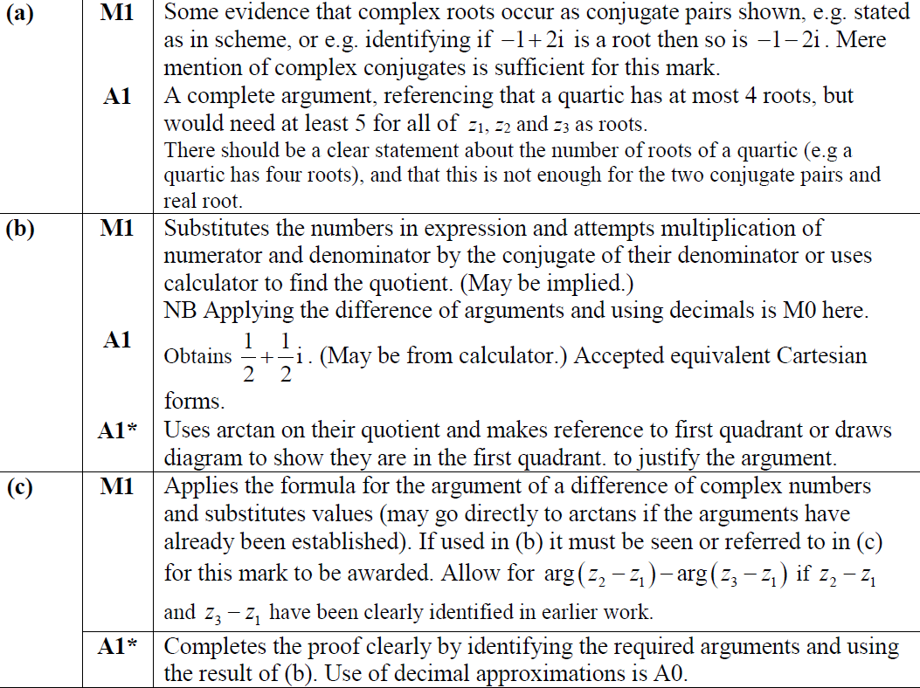
2019
A notes
B notes
C notes

Slide 27
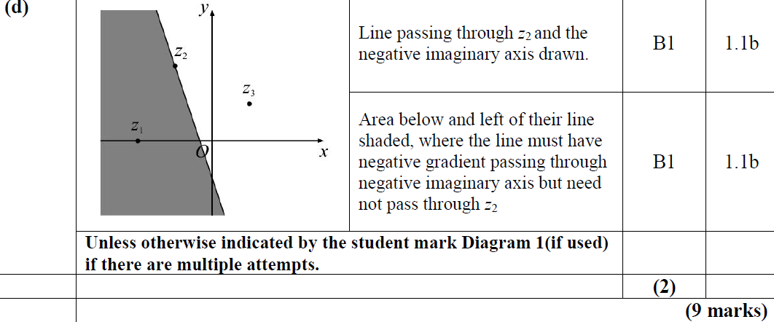
2019
D

Slide 28
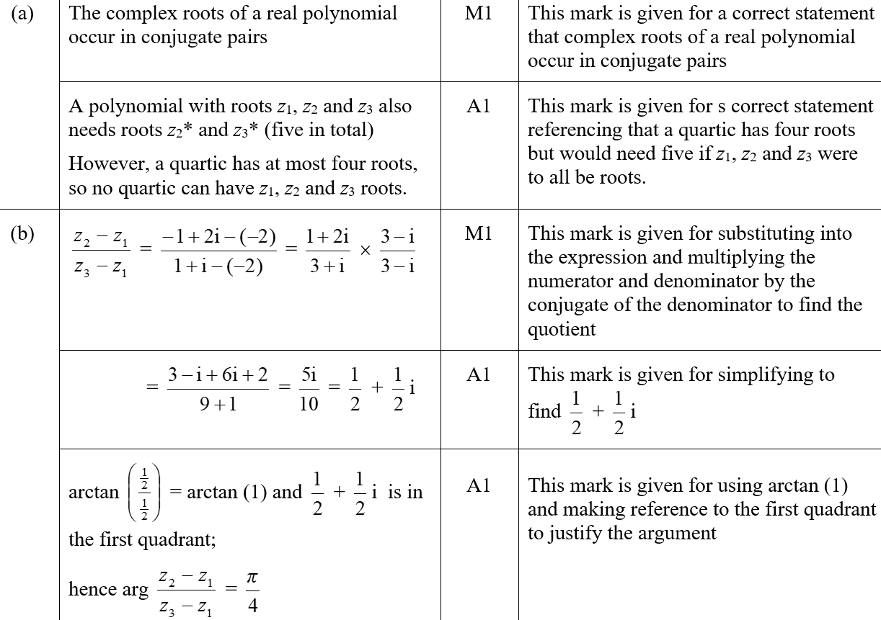
2019
A SF
B SF

Slide 29
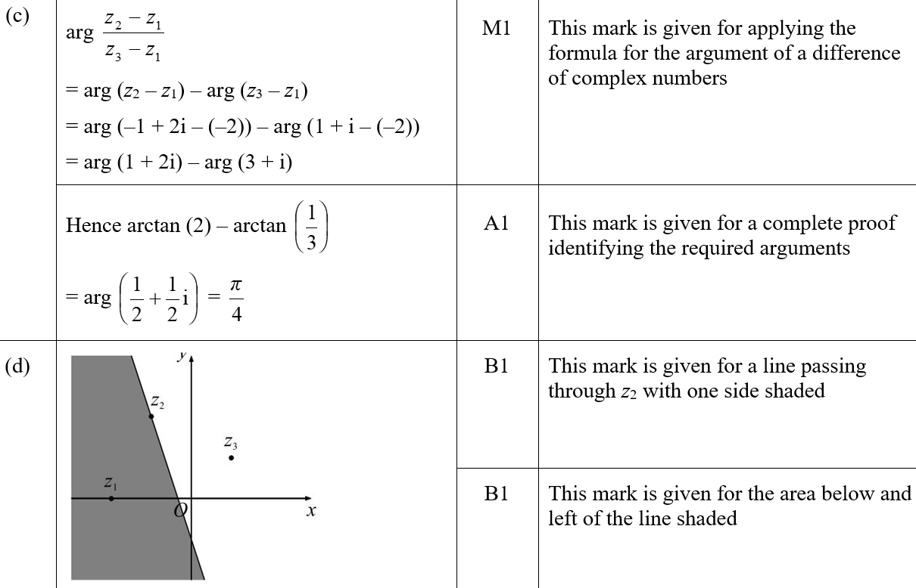
2019
C SF
D SF

Slide 30
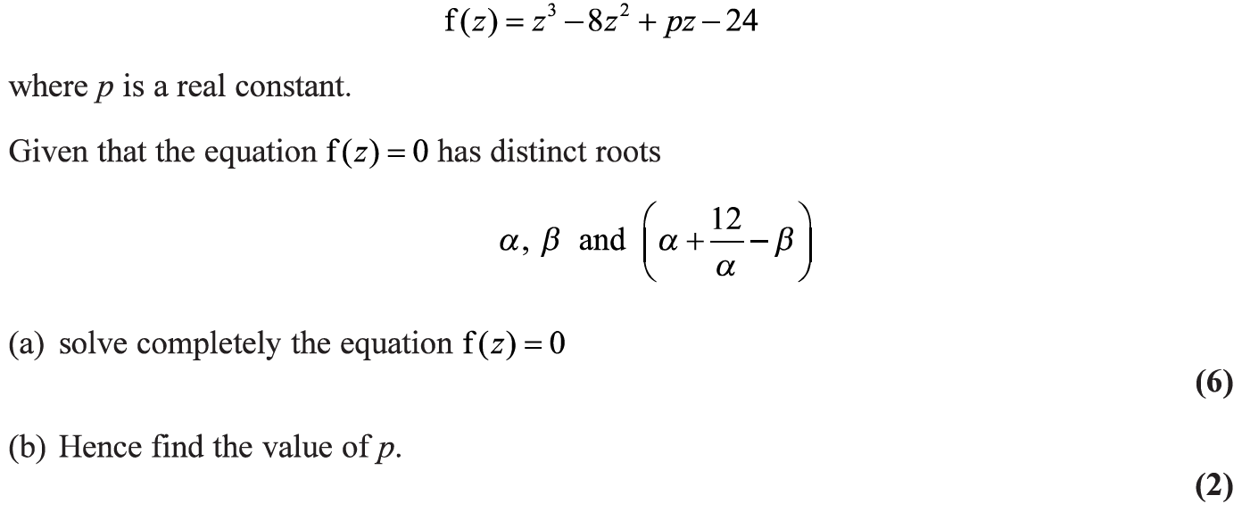
2019

Slide 31
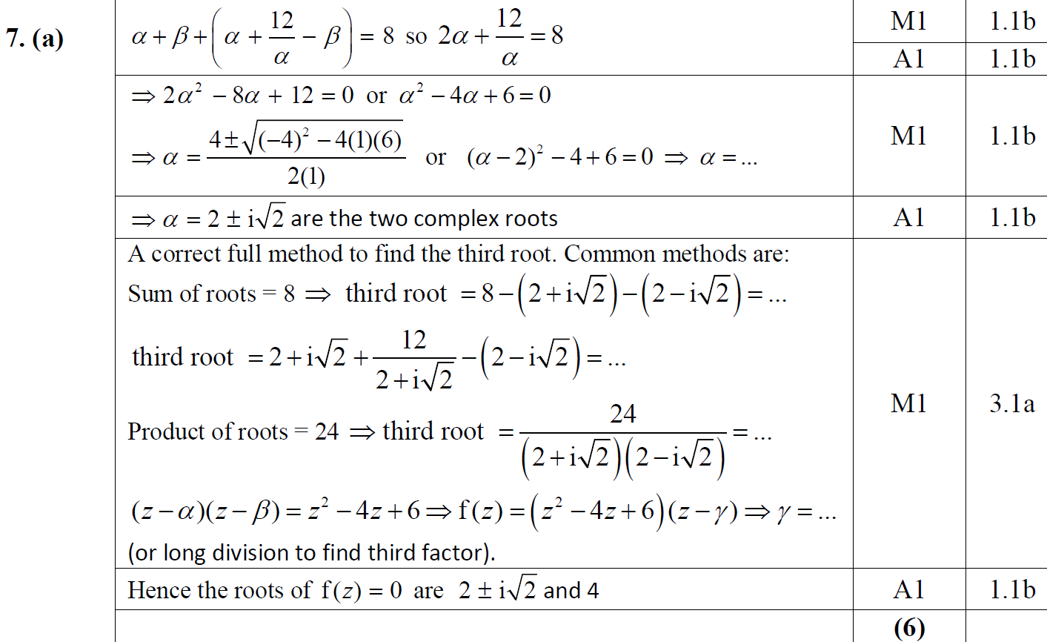
2019
A

Slide 32
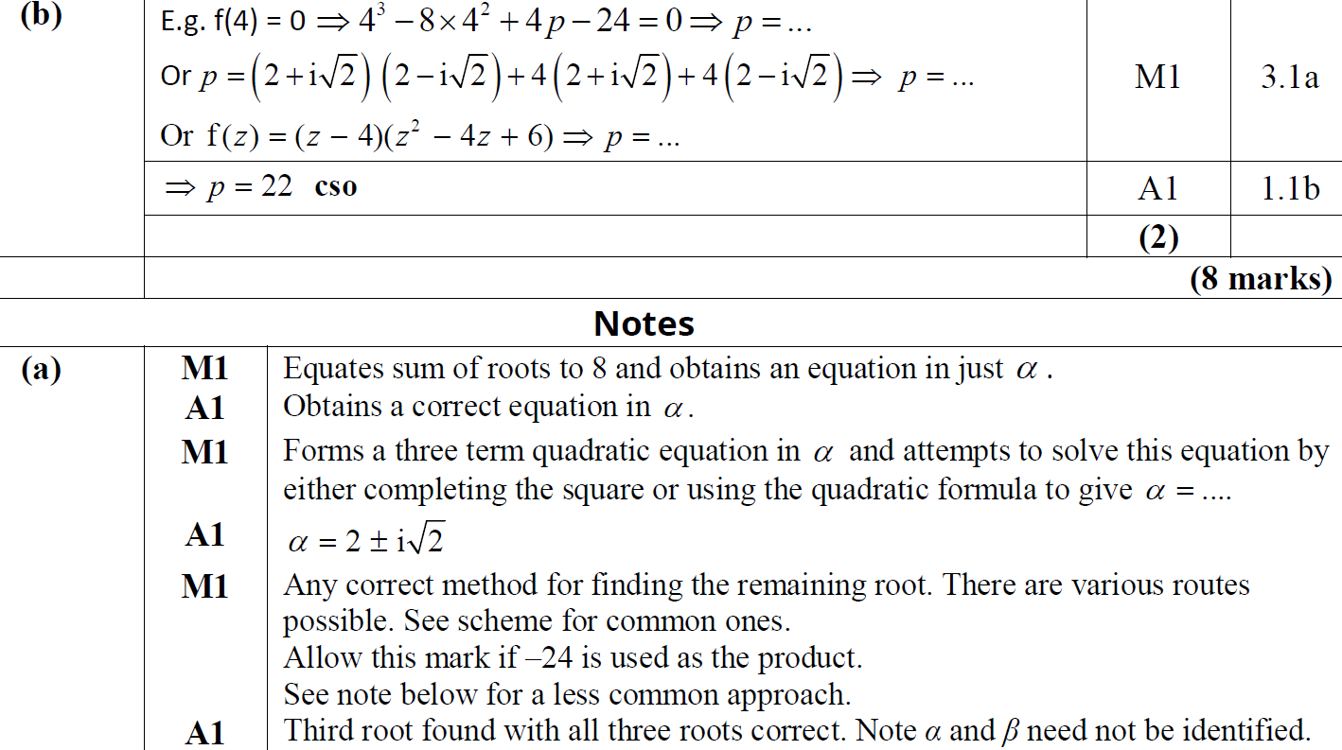
2019
B
A notes

Slide 33
2019
B notes
Further A notes

Slide 34
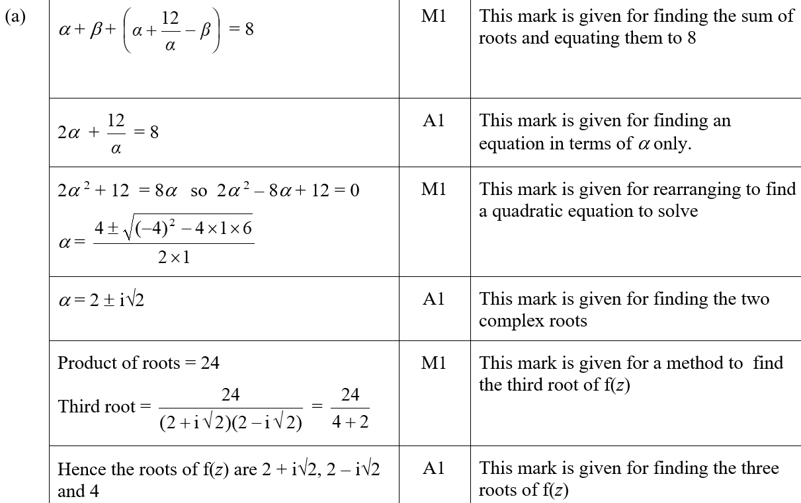
2019
A SF

Slide 35
2019
B SF

Slide 36
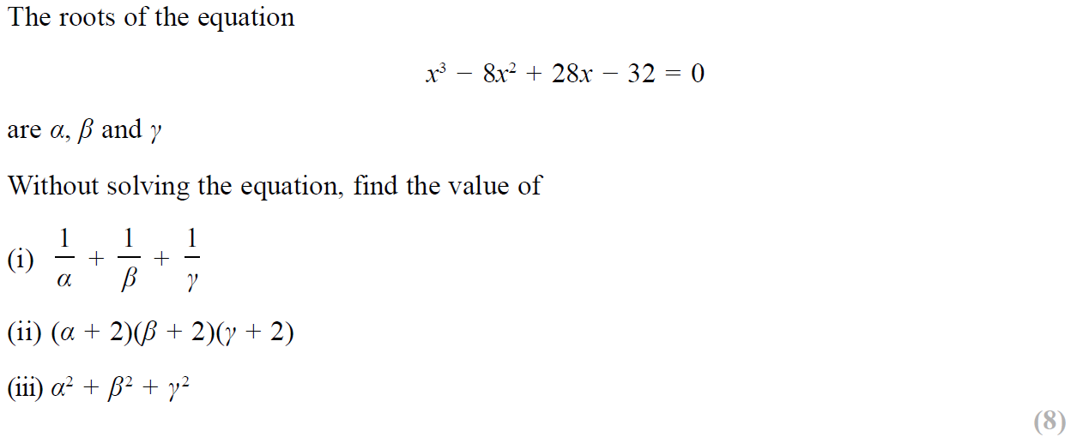
SAM Paper 2

Slide 37
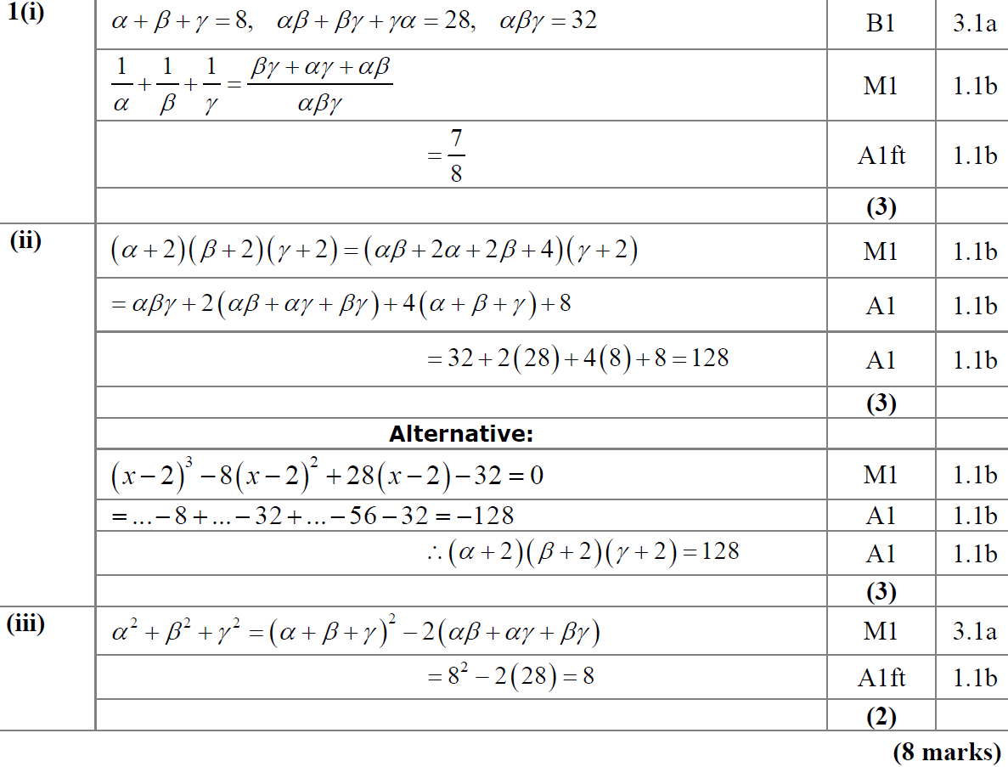
SAM Paper 2
(i)
(ii)
(iii)

Slide 38
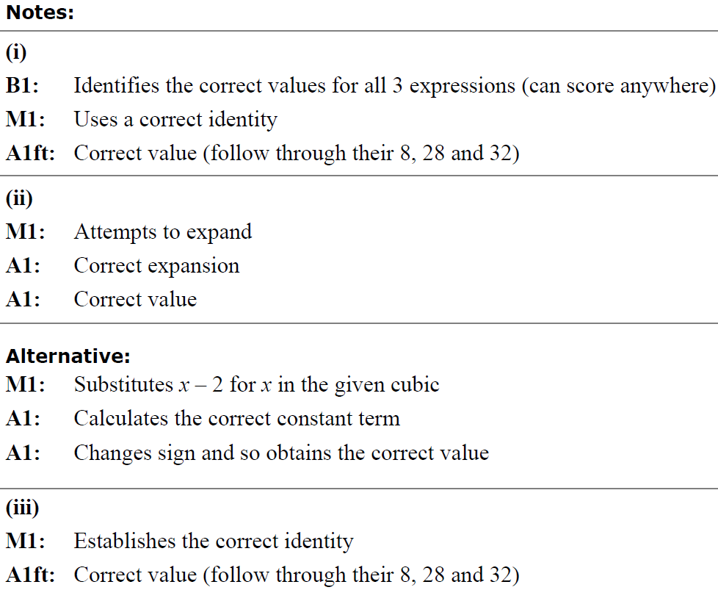
SAM Paper 2
(i) notes
(ii) notes
(iii) notes

Slide 39
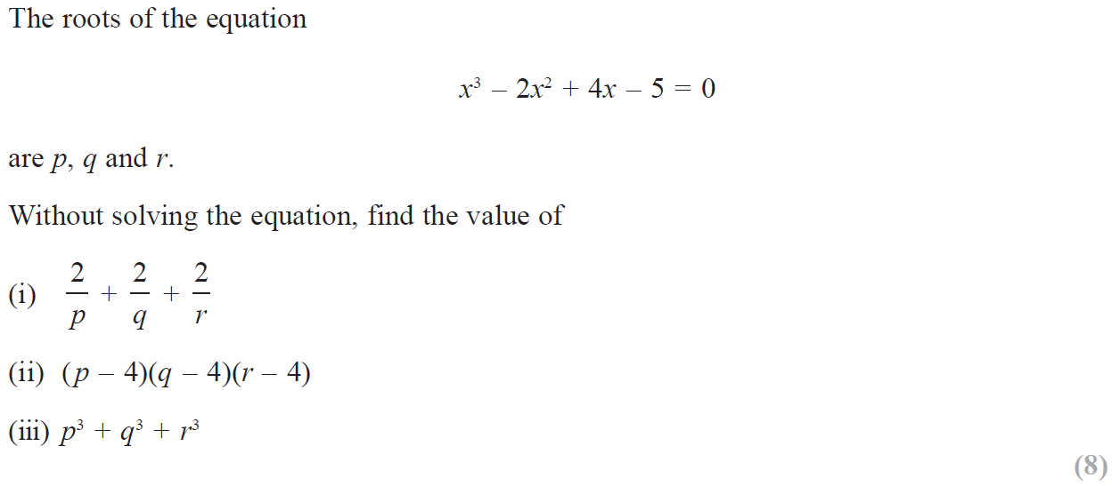
2019 Paper 2

Slide 40
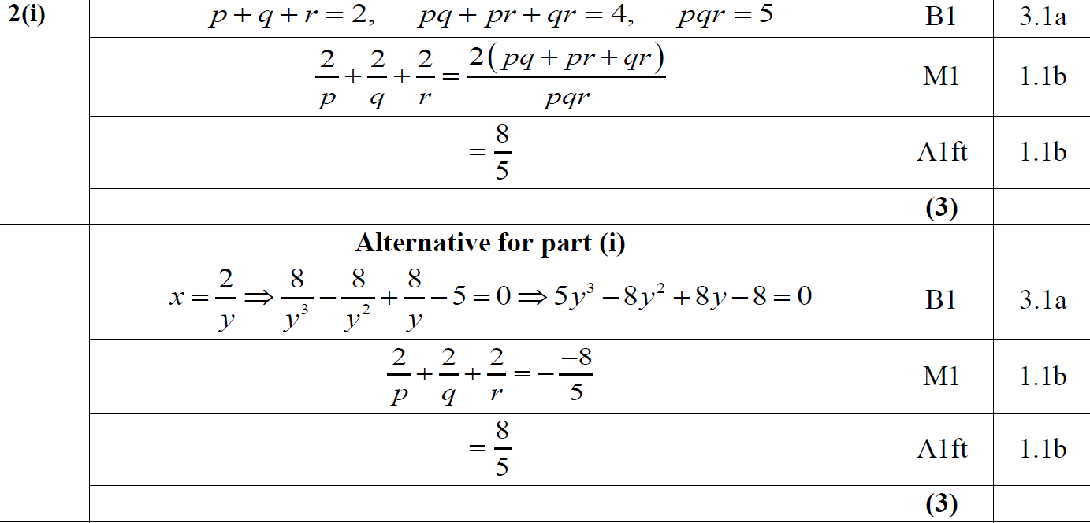
2019 Paper 2
(i)

Slide 41
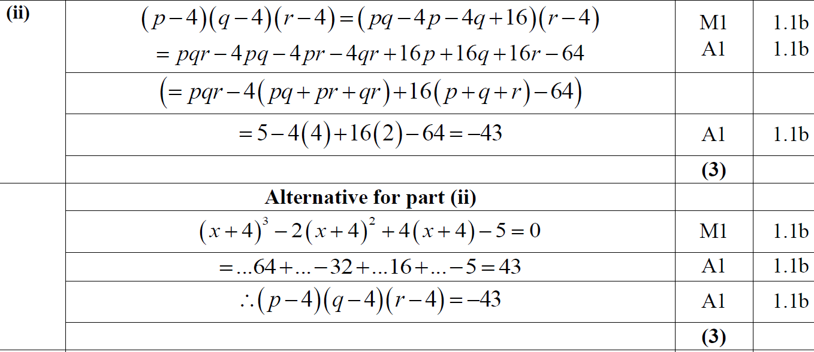
2019 Paper 2
(ii)

Slide 42
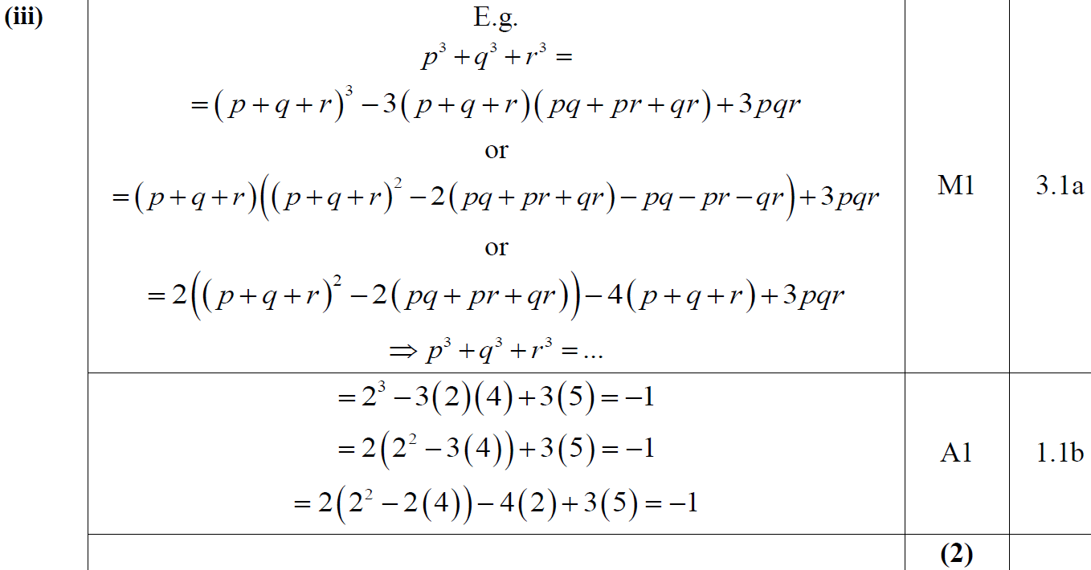
2019 Paper 2
(ii)

Slide 43
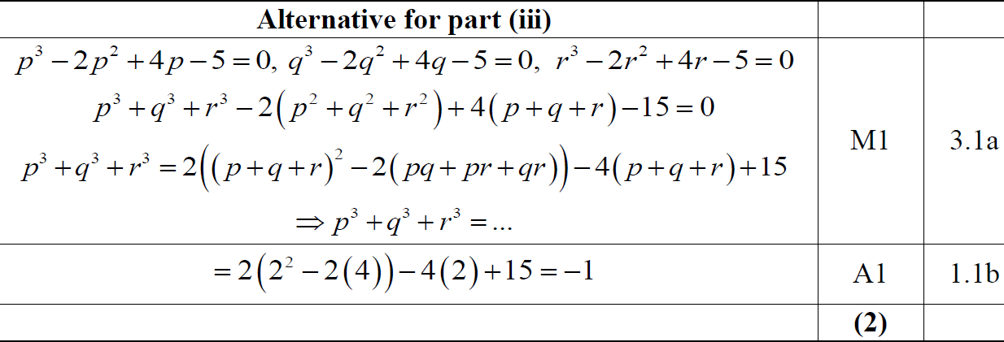
2019 Paper 2
(iii) Alternative

Slide 44
2019 Paper 2
(i) notes
(ii) notes
(iii) notes

