Slide 1
Upper & Lower Bounds
Upper & Lower Bounds
June 2017
3H Q7
June 2018
2H Q9
June 2017
3H Q20
June 2018
2H Q24
SAM
3H Q21
1 Marker
Nov 2017
1H Q8
Nov 2018
3H Q5
Nov 2017
2H Q25
Nov 2018
3H Q19

Slide 2
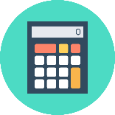
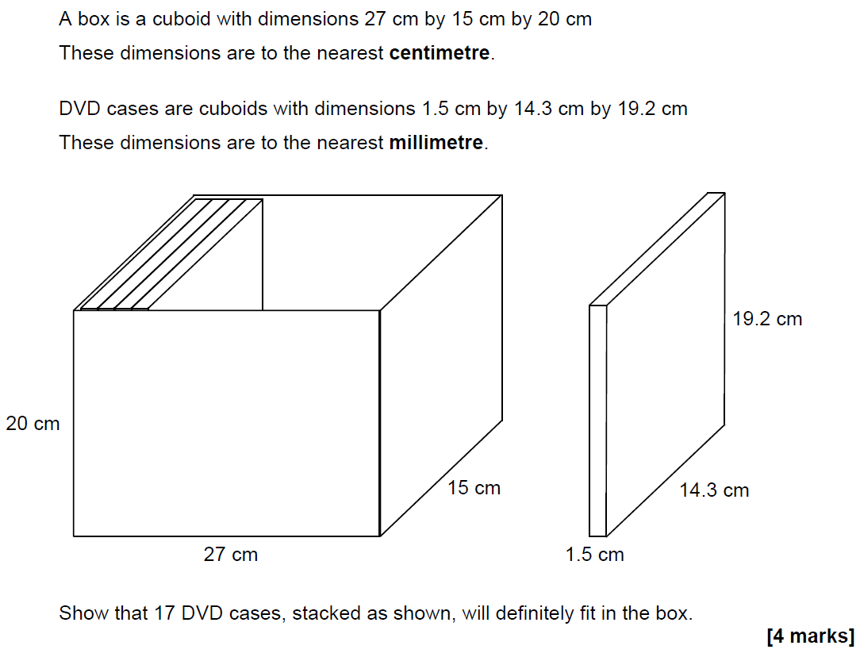
Upper & Lower Bounds
SAM 3H Q21

Slide 3
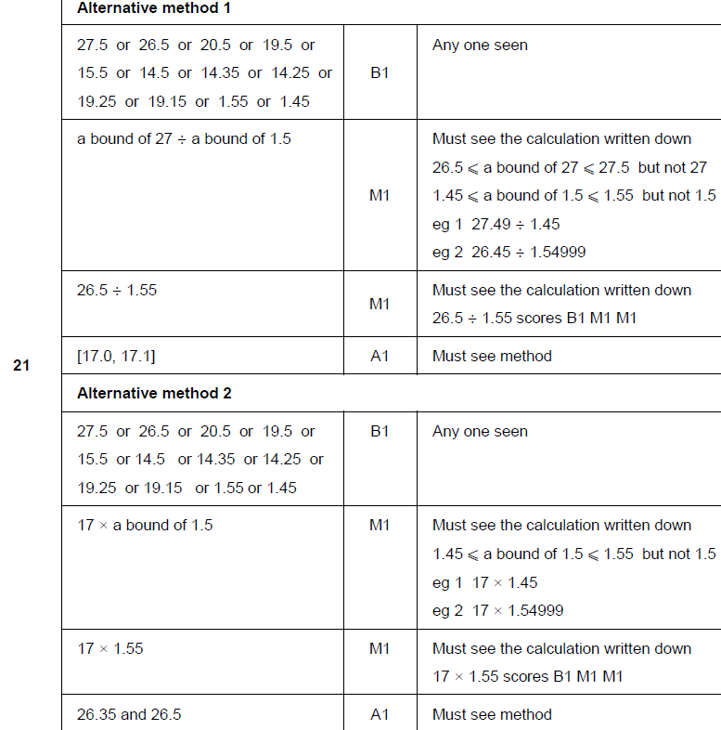
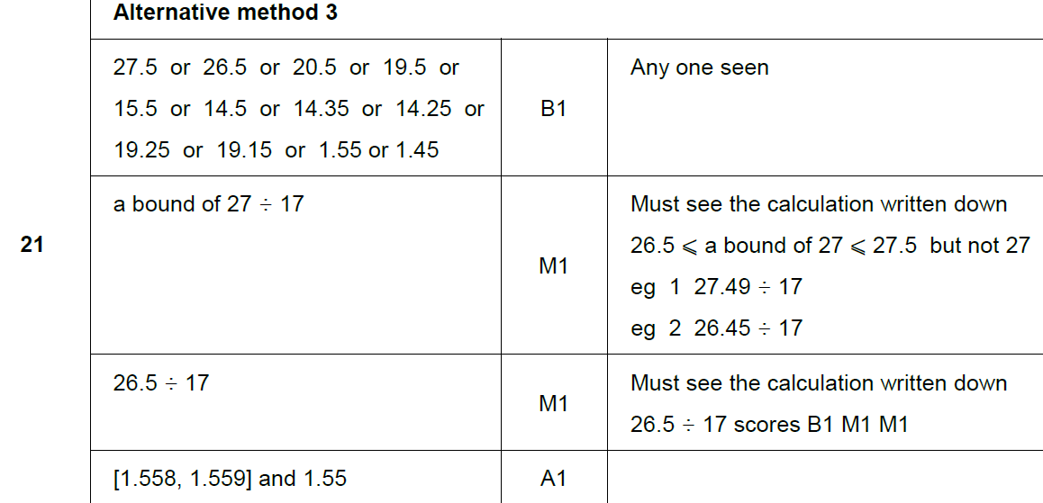
Upper & Lower Bounds
SAM 3H Q21
A

Slide 4
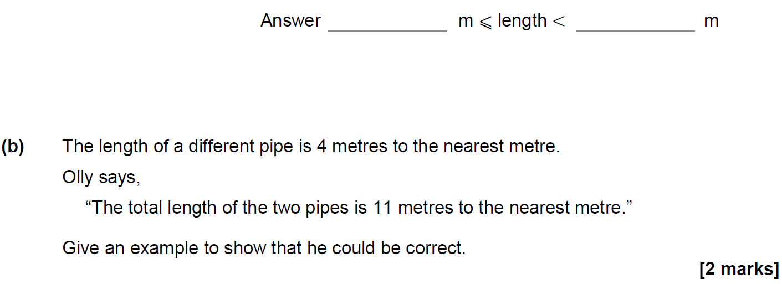
Upper & Lower Bounds
June 2017 3H Q7

Slide 5
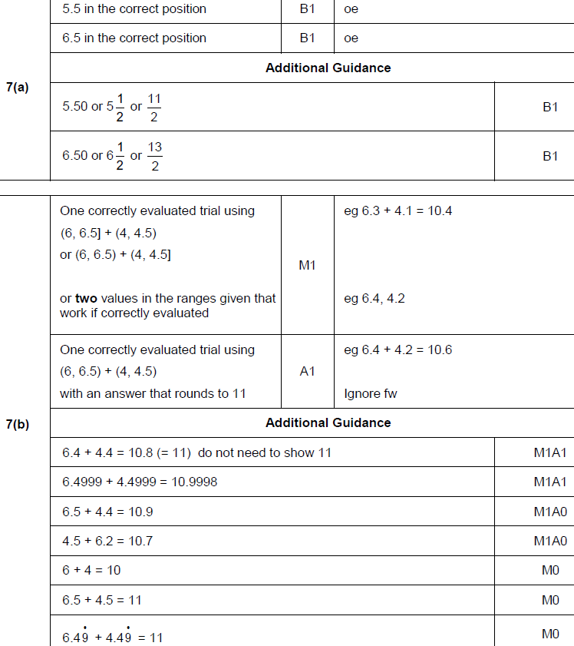
Upper & Lower Bounds
June 2017 3H Q7
A
B

Slide 6
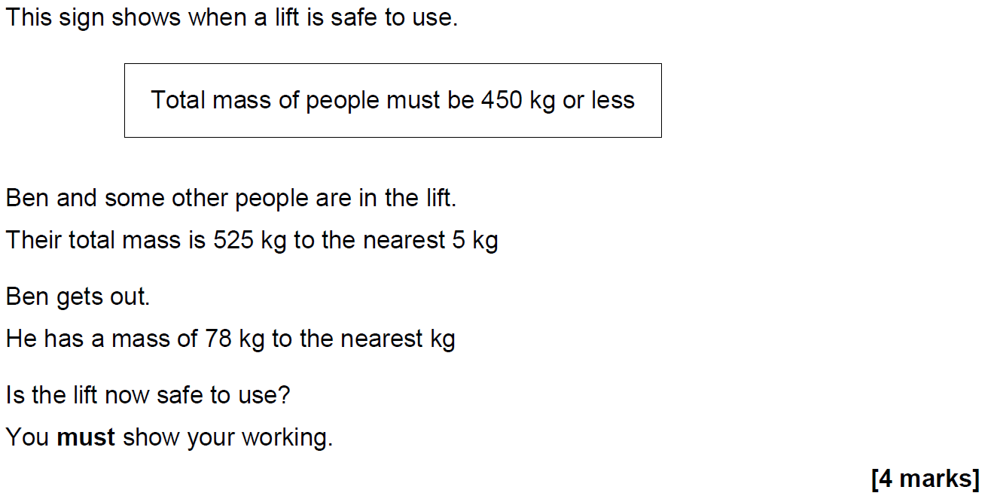
Upper & Lower Bounds
June 2017 3H Q20

Slide 7
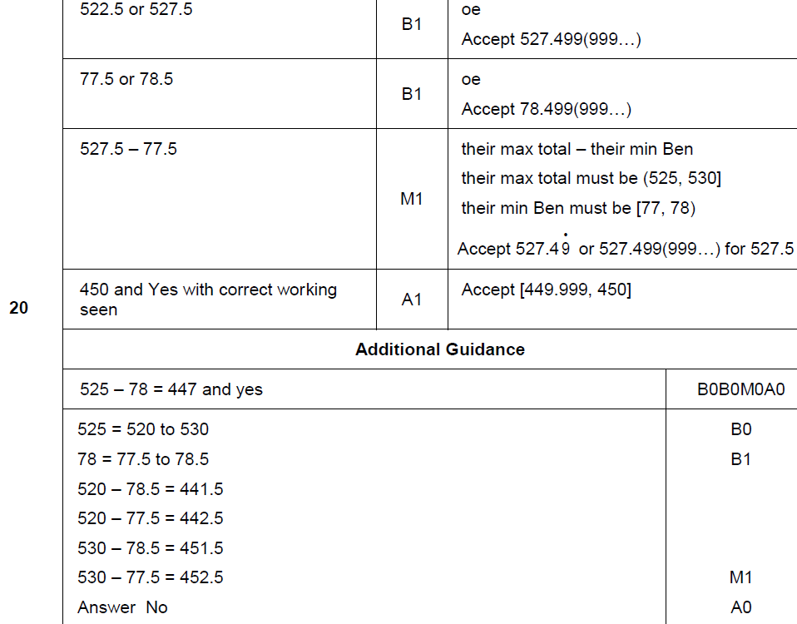
Upper & Lower Bounds
June 2017 3H Q20
A

Slide 8
Upper & Lower Bounds
Nov 2017 1H Q8

Slide 9
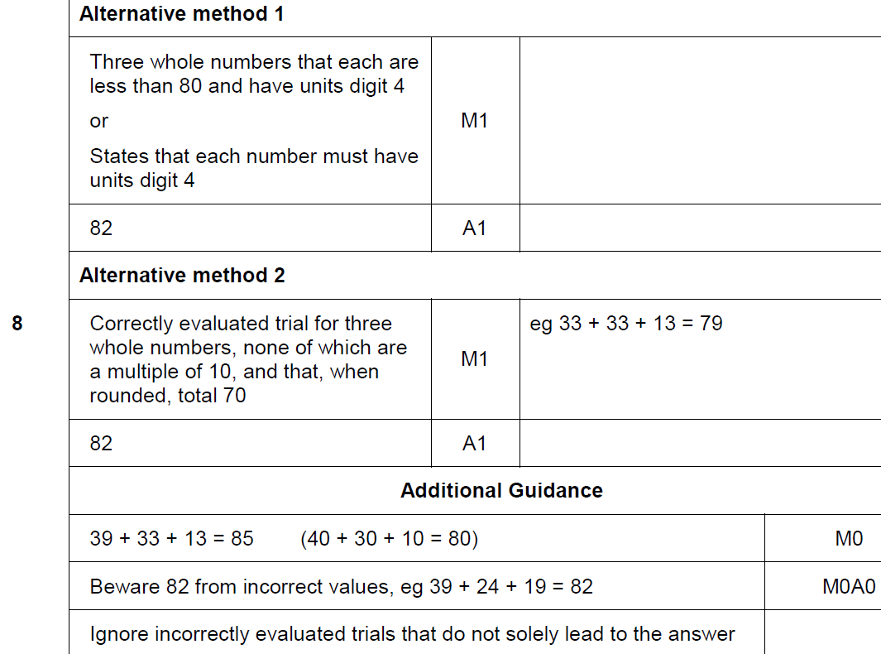
Upper & Lower Bounds
Nov 2017 1H Q8
A

Slide 10
Upper & Lower Bounds
Nov 2017 2H Q25

Slide 11
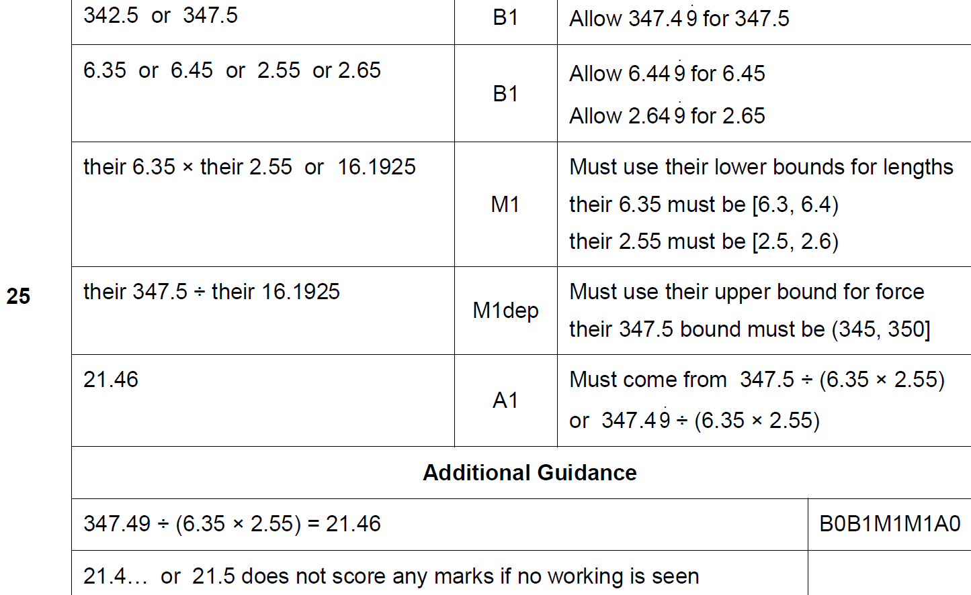
Upper & Lower Bounds
Nov 2017 2H Q25
A

Slide 12
Upper & Lower Bounds
June 2018 2H Q9

Slide 13
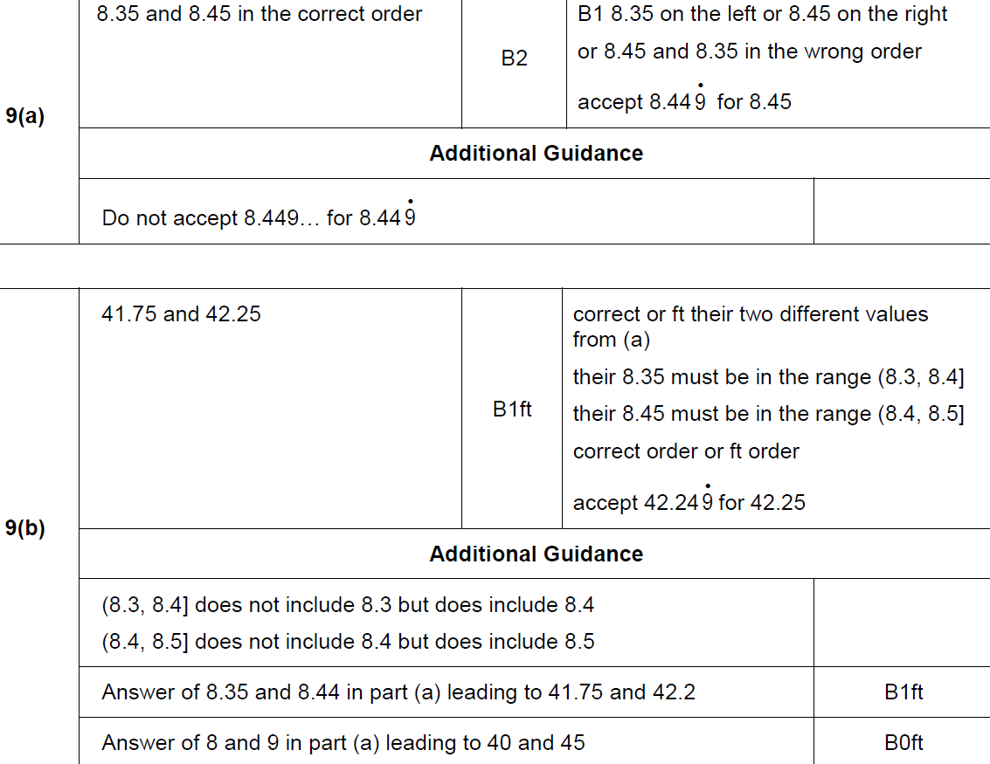
Upper & Lower Bounds
June 2018 2H Q9
A
B

Slide 14
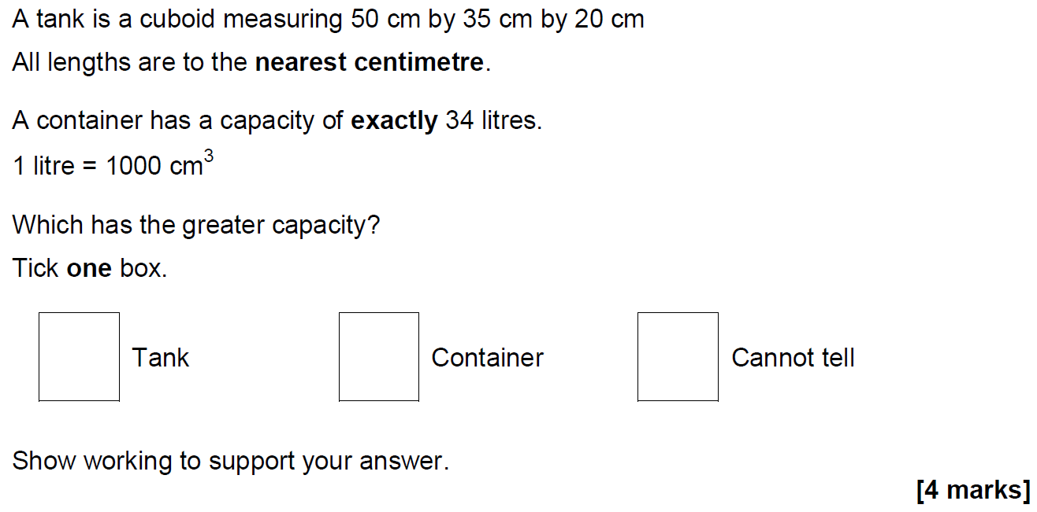
Upper & Lower Bounds
June 2018 2H Q24

Slide 15
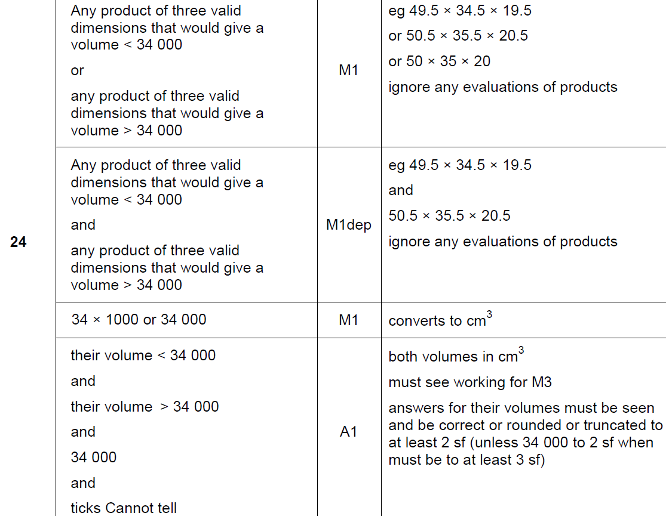
Upper & Lower Bounds
June 2018 2H Q24
A

Slide 16
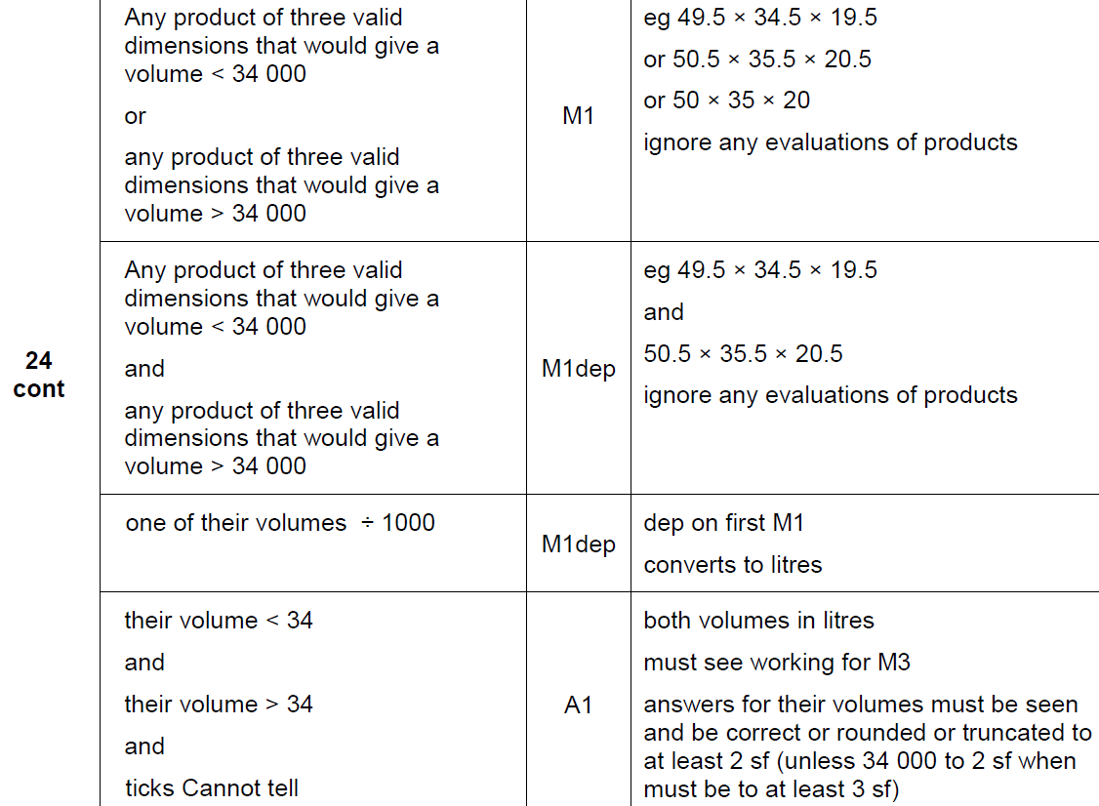
Upper & Lower Bounds
June 2018 2H Q24
A

Slide 17
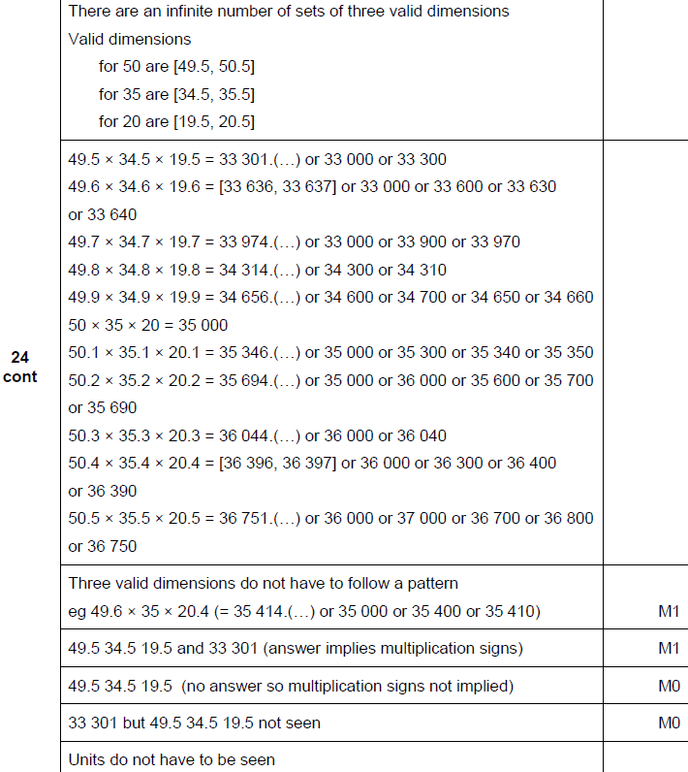
Upper & Lower Bounds
June 2018 2H Q24
A notes

Slide 18
Upper & Lower Bounds
Nov 2018 3H Q5

Slide 19
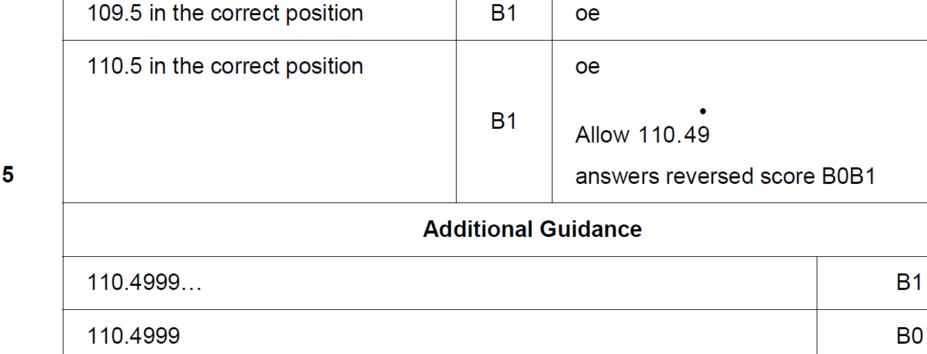
Upper & Lower Bounds
Nov 2018 3H Q5
A

Slide 20
Upper & Lower Bounds
Nov 2018 3H Q19
The length of a roll of ribbon is 30 metres, correct to the nearest half-metre.
A piece of length 5.8 metres, correct to the nearest 10 centimetres, is cut from the roll.
Work out the maximum possible length of ribbon left on the roll.
[3 marks]

Slide 21
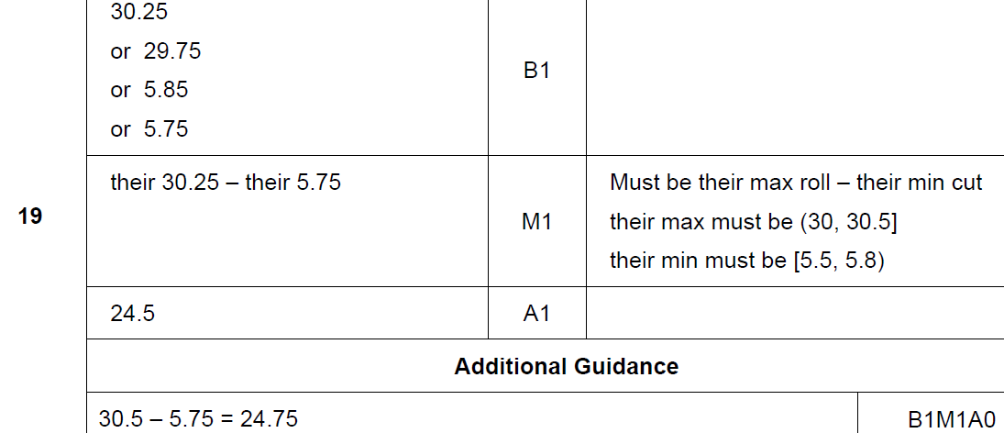
Upper & Lower Bounds
Nov 2018 3H Q19
A

