Slide 1
Upper & Lower Bounds
Upper & Lower Bounds
SAM
2H Q18
June 2017
2H Q7
June 2018
2H Q21
Edexcel
Spec 1
2H Q22
June 2017
3H Q17
Nov 2018
2H Q9
AQA
Spec 1
3H Q2
Nov 2017
1H Q13
Nov 2018
2H Q18
OCR
Spec 2
2H Q17
Nov 2017
3H Q5
June 2019
2H Q6
Spec 2
3H Q4
Nov 2017
3H Q16
June 2019
3H Q19

Slide 2
Upper & Lower Bounds
Upper & Lower Bounds
June 2017
3H Q7
June 2018
2H Q9
Edexcel
June 2017
3H Q20
June 2018
2H Q24
AQA
SAM
3H Q21
1 Marker
Nov 2017
1H Q8
Nov 2018
3H Q5
OCR
Nov 2017
2H Q25
Nov 2018
3H Q19

Slide 3
Upper & Lower Bounds
Upper & Lower Bounds
Edexcel
May 2017
1H Q2
June 2018
3H Q14
SAM
2H Q8
AQA
June 2017
3H Q11
Nov 2018
3H Q4
Practice
1H Q1
OCR
Nov 2017
1H Q12
Nov 2018
3H Q16

Slide 4
Upper & Lower Bounds
SAM 2H Q18

Slide 5
Upper & Lower Bounds
SAM 2H Q18
A

Slide 6
Upper & Lower Bounds
Specimen Set 1 2H Q22

Slide 7
Upper & Lower Bounds
Specimen Set 1 2H Q22
A

Slide 8
Upper & Lower Bounds
Specimen Set 1 3H Q2

Slide 9
Upper & Lower Bounds
Specimen Set 1 3H Q2
A

Slide 10
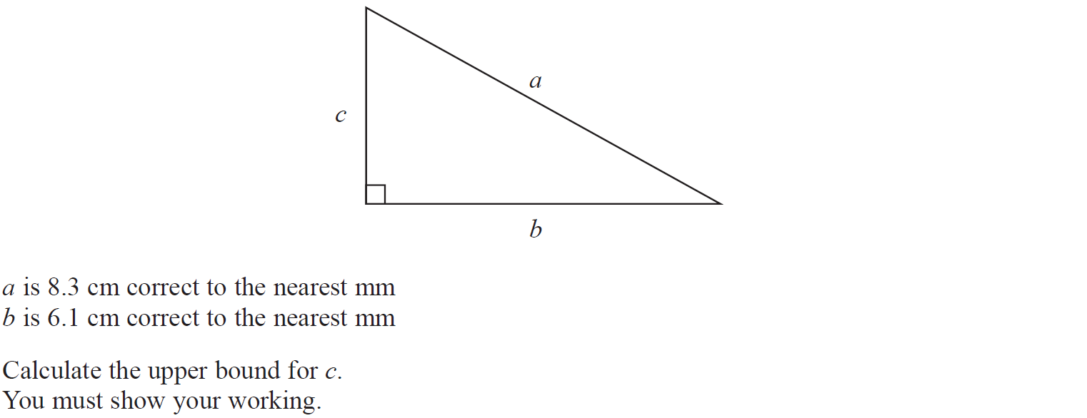
Upper & Lower Bounds
Specimen Set 2 2H Q17

Slide 11
Upper & Lower Bounds
Specimen Set 2 2H Q17
A

Slide 12
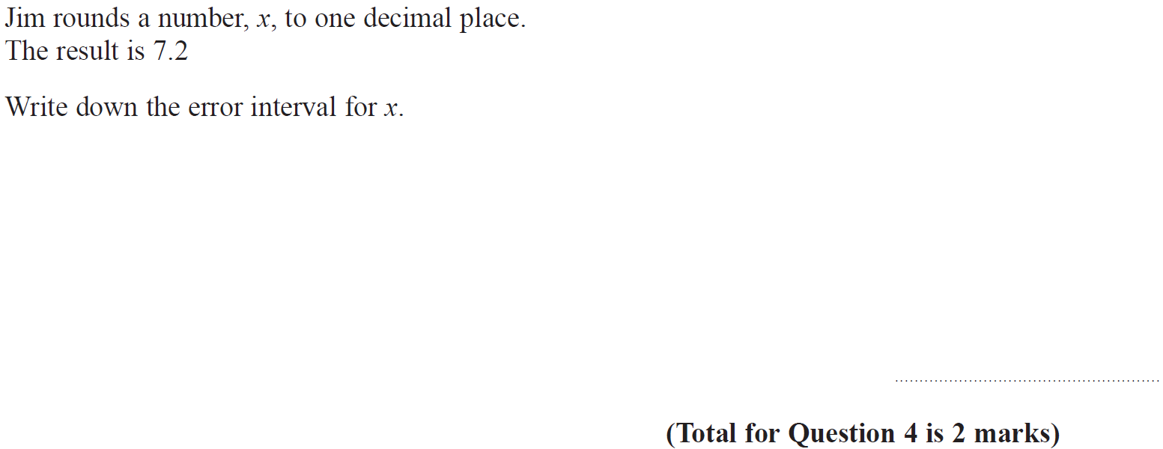
Upper & Lower Bounds
Specimen Set 2 3H Q4

Slide 13
Upper & Lower Bounds
Specimen Set 2 3H Q4
A

Slide 14
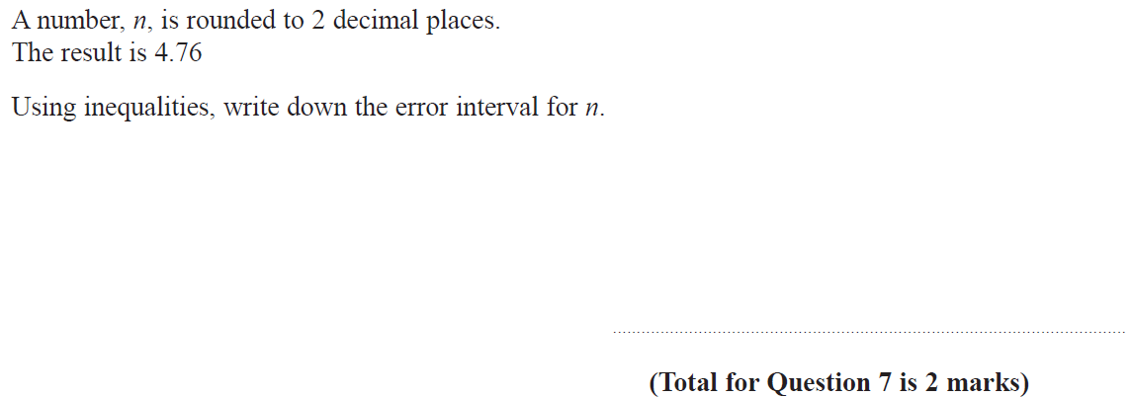
Upper & Lower Bounds
June 2017 2H Q7

Slide 15
Upper & Lower Bounds
June 2017 2H Q7
A

Slide 16
Upper & Lower Bounds
June 2017 3H Q17

Slide 17
Upper & Lower Bounds
June 2017 3H Q17
A
B

Slide 18
Upper & Lower Bounds
Nov 2017 1H Q13

Slide 19
Upper & Lower Bounds
Nov 2017 1H Q13
A

Slide 20
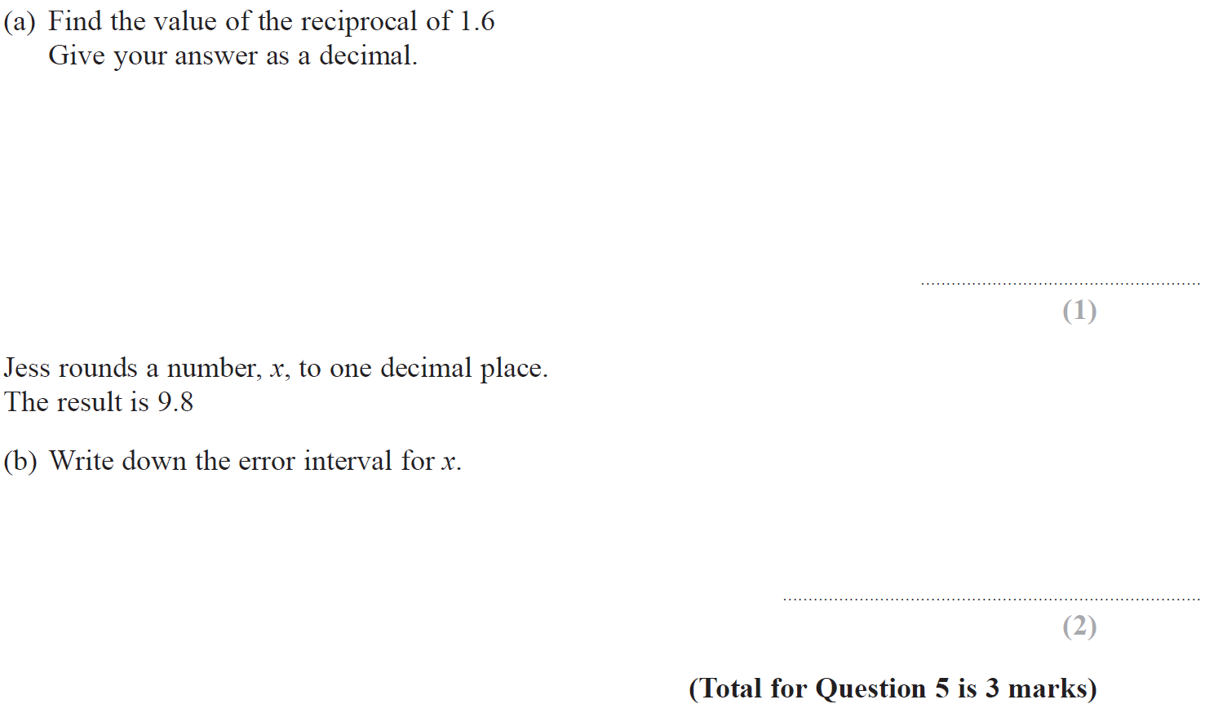
Upper & Lower Bounds
Nov 2017 3H Q5

Slide 21
Upper & Lower Bounds
Nov 2017 3H Q5
A
B

Slide 22
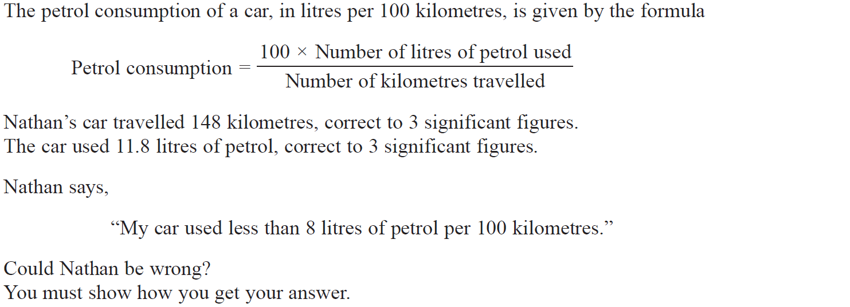
Upper & Lower Bounds
Nov 2017 3H Q16

Slide 23
Upper & Lower Bounds
Nov 2017 3H Q16
A

Slide 24
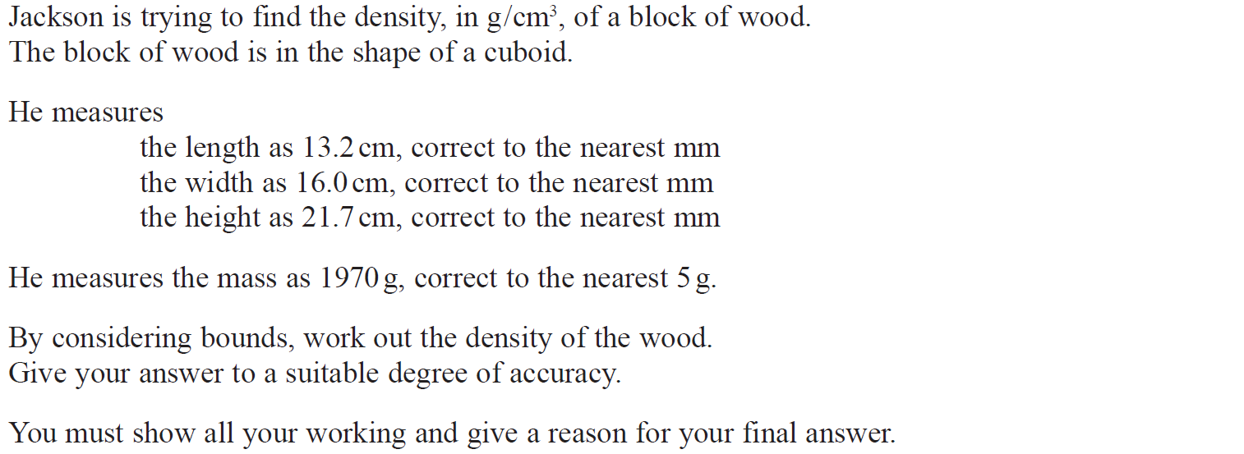
Upper & Lower Bounds
June 2018 2H Q21

Slide 25
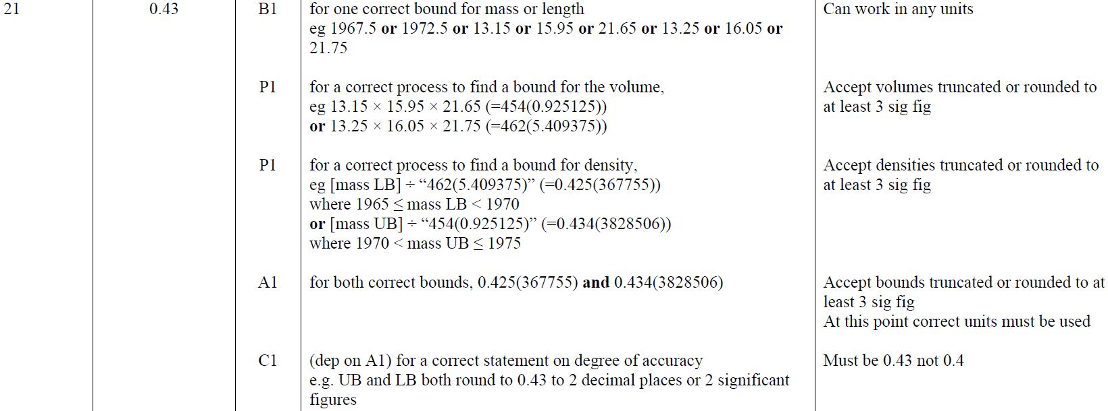
Upper & Lower Bounds
June 2018 2H Q21
A

Slide 26
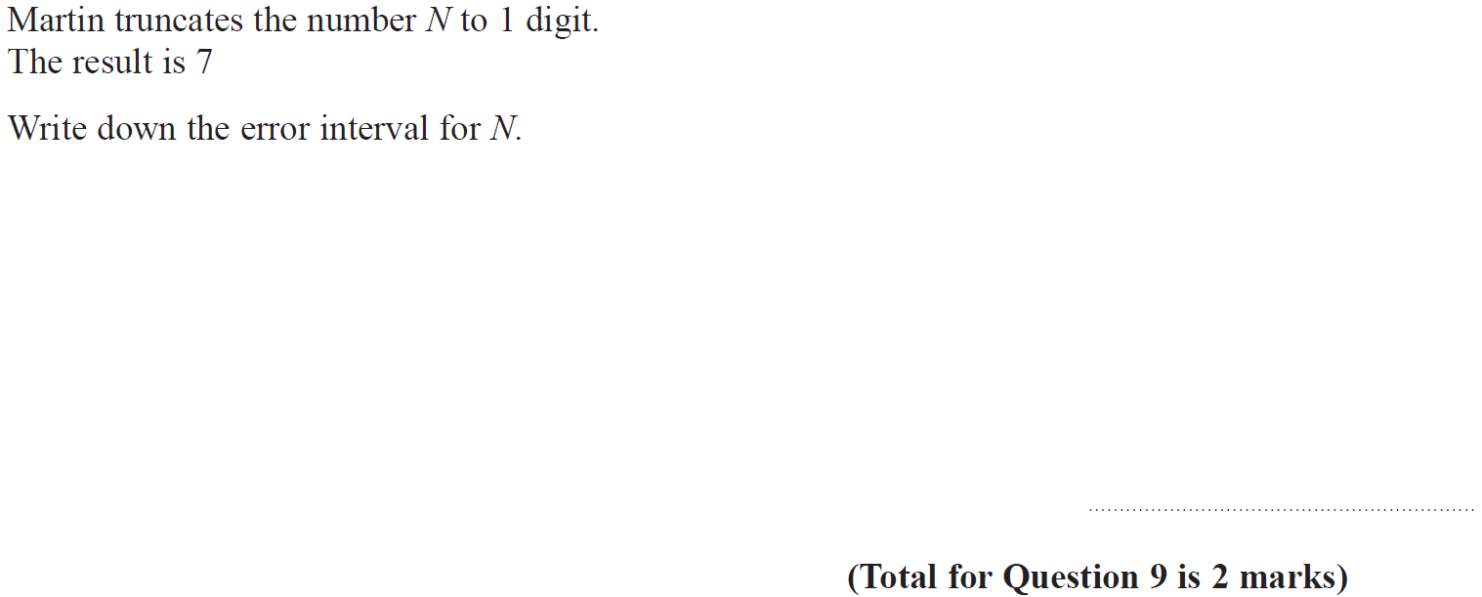
Upper & Lower Bounds
Nov 2018 2H Q9

Slide 27
Upper & Lower Bounds
Nov 2018 2H Q9
A

Slide 28
Upper & Lower Bounds
Nov 2018 3H Q18

Slide 29
Upper & Lower Bounds
Nov 2018 3H Q18
A

Slide 30
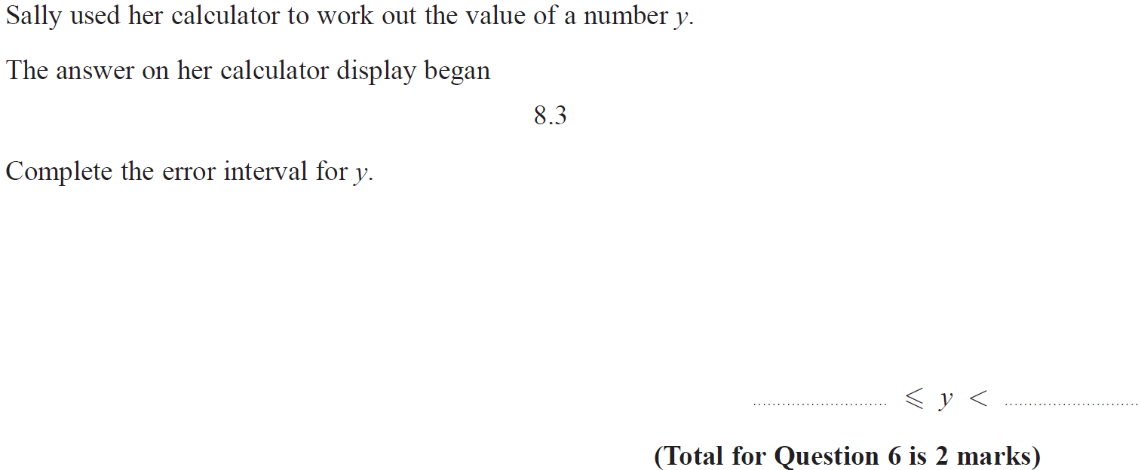
Upper & Lower Bounds
June 2019 2H Q6

Slide 31
Upper & Lower Bounds
June 2019 2H Q6
A
A SF

Slide 32
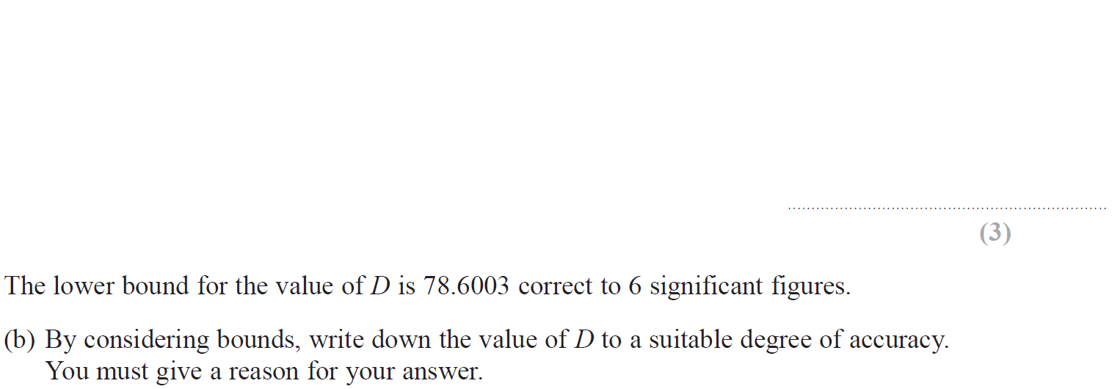
Upper & Lower Bounds
June 2019 3H Q19

Slide 33
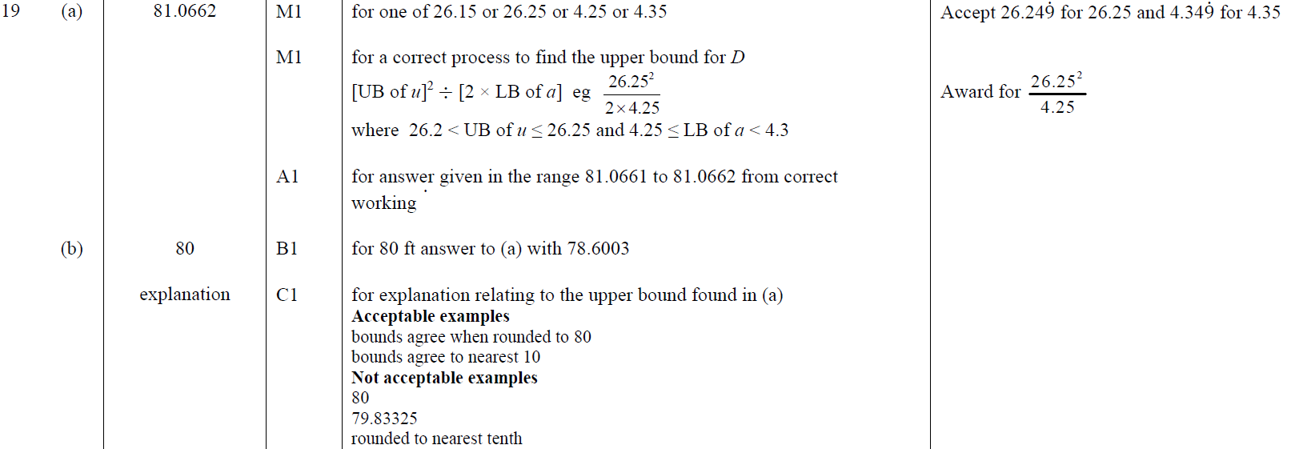
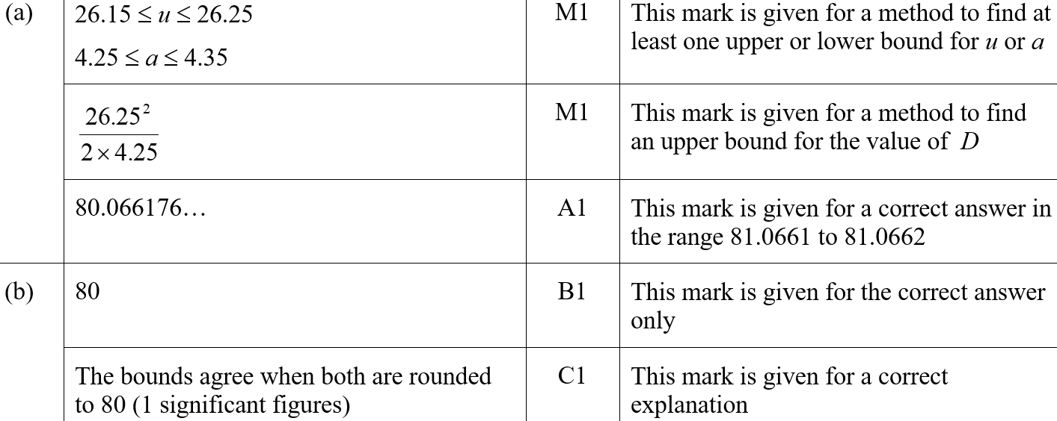
Upper & Lower Bounds
June 2019 3H Q19
A
B
A SF
B SF

Slide 34
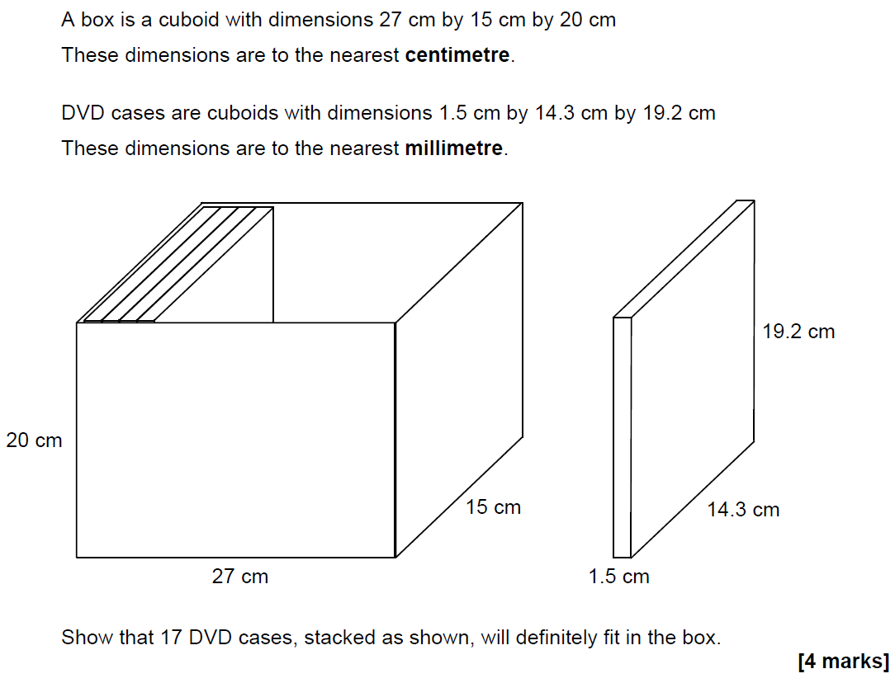
Upper & Lower Bounds
SAM 3H Q21

Slide 35
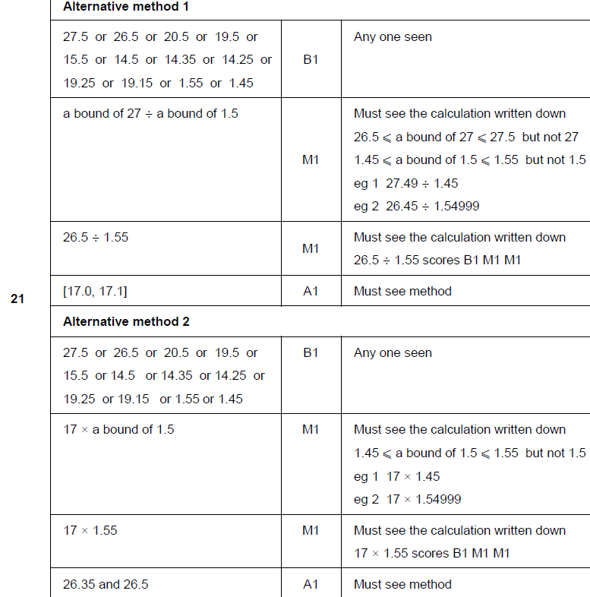
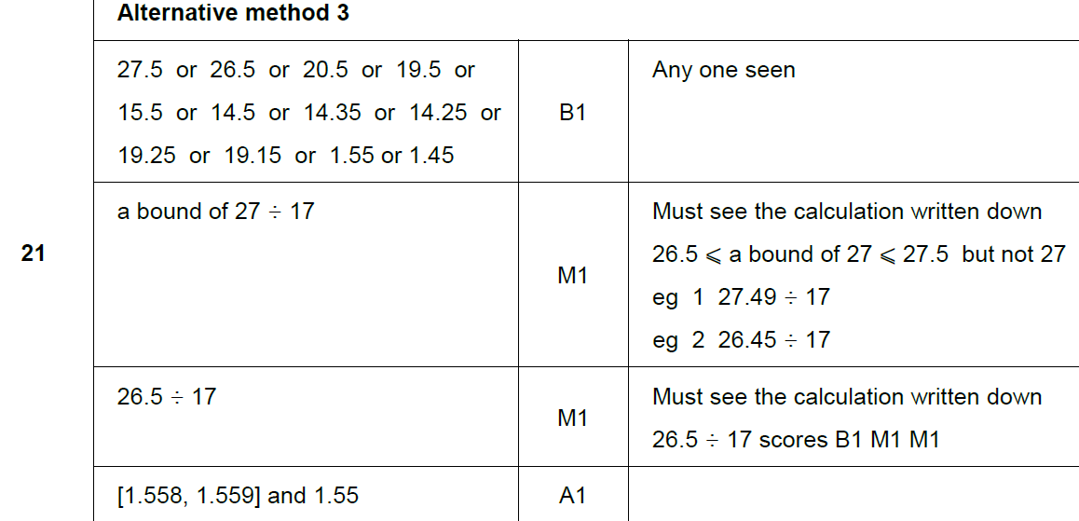
Upper & Lower Bounds
SAM 3H Q21
A

Slide 36
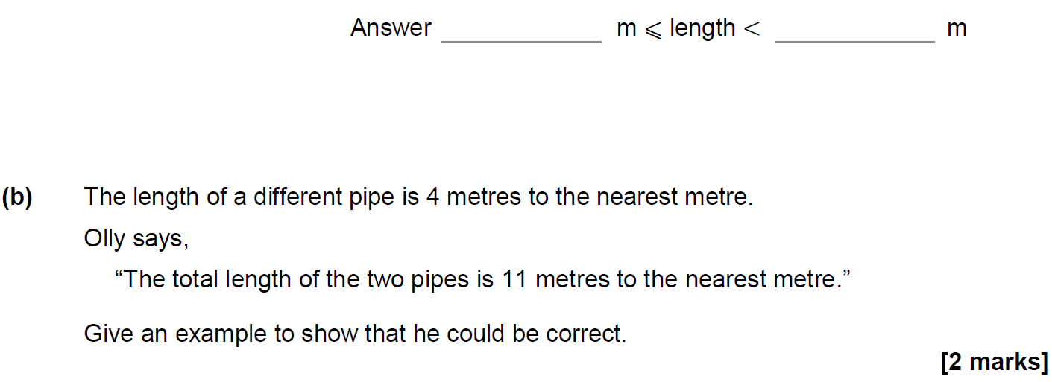
Upper & Lower Bounds
June 2017 3H Q7

Slide 37
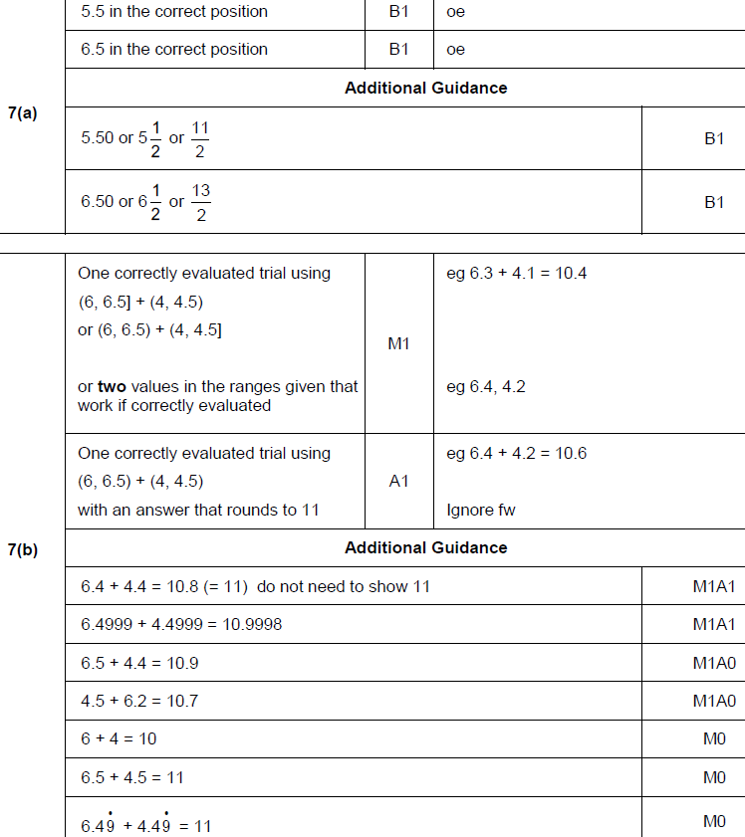
Upper & Lower Bounds
June 2017 3H Q7
A
B

Slide 38
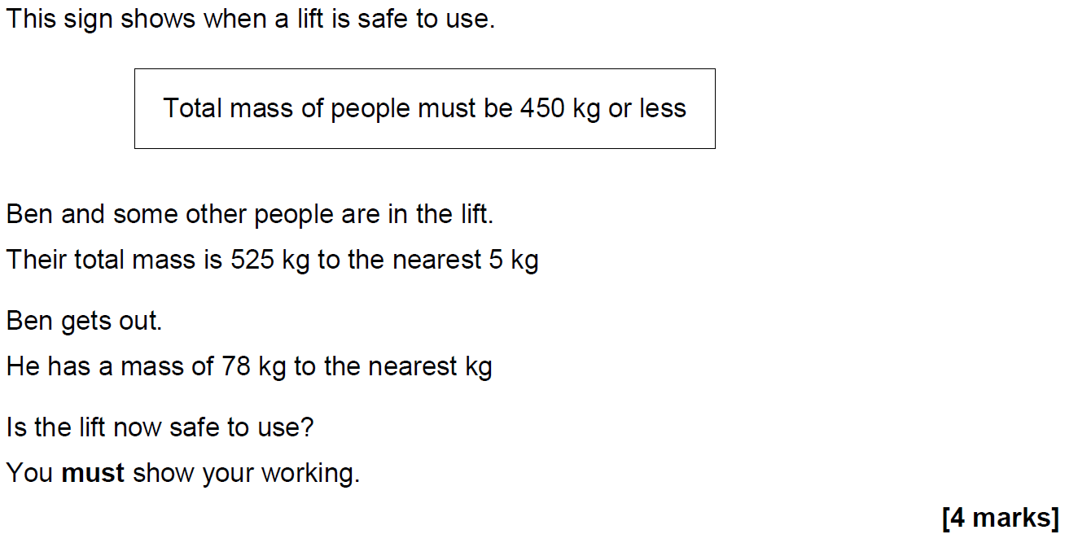
Upper & Lower Bounds
June 2017 3H Q20

Slide 39
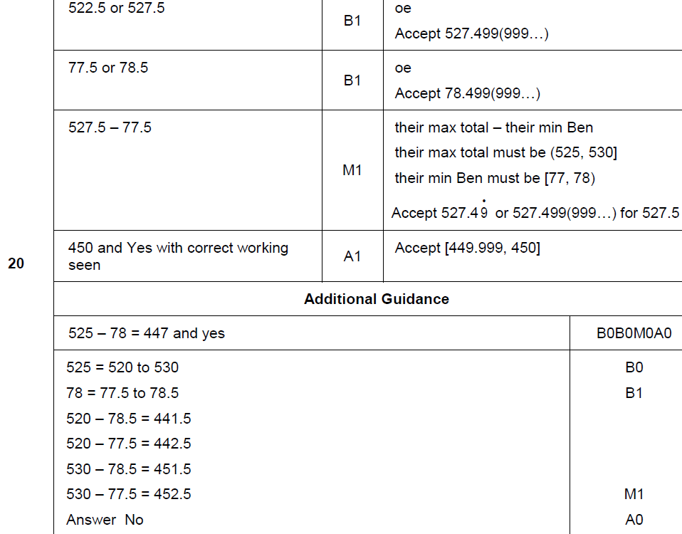
Upper & Lower Bounds
June 2017 3H Q20
A

Slide 40
Upper & Lower Bounds
Nov 2017 1H Q8

Slide 41
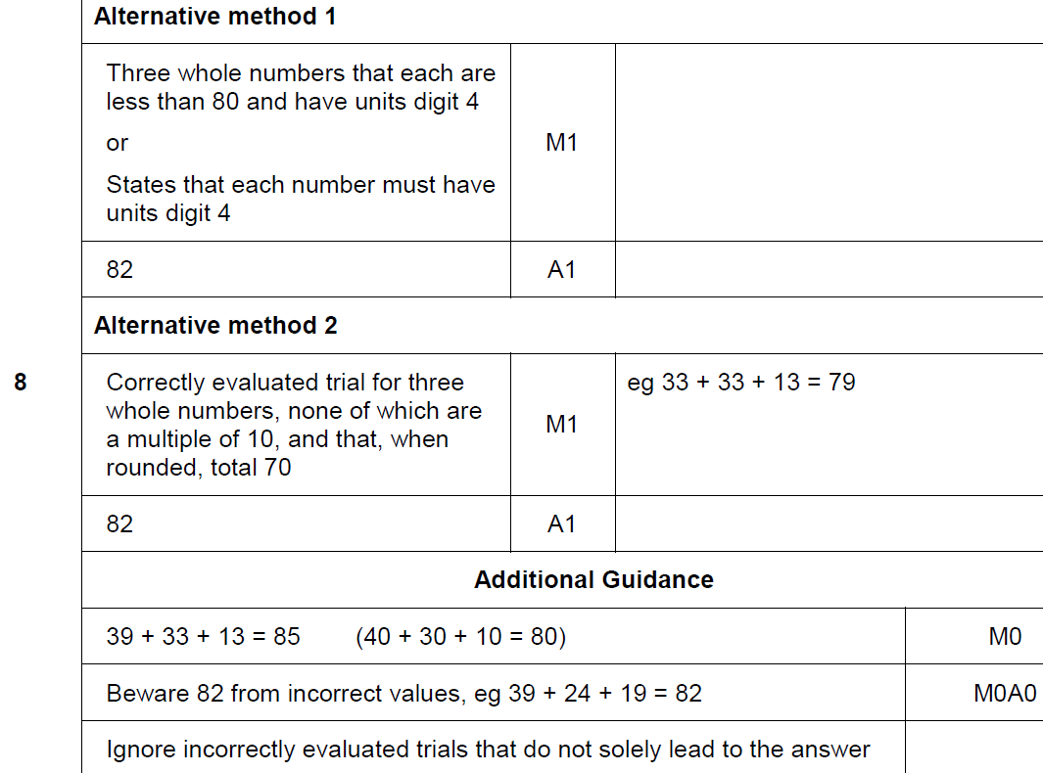
Upper & Lower Bounds
Nov 2017 1H Q8
A

Slide 42
Upper & Lower Bounds
Nov 2017 2H Q25

Slide 43
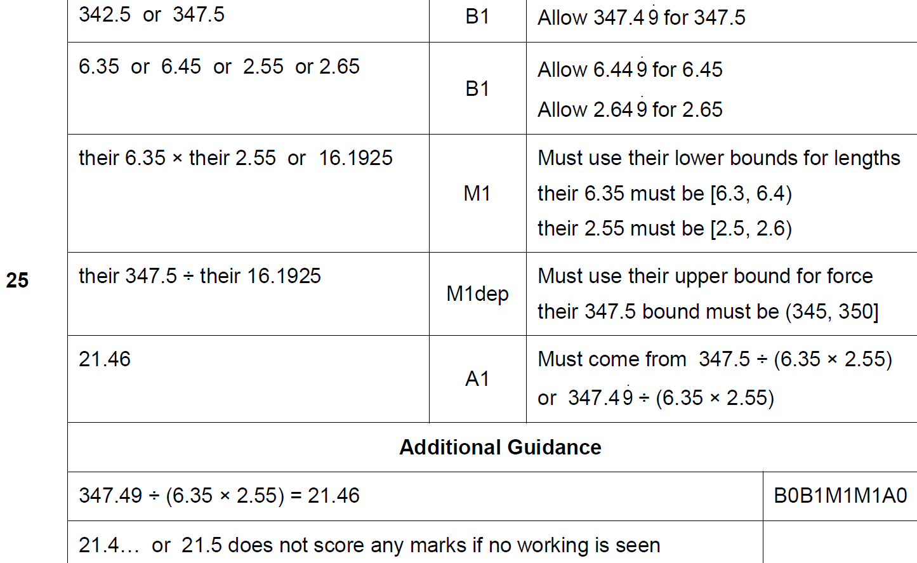
Upper & Lower Bounds
Nov 2017 2H Q25
A

Slide 44
Upper & Lower Bounds
June 2018 2H Q9

Slide 45
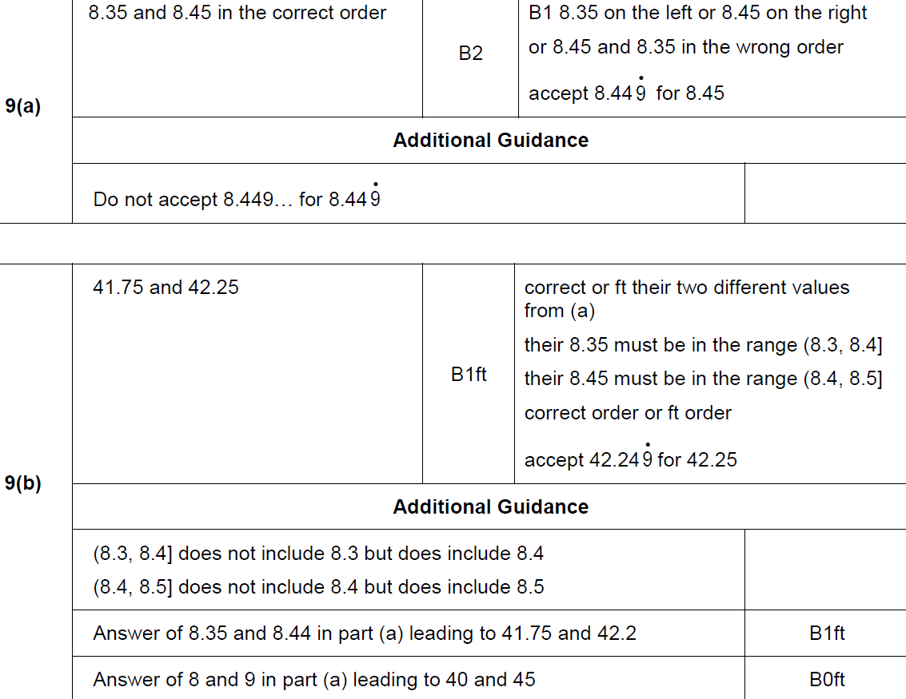
Upper & Lower Bounds
June 2018 2H Q9
A
B

Slide 46
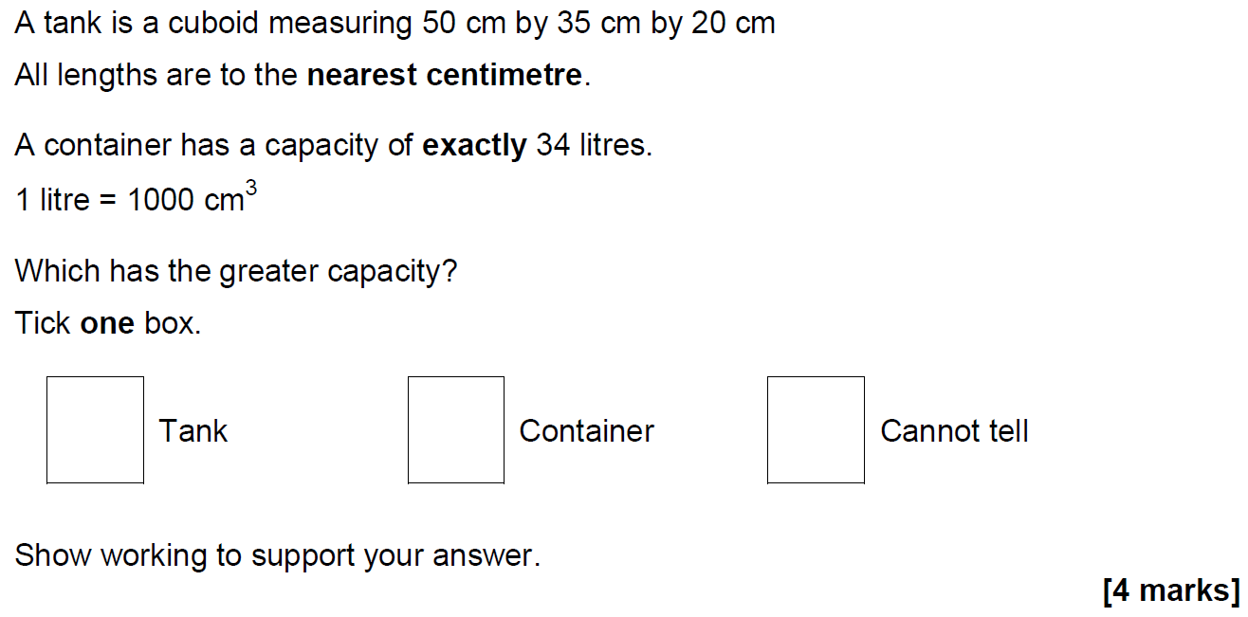
Upper & Lower Bounds
June 2018 2H Q24

Slide 47
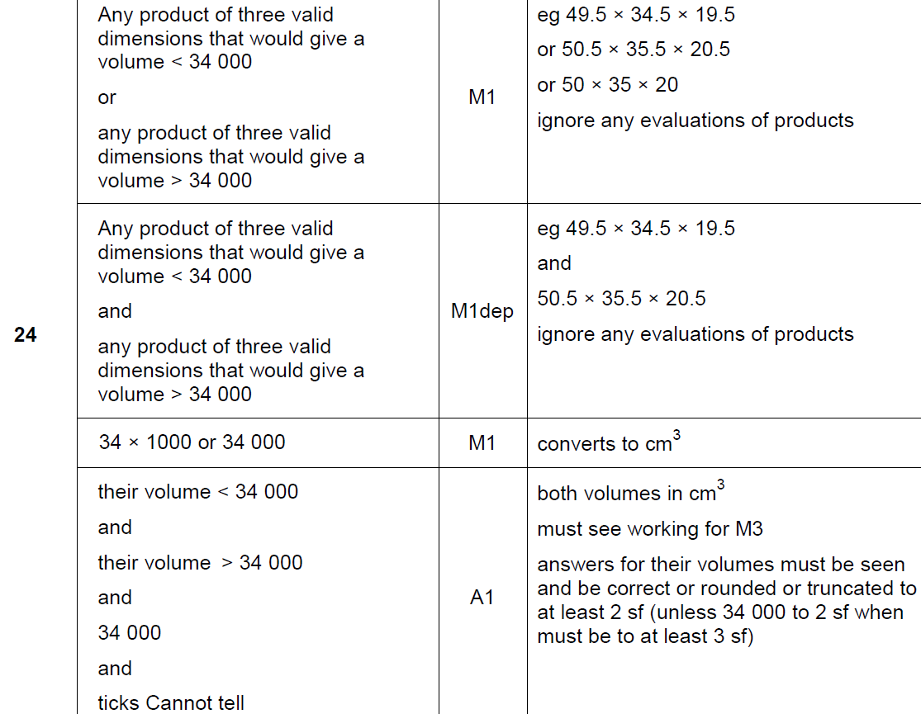
Upper & Lower Bounds
June 2018 2H Q24
A

Slide 48
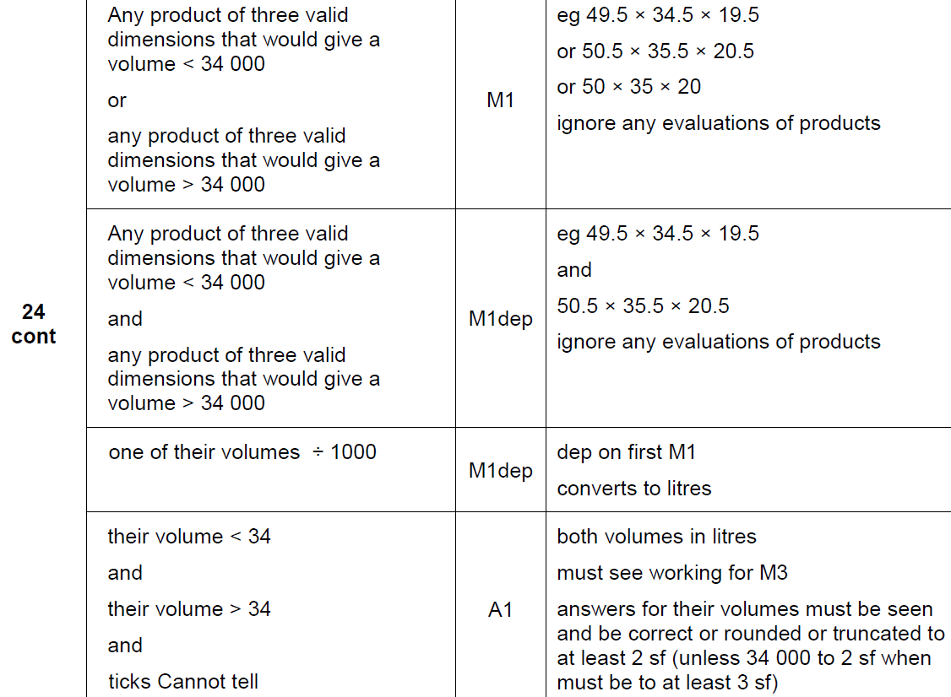
Upper & Lower Bounds
June 2018 2H Q24
A

Slide 49
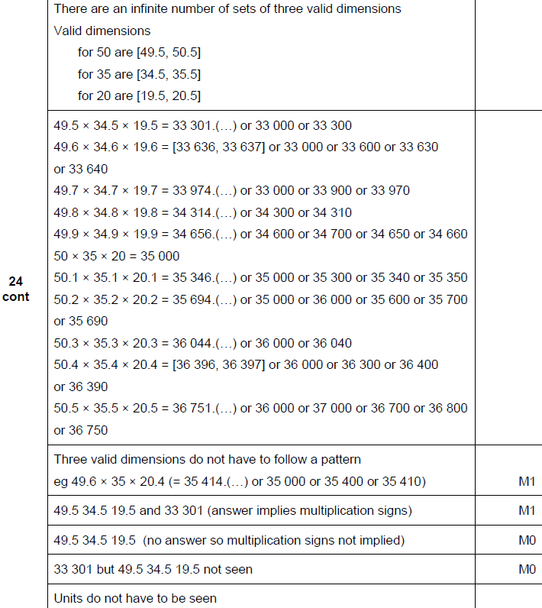
Upper & Lower Bounds
June 2018 2H Q24
A notes

Slide 50
Upper & Lower Bounds
Nov 2018 3H Q5

Slide 51
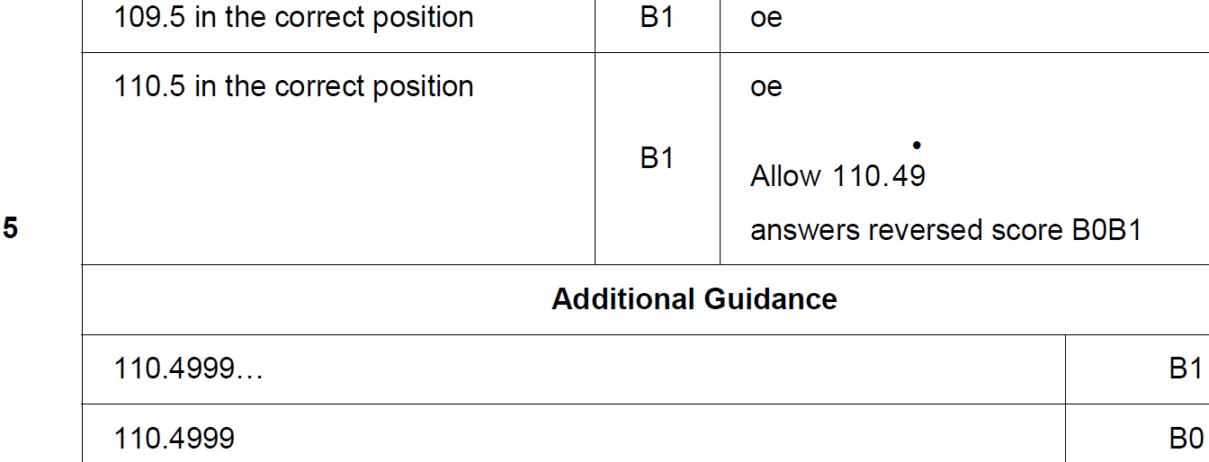
Upper & Lower Bounds
Nov 2018 3H Q5
A

Slide 52
Upper & Lower Bounds
Nov 2018 3H Q19
The length of a roll of ribbon is 30 metres, correct to the nearest half-metre.
A piece of length 5.8 metres, correct to the nearest 10 centimetres, is cut from the roll.
Work out the maximum possible length of ribbon left on the roll.
[3 marks]

Slide 53
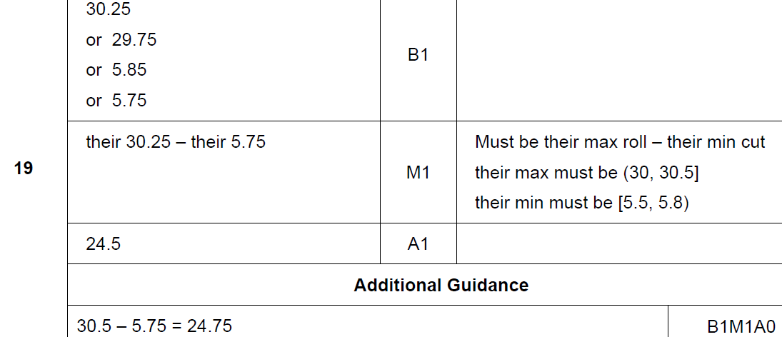
Upper & Lower Bounds
Nov 2018 3H Q19
A

Slide 54
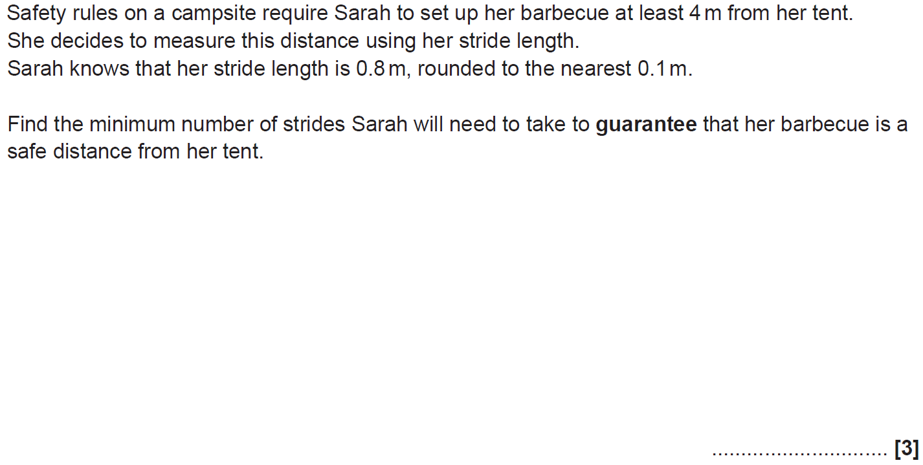
Upper & Lower Bounds
SAM 2H Q8

Slide 55
Upper & Lower Bounds
SAM 2H Q8
A

Slide 56
Upper & Lower Bounds
Practice 1H Q1

Slide 57
Upper & Lower Bounds
Practice 1H Q1
A (i)
A (ii)
B

Slide 58
Upper & Lower Bounds
May 2017 1H Q2

Slide 59
Upper & Lower Bounds
May 2017 1H Q2
A

Slide 60
Upper & Lower Bounds
June 2017 3H Q11

Slide 61
Upper & Lower Bounds
June 2017 3H Q11
A

Slide 62
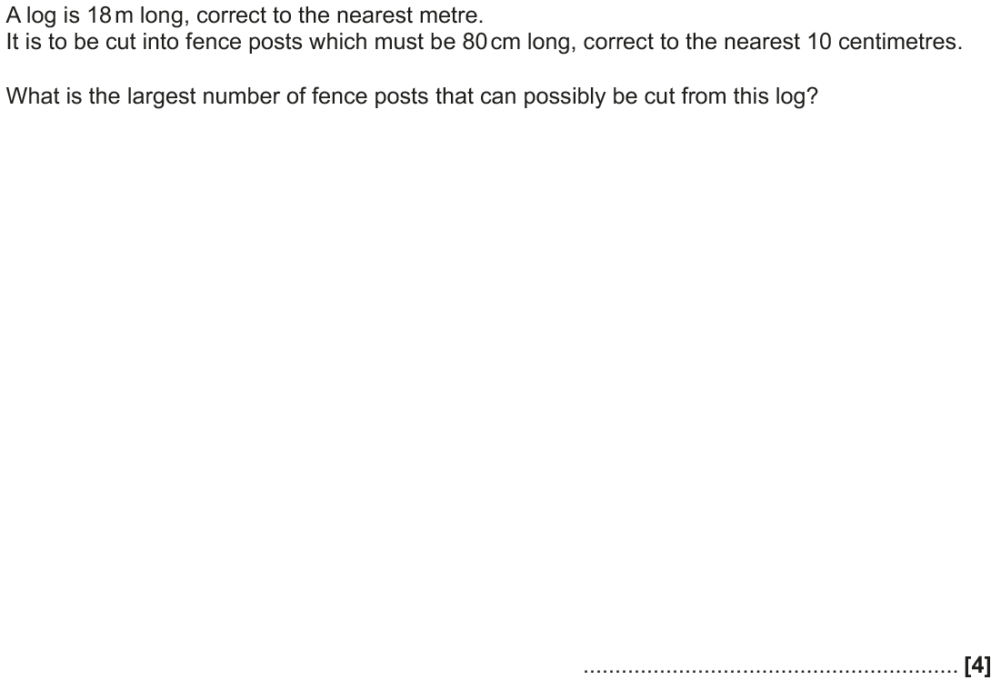
Upper & Lower Bounds
Nov 2017 1H Q12

Slide 63
Upper & Lower Bounds
Nov 2017 1H Q12
A

Slide 64
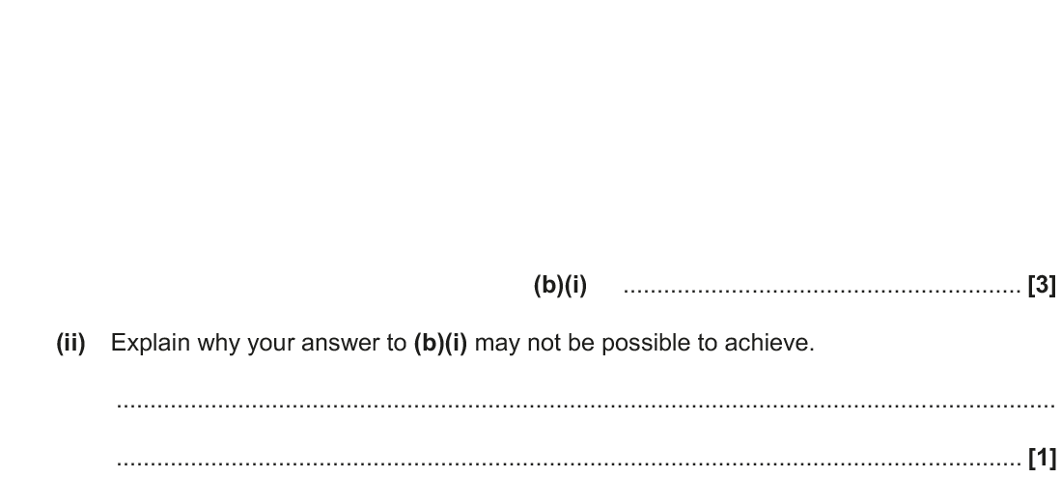
Upper & Lower Bounds
June 2018 3H Q14

Slide 65
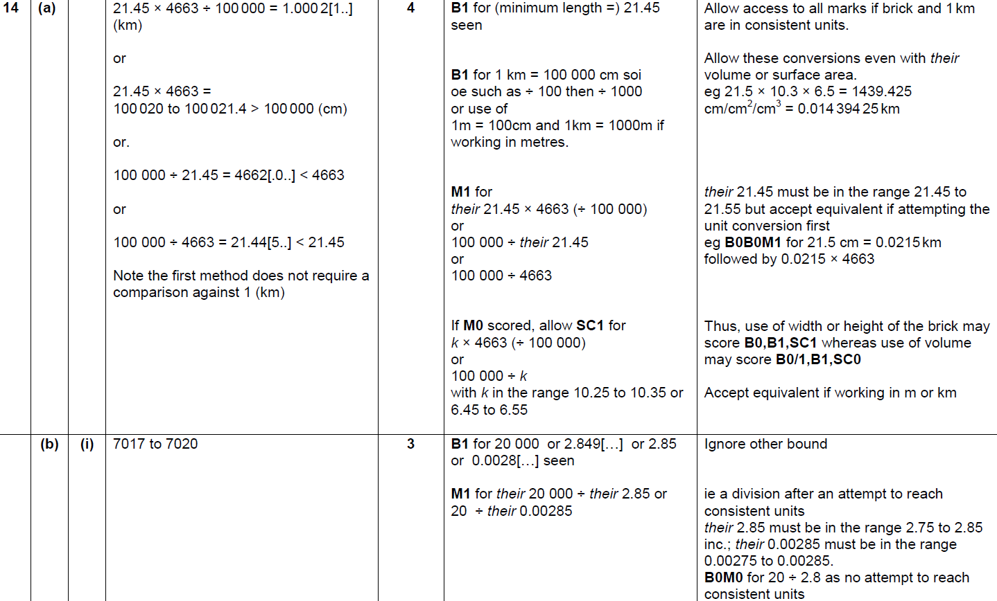
Upper & Lower Bounds
June 2018 3H Q14
A
B (i)
B (ii)

Slide 66
Upper & Lower Bounds
Nov 2018 3H Q4

Slide 67
Upper & Lower Bounds
Nov 2018 3H Q4
A

Slide 68
Upper & Lower Bounds
Nov 2018 3H Q16

Slide 69
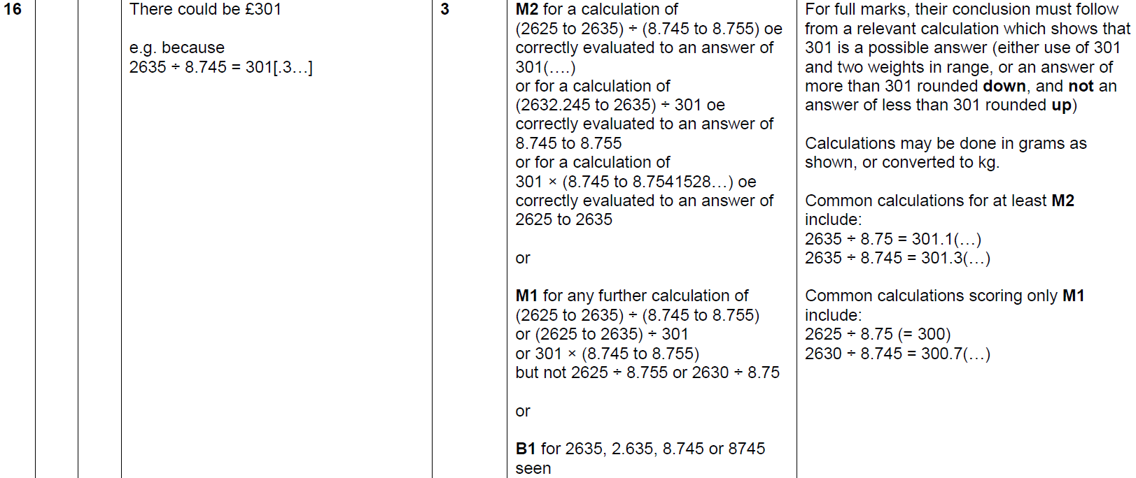
Upper & Lower Bounds
Nov 2018 3H Q16
A

