Slide 1
Upper & Lower Bounds
Upper & Lower Bounds
Old Spec Q’s
NTSQ
Q15
NTSQ
Q16
SAM
1H Q17
June 2018
2H Q15
June 2018
2HR Q19
Jan 2019
2H Q18
Jan 2019
2HR Q17
May 2019
1H Q11

Slide 2
Upper & Lower Bounds
NTSQ Q15

Slide 3
Upper & Lower Bounds
NTSQ Q15
A

Slide 4
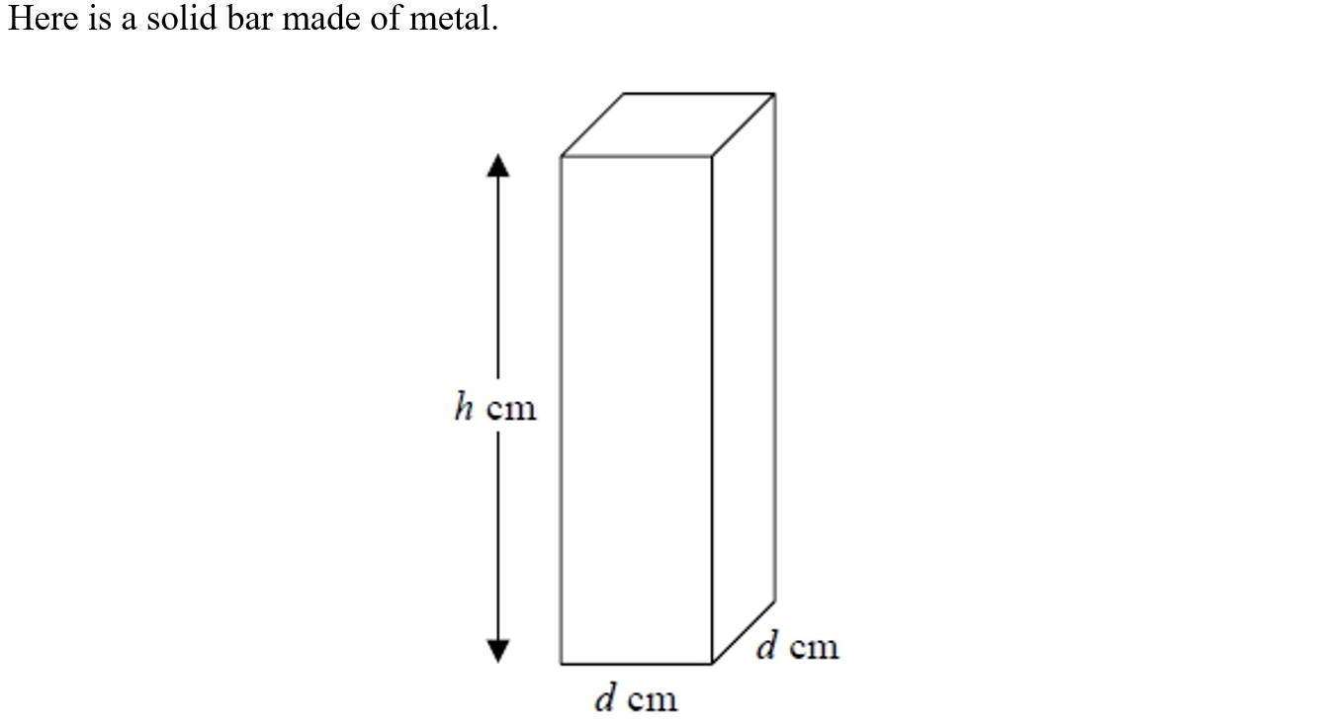
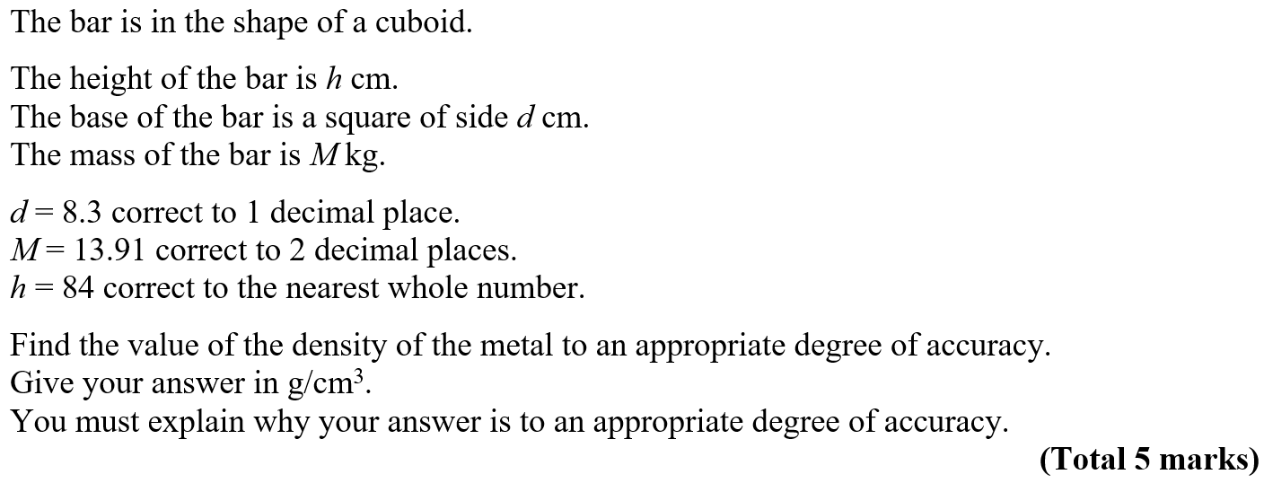
Upper & Lower Bounds
NTSQ Q16

Slide 5
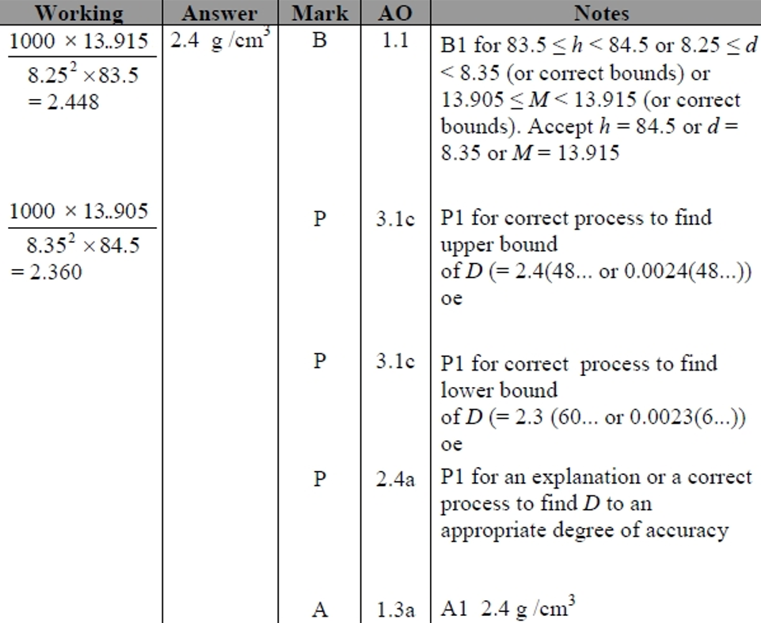
Upper & Lower Bounds
NTSQ Q16
A

Slide 6
Upper & Lower Bounds
SAM 1H Q17

Slide 7
Upper & Lower Bounds
SAM 1H Q17
A

Slide 8
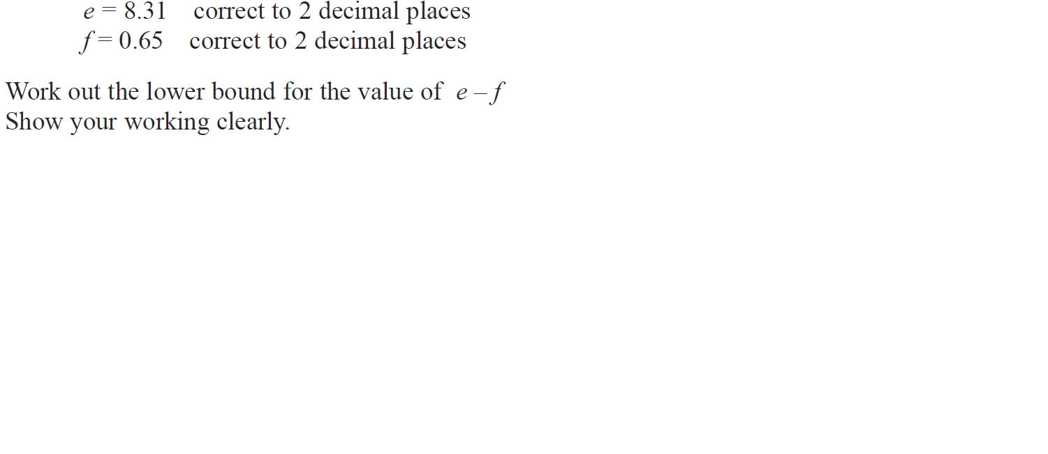
Upper & Lower Bounds
June 2018 2H Q15

Slide 9
Upper & Lower Bounds
June 2018 2H Q15
A

Slide 10
Upper & Lower Bounds
June 2018 2HR Q19

Slide 11
Upper & Lower Bounds
June 2018 2HR Q19
A

Slide 12
Upper & Lower Bounds
Jan 2019 2H Q18

Slide 13
Upper & Lower Bounds
Jan 2019 2H Q18
A

Slide 14
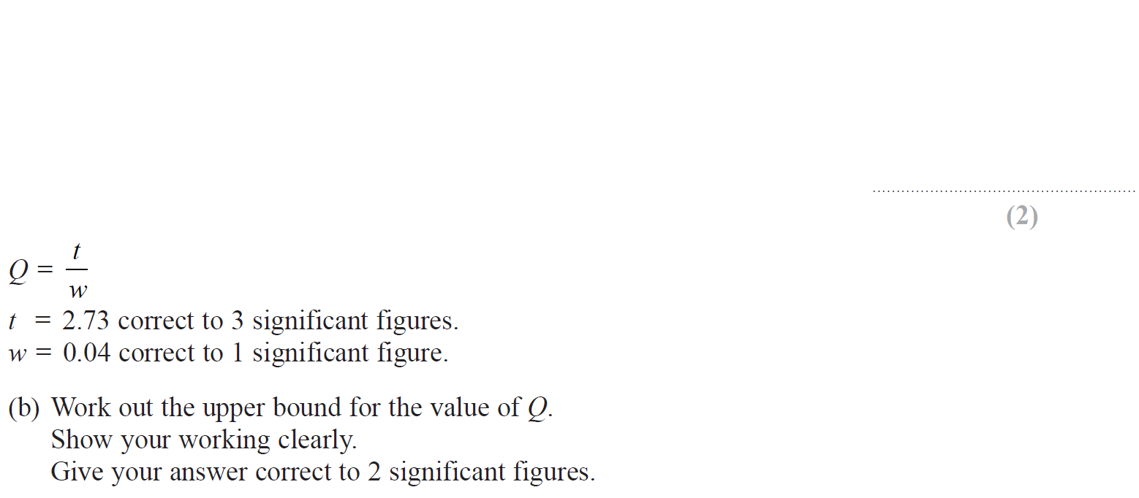
Upper & Lower Bounds
Jan 2019 2HR Q17

Slide 15
Upper & Lower Bounds
Jan 2019 2HR Q17
A
B

Slide 16
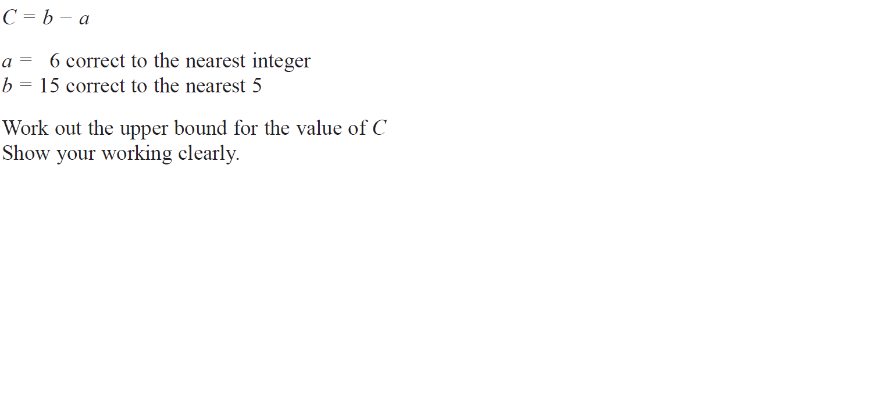
Upper & Lower Bounds
May 2019 1H Q11

Slide 17
Upper & Lower Bounds
May 2019 1H Q11
A

Slide 18
Upper & Lower Bounds
Upper & Lower Bounds
New Spec Q’s
May 2004
3H Q15
May 2008
3H Q15
Jan 2013 3H Q8
Jan 2015 3HR Q10
June 2017 4H Q20
May 2004
4H Q10
May 2009
3H Q20
May 2013 3H Q19
May 2015 3H Q18
June 2017 4HR Q23
Nov 2004
4H Q21
Nov 2009
3H Q23
May 2013 3HR Q16
May 2015 3HR Q21
Jan 2018 4H Q21
Nov 2005
4H Q14
June 2010
3H Q14
Jan 2014 4H Q21
Jan 2016 3H Q9
Jan 2018 4HR Q18
May 2006
3H Q17
June 2011 3H Q14
Jan 2014 4HR Q19
May 2016 3H Q20
June 2018 4HR Q25
Nov 2006
4H Q14
June 2011 4H Q9
May 2014 3H Q19
Jan 2017 3H Q20
May 2007
3H Q14
Jan 2012 3H Q9
May 2014 4H Q3
Jan 2017 4H Q8
Nov 2007
3H Q18
May 2012 3H Q20
Jan 2015 4H Q18
Jan 2017 4HR Q9

Slide 19
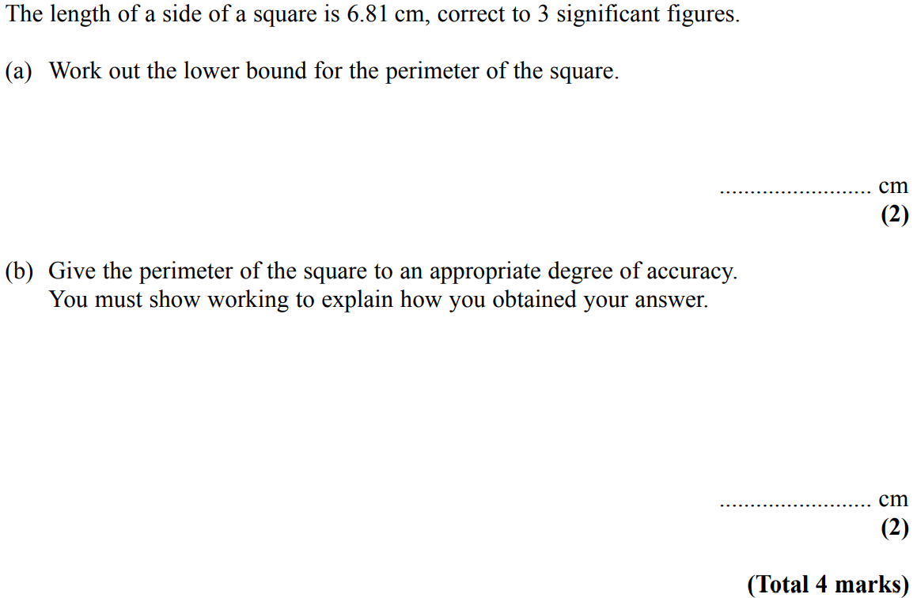
Upper & Lower Bounds
May 2004 3H Q15

Slide 20
Upper & Lower Bounds
May 2004 3H Q15
A
B

Slide 21
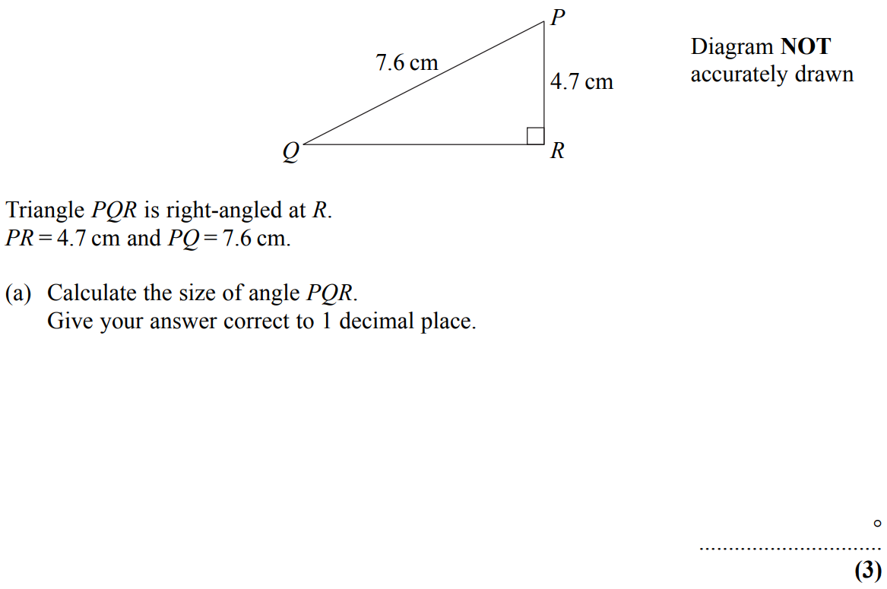
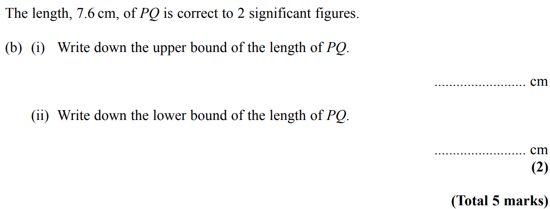
Upper & Lower Bounds
May 2004 4H Q10

Slide 22
Upper & Lower Bounds
May 2004 4H Q10
A
B (i)
B (ii)

Slide 23
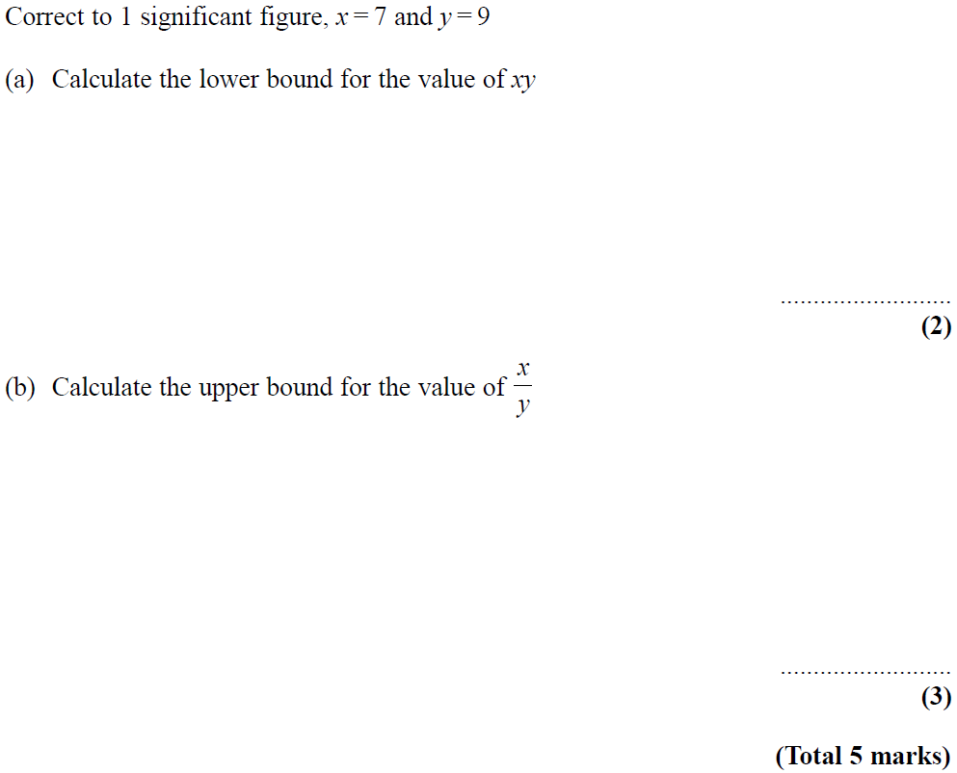
Upper & Lower Bounds
Nov 2004 4H Q21

Slide 24
Upper & Lower Bounds
Nov 2004 4H Q21
A
B

Slide 25
Upper & Lower Bounds
Nov 2005 4H Q14

Slide 26
Upper & Lower Bounds
Nov 2005 4H Q14
A

Slide 27
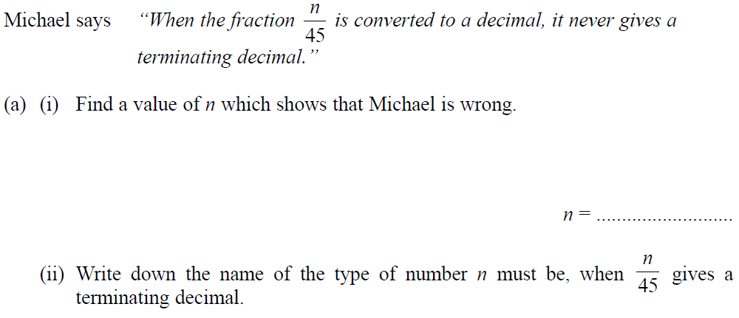
Upper & Lower Bounds
May 2006 3H Q17

Slide 28
Upper & Lower Bounds
May 2006 3H Q17
A (i)
A (ii)
B

Slide 29
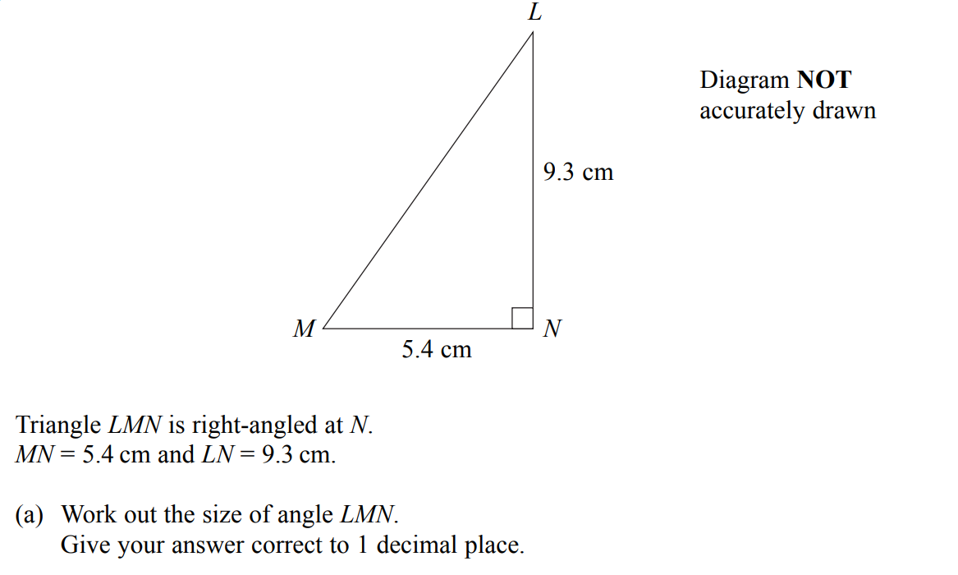
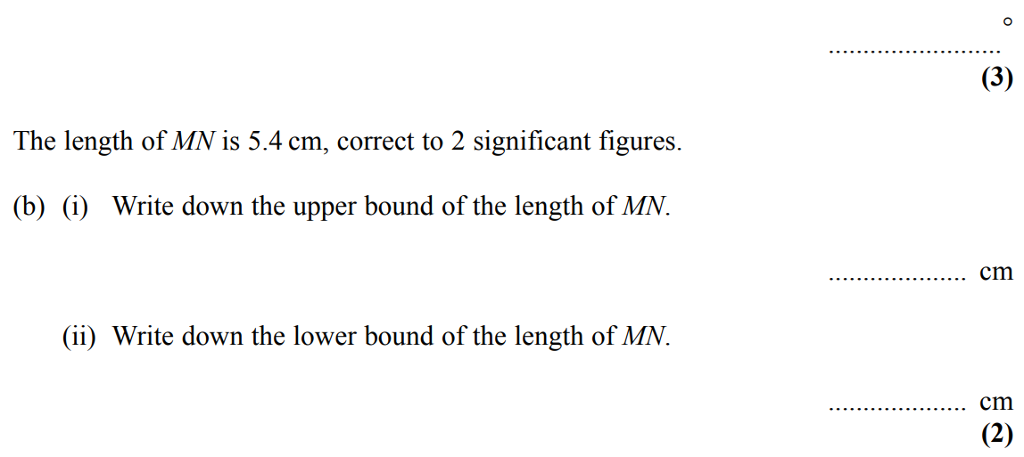
Upper & Lower Bounds
Nov 2006 4H Q14

Slide 30
Upper & Lower Bounds
Nov 2006 4H Q14
A
B (i)
B (ii)
C

Slide 31
Upper & Lower Bounds
May 2007 3H Q14

Slide 32
Upper & Lower Bounds
May 2007 3H Q14
A
B (i)
B (ii)

Slide 33
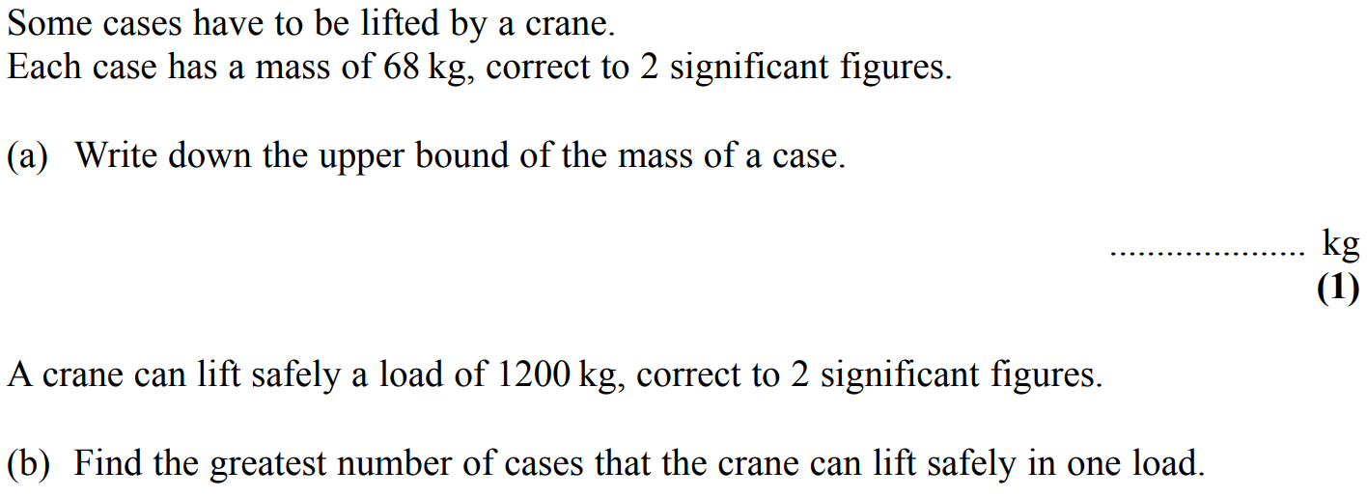
Upper & Lower Bounds
Nov 2007 3H Q18

Slide 34
Upper & Lower Bounds
Nov 2007 3H Q18
A
B

Slide 35
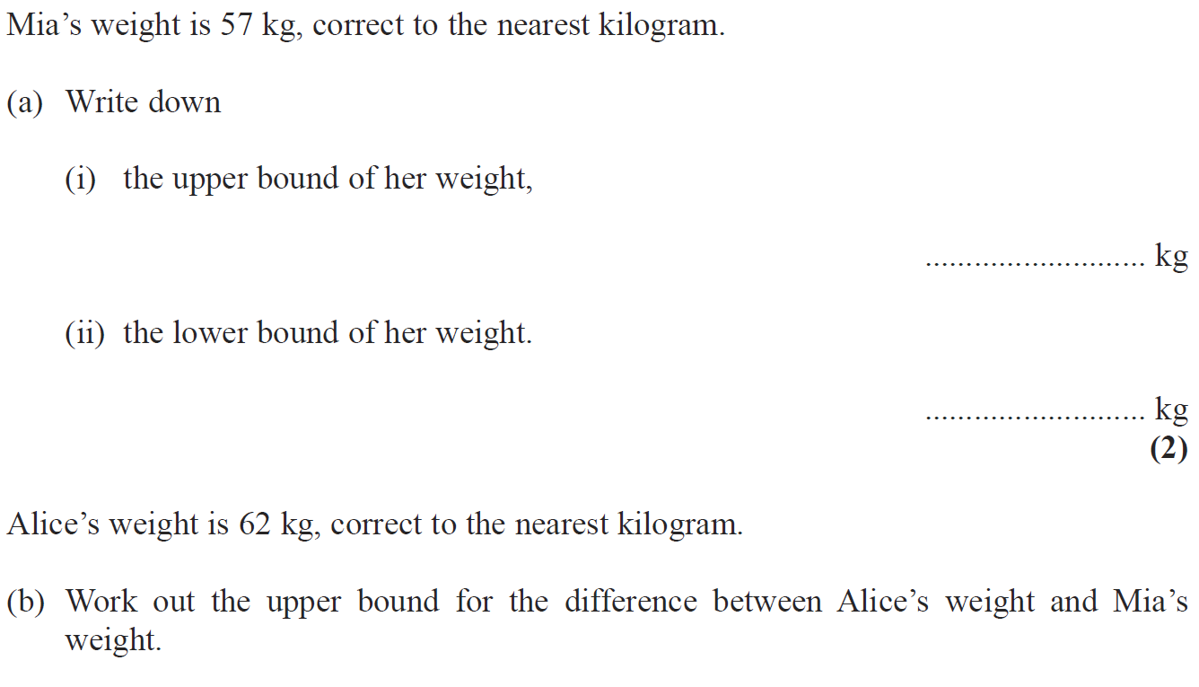
Upper & Lower Bounds
May 2008 3H Q15

Slide 36
Upper & Lower Bounds
May 2008 3H Q15
A (i)
A (ii)
B

Slide 37
Upper & Lower Bounds
May 2009 3H Q20

Slide 38
Upper & Lower Bounds
May 2009 3H Q20
A

Slide 39
Upper & Lower Bounds
Nov 2009 3H Q23

Slide 40
Upper & Lower Bounds
Nov 2009 3H Q23
A

Slide 41
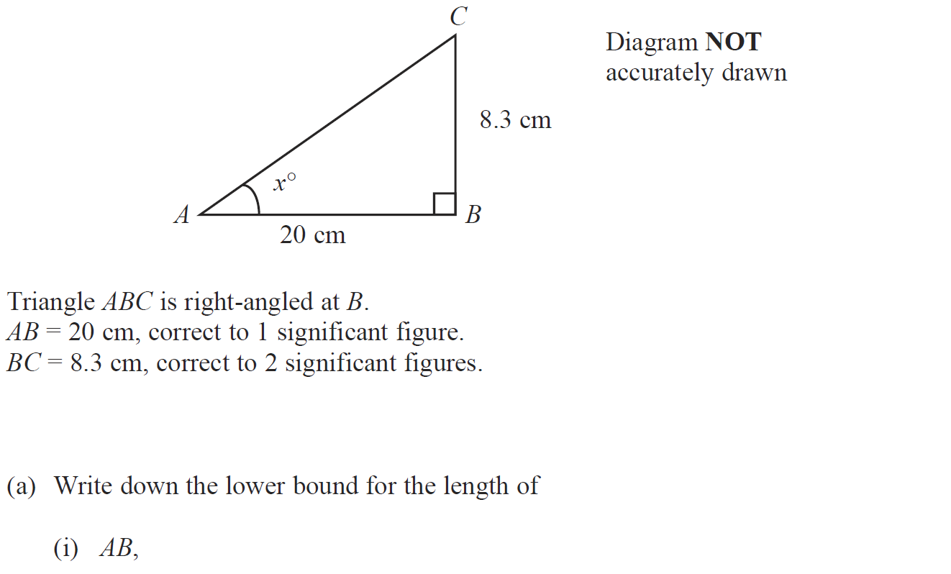
Upper & Lower Bounds
June 2010 3H Q14

Slide 42
Upper & Lower Bounds
June 2010 3H Q14
A (i)
A (ii)
B
C

Slide 43
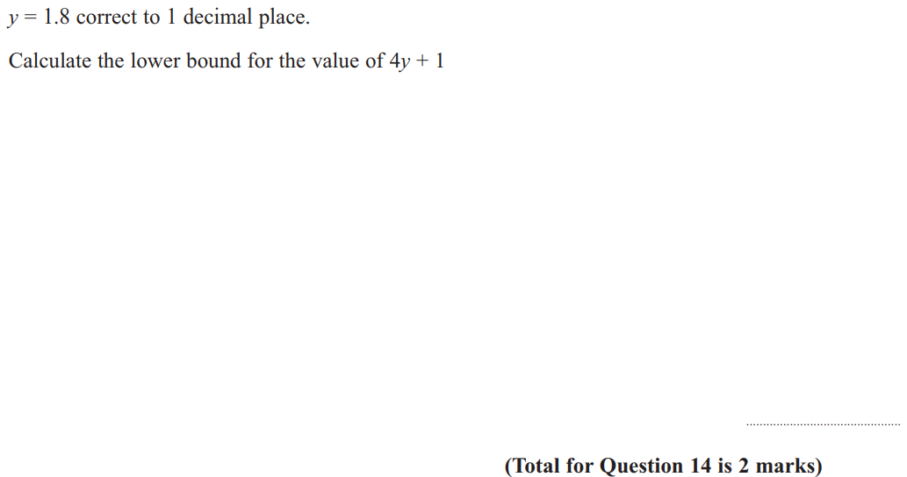
Upper & Lower Bounds
June 2011 3H Q14

Slide 44
Upper & Lower Bounds
June 2011 3H Q14
A

Slide 45
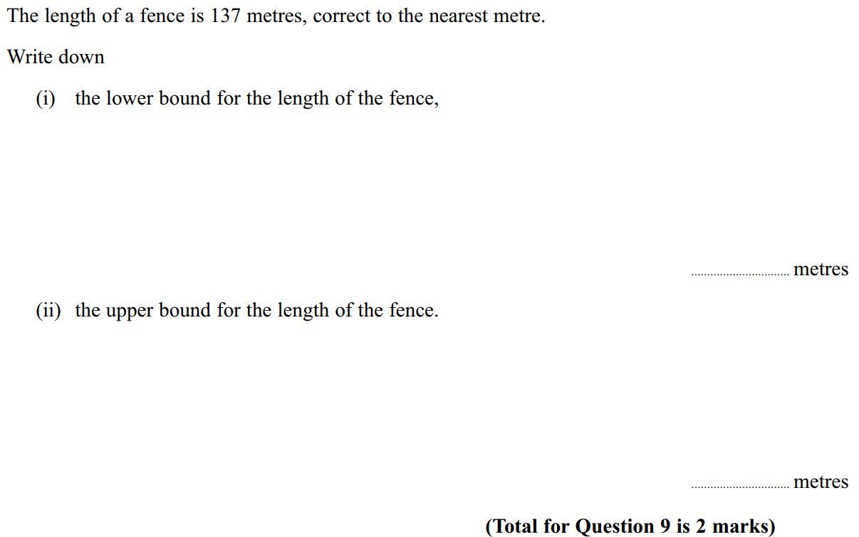
Upper & Lower Bounds
June 2011 4H Q9

Slide 46
Upper & Lower Bounds
June 2011 4H Q9
i
ii

Slide 47
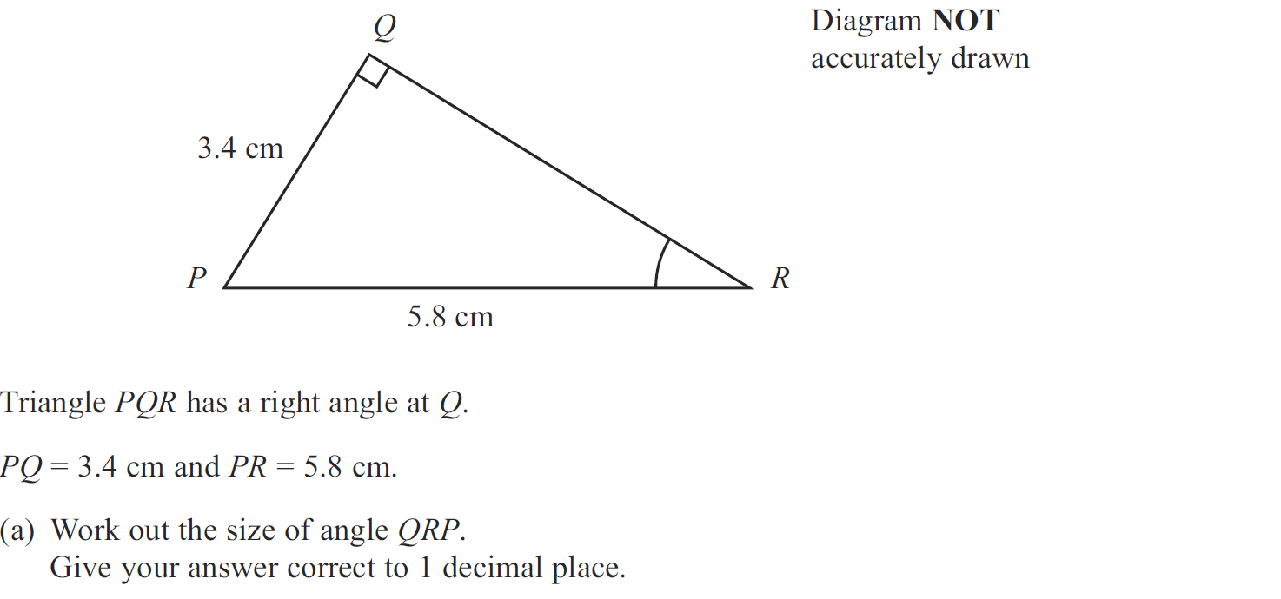
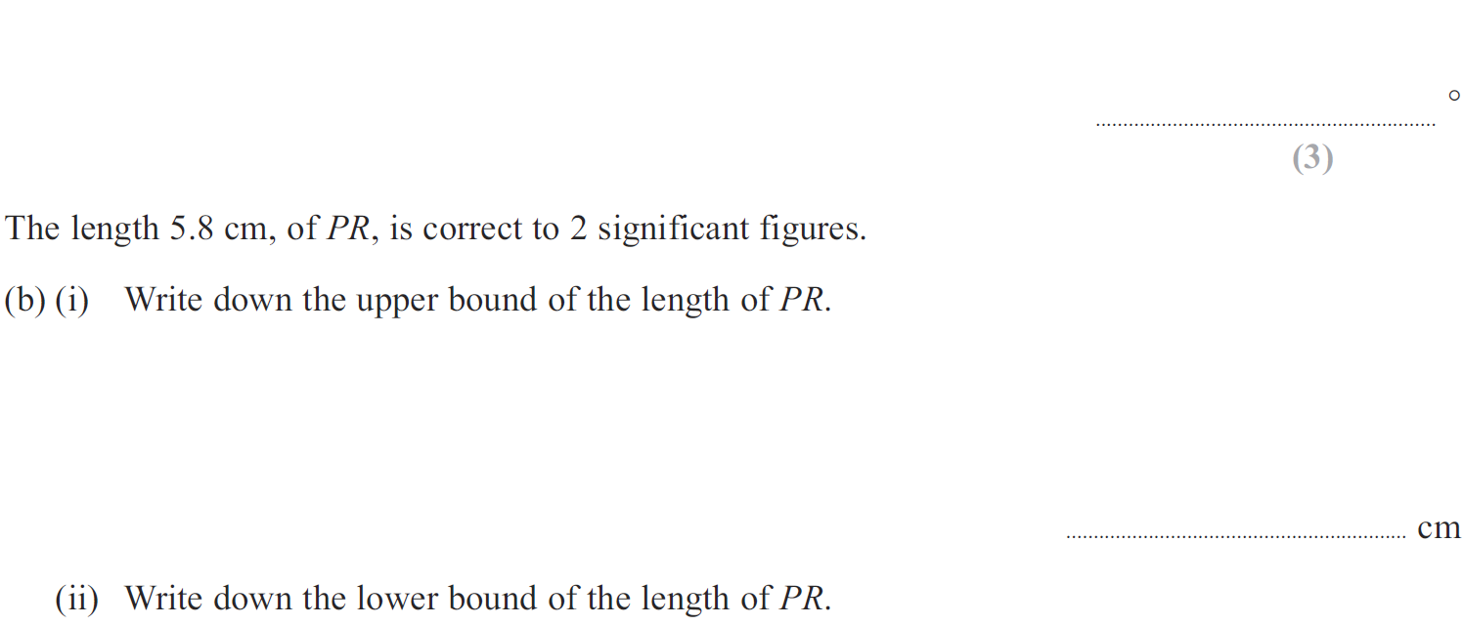
Upper & Lower Bounds
Jan 2012 3H Q9

Slide 48
Upper & Lower Bounds
Jan 2012 3H Q9
A
B (i)
B (ii)

Slide 49
Upper & Lower Bounds
May 2012 3H Q20

Slide 50
Upper & Lower Bounds
May 2012 3H Q20
A

Slide 51
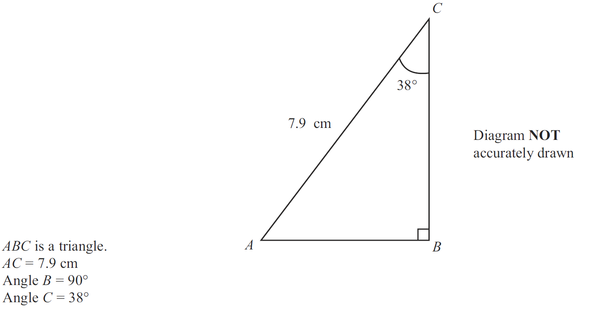
Upper & Lower Bounds
Jan 2013 3H Q8

Slide 52
Upper & Lower Bounds
Jan 2013 3H Q8
A
B (i)
B (ii)

Slide 53
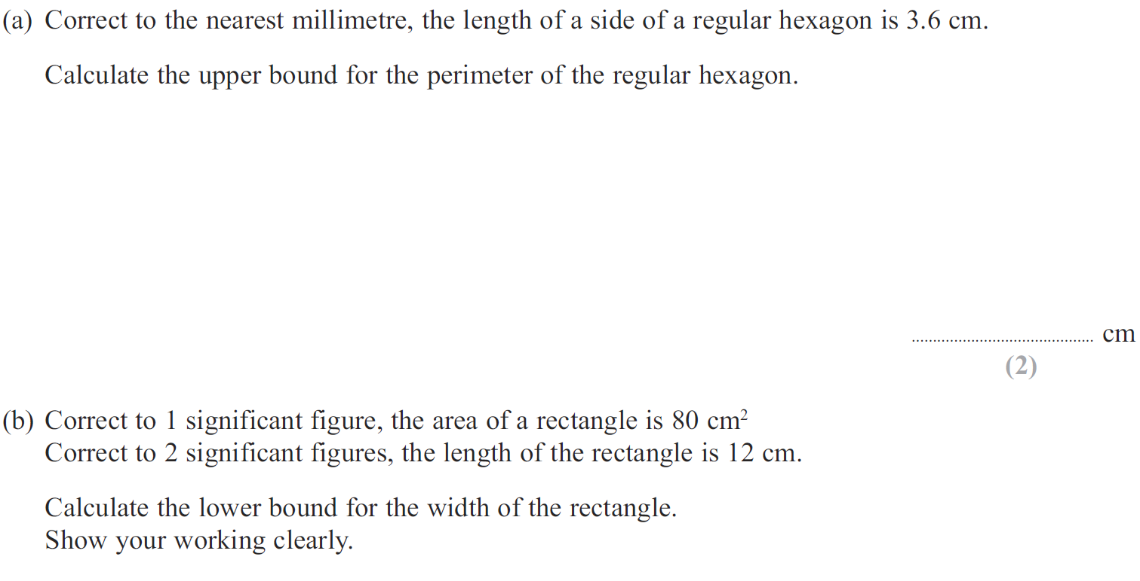
Upper & Lower Bounds
May 2013 3H Q19

Slide 54
Upper & Lower Bounds
May 2013 3H Q19
A
B

Slide 55
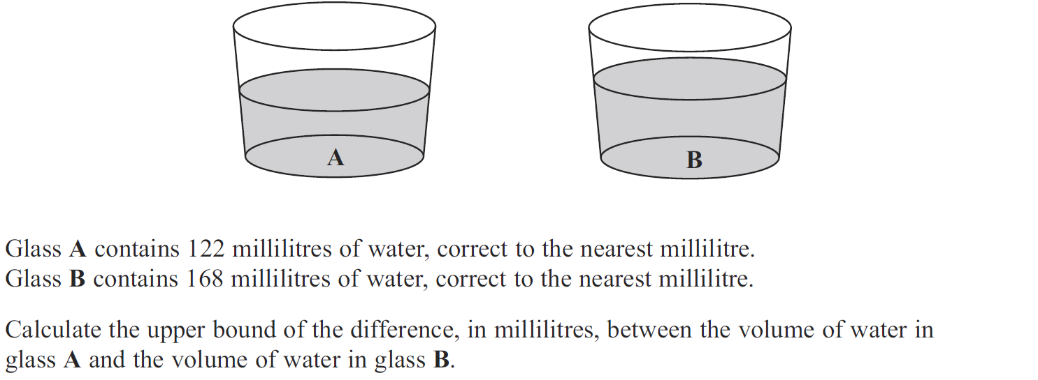
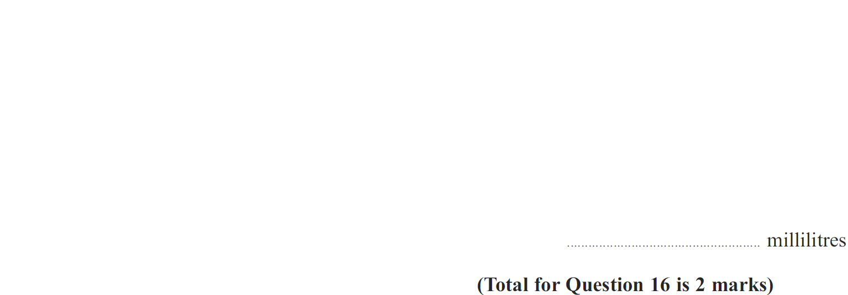
Upper & Lower Bounds
May 2013 3HR Q16

Slide 56
Upper & Lower Bounds
May 2013 3HR Q16
A

Slide 57
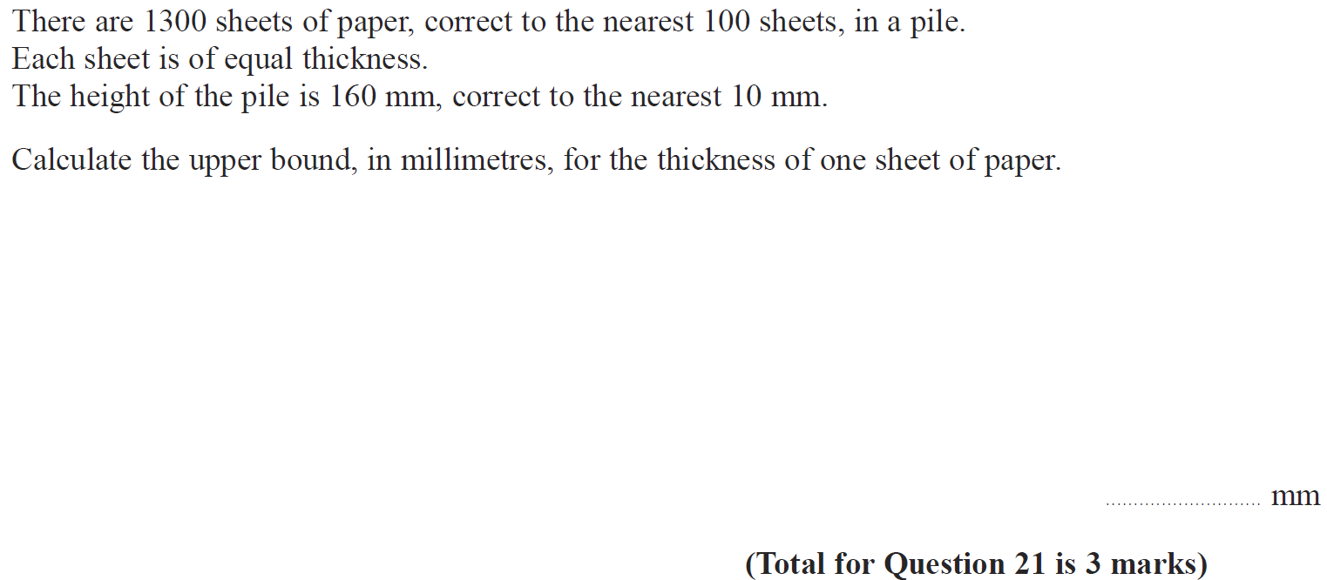
Upper & Lower Bounds
Jan 2014 4H Q21

Slide 58
Upper & Lower Bounds
Jan 2014 4H Q21
A

Slide 59
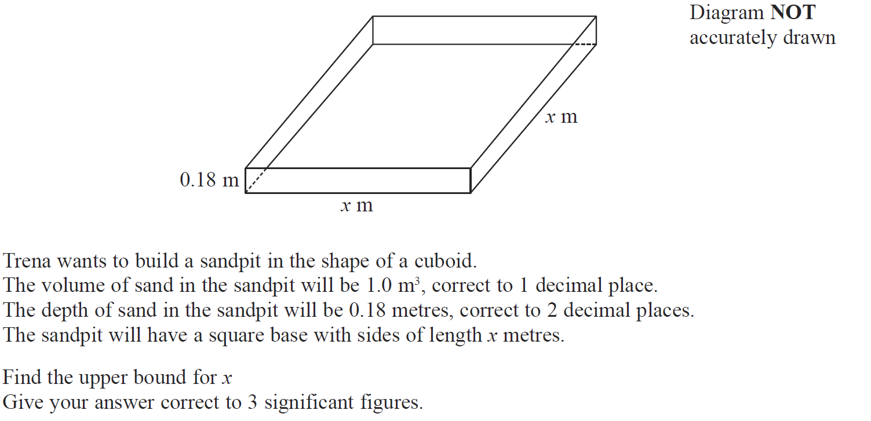
Upper & Lower Bounds
Jan 2014 4HR Q19

Slide 60
Upper & Lower Bounds
Jan 2014 4HR Q19
A

Slide 61
Upper & Lower Bounds
May 2014 3H Q19

Slide 62
Upper & Lower Bounds
May 2014 3H Q19
A

Slide 63
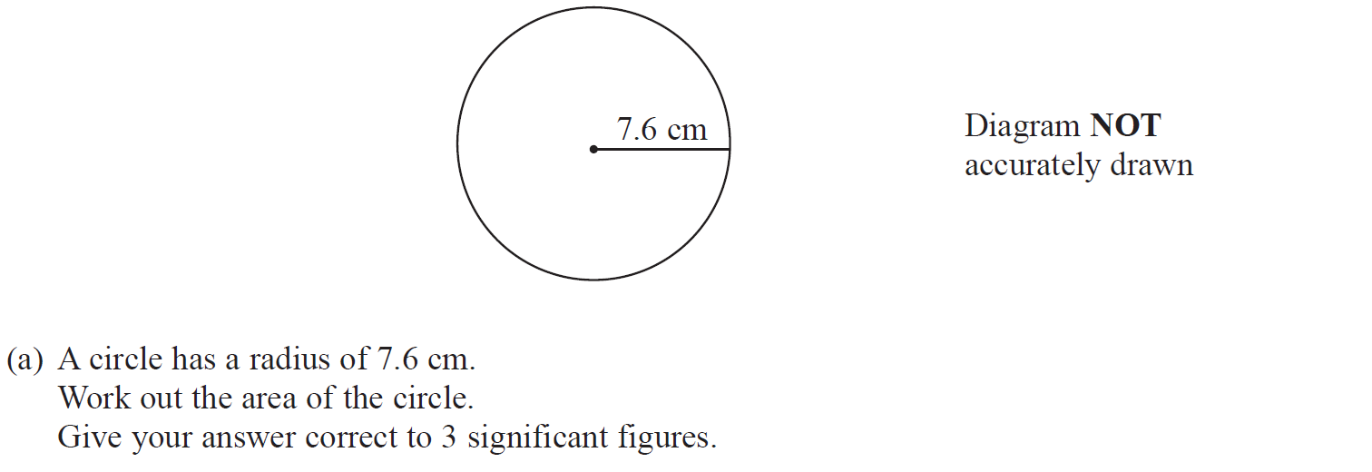
Upper & Lower Bounds
May 2014 4H Q3

Slide 64
Upper & Lower Bounds
May 2014 4H Q3
A
B (i)
B (ii)

Slide 65
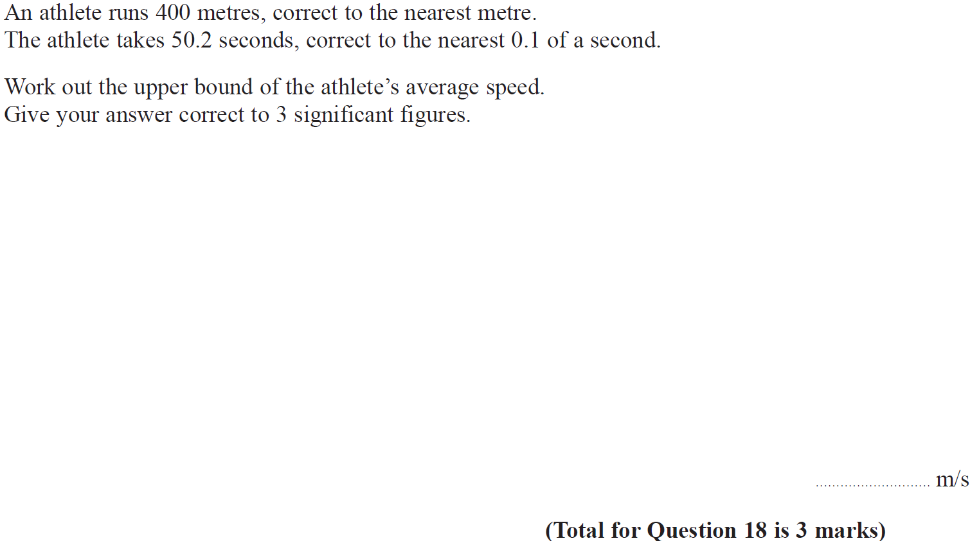
Upper & Lower Bounds
Jan 2015 4H Q18

Slide 66
Upper & Lower Bounds
Jan 2015 4H Q18
A

Slide 67
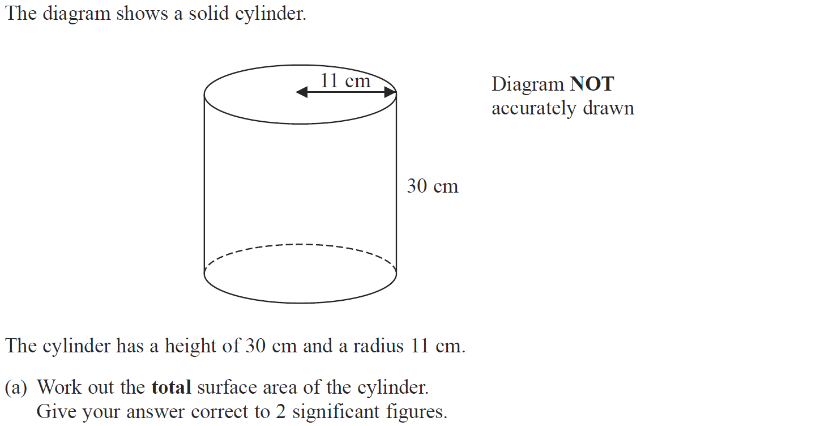
Upper & Lower Bounds
Jan 2015 3HR Q10

Slide 68
Upper & Lower Bounds
Jan 2015 3HR Q10
A
B (i)
B (ii)

Slide 69
Upper & Lower Bounds
May 2015 3H Q18

Slide 70
Upper & Lower Bounds
May 2015 3H Q18
A

Slide 71
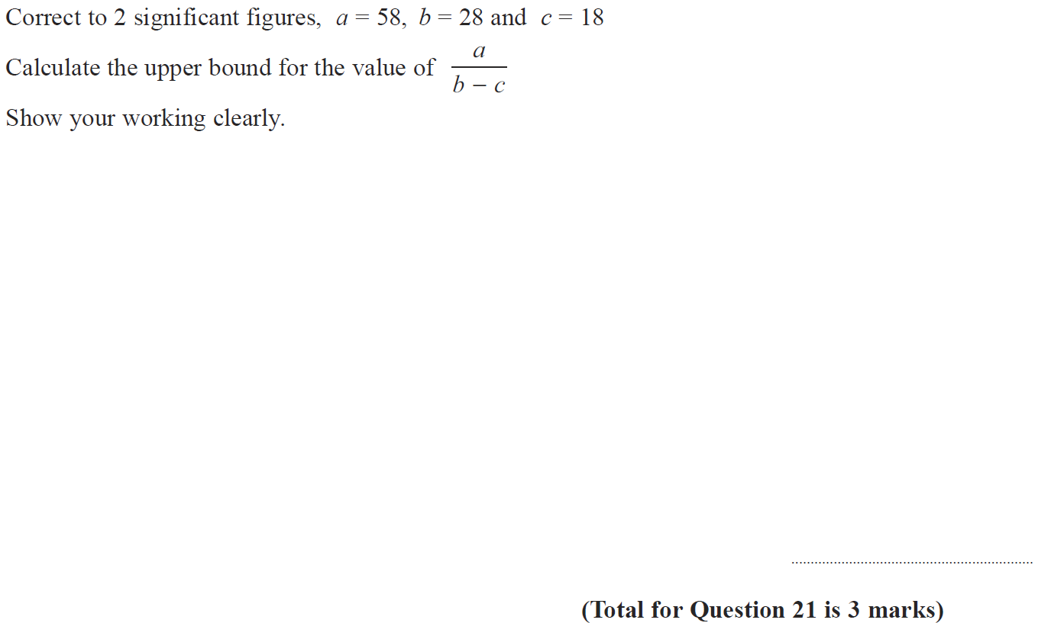
Upper & Lower Bounds
May 2015 3HR Q21

Slide 72
Upper & Lower Bounds
May 2015 3HR Q21
A

Slide 73
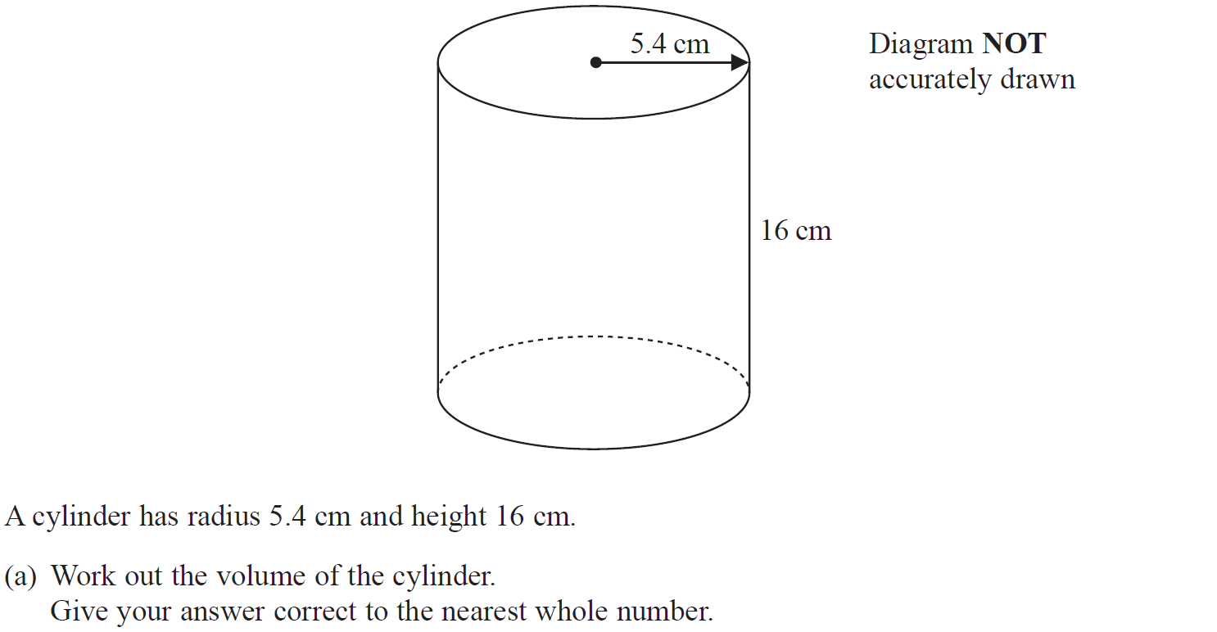
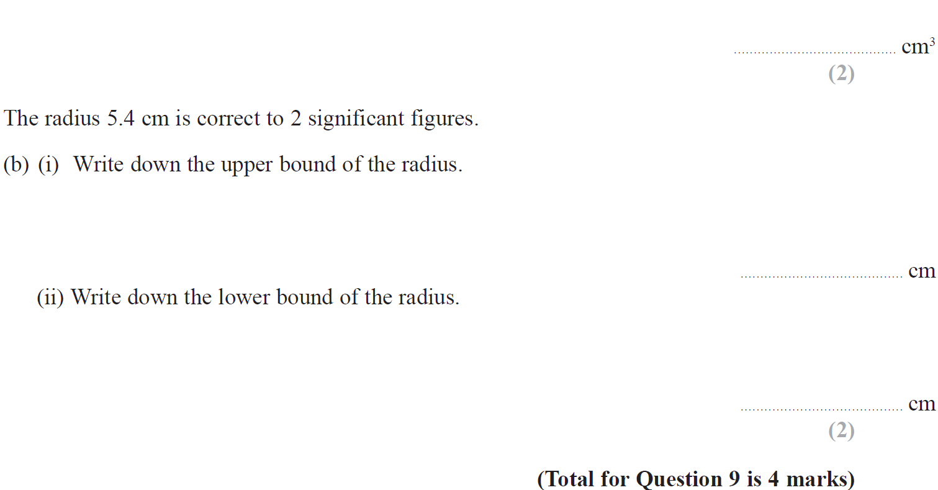
Upper & Lower Bounds
Jan 2016 3H Q9

Slide 74
Upper & Lower Bounds
Jan 2016 3H Q9
A
B (i)
B (ii)

Slide 75
Upper & Lower Bounds
May 2016 3H Q20

Slide 76
Upper & Lower Bounds
May 2016 3H Q20
A

Slide 77
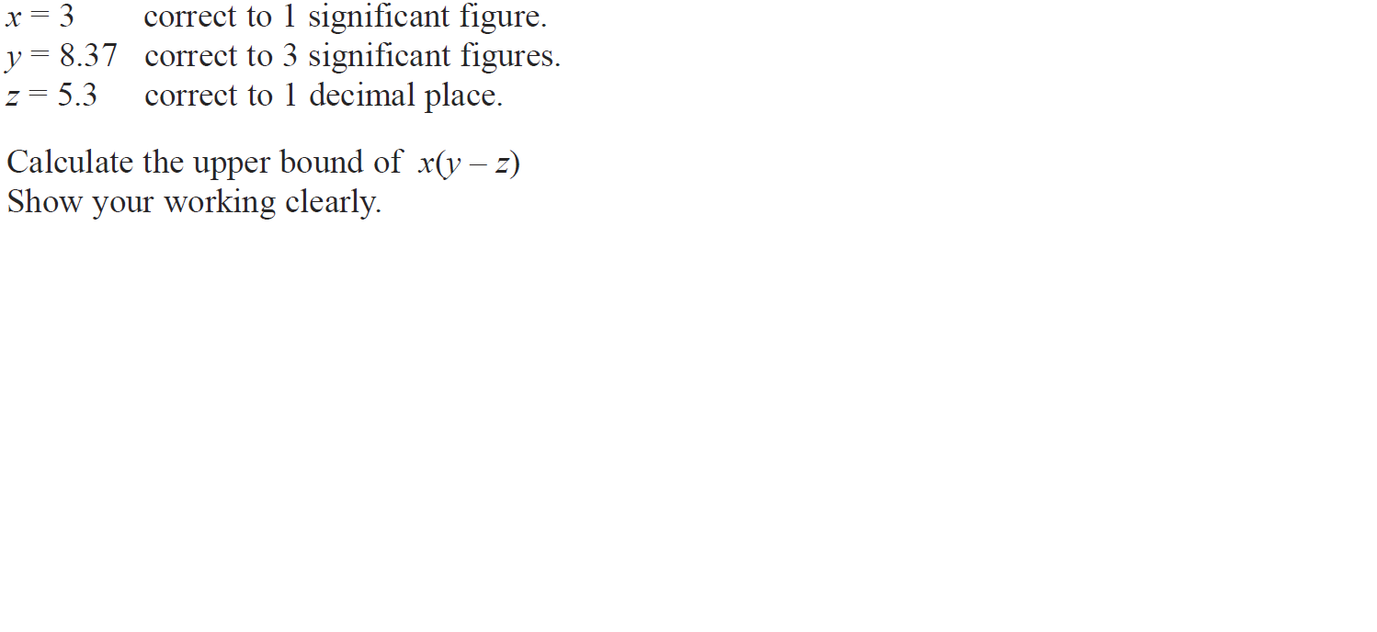
Upper & Lower Bounds
Jan 2017 3H Q20

Slide 78
Upper & Lower Bounds
Jan 2017 3H Q20
A

Slide 79
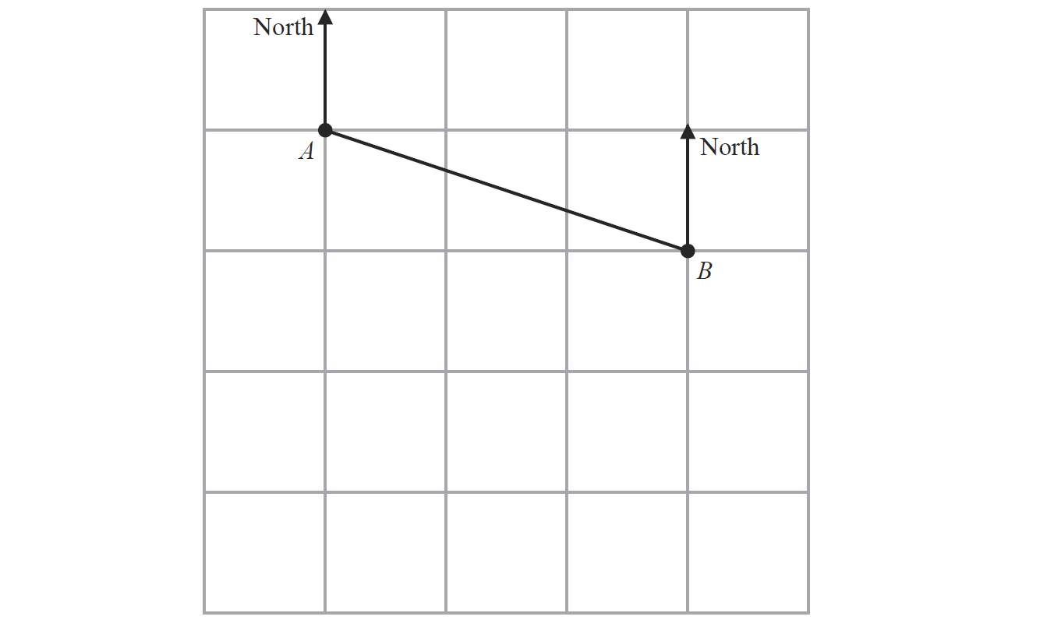
Upper & Lower Bounds
Jan 2017 4H Q8

Slide 80
Upper & Lower Bounds
Jan 2017 4H Q8
A
B
C

Slide 81
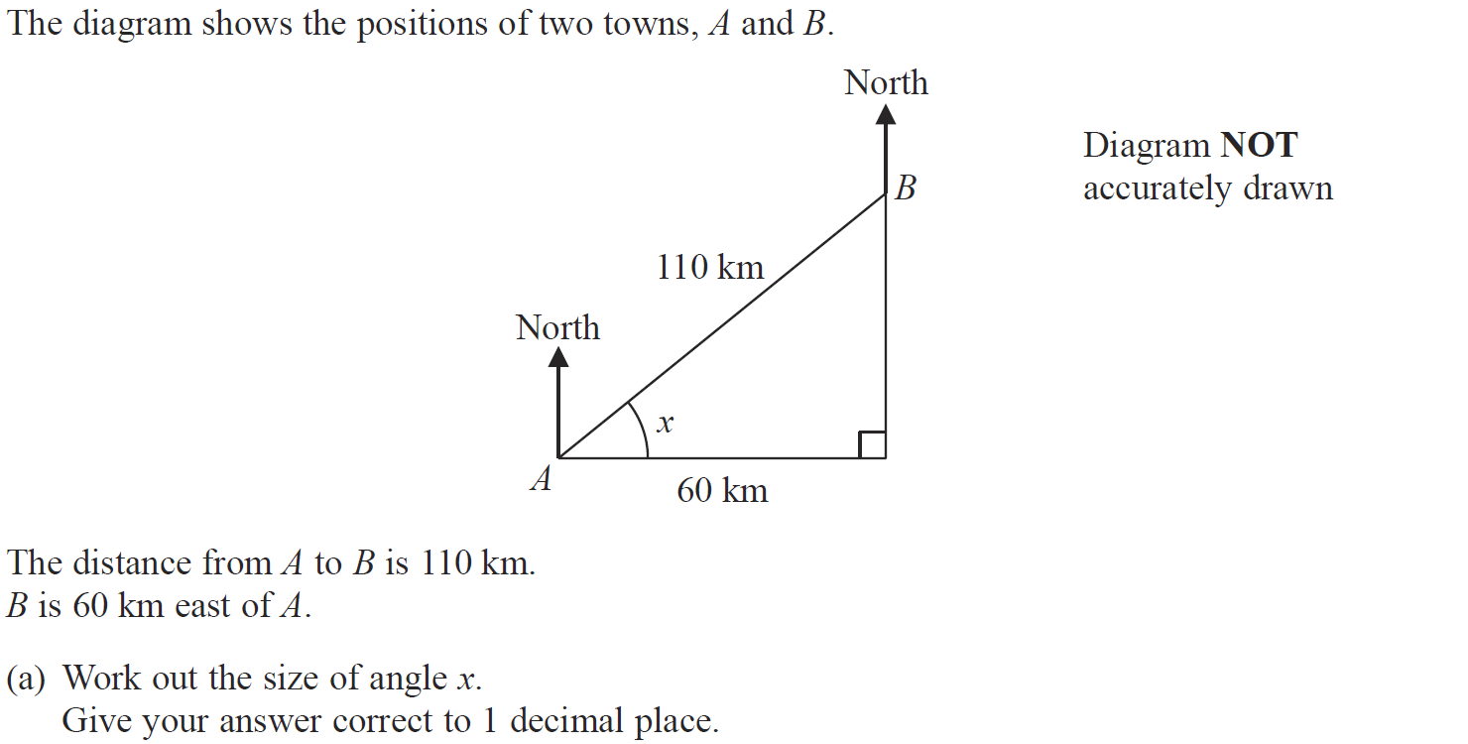
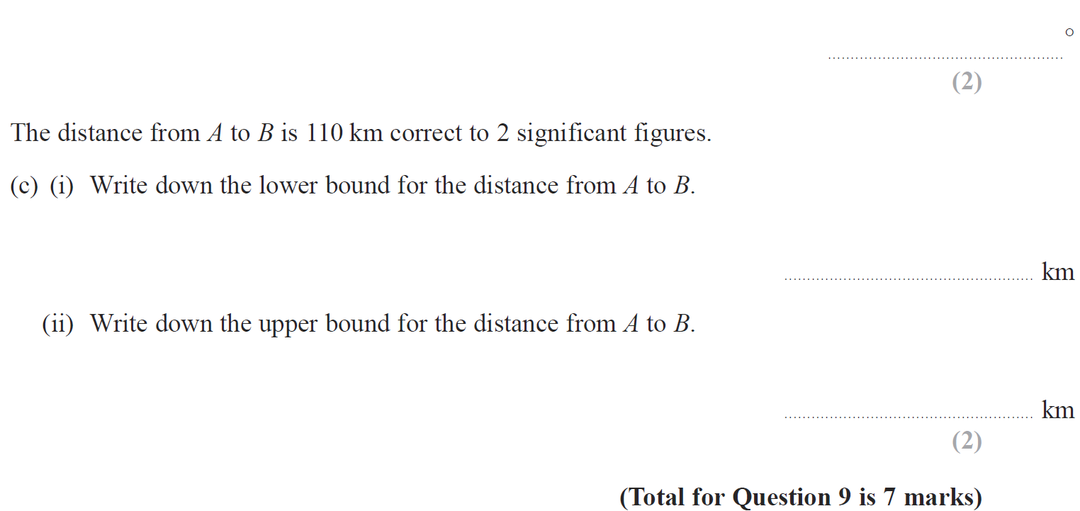
Upper & Lower Bounds
Jan 2017 4HR Q9

Slide 82
Upper & Lower Bounds
Jan 2017 4HR Q9
A
B
C (i)
C (ii)

Slide 83
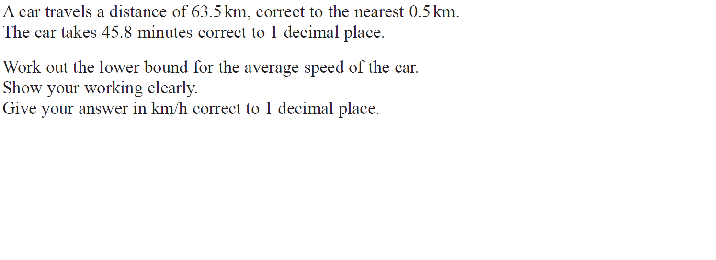
Upper & Lower Bounds
June 2017 4H Q20

Slide 84
Upper & Lower Bounds
June 2017 4H Q20
A

Slide 85
Upper & Lower Bounds
June 2017 4HR Q23

Slide 86
Upper & Lower Bounds
June 2017 4HR Q23
A

Slide 87
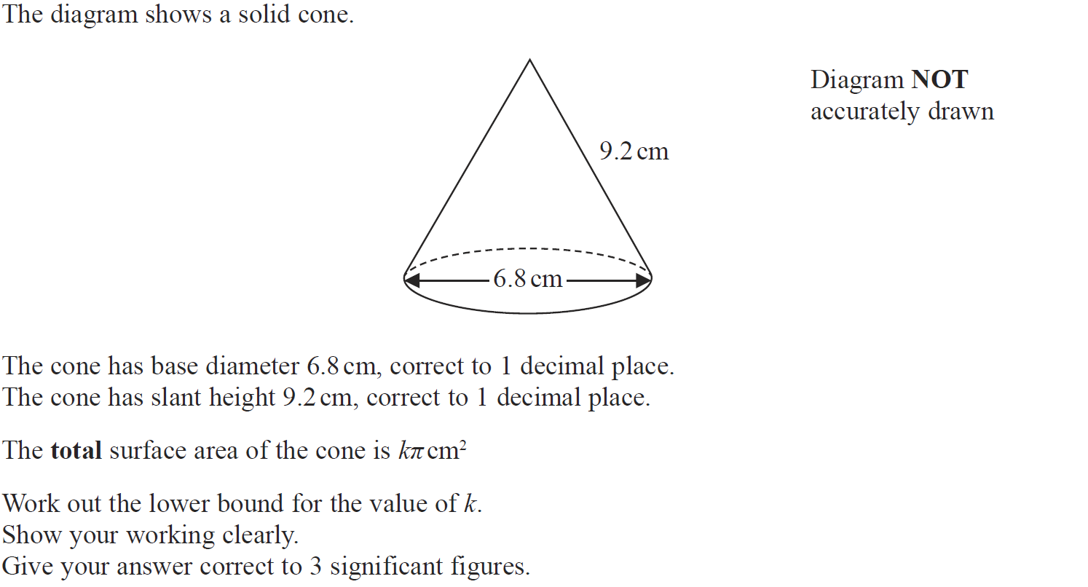
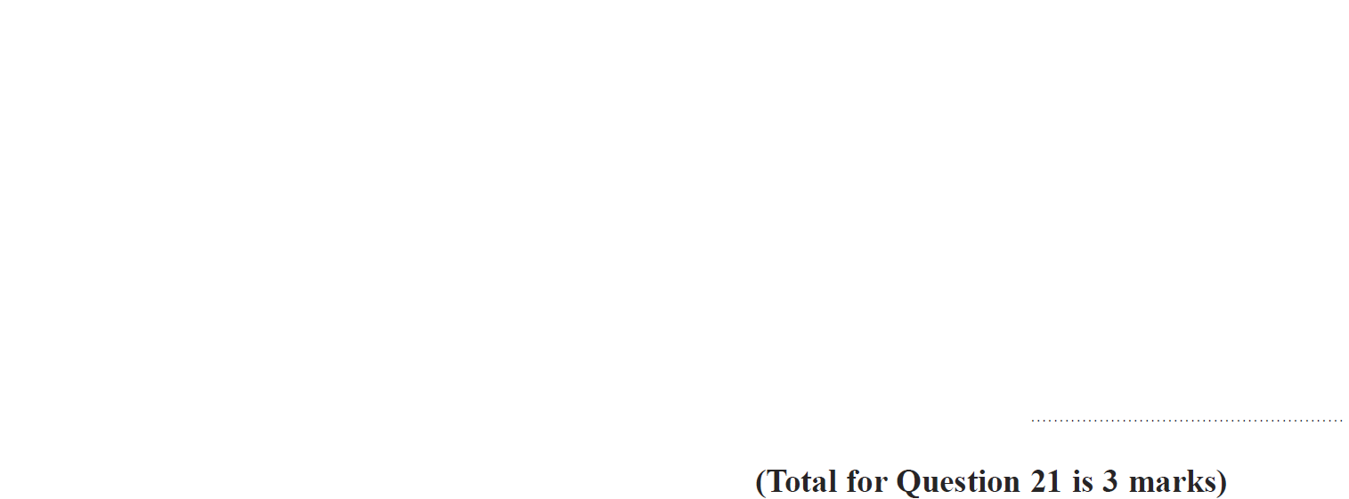
Upper & Lower Bounds
Jan 2018 4H Q21

Slide 88
Upper & Lower Bounds
Jan 2018 4H Q21
A

Slide 89
Upper & Lower Bounds
Jan 2018 4HR Q18

Slide 90
Upper & Lower Bounds
Jan 2018 4HR Q18
A

Slide 91
Upper & Lower Bounds
June 2018 4HR Q25

Slide 92
Upper & Lower Bounds
June 2018 4HR Q25
A

