Slide 1
Time-Series
Time-Series
Old Spec Q’s
May 2019 1H Q2

Slide 2
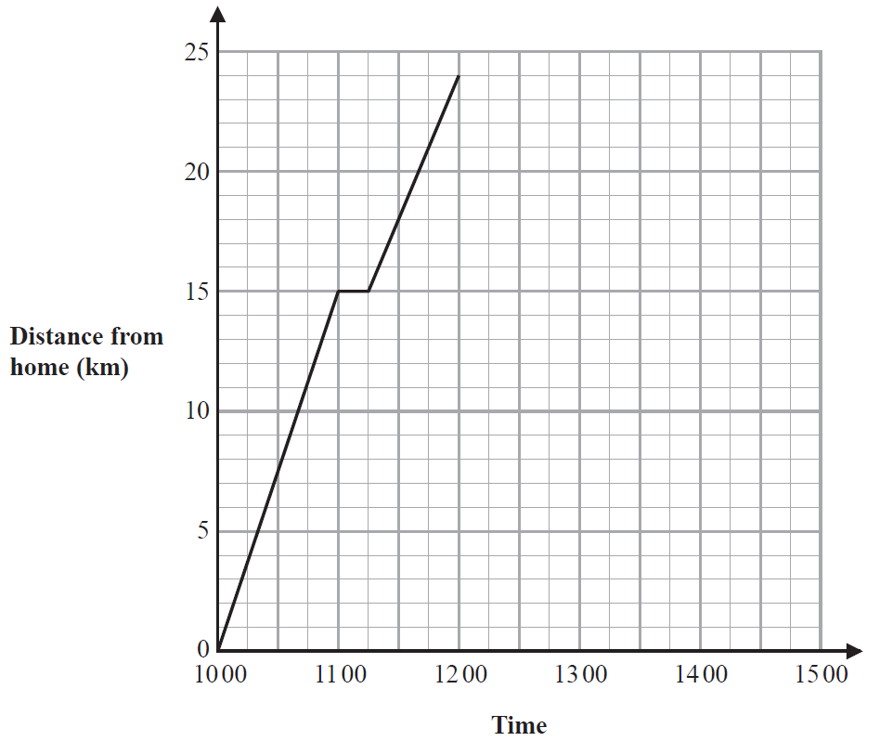
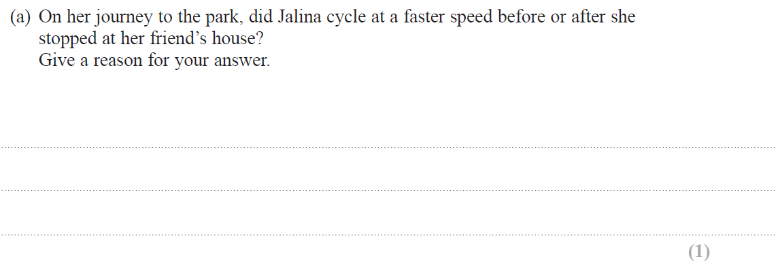
Time-Series
May 2019 1H Q2

Slide 3
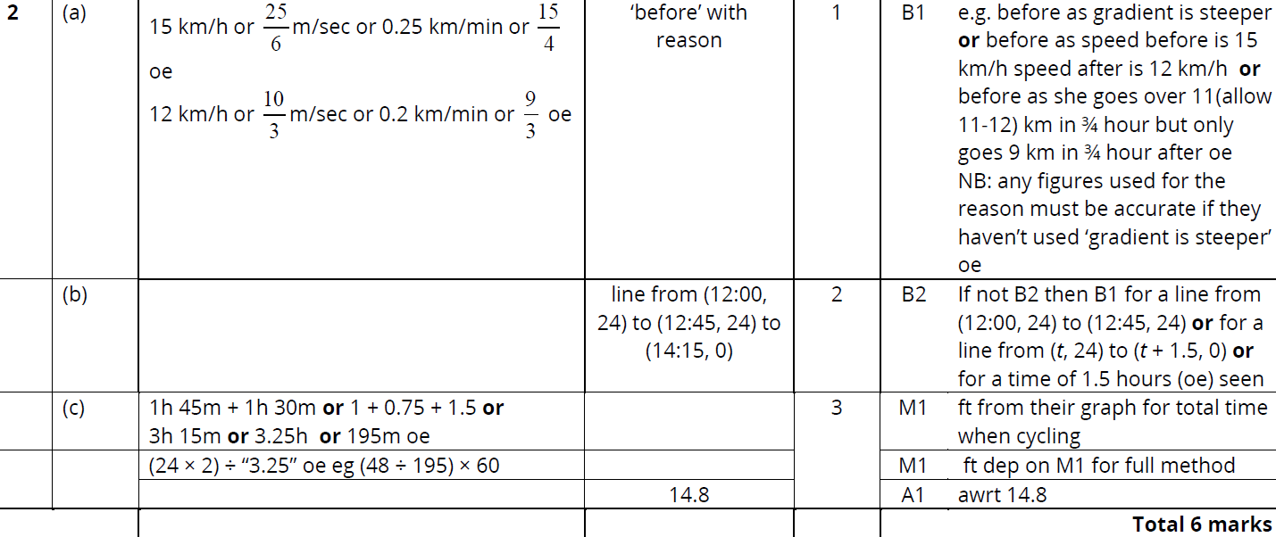
Time-Series
May 2019 1H Q2
A
B
C

Slide 4
Time-Series
Time-Series
New Spec Q’s
Nov 2005
4H Q4
Nov 2008
4H Q8
May 2012
4H Q3
Jan 2014
4HR Q6
June 2015
4H Q3
Jan 2017
4H Q5

Slide 5
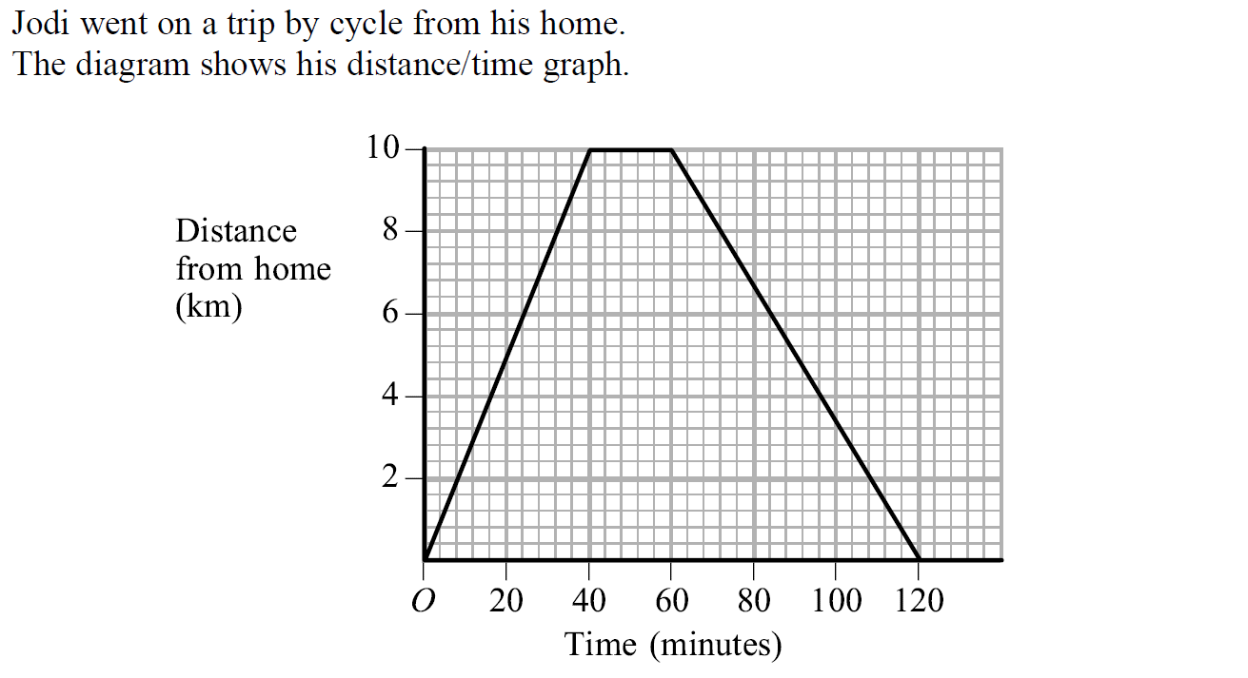
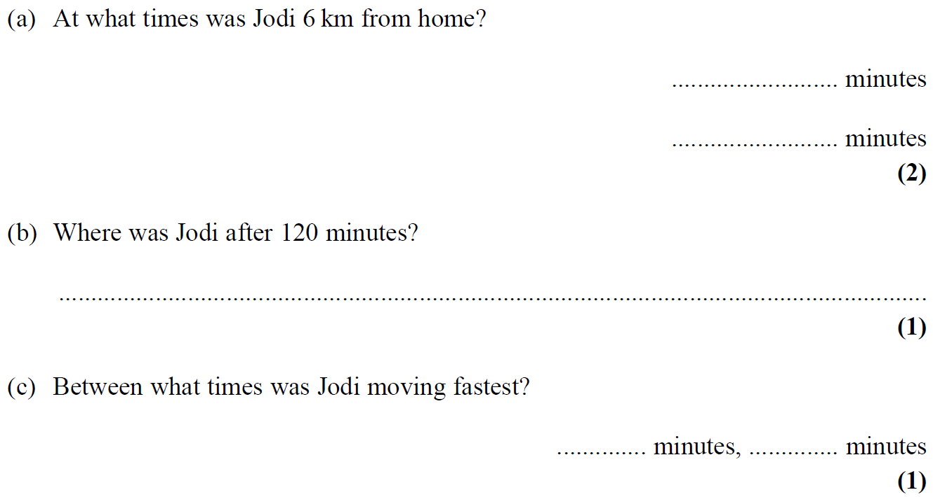
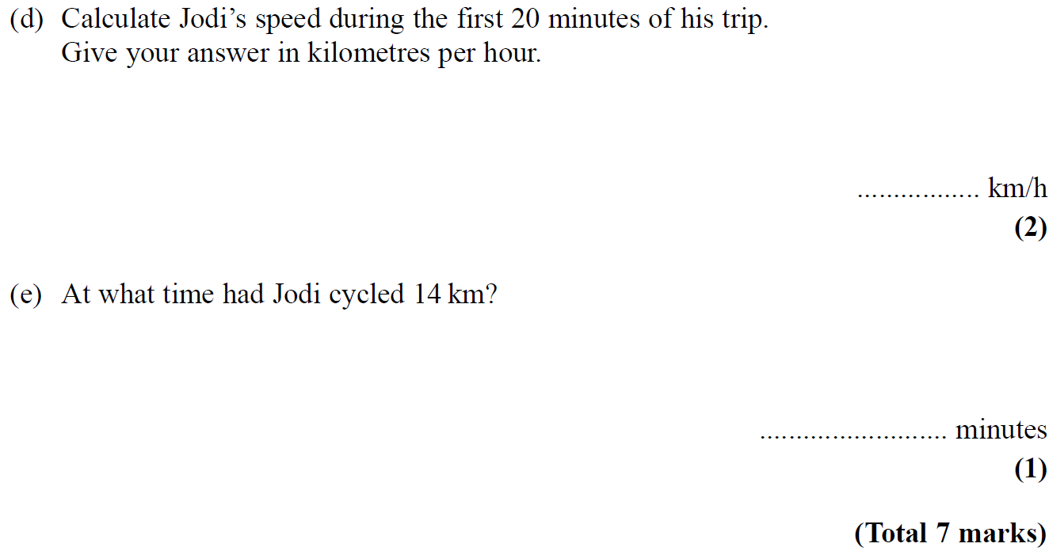
Time-Series
Nov 2005 4H Q4

Slide 6
Time-Series
Nov 2005 4H Q4
A
B
C
D
E

Slide 7
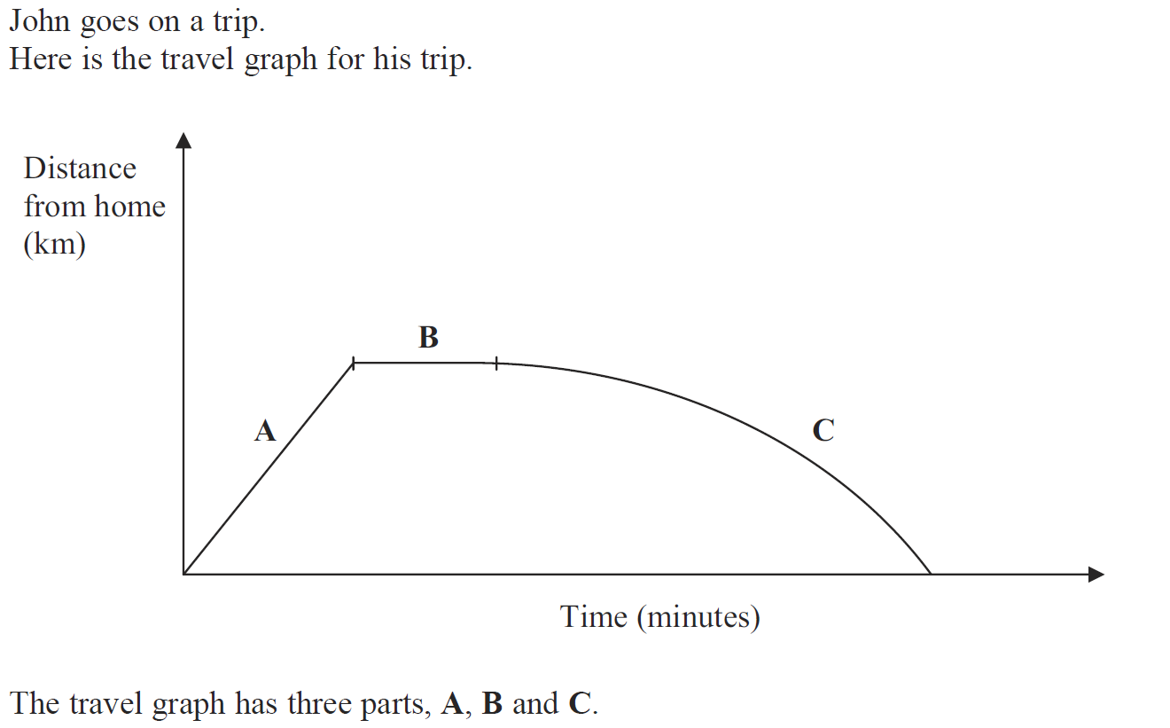
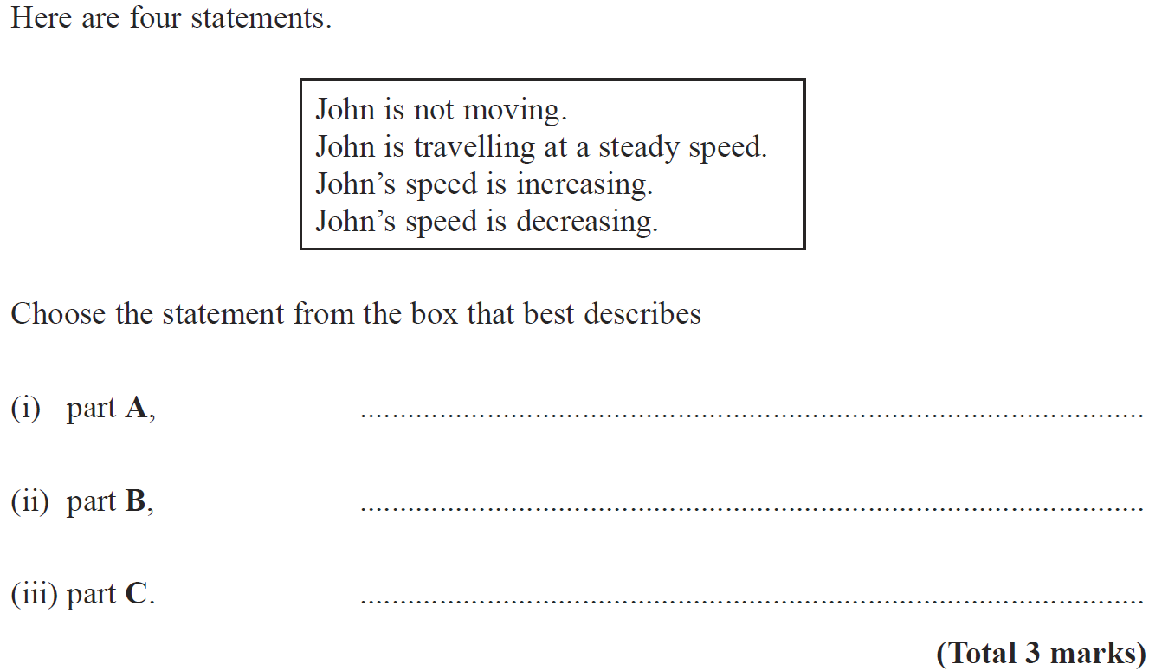
Time-Series
Nov 2008 4H Q8

Slide 8
Time-Series
Nov 2008 4H Q8
A
B
C

Slide 9
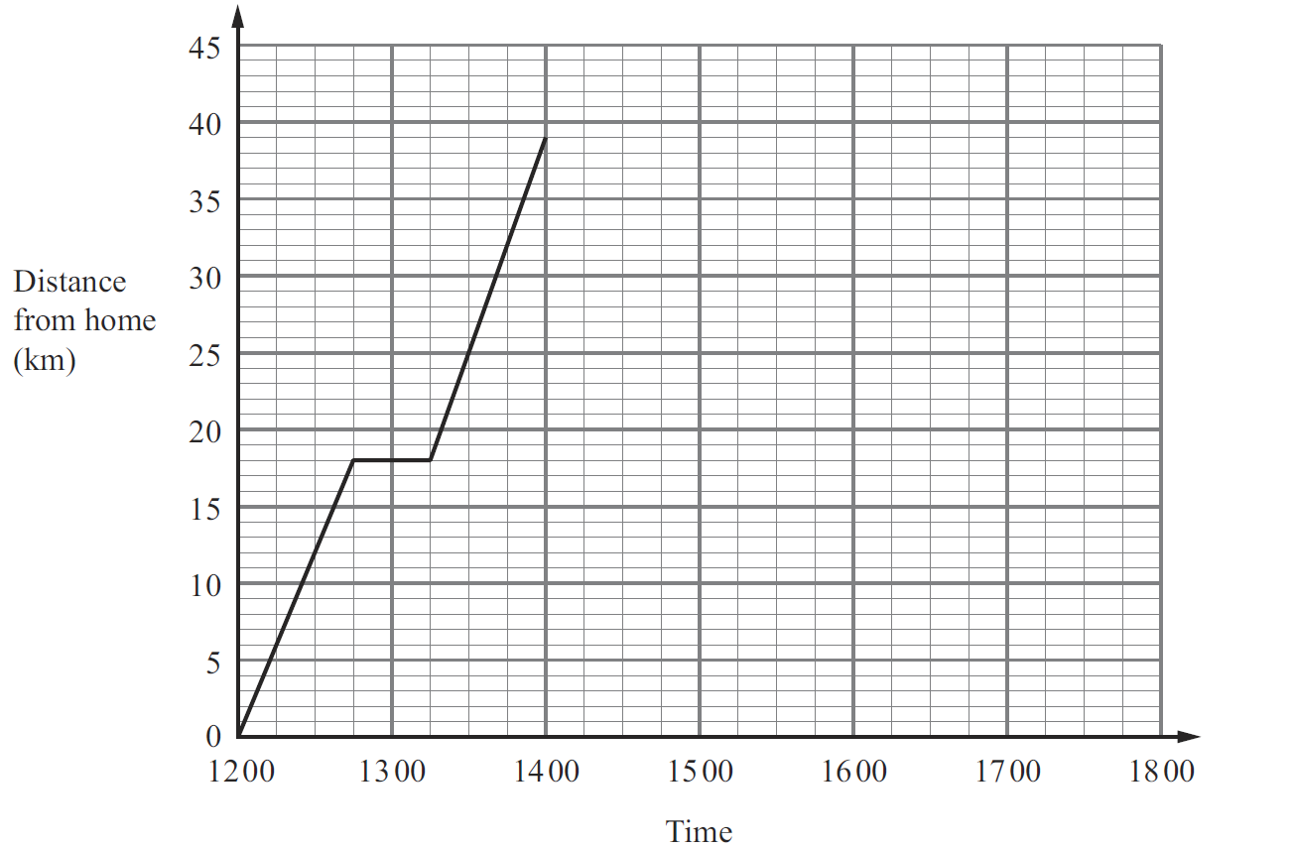
Time-Series
May 2012 4H Q3

Slide 10
Time-Series
May 2012 4H Q3
A (i)
A (ii)
B
C
D

Slide 11
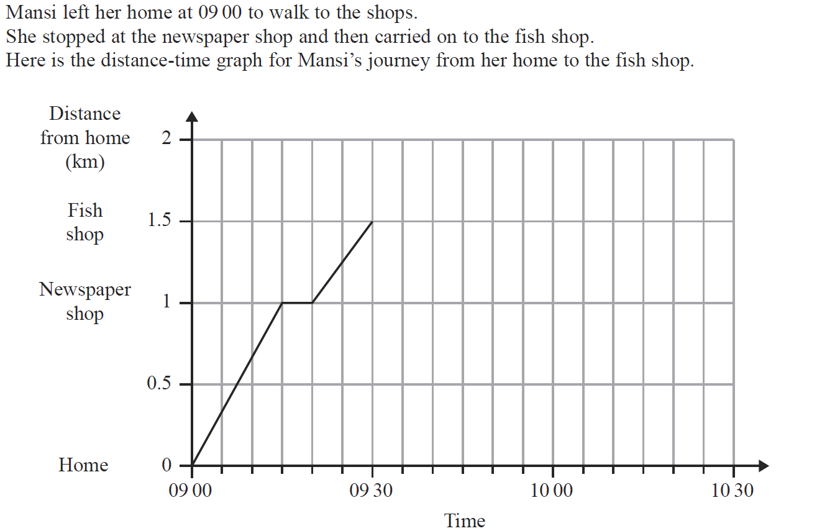
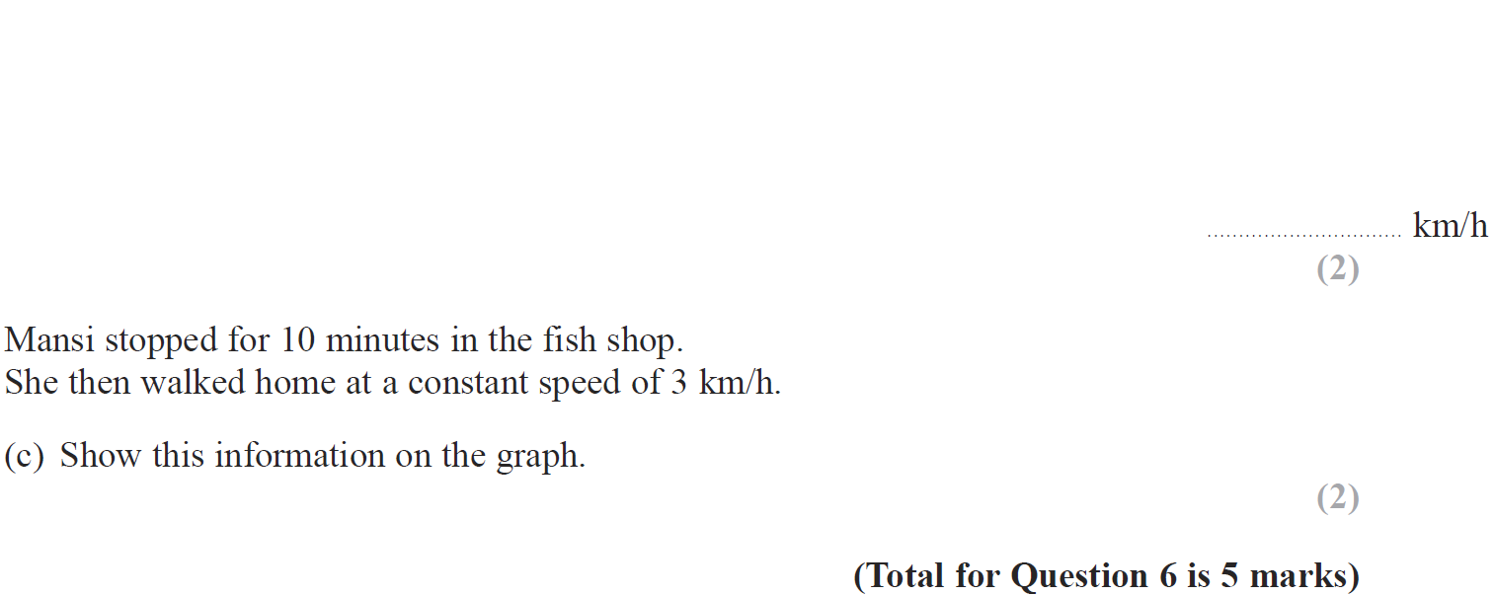
Time-Series
Jan 2014 4HR Q6

Slide 12
Time-Series
Jan 2014 4HR Q6
A
B
C

Slide 13
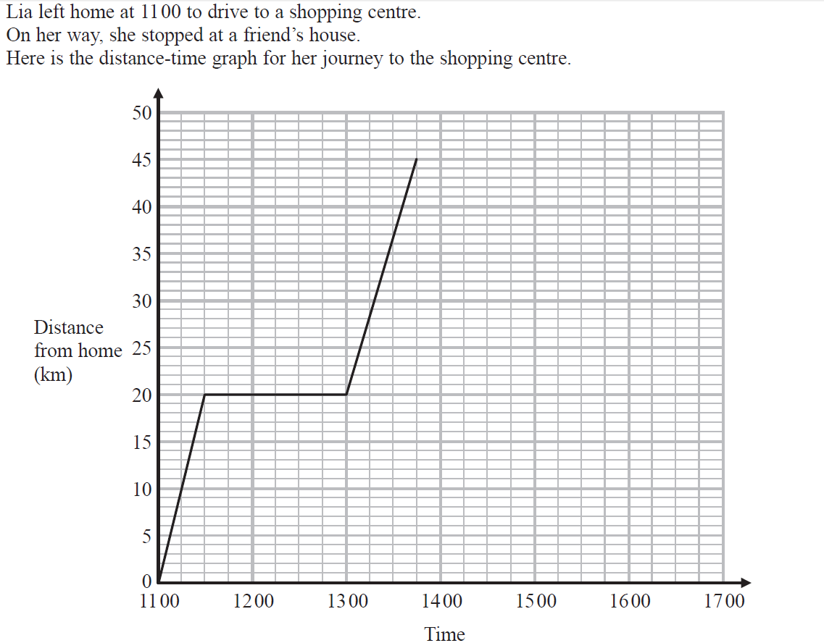
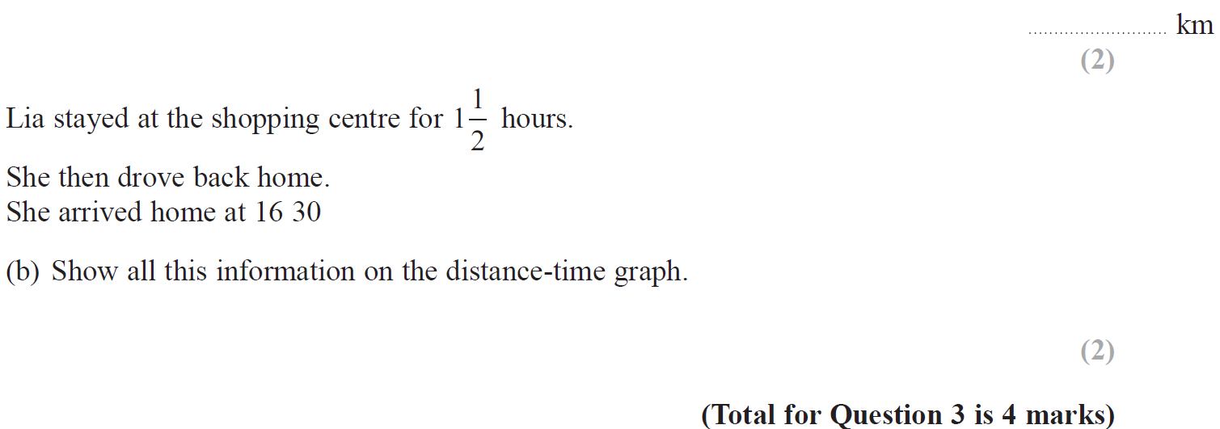
Time-Series
June 2015 4H Q3

Slide 14
Time-Series
June 2015 4H Q3
A (i)
A (ii)
B

Slide 15
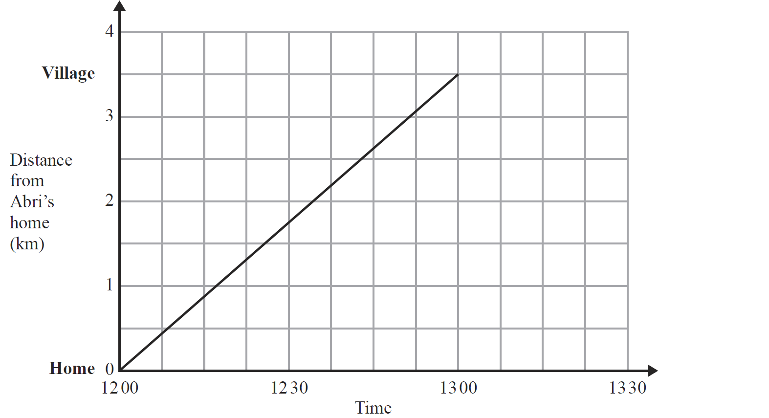
Time-Series
Jan 2017 4H Q5

Slide 16
Time-Series
Jan 2017 4H Q5
A
B

