Slide 1

Super Trig PowerPoint

Slide 2

Introduction-
Finding lengths
Sin, cos or tan to find lengths?
Finding Missing Angles
Finding lengths and angles (more practise)
Finding missing lengths worksheet
The Sine rule
The Cosine Rule
The Sine and Cosine Rule (quiz and worksheet)
The Sine rule proof
The Cosine Rule proof
Finding the Area of Triangles and Segments
Trig graphs
Trig graphs- matching cards
Combining the Rules

Slide 3
Use sin, cos and tan to find the missing lengths, and use that answer to work out the next length.
Side | Length (rounded to 1 dp)
a
b
c
d
e
f
g
h
i
51˚
30˚
10cm
i
a
40˚
e
50˚
b
d
45˚
42˚
c
27˚
f
35˚
g
h
38˚

Slide 4
Use sin, cos and tan to find the missing lengths, and use that answer to work out the next length.
Side | Length (rounded to 1 dp)
a
b
c
d
e
f
g
h
i
Side | Length (rounded to 1 dp)
a | 5
b | 4.2
c | 3.2
d | 2.3
e | 3.2
f | 3.5
g | 1.8
h | 2.9
i | 9.9
51˚
30˚
10cm
i
a
40˚
e
50˚
b
d
45˚
42˚
c
27˚
f
35˚
g
h
38˚

Slide 5

Home

Slide 6
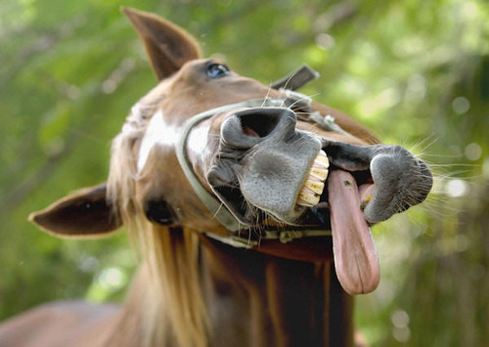
Trigonometry 1

Slide 7

Warm up
Solve the following equations:
20=
15=
8=
7=
16=
32
X
X
2
21
X
X
3
64
X

Slide 8
Trigonometry
We can use trigonometry to find missing angles and lengths of triangles.
Trigonometry uses three functions, these are called:
  Sine (shortened to Sin and pronounced “sign”)
  Cosine (shortened to Cos)
  Tangent (shortened to Tan)
We will start working with right angled triangles

Slide 9
Labelling the sides
Before we can use Sin, Cos and Tan we need to be able to label the sides of a right angled triangle
The longest side, the one opposite the right angle is called the hypotenuse
Hypotenuse

Slide 10
Labelling the sides
What we call the other two sides will change depending on which angle we are working with, for example..
If we are given (or need to work out) this angle, we label the other sides like this..
Adjacent
Opposite
But if we are working with this angle, we label the sides like this...
ϴ
Opposite
Adjacent

Slide 11
Labelling Right Angle Triangle
10 multiple choice questions

Slide 12
What is the side marked with an X?
X
ϴ
Adjacent
Opposite
A)
B)
Hypotenuse
C)

Slide 13
What is the side marked with an X?
ϴ
X
Hypotenuse
Opposite
A)
B)
Adjacent
C)

Slide 14
What is the side marked with an X?
X
ϴ
Hypotenuse
Opposite
A)
B)
Adjacent
C)

Slide 15
What is the side marked with an X?
ϴ
X
Opposite
Adjacent
A)
B)
Hypotenuse
C)

Slide 16
What is the side marked with an X?
X
ϴ
Adjacent
Opposite
A)
B)
Hypotenuse
C)

Slide 17
What is the side marked with an X?
X
ϴ
Opposite
Adjacent
A)
B)
Hypotenuse
C)

Slide 18
What is the side marked with an X?
ϴ
X
Opposite
Adjacent
A)
B)
Hypotenuse
C)

Slide 19
What is the side marked with an X?
X
ϴ
Opposite
Hypotenuse
A)
B)
Adjacent
C)

Slide 20
What is the side marked with an X?
ϴ
X
Hypotenuse
Adjacent
A)
B)
Opposite
C)

Slide 21
What is the side marked with an X?
X
ϴ
Hypotenuse
Opposite
A)
B)
Adjacent
C)

Slide 22
Sine (sin)
10cm
We use Sine when we have the Opposite length and the Hypotenuse
5cm
The rule we use is:
30˚
Opposite
Hypotenuse
Sinϴ=
Try entering sin30 in your calculator, it should give the same answer as 5 ÷ 10
5
10
Sin30=

Slide 23
Sin Example 1
7cm
We can use Sin as the question involves the Opposite length and the Hypotenuse
x
The rule we use is:
42˚
Opposite
Hypotenuse
Sinϴ=
x
7
Sin42=
7 x Sin42= x
4.68 cm (2dp)= x

Slide 24
Sin Example 2
x
We can use Sin as the question involves the Opposite length and the Hypotenuse
10cm
The rule we use is:
17˚
Opposite
Hypotenuse
10
x
Sinϴ=
Sin17=
x x Sin17= 10
x = 10
Sin17
x = 34.2 cm (1dp)

Slide 25
Cosine (cos)
We use cosine when we have the Adjacent length and the Hypotenuse
Hypotenuse
The rule we use is:
50˚
Adjacent
Hypotenuse
Cosϴ=
Adjacent

Slide 26
Cos Example 1
9cm
We can use Cos as the question involves the Adjacent length and the Hypotenuse
The rule we use is:
53˚
Adjacent
Hypotenuse
Cosϴ=
x
x
9
Cos53=
9 x Cos53= x
5.42 cm (2dp)= x

Slide 27
Cos Example 2
17˚
x
We can use Cos as the question involves the Adjacent length and the Hypotenuse
9cm
The rule we use is:
Adjacent
Hypotenuse
9
x
Cosϴ=
Cos17=
x x Cos17= 9
x= 9
Cos17
x= 9.41 cm (2dp)

Slide 28
Tangent (tan)
We use tangent when we have the Opposite and Adjacent lengths.
10cm
The rule we use is:
50˚
Opposite
Adjacent
Tanϴ=
6.4cm (1dp)

Slide 29
Tan Example 1
53˚
We can use Tan as the question involves the Adjacent and Opposite lengths
11cm
The rule we use is:
Opposite
Adjacent
x
Tanϴ=
x
11
Tan53=
11 x Tan53= x
14.6 cm (1dp)= x

Slide 30
Tan Example 2
35˚
x
We can use Tan as the question involves the Adjacent and Opposite lengths
The rule we use is:
21cm
Opposite
Adjacent
Tanϴ=
21
x
Tan35=
x x Tan35= 21
x= 21
Tan35
x= 29.99 cm (2dp)

Slide 31
The three rules
So we have:
Opposite
Hypotenuse
Adjacent
Hypotenuse
Opposite
Adjacent
Sinϴ=
Cosϴ=
Tanϴ=
O
H
A
H
O
A
Sinϴ=
Cosϴ=
Tanϴ=
SOHCAHTOA
There are a few ways to remember this

Slide 32
Silly Old Horses Can’t Always Hear The Other Animals
SOHCAHTOA
WHAT?

Slide 33
Practise
Use Sine to find the missing lengths on these triangles:
2. Use Cosine to find the missing lengths on these triangles:
3. Use Tangent to find the missing lengths on these triangles:
H
15cm
60˚
Opposite
Hypotenuse
O
Sinϴ=
50˚
17cm
22cm
60˚
H
Adjacent
Hypotenuse
25cm
Cosϴ=
38˚
A
60˚
Opposite
Adjacent
Tanϴ=
O
A
42˚
15cm
11cm

Slide 34
Home

Slide 35
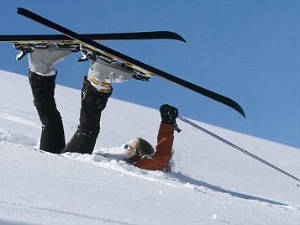
Trigonometry 2

Slide 36
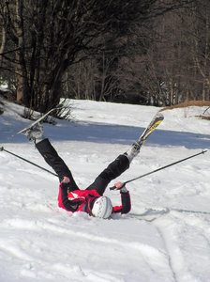
Skiers On Holiday Can Always Have The Occasional Accident
SOHCAHTOA
Opposite
Hypotenuse
Adjacent
Hypotenuse
Opposite
Adjacent
Sinϴ=
Cosϴ=
Tanϴ=

Slide 37
Our aim today
We have looked at the three rules and have practised labelling triangles.
Today we will have to decide whether we are using Sin, Cos or Tan when answering questions.

Slide 38
SOH CAH TOA
This question will use Sine
O
H
Sinϴ=
7cm
X
X
7
Hypotenuse
Sin35=
opposite
35˚

Slide 39
SOH CAH TOA
This question will use Tan
O
A
Tanϴ=
Adjacent
17˚
8
X
Tan17=
X
8cm
opposite

Slide 40
SOH CAH TOA
This question will use Sin
O
H
Sinϴ=
X
43˚
8
X
Sin43=
Hypotenuse
8cm
opposite

Slide 41
SOH CAH TOA
This question will use Cosine
O
A
cosϴ=
Adjacent
26˚
Hypotenuse
X
8
cos26=
8cm
X

Slide 42
Sin, Cos or Tan?
10 multiple choice questions

Slide 43
Will you use Sin, Cos or Tan with this question?
11cm
X
35˚
Cos
Sin
A)
B)
Tan
C)

Slide 44
Will you use Sin, Cos or Tan with this question?
14˚
15cm
X
Sin
Tan
A)
B)
Cos
C)

Slide 45
Will you use Sin, Cos or Tan with this question?
X
40˚
17cm
Sin
Cos
A)
B)
Tan
C)

Slide 46
Will you use Sin, Cos or Tan with this question?
50˚
5cm
X
Tan
Sin
A)
B)
Cos
C)

Slide 47
Will you use Sin, Cos or Tan with this question?
X
51˚
6cm
Cos
Tan
A)
B)
Sin
C)

Slide 48
Will you use Sin, Cos or Tan with this question?
X
16˚
8cm
Sin
Tan
A)
B)
Cos
C)

Slide 49
Will you use Sin, Cos or Tan with this question?
X
42˚
14cm
Sin
Cos
A)
B)
Tan
C)

Slide 50
Will you use Sin, Cos or Tan with this question?
X
35˚
4cm
Tan
Cos
A)
B)
Sin
C)

Slide 51
Will you use Sin, Cos or Tan with this question?
63˚
3.4cm
X
Cos
Tan
A)
B)
Sin
C)

Slide 52
Will you use Sin, Cos or Tan with this question?
X
5mm
71˚
Sin
Tan
A)
B)
Cos
C)

Slide 53
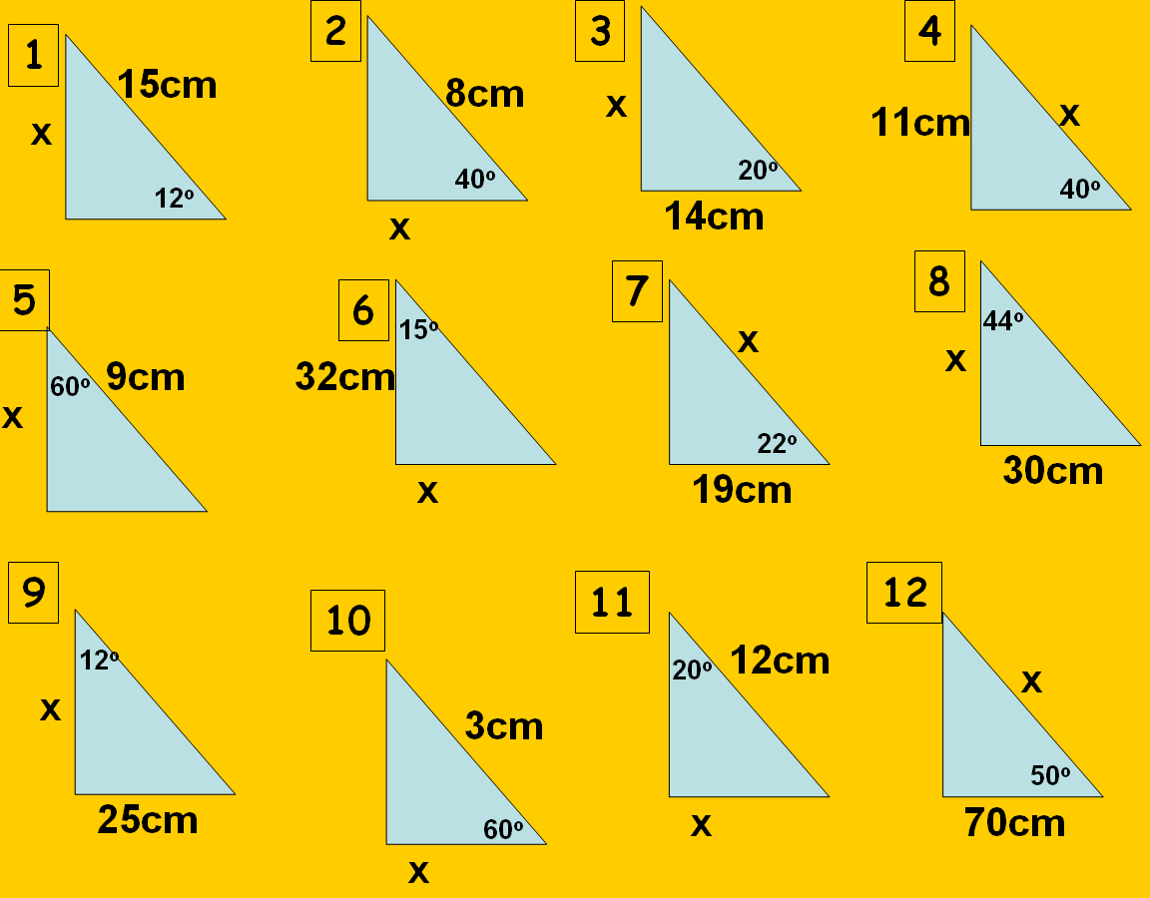
Practice
Answers:
3.1cm
6.1cm
5.1cm
17.1cm
4.5cm
8.6cm
20.5cm
31.1cm
117.6cm
1.5cm
4.1cm
108.9cm

Slide 54
Home

Slide 55

The Sine Rule

Slide 56
A
b
c
C
B
a
This is the Sine rule
We can also write it like this
SinA
SinB
SinC
=
=
a
b
c
We can use it to find out missing sides and angles of non right angle triangles

Slide 57
50˚
5cm
SinA
SinB
=
B
a
b
7cm
Because we’re looking for an angle, I'm going to use the version of the rule which has Sin on top
Sin50
SinB
(multiply both sides by 5)
=
7
5
5xSin50
SinB
=
7
0.54717...
SinB
=
Sin⁻¹0.54717...
=
33.2˚ (1dp)

Slide 58
38˚
8cm
SinA
SinB
=
C
a
b
11cm
Because we’re looking for an angle, I'm going to use the version of the rule which has Sin on top
Sin38
SinC
(multiply both sides by 58)
=
11
8
8xSin38
SinC
=
11
0.447753..
SinC
=
Sin⁻¹0.447753...
=
26.6˚ (1dp)

Slide 59
50˚
5cm
a
b
=
35˚
sinA
sinB
a
Because we’re looking for a length, I'm going to use the version of the rule which has the length on top
5
a
(multiply both sides by Sin50)
=
Sin35
Sin50
5xSin50
a
=
sin35
6.7cm(1dp)
a
=

Slide 60
64˚
c
a
c
=
21˚
SinA
SinC
9cm
Because we’re looking for a length, I'm going to use the version of the rule which has the length on top
9
c
(multiply both sides by Sin21)
=
Sin64
Sin21
9xSin21
=
c
sin64
3.6cm(1dp)
=
c

Slide 61
The Sine Rule Quiz
10 multiple choice questions

Slide 62
Can you use the sine rule to find the missing value?
20˚
12cm
a
10cm
Yes
No
A)
B)

Slide 63
Can you use the sine rule to find the missing value?
30˚
15cm
a
9cm
Yes
No
A)
B)

Slide 64
Can you use the sine rule to find the missing value?
20˚
X
85˚
10cm
Yes
No
A)
B)

Slide 65
Can you use the sine rule to find the missing value?
15cm
10cm
12cm
a
Yes
No
A)
B)

Slide 66
Can you use the sine rule to find the missing value?
20˚
12cm
X
38 ˚
10cm
Yes
No
A)
B)

Slide 67
Can you use the sine rule to find the missing value?
20˚
a
72˚
88˚
Yes
No
A)
B)

Slide 68
Can you use the sine rule to find the missing value?
12cm
10cm
Yes
No
A)
B)

Slide 69
Can you use the sine rule to find the missing value?
But you could also use
Sin35= 10 ÷ x
35˚
x
10cm
Yes
No
A)
B)

Slide 70
Can you use the sine rule to find the missing value?
34˚
21cm
a
9.8cm
Yes
No
A)
B)

Slide 71
Can you use the sine rule to find the missing value?
6cm
7cm
a
5cm
Yes
No
A)
B)

Slide 72
Practise Questions
45˚
23˚
b
c
c
8cm
37˚
45˚
61˚
11cm
25cm
37˚
Answers:
9.4cm
9.9cm
38.5cm
50˚
15˚
34.1˚
59cm
B
C
110˚
80˚
5.6cm
A
34cm
57cm
47cm
7.2cm
19˚

Slide 73
Home

Slide 74

The Cosine Rule

Slide 75
Warm up
Find the missing sides and angles
x= 8.5cm
x
23cm
x= 15.1cm
x
35˚
41˚
7cm
ϴ=27.9˚
ϴ
7.1cm
ϴ=49.1˚
29cm
ϴ
19cm
13.4cm

Slide 76
a
c
b
A
a²=b² + c² – 2bccosA
The length here, has to be the length opposite this angle
Which side is b and which is c doesn’t matter

Slide 77
a
8cm
5cm
95˚
a²=5² + 8² – 2x5x8xcos95
The length here, has to be the length opposite this angle
a²=25 + 64 – 80xcos95
a²=89– 80xcos95
a=9.9291..
a²=89– -9.58.....
a=9.9cm (1dp)
a²=98.58...

Slide 78
a
12cm
7cm
81˚
a²=7² + 12² – 2x7x12xcos81
The length here, has to be the length opposite this angle
a²=49 + 144 – 168xcos81
a²=193– 168xcos81
a=12.911..
a²=193– 26.280...
a=12.9cm (1dp)
a²=166.7190...

Slide 79
11cm
8cm
5cm
A
11²=5² + 8² – 2x5x8xcosA
The length here, has to be the length opposite this angle
11²=5² + 8² – 2x5x11xcosA
121=89– 2x5x11xcosA
-0.2909090..=cosA
32=-110xcosA
Cos⁻¹-0.209090..=A
106.9˚ (1dp)=A
32 ÷ -110=cosA

Slide 80
20cm
8cm
13cm
A
20²=13² + 8² – 2x13x11xcosA
The length here, has to be the length opposite this angle
20²=13² + 8² – 2x13x8xcosA
400=233– 208cosA
-0.80288.....cosA
167=-208xcosA
Cos⁻¹-0.80288...=A
143.4˚ (1dp)=A
167 ÷ -208=cosA

Slide 81
Practise Questions
Answers:
8.9cm
13.1cm
17.1cm
49.1˚
49.9˚
55.8 ˚
12cm
x
C
x
8cm
28cm
45˚
61˚
11cm
15cm
25cm
37˚
59cm
23cm
3.4cm
b
c
5.6cm
a
48cm
51cm
57cm
47cm
7.2cm

Slide 82
Home

Slide 83
The Sine Rule proof
What would you like to do?
Be shown the proof
Try to prove it yourself

Slide 84
Why does the Sine Rule Work?
A
b
b
c
B
B
C
a
The red line is b x sinC and c x sinB
So b x sinC= c x sinB
Using the rule that:
Sinϴ=O/A
We can show that the red line is:
Using the rule that:
Sinϴ=O/A
We can show that the red line is:
We can rearrange to make:
b
sinB
c
sinC
Red line=c x sinB
Red line=b x sinC
or
SinB
b
SinC
c
=
=

Slide 85
Why does the Sine Rule Work?
A
A
b
b
c
B
B
C
a
a
The red line is b x sinA and a x sinB
So b x sinA= a x sinB
Using the rule that:
Sinϴ=O/A
We can show that the red line is:
Using the rule that:
Sinϴ=O/A
We can show that the red line is:
We can rearrange to make:
b
sinB
a
sinA
Red line=a x sinB
or
SinB
b
SinA
a
Red line=b x sinA
=
=

Slide 86
Why does the Sine Rule Work?
So far we have shown that:
b
sinB
a
sinA
b
sinB
c
sinC
and
=
=
Therefore:
a
sinA
b
sinB
c
sinC
=
=
(We could have also used the version with the angles on top)

Slide 87
Home

Slide 88

The Sine Rule
What would you like to do?
Be shown the proof
Try to prove it yourself

Slide 89
Prove the Sine Rule!
Hint 1
Start with a diagram like this:
c
B
a
A
C
b
Hint 2
Split it into 2 right angled triangles
Hint 3
Can you find 2 different ways to find the length of the line you drew?
Hint 4
Can you split the triangle any other way?
Show me the proof
Home

Slide 90
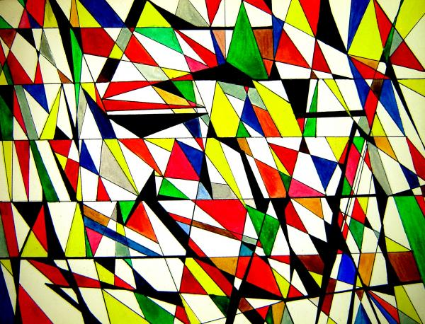
Finding the Areas of Triangles

Slide 91
Can we find the area of this triangle?
We need the base and the height (area= half base times height)
8cm
8cm
h
h
40˚
40˚
Can we find the height of this triangle using trigonometry?
10cm
Sin40=h÷8
8 x Sin40=h
So the height of the triangle is 8 x sin40, we know that the area of a triangle is half base times height so..
Area= ½ base x height
Area= ½ x 10 x 8 x sin40

Slide 92
Can we find the area of this triangle?
This is what we’d call
b
h
h
C
Can we find the height of this triangle using trigonometry?
a
SinC=h÷b
b x SinC=h
So the height of the triangle is b x sinC, we know that the area of a triangle is half base times height so..
The formula for the area of a triangle is:
Area= ½ absinC
Area= ½ base x height
Area= ½ x a x b x sinC

Slide 93
The formula for the area of a triangle is:
Area= ½ absinC
We can use this formula to find the area of non right angled triangles when we haven’t been given the perpendicular height
All we need to know is:
The length of two sides and the size of the angle between them

Slide 94
Practise Questions
Challenge Questions
Find the areas of the following triangles
Find the missing lengths/angles of the following triangles
Area=30cm²
10cm
38˚
a
Area=25cm²
7cm
40˚
a
9cm
7cm
Area=30cm²
Answers:
13.9cm
10.7cm
9.8cm
56.4˚
42.5 ˚
13cm
28˚
12˚
72˚
8cm
12cm
10cm
6.5cm
Answers:
28.9cm²
21.6cm²
10cm²
49.6cm²
70.8cm²
28˚
b
Area=75cm²
11cm
Area=52cm²
20cm
ϴ
14cm
15cm
19cm
35˚
9.1cm
ϴ
12cm
13cm

Slide 95
Area of Segments

Slide 96
Area of Segments
Here we will look at finding the area of sectors
You will need to be able to do two things:
Find the area of a sector using the formula-
Find the area of a triangle using the formula-
Area= ½ absinC
Area of sector= Angle of Sector x πr²
360
a
C
b

Slide 97
Example- find the area of the blue segment
Step 1- find the area of the whole sector
Area= 100/360 x π x r²
= 100/360 x π x 10²
=100/360 x π x 100
=87.3cm²
Step 2- find the area of the triangle
Area= ½ absinC
=1/2 x 10 x 10 x sin100
= 49.2cm²
10cm
10cm
100°
Step 3- take the area of the triangle from the area of the segment
87.3 – 49.3 = 38 cm²

Slide 98
Example- find the area of the blue segment
Step 1- find the area of the whole sector
Area= 120/360 x π x r²
= 120/360 x π x 12²
=120/360 x π x 144
=150.8cm²
Step 2- find the area of the triangle
Area= ½ absinC
=1/2 x 12 x 12 x sin120
= 62.4cm²
12cm
12cm
120°
Step 3- take the area of the triangle from the area of the segment
150.8 – 62.4 = 88.4 cm²

Slide 99
Questions
Find the area of the blue segments, to 1 decimal place
1
2
3
10cm
85°
170°
130°
11cm
12cm
Answers:
75.1cm²
29.5cm²
201.1cm²
8.3cm²
51.8cm²
33cm²
6
4
5
6.5cm
95°
5cm
65°
17cm
160°

Slide 100
Home

Slide 101
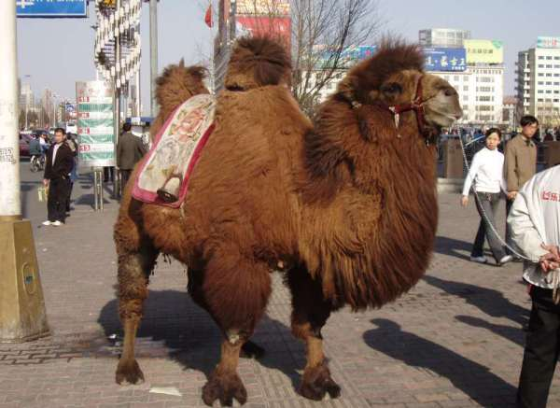
Trigonometry 3
Finding missing angles

Slide 102
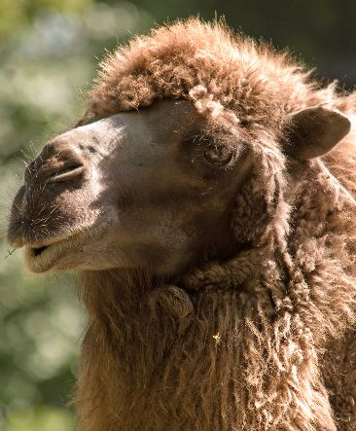
Some Old Hairy Camels Are Hairier Than Other Animals
SOHCAHTOA
Opposite
Hypotenuse
Adjacent
Hypotenuse
Opposite
Adjacent
Sinϴ=
Cosϴ=
Tanϴ=

Slide 103
Warm up
Alan presses SIN then an angle, he gets the answer 0.5, what angle did he enter?
Sinϴ=0.5
We can use the inverse of sin to find out
Sin⁻¹0.5= ϴ
30˚= ϴ

Slide 104
Warm up
Use the inverse of Sin, Cos and Tan to find the missing angles, rounded to 1dp:
sinϴ=0.7 (type sin⁻¹0.7)
sinϴ=0.3
cosϴ=0.5
cosϴ=0.9
tanϴ=0.3
tanϴ=0.25
Answers:
44.4˚
17.5˚
60˚
25.8˚
16.7˚
14˚

Slide 105
Find the missing angle
SOH CAH TOA
This question will use Sin
O
H
7cm
Sinϴ=
3cm
3
7
Hypotenuse
Sinϴ=
opposite
ϴ
What angle would give us this answer?
You could use the ANS button on your calculator
Sin⁻¹ANS= ϴ
Sin⁻¹0.42857...= ϴ
25.4˚ (1dp)= ϴ

Slide 106
Find the missing angle
SOH CAH TOA
This question will use Tan
O
A
Tanϴ=
6cm
ϴ
8
6
Tanϴ=
Adjacent
Tanϴ=1.25
What angle would give us this answer?
8cm
Opposite
Tan⁻¹1.25= ϴ
53.1˚ (1dp)= ϴ

Slide 107
Find the missing angle
SOH CAH TOA
This question will use Cos
A
H
12cm
Cosϴ=
9cm
ϴ
9
12
Hypotenuse
Cosϴ=
Adjacent
Cosϴ=0.75
What angle would give us this answer?
You could use the ANS button on your calculator
Cos⁻¹ANS= ϴ
Cos⁻¹0.75= ϴ
41.4˚ (1dp)= ϴ

Slide 108
Practise Questions
Answers:
50.2˚
28.6˚
59.1˚
52.3˚
63.4˚
65.4˚
28.6˚
40.9˚
ϴ
11cm
23cm
35cm
ϴ
10cm
17cm
ϴ
ϴ
12cm
18cm
22cm
ϴ
12cm
20cm
11cm
13cm
ϴ
ϴ
ϴ
10cm
5cm
6cm
15cm

Slide 109
Home

Slide 110
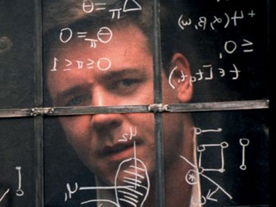
The Cosine Rule
What would you like to do?
Be shown the proof
Try to prove it yourself

Slide 111
Prove the Cosine Rule!
For this proof you need to know that- (SinA)² + (CosA)² = 1
Hint 1
Start with a diagram like this:
c
a
A
b
Hint 2
Split it into 2 right angled triangles
Hint 3
You could use pythagoras to find the length of a in the right angled triangle on the right if you had the other two lengths
Hint 4
Expand and tidy up, using factorising (don’t forget the identity at the top!)
Show me the proof
Home

Slide 112
Home

Slide 113

Find the missing lengths and angles
Answers:
8cm
22.2cm
48.6 ˚
41.8 ˚
58.1 ˚
16.0cm
42.7 ˚
19.5cm
11.0cm
19.3˚
41.0 ˚
21.6cm
60 ˚
11.7cm
55.5 ˚
49.8 ˚
1
2
3
ϴ
4
16cm
X
X
12cm
15cm
8cm
30˚
51˚
ϴ
14cm
17cm
5
6
7
8
ϴ
ϴ
36cm
18cm
19cm
X
9cm
11.2cm
X
63˚
35˚
8.3cm
9
10
11
12
15cm
50˚
ϴ
53cm
46cm
X
40cm
X
43˚
28˚
X
23cm
13
14
16
15
ϴ
32cm
ϴ
106cm
16cm
X
61cm
74cm
18˚
36cm
ϴ
81cm

Slide 114
Home

Slide 115
Why does the Cosine rule work?
c
a
A
b
The cosine rule has “a” as it’s subject, so we need to think of how we could find a in this triangle
If we knew the lengths of the red and purple lines, we could use Pythagoras’ theorem to find a
The red is cSinA
The purple will be the length of b takeaway the green length
The green will be cCosA so the purple is b-cCosA

Slide 116
From Pythagoras we know that:
a
a²= (cSinA)² + (b-cCosA)²
cSinA
So.....
a²= c²(SinA)² + b²+c²(CosA)² –bcCosA-bcCosA
a²= b²+c²(SinA)² +c²(CosA)² –2bcCosA
b-cCosA
a²= b²+c²((SinA)² + (CosA)²) –2bcCosA
a²= b²+c²(1)–2bcCosA
(SinA)² + (CosA)² = 1
This is something that will come up whilst you are doing your A levels
QED
a²= b²+c²–2bcCosA
QED stands for the latin phrase “quod erat demonstrandum” which mean, “which had to be demonstrated” it’s a way for us to say we have finished our proof

Slide 117
Home

Slide 118
Sine or Cosine Rule?
10 multiple choice questions

Slide 119
How would you find the missing value?
11˚
X
120˚
11cm
Sine Rule
Cosine Rule
A)
B)

Slide 120
How would you find the missing value?
110cm
X
40cm
62cm
Sine Rule
Cosine Rule
A)
B)

Slide 121
How would you find the missing value?
X
86˚
25˚
11cm
Sine Rule
Cosine Rule
A)
B)

Slide 122
How would you find the missing value?
32cm
X
40cm
16cm
Sine Rule
Cosine Rule
A)
B)

Slide 123
How would you find the missing value?
X
6cm
22˚
110˚
Sine Rule
Cosine Rule
A)
B)

Slide 124
How would you find the missing value?
X
6cm
110˚
4cm
Sine Rule
Cosine Rule
A)
B)

Slide 125
How would you find the missing value?
X
3.7cm
81˚
4.2cm
Sine Rule
Cosine Rule
A)
B)

Slide 126
How would you find the missing value?
6cm
32˚
X
115˚
Sine Rule
Cosine Rule
A)
B)

Slide 127
How would you find the missing value?
27cm
X
13cm
114˚
Sine Rule
Cosine Rule
A)
B)

Slide 128
How would you find the missing value?
X
6cm
7cm
4cm
Sine Rule
Cosine Rule
A)
B)

Slide 129
Find the missing lengths and angles
(give your answers to 1dp)
13cm
11cm
X
35˚
Answers:
91.2˚
29 ˚
10.3cm
9.6cm
60 ˚
30.5 ˚
13.2cm
27.9cm
35.1 ˚
45˚
9cm
ϴ
9.2cm
13cm
25cm
ϴ
17˚
X
7cm
17cm
41˚
11cm
43˚
14cm
8cm
22cm
5cm
ϴ
ϴ
23cm
12cm
31˚
˚
32˚
ϴ
11cm
14cm
X
7cm
25cm
77˚
X

Slide 130
Home

Slide 131
For each question say what method you would use to find the missing value
Combining the Rules
Warm up

Slide 132
How would you find the missing length in this triangle?
x
7cm
6cm
Sine Rule
SOHCAHTOA
A)
B)
Pythagoras’ Theorem
Cosine Rule
C)
D)

Slide 133
How would you find the missing length in this triangle?
12cm
x
30˚
Sine Rule
SOHCAHTOA
A)
B)
Pythagoras’ Theorem
Cosine Rule
C)
D)

Slide 134
How would you find the missing length in this triangle?
19cm
46˚
13cm
x
Sine Rule
SOHCAHTOA
A)
B)
Pythagoras’ Theorem
Cosine Rule
C)
D)

Slide 135
How would you find the missing length in this triangle?
x
40˚
13cm
Sine Rule
SOHCAHTOA
A)
B)
Pythagoras’ Theorem
Cosine Rule
C)
D)

Slide 136
How would you find the missing length in this triangle?
11˚
X
120˚
11cm
Sine Rule
SOHCAHTOA
A)
B)
Pythagoras’ Theorem
Cosine Rule
C)
D)

Slide 137
How would you find the missing length in this triangle?
X
6cm
110˚
4cm
Sine Rule
SOHCAHTOA
A)
B)
Pythagoras’ Theorem
Cosine Rule
C)
D)

Slide 138
How would you find the missing length in this triangle?
25˚
x
12cm
Sine Rule
SOHCAHTOA
A)
B)
Pythagoras’ Theorem
Cosine Rule
C)
D)

Slide 139
How would you find the missing length in this triangle?
X
3.7cm
81˚
4.2cm
Sine Rule
SOHCAHTOA
A)
B)
Pythagoras’ Theorem
Cosine Rule
C)
D)

Slide 140
16cm
8cm
x
Sine Rule
SOHCAHTOA
A)
B)
Pythagoras’ Theorem
Cosine Rule
C)
D)

Slide 141
How would you find the missing length in this triangle?
X
6cm
22˚
110˚
Sine Rule
SOHCAHTOA
A)
B)
Pythagoras’ Theorem
Cosine Rule
C)
D)

Slide 142
Home

Slide 143

Graphs of Trig Functions

Slide 144
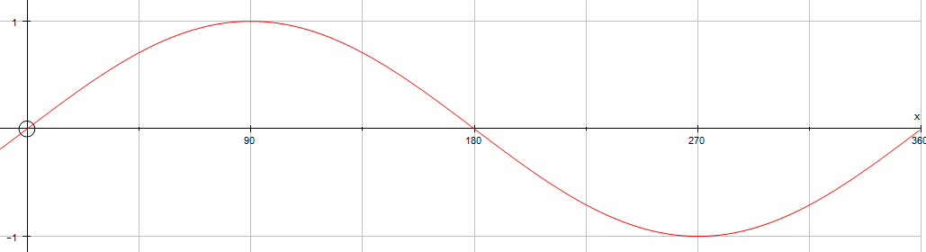
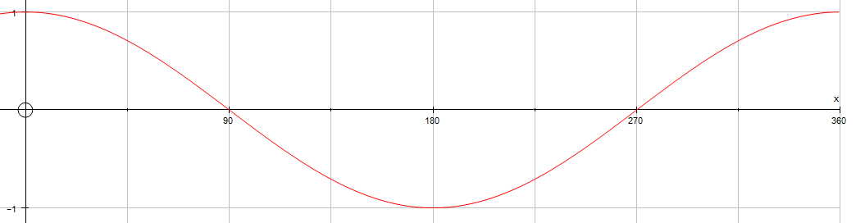
The Sine Curve
The Cosine Curve

Slide 145
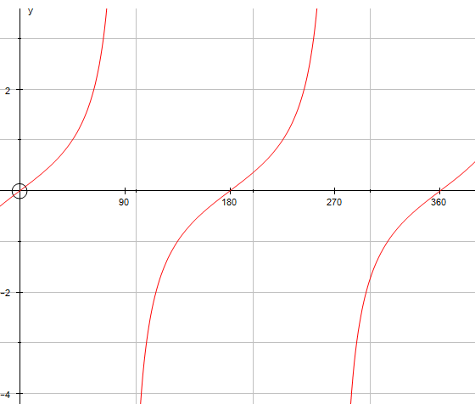
The Tan Curve

Slide 146
Key Values
Angle | SinX | CosX
0 | 0 | 1
90 | 1 | 0
180 | -0 | -1
270 | -1 | 0
360 | 0 | 1
As you can see both sine and cosine follow the same pattern.
The difference is that sine starts at 0, whereas cosine starts at 1

Slide 147
Key Values
Angle | TanX
0 | 0
90 | ∞
180 | 0
270 | ∞
360 | 0

Slide 148
Reading off values
0.5
30
150
If sinx=0.5 what is x?
A calculator would tell us that it is 30˚, but there are other values that would give 0.5
The solutions for sinx=0.5 between 0 and 360 are x=30 and x=150

Slide 149
Reading off values
197.5
342.5
-0.3
If sinx=-0.3 what is x?
The solutions for sinx=-0.3 between 0 and 360 are x=197.5 and x=342.5

Slide 150
Transformation of trig graphs
Here instead we will use f(x) instead of sin, cos or tan, as what we will describe works not only with these three functions but all other functions.
(
0
k
)
y=f(x) + k Translation through
y=f(x+k) Translation through
y=kf(x) Stretch by factor k parallel to the y axis
y=f(kx) Stretch by factor 1/k parallel to the x axis
y=-f(x) Reflection in the x axis
y=f(-x) Reflection in the y axis
(
-k
0
)

Slide 151
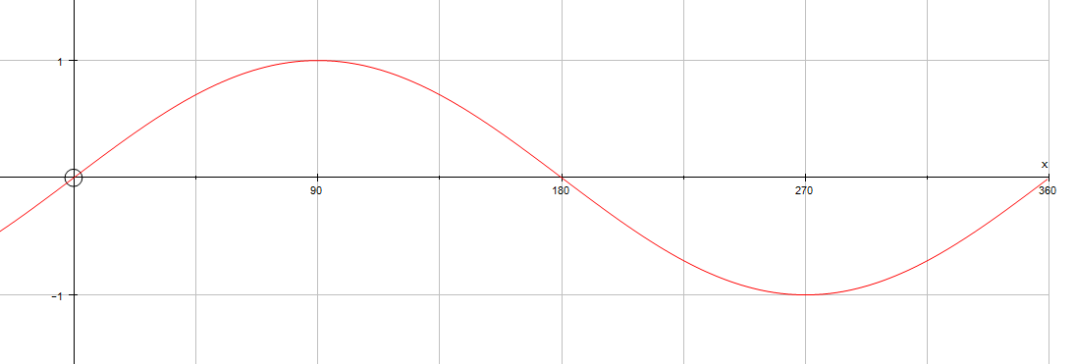
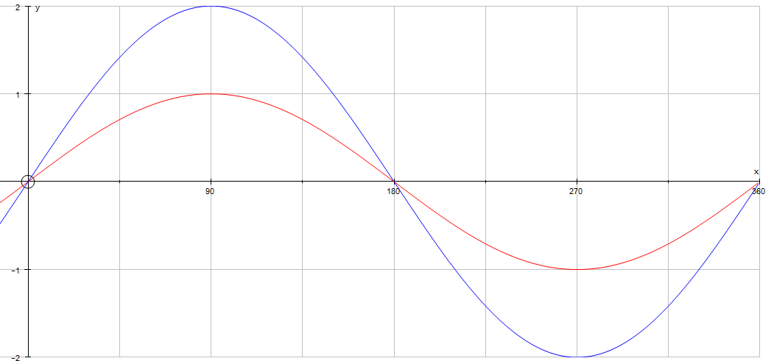
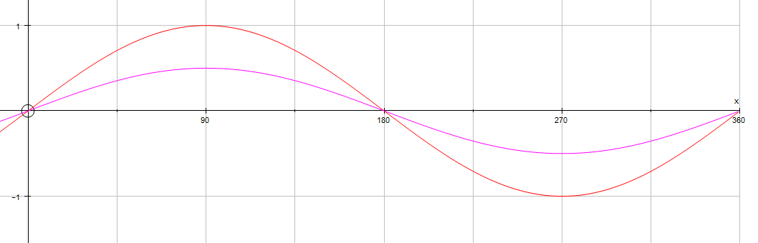
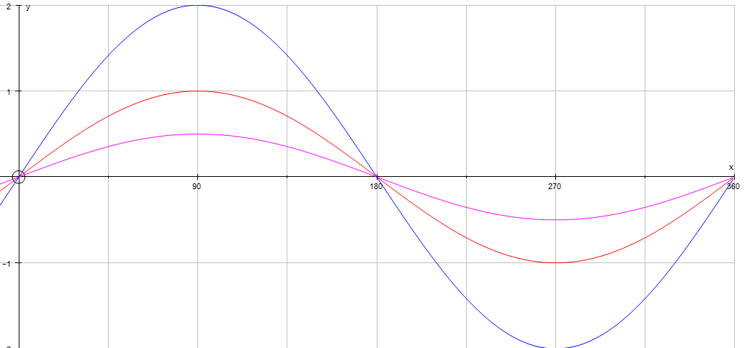
y=sinx
y=2sinx (stretches the curve vertically)
y=0.5sinx (squashes vertically)

Slide 152
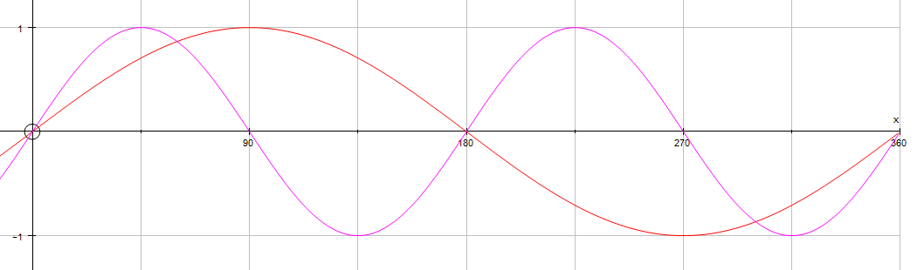

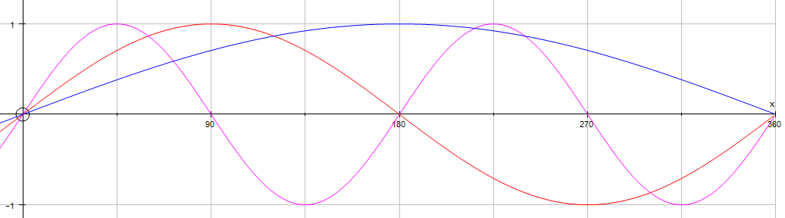
y=sinx
y=sin0.5x (stretches horizontally)
y=sin2x (squashes horizontally)

Slide 153
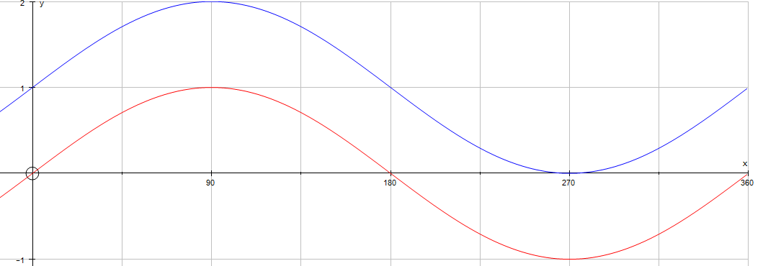
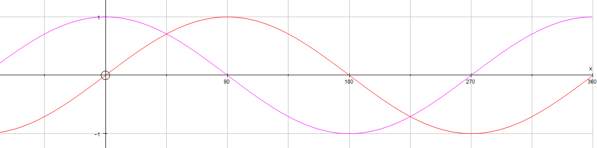
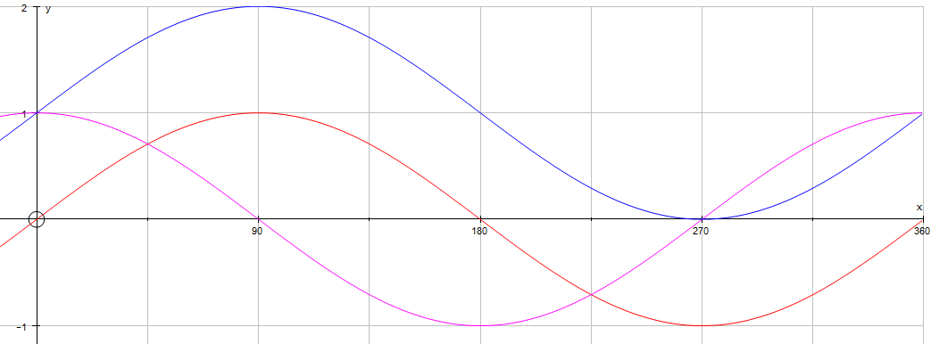
y=sinx
y=sinx + 1 (moves curve upwards)
y=sin(x+90) (moves curve to the right)

Slide 154
Transformations of Trig Graphs
10 multiple choice questions

Slide 155
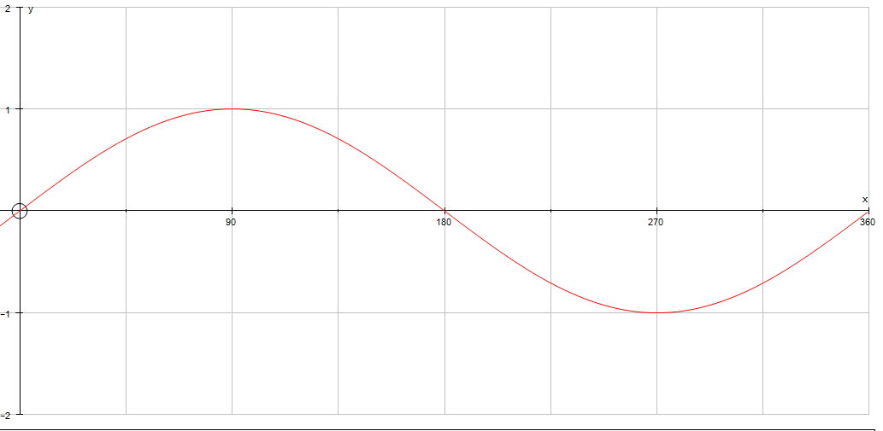
Y=cosx
Y=tanx
A)
B)
Y=sinx
Y=cosx-1
C)
D)

Slide 156
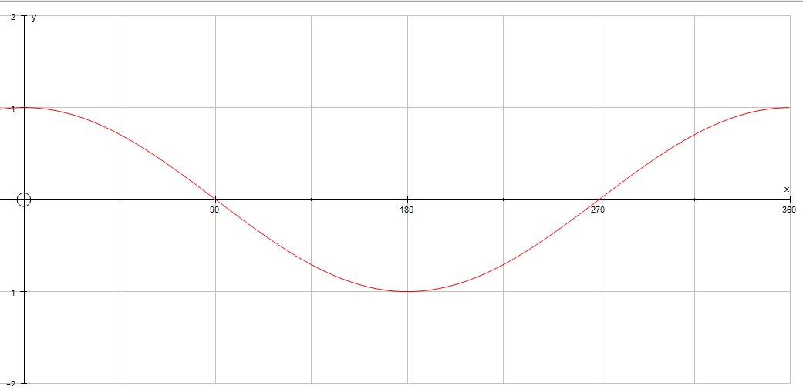
Y=tanx
Y=cosx
A)
B)
Y=2cosx
Y=cos2x
C)
D)

Slide 157
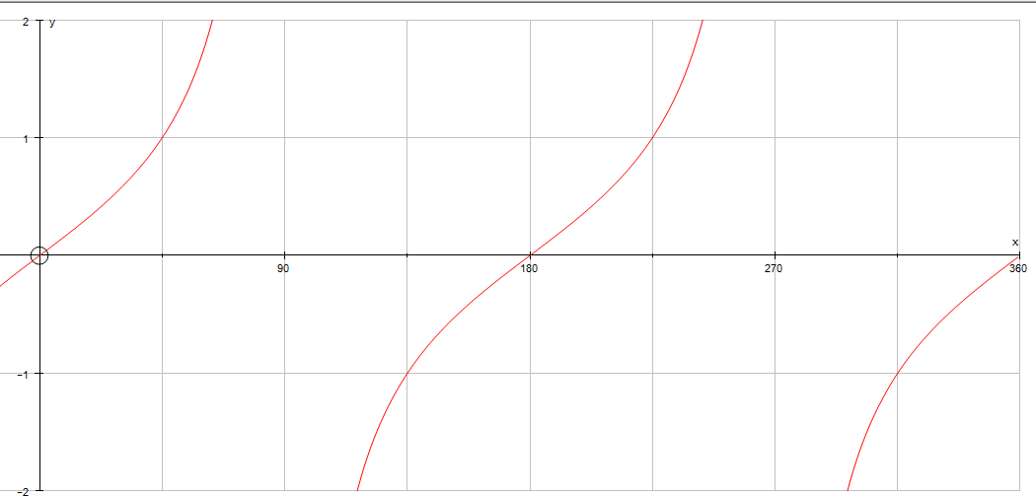
Y=tan2x
Y=0.5tanx
A)
B)
Y=-tanx
Y=tanx
C)
D)

Slide 158
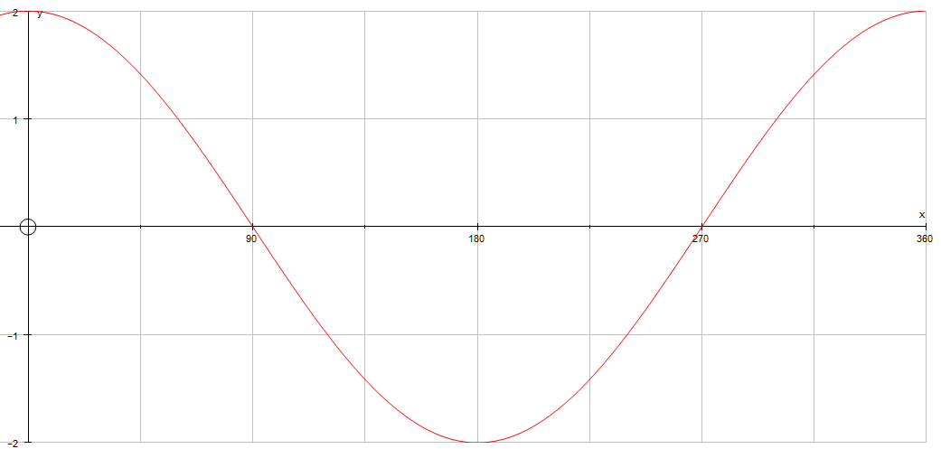
Y=2cosx
Y=cos2x
A)
B)
Y=sin2x
Y=2sinx
C)
D)

Slide 159
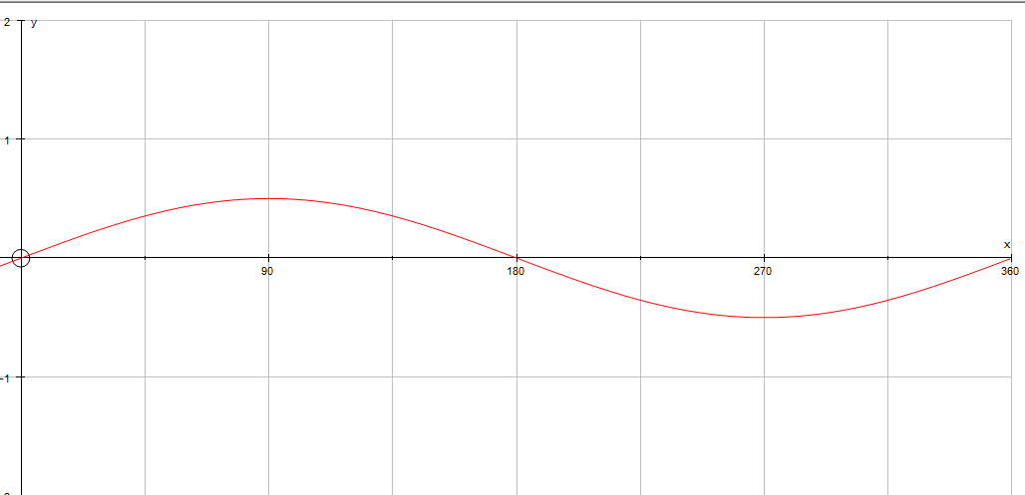
Y=sin2x
y=sin0.5x
A)
B)
Y=0.5cosx
Y=0.5sinx
C)
D)

Slide 160
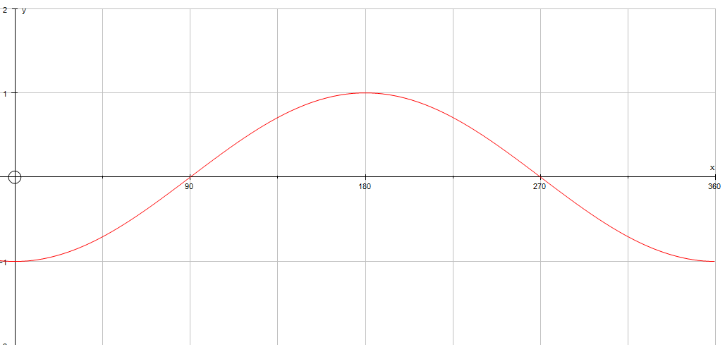
Y=-sinx
Y=-cosx
A)
B)
Y=cos(-x)
Y=sinx-1
C)
D)

Slide 161
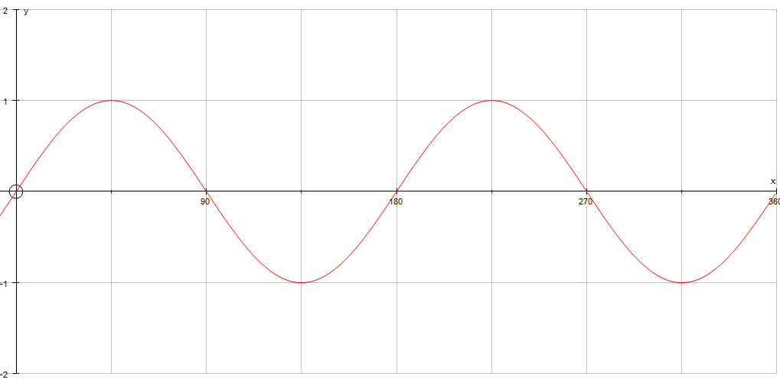
Y=0.5sinx
Y=sin2x
A)
B)
Y=sin0.5x
Y=2sinx
C)
D)

Slide 162
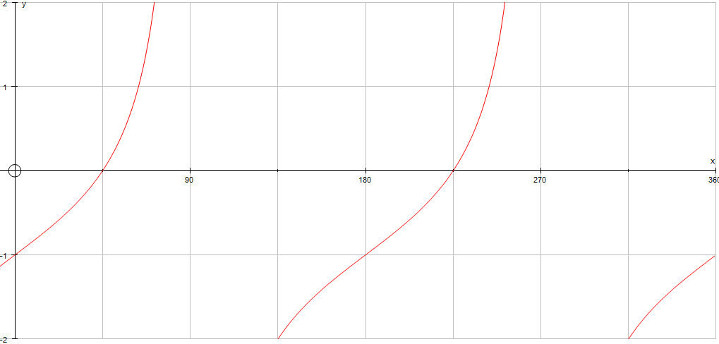
Y=tanx+1
Y=tan(x-1)
A)
B)
Y=tanx
Y=tanx-1
C)
D)

Slide 163
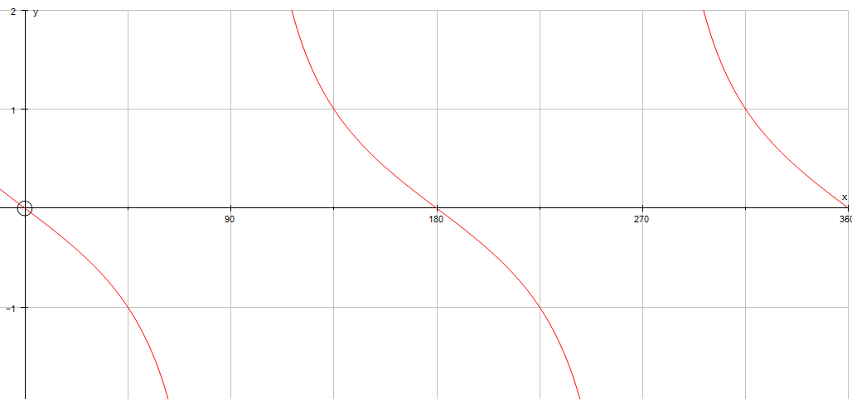
Y=tan(x+90)
Y=2tanx
A)
B)
Y=-tanx
Y=tan2x
C)
D)

Slide 164
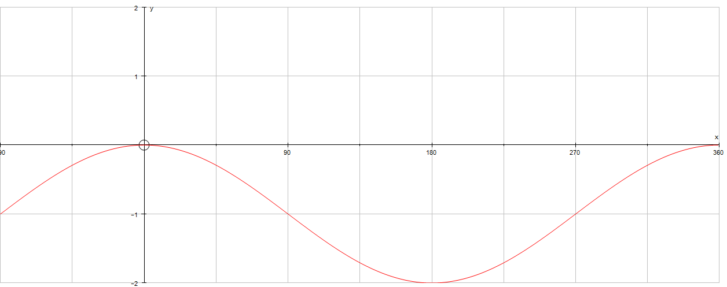
Y=cosx-1
Y=-cosx
A)
B)
Y=sinx-1
Y=cos(-x)
C)
D)

Slide 165
Practise Questions
Sketch the graph y=cosx
  Use your graph to find all of the solutions for cosx=0.7 between 0 and 360
  Use your graph to find all of the solutions for cosx=-0.5 between 0 and 360
Sketch the graph y=tanx
  Use your graph to find all the solutions for tanx=1.5 between 0 and 360
3. Sketch the following graphs:
  y=3sinx
  y=sin3x
  y=cosx + 5
  y=cos(x-45)
  Y=tan(x+10)

Slide 166
Home

Slide 167
y=sinx
y=sin2x
y=cosx
y=-cosx
y=tanx
y=sin(x-90)
y=2cosx
y=sin(x+90)
y=0.5sinx
y=tanx-1
y=tan(-x)
y=cosx-1
y=-tanx
y=cos0.5x
Cut out the cards and match them to the graphs- (some graphs may have more than one label!)

Slide 170
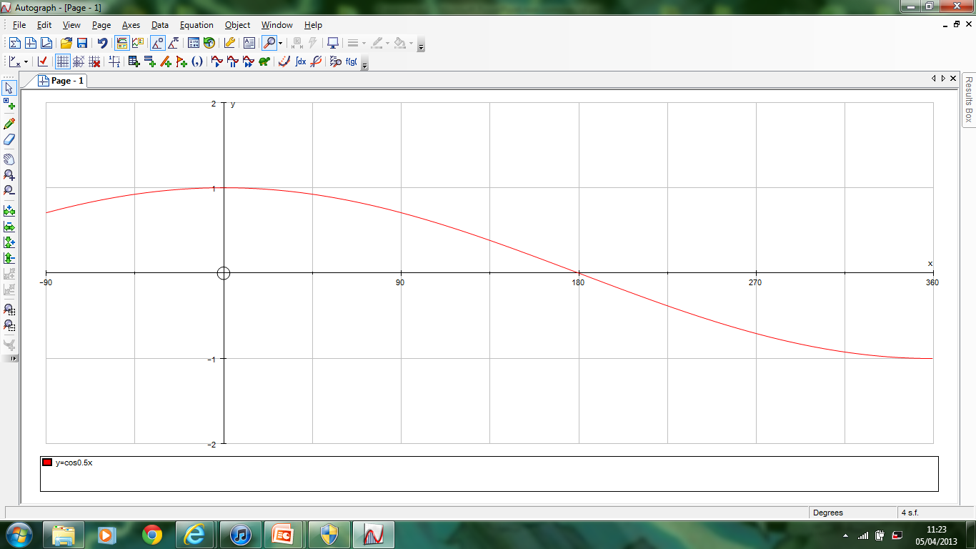

Slide 171
Home

