Slide 1
Standard Form
Standard Form
May 2017
1H Q8
SAM
1H Q9
June 2017
2H Q10
SAM
1H Q11
Nov 2017
3H Q7
Edexcel
SAM
3H Q8
June 2018
3H Q9
AQA
Spec 1
1H Q8
Nov 2018
2H Q7
OCR
Spec 1
3H Q19
May 2019
1H Q8
Spec 2
3H Q10
June 2019
2H Q8
June 2019
3H Q11

Slide 2
Standard Form
Standard Form
May 2017
1H Q13
Edexcel
May 2018
1H Q12
SAM
1H Q15
June 2017
2H Q11
AQA
June 2018
2H Q2
1 Marker
SAM
2H Q12
June 2017
3H Q2
OCR
Nov 2018
2H Q12
Nov 2017
1H Q2

Slide 3
Standard Form
Standard Form
June 2017
3H Q1
Edexcel
Nov 2017
3H Q5
SAM
1H Q13
AQA
June 2018
2H Q1
Practice
3H Q6
OCR
Nov 2018
2H Q1
Nov 2018
3H Q3

Slide 4
Standard Form
SAM 1H Q9

Slide 5
Standard Form
SAM 1H Q9
A

Slide 6
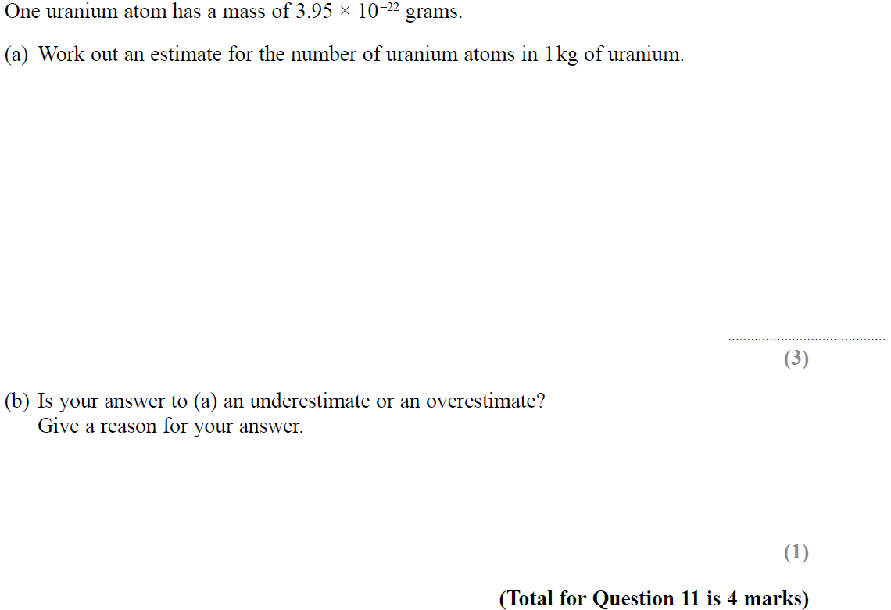
Standard Form
SAM 1H Q11

Slide 7
Standard Form
SAM 1H Q11
A
B

Slide 8
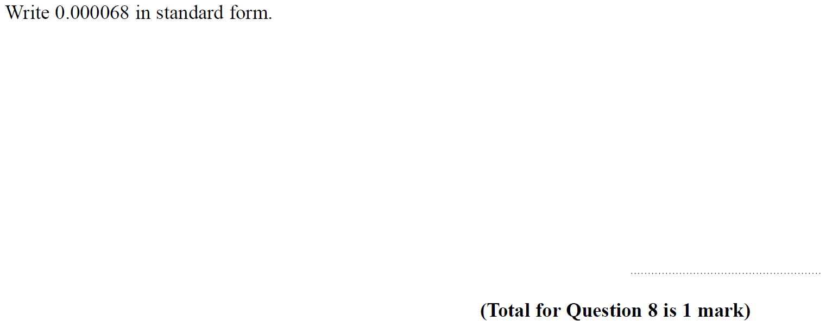
Standard Form
SAM 3H Q8

Slide 9
Standard Form
SAM 3H Q8
A

Slide 10
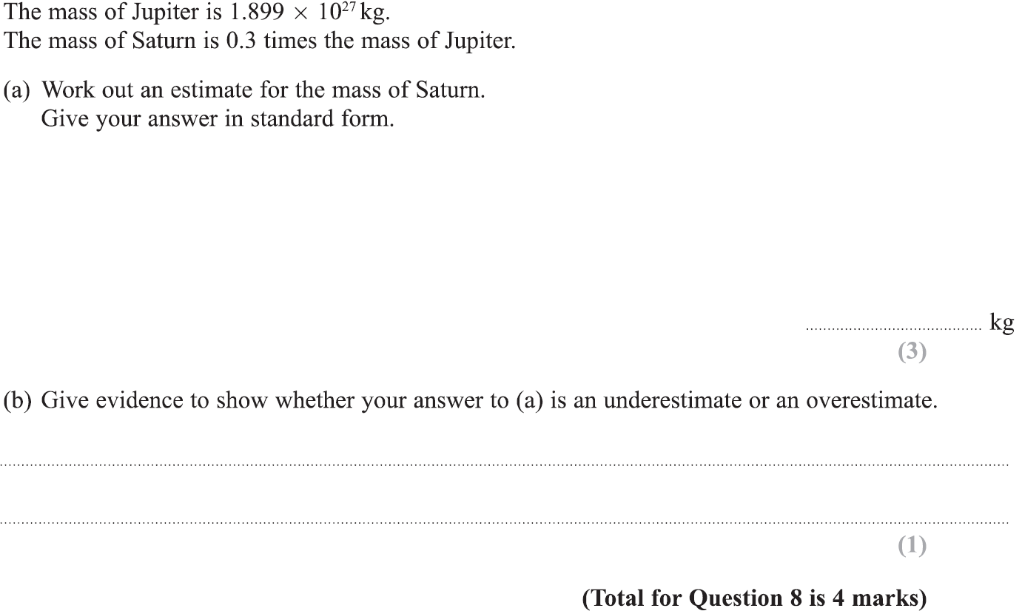
Standard Form
Specimen Set 1 1H Q8

Slide 11
Standard Form
Specimen Set 1 1H Q8
A
B

Slide 12
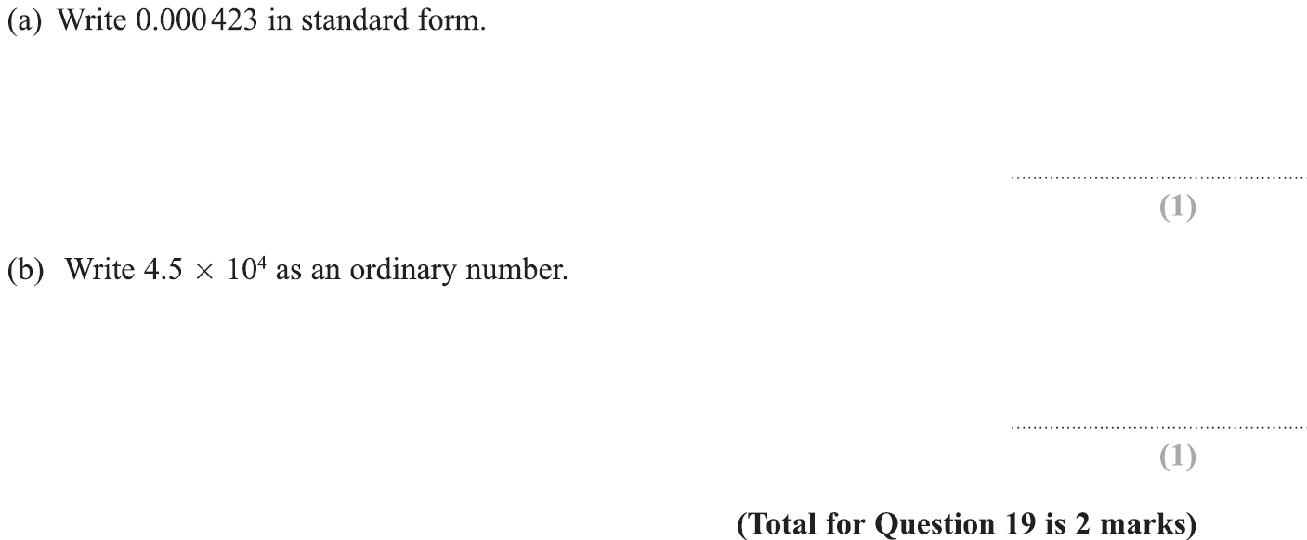
Standard Form
Specimen Set 1 3H Q19

Slide 13
Standard Form
Specimen Set 1 3H Q19
A
B

Slide 14
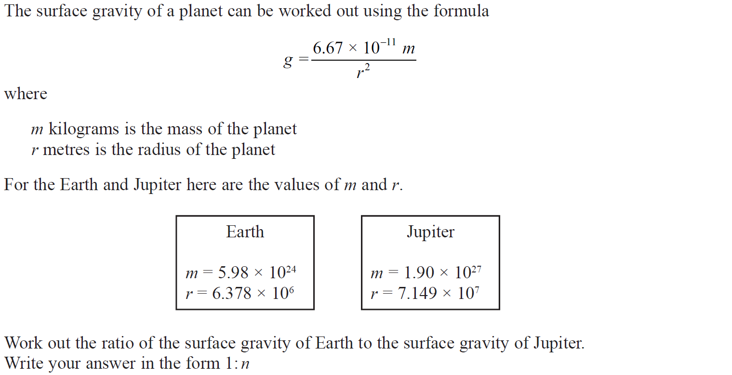
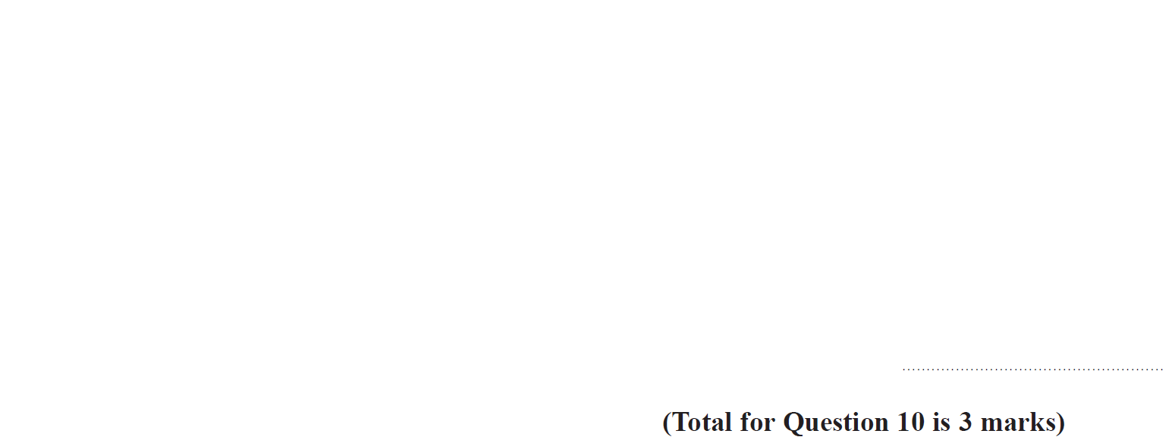
Standard Form
Specimen Set 2 3H Q10

Slide 15
Standard Form
Specimen Set 2 3H Q10
A

Slide 16
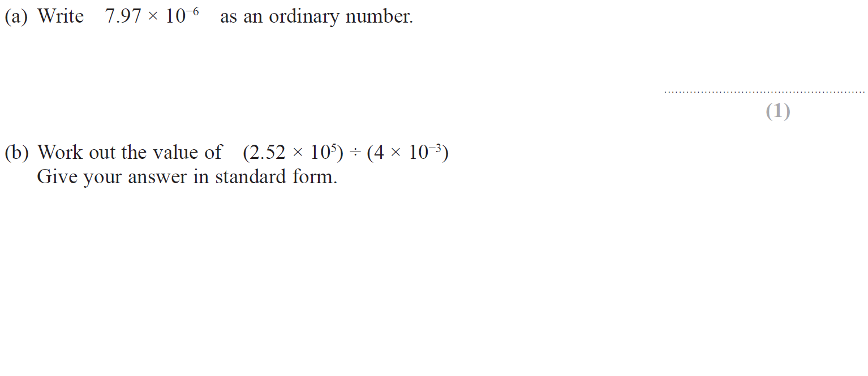
Standard Form
May 2017 1H Q8

Slide 17
Standard Form
June 2017 2H Q10
A
B

Slide 18
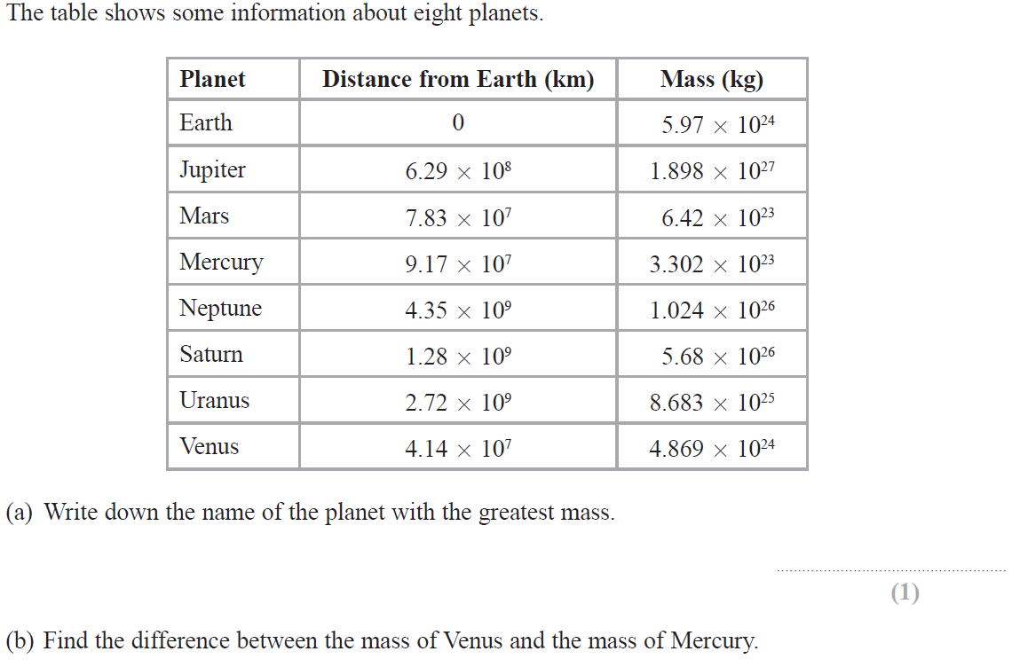
Standard Form
June 2017 2H Q10

Slide 19
Standard Form
June 2017 2H Q10
A
B
C

Slide 20
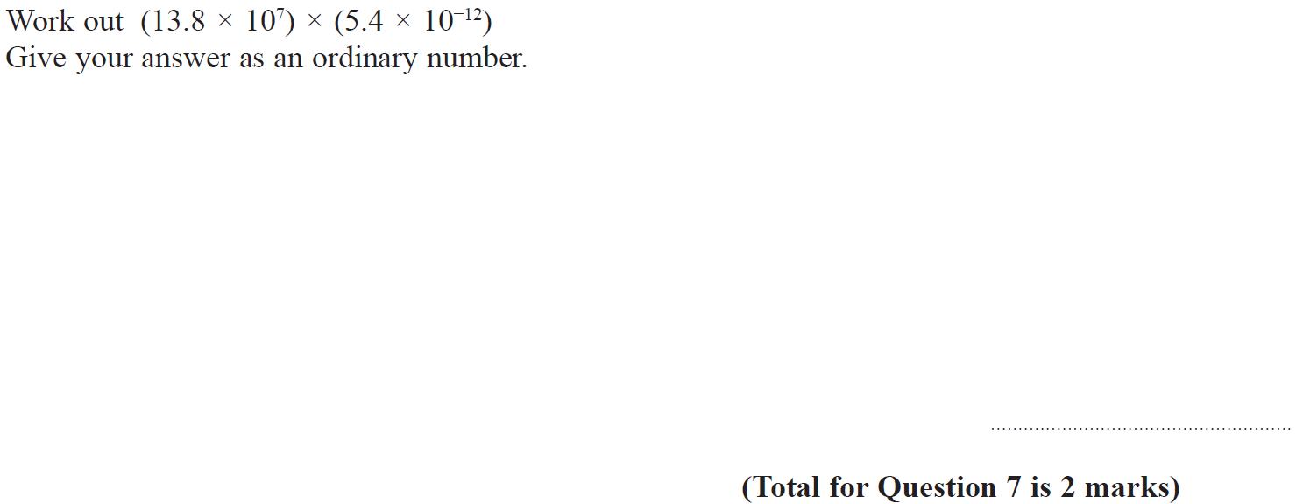
Standard Form
Nov 2017 3H Q7

Slide 21
Standard Form
Nov 2017 3H Q7
A

Slide 22
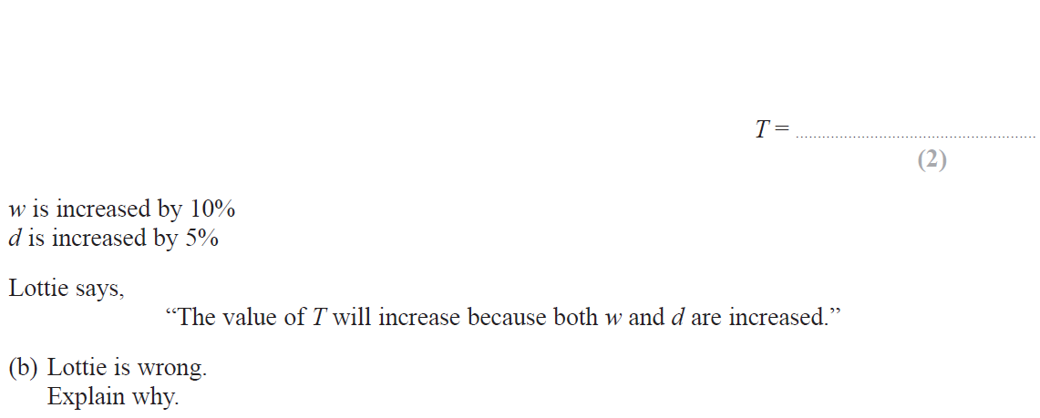
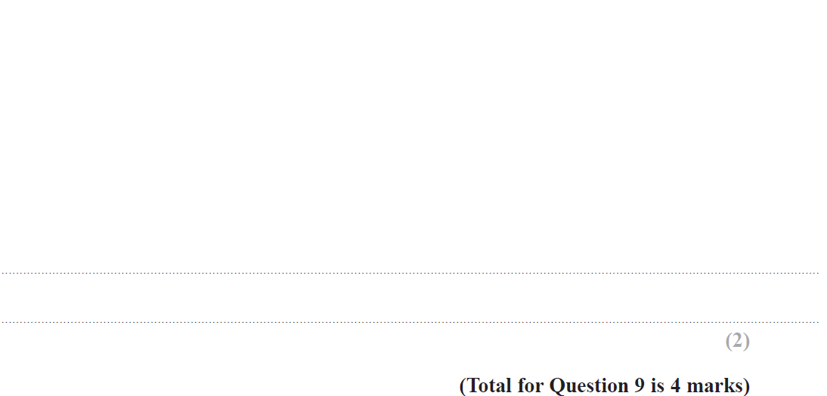
Standard Form
June 2018 3H Q9

Slide 23
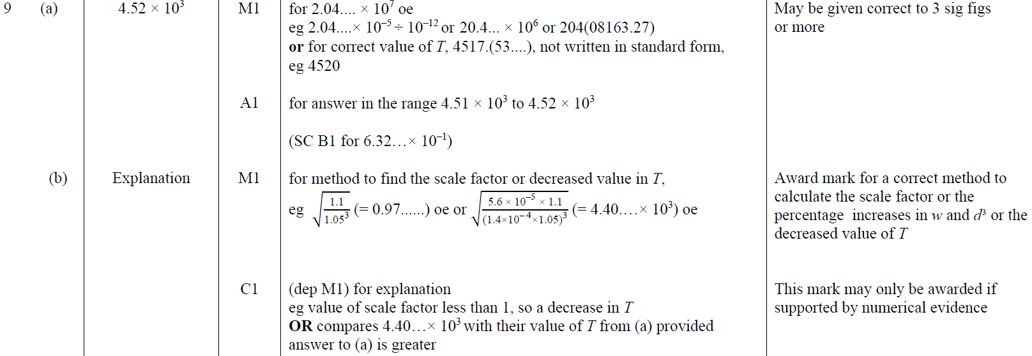
Standard Form
June 2018 3H Q9
A
B

Slide 24
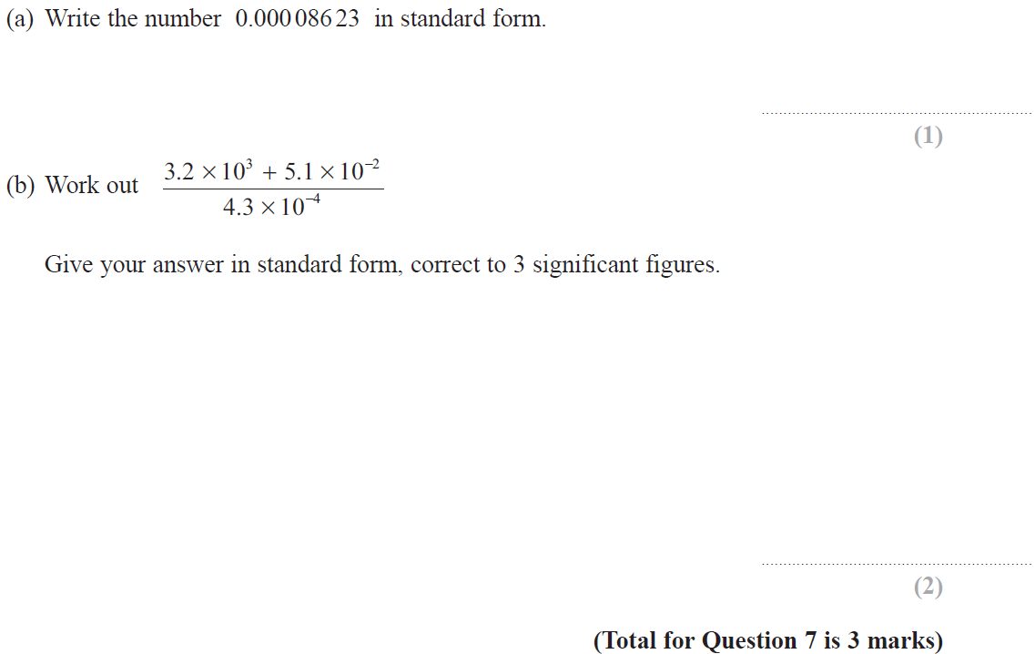
Standard Form
Nov 2018 2H Q7

Slide 25
Standard Form
Nov 2018 2H Q7
A
B

Slide 26
Standard Form
May 2019 1H Q8

Slide 27
Standard Form
May 2019 1H Q8
A
B
C
A SF
B SF
C SF

Slide 28
Standard Form
June 2019 2H Q8

Slide 29
Standard Form
June 2019 2H Q8
A
B
A SF
B SF

Slide 30
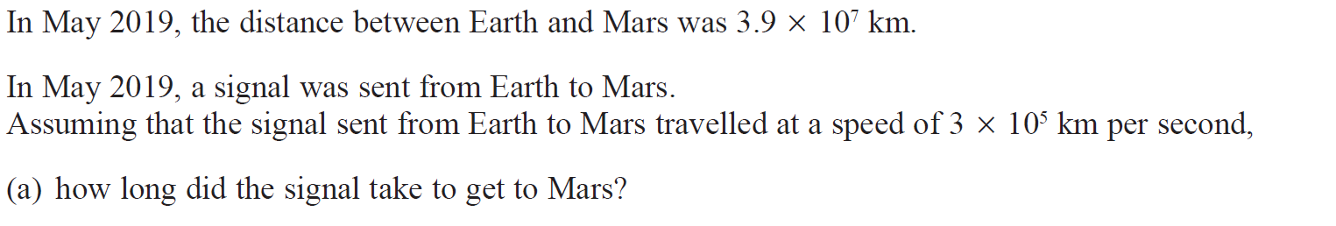
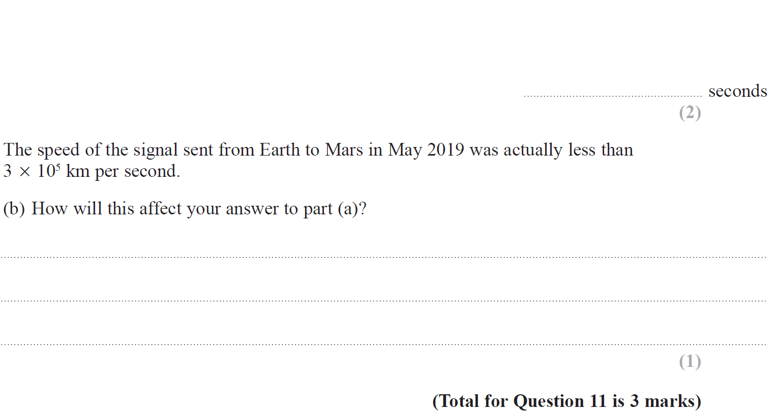
Standard Form
June 2019 3H Q11

Slide 31
Standard Form
June 2019 3H Q11
A
B
A SF
B SF

Slide 32
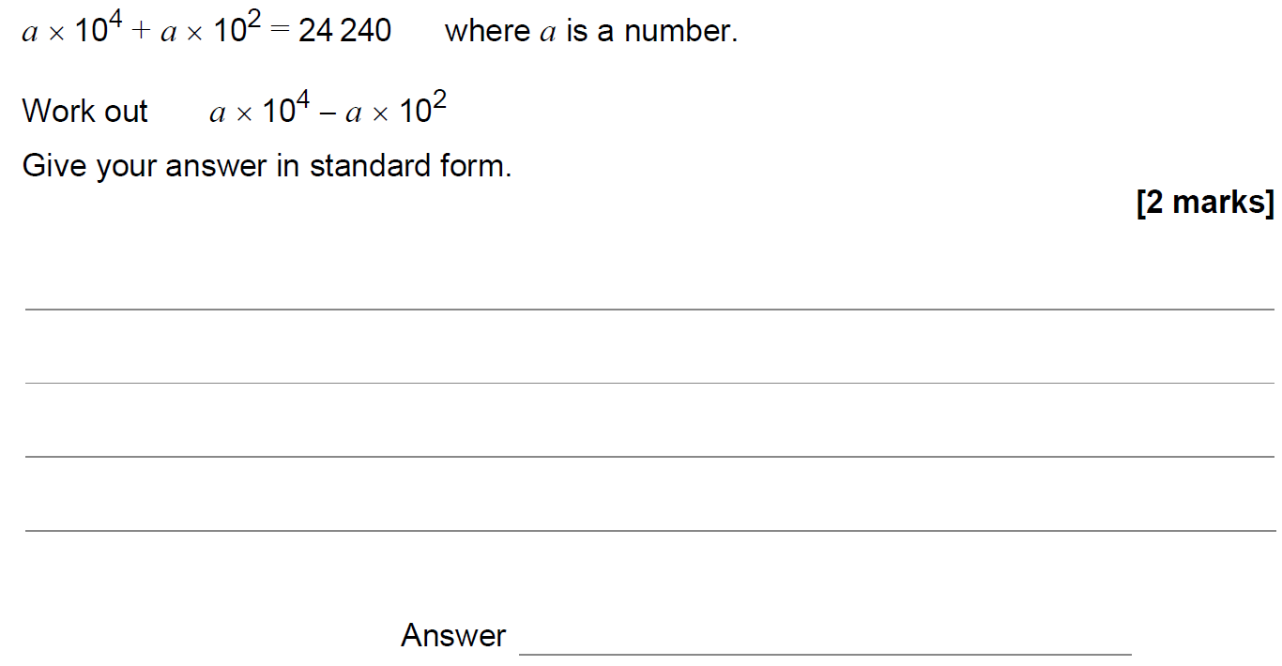
Standard Form
SAM 1H Q15

Slide 33
Standard Form
SAM 1H Q15
A

Slide 34
Standard Form
SAM 2H Q12

Slide 35
Standard Form
SAM 2H Q12
A

Slide 36
Standard Form
May 2017 1H Q13

Slide 37
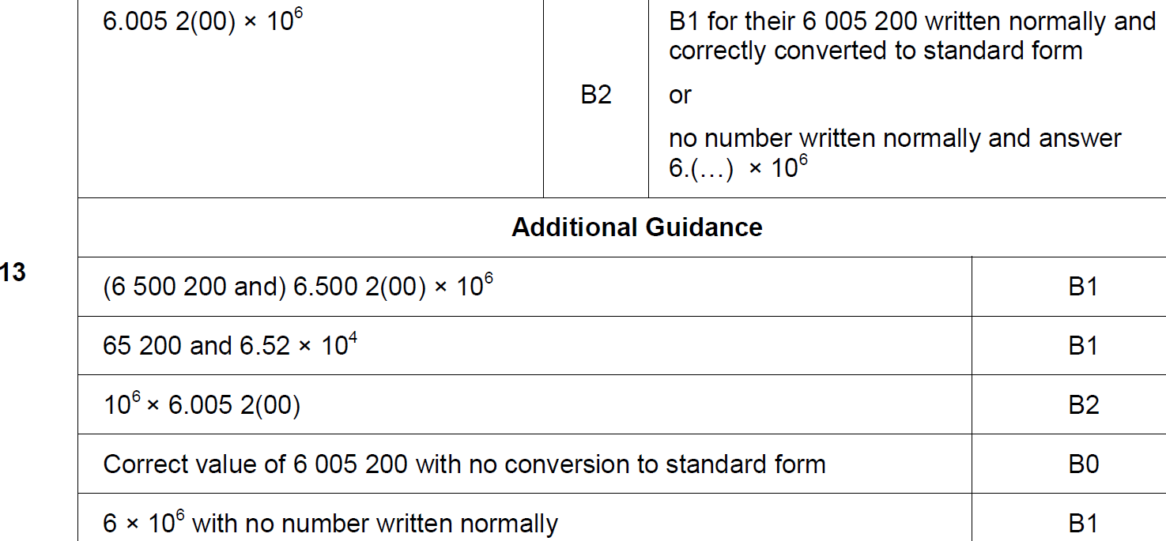
Standard Form
May 2017 1H Q13
A

Slide 38
Standard Form
June 2017 2H Q11

Slide 39
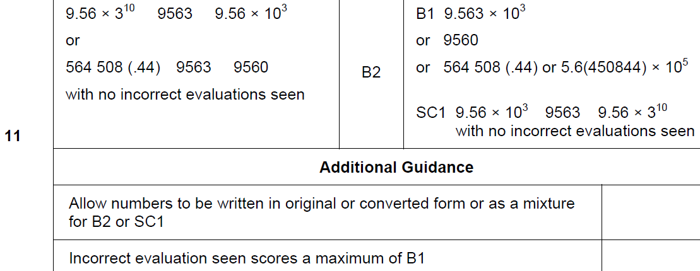
Standard Form
June 2017 2H Q11
A

Slide 40
Standard Form
June 2017 3H Q2

Slide 41
Standard Form
June 2017 3H Q2
A

Slide 42
Standard Form
Nov 2017 1H Q2

Slide 43
Standard Form
Nov 2017 1H Q2
A

Slide 44
Standard Form
May 2018 1H Q12

Slide 45
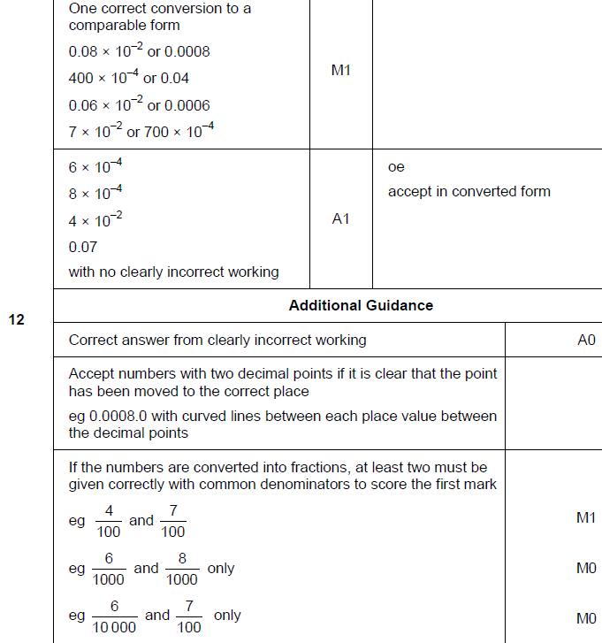
Standard Form
May 2018 1H Q12
A

Slide 46
Standard Form
June 2018 2H Q2

Slide 47
Standard Form
June 2018 2H Q2
A

Slide 48
Standard Form
Nov 2018 2H Q12

Slide 49
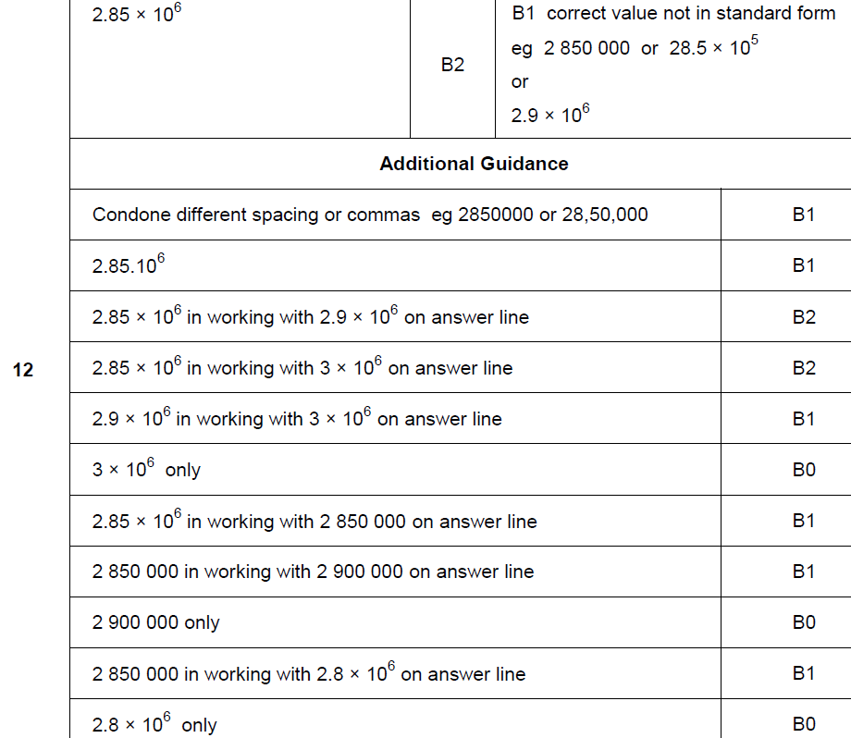
Standard Form
Nov 2018 2H Q12
A

Slide 50
Standard Form
SAM 1H Q13

Slide 51
Standard Form
SAM 1H Q13
A

Slide 52
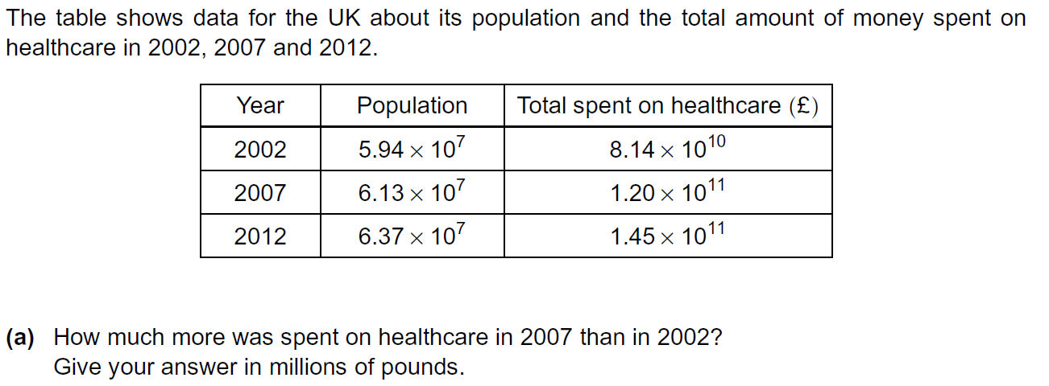
Standard Form
Practice 3H Q6

Slide 53
Standard Form
Practice 3H Q6
A
B

Slide 54
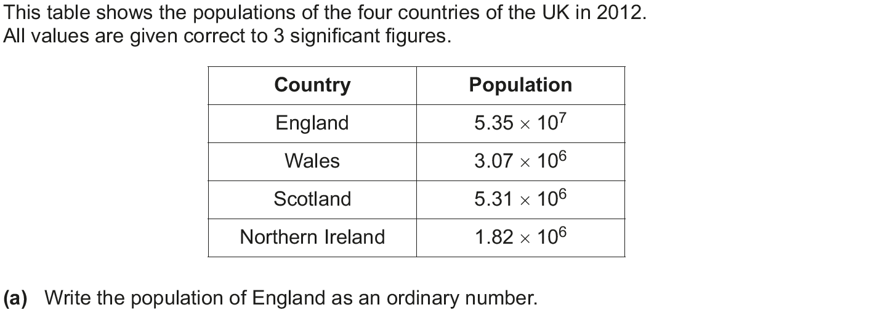
Standard Form
June 2017 3H Q1

Slide 55
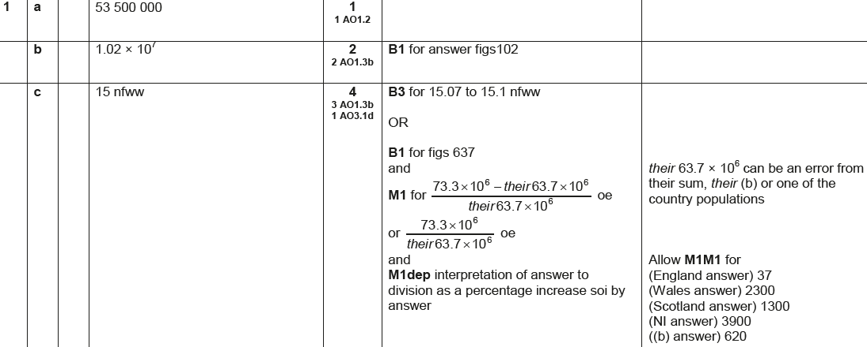
Standard Form
June 2017 3H Q1
A
B
C

Slide 56
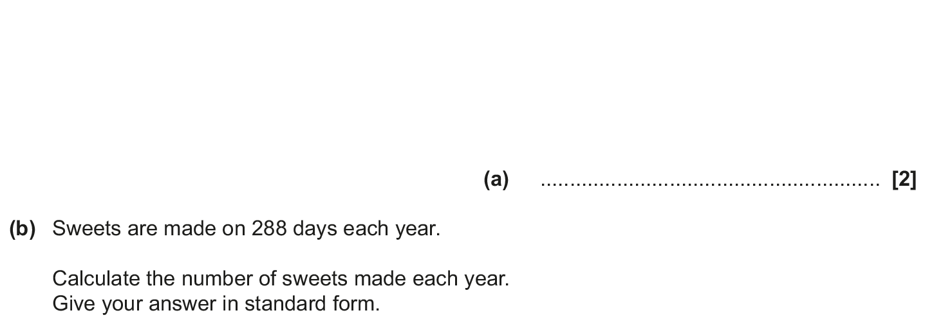
Standard Form
Nov 2017 3H Q5

Slide 57
Standard Form
Nov 2017 3H Q5
A
B
C (i)
C (ii)

Slide 58
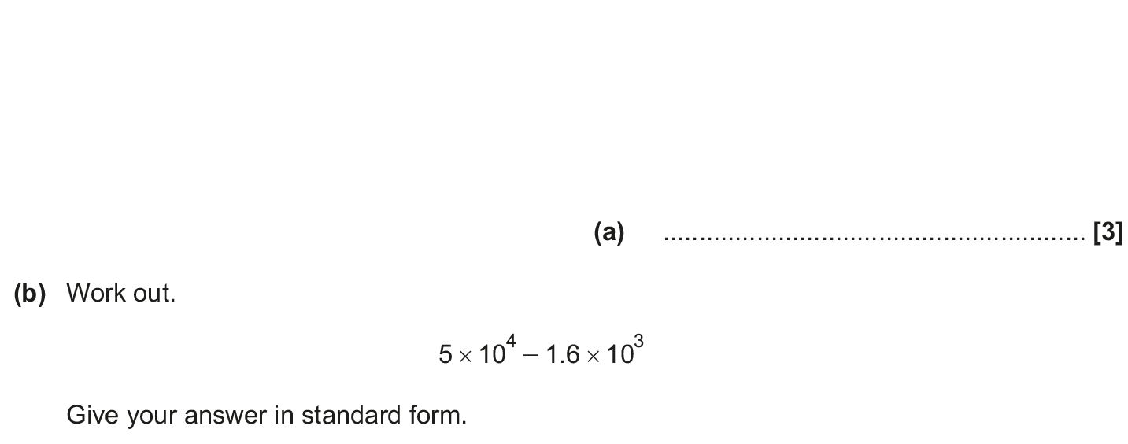
Standard Form
June 2018 2H Q1

Slide 59
Standard Form
June 2018 2H Q1
A
B

Slide 60
Standard Form
Nov 2018 2H Q1

Slide 61
Standard Form
Nov 2018 2H Q1
A
B

Slide 62
Standard Form
Nov 2018 3H Q3

Slide 63
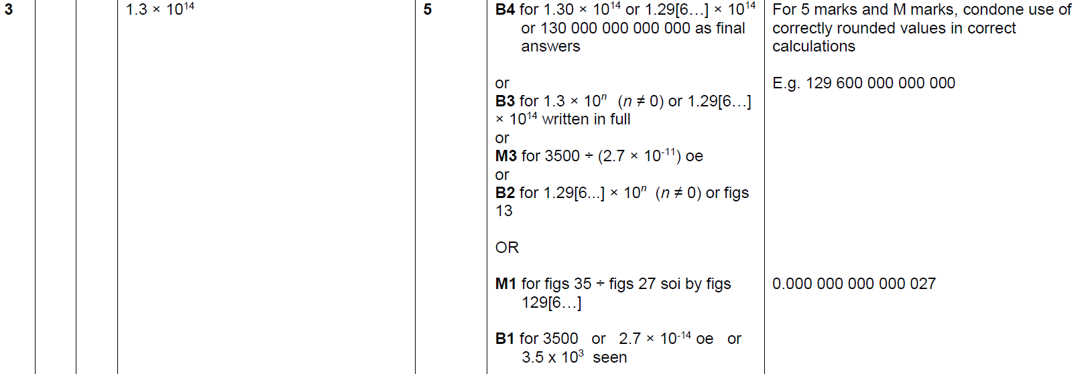
Standard Form
Nov 2018 3H Q3
A

