Slide 1
Sets
Sets
Old Spec Q’s
SAM
2H Q15*
May 2019
2H Q3
May 2018
1H Q4*
June 2018
2HR Q15
Jan 2019
1H Q13*
Jan 2019
2H Q4
Jan 2019
2HR Q16
May 2019
1H Q14
*Element of probability
With Venn Diagrams

Slide 2
Sets
SAM 2H Q15

Slide 3
Sets
SAM 2H Q15
A
B
C

Slide 4
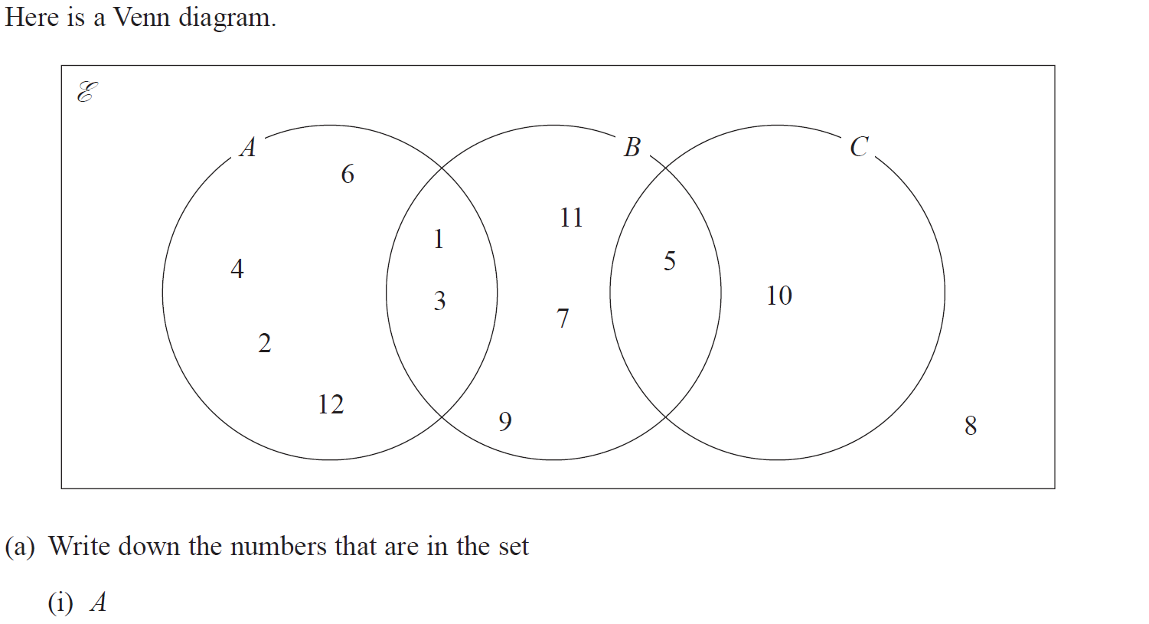
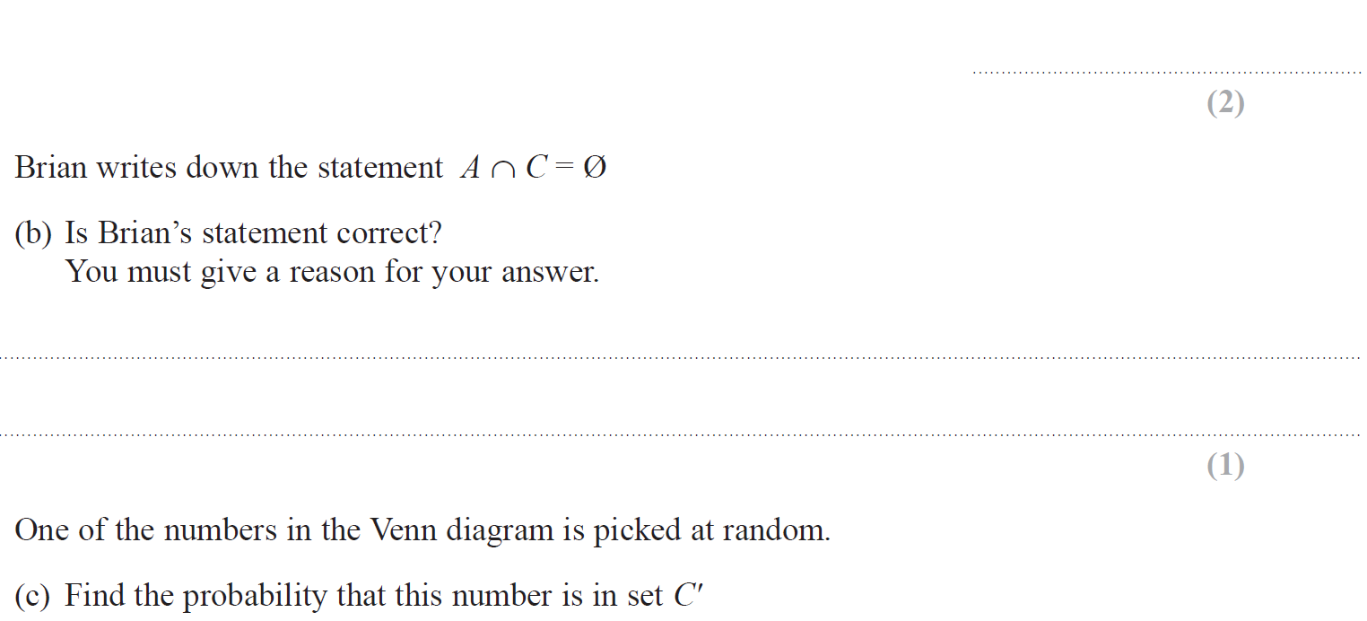
Sets
May 2018 1H Q4

Slide 5
Sets
May 2018 1H Q4
A (i)
A (ii)
B
C

Slide 6
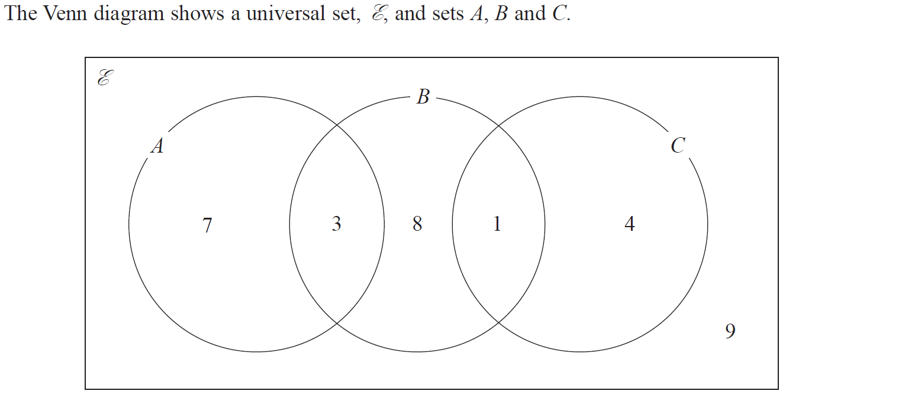
Sets
June 2018 2HR Q15

Slide 7
Sets
June 2018 2HR Q15
(i)
(ii)
(iii)

Slide 8
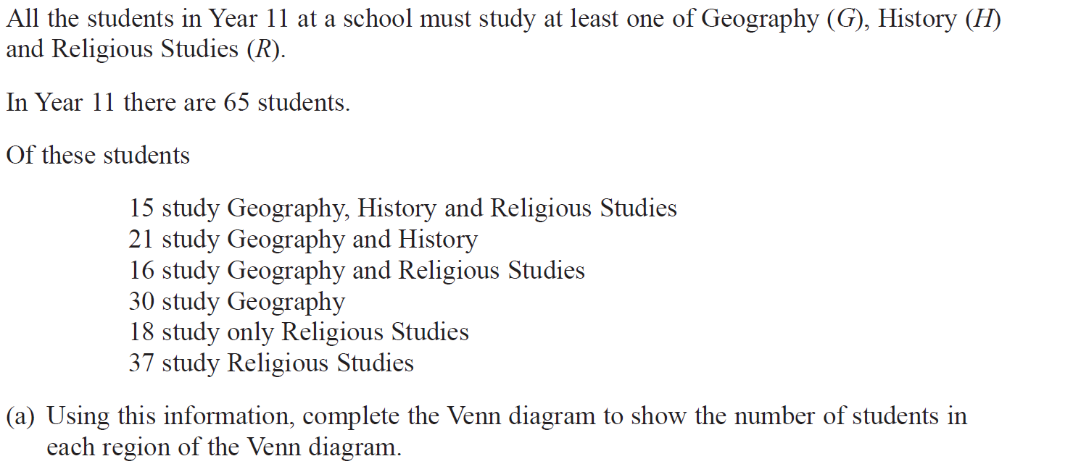
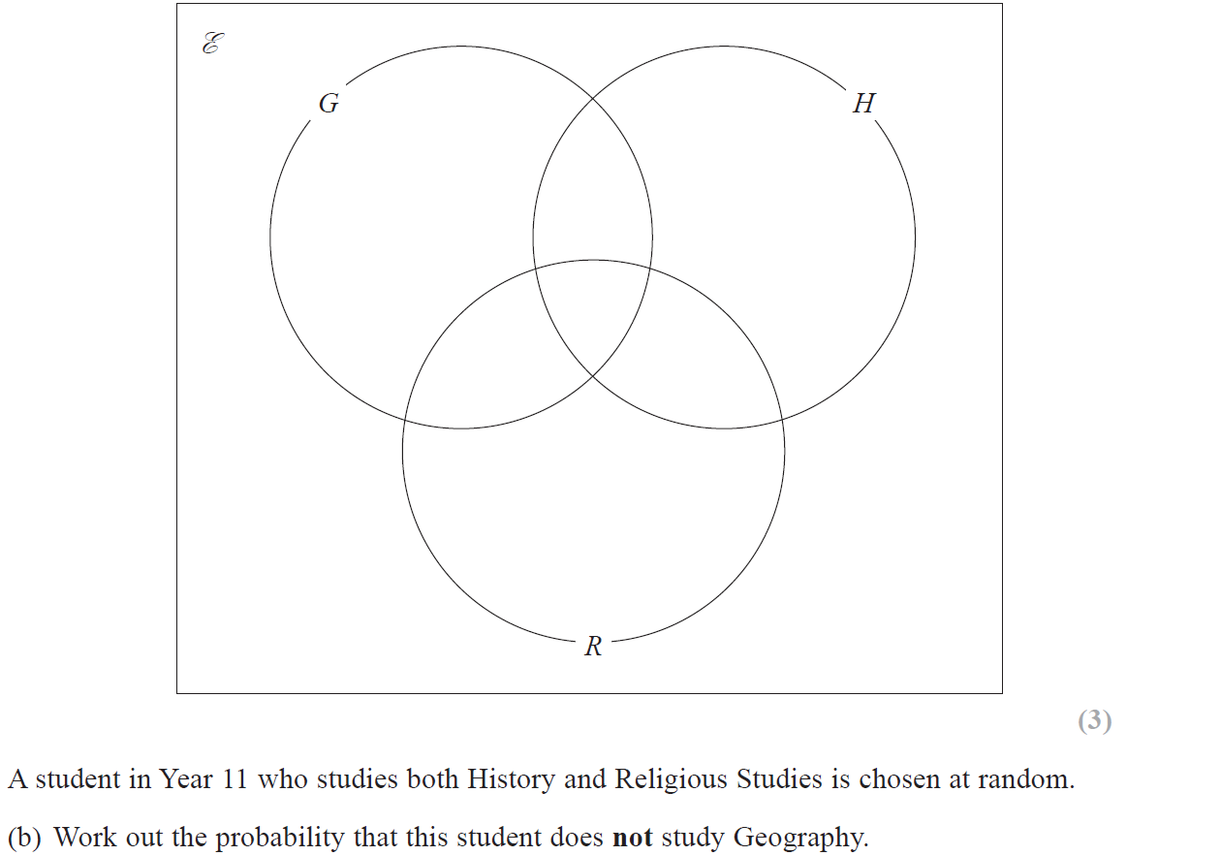
Sets
Jan 2019 1H Q13

Slide 9
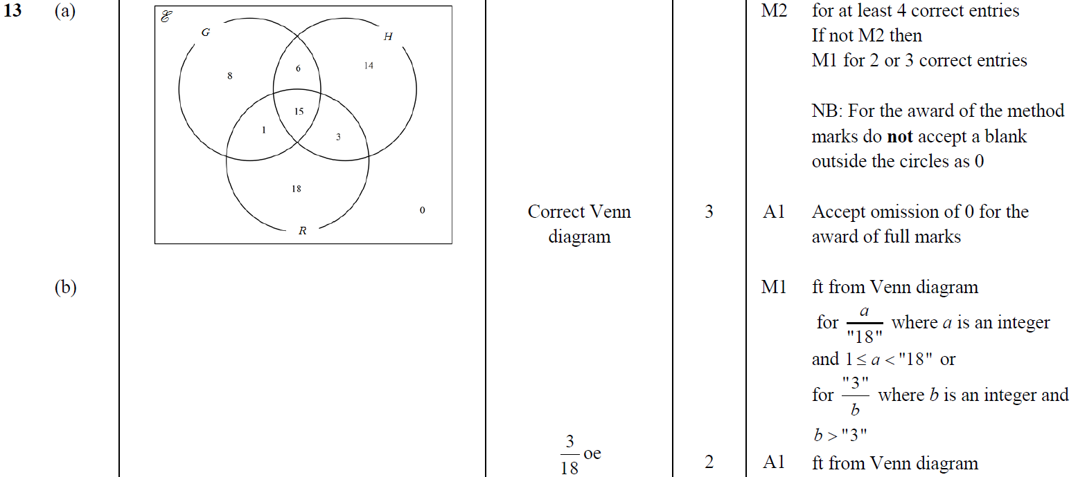
Sets
Jan 2019 1H Q13
A
B

Slide 10
Sets
Jan 2019 2H Q4

Slide 11
Sets
Jan 2019 2H Q4
A

Slide 12
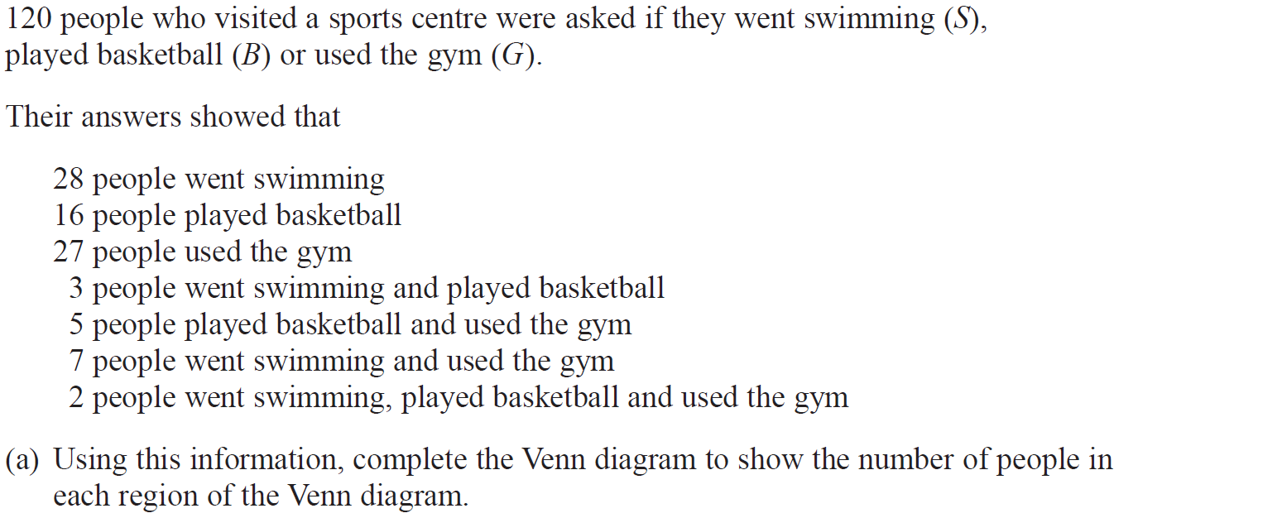
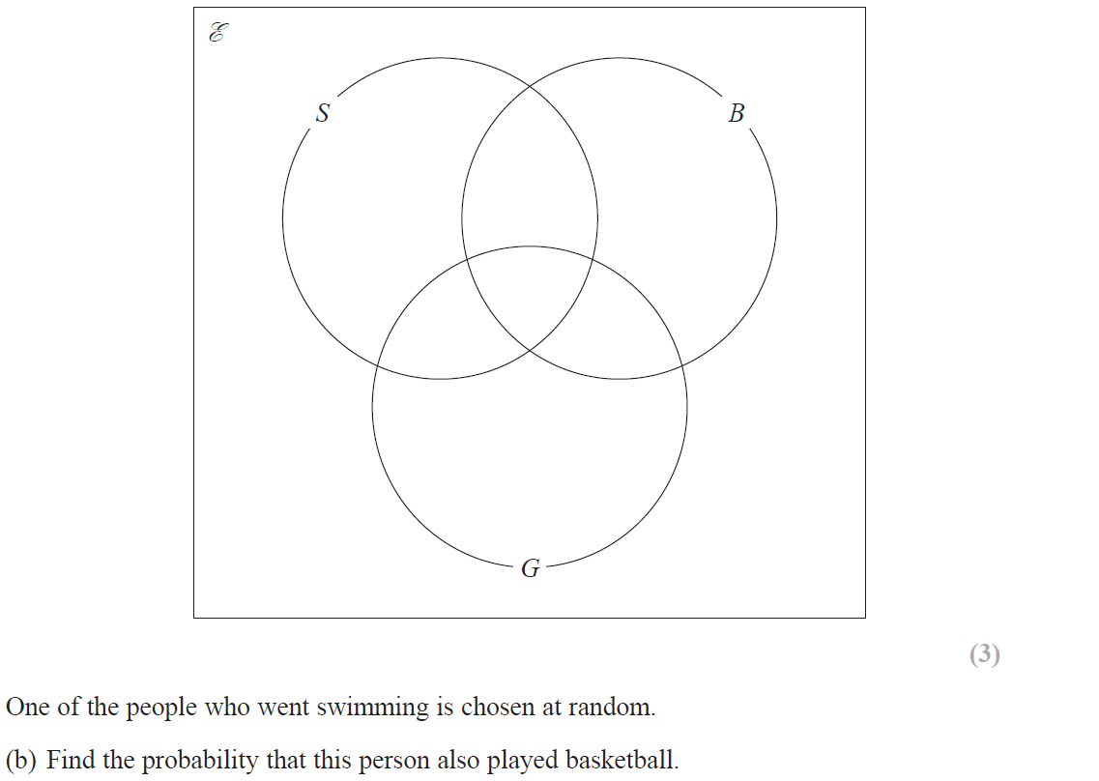
Sets
Jan 2019 2HR Q16

Slide 13
Sets
Jan 2019 2HR Q16
A
B

Slide 14
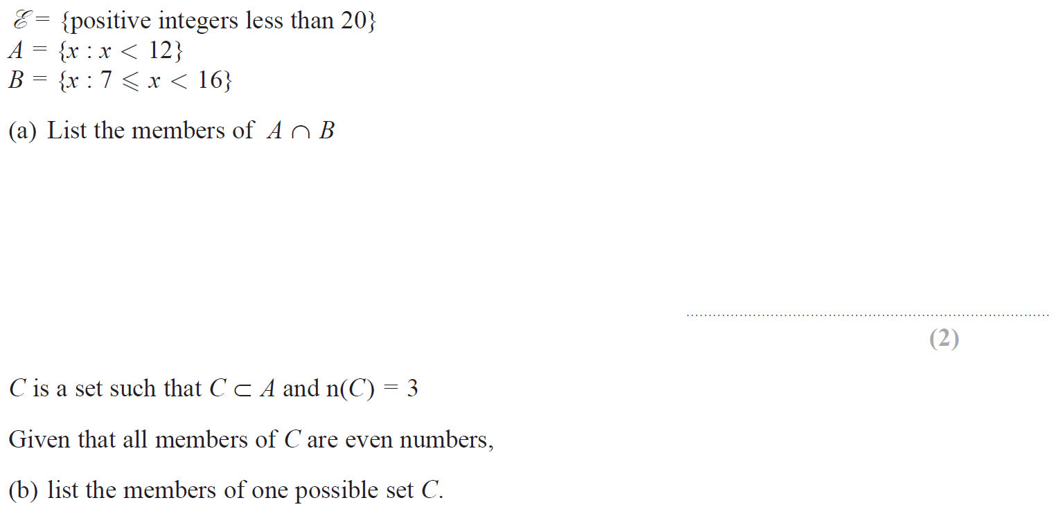
Sets
May 2019 1H Q14

Slide 15
Sets
May 2019 1H Q14
A
B

Slide 16
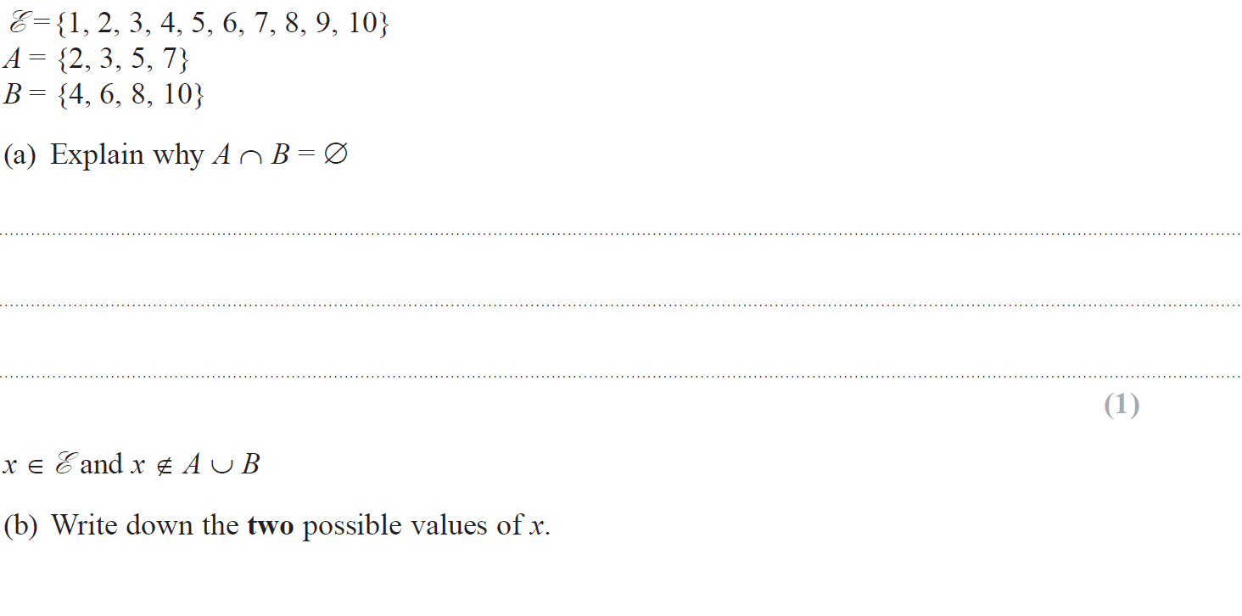
Sets
June 2019 2H Q3

Slide 17
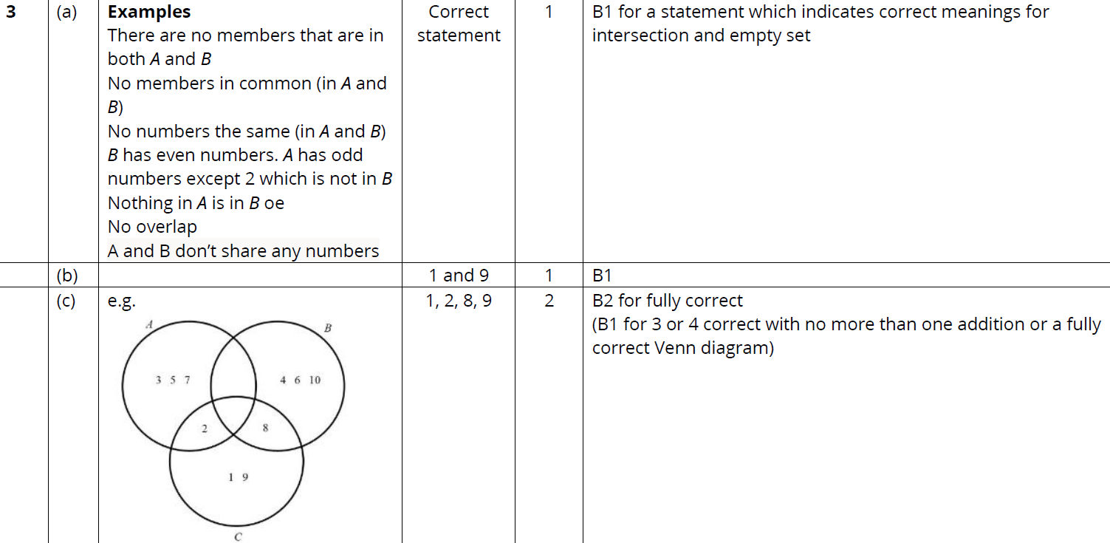
Sets
June 2019 2H Q3
A
B
C

Slide 18
Sets
Sets
New Spec Q’s
May 2004
3H Q7
Nov 2006
3H Q19
Nov 2009
4H Q20
Jan 2013 4H Q5
Jan 2015 3H Q19
June 2016 4H Q21
Jan 2017 3HR Q10
May 2004
3H Q16
Nov 2006
4H Q6
June 2010
4H Q6
May 2013 3H Q7
Jan 2015 4H Q6
June 2016 4HR Q18
June 2017 4H Q17
Nov 2004
3H Q11
May 2007
4H Q15
Nov 2010
3H Q7
May 2013 4H Q20
Jan 2015 4HR Q9
Jan 2017 3H Q21
May 2017 3HR Q6
May 2005
4H Q8
Nov 2007
3H Q7
June 2011 3H Q8
May 2013 3HR Q8
June 2015 4H Q18
Jan 2017 4H Q7
Nov 2005
3H Q20
Nov 2007
4H Q19
Jan 2012 3H Q6
May 2013 4HR Q21
June 2015 4HR Q1
Jan 2017 4HR Q5
Nov 2005
4H Q1
May 2008
3H Q5
Jan 2012 3H Q19
Jan 2014 4H Q9
Jan 2016 3H Q7
May 2017 3H Q18
May 2006
3H Q15
Nov 2008
4H Q9
May 2012 4H Q12
Jan 2014 3HR Q5
Jan 2016 3HR Q17
June 2017 4H Q1
May 2006
4H Q5
May 2009
3H Q8
May 2012 4H Q14
May 2014 3H Q7
Jan 2016 4HR Q4
June 2017 4HR Q2
Nov 2006
3H Q16
Nov 2009
3H Q6
Jan 2013 3H Q15
May 2014 3HR Q2
May 2016 3H Q4
Jan 2017 4H Q9
With Venn Diagrams

Slide 19
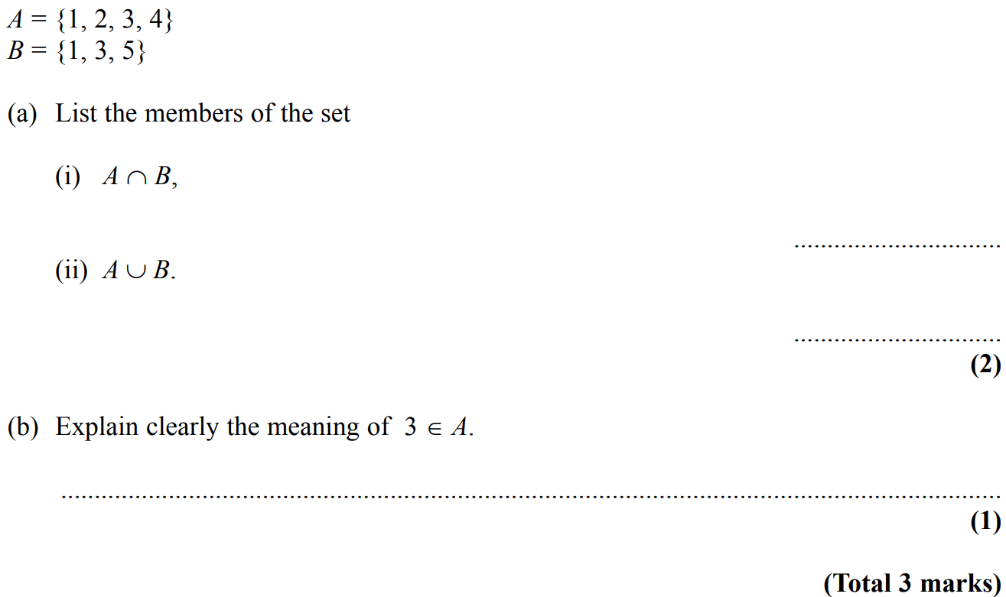
Sets
May 2004 3H Q7

Slide 20
Sets
May 2004 3H Q7
A (i)
A (ii)
B

Slide 21
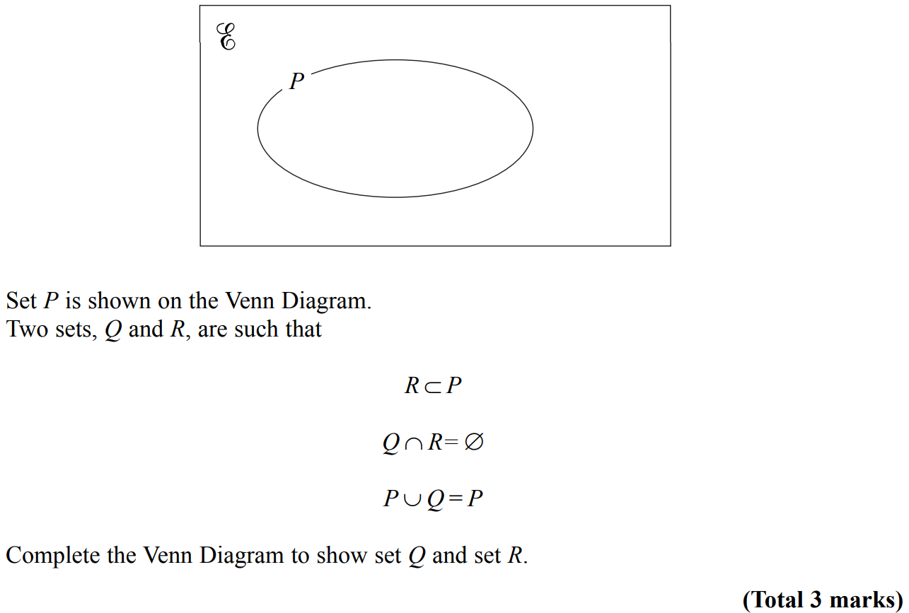
Sets
May 2004 3H Q16

Slide 22
Sets
May 2004 3H Q16
A

Slide 23
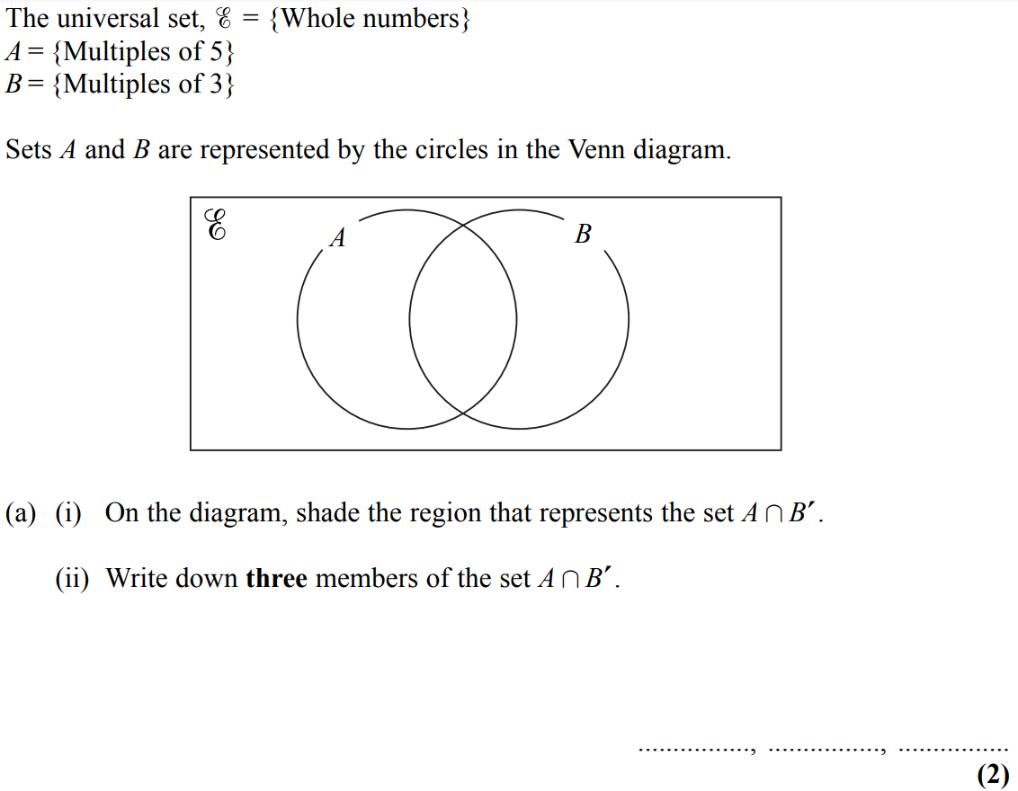
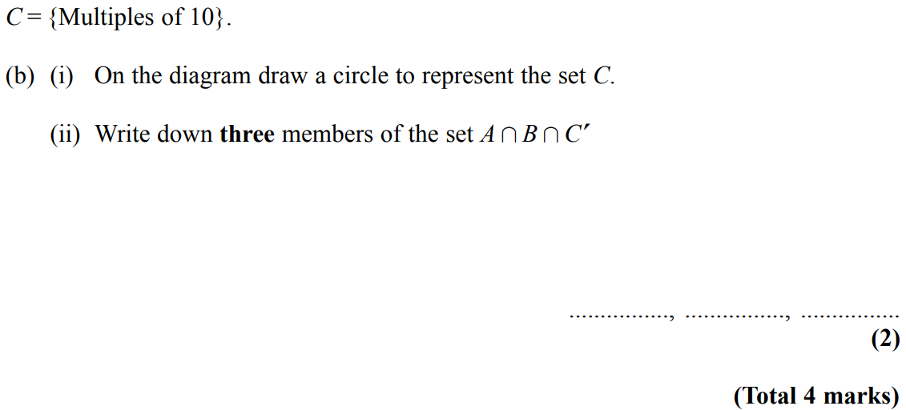
Sets
Nov 2004 3H Q11

Slide 24
Sets
Nov 2004 3H Q11
A (i)
A (ii)
B (i)
B (ii)

Slide 25
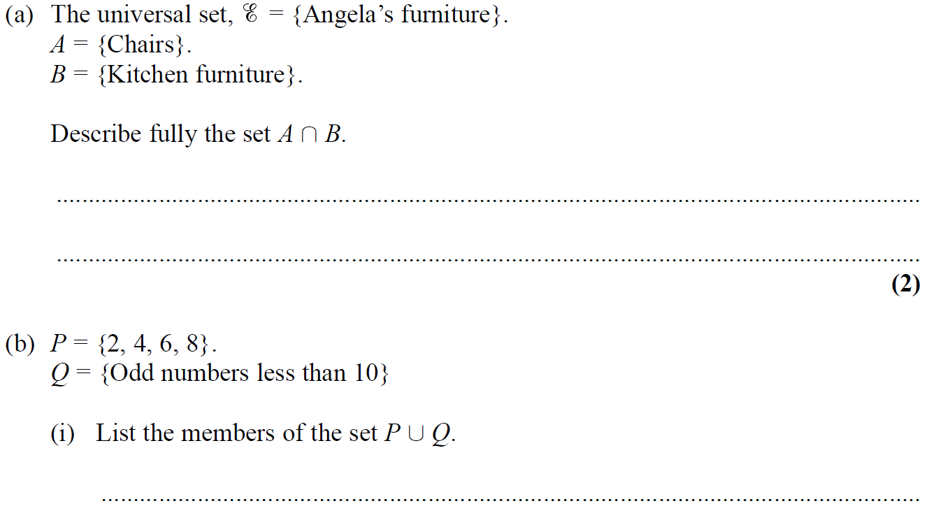
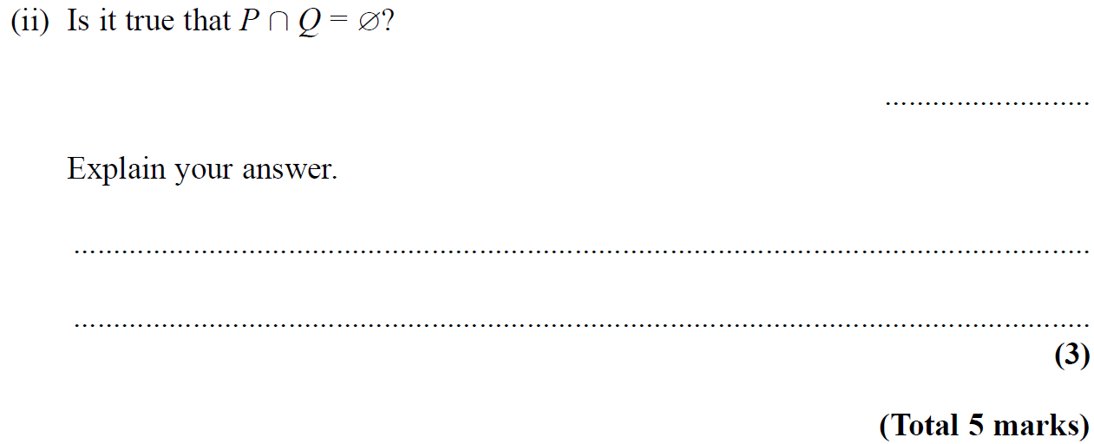
Sets
May 2005 4H Q8

Slide 26
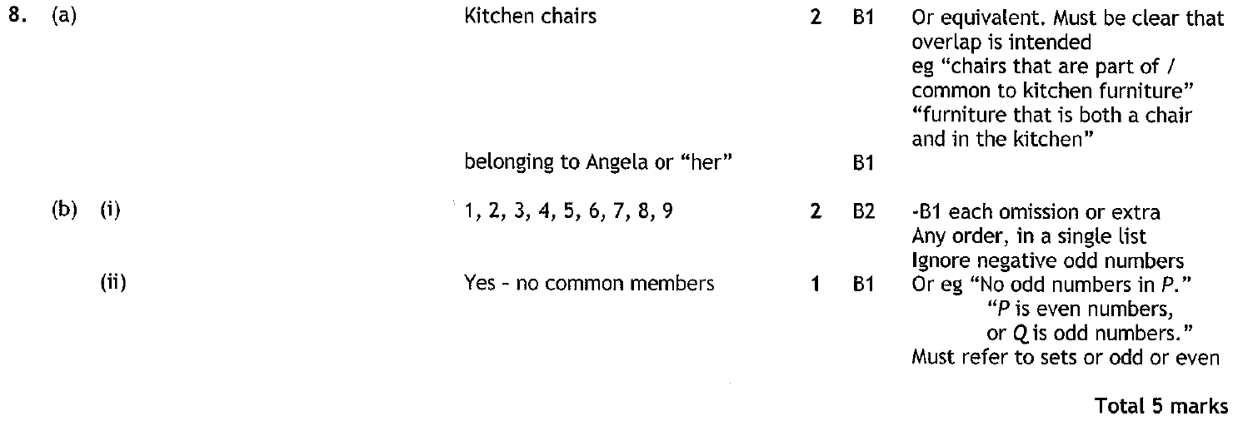
Sets
May 2005 4H Q8
A
B (i)
B (ii)

Slide 27
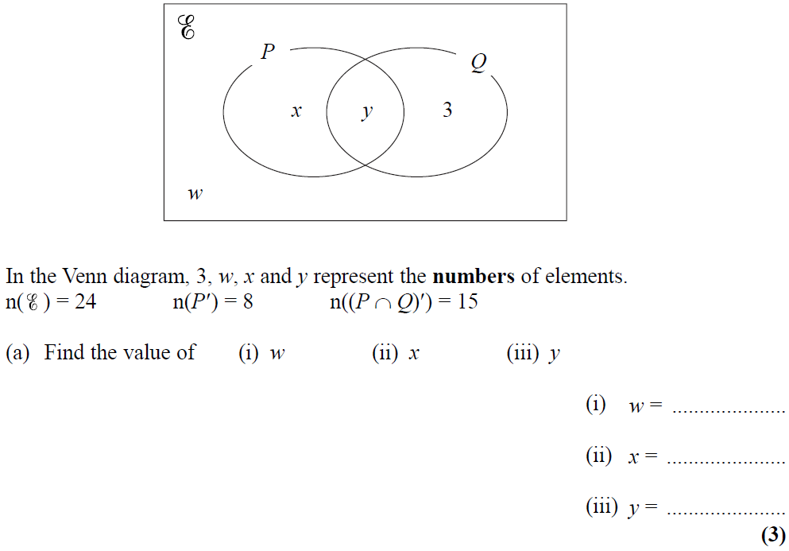
Sets
Nov 2005 3H Q20

Slide 28
Sets
Nov 2005 3H Q20
A (i)
A (ii)
A (iii)
B (i)
B (ii)
B (iii)

Slide 29
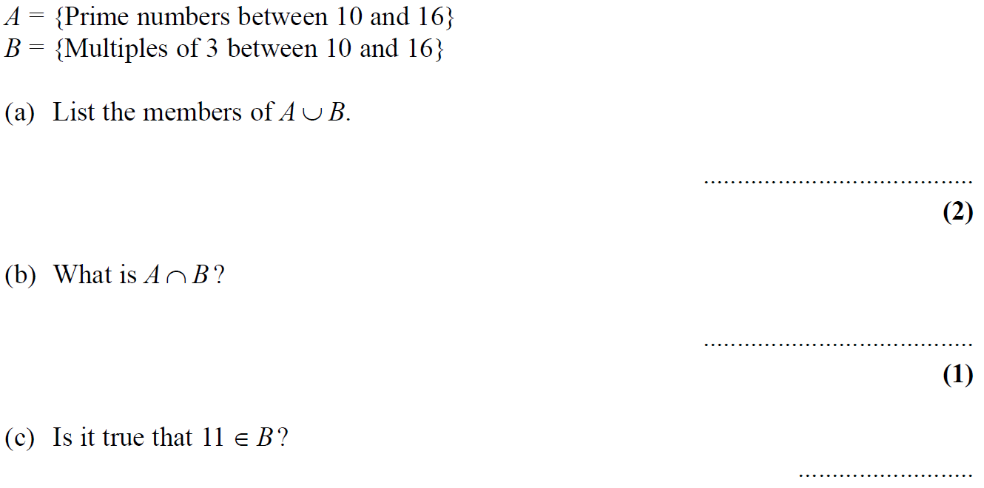
Sets
Nov 2005 4H Q1

Slide 30
Sets
Nov 2005 4H Q1
A
B
C

Slide 31
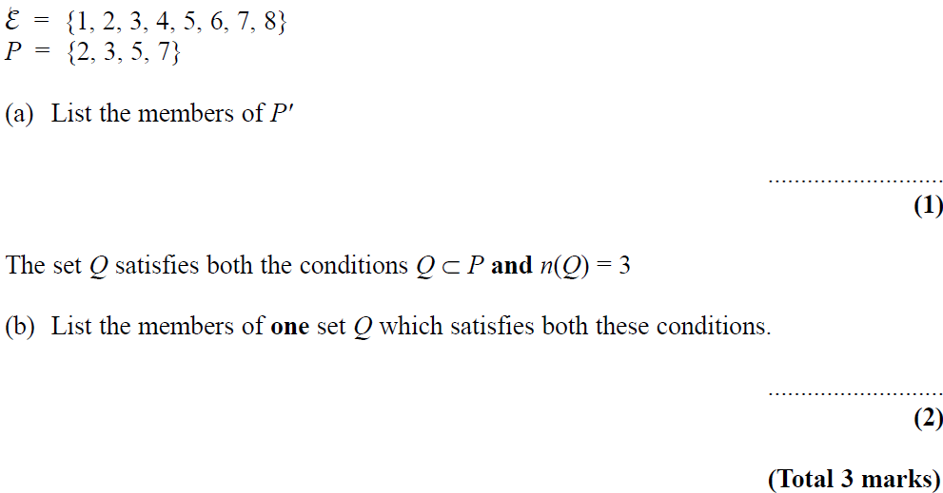
Sets
May 2006 3H Q15

Slide 32
Sets
May 2006 3H Q15
A
B

Slide 33
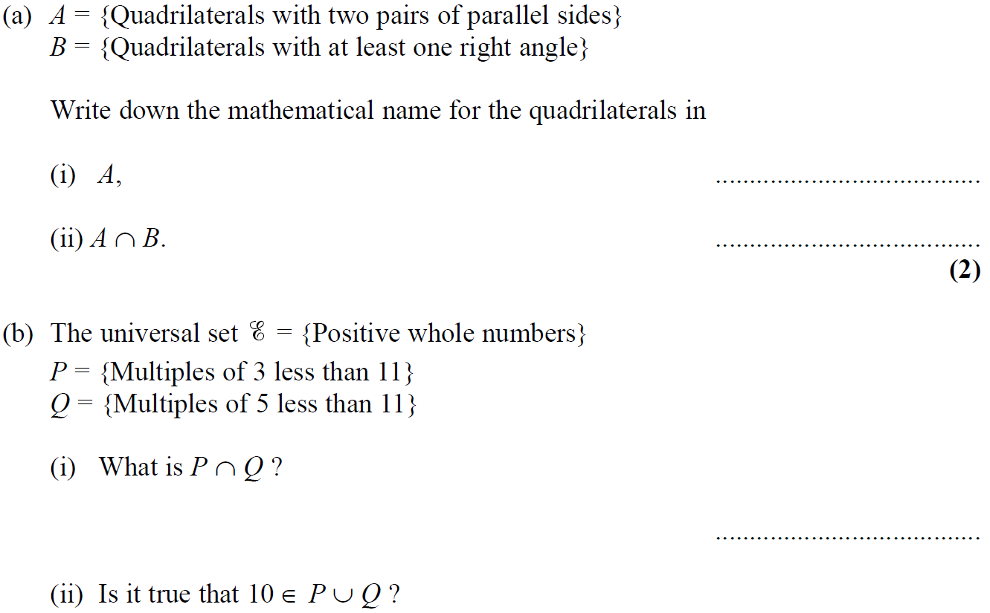
Sets
May 2006 4H Q5

Slide 34
Sets
May 2006 4H Q5
A (i)
A (ii)
B (i)
B (ii)

Slide 35
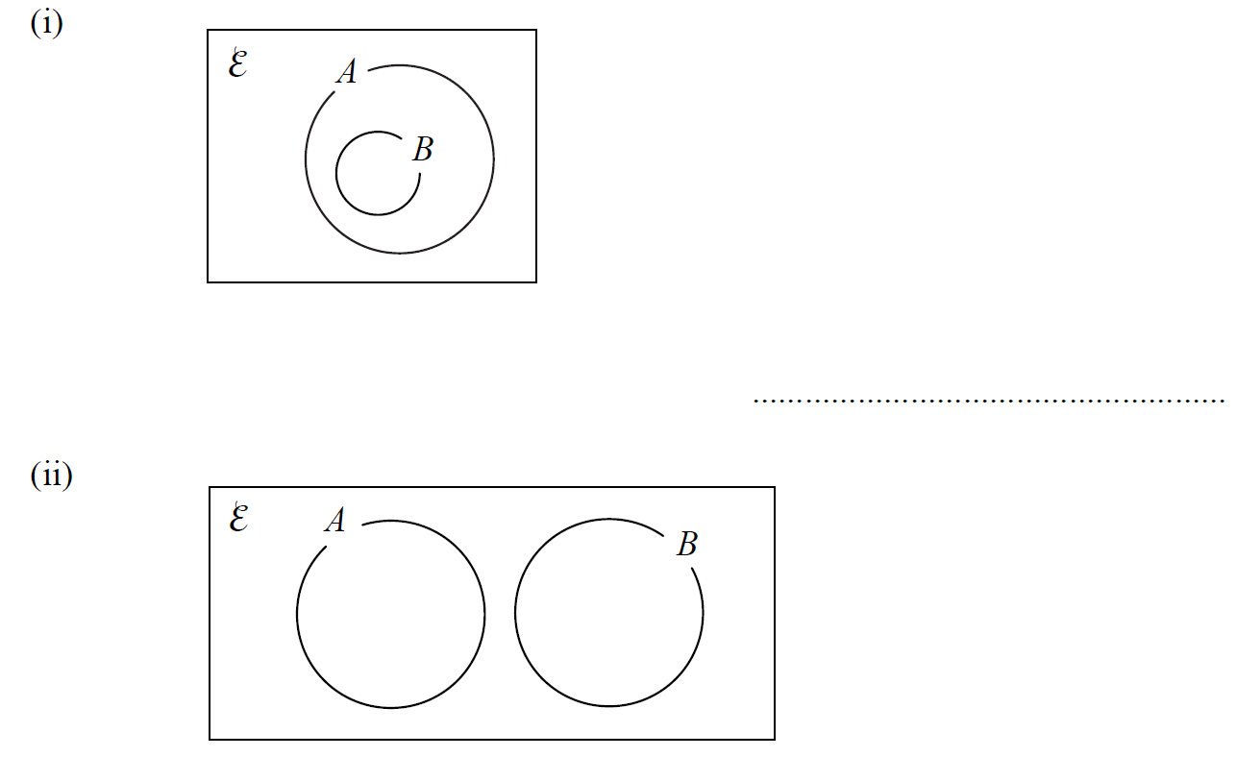
Sets
Nov 2006 3H Q16

Slide 36
Sets
Nov 2006 3H Q16
(i)
(ii)

Slide 37
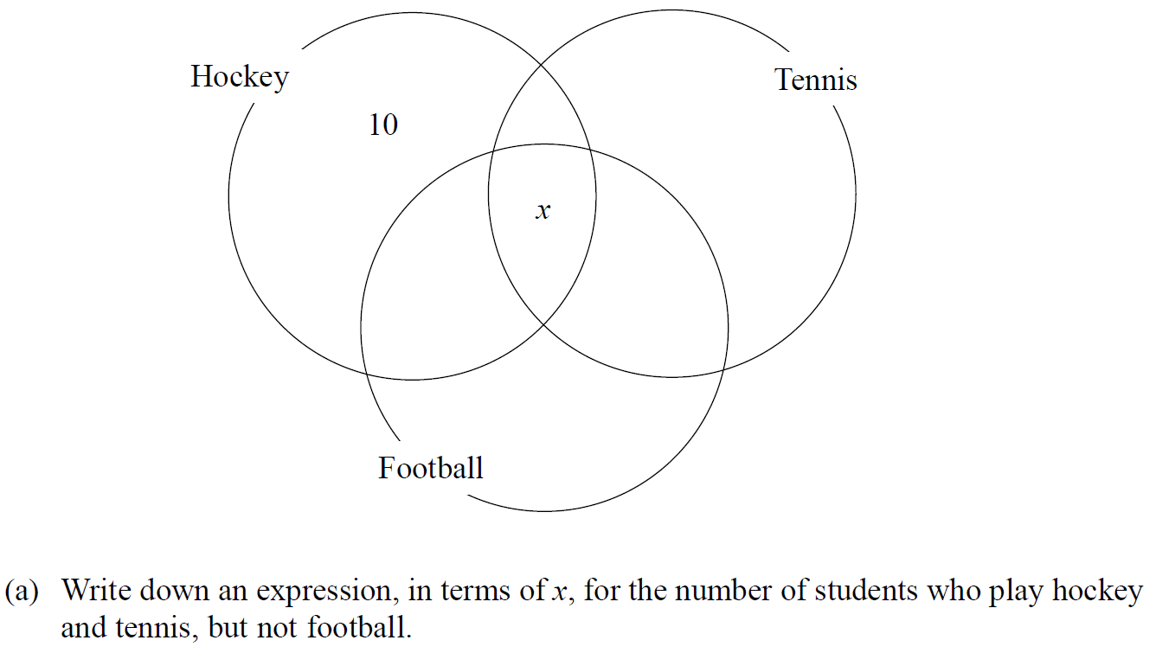
Sets
Nov 2006 3H Q19

Slide 38
Sets
Nov 2006 3H Q19
A
B

Slide 39
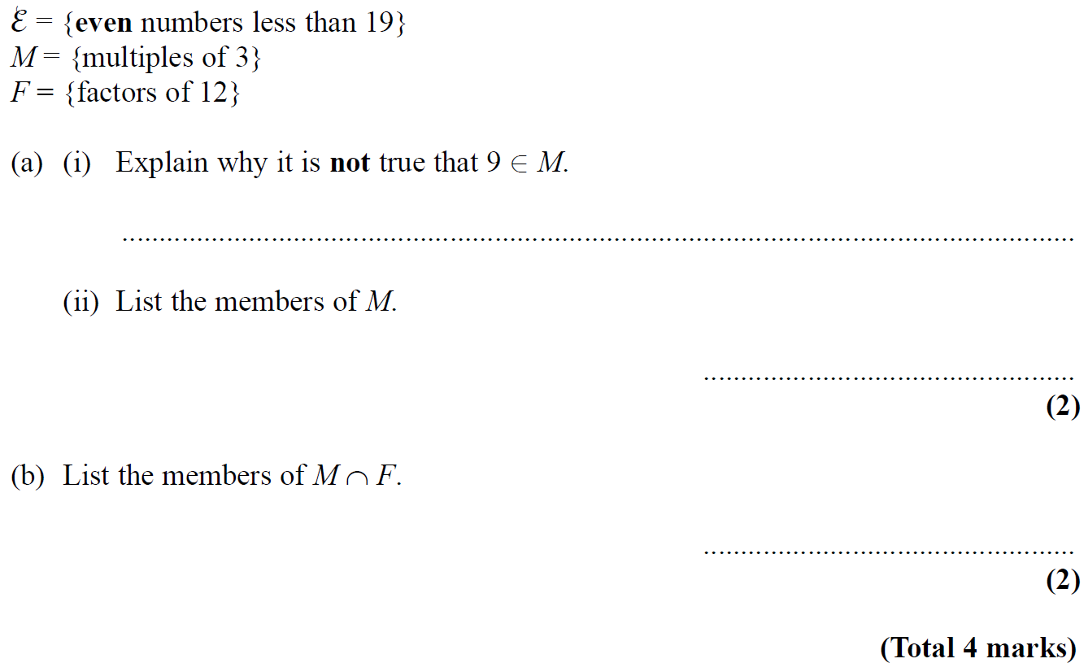
Sets
Nov 2006 4H Q6

Slide 40
Sets
Nov 2006 4H Q6
A (i)
A (ii)
B

Slide 41
Sets
May 2007 4H Q15

Slide 42
Sets
May 2007 4H Q15
A

Slide 43
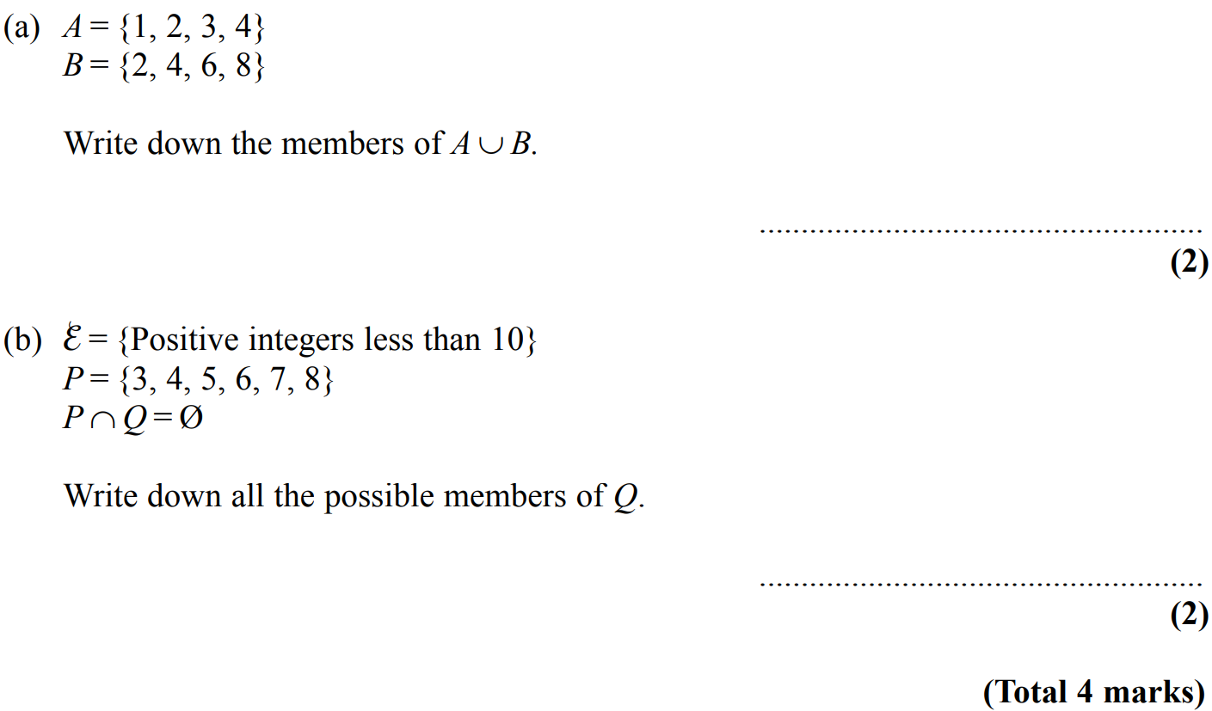
Sets
Nov 2007 3H Q7

Slide 44
Sets
Nov 2007 3H Q7
A
B

Slide 45
Sets
Nov 2007 4H Q19

Slide 46
Sets
Nov 2007 4H Q19
(i)
(ii)
(iii)
(iv)

Slide 47
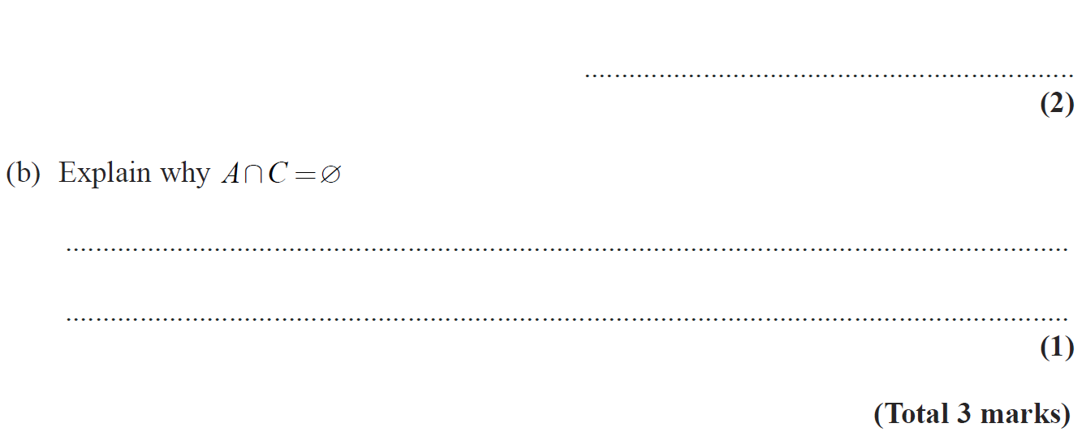
Sets
May 2008 3H Q5

Slide 48
Sets
May 2008 3H Q5
A (i)
A (ii)
B

Slide 49
Sets
Nov 2008 4H Q9

Slide 50
Sets
Nov 2008 4H Q9
A (i)
A (ii)
B (i)
B (ii)

Slide 51
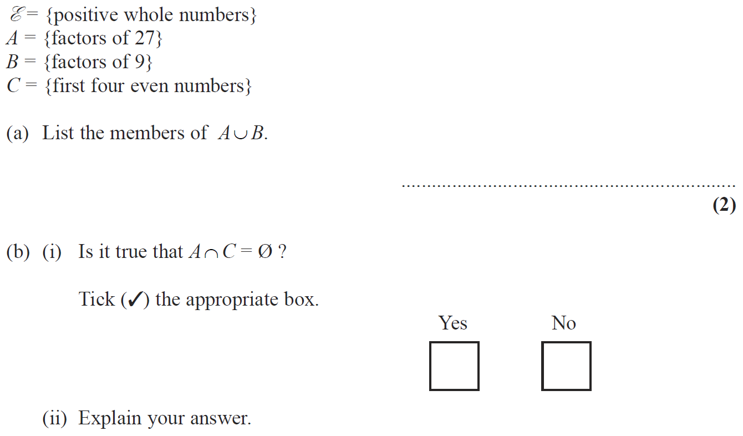
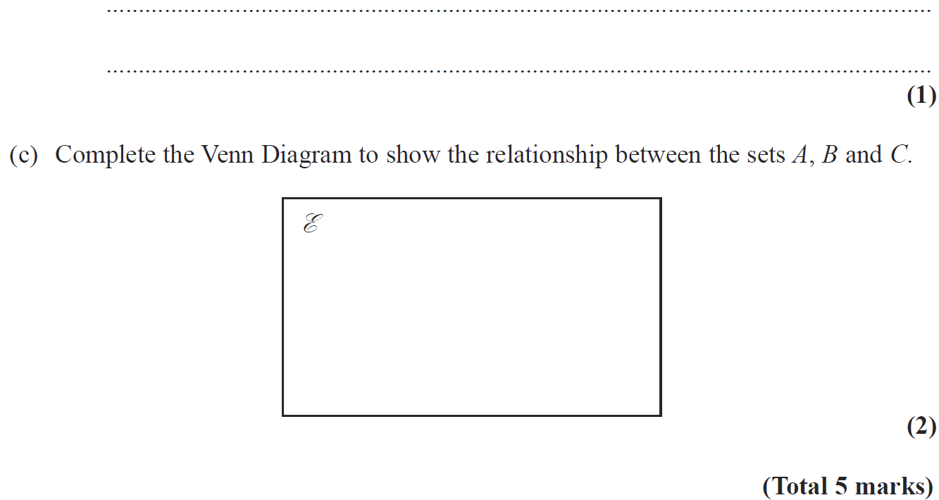
Sets
May 2009 3H Q8

Slide 52
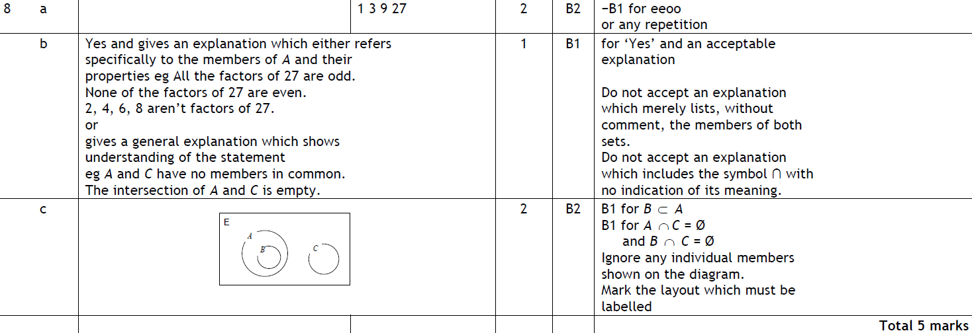
Sets
May 2009 3H Q8
A
B
C

Slide 53
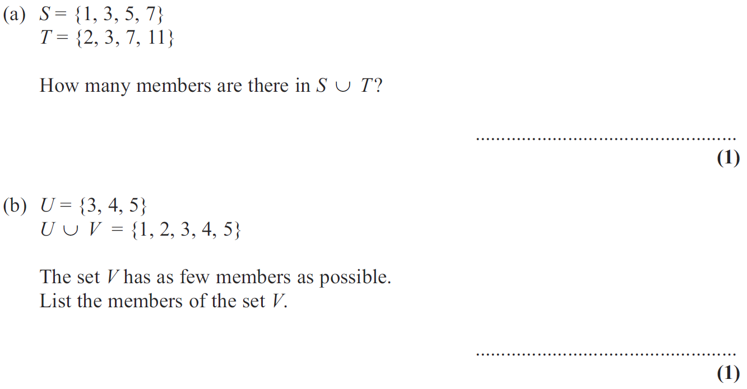
Sets
Nov 2009 3H Q6

Slide 54
Sets
Nov 2009 3H Q6
A
B
C

Slide 55
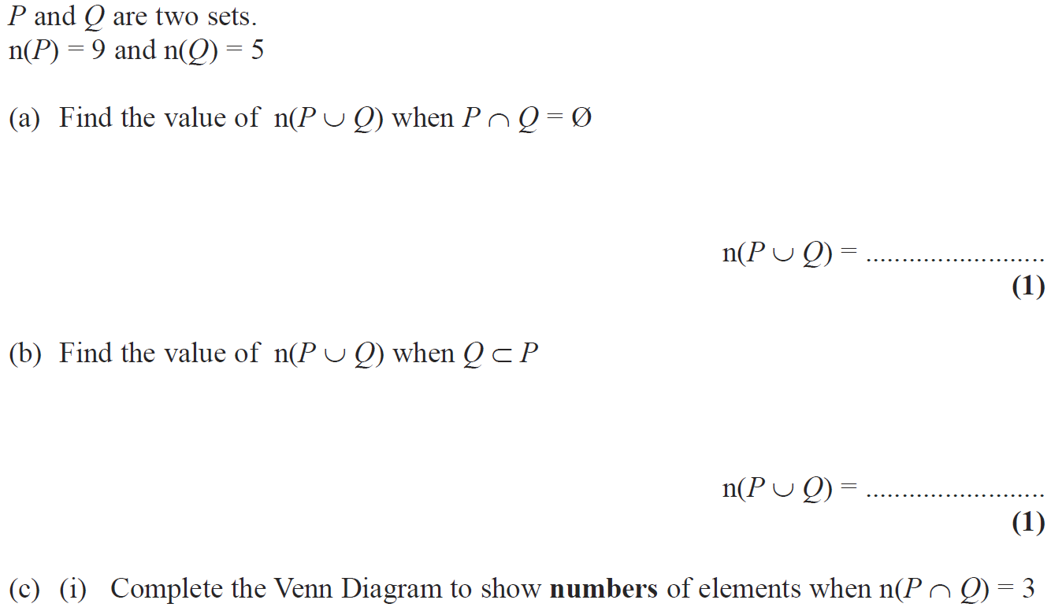
Sets
Nov 2009 4H Q20

Slide 56
Sets
Nov 2009 4H Q20
A
B
C (i)
C (ii)

Slide 57
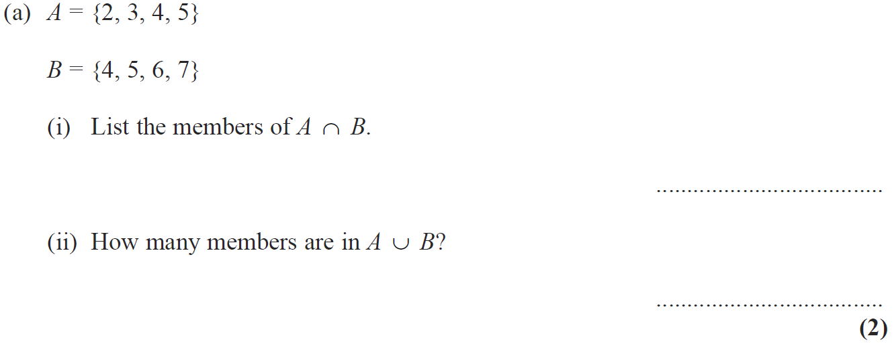
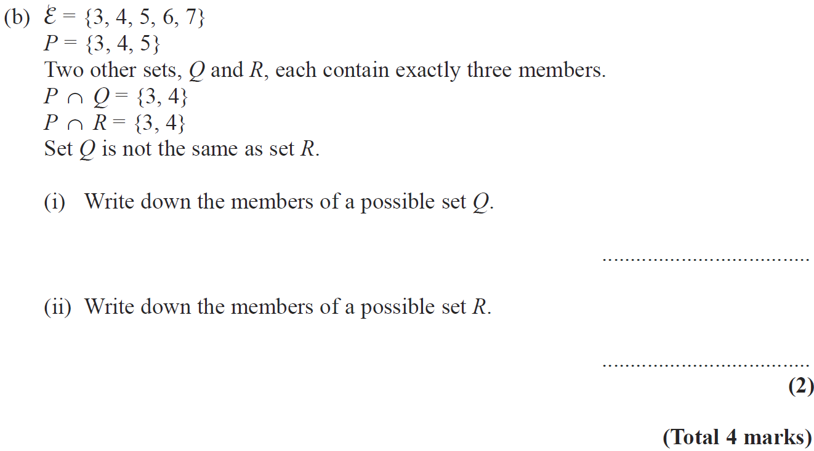
Sets
June 2010 4H Q6

Slide 58
Sets
June 2010 4H Q6
A (i)
A (ii)
B (i)
B (ii)

Slide 59
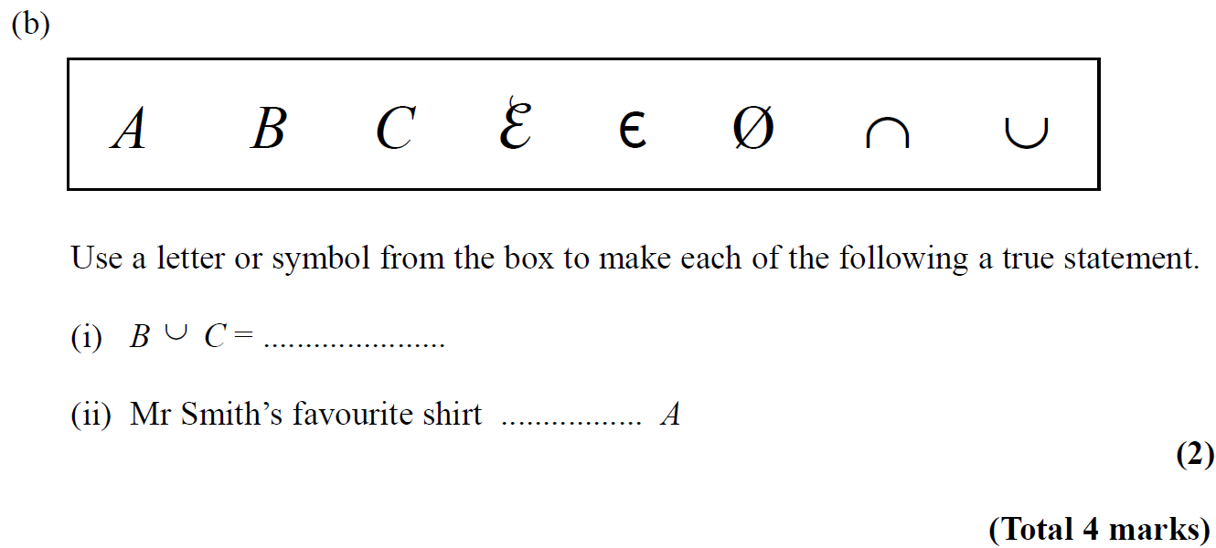
Sets
Nov 2010 3H Q7

Slide 60
Sets
Nov 2010 3H Q7
A (i)
A (ii)
B (i)
B (ii)

Slide 61
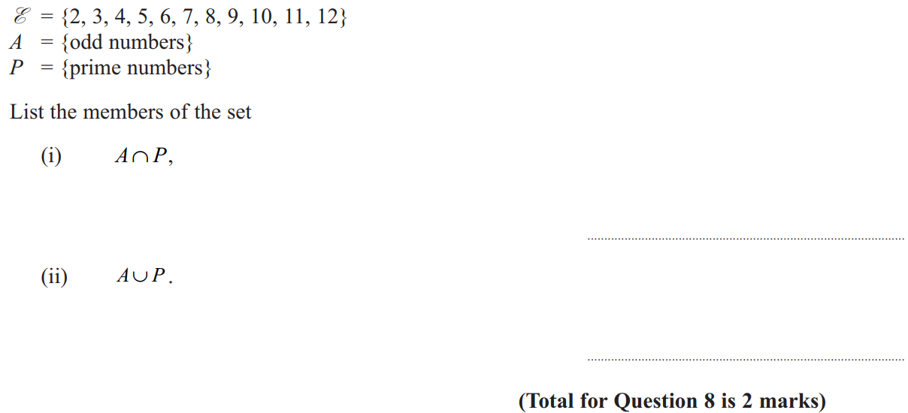
Sets
June 2011 3H Q8

Slide 62
Sets
June 2011 3H Q8
i
ii

Slide 63
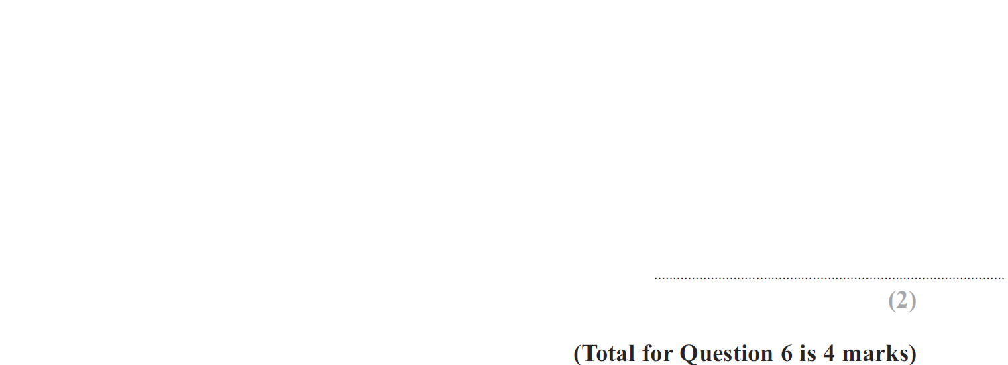
Sets
Jan 2012 3H Q6

Slide 64
Sets
Jan 2012 3H Q6
A (i)
A (ii)
B

Slide 65
Sets
Jan 2012 4H Q19

Slide 66
Sets
Jan 2012 4H Q19
A (i)
A (ii)
B

Slide 67
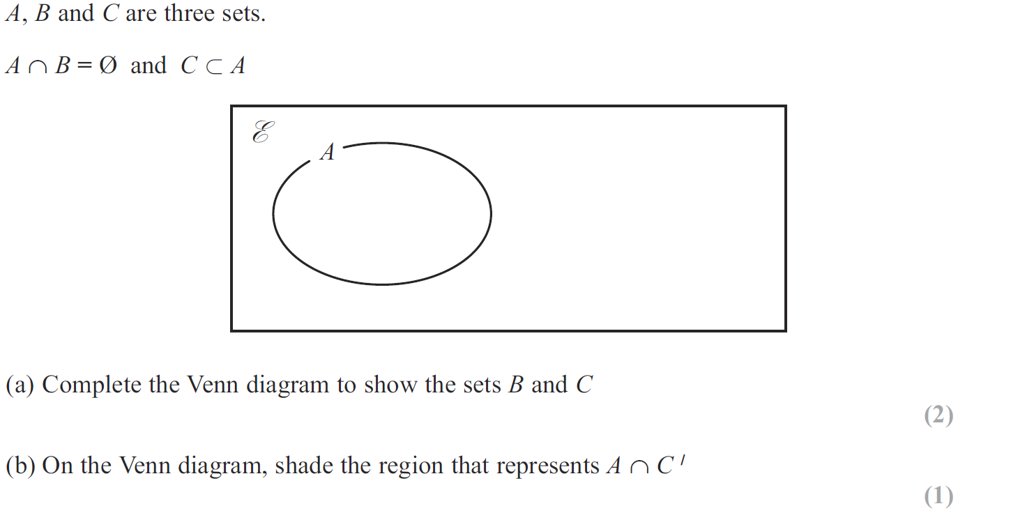
Sets
May 2012 4H Q12

Slide 68
Sets
May 2012 4H Q12
A
B

Slide 69
Sets
May 2012 4H Q14

Slide 70
Sets
May 2012 4H Q14
A

Slide 71
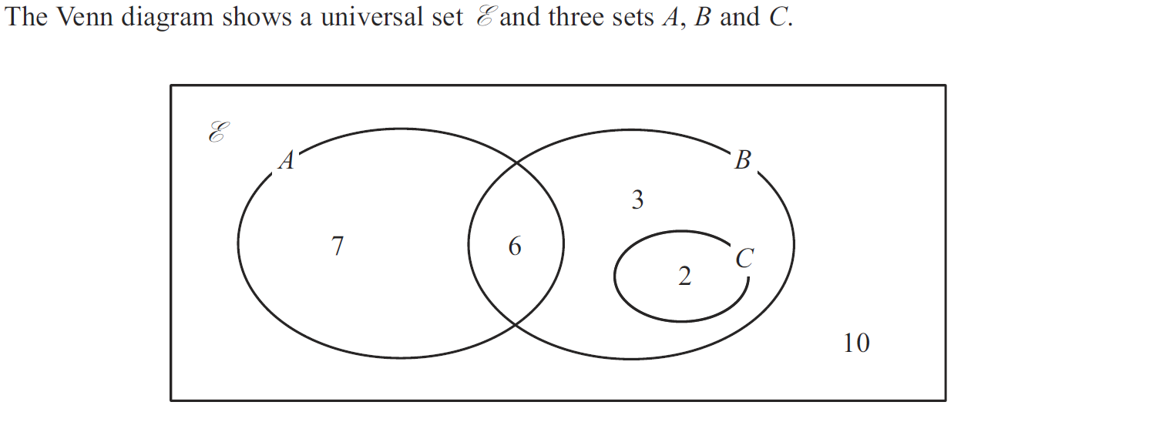
Sets
Jan 2013 3H Q15

Slide 72
Sets
Jan 2013 3H Q15
(i)
(ii)
(iii)
(iv)

Slide 73
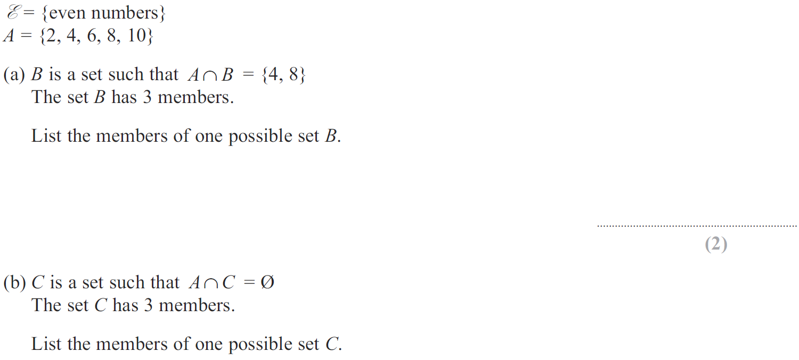
Sets
Jan 2013 4H Q5

Slide 74
Sets
Jan 2013 4H Q5
A
B

Slide 75
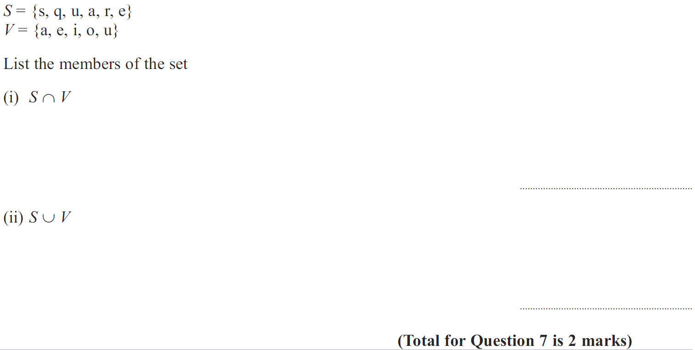
Sets
May 2013 3H Q7

Slide 76
Sets
May 2013 3H Q7
A
B

Slide 77
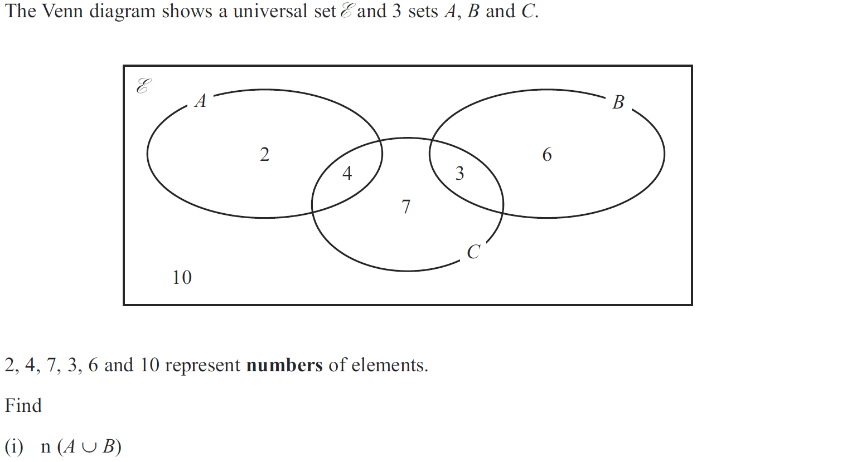
Sets
May 2013 4H Q20

Slide 78
Sets
May 2013 4H Q20
(i)
(ii)
(iii)
(iv)

Slide 79
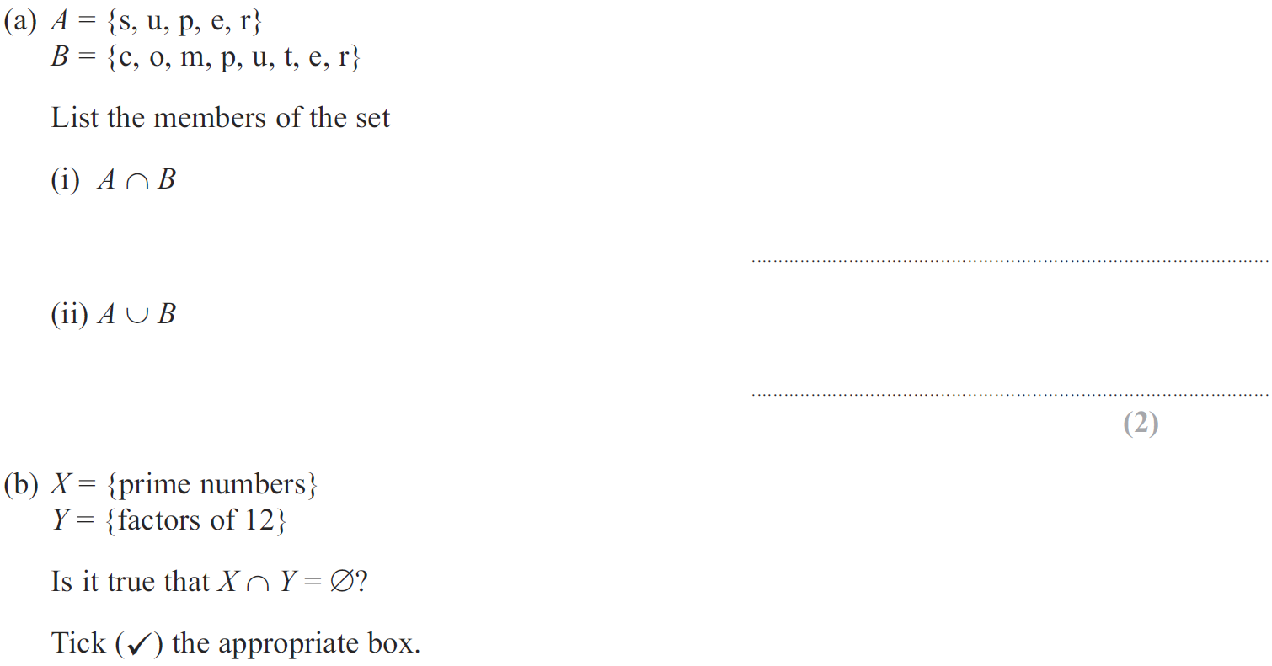
Sets
May 2013 3HR Q8

Slide 80
Sets
May 2013 3HR Q8
A (i)
A (ii)
B

Slide 81
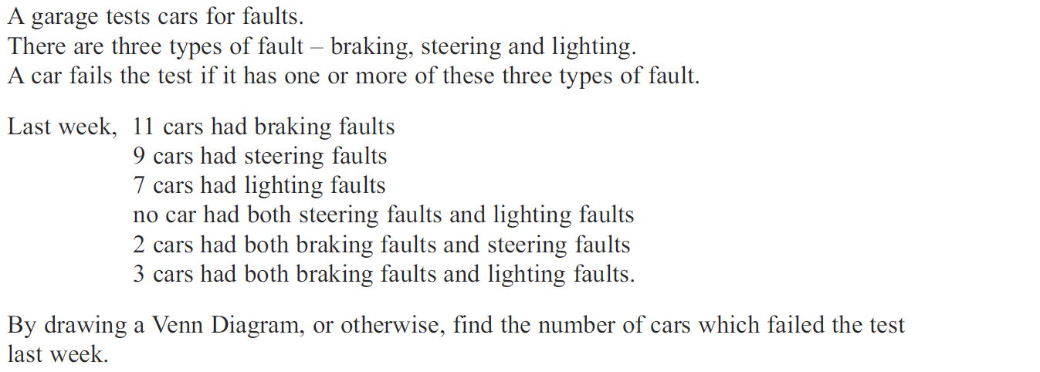
Sets
May 2013 3HR Q21

Slide 82
Sets
May 2013 3HR Q21
A

Slide 83
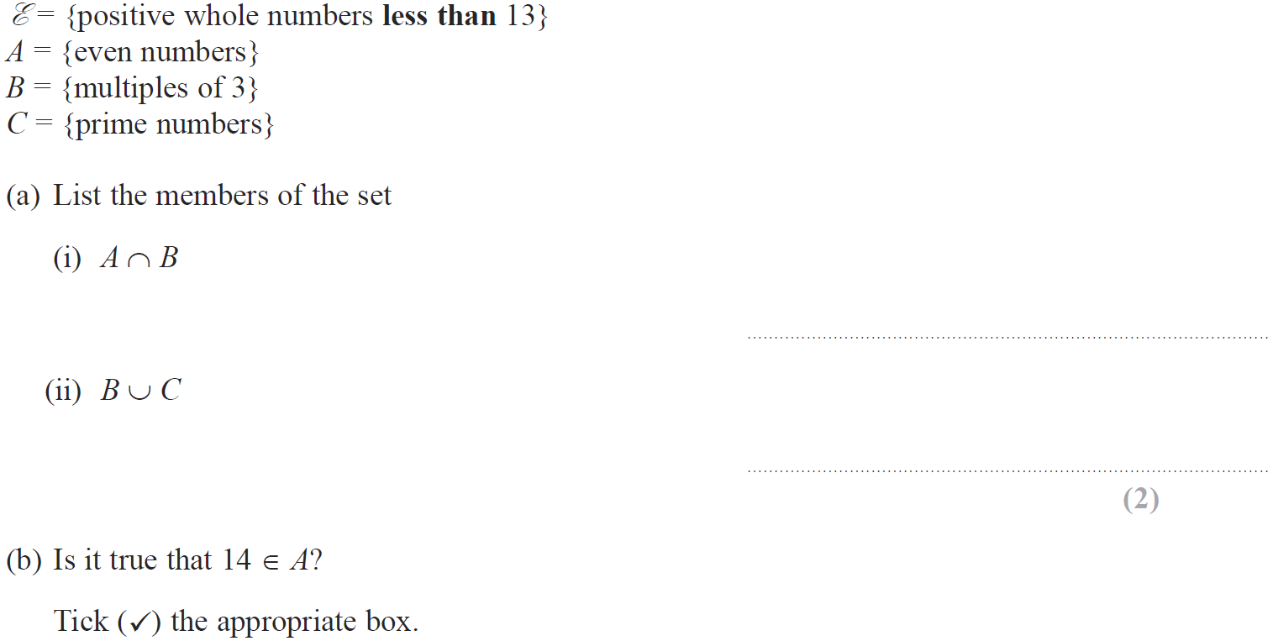
Sets
Jan 2014 4H Q9

Slide 84
Sets
Jan 2014 4H Q9
A (i)
A (ii)
B

Slide 85
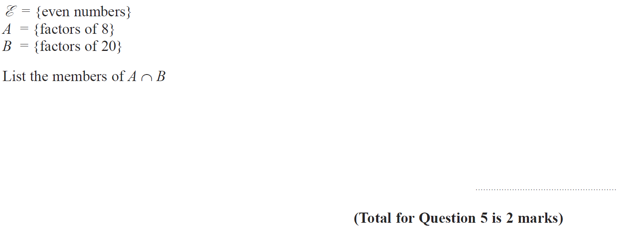
Sets
Jan 2014 3HR Q5

Slide 86
Sets
Jan 2014 3HR Q5
A

Slide 87
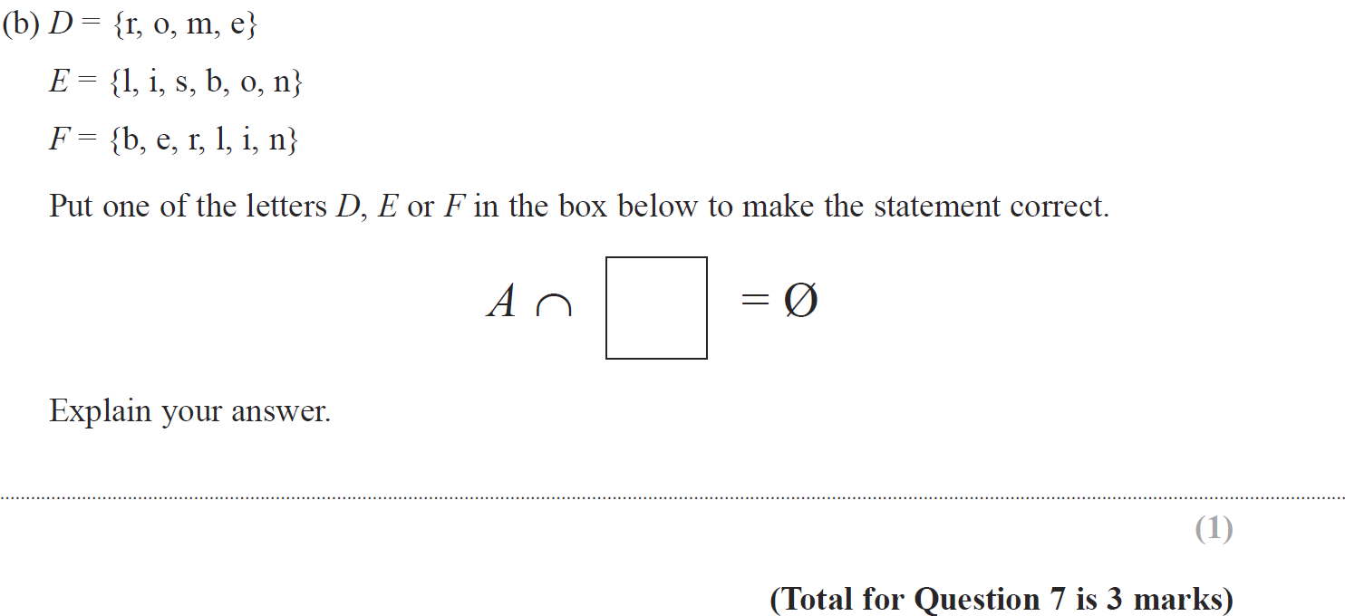
Sets
May 2014 3H Q7

Slide 88
Sets
May 2014 3H Q7
A (i)
A (ii)
B

Slide 89
Sets
May 2014 3HR Q2

Slide 90
Sets
May 2014 3HR Q2
A
B
C

Slide 91
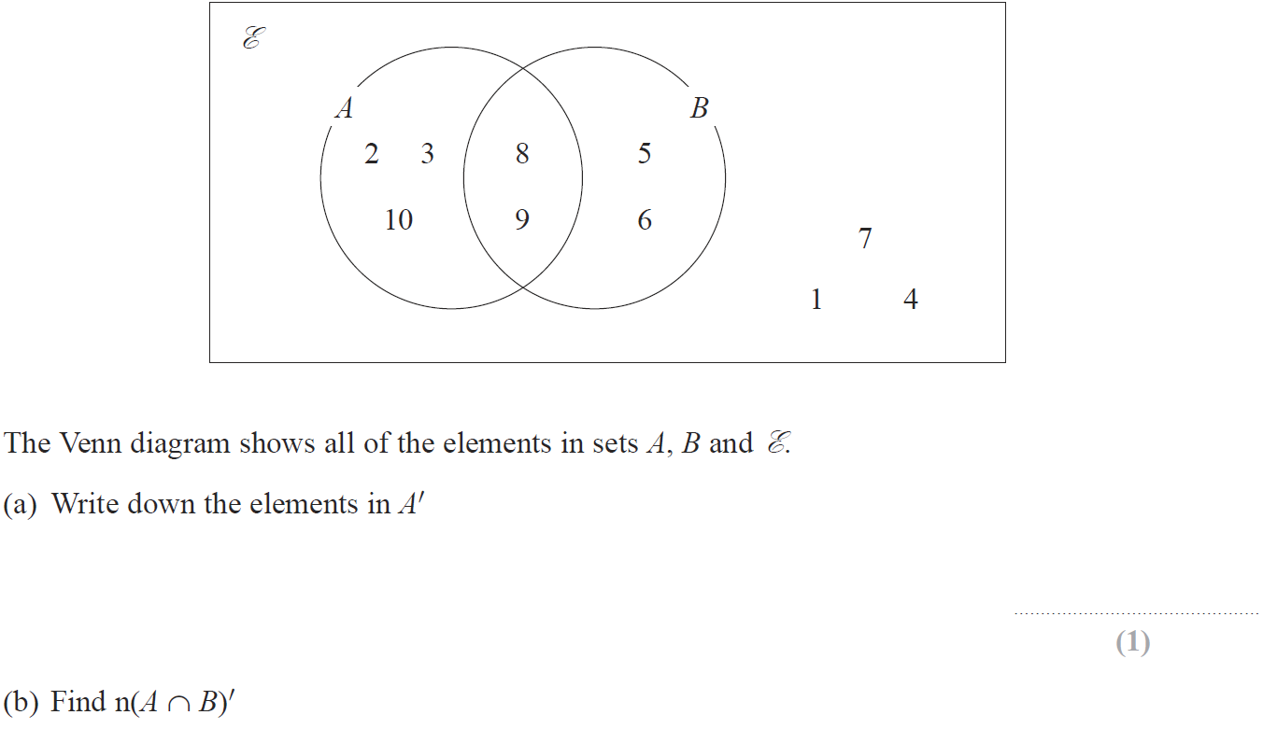
Sets
Jan 2015 3H Q19

Slide 92
Sets
Jan 2015 3H Q19
A
B
C
D

Slide 93
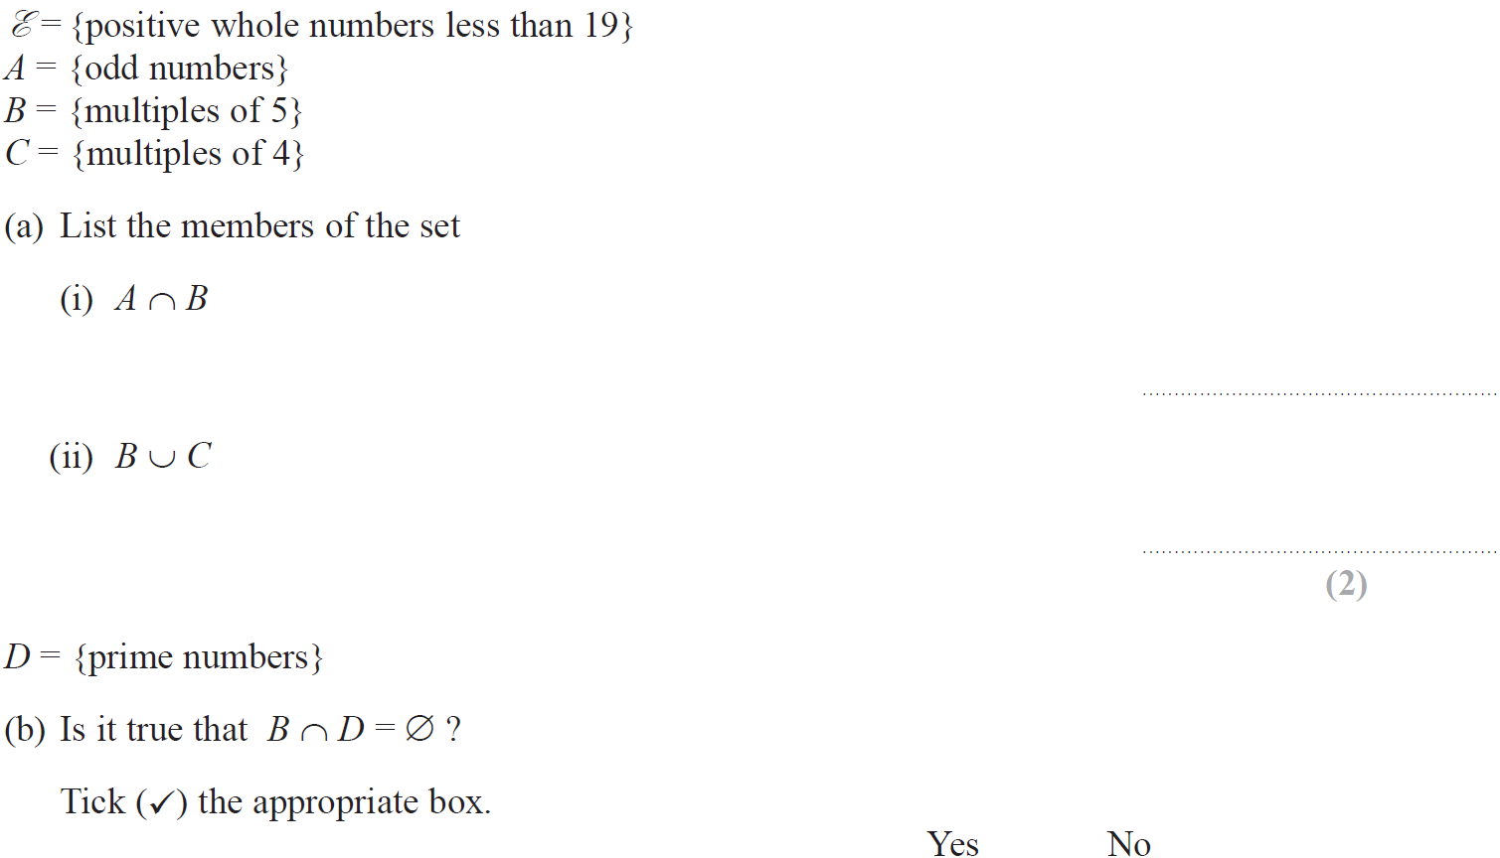
Sets
Jan 2015 4H Q6

Slide 94
Sets
Jan 2015 4H Q6
A (i)
A (ii)
B

Slide 95
Sets
Jan 2015 4HR Q9

Slide 96
Sets
Jan 2015 4HR Q9
A
B
C
D

Slide 97
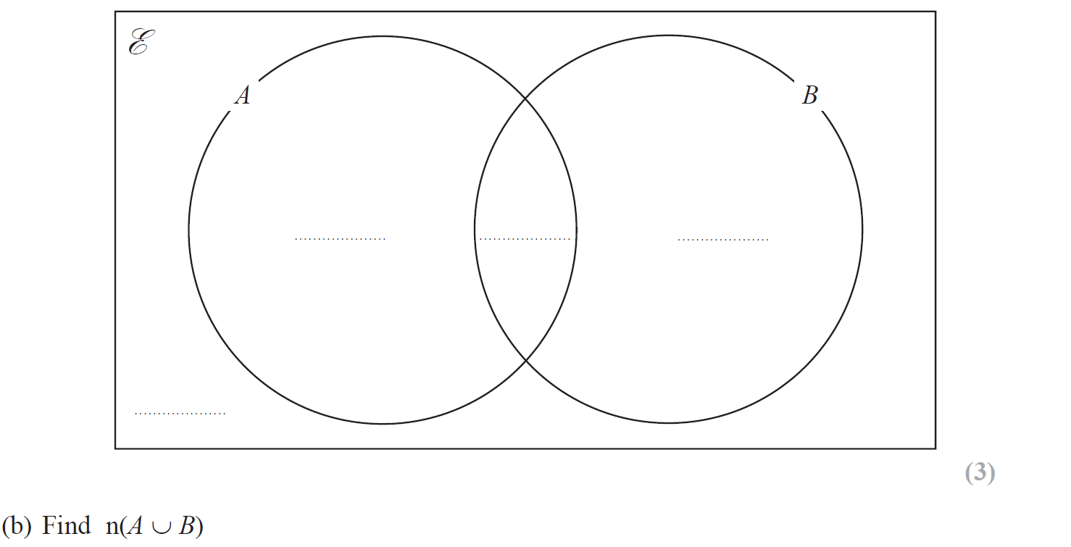
Sets
June 2015 4H Q18

Slide 98
Sets
June 2015 4H Q18
A
B
C

Slide 99
Sets
June 2015 4HR Q1

Slide 100
Sets
June 2015 4HR Q1
(i)
(ii)

Slide 101
Sets
Jan 2016 3H Q7

Slide 102
Sets
Jan 2016 3H Q7
A
B

Slide 103
Sets
Jan 2016 3HR Q17

Slide 104
Sets
Jan 2016 3HR Q17
A
B
C
D

Slide 105
Sets
Jan 2016 4HR Q4

Slide 106
Sets
Jan 2016 4HR Q4
A

Slide 107
Sets
May 2016 3H Q4

Slide 108
Sets
May 2016 3H Q4
A (i)
A (ii)
B

Slide 109
Sets
June 2016 4H Q21

Slide 110
Sets
June 2016 4H Q21
A
B

Slide 111
Sets
June 2016 4HR Q18

Slide 112
Sets
June 2016 4HR Q18
A
B (i)
B (ii)

Slide 113
Sets
Jan 2017 3H Q21

Slide 114
Sets
Jan 2017 3H Q21
A
B
C

Slide 115
Sets
Jan 2017 4H Q7

Slide 116
Sets
Jan 2017 4H Q7
A
B

Slide 117
Sets
Jan 2017 4HR Q5

Slide 118
Sets
Jan 2017 4HR Q5
A (i)
A (ii)
B

Slide 119
Sets
May 2017 3H Q18

Slide 120
Sets
May 2017 3H Q18
A
B (i)
B (ii)

Slide 121
Sets
June 2017 4H Q1

Slide 122
Sets
June 2017 4H Q1
A (i)
A (ii)
B

Slide 123
Sets
June 2017 4HR Q2

Slide 124
Sets
June 2017 4HR Q2
A (i)
A (ii)
B

Slide 125
Sets
Jan 2018 4H Q9

Slide 126
Sets
Jan 2018 4H Q9
A
B
C

Slide 127
Sets
Jan 2018 3HR Q10

Slide 128
Sets
Jan 2018 3HR Q10
A
B

Slide 129
Sets
June 2018 4H Q17

Slide 130
Sets
June 2018 4H Q17
A
B (i)
B (ii)
A

Slide 131
Sets
May 2018 3HR Q6

Slide 132
Sets
May 2018 3HR Q6
A
B
C

