Slide 1
Old Spec Q’s
Series
differences
SAM
SAM 1
2018
2019 1
2019

Slide 2
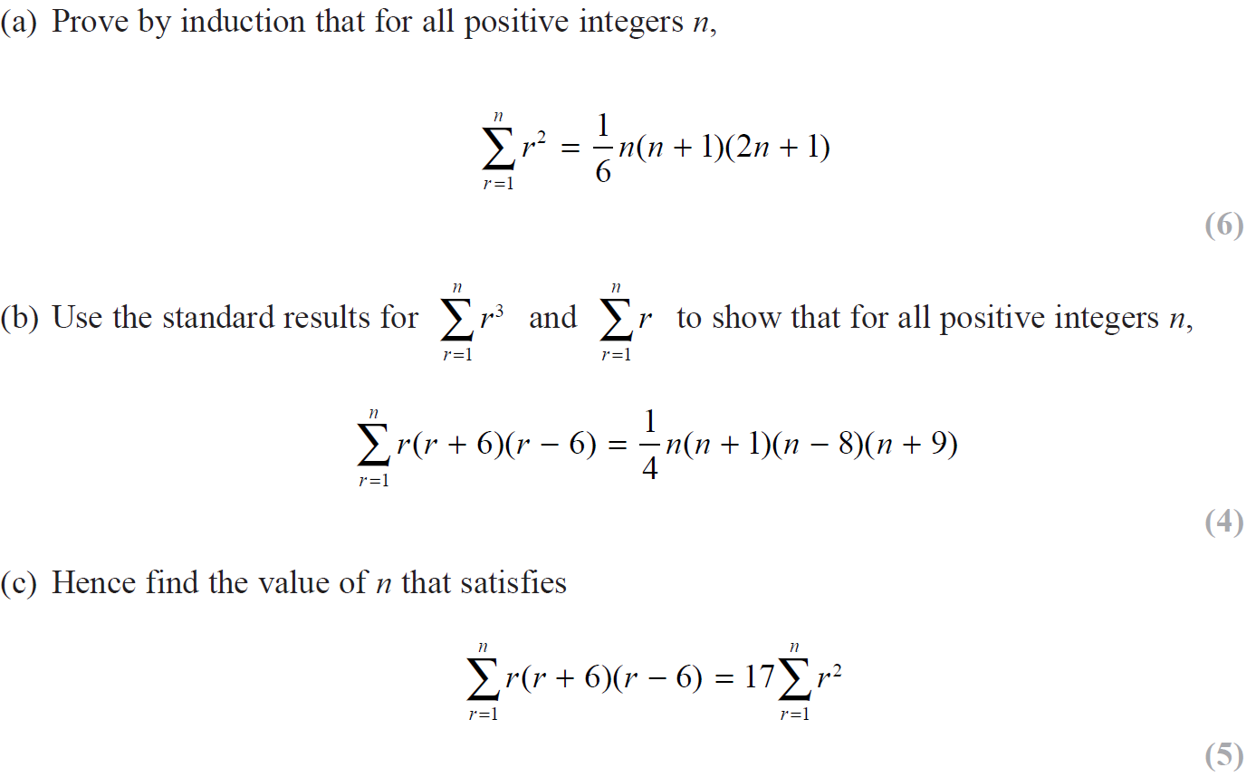
SAM

Slide 3
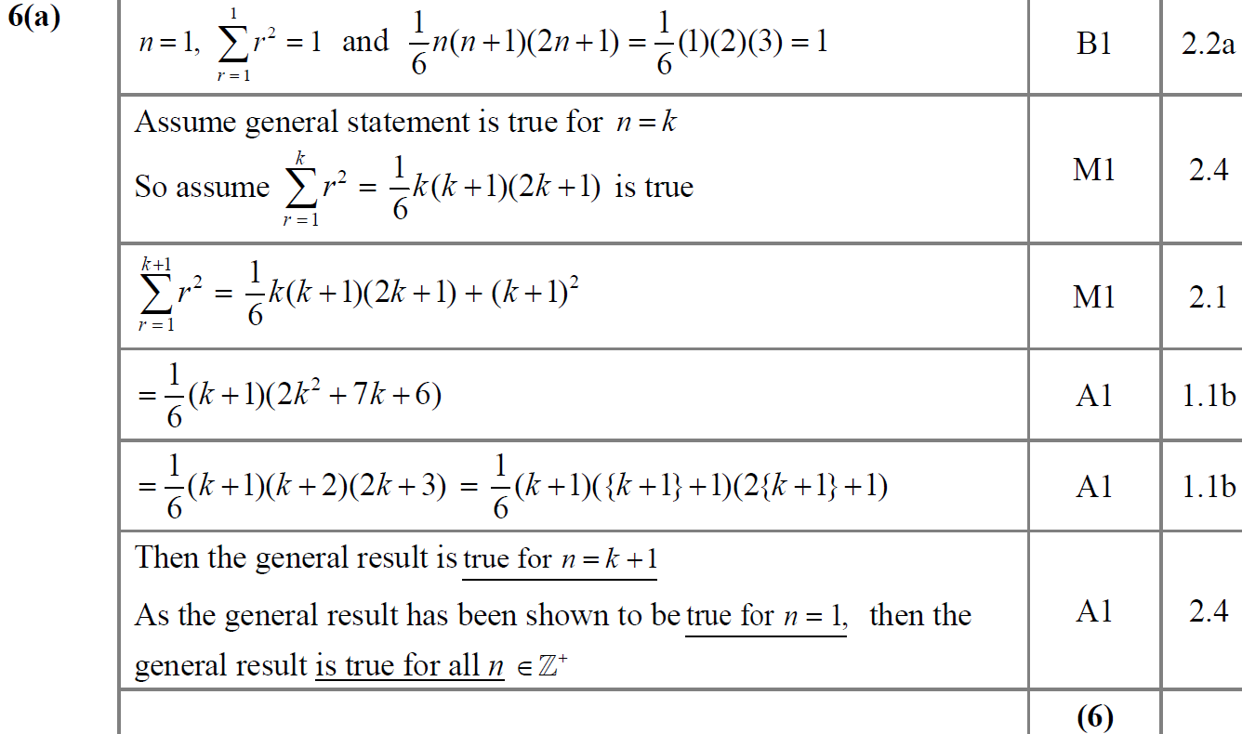
SAM
A

Slide 4
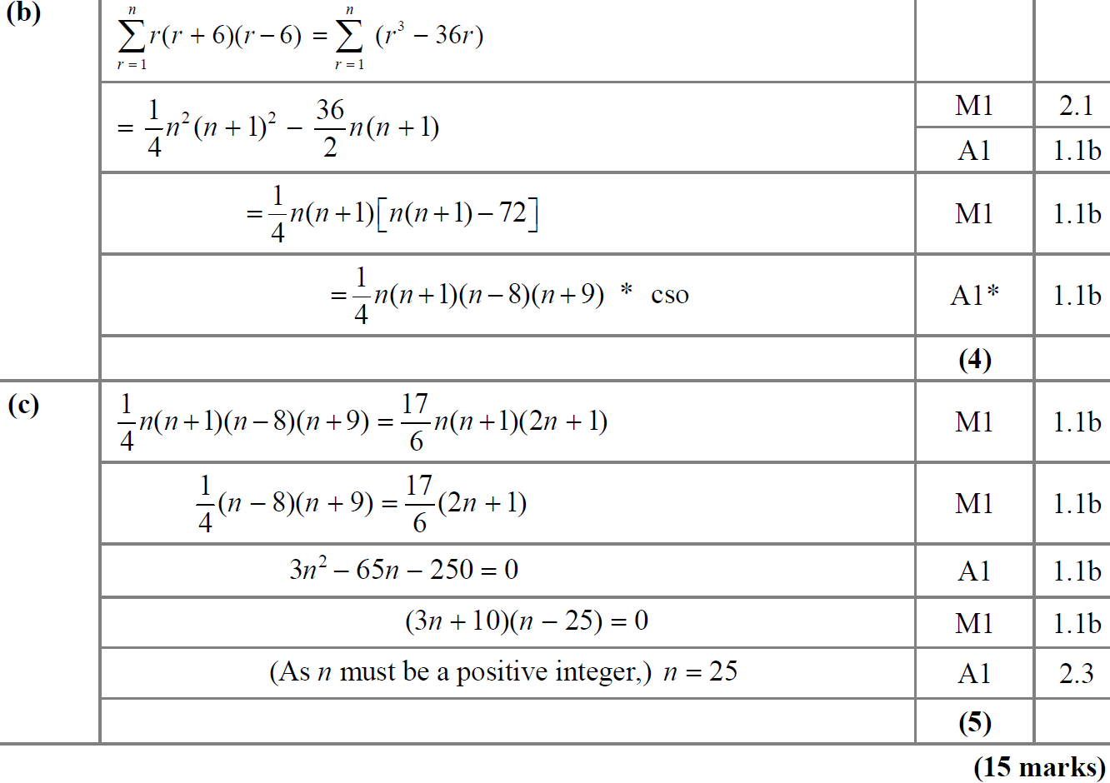
SAM
B
C

Slide 5
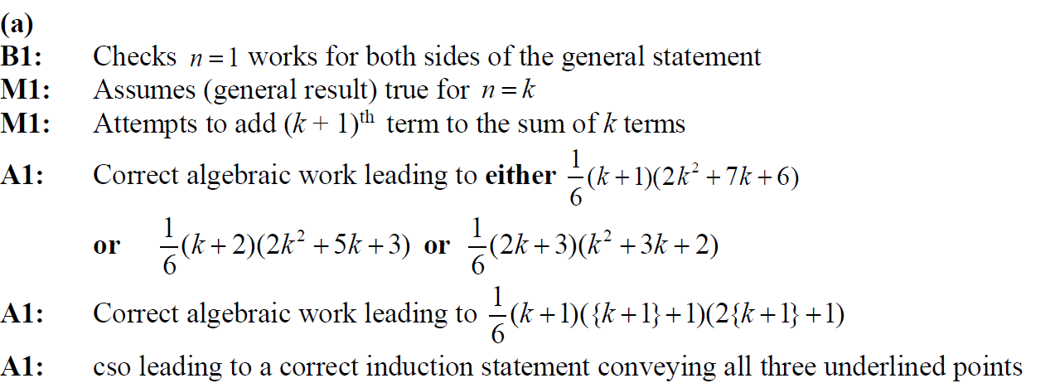
SAM
A notes

Slide 6
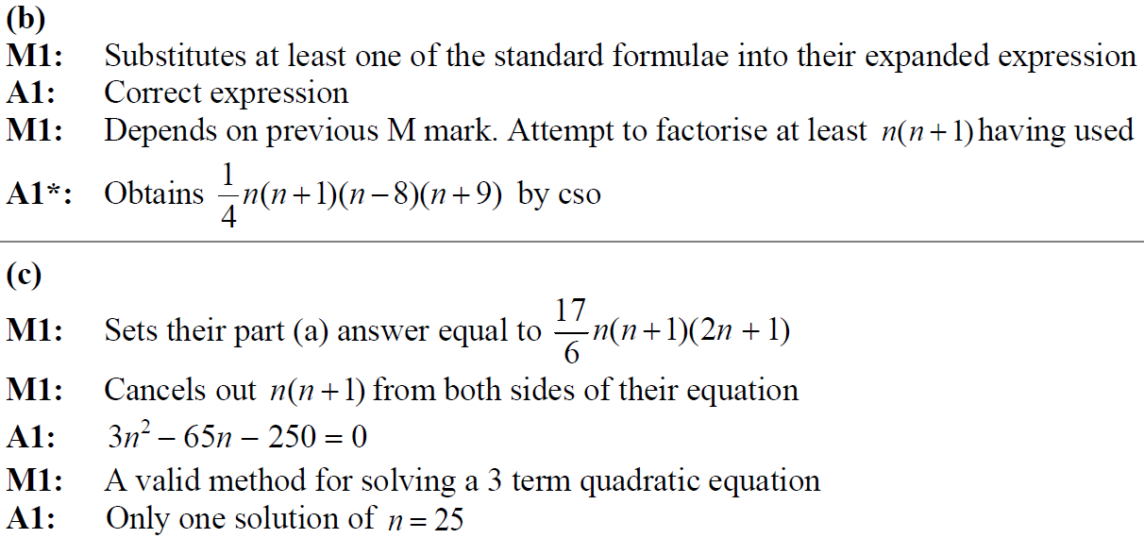
SAM
B notes
C notes

Slide 7
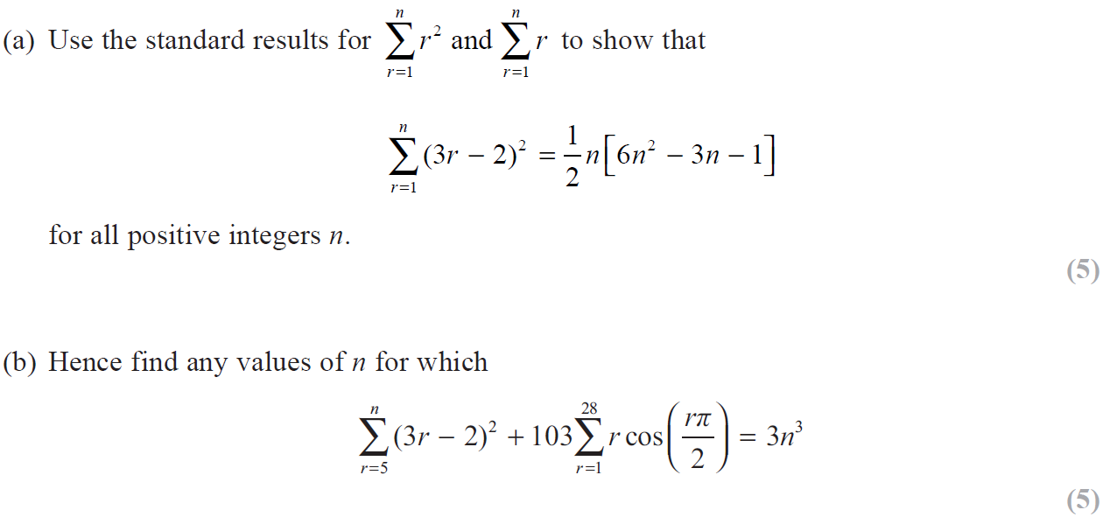
2018

Slide 8
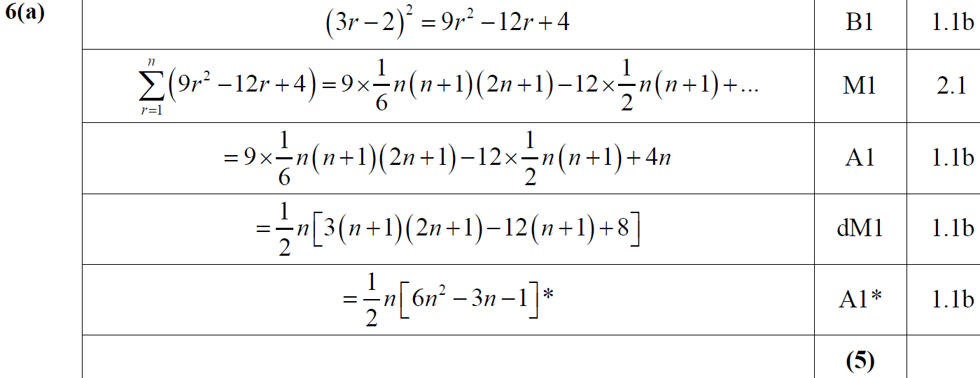
2018
A

Slide 9
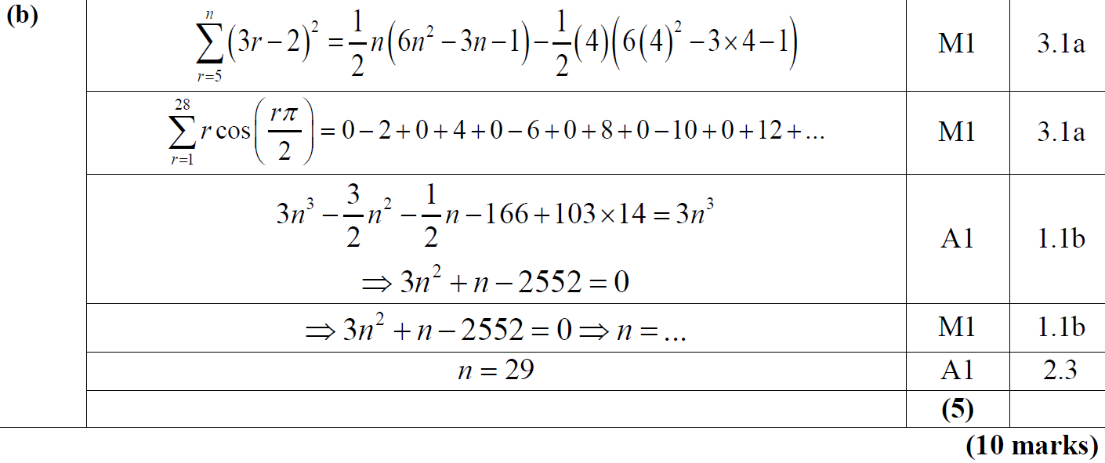
2018
B

Slide 10
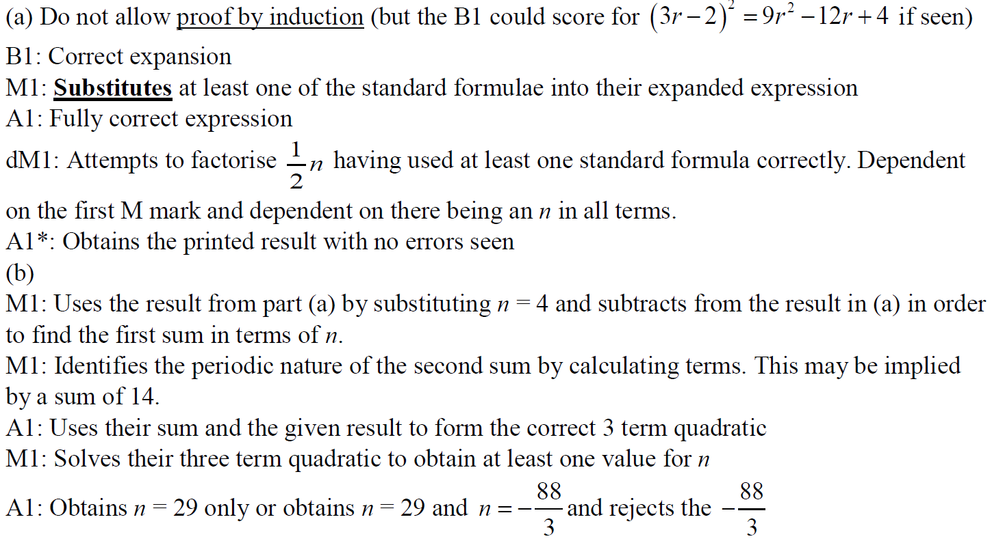
2018
A notes
B notes

Slide 11
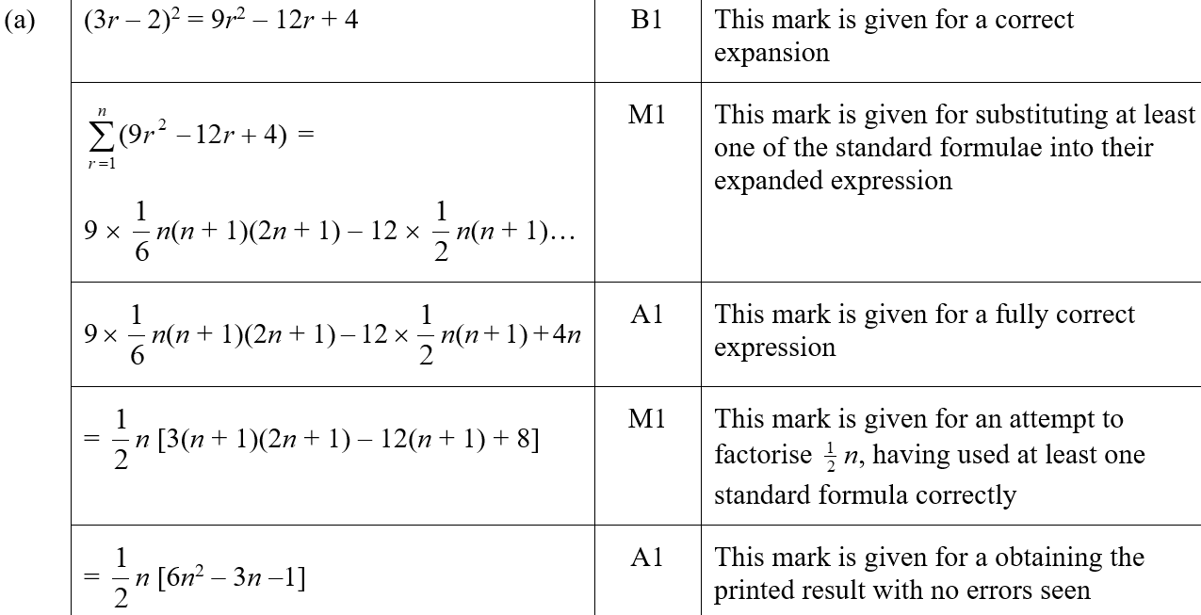
2018
A SF

Slide 12
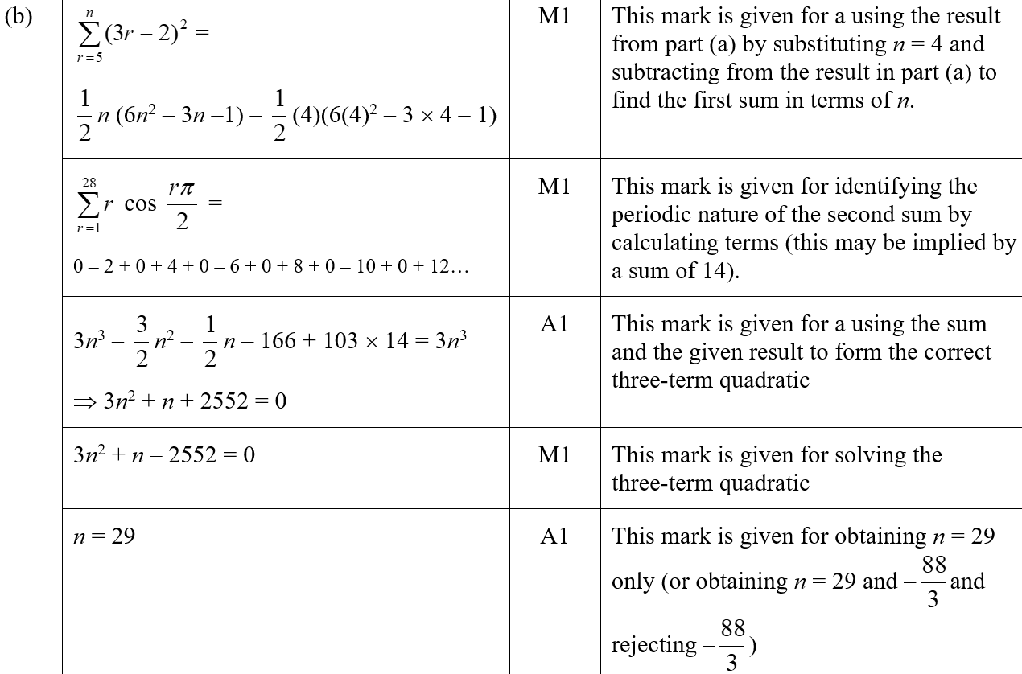
2018
B SF

Slide 13
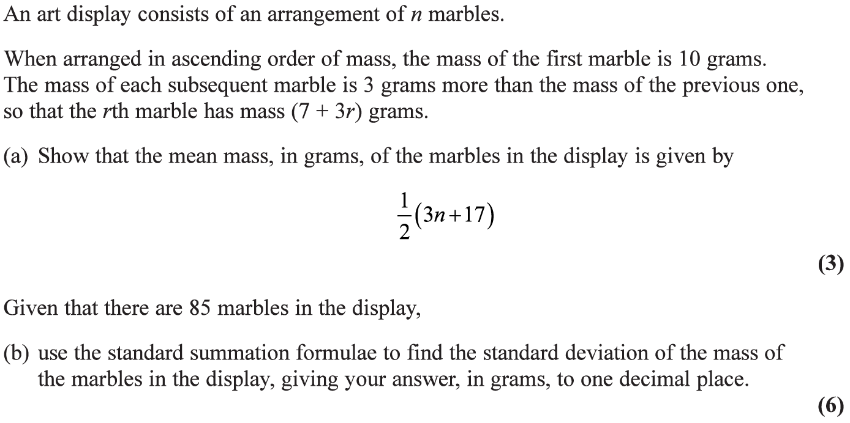
2019

Slide 14
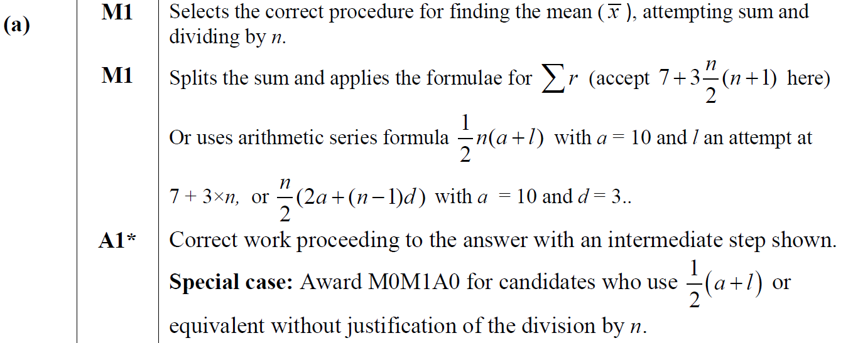
2019
A

Slide 15
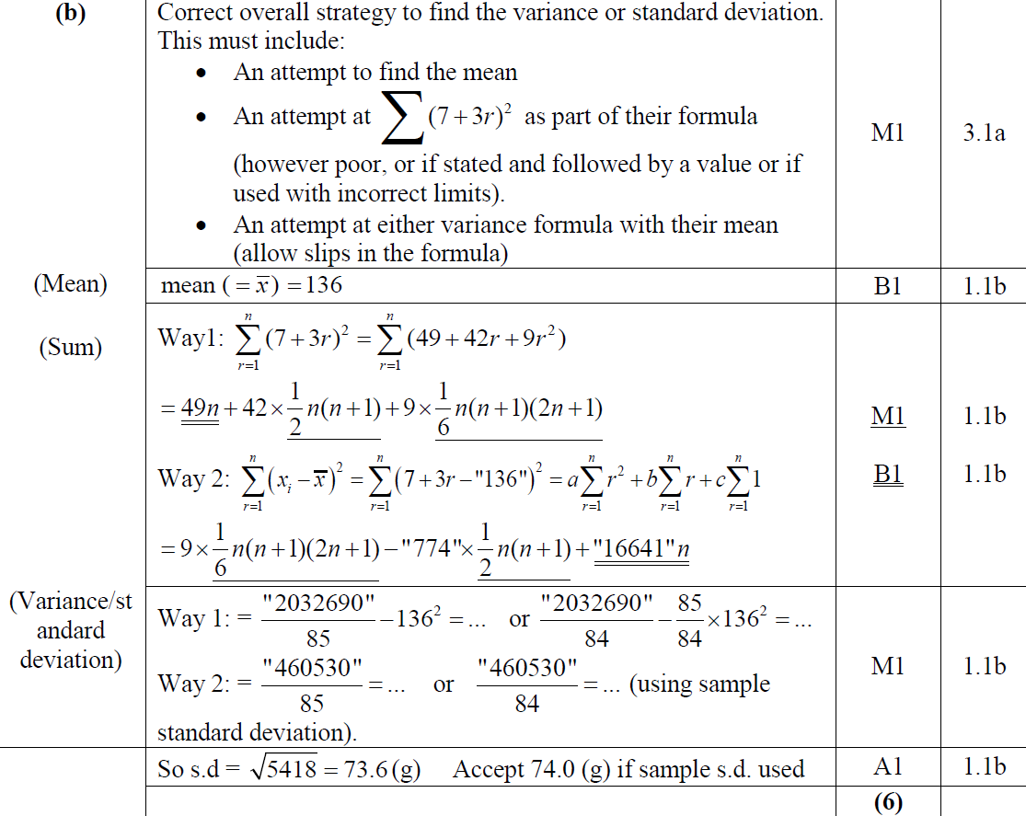
2019
B

Slide 16
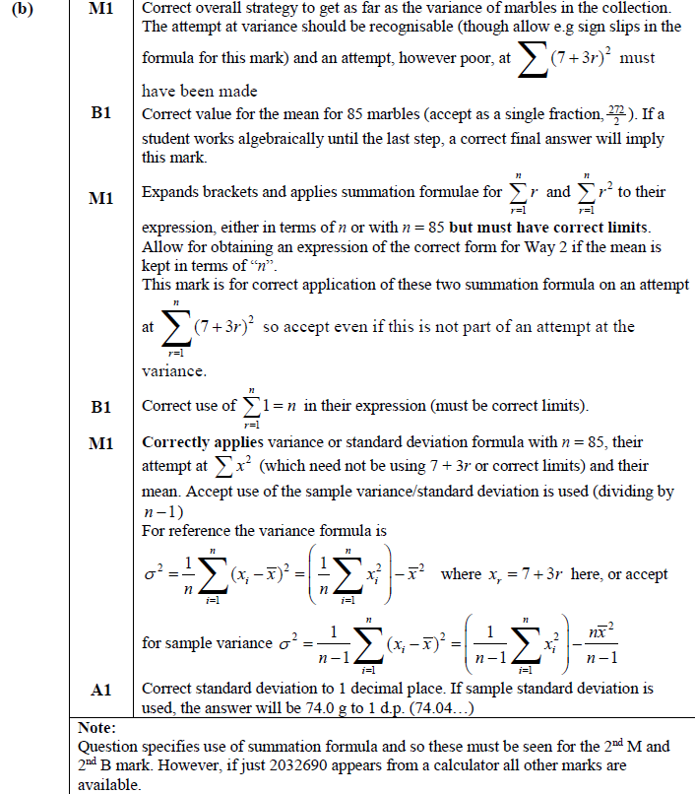
2019
B notes

Slide 17
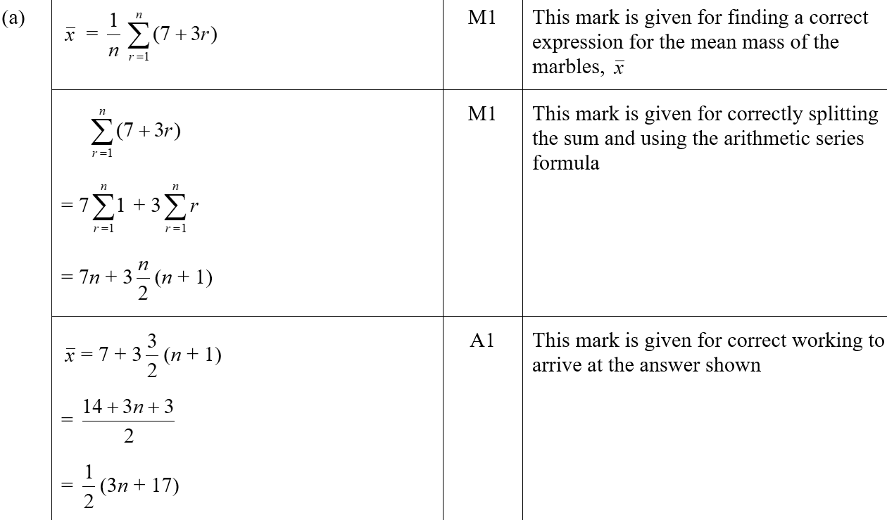
2019
A SF

Slide 18
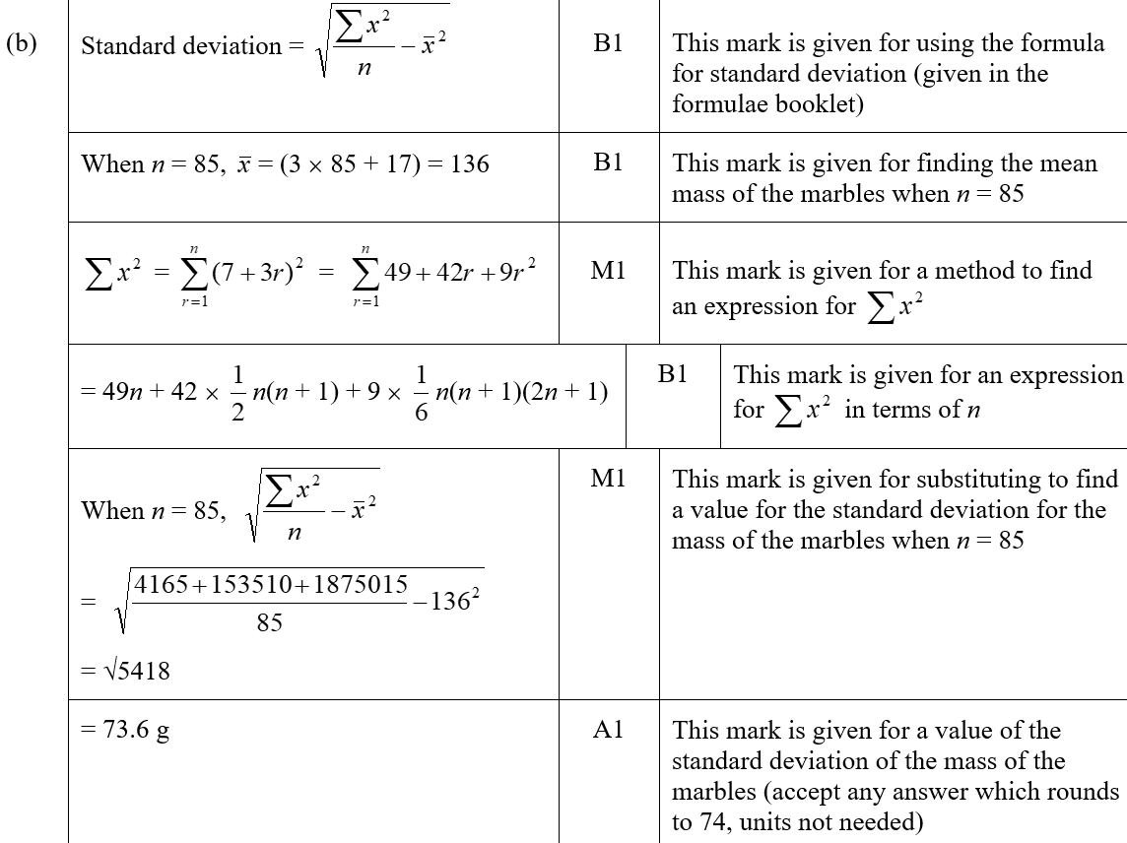
2019
B SF

Slide 19
SAM Paper 1

Slide 20
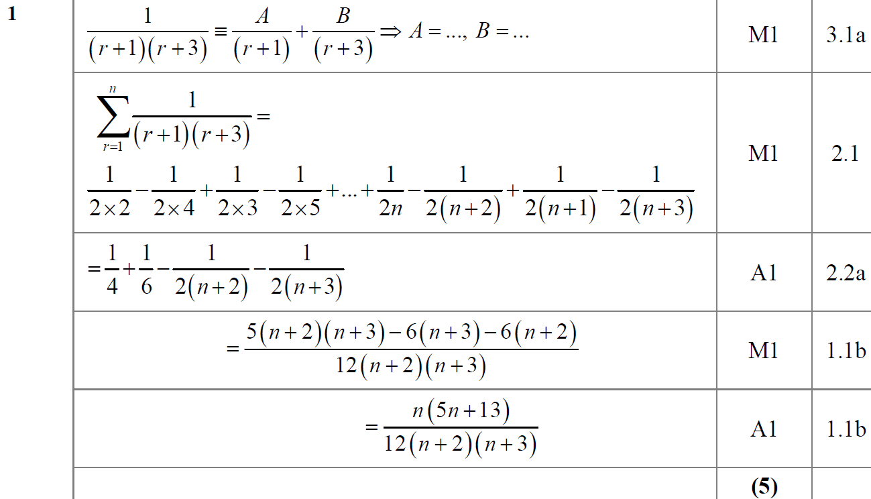
SAM Paper 1
A

Slide 21
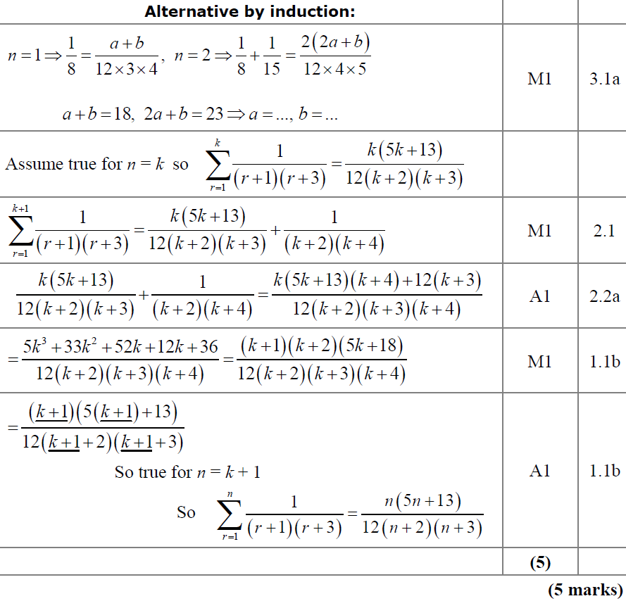
SAM Paper 1
A Alternative

Slide 22
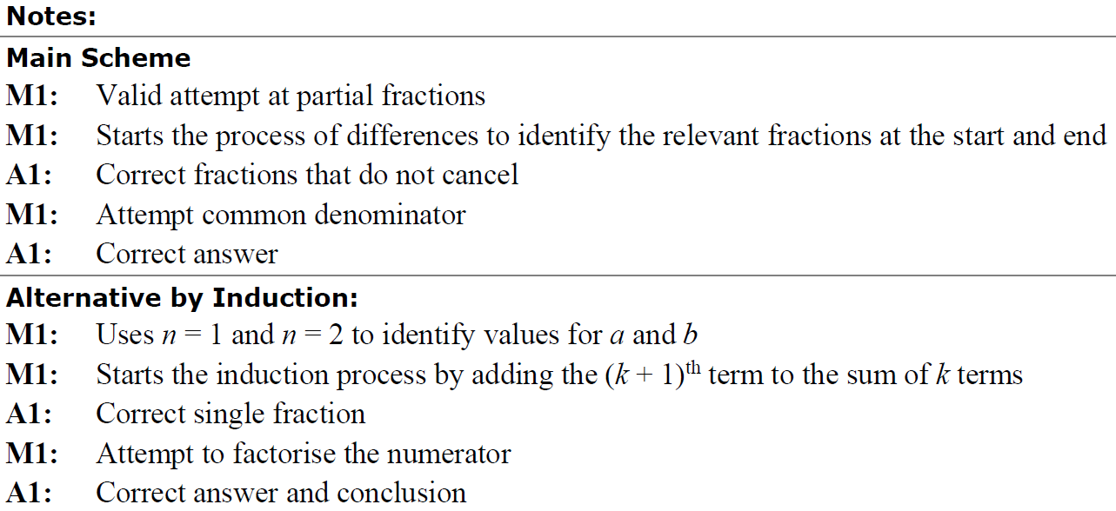
SAM Paper 1
A notes

Slide 23
2019 Paper 1

Slide 24
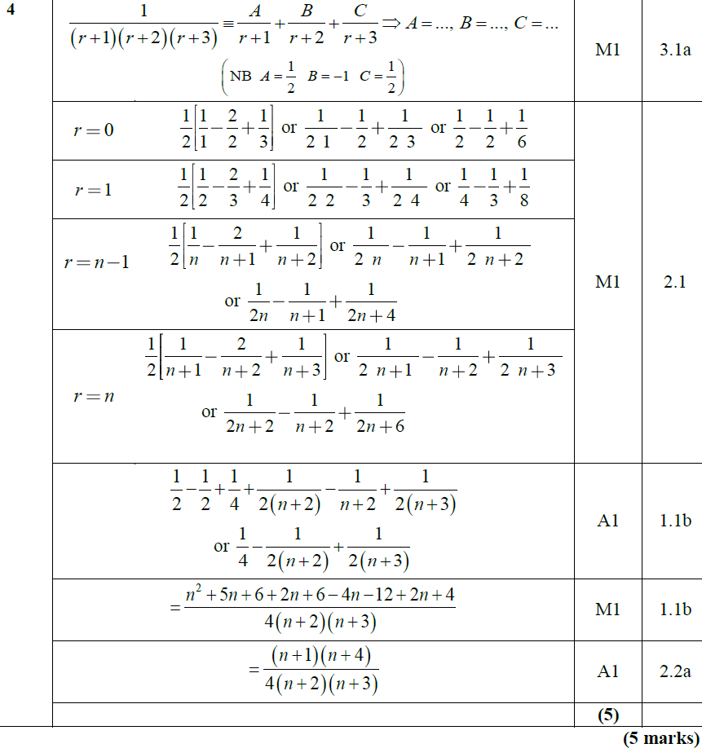
2019 Paper 1
A

Slide 25
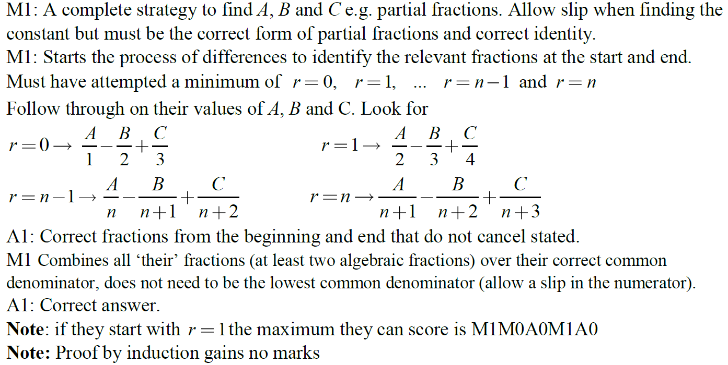
2019 Paper 1
A notes

Slide 26
New Spec Q’s
Old Spec Series
differences
P4/ Old FP1
FP1
FP2
Jan 2002
June 2006
Jan 2009
June 2013
June 2009
June 2015
June 2002
Jan 2007
June 2009
June 2013 R (i)
June 2010
June 2016
Jan 2003
June 2007
Jan 2010
June 2013 R (ii)
June 2011
June 2017
June 2003
Jan 2008
June 2010
June 2013 W
June 2012
June 2018
Jan 2004
June 2008
Jan 2011
June 2014
June 2013
June 2019
June 2004
Jan 2009
June 2011
June 2014 R
June 2013 R
Jan 2005
June 2009
Jan 2012
June 2015
June 2013 W
June 2005
Jan 2010
June 2012
May 2016
June 2014
Jan 2006
Jan 2013
May 2017
June 2014 R

Slide 27
Jan 2002

Slide 28
Jan 2002
A

Slide 29
June 2002

Slide 30
June 2002
A

Slide 31
Jan 2003

Slide 32
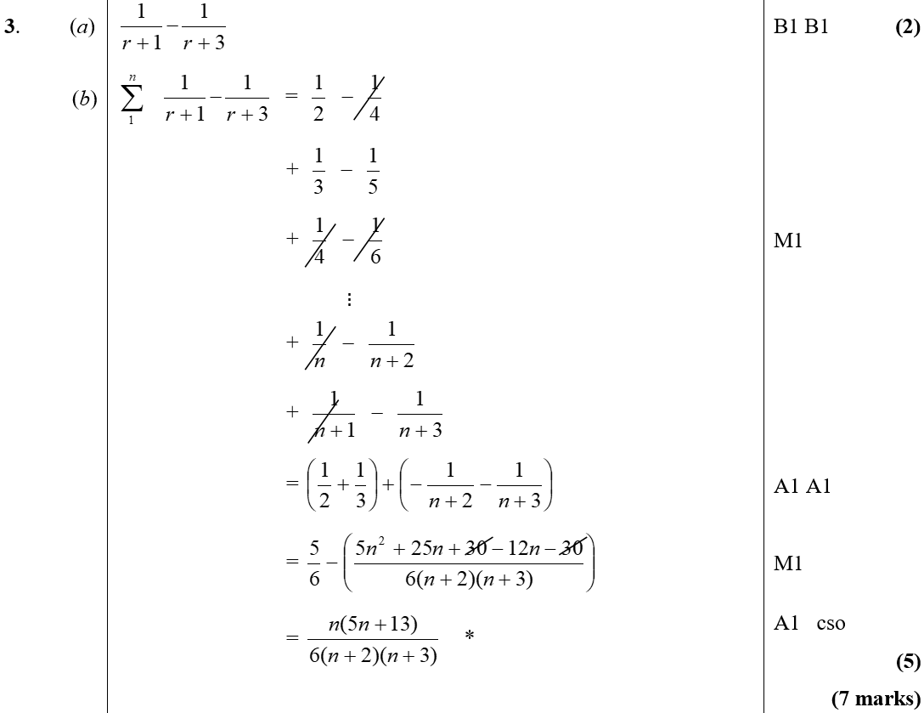
Jan 2003
A
B

Slide 33
June 2003

Slide 34
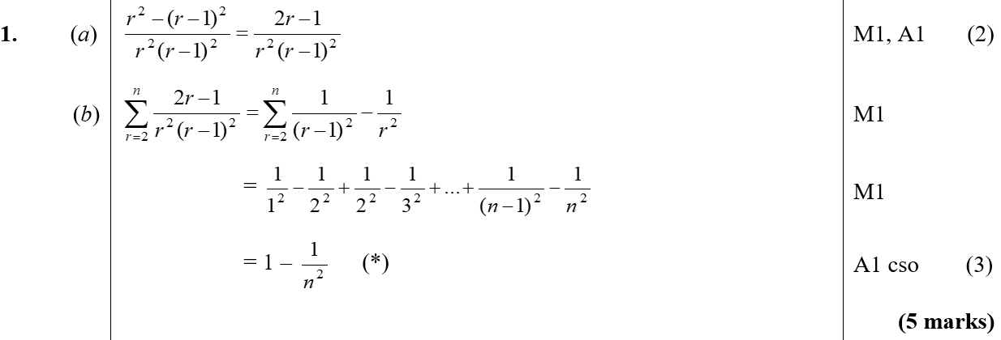
June 2003
A
B

Slide 35
Jan 2004

Slide 36
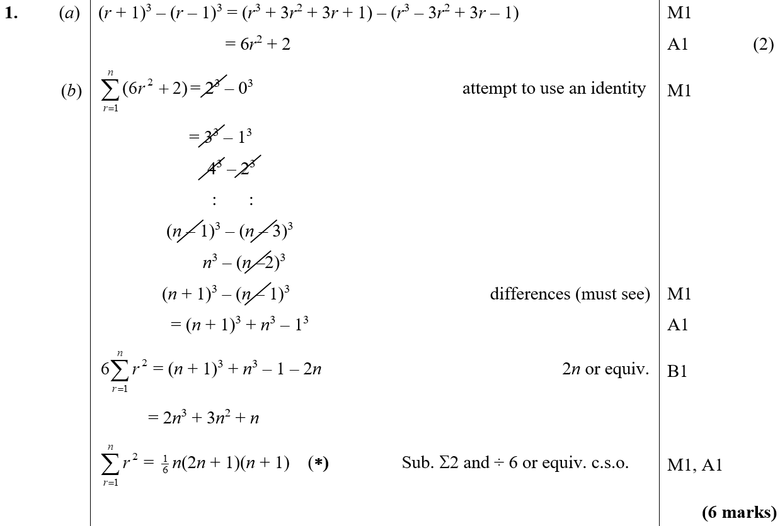
Jan 2004
A
B

Slide 37
June 2004

Slide 38
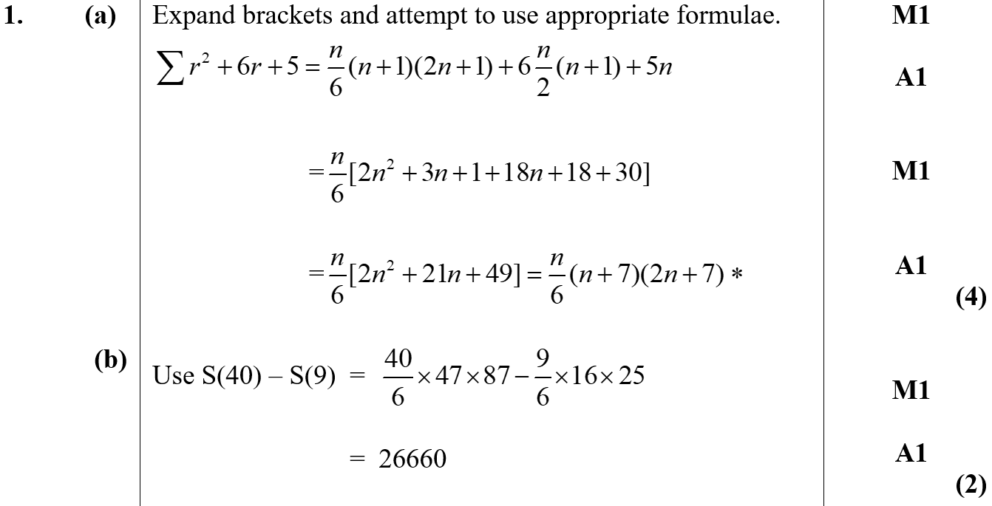
June 2004
A
B

Slide 39
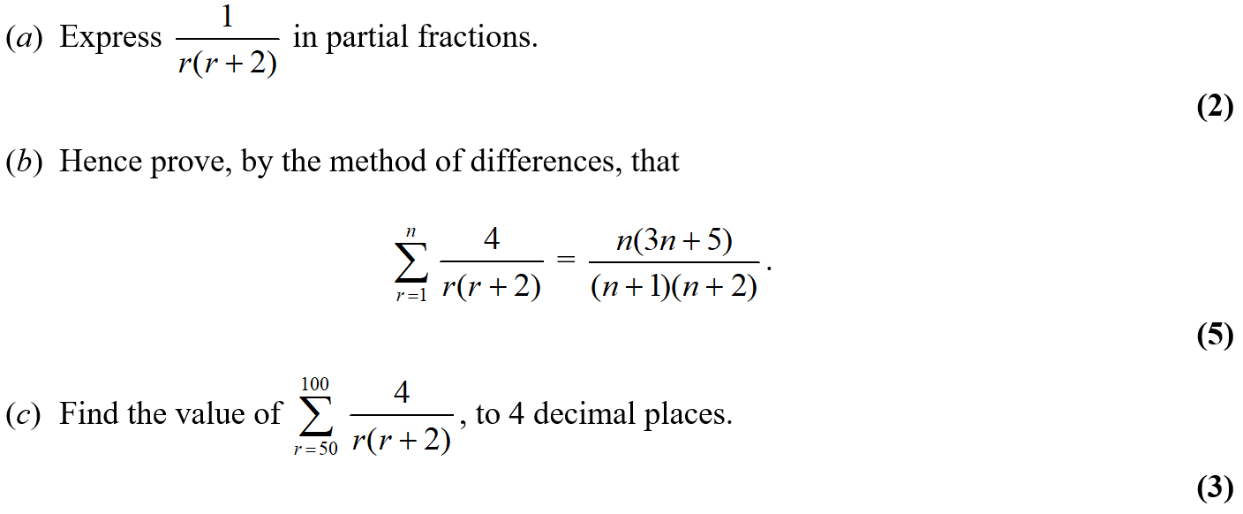
Jan 2005

Slide 40
Jan 2005
A
C

Slide 41
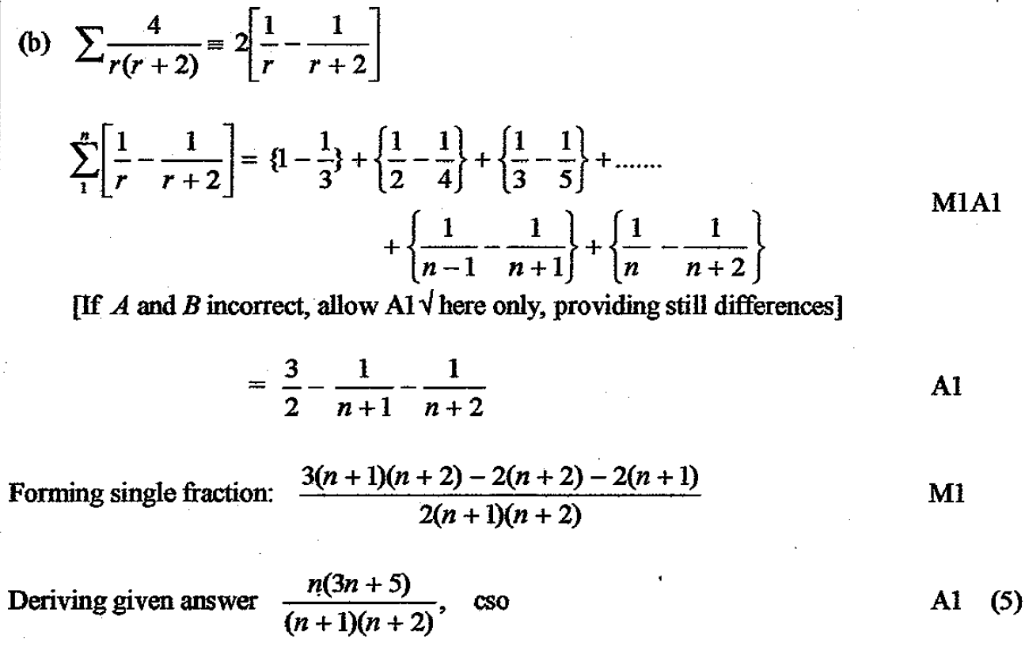
Jan 2005
B

Slide 42
June 2005

Slide 43
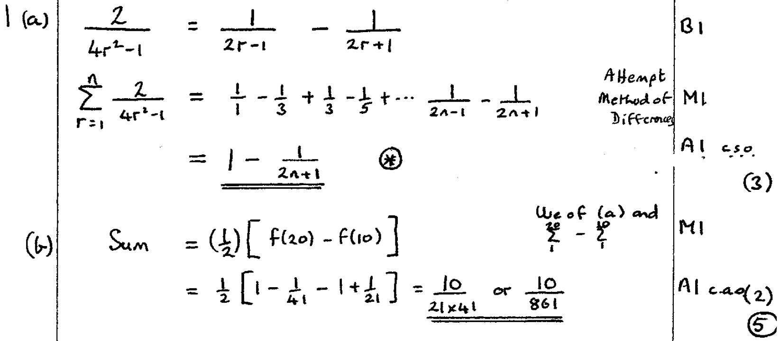
June 2005
A
B

Slide 44
Jan 2006

Slide 45
Jan 2006
A

Slide 46
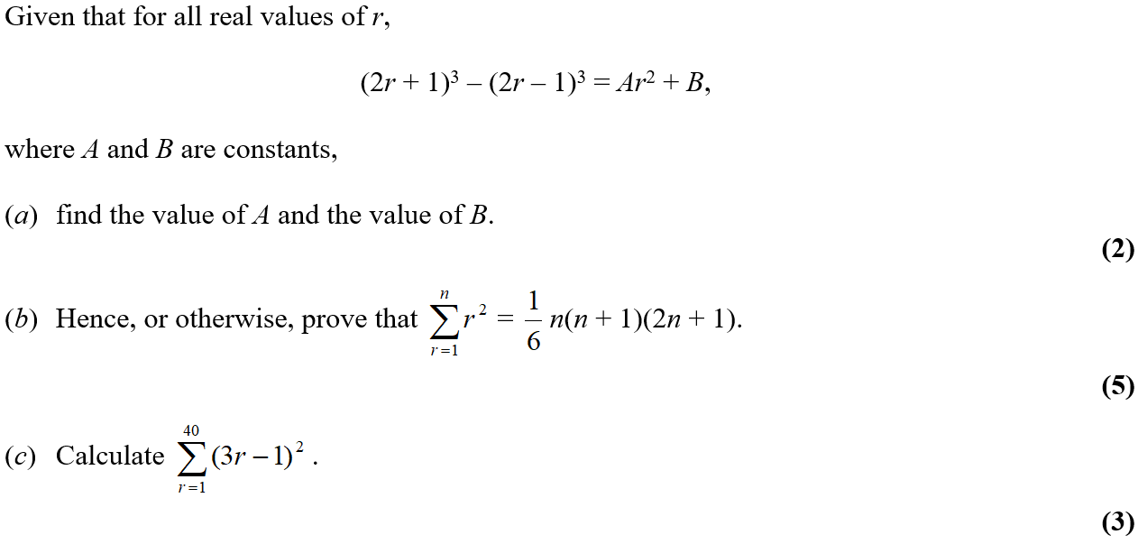
June 2006

Slide 47
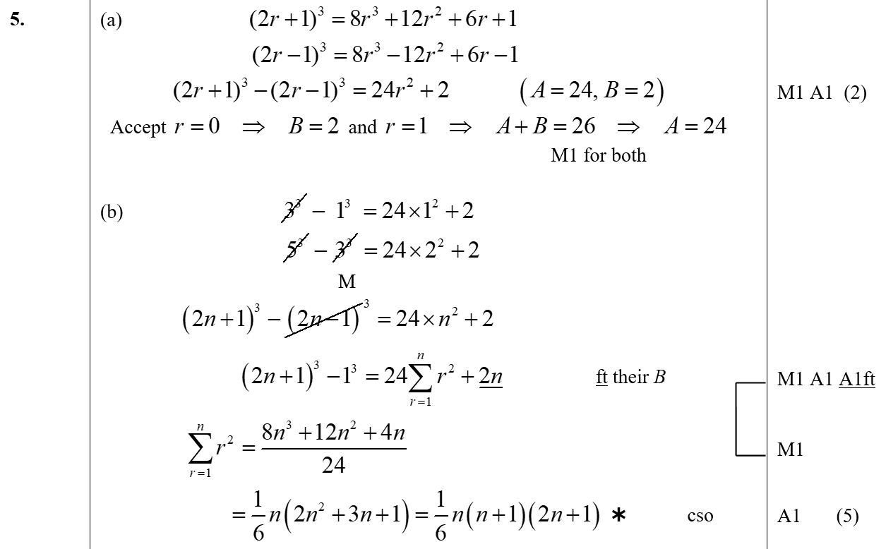
June 2006
A
B

Slide 48
June 2006
C

Slide 49
Jan 2007

Slide 50
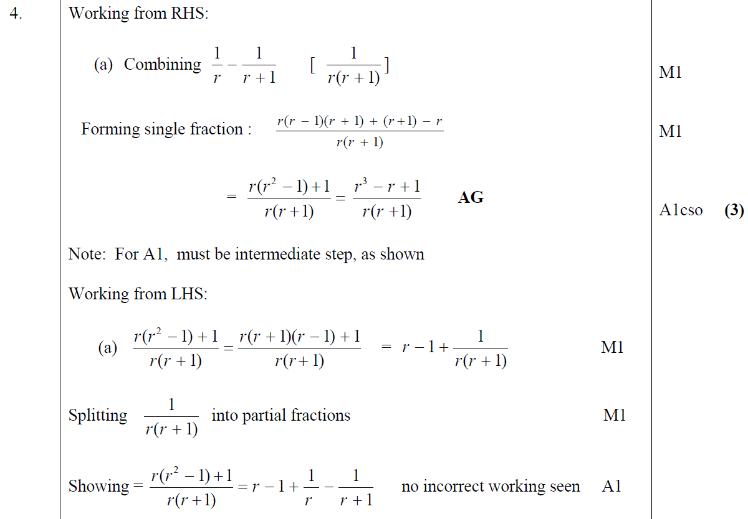
Jan 2007
A

Slide 51
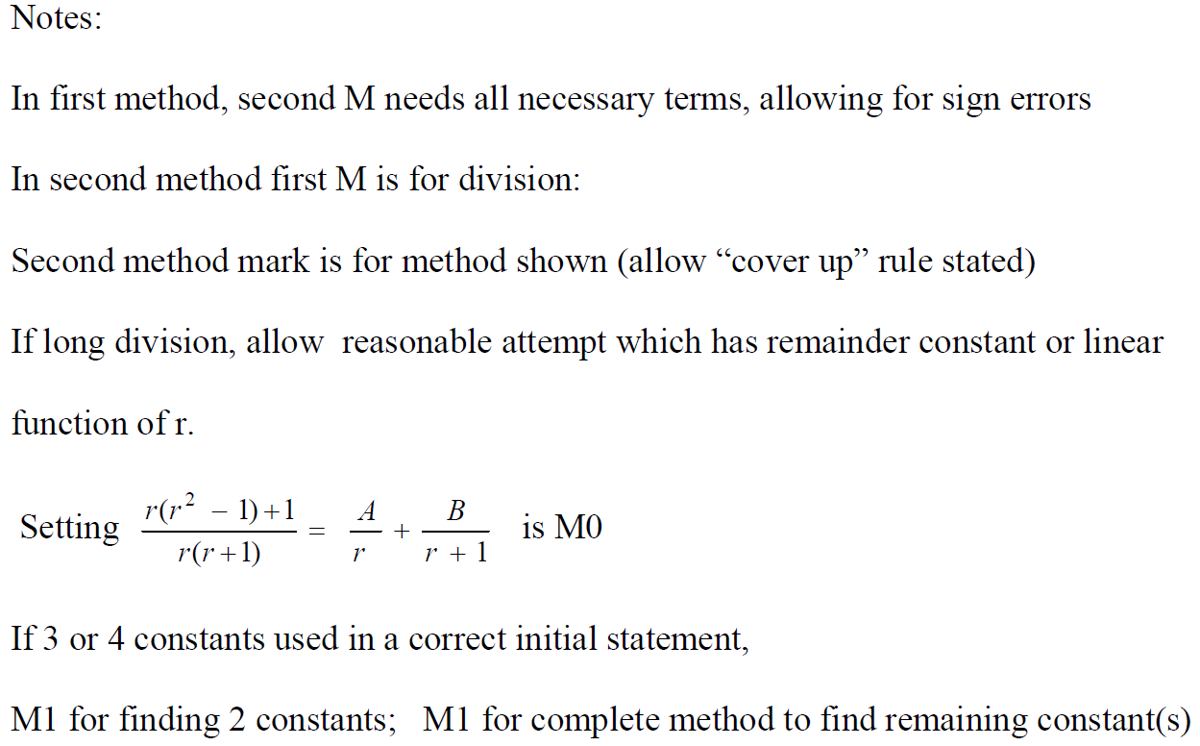
Jan 2007
A notes

Slide 52
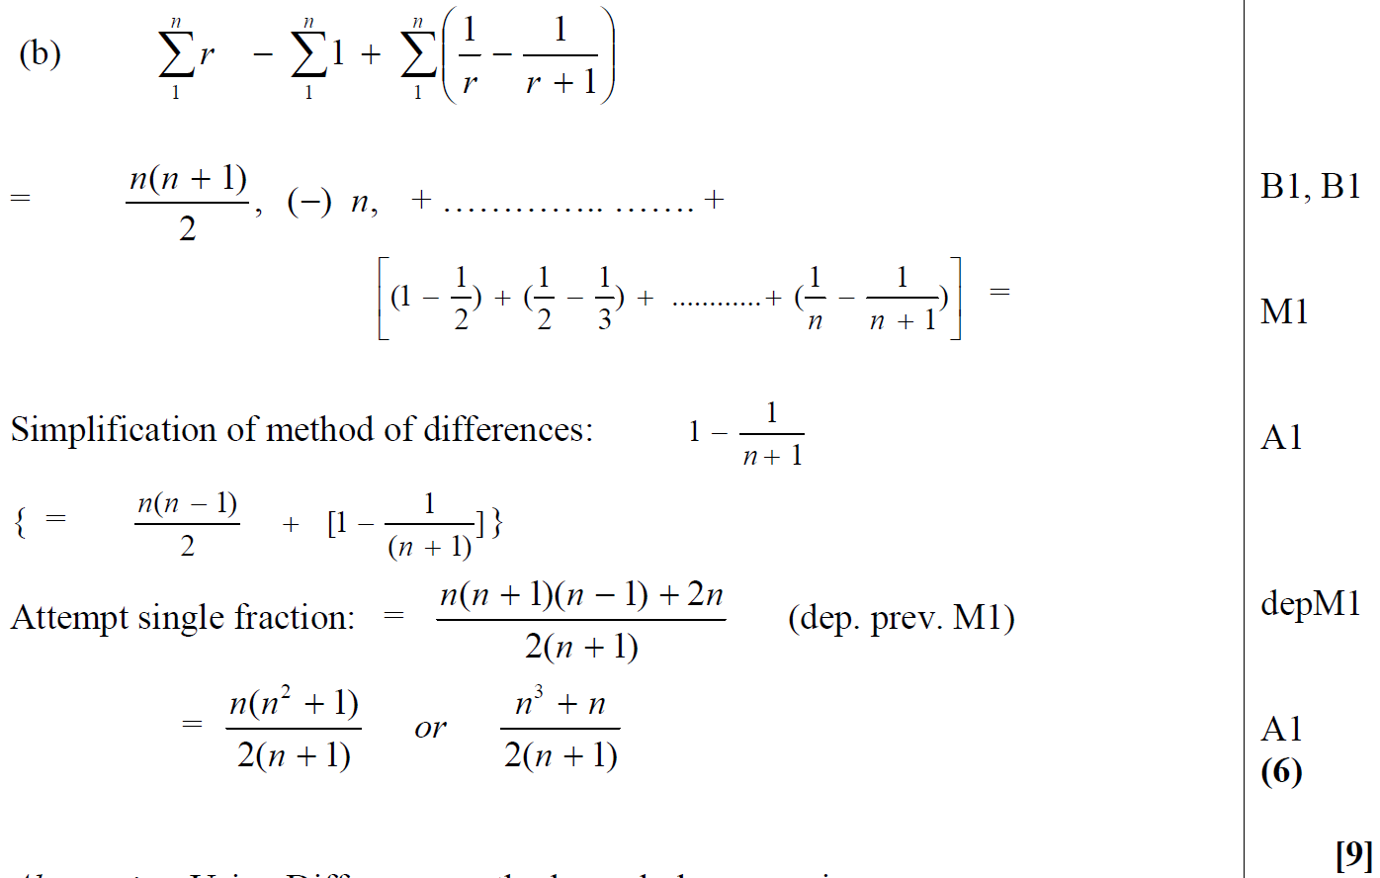
Jan 2007
B

Slide 53
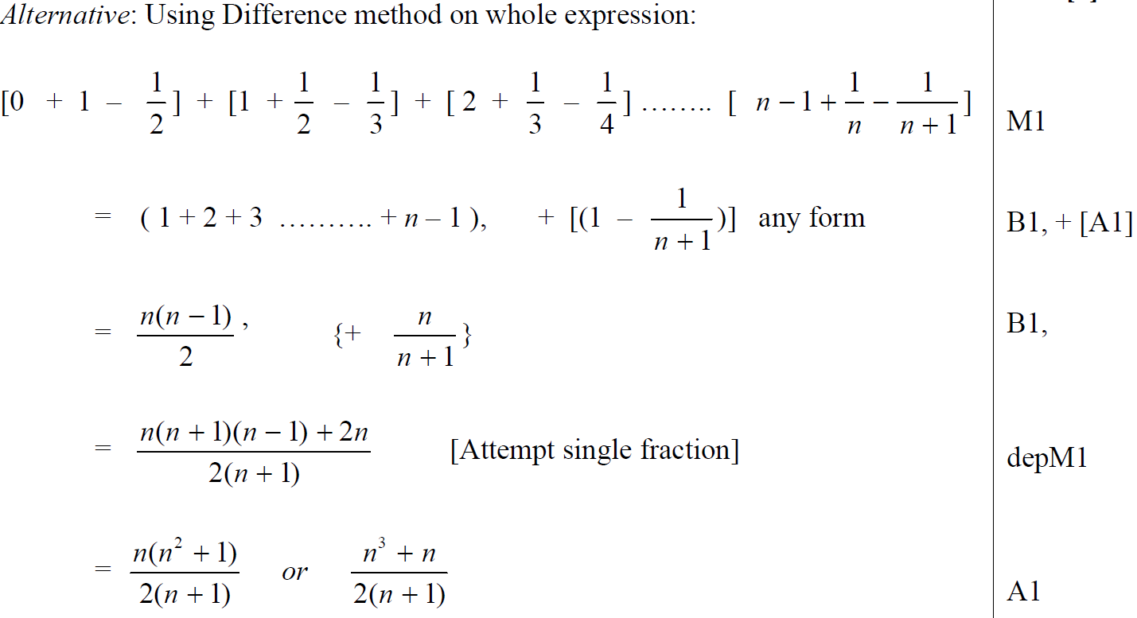
Jan 2007
B Alternative

Slide 54
Jan 2007
B notes

Slide 55
June 2007

Slide 56
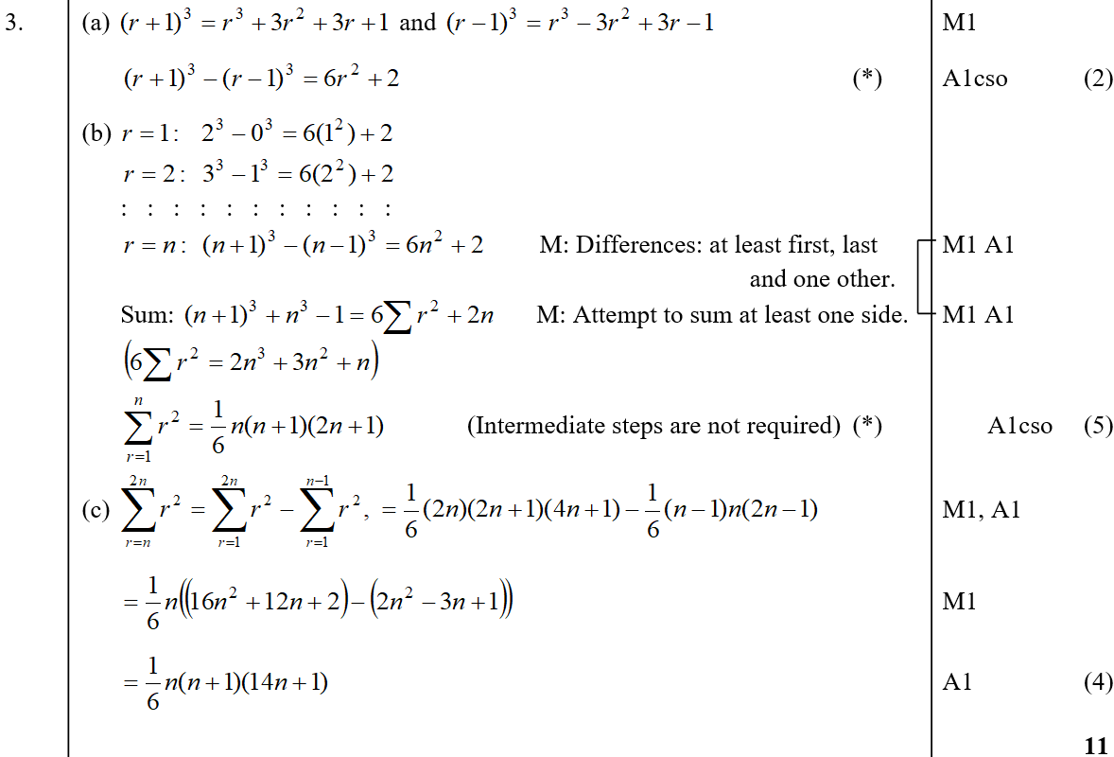
June 2007
A
B
C

Slide 57
June 2007
B notes
C notes

Slide 58
Jan 2008

Slide 59
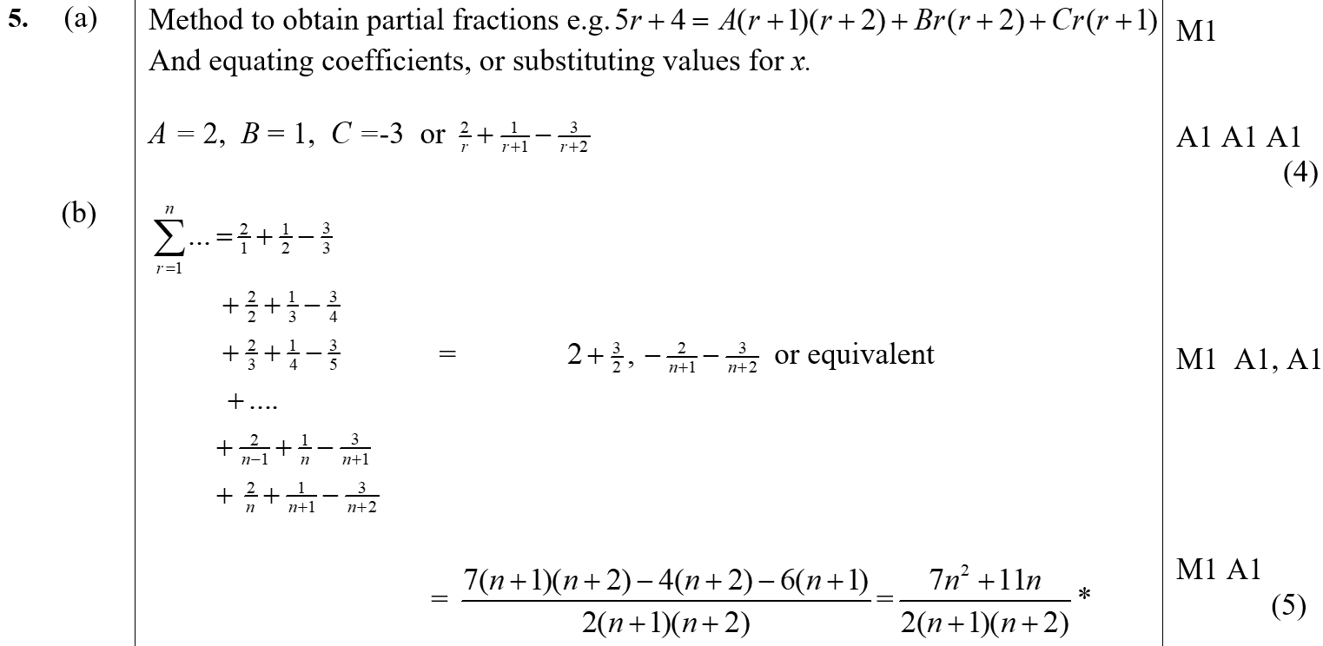
Jan 2008
A
B

Slide 60
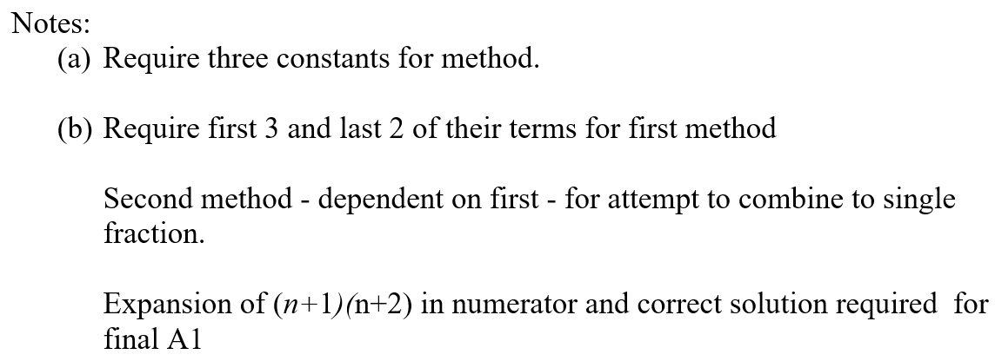
Jan 2008
A notes
B notes

Slide 61
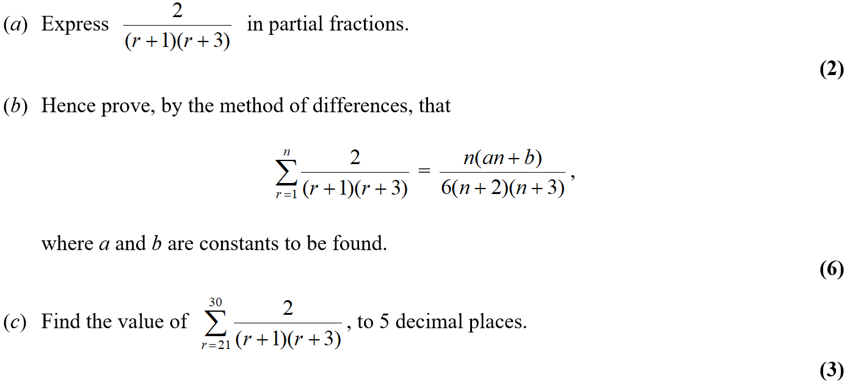
June 2008

Slide 62
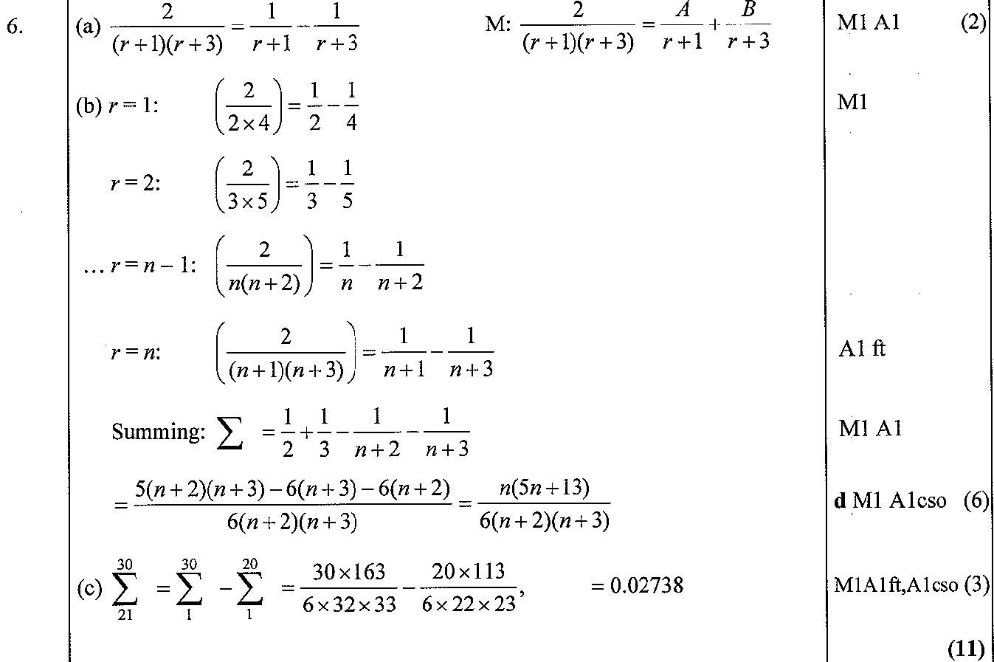
June 2008
A
B
C

Slide 63
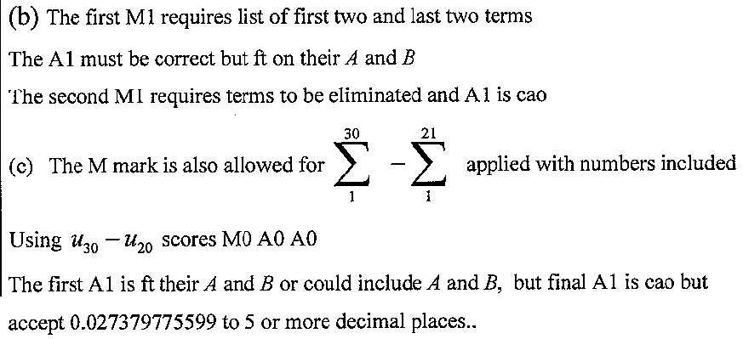
June 2008
B notes
C notes

Slide 64
Jan 2009

Slide 65
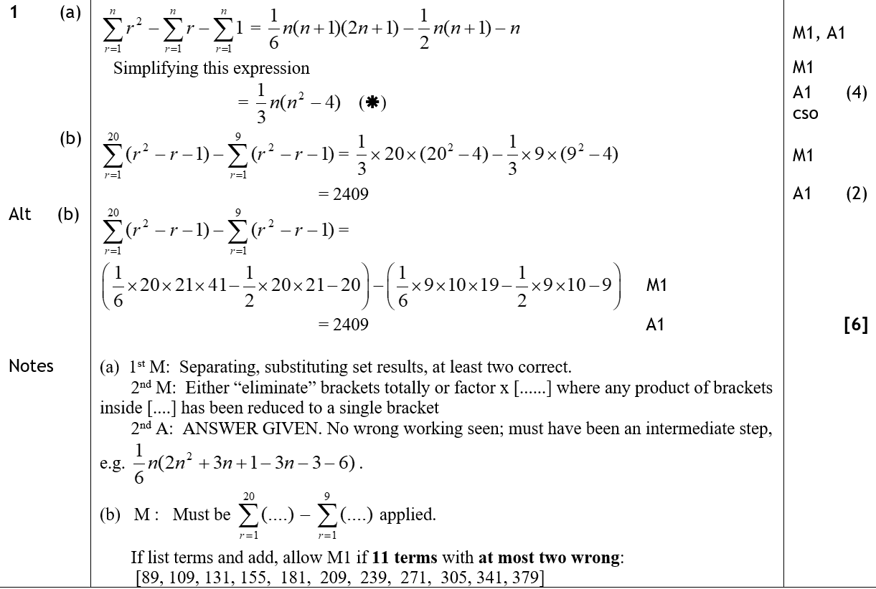
Jan 2009
A
B
A notes
B notes

Slide 66
June 2009

Slide 67
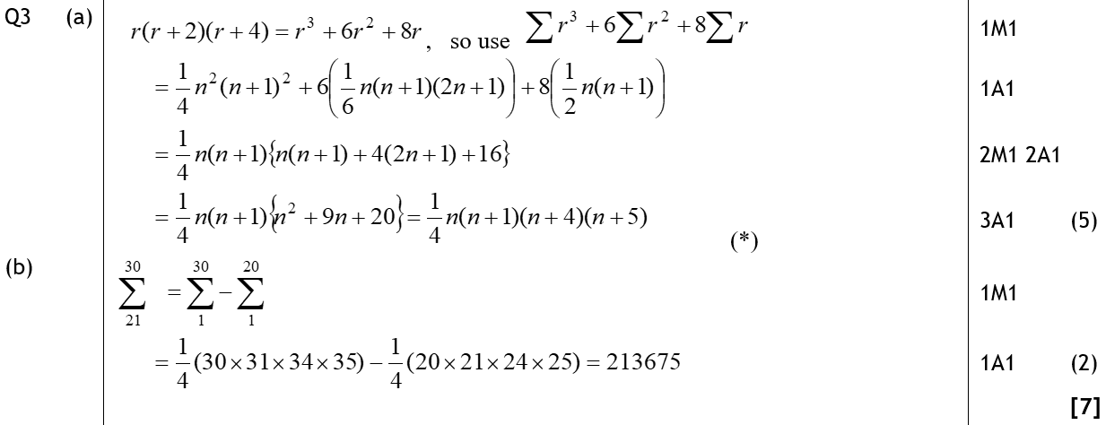
June 2009
A
B

Slide 68
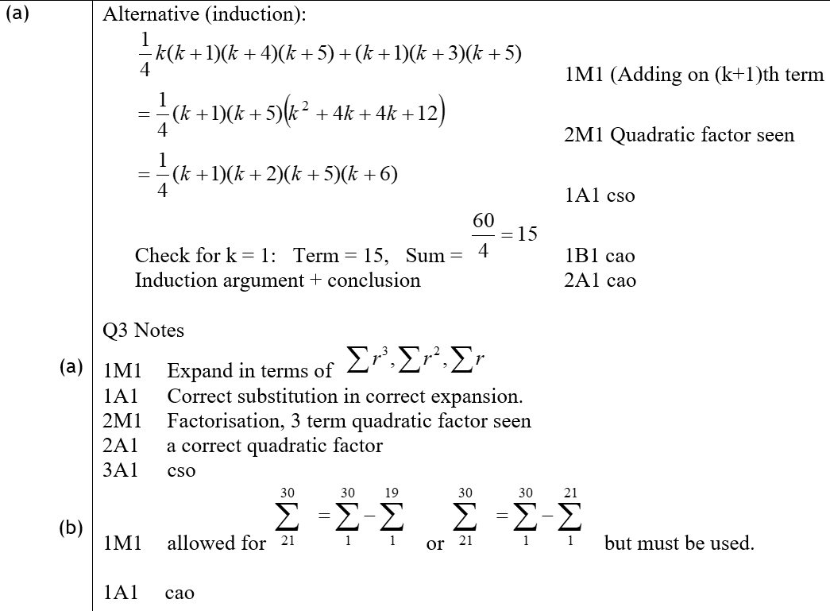
June 2009
A Alternative
A notes
B notes

Slide 69
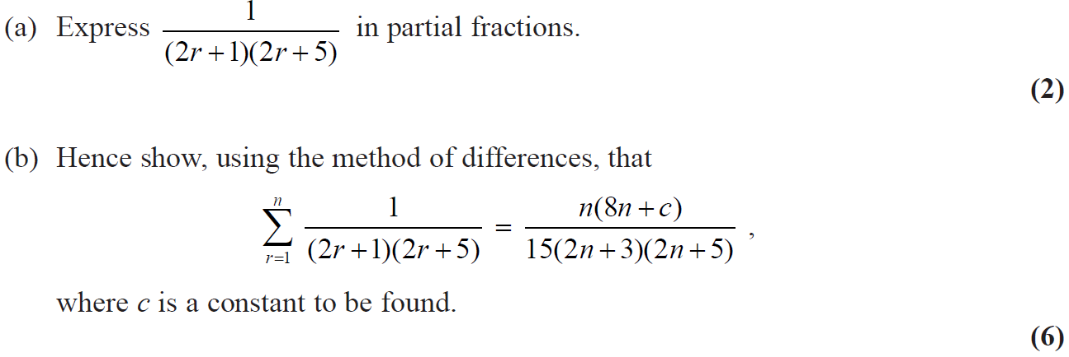
Jan 2010

Slide 70
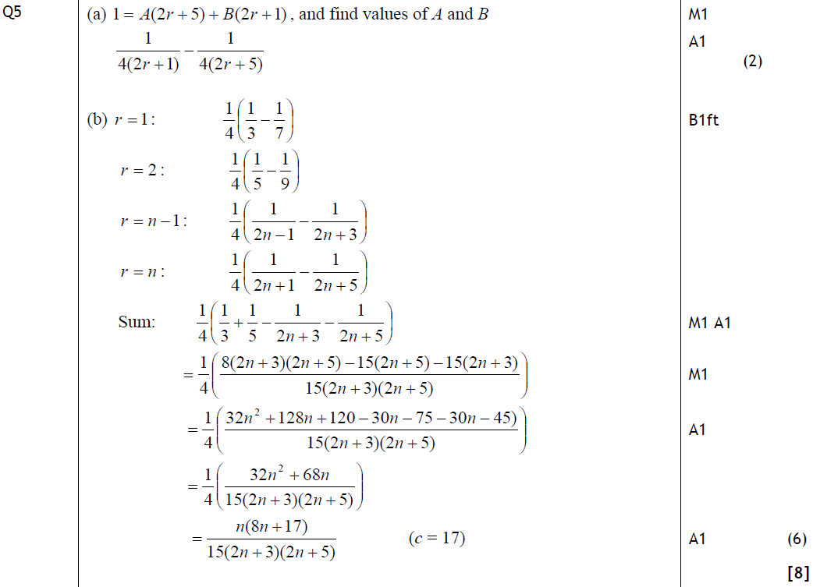
Jan 2010
A
B

Slide 71
Jan 2010
B notes

Slide 72
Jan 2009

Slide 73
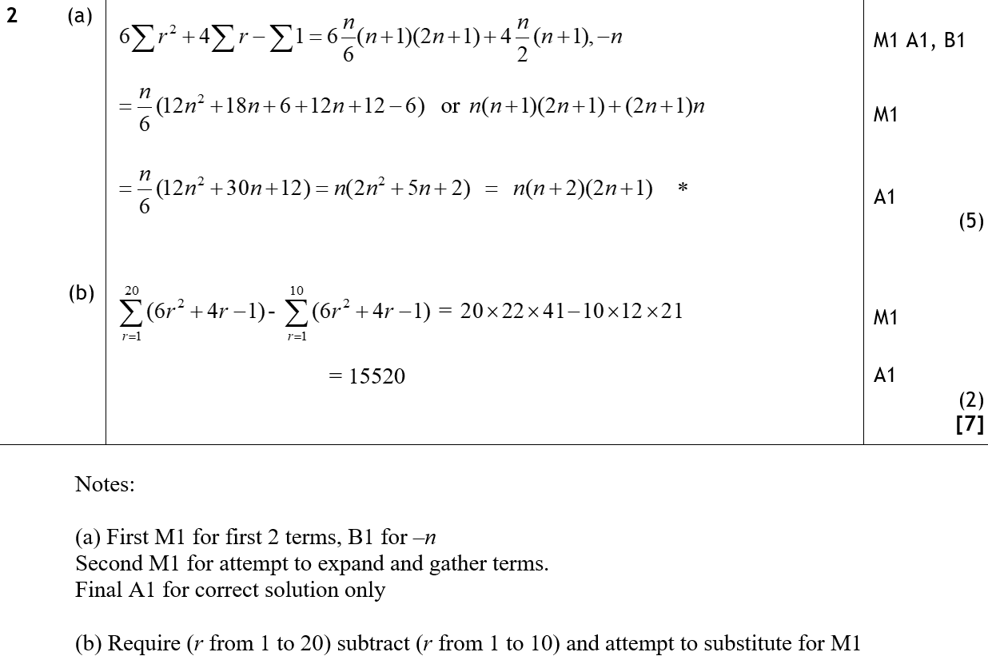
Jan 2009
A
B
A notes
B notes

Slide 74
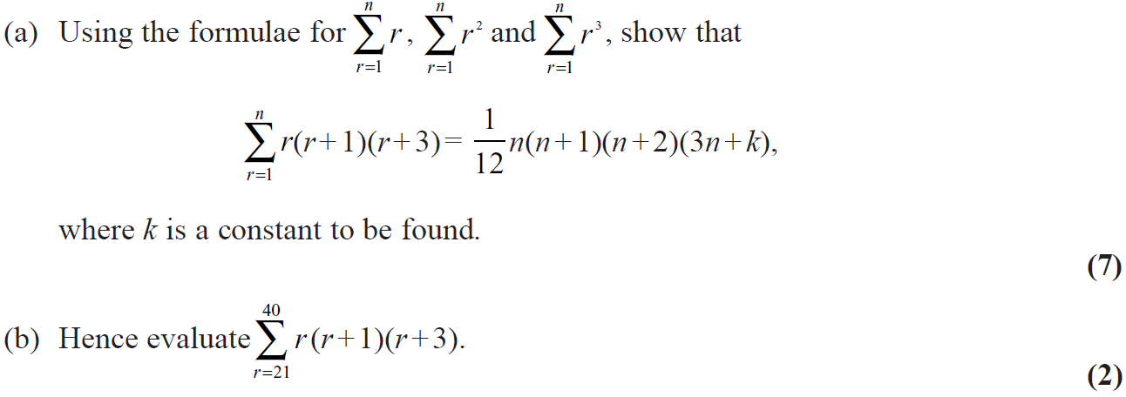
June 2009

Slide 75
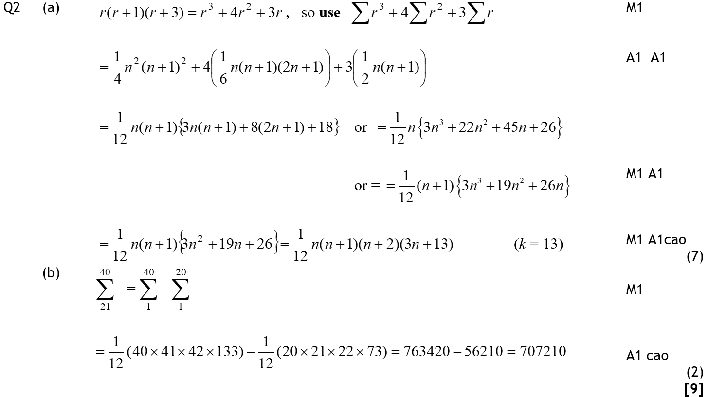
June 2009
A
B

Slide 76
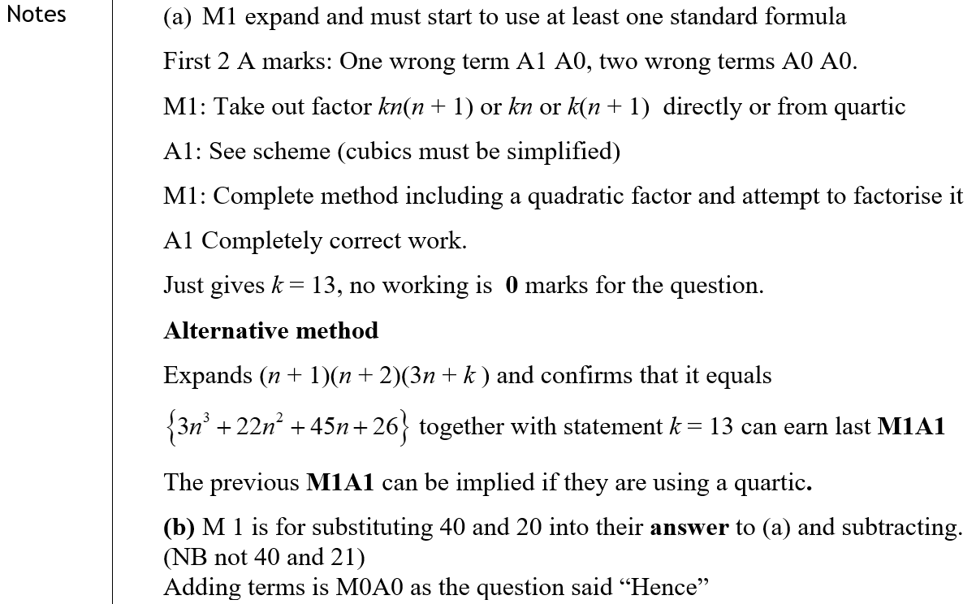
June 2009
A notes
B notes

Slide 77
Jan 2010

Slide 78
Jan 2010
A
B

Slide 79
Jan 2010
C
A notes
B notes
C notes

Slide 80
June 2010

Slide 81
June 2010
A

Slide 82
June 2010
B
C

Slide 83
June 2010
A notes
B notes
C notes

Slide 84
Jan 2011

Slide 85
Jan 2011
A

Slide 86
Jan 2011
B

Slide 87
June 2011

Slide 88
June 2011
A

Slide 89
June 2011
B

Slide 90
Jan 2012

Slide 91
Jan 2012
A

Slide 92
Jan 2012
B
C

Slide 93
June 2012

Slide 94
June 2012
A

Slide 95
June 2012
A Alternative

Slide 96
June 2012
B

Slide 97
Jan 2013

Slide 98
Jan 2013
A

Slide 99
June 2013

Slide 100
June 2013
A

Slide 101
June 2013
B

Slide 102
June 2013 Reserve

Slide 103
June 2013 Reserve
A

Slide 104
June 2013 Reserve
B

Slide 105
June 2013 Reserve

Slide 106
June 2013 Reserve
(i)
(ii)

Slide 107
June 2013 Withdrawn

Slide 108
June 2013 Withdrawn
A

Slide 109
June 2013 Withdrawn
B
A notes
B notes

Slide 110
June 2014

Slide 111
June 2014
A

Slide 112
June 2014
B

Slide 113
June 2014 Reserve

Slide 114
June 2014 Reserve
A

Slide 115
June 2014 Reserve
B

Slide 116
June 2015

Slide 117
June 2015
A
B

Slide 118
June 2015
A notes
B notes

Slide 119
May 2016

Slide 120
May 2016
A
B

Slide 121
May 2016
A notes
B notes

Slide 122
May 2017

Slide 123
May 2017
A

Slide 124
May 2017
B

Slide 125
June 2009

Slide 126
June 2009
A

Slide 127
June 2009
B

Slide 128
June 2010

Slide 129
June 2010
A
B
C

Slide 130
June 2011

Slide 131
June 2011
A
B
C

Slide 132
June 2012

Slide 133
June 2012
A
B

Slide 134
June 2012
C
A notes
B notes
C notes

Slide 135
June 2013

Slide 136
June 2013
A
B

Slide 137
June 2013
A notes
B notes

Slide 138
June 2013 Reserve

Slide 139
June 2013 Reserve
A

Slide 140
June 2013 Reserve
B

Slide 141
June 2013 Reserve
C

Slide 142
June 2013 Reserve
B notes

Slide 143
June 2013 Withdrawn

Slide 144
June 2013 Withdrawn
A
B

Slide 145
June 2014

Slide 146
June 2014
A
B

Slide 147
June 2014
B Alternative

Slide 148
June 2014 Reserve

Slide 149
June 2014 Reserve
A
B

Slide 150
June 2014 Reserve
A notes
B notes

Slide 151
June 2015

Slide 152
June 2015
A
B

Slide 153
June 2015
A notes
B notes

Slide 154
June 2016

Slide 155
June 2016
A

Slide 156
June 2016
B

Slide 157
June 2017

Slide 158
June 2017
A
B

Slide 159
June 2017
A

Slide 160
June 2017
B Alternative & notes

Slide 161
June 2018

Slide 162
June 2018
A

Slide 163
June 2018
B

Slide 164
June 2018
C

Slide 165
June 2019

Slide 166
June 2019
A
B

Slide 167
June 2019
A notes
B notes

