Slide 1
Sequences
Sequences
May 2017
1H Q3
May 2018
1H Q20
June 2017
2H Q4
June 2018
2H Q5
SAM
1H Q9
June 2017
3H Q22
June 2018
3H Q10
SAM
2H Q1
Nov 2017
2H Q10
1 Marker
Nov 2018
1H Q21
SAM
3H Q14
Nov 2017
2H Q14
Nov 2018
2H Q3
Nov 2017
3H Q3
Nov 2018
3H Q3
May 2018
1H Q14
Quadratic
Geometric

Slide 2
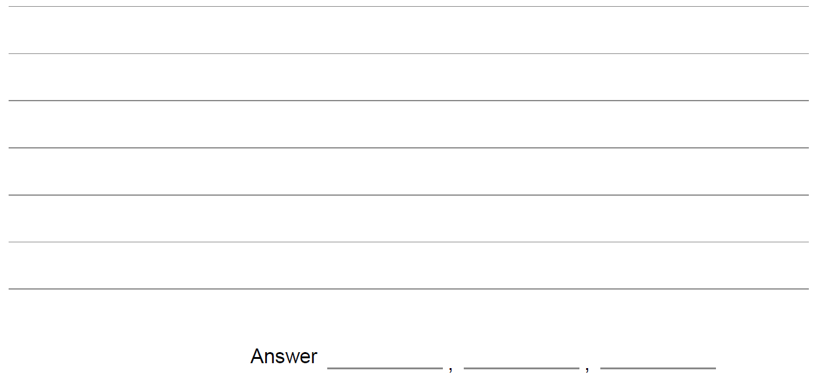
Sequences
SAM 1H Q9

Slide 3
Sequences
SAM 1H Q9
A

Slide 4
Sequences
SAM 2H Q1

Slide 5
Sequences
SAM 2H Q1
A

Slide 6
Sequences
SAM 3H Q14

Slide 7
Sequences
SAM 3H Q14
A
B

Slide 8
Sequences
May 2017 1H Q3

Slide 9
Sequences
May 2017 1H Q3
A

Slide 10
Sequences
June 2017 2H Q4

Slide 11
Sequences
June 2017 2H Q4
A

Slide 12
Sequences
June 2017 3H Q22

Slide 13
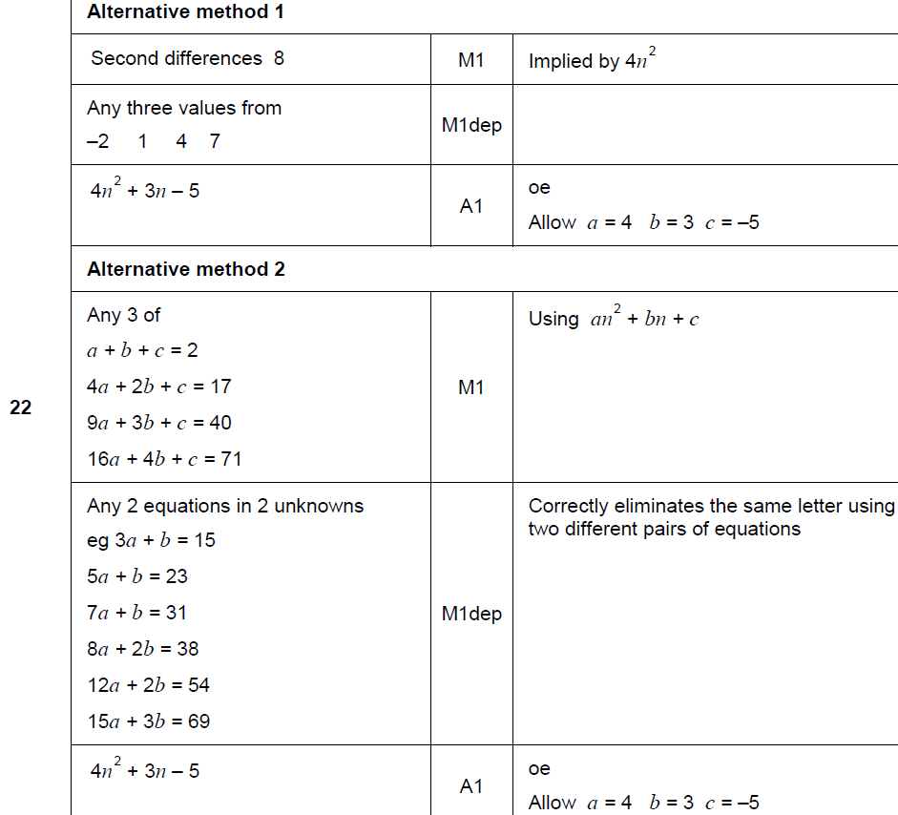
Sequences
June 2017 3H Q22
A

Slide 14
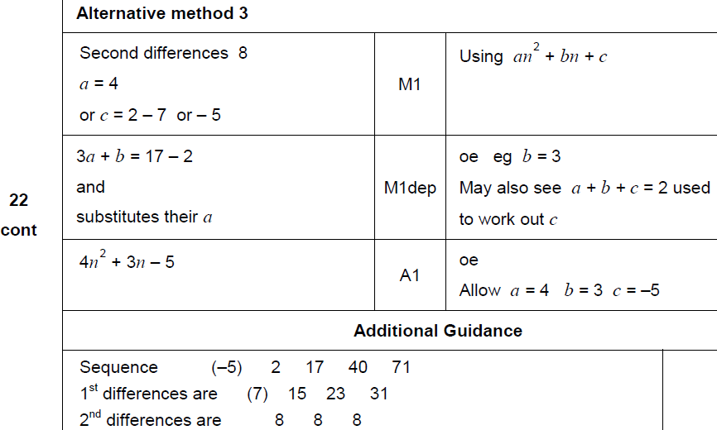
Sequences
June 2017 3H Q22
A Alternative & notes

Slide 15
Sequences
Nov 2017 2H Q10

Slide 16
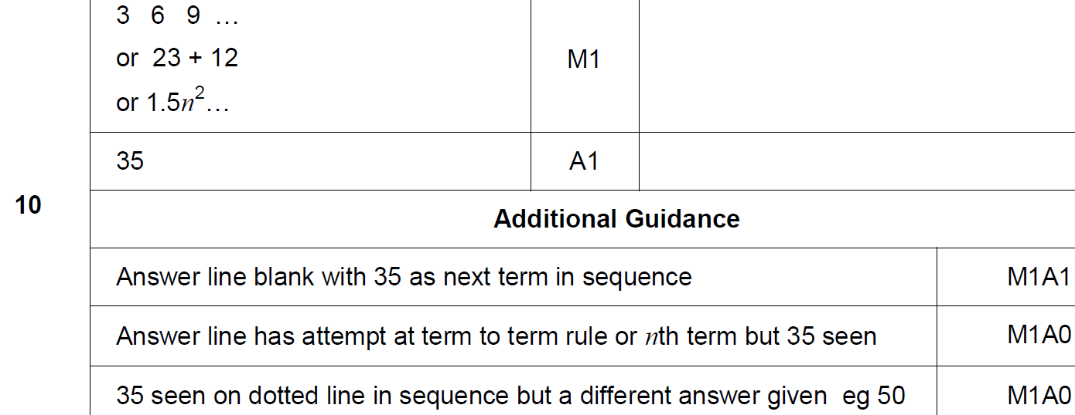
Sequences
Nov 2017 2H Q10
A

Slide 17
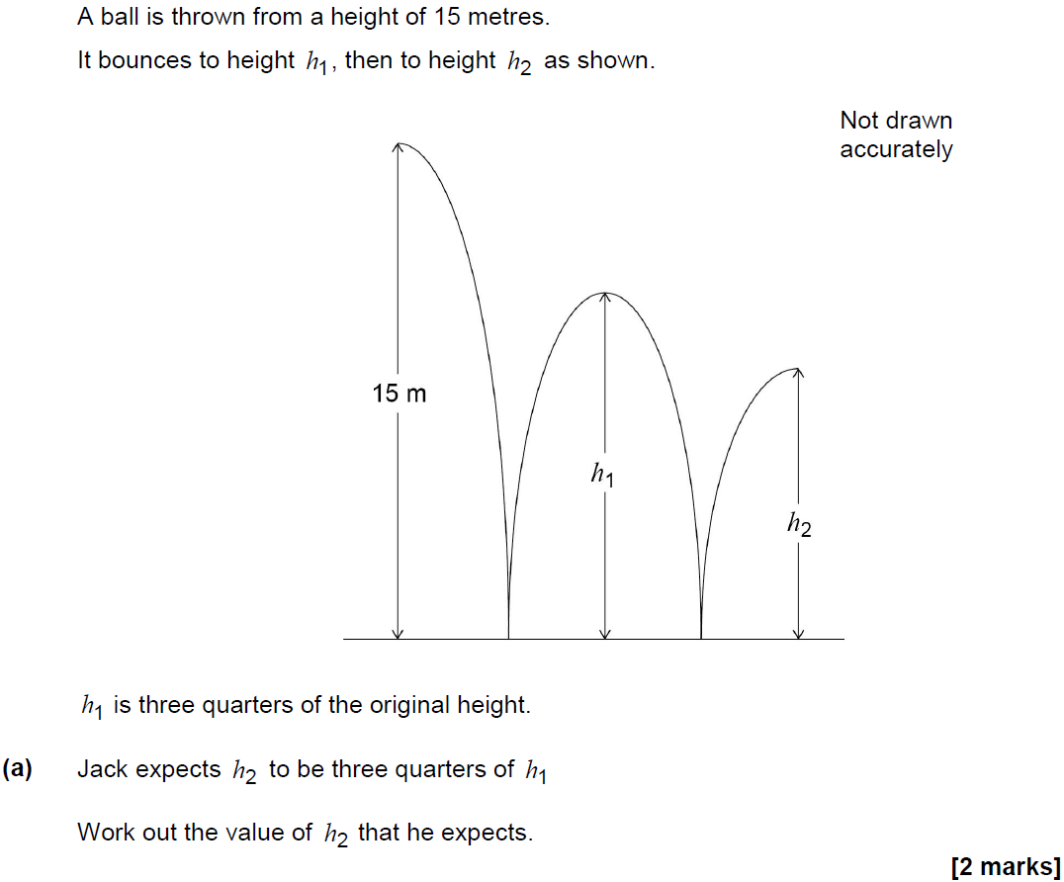
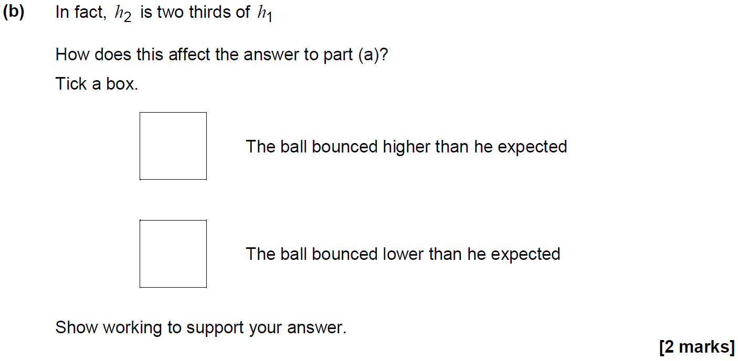
Sequences
Nov 2017 2H Q14

Slide 18
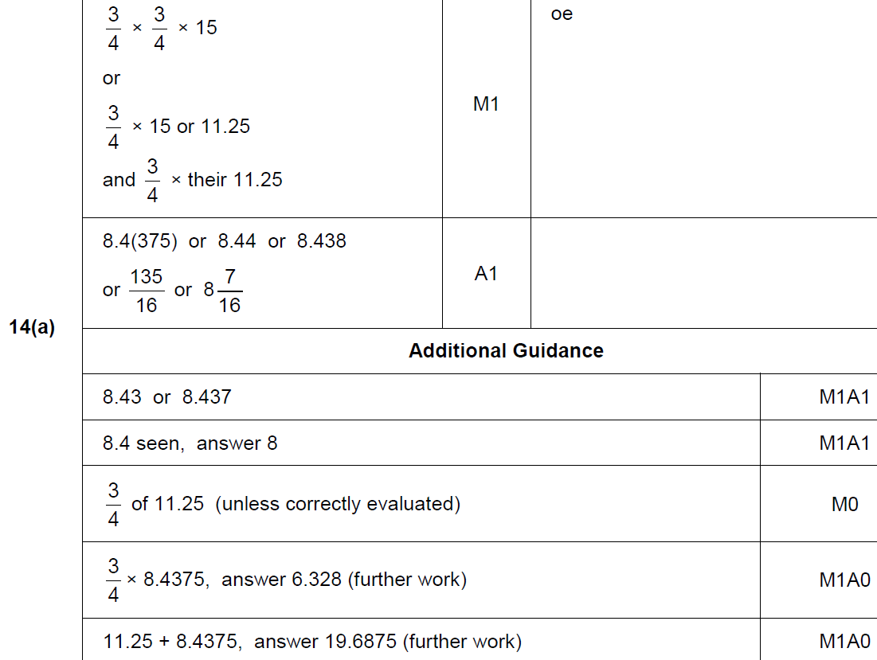
Sequences
Nov 2017 2H Q14
A

Slide 19
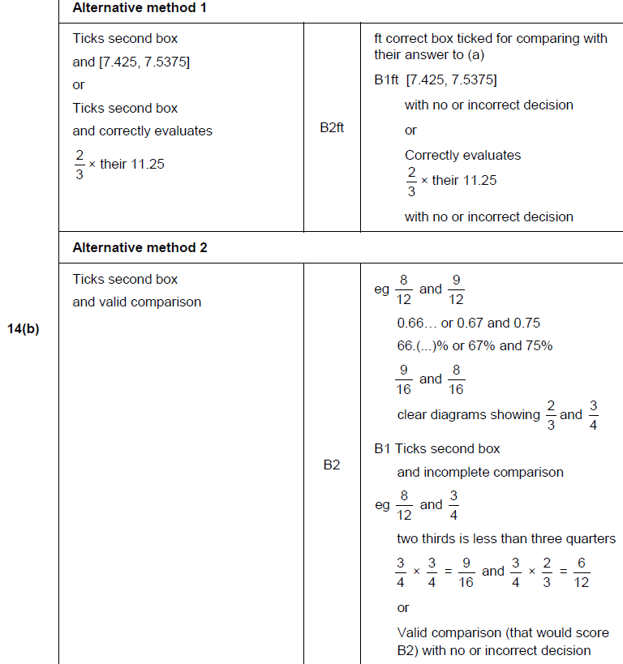
Sequences
Nov 2017 2H Q14
B

Slide 20
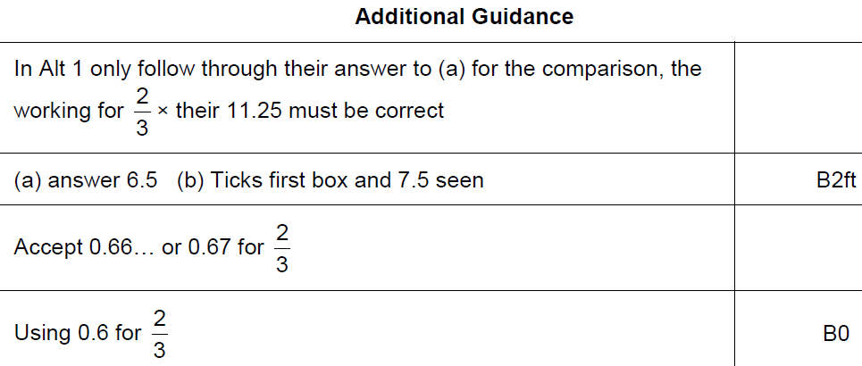
Sequences
Nov 2017 2H Q14
B notes

Slide 21
Sequences
Nov 2017 3H Q3

Slide 22
Sequences
Nov 2017 3H Q3
A

Slide 23
Sequences
May 2018 1H Q14

Slide 24
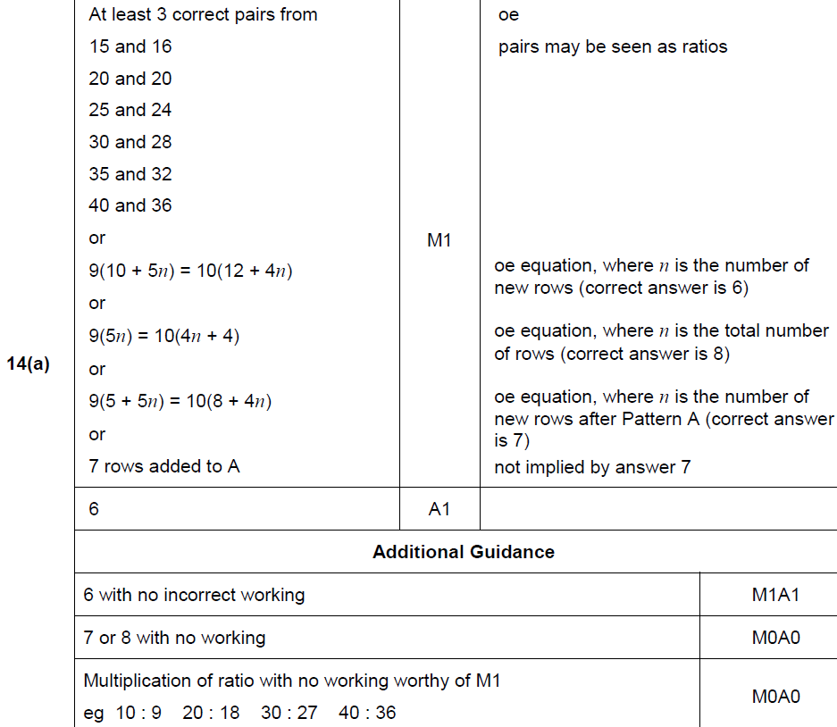
Sequences
May 2018 1H Q14
A

Slide 25
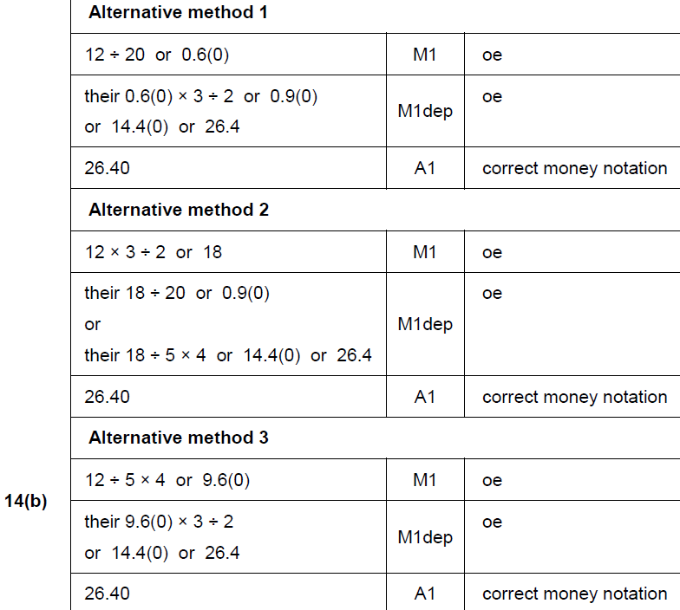
Sequences
May 2018 1H Q14
B

Slide 26
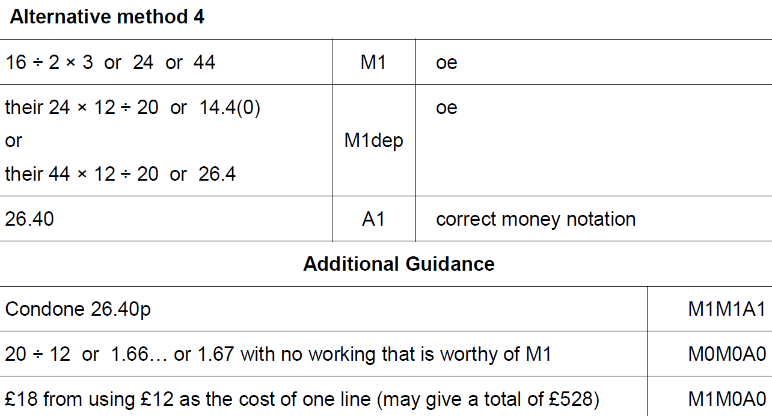
Sequences
May 2018 1H Q14
B Alternative 3 & notes

Slide 27
Sequences
May 2018 1H Q20

Slide 28
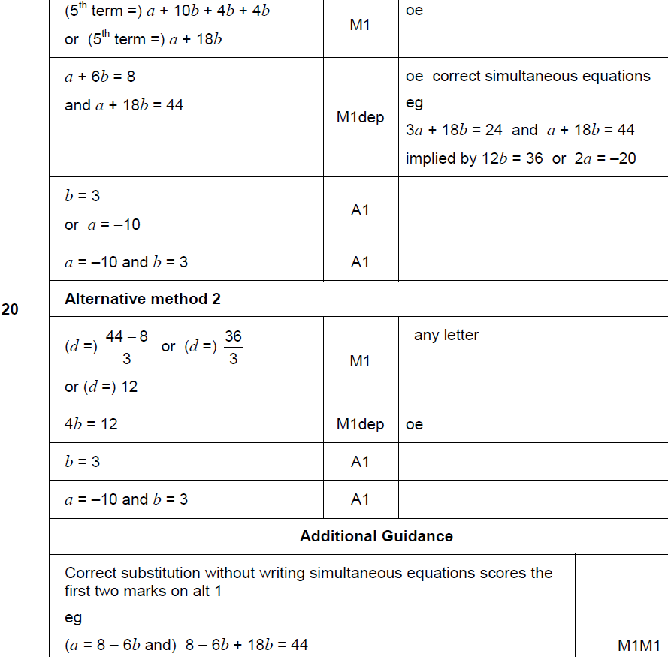
Sequences
May 2018 1H Q20
A

Slide 29
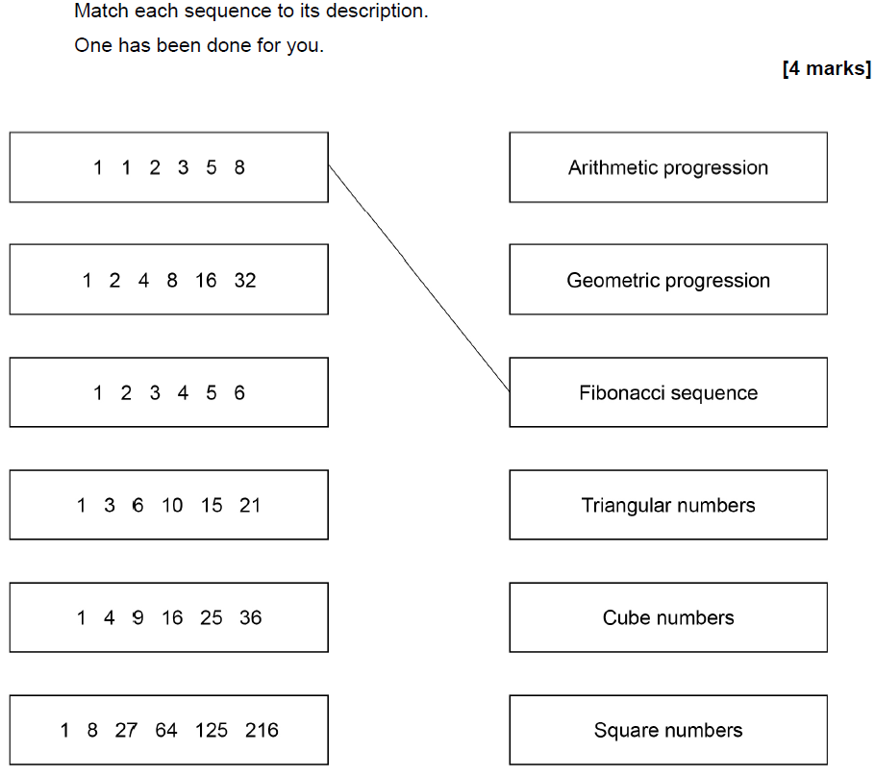
Sequences
June 2018 2H Q5

Slide 30
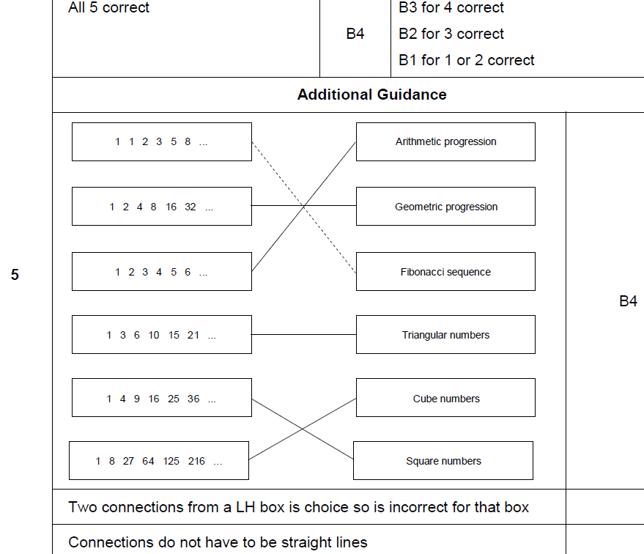
Sequences
June 2018 2H Q5
A

Slide 31
Sequences
June 2018 3H Q10
The nth term of a sequence is 12n – 5
Work out the numbers in the sequence that
have two digits
and
are not prime.
[3 marks]

Slide 32
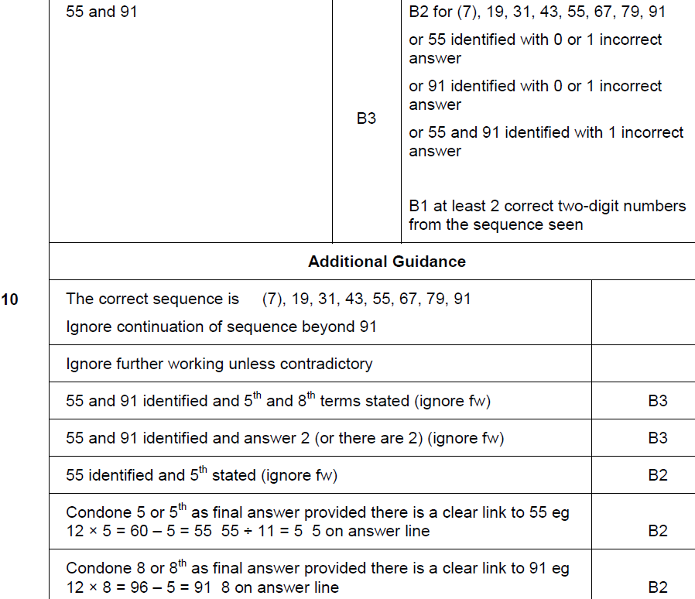
Sequences
June 2018 3H Q10
A

Slide 33
Sequences
Nov 2018 1H Q21

Slide 34
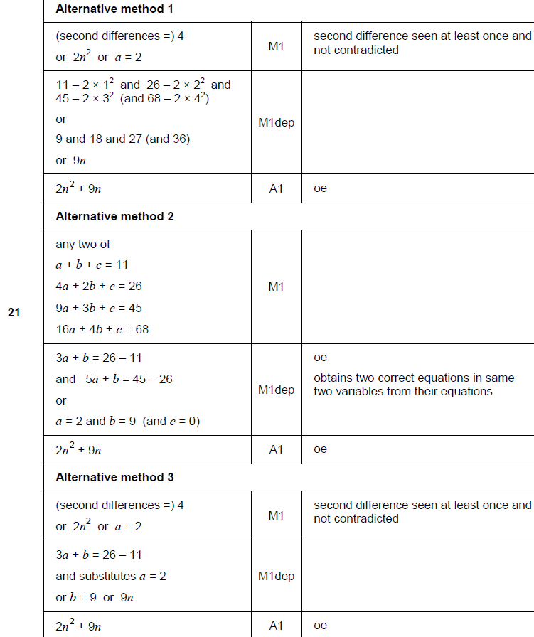
Sequences
Nov 2018 1H Q21
A

Slide 35
Sequences
Nov 2018 2H Q3

Slide 36
Sequences
Nov 2018 2H Q3
A

Slide 37
Sequences
Nov 2018 3H Q3

Slide 38
Sequences
Nov 2018 3H Q3
A

