Slide 1
Old Spec Q’s
Second Order Differentials
SAM 1
SAM 2
2019 1
2019 2

Slide 2
SAM Paper 1

Slide 3
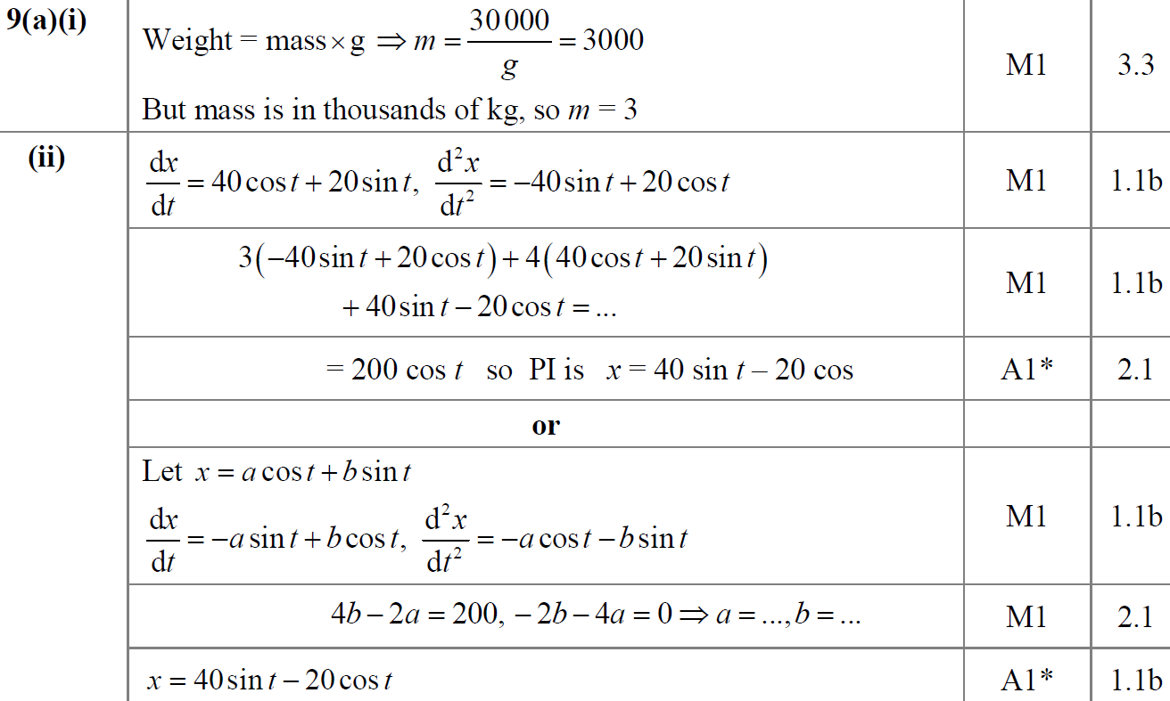
SAM Paper 1
A (i)
A (ii)

Slide 4
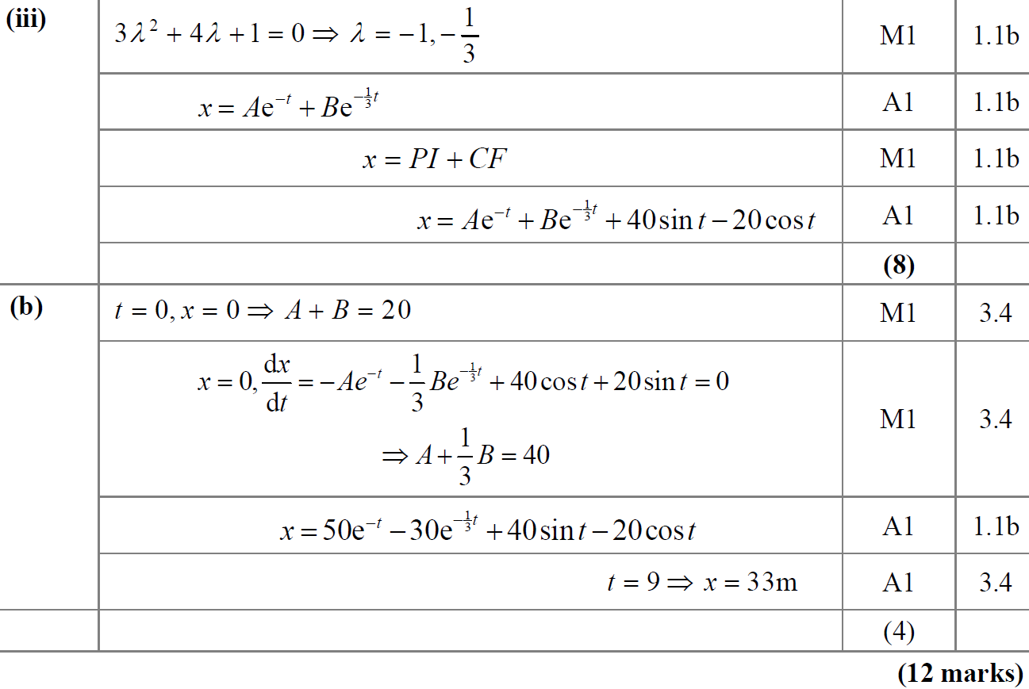
SAM Paper 1
A (iii)
B

Slide 5
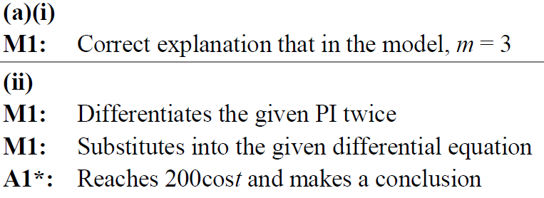
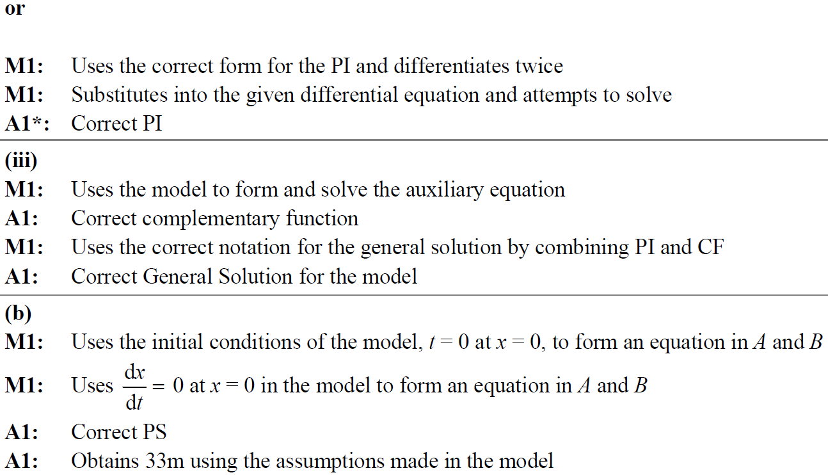
SAM Paper 1
A (i) notes
A (ii) notes
A (iii) notes
B notes

Slide 6
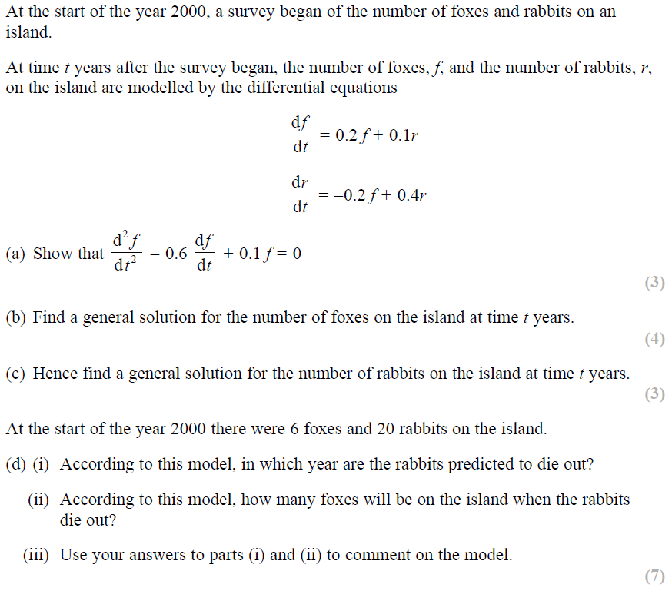
SAM Paper 2

Slide 7
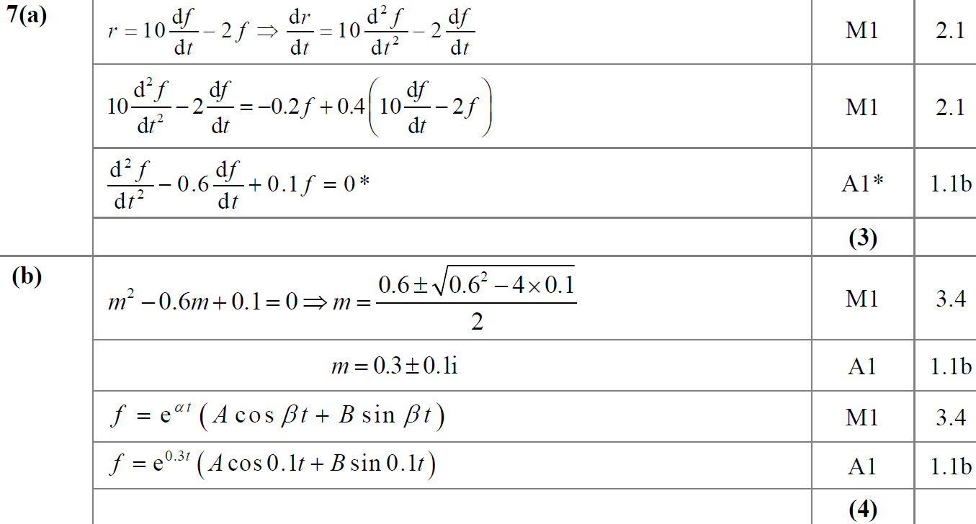
SAM Paper 2
A
B

Slide 8
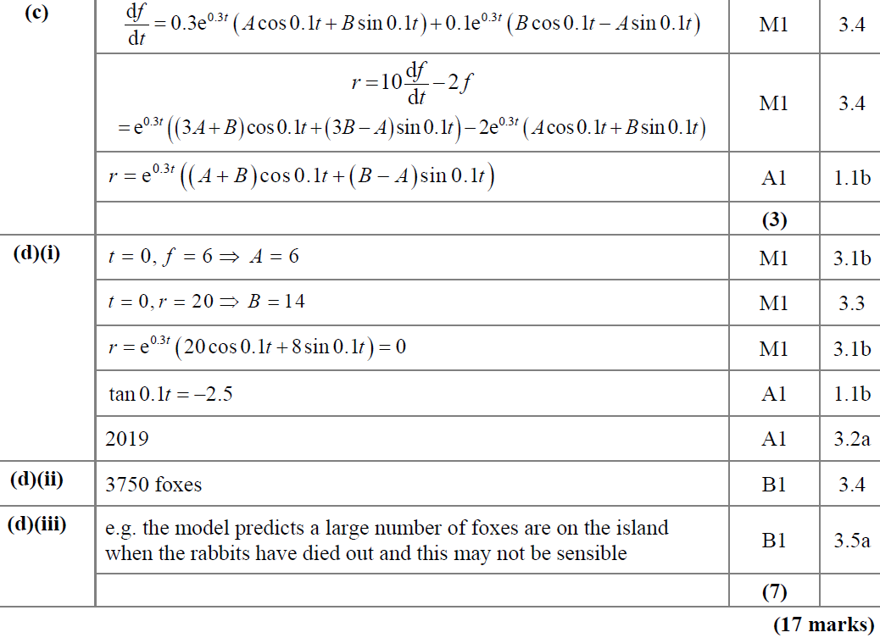
SAM Paper 2
C
D (i)
D (ii)
D (iii)

Slide 9
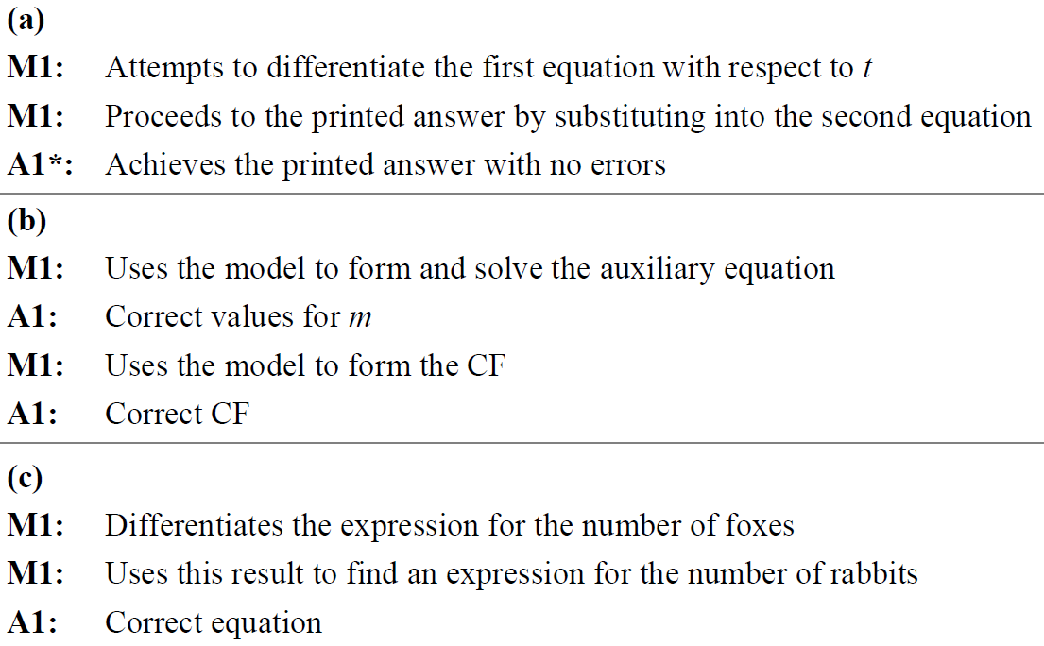
SAM Paper 2
A notes
B notes
C notes

Slide 10
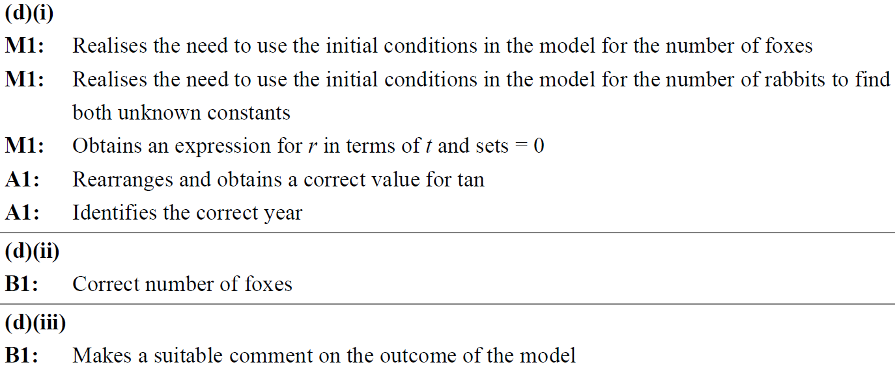
SAM Paper 2
D (i) notes
D (ii) notes
D (iii) notes

Slide 11
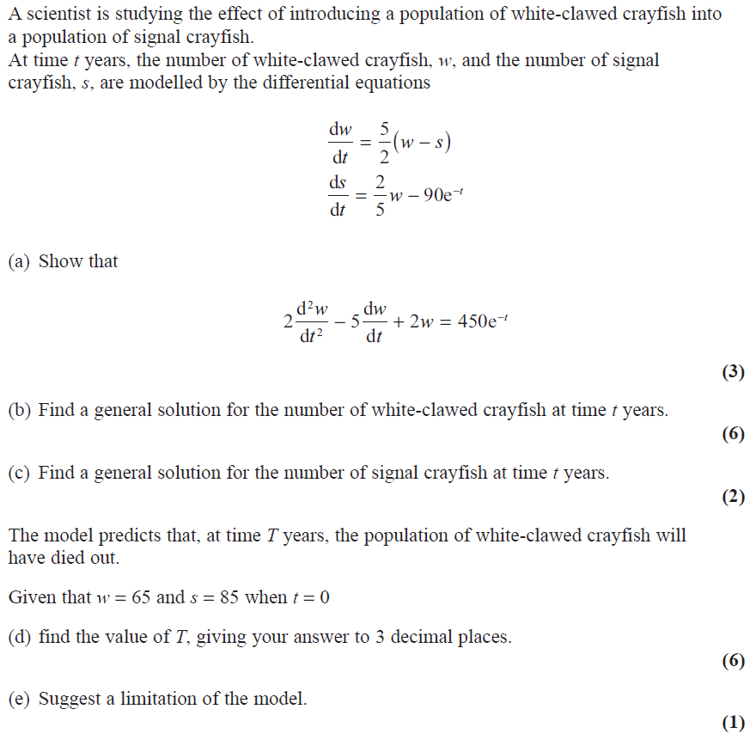
2019 Paper 1

Slide 12
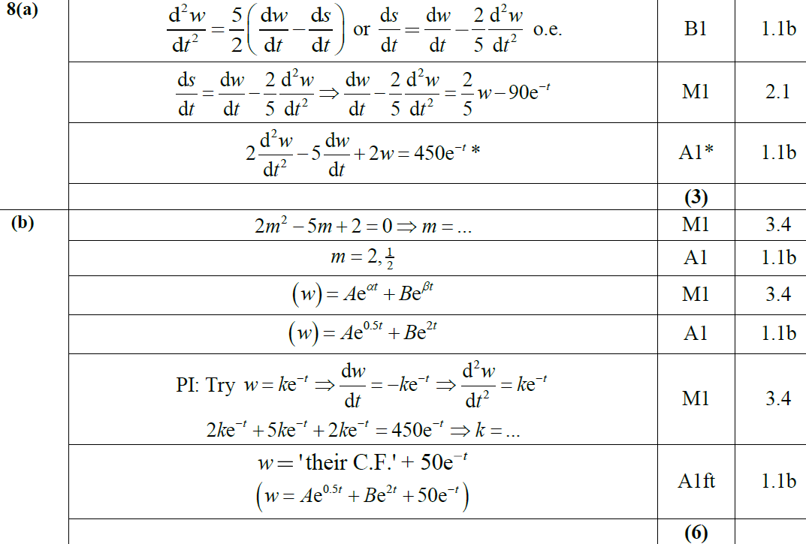
2019 Paper 1
A
B

Slide 13
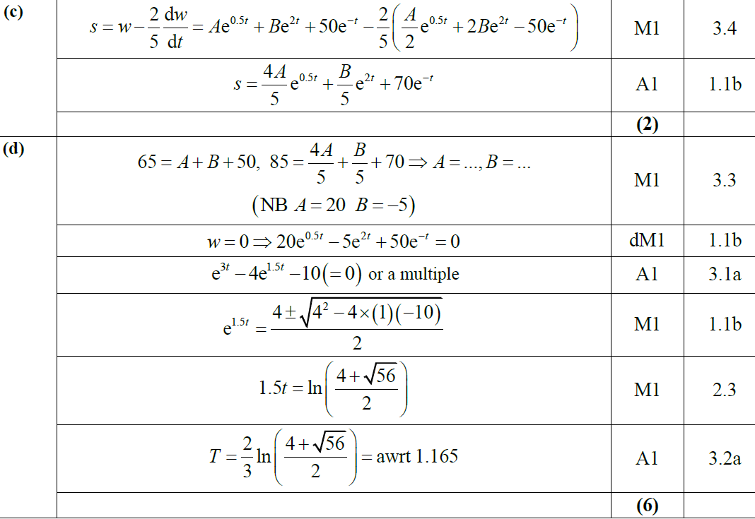
2019 Paper 1
C
D

Slide 14
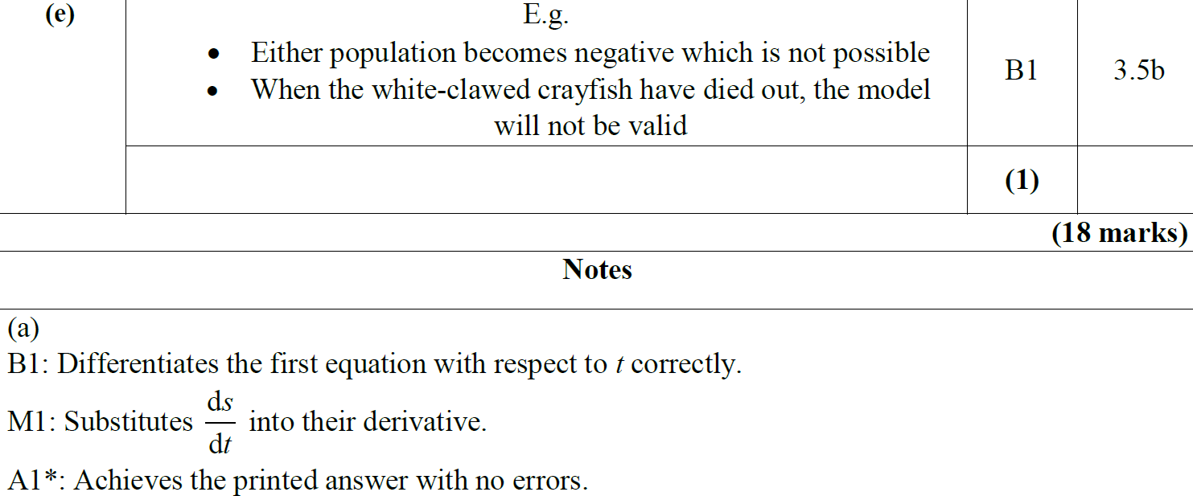
2019 Paper 1
E
A notes
E notes

Slide 15
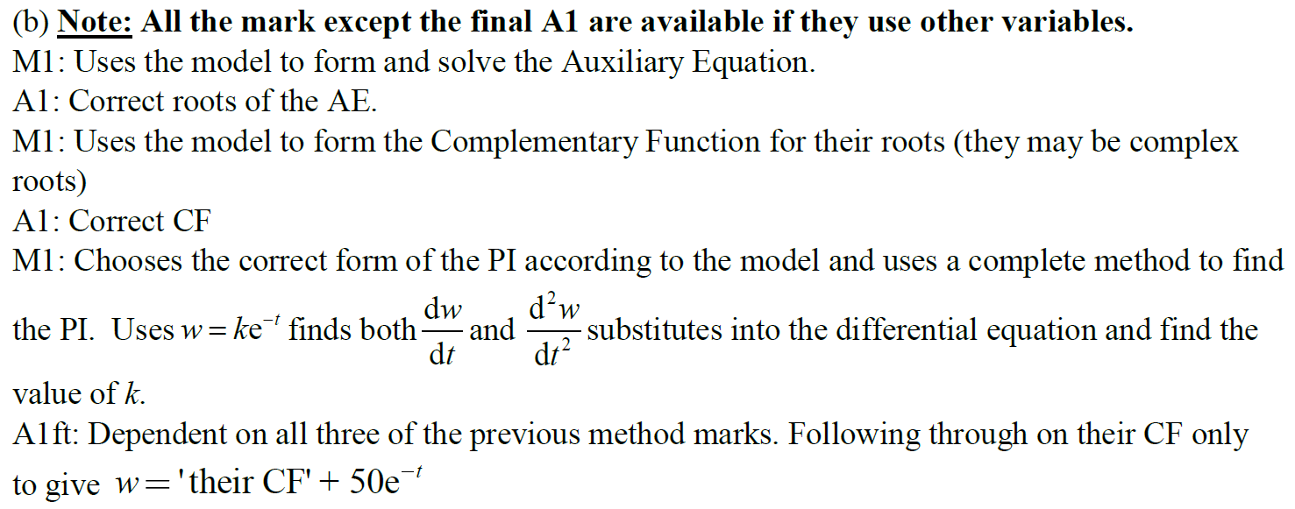
2019 Paper 1
B notes

Slide 16
2019 Paper 1
C notes
D notes

Slide 17
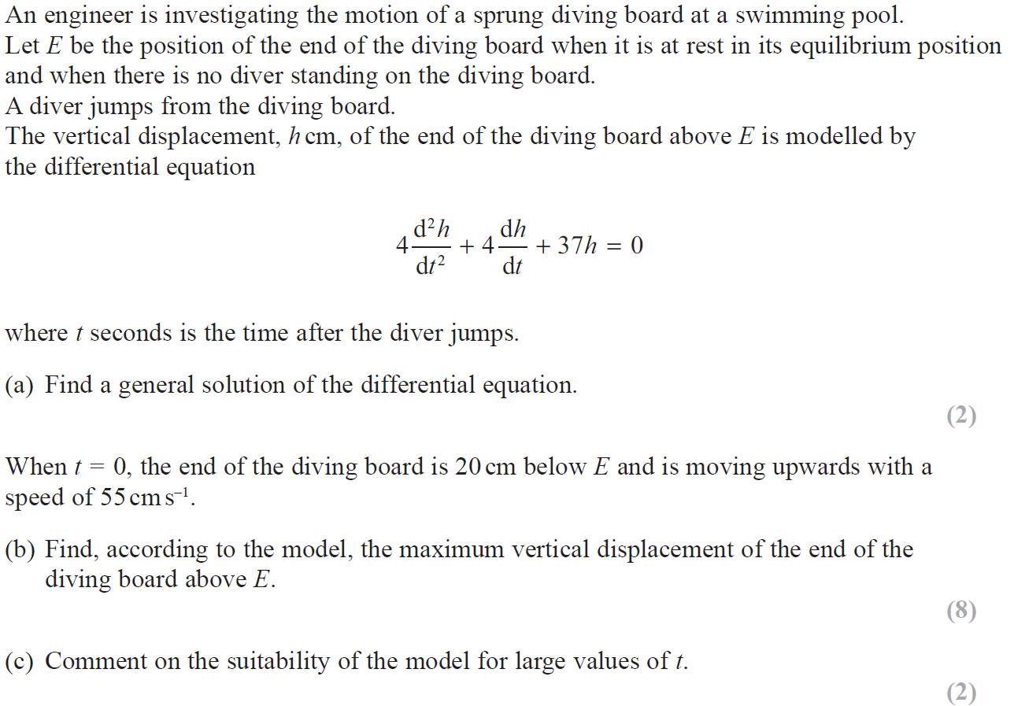
2019 Paper 2

Slide 18
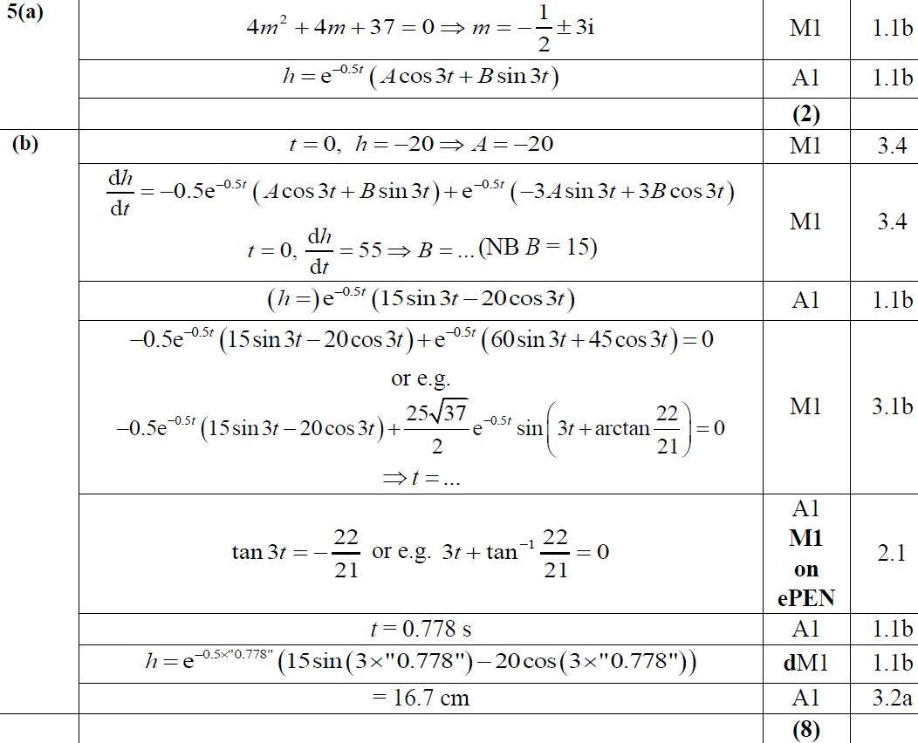
2019 Paper 2
A
B

Slide 19
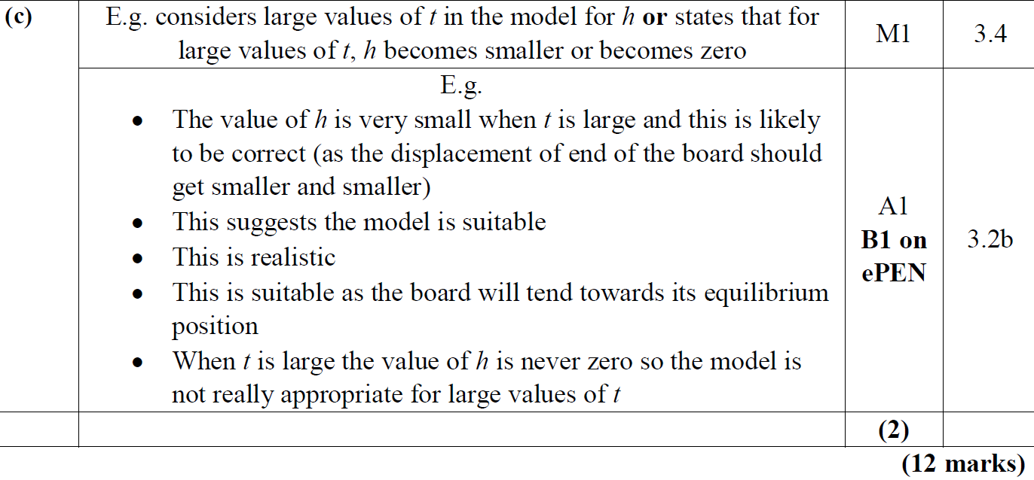
2019 Paper 2
C

Slide 20
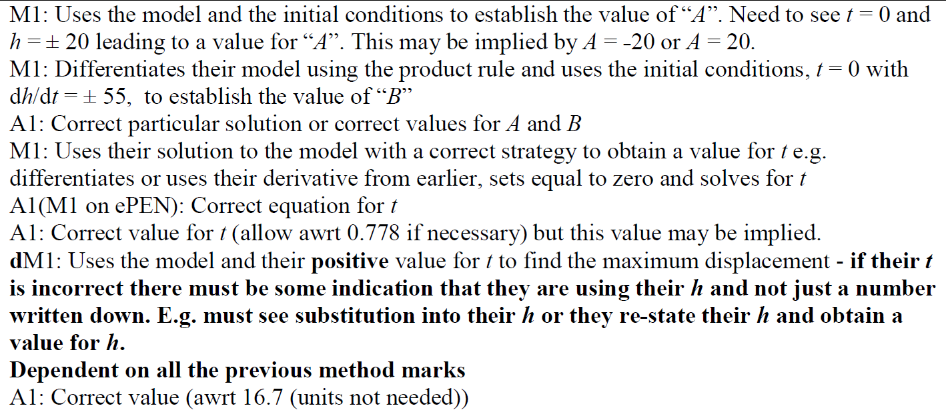
2019 Paper 2
A notes
B notes

Slide 21
New Spec Q’s
M4 modelling (all contain element not in Core Spec)
Old Spec Second Order Differentials
P4/ Old FP1
FP2
M4
Jan 2006
June 2014
Jan 2002
Jan 2006
June 2009
June 2014 R
Jan 2002
June 2006
June 2014 R
June 2002
June 2006
June 2010
June 2015
June 2002
June 2007
June 2015
Jan 2003
Jan 2007
June 2011
June 2016
Jan 2003
June 2008 (i)
June 2016 (i)
June 2003
June 2007
June 2012
June 2017
June 2003
June 2008 (ii)
June 2016 (ii)
June 2003
Jan 2008
June 2013
June 2018
Jan 2004
June 2009
June 2017
Jan 2004
June 2008
June 2013 R
June 2019
June 2004
June 2010
June 2019
June 2004
Jan 2009
June 2013 W
Jan 2005
June 2011
Jan 2005
June 2009
June 2014
June 2005
June 2013
June 2005
Jan 2010
reduce with substitution part (ignore as not in this spec yet)
June 2013 R

Slide 22
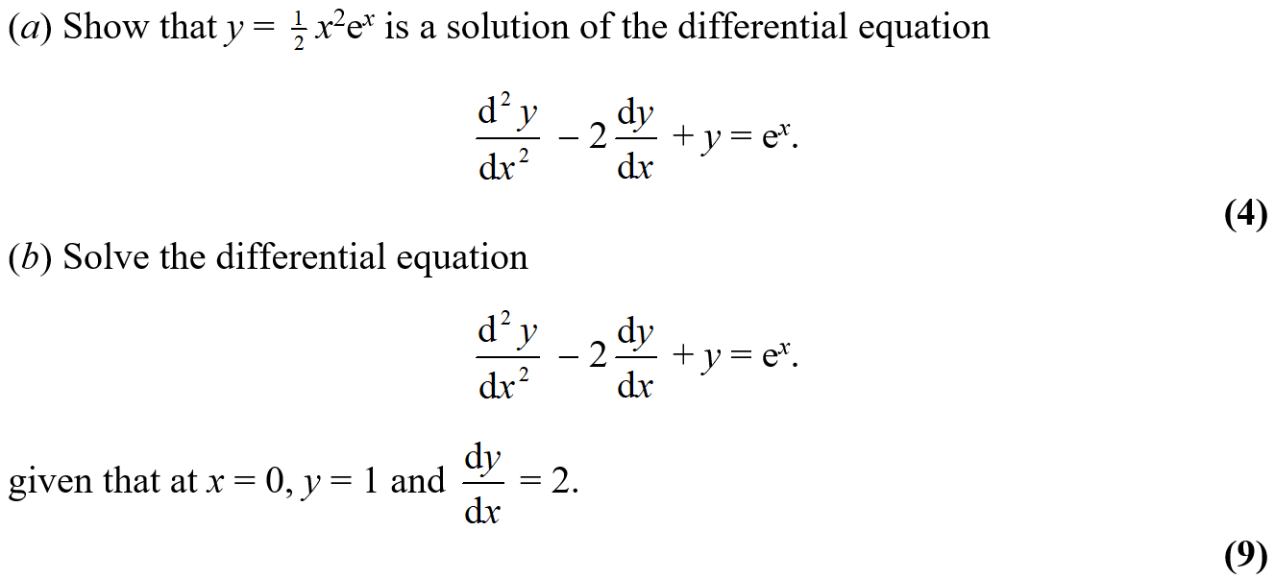
Jan 2002

Slide 23
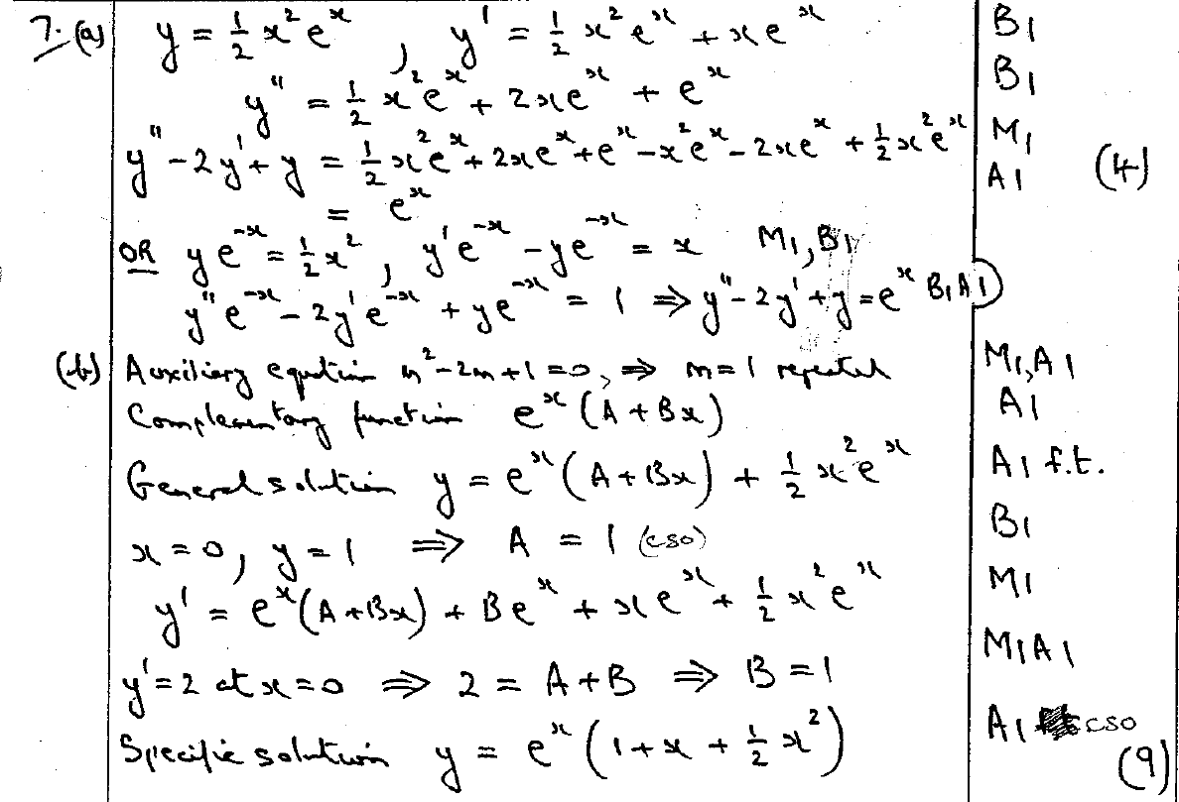
Jan 2002
A
B

Slide 24
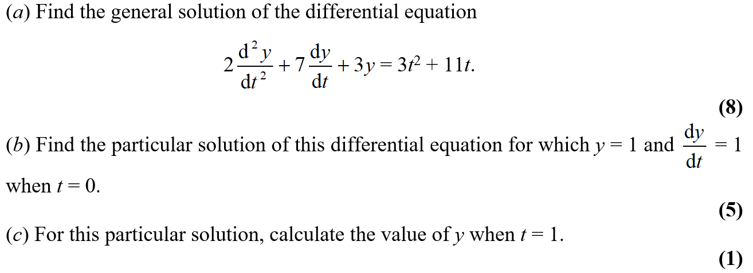
June 2002

Slide 25
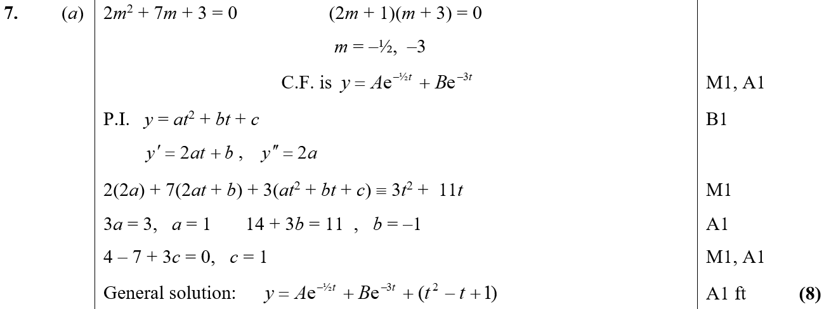
June 2002
A

Slide 26
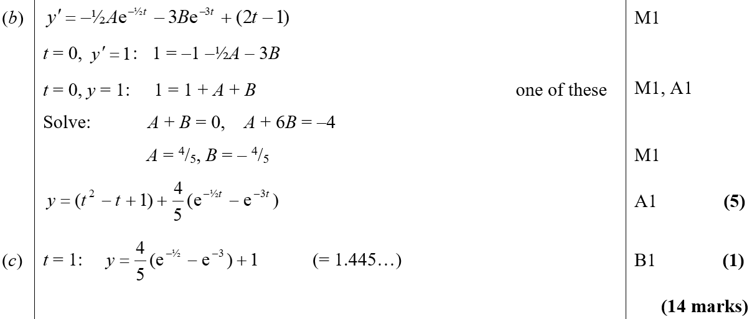
June 2002
B
C

Slide 27
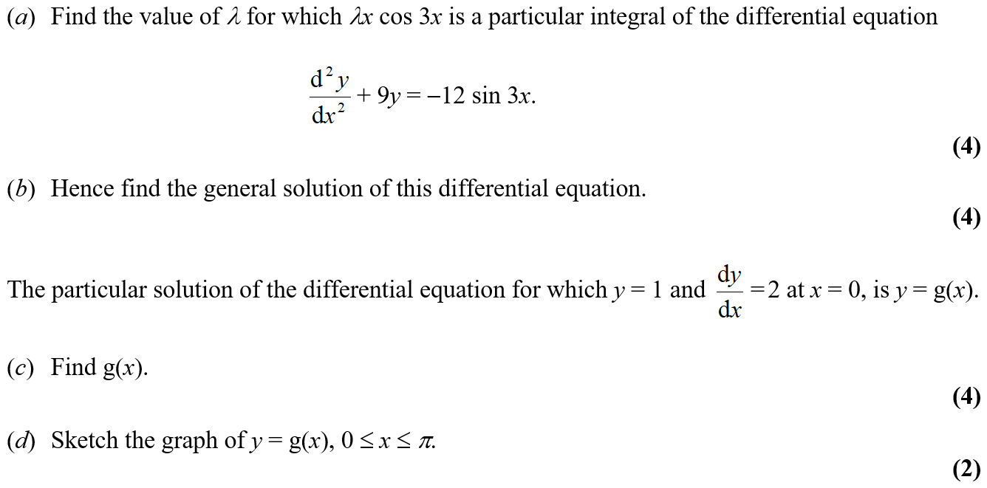
Jan 2003

Slide 28
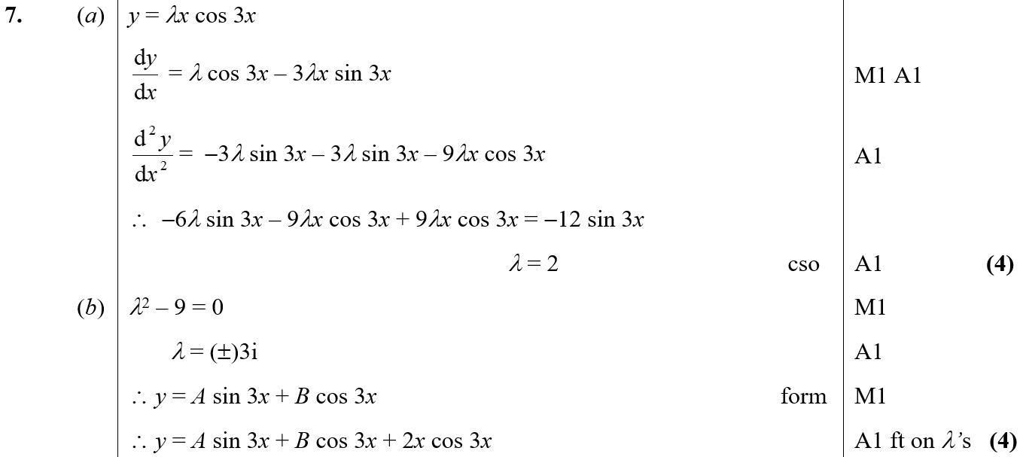
Jan 2003
A
B

Slide 29
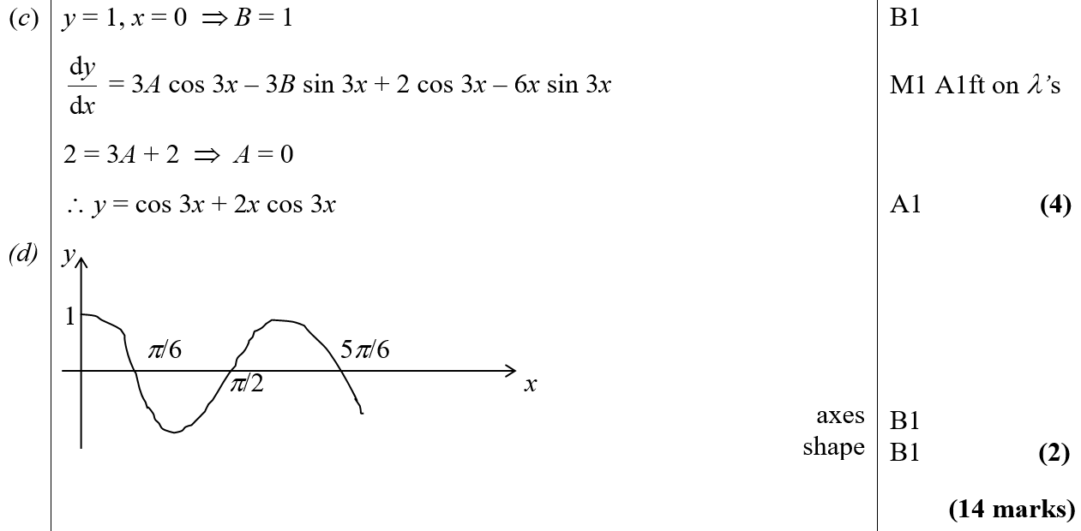
Jan 2003
C
D

Slide 30
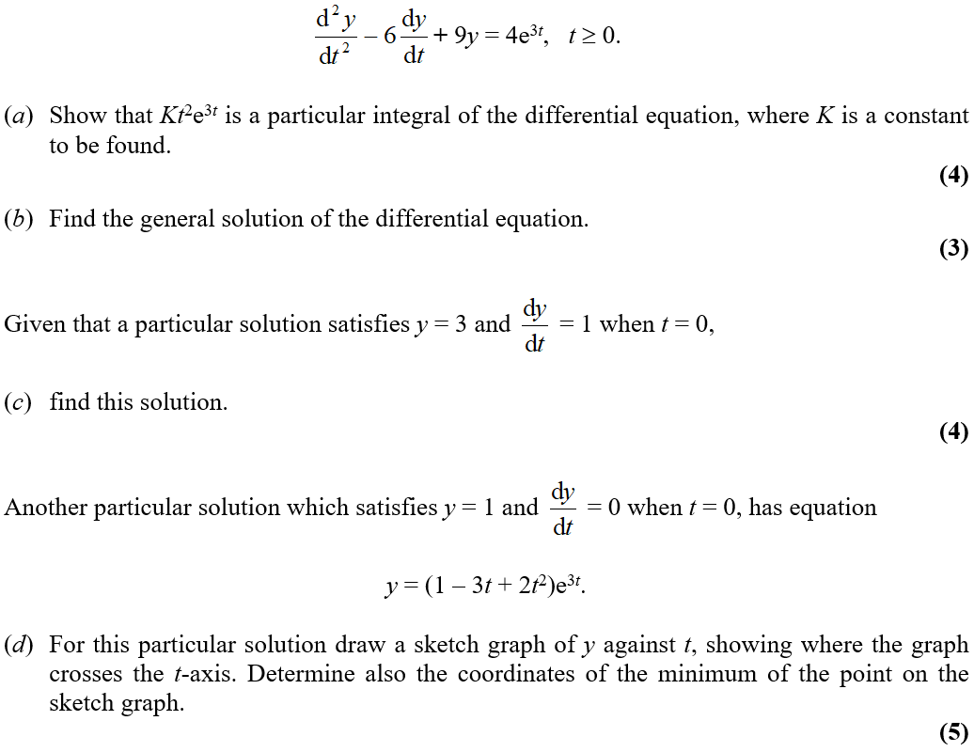
June 2003

Slide 31
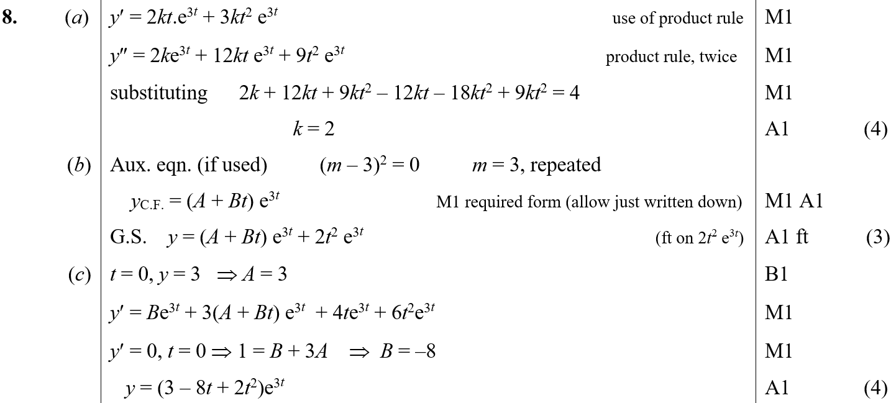
June 2003
A
B
C

Slide 32
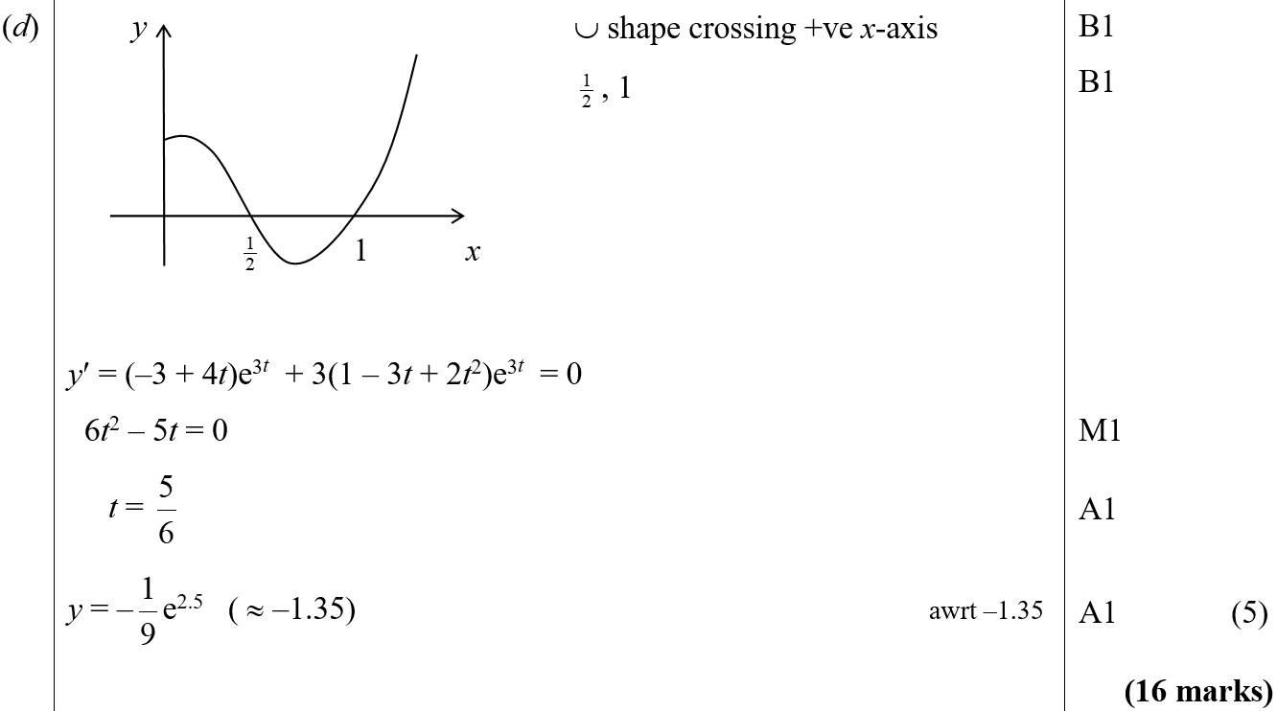
June 2003
D

Slide 33
Jan 2004

Slide 34
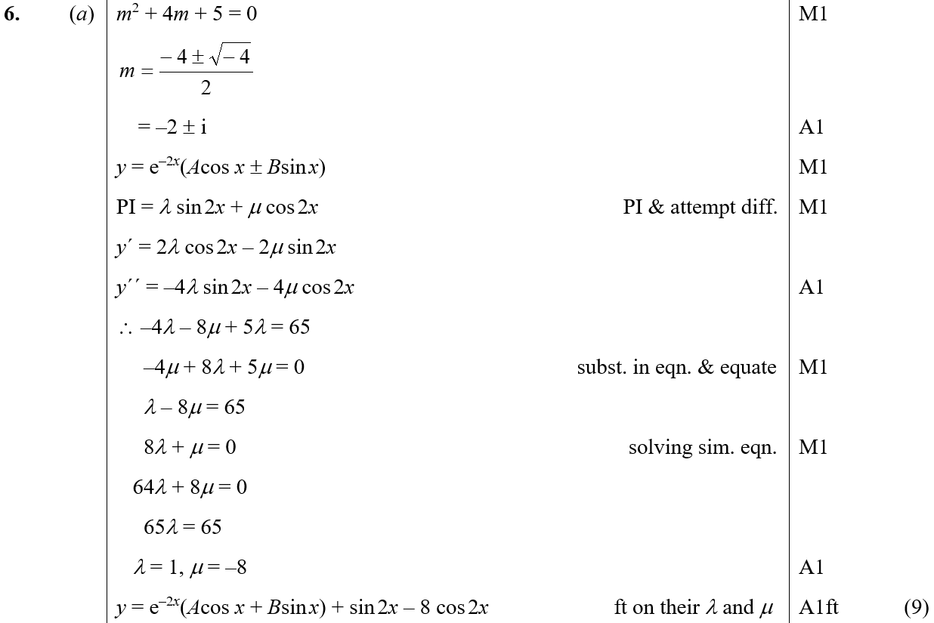
Jan 2004
A

Slide 35
Jan 2004
B

Slide 36
June 2004

Slide 37
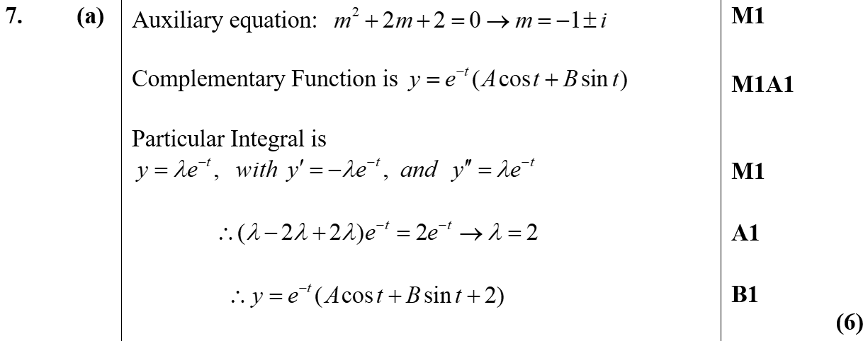
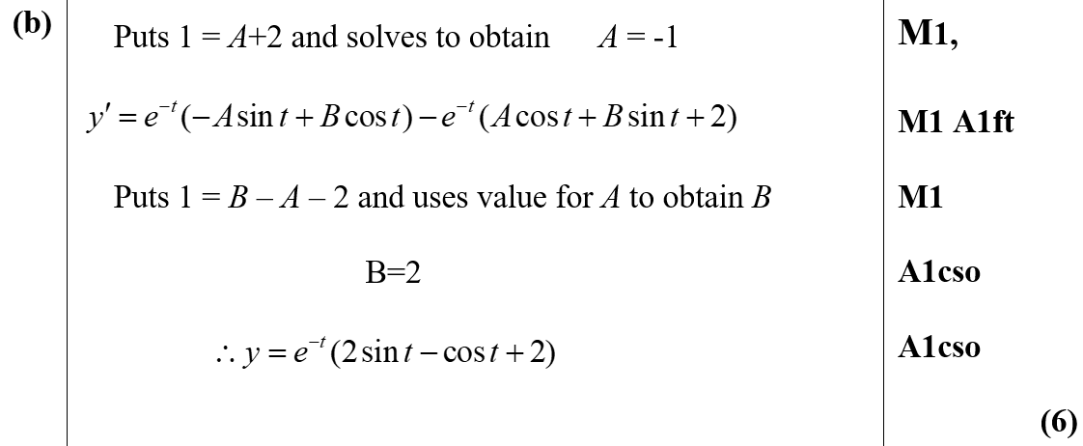
June 2004
A
B

Slide 38
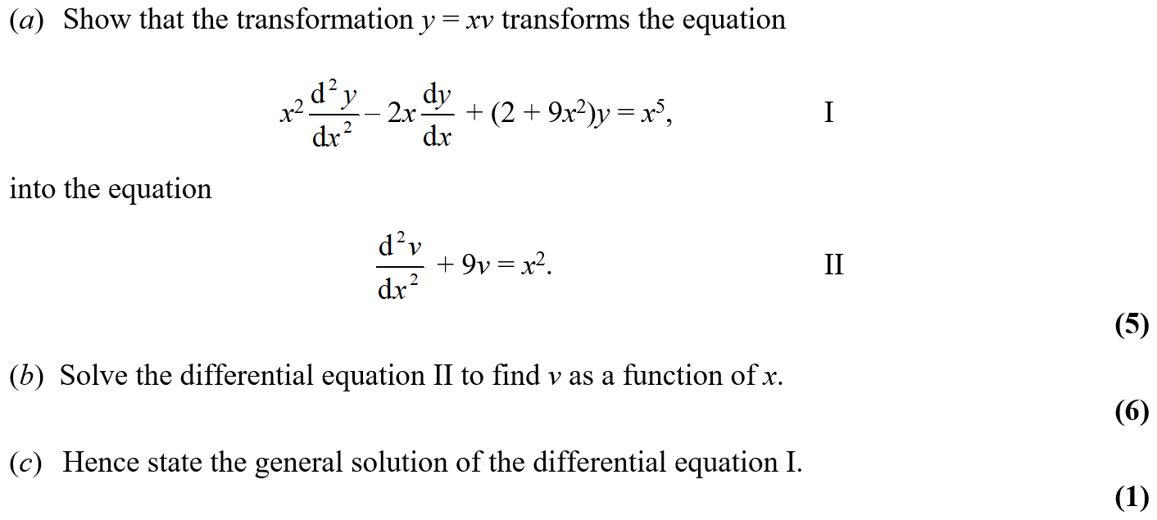
Jan 2005

Slide 39
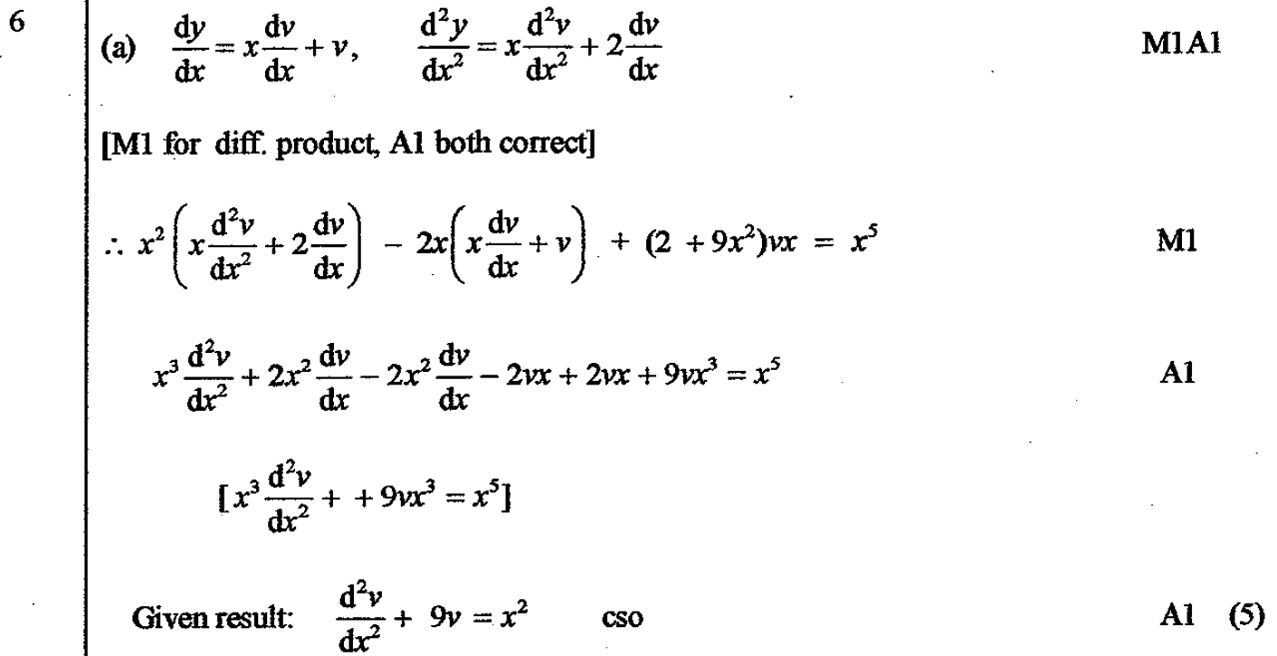
Jan 2005
A

Slide 40
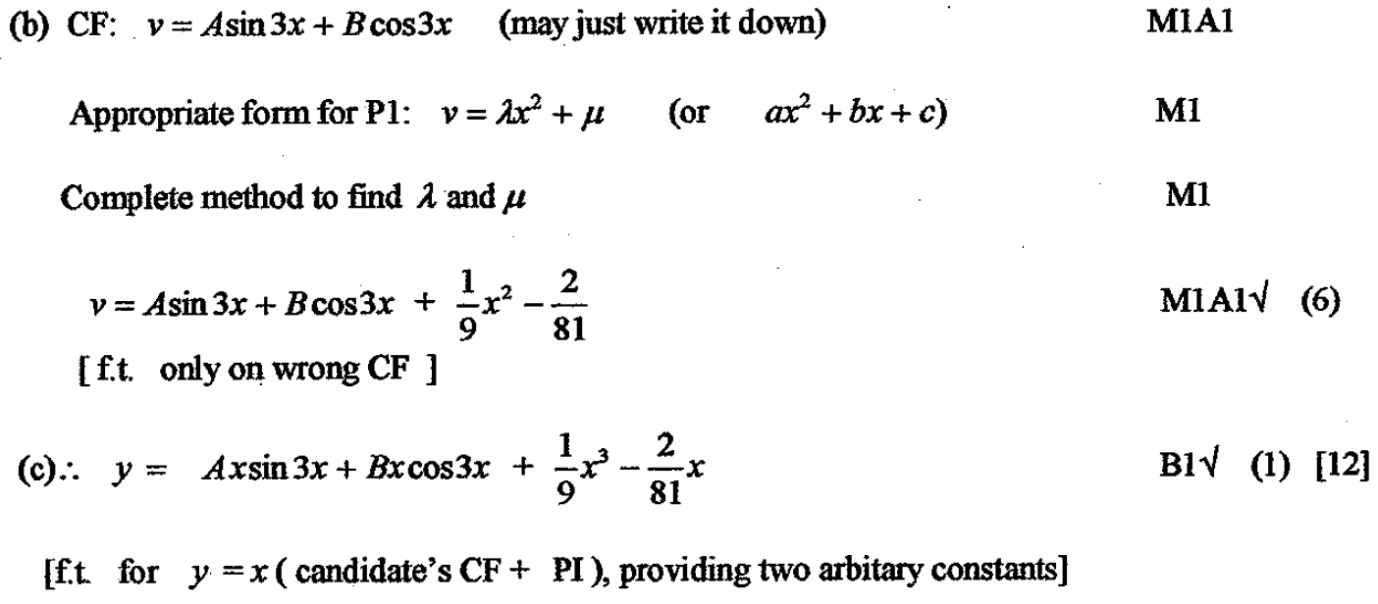
Jan 2005
B
C

Slide 41
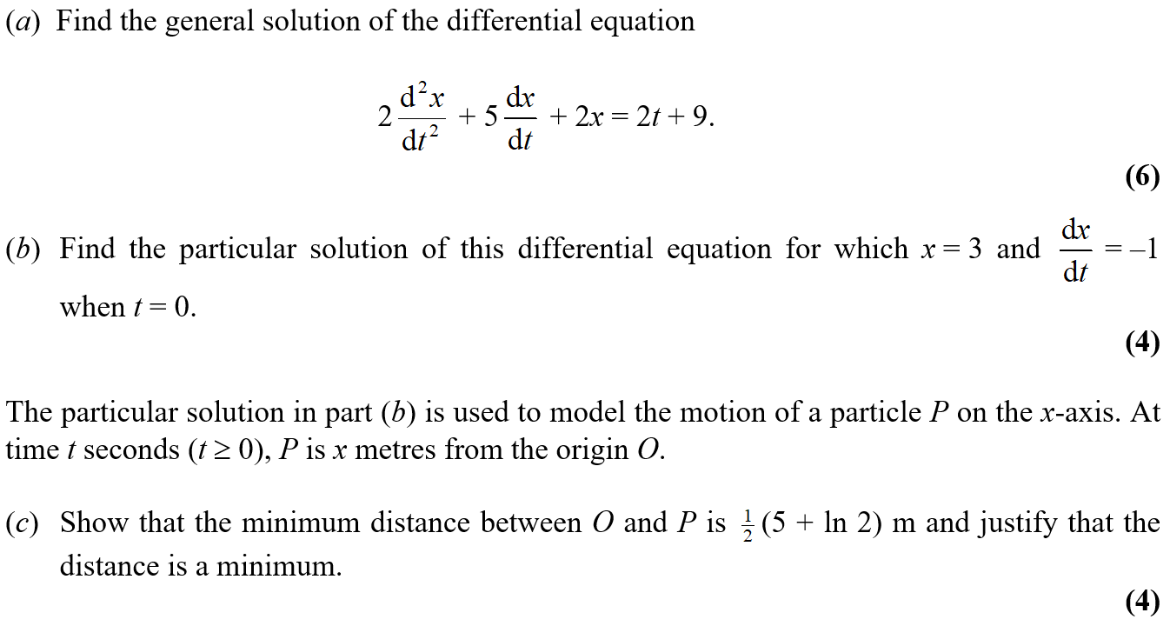
June 2005

Slide 42
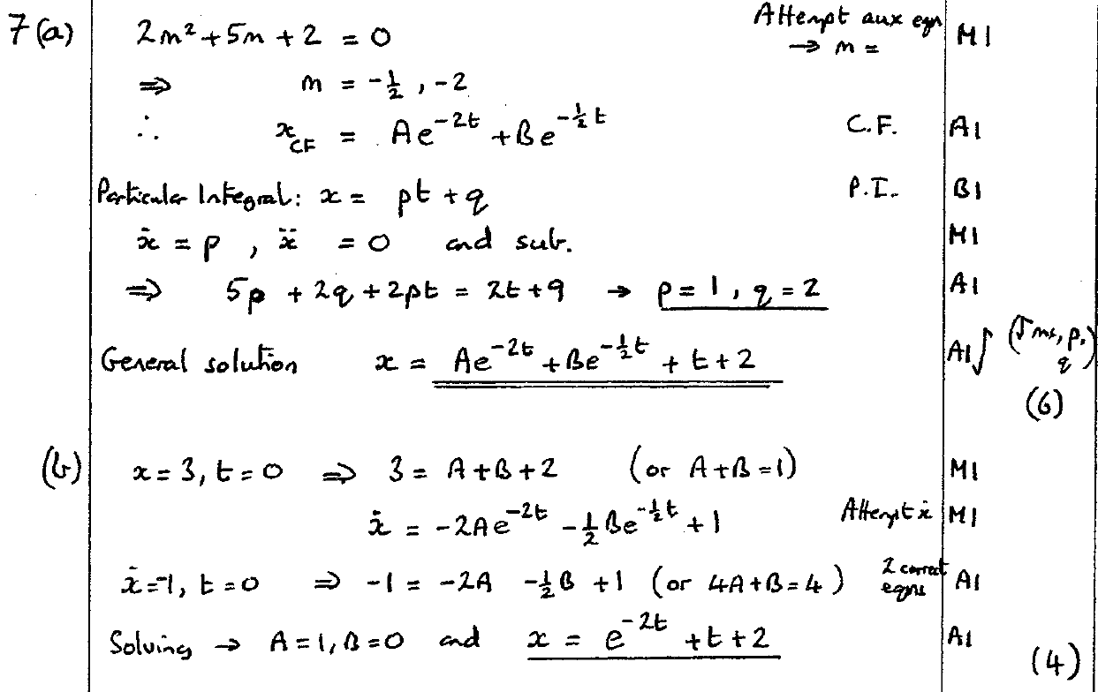
June 2005
A
B

Slide 43
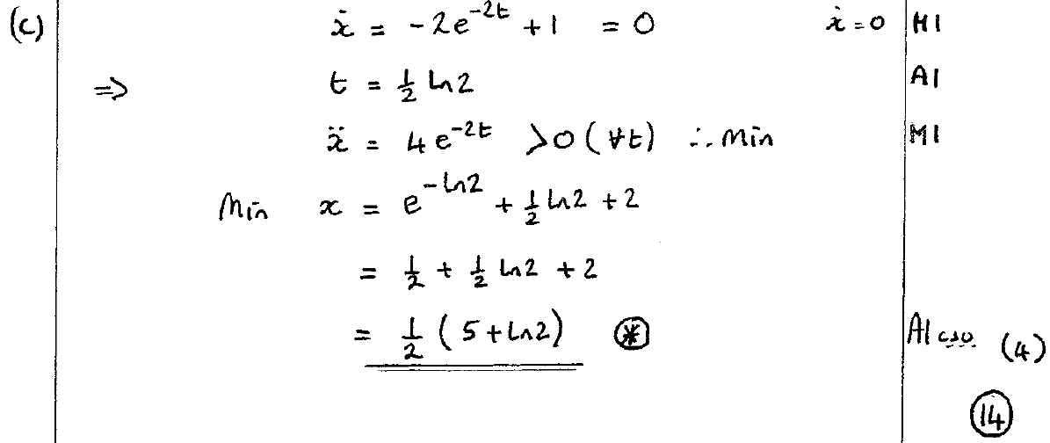
June 2005
C

Slide 44
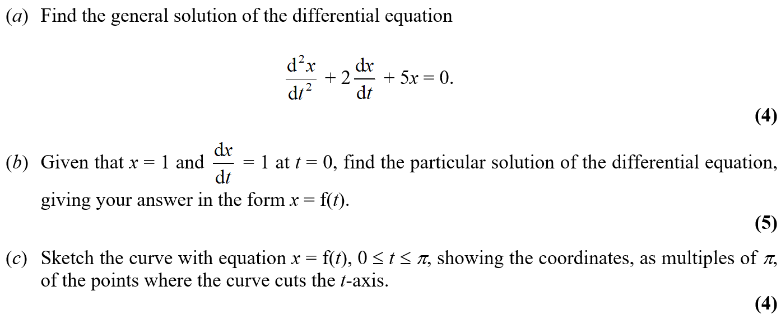
Jan 2006

Slide 45
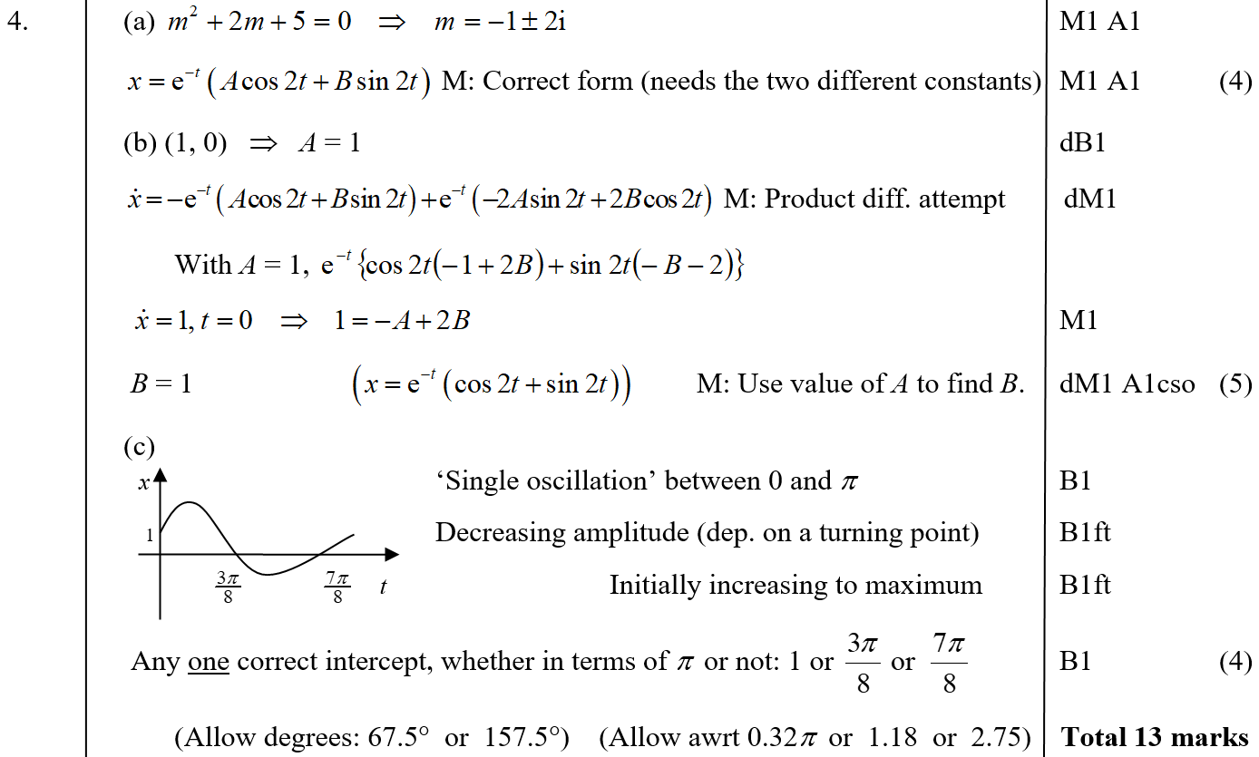
Jan 2006
A
B
C

Slide 46
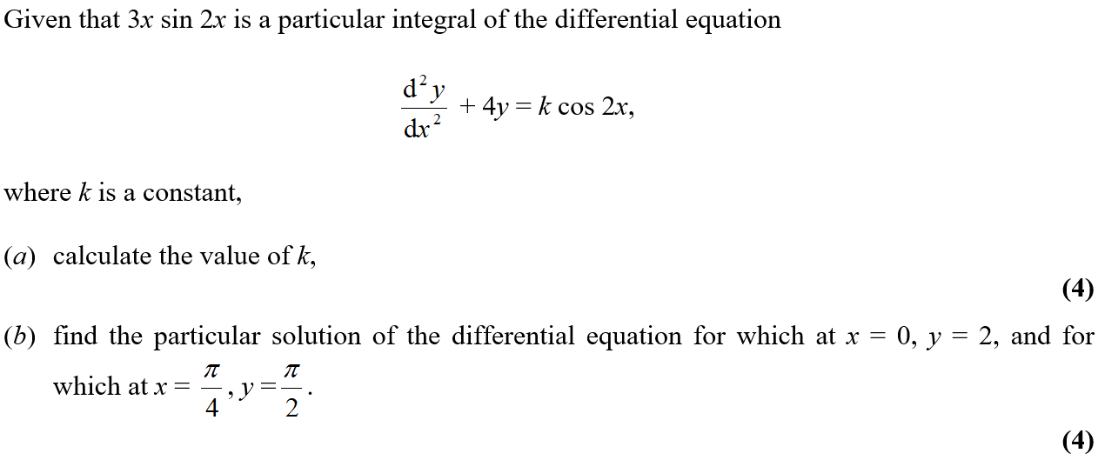
June 2006

Slide 47
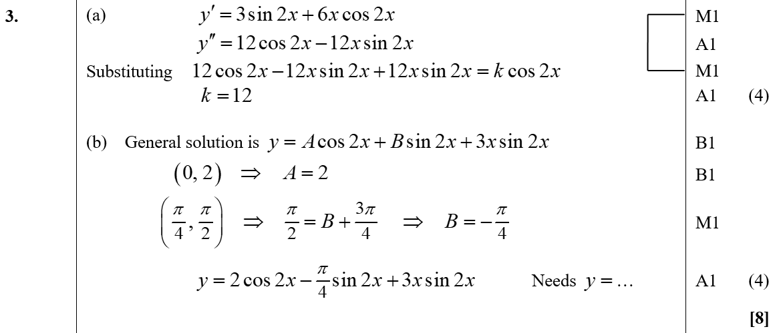
June 2006
A
B

Slide 48
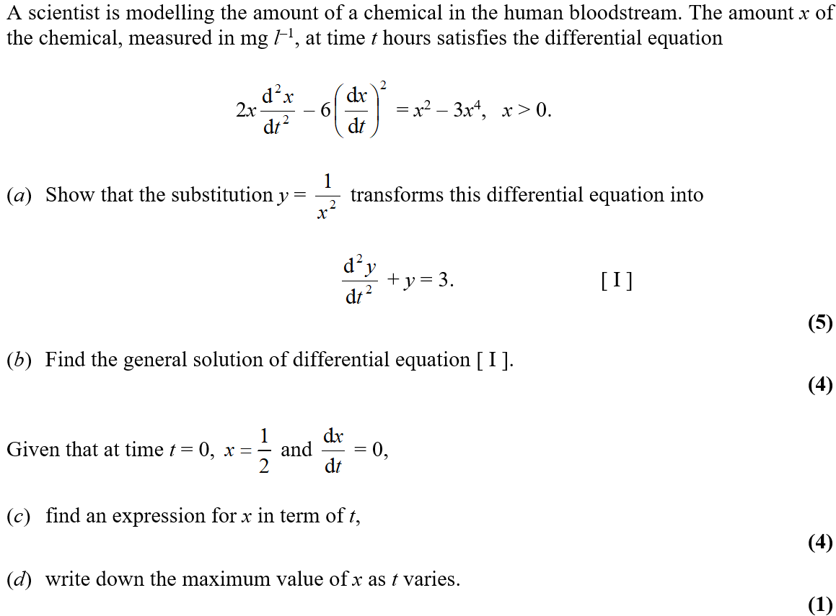
Jan 2007

Slide 49
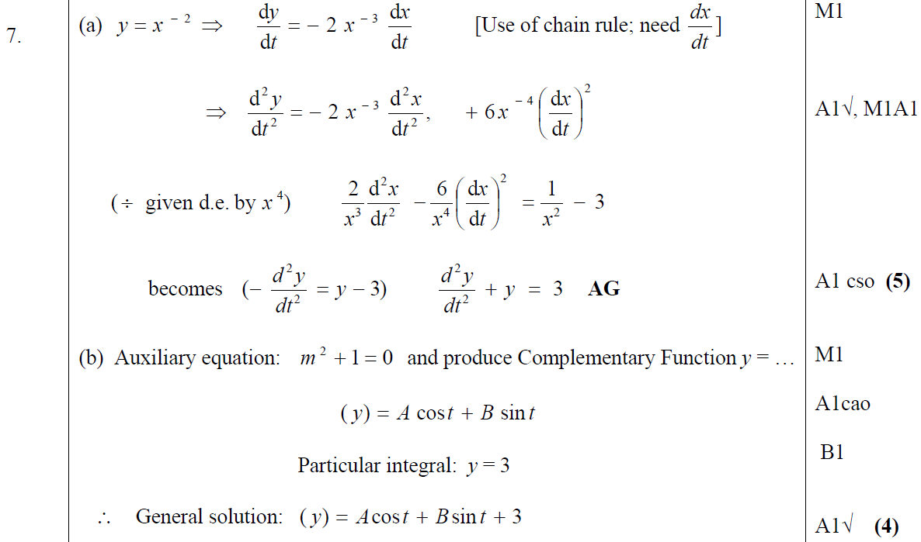
Jan 2007
A
B

Slide 50
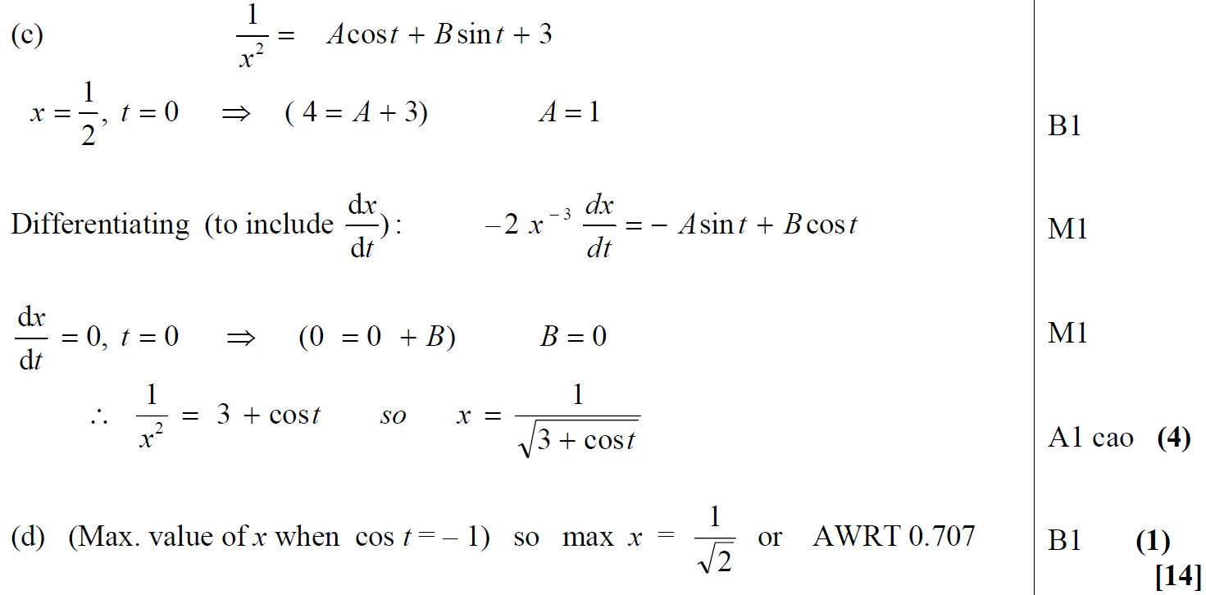
Jan 2007
C
D

Slide 51
Jan 2007
A notes
B notes

Slide 52
June 2007

Slide 53
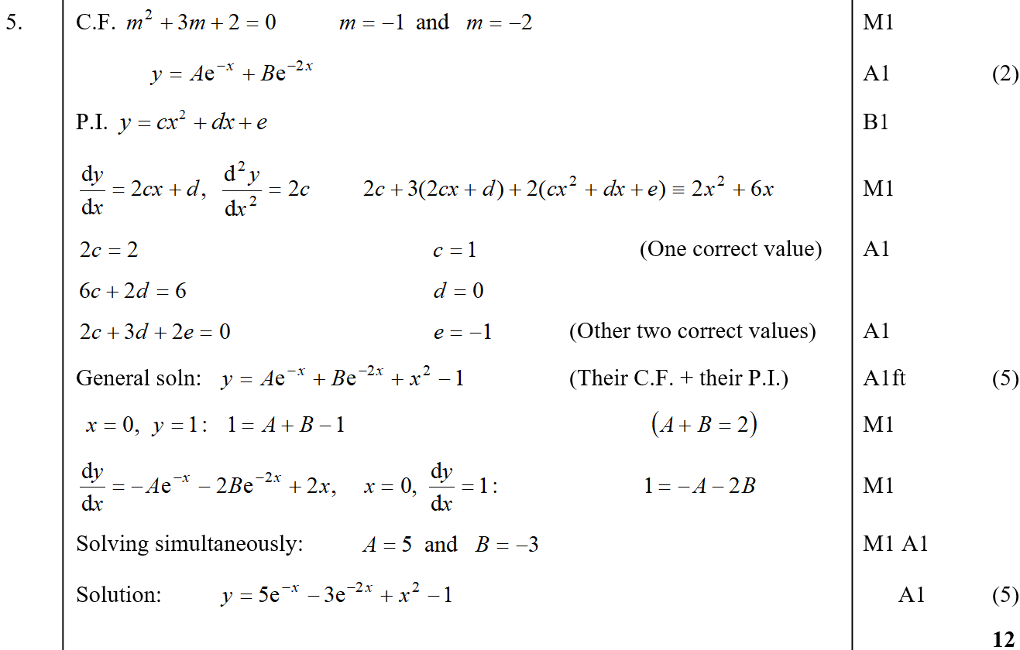
June 2007
A
B
C

Slide 54
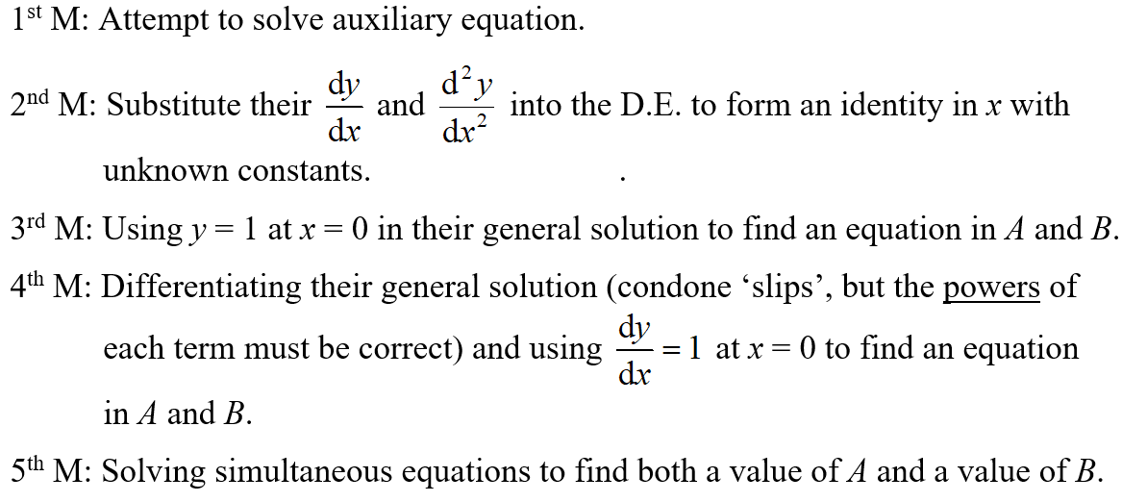
June 2007
notes

Slide 55
Jan 2008

Slide 56
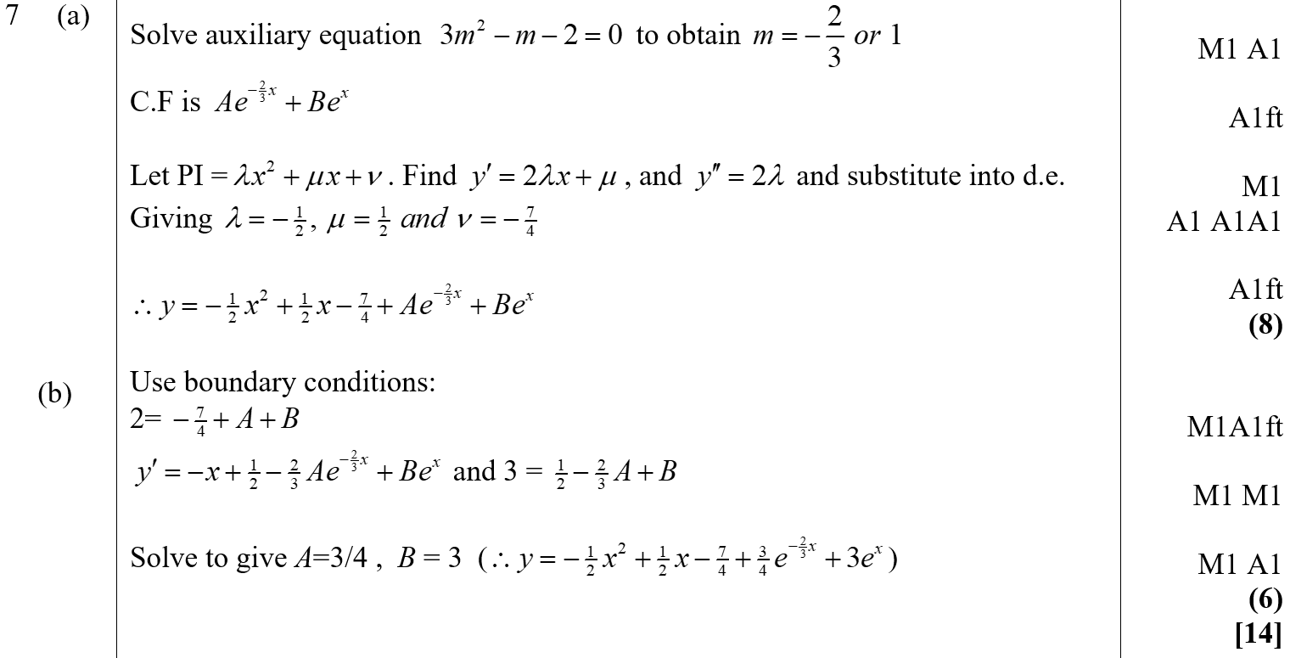
Jan 2008
A
B

Slide 57
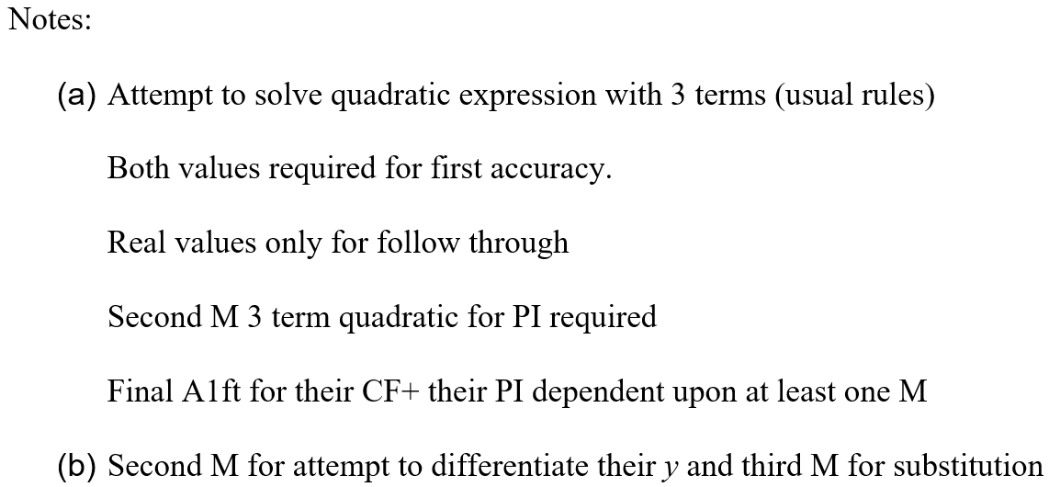
Jan 2008
A notes
B notes

Slide 58
June 2008

Slide 59
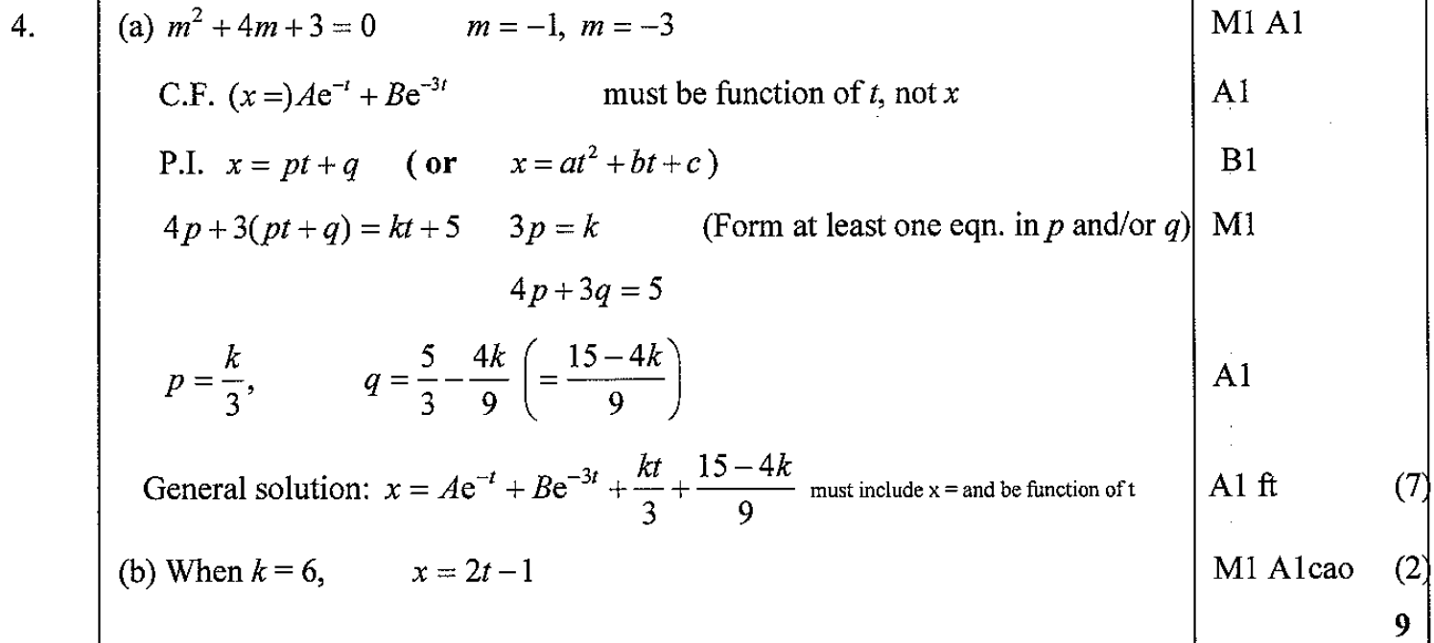
June 2008
A
B
A notes
B notes

Slide 60
Jan 2009

Slide 61
Jan 2009
A
B

Slide 62
Jan 2009
C

Slide 63
Jan 2009
A notes
B notes
C notes

Slide 64
June 2009

Slide 65
June 2009
A
A notes

Slide 66
Jan 2010

Slide 67
Jan 2010
A

Slide 68
June 2009

Slide 69
June 2009
A

Slide 70
June 2009
B

Slide 71
June 2010

Slide 72
June 2010
A
B

Slide 73
June 2010
C
D

Slide 74
June 2011

Slide 75
June 2011
A
x’
x’’

Slide 76
June 2011
B
C

Slide 77
June 2012

Slide 78
June 2012
A

Slide 79
June 2012
A notes

Slide 80
June 2013

Slide 81
June 2013
A
C

Slide 82
June 2013
A
x’
x’’

Slide 83
June 2013
A Alternative

Slide 84
June 2013
A notes

Slide 85
June 2013
A Alternative notes

Slide 86
June 2013
B notes
C notes

Slide 87
June 2013 Reserve

Slide 88
June 2013 Reserve
A

Slide 89
June 2013 Reserve
B

Slide 90
June 2013 Reserve
C

Slide 91
June 2013 Reserve
A notes

Slide 92
June 2013 Reserve
B notes
C notes

Slide 93
June 2013 Withdrawn

Slide 94
June 2013 Withdrawn
A
B

Slide 95
June 2014

Slide 96
June 2014
A

Slide 97
June 2014
B

Slide 98
June 2014
B Alternative

Slide 99
June 2014 Reserve

Slide 100
June 2014 Reserve
A

Slide 101
June 2014 Reserve
A Alternative

Slide 102
June 2014 Reserve
B

Slide 103
June 2014 Reserve
C
A notes

Slide 104
June 2014 Reserve
B notes
C notes

Slide 105
June 2015

Slide 106
June 2015
A

Slide 107
June 2015
A notes

Slide 108
June 2015
A Alternative 1

Slide 109
June 2015
A Alternative 2

Slide 110
June 2015
B

Slide 111
June 2015
C
B notes
C notes

Slide 112
June 2016

Slide 113
June 2016
A

Slide 114
June 2016
A notes

Slide 115
June 2016
A Alternative 1

Slide 116
June 2016
A Alternative 2

Slide 117
June 2016
B

Slide 118
June 2016
C

Slide 119
June 2017

Slide 120
June 2017
A

Slide 121
June 2017
B

Slide 122
June 2017
A Alternative

Slide 123
June 2018

Slide 124
June 2018
A

Slide 125
June 2018
B

Slide 126
June 2019

Slide 127
June 2019
A

Slide 128
June 2019
A notes

Slide 129
Jan 2002

Slide 130
Jan 2002
A
B
C
D

Slide 131
June 2002

Slide 132
June 2002
A

Slide 133
June 2002
B

Slide 134
Jan 2003

Slide 135
Jan 2003
A

Slide 136
Jan 2003
B
C
D

Slide 137
June 2003

Slide 138
June 2003
A
B

Slide 139
June 2003
C

Slide 140
Jan 2004

Slide 141
Jan 2004
A

Slide 142
Jan 2004
B

Slide 143
Jan 2004
B

Slide 144
June 2004

Slide 145
June 2004
A
B

Slide 146
June 2004
C
D

Slide 147
Jan 2005

Slide 148
Jan 2005
A
B

Slide 149
Jan 2005
C
D

Slide 150
June 2005

Slide 151
June 2005
A
B

Slide 152
June 2005
C

Slide 153
Jan 2006

Slide 154
Jan 2006
A
B
C

Slide 155
June 2006

Slide 156
June 2006
A

Slide 157
June 2006
B

Slide 158
June 2006
C

Slide 159
June 2007

Slide 160
June 2007
A

Slide 161
June 2007
B

Slide 162
June 2007
C

Slide 163
June 2007
D

Slide 164
June 2008

Slide 165
June 2008
A

Slide 166
June 2008
B
C

Slide 167
June 2008

Slide 168
June 2008
A
B

Slide 169
June 2008
C

Slide 170
June 2009

Slide 171
June 2009
A

Slide 172
June 2009
B
C
D

Slide 173
June 2010

Slide 174
June 2010
A
B

Slide 175
June 2010
C

Slide 176
June 2011

Slide 177
June 2011
A
B
C

Slide 178
June 2013

Slide 179
June 2013
A
B
C
D

Slide 180
June 2013 Reserve

Slide 181
June 2013 Reserve
A

Slide 182
June 2013 Reserve
B
C

Slide 183
June 2013 Reserve
D

Slide 184
June 2014

Slide 185
June 2014
A
B
C

Slide 186
June 2014 Reserve

Slide 187
June 2014 Reserve
A
B

Slide 188
June 2014 Reserve
C

Slide 189
June 2015

Slide 190
June 2015
A
B

Slide 191
June 2016

Slide 192
June 2016
A
B

Slide 193
June 2016
B Alternative
C

Slide 194
June 2016

Slide 195
June 2016
A (i)
A (ii)

Slide 196
June 2016
B
C

Slide 197
June 2016
D

Slide 198
June 2017

Slide 199
June 2017
A

Slide 200
June 2017
B

Slide 201
June 2017
C

Slide 202
June 2019

Slide 203
June 2019
A
B

Slide 204
June 2019
C

