Slide 1
Rounding
Rounding
Old Spec Q’s
No Q’s to date

Slide 2
Rounding
Rounding
New Spec Q’s
May 2004
4H Q8
June 2011 3H Q1
Jan 2017 4H Q4
Nov 2005
3H Q1
Jan 2013 4H Q1
May 2017 3H Q5
May 2007
3H Q1
May 2013 3H Q2
June 2017 4HR Q3
May 2007
4H Q4
May 2013 3H Q9
Jan 2018 3H Q2
May 2008
4H Q11
May 2014 3H Q1
May 2018 3H Q1
June 2009
4H Q11
May 2014 3HR Q1
May 2018 3HR Q1
Nov 2010
3H Q4
Jan 2015 3HR Q2
Nov 2010
4H Q1
Jan 2016 4H Q1

Slide 3
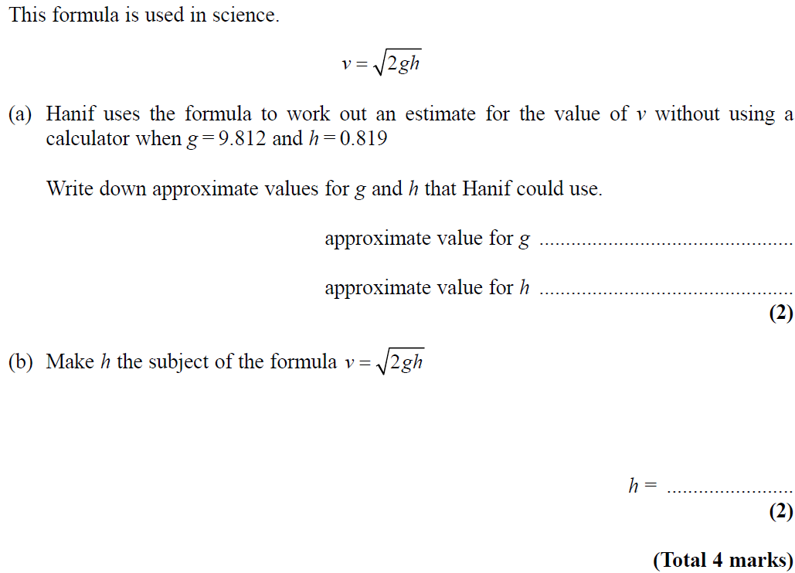
Rounding
May 2004 4H Q8

Slide 4
Rounding
May 2004 4H Q8
A
B

Slide 5
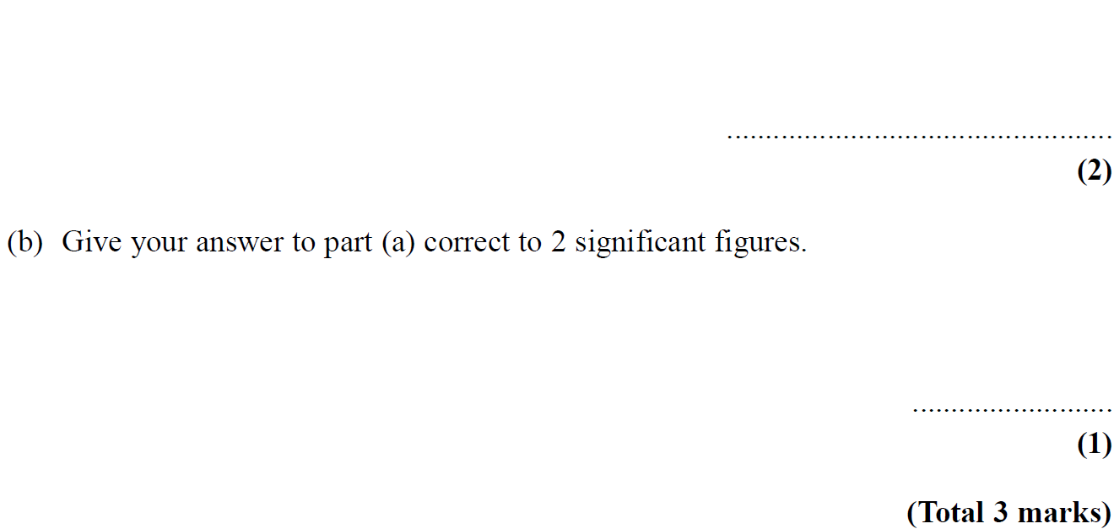
Rounding
Nov 2005 3H Q1

Slide 6
Rounding
Nov 2005 3H Q1
A
B

Slide 7
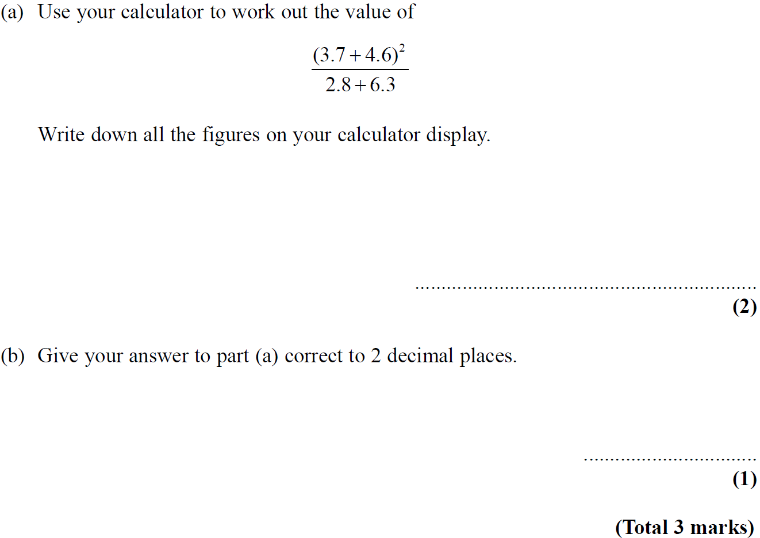
Rounding
May 2007 3H Q1

Slide 8
Rounding
May 2007 3H Q1
A
B

Slide 9
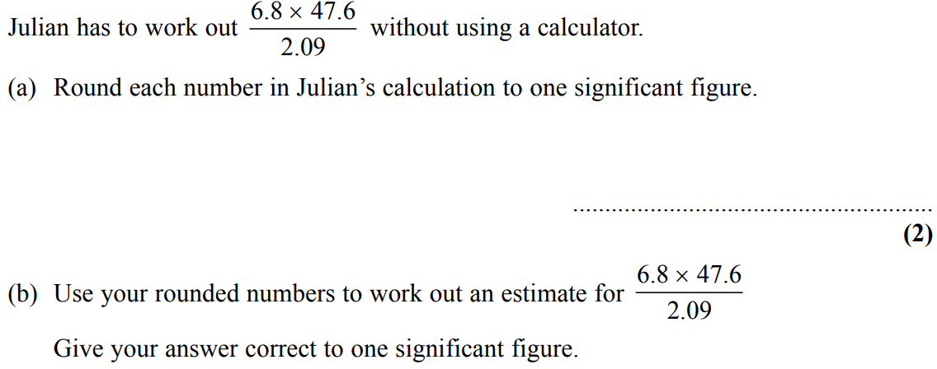
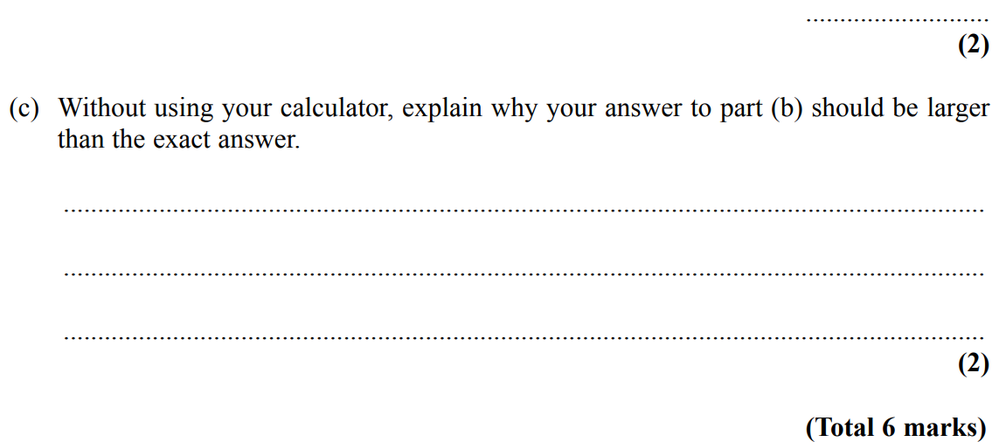
Rounding
May 2007 4H Q4

Slide 10
Rounding
May 2007 4H Q4
A
B
C

Slide 11
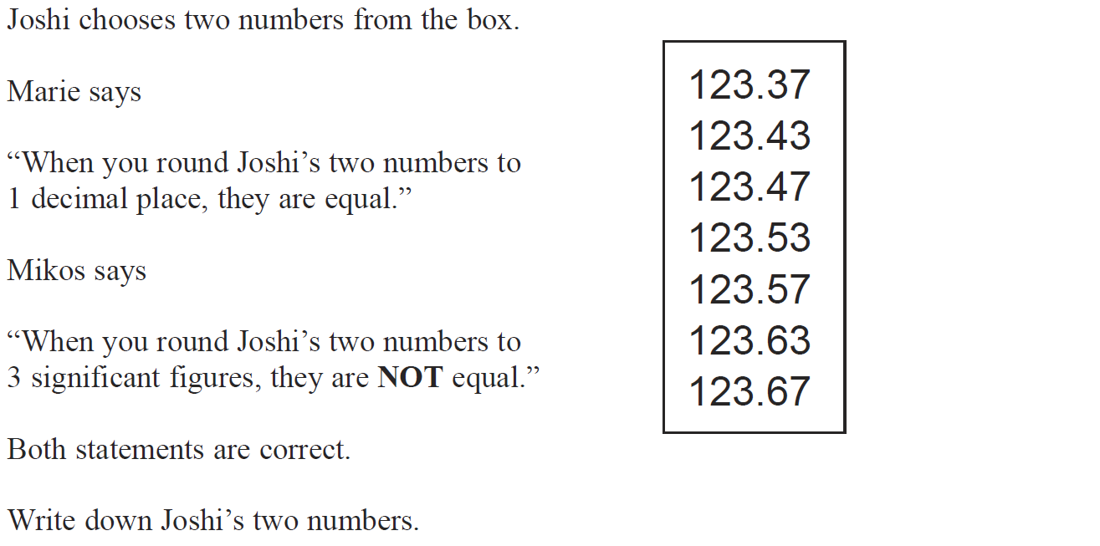
Rounding
May 2008 4H Q11

Slide 12
Rounding
May 2008 4H Q11
A

Slide 13
Rounding
June 2009 4H Q11

Slide 14
Rounding
June 2009 4H Q11
A

Slide 15
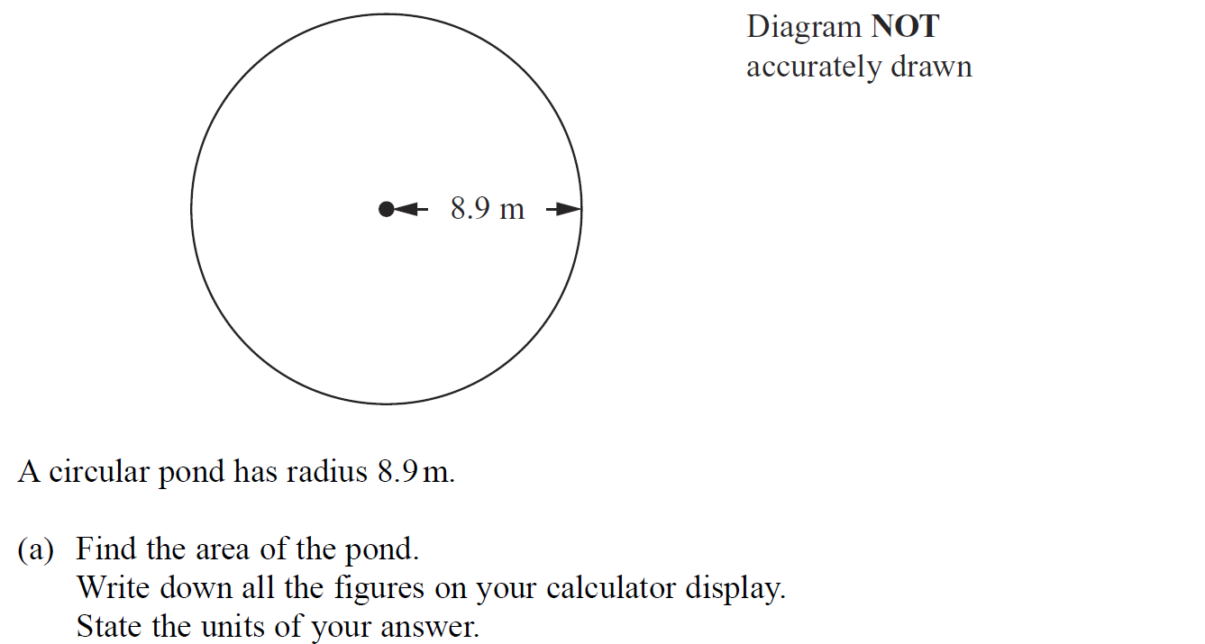
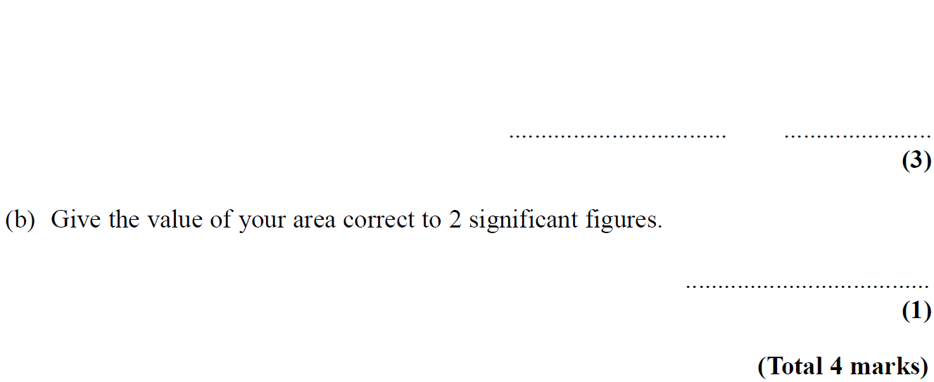
Rounding
Nov 2010 3H Q4

Slide 16
Rounding
Nov 2010 3H Q4
A
B

Slide 17
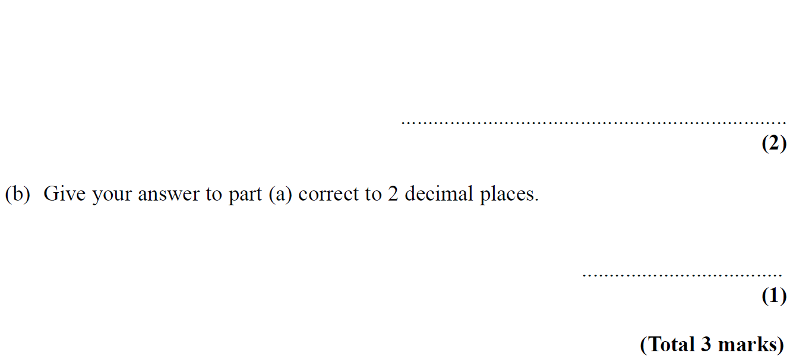
Rounding
Nov 2010 4H Q1

Slide 18
Rounding
Nov 2010 4H Q1
A

Slide 19
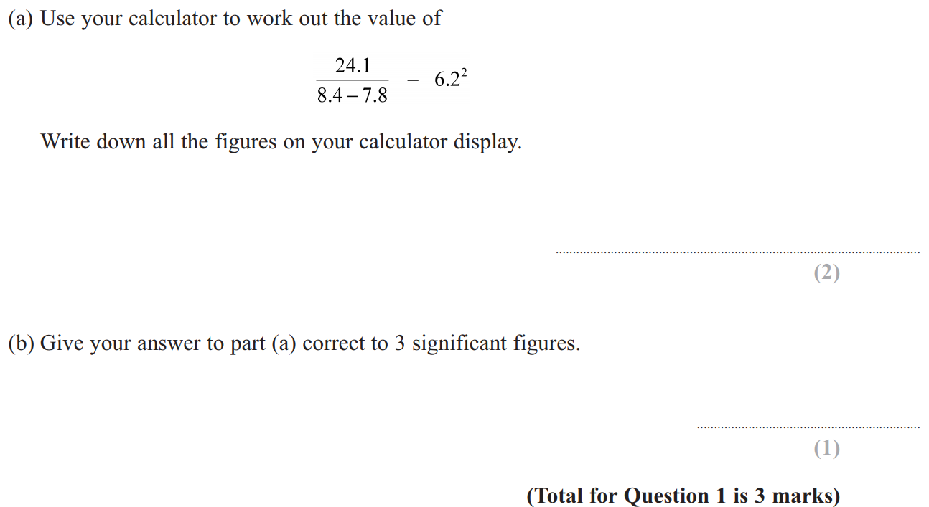
Rounding
June 2011 3H Q1

Slide 20
Rounding
June 2011 3H Q1
A
B

Slide 21
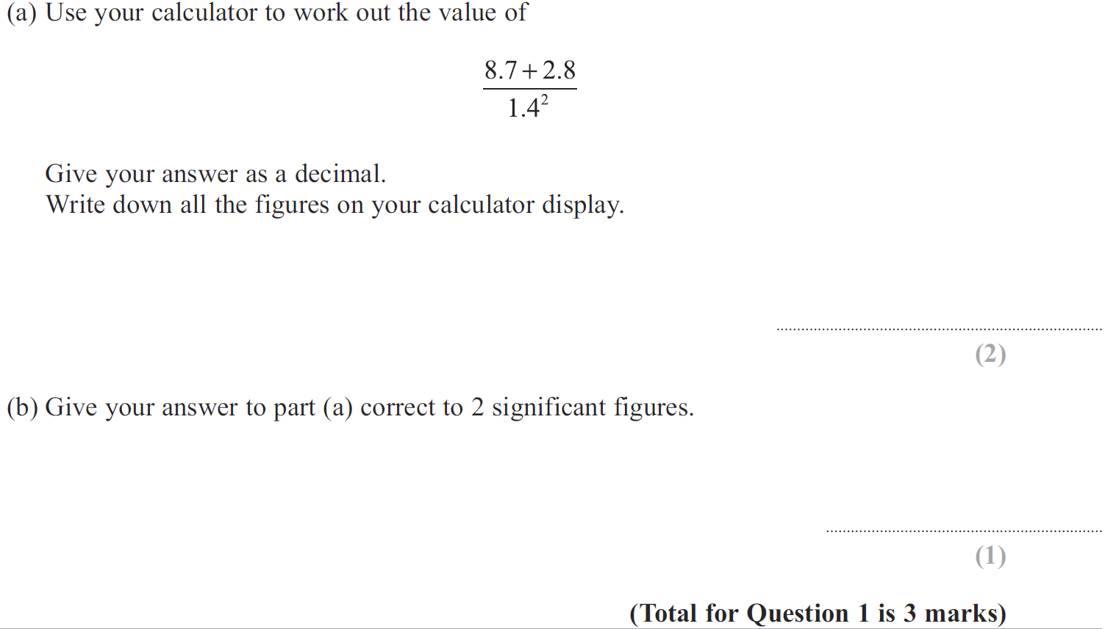
Rounding
Jan 2013 4H Q1

Slide 22
Rounding
Jan 2013 4H Q1
A
B

Slide 23
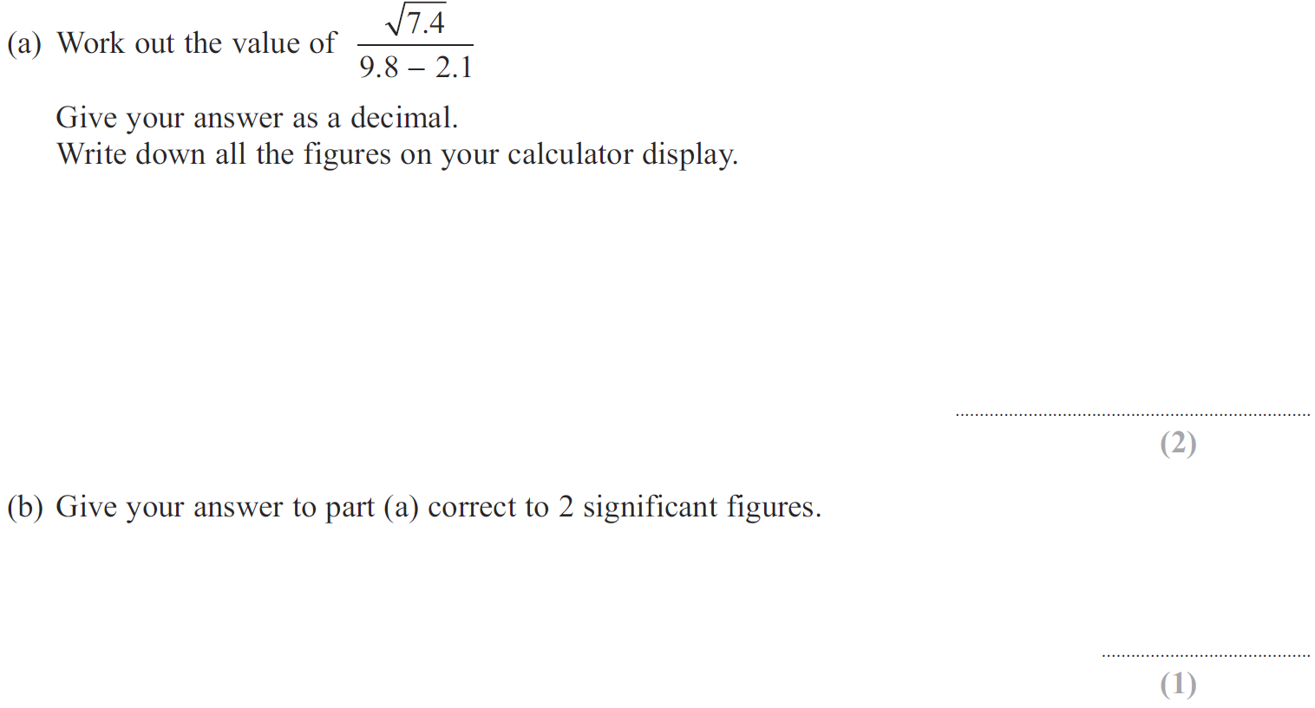
Rounding
May 2013 3H Q2

Slide 24
Rounding
May 2013 3H Q2
A
B

Slide 25
Rounding
May 2013 3H Q9

Slide 26
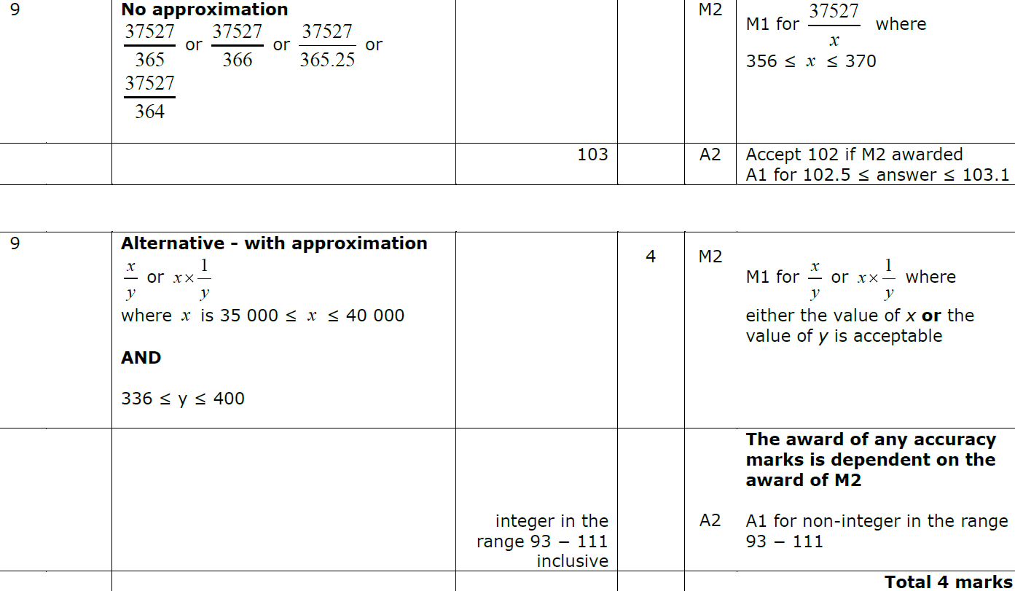
Rounding
May 2013 3H Q9
A

Slide 27
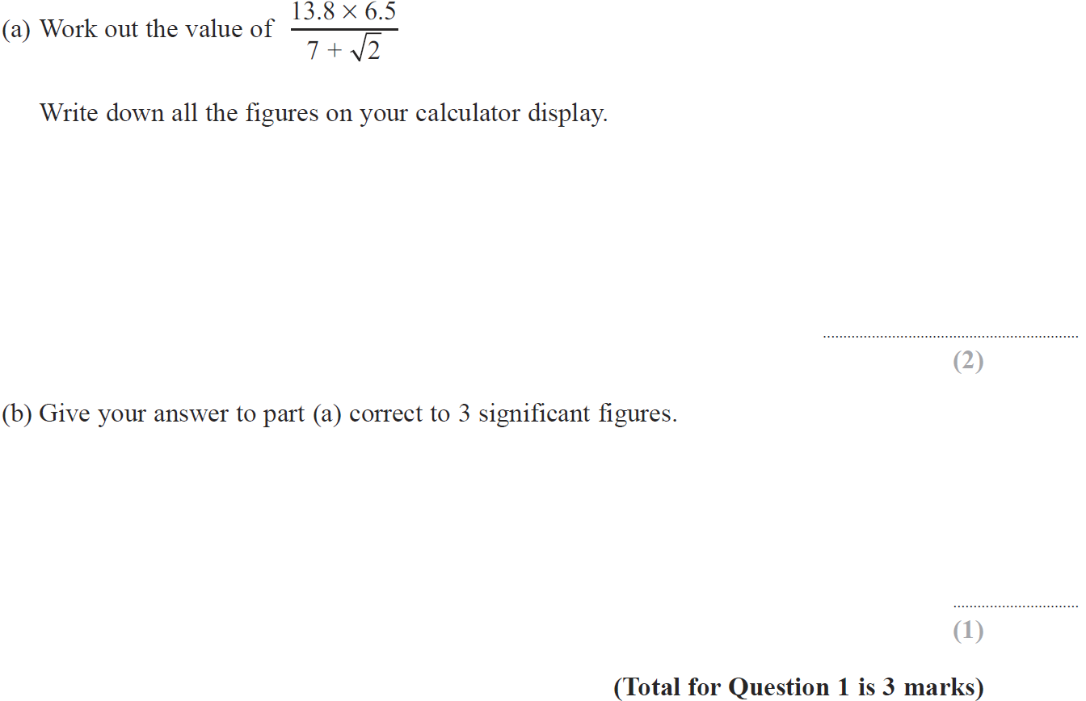
Rounding
May 2014 3H Q1

Slide 28
Rounding
May 2014 3H Q1
A
B

Slide 29
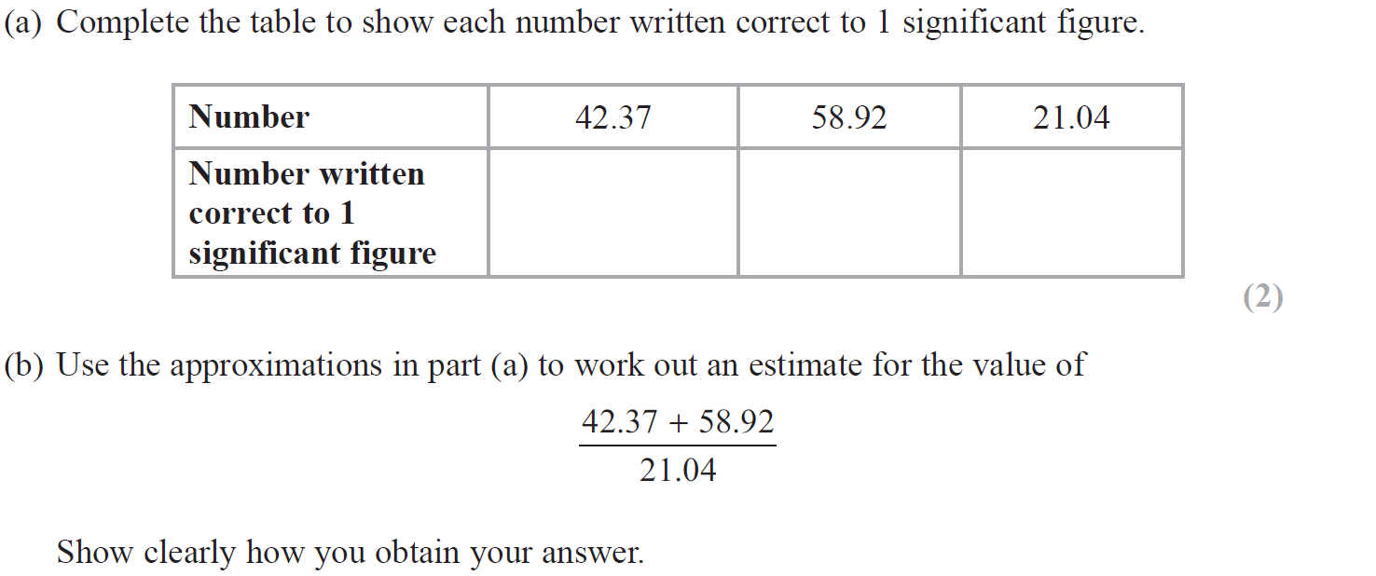
Rounding
May 2014 3HR Q1

Slide 30
Rounding
May 2014 3HR Q1
A
B

Slide 31
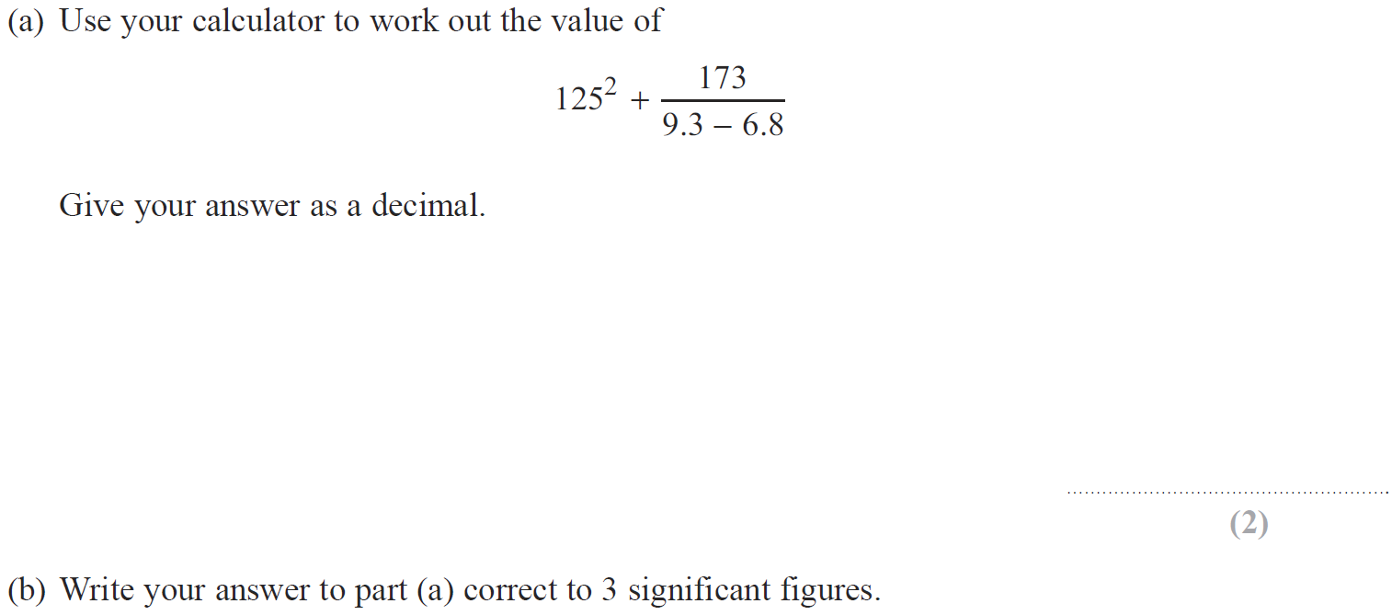
Rounding
Jan 2015 3HR Q2

Slide 32
Rounding
Jan 2015 3HR Q2
A
B

Slide 33
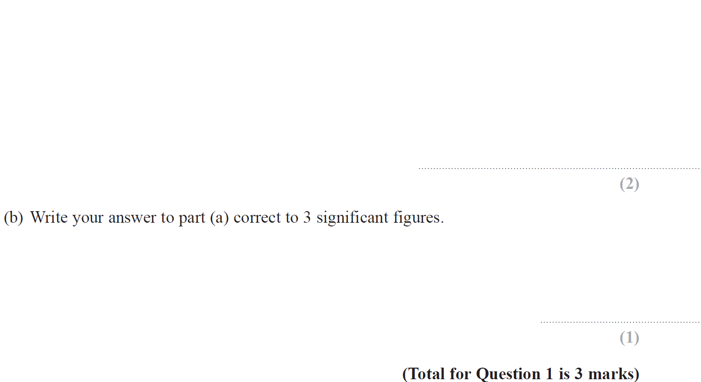
Rounding
Jan 2016 4H Q1

Slide 34
Rounding
Jan 2016 4H Q1
A
B

Slide 35
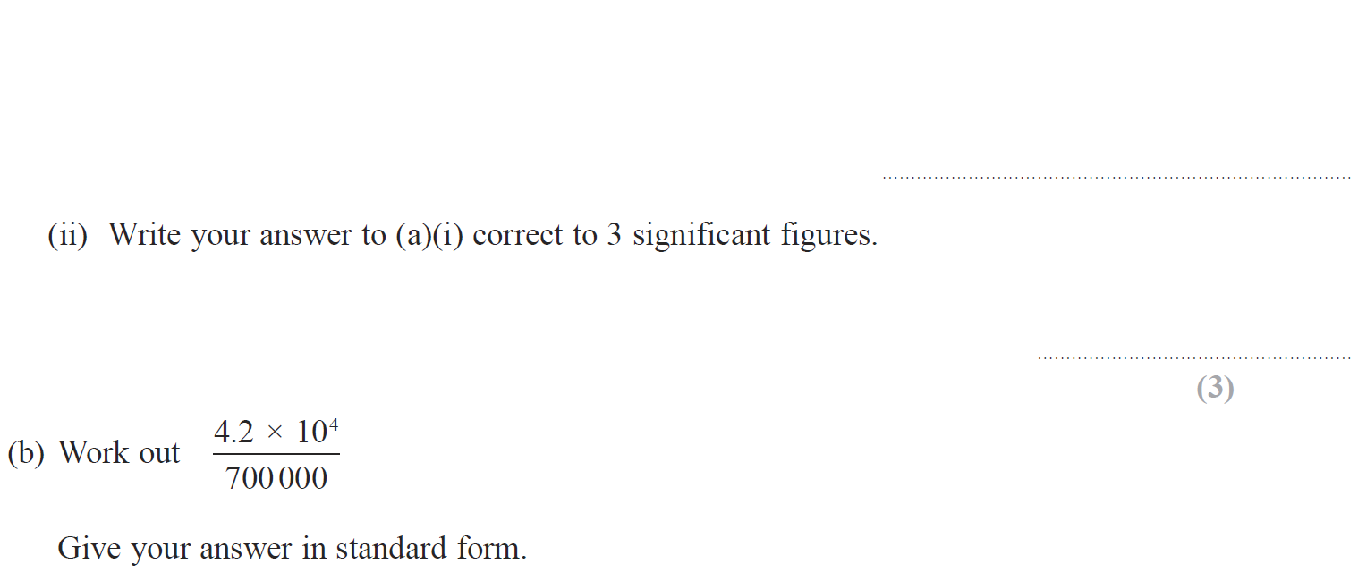
Rounding
Jan 2017 4H Q4

Slide 36
Rounding
Jan 2017 4H Q4
A (i)
A (ii)
B

Slide 37
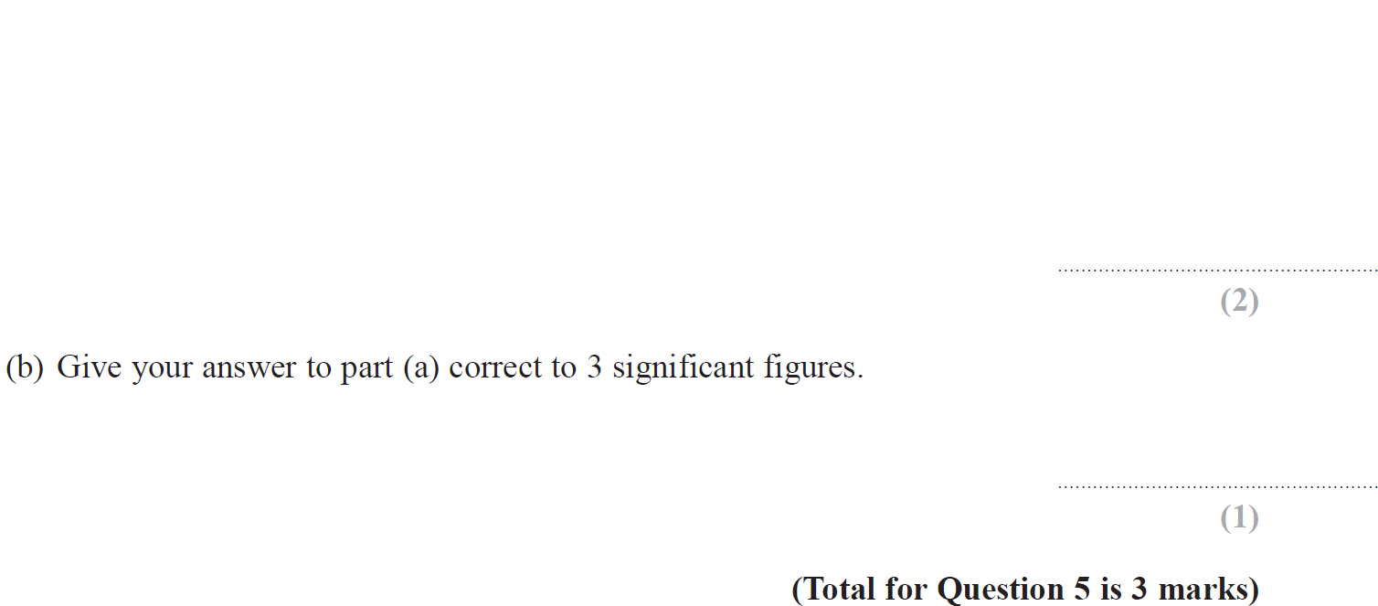
Rounding
May 2017 3H Q5

Slide 38
Rounding
May 2017 3H Q5
A
B

Slide 39
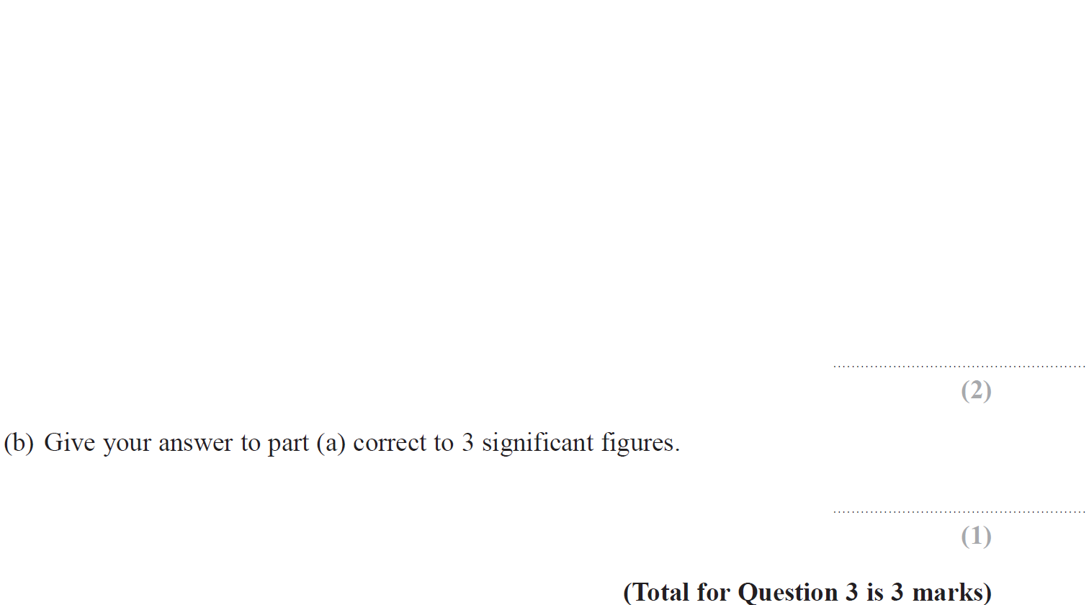
Rounding
June 2017 4HR Q3

Slide 40
Rounding
June 2017 4HR Q3
A
B

Slide 41
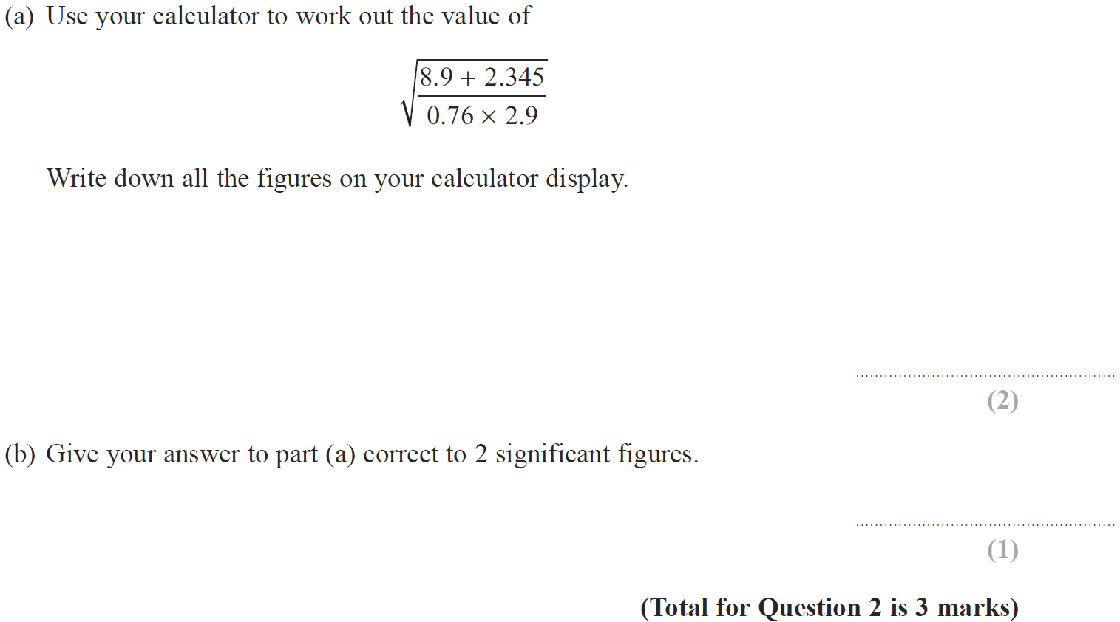
Rounding
Jan 2018 3H Q2

Slide 42
Rounding
Jan 2018 3H Q2
A
B

Slide 43
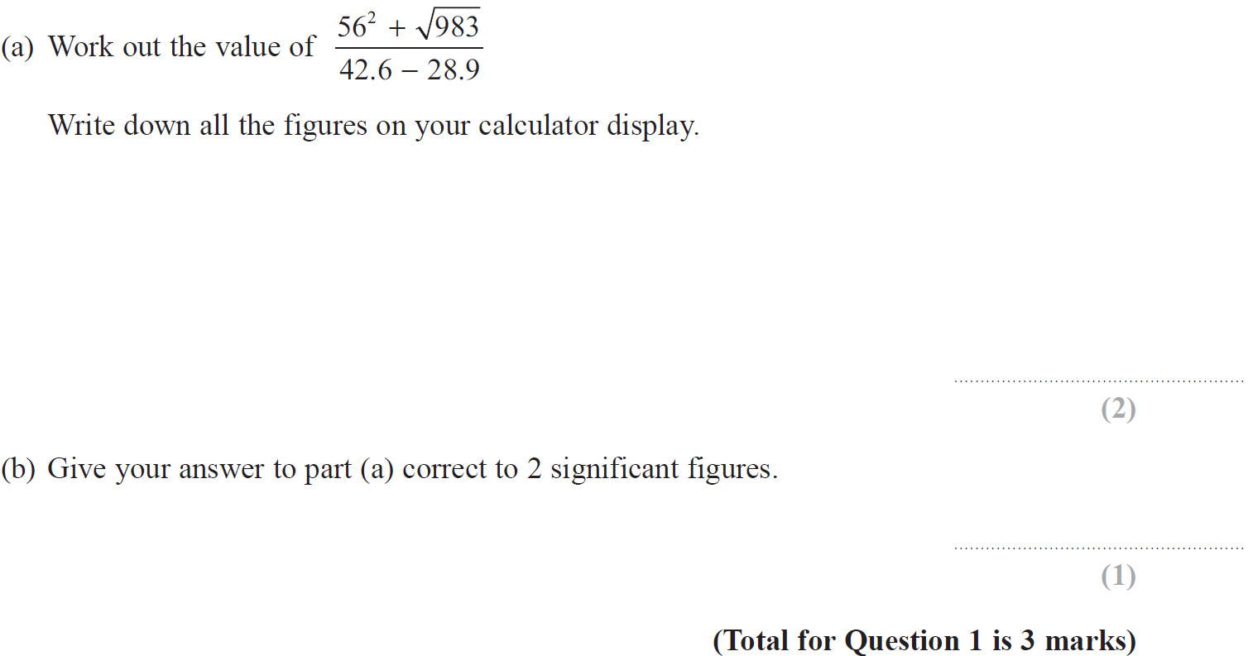
Rounding
May 2018 3H Q1

Slide 44
Rounding
May 2018 3H Q1
A
B

Slide 45
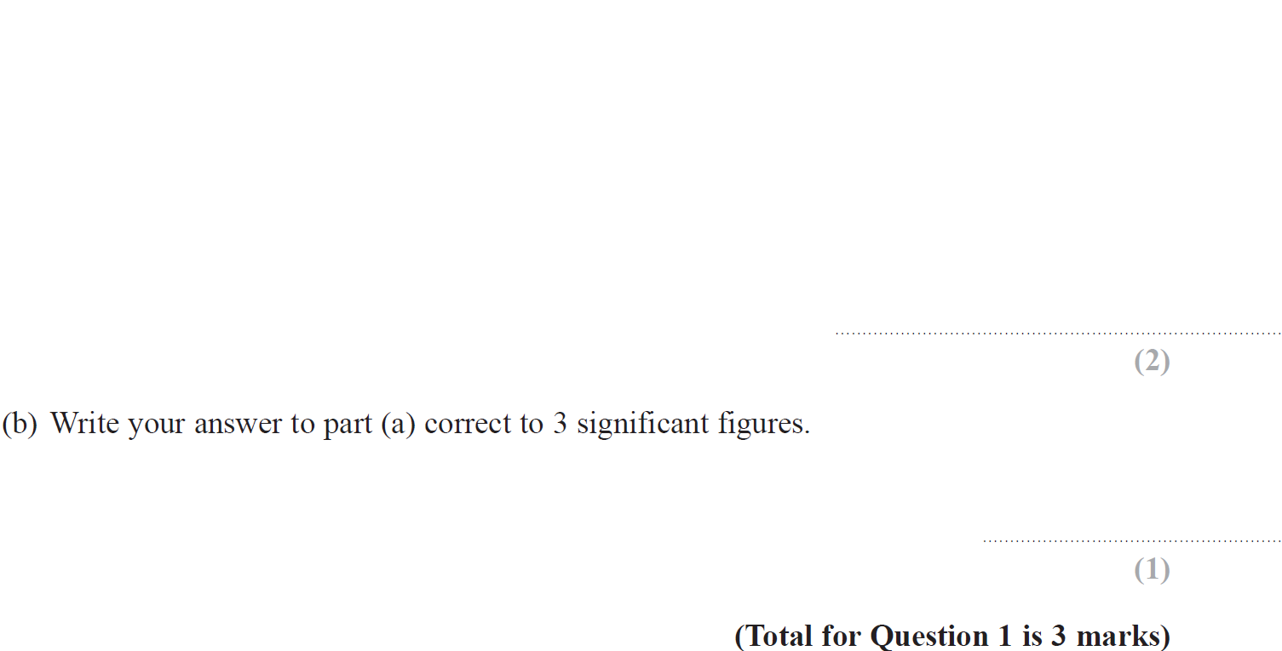
Rounding
May 2018 3HR Q1

Slide 46
Rounding
May 2018 3HR Q1
A
B

