Slide 1
Old Spec Q’s
Roots of Polynomials
SAM
SAM 1
2018
2019 1

Slide 2
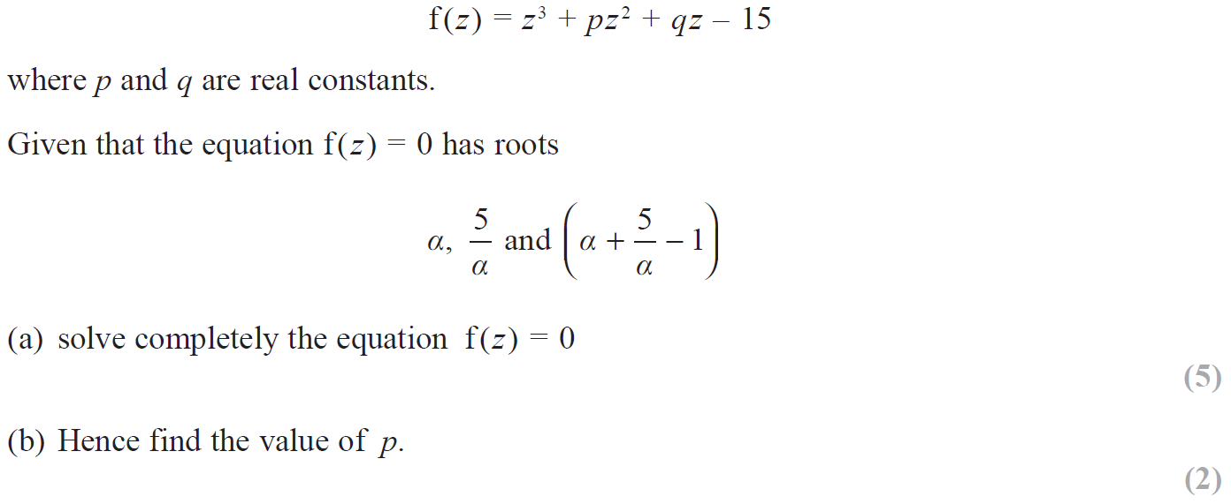
SAM

Slide 3
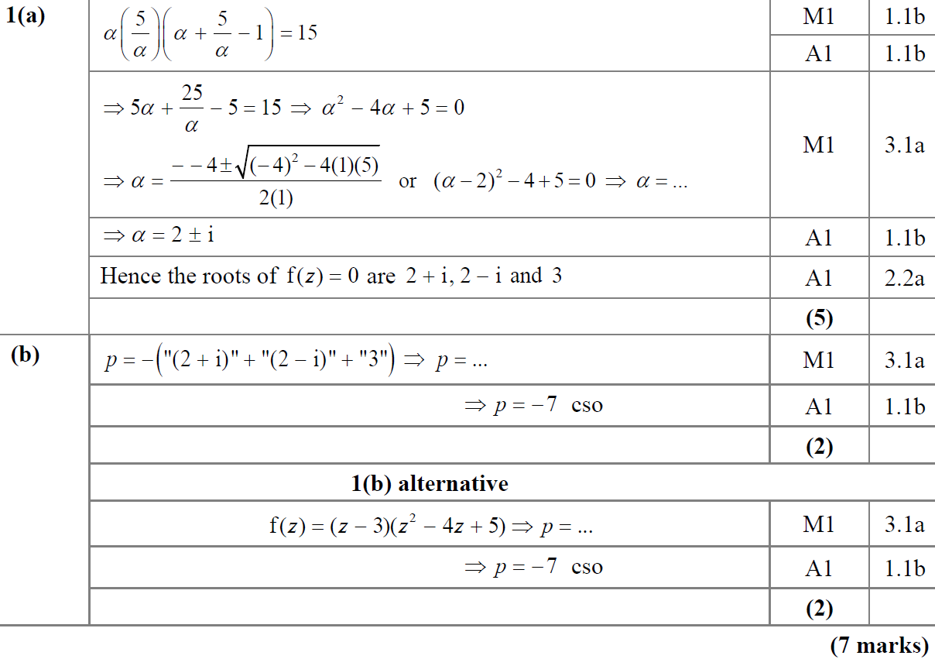
SAM
A
B

Slide 4
SAM
A notes
B notes

Slide 5
2018

Slide 6
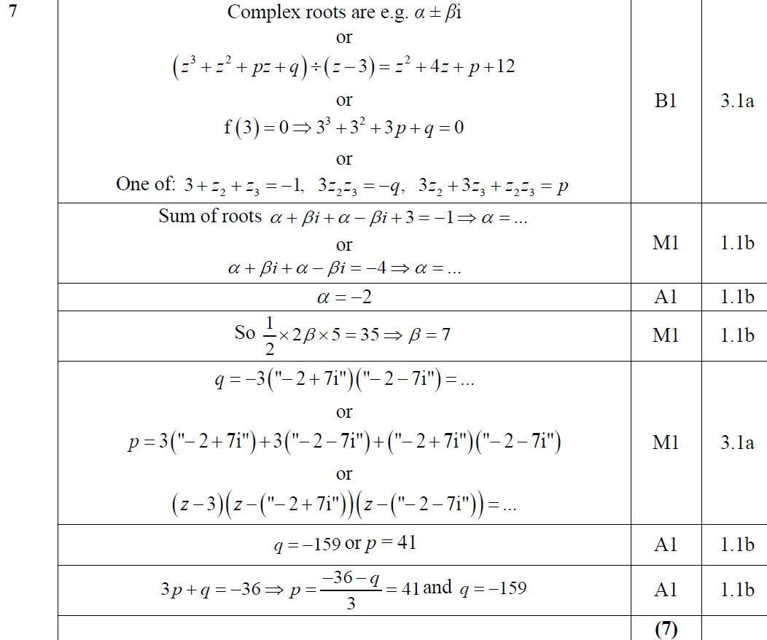
2018
A

Slide 7
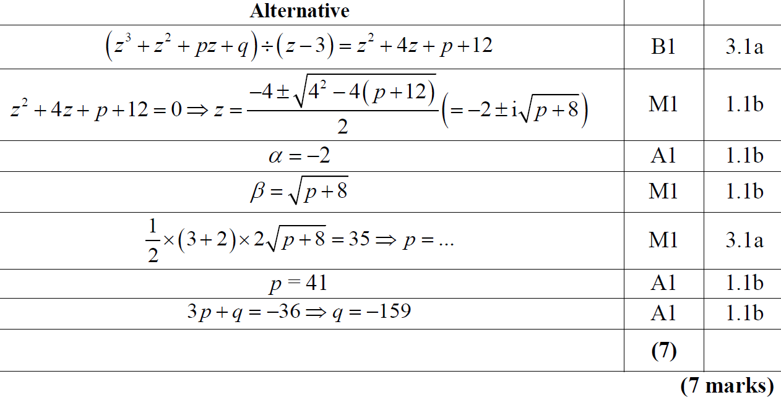
2018
A Alternative

Slide 8
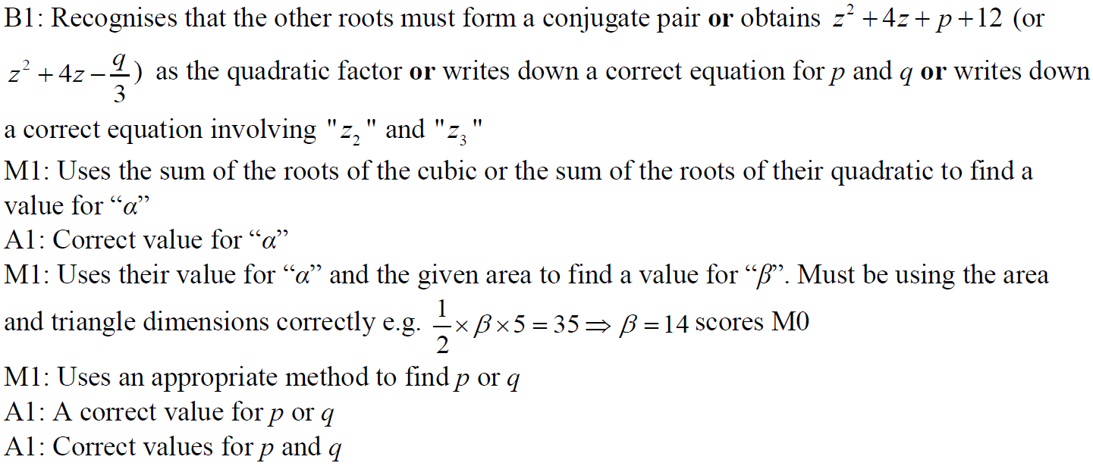
2018
A notes

Slide 9
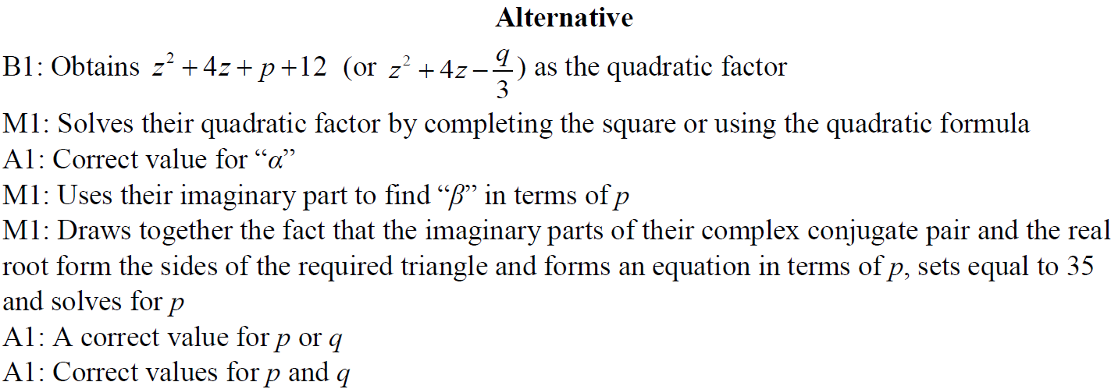
2018
A Alternative notes

Slide 10
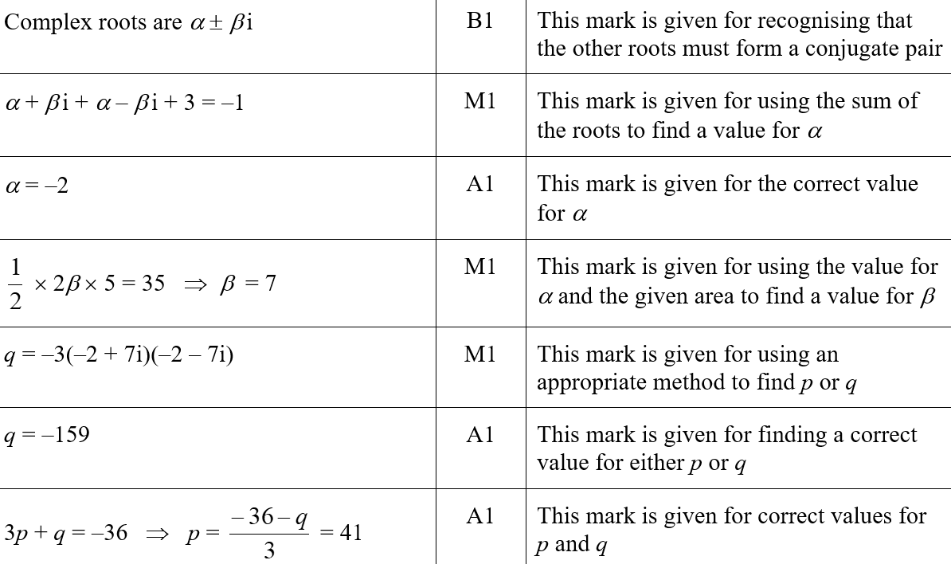
2018
A SF

Slide 11
SAM Paper 1

Slide 12
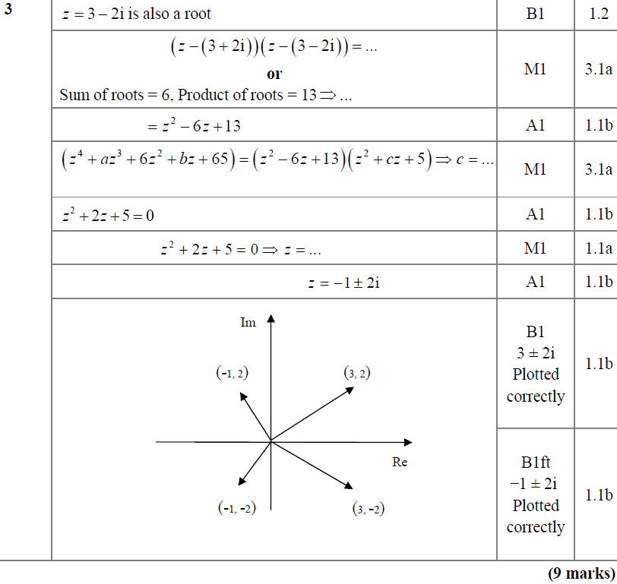
SAM Paper 1
A

Slide 13
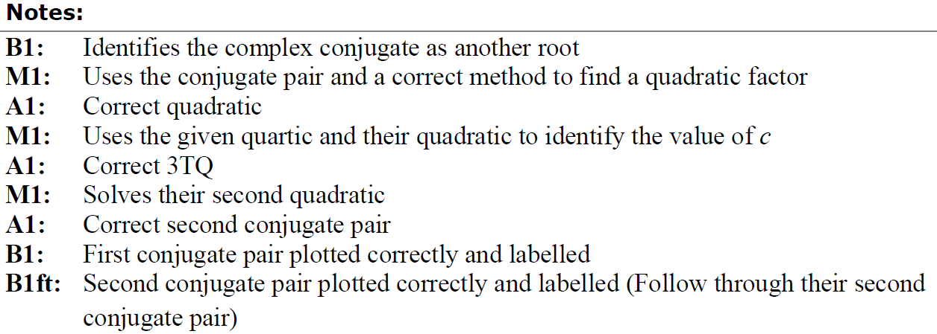
SAM Paper 1
A notes

Slide 14
2019 Paper 1

Slide 15
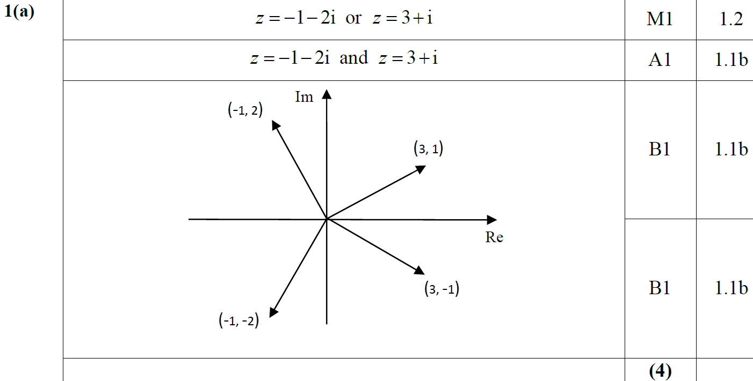
2019 Paper 1
A

Slide 16
2019 Paper 1
A notes

Slide 17
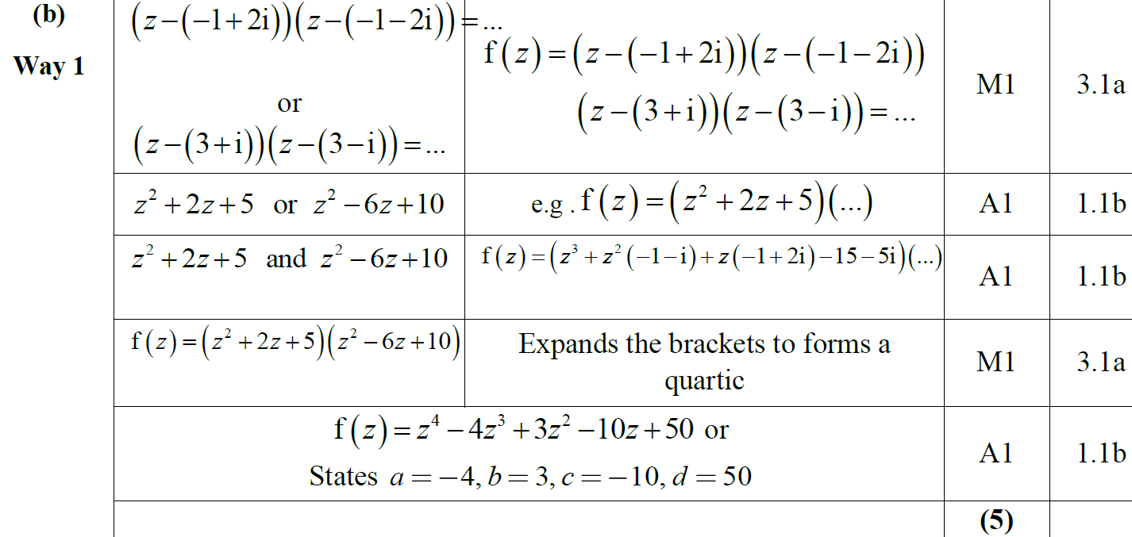
2019 Paper 1
B

Slide 18
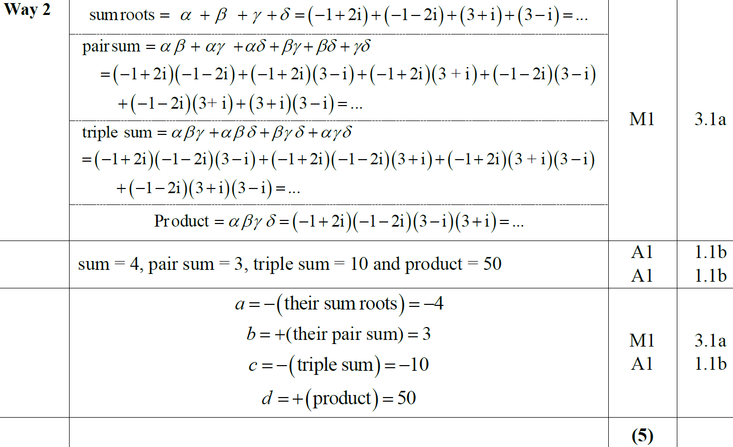
2019 Paper 1
B Alternative (i)

Slide 19
2019 Paper 1
B Alternative (i) notes

Slide 20
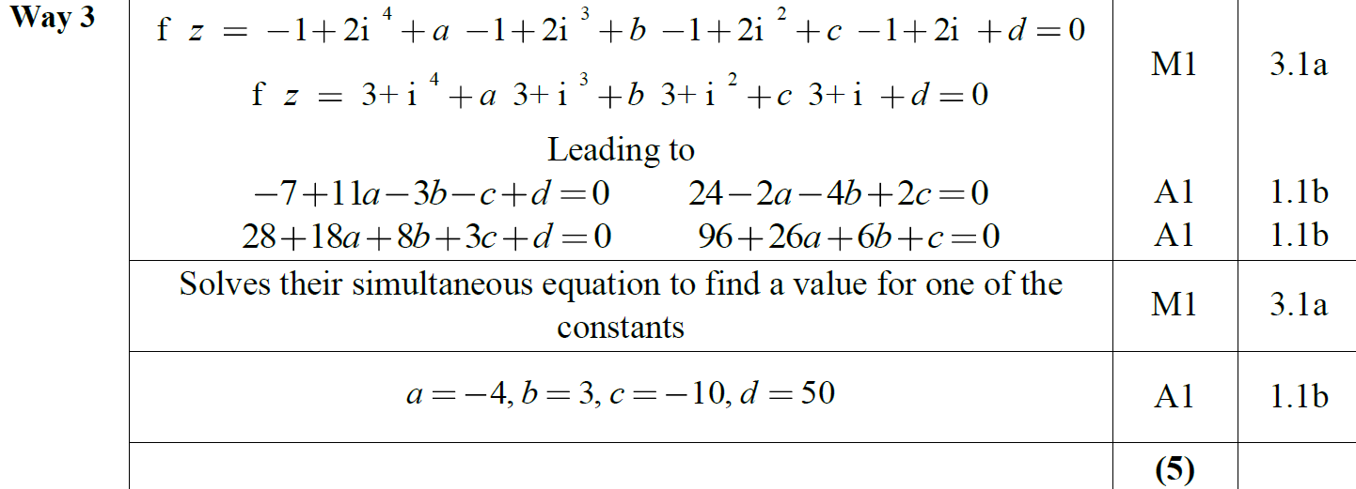
2019 Paper 1
B Alternative (ii)

Slide 21
New Spec Q’s
Old Spec Roots of Polynomials
P4/ Old FP1
FP1
Cubic properties
Jan 2002
Jan 2008
Jan 2009
June 2013
June 2002
June 2008
June 2009
June 2013R
June 2003
Jan 2009
Jan 2010
June 2013W
June 2004
June 2009
June 2010
June 2014
Jan 2005
Jan 2010
Jan 2011
June 2014R
June 2005
Jan 2012
June 2015
June 2006
June 2012
May 2017
Jan 2007
Jan 2013

Slide 22
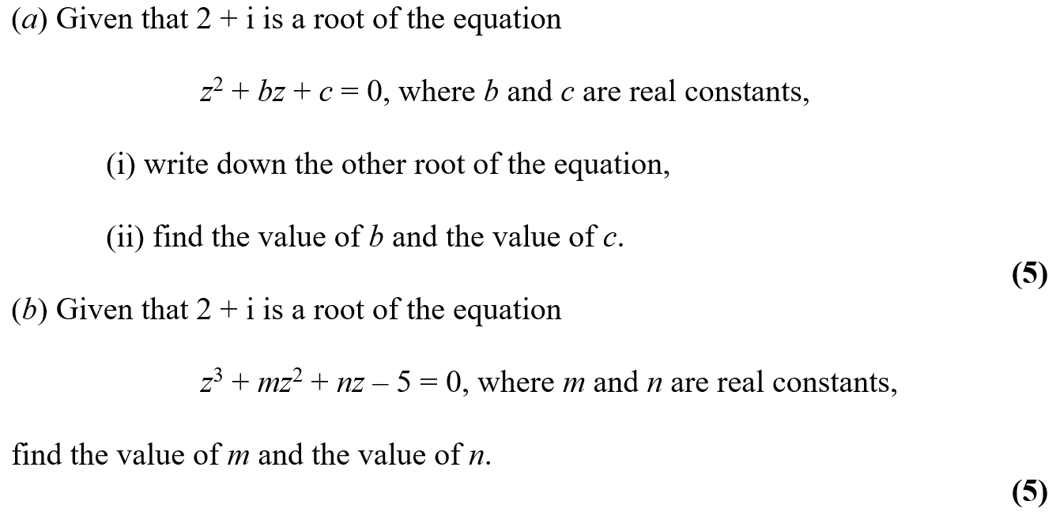
Jan 2002

Slide 23
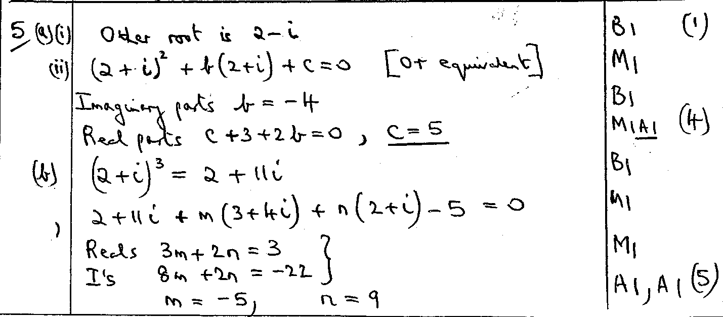
Jan 2002
A
B

Slide 24
June 2002

Slide 25
June 2002
A
B

Slide 26
June 2003

Slide 27
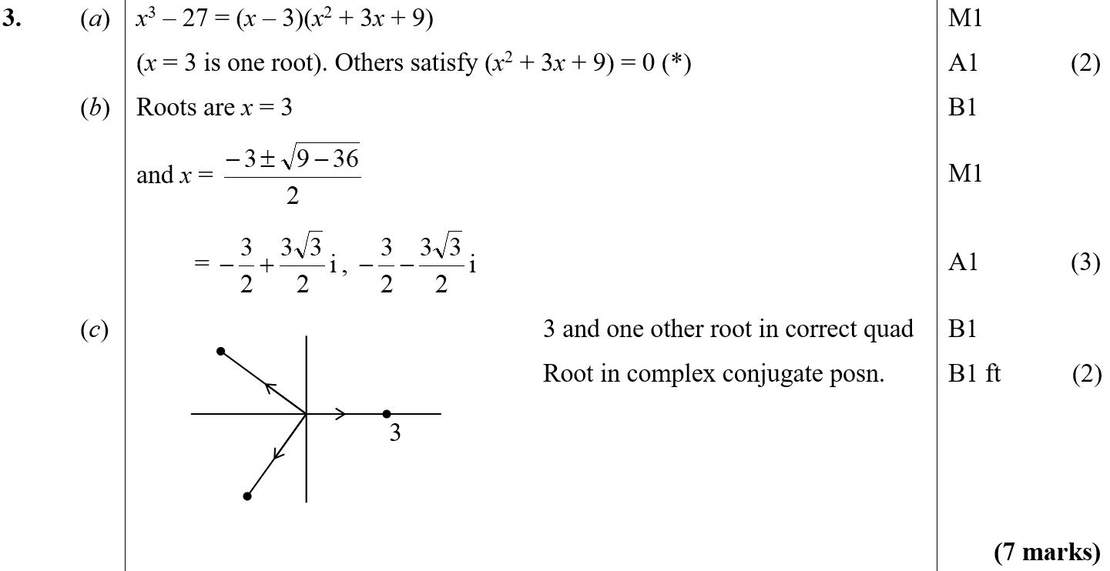
June 2003
A
B
C

Slide 28
June 2004

Slide 29
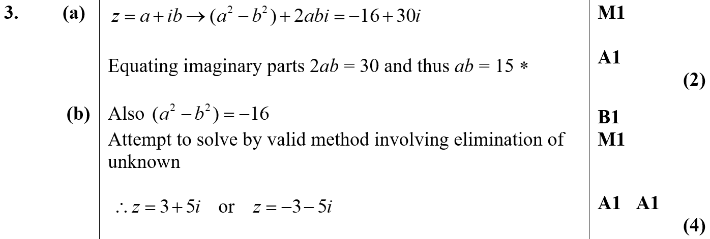
June 2004
A
B

Slide 30
Jan 2005

Slide 31
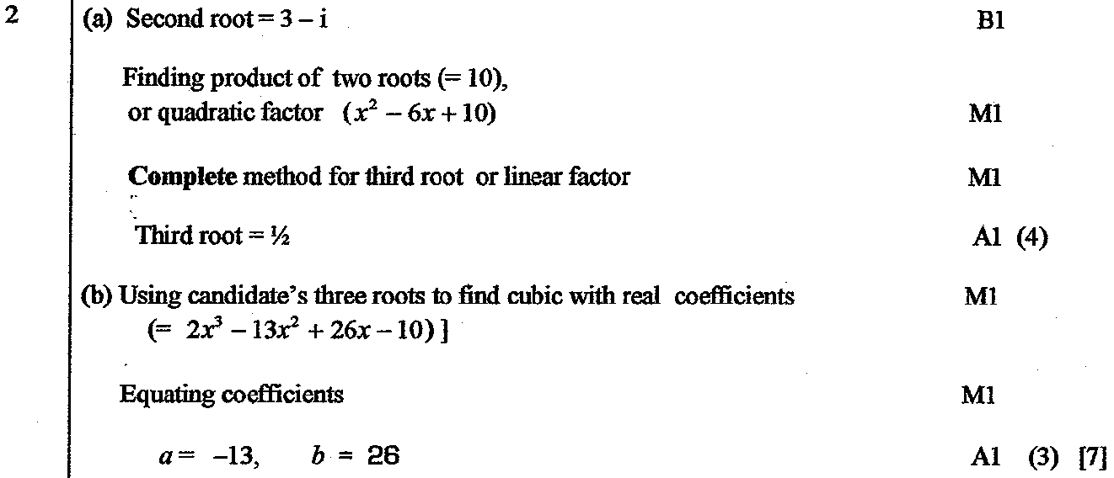
Jan 2005
A
B

Slide 32
June 2005

Slide 33
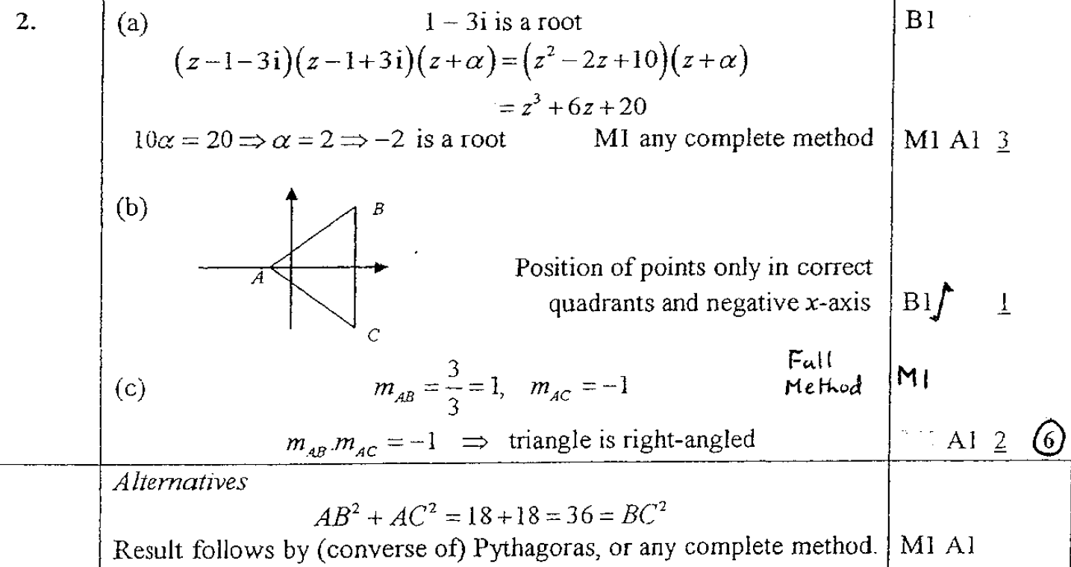
June 2005
A
B
C

Slide 34
June 2006

Slide 35
June 2006
A

Slide 36
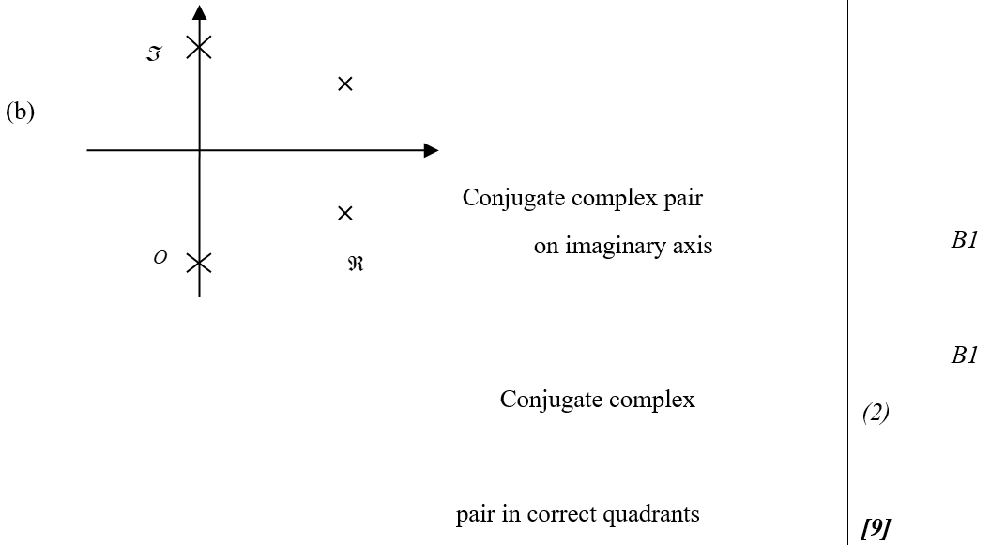
June 2006
B

Slide 37
Jan 2007

Slide 38
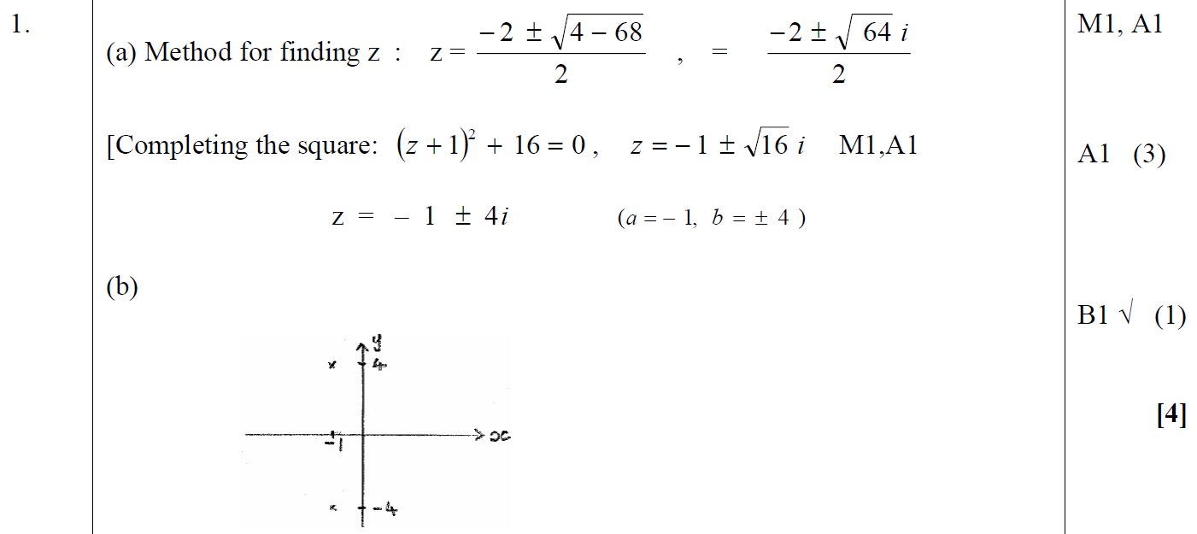
Jan 2007
A
B

Slide 39
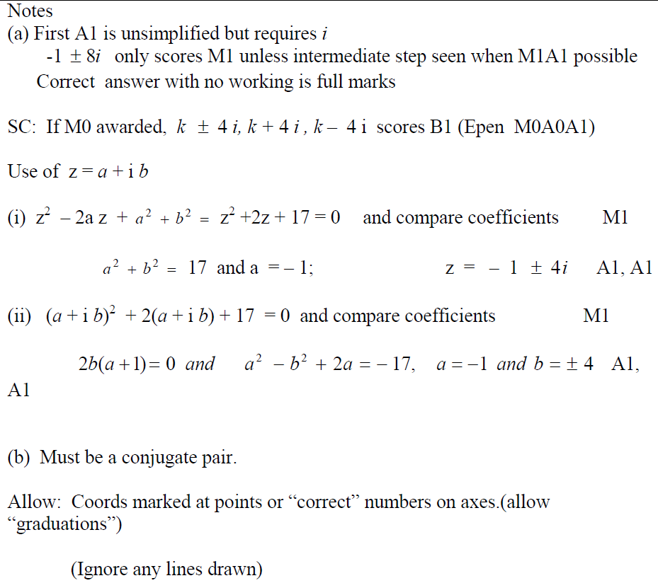
Jan 2007
A notes
B notes

Slide 40
Jan 2008

Slide 41
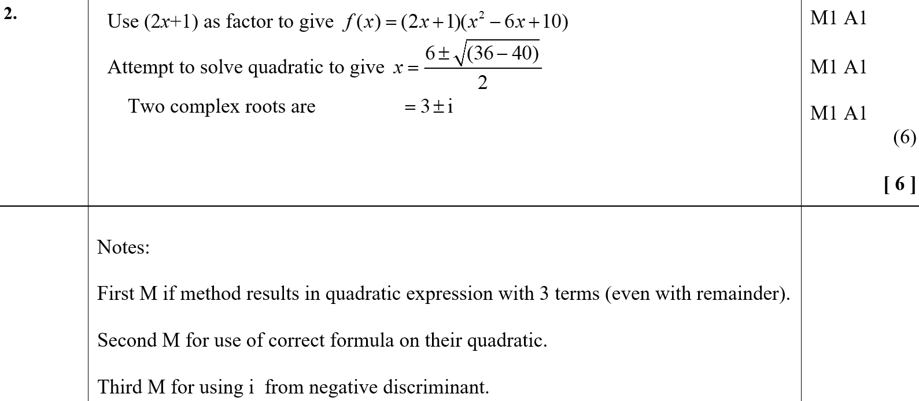
Jan 2008
A

Slide 42
June 2008

Slide 43
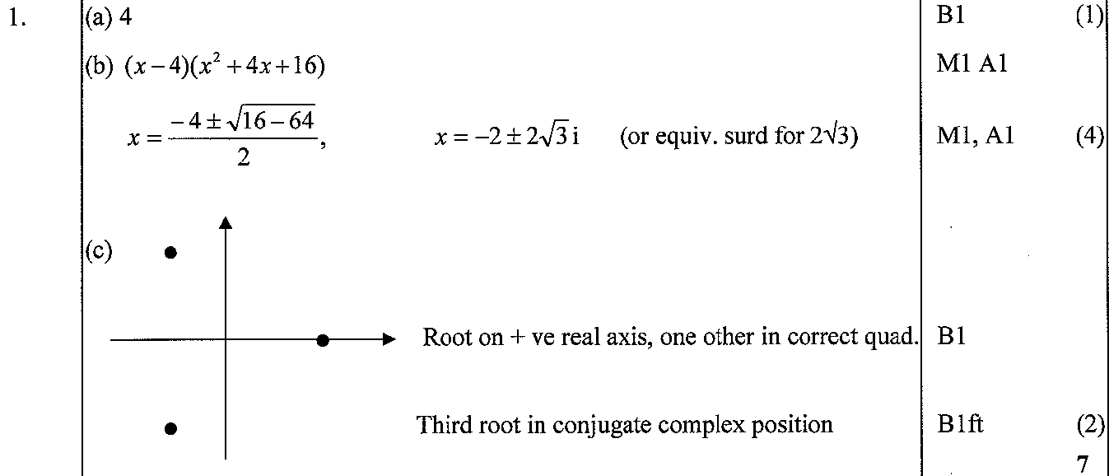
June 2008
A
B
C

Slide 44
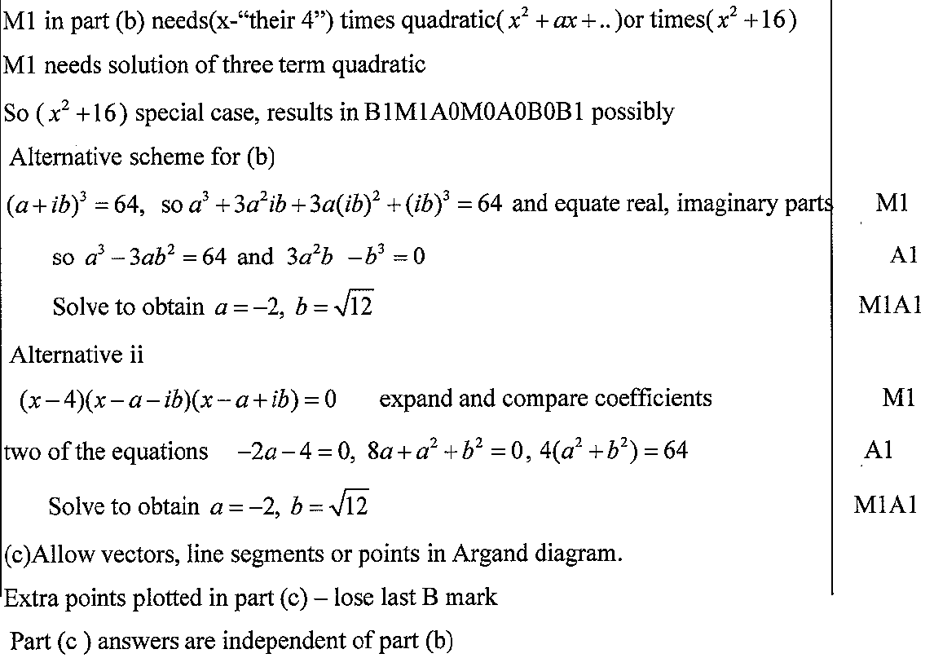
June 2008
B notes
C notes

Slide 45
Jan 2009

Slide 46
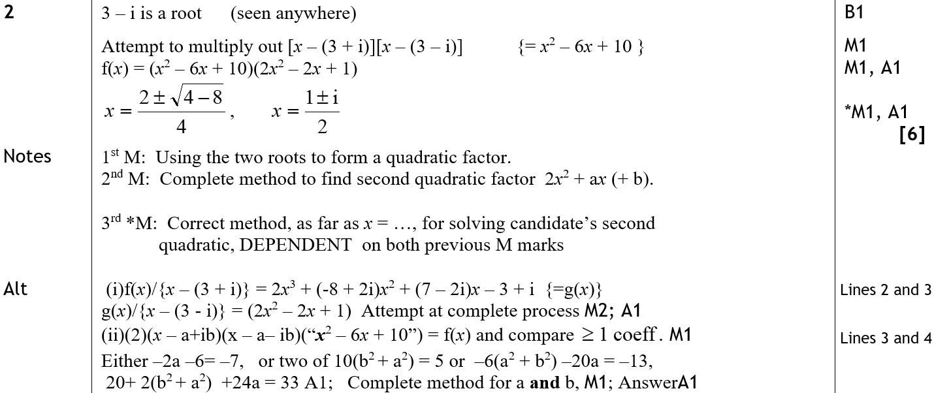
Jan 2009
A

Slide 47
Jan 2009

Slide 48
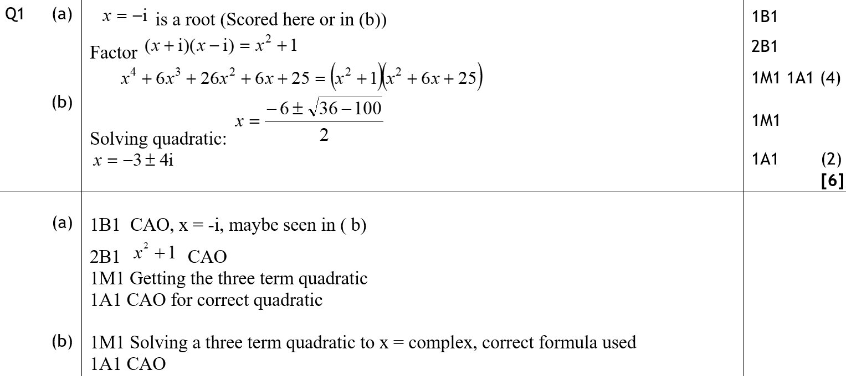
Jan 2009
A
B
A notes
B notes

Slide 49
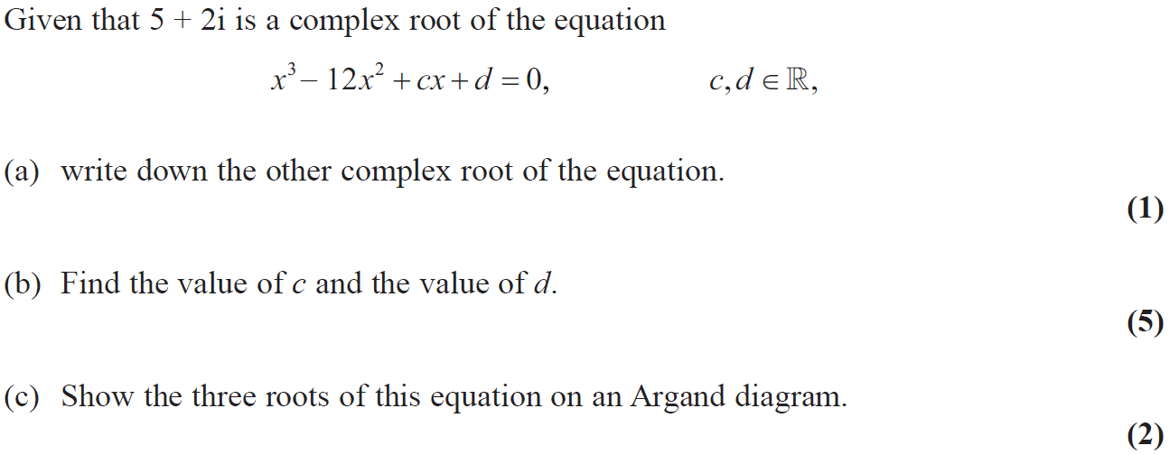
Jan 2010

Slide 50
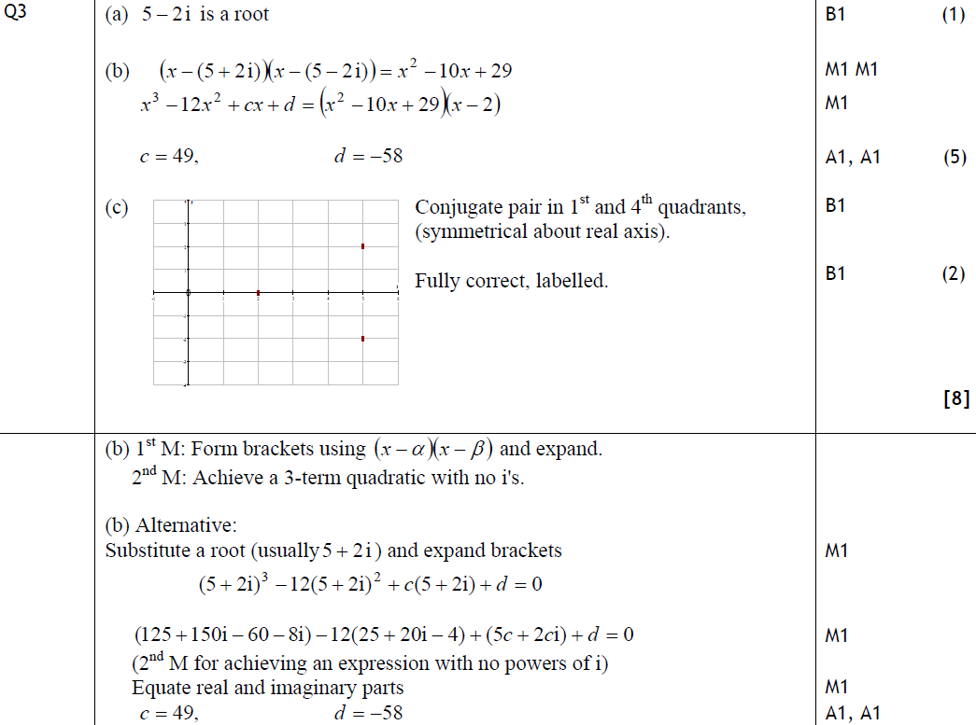
Jan 2010
A
B
C
B Alternative & notes

Slide 51
Jan 2009

Slide 52
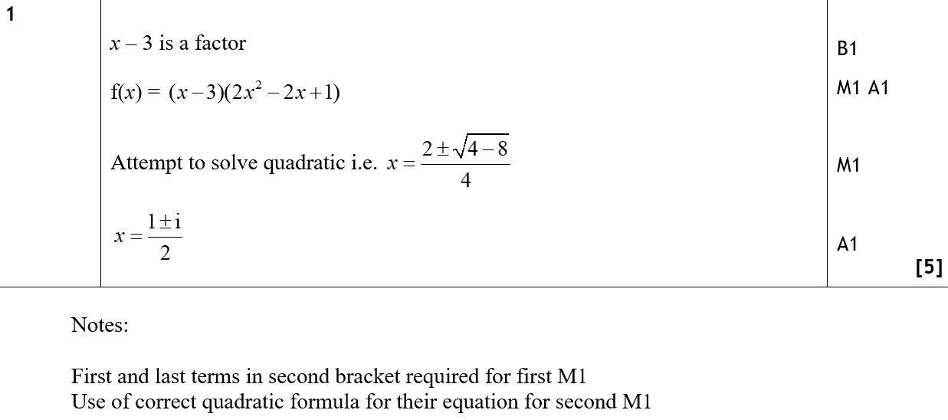
Jan 2009
A

Slide 53
June 2009

Slide 54
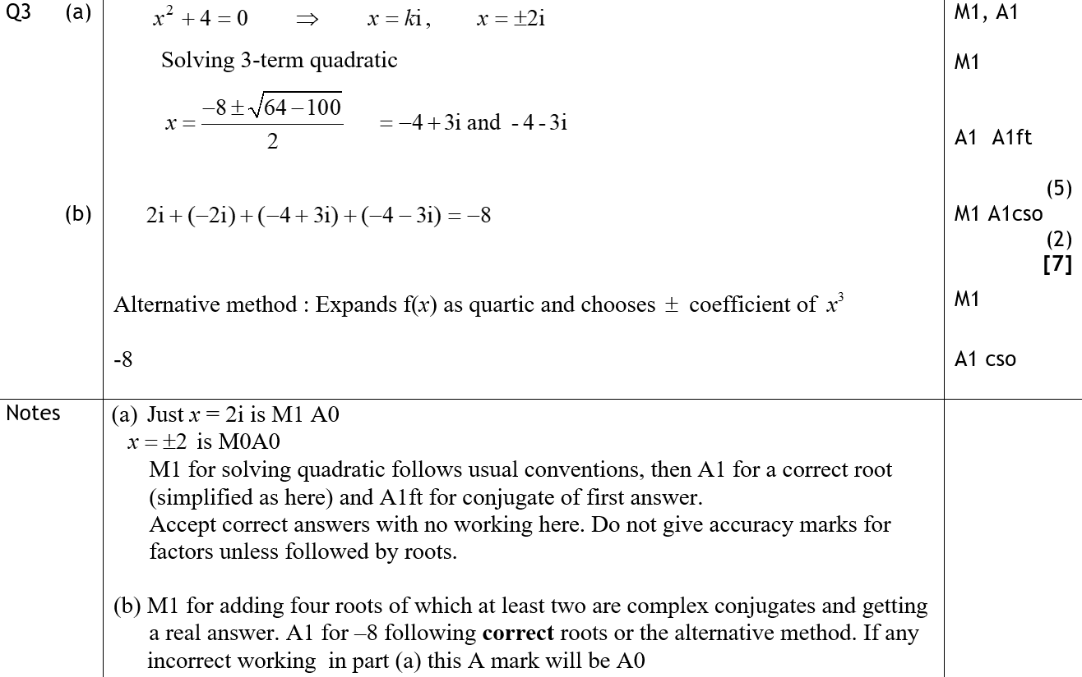
June 2009
A
B
A notes
B notes

Slide 55
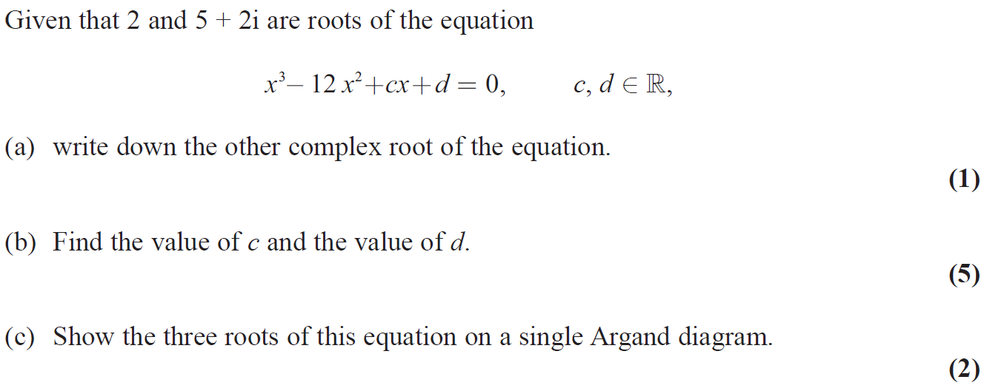
Jan 2010

Slide 56
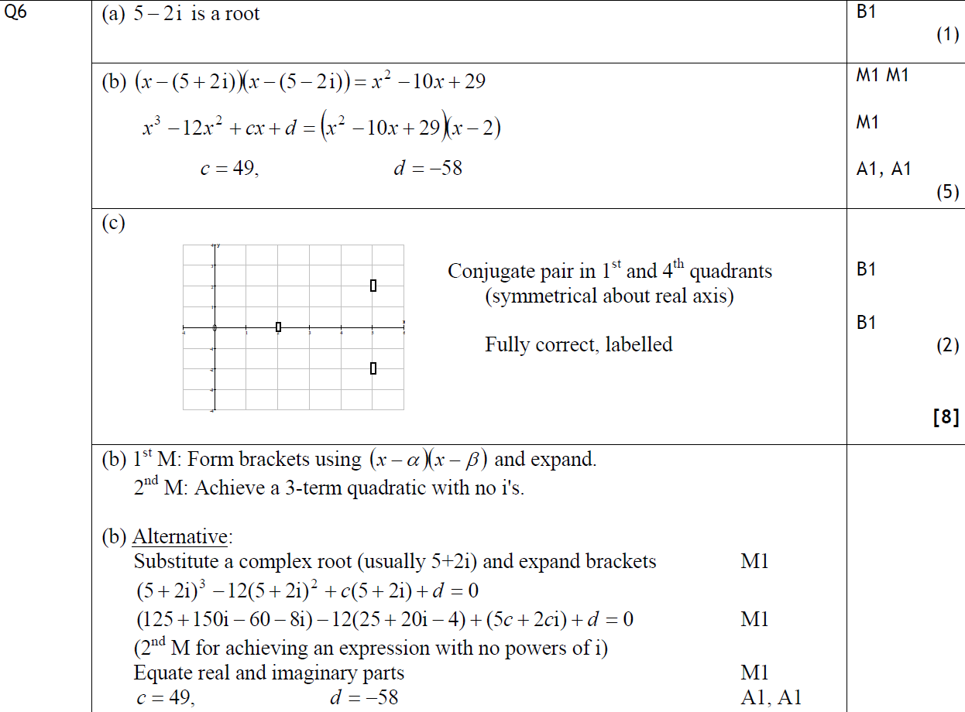
Jan 2010
A
B
C
B notes

Slide 57
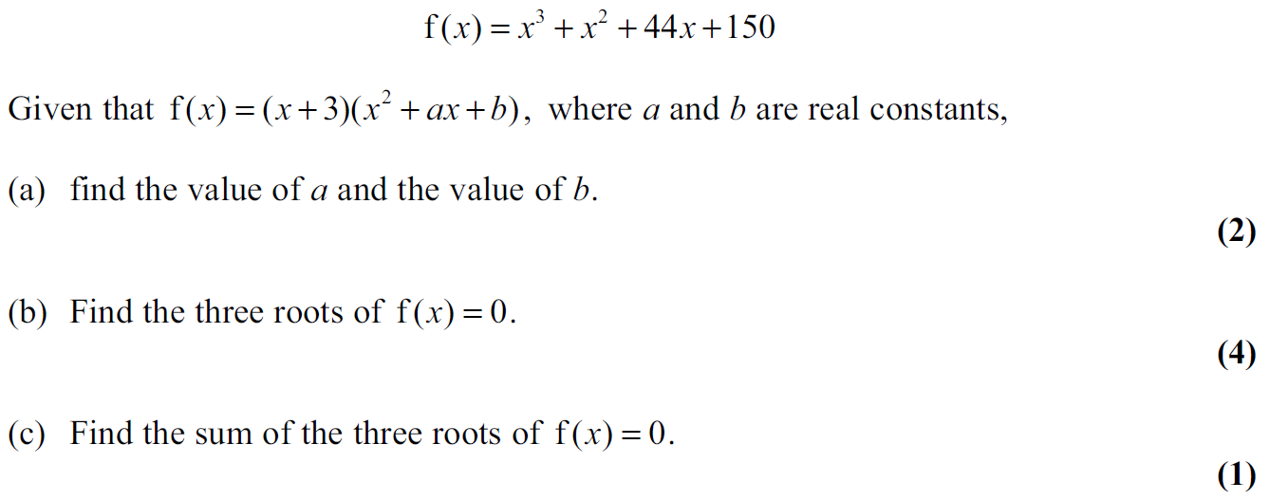
June 2010

Slide 58
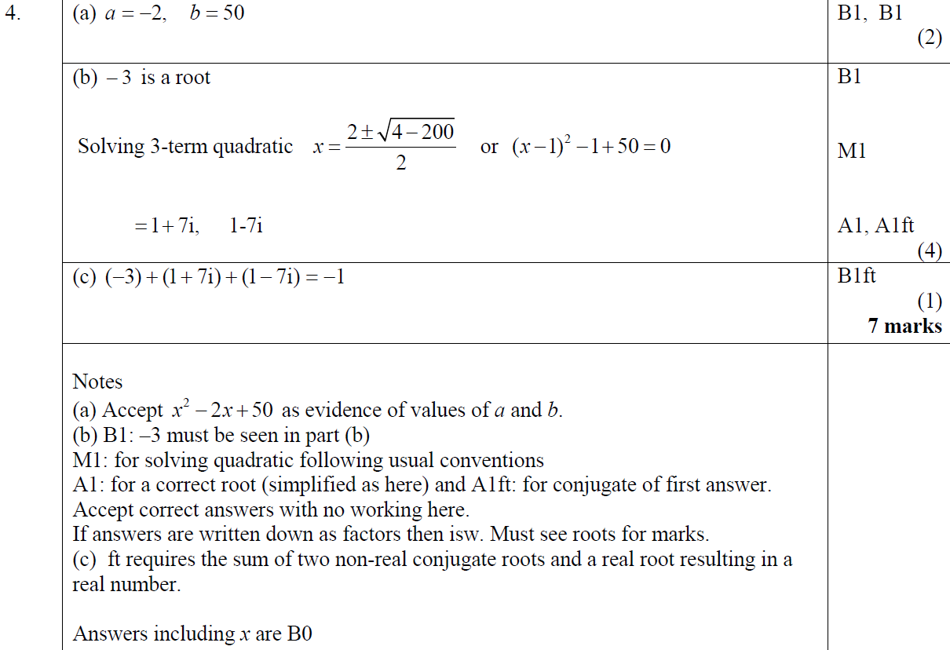
June 2010
A
B
C
A notes
B notes
C notes

Slide 59
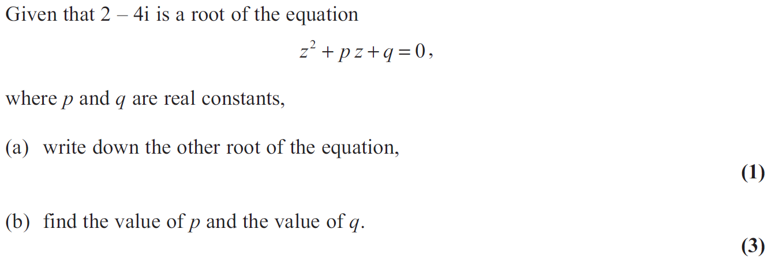
Jan 2011

Slide 60
Jan 2011
A
B

Slide 61
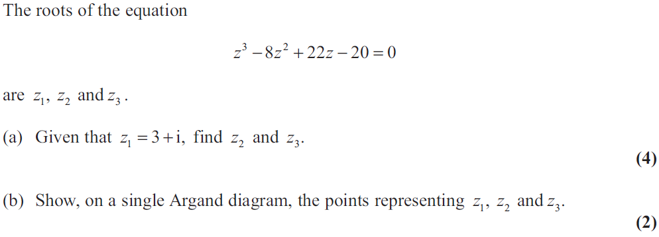
Jan 2012

Slide 62
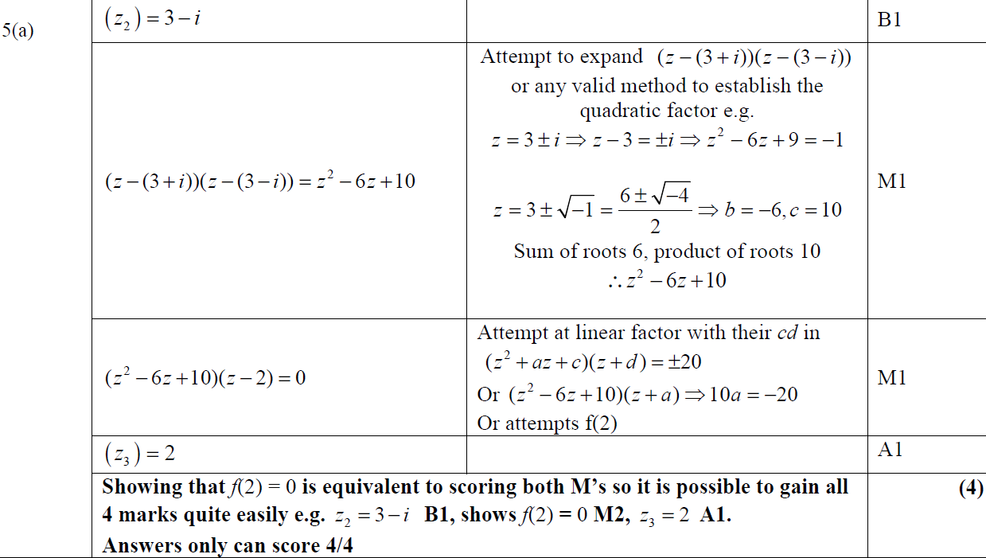
Jan 2012
A

Slide 63
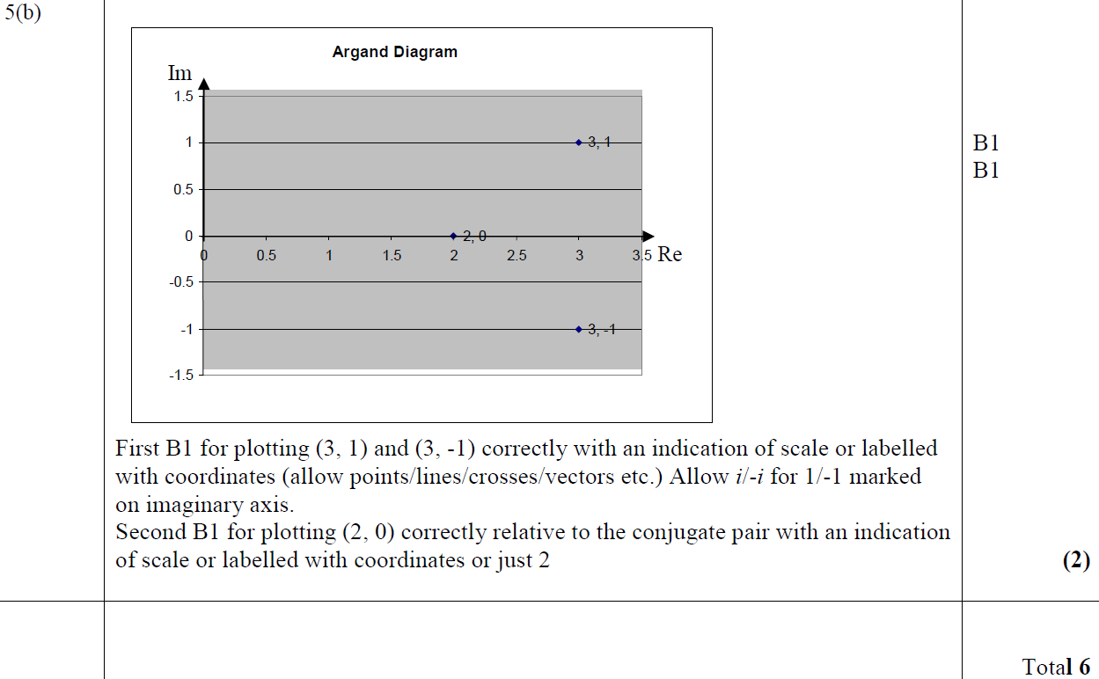
Jan 2012
B

Slide 64
June 2012

Slide 65
June 2012
A

Slide 66
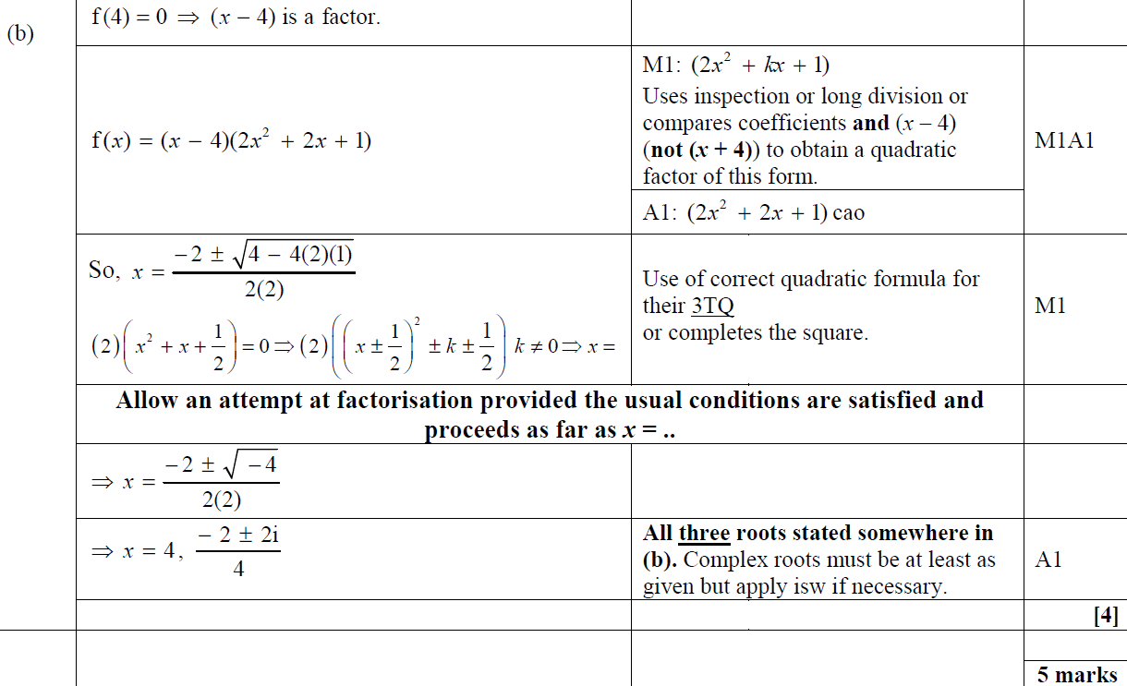
June 2012
B

Slide 67
Jan 2013

Slide 68
Jan 2013
A

Slide 69
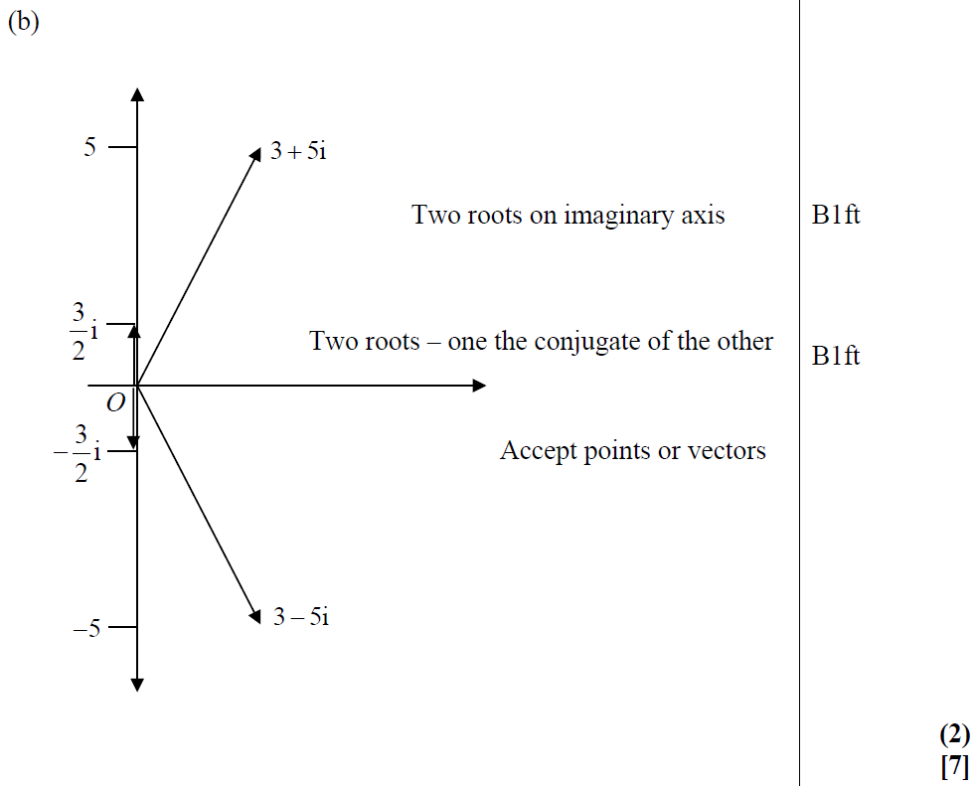
Jan 2013
B

Slide 70
Jan 2013
A notes
B notes

Slide 71
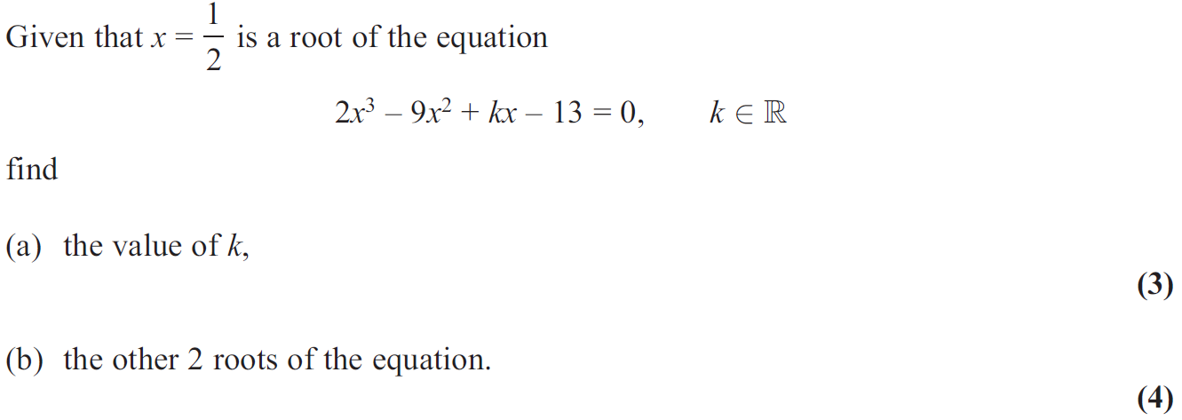
June 2013

Slide 72
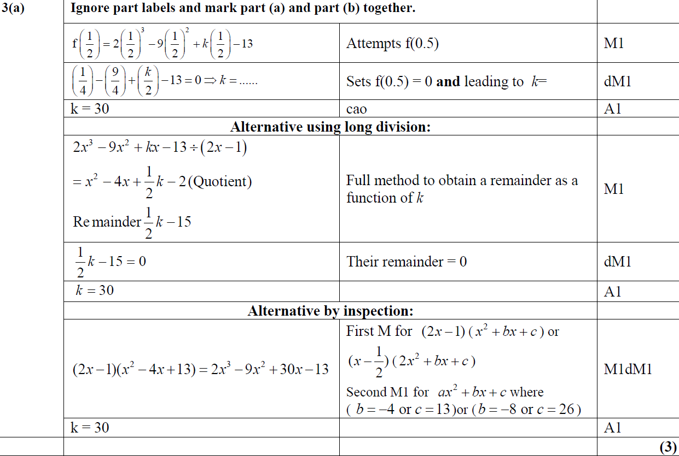
June 2013
A

Slide 73
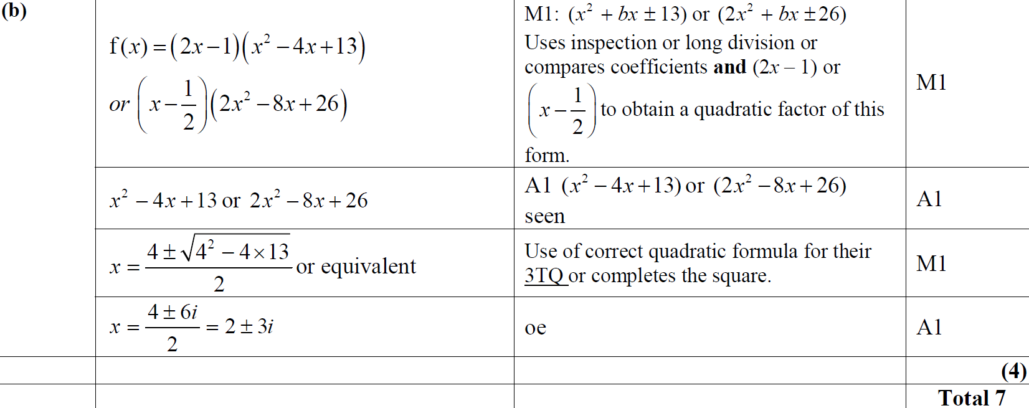
June 2013
B

Slide 74
June 2013 Reserve

Slide 75
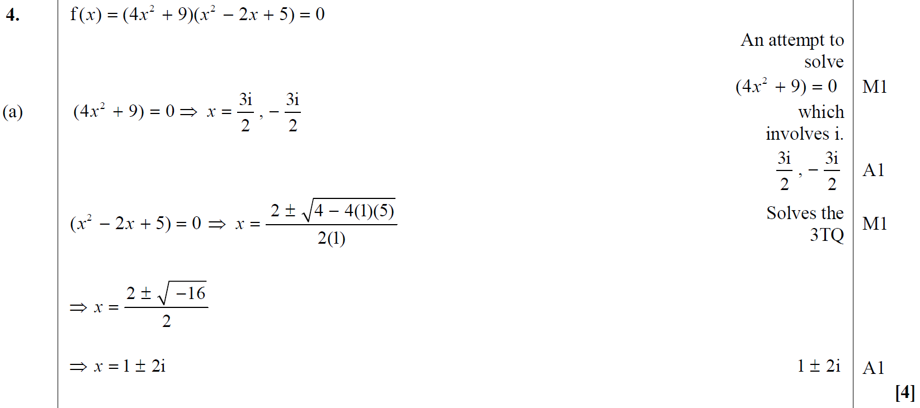
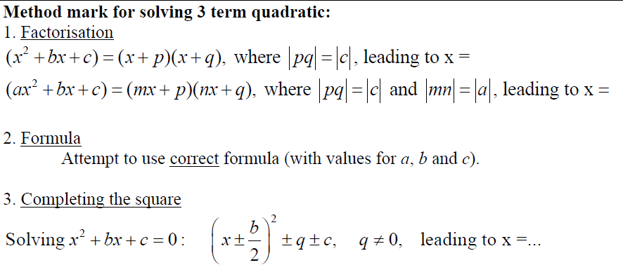
June 2013 Reserve
A

Slide 76
June 2013 Reserve
B

Slide 77
June 2013 Withdrawn

Slide 78
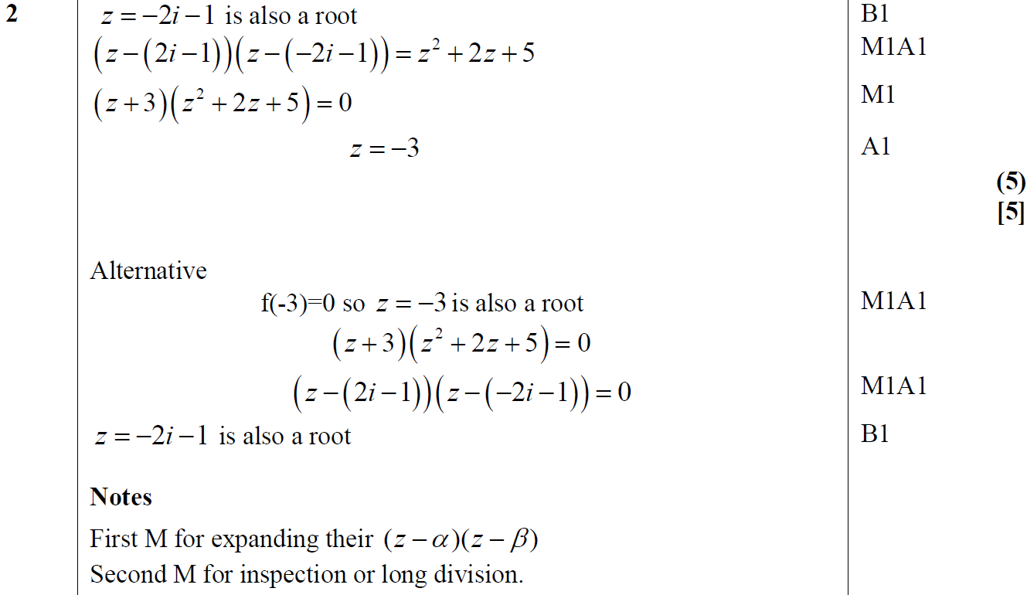
June 2013 Withdrawn
A

Slide 79
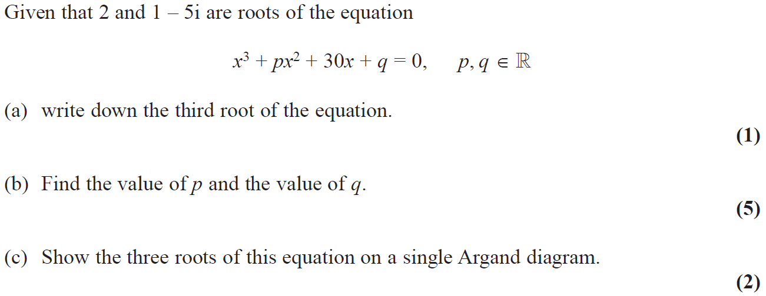
June 2014

Slide 80
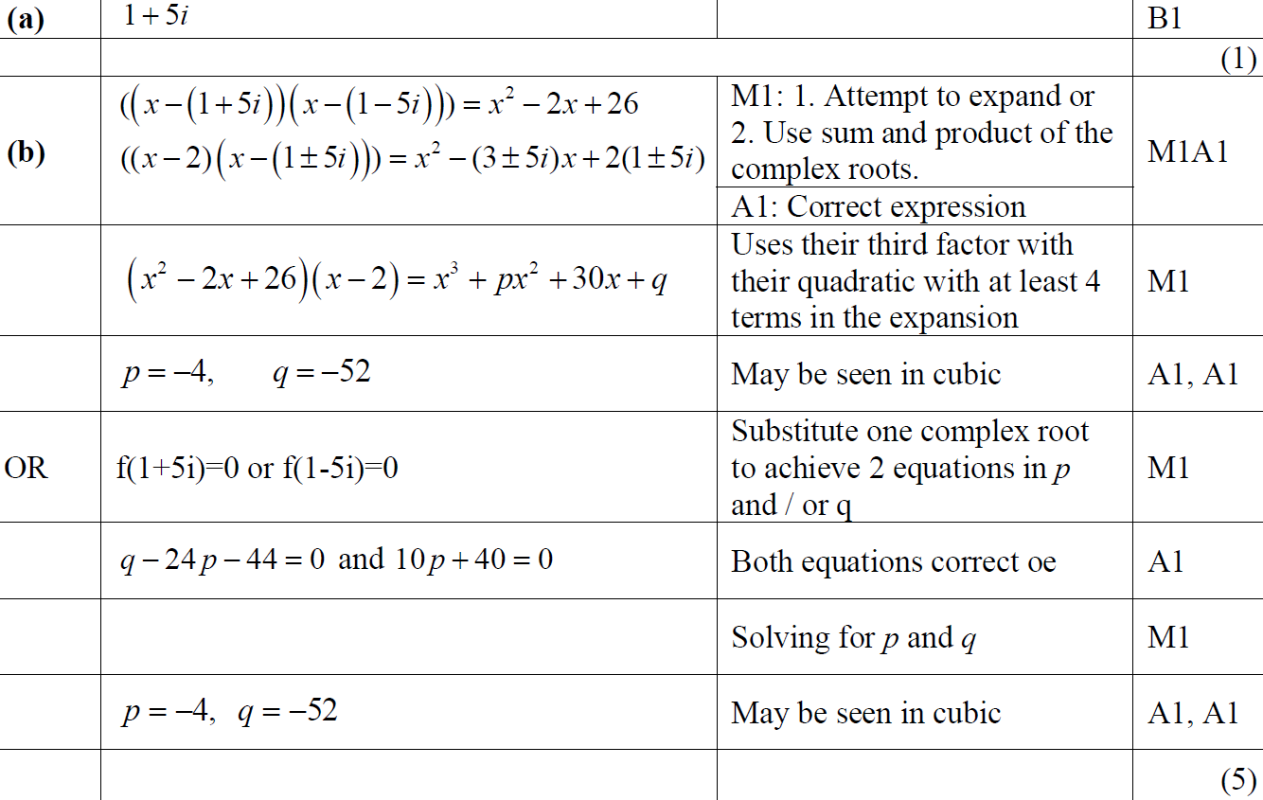
June 2014
A
B

Slide 81
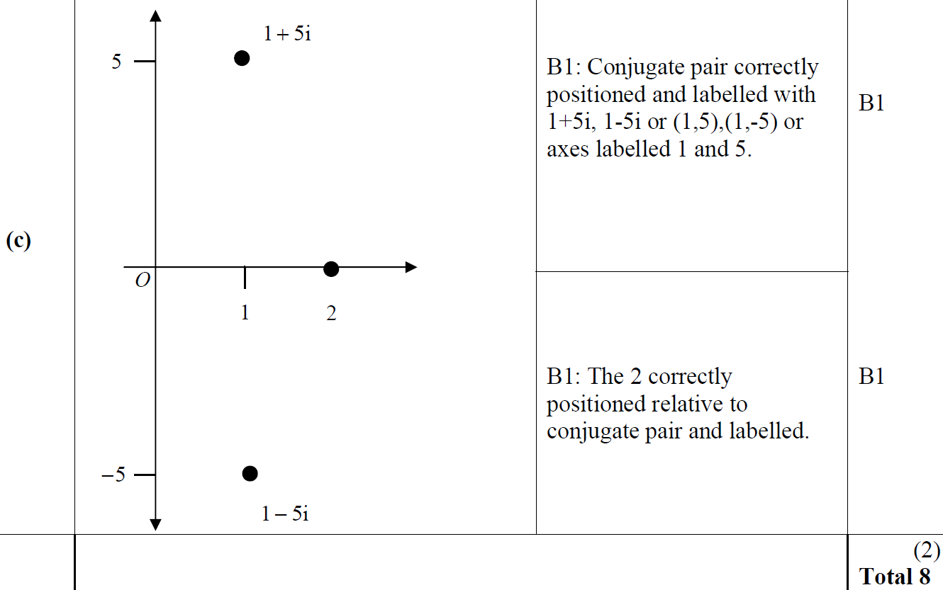
June 2014
C

Slide 82
June 2014 Reserve

Slide 83
June 2014 Reserve
A

Slide 84
June 2015

Slide 85
June 2015
A

Slide 86
May 2017

Slide 87
May 2017
A
B

Slide 88
May 2017
B Alternatives

Slide 89
May 2017
more B Alternatives

