Slide 1
Recurring Decimals
Recurring Decimals
Old Spec Q’s
June 2018
2HR Q17
May 2019
1H Q15

Slide 2
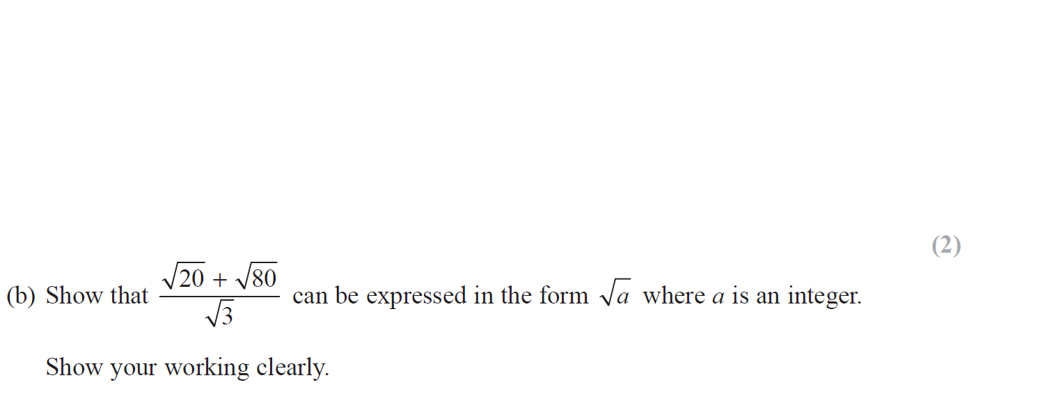
Recurring Decimals
June 2018 2HR Q17

Slide 3
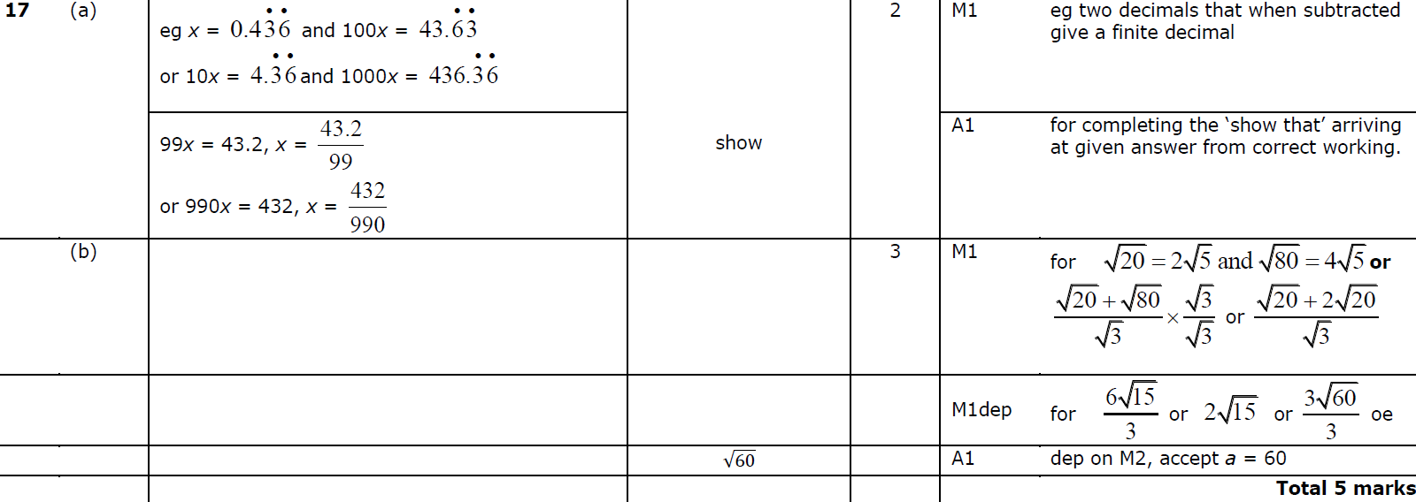
Recurring Decimals
June 2018 2HR Q17
A
B

Slide 4
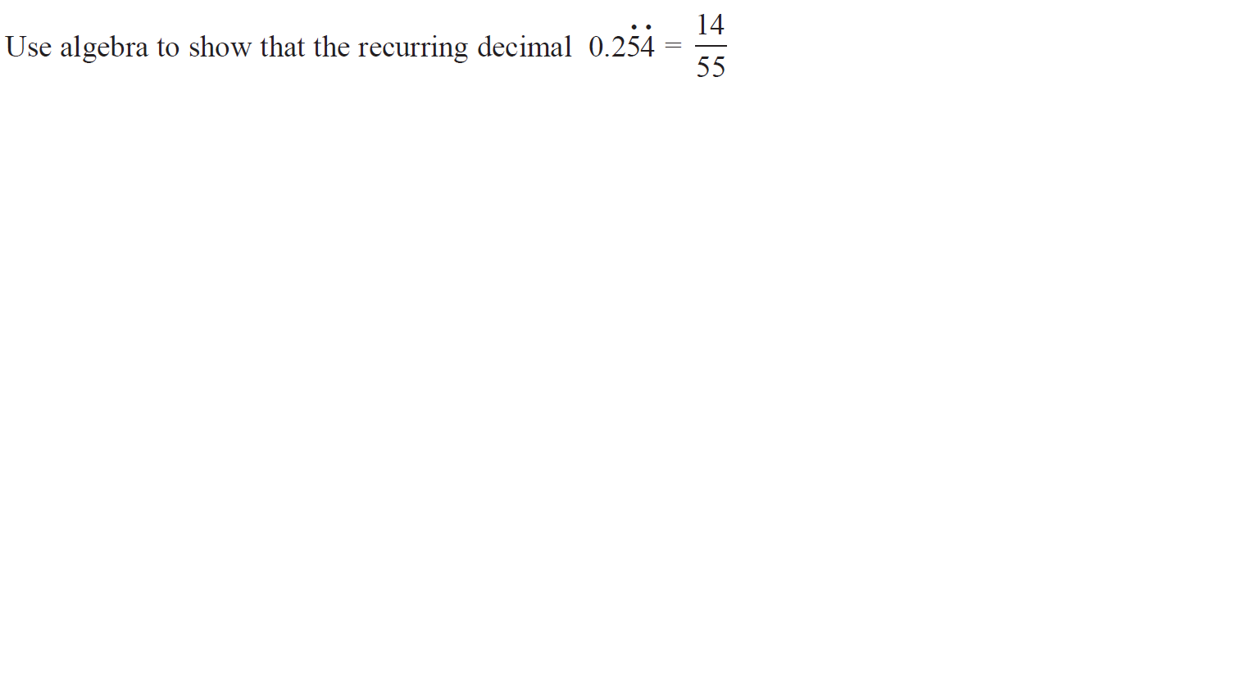
Recurring Decimals
May 2019 1H Q15

Slide 5
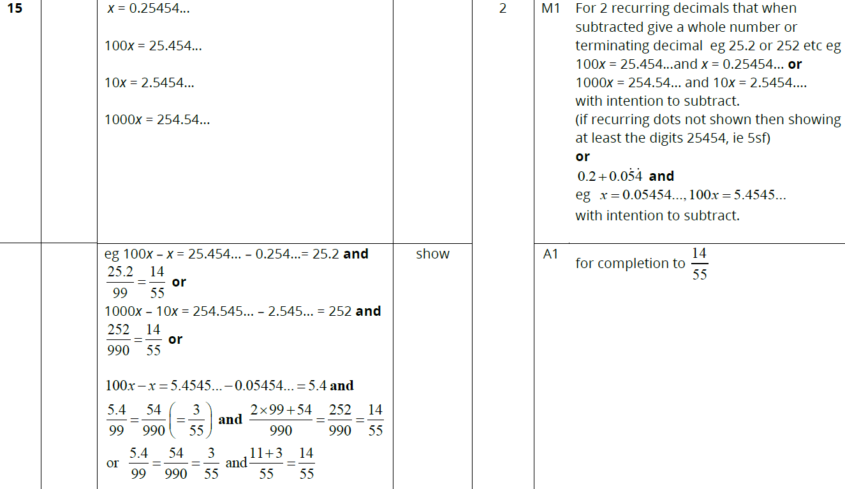
Recurring Decimals
May 2019 1H Q15
A

Slide 6
Recurring Decimals
Recurring Decimals
New Spec Q’s
May 2004
4H Q17
May 2014 4H Q20
May 2005
4H Q19
May 2014 3HR Q15
Nov 2006
4H Q19
Jan 2016 4HR Q15
Nov 2008
3H Q17
Jan 2018 3H Q16
June 2011 4H Q18
June 2018 4HR Q20
Jan 2012 3H Q17
Jan 2014 4H Q20

Slide 7
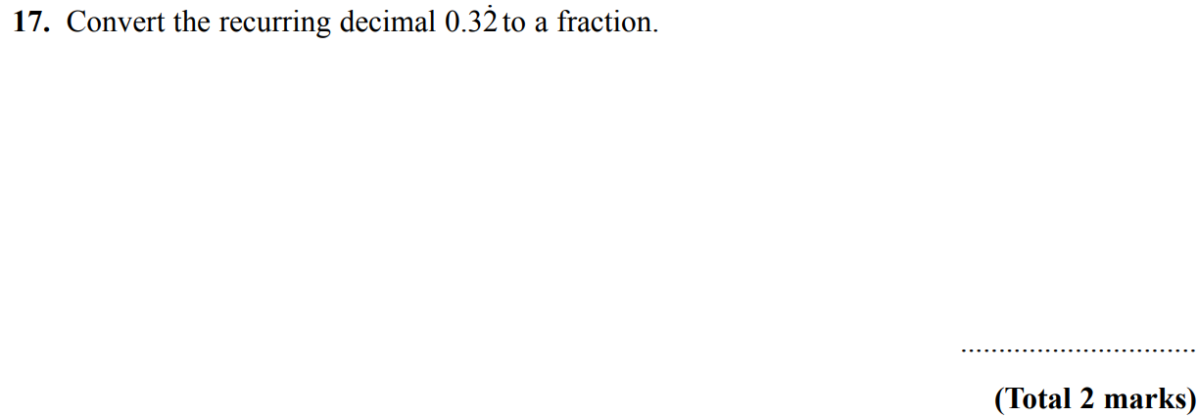
Recurring Decimals
May 2004 4H Q17

Slide 8
Recurring Decimals
May 2004 4H Q17
A

Slide 9
Recurring Decimals
May 2005 4H Q19

Slide 10
Recurring Decimals
May 2005 4H Q19
A

Slide 11
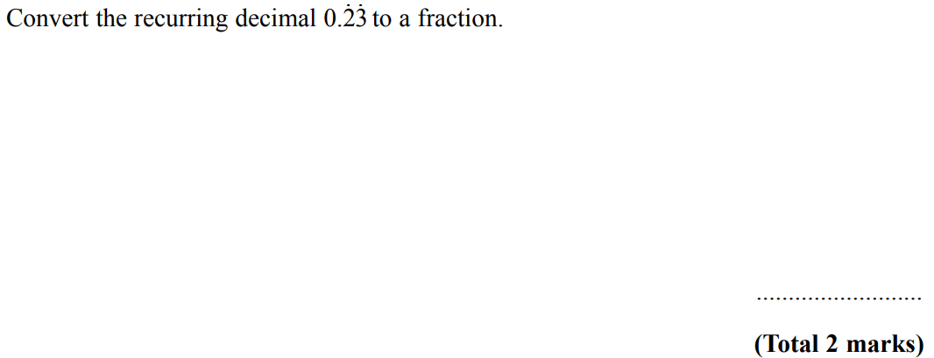
Recurring Decimals
Nov 2006 4H Q19

Slide 12
Recurring Decimals
Nov 2006 4H Q19
A

Slide 13
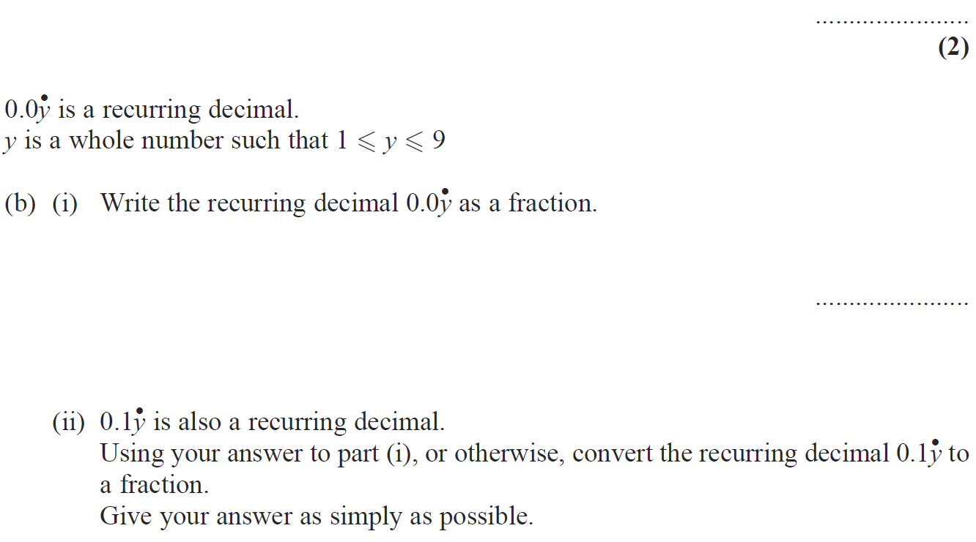
Recurring Decimals
Nov 2008 3H Q17

Slide 14
Recurring Decimals
Nov 2008 3H Q17
A
B (i)
B (ii)

Slide 15
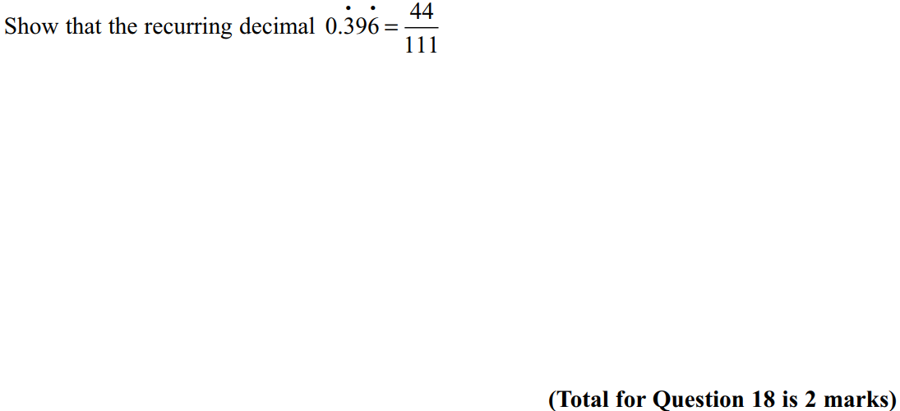
Recurring Decimals
June 2011 4H Q18

Slide 16
Recurring Decimals
June 2011 4H Q18
A

Slide 17
Recurring Decimals
Jan 2012 3H Q17

Slide 18
Recurring Decimals
Jan 2012 3H Q17
A

Slide 19
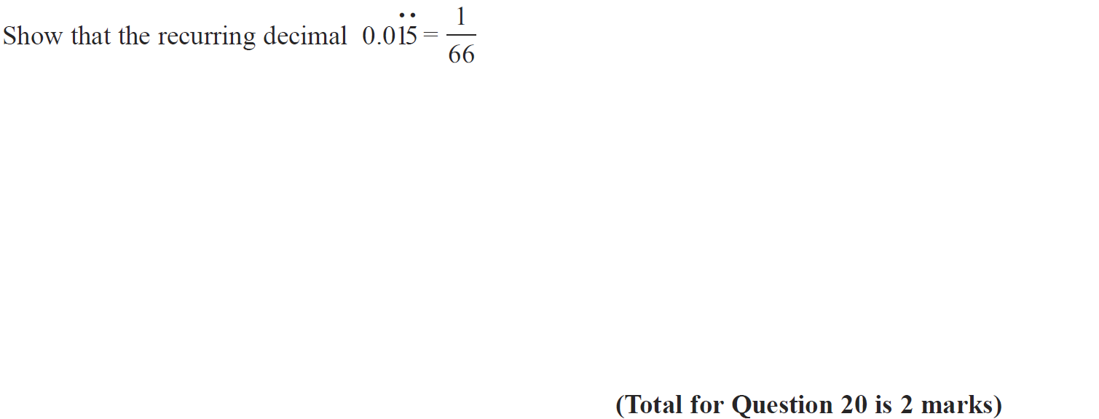
Recurring Decimals
Jan 2014 4H Q20

Slide 20
Recurring Decimals
Jan 2014 4H Q20
A

Slide 21
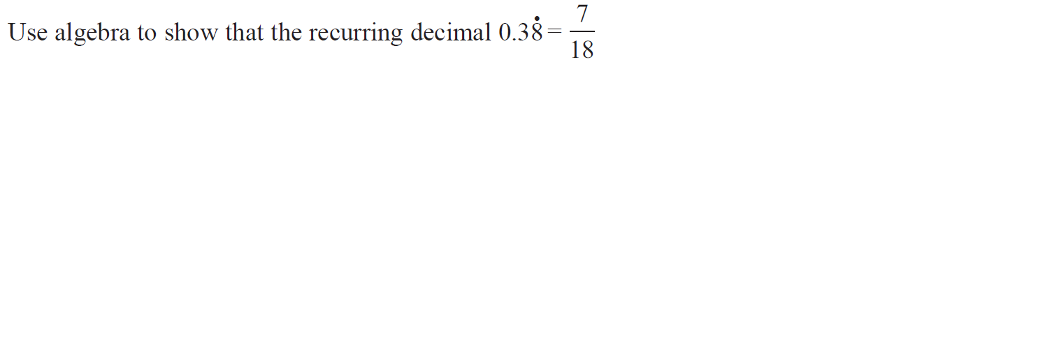
Recurring Decimals
May 2014 4H Q20

Slide 22
Recurring Decimals
May 2014 4H Q20
A

Slide 23
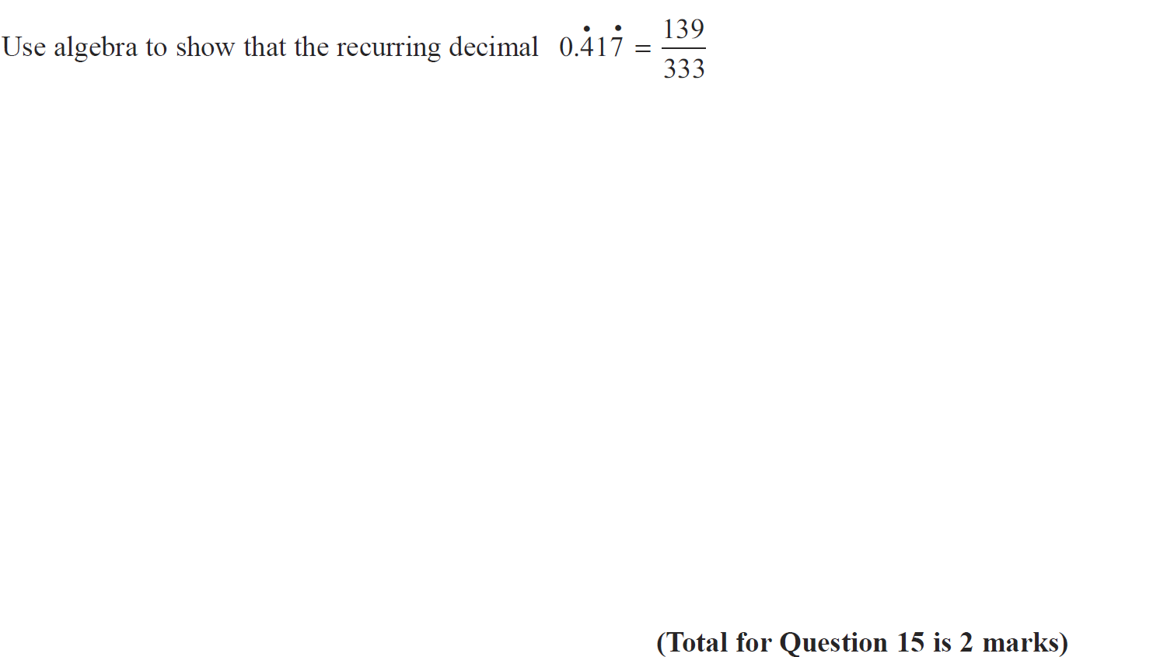
Recurring Decimals
May 2015 3HR Q15

Slide 24
Recurring Decimals
May 2015 3HR Q15
A

Slide 25
Recurring Decimals
Jan 2016 4HR Q15

Slide 26
Recurring Decimals
Jan 2016 4HR Q15
A

Slide 27
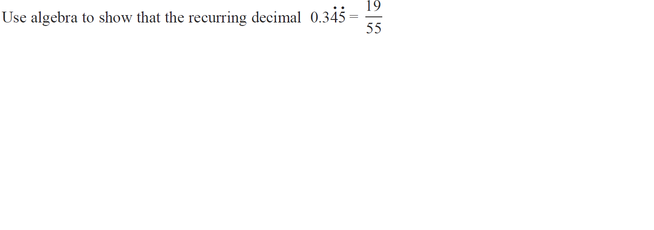
Recurring Decimals
Jan 2018 3H Q16

Slide 28
Recurring Decimals
Jan 2018 3H Q16
A

Slide 29
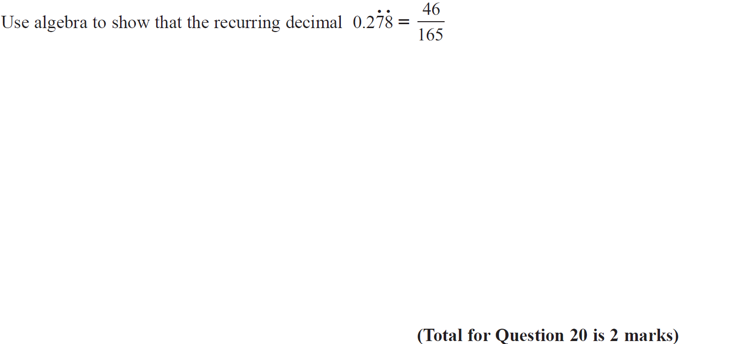
Recurring Decimals
June 2018 4HR Q20

Slide 30
Recurring Decimals
June 2018 4HR Q20
A

