Slide 1
Ratio & Basic Proportion
Ratio & Basic Proportion
Old Spec Q’s
NTSQ
Q14
Jan 2019
1HR Q2
SAM
1H Q2
SAM
1H Q9
May 2018
1H Q2
June 2018
2H Q2
May 2018
1HR Q4
Jan 2019
2H Q1
Jan 2019
2H Q3

Slide 2
Ratio & Basic Proportion
NTSQ Q14

Slide 3
Ratio & Basic Proportion
NTSQ Q14
A

Slide 4
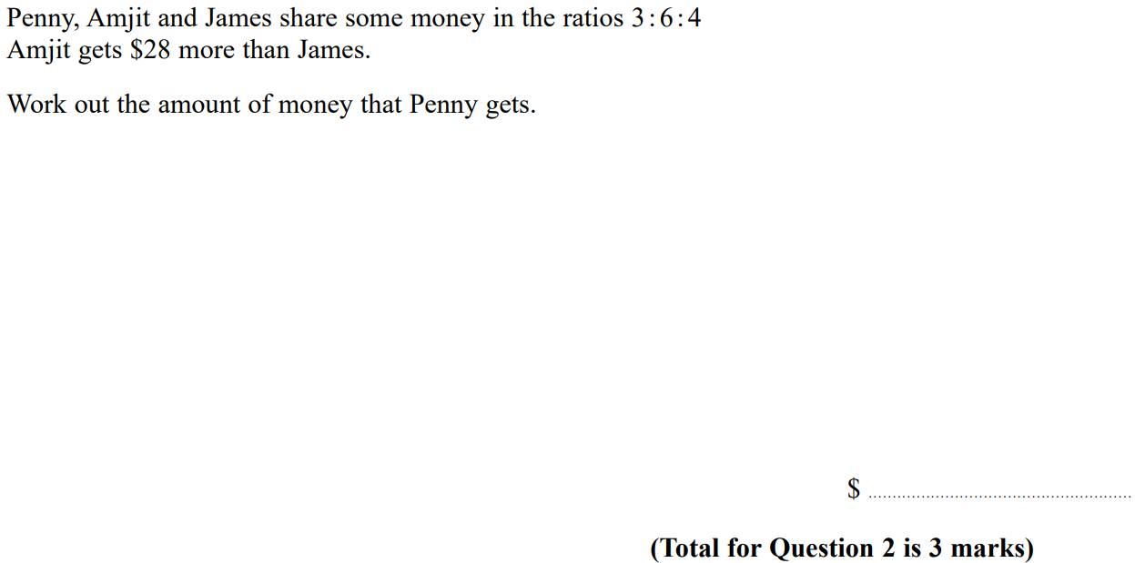
Ratio & Basic Proportion
SAM 1H Q2

Slide 5
Ratio & Basic Proportion
SAM 1H Q2
A

Slide 6
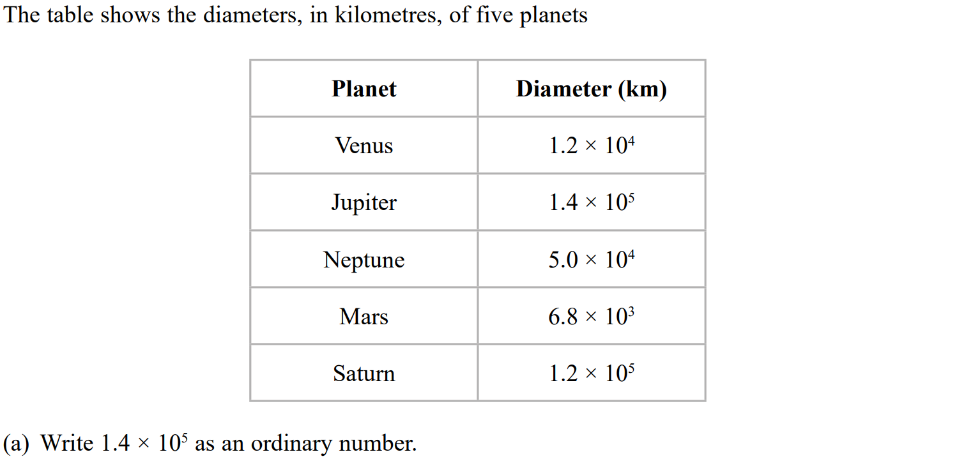
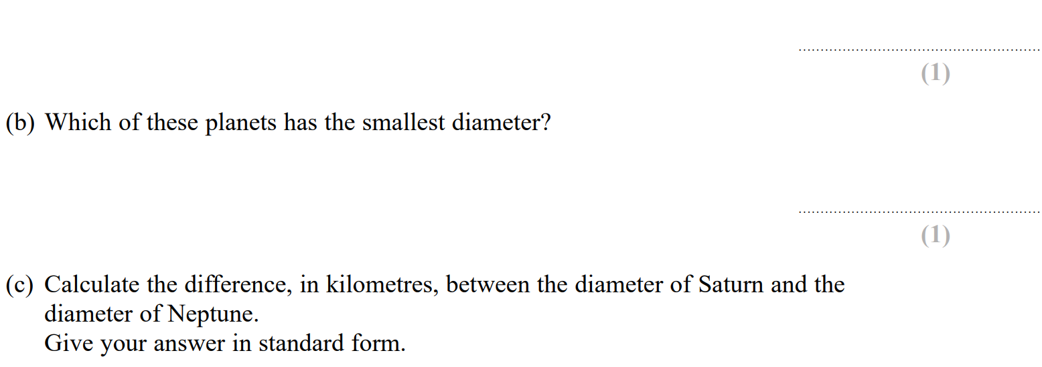
Ratio & Basic Proportion
SAM 1H Q9

Slide 7
Ratio & Basic Proportion
SAM 1H Q9
A
B
C
D

Slide 8
Ratio & Basic Proportion
May 2018 1H Q2

Slide 9
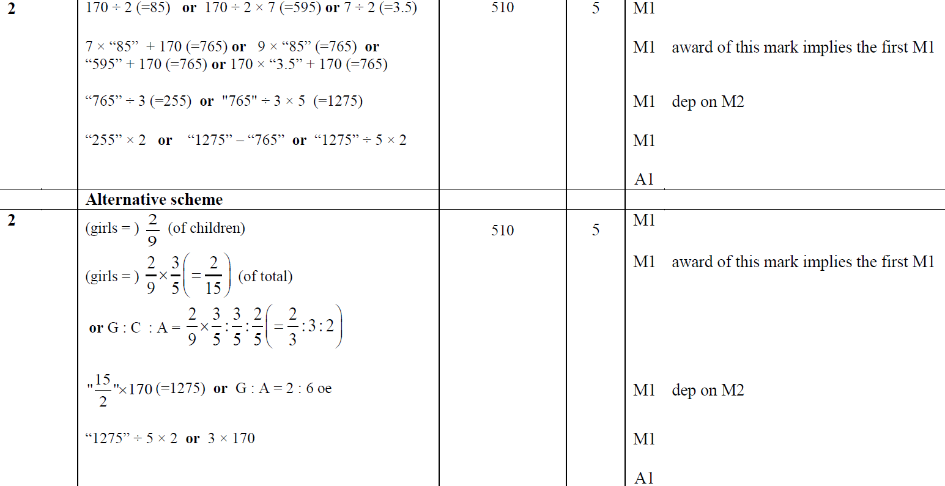
Ratio & Basic Proportion
May 2018 1H Q2
A

Slide 10
Ratio & Basic Proportion
June 2018 2H Q2

Slide 11
Ratio & Basic Proportion
June 2018 2H Q2
A

Slide 12
Ratio & Basic Proportion
May 2018 1HR Q4

Slide 13
Ratio & Basic Proportion
May 2018 1HR Q4
A

Slide 14
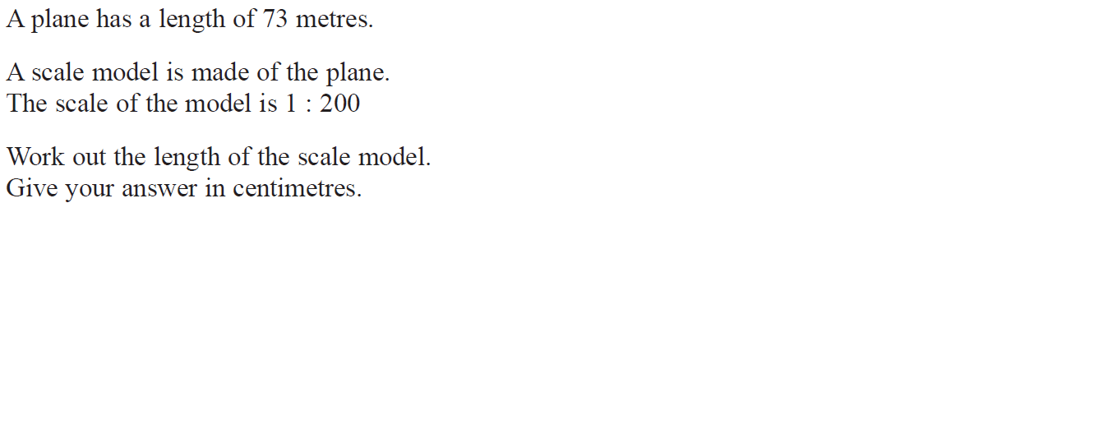
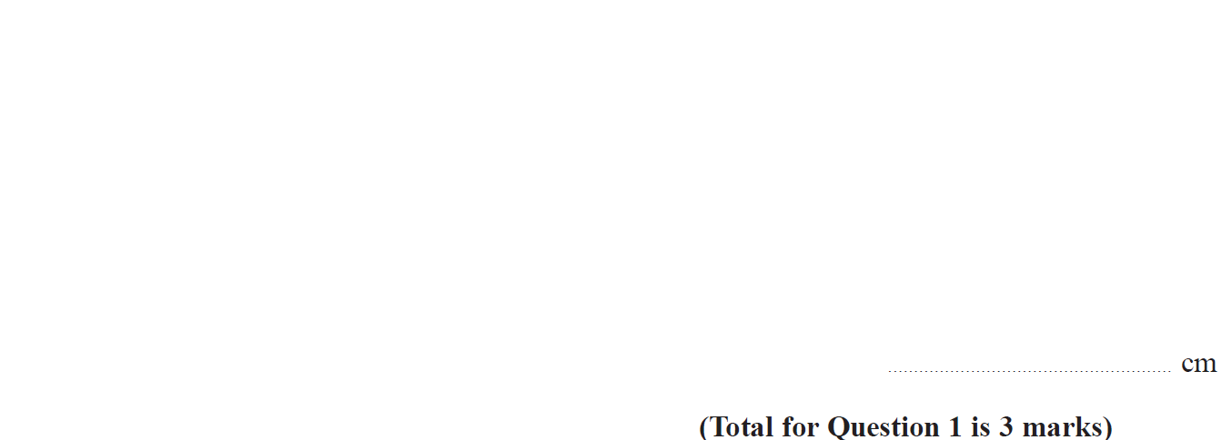
Ratio & Basic Proportion
Jan 2019 2H Q1

Slide 15
Ratio & Basic Proportion
Jan 2019 2H Q1
A

Slide 16
Ratio & Basic Proportion
Jan 2019 2H Q3

Slide 17
Ratio & Basic Proportion
Jan 2019 2H Q3
A

Slide 18
Ratio & Basic Proportion
Jan 2019 1HR Q2

Slide 19
Ratio & Basic Proportion
Jan 2019 1HR Q2
A

Slide 20
Ratio & Basic Proportion
Ratio & Basic Proportion
New Spec Q’s
May 2004
4H Q5
May 2007
4H Q2
June 2009
3H Q1
May 2013 4H Q10
May 2014 4HR Q14
June 2015 4HR Q8
Jan 2017 4H Q3
Jan 2018 3HR Q3
Nov 2004
3H Q10
May 2007
4H Q5
Nov 2010
4H Q5
May 2013 4HR Q1
Jan 2015 3H Q1
Jan 2016 3H Q1
Jan 2017 3HR Q5
Jan 2018 3HR Q8
Nov 2004
4H Q1
Nov 2007
4H Q3
Nov 2010
4H Q8
May 2013 4HR Q5
Jan 2015 4H Q7
Jan 2016 4H Q10
Jan 2017 3HR Q8
Jan 2018 4HR Q4
May 2005
3H Q12
Nov 2007
4H Q5
June 2011 3H Q7
Jan 2014 3H Q1
Jan 2015 3HR Q1
Jan 2016 4HR Q1
Jan 2017 4HR Q1
Jan 2018 4HR Q10
Nov 2005
4H Q2
May 2008
3H Q4
June 2011 4H Q3
Jan 2014 4H Q1
Jan 2015 4HR Q1
May 2016 3H Q1
May 2017 3H Q3
May 2018 3H Q2
May 2006
3H Q1
Nov 2008
4H Q2
Jan 2012 4H Q6
Jan 2014 3HR Q2
May 2015 3H Q1
May 2016 3H Q9
June 2017 4H Q3
June 2018 4H Q5
May 2006
3H Q8
Nov 2008
4H Q3
May 2012 3H Q1
Jan 2014 4HR Q9
May 2015 3H Q2
May 2016 3HR Q1
June 2017 4H Q9
May 2018 3HR Q4
May 2006
4H Q10
May 2009
3H Q1
Jan 2013 3H Q9
May 2014 4H Q1
May 2015 3H Q5
June 2016 4HR Q3
May 2017 3HR Q4
Nov 2006
3H Q6
May 2009
3H Q12
Jan 2013 4H Q11
May 2014 4H Q6
May 2015 3H Q7
June 2016 4HR Q8
May 2017 4HR Q1
Nov 2006
4H Q3
Nov 2009
4H Q7
May 2013 4H Q2
May 2014 4HR Q10
June 2015 4H Q2
Jan 2017 3H Q7
Jan 2018 3H Q1

Slide 21
Ratio & Basic Proportion
May 2004 4H Q5

Slide 22
Ratio & Basic Proportion
May 2004 4H Q5
A
B

Slide 23
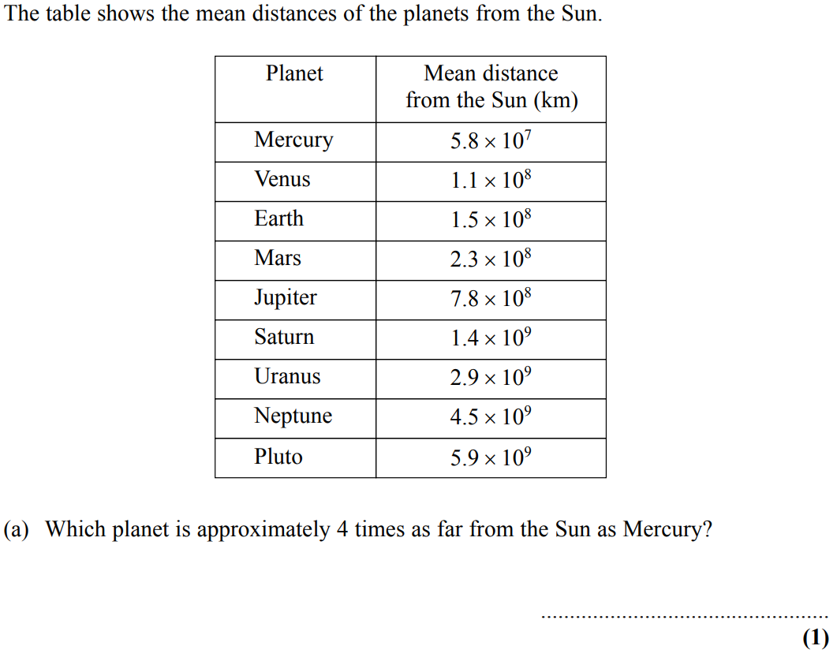
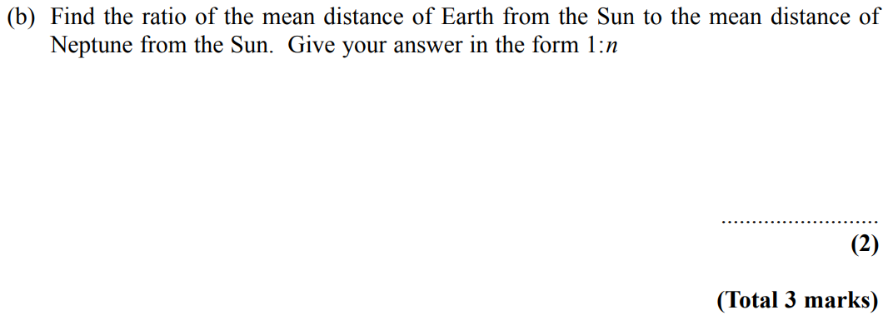
Ratio & Basic Proportion
Nov 2004 3H Q10

Slide 24
Ratio & Basic Proportion
Nov 2004 3H Q10
A
B

Slide 25
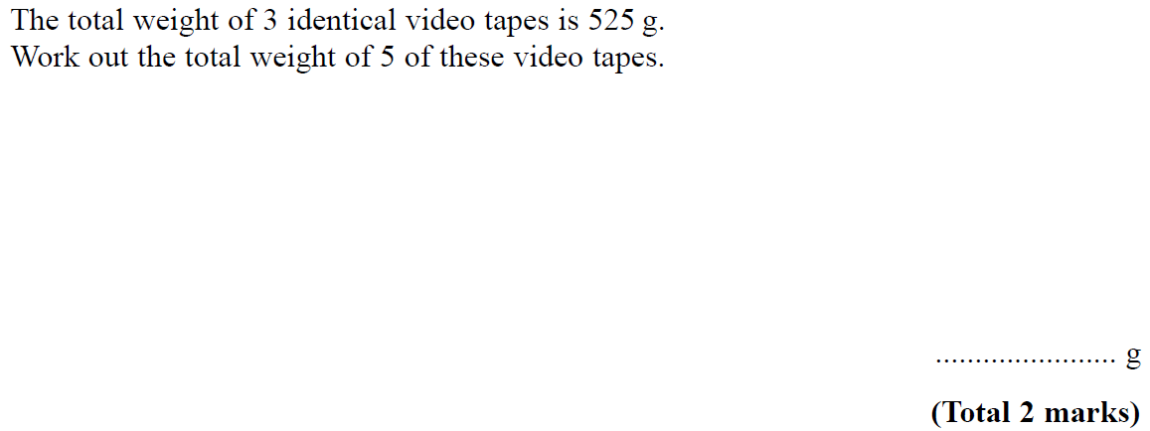
Ratio & Basic Proportion
Nov 2004 4H Q1

Slide 26
Ratio & Basic Proportion
Nov 2004 4H Q1
A

Slide 27
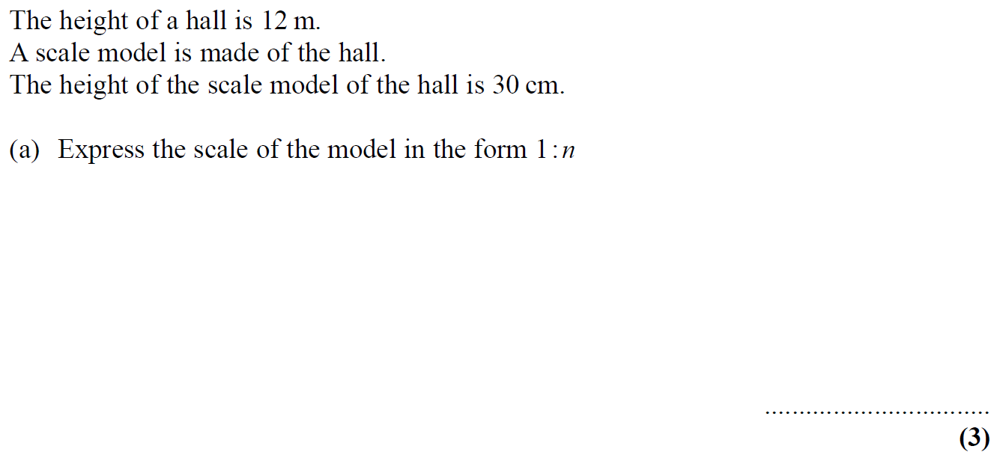
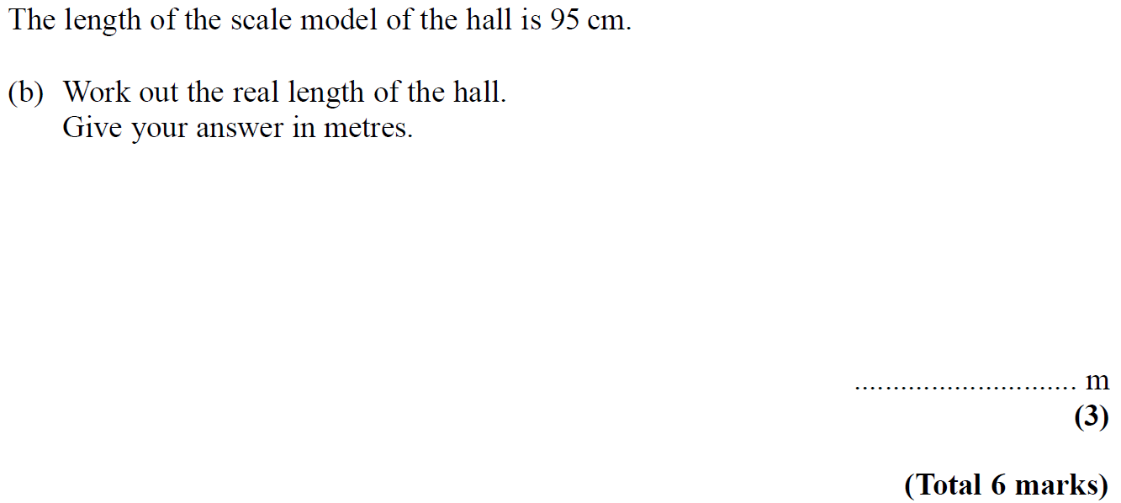
Ratio & Basic Proportion
May 2005 3H Q12

Slide 28
Ratio & Basic Proportion
May 2005 3H Q12
A
B

Slide 29
Ratio & Basic Proportion
Nov 2005 4H Q2

Slide 30
Ratio & Basic Proportion
Nov 2005 4H Q2
A
B

Slide 31
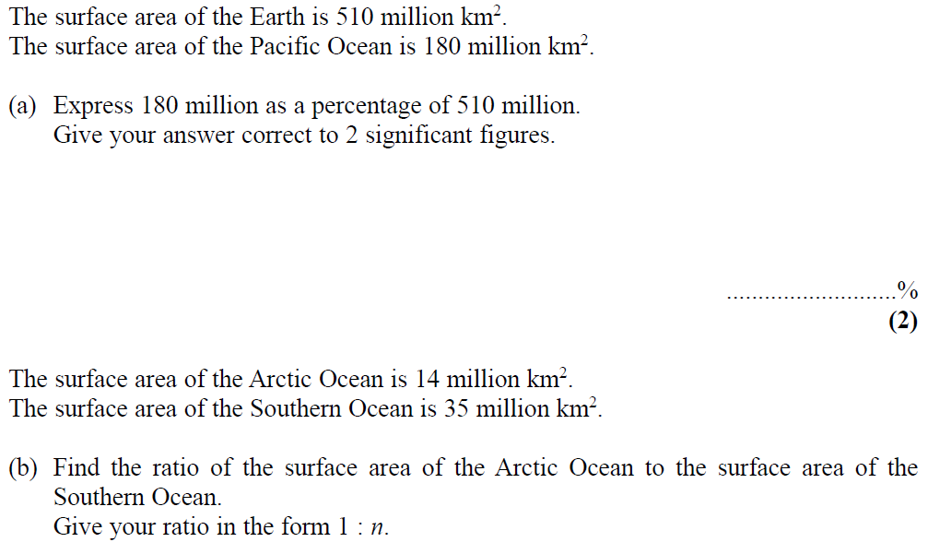
Ratio & Basic Proportion
May 2006 3H Q1

Slide 32
Ratio & Basic Proportion
May 2006 3H Q1
A
B

Slide 33
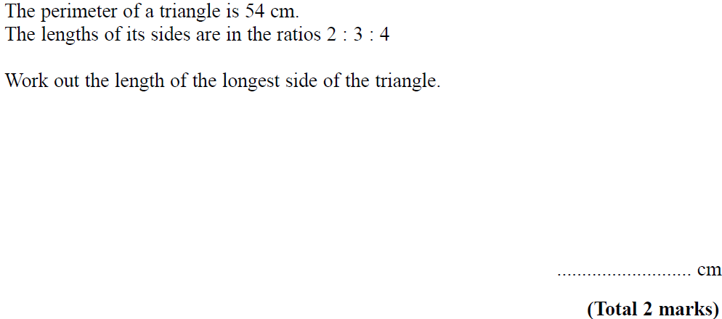
Ratio & Basic Proportion
May 2006 3H Q8

Slide 34
Ratio & Basic Proportion
May 2006 3H Q8
A

Slide 35
Ratio & Basic Proportion
May 2006 4H Q10

Slide 36
Ratio & Basic Proportion
May 2006 4H Q10
A
B
C

Slide 37
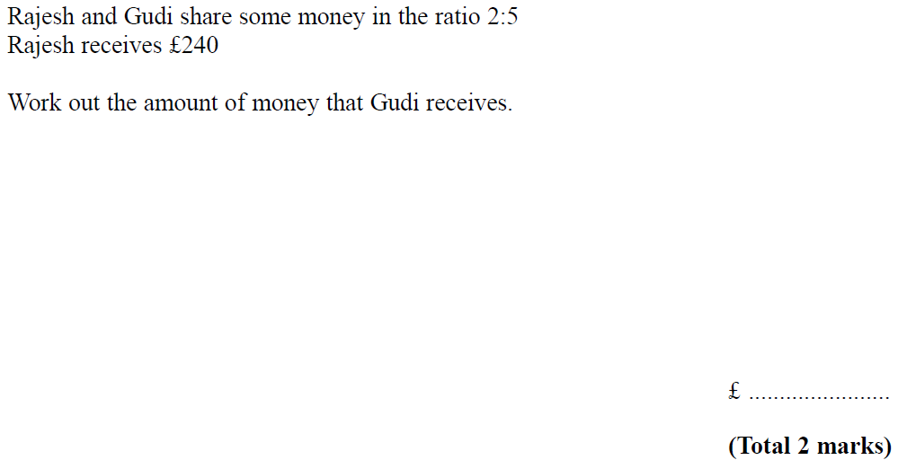
Ratio & Basic Proportion
Nov 2006 3H Q6

Slide 38
Ratio & Basic Proportion
Nov 2006 3H Q6
A

Slide 39
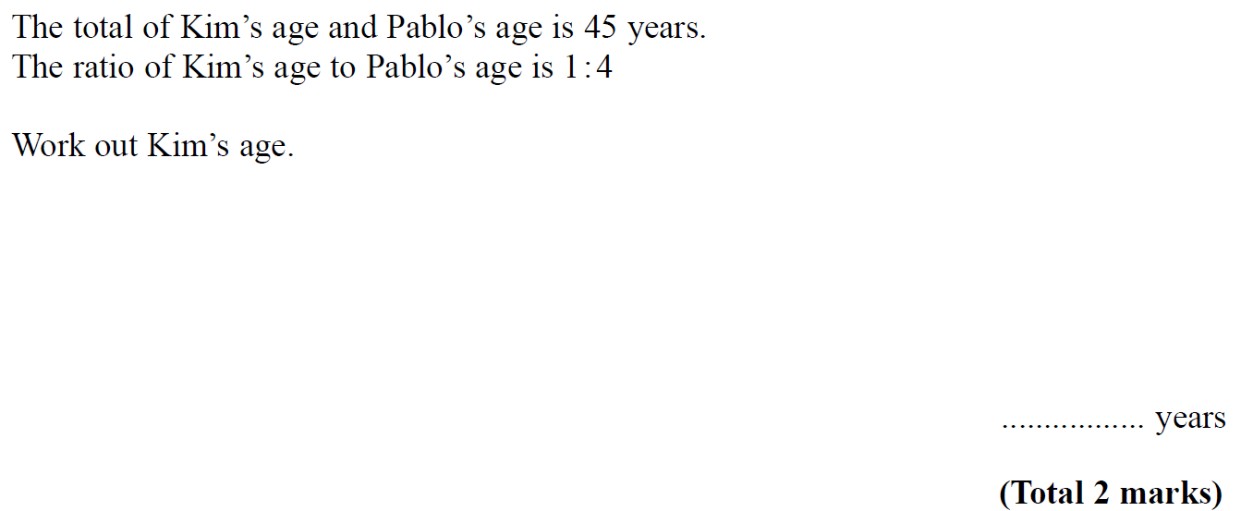
Ratio & Basic Proportion
Nov 2006 4H Q3

Slide 40
Ratio & Basic Proportion
Nov 2006 4H Q3
A

Slide 41
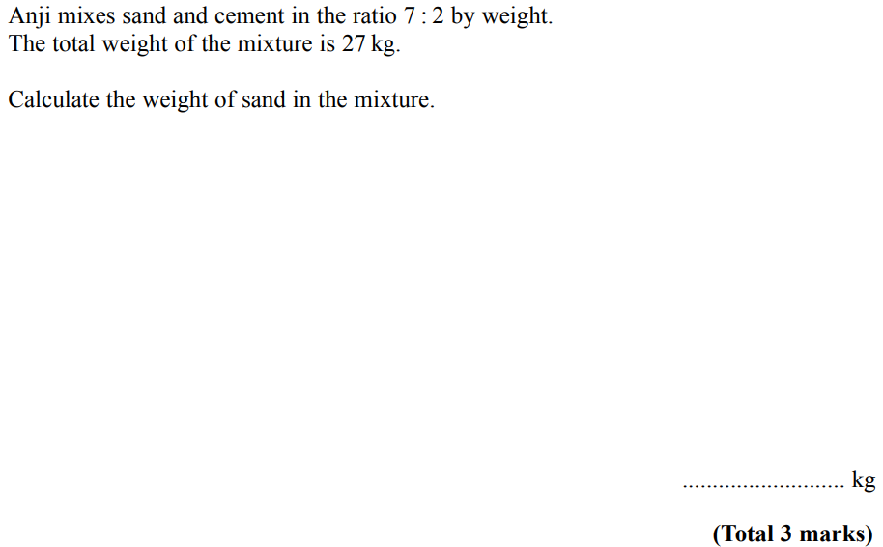
Ratio & Basic Proportion
May 2007 4H Q2

Slide 42
Ratio & Basic Proportion
May 2007 4H Q2
A

Slide 43
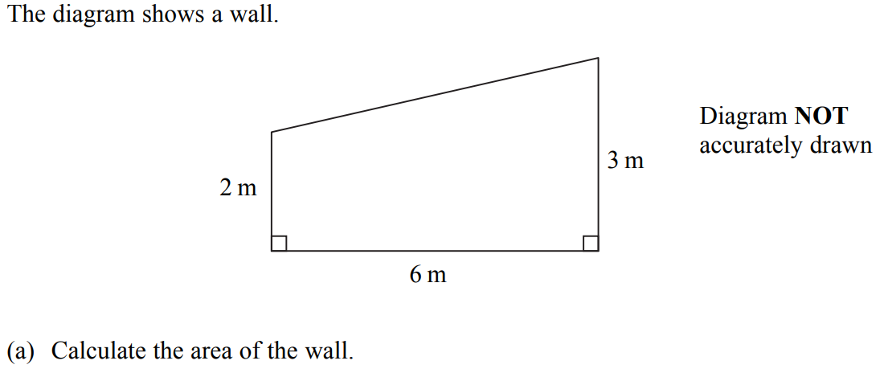
Ratio & Basic Proportion
May 2007 4H Q5

Slide 44
Ratio & Basic Proportion
May 2007 4H Q5
A

Slide 45
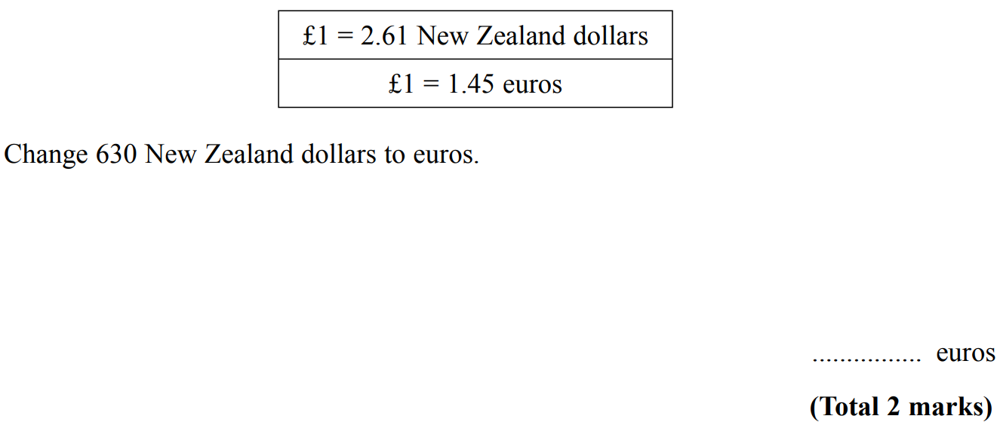
Ratio & Basic Proportion
Nov 2007 4H Q3

Slide 46
Ratio & Basic Proportion
Nov 2007 4H Q3
A

Slide 47
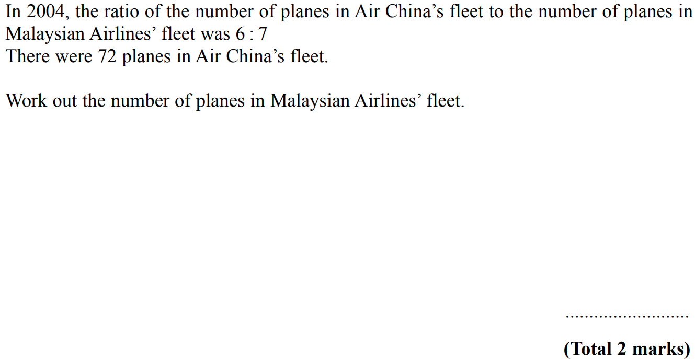
Ratio & Basic Proportion
Nov 2007 4H Q5

Slide 48
Ratio & Basic Proportion
Nov 2007 4H Q5
A

Slide 49
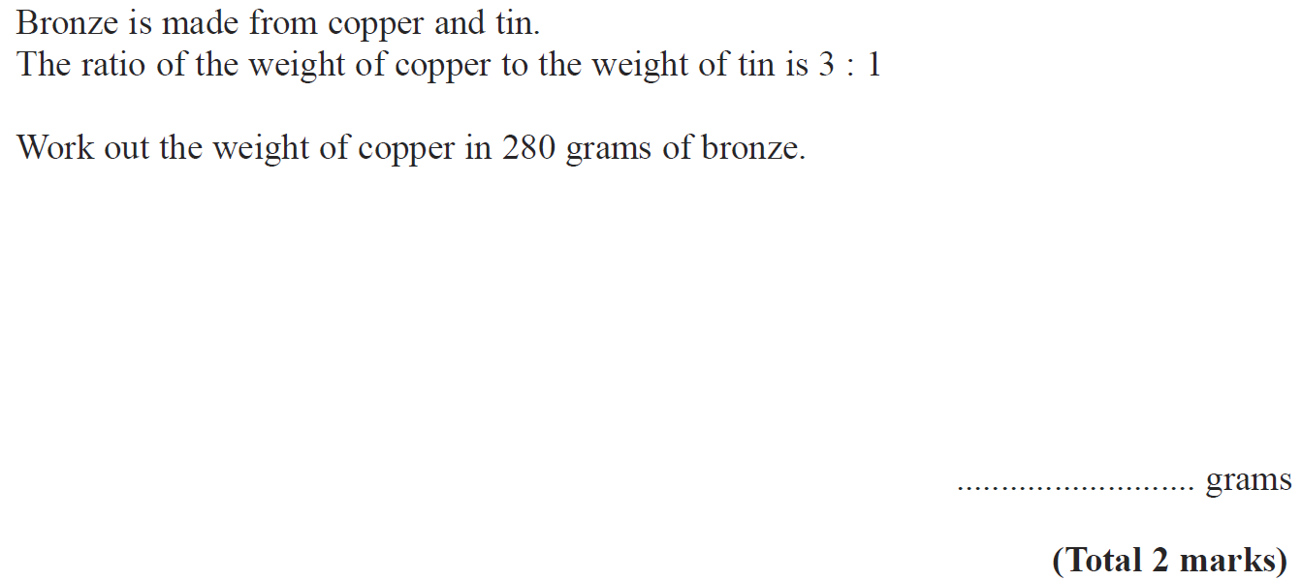
Ratio & Basic Proportion
May 2008 3H Q4

Slide 50
Ratio & Basic Proportion
May 2008 3H Q4
A

Slide 51
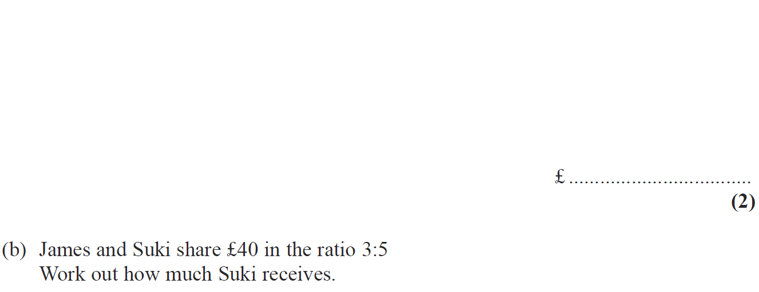
Ratio & Basic Proportion
Nov 2008 4H Q2

Slide 52
Ratio & Basic Proportion
Nov 2008 4H Q2
A

Slide 53
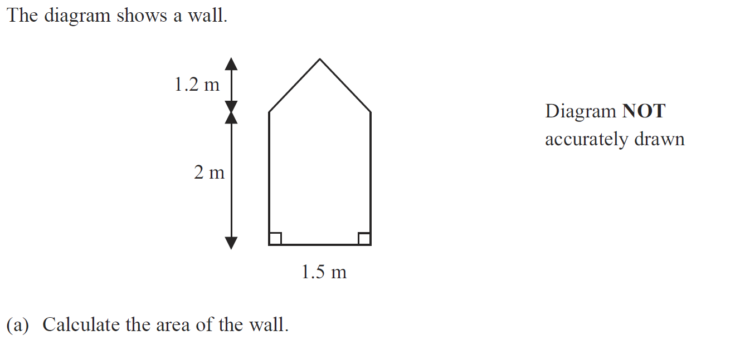
Ratio & Basic Proportion
Nov 2008 4H Q3

Slide 54
Ratio & Basic Proportion
Nov 2008 4H Q3
A
B

Slide 55
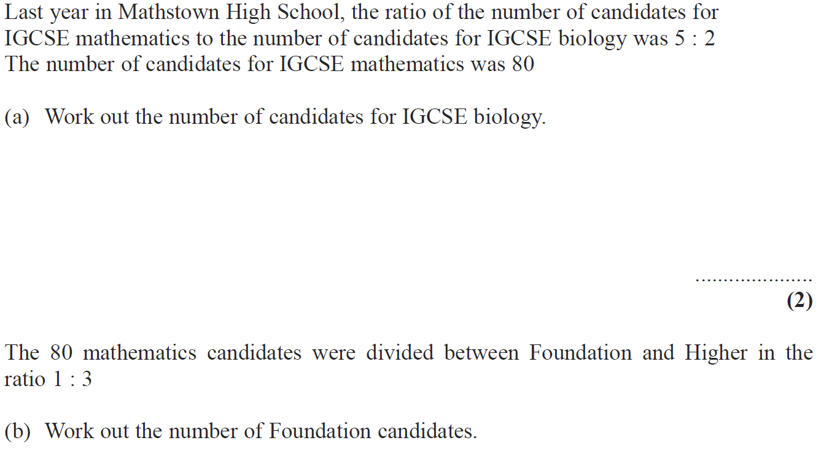
Ratio & Basic Proportion
May 2009 3H Q1

Slide 56
Ratio & Basic Proportion
May 2009 3H Q1
A
B

Slide 57
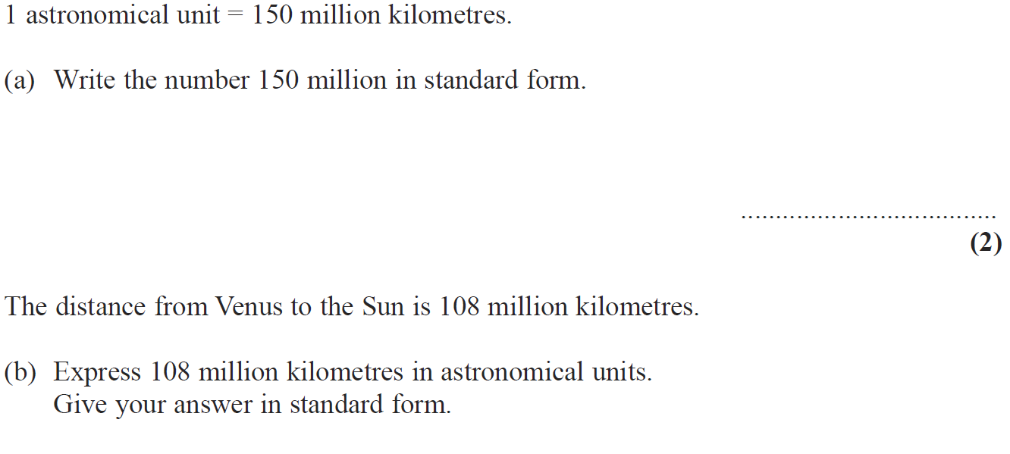
Ratio & Basic Proportion
May 2009 3H Q12

Slide 58
Ratio & Basic Proportion
May 2009 3H Q12
A
B

Slide 59
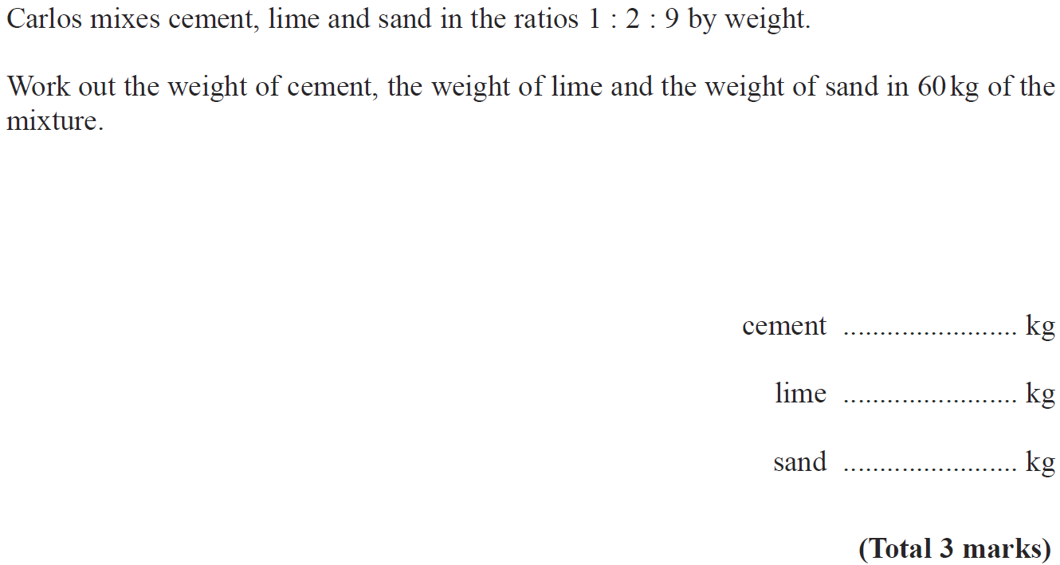
Ratio & Basic Proportion
Nov 2009 4H Q7

Slide 60
Ratio & Basic Proportion
Nov 2009 4H Q7
A

Slide 61
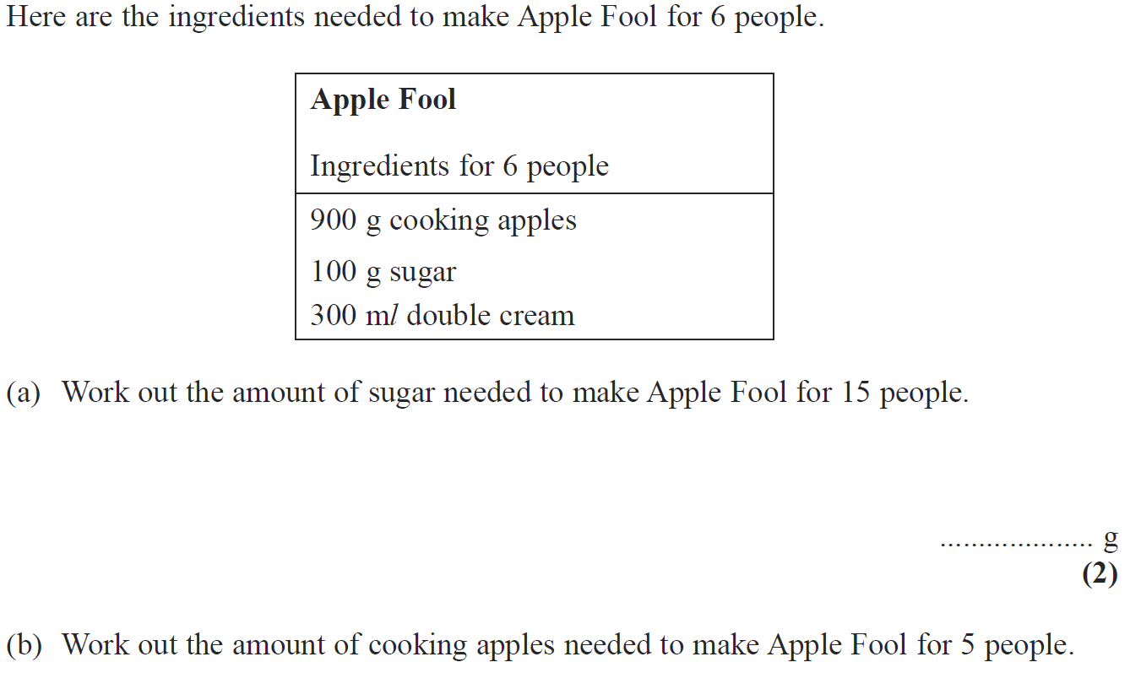
Ratio & Basic Proportion
June 2010 3H Q1

Slide 62
Ratio & Basic Proportion
June 2010 3H Q1
A
B

Slide 63
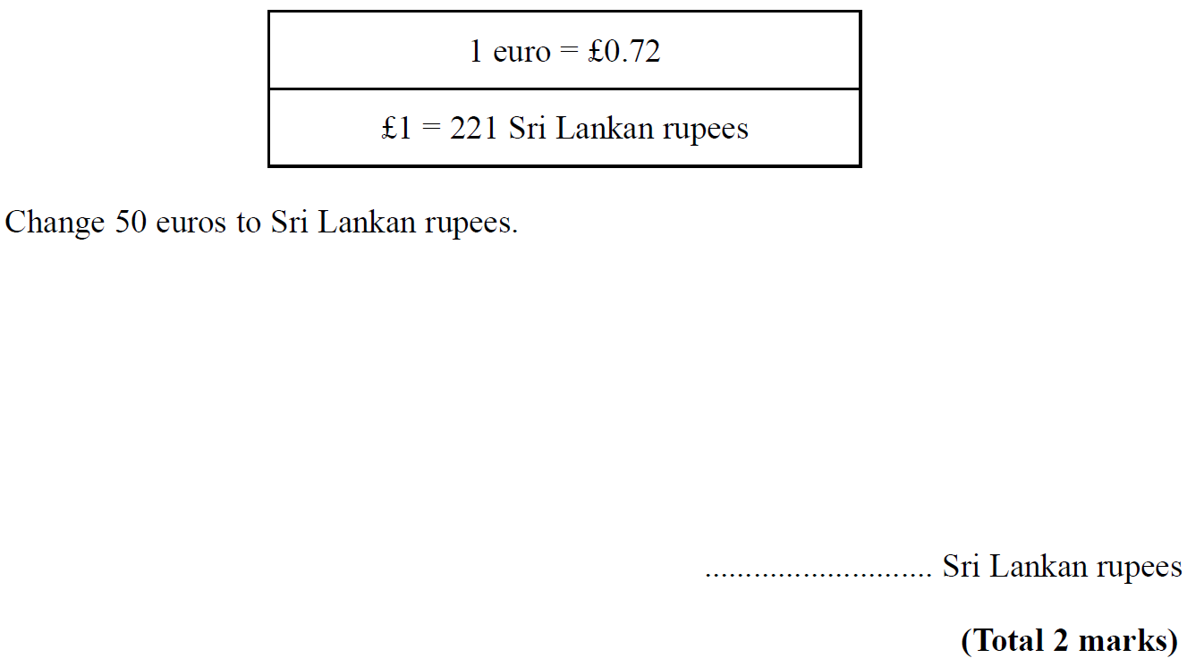
Ratio & Basic Proportion
Nov 2010 4H Q5

Slide 64
Ratio & Basic Proportion
Nov 2010 4H Q5
A

Slide 65
Ratio & Basic Proportion
Nov 2010 4H Q8

Slide 66
Ratio & Basic Proportion
Nov 2010 4H Q8
A

Slide 67
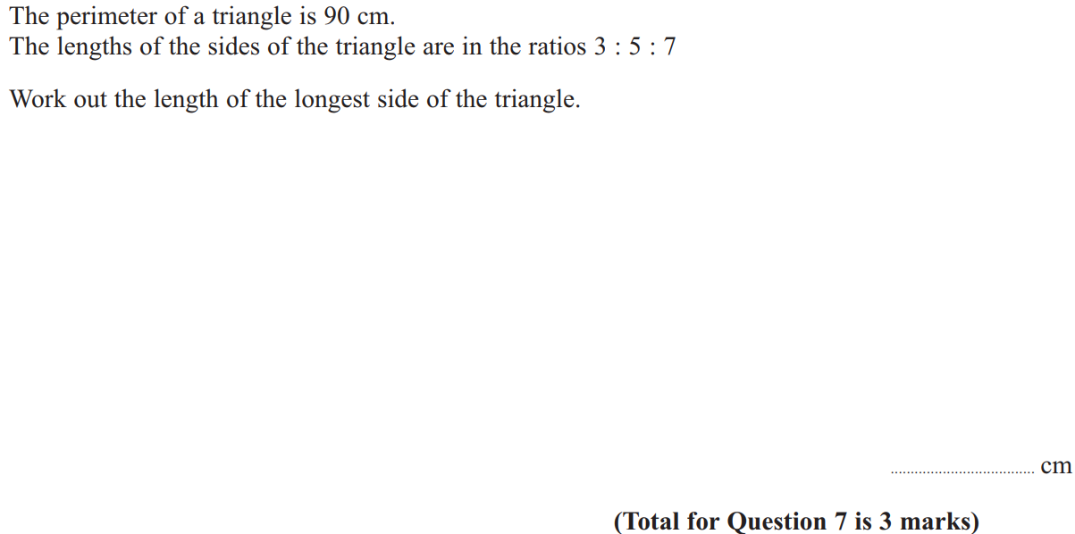
Ratio & Basic Proportion
June 2011 3H Q7

Slide 68
Ratio & Basic Proportion
June 2011 3H Q7
A

Slide 69
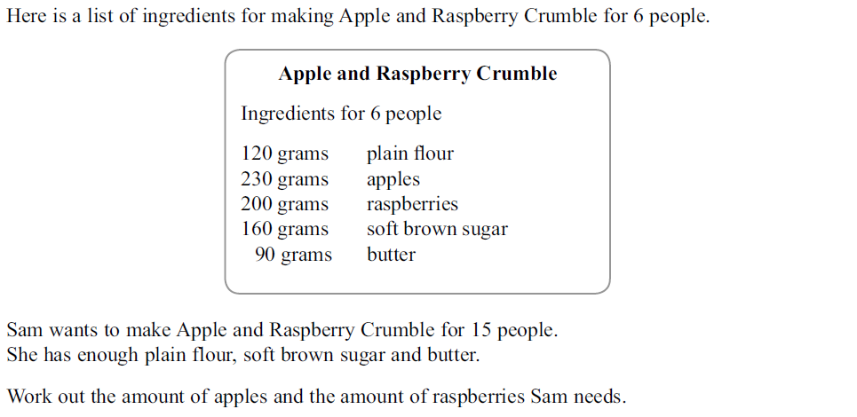
Ratio & Basic Proportion
June 2011 4H Q3

Slide 70
Ratio & Basic Proportion
June 2011 4H Q3
A

Slide 71
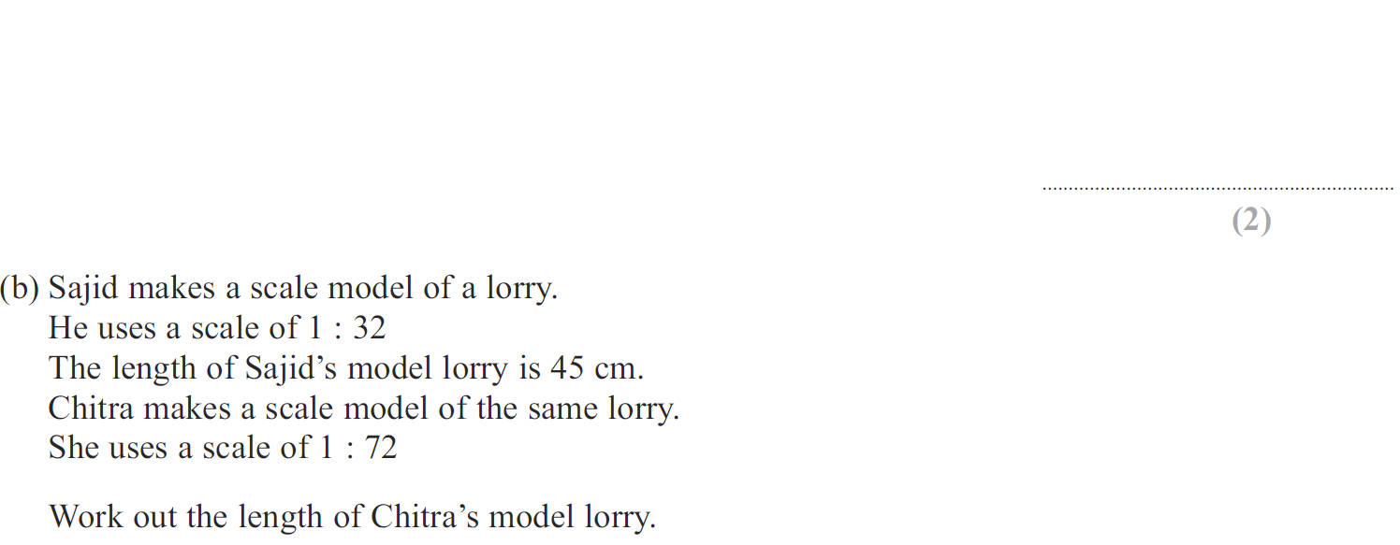
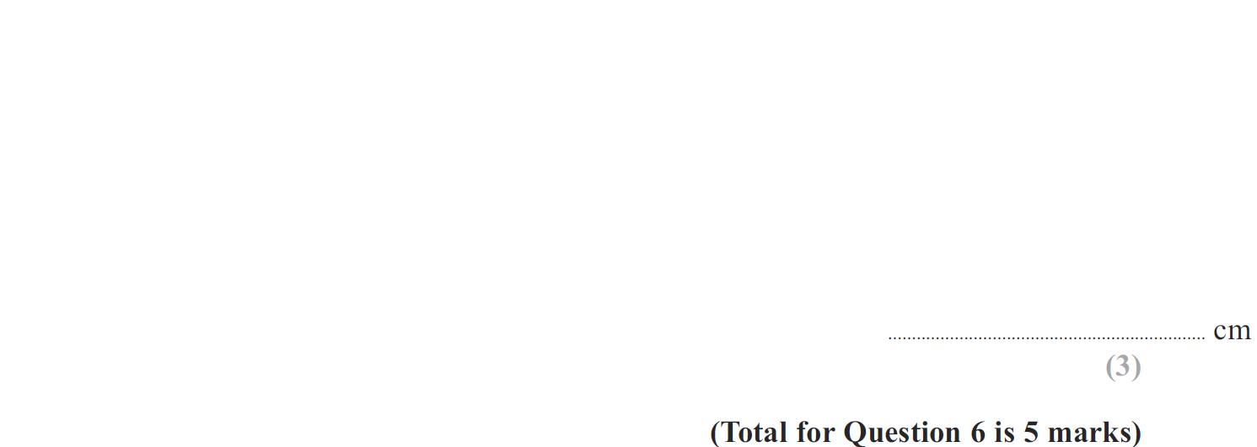
Ratio & Basic Proportion
Jan 2012 4H Q6

Slide 72
Ratio & Basic Proportion
Jan 2012 4H Q6
A
B

Slide 73
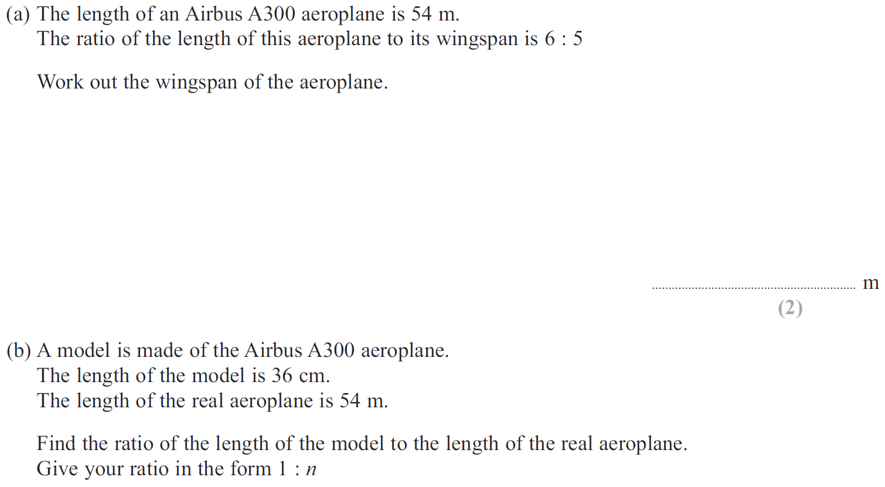
Ratio & Basic Proportion
May 2012 3H Q1

Slide 74
Ratio & Basic Proportion
May 2012 3H Q1
A
B

Slide 75
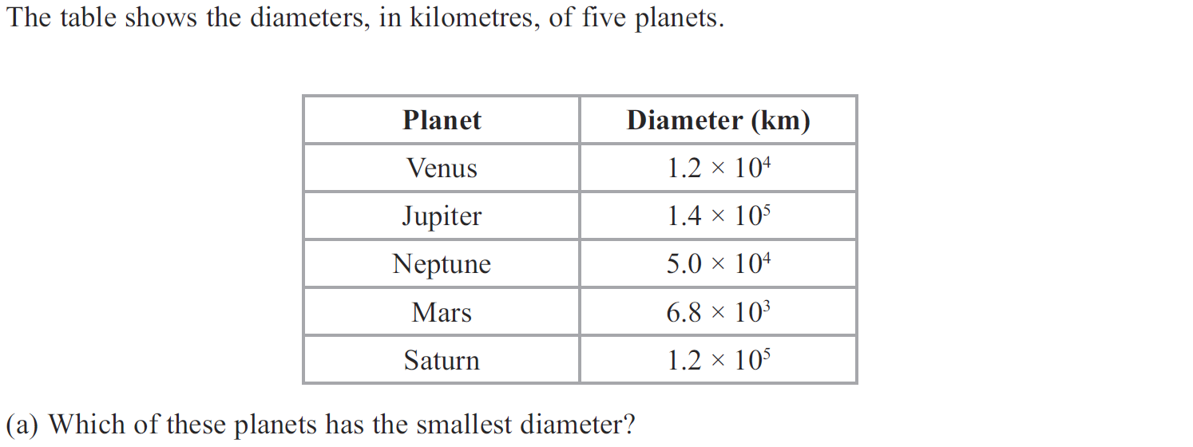
Ratio & Basic Proportion
Jan 2013 3H Q9

Slide 76
Ratio & Basic Proportion
Jan 2013 3H Q9
A
B
C

Slide 77
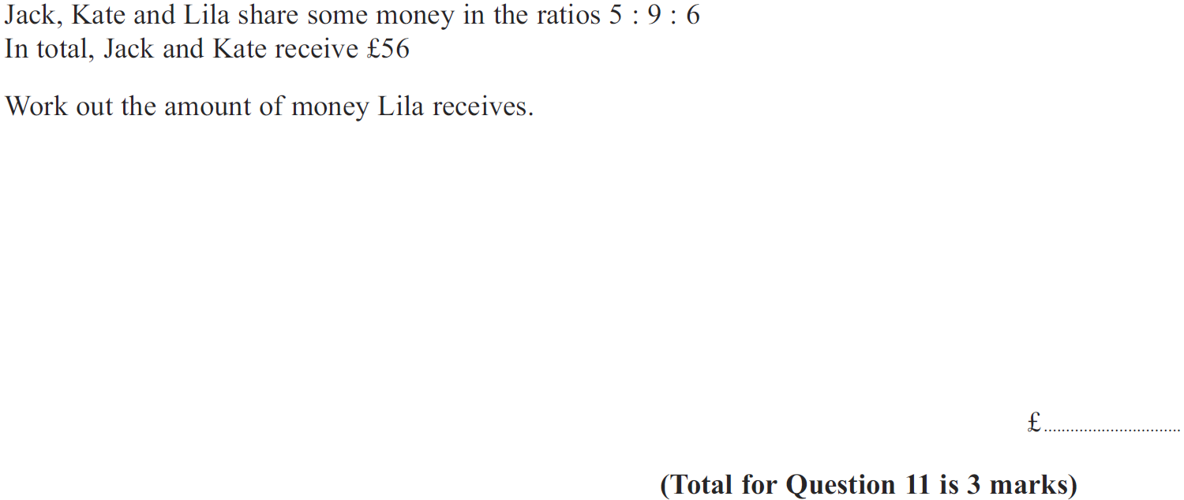
Ratio & Basic Proportion
Jan 2013 4H Q11

Slide 78
Ratio & Basic Proportion
Jan 2013 4H Q11
A

Slide 79
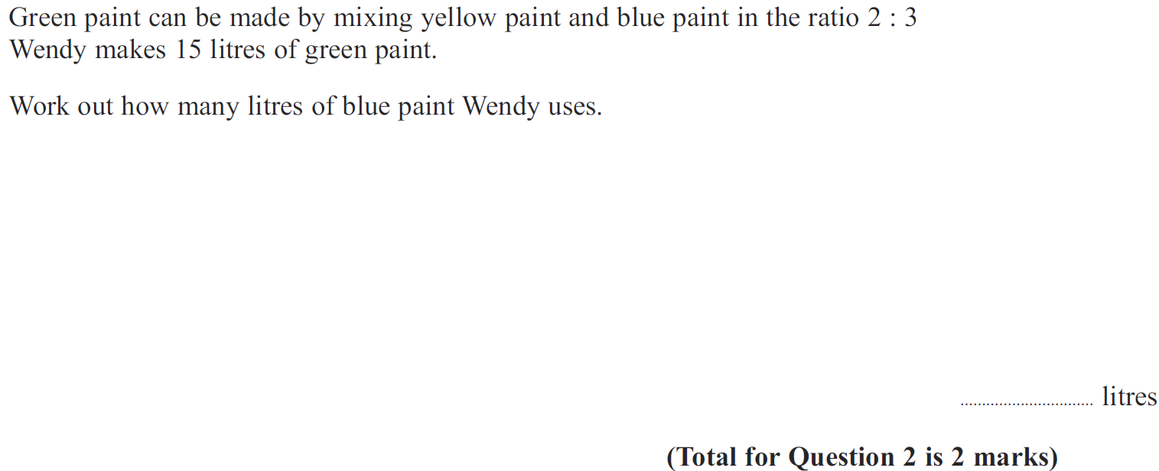
Ratio & Basic Proportion
May 2013 4H Q2

Slide 80
Ratio & Basic Proportion
May 2013 4H Q2
A

Slide 81
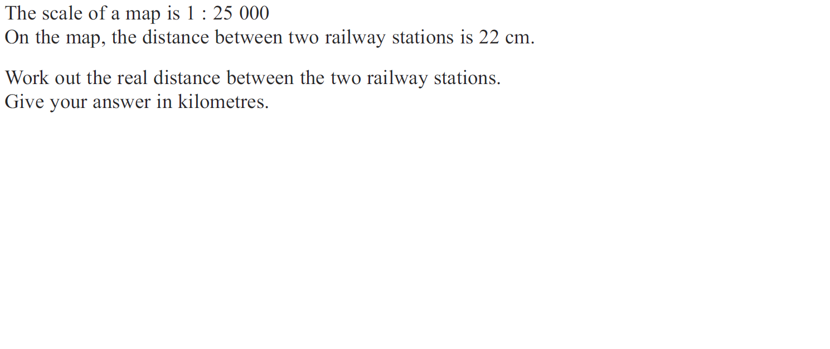
Ratio & Basic Proportion
May 2013 4H Q10

Slide 82
Ratio & Basic Proportion
May 2013 4H Q10
A

Slide 83
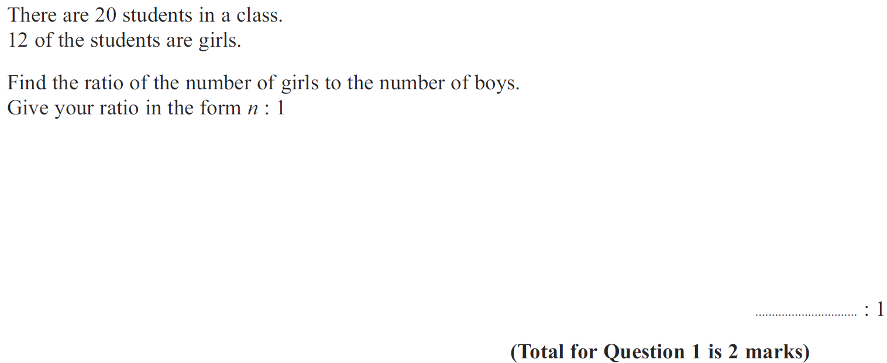
Ratio & Basic Proportion
May 2013 4HR Q1

Slide 84
Ratio & Basic Proportion
May 2013 4HR Q1
A

Slide 85
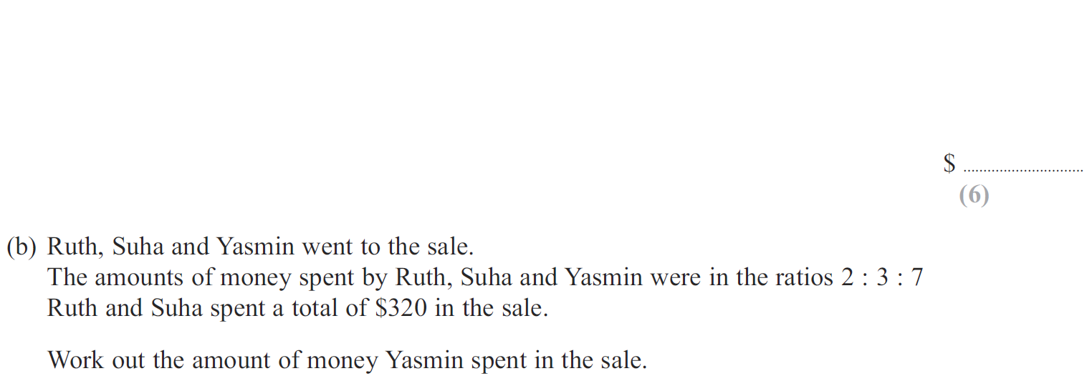
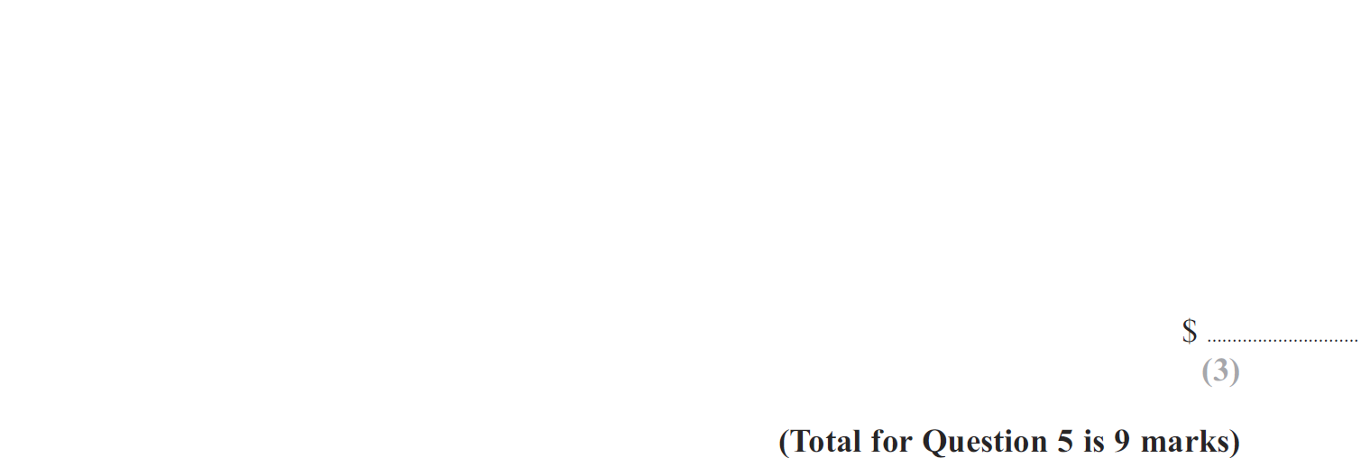
Ratio & Basic Proportion
May 2013 4HR Q5

Slide 86
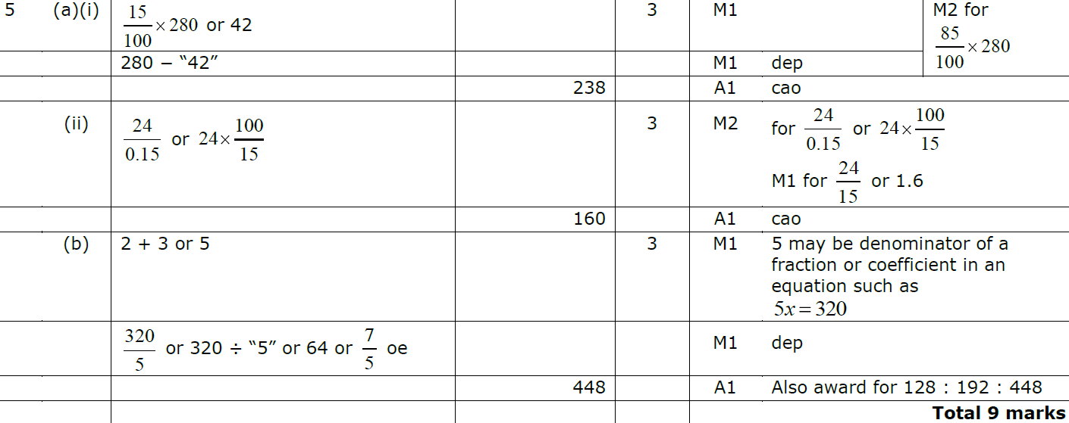
Ratio & Basic Proportion
May 2013 4HR Q5
A (i)
A (ii)
B

Slide 87
Ratio & Basic Proportion
Jan 2014 3H Q1

Slide 88
Ratio & Basic Proportion
Jan 2014 3H Q1
A
B

Slide 89
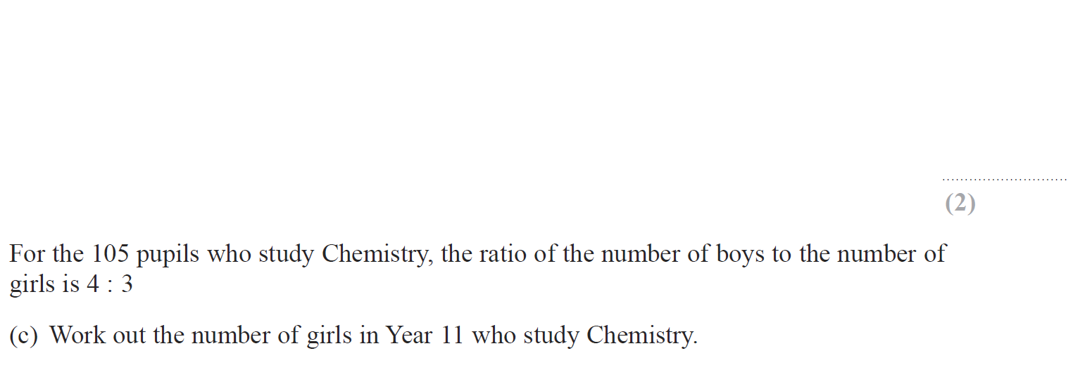
Ratio & Basic Proportion
Jan 2014 4H Q1

Slide 90
Ratio & Basic Proportion
Jan 2014 4H Q1
A
B
C

Slide 91
Ratio & Basic Proportion
Jan 2014 3HR Q2

Slide 92
Ratio & Basic Proportion
Jan 2014 3HR Q2
A
B

Slide 93
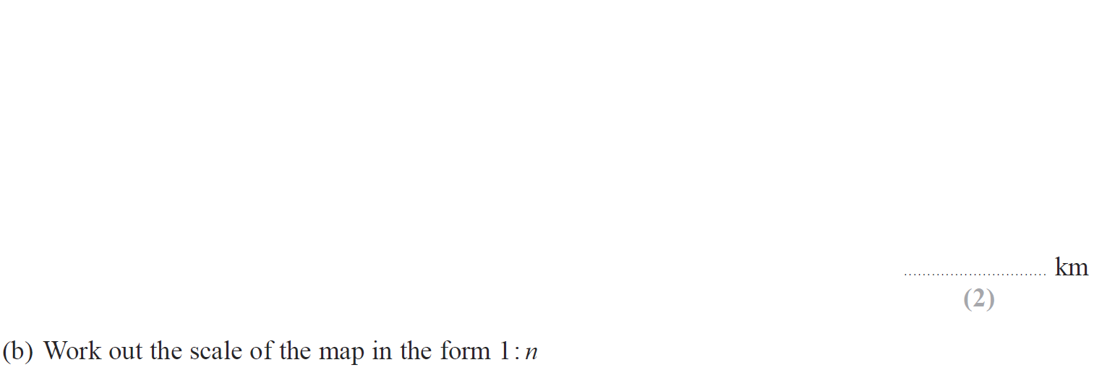
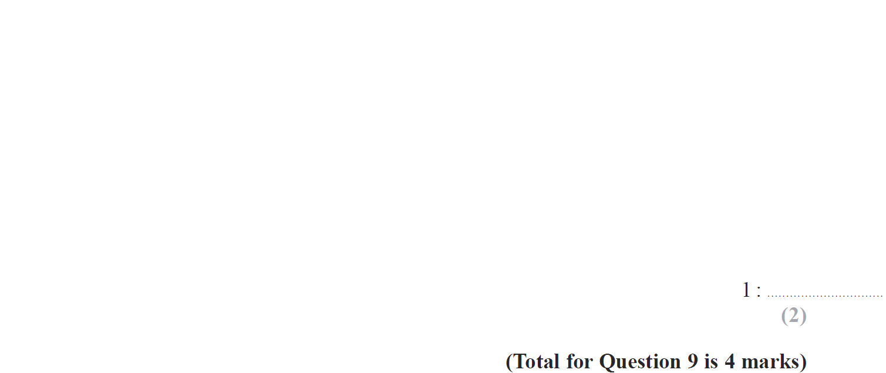
Ratio & Basic Proportion
Jan 2014 4HR Q9

Slide 94
Ratio & Basic Proportion
Jan 2014 4HR Q9
A
B

Slide 95
Ratio & Basic Proportion
May 2014 4H Q1

Slide 96
Ratio & Basic Proportion
May 2014 4H Q1
A

Slide 97
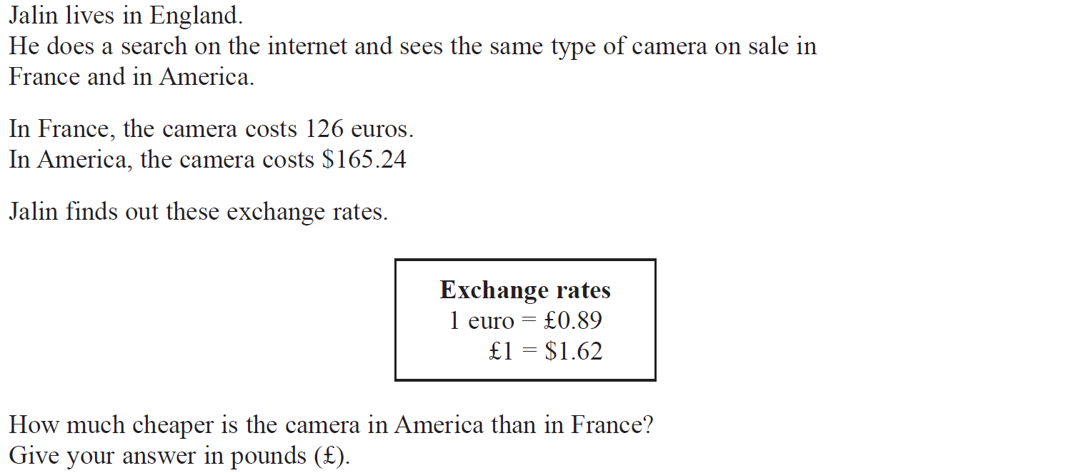
Ratio & Basic Proportion
May 2014 4H Q6

Slide 98
Ratio & Basic Proportion
May 2014 4H Q6
A

Slide 99
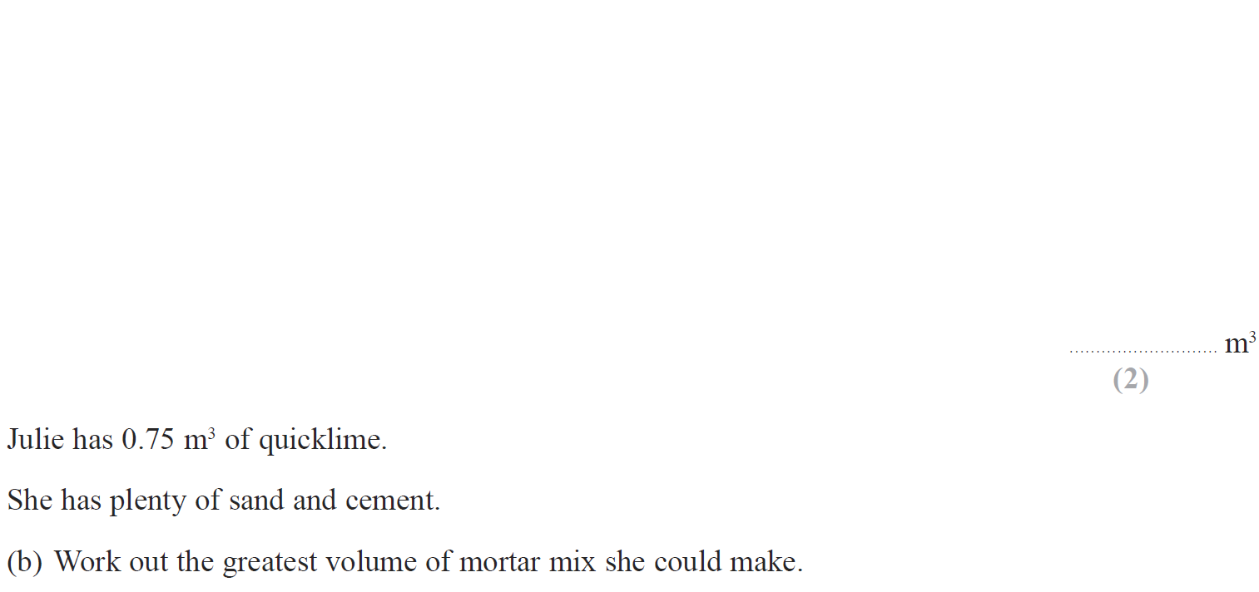
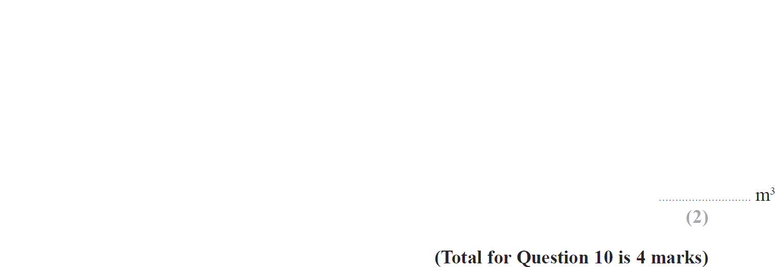
Ratio & Basic Proportion
May 2014 4HR Q10

Slide 100
Ratio & Basic Proportion
May 2014 4HR Q10
A
B

Slide 101
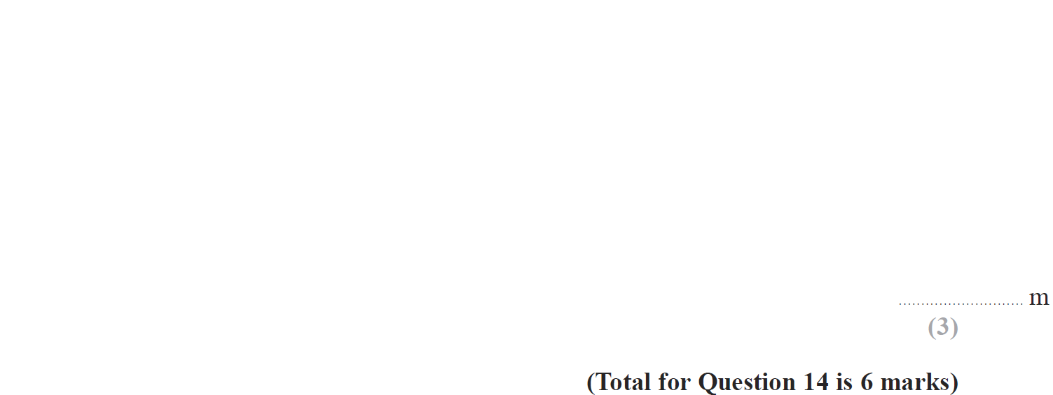
Ratio & Basic Proportion
May 2014 4HR Q14

Slide 102
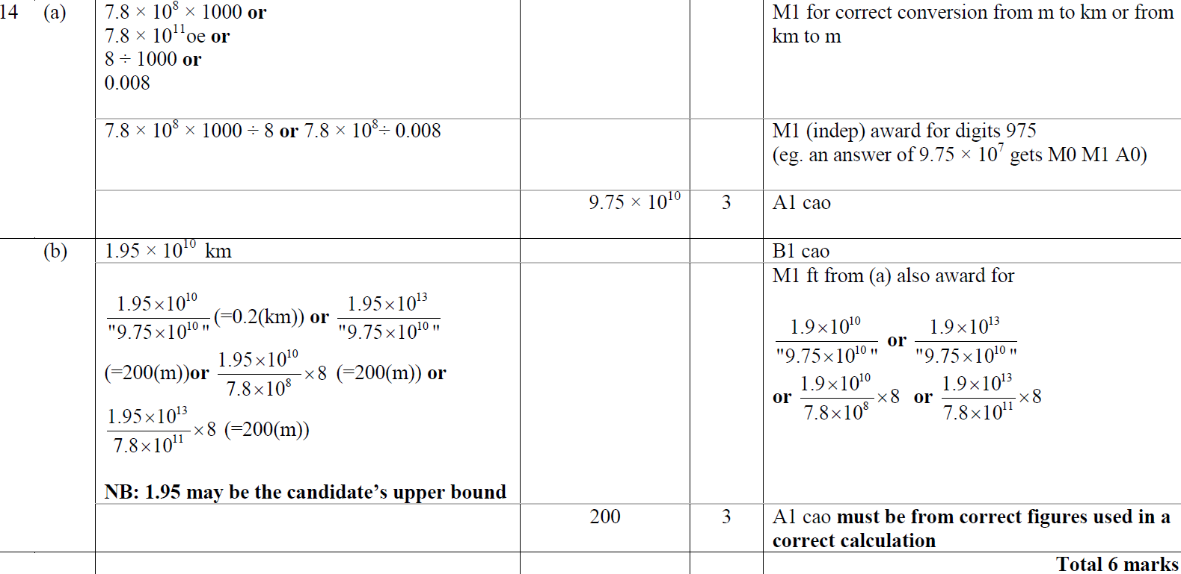
Ratio & Basic Proportion
May 2014 4HR Q14
A
B

Slide 103
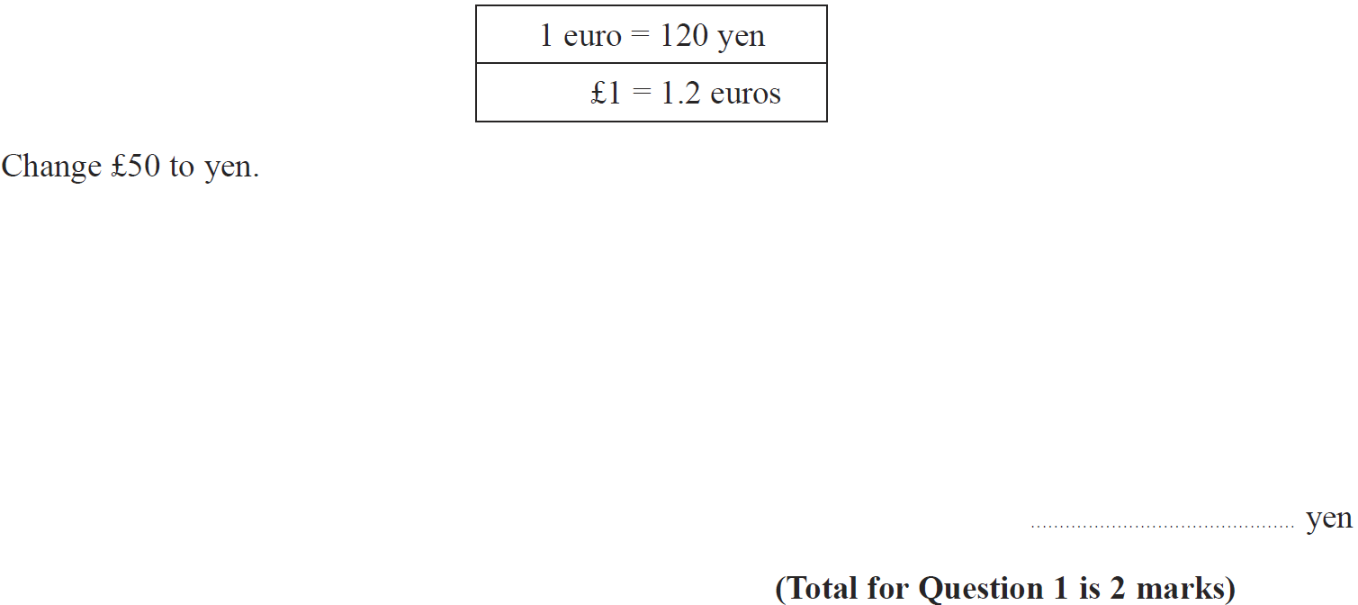
Ratio & Basic Proportion
Jan 2015 3H Q1

Slide 104
Ratio & Basic Proportion
Jan 2015 3H Q1
A

Slide 105
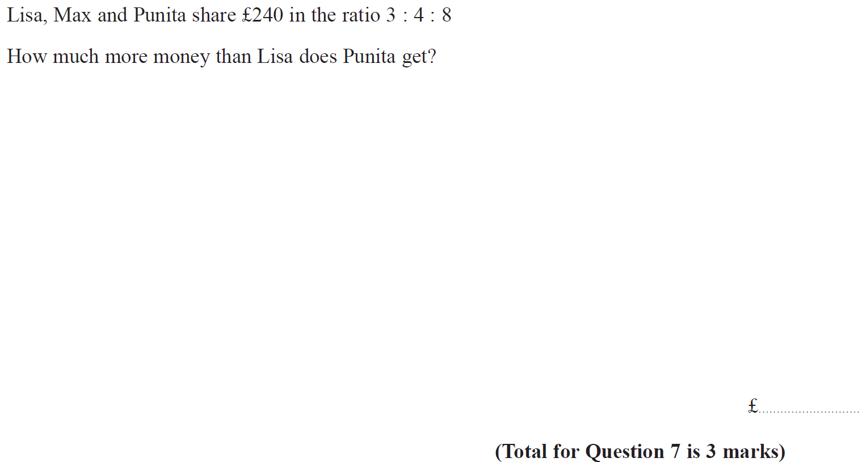
Ratio & Basic Proportion
Jan 2015 4H Q7

Slide 106
Ratio & Basic Proportion
Jan 2015 4H Q7
A

Slide 107
Ratio & Basic Proportion
Jan 2015 3HR Q1

Slide 108
Ratio & Basic Proportion
Jan 2015 3HR Q1
A

Slide 109
Ratio & Basic Proportion
Jan 2015 4HR Q1

Slide 110
Ratio & Basic Proportion
Jan 2015 4HR Q1
A

Slide 111
Ratio & Basic Proportion
May 2015 3H Q1

Slide 112
Ratio & Basic Proportion
May 2015 3H Q1
A

Slide 113
Ratio & Basic Proportion
May 2015 3H Q2

Slide 114
Ratio & Basic Proportion
May 2015 3H Q2
A

Slide 115
Ratio & Basic Proportion
May 2015 3H Q5

Slide 116
Ratio & Basic Proportion
May 2015 3H Q5
A
B

Slide 117
Ratio & Basic Proportion
May 2015 3H Q7

Slide 118
Ratio & Basic Proportion
May 2015 3H Q7
A
B

Slide 119
Ratio & Basic Proportion
June 2015 4H Q2

Slide 120
Ratio & Basic Proportion
June 2015 4H Q2
A

Slide 121
Ratio & Basic Proportion
June 2015 4HR Q8

Slide 122
Ratio & Basic Proportion
June 2015 4HR Q8
A
B
C

Slide 123
Ratio & Basic Proportion
Jan 2016 3H Q1

Slide 124
Ratio & Basic Proportion
Jan 2016 3H Q1
A
B

Slide 125
Ratio & Basic Proportion
Jan 2016 4H Q10

Slide 126
Ratio & Basic Proportion
Jan 2016 4H Q10
A

Slide 127
Ratio & Basic Proportion
Jan 2016 4HR Q1

Slide 128
Ratio & Basic Proportion
Jan 2016 4HR Q1
A
B
C

Slide 129
Ratio & Basic Proportion
May 2016 3H Q1

Slide 130
Ratio & Basic Proportion
May 2016 3H Q1
A
B

Slide 131
Ratio & Basic Proportion
May 2016 3H Q9

Slide 132
Ratio & Basic Proportion
May 2016 3H Q9
A

Slide 133
Ratio & Basic Proportion
May 2016 3HR Q1

Slide 134
Ratio & Basic Proportion
May 2016 3HR Q1
A
B

Slide 135
Ratio & Basic Proportion
June 2016 4HR Q3

Slide 136
Ratio & Basic Proportion
June 2016 4HR Q3
A
B
C

Slide 137
Ratio & Basic Proportion
June 2016 4HR Q8

Slide 138
Ratio & Basic Proportion
June 2016 4HR Q8
A
B

Slide 139
Ratio & Basic Proportion
Jan 2017 3H Q7

Slide 140
Ratio & Basic Proportion
Jan 2017 3H Q7
A

Slide 141
Ratio & Basic Proportion
Jan 2017 4H Q3

Slide 142
Ratio & Basic Proportion
Jan 2017 4H Q3
A

Slide 143
Ratio & Basic Proportion
Jan 2017 3HR Q5

Slide 144
Ratio & Basic Proportion
Jan 2017 3HR Q5
A

Slide 145
Ratio & Basic Proportion
Jan 2017 3HR Q8

Slide 146
Ratio & Basic Proportion
Jan 2017 3HR Q8
A
B

Slide 147
Ratio & Basic Proportion
Jan 2017 4HR Q1

Slide 148
Ratio & Basic Proportion
Jan 2017 4HR Q1
A
B

Slide 149
Ratio & Basic Proportion
May 2017 3H Q3

Slide 150
Ratio & Basic Proportion
May 2017 3H Q3
A
B

Slide 151
Ratio & Basic Proportion
June 2017 4H Q3

Slide 152
Ratio & Basic Proportion
June 2017 4H Q3
A
B

Slide 153
Ratio & Basic Proportion
June 2017 4H Q9

Slide 154
Ratio & Basic Proportion
June 2017 4H Q9
A

Slide 155
Ratio & Basic Proportion
May 2017 3HR Q4

Slide 156
Ratio & Basic Proportion
May 2017 3HR Q4
A
B
C

Slide 157
Ratio & Basic Proportion
June 2017 4HR Q1

Slide 158
Ratio & Basic Proportion
June 2017 4HR Q1
A
B

Slide 159
Ratio & Basic Proportion
Jan 2018 3H Q1

Slide 160
Ratio & Basic Proportion
Jan 2018 3H Q1
A
B

Slide 161
Ratio & Basic Proportion
Jan 2018 3HR Q3

Slide 162
Ratio & Basic Proportion
Jan 2018 3HR Q3
A

Slide 163
Ratio & Basic Proportion
Jan 2018 3HR Q8

Slide 164
Ratio & Basic Proportion
Jan 2018 3HR Q8
A

Slide 165
Ratio & Basic Proportion
Jan 2018 4HR Q4

Slide 166
Ratio & Basic Proportion
Jan 2018 4HR Q4
A

Slide 167
Ratio & Basic Proportion
Jan 2018 4HR Q10

Slide 168
Ratio & Basic Proportion
Jan 2018 4HR Q10
A
B
C
D

Slide 169
Ratio & Basic Proportion
May 2018 3H Q2

Slide 170
Ratio & Basic Proportion
May 2018 3H Q2
A

Slide 171
Ratio & Basic Proportion
June 2018 4H Q5

Slide 172
Ratio & Basic Proportion
June 2018 4H Q5
A
B
C

Slide 173
Ratio & Basic Proportion
May 2018 3HR Q4

Slide 174
Ratio & Basic Proportion
May 2018 3HR Q4
A

