Slide 1
Pythagoras
Pythagoras
Old Spec Q’s
SAM
1H Q10
June 2019
2H Q14
SAM
2H Q23
June 2019
2H Q21
May 2018
1H Q6
June 2018
2H Q19
June 2018
2HR Q8
Jan 2019
1H Q8
Jan 2019
1HR Q3
Jan 2019
1HR Q20
May 2019
1H Q9
3D
*May use Trigonometry instead

Slide 2
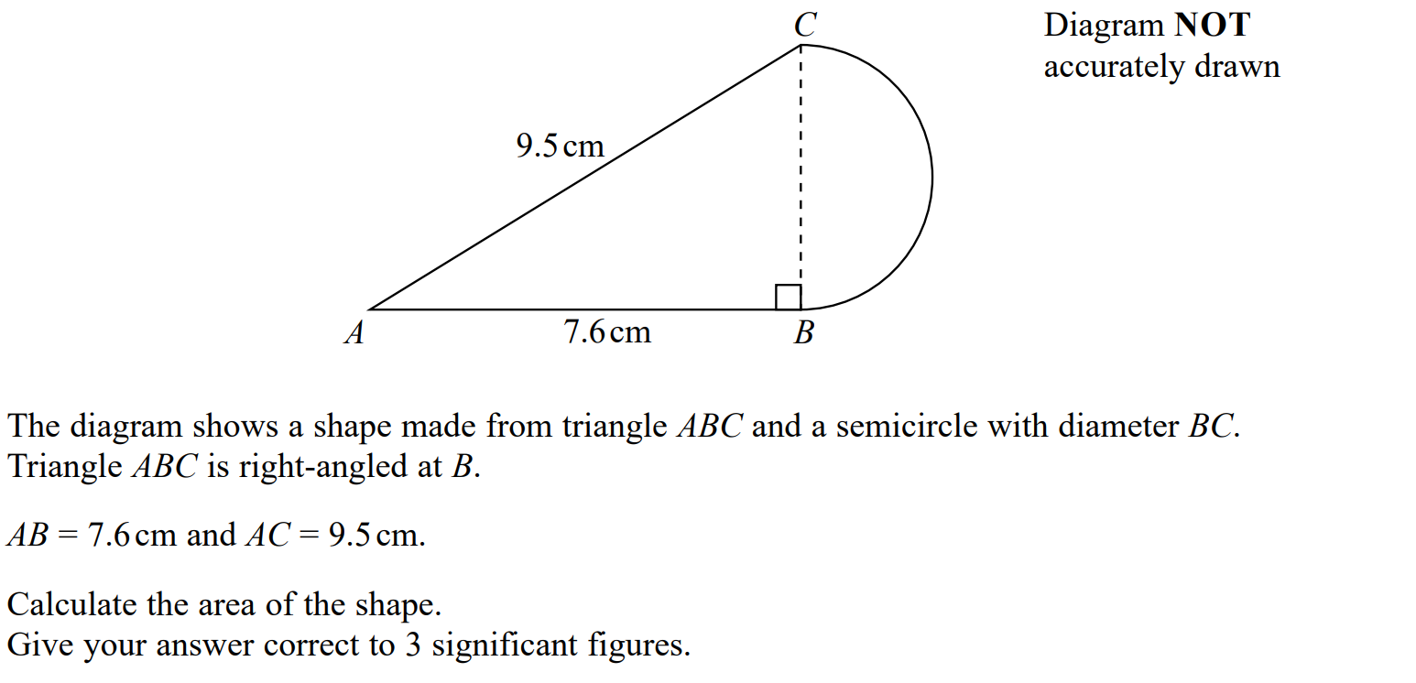
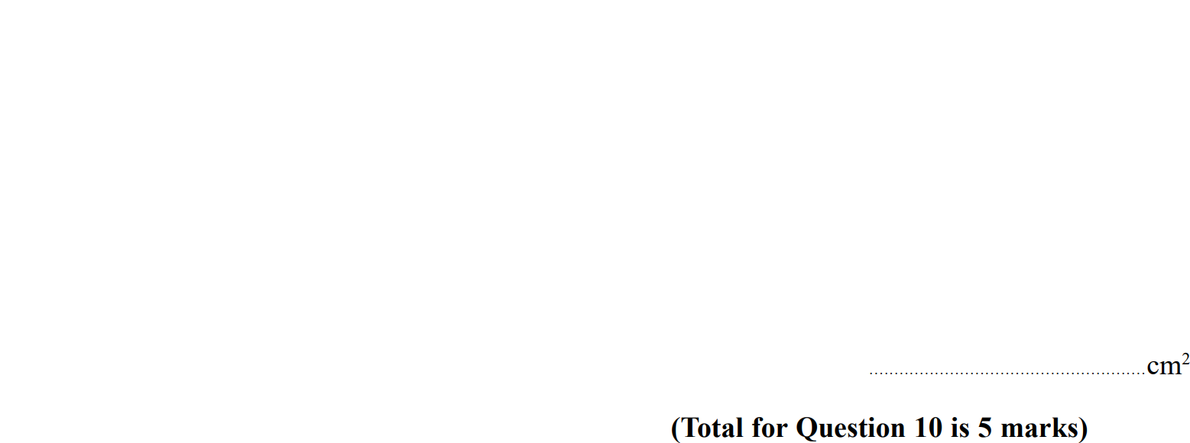
Pythagoras
SAM 1H Q10

Slide 3
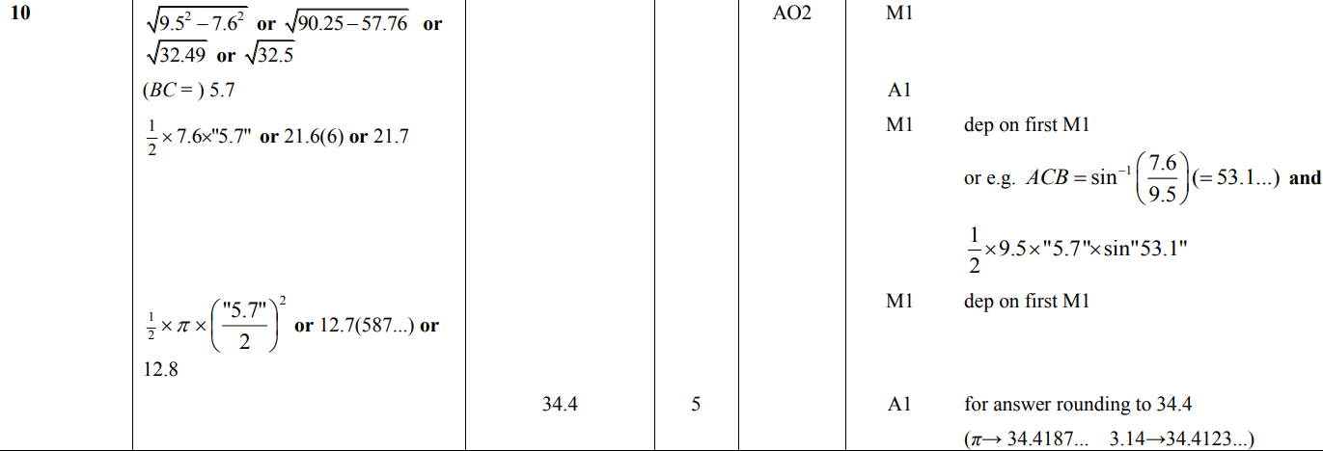
Pythagoras
SAM 1H Q10
A

Slide 4
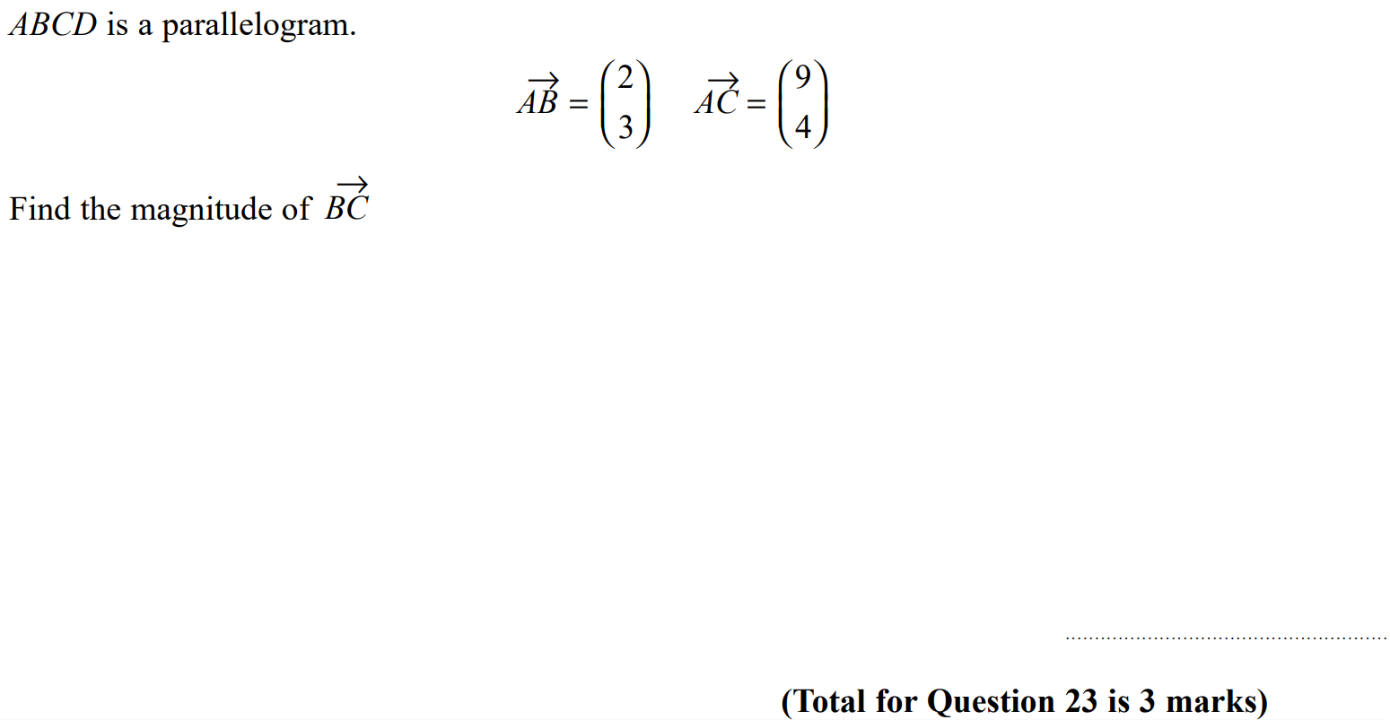
Pythagoras
SAM 2H Q23

Slide 5
Pythagoras
SAM 2H Q23
A

Slide 6
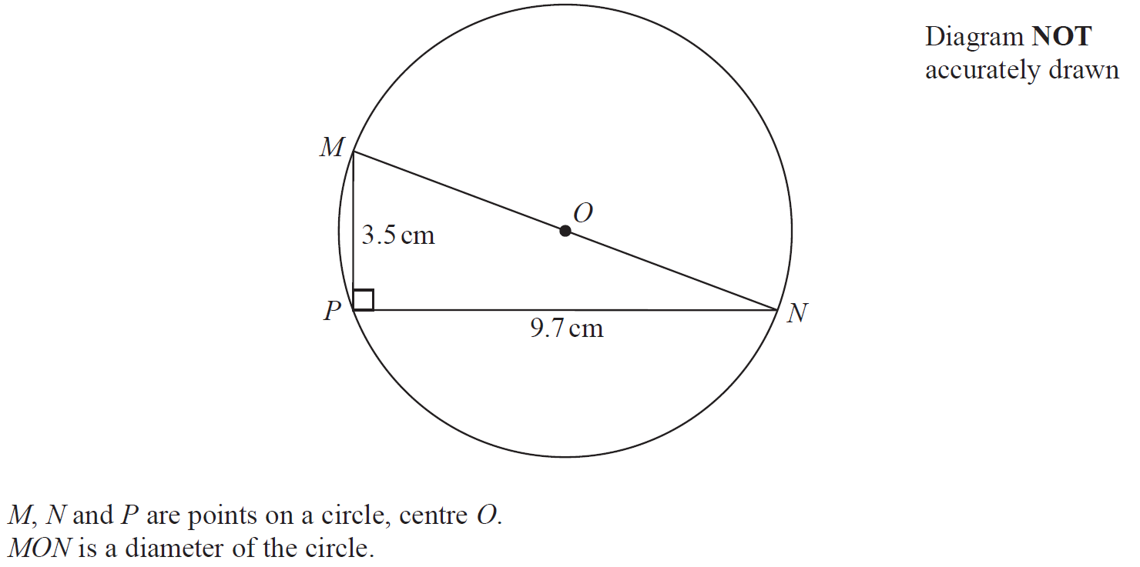
Pythagoras
May 2018 1H Q6

Slide 7
Pythagoras
May 2018 1H Q6
A

Slide 8
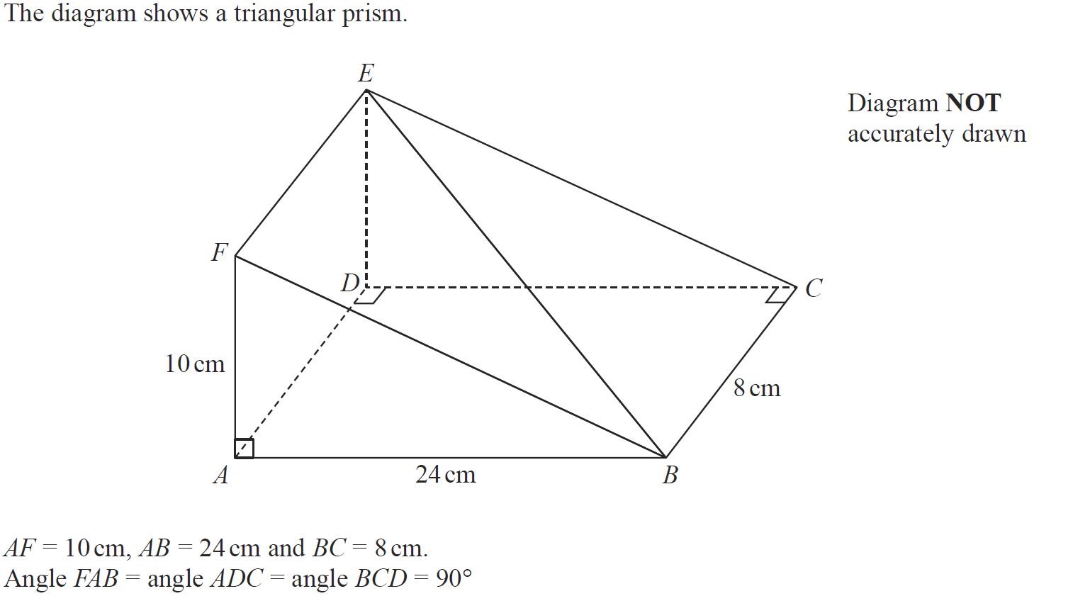
Pythagoras
June 2018 2H Q19

Slide 9
Pythagoras
June 2018 2H Q19
A

Slide 10
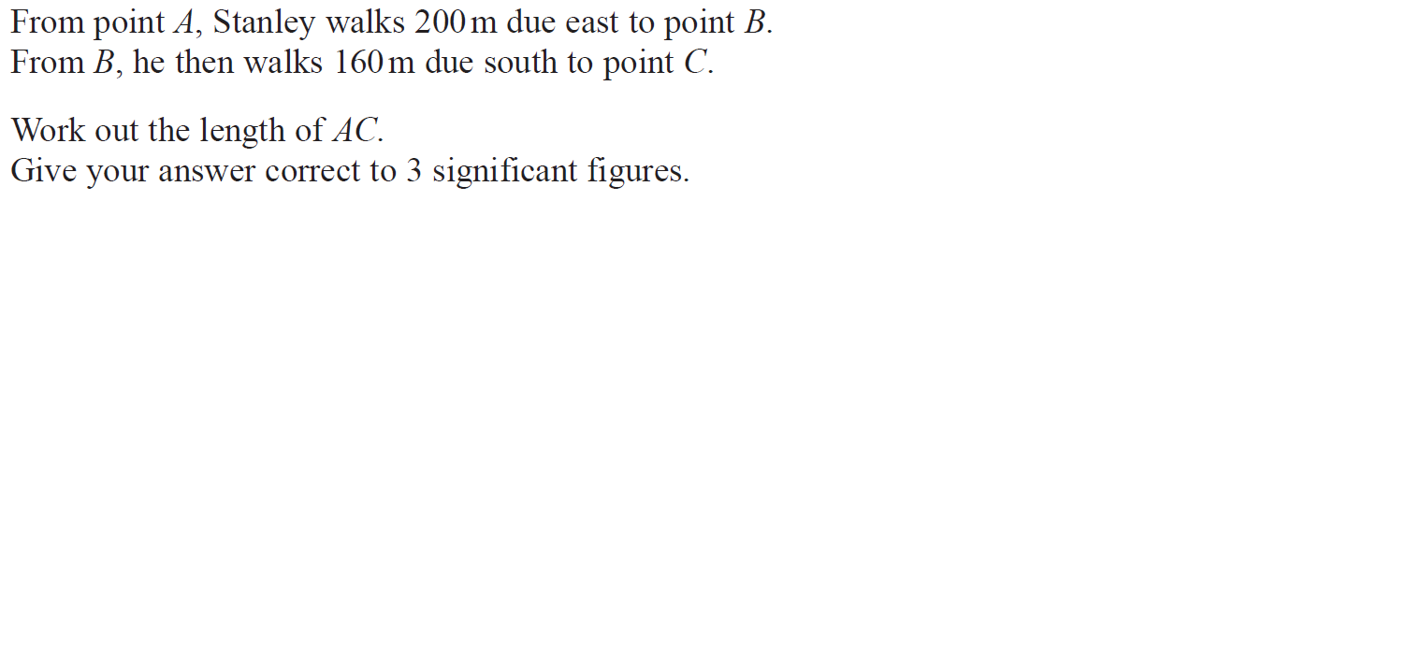
Pythagoras
June 2018 2HR Q8

Slide 11
Pythagoras
June 2018 2HR Q8
A

Slide 12
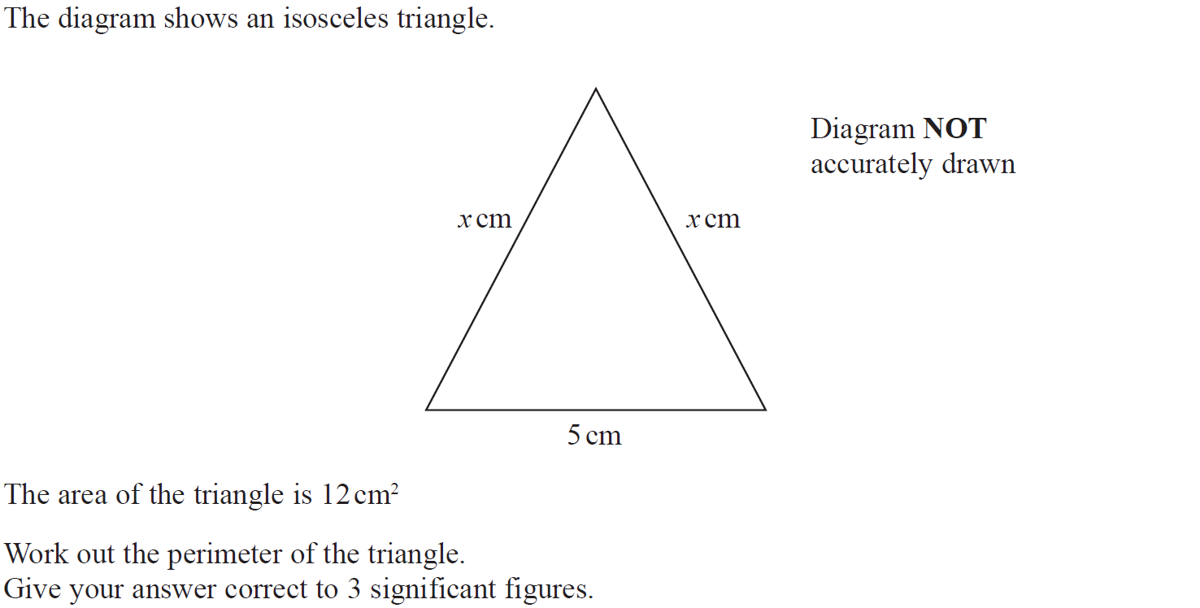
Pythagoras
Jan 2019 1H Q8

Slide 13
Pythagoras
Jan 2019 1H Q8
A

Slide 14
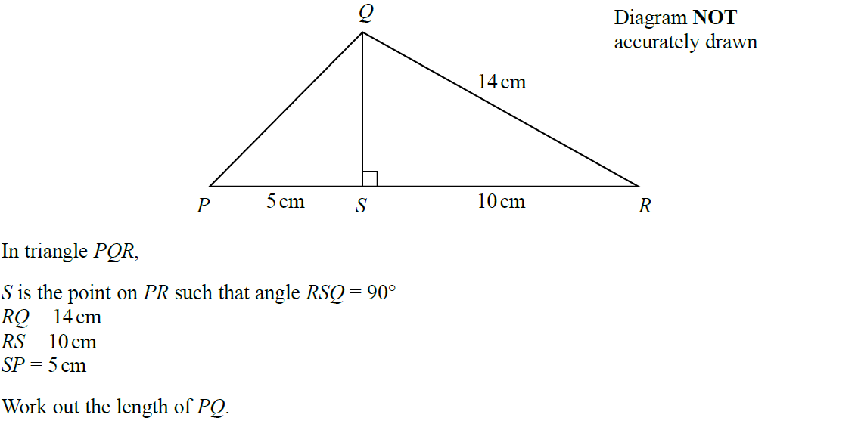
Pythagoras
Jan 2019 1HR Q3

Slide 15
Pythagoras
Jan 2019 1HR Q3
A

Slide 16
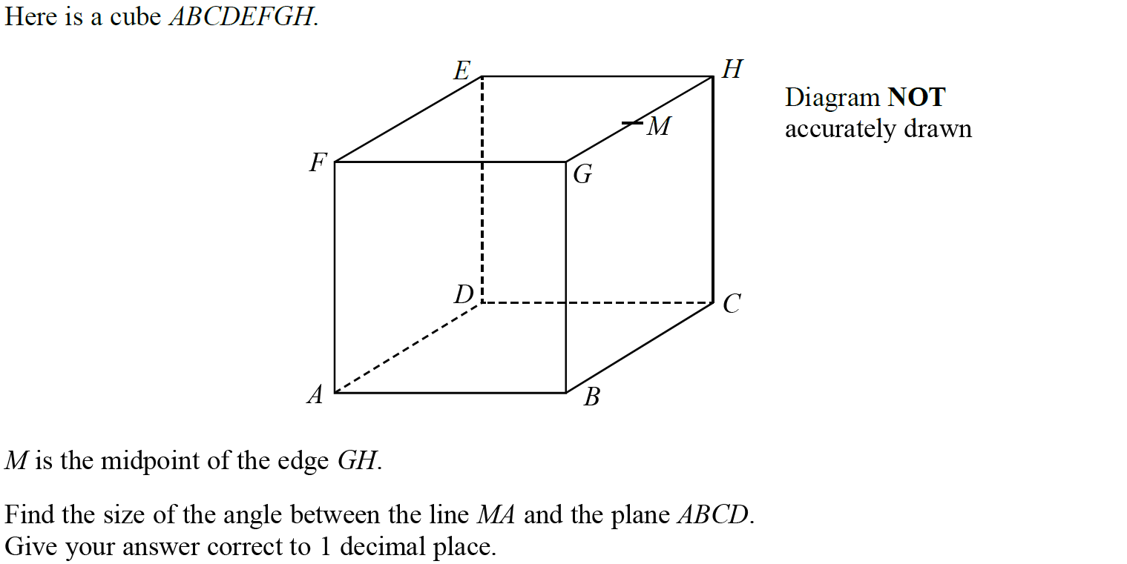
Pythagoras
Jan 2019 1HR Q20

Slide 17
Pythagoras
Jan 2019 1HR Q20
A

Slide 18
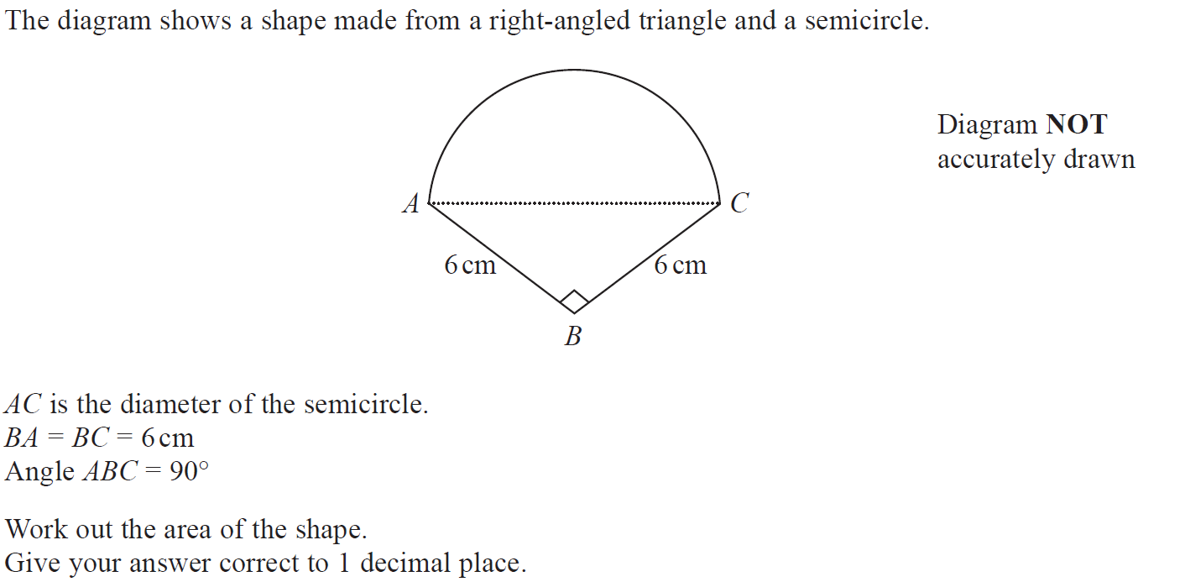
Pythagoras
May 2019 1H Q9

Slide 19
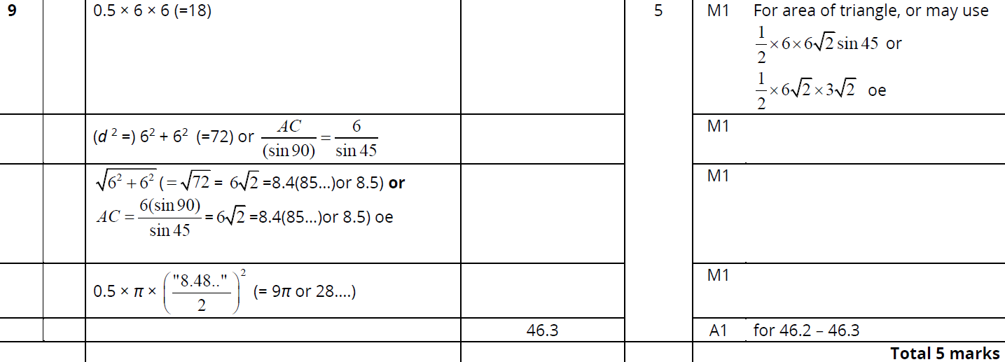
Pythagoras
May 2019 1H Q9
A

Slide 20
Pythagoras
June 2019 2H Q14

Slide 21
Pythagoras
June 2019 2H Q14
A

Slide 22
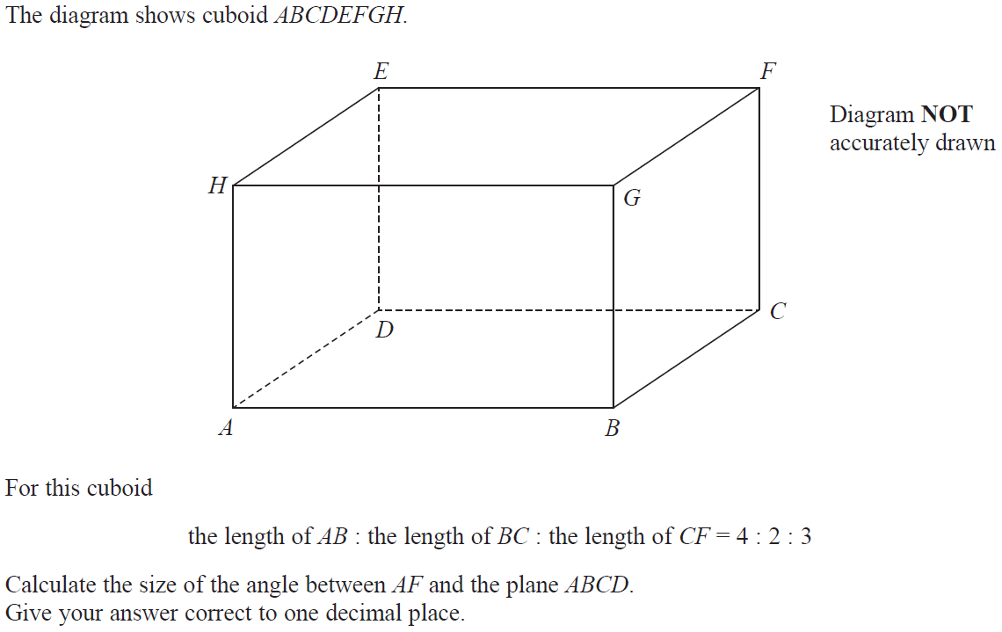
Pythagoras
June 2019 2H Q21

Slide 23
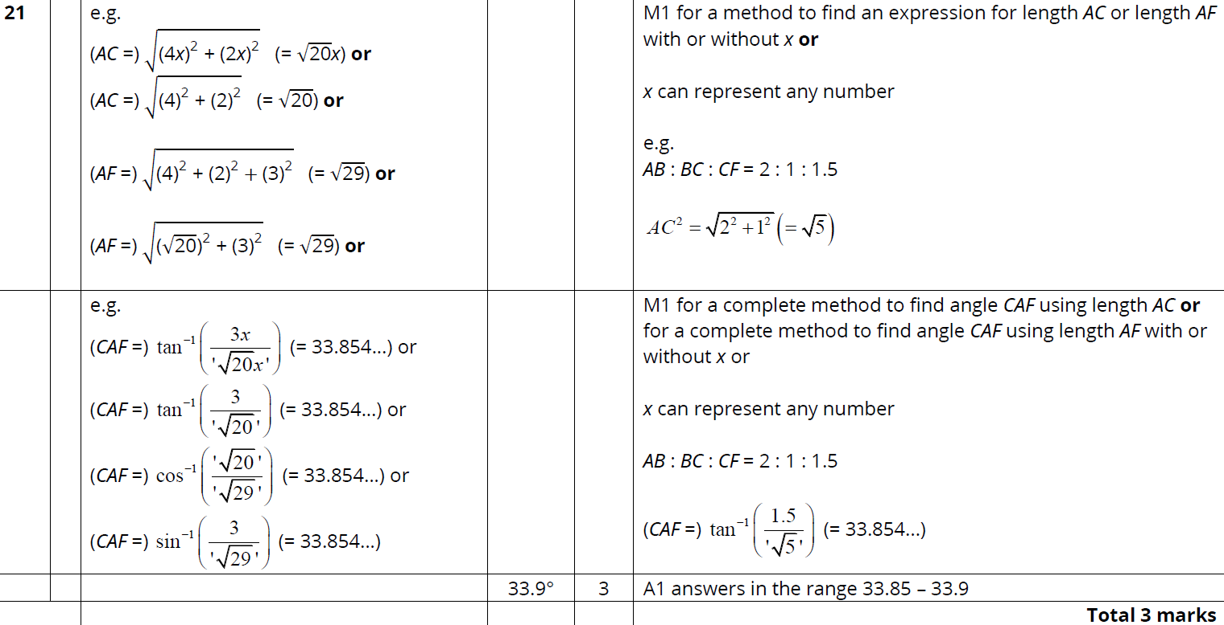
Pythagoras
June 2019 2H Q21
A

Slide 24
Pythagoras
Pythagoras
New Spec Q’s
May 2004
3H Q6
Nov 2006
3H Q9
June 2009
4H Q8
May 2012 3H Q4
Jan 2014 3HR Q7
Jan 2015 3H Q21
May 2016 3H Q22
June 2017 4HR Q22
May 2004
4H Q20
Nov 2006
4H Q14
June 2009
4H Q20
Jan 2013 3H Q11
Jan 2014 3HR Q17
Jan 2015 4H Q19
June 2016 4H Q9
Jan 2018 3H Q6
Nov 2004
3H Q1
Nov 2006
4H Q25
Nov 2009
3H Q12
Jan 2013 3H Q21
Jan 2014 4HR Q18
Jan 2015 4HR Q7
May 2016 3HR Q13
Jan 2018 4H Q11
Nov 2004
4H Q18
May 2007
4H Q9
Nov 2009
4H Q18
Jan 2013 4H Q9
May 2014 3H Q9
Jan 2015 4HR Q15
June 2016 4HR Q17
Jan 2018 3HR Q11
May 2005
3H Q16
Nov 2007
3H Q12
June 2010
3H Q20
May 2013 3H Q20
May 2014 3H Q13
May 2015 3H Q8
Jan 2017 4H Q9
Jan 2018 4HR Q17
May 2005
4H Q7
Nov 2007
4H Q12
June 2010
4H Q5
May 2013 4H Q7
May 2014 4H Q8
May 2015 3H Q23
Jan 2017 4H Q15
May 2018 3H Q7
Nov 2005
3H Q14
May 2008
3H Q22*
Nov 2010
3H Q8
May 2013 4H Q22
May 2014 4H Q23
May 2015 3HR Q7
Jan 2017 3HR Q10
May 2018 3HR Q10
Nov 2005
4H Q11
May 2008
4H Q10
June 2011 4H Q6
May 2013 3HR Q24
May 2014 3HR Q3
Jan 2016 3H Q22
Jan 2017 4HR Q6
June 2018 4HR Q23
Nov 2005
4H Q21
Nov 2008
3H Q20
June 2011 4H Q22
May 2013 4HR Q8
May 2014 3HR Q18
Jan 2016 3HR Q5
May 2017 3H Q21
May 2006
3H Q7
Nov 2008
4H Q7
Jan 2012 3H Q21
Jan 2014 3H Q12
May 2014 4HR Q20
Jan 2016 4HR Q21
June 2017 4H Q11
May 2006
4H Q9
May 2009
3H Q9
Jan 2012 4H Q9
Jan 2014 4H Q23
Jan 2015 3H Q8
May 2016 3H Q16
June 2017 4HR Q8
3D
*May use Trigonometry instead

Slide 25
Pythagoras
May 2004 3H Q6

Slide 26
Pythagoras
May 2004 3H Q6
A
B

Slide 27
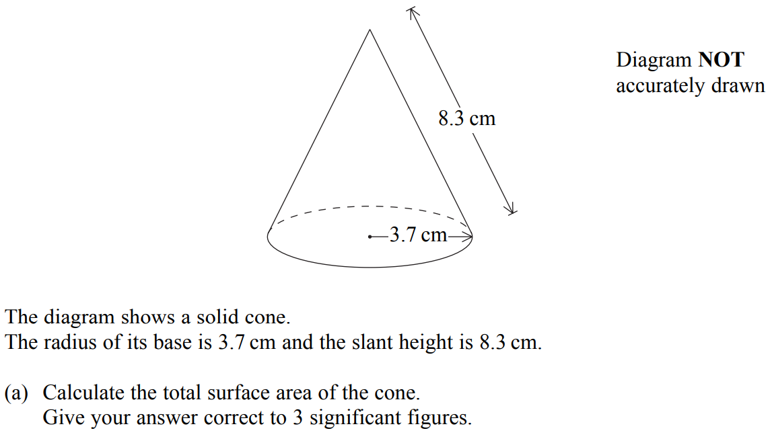
Pythagoras
May 2004 4H Q20

Slide 28
Pythagoras
May 2004 4H Q20
A
B

Slide 29
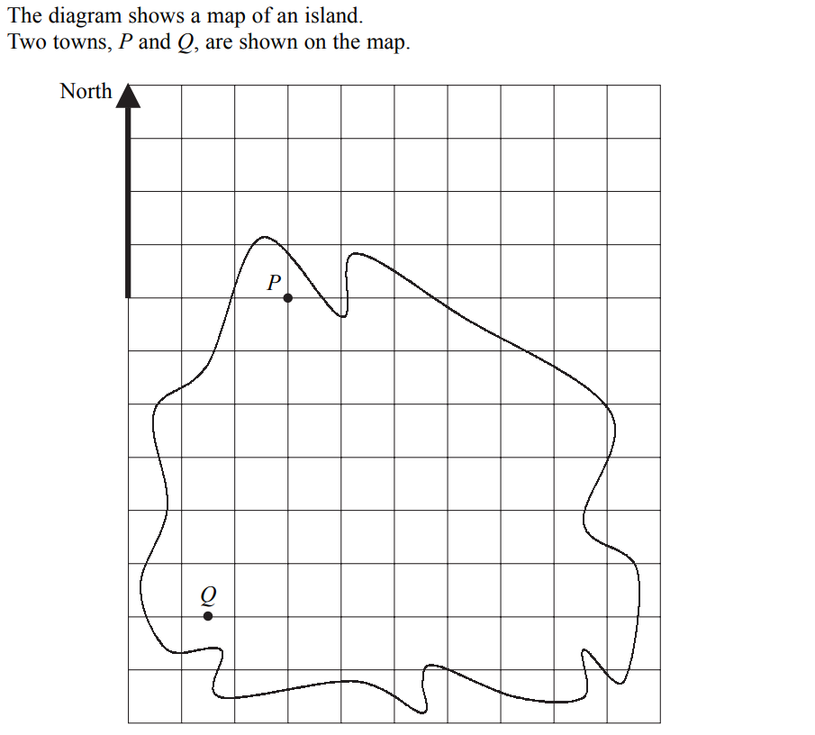
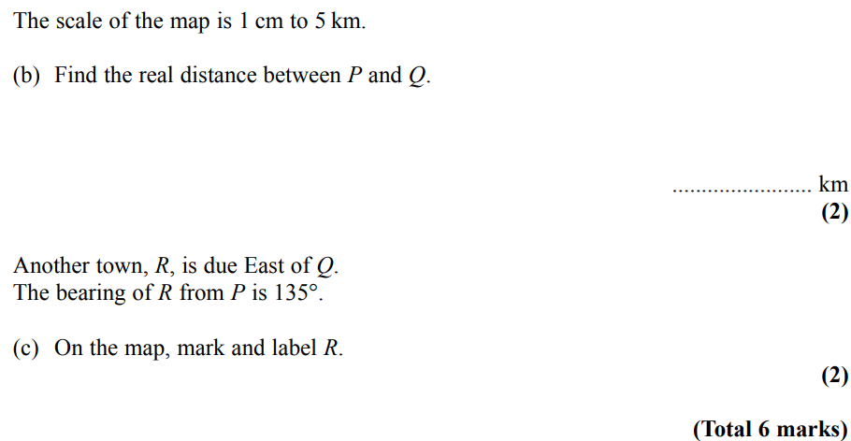
Pythagoras
Nov 2004 3H Q1
*Note that the intension of this question was for it to be physically measured

Slide 30
Pythagoras
Nov 2004 3H Q1
A
B
C

Slide 31
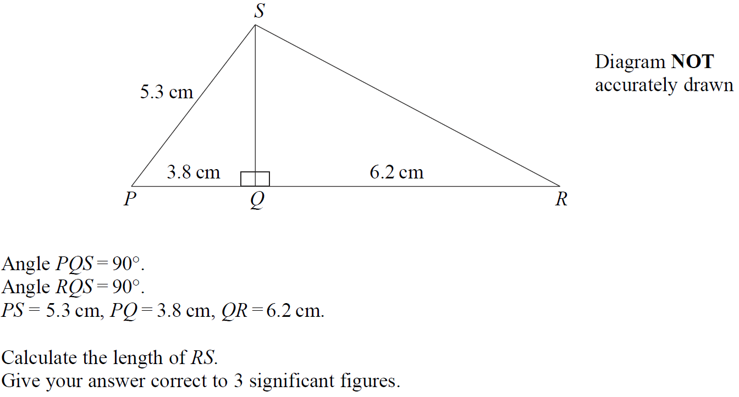
Pythagoras
Nov 2004 4H Q18

Slide 32
Pythagoras
Nov 2004 4H Q18
A

Slide 33
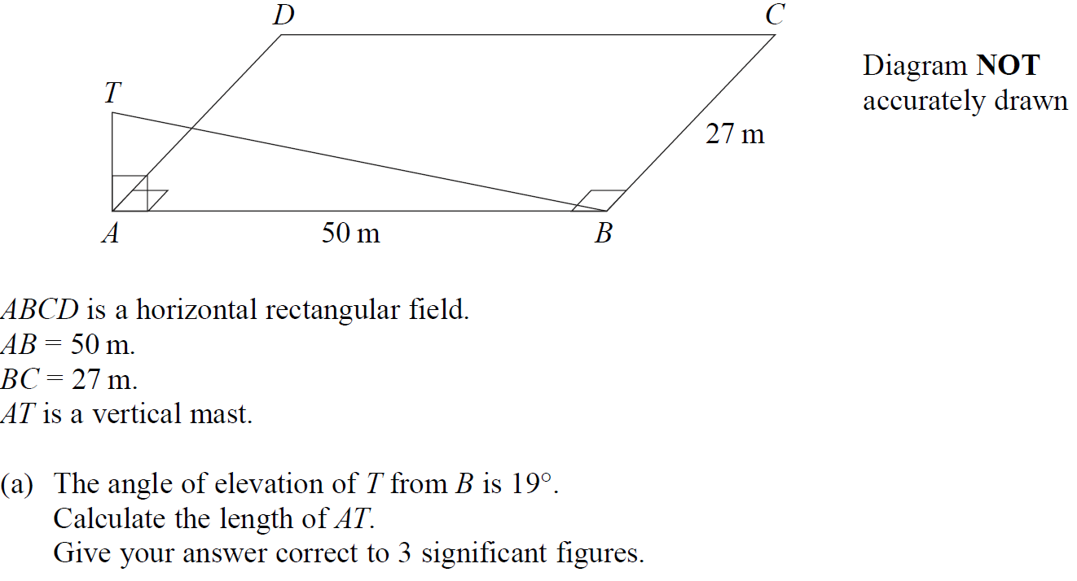
Pythagoras
May 2005 3H Q16

Slide 34
Pythagoras
May 2005 3H Q16
A
B

Slide 35
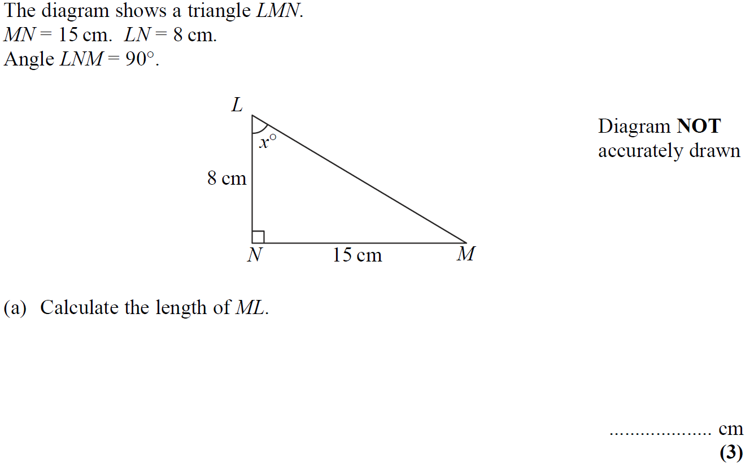
Pythagoras
May 2005 4H Q7

Slide 36
Pythagoras
May 2005 4H Q7
A
B

Slide 37
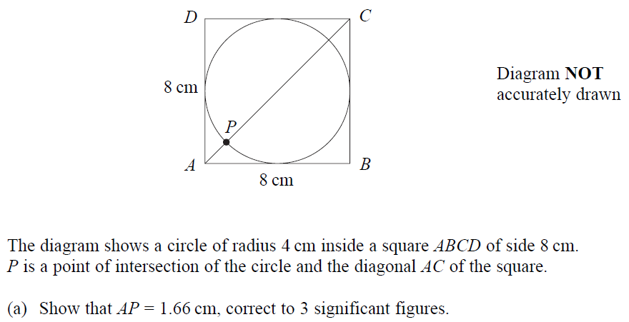
Pythagoras
Nov 2005 3H Q14

Slide 38
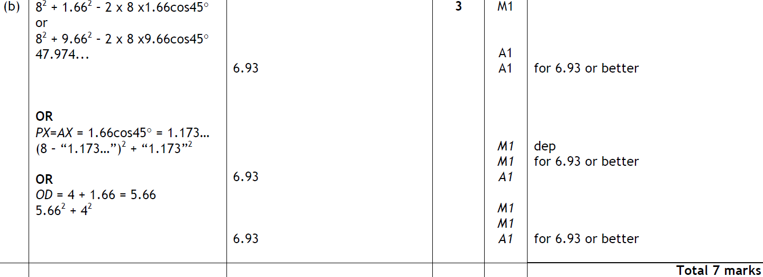
Pythagoras
Nov 2005 3H Q14
A
B

Slide 39
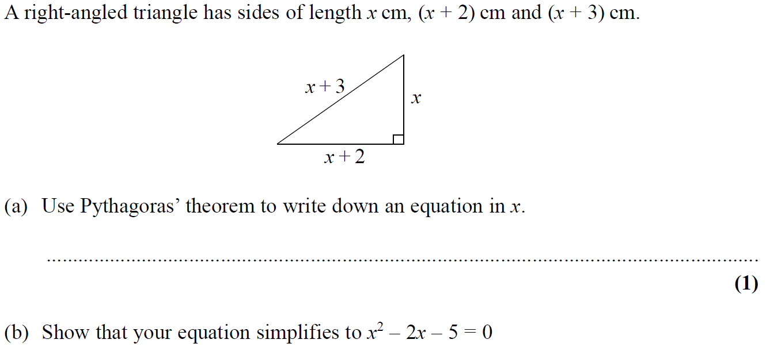
Pythagoras
Nov 2005 4H Q11

Slide 40
Pythagoras
Nov 2005 4H Q11
A
B
C

Slide 41
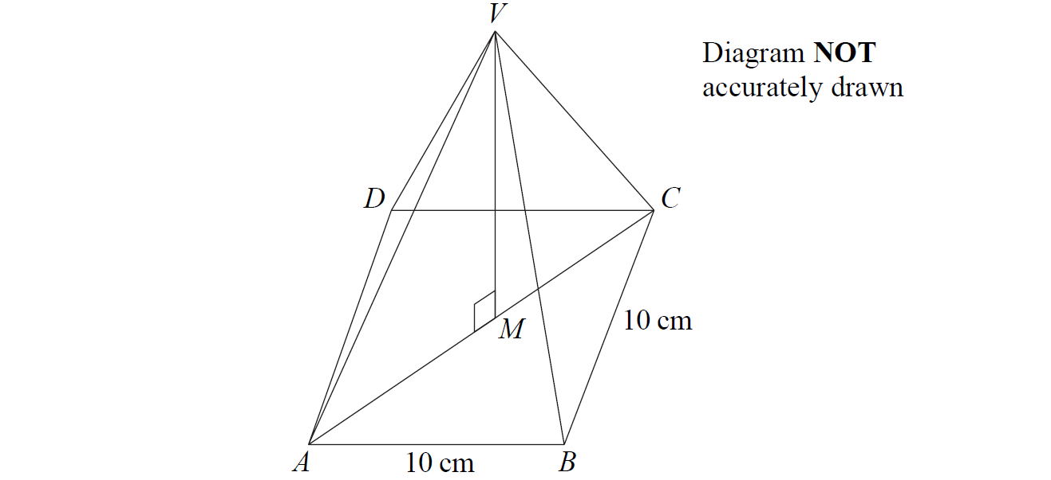
Pythagoras
Nov 2005 4H Q21

Slide 42
Pythagoras
Nov 2005 4H Q21
A

Slide 43
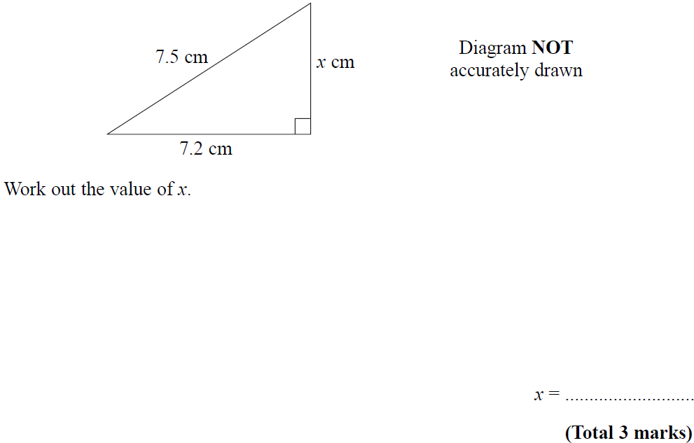
Pythagoras
May 2006 3H Q7

Slide 44
Pythagoras
May 2006 3H Q7
A

Slide 45
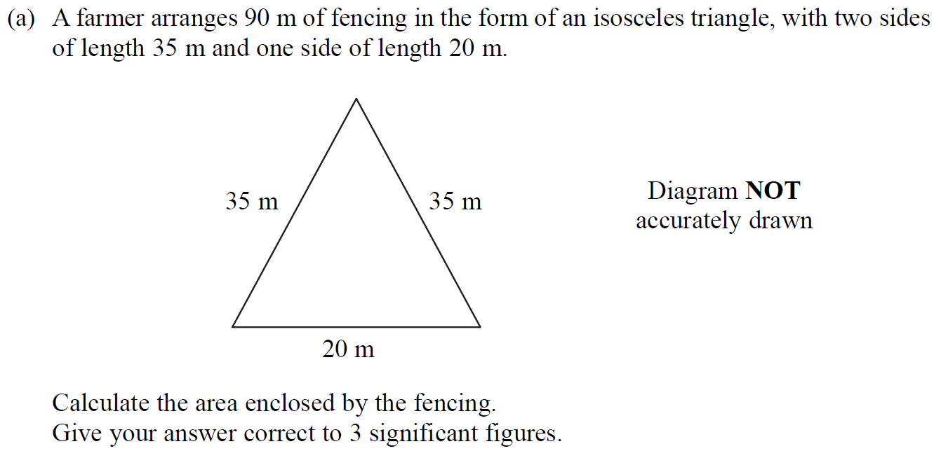
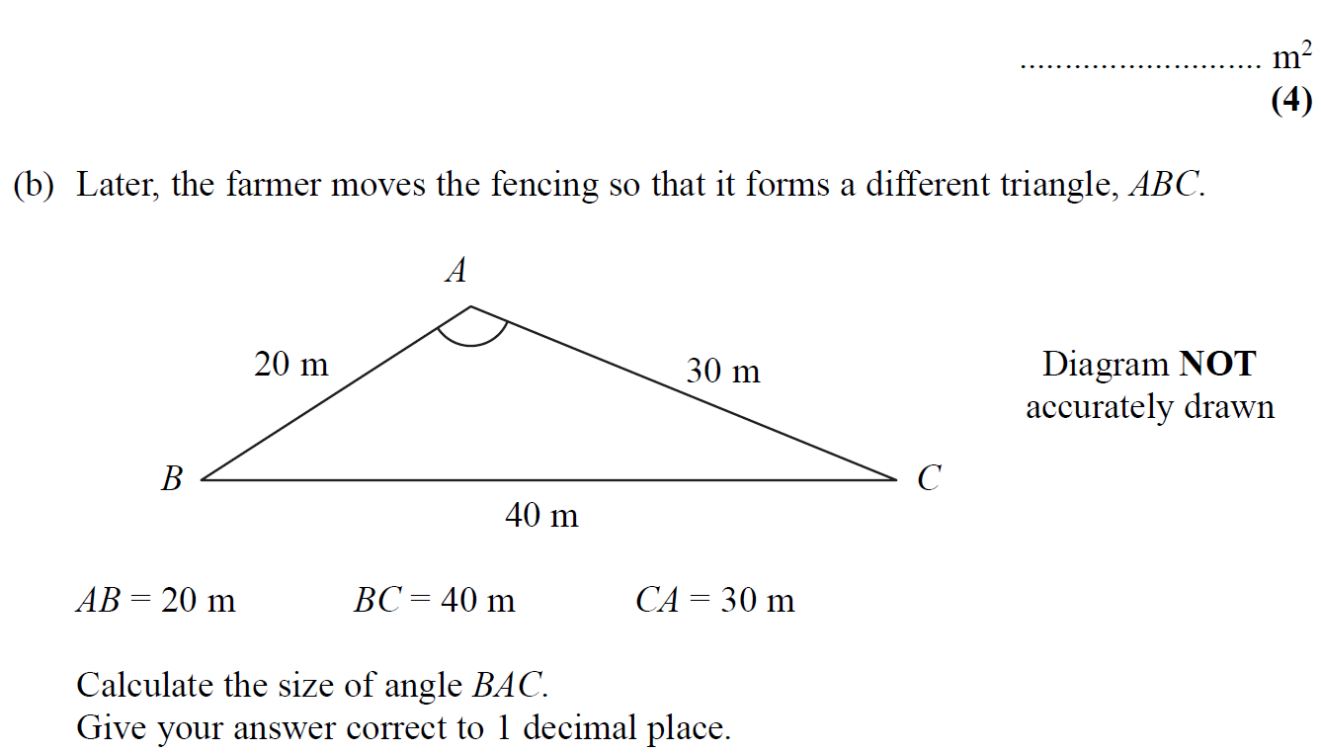
Pythagoras
May 2006 4H Q9

Slide 46
Pythagoras
May 2006 4H Q9
A
B

Slide 47
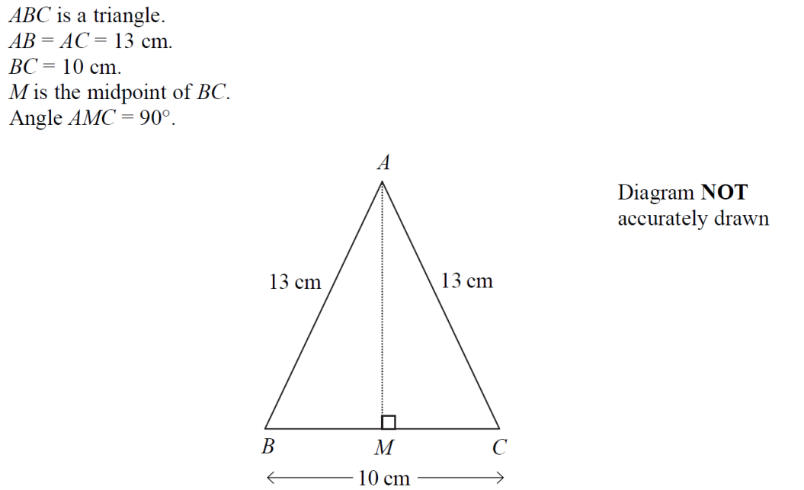
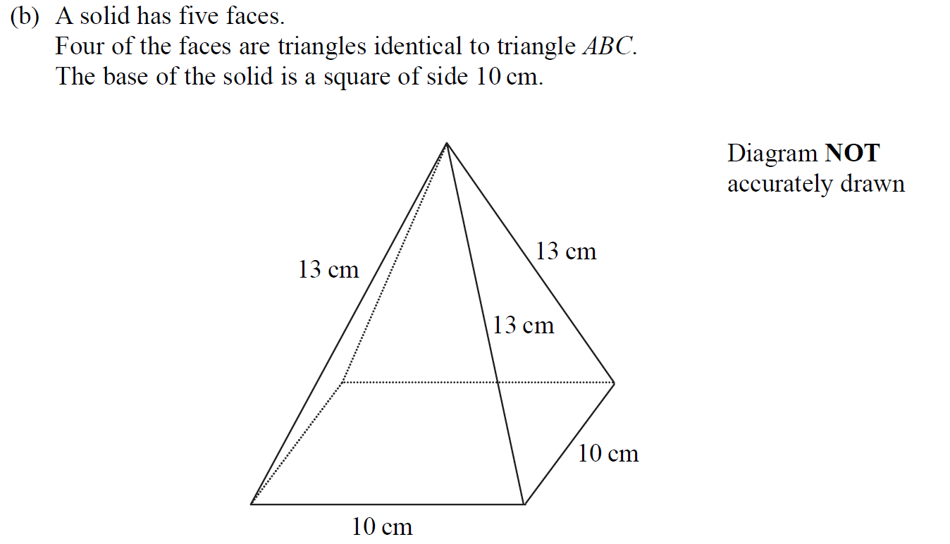
Pythagoras
Nov 2006 3H Q9

Slide 48
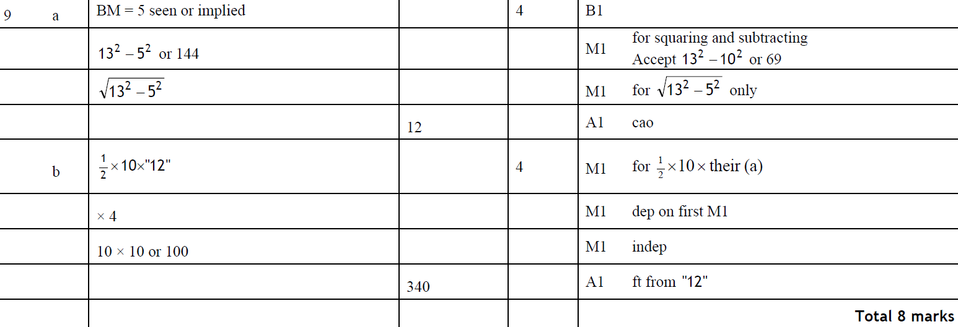
Pythagoras
Nov 2006 3H Q9
A
B

Slide 49
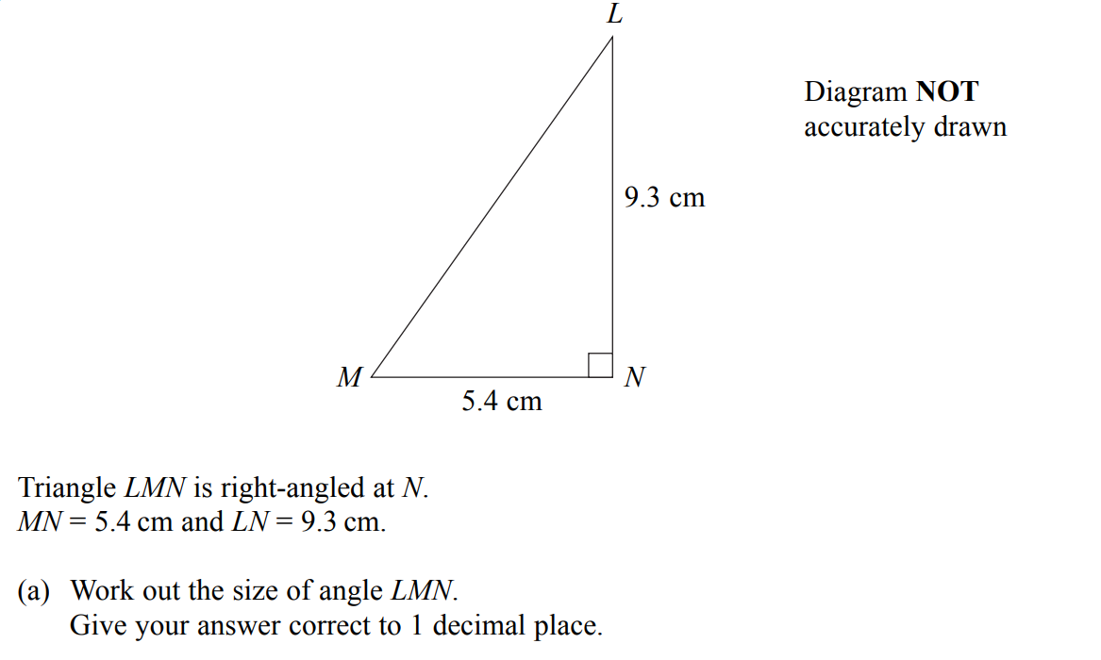
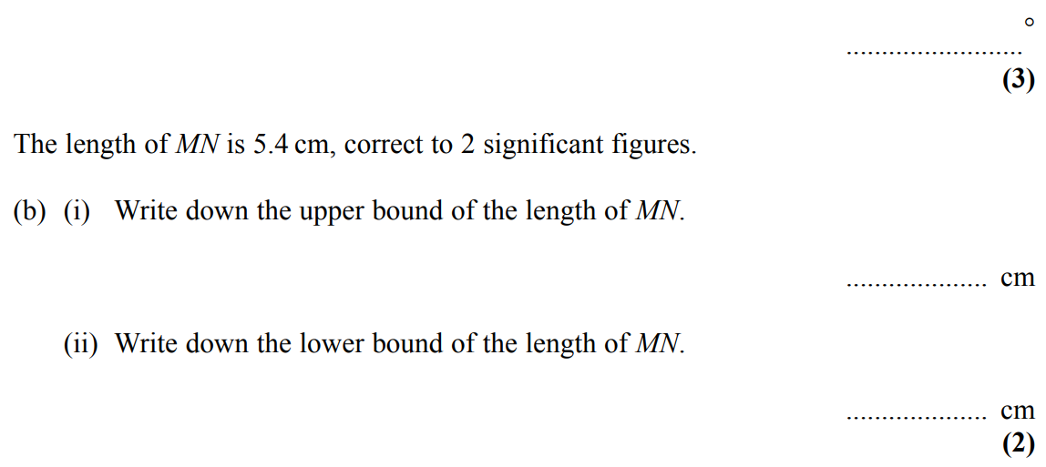
Pythagoras
Nov 2006 4H Q14

Slide 50
Pythagoras
Nov 2006 4H Q14
A
B (i)
B (ii)
C

Slide 51
Pythagoras
Nov 2006 4H Q25

Slide 52
Pythagoras
Nov 2006 4H Q25
A
B

Slide 53
Pythagoras
May 2007 4H Q9

Slide 54
Pythagoras
May 2007 4H Q9
A

Slide 55
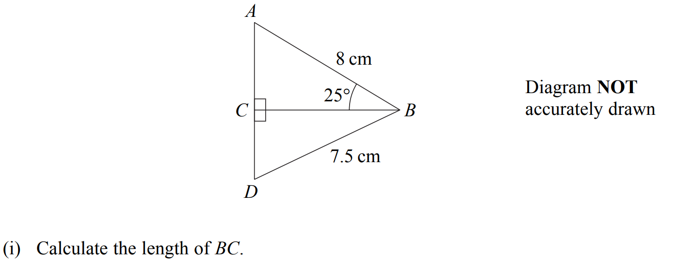
Pythagoras
Nov 2007 3H Q12

Slide 56
Pythagoras
Nov 2007 3H Q12
A
B

Slide 57
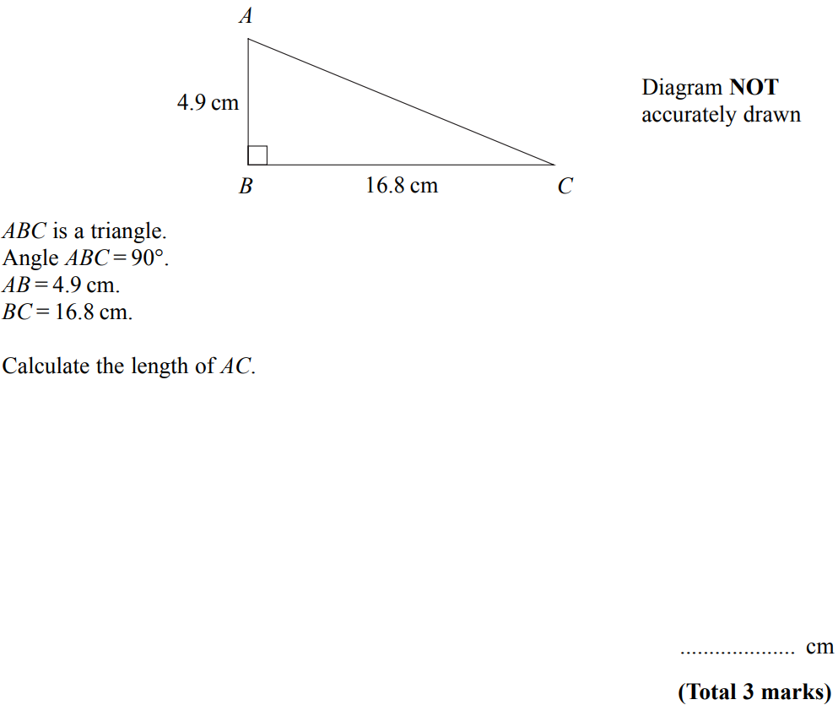
Pythagoras
Nov 2007 4H Q12

Slide 58
Pythagoras
Nov 2007 4H Q12
A

Slide 59
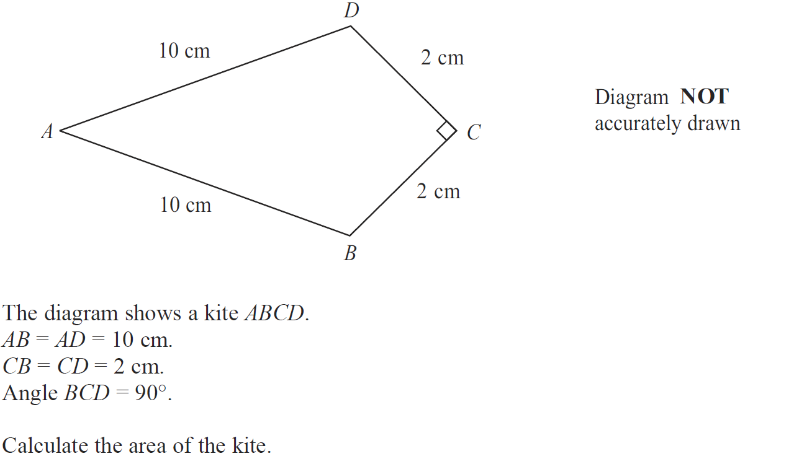
Pythagoras
May 2008 3H Q22

Slide 60
Pythagoras
May 2008 3H Q22
A

Slide 61
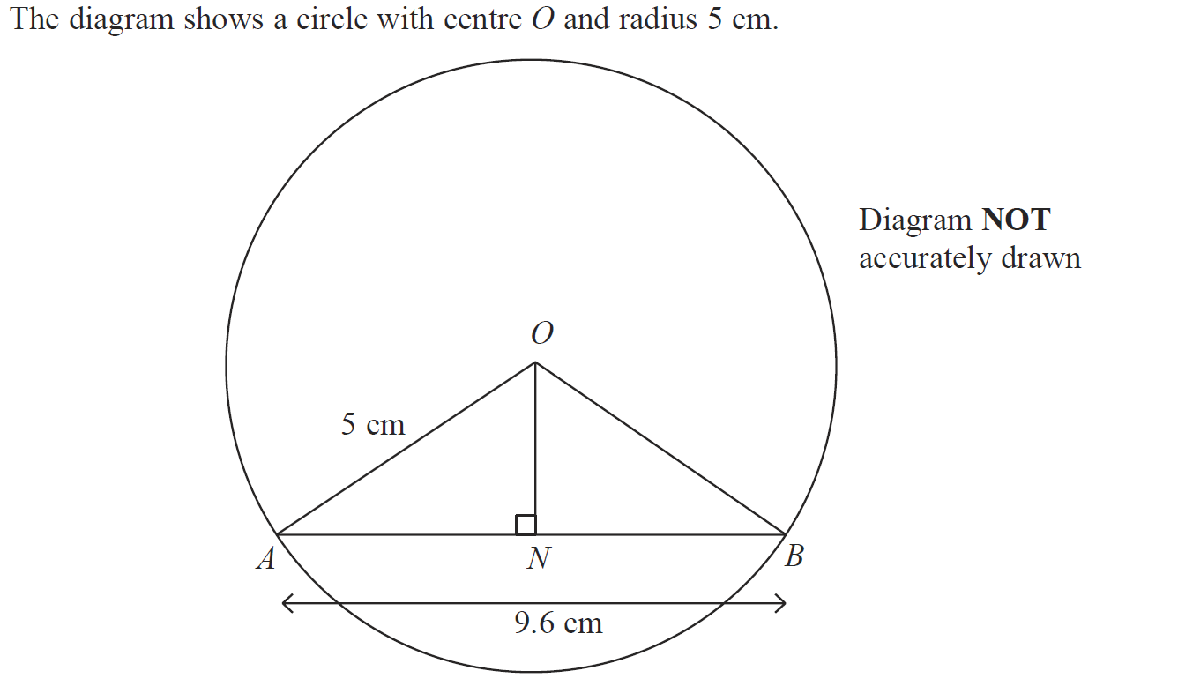
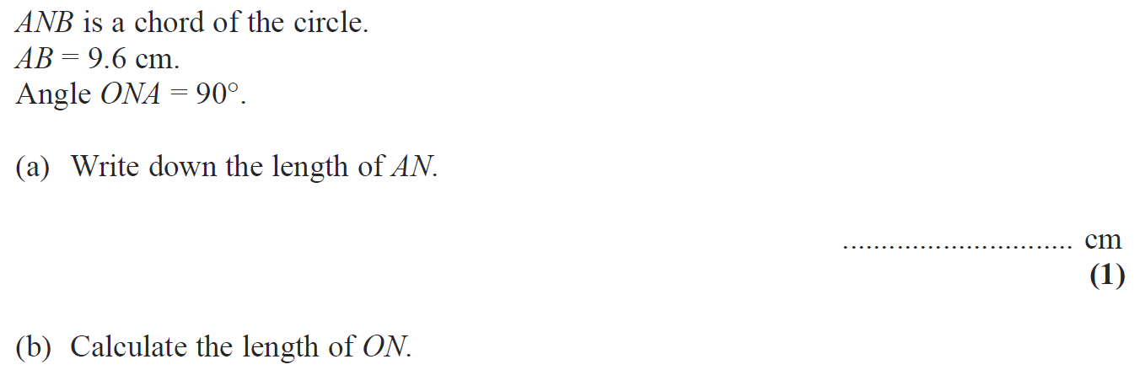
Pythagoras
May 2008 4H Q10

Slide 62
Pythagoras
May 2008 4H Q10
A
B

Slide 63
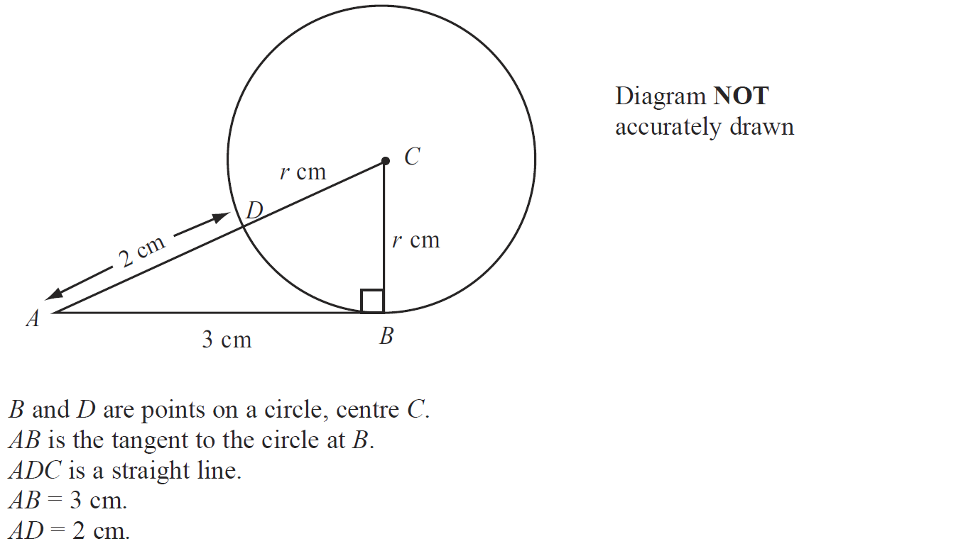
Pythagoras
Nov 2008 3H Q20

Slide 64
Pythagoras
Nov 2008 3H Q20
A

Slide 65
Pythagoras
Nov 2008 4H Q7

Slide 66
Pythagoras
Nov 2008 4H Q7
A

Slide 67
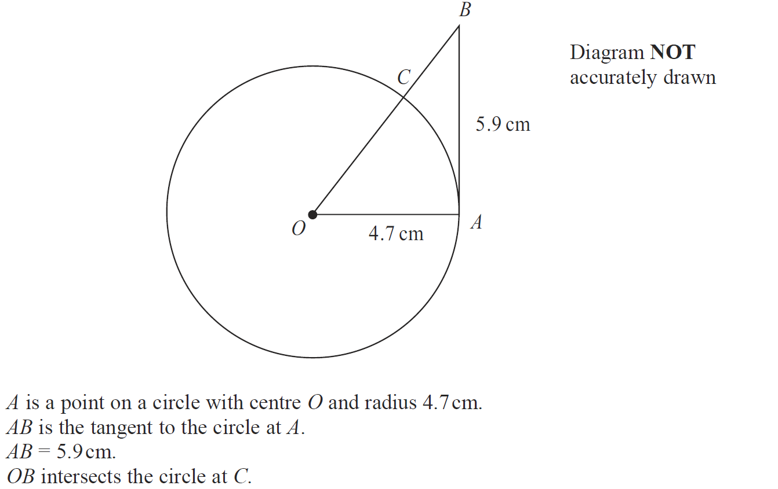
Pythagoras
May 2009 3H Q9

Slide 68
Pythagoras
May 2009 3H Q9
A

Slide 69
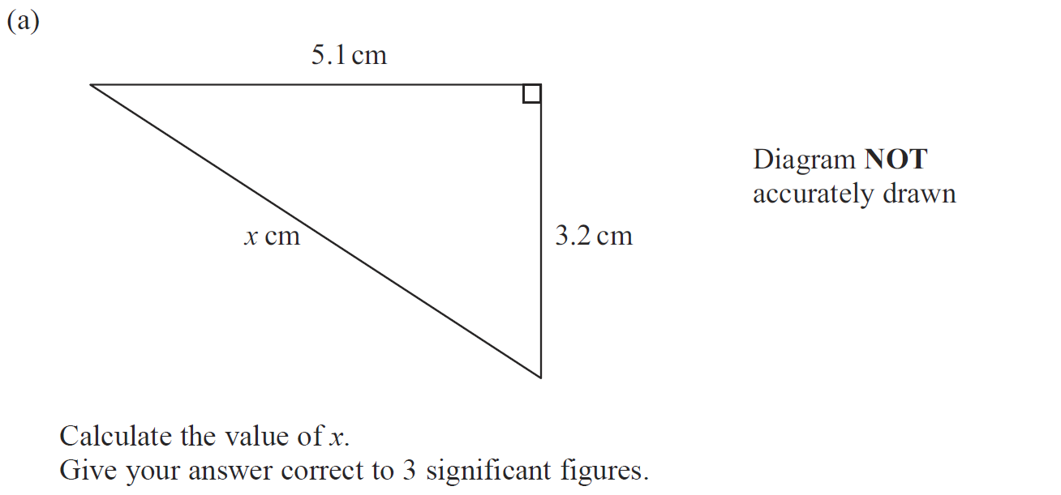
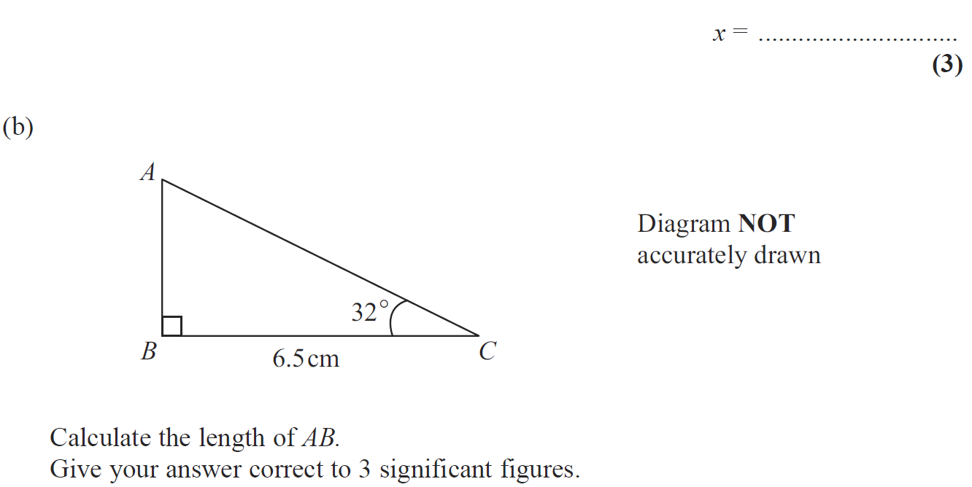
Pythagoras
June 2009 4H Q8

Slide 70
Pythagoras
June 2009 4H Q8
A
B

Slide 71
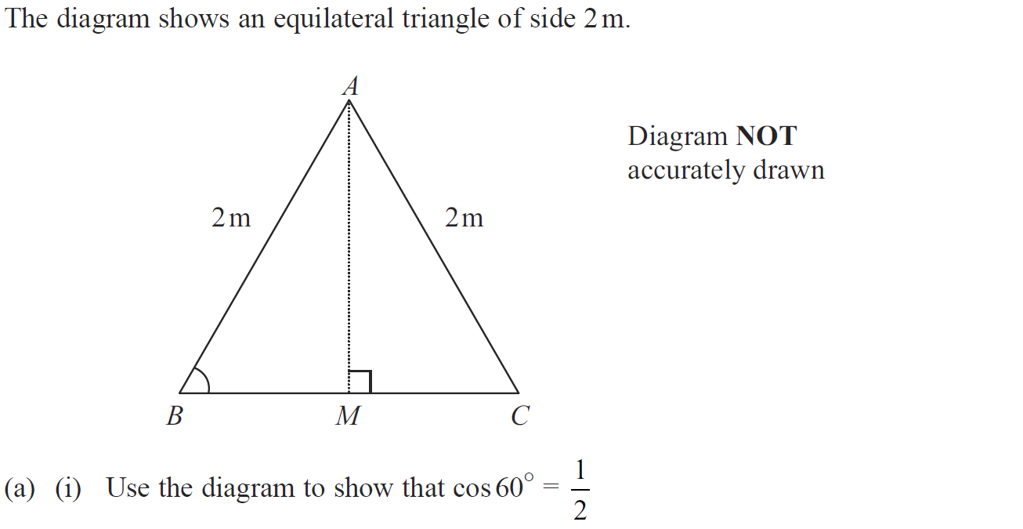
Pythagoras
June 2009 4H Q20

Slide 72
Pythagoras
June 2009 4H Q20
A (i)
A (ii)
B

Slide 73
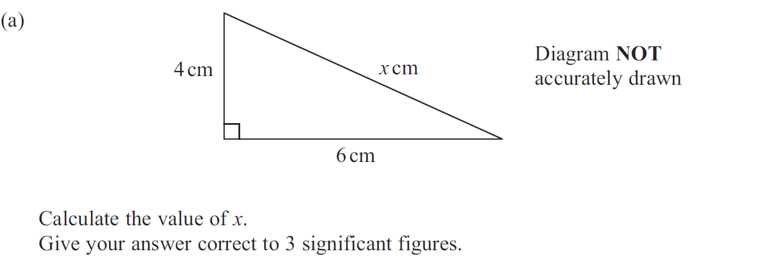
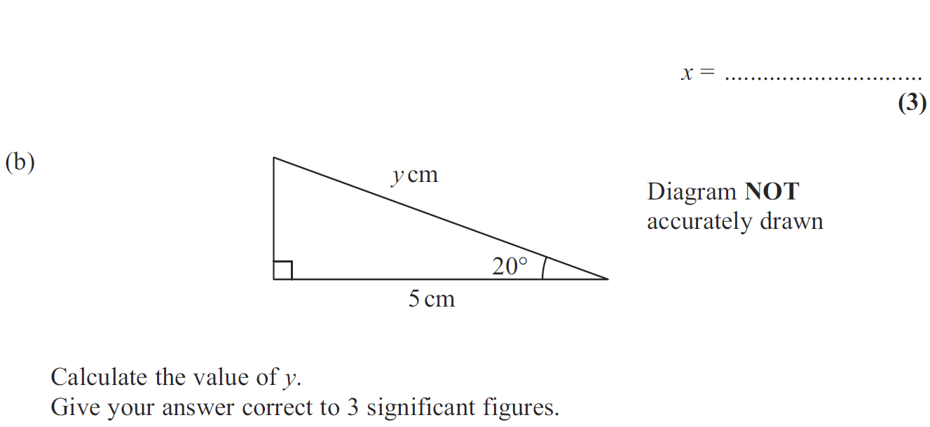
Pythagoras
Nov 2009 3H Q12

Slide 74
Pythagoras
Nov 2009 3H Q12
A
B

Slide 75
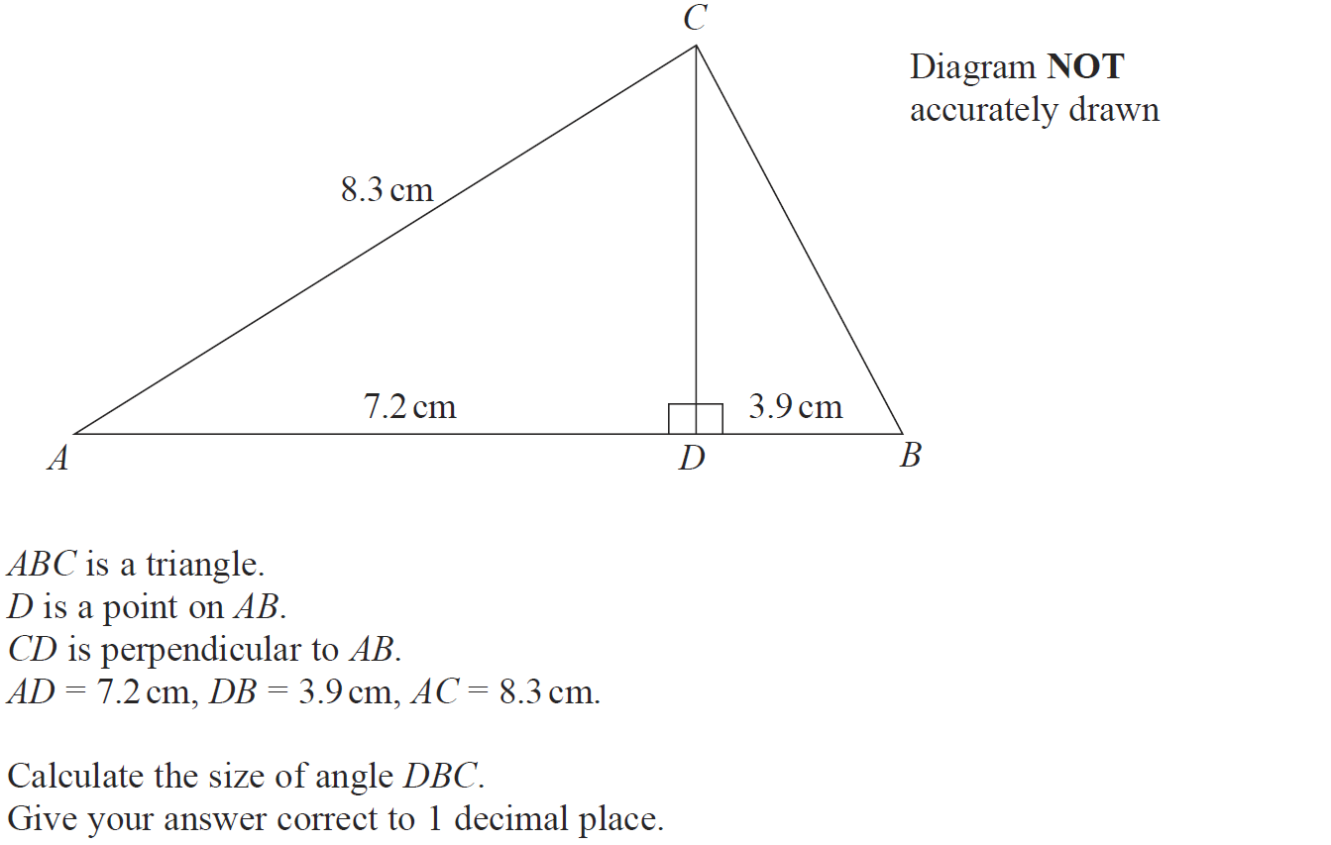
Pythagoras
Nov 2009 4H Q18

Slide 76
Pythagoras
Nov 2009 4H Q18
A
Alternative 1
Alternative 2

Slide 77
Pythagoras
Nov 2009 4H Q18
Alternative 3
Alternative 4

Slide 78
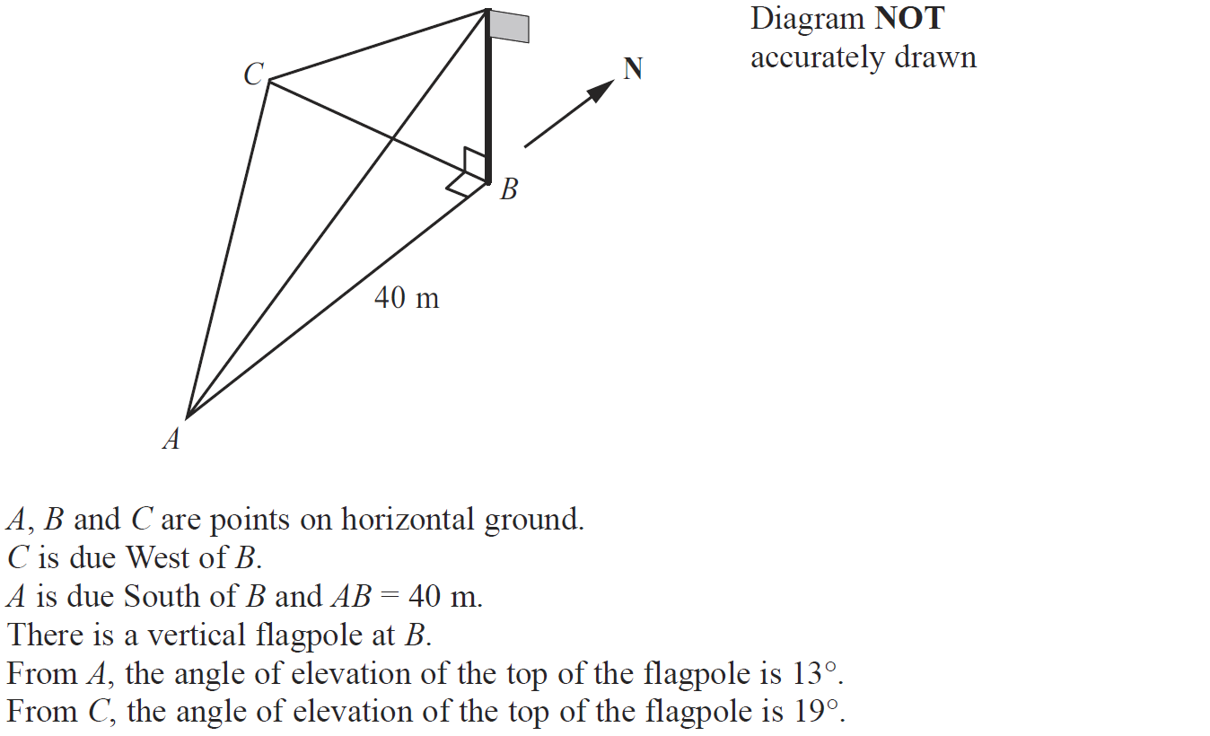
Pythagoras
June 2010 3H Q20

Slide 79
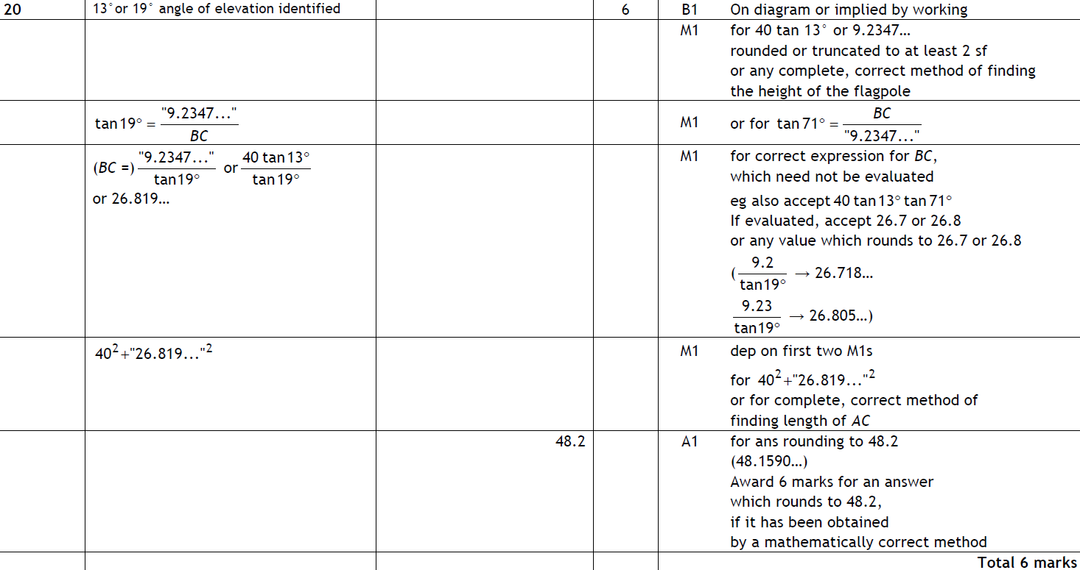
Pythagoras
June 2010 3H Q20
A

Slide 80
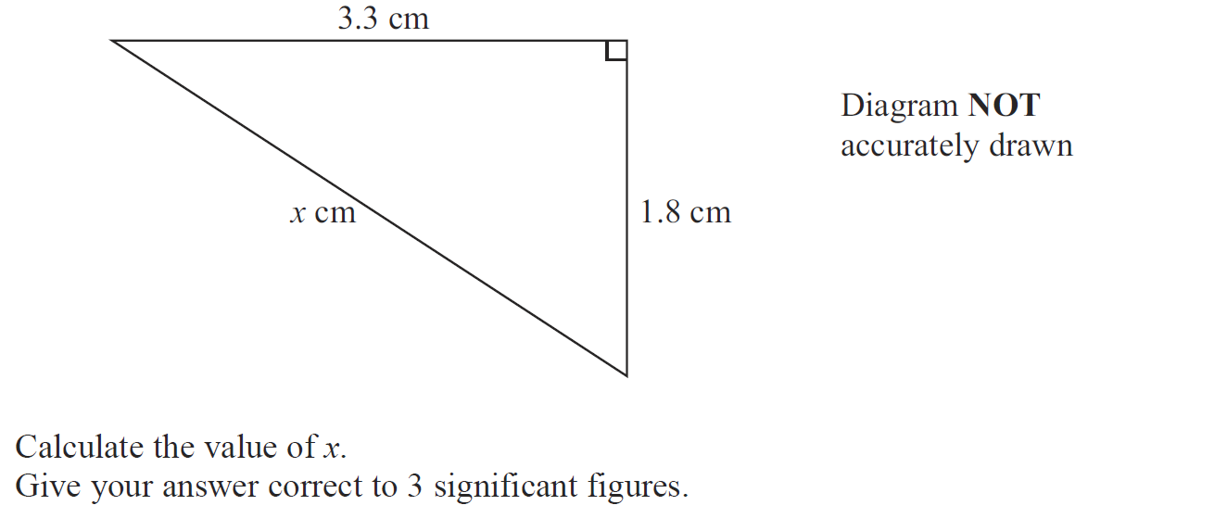
Pythagoras
June 2010 4H Q5

Slide 81
Pythagoras
June 2010 4H Q5
A

Slide 82
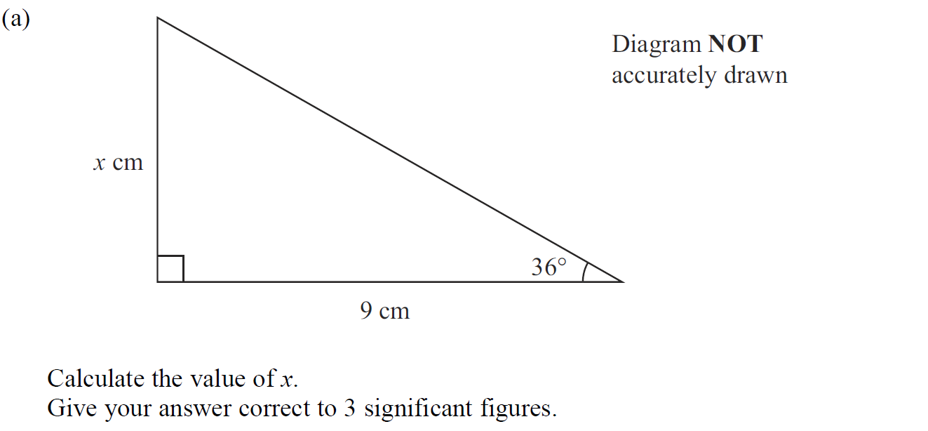
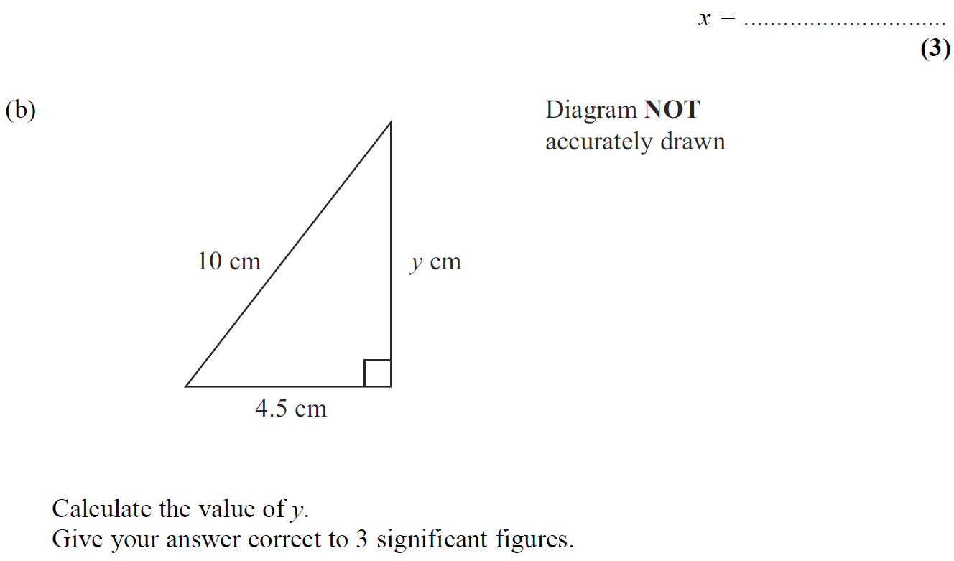
Pythagoras
Nov 2010 3H Q8

Slide 83
Pythagoras
Nov 2010 3H Q8
A
B

Slide 84
Pythagoras
June 2011 4H Q6

Slide 85
Pythagoras
June 2011 4H Q6
A
B

Slide 86
Pythagoras
June 2011 4H Q22

Slide 87
Pythagoras
June 2011 4H Q22
A
B

Slide 88
Pythagoras
Jan 2012 3H Q21

Slide 89
Pythagoras
Jan 2012 3H Q21
A
B

Slide 90
Pythagoras
Jan 2012 4H Q9

Slide 91
Pythagoras
Jan 2012 4H Q9
A
B

Slide 92
Pythagoras
May 2012 3H Q4

Slide 93
Pythagoras
May 2012 3H Q4
A

Slide 94
Pythagoras
Jan 2013 3H Q11

Slide 95
Pythagoras
Jan 2013 3H Q11
A

Slide 96
Pythagoras
Jan 2013 3H Q21

Slide 97
Pythagoras
Jan 2013 3H Q21
A

Slide 98
Pythagoras
Jan 2013 4H Q9

Slide 99
Pythagoras
Jan 2013 4H Q9
A

Slide 100
Pythagoras
May 2013 3H Q20

Slide 101
Pythagoras
May 2013 3H Q20
A
B

Slide 102
Pythagoras
May 2013 4H Q7

Slide 103
Pythagoras
May 2013 4H Q7
A
B

Slide 104
Pythagoras
May 2013 4H Q22

Slide 105
Pythagoras
May 2013 4H Q22
A

Slide 106
Pythagoras
May 2013 3HR Q24

Slide 107
Pythagoras
May 2013 3HR Q24
A

Slide 108
Pythagoras
May 2013 4HR Q8

Slide 109
Pythagoras
May 2013 4HR Q8
A

Slide 110
Pythagoras
Jan 2014 3H Q12

Slide 111
Pythagoras
Jan 2014 3H Q12
A

Slide 112
Pythagoras
Jan 2014 4H Q23

Slide 113
Pythagoras
Jan 2014 4H Q23
A

Slide 114
Pythagoras
Jan 2014 3HR Q7

Slide 115
Pythagoras
Jan 2014 3HR Q7
A
B

Slide 116
Pythagoras
Jan 2014 3HR Q17

Slide 117
Pythagoras
Jan 2014 3HR Q17
A

Slide 118
Pythagoras
Jan 2014 4HR Q18

Slide 119
Pythagoras
Jan 2014 4HR Q18
A (i)
A (ii)
A (iii)
B

Slide 120
Pythagoras
May 2014 3H Q9

Slide 121
Pythagoras
May 2014 3H Q9
A

Slide 122
Pythagoras
May 2014 3H Q13

Slide 123
Pythagoras
May 2014 3H Q13
A

Slide 124
Pythagoras
May 2014 4H Q8

Slide 125
Pythagoras
May 2014 4H Q8
A

Slide 126
Pythagoras
May 2014 4H Q23

Slide 127
Pythagoras
May 2014 4H Q23
A

Slide 128
Pythagoras
May 2014 3HR Q3

Slide 129
Pythagoras
May 2014 3HR Q3
A
B

Slide 130
Pythagoras
May 2014 3HR Q18

Slide 131
Pythagoras
May 2014 3HR Q18
A
B

Slide 132
Pythagoras
May 2014 4HR Q20

Slide 133
Pythagoras
May 2014 4HR Q20
A

Slide 134
Pythagoras
Jan 2015 3H Q8

Slide 135
Pythagoras
Jan 2015 3H Q8
A
B

Slide 136
Pythagoras
Jan 2015 3H Q21

Slide 137
Pythagoras
Jan 2015 3H Q21
A

Slide 138
Pythagoras
Jan 2015 4H Q19

Slide 139
Pythagoras
Jan 2015 4H Q19
A
B
C

Slide 140
Pythagoras
Jan 2015 4HR Q7

Slide 141
Pythagoras
Jan 2015 4HR Q7
A
B

Slide 142
Pythagoras
Jan 2015 4HR Q15

Slide 143
Pythagoras
Jan 2015 4HR Q15
A
B
C

Slide 144
Pythagoras
May 2015 3H Q8

Slide 145
Pythagoras
May 2015 3H Q8
A

Slide 146
Pythagoras
May 2015 3H Q23

Slide 147
Pythagoras
May 2015 3H Q23
A

Slide 148
Pythagoras
May 2015 3HR Q7

Slide 149
Pythagoras
May 2015 3HR Q7
A

Slide 150
Pythagoras
Jan 2016 3H Q22

Slide 151
Pythagoras
Jan 2016 3H Q22
A

Slide 152
Pythagoras
Jan 2016 3HR Q5

Slide 153
Pythagoras
Jan 2016 3HR Q5
A
B

Slide 154
Pythagoras
Jan 2016 4HR Q21

Slide 155
Pythagoras
Jan 2016 4HR Q21
A

Slide 156
Pythagoras
May 2016 3H Q16

Slide 157
Pythagoras
May 2016 3H Q16
A

Slide 158
Pythagoras
May 2016 3H Q22

Slide 159
Pythagoras
May 2016 3H Q22
A

Slide 160
Pythagoras
June 2016 4H Q9

Slide 161
Pythagoras
June 2016 4H Q9
A

Slide 162
Pythagoras
May 2016 3HR Q13

Slide 163
Pythagoras
May 2016 3HR Q13
A

Slide 164
Pythagoras
June 2016 4HR Q17

Slide 165
Pythagoras
June 2016 4HR Q17
A

Slide 166
Pythagoras
Jan 2017 4H Q9

Slide 167
Pythagoras
Jan 2017 4H Q9
A
B

Slide 168
Pythagoras
Jan 2017 4H Q15

Slide 169
Pythagoras
Jan 2017 4H Q15
A
B

Slide 170
Pythagoras
Jan 2017 3HR Q10

Slide 171
Pythagoras
Jan 2017 3HR Q10
A

Slide 172
Pythagoras
Jan 2017 4HR Q6

Slide 173
Pythagoras
Jan 2017 4HR Q6
A

Slide 174
Pythagoras
May 2017 3H Q21

Slide 175
Pythagoras
May 2017 3H Q21
A

Slide 176
Pythagoras
June 2017 4H Q11

Slide 177
Pythagoras
June 2017 4H Q11
A

Slide 178
Pythagoras
June 2017 4HR Q8

Slide 179
Pythagoras
June 2017 4HR Q8
A

Slide 180
Pythagoras
June 2017 4HR Q22

Slide 181
Pythagoras
June 2017 4HR Q22
A

Slide 182
Pythagoras
Jan 2018 3H Q6

Slide 183
Pythagoras
Jan 2018 3H Q6
A
B
C

Slide 184
Pythagoras
Jan 2018 4H Q11

Slide 185
Pythagoras
Jan 2018 4H Q11
A

Slide 186
Pythagoras
Jan 2018 3HR Q11

Slide 187
Pythagoras
Jan 2018 3HR Q11
A

Slide 188
Pythagoras
Jan 2018 4HR Q17

Slide 189
Pythagoras
Jan 2018 4HR Q17
A (i)
A (ii)
B
C

Slide 190
Pythagoras
May 2018 3H Q7

Slide 191
Pythagoras
May 2018 3H Q7
A

Slide 192
Pythagoras
May 2018 3HR Q10

Slide 193
Pythagoras
May 2018 3HR Q10
A

Slide 194
Pythagoras
June 2018 4HR Q23

Slide 195
Pythagoras
June 2018 4HR Q23
A

